Slide 1
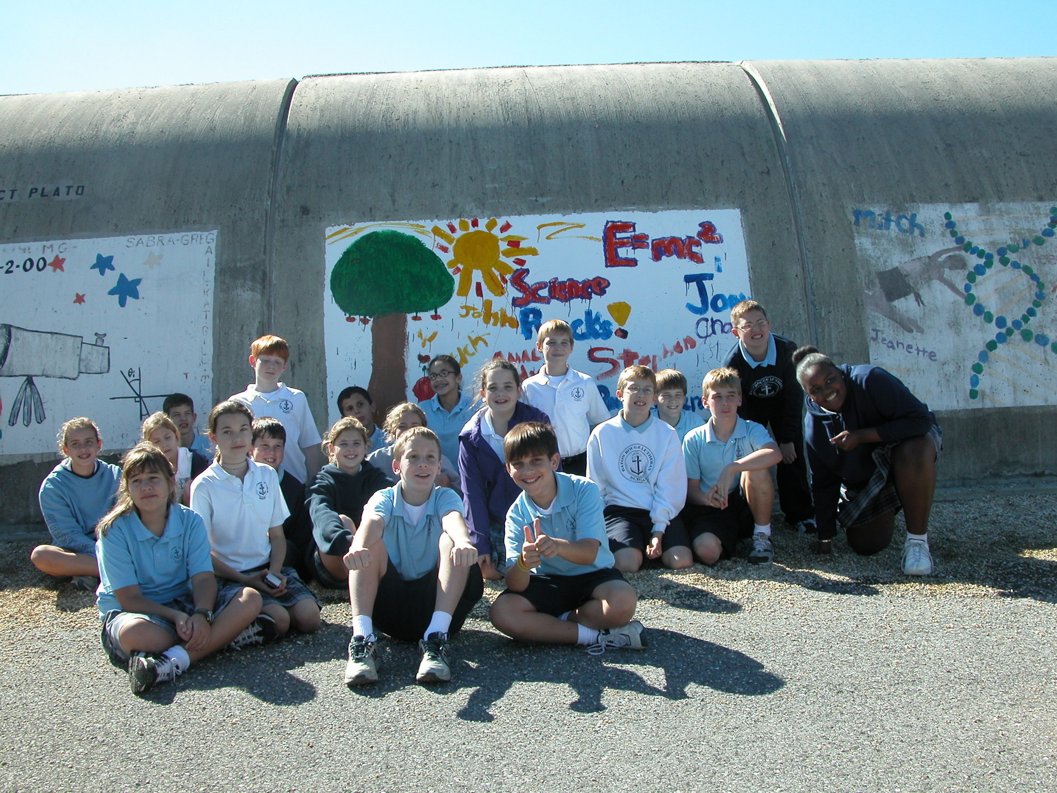
LIGO Science Education Center: Building an Informal Education Center on Collaborations
Amber L. Stuver
LIGO Livingston Observatory

Slide 2
What are Gravitational Waves?

Slide 3
Later..

Slide 4
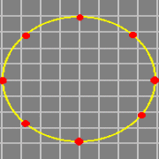
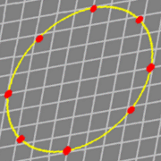
The Effects of Gravitational Waves
A gravitational wave will alternatingly compress and expand a ring of freely falling masses in orthogonal directions
2 polarizations:

Slide 5
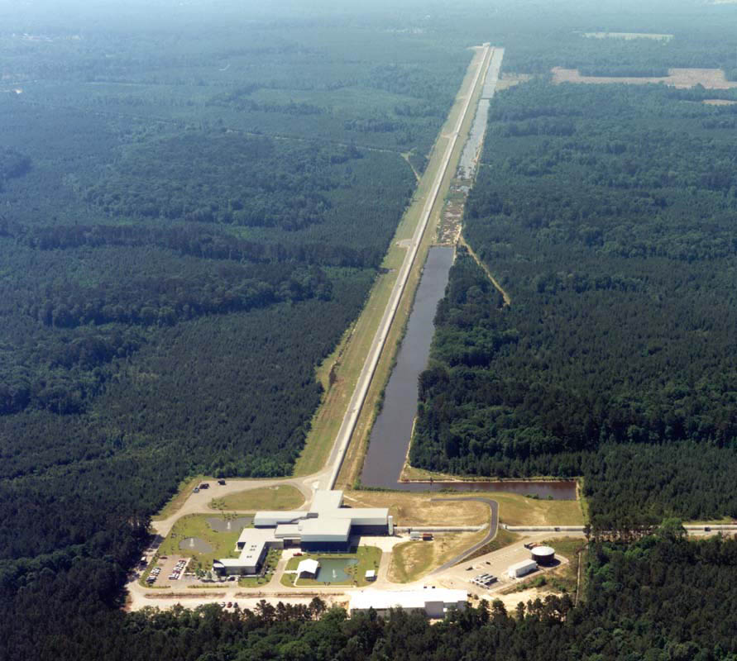
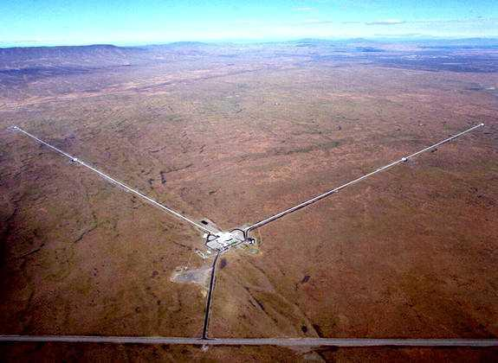
The LIGO Observatories
Livingston, Louisiana
Hanford, Washington

Slide 6
LIGO Science Education Center: Funding
NSF:
General operation (incl. staff salaries) is funded through the general LIGO operations grant.
Grant awarded to LIGO Lab
Caltech/MIT/LIGO Observatories
BRAF:
Funding partner for educational research support, including long-term longitudinal studies of both visiting students and teachers receiving PD. Grants are obtained through the NSF.

Slide 7
SEC Objectives
Communicating LIGO-related science concepts to the public
Strengthening pre-service and in-service science teaching
Reaching a broad audience of students in Louisiana and the surrounding region
Create a national model for ways in which scientists and educators can work together to support inquiry-based teaching and learning

Slide 8
The Southeastern Louisiana Community
For Louisiana:
Nearly 20% of residents live in poverty.
36.5% of residents are members of a racial minority, the majority (32.4%) identifying as black or African-American.
Lower percentage of high school graduates by age 25 than the national average.
The difference is even more pronounced for bachelors(+) degree.
For Southeastern Louisiana Parishes:
Most parishes have a nearly 50/50 split between white and black populations (several parishes have >50% black residents).
The poverty rate approaches 30% in parishes with larger proportions of minority residents.
College graduation rates as low as half that of Louisiana average.
Notes:
http://quickfacts.census.gov/qfd/states/22000.html

Slide 9
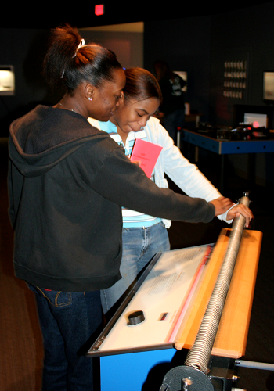
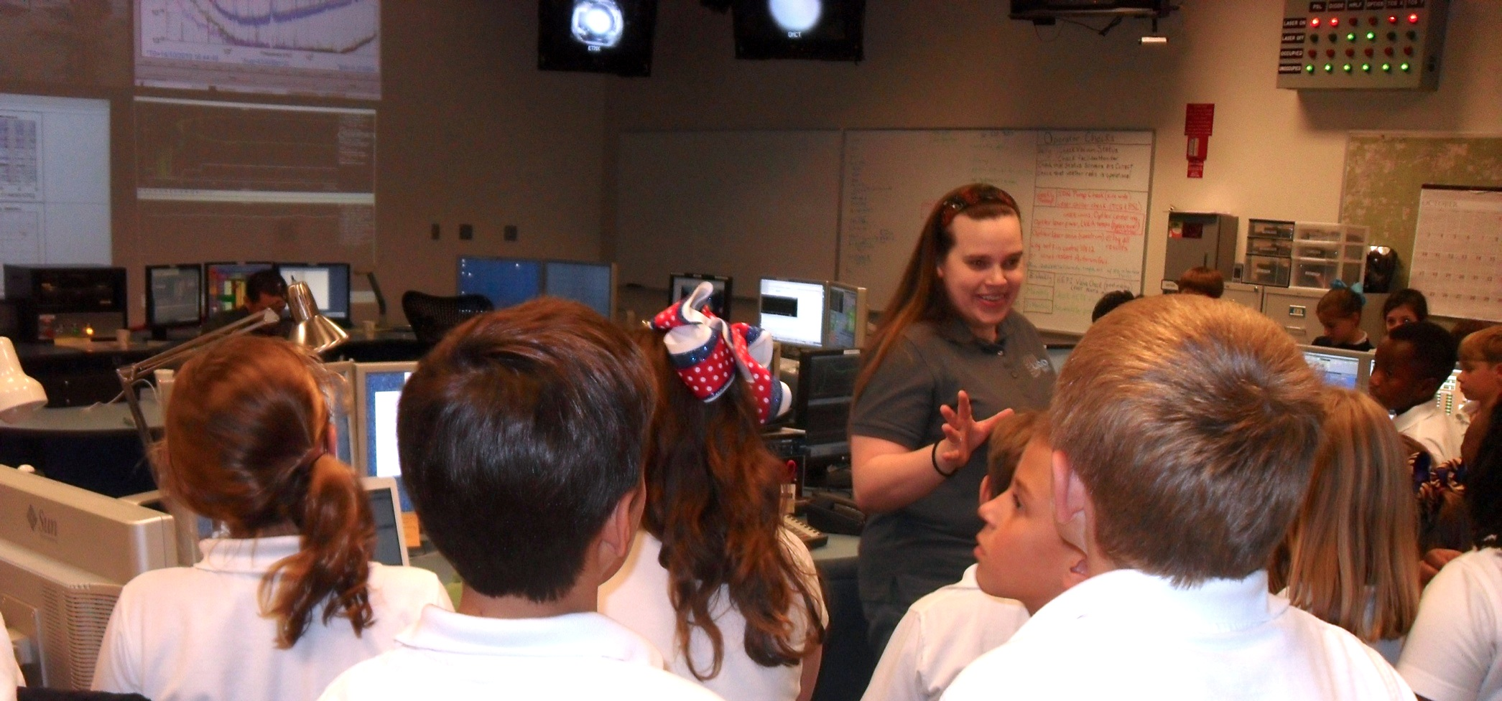
SEC Programs
Student (field trip and school visit) programs
Seeing scientists at work
Inquiry based classroom activities
Free exploration of hands-on exhibits
Public Open Houses
Different theme every month with standard facility tours and exhibit hall exploration.

Slide 10
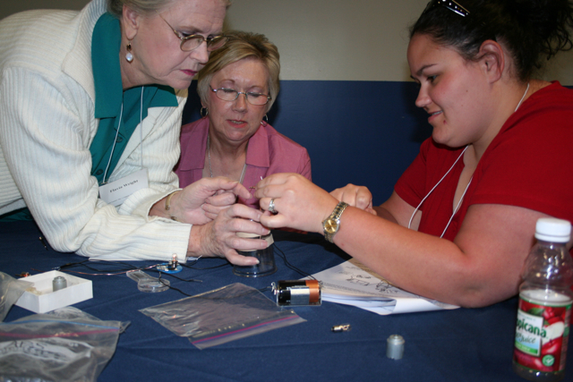
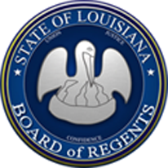
SEC Programs
Teacher professional development
Inquiry focused – how to teach through inquiry
“Snack” focused – provide teachers the knowledge and skills to make inexpensive classroom demonstrations.
Please see Kathy Holt’s talk on SWIMs (Science With Inexpensive Materials) later in this session.
Many have been supported by LA Board of Regents

Slide 11
Exploratorium
~50 hands-on exhibits comprising the SEC exhibit hall.
Provides training to SEC staff through Institute for Inquiry.
Provides teacher PD on-site at the SEC
Several teachers from surrounding area are sponsored by the SEC to participate in the summer Teacher Institute at the Exploratorium.
Provides on-site training to docents in a model similar to Exploratorium docent training.

Slide 12
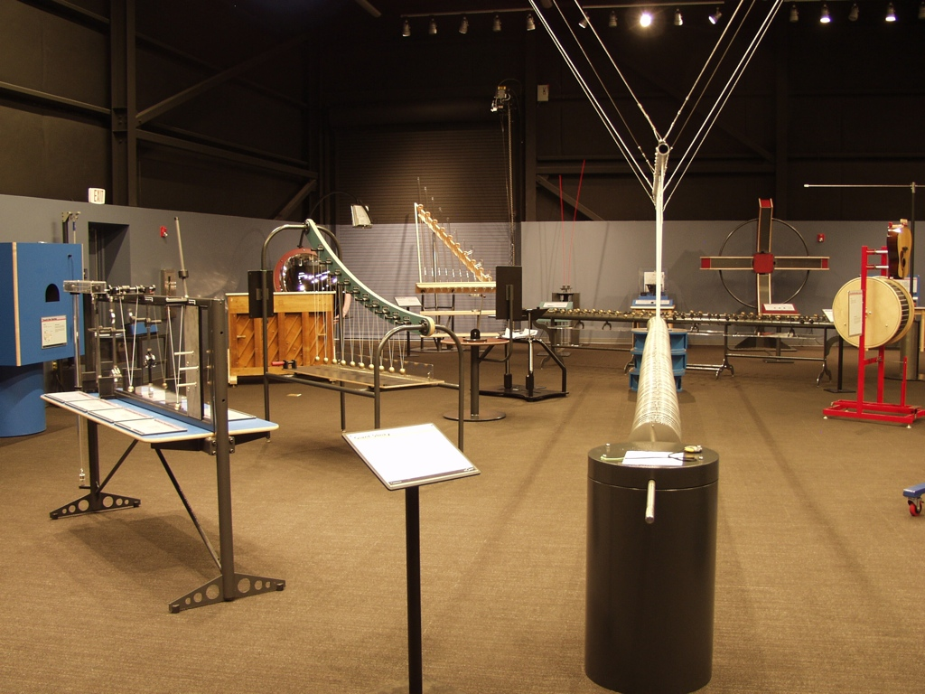
SEC Exhibit Hall

Slide 13
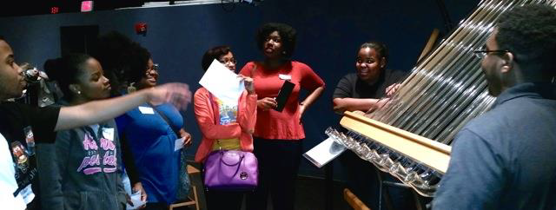
Southern University
Only HBCU system in nation
Docents: “exhibit explainer”
Exploratorium and SEC trained
Docents are in STEM and education majors
Role models on the pathway to becoming a STEM professional
Almost all complete their bachelor degree, several have gone on to graduate study, and one has even been hired by LIGO as an operator.
3 science education research dissertations have been defended with a 4th expected in May 2015.

Slide 14
Educational Research at the SEC
Tulane – (complete) Graduate research on student attitudes after visiting the LIGO.
Univ. of S. Florida – (complete) Postdoctoral research in attitude changes and concept gains after visiting LIGO
Univ. of N. Texas – (ongoing) Postdoctoral research on docent effects on visitor responses to exhibits, and how the public starts seeing themselves as scientists at open houses.

Slide 15
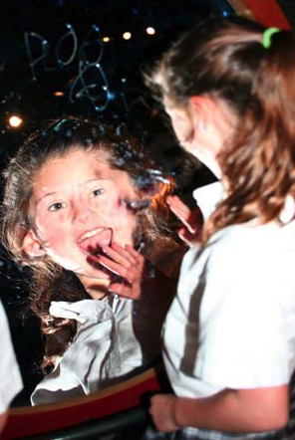
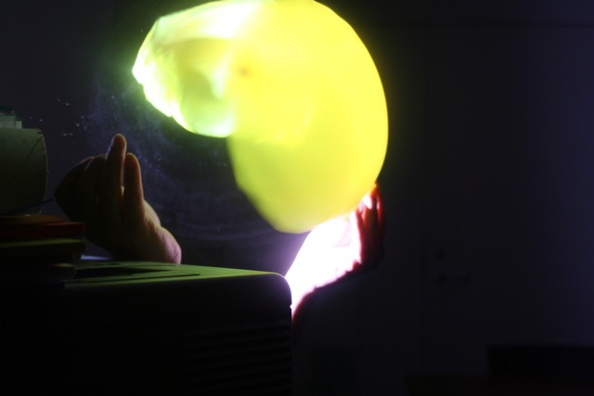
Collaborations
Knowing who we serve and seeking collaborations in the community and from national experts have helped LIGO successfully develop an informal education center.

Slide 16
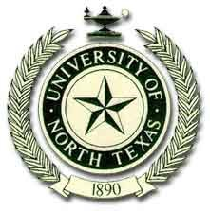
Collaborators: Past and Present

