Slide 1
Minimising Quantum Back-Action Noise in Quantum State Tomography of Cavities
Bence Börcsök
Mentors: Rana Adhikari, Yanbei Chen and Nicolas Smith-Lefebvre

Slide 2
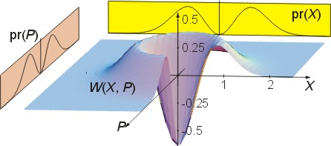
Quantum Tomography
Reconstructing the quantum state of the system
Deduce the Wigner-function

Slide 4
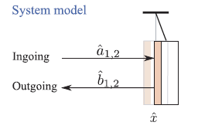
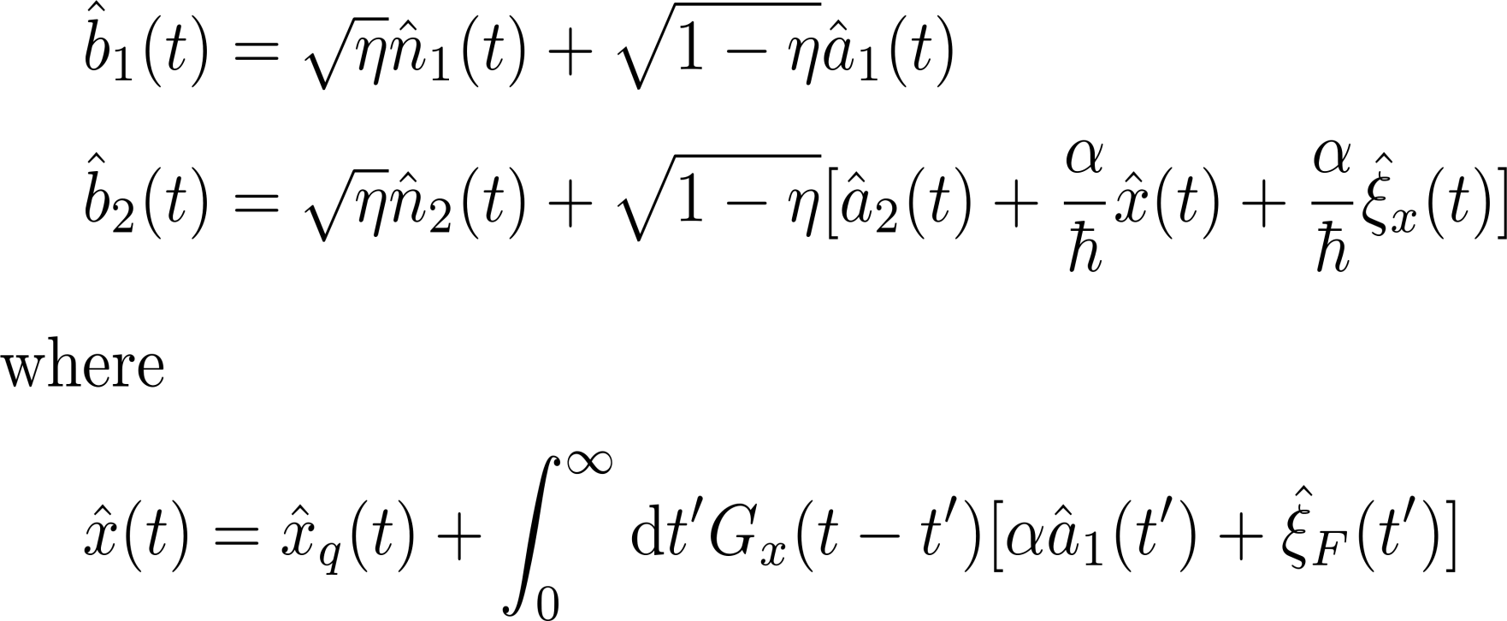
Broadband cavity

Slide 5
Cavity with finite bandwidth

Slide 6
Homodyne detection

Slide 7
Homodyne detection
Outgoing optical field: Local oscillator: Photocurrent: Signal:

Slide 8
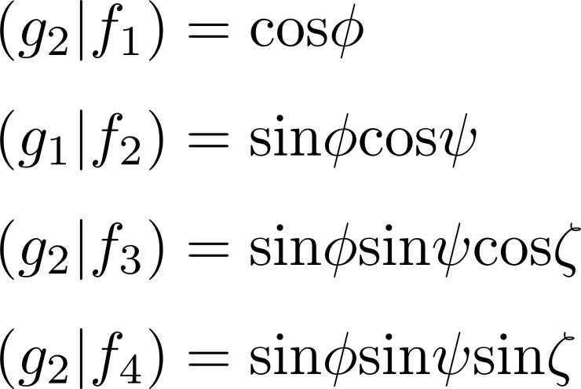
Normalisation
We want: Constraints:

Slide 9
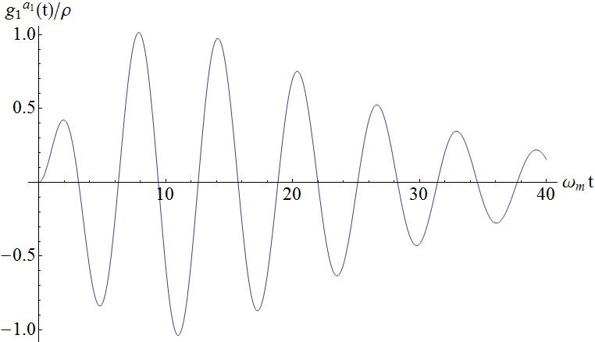
Result so far

Slide 10
Further work
Calculating the full filtering function for both quadratures
Obtaining the covariance matrix
Comparing results with actual experiments

Slide 11
Acknowledgements
Rana Adhikari, Yanbei Chen and Nicolas Smith-Lefebvre
Bassam Helou
Michael Coughlin
Alan Weinstein

Slide 12
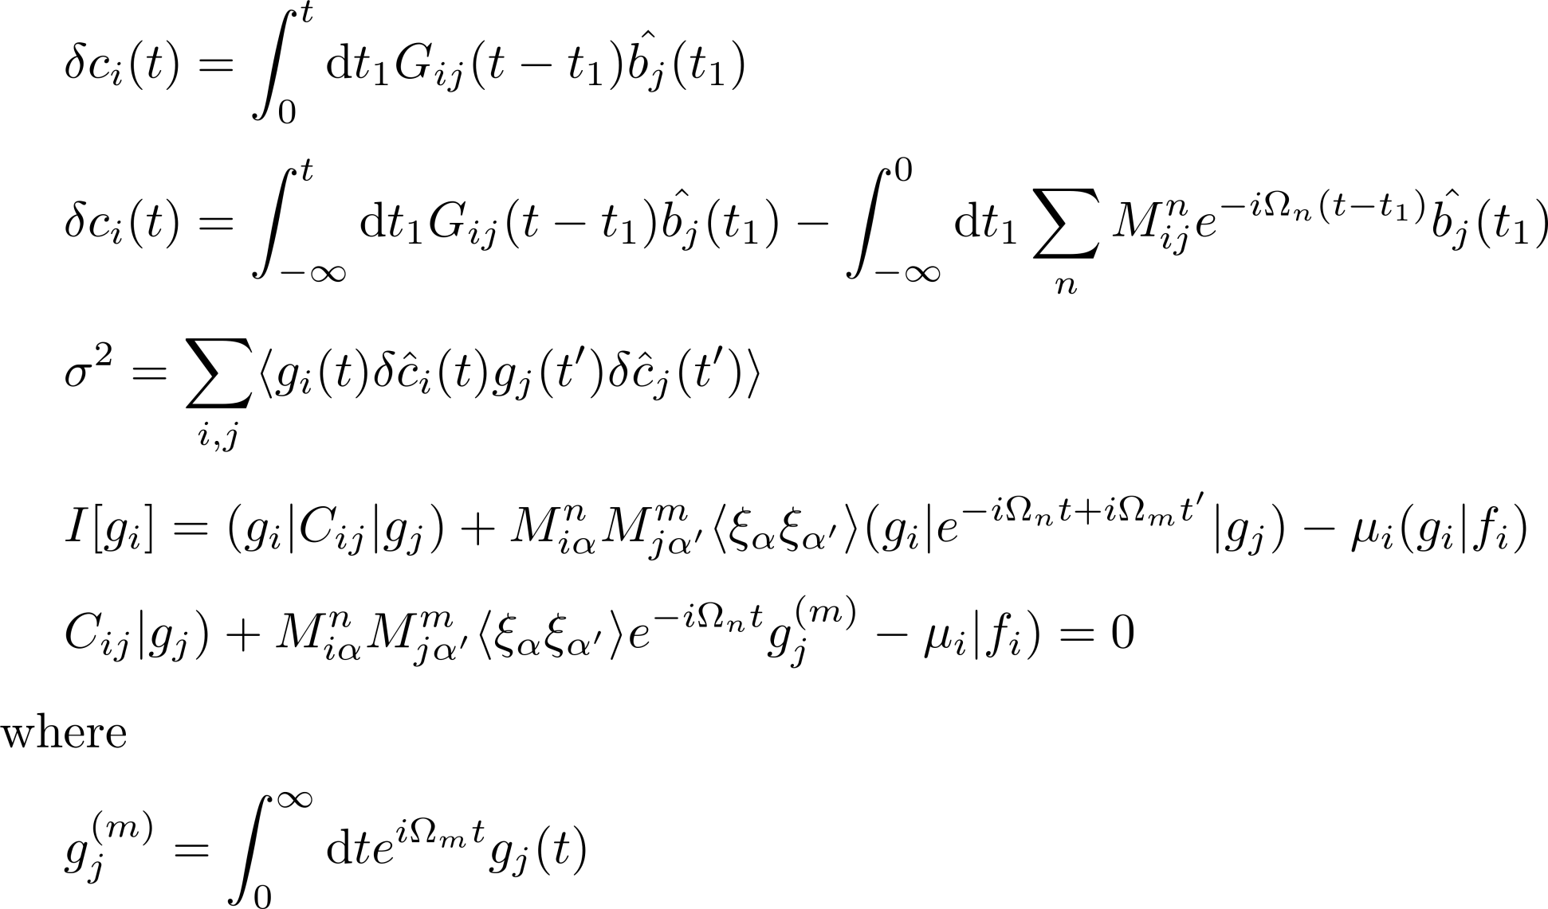
General method

Slide 13
Solution in the frequency domain

