Slide 1
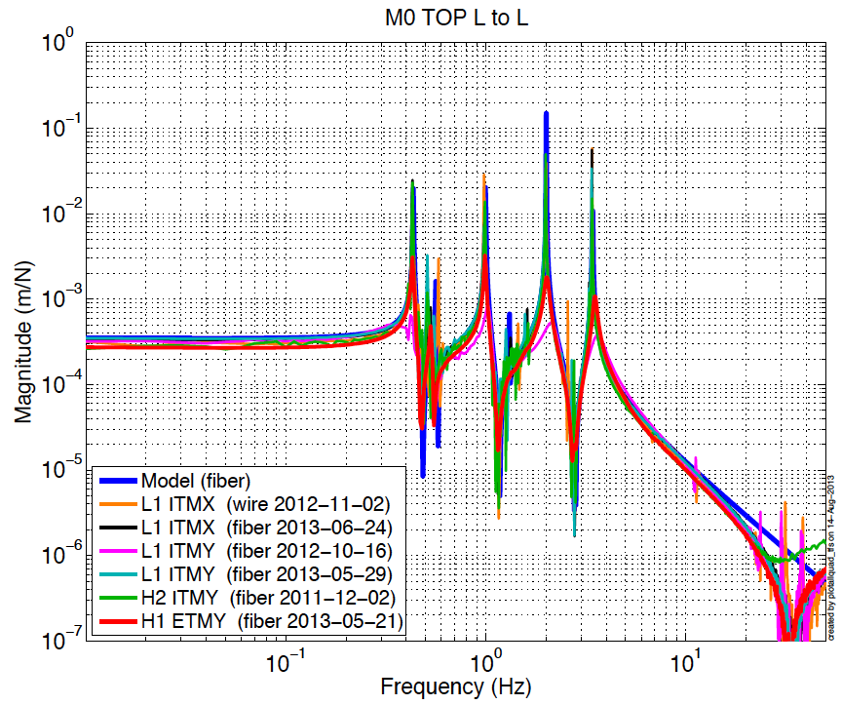
Noise Analysis of OSEM Actuator to Sensor Coupling - G1401205
These slides will show that the coupling between the OSEM coil and sensor will not harm our noise performance, given certain assumptions.
Coupling observed in measured transfer functions.
AKA, the ‘turnups’.
https://services.ligo-wa.caltech.edu/integrationissues/show_bug.cgi?id=327

Slide 2
Damping model with OSEM coupling
Assumptions:
The actuation signal couples to the sensor signal
The sensor noise is summed after this coupling
The coupling is linear
e
-D
OSEM force output
P
+
y
Top mass displacement
f
B
n
OSEM sensor output
s
+
P = top mass to top mass plant
D = damping filter
B = OSEM actuator to sensor coupling
y = top mass displacement
e = top mass TF excitation for measurements
f = OSEM force
s = OSEM sensor output
n = OSEM sensor noise

Slide 3
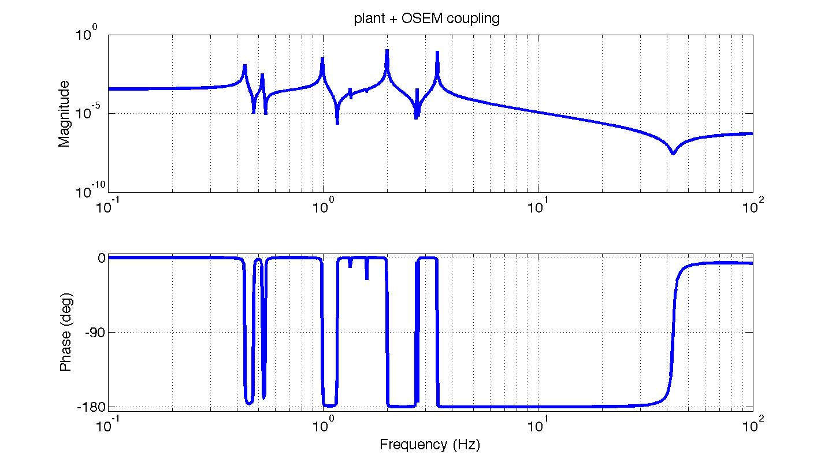
The measured open loop TFs
In this case the damping filter D = 0. So the sensor signal from an excitation is.
The measured top mass to top mass TF is then
Simulated top mass L to top mass L TF = (P+B)
If
0.004
B = -----------------
(s+1000*2*pi)
This shape has the right phase
to generate the notch feature.
However, LHO alog 1753 shows
an f^1 shape. We’ll see the shape
does not matter for noise in general.
The notch sometimes seen in the TFs

Slide 4
Derivation of closed loop noise transmission with OSEM coupling
- It helps to reference the block diagram on slide 2 for this slide.
Measured closed loop displacement with OSEM sensor
The top mass displacement, y, expressed in terms of s
The damping force, f, expressed in terms of s
Plugging y and f back in
Factoring out the sensor signal s
The measured closed loop TF between sensor noise and sensor
Then plugging gives us the top mass performance
* Key Result: OSEM sensor noise to top mass displacement TF with OSEM coupling. This results suggests the shape of B is unimportant, provided (P+B)*D is less than 1 outside the damping band.

Slide 5
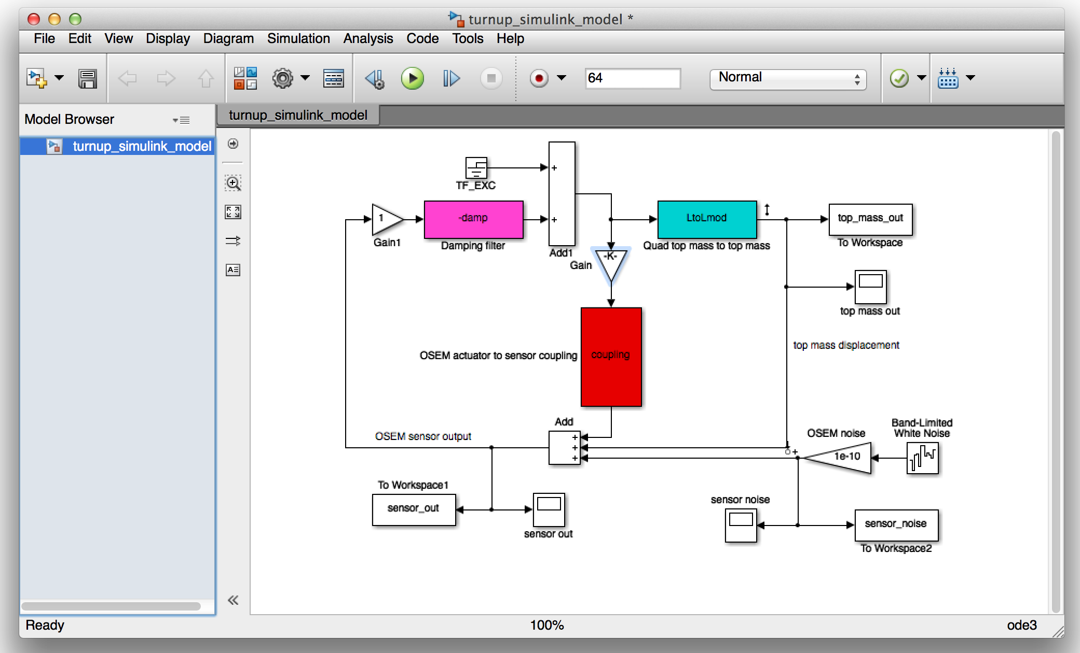
Simulink check
A closed loop simulation with the coupling term B and damping filter D on slide 6.

Slide 6
Filters in the Simulink simulation
D
damp =
1e05 s (s+8.162) (s+0.9069)
----------------------------------
(s+15*2*pi)^2 (s^2 + 1.814s + 7.402)
Velocity damping with a two pole roll-off at 15 Hz and a resgain bump at the 0.43 Hz mode.
Simulated top mass L to top mass L TF = (P+B)
B
coupling =
0.004
--------
(s+1000*2*pi)

Slide 7
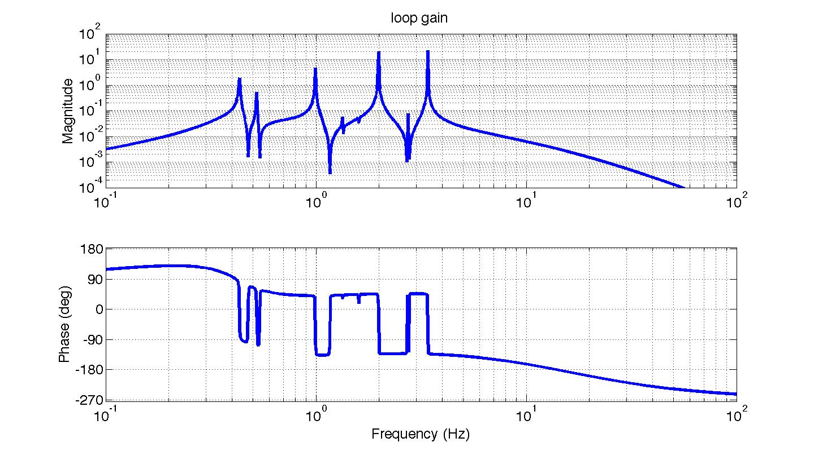
Top mass loop gain in simulink
Showing the loop gain P*D to provide some sense of the damping design and performance.

Slide 8
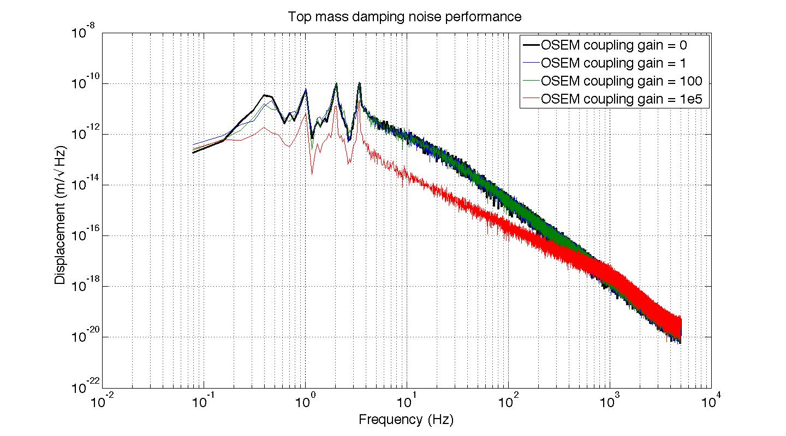
Simulink result: Top mass displacement from OSEM sensor noise with various gains on the coupling
The OSEM coupling B in general has negligible influence on the top mass displacement. In the extreme case where B is very large, red, the top mass displacement is actually suppressed.

