Slide 1
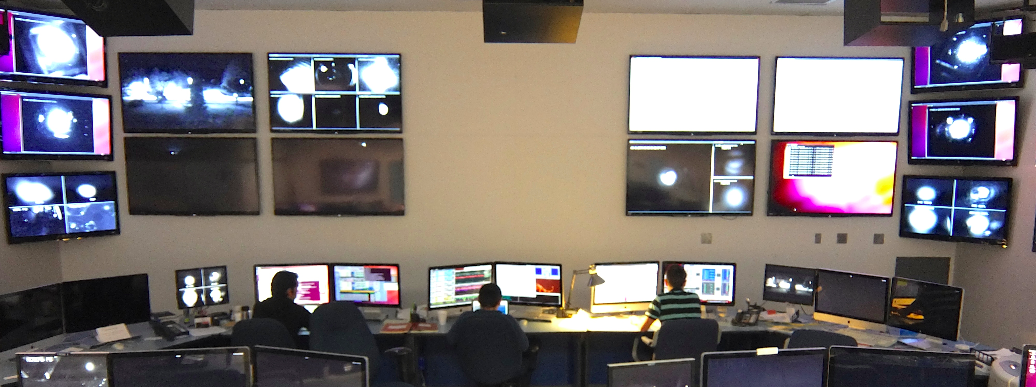
Advanced LIGO
Commissioning Overview
GRITTS Seminar, October 15, 2014
Daniel Sigg

Slide 2
History of Integrated Testing
Integrated testing phases interleaved with installation
Complementary division between LHO and LLO
  Designed to address biggest areas of risk as soon as possible
  H1 focused on long arm cavities; L1 worked outward from the vertex
July 2012
Oct 2012
Jan 2013
Apr 2013
July2013
Oct 2013
Jan 2014
Apr 2014
July2014
One Arm Test 1st arm cavity Green only
Input Mode Cleaner
HIFO-XY
Both arms + corner
No AS port
H1
HIFO-Y Y-arm + corner
Green + PSL IR
Build & test from the arms backward
L1
Input Mode Cleaner with high power test
Dual recycled Michelson
Full Interferometer
I
II
III
Build & test from the laser outward

Slide 3
Current Timeline

Slide 4
L1 Locking Statistics
157 locks lasting < 5 min
Nearly 300 locks (> 1 min) since end of May
Most short locks broken because of commissioning work
Longer locks came as more alignment DoF were globally controlled

Slide 5
Sensitivity Improvements

Slide 6
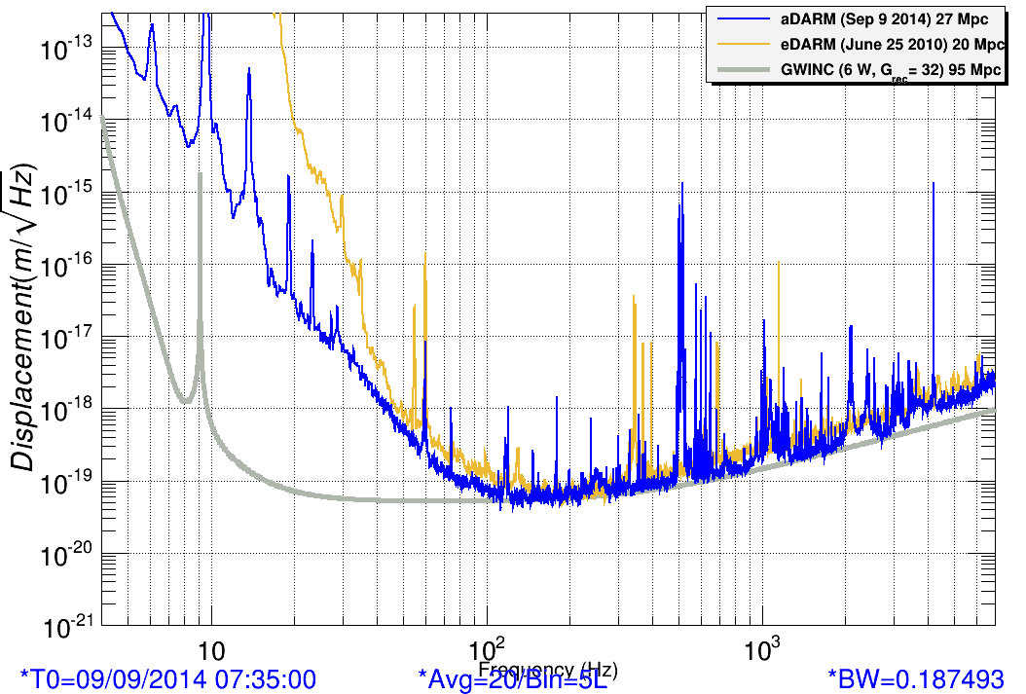
Compare with Enhanced LIGO

Slide 7
L1 Noise Budget & Range

Slide 8
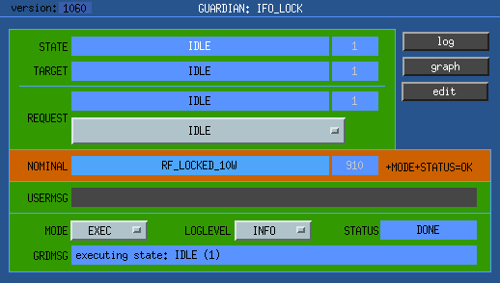
Subsystem highlights
Pre-Stabilized Laser (PSL) commissioned
Input Mode Cleaner (IMC) has been fully commissioned
All seismic isolators (SEI) work as designed and are fully automated
All suspensions (SUS) work as designed and are fully automated
Interferometer locking
  Routine at LLO
  Immanent at LHO
Interferometer Automation
  Significant progress

Slide 9
Commissioning Focus on the First Observational Run
Target sensitivity
  Binary neutron star coalescence range of 40–80 Mpc, each detector
  Important frequency band: 20–300 Hz
  Input laser power: 25 W
Nominal duration
  3 months
Run start
  Some time in 2015, perhaps mid 2015

Slide 10
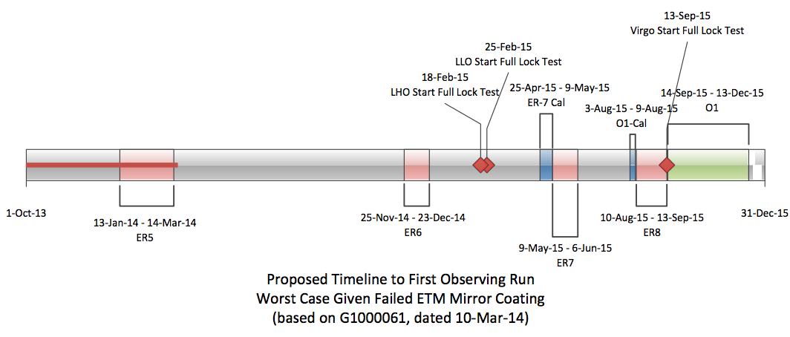
Run Planning

Slide 11
Electro-Static Charging & Actuation
Each End Test Mass has electro-static actuation, via electrodes on the adjacent reaction mass
Measurements of force vs bias indicates there is static charge present, equivalent to 10’s to several 100’s of volts
  ‘static’ charge will fluctuate and create noise
  Charge is not uniform; makes it hard to lower the bias for low noise
Work in progress: source of charging not clear
  Discharging procedure with ion-gun
  But: recharging after a few hours/days
  Ion pumps?
Noise from ESD needs to be reduced: need factor of 3-5x for now
  Via bias reduction, or lower noise signal path, or both

Slide 12
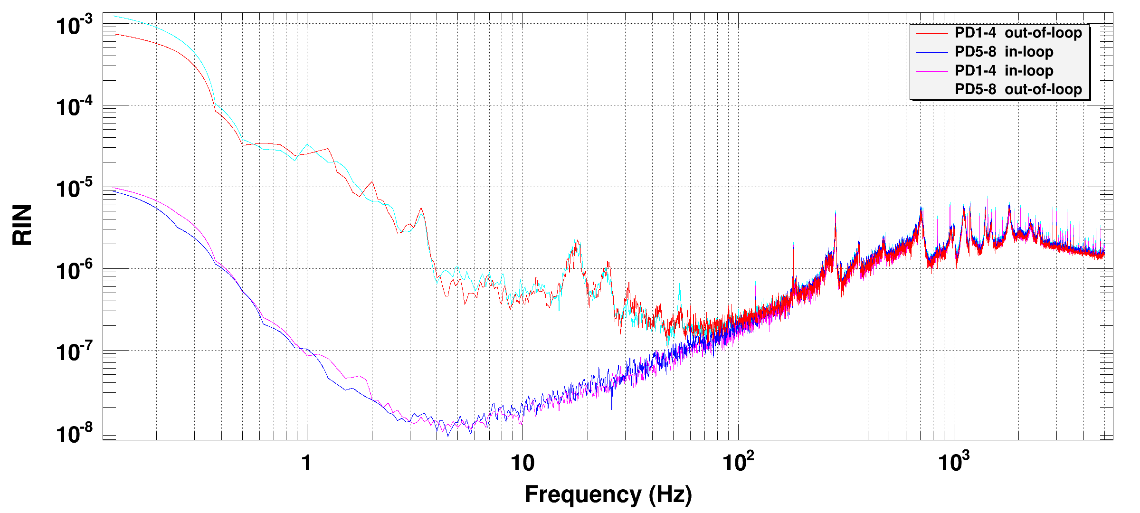
Laser intensity noise & coupling
Laser intensity stabilization is done in 2 stages
  Second stage detects a sample of the IMC transmitted light in vacuum, to reduce vibration related sensing noise
  Initial versions of the in-vacuum sensor had several design & assembly problems; essentially non-functional
  A new version that incorporates several design improvements has been installed and tested in H1
Typical ISS performance on H1
requirement

Slide 13
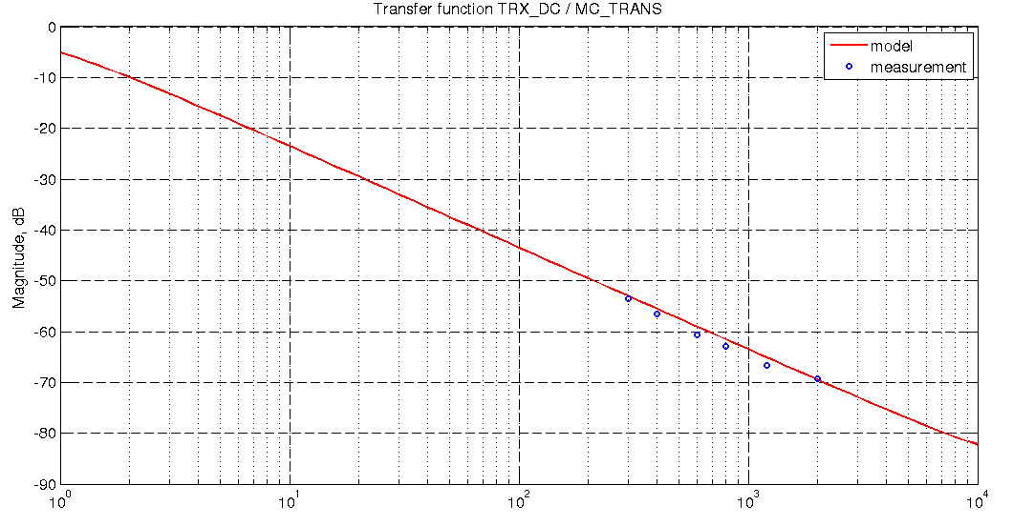
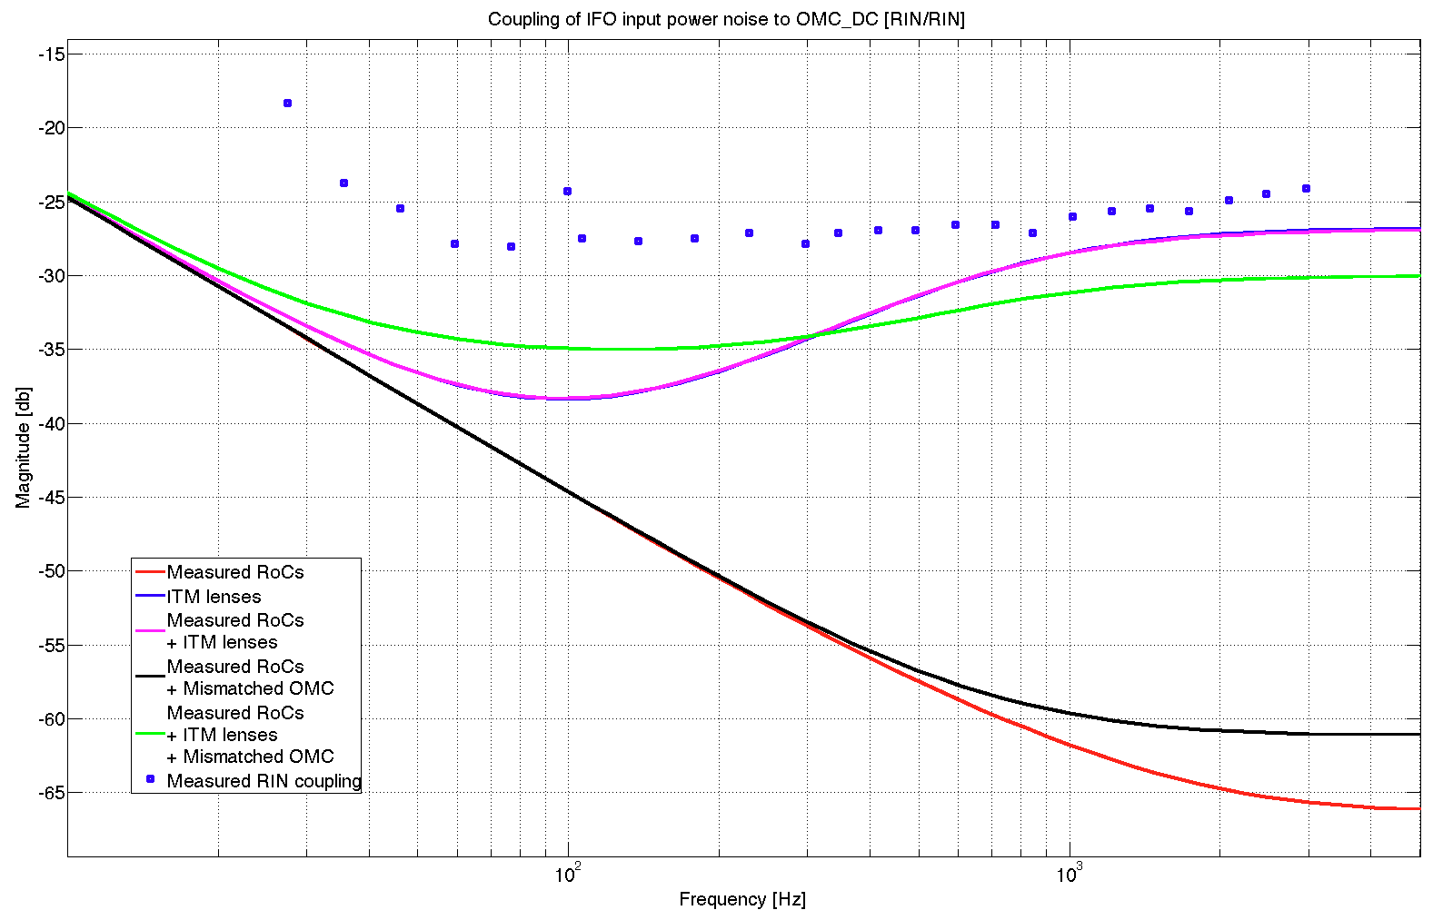
Intensity noise coupling
Transfer function to arm cavity shows expected filtering:
Transfer function to OMC readout does not …
measurement
model
measurement
models
10
100
1000
Frequency (Hz)
10
100
1000
Frequency (Hz)
Increased RIN coupling is due to the carrier higher order modes creates at the dark port by the ITM lenses
OMC matching plays a significant role, since it will convert higher order modes in input to TEM00 mode in output

Slide 14
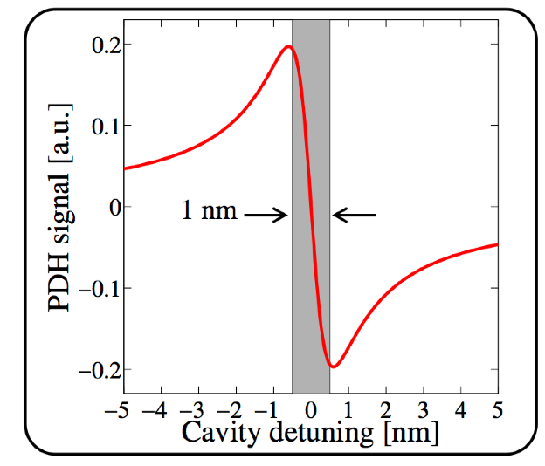
Challenges of Lock Acquisition for Advanced LIGO
Narrow locking range
Low noise,
weak actuators
Advanced LIGO has
5 length DOFs:
the cavities are formed
by the same optics,
so the five DOFs are coupled
Locking one cavity can contaminate the error signal used to lock another cavity
LIGO-G1300524

Slide 15

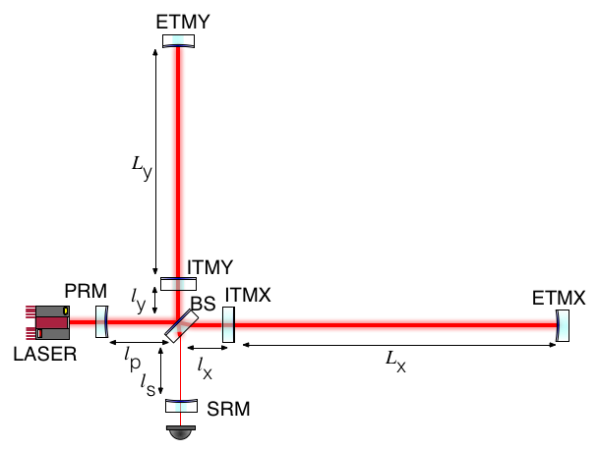
Controlled
Degrees of Freedom
Differential Arm Cavity Length = $L_{x}−L_{y}$
Common Arm Cavity Length = $\frac{L_{x}+L_{y}}{2}$
Power Recycling Length = $l_{p}+\frac{l_{x}+l_{y}}{2}$
Signal Recycling Length = $l_{s}+\frac{l_{x}+l_{y}}{2}$
Michelson = $l_{x}−l_{y}$

Slide 16

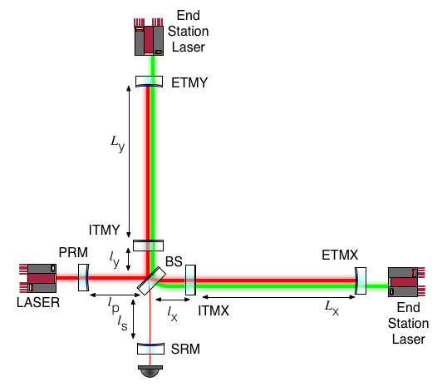
Arm Length Stabilization System
Differential Arm Cavity Length = $L_{x}−L_{y}$
Common Arm Cavity Length = $\frac{L_{x}+L_{y}}{2}$
Power Recycling Length = $l_{p}+\frac{l_{x}+l_{y}}{2}$
Signal Recycling Length = $l_{s}+\frac{l_{x}+l_{y}}{2}$
Michelson = $l_{x}−l_{y}$

Slide 17
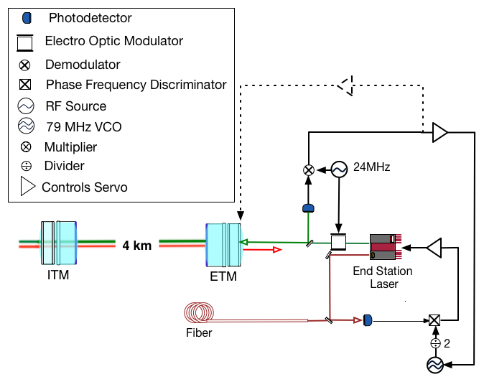
End Station Servos

Slide 18
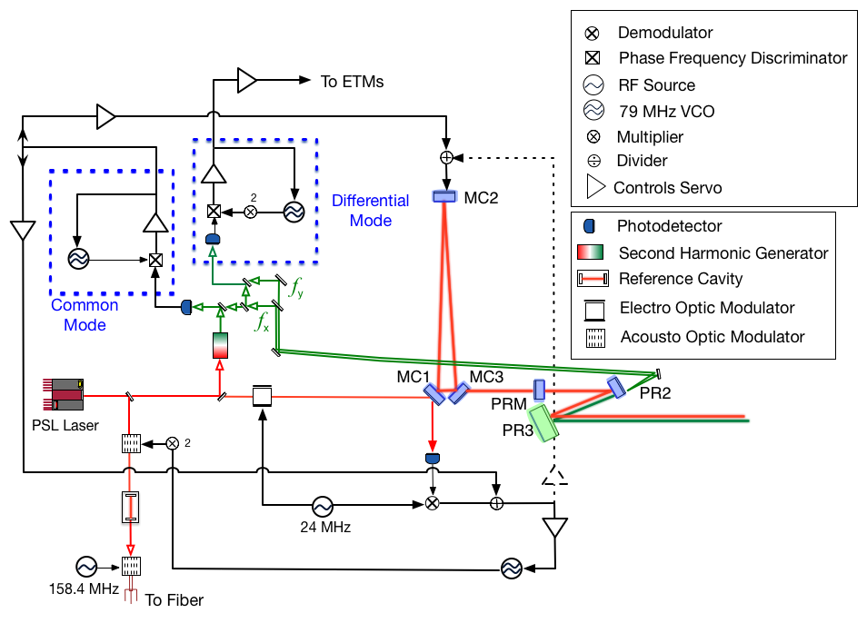
Common Mode Control

Slide 19
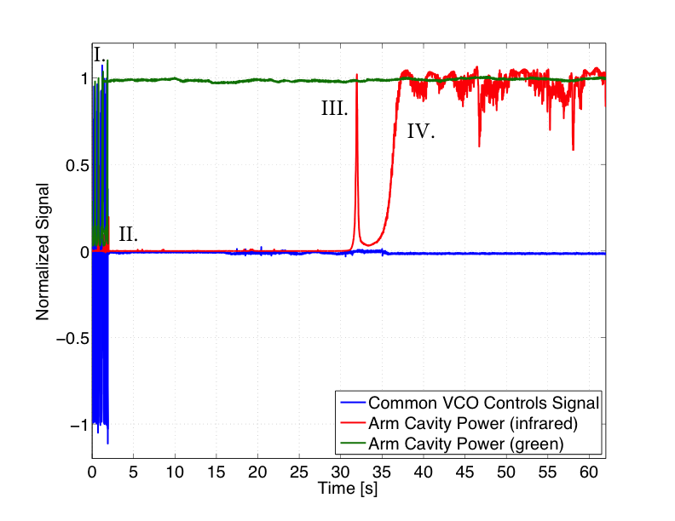
Arm Locking

Slide 20
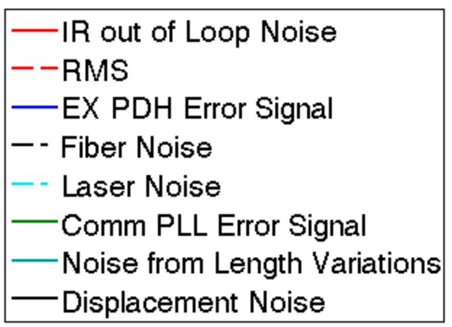
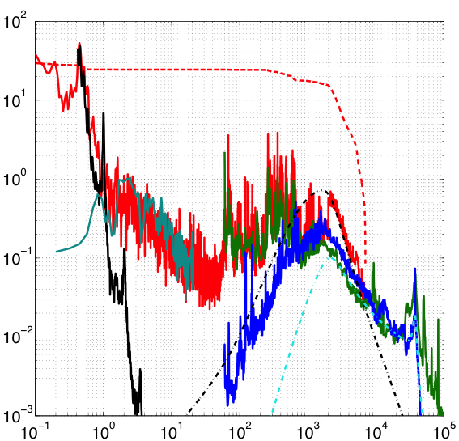
Arm Locking Noise

Slide 21
Differential Mode Control

Slide 22
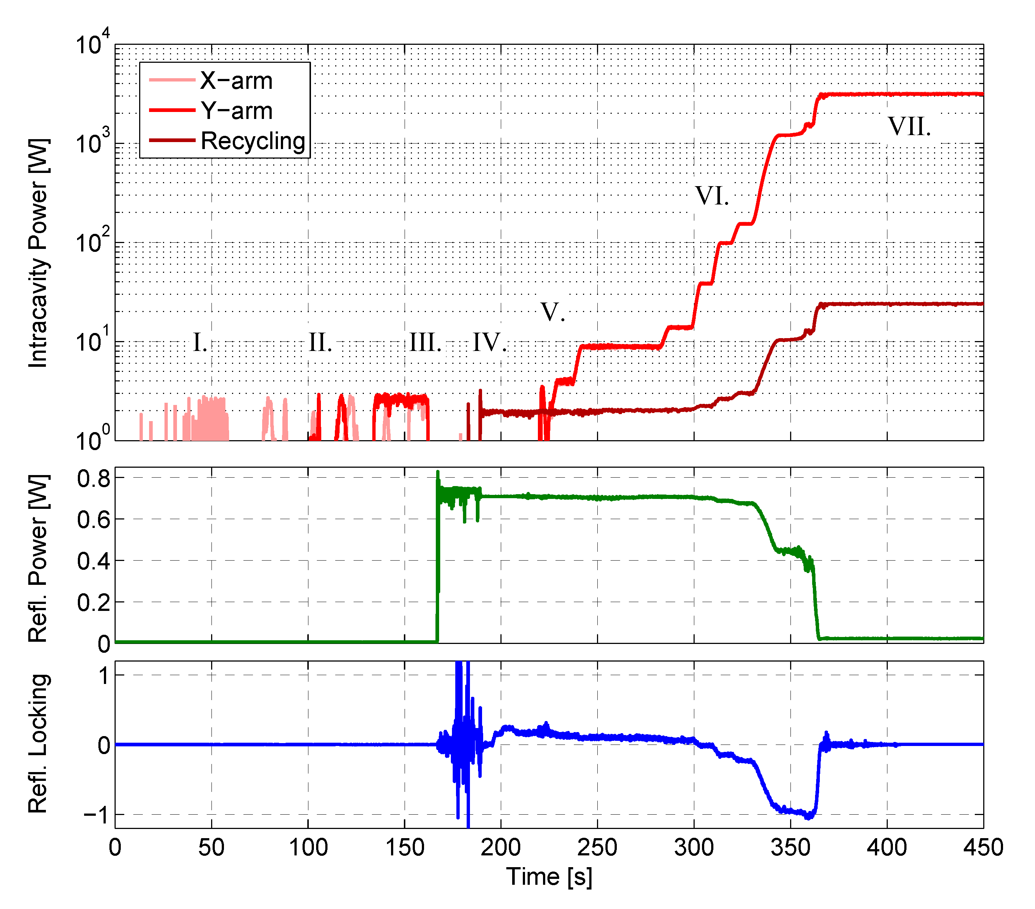
Full Lock Sequence
1f DRMI
1f REFL
3f DRMI
Switch
ALS
Scan
500 Hz

Slide 23
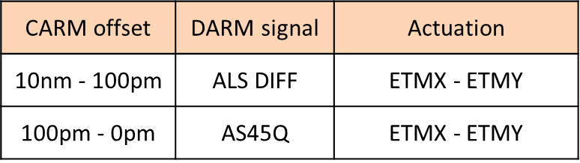
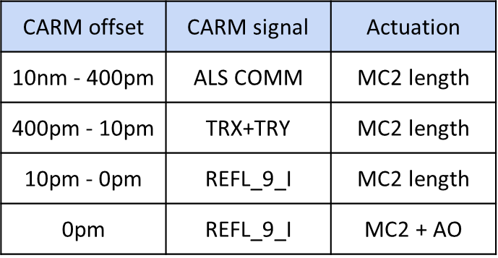
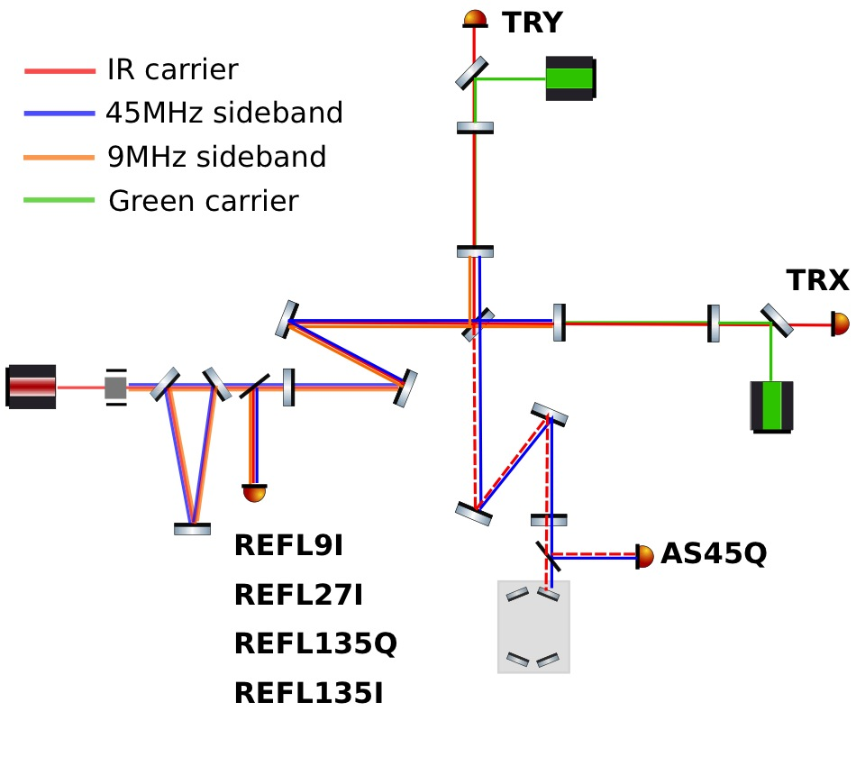
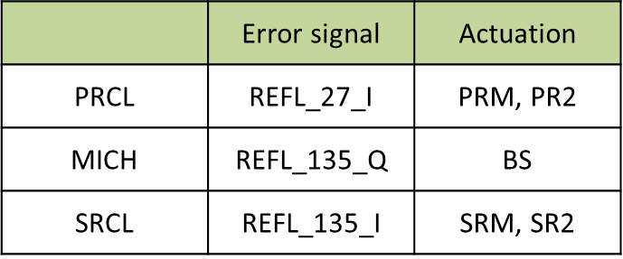
Common Arm Offset Reduction
Should be able to use
AO from beginning
DRMI Length Control

Slide 24
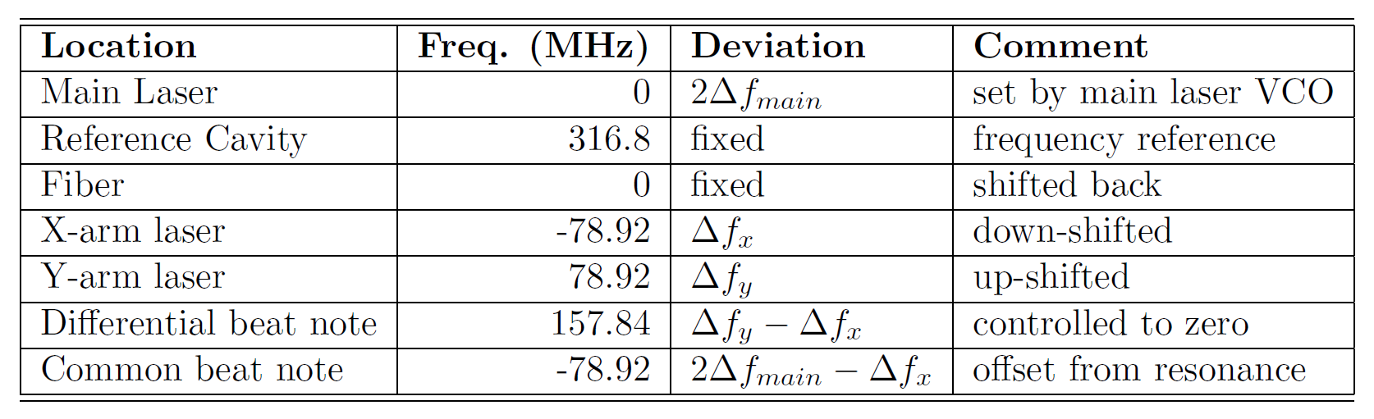
Exact Frequencies
All frequency measured ±1 Hz
Ambiguous: 1 IR resonance for 2 GR resonances
Depends somewhat on green alignment

Slide 25
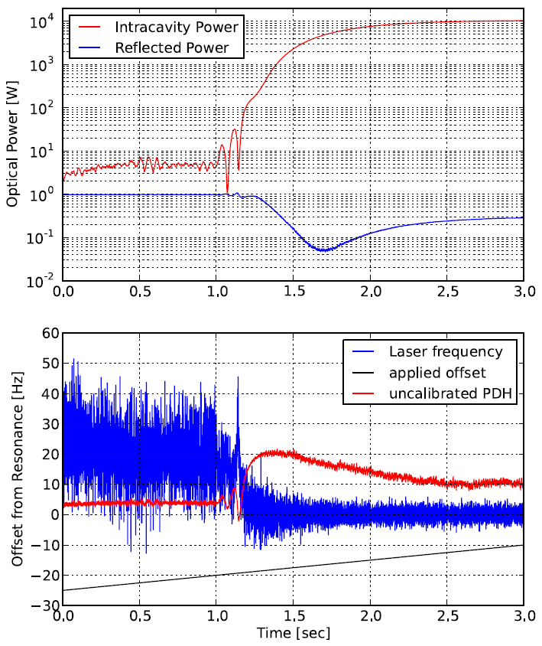
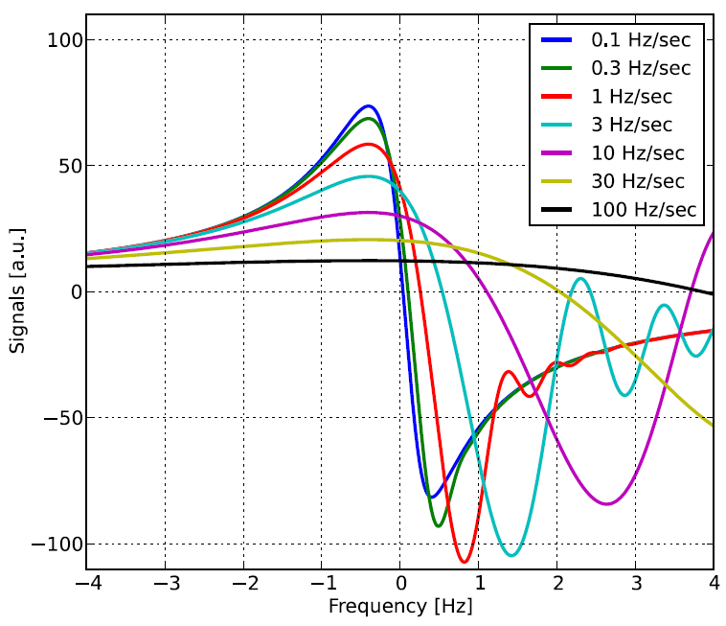
Self-Amplified Lock
Combine a “noisy” wide range
sensor (ALS) with good
narrow range sensor (REFL)
Once cavity power builds up,
REFL gain will dominate
Optics Letters, Vol. 39, Issue 18, pp. 5285-5288 (2014)

Slide 26
In Conclusion
Initial commissioning has progressed quickly
  The only significant delay was due to the green coating issue.
  Arm Length Stabilization successfully decouples arm cavities from the interferometer for lock acquisition.
  Arm Length Stabilization noise well understood.
  Advanced LIGO can be locked with Arm Length Stabilization!
Next up: get H1 caught up with L1
  H1 will test some ideas for improving the locking scheme
  H1 has the improved second stage detector for the laser intensity stabilization in place
  Full lock immanent
L1 has reached the Advanced LIGO
project milestone for integration: 2 hour lock

Slide 27
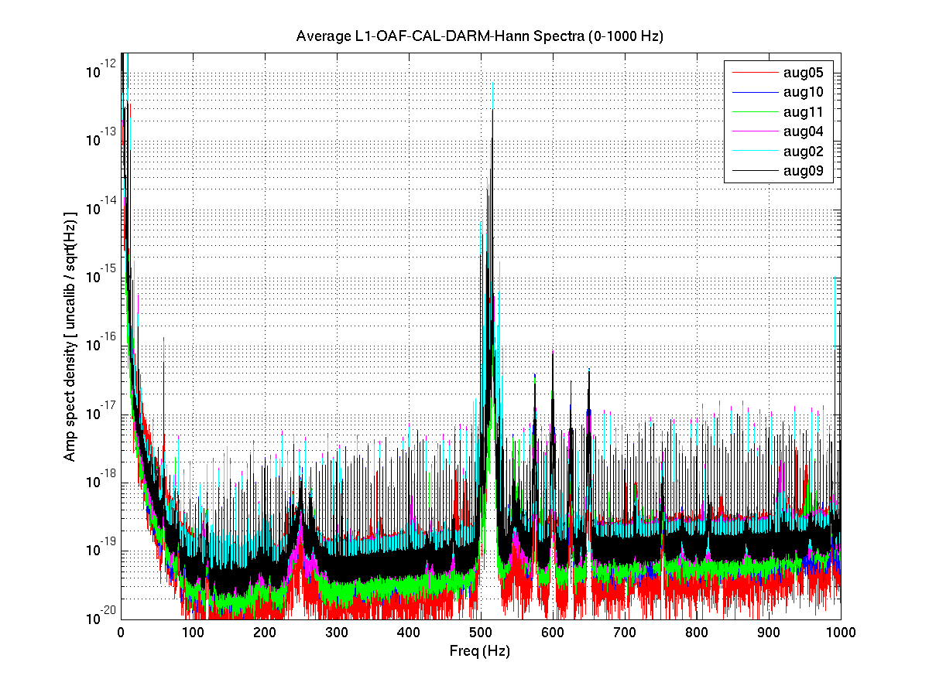
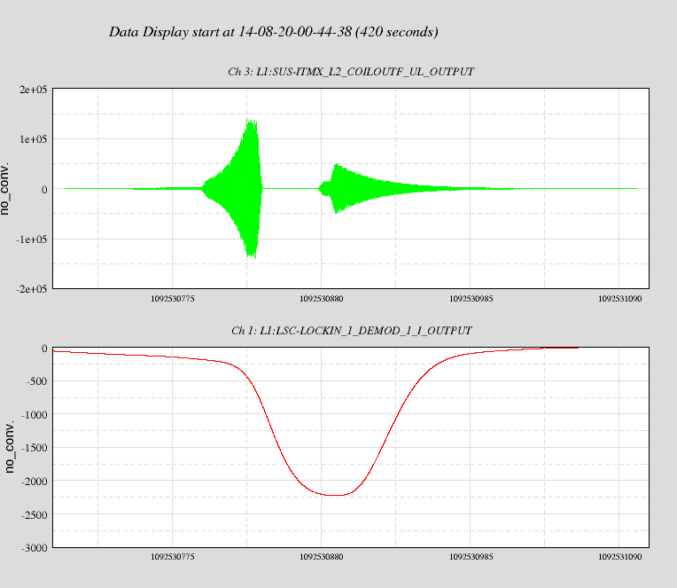
Suspension violin modes
Test mass suspension violin modes, at 500 Hz, are excited several orders of magnitude above thermal
We do not understand why they are vibrating so much
Prevents us from engaging full whitening on the GW readout channels: excess ADC noise
Need to actively damp the modes, using interferometer signal to feed back to the quad penultimate stages
  Should be doable, but it is tricky: 16 very high Q modes in a narrow frequency range
  Some progress recently on L1 with the DRMI
Feedback signal
excitation
damping
Violin mode amplitude

Slide 28
Glitches from digital-to-analog converters
DAC transitions are accompanied by a step
  Largest at the zero-crossing (all bits flip), next largest at ¼ & ¾ of full scale
  DAC needs calibration after restart!
Observed to create low frequency noise in the recycling cavity signals
Noise mechanism not completely clear
Error signal
Solutions:
Offsets on control signals
Low pass filters after DAC
Control signal
Also an issue for ESD feedback, at ¾ range transition

Slide 29
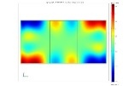
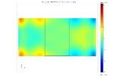
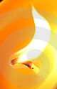
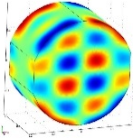
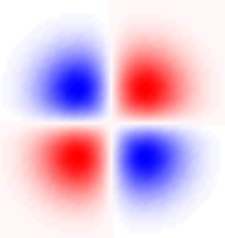
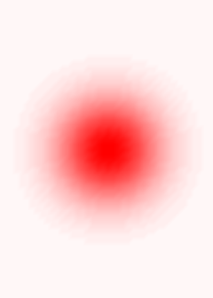
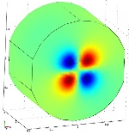
Parametric Instabilities
High Finesse
Cavity
Combination of high stored optical power and low mechanical loss could cause an instability
Nascent
Excitation
Mechanical
Mode
Pump
Field
φ
Scattered
Field
(cavity gain)
Radiation
Pressure
Latest analysis (S Gras) suggests we are more prone to PI than we thought
  MC simulation with distribution of RoC’s and acoustic mode frequencies of test masses
Start to look for risky modes even before they become unstable (UWA idea)

Slide 30
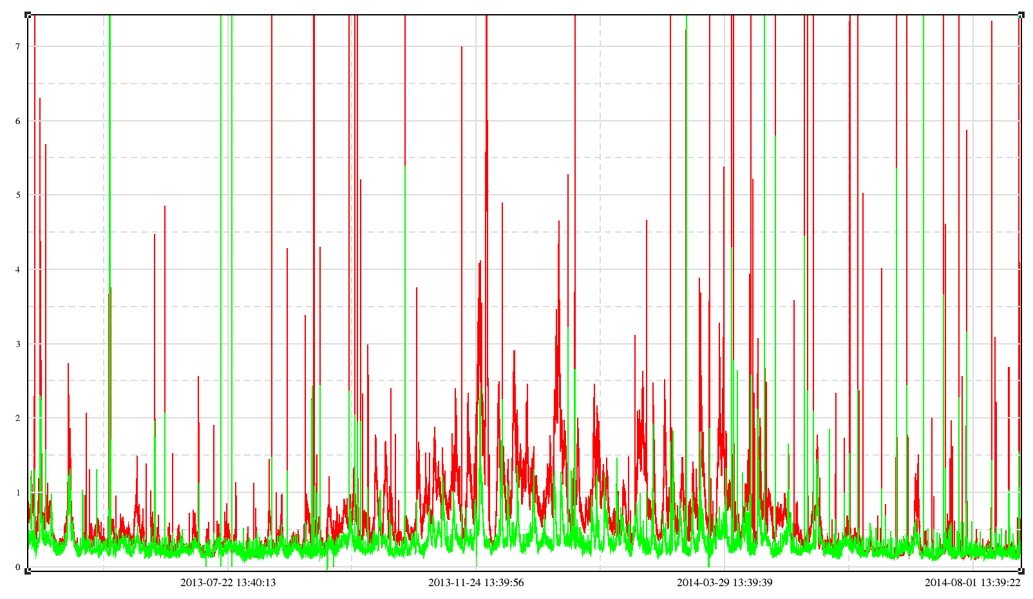
Seasonal variability of ground motion
LLO ground motion over 500 days
7
rms in:
0.1—0.3 Hz
0.3—1 Hz
6
5
4
microns/second
3
2
1
0
June
July
Aug
Sep
Oct
Nov
Dec
Jan
Feb
Mar
Apr
May
June
So far, commissioning has been during periods of low microseism

Slide 31
Impact of higher ground motion
Arm Length Stabilization could suffer
  Arm cavity finesse at 532 nm is much lower than desired:
    ETMs have too large a transmission at 532 nm
    Finesse: 5-10 (actual) vs. 100 (desired)
  Makes the cavity locking point much more sensitive to alignment and alignment fluctuations
Replacing the ETMs could be the best solution
  ETMs now coming out of LMA have the right 532 nm transmission
  Downside would be a 2 month hit for replacement

