Slide 1
What Advanced LIGO is about to see
Peter R. Saulson
Syracuse University

Slide 2
Outline
What is a gravitational wave?
What will we learn from detecting them?
The challenge of detecting GWs
How will we meet the challenge?
What have we learned so far?
What is Advanced LIGO about to see?

Slide 3
A long time ago in a galaxy far, far away …

Slide 4
Much closer to home …
In 1974, Russell Hulse and Joe Taylor found PSR 1913+16, a pulsar in a binary orbit with another neutron star.
As Taylor followed the orbit over the years, he found it “getting ahead of itself.” Energy loss caused the two neutron stars to fall closer together and orbit faster.
This was the discovery of gravitational radiation.

Slide 5
How to measure spacetime curvature

Slide 6
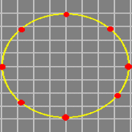
What happens when a gravitational wave passes by

Slide 7
Gravitational wave: a transverse wave of quadrupolar strain
strain amplitude: h = 2 ΔL/L

Slide 8
Gravitational waveform = oscillation pattern of test masses

Slide 9
Since we understand gravity, we can calculate waveforms
Stellar-mass objects give signals in the audio band. (!)

Slide 10
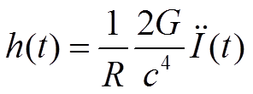
Gravitational waveforms let us read out source dynamics
The evolution of the mass distribution can be read out from the gravitational waveform:
I is the mass quadrupole moment of the source.
Coherent relativistic motion of large masses can be directly observed.

Slide 11
What is interesting about gravitational waves?
Embody gravity’s obedience to the principle “no signal faster than light”
Travel through otherwise opaque matter
Can be generated by pure spacetime
Black holes
Early universe fluctuations
Thus, gravitational waves can reveal, like nothing else can, the dynamics of strongly-curved spacetime.

Slide 12
What kinds of things might we see? Might we learn?
Binaries of neutron stars and black holes
Study black hole spacetime
Learn neutron star equation of state
What is the engine of gamma ray bursts?
Stellar core collapse
Dynamics that lead to supernova
Rotating neutron stars
What mechanisms can make neutron stars lumpy?
Early universe dynamics

Slide 13
What does it take to build a gravitational wave detector?
We’ll need:
A set of free test masses
A means to measure their relative motion
Isolation of the masses from other causes of motion.
Here’s the challenge:
Best astrophysical estimates predict fractional separation changes of only 1 part in 10²², or less.

Slide 14
Let’s invent a gravitational wave detector

Slide 15
Use a Michelson interferometer to measure relative motion

Slide 16
Michelson interferometer = transducer from length difference to brightness
Light from x arm
Brightness of superposed beams of light from the two arms.
Light from y arm

Slide 17
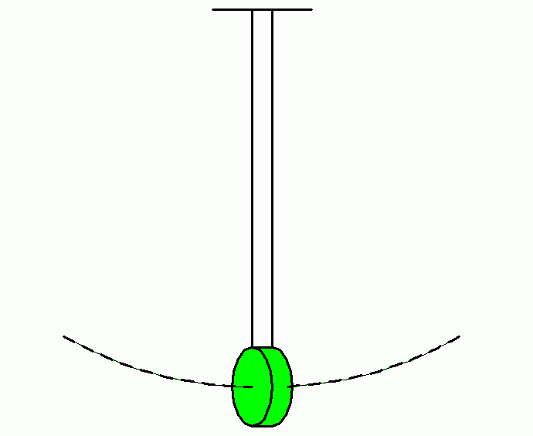
Free test masses
A pendulum bob is dynamically free (above its resonant frequency).
“bob” = test mass = interferometer mirror A mass suspended as a pendulum is also isolated from external motions.

Slide 18
Can it work?
What is required for LIGO to succeed:
interferometry with free masses,
strain sensitivity of 10⁻²²
in the presence of very large noise.
If you don’t worry that this is impossible, you aren’t taking it seriously.

Slide 19
Here’s the sensible way to build an interferometer

Slide 20
Here’s how we do it: feedback everywhere
Mirror alignment and position controlled by a system of sensors and actuators. The system stays very close to a chosen operating point, while leaving the mirrors nearly free.

Slide 21
Can we measure h ~ 10⁻²²?
An interferometer is a transducer from length difference to brightness.
Make the signal big by making the arms long.
Make the transduction factor big by folding the arms.
Allow fine measurement of output power by using lots of light.

Slide 22
aLIGO optical design
Laser power: 125 W
Folding of arms by factor of 450.
Arms are resonant Fabry-Perot cavities.
Re-use laser power by a factor of 500 by reflecting light back into the interferometer.
“power recycling”
Resonantly build up signal by reflecting “signal sidebands” back into interferometer.
“signal recycling”

Slide 23
aLIGO optical layout (still simplified)

Slide 24
Isolate against seismic noise
Strain of 10⁻²² corresponds to mirror motions of a few x 10⁻¹⁹ m (!), with 4 km arms.
Seismic motion of the ground is about 10 orders of magnitude larger.
“Isolate, isolate, isolate.”

Slide 25
Caveats re isolation
Resonant vibration isolators don’t work at low frequencies.
Also, there’s a gravitational “short-circuit” around a mechanical isolator.
Ask Vuk for details.
There’s also a very large Brownian motion of the mirror, that needs to be tamed.
Ask me in the question period, if you want.
Maybe, next time, we should go into space. (Or at least into a mine …)

Slide 26
Noise power spectrum of initial LIGO
Noise was well understood at almost all frequencies. Photon shot noise dominated above 100 Hz. Noise from servo loops was important below 50 Hz.

Slide 27
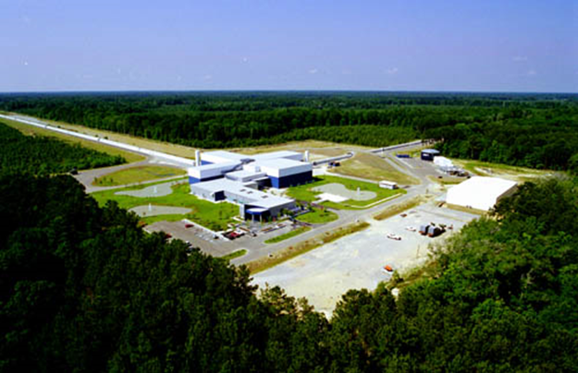
LIGO’s two sites went into operation in 2005
LIGO Hanford Observatory, WA
LIGO Livingston Observatory, LA
Two years’ worth of integrated coincident data, at or beyond design sensitivity, collected between 2005 and 2010.

Slide 28
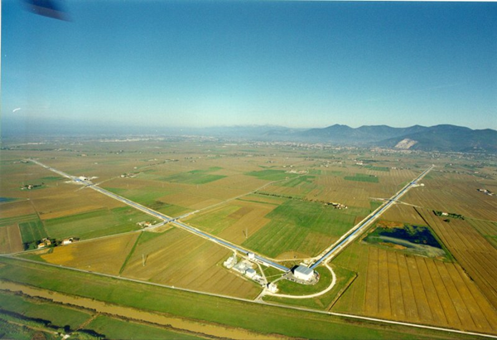
GEO and Virgo observed and analyzed data with us
GEO, 600 m arms, near Hannover
Virgo, 3 km arms, near Pisa

Slide 29
LIGO’s 4 km arms, 10⁻⁸ torr

Slide 30
Vacuum chambers here, beamsplitter and input test masses

Slide 31
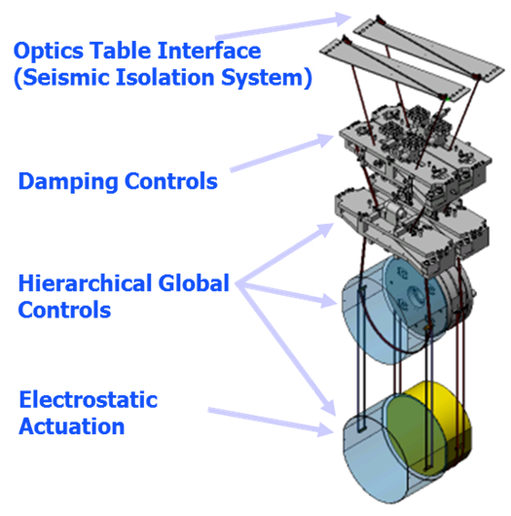
Quadruple pendulums suspend and isolate the test masses

Slide 32
Test masses suspended on fused silica fibers, welded in place
Note: Clean-room practice must be rigorously enforced.

Slide 33
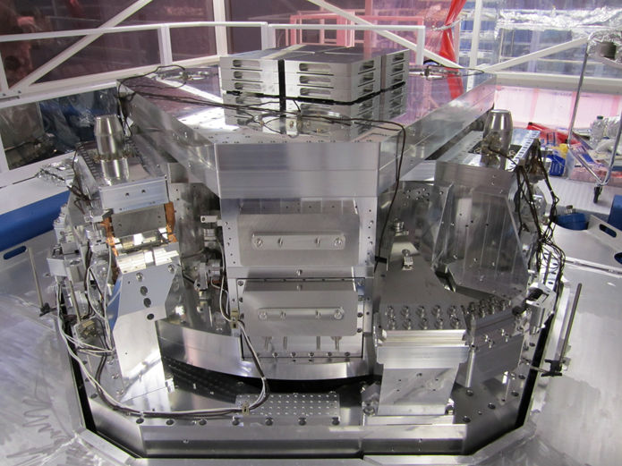
Two stages of active isolation supplement the pendulums

Slide 34
Initial LIGO didn’t detect any gravitational wave signals
We were disappointed, but not surprised.
We could see neutron star binaries only out to 20 Mpc, while we needed to see to ~200 Mpc to expect a few per year.
Advanced LIGO will see to 200 Mpc.

Slide 35
An interesting upper limit from initial LIGO observations
GRB 070201 was a short hard gamma ray burst, apparently in M31. (Distance = 0.8 Mpc, close!)
If it had been caused by a neutron star binary (or NS-BH binary), we would have seen it. We didn’t.
Most likely conclusion: It wasn’t a classic short hard GRB, but was instead an SGR giant flare.

Slide 36
Another interesting upper limit from initial LIGO
Initial LIGO set upper limits on the strength of a stochastic background of GWs that are competitive with most other techniques. (Stay tuned re BICEP 2 … )
aLIGO will test some interesting models. Ask Vuk and Gwynne for more details.

Slide 37
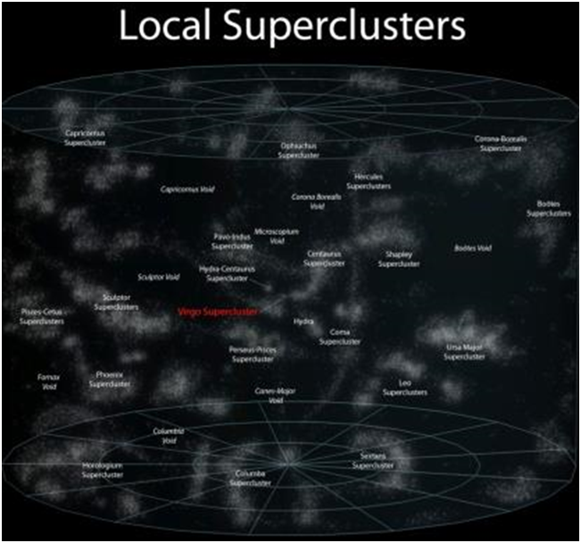
aLIGO will soon have the sensitivity that we need
iLIGO could see the Virgo Cluster.
aLIGO will survey 1000x more volume.

Slide 38
Today, aLIGO can see twice as far as initial LIGO did.
A week-long Engineering Run starts next week at Livingston.

Slide 39
Binary neutron star signals expected by 2017-19
aLIGO will reach design sensitivity by 2019.
Binaries with black holes will likely turn up as well.
There will be a lot of good physics and astrophysics to do.

Slide 40
Prospects
Soon, Advanced Virgo will join the network. That will allow sky localization, opening the way to multi-messenger GW astronomy.
A few years later, LIGO India will give us much tighter error boxes.
The gravitational wave future looks very bright!

