Slide 1
LLO X-End Excess Gas Load
Excess gas load based on pressure, RGA data and helium leak checking activities.

Slide 2
A Brief History
A noticeable difference in pump down times and ultimate pressure raised suspicion after the X-End vent/pump down Aug 28, 2014. (see plot next slide)
Also following the successful repair of GV7 and comparing ultimate pressures of both X & Y end stations also heightened this sense of awareness and concern.

Slide 3
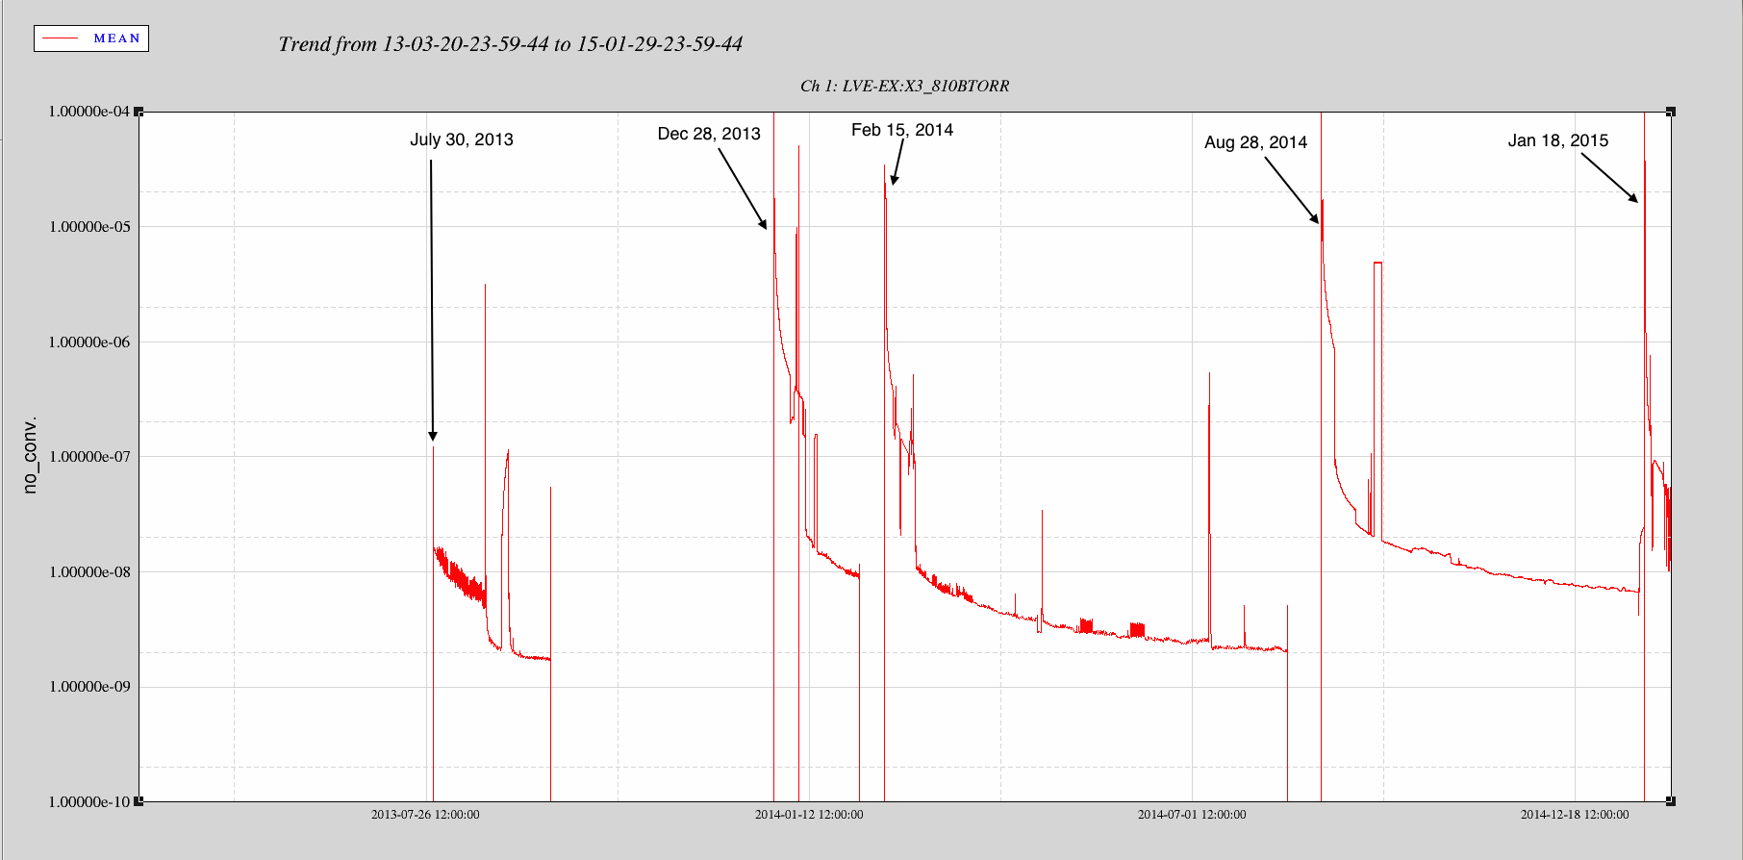
X-End Trend History for BSC4/PT810B

Slide 4
X-End RGA and Leak Checking
Opportunity surfaced during the PSL maintenance period and simultaneously the vacuum recovery process post Test Mass Discharge attempts.
Jan 19th 2015
Vacuum certification efforts began to commission the Balzers RGA located on the BSC4 chamber and extensive leak checking in the building with GV12 closed.

Slide 5
Pumping & Leak Checking
Configuration
All pumping, leak checking and RGA data is performed from the BSC side of GV12
Pumping station configuration: Seiko Turbo backed by the QDP80 roughing pump, no ion pump was introduced to the system during this time due to charge measurements taking place.
Leak Checking station configuration: Seiko Turbo backed by the Inficon UL5000 leak detector. NOTE: This configuration is used only during the leak checking process or when monitoring the helium background after a direct hit of an outside air leak.

Slide 6
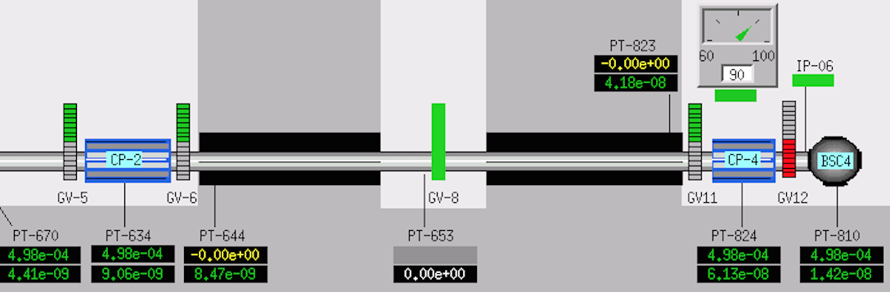
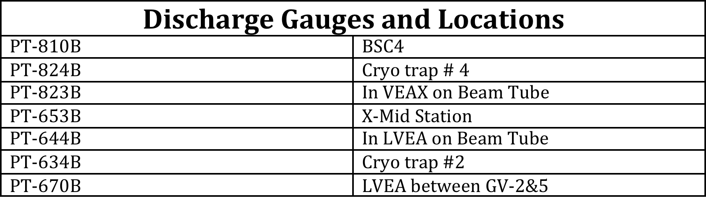
Map of Instrumentation

Slide 7
Initial Leak Checking Results
Jan 19, 2015
Start of extensive leak checking with GV12 closed. Leak checking activities covered the entire BSC and associated spool piece including GV12 annulus mini CF and sniffed around bonnet. NOTE: GV12 dust cover was not part of this leak checking process.
Jan 21, 2015
A small permeation leak (~1e-9 torr l/s) was detected on a view port ETM-X-Video2 (VP6). View Port Assembly # LIGO-D1100999-v4
Fault report entered 1/21/15 2587
No other detectable leaks were found during this time period.

Slide 8
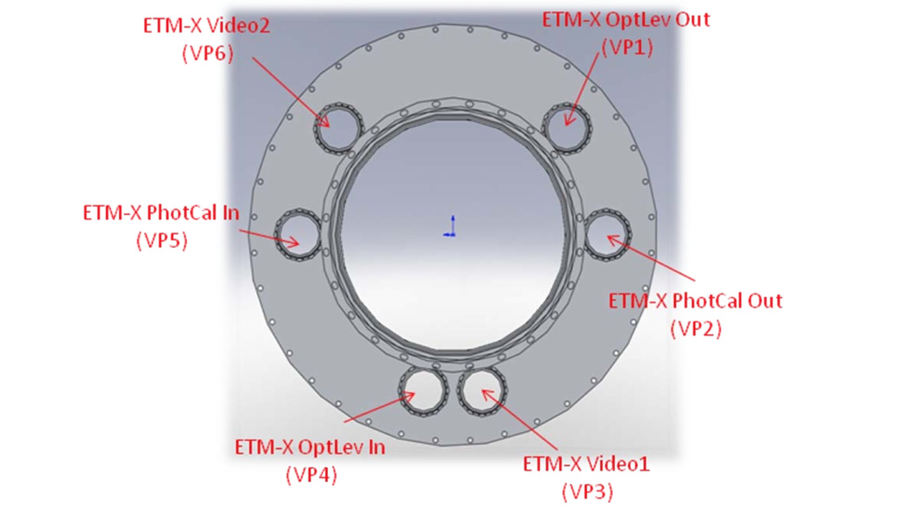
View Port Flange Location

Slide 9
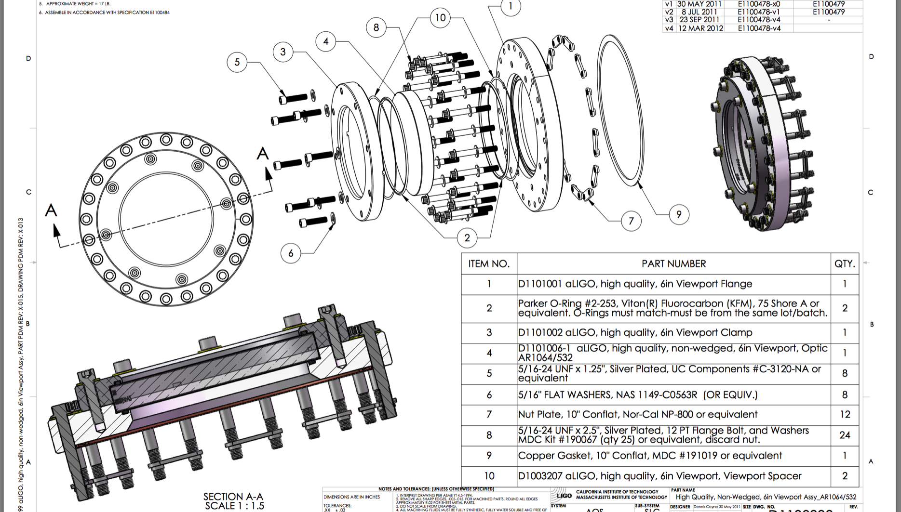
View Port- LIGO-D1100999

Slide 10
RGA DATA With GV12 Closed
Jan 23, 2015 RGA scans saved
RGA scan with GV12 closed (next slide)
Water is the highest peak.
No signs of an outside air leak.

Slide 11
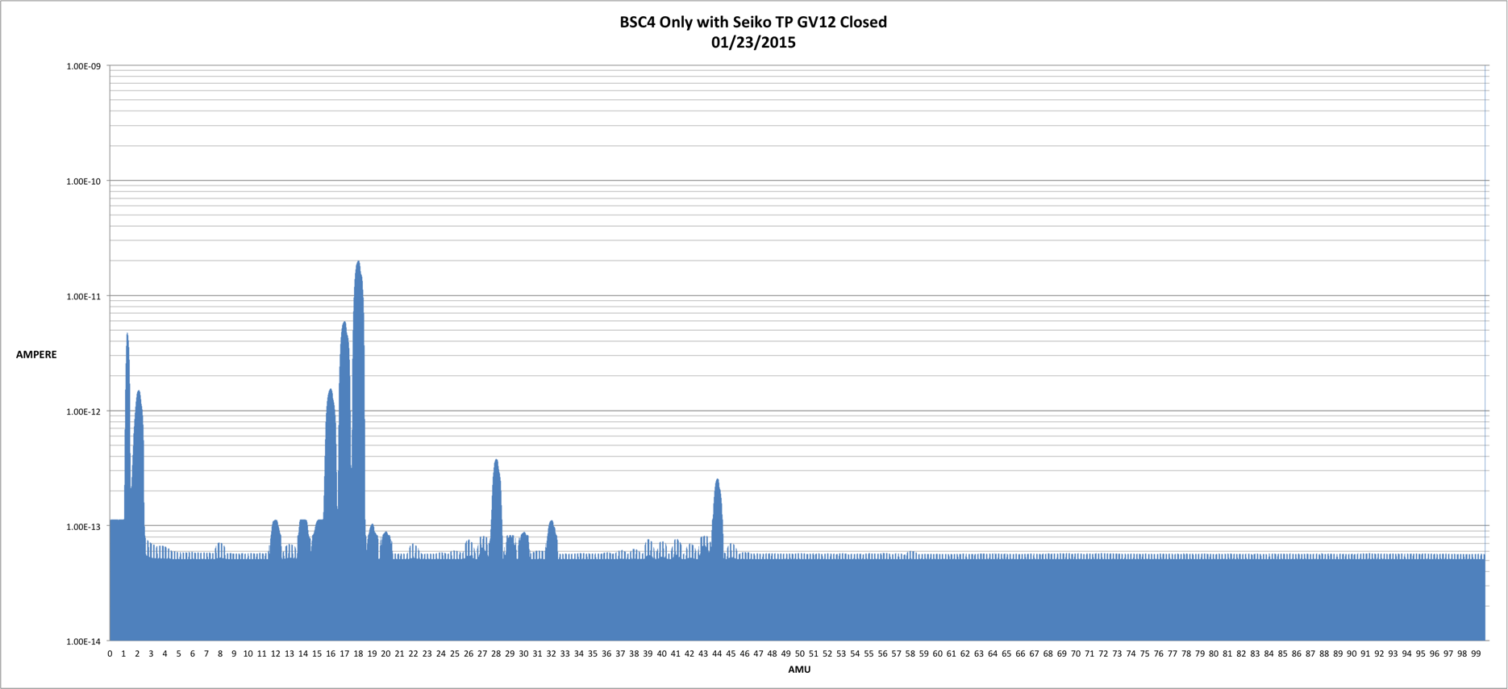
RGA DATA With GV12 Closed
Jan 23, 2015

Slide 12
RGA Data With GV12 Open
Jan 26, 2015
GV12 was opened, rendering the BSC4 chamber common with the Cryo Trap and X-Arm (GV11 Open).
RGA scan displays a “text book” outside air leak signature (next slide)
Peeks at AMU 14, 28, 32, and 40 indicate an air leak.

Slide 13
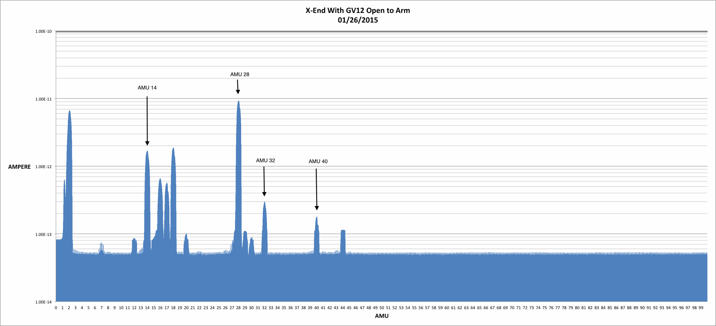
RGA Data With GV12 Open

Slide 14
RGA Data and Leak Checking
Jan 26, 2015
RGA scans indicated an air signature on the east side of GV12.
Begin a complete leak check of all components accessible in the VEA performed to validate if the air signature was coming from the beam tube or something inside the VEA.

Slide 15
Leak Checking Continued
Jan 26, 2015
Ruled out all suspect flanges, welds, all metal valves (pump out ports), gate valve on CP-4, and feed-through locations.
Jan 27, 2015
A delayed (~ 5-10 min) response but positive, on the leak detector after spraying helium in the dust cover of GV11 and in the process of spraying GV12 dust cover.

Slide 16
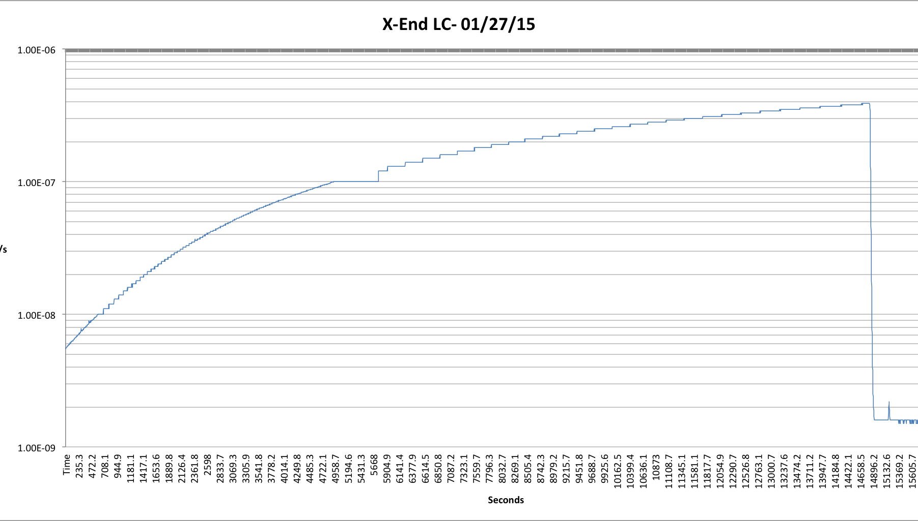
INFICON UL5000 Leak Detector Data
Notes:
Some data points were lost in the process of trying to record the positive hit. LR started ~ 8e-10 torr l/s, after the hit recorded data started ~5.1e-9 torr l/s

Slide 17
Post Leak Checking
Jan 28, 2015 Morning Activities
Use the Seiko TP to pump down and recover the pressure (no ion pump).
Introducing the leak detector and isolating the QDP80 to sample the helium back ground in the morning.
Leak rate 2e-6 torr l/s
Repeat this method daily through Friday Jan 30, 2015. Each days results were very close and repeatable.

Slide 18
RGA Data Post Leak Checking LGV Dust Covers
Feb 2, 2015
The vacuum system was left static over the weekend, no pumping from Seiko or Ion pump (~70 hrs.)
RGA scan (next slide) demonstrates the helium in the system is substantial. RGA in faraday cup mode (No CEM) indicates two things now.
  Outside air leak
  Helium saturation overcomes the water peak

Slide 19
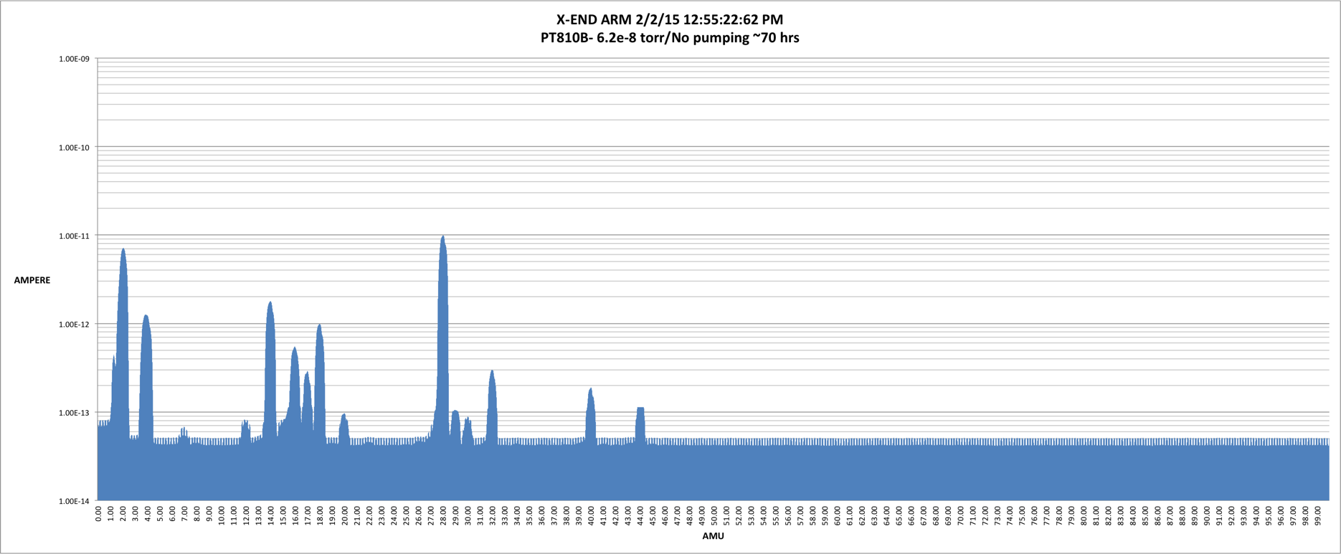
RGA Scan Baseline
~ 70 hrs. With No Pumping

Slide 20
Test Integrity of GV12
Feb 3, 2015
A test was initiated to determine if both LGV’s were contributing to the source of helium.
Test consisted of base line readings of pressures at the BSC and Cryo Trap, helium leak rate on the leak detector (common with the main volume) and RGA data monitoring.
After all base line measurements were recorded GV12 was closed for ~ 6 hrs. and then re-opened.
During this time period the data proved that GV12 was not a source of the outside air leak and present helium background.

Slide 21
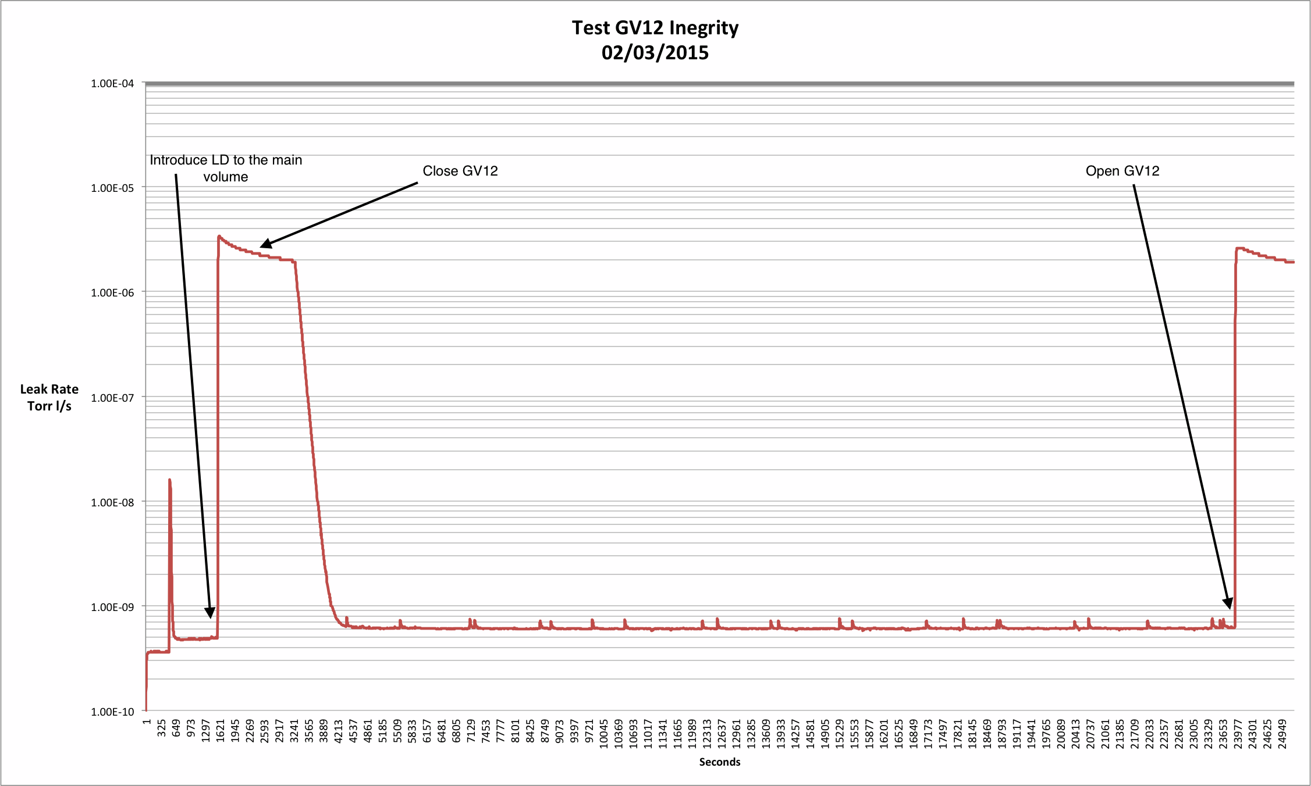
INFICON Leak Detector Data
During GV12 Integrity Test

Slide 22
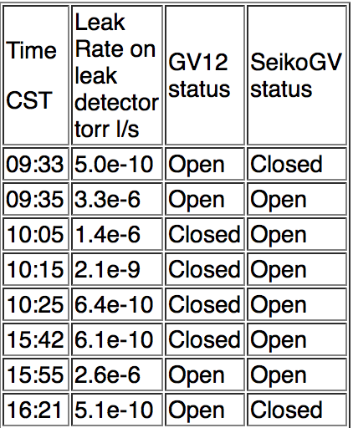
Notes of INFICON Leak Detector
During GV12 Integrity Test
Feb 3, 2015

Slide 23
RGA Data with GV12 Closed for ~ 6 hrs.
Helium peak (AMU 4) reduced significantly. Helium was reduced from ~ 1.1e-12 amps to 2.2e-13 amps in 6 hours.
Air signature (AMU 14, 28, 32, 40) also reduced significantly.
Water (AMU 18) is higher due to lack of cryo trap when GV12 is closed.
See scan on the next slide

Slide 24
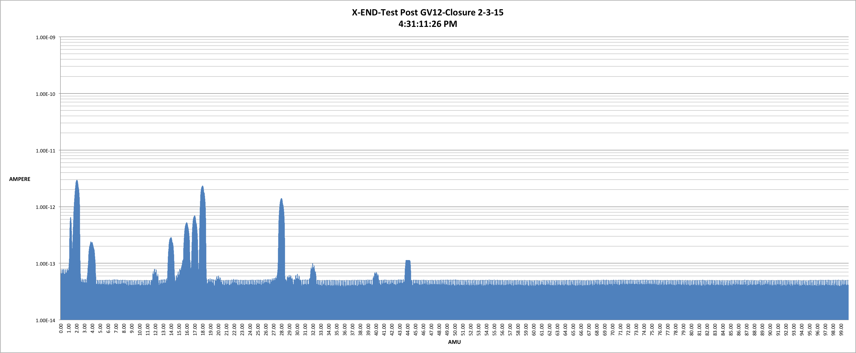
RGA Data with GV12 Closed for ~ 6 hrs.

Slide 25
GV12 & GV11 Total Cycles
GV11 | GV12
63 | 52

Slide 26
Action Items
Up for discussion
Measure leak rate now and monitor over time
  How
  When
Monitor LN2 consumption on CP-4 and CP-3
  How
  Who
  When
Install RGA at X-Mid
  In Progress, RGA is working (currently in VPW)
Get helium Out
  How
  When
Leak check GV8 and other LGV’s
  When

