Slide 1
Highlights from the commissioning of Advanced LIGO
L. Barsotti
for the Advanced LIGO Team
LIGO-G1500414

Slide 2
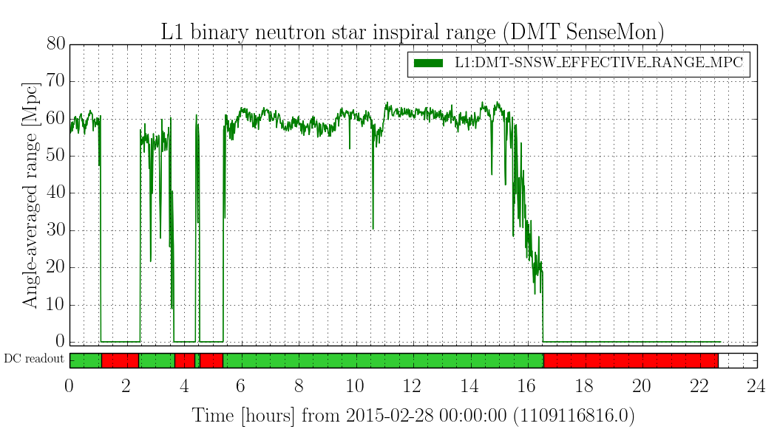
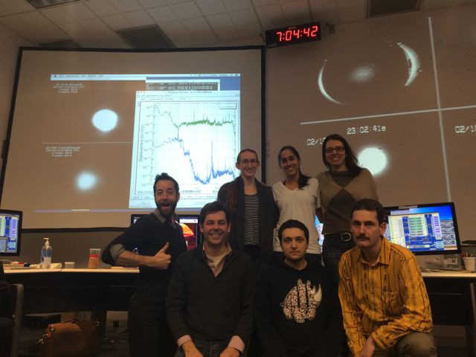
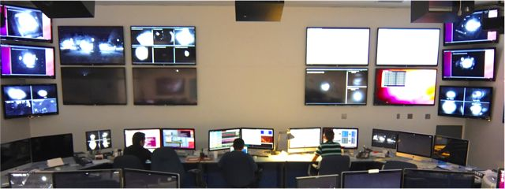
Since the last LVC…
Best L1 Sensitivity = 65 Mpc
10h lock = 20 days of eLIGO
H1 achieved full lock!
Best sensitivity = 15 Mpc

Slide 3
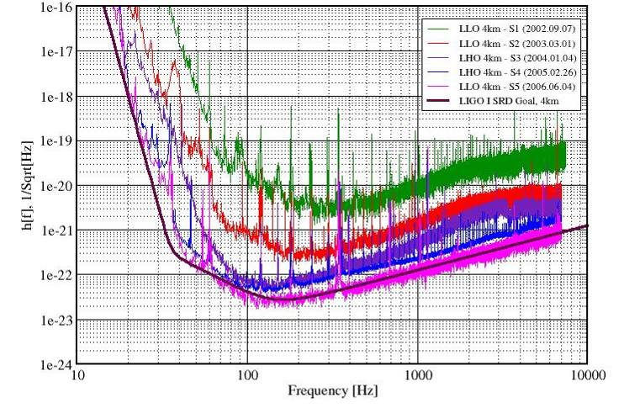
Reminder from Initial LIGO: from 100 kpc to 15 Mpc in 3+ years (with observing time)
LIGO: First lock at the end of 2000…
S2: Feb.- Apr. 2003
59 days BNS reach ~ 1Mpc
S3: Oct. ‘03 - Jan. ‘04
70 days BNS reach ~ 3Mpc
Science Requirement. document (1995)
S1: Aug. - Sep. 2002
17 days BNS reach ~100kpc
S4: Feb. - Mar. 2005
30 days BNS reach ~ 15Mpc
15 Mpc
S5: Nov 2005 – Oct 2007

Slide 4
aLIGO L1: from 0.5 Mpc to 60 Mpc in 9 months!
LIGO: First lock in May 2014
G1401390

Slide 5
L1/H1 Commissioning Strategy
L1: “make the noise lower”
➔ Pathfinder of noise sources/coupling mechanisms (aLIGO upgrade started ~1 year earlier than in H1)
H1: Improve the sensitivity following L1 path
In parallel, both interferometers: work on locking robustness, automation, training of operators
We expect H1 sensitivity to be comparable (at least) to current L1 sensitivity by O1: no reason to believe otherwise at the moment

Slide 6
L1 Noise vs Fundamental Noises
(D. Martynov, G1500281)
Shot noise @ high frequency
What about low frequency?
25W input power
100 kW circulating power

Slide 7
The usual answer: “technical noises”
(many of them)
YELLOW: scattered light projections
ORANGE: “charge” noise
Frequency (Hz)

Slide 8
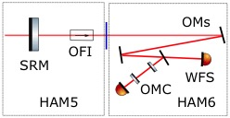
Most “hot” noise sources these days
Scattered light
Charge
Evidence of noise introduced by scattered light
Investigations focused on the path between the Signal Recycling Mirror and the Output Mode Cleaner
Short version of the story: we have charge on our test masses and this is bad for many reasons
In particular, first order interaction with time varying electric fields in the chamber
➔ noise in DARM
DISCHARGE effort on going RIGHT NOW at LLO
R. Weiss, G1500264

Slide 9
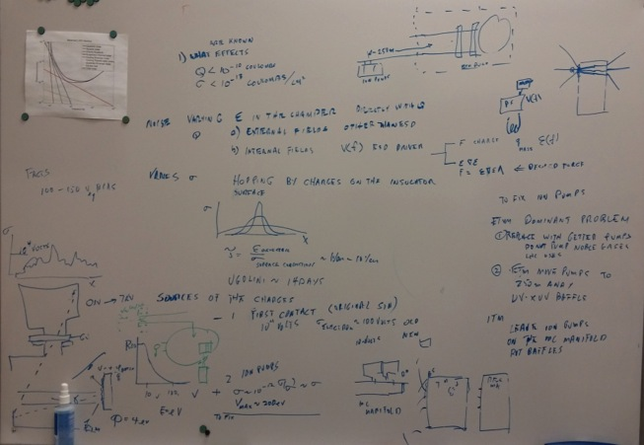
Most “hot” noise sources these days
Scattered light
Charge
Evidence of noise introduced by scattered light
Investigations focused on the path between the Signal Recycling Mirror and the Output Mode Cleaner
Long version of the story: ask Rai
Short version of the story: we have charge on our test masses and this is bad for many reasons
In particular, first order interaction with time varying electric fields in the chamber
➔ noise in DARM
DISCHARGE effort on going RIGHT NOW at LLO
R. Weiss, G1500264

Slide 10
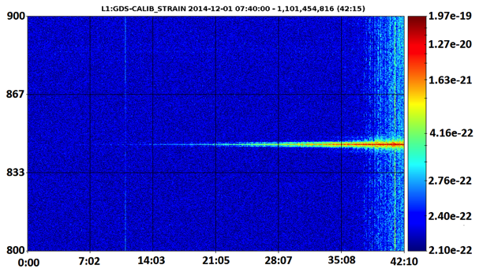
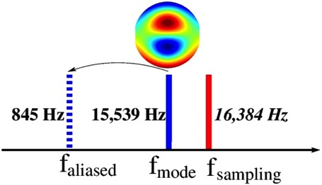
Observed, long expected, problem: parametric instabilities (S. Gras, G1500283)
M.Evans, S. Gras, et al., “Observation of Parametric Instability in Advanced LIGO”, arXiv: 1502.06058, submitted to PRL (2015)
Very well understood mechanism: mechanical mode of test mass driven by (classical) radiation pressure
More likely to happen with higher the power stored in the arm cavities
Parametric instability @ 15.54 kHz observed for the first time in L1 in December
Effect is a huge line aliased in band (843 Hz) which saturates the controls

Slide 11
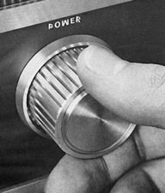
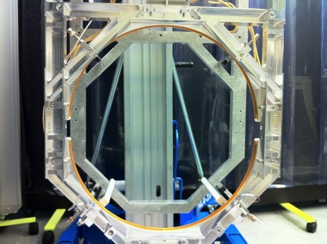
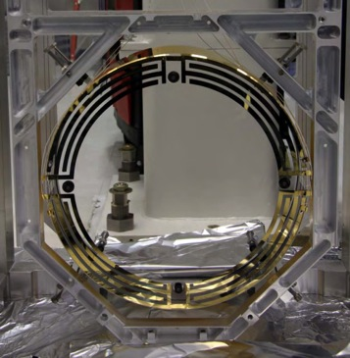
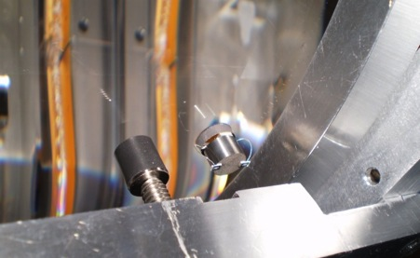
What can we do about parametric instabilities?
  0. Lower the power → DONE
  Break “instability” by slightly change radius of curvature of optics → DONE
  Actively damp the instability by using electro-static actuators → tried on MIT suspension prototype, good for small number of modes
  J. Miller, et al., Phys. Lett. A, 375, 788 (2011)
  3. Attach passive dampers to each test mass
  → tried on MIT prototype, not active control required, BUT stringent thermal noise requirements on materials
  S. Gras et al., arXiv:1502.06056, (2015)

Slide 12
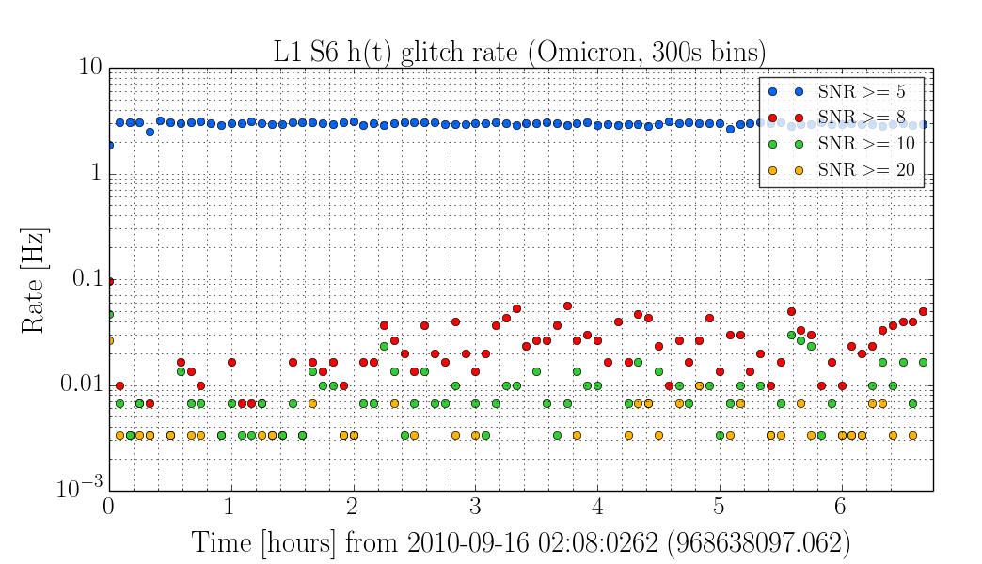
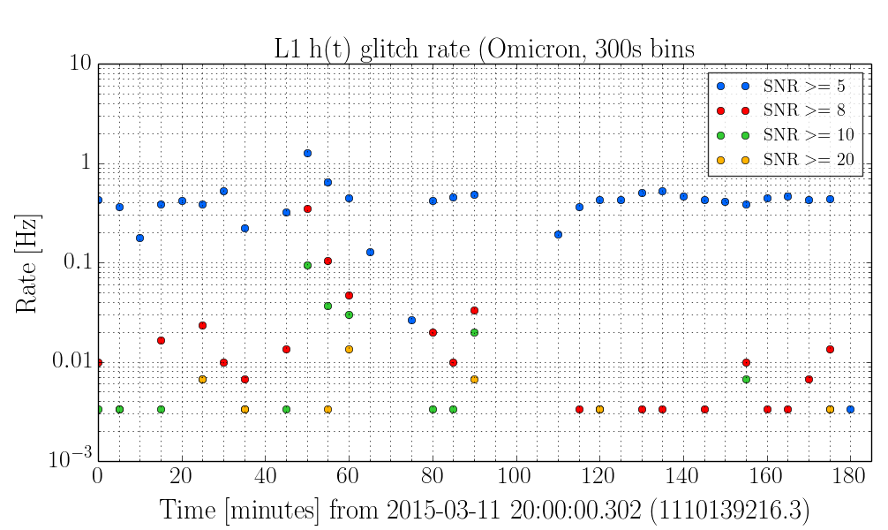
What can we say about glitches?
Where we are with respect, for example, S6?
Answer: Laura Nuttall, Josh, et al (G1500259)
S6
aLIGO L1
Successful commissioning + DetChar campaigns against glitches over the past months

Slide 13
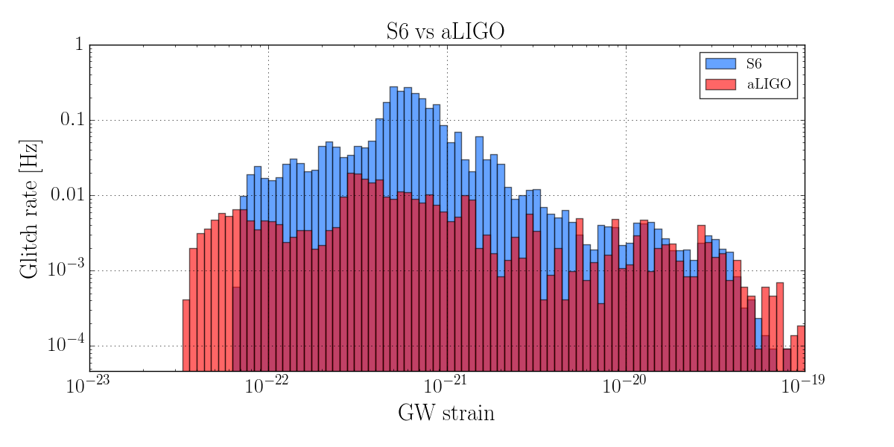
S6 vs aLIGO glitch comparison
Duncan Macleod

Slide 14
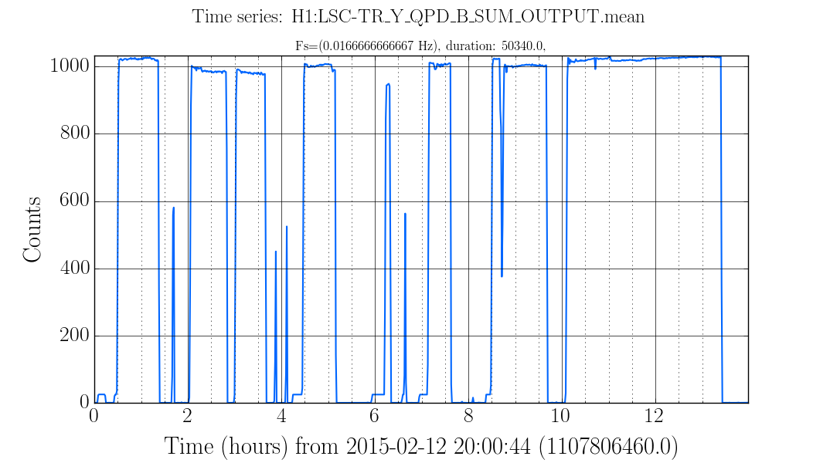
Progress @ Hanford
Just a few days after first stable lock in February…several hours of reliable lock
Arm power

Slide 15
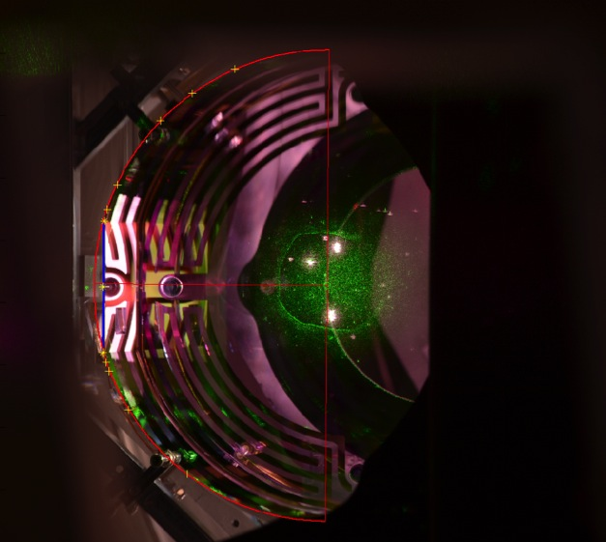
First full lock achieved in early December, BUT…
…losses in the arms much higher than expected (700ppm vs 100ppm, E. King, G1500288)
Residuals from cleaning (pieces of “first contact” film left on the optic)
Losses comparable to L1 after (re)cleaning (~100 pm)
Image of Front of End – Y optic

Slide 16
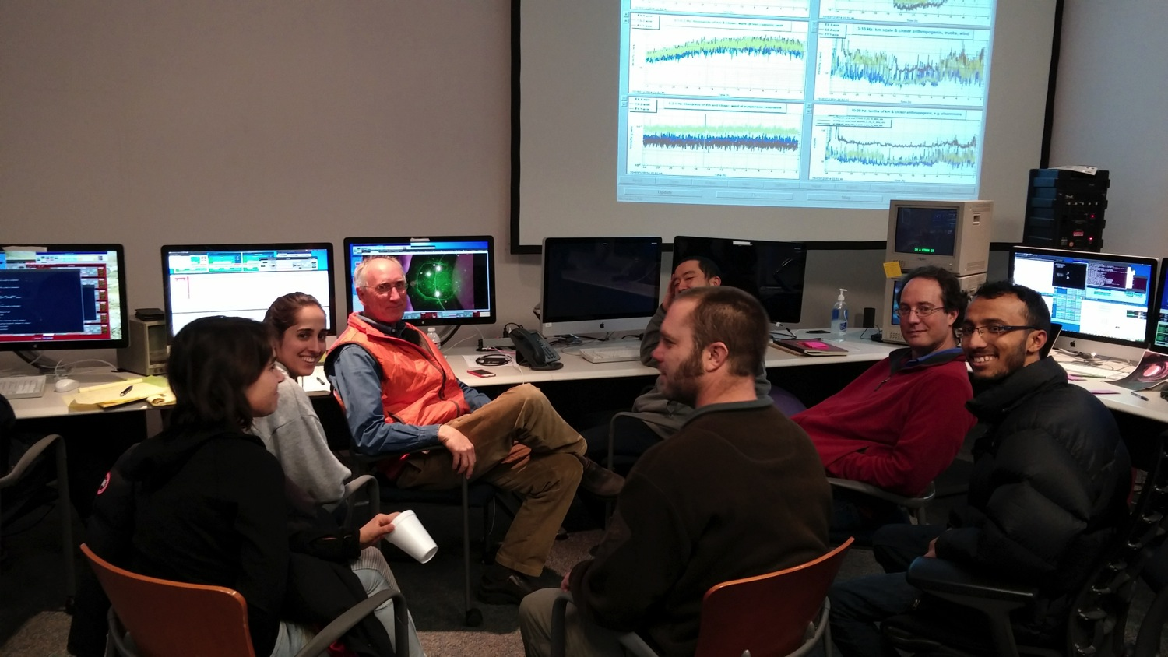
Macroscopic problems are easy to find and fix!
…losses in the arms much higher than expected (700ppm vs 100ppm, E. King, G1500288)
Problem easily recognized and fixed
Image of Front of End – Y optic
Residuals from cleaning (pieces of “first contact” film left on the optic)
Losses comparable to L1 after (re)cleaning (~100 pm)

Slide 17
Hanford Sensitivity
(E. Hall, G1500256)
15 Mpc, sensitivity understood
Actuator noise limiting low frequency sensitivity (expected)

Slide 18
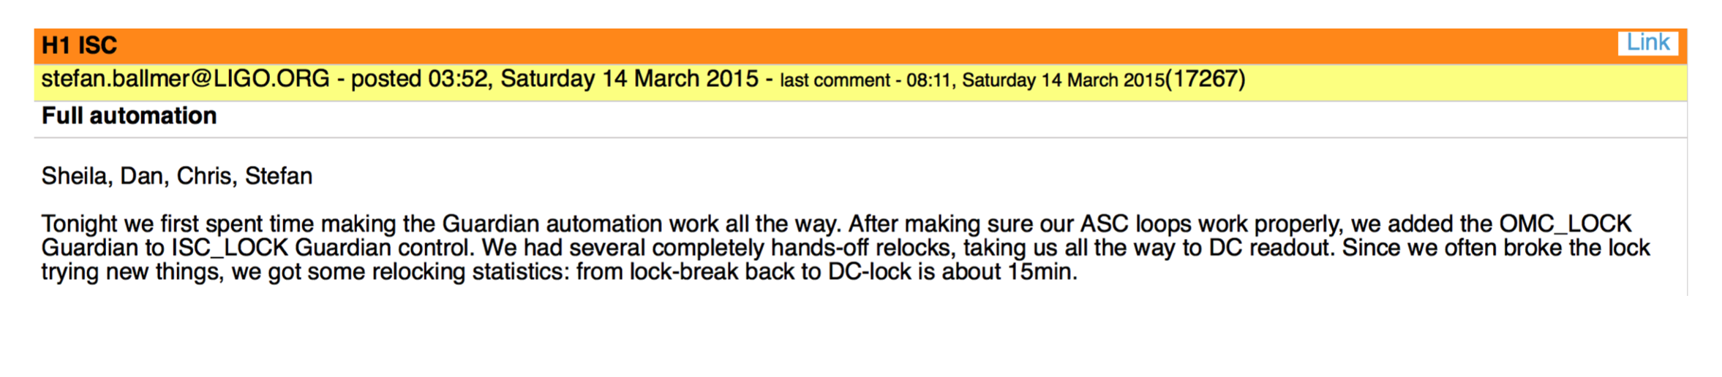
Current effort on robustness/reliability
Locking sequence fully automated, 15 min
Work on reliable initial alignment strategy
Global alignment control

Slide 19
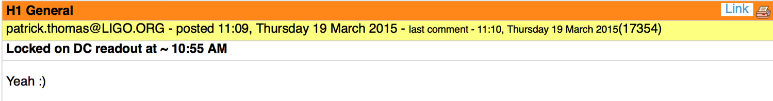
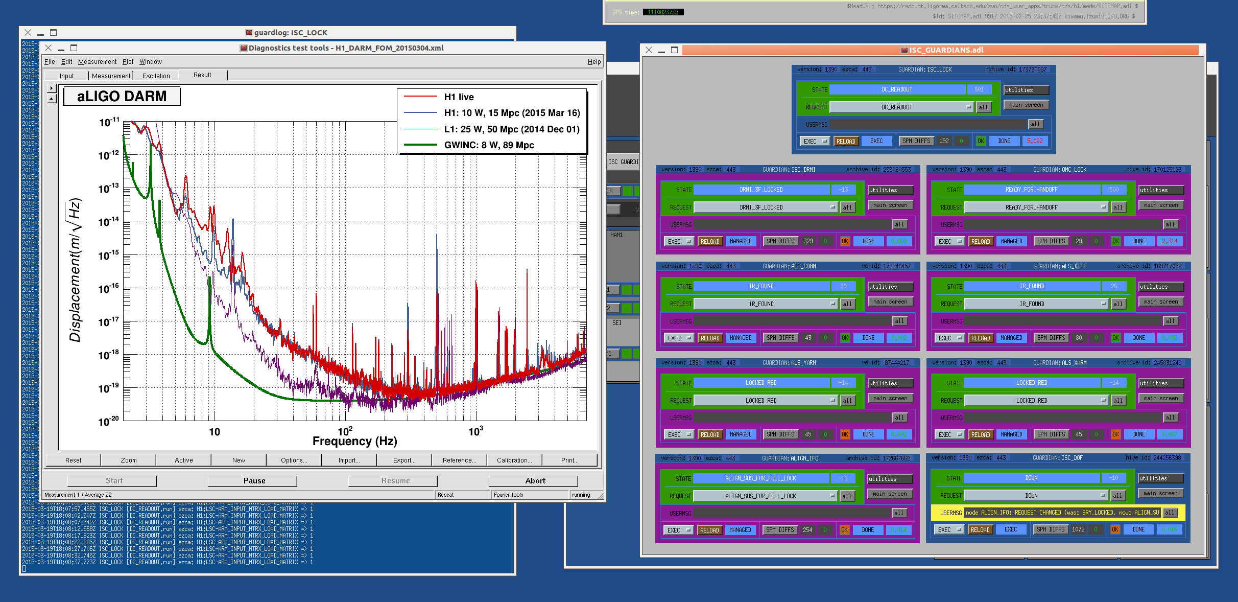
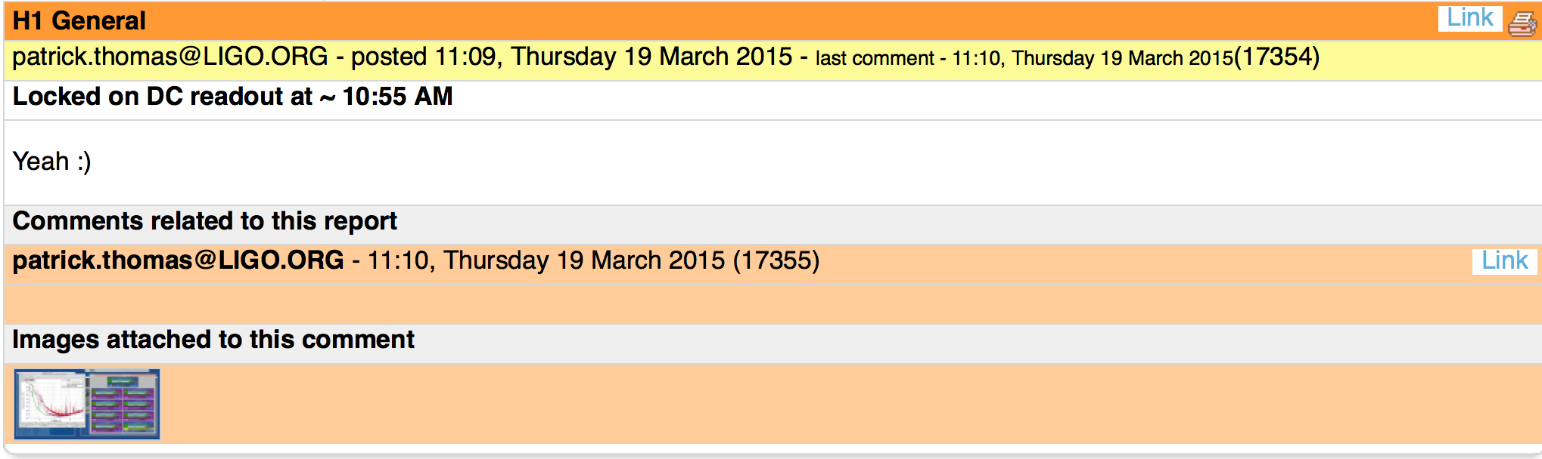
Current effort on robustness/reliability
Locking sequence fully automated, 15 min
Work on reliable initial alignment strategy
Global alignment control

Slide 20
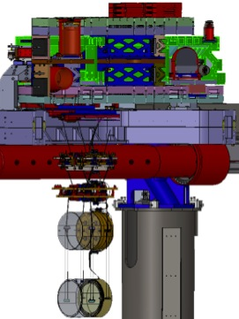
LHO Seismic Isolation Performance
Displacement m/sqrt(Hz)
Next challenge:
fight bad weather
Frequency (Hz)

Slide 21
➔ What are the most difficult problems we have faced so far?
➔ What are the biggest problem we still have to face to reach design sensitivity and high duty cycle?

Slide 22
Overall, what are the biggest problems we have faced so far?
(source: aligo-ifo and aligo-isc mailing lists)
1) Charging
2) Alignment 2) Green Coating

Slide 23
Overall, what are the biggest problems we have faced so far?
(source: aligo-ifo and aligo-isc mailing lists)
1) Charge
2) Alignment 2) Green Coating
(source: front line commissioners)
1) LLO: Lock of the central part of the interferometer
(because we don’t have actuators on the beam splitter optic)
1) LHO: Green coating
2) LLO & LHO: Alignment

Slide 24
What are the biggest problem we still have to face to reach design sensitivity and high duty cycle?
(source: aligo-ifo and aligo-isc mailing lists)
1) “High Power” 1) Scattered light
2) “Upconversion”
(source: front line commissioners)
Scattering
2) Alignment
3) Charge

Slide 25
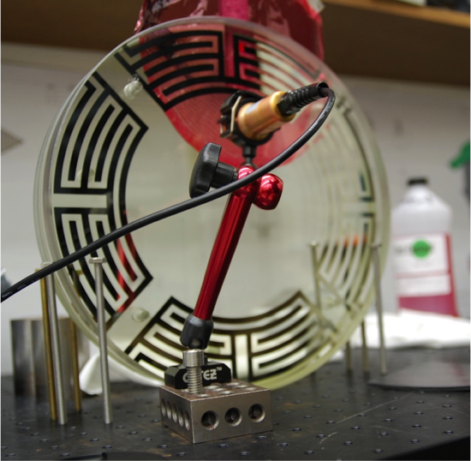
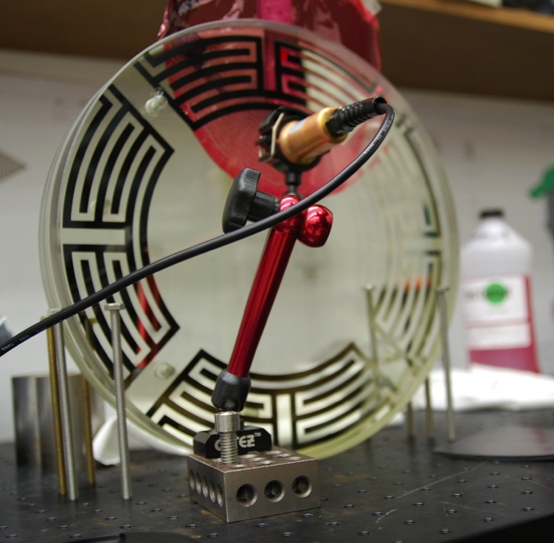
CHARGE
How about solutions?
Source of charge identified: first contact (-), ion pumps (+)
Diagnostic developed to quantify the problem
L1: charge localized on back of ETMY
Discharge methods developed, discharge attempts @ LLO
Other charge-related noise mechanisms might become dominant in the future
R&D @ Caltech and MIT
(Poster, K. Baric G1500383)

Slide 26
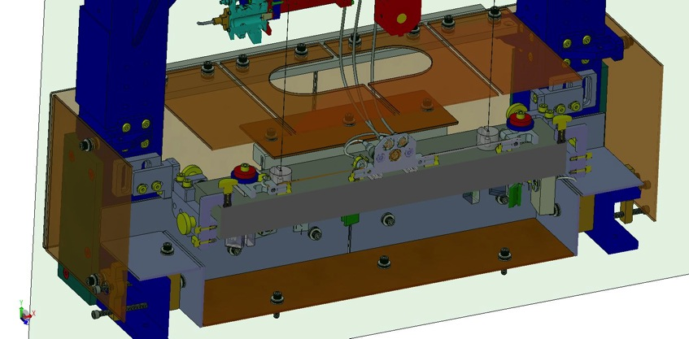
SCATTERED LIGHT
How about solutions?
On going investigations at LLO (and soon at LHO) to track down scattering sources/coupling mechanisms
“Shroud” for the output mode cleaner

Slide 27
Outlook
L1 is hunting noises:
  Main enemies right now: scatter light/charge noise
  Several possible scenarios depending on outcome
  For high frequency, power increase is the next step
H1: good progress, clear path to catch up with L1
Reliability/automation in parallel at both sites
Getting ready for Science!

Slide 28
Fast (sometimes incredibly fast) progress, very encouraging results
PRELIMINARY

Slide 29
NEW PRIZEs: best logbook entry!
(one for LHO log, one for LLO log)
Committee: Peter, Lisa, Dave
Criteria:
    Relevance and impact
    Clarity (summary/details format)
    Data calibrated in physical units
$150 per prize @ each LVC

Slide 30
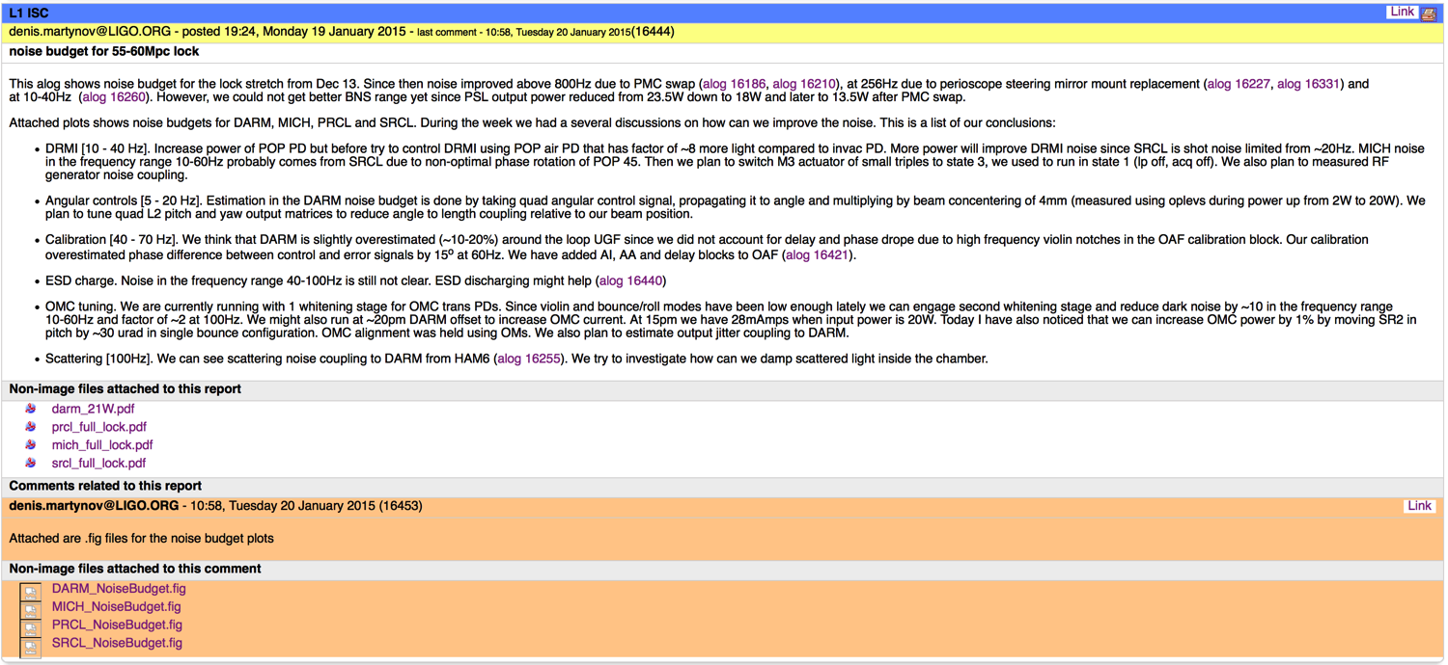
LLO log winner: entry 16444, Den Martynov

Slide 31
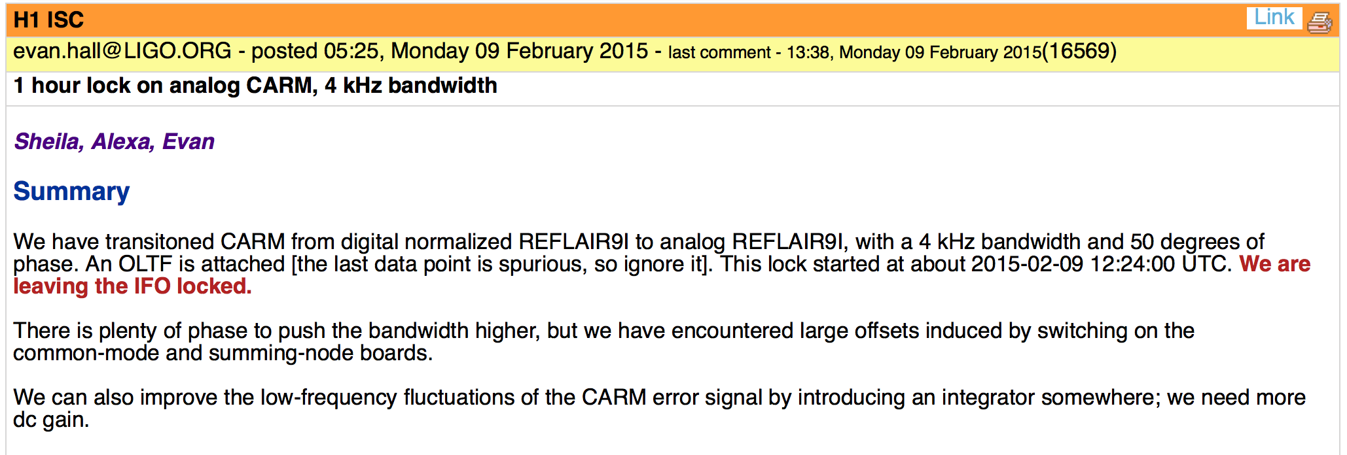
LHO log winner: entry 16569, Evan Hall
(+ Sheila Dwyer and Alexa Staley)

Slide 32
Keep climbing..
D. Shoemaker G1500192

Slide 33

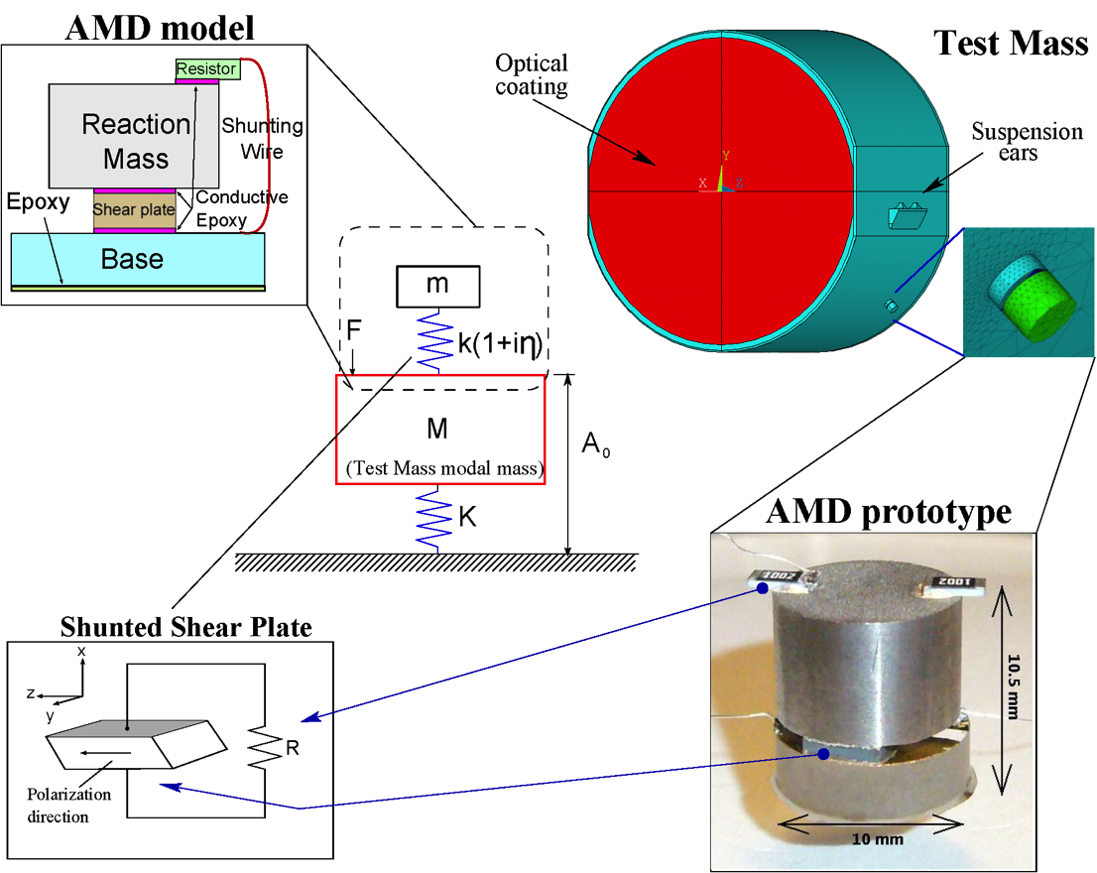
Acoustic Mode Damper
LIGO-G1500283-v1
S.Gras, LSC-Virgo meeting, Pasadena 2015

Slide 34
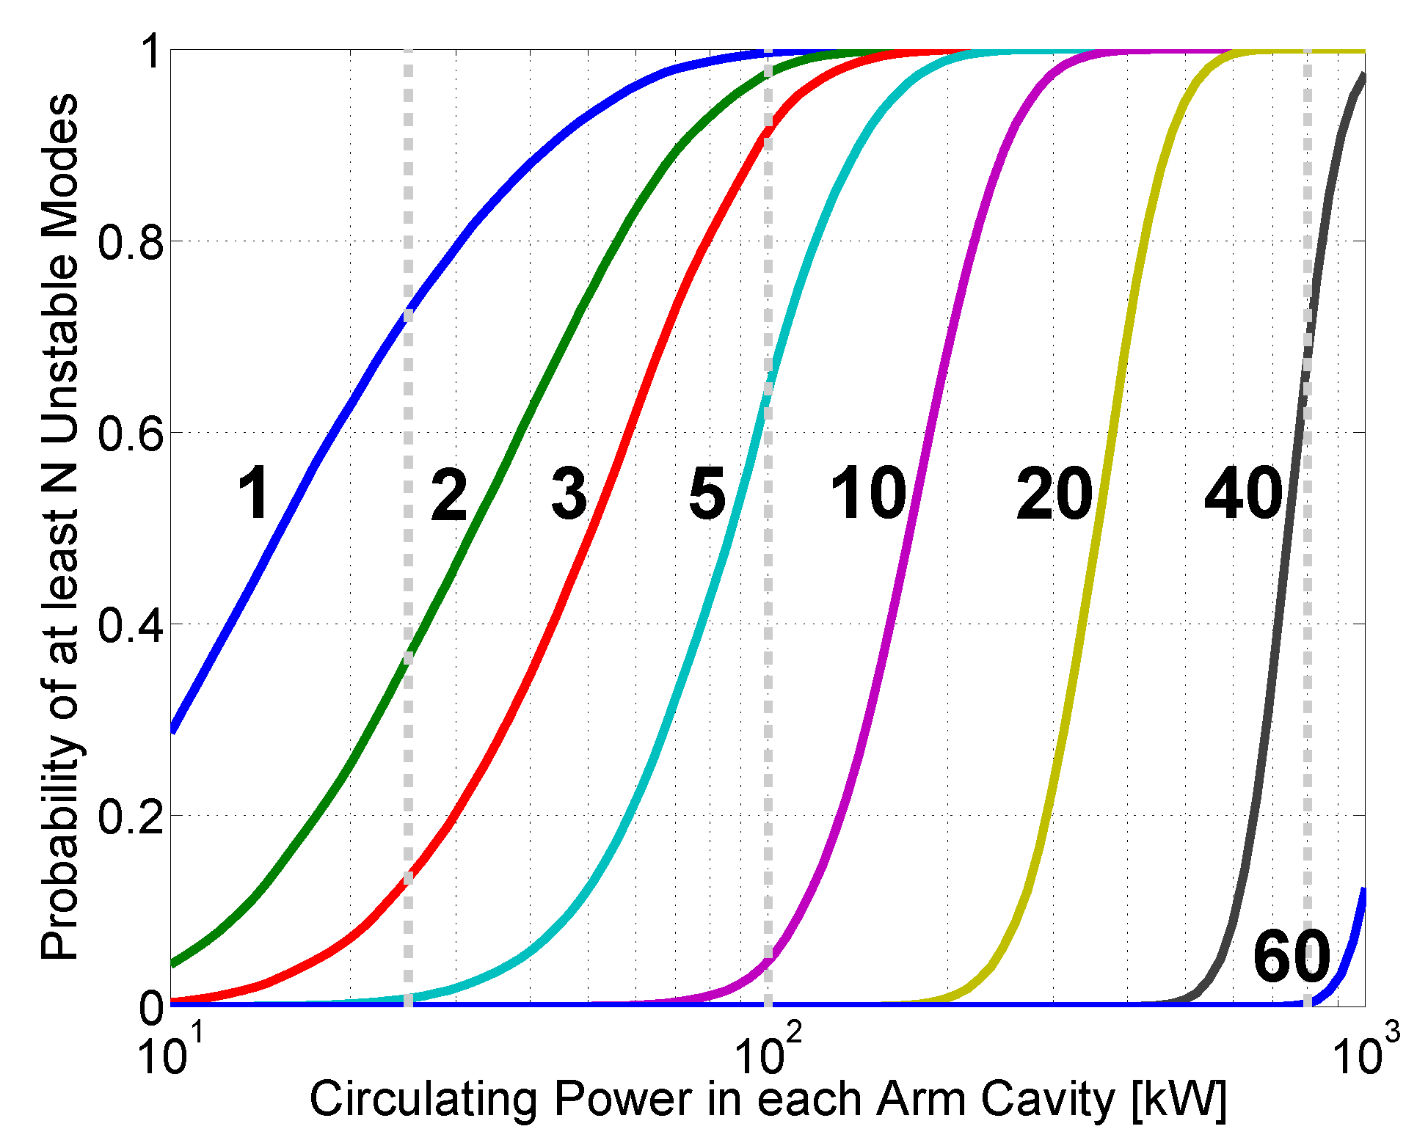
Forecast for the future
PI threshold
Current (LLO)
Full power
25 kW
100 kW
800 kW
More than 40 modes needed to be damped at 800 kW
LIGO-G1500283-v1
S.Gras, LSC-Virgo meeting, Pasadena 2015

Slide 35
R. Weiss, G1500264

Slide 36
E. Oelker, G1500337
Evans’ group @ MIT

Slide 37
Path to O1
LIGO-G1301309
ER7: beginning of June:
- in less than 3 months
- length/scope similar to ER6 on BOTH L1 & H1
ER8: end of August, as preparation for O1
O1 starting mid-September:
- up to 3 months of data taking

