Slide 1
Listening in on Black Holes: What Advanced LIGO is About to Hear
Peter R. Saulson
Martin A. Pomerantz ‘37 Professor of Physics
Syracuse University
Spokesperson, LIGO Scientific Collaboration, 2003-2007

Slide 2
Black hole at the center of our Galaxy

Slide 3
The black hole in Centaurus A, via multi-messenger astronomy

Slide 4
A long time ago in a galaxy far, far away …

Slide 5
Listening to the vibrations of spacetime?
We can find black hole binaries, and listen to them coalesce, if we build “audio telescopes” to sense the vibrations of spacetime that these events send out.
This is the project of gravitational wave detection.
Gravitational wave detectors will also let us hear neutron star binaries, the stellar core collapse that ignites a supernova, and many other phenomena.

Slide 6
We’ve already seen that gravitational waves exist
In 1974, Russell Hulse and Joe Taylor found PSR 1913+16, a pulsar in a binary orbit with another neutron star.
As Taylor followed the orbit over the years, he found it “getting ahead of itself.” Energy loss caused the two neutron stars to fall closer together and orbit faster.
This was the discovery of gravitational radiation.

Slide 7
How to sense the vibrations of spacetime

Slide 8
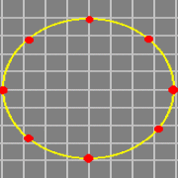
What happens when a gravitational wave passes by

Slide 9
Gravitational wave “strain” pattern
strain amplitude: h = 2 ΔL/L
The effect is bigger over longer baselines.

Slide 10
Gravitational waveform = oscillation pattern of test masses

Slide 11
Since we understand gravity, we can calculate waveforms
Stellar-mass objects give signals in the audio band. (!)

Slide 12
Gravitational waves will give us a new “take” on the sky
Embody gravity’s obedience to the principle “no signal faster than light”
Are made when large masses move at relativistic speeds
Travel through otherwise opaque matter
Can be generated by pure spacetime
Black holes
Early universe fluctuations

Slide 13
Gravitational waves are a new “messenger” for astronomy
Binaries of neutron stars and black holes
Study black hole spacetime
Learn the internal forces in neutron stars
Determine the causes of gamma ray bursts
Stellar core collapse
Dynamics that lead to supernova
Rotating neutron stars
What mechanisms can make neutron stars lumpy?
Early universe dynamics

Slide 14
What does it take to build a gravitational wave detector?
We’ll need:
A set of free test masses, far apart,
A means to measure their relative motion, and
Isolation of the masses from other causes of motion.
Here’s the challenge:
Best astrophysical estimates predict fractional separation changes of only 1 part in 10²², or less.
If test masses are separated by 4 km, that means a length change less than 10⁻¹⁹ m!

Slide 15
How small is 10⁻¹⁹ m?
Diameter of human hair: 10⁻⁵ m
Diameter of atom: 10⁻¹⁰ m
Diameter of atomic nucleus: 10⁻¹⁴ m
Diameter of proton: 10⁻¹⁵ m
To succeed, we need to discern length changes 10,000 times smaller than a proton.
We can do it!

Slide 16
Let’s invent a gravitational wave detector
In principle, there’s no limit to how far apart we can put our test masses.
We’ve put ours 4 km apart.

Slide 17
Use a Michelson interferometer to measure relative motion

Slide 18
Michelson interferometer = transducer from length difference to brightness
Light from x arm
Brightness of superposed beams of light from the two arms.
Light from y arm

Slide 19
Here’s how A.A. Michelson showed that there’s no “ether”

Slide 20
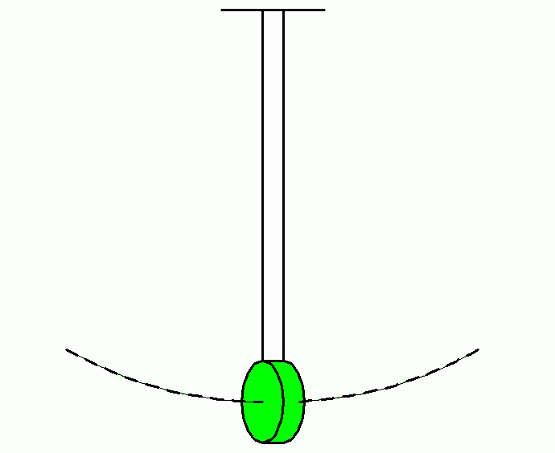
We suspend our mirrors instead of bolting them down, because …
A pendulum bob is dynamically free (above its resonant frequency).
“bob” = test mass = interferometer mirror
A mass suspended as a pendulum is also isolated from external motions.

Slide 21
Isolate against seismic noise
Seismic motion of the ground is about 10 orders of magnitude larger than motion of mirrors from gravitational waves.
“Isolate, isolate, isolate.”

Slide 22
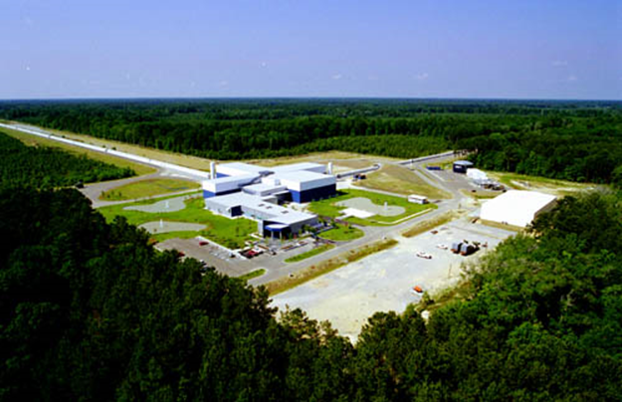
LIGO’s two sites turned on in 2005, listened until 2010
LIGO Hanford Observatory, WA
LIGO Livingston Observatory, LA
Two years’ worth of integrated coincident data, at or beyond design sensitivity, collected between 2005 and 2010.

Slide 23
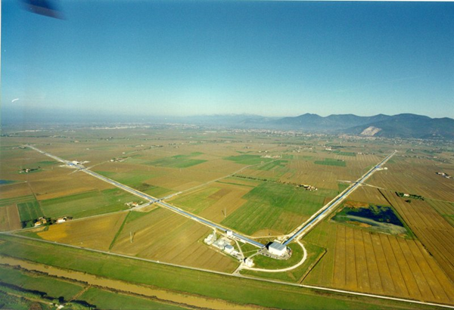
GEO and Virgo observed and analyzed data with us
GEO, 600 m arms, near Hannover
Virgo, 3 km arms, near Pisa

Slide 24
LIGO’s 4 km arms, 10⁻⁸ torr

Slide 25
Vacuum chambers here, beamsplitter and input test masses

Slide 26
Advanced LIGO’s 200 W Nd:YAG laser
Custom designed/built by Laser Zentrum Hannover

Slide 27
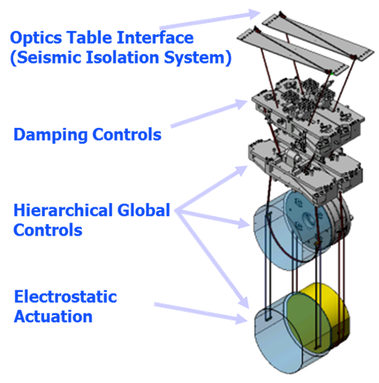
Quadruple pendulums suspend and isolate the test masses
Designed by the University of Glasgow

Slide 28
Test masses suspended on fused silica fibers, welded in place
Note: Clean-room practice must be rigorously enforced.

Slide 29
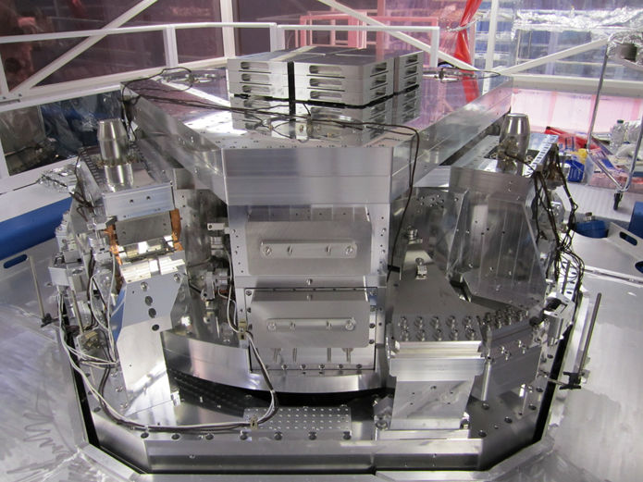
Two stages of active isolation supplement the pendulums

Slide 30
Initial LIGO didn’t detect any gravitational wave signals
We were disappointed, but not surprised.
We could see neutron star binaries only out to 20 Mpc, while we needed to see to ~200 Mpc to expect a few per year.
Advanced LIGO will see to 200 Mpc.

Slide 31
An interesting upper limit from initial LIGO observations
GRB 070201 was a short hard gamma ray burst, apparently in M31. (Distance = 0.8 Mpc, close!)
If it had been caused by a neutron star binary (or NS-BH binary), we would have seen it. We didn’t.
Most likely conclusion: It wasn’t a classic short hard GRB, but was instead an SGR giant flare.

Slide 32
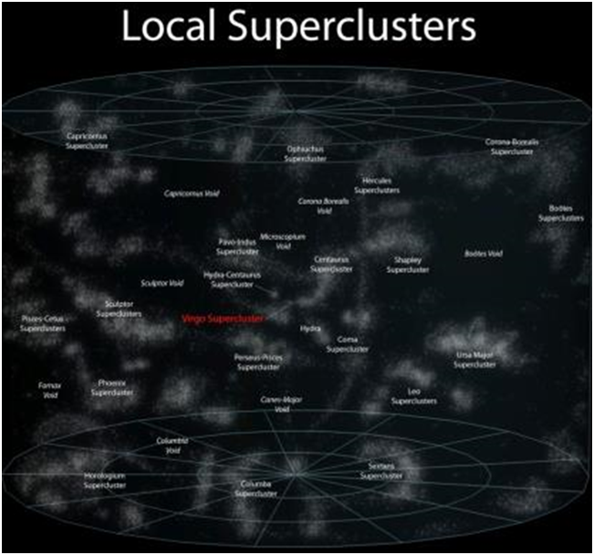
aLIGO will soon have the sensitivity that we need
iLIGO could see the Virgo Cluster.
aLIGO will survey 1000x more volume.

Slide 33
Today, aLIGO can see three times as far as initial LIGO did.
Our first observing run with Advanced LIGO starts Sept 2015.

Slide 34
Binary neutron star signals expected by 2017-19
aLIGO will reach design sensitivity by 2019.
Binaries with black holes will likely turn up as well.
There will be a lot of good physics and astrophysics to do.

Slide 35
We need a global network to do gravitational wave astronomy
Like an ear, listening with a gravitational wave telescope is omni-directional. But with two (or more) ears, you can tell where a signal came from.
Advanced Virgo will join our network next year; a LIGO detector in India will turn on in 2022.
Soon, we’ll be listening to the universe in high-fidelity quadraphonic audio.

Slide 36
Someday soon, we’ll put GW detectors in space

Slide 37
There’s a whole gravitational wave spectrum

