Slide 1
What comes next for LIGO? Planning for the post-detection era in gravitational-wave detectors and astrophysics
Gabriela González,
Louisiana State University
Silver Springs, MD
May 7, 2015

Slide 2
Why are we here?
Advanced LIGO detectors, a concept that was part of the original LIGO proposal, will soon discover gravitational waves;
What happens after Advanced LIGO discoveries?
Will those discoveries affect…
… the short term R&D for Advanced LIGO detectors improvements?
… the searches for astrophysical sources?
… the plans for multi-messenger astronomy?
… US plans for GW science?
…the dynamics of the international network?
The answer is YES.
The real question is HOW those discoveries may affect these aspects: this is what we want to discuss here.

Slide 3
When? Soon!

Slide 4
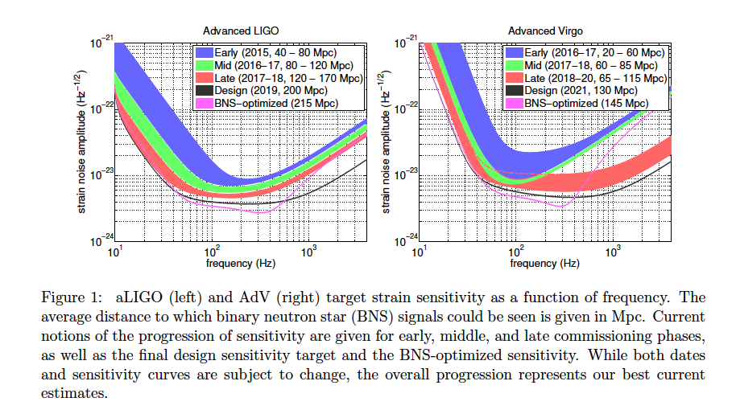
A reminder: Observing Scenario
Prospects for Localization of Gravitational Wave Transients by the Advanced LIGO and Advanced Virgo Observatories, The LIGO Scientific Collaboration and The Virgo Collaboration, arXiv:1304.0670

Slide 5
Very rapid commissioning progress
Latest calibrated spectra in https://dcc.ligo.org/LIGO-G1401390/public

Slide 6
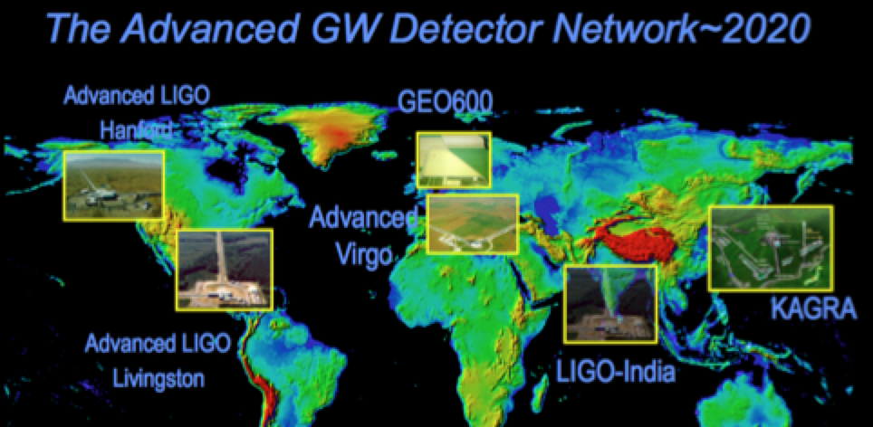
Detections are coming
It will be a milestone discovery!
Probably followed soon (or preceded) by other gravitational wave detections (pulsar timing, CMB polarization)

Slide 7
What comes next for LIGO?
We have a “default” plan for LIGO – will need adapting to known sources after we have detections.

Slide 8
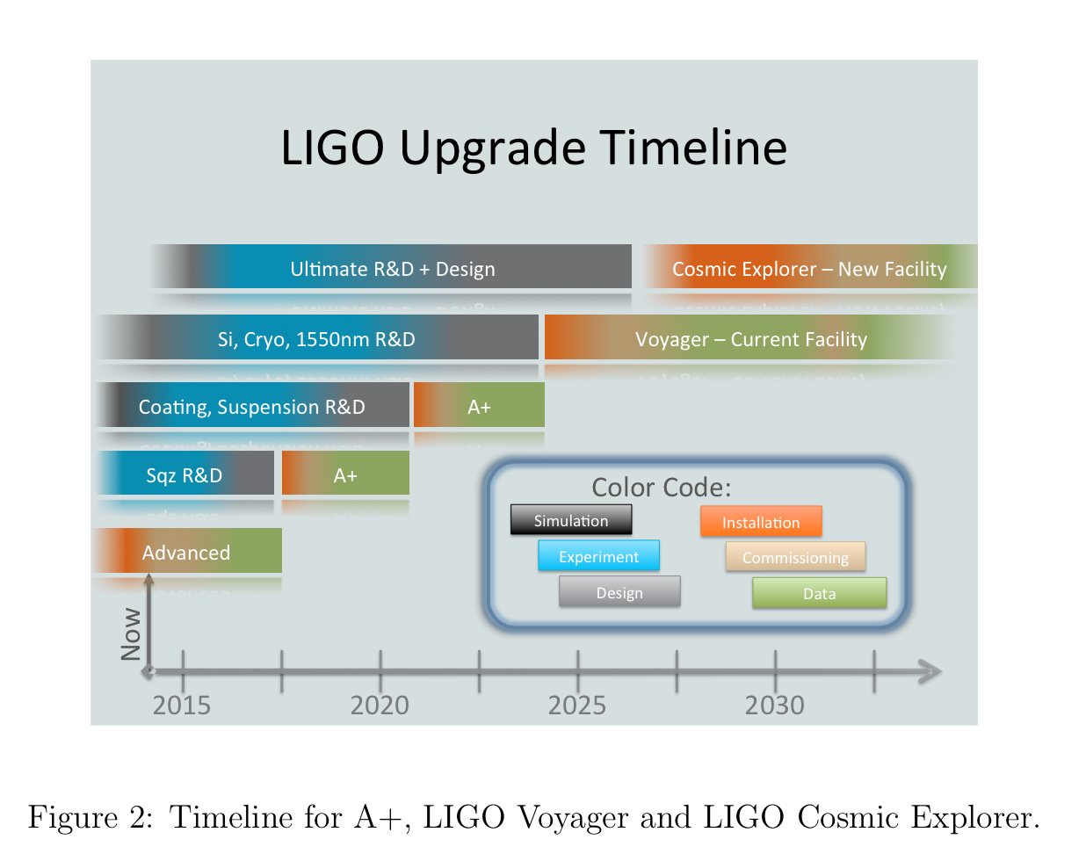
Current plan: white papers
LSC Instrument Science White Paper
https://dcc.ligo.org/LIGO-T1400316/public

Slide 9
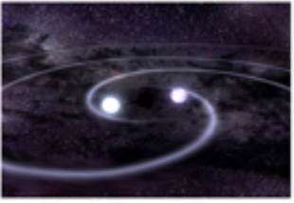
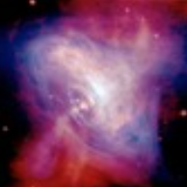
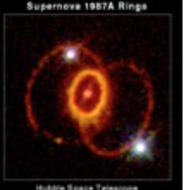
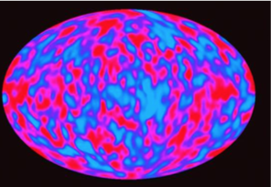
Current plan: white papers

Slide 10
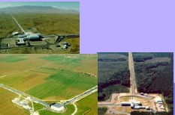
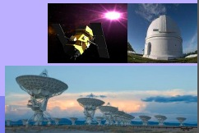
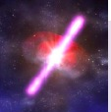
Current plan: astronomy partners
http://www.ligo.org/scientists/GWEMalerts.php
More than 70 agreements signed from 20 countries, with about 150 instruments covering the full spectrum, from radio to high-energy gamma-rays.
Shortly after a few detections, LSC/Virgo will publicly release GW triggers for follow up: dcc.ligo.org, LIGO-M1200055.

Slide 11
Current plans have multiple paths
How will first few detections influence paths in the years that follow? In short term, different paths may compete with each other…
How can the community be prepared with appropriate plans? We may consider different scenarios if they depend on the nature of the first detections.
Five sessions on plans for:
multi-messenger astronomy;
data analysis;
aLIGO improvements;
international network;
GW science in the context of US science.

Slide 12
What’s next?
Expect from each session active discussion, converging in consensus (of attendants) or description of plans following detections.
A brief write-up of results of discussions will be compiled by session chairs and circulated within ~ a month; later posted in conference website.
Let’s get to work!

