Slide 1
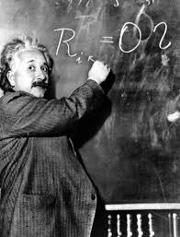
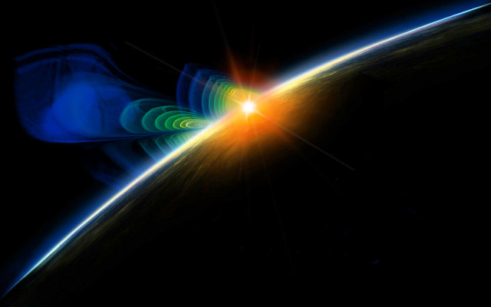
Einstein’s GR @ 100:
LIGO-enabled Science
Gabriela González,
Louisiana State University
Advanced LIGO Dedication
LIGO Hanford Observatory, May 19, 2015

Slide 2
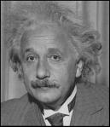
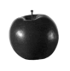
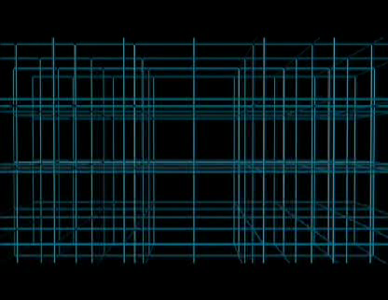

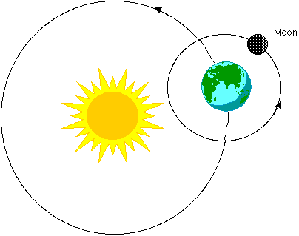
Einstein’s gravitation
No “instantaneous gravitational force”
When masses move, they wrinkle the space time fabric, making other masses move.
Credit: AMNH
Explains just as well as Newton’s why apples fall and planetary motion…
.. but it also predicts
traveling away from moving masses!
gravitational waves

Slide 3
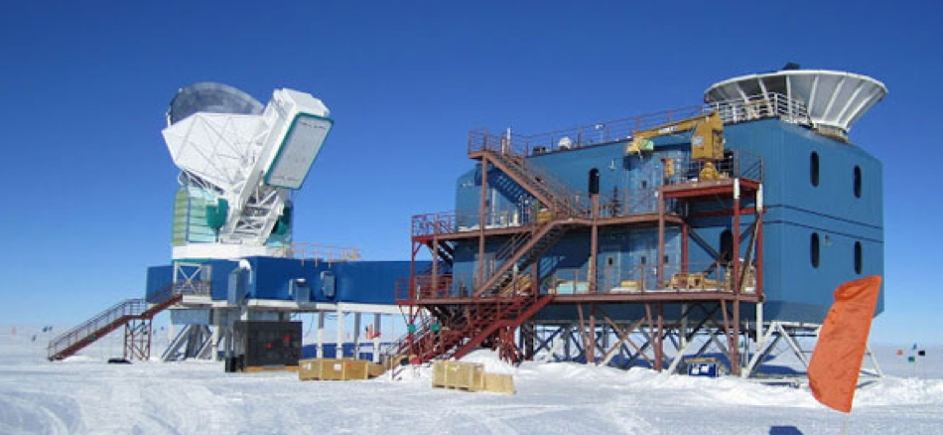


GW landscape
Many sources, many frequencies, many detectors, many collaborations
Credit: Nanograv/Bicep2

Slide 4
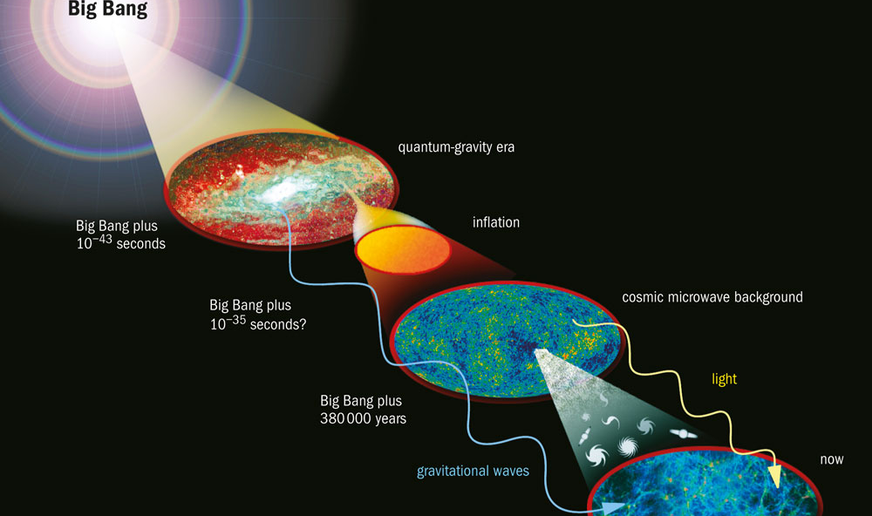
GWs from a stochastic background
(Courtesy: NASA)
We have learned much about the early history of the Universe from observation of the “cosmic microwave background” (and using Einstein’s theory) – but there is also a “gravitational wave background” from even earlier times.

Slide 5
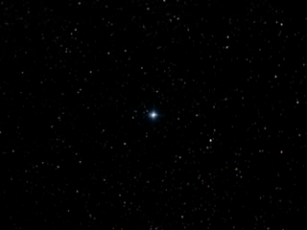
GWs from Supernova explosions
Credit: NASA
SN explosions generated by the collapse of a star under its own gravity give birth to neutron stars and black holes with mass close to the Sun’s, but with the size of a city.
If the explosion is not perfectly symmetric, and happens in our Galaxy or very nearby, we may detect the gravitational waves produced with LIGO.
Notes:
https://www.nasa.gov/centers/goddard/news/topstory/2003/0702pulsarspeed.html

Slide 6
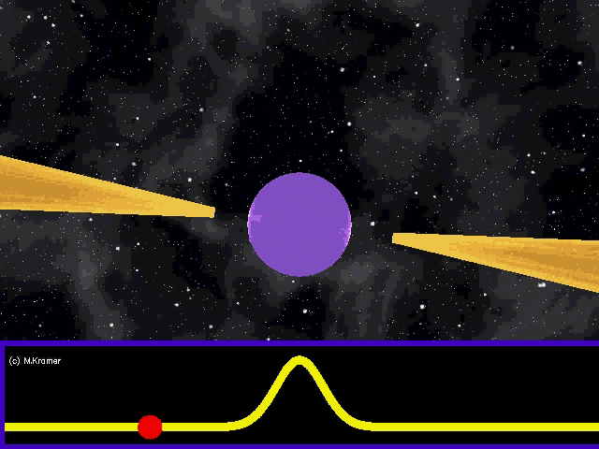
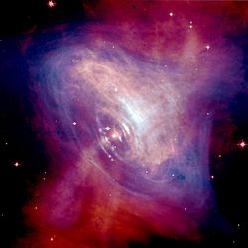
GWs from rotating stars
Crab pulsar and nebula
Credit: NASA/CXC/ASU/J. Hester et al.
Credit: M. Kramer
Neutron stars are born rapidly spinning, emitting electromagnetic beams: they are “pulsars”. Eventually, electromagnetic power is exhausted, and older neutron stars do not pulsate.
Pulsars are very precise clocks – rivaling atomic clocks. “Pulsar timing” will allow detection of gravitational waves with parsec scale wavelengths and periods of years.
The structure of the interior of neutron stars, or “equation of state”, is not well known, and is something we can learn about from gravitational waves.

Slide 7
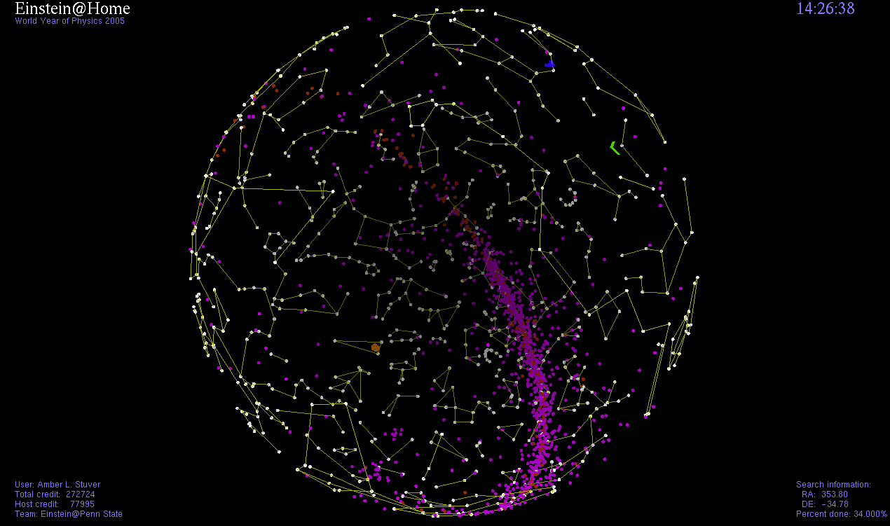

Neutron stars
Neutron stars emit gravitational waves themselves, with an amplitude proportional to their non-spherical shape and twice their rotation frequency – but neutron stars are very smooth!
There are about 2,000 pulsars observed in our galaxy, but there are about 100 million neutron stars in the Milky way.

Slide 8
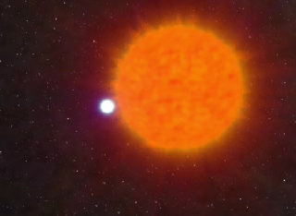
Neutron stars in Binary systems
Credit: John Rowe animations
About 5% of neutron stars are part of a binary system, eventually forming a binary system with two neutron stars, or a neutron star and a black hole.

Slide 9


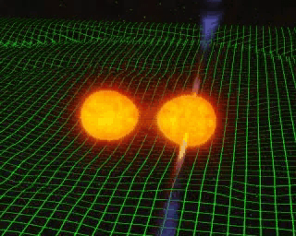
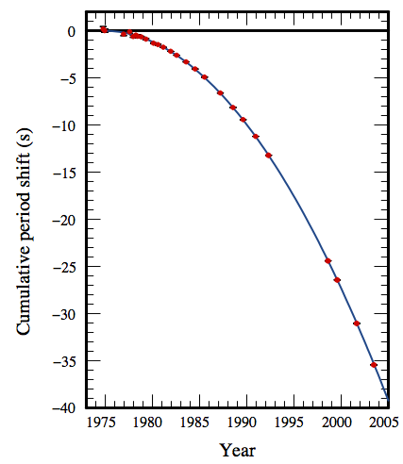
GWs from binary systems
Hulse, Taylor
Nobel Prize 1993
GR prediction
Weisberg, Nice & Taylor, 2010
(Courtesy Joel Weisberg)
Credit: John Rowe animations
Binary systems of compact objects as neutron stars and black holes lose energy to gravitational waves, orbiting closer and closer until merging into a larger black hole. The amplitude and frequency of the gravitational wave before the merger is “easy” to calculate using Einstein’s theory – this is likely to be the bread-and-butter of Advanced LIGO when it begins detecting astrophysical signals.

Slide 10
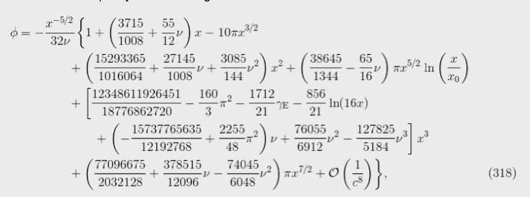

GR theory and waveforms
“Post Newtonian expansion”
1 PN
1.5 PN
Expansion parameter
Living Rev. Relativity, 17 (2014), 2

Slide 11
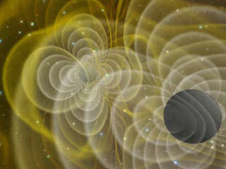
Einstein’s GR on computers
Credit: Henze, NASA

Slide 12
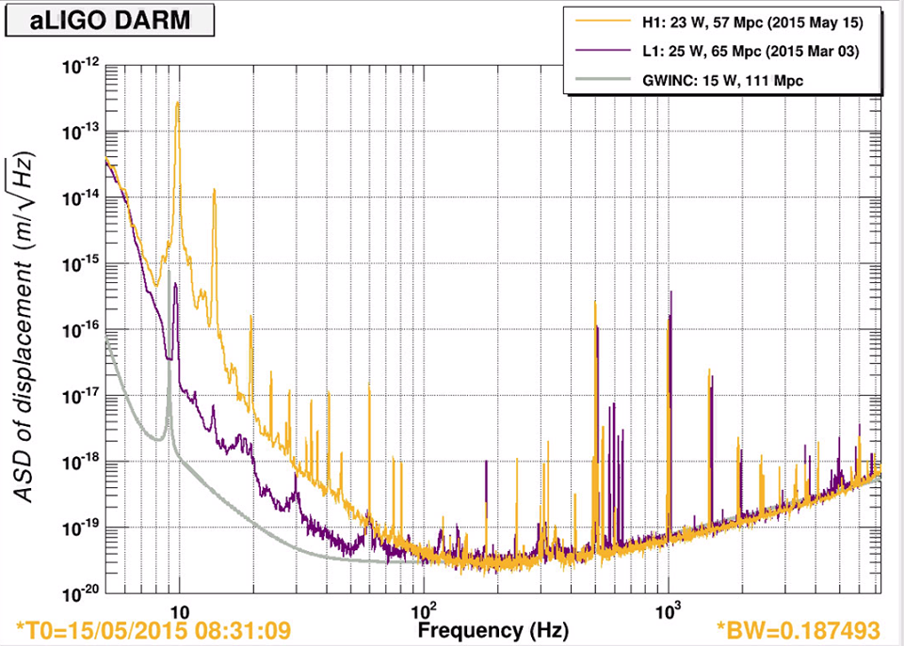
How far can we see?
Using known waveforms for binary systems, given the “noise” in a detector we can calculate how far we can detect signals with enough “signal to noise” ratio.
“Average” distance reach to binary neutron star systems. With optimal position and orbit, we can see more than twice as far!

Slide 13

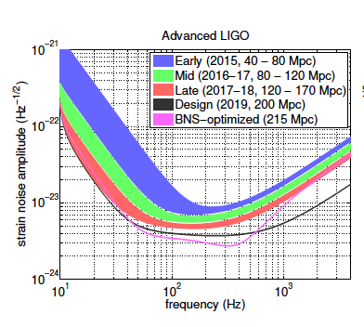
When will we detect GWs?
Already here!

Slide 14
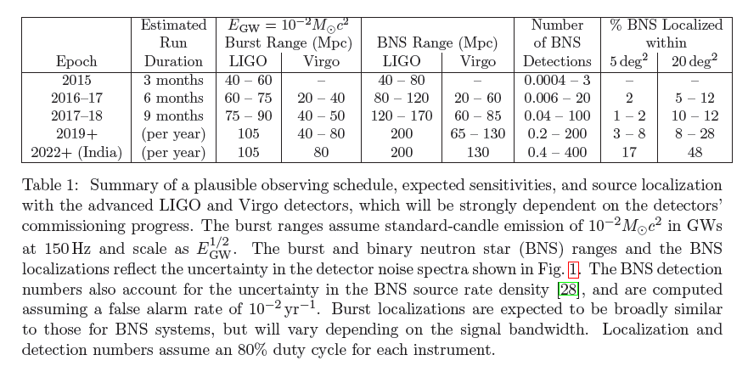
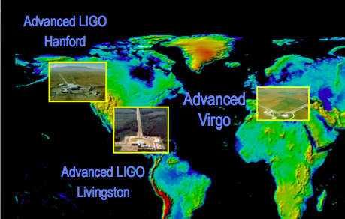
We’ll have GWs soon
arXiv:1304.0670

Slide 15
But that’s only the beginning…
Science with GWs will need more than the first few detections:
  Astrophysics will need EM counterparts : multi-messenger astronomy.
  Source localization and more uptime will need a world-wide gravitational network with several detectors.
  Testing GR will need large signal-to-noise ratio detections, and comparison with numerical relativity simulations.
  Equation of state of neutron stars information will arise from detectors’ sensitivity at ~kHz frequencies of the binary merger.
  Population studies will need large statistics.

Slide 16
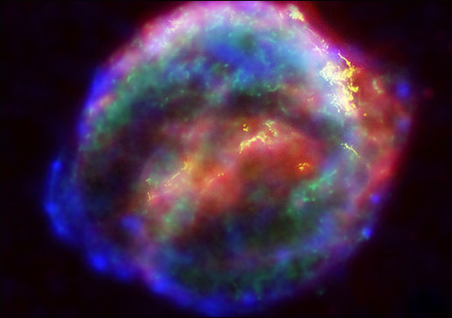
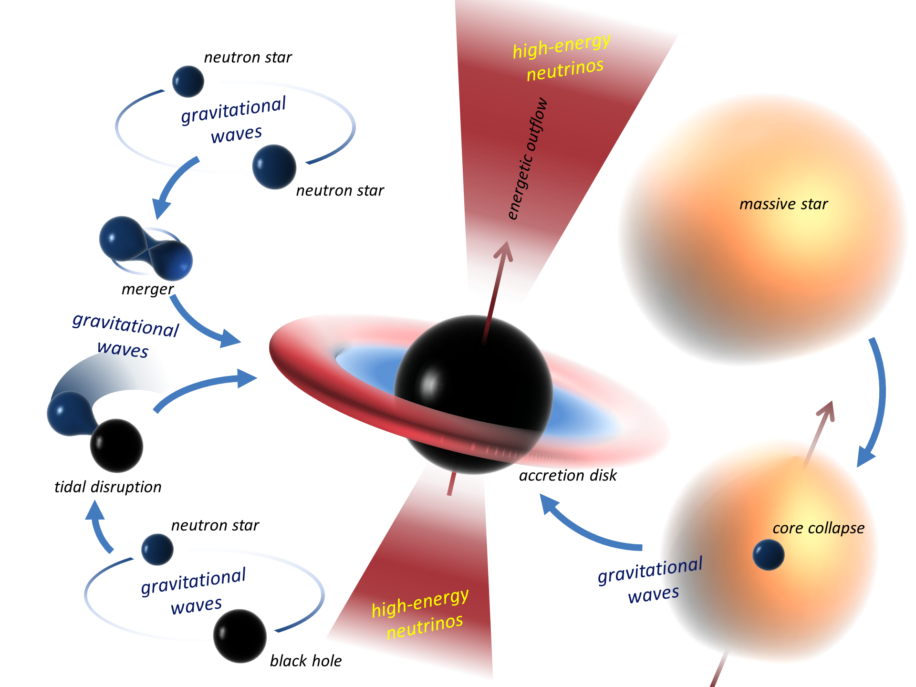
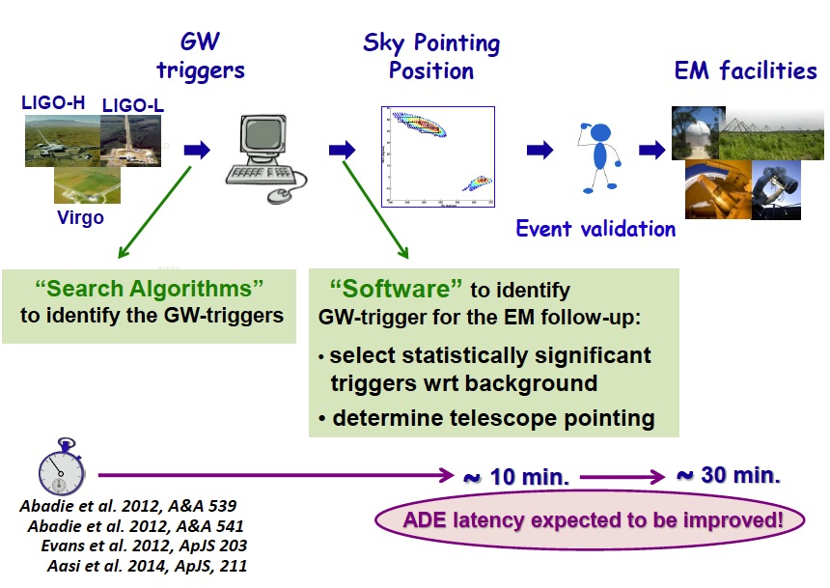
Multi-messenger astronomy

Slide 17
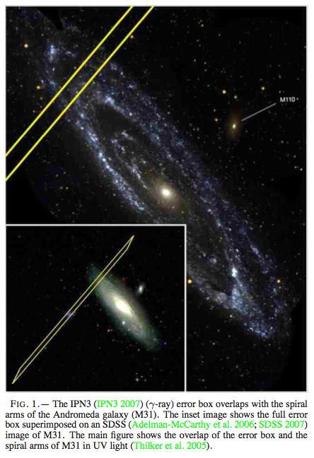
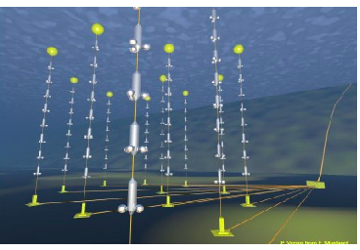
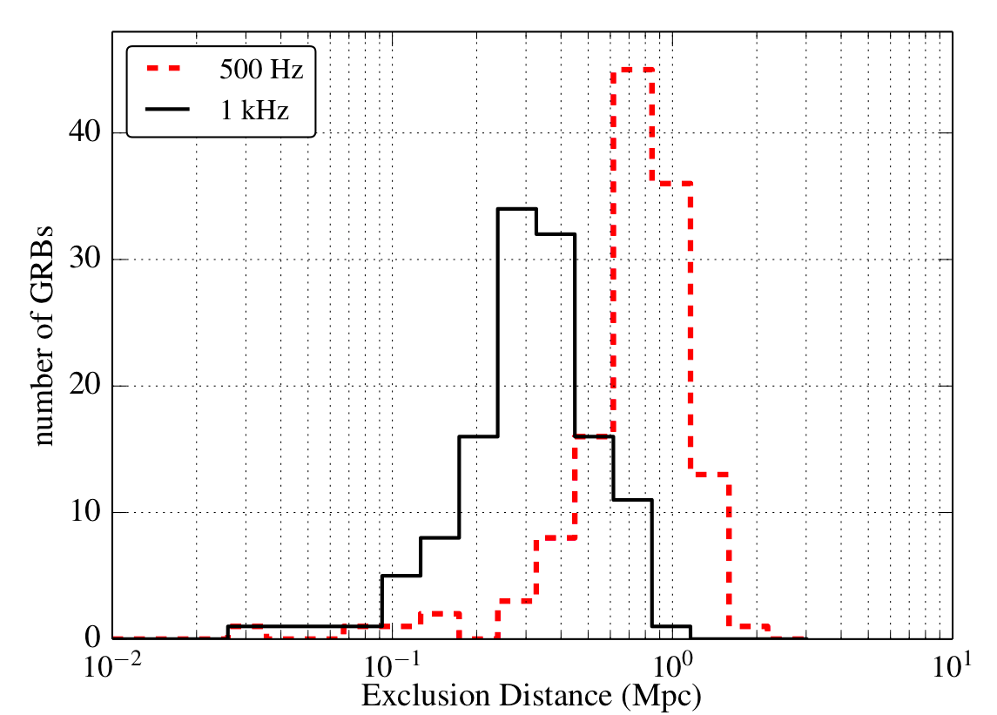
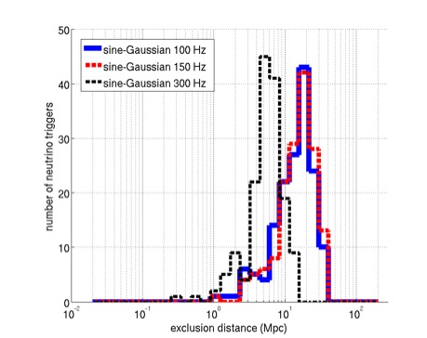

GW detectors follow HE, EM signals
Knowledge of transients from electromagnetic telescopes or satellites (GRBs) or neutrino detectors can be followed up in the GW data with more prior information.
GRB070201
Astrophys. J. 681 (2008) 1419
Follow up of 129 GRBs
Joint search with Antares
PRD 89 (2014), 122004
JCAP 1306 (2013) 008

Slide 18
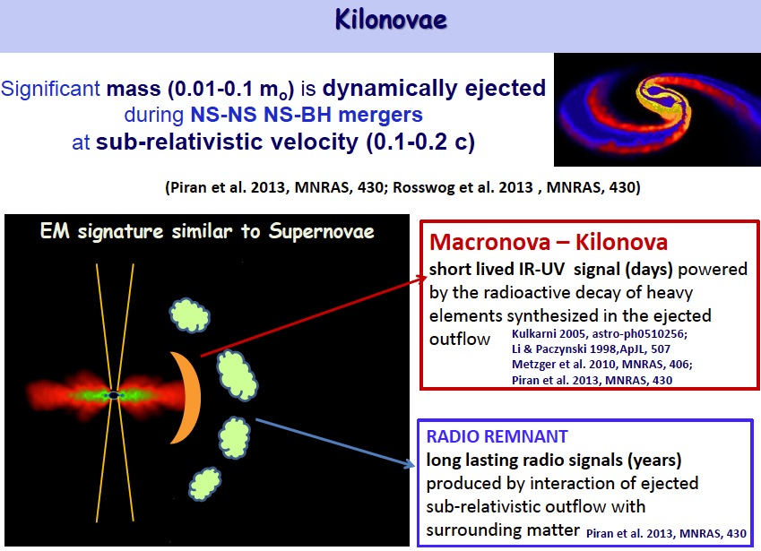
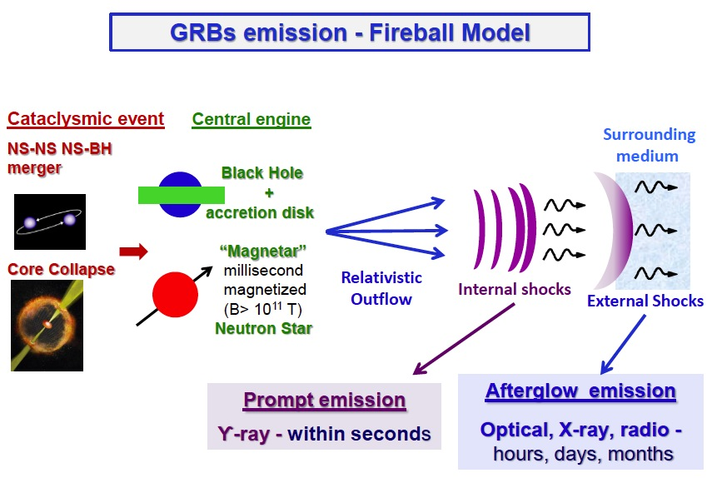
Known multi-messengers

Slide 19






The GW Detector Network~2022
Advanced LIGO
Hanford
GEO600
Advanced
Virgo
KAGRA
Advanced LIGO
Livingston
LIGO-India
(planned)
19

Slide 20



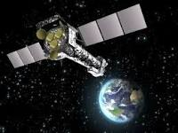
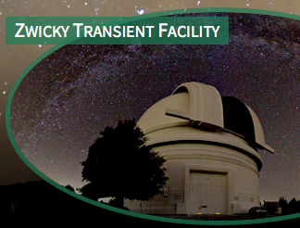



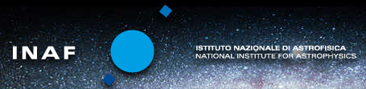

Some of our partners – ready to observe!
More than 70 astronomy agreements with partners for 2015-18

Slide 21
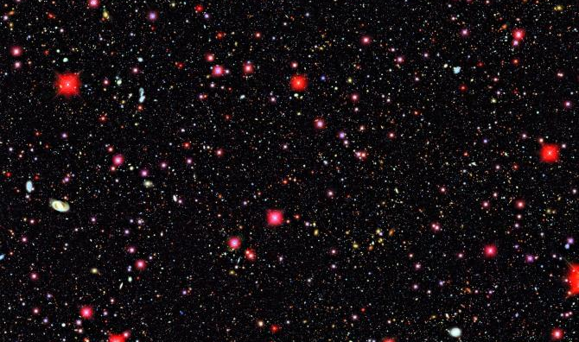

Exciting near future observations
LSST received its federal construction start in 2014 and will achieve engineering first light five years after that. Full science operations for the ten-year survey will begin two years after engineering first light.
What 0.5deg² will look like with LSST:
Deep Lens Survey / UC Davis / NOAO

Slide 22
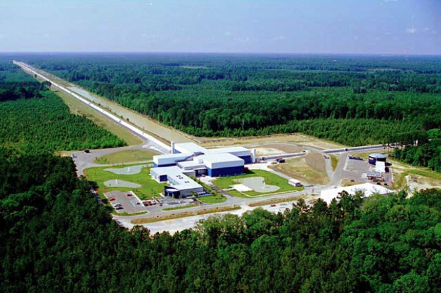
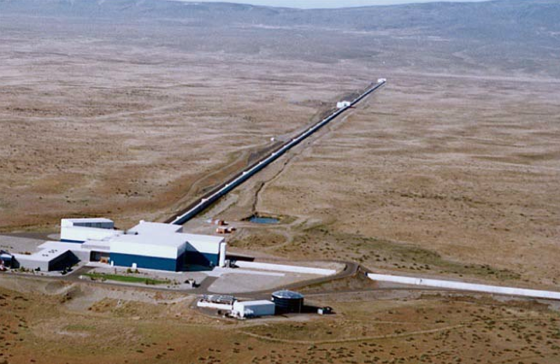
GR@100 and LIGO
Einstein would be very happy visiting LIGO today, and would not doubt we are at the dawn of gravitational wave astrophysics.

