Slide 1

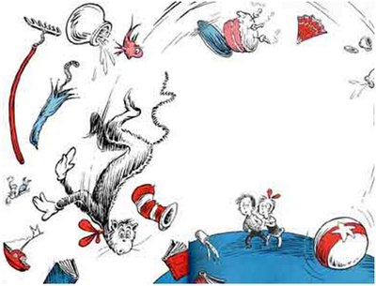
GWADW
Summary of
Controls Sessions
we make it look easy, but …

Slide 2
General Comments
Controls is a new topical session for the GWADW this year
Based on the number of participants in the controls session, we should include controls as a topical session in future GWADWs

Slide 3
Controls Sessions
A | System identification and modern Control
B | Optimal feedback
C | Noise feedforward and subtraction
D | Lock acquisition problems and improvements
E | Interferometer stability (Keeping the IFO Lock)
F | Next Generation Control System Architecture
  Good sessions, good discussions, useful, but …
  Perhaps too much scope – not focused enough, not enough “homework” in preparation in advance?
  A few too many prepared talks
  In future GWADWs, address next generation systems (V+, A+, Voyager, Longo,…)

Slide 5
Summary D: Lock Acquisition Problems & Improvements
Acquisition overview/problems & discussions
aLIGO (Shiela Dwyer, Keita Kawabe (LHO); Anamaria Effler (LLO))
  Lock acquisition is deterministic for the arms (ALS) but stochastic for DRMI
  Works most of the time; acquires in 15-30 min
  Reasons for lock difficulty:
    Poor initial alignment (drift)
    Mode hopping
    Bounce & roll modes not adequately damped sometimes (plant drifts)
    CARM depends on RC gain
    High winds (LHO)
      causes DRMI lock to take more time
      with high ETM green transmission, ALS arm lock problems
  Simulation:
    Optickle (and derivatives), E2E

Slide 6
Summary D: Lock Acquisition Problems & Improvements
Acquisition overview/problems & discussions (continued)
Virgo (Gabriele Vajente, Bas Swinkels)
  iVirgo Thermal transients in ITM at full lock caused drift
    solution was to wait ~10 minutes
    Lower absorption for aVirgo
  Planning to use same variable finesse locking technique, but don’t yet have a solution for SRC
  Added high frequency RF sidebands (132 MHz) for use in lock acquisition – less sensitive to aberrations (thermal et. al.)
  Plan to use guided lock acquisition (ala TAMA) if needed
    aVirgo arm cavity finesse is 450 (was 150 for iVirgo)
    Simulation indicates that guided lock acquisition may not always be needed
  Digital demodulation
  Simulation:
    E2E, Optickle, Finesse (for thermal)

Slide 7
Summary D: Lock Acquisition Problems & Improvements
Acquisition overview/problems & discussions (continued)
Geo (Emil Schreiber, [Hartmut Grote])
  “only” 3 DOFs, but PR factor is higher
  Automated, guided, stochastic locking for each DOF in sequence
    PRC → Michelson (with 2kHz detuned SRC via heterodyne) → SRC
    Then OMC beacon lock acq.; switch on slow controls (alignment, power ramp up, …)
    ~3 – 5 min total for lock sequence
  No (significant) lock acquisition problems
KAGRA (Yuta Michimura)
  Same basic approach as for aLIGO, with 2 differences:
    Inject green ALS beam through PR2/SR2 (rather than fiber to ETMs)
    Non-resonant SB for DRMI instead of 3f (AM, not PM)

Slide 8
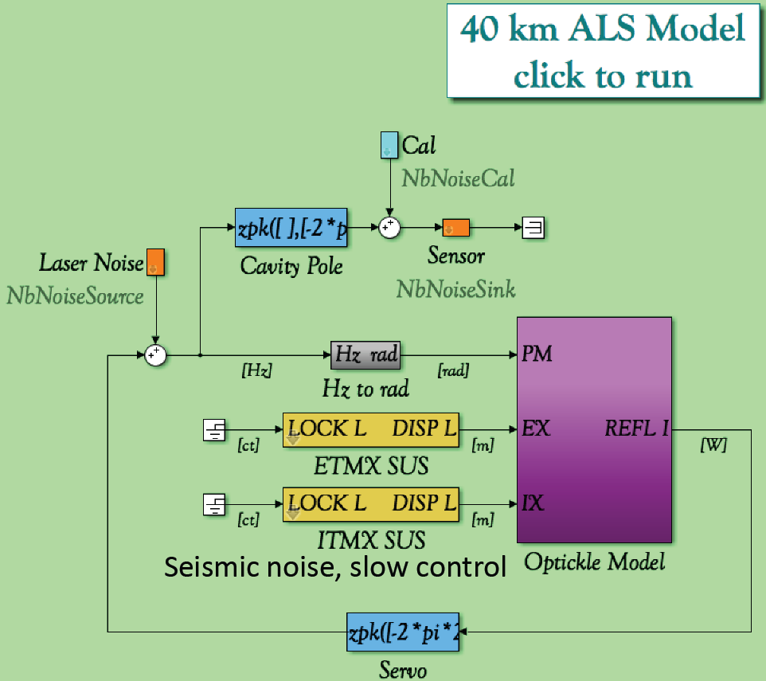
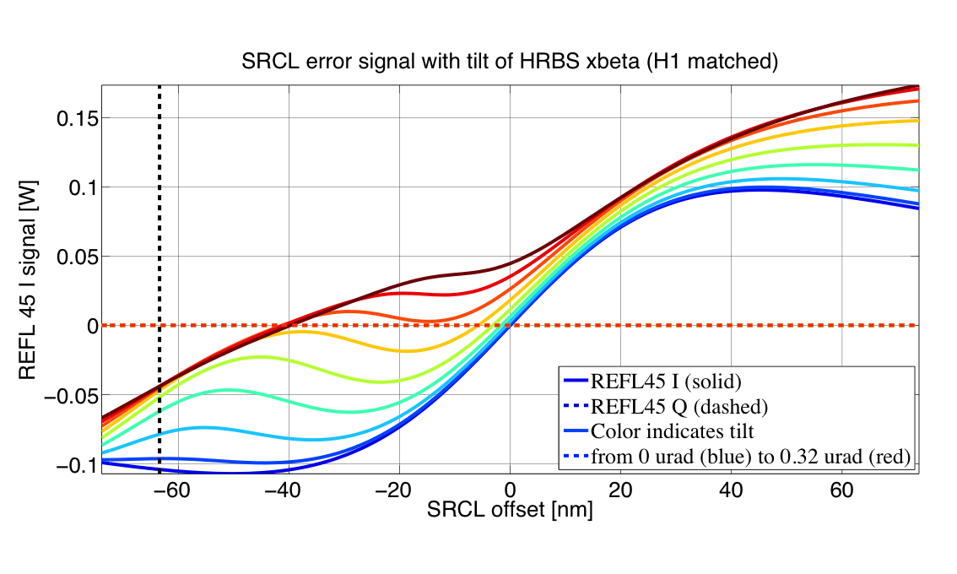
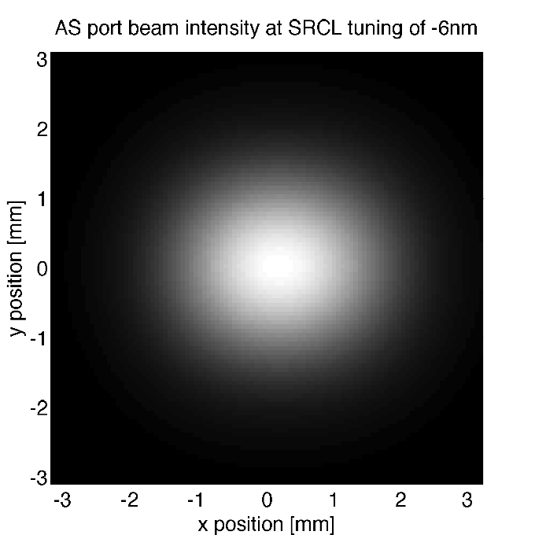
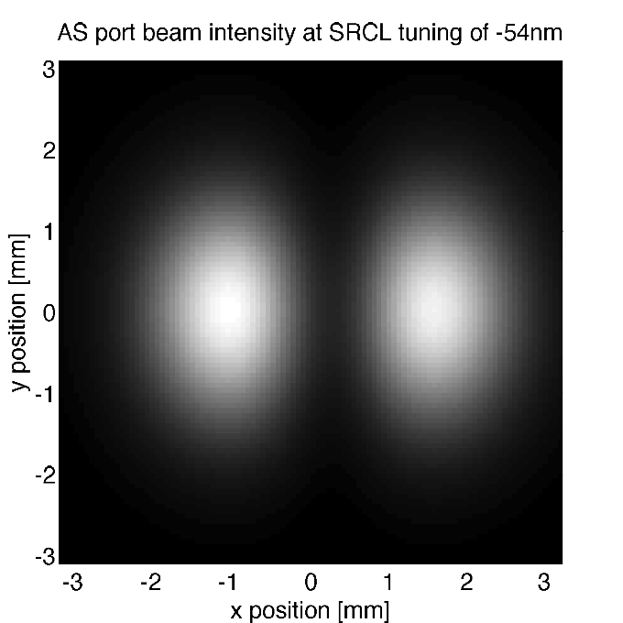
Summary D: Lock Acquisition
Problems & Improvements
Mode Hopping Problems (Paul Fulda)
  ALS
    Causes: Low finesse; alignment
    Solutions: improved SEI performance (tuning); ALS green WFS (H1 only)
    Will replace ETMs with proper green transmission
  H1 DRMI (but not L1)
    Causes: Alignment; mode matching; Gouy phase; Cross-coupling
    Solutions: improve alignment, increase HOM separation
    Would be good to measure RC optics with better ROC accuracy
Simulation for Commissioning/Controls (Chris Wipf)
  SimulinkNB – noise budget tool
  Example application: ALS for 40 km long arm (FSR @3kHz)
  Tool for designers and commissioners

Slide 9
Summary D: Lock Acquisition Problems & Improvements
Bayesian approach for locking high finesse cavities
(Manuel Marchiò, Giancarlo Cella)
  Apply force outside of resonance (to slow down the optic) based on a dynamics model
  State space (position, velocity) Guassian distribution + linear dynamics → Kalman filter estimator
  Use transmitted power to know that you are passing a TEM00 resonance
  Plan to include PDH off-resonance signal with particle filter (sum of Gaussians) method
  Could this approach work for DRMI, for a more deterministic lock?

Slide 10
D: Lock Acquisition Problems & Improvements: goals/questions
From each interferometer, gather a compendium of
  lock acquisition problems
  Locking metrics & statistics
Discuss approaches to address each lock acquisition problem and their relative merits and success to date
Are the pre-lock auxiliary systems (OptLev, ALS, TCS, …) adequate, or are improvements necessary?
Shouldn’t future interferometers be designed to observe and control all DOF (bounce, roll, violin modes)?
Would we benefit from embedding independent sensing/actuation into the interferometers for routine diagnostic measurements & characterization?
Which lock acquisition problems can & should be pursued on small scale research interferometers?
SIMULATION TOOLS
STOCHASTIC LOCKING NOT GOOD

Slide 11
Summary E: Interferometer Stability
Lock Loss Causes
aLIGO (Keita Kawabe, Shiela Dwyer (LHO); Anamaria Effler (LLO))
  We can automatically detect lock loss, but not the cause (yet)
  Detchar has a tool for auto plotting signals of typical interest just preceding a lock loss event
    Will make auto & publish
  Clear need for better local sensing of poorly controlled (damped) modes: roll, bounce, violin modes
  Not yet clear if the limited actuation authority for these modes is stable/reliable or not (i.e. do we also need better actuation?)
    Depends on alignment & beam position
    Bounce & roll don’t change at LLO; stable with good alignment
    Find good alignment based on RC gains (automated procedure)
  Inspiral range creeps down (sometimes) – thermal?
  Leading lock loss causes at LLO:
    Parametric Instability
    EQs every 2-3 days
  Saturation
    Detchar is working on ODC checks on saturation
    DAQ system has automatic saturation detection code

Slide 12
Summary E: Interferometer Stability
Lock Loss Causes (continued)
Virgo (Bas Swinkels)
  Reviewed VSR1 – 3 lock/unlock statistics
  Improved caused lock loss events from 1-2/week (mag 6, Indonesia) to 1 per 2-3 weeks (mag 7, Indonesia)
  VSR3: 90% locked, 80% science, 143 hr longest lock
  Maintenance period (typ 4 hr/week) was largest contributor
  Instrument/hardware reliability comparable to maintenace
Geo (Emil Schreiber)
  Auto lock loss detection (& plotting) and re-acquire

Slide 13
Summary E: Interferometer Stability
Ground Tilt (Krishna Venkateswara)
  Wind induced gnd tilt is significant for LHO (> 20 mph, 15% time)
  Optic yaw response in high wind
    Might be bilinear coupling with mis-centered beam?
    Could be mis-balanced coil drivers
    Investigate ISI to SUS cross-coupling, esp. yaw
    Suggestion to simulate wind (high amplitude motion in ISI) to discover coupling path
    LIGO pursuing a 2nd Beam Rotation Sensor (BRS) for LHO testing
TCS (Alastair Heptonstall)
  Plan to maintain ITM/CP thermal lens with CO2 laser when main beam losses lock – Operator sets thermal lens power with Guardian
  Need to separately tune SRC & PRC (Virgo does this already for PRC) – LIGO considering the addition of a “ring heater” (or similar) to SR3 & PR3

Slide 14
Summary E: Interferometer Stability
Earthquakes (Sebastien Biscans, et. al.)
  LIGO has a few unlocks per week
    (maybe same order of magnitude for Virgo)
  Tilt is not well known for EQs
  Displacement ASD high < 0.1 Hz
  LIGO ISI platform (apparently) tilts a lot in response
  ISI platform trips on S-wave or surface waves , approx. 30 min typ from EQ p-wave → time to prepare
    With USGS network at least a few min warning for “all” EQs
    EQ Monitor (Jan Harms, Michael Coughlin) can predict to amplitude factor of 4 & 1-2 sec arrival
    Reduce digital gain & increase analog gain
    What to do to prepare & ride-out a mild EQ, e.g. higher blend freq.
    Each EQ is different; requires testing. LASTI?

Slide 15
E: Interferometer stability (maintaining lock) goals/questions
Gather a compendium of lock loss event causes
  Do we have detchar infrastructure for automatic detection, logging, and calculation of statistical metrics?
Discuss approaches to address each lock loss cause and their relative merits and success to date
Are the lock loss prevention auxiliary systems adequate, or are improvements necessary?
Would we benefit from embedding independent sensing/actuation into the interferometers for environment sensing?
Which lock loss problems can & should be pursued on small scale research interferometers?

Slide 16
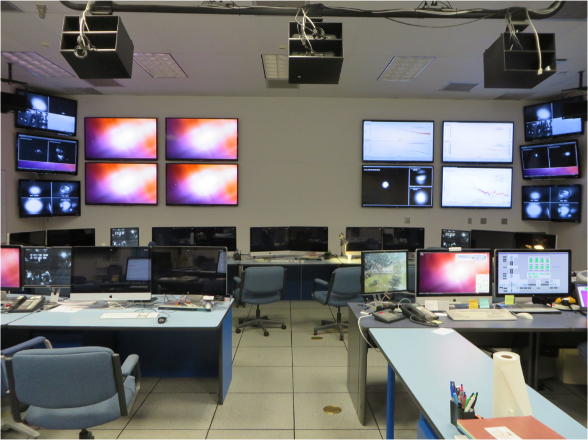
Summary F: Next Generation Control System Architecture
How can we improve controls infrastructures to facilitate development of "modern" or "advanced" controls?
Rolf Bork and Bas Swinkels gave brief overviews of the current aLIGO and aVirgo controls infrastructure
Leverage commercial off-the shelf
(LIGO: server-class computers, PCIe I/O, Beckhoff, RT linux patch, EPICs, etc.)
vs
flexibility and control of custom
(Virgo: DSPs, TOLM, ALP, etc.)
  Both can work.
  Virgo hopes to move from ALP to Tango. Should LIGO move from EPICs to Tango to leverage the entire LVC community?
  No group conclusions; not really all the right people/expertise

Slide 17
Summary F: Next Generation Control System Architecture
We then heard from people working on controls technology about what they would like to see:
  Increase availability to modern/advanced algorithms that are ready to move beyond R&D (e.g. drop in "RCG part"):
    State Space/LQR
    Kalman filters
    LQG adaptive algorithms (prototyped at 40m Lab)
  Adaptation rate < loop rate
    Leverage multiple processors to offload adaptive calculations from front-ends, or
    multi-rate front-end calculations
  Increase accessibility, e.g. reduce hardware requirements, to facilitate development of prototypes, simulations, etc.
  Modularity and flexibility in the infrastructure is the key to facilitating future controls development
  Build a set of canonical problems (e.g. SUS angular control) and matching algorithms (e.g. Kalman filter) to develop a super-set of control system requirements
  Couple the control system design tool (RCG for LIGO) directly to a simulation (e.g. SimPlant prototype at 40m Lab)

Slide 18
Final Comments
How can we as a community share and sustain a growing expertise in the application of advanced/modern controls to GW interferometer systems?
  LVC wiki pages for Controls
    Get a critical mass
    Share examples, code, experiences
  Regular LVC (virtual) meetings on Controls
    Perhaps an “official” LVC working group on controls?
  Detchar “gold star” vetted tools wiki page
In future GWADWs:
  Address next generation systems (V+, A+, Voyager, Longo, …)
  Consider truly advanced techniques, with adequate prep (NN, deep learning, …)

