Slide 1
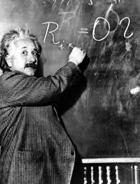
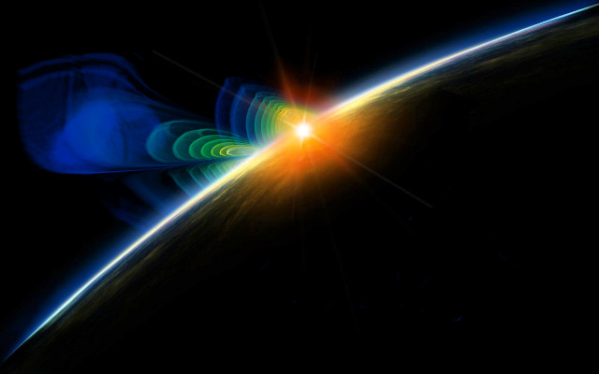
Gravitational Waves
Einstein’s Astrophysical Messengers
Gabriela González
Louisiana State University

Slide 2
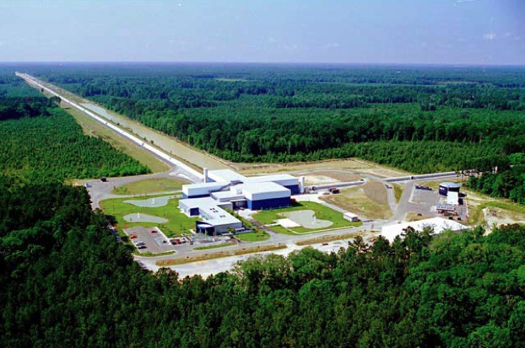
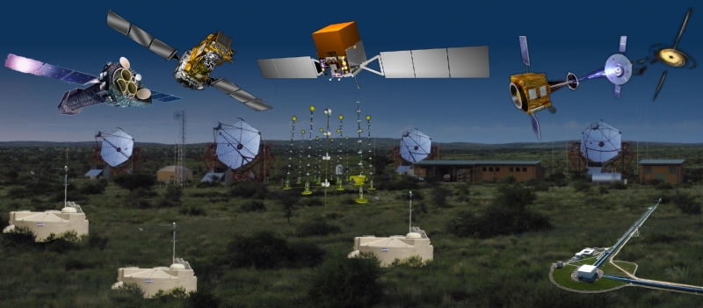
Lecture plan
Einstein’s gravity
Sources of gravitational waves
Detecting gravitational waves
Multi-messenger astronomy

Slide 3
Einstein’s gravity

Slide 4

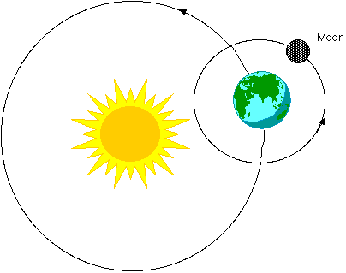
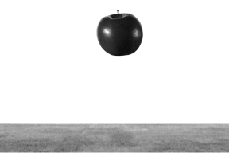
Newton’s gravity
“Newton’s law”: F = Gm₁m₂/r²
Explains why apples fall, why the planets move around the Sun,…

Slide 5
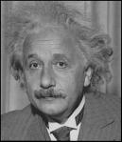
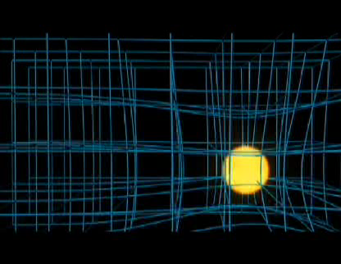
Einstein’s gravity
sciencebulletins.amnh.org
And in YouTube!

Slide 6


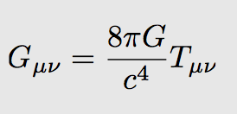
Einstein’s gravity
When masses move, they wrinkle the space time fabric, making other masses move.
Explains just as well as Newtons’ why things fall and planetary motion.

Slide 7
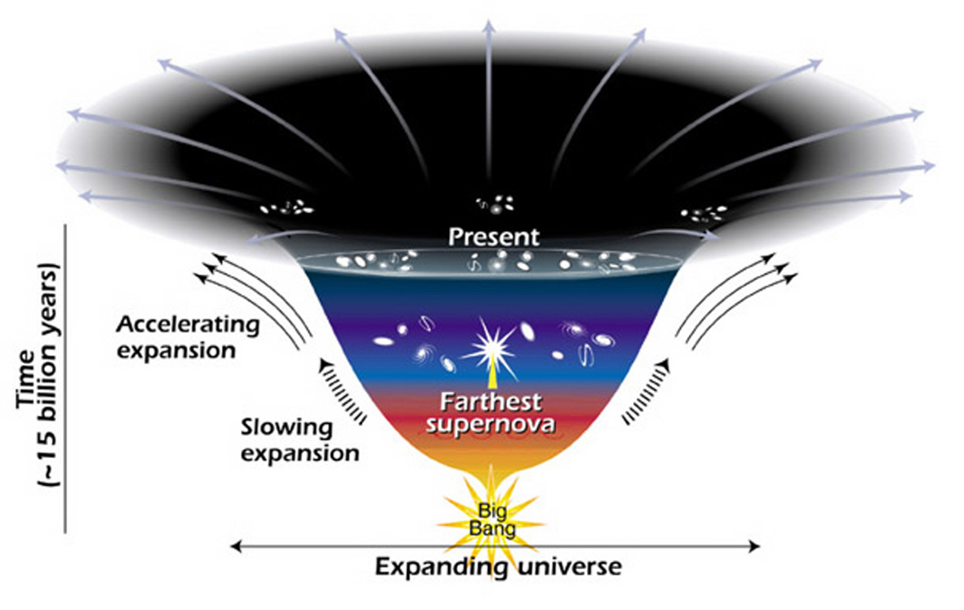
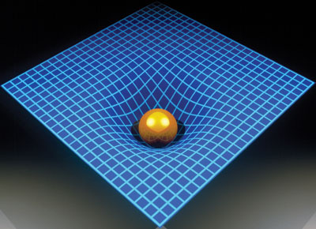
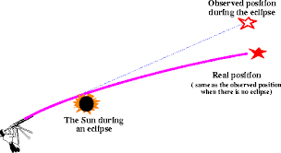
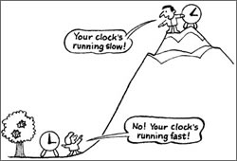
(Some of) Einstein’s predictions
The Universe expands.
There are “black holes”.
Light bends its path around matter
(following with space-time).
Clocks run at different rates at different
heights from Earth.

Slide 8
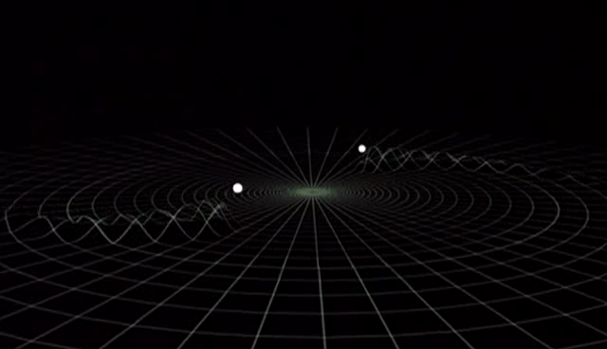
Einstein’s gravity
Einstein’s messengers,
National Science Foundation video
www.einsteinsmessengers.org
Also predicts traveling away from moving masses, and carrying energy away.
Two stars would orbit around each getting closer and closer together, as energy is emitted from the system through gravitational waves
gravitational waves

Slide 9
Sources of Gravitational Waves

Slide 10
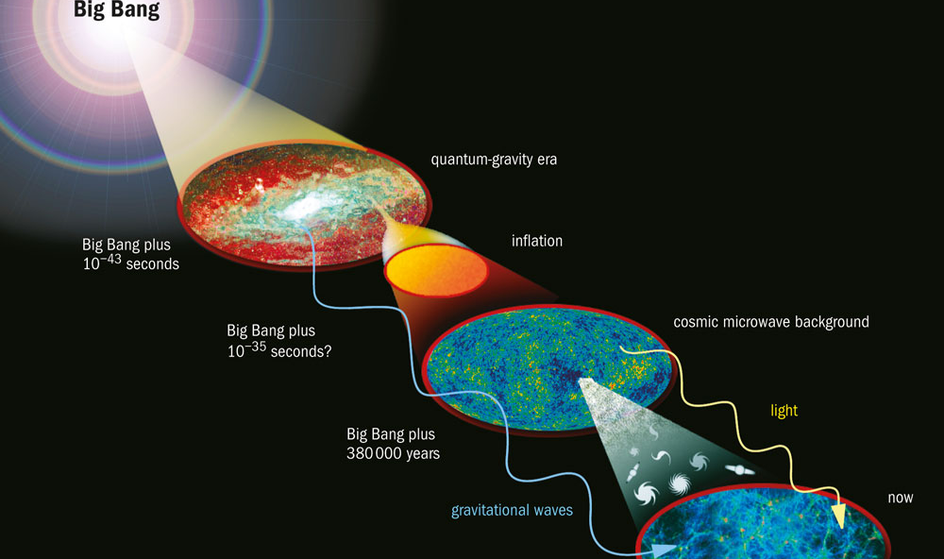
Early Universe
(Courtesy: NASA)
We have learned much about the early history of the Universe from observation of the “cosmic microwave background – there is also a “gravitational wave background” from even earlier times.

Slide 11
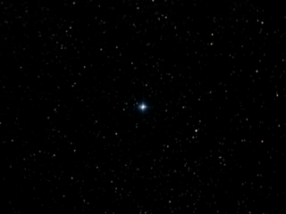
Supernova explosions
Credit: NASA
SN explosions generated by the collapse of a star under its own gravity give birth to neutron stars and black holes with masses close to the Sun’s, but with the size of a city.
If the explosion is not perfectly symmetric, it produces gravitational waves that may be detected on Earth.
Notes:
https://www.nasa.gov/centers/goddard/news/topstory/2003/0702pulsarspeed.html

Slide 12
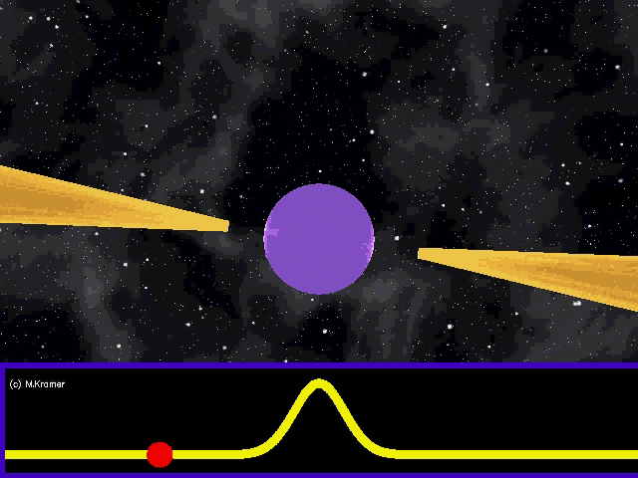
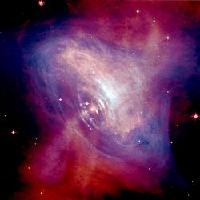
Rotating stars
Crab pulsar and nebula
Credit: NASA/CXC/ASU/J. Hester et al.
Credit: M. Kramer
Neutron stars are born rapidly spinning, emitting electromagnetic beams: they are “pulsars”. Eventually, electromagnetic power is exhausted, and older, isolated, neutron stars do not emit beams. Pulsars are very precise clocks – rivaling atomic clocks.

Slide 13
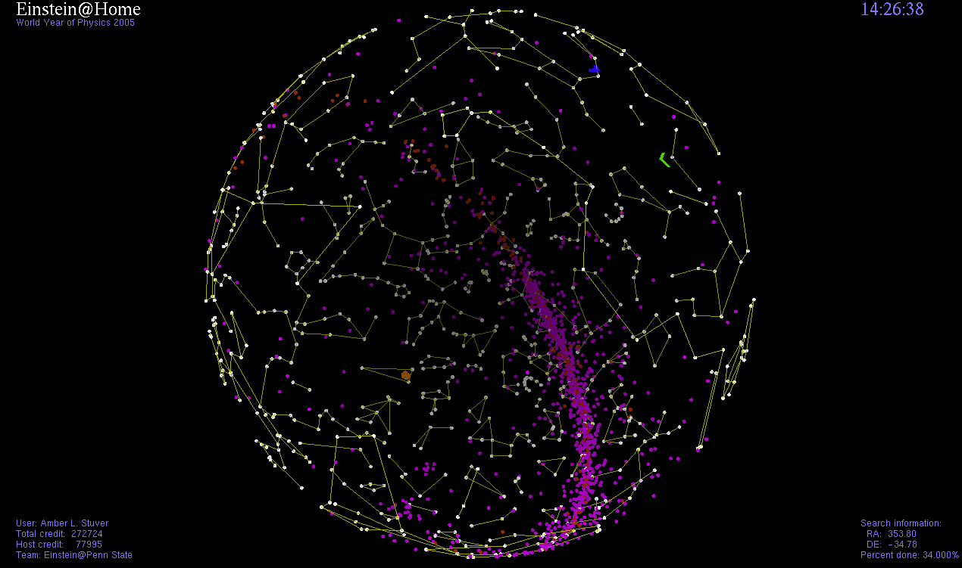
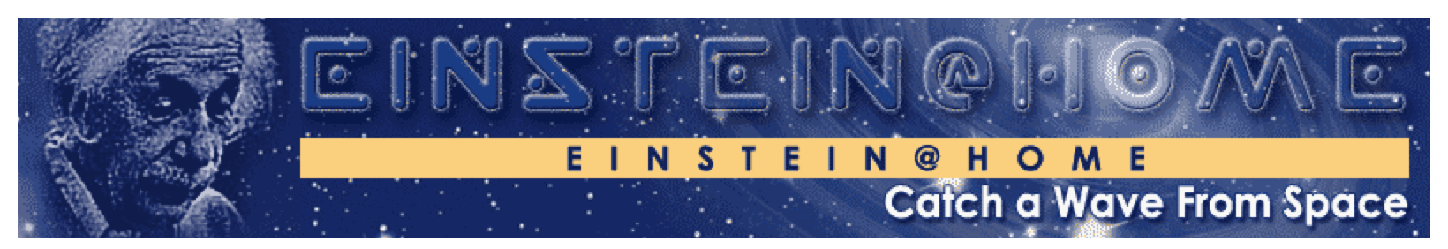
Neutron stars
Neutron stars emit gravitational waves themselves, with an amplitude proportional to their non-spherical shape and twice their rotation frequency – but neutron stars are very smooth!
There are about 2,000 pulsars observed in our galaxy, but there are about 100 million neutron stars in the Milky way.

Slide 14
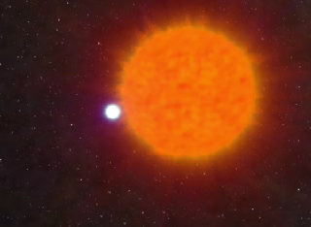
Neutron stars in Binary systems
Credit: John Rowe animations
About 5% of neutron stars are part of a binary system, eventually forming a binary system with two neutron stars, or a neutron star and a black hole.

Slide 15
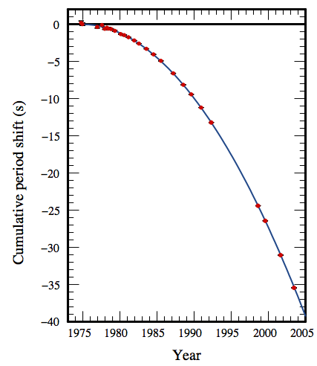
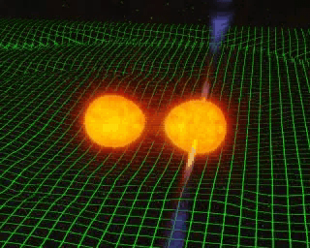

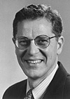
Binary systems
Hulse, Taylor
Nobel Prize 1993
GR prediction
Weisberg, Nice & Taylor, 2010
(Courtesy Joel Weisberg)
Credit: John Rowe animations
Binary systems of compact objects as neutron stars and black holes lose energy to gravitational waves, orbiting closer and closer until merging into a larger black hole. The amplitude and frequency of the gravitational wave before the merger is “easy” to calculate using Einstein’s theory – this is likely to be the bread-and-butter of Advanced LIGO when it begins detecting astrophysical signals.

Slide 16
Detecting gravitational waves

Slide 17
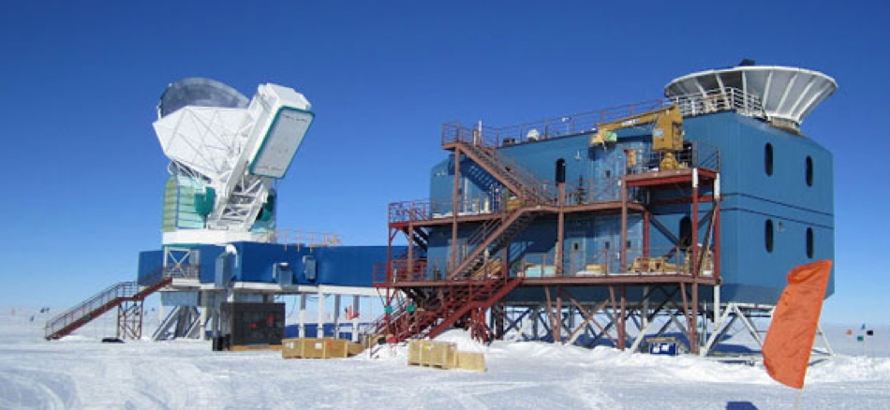


GW landscape
Many sources, many frequencies, many detectors, many collaborations
Credit: Nanograv/Bicep2

Slide 18
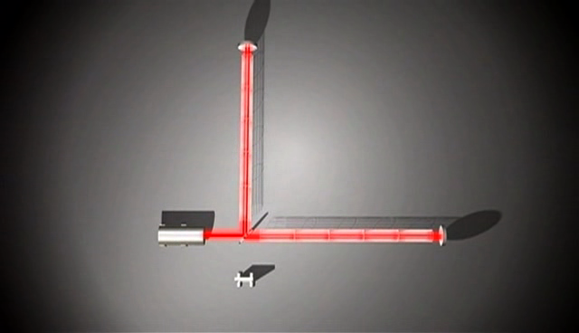
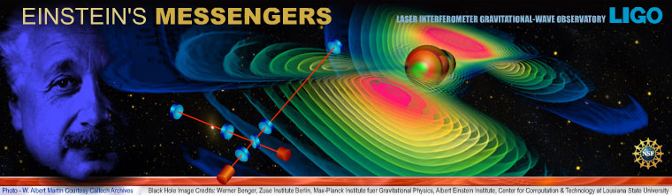
How to detect gravitational waves with an interferometer
Einstein’s messengers,
National Science Foundation video
http://www.einsteinsmessengers.org/

Slide 19

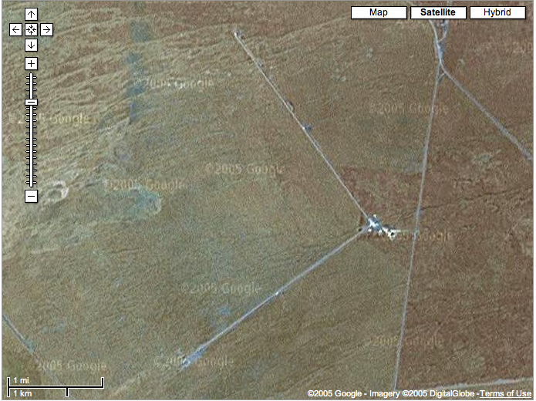
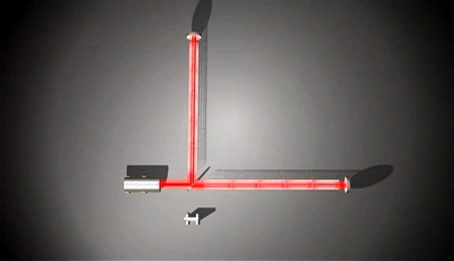
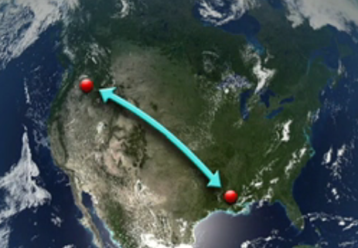
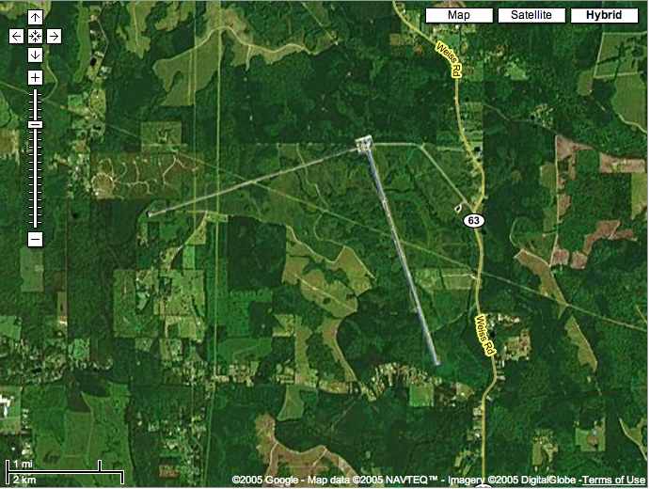
The LIGO Observatories
Hanford, WA
Livingston, LA
Hundreds of people in 16 countries working on the experiment and looking at the data:
LIGO Scientific Collaboration
www.ligo.org

Slide 20
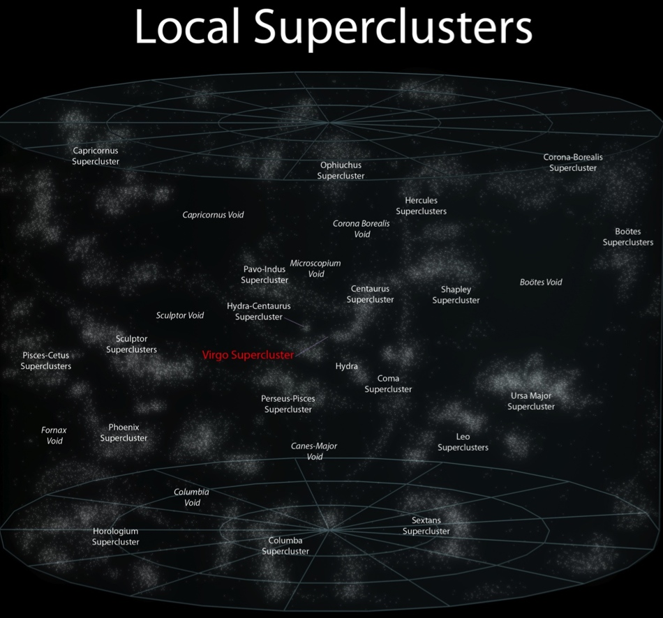
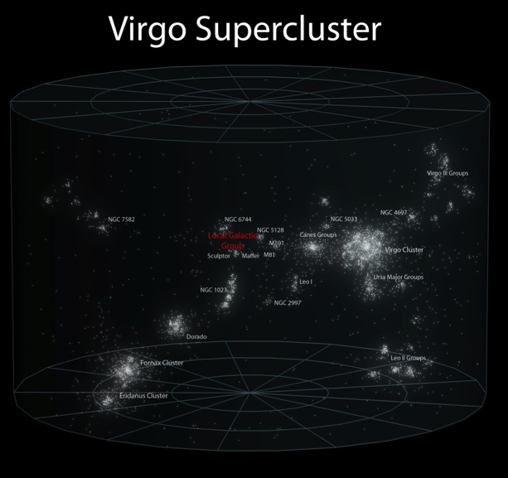
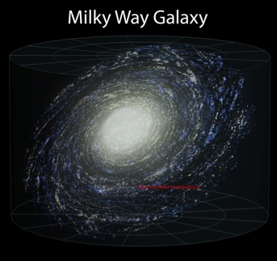
Initial and Advanced LIGO
Advanced LIGO will be ~10x more sensitive than initial LIGO (2005-2010), sensitive to colliding neutron stars in ~100,000 galaxies, expecting many detections per year.
Initial Reach
Advanced Reach

Slide 21
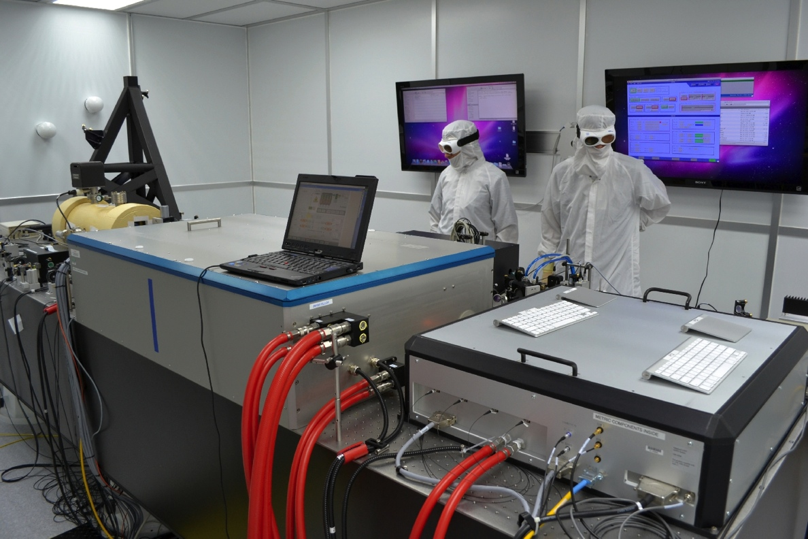
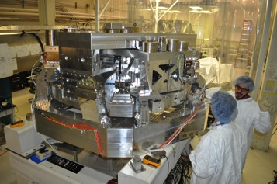
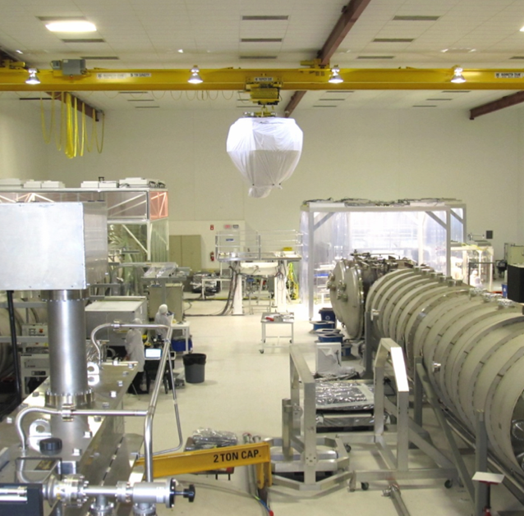
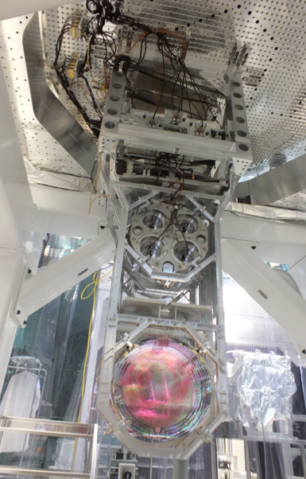
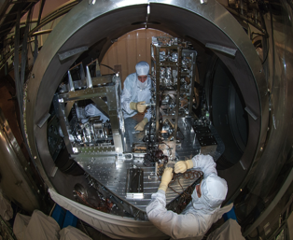
Advanced LIGO in Pictures
Pre-stabilized Laser
Active Seismic Isolation
‘Test Mass’ Mirror
Output Mode Cleaner
‘TransMon’ Telescope

Slide 22

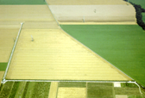


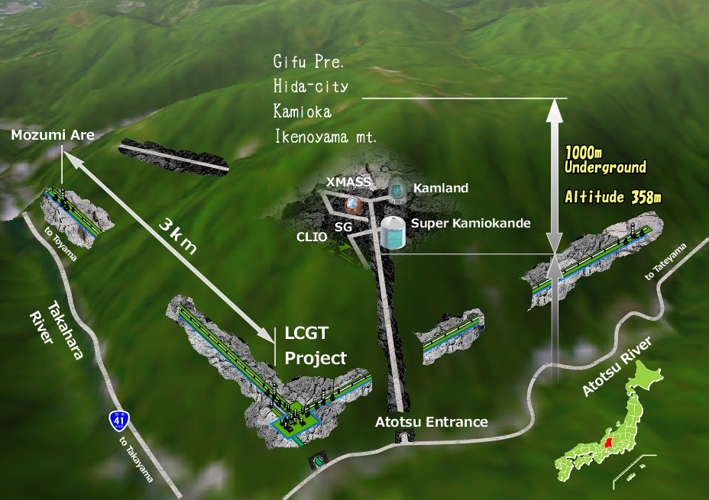

The GW Detector Network~2022
Advanced LIGO
Hanford
GEO600
Advanced
Virgo
KAGRA
Advanced LIGO
Livingston
LIGO-India
(planned)
22

Slide 23
Multi-messenger astronomy
Credit: Heidi Sagerud

Slide 24
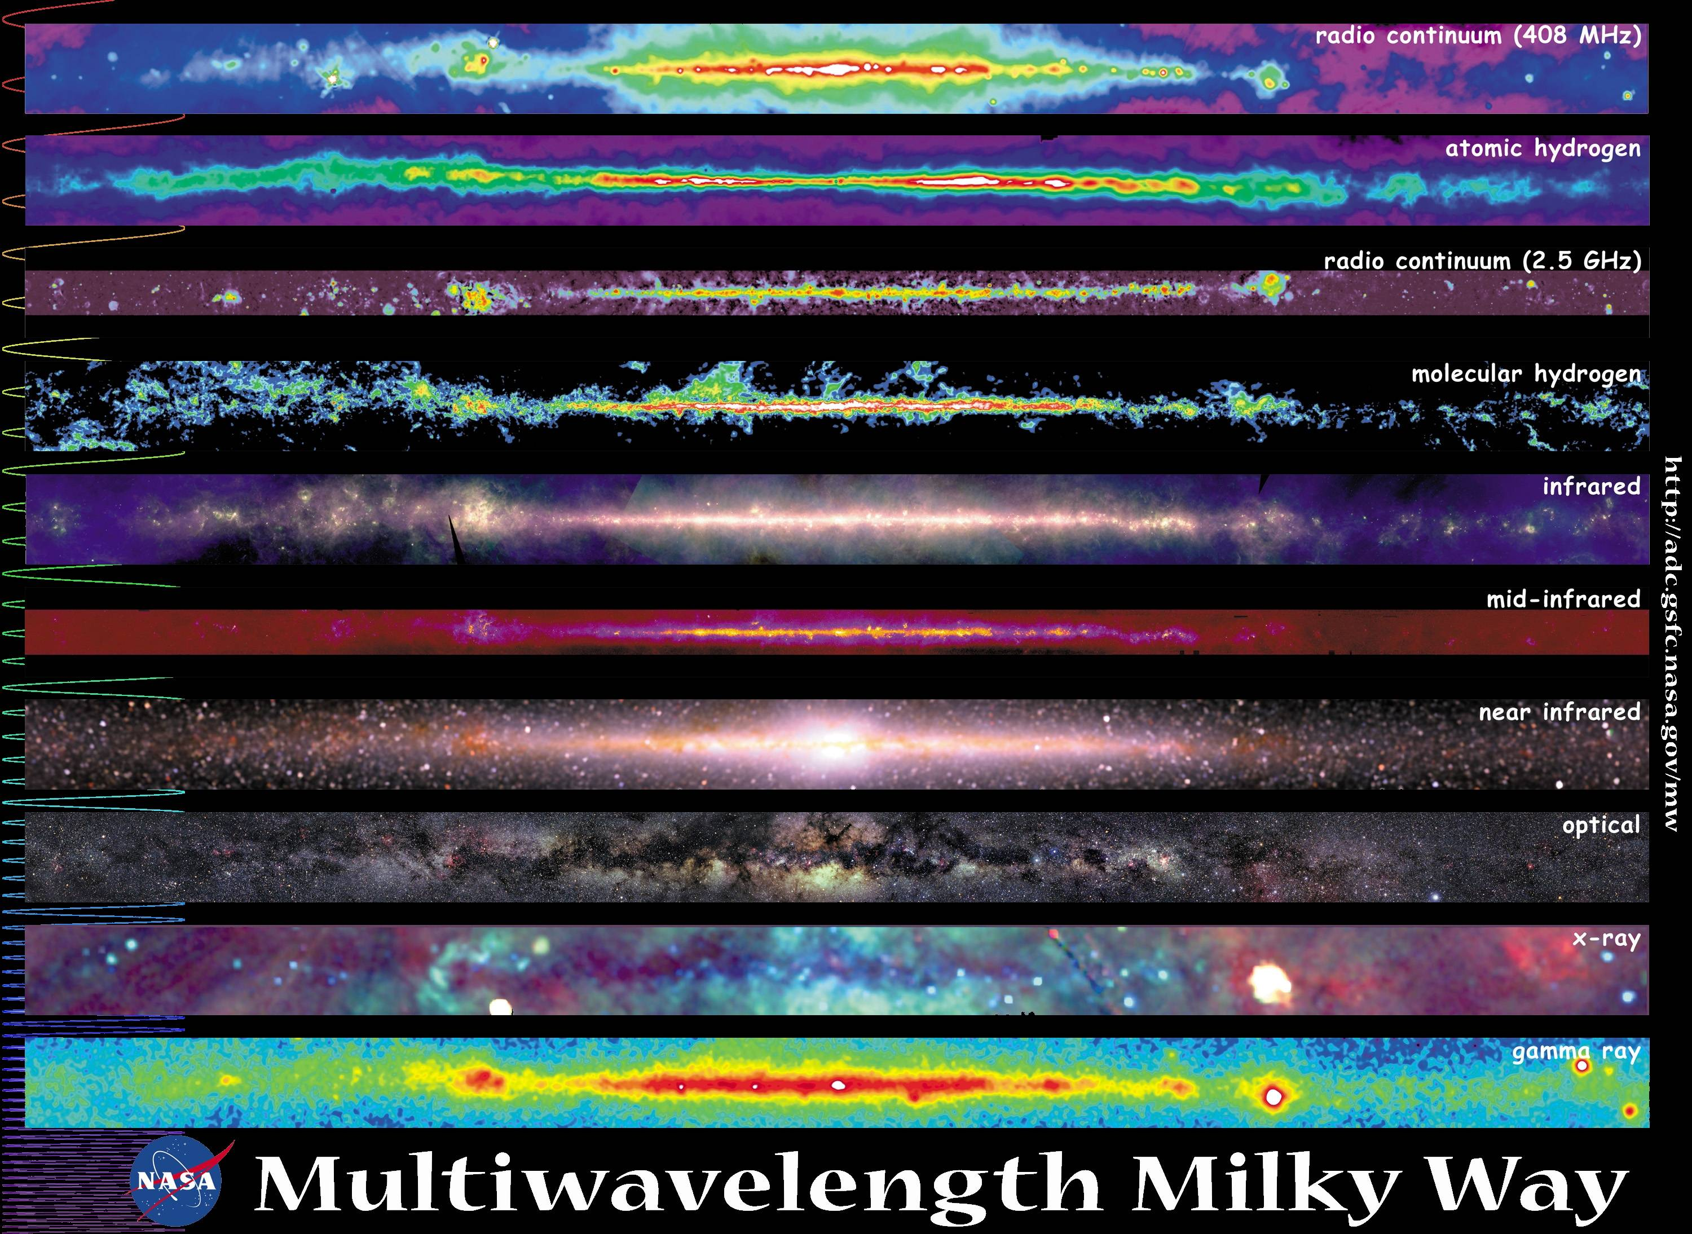
Multiple wavelengths

Slide 25
Multiple messengers
Credit: Heidi Sagerud

Slide 26
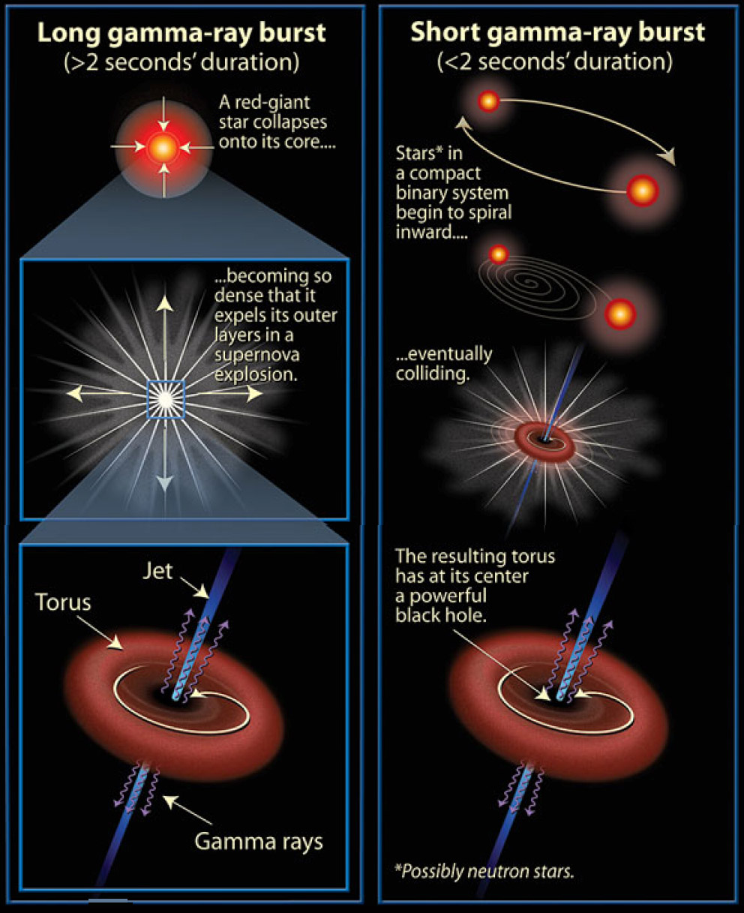
Gamma Ray Bursts

Slide 27
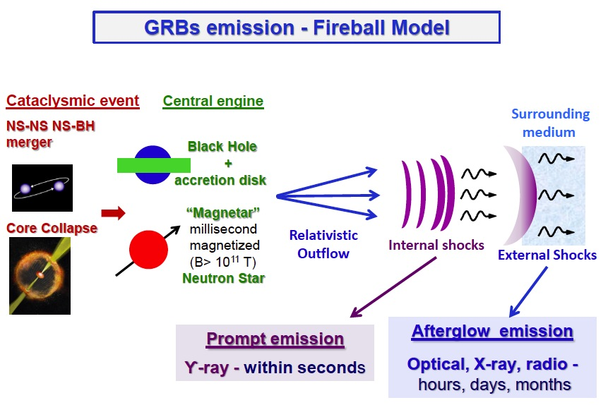
GRBs as multi-messengers
And gravitational waves!

Slide 28
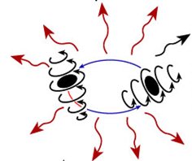
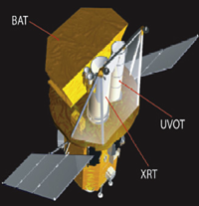
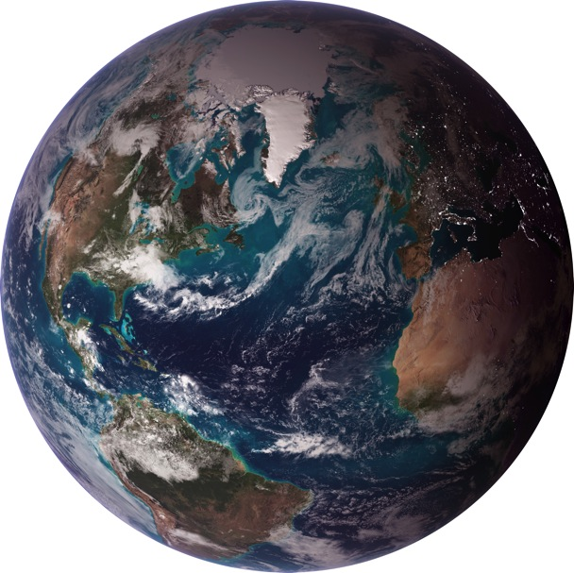
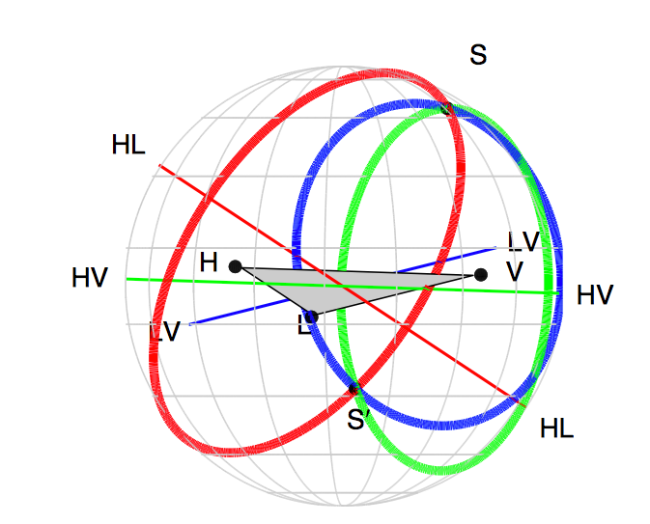
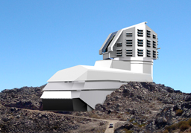
GW localization: networks
Swift
Satellite
X-ray, γ-ray
follow-up
LIGO
Hanford
t₁
GW
Detector
Network
t₂
Virgo
t₃
LIGO
Livingston
LSST
Optical
follow-up
Image:
http://earthobservatory.nasa.gov/

Slide 29
The GW Detector Network~2022
Advanced LIGO
Hanford
GEO600
Advanced
Virgo
KAGRA
Advanced LIGO
Livingston
LIGO-India
(planned)
29

Slide 30
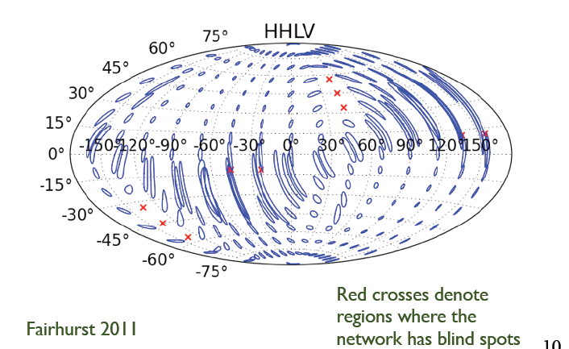
Localization with
LIGO-Virgo only

Slide 31

Localization: LIGO-Virgo plus LIGO-India

Slide 32
Gravitational Waves
Einstein’s Astrophysical Messengers
Questions? Email gonzalez@lsu.edu, or go to www.ligo.org

