Slide 1


Frequency Dependent Squeezing
Roadmap toward 10dB
Tomoki Isogai
LIGO MIT
In collaboration with:
Eric Oelker, John Miller, Patrick Kwee, Maggie Tse,
Lisa Barsotti, Mattew Evans, Nergis Mavalvala
G1500727

Slide 2
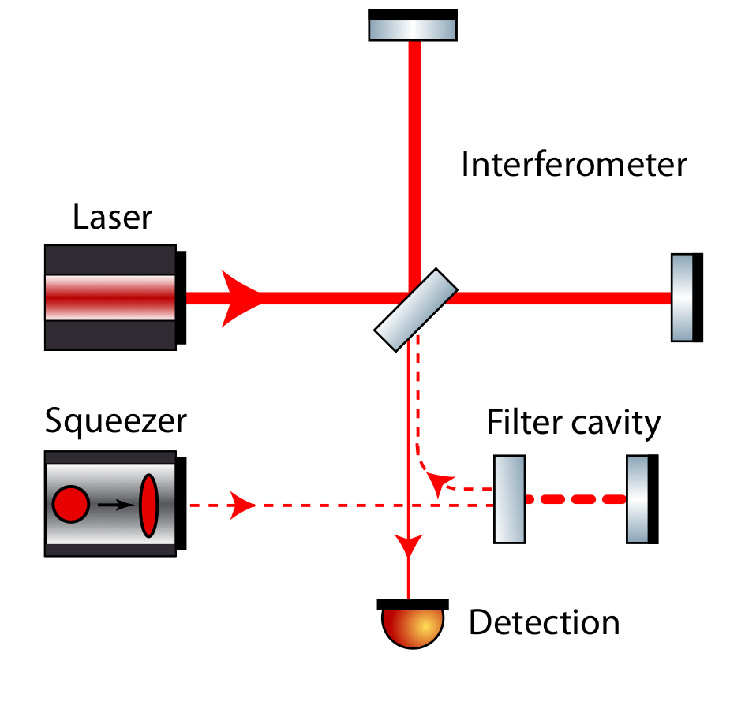
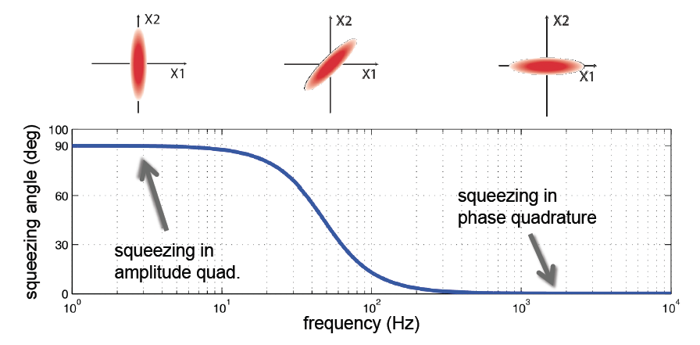
Audio-band frequency dependent squeezing is now real.
For aLIGO and beyond, almost all the detection band will be limited by the quantum noise, and we need frequency dependent squeezing
Audio-band frequency dependent squeezing using a filter cavity was demonstrated at MIT

Slide 3
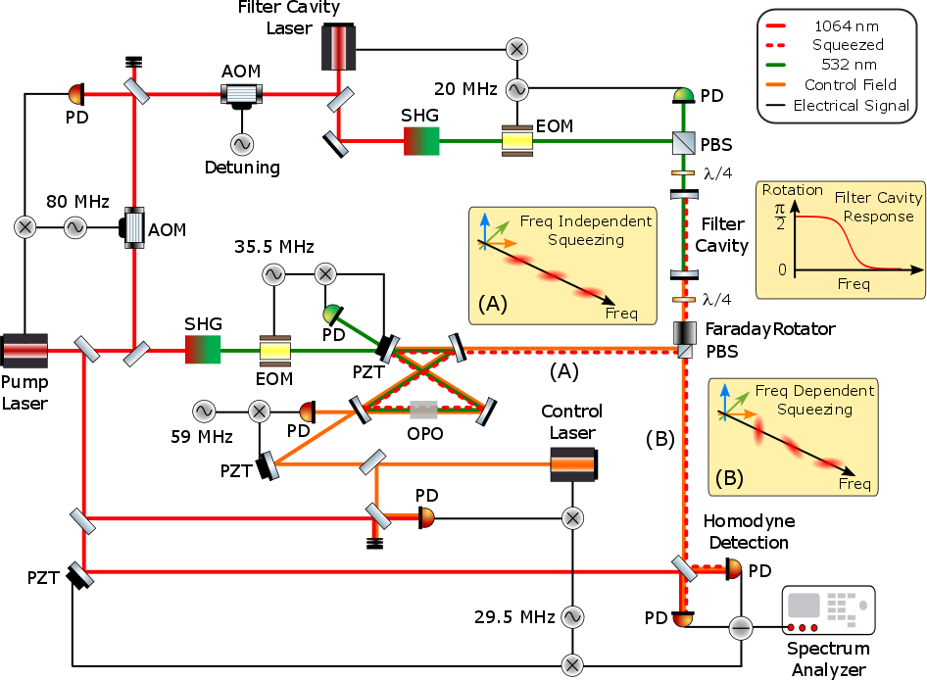
MIT Filter Cavity Demonstration
Notes:
Dually Resonant 2 Meter Linear Filter Cavity
Low Finesse (~150) 532nm cavity
High Finesse, Narrow linewidth 1064 nm cavity (Finesse ~ 30000, Linewidth ~2.5 kHz)
Low Optical losses: < 1 ppm/m
Length servo uses low finesse 532 nm cavity (similar to aLIGO ALS)
30 kHz Bandwidth PDH servo locks laser to filter cavity
Variable detuning for 1064 nm using AOM.
Same squeezer used for H1 Squeezing experiment in 2011.
Bow-tie doubly resonant OPO based on ANU design [4].
Pump laser is phase locked to Filter cavity laser.
Detuning of squeezed field controlled by AOM on filter cavity table

Slide 4
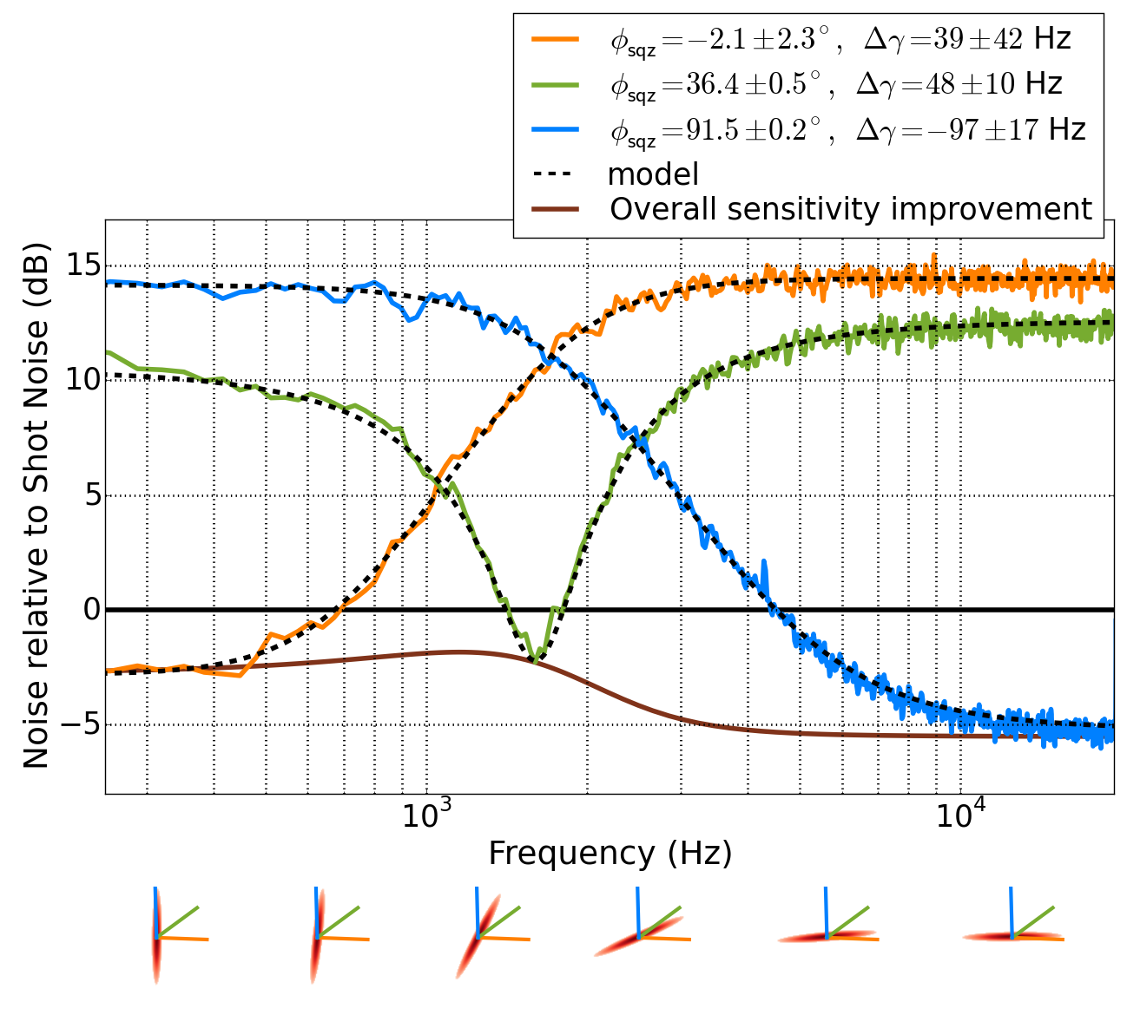
MIT Filter Cavity Experiment
Cavity line width: about 1.2 kHz
5.5dB at high frequency, 2.5 dB at low frequency
Frequency dependent squeezing is a potential early upgrade for aLIGO
Verified that the model [1] accounts for most degradation factors
[1] P. Kwee et al. Phys. Rev. D 90, 062006 (2014).
Notes:
Model seems to work -> we can play around with it!
Cite the paper

Slide 5
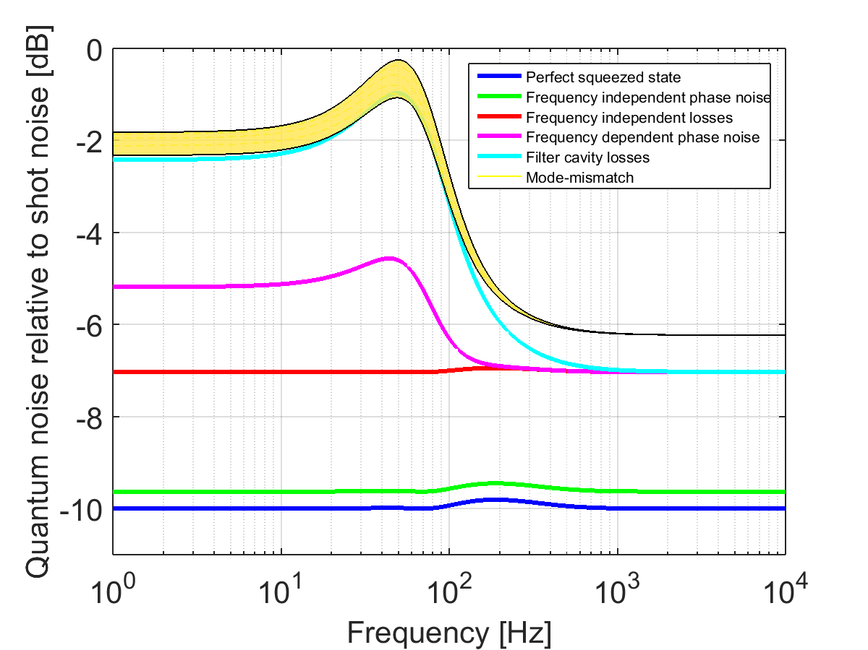
For aLIGO, we can aim for 2 dB squeezing at low frequency.
Parameter | Value
Filter cavity length | 16 m
Filter cavity loss | 16 ppm
Frequency- independent loss | 10 %
Mode-mismatch (Squeezer – Filter cavity) | 2 %
Mode-mismatch (Squeezer – Local oscillator) | 5 %
Frequency-independent phase noise (RMS) | 30 mrad
Filter cavity length noise (RMS) | 0.3 pm
Injected squeezing | 10 dB
P. Kwee et al. Phys. Rev. D 90, 062006 (2014).

Slide 6
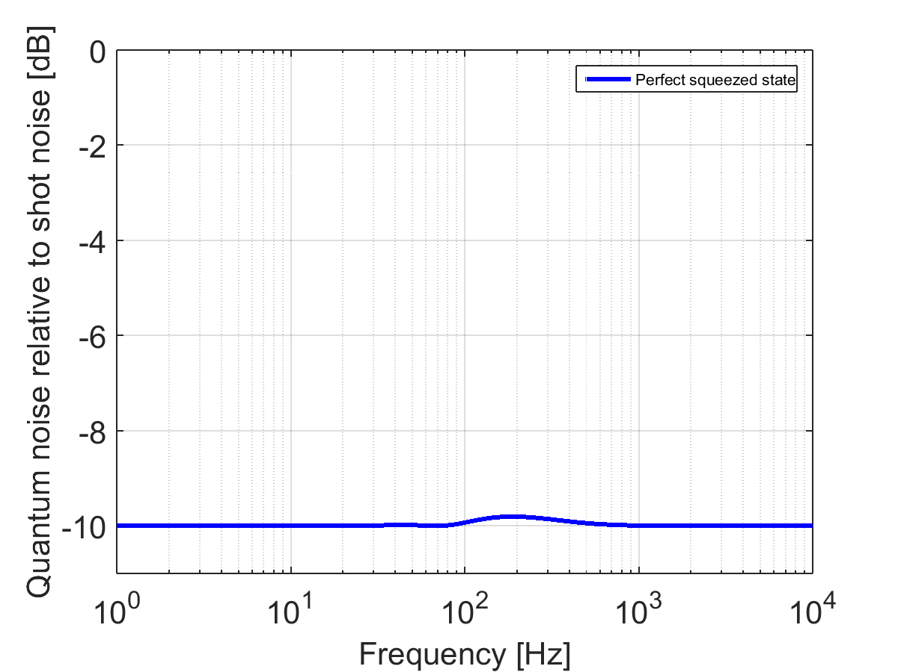
Squeezing injected: 10dB

Slide 7
For aLIGO parameters, about 10dB injection is optimal.
Injecting more squeezing is not always a good thing
Coupling from anti-squeezing can increase the noise
Figure Credit: John Miller

Slide 8
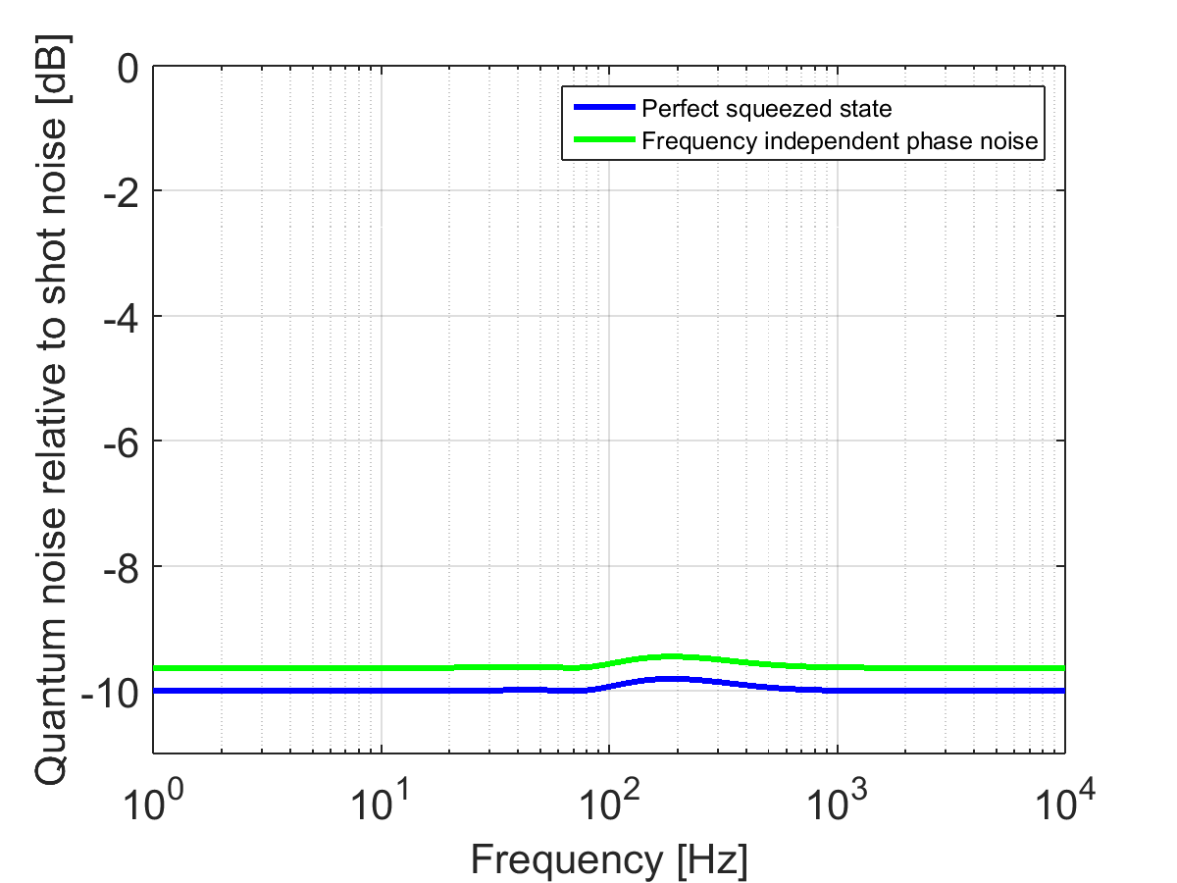
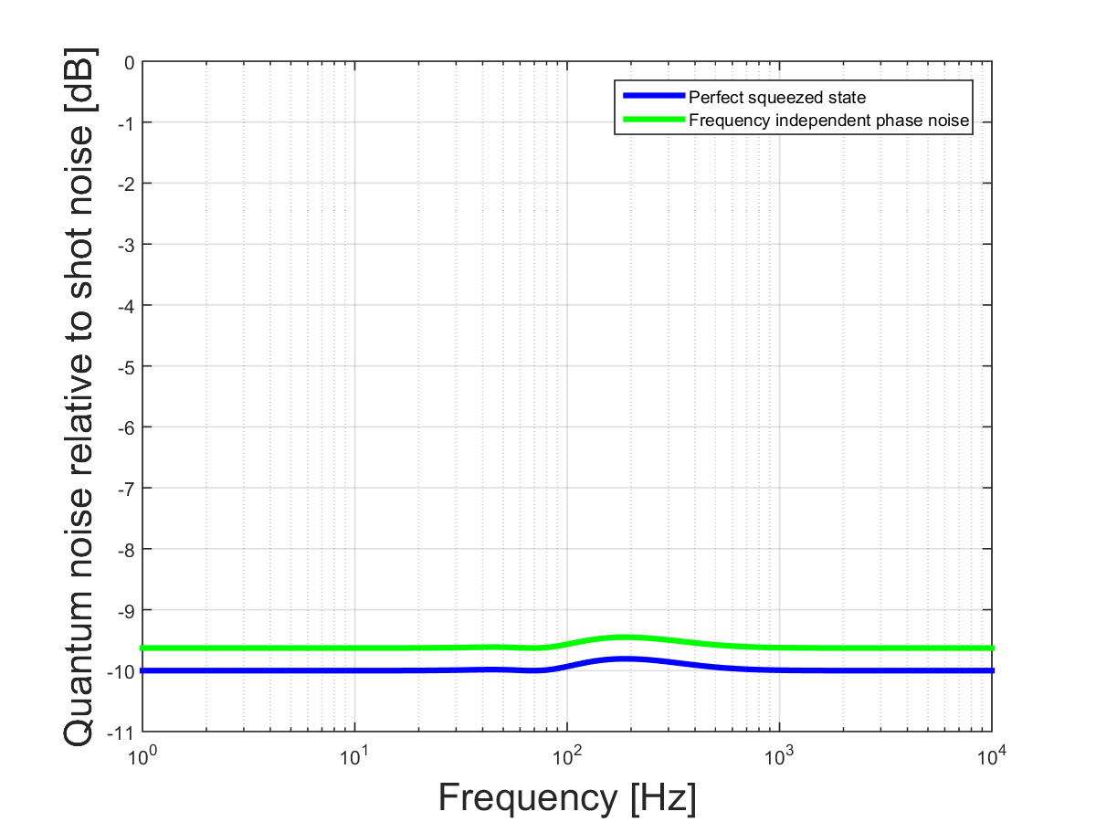
Frequency independent phase noise: 30 mrad
During the H1 squeezing test, 37 +/- 6 mrad phase noise was measured
This number is very conservative; For the new in-vacuum OPO design, we can expect a lot of improvement

Slide 9
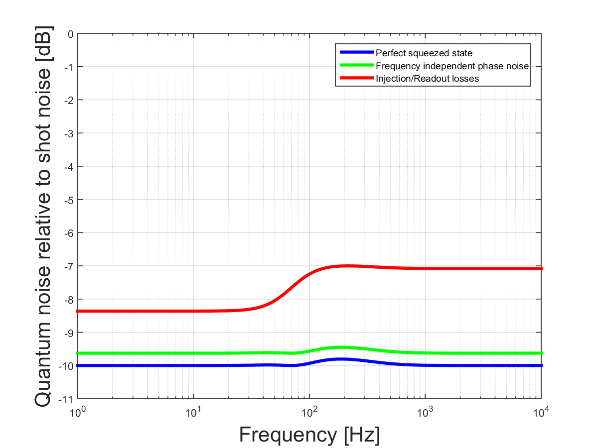
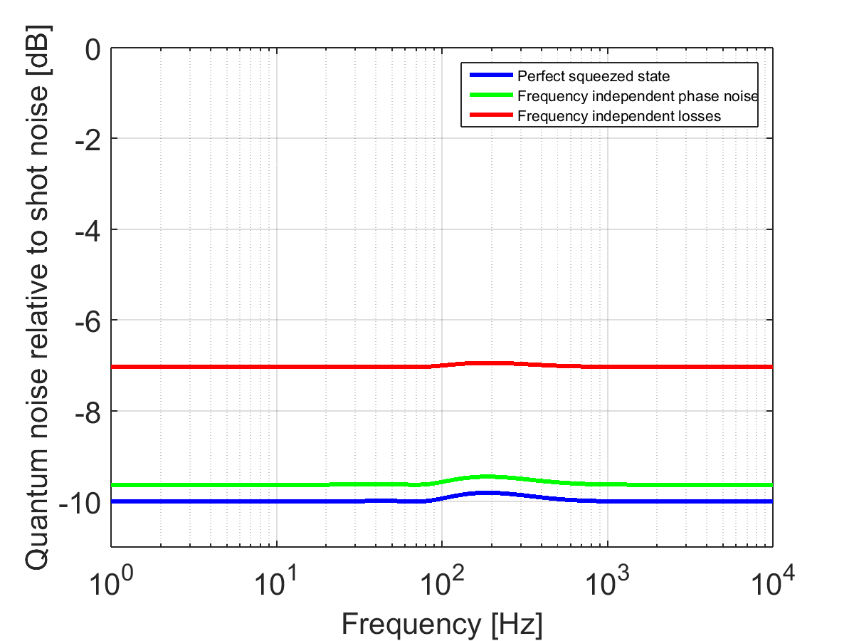
Frequency independent loss: 10% total
Faraday isolators
Wave plates / PBS
OMC
Polarization mismatch for pickoff
PD Quantum Efficiency
etc.

Slide 10
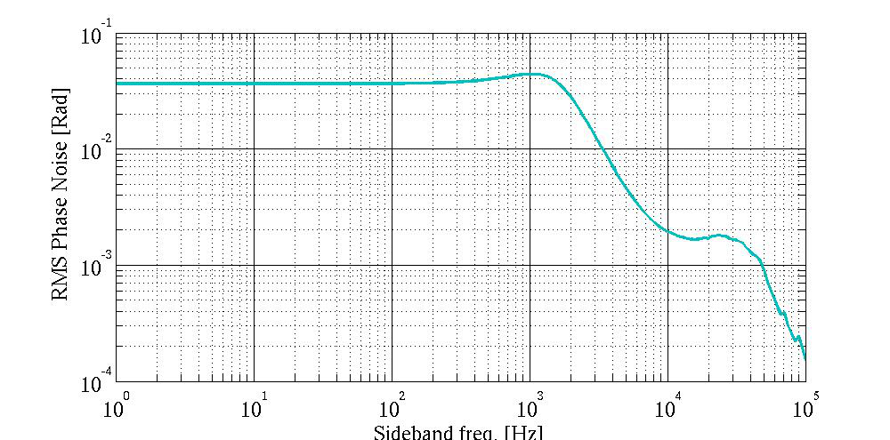
Frequency Dependent Phase Noise
Filter cavity length fluctuation adds a phase noise in a frequency dependent way
We had ~35 mrad phase noise at MIT, but we did not have any vibrational isolation from the ground
Figure Credit: Eric Oelker
Notes:
Get rid of the plot and merge to the next slide?

Slide 11
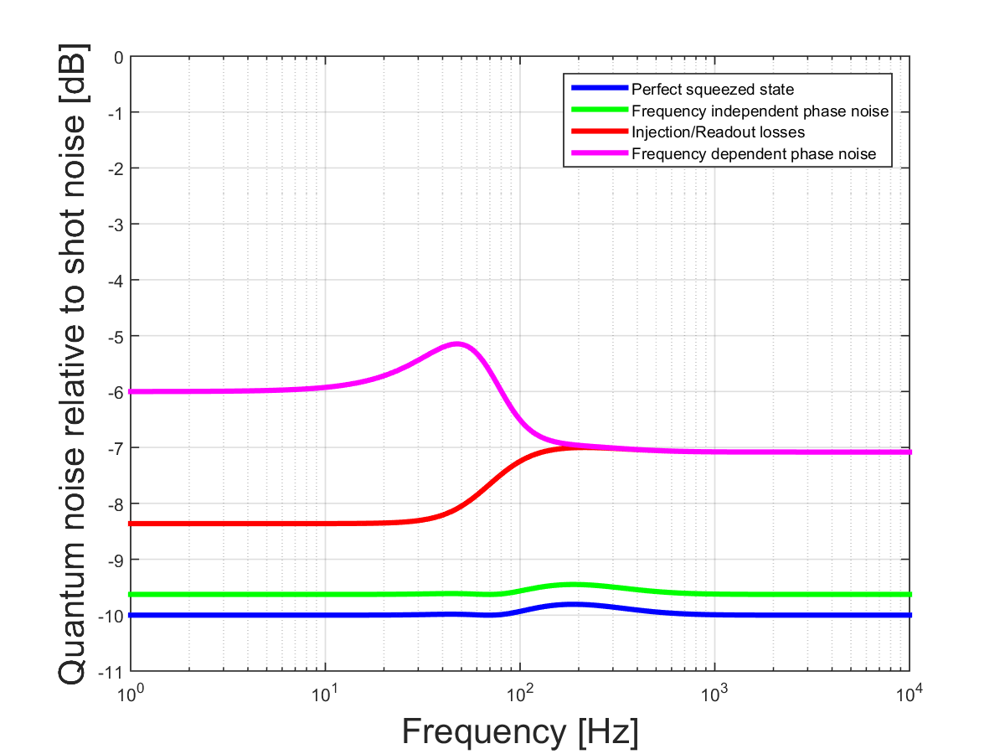
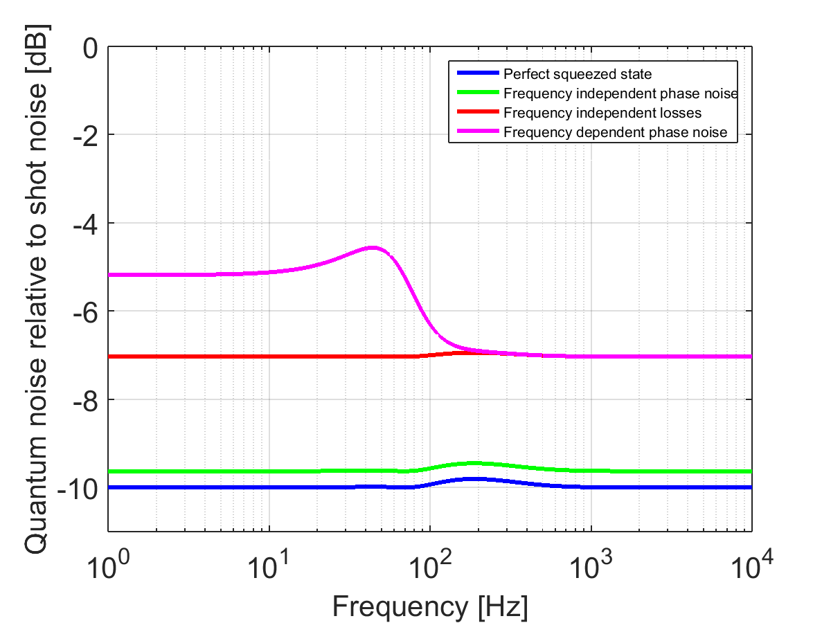
Frequency Dependent Phase Noise
For aLIGO, we can expect the filter cavity length fluctuation to be much smaller (suspended, in vacuum etc.)
Cavity length noise: 0.3 pm
Notes:
In terms of filter cavity

Slide 12
Frequency Dependent Loss
Figure Credit: N Smith et al. LIGO-T1400226
Intra-cavity loss in the filter cavity causes frequency dependent loss
At MIT, using various methods, the cavity mirror loss was characterized:
  Over a range of a few mm spot size, loss does not depend on spot size strongly
  Spot position seems to be more important
Isogai et. al. Optics Express 21 (2013)
LIGO-T1400226
Notes:
Fill in the values in the table
20 ppm?
For different wave length?
2m value is for 1.2kHz HWHM, convert it to 50Hz HWHM

Slide 13
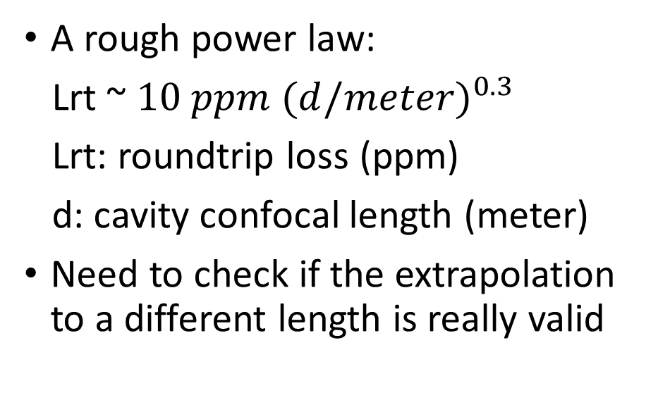
Frequency Dependent Loss
Figure Credit: N Smith et al. LIGO-T1400226
A rough power law:
Lrt ~ $10 ppm ({d/meter)}^{0.3}$
Lrt: roundtrip loss (ppm)
d: cavity confocal length (meter)
Need to check if the extrapolation to a different length is really valid
Cavity Length | 16m | 100m | 300m (@ 1560nm) | 1km | 4km
Roundtrip Loss | 16 ppm | 40 ppm | 20ppm | 80 ppm | 120 ppm
Isogai et. al. Optics Express 21 (2013)
LIGO-T1400226
Notes:
Fill in the values in the table
20 ppm?
For different wave length?
2m value is for 1.2kHz HWHM, convert it to 50Hz HWHM

Slide 14
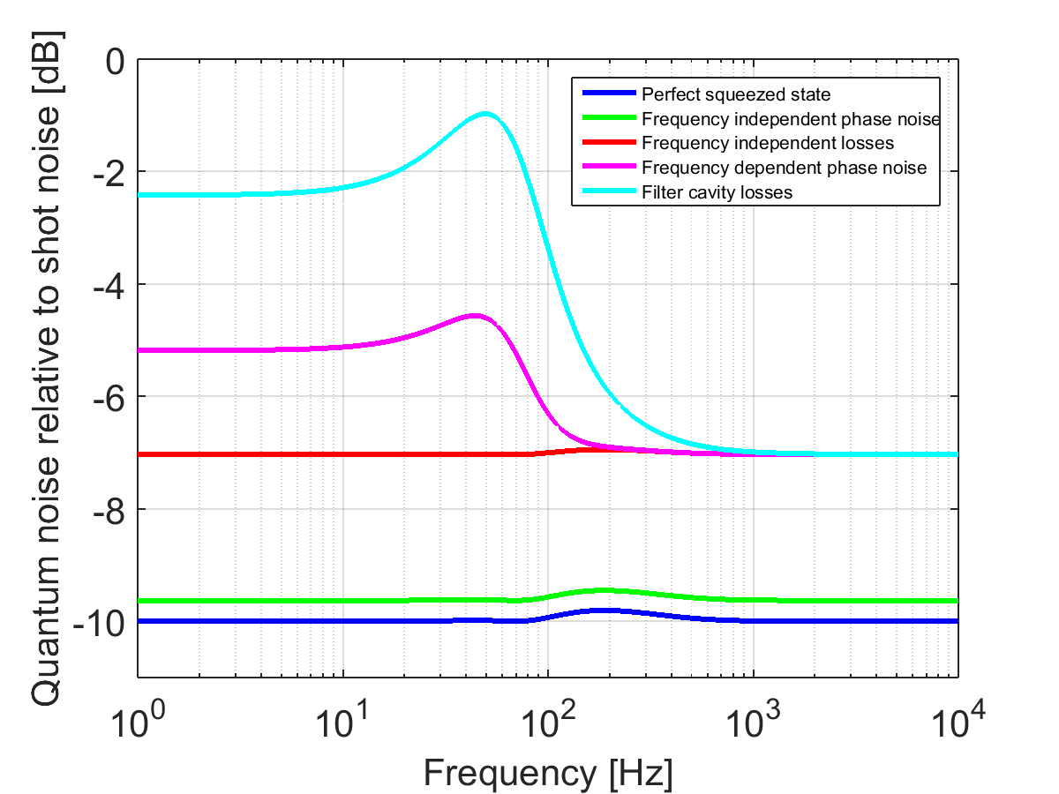
Frequency dependent loss: 16m cavity, 16ppm loss
A big contributor to degrade squeezing in low frequency, where the light couples into the filter cavity
The peak @ 1.2kHz corresponds to the resonance of the filer cavity

Slide 15
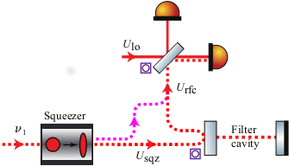
Mode Mismatch
Squeezed light that does not couple into the filter cavity contaminates our squeezing by mixing anti-squeezing
This modifies our noise spectrum in a frequency dependent way
Good mode matching into the filter cavity is essential
Notes:
Remake the figure to include ifo, OMC etc?

Slide 16
Mode Mismatch:
From constraints that can easily be measured experimentally, we cannot completely specify the spectrum, and we get some range.

Slide 17
aLIGO with filter cavity:
2 dB @ low freq, 6dB @ high freq
Parameter | Value
Filter cavity length | 16 m
Filter cavity loss | 16 ppm
Frequency- independent loss | 10 %
Mode-mismatch (Squeezer – Filter cavity) | 2 %
Mode-mismatch (Squeezer – Local oscillator) | 5 %
Frequency-independent phase noise (RMS) | 30 mrad
Filter cavity length noise (RMS) | 0.3 pm
Injected squeezing | 10 dB
List parameters

Slide 18
With a realistic filter cavity, the binary neutron star range is ~236Mpc.
Figure Credit: John Miller
Notes:
Check the number

Slide 19
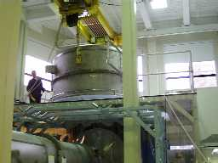
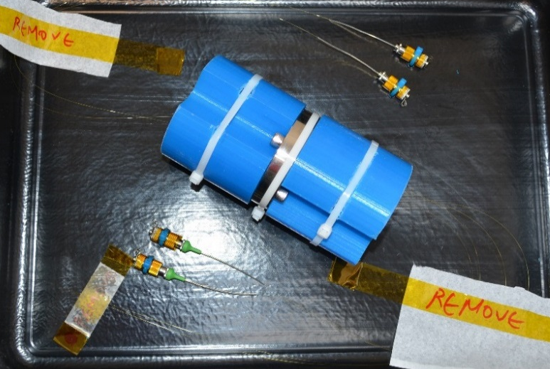
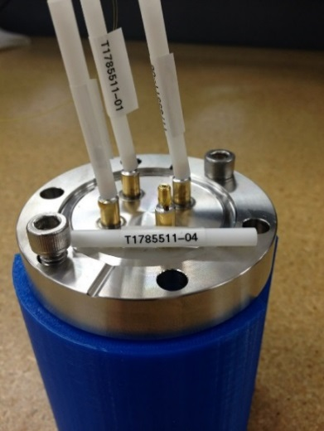
Getting ready for aLIGO installation
Prototyping the in-vacuum OPO
  Fiber coupling the pump and control fields
  testing aLIGO squeezer control scheme
Prototyping a full scale Filter Cavity
  16 meter filter cavity @ LASTI
  Suspended optics
  Combining with the in-vacuum OPO
PM Prototype

Slide 20
Can we achieve 10dB of squeezing at low frequency?

Slide 21
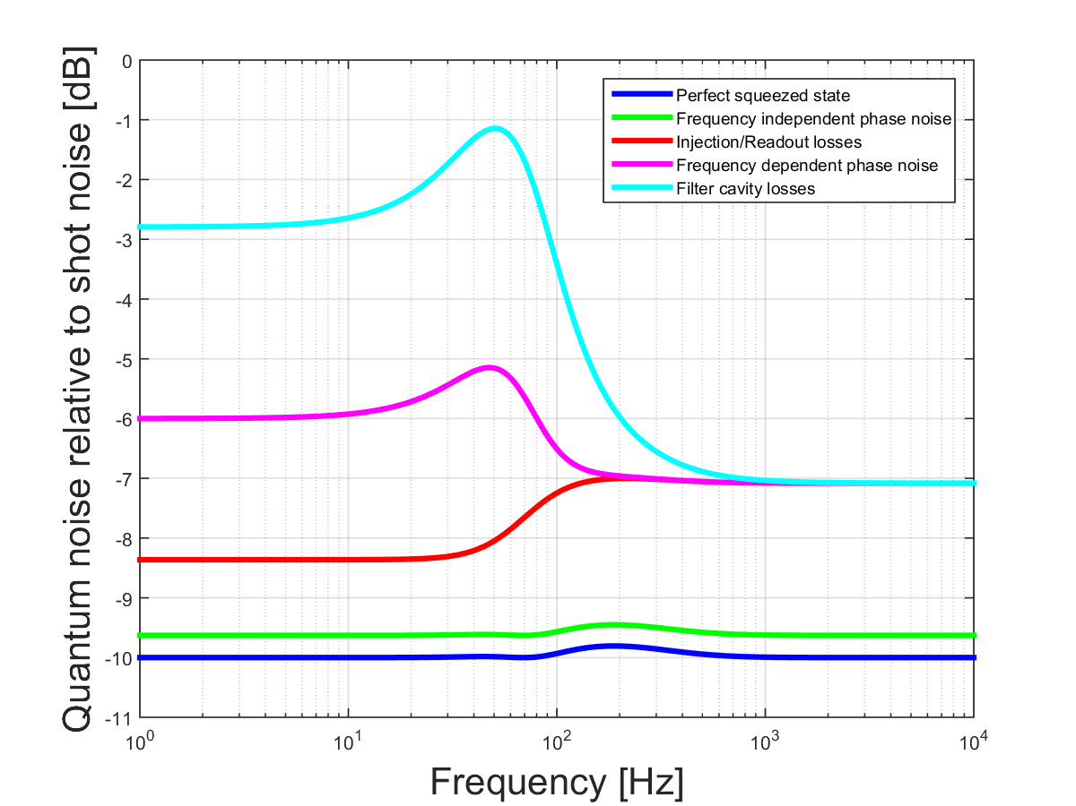
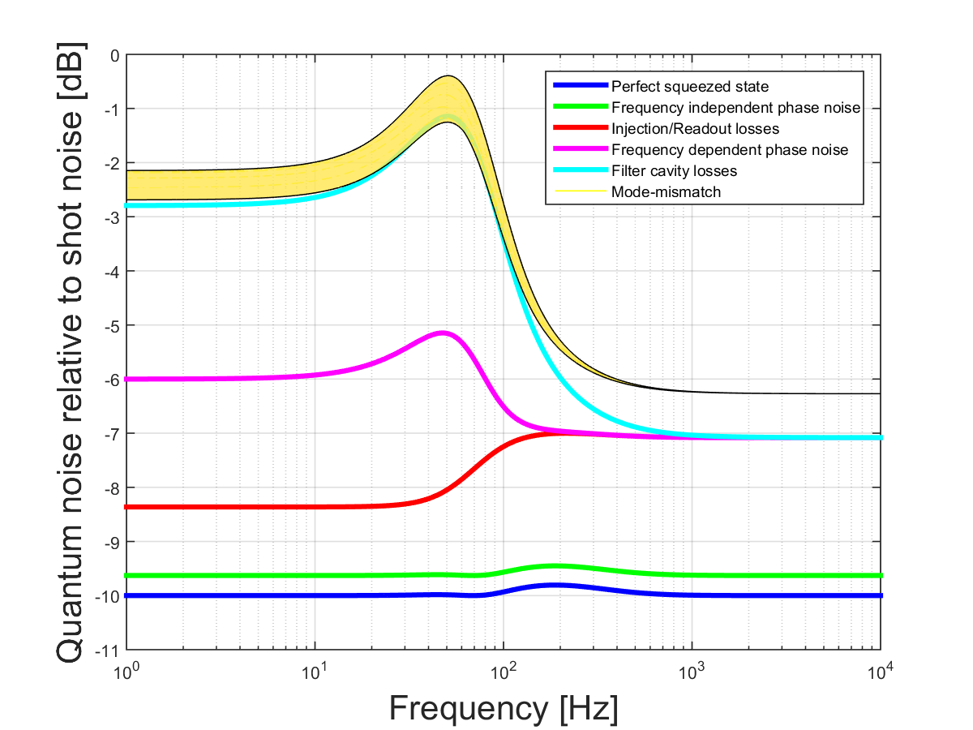
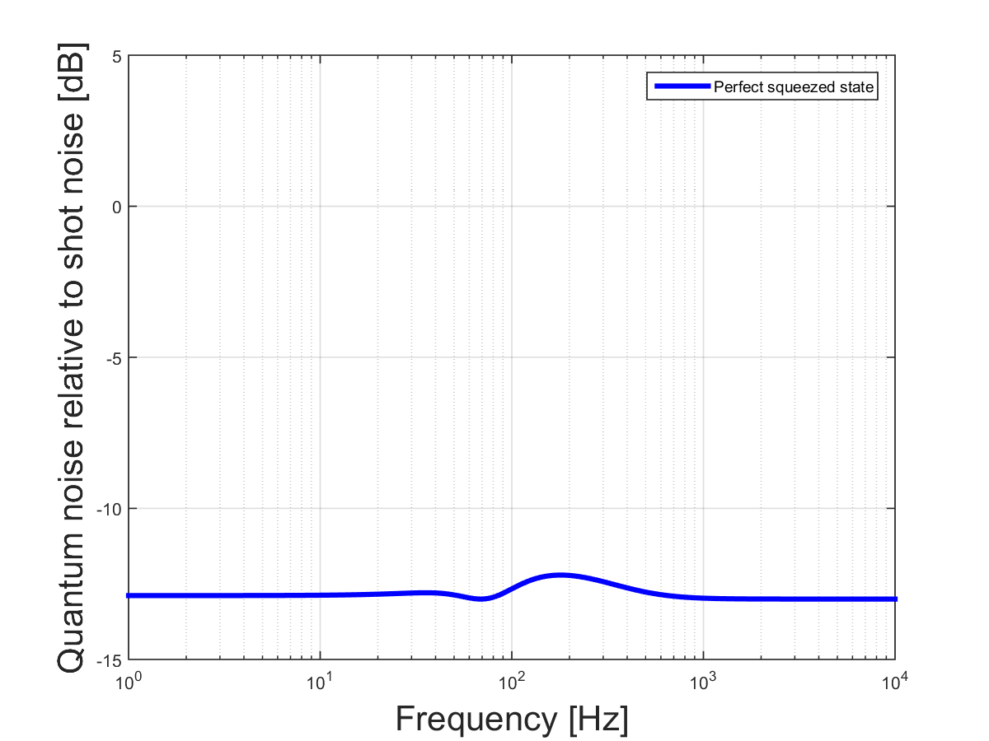
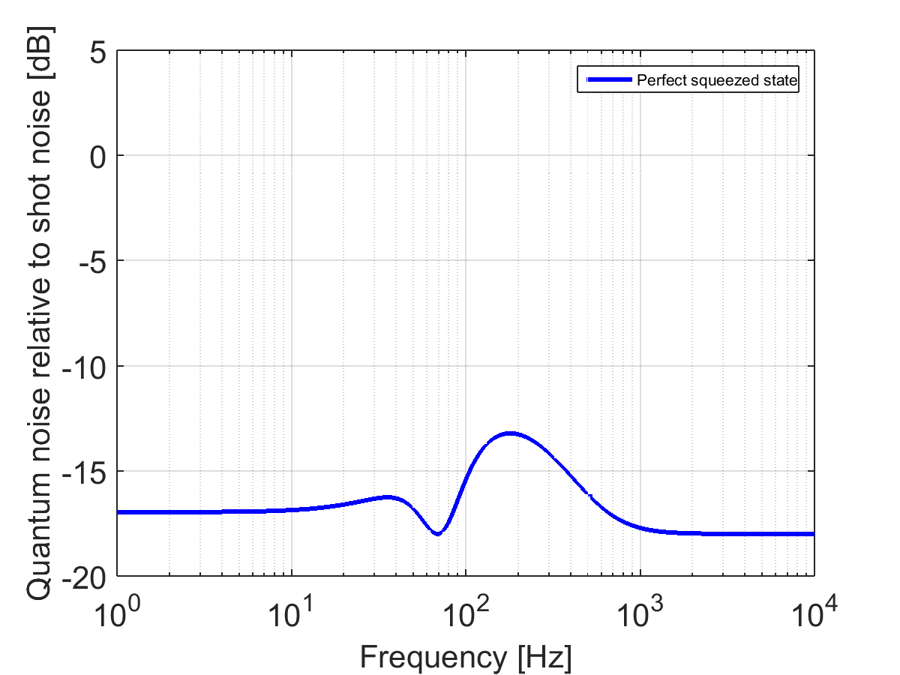
18dB of injected squeezing
Again, injecting more squeezing is not always better because of anti-squeezing coupling
Notes:
Trade off at frequency

Slide 22
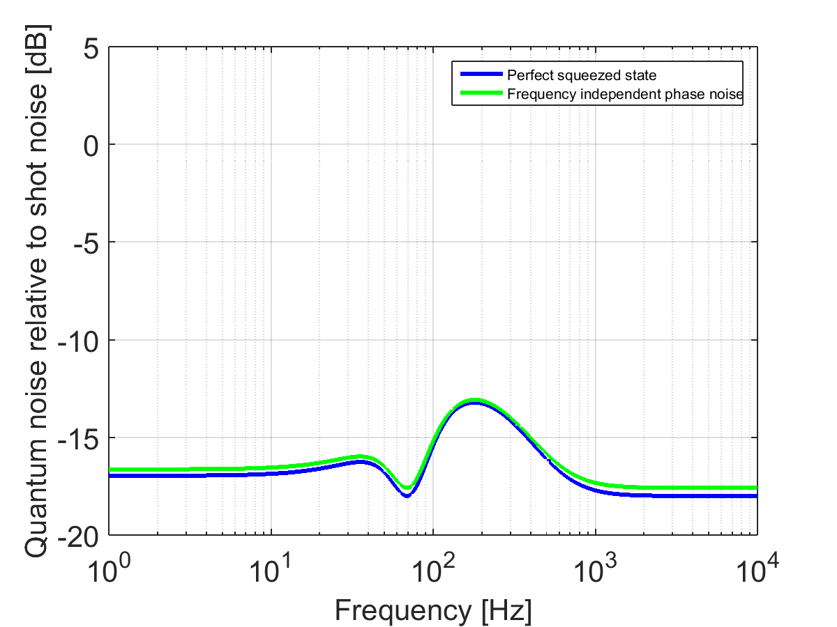
Frequency independent phase noise: 5 mrad
30 mrad -> 5 mrad
May not be too crazy
Not a big contributor to degrade squeezing (at this squeezing level)

Slide 23
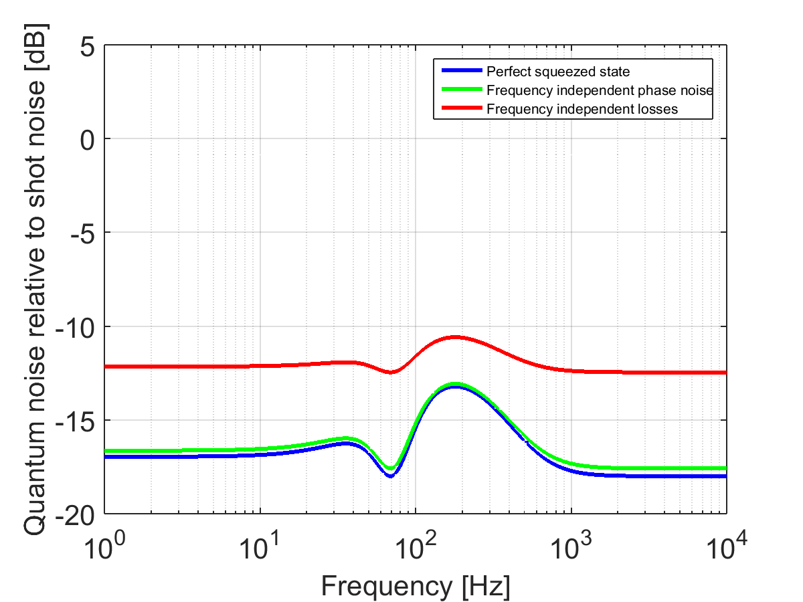
Frequency independent loss: 4% total
10% -> 4%
Very challenging
Notes:
In the middle, not affected as much by the phase noise?

Slide 24
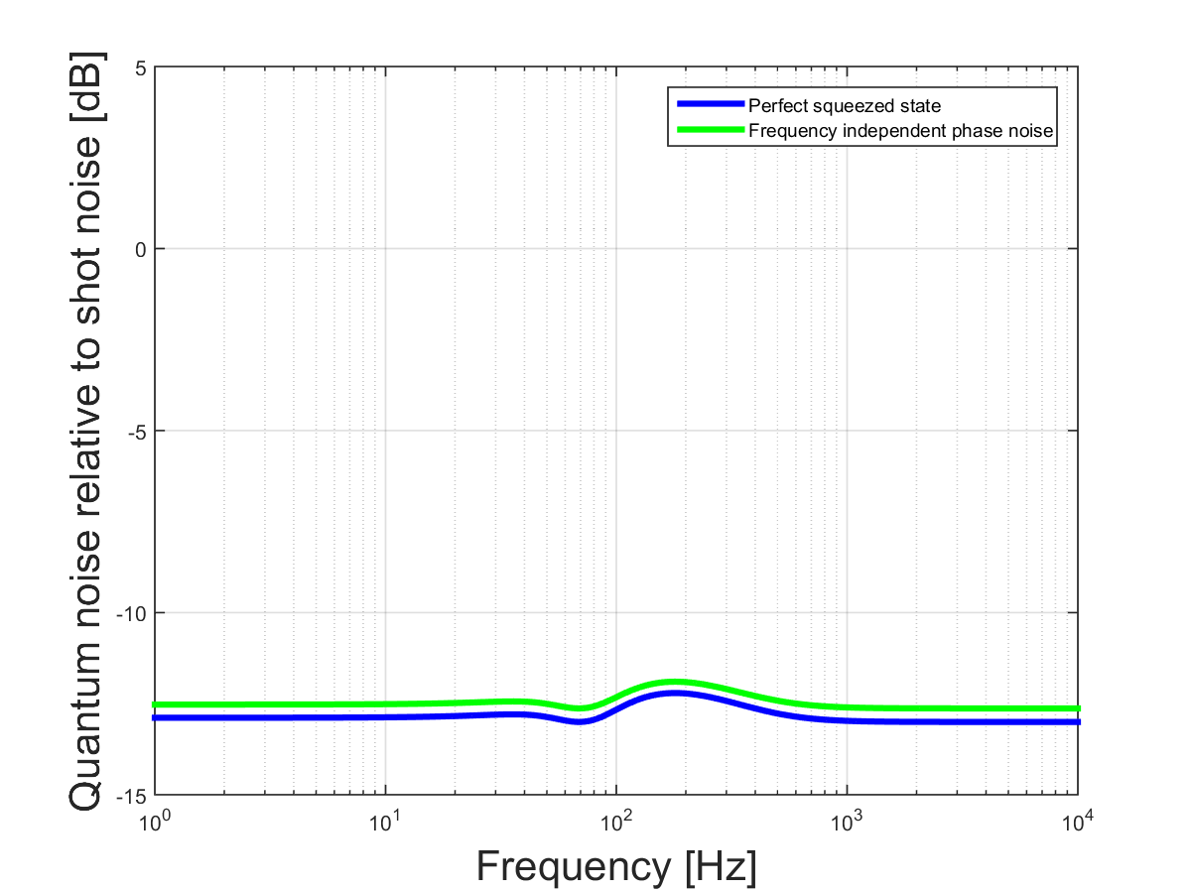
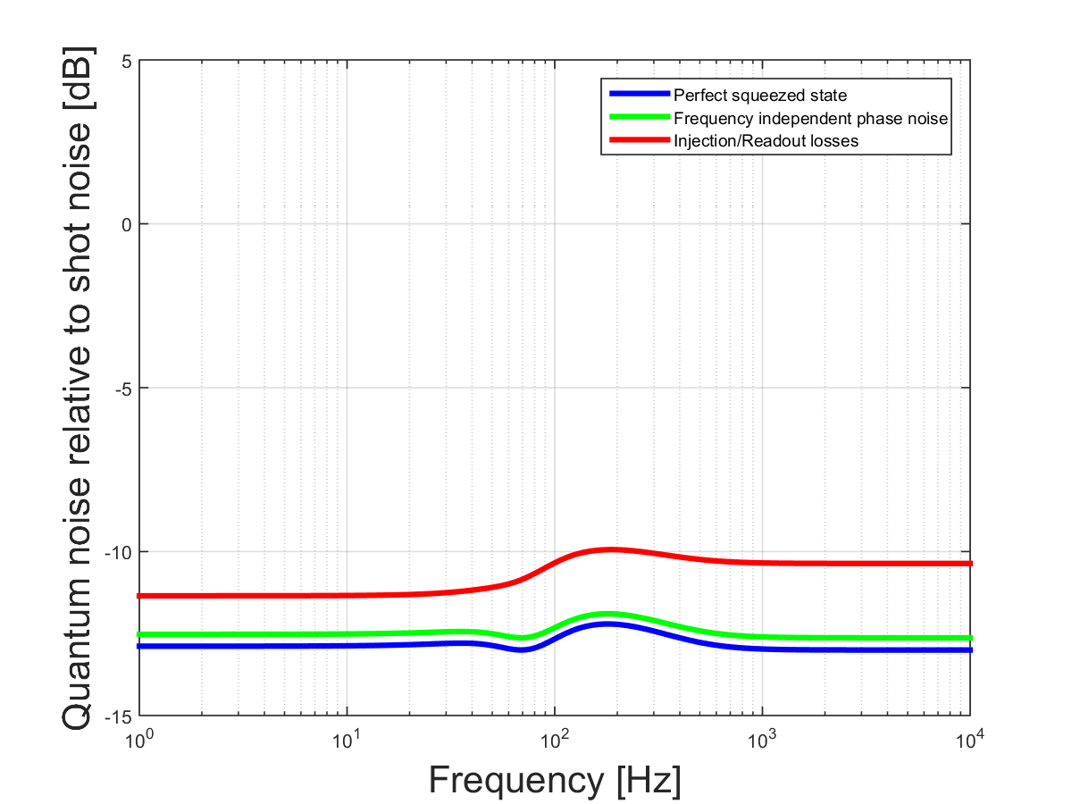
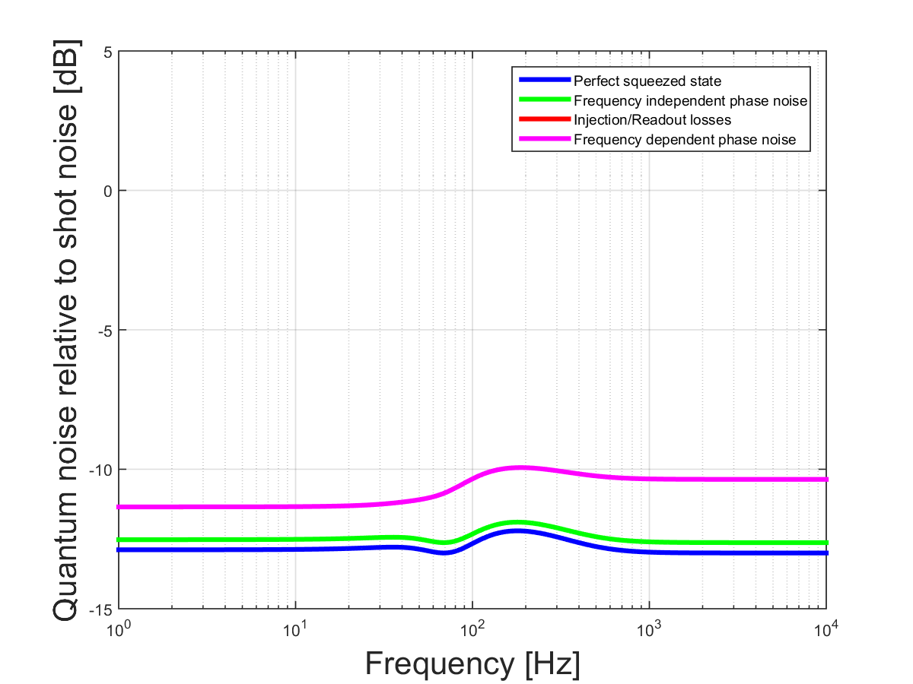
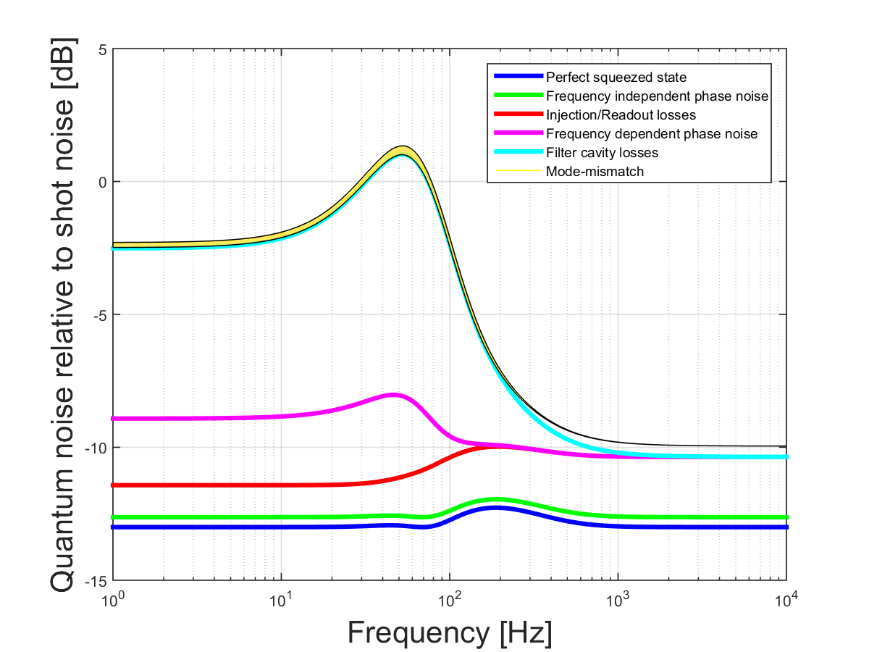
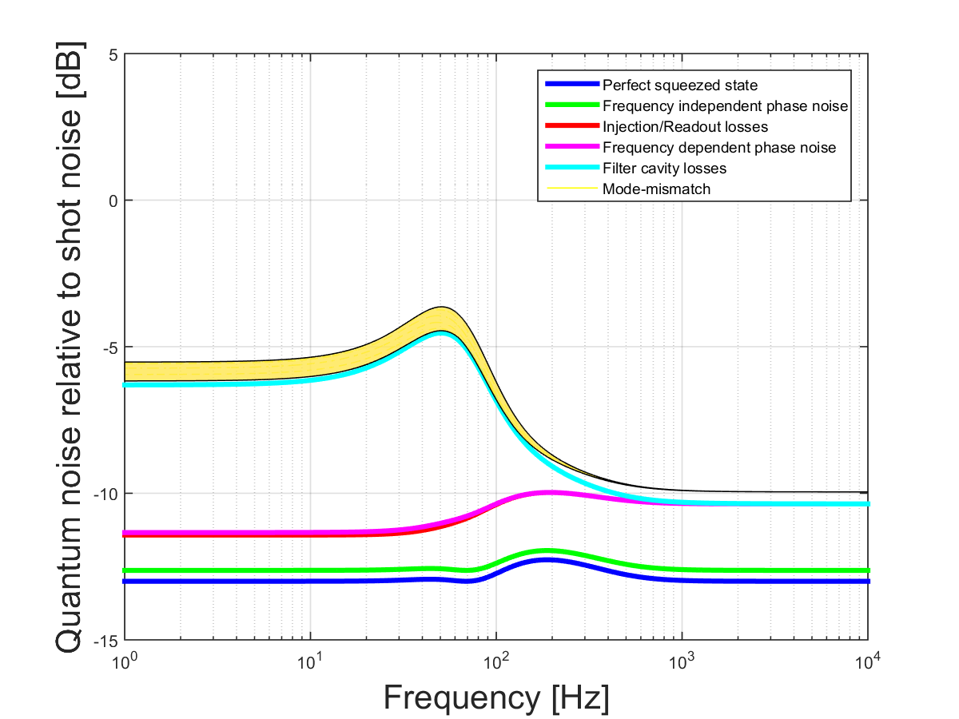
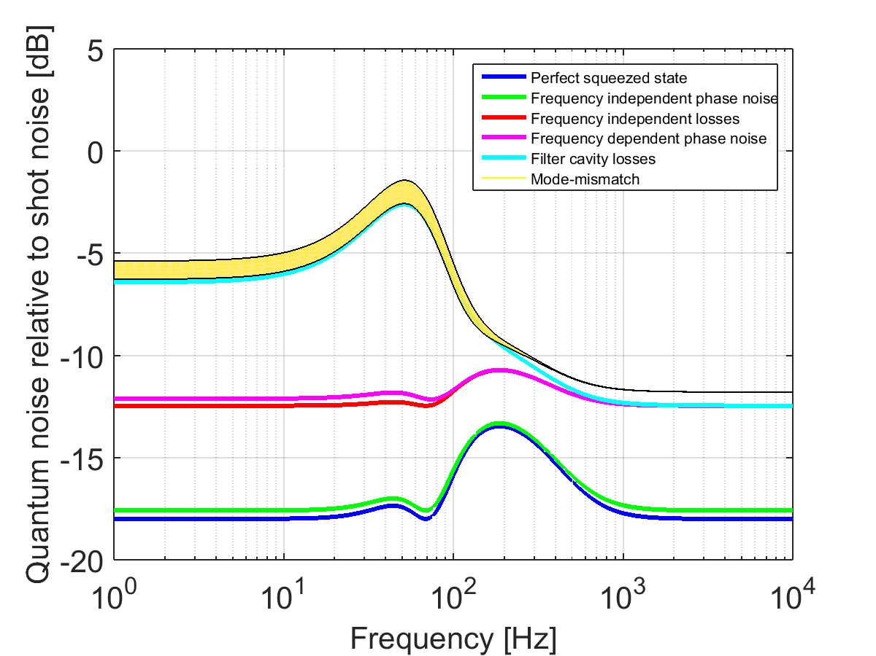
100m Filter Cavity: 5 ~ 6 dB @ low freq
Cavity length noise
  0.3pm -> 0.15 pm
Mode Mismatch
  2% -> 1% (Sqz – FC)
  5% -> 1% (Sqz – LO)
Filter cavity loss
  40 ppm

Slide 25
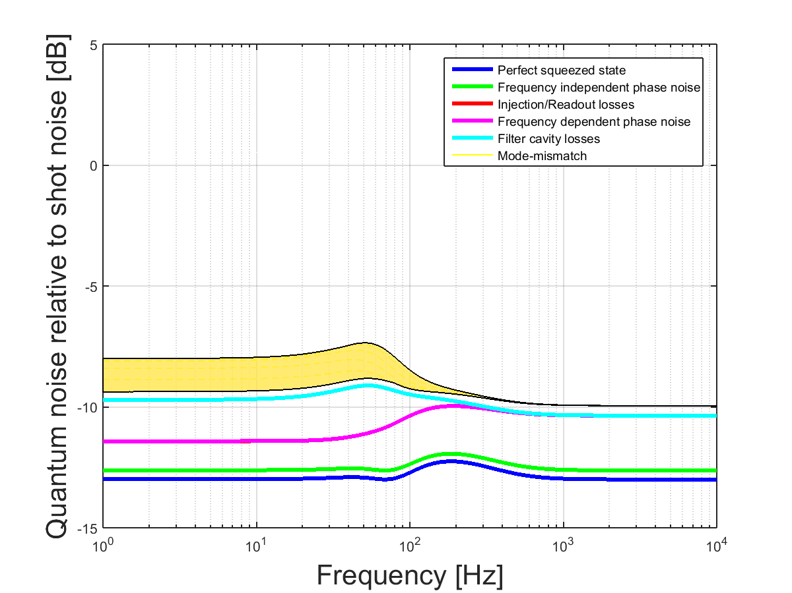
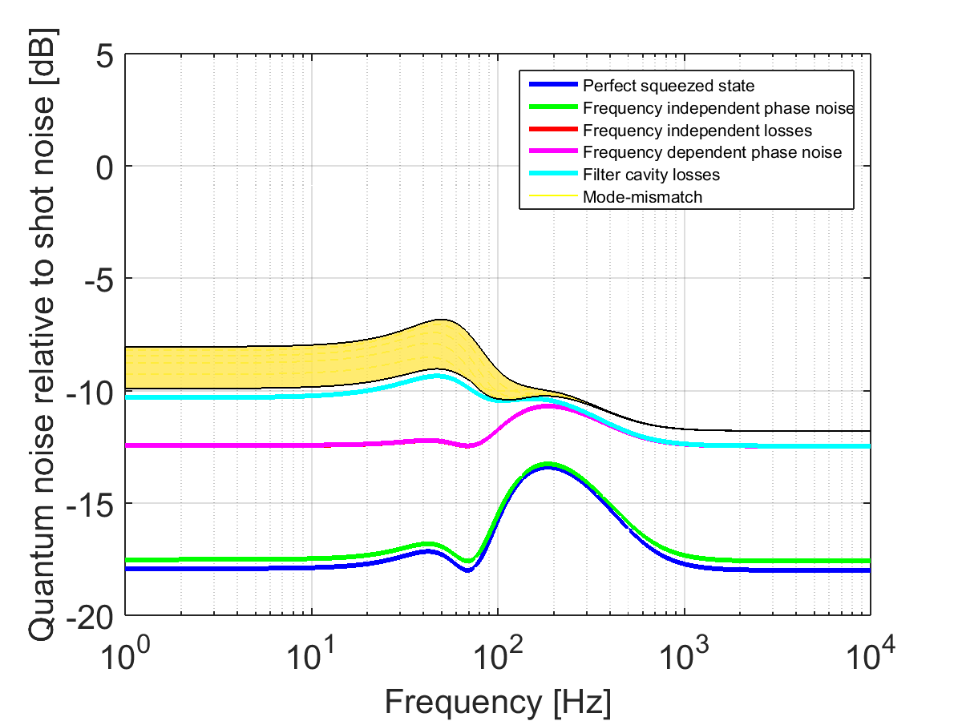
1km Filter Cavity: 8 ~ 10 dB
Cavity length noise
  0.3pm -> 0.15 pm
Mode Mismatch
  2% -> 1% (Sqz – FC)
  5% -> 1% (Sqz – LO)
Filter cavity loss
  80 ppm
Suggested in Lungo (40km interferometer)

Slide 26
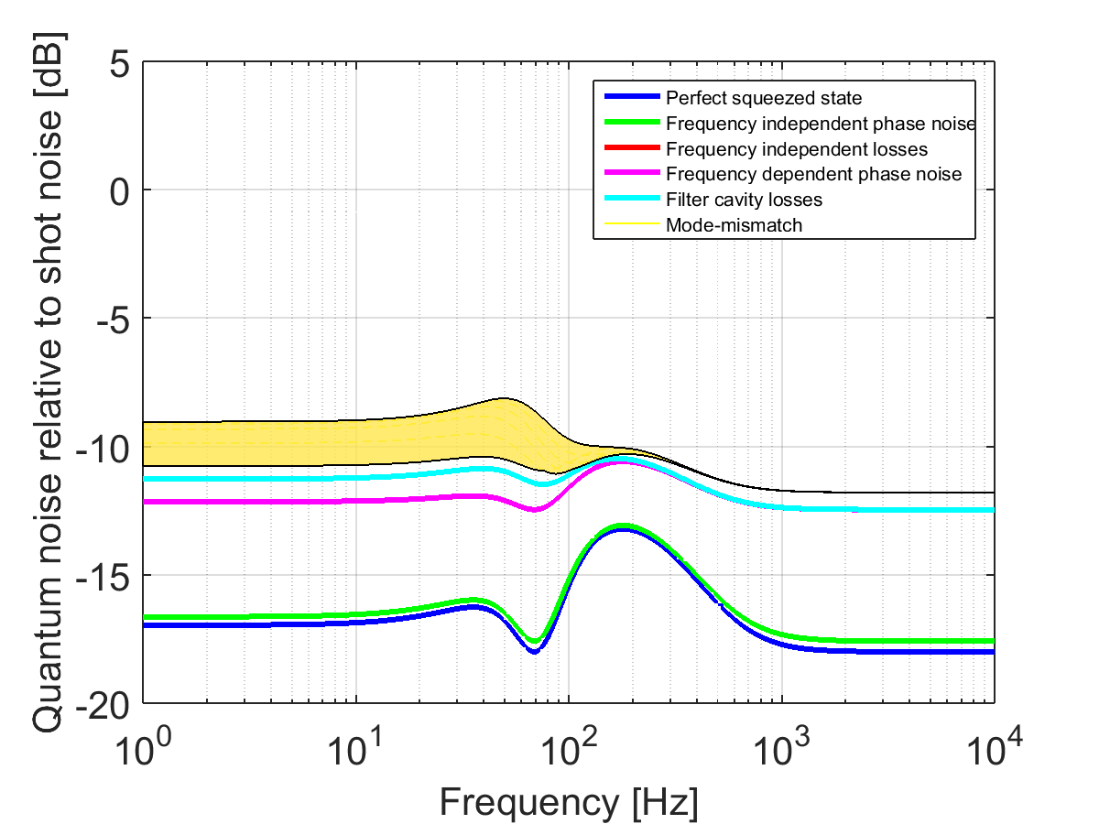
4km Filter Cavity: 9 ~ 11 dB @ low freq
Cavity length noise
  0.3pm -> 0.15 pm
Mode Mismatch
  2% -> 1% (Sqz – FC)
  5% -> 1% (Sqz – LO)
Filter cavity loss
  120 ppm

Slide 27

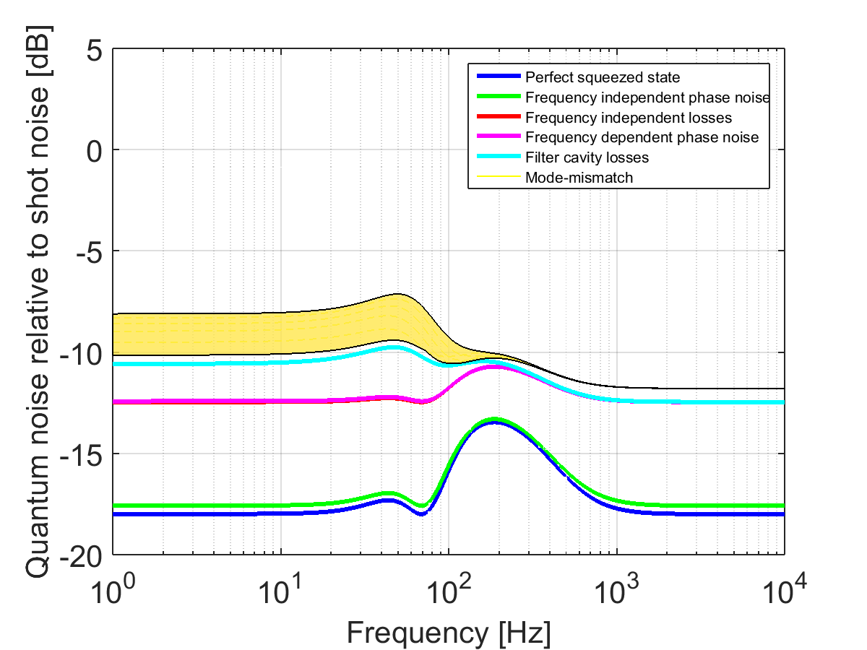
1560nm wavelength: 300m length
“LIGO III Blue Paper” (LIGO-T1400226) discusses changing the wavelength
For a few mm spot size, the “golden rule” might apply:
20 ppm loss is assumed
Notes:
Check if 4km really works

Slide 28
Parameter Summary: getting to 10dB is challenging!
Parameter | Value
Filter cavity length | 16 m
Filter cavity loss | 16 ppm
Frequency- independent loss | 10 %
Mode-mismatch (Squeezer – Filter cavity) | 2 %
Mode-mismatch (Squeezer – Local oscillator) | 5 %
Frequency-independent phase noise (RMS) | 30 mrad
Filter cavity length noise (RMS) | 0.3 pm
Injected squeezing | 10 dB
Parameter | Value
Filter cavity length | 4 km
Filter cavity loss | 120 ppm
Frequency- independent loss | 4 %
Mode-mismatch (Squeezer – Filter cavity) | 1 %
Mode-mismatch (Squeezer – Local oscillator) | 1 %
Frequency-independent phase noise (RMS) | 5 mrad
Filter cavity length noise (RMS) | 0.15 pm
Injected squeezing | 18 dB
Toward 10dB

Slide 29
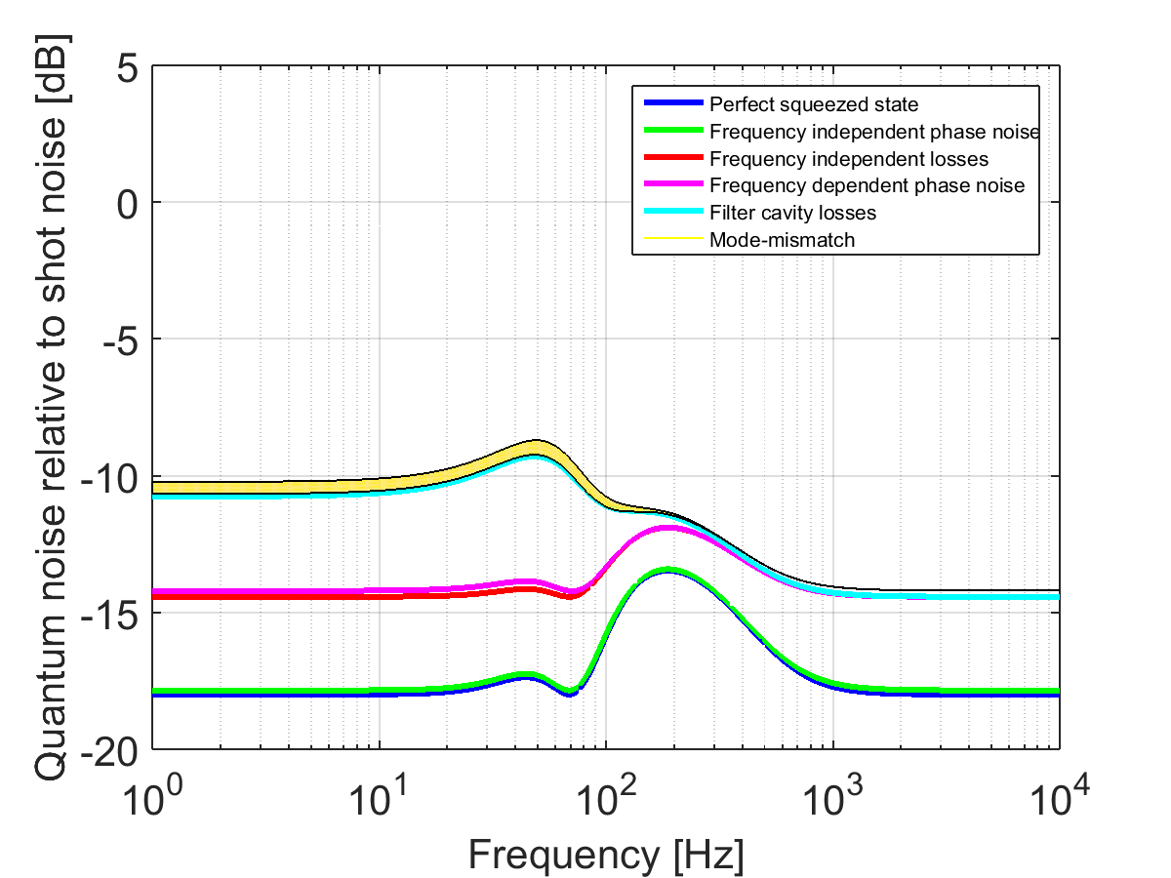
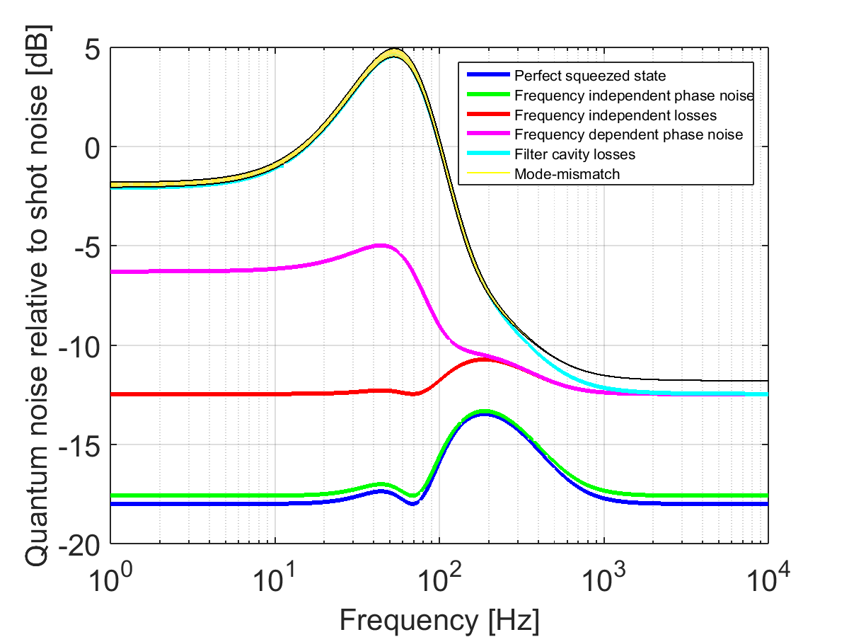
16m Filter Cavity:
Parameter | Value
Filter cavity length | 16 m
Filter cavity loss | 16 ppm
Frequency- independent loss | 4 %
Mode-mismatch (Squeezer – Filter cavity) | 1 %
Mode-mismatch (Squeezer – Local oscillator) | 1 %
Frequency-independent phase noise (RMS) | 5 mrad
Filter cavity length noise (RMS) | 0.15 pm
Injected squeezing | 18 dB

Slide 30
16m Filter Cavity:
Parameter | Value
Filter cavity length | 16 m
Filter cavity loss | 1.6 ppm
Frequency- independent loss | 2 %
Mode-mismatch (Squeezer – Filter cavity) | 0.2 %
Mode-mismatch (Squeezer – Local oscillator) | 0.2 %
Frequency-independent phase noise (RMS) | 3 mrad
Filter cavity length noise (RMS) | 0.015 pm
Injected squeezing | 18 dB

Slide 31
Summary
Squeezing with an input filtering looks promising and can be an upgrade option for aLIGO
To get a 10 dB of squeezing, loss and phase noise need to be controlled very well.
For low frequency squeezing, lowering cavity roundtrip loss is crucial, and unless there is a technology advancement to reduce mirror’s scattering loss, we need a km scale filter cavity to reach 10 dB squeezing

Slide 32
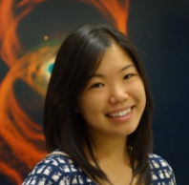
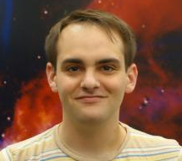


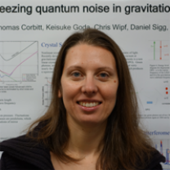

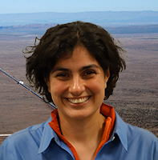

Filter Cavity Team @ MIT
Maggie Tse
Eric Oelker
Patrick Kwee
John Miller
Lisa Barsotti
Matthew Evans
Nergis Mavalvala
Peter Fritschel

Slide 34
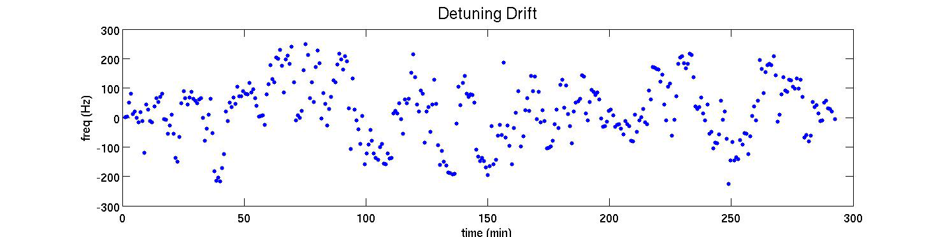
Other things to watch out for
Need to control the filter cavity detuning
  Observed a quite large drift during the filter cavity experiment at MIT
Other noise sources we did not account for?
  E.g. as we go to a higher finesse
Balanced homodyne readout?

Slide 35
aLIGO with filter cavity:
2.5 dB @ low, 6dB at high
Figure Credit: John Miller
Notes:
Match up the color or erase this slide

Slide 36
Modeling: what we still needs
Loss extrapolation
Mode mathing
IFO loss consideration
Notes:
Too many degeneracy

Slide 37
Modeling: where we are
 | Filter Cavity | Power / Signal Recycling | IFO Loss | SQZ Propagation Loss | Phase Noise | Cavity Loss | Cavity Length Noise | Mode Matching | Note
KLMTV | Yes | No
BC | No | Yes | Yes
Jan's | Yes | No PR
Realistic Filter Cavity' | Yes | Only tuned SR case |  |  |  |  |  |  | Input transmission values are set incorrectly
D&D | Yes | Only tuned SR case | No | Yes | Yes | Yes | Yes | Yes but has some errors

