Slide 1
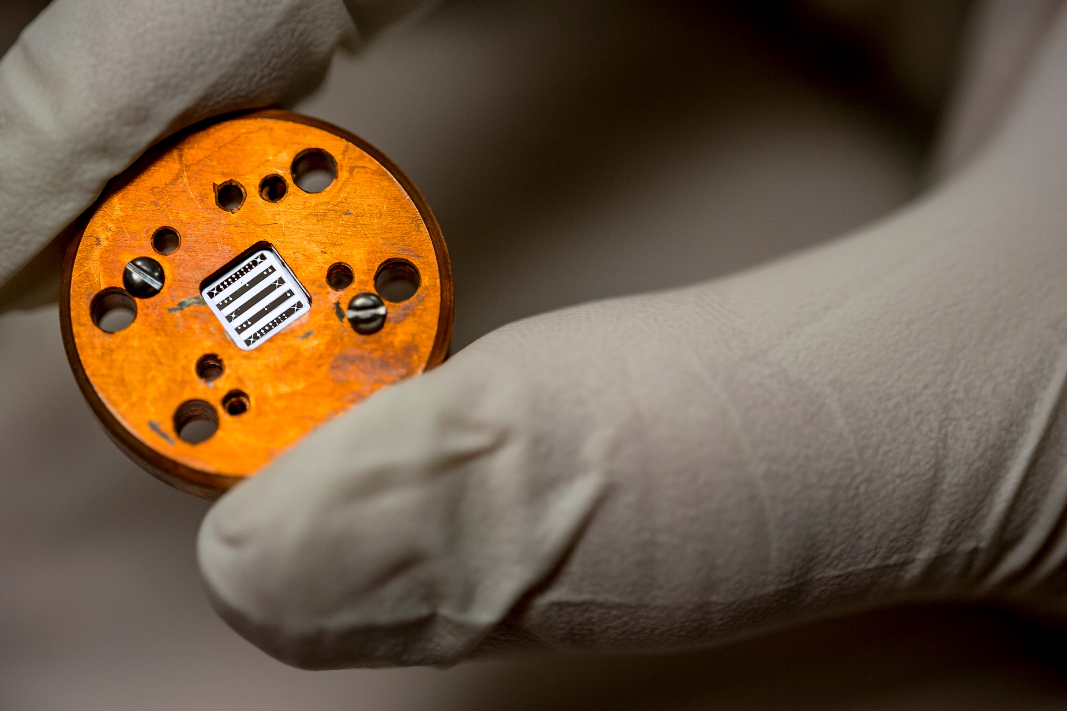
Ponderomotive Squeezing & Opto-mechanics
Adam Libson and Thomas Corbitt
GWADW 2015
G1500733

Slide 2
Outline
Intro to ponderomotive squeezing & opto-mechanics
State of the field
Our approach
Is any of this be useful for A+, Voyager, Lungo, etc?

Slide 3
Two pieces
Opto-mechanics
Essentially feedback between optical field and mechanical motion.
Optical spring, optical damping, parametric instability, angular instability.
Well understood and experimentally demonstrated.
Classical in nature, but changes behavior of quantum noise.
Quantum noise
Shot & radiation pressure noise, topologies, injection of squeezed light, production of squeezed light (ponderomotive).
Well understood (we think), but apart from injection of squeezed light, not experimentally demonstrated.

Slide 4
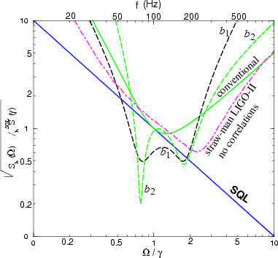
The forgotten resonance
Optical noise correlations and beating the standard quantum limit in advanced gravitational-wave detectors
Alessandra Buonanno and Yanbei Chen 2001 Class. Quantum Grav. 18 L95. (2001)
Sensitivity improvement from optical spring more robust against optical loss because it amplifies signal.

Slide 5
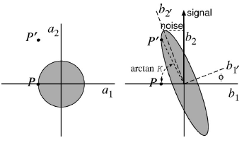
Ponderomotive Squeezing
Amplitude fluctuations of incoming light cause fluctuations in position of cavity end mirror
Causes cavity length to change
Causes phase of reflected light to change
Amplitude fluctuations correlated to phase fluctuations
Generates squeezed state
If phase is rotated back to amplitude (detuned cavity, higher order optical modes), optical spring or parametric instability can form.
Notes:
Low noise Kerr nonlinear medium. δX2→δX2+r*δX2
LIGO measures b2 bc operate slightly off dark fringe. Signal in b2
Ours has signal in both quadratures

Slide 6
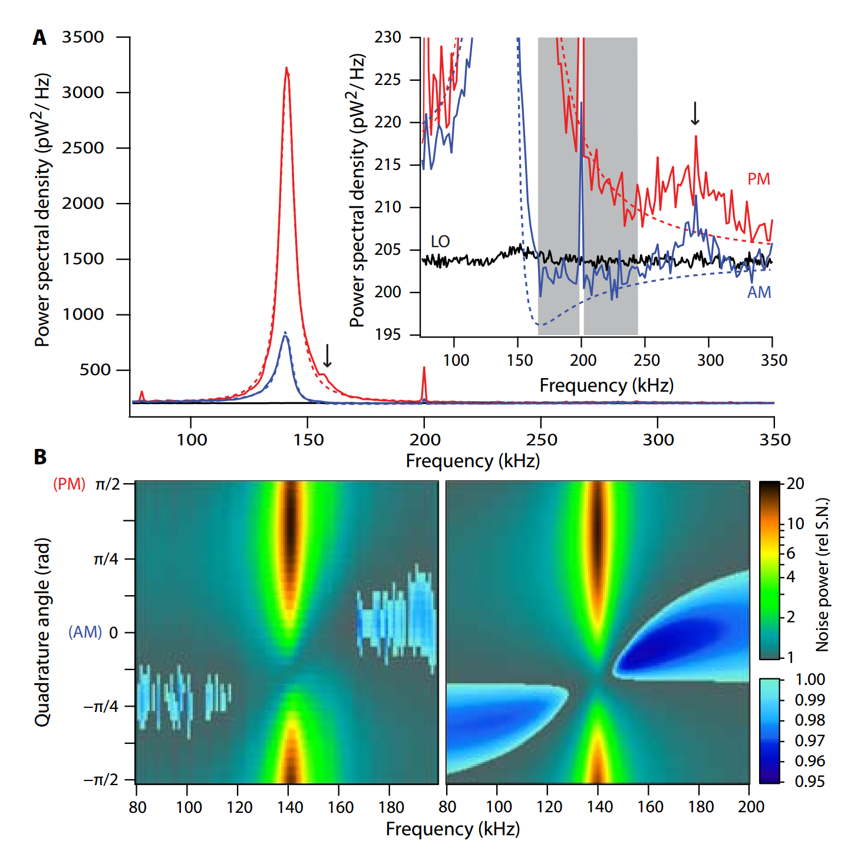
Squeezing with atoms
Here we implement such a system, in which quantum photon-number fluctuations significantly drive the center of mass of an atomic ensemble inside a Fabry-Perot cavity. We observe sub-shot-noise ponderomotive squeezing of quantum fluctuations and also demonstrate that classical optical fluctuations can be attenuated by 26 dB or amplified by 20 dB with a weak input pump power of < 40 pW.
Non-classical light generated by quantum-noise-driven cavity optomechanics, D. Brooks et al, Nature 488, 476-480 (2012).
Stamper-Kurn group.

Slide 7
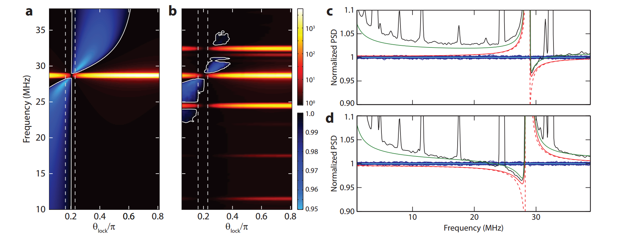
Squeezing with silicon microchip
In spite of the mechanical resonator’s highly excited thermal state (10, 000 phonons), we observe squeezing at the level of 4.5 ± 0.5% below that of shot-noise over a few MHz bandwidth around the mechanical resonance frequency of 28 MHz. This squeezing is interpreted as an unambiguous quantum signature of radiation pressure shot-noise.
Squeezed light from a silicon micromechanical resonator, A. Safavi-Naeini et al, Nature 500, 185-189 (2013).
Painter group.

Slide 8
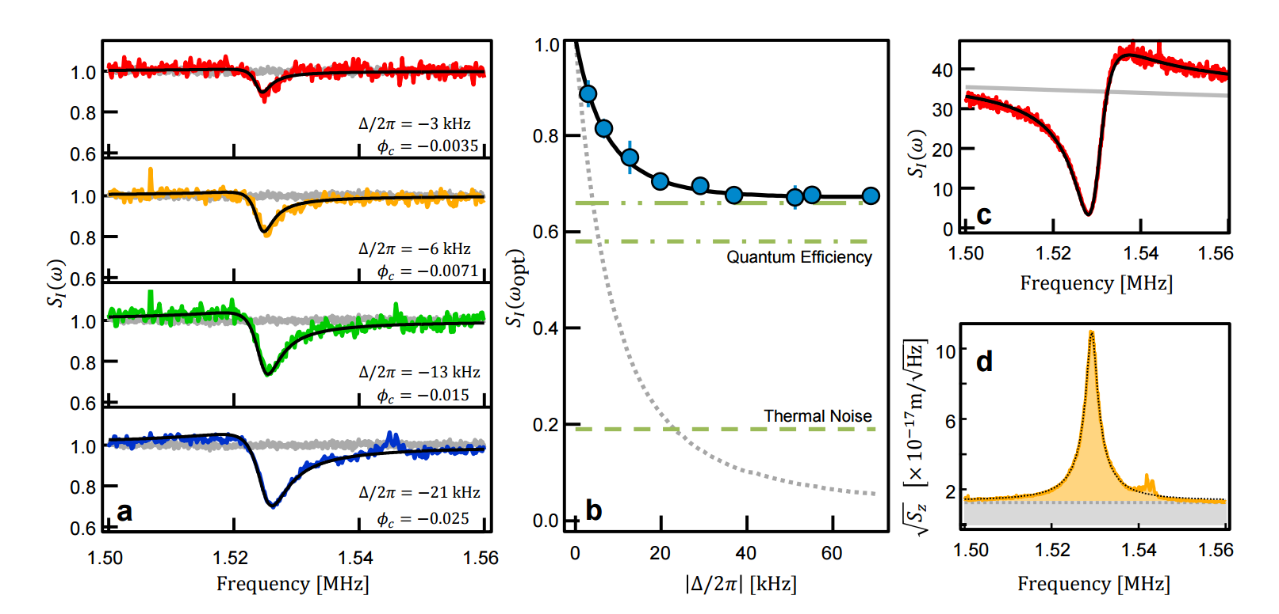
Squeezing with silicon nitride membrane
We experimentally demonstrate strong and continuous optomechanical squeezing of 1.7 ± 0.2 dB below the shot noise level.
Strong Optomechanical Squeezing of Light, T. Purdy et al, Phys. Rev. X 3 031012 (2013).
Regal group.

Slide 9
Discussion of prior results
Impressive and important results (demonstrates that ponderomotive squeezing is real). Fundamental physics is identical to our interferometers.
…but:
Squeezing is small (<2 dB) in a narrow band around a mechanical resonance (150 kHz, 25 MHz, 1.5 MHz).
From either crystal or ponderomotive squeezing, we would like 5-10dB in wide bandwidth from 10 Hz to 10 kHz.
Not an ideal prototype for testing ideas, as advanced detectors will generate broadband ponderomotive squeezing.

Slide 10
Prototype experiment for QRPN, opto-mechanics
Many possible choices, but generally:
Small mass for large radiation pressure interaction
High mechanical Q and low frequency resonances for low thermal noise
High optical quality
Generally speaking:
Creating a large opto-mechanical interaction is not too difficult (see numerous experiments showing optical spring, PI), but:
Making the quantum noise larger from the thermal noise is usually the hard part.

Slide 11
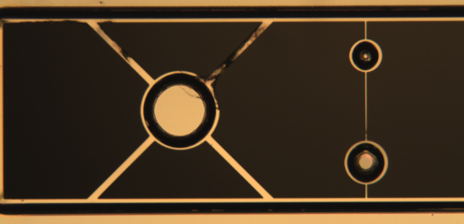
Experimental Setup
Optomechanical cavity
Mass of cantilever: 250 ng
Length: 100 µm
Thickness: 325 nm
Natural Frequency: 100 Hz-1 kHz (presently using 273 Hz)
Multilayer AlGaAs/GaAs (~40 layer pairs) processed into mirror padsand cantilevers
$$≈5 mm$$
$$≈100 µm$$
Notes:
Thermal noise of input mirror is small bc it is larger.
Q cantilever =10,000
GaAs (Galium Aresinide), AlGaAs, InGaAs (Indium)
EOM amp modulator. Change refractive index with E field
Locking. Modulation creates sidebands. Beat between carrier and sidebands gives error signal

Slide 12
Cryogenic Optomechnical Cavity
Piezo mounted Input coupler
1 cm long
Cavity Finesse: ~60,000
Circulating Power: ~500 mW
High Optical Spring: (up to) 200 kHz
Cantilever Chip mount, 16 K
Agilis Mount, 293 K
Cold finger
G10 Rods
Notes:
Optical spring: intracavity power changes linearly for small displacements

Slide 13
Cryogenic Operation
273 Hz cantilever
Measured noise matches model at room temperature
Measured noise below modeled RPN from ~ 3 kHz-20 kHz

Slide 14
Ponderomotive Squeezing
Detuning (linewidths) | Readout Angle (rad) | Squeezing (dB)
3 | -0.51 | 1.70
2 | -0.42 | 2.07
1.5 | -0.34 | 2.29
1 | -0.25 | 2.50
0.5 | -0.13 | 2.67
Notes:
Higher sqz more effected by deviation from readout. Sharper peak.
Second field would create mirror motion that would be and extra noise term. Would have to add in where we add thermal noise.
Create entanglement of two fields.
Decreasing detuning increases opt spring freq.
Measure only SN at 0 readout
Input power = 0.1 mW
Different optimal angle at each frequency → variational (frequency dependent) readout
Linewidth δ=T1*c/(4L)

Slide 15
Pondromotive Squeezing (Continued)
Adam Libson

Slide 16
Thermal Noise Modeling
COMSOL used for finite element analysis
Full anisotropic model of crystal mechanical properties
Used to calculate coupling to the cavity laser
Susceptibility and thermal noise calculated using Sum-Of-Modes Technique

Slide 17
Thermo-Elastic Damping
Coefficient of thermal expansion leads to heat flow and losses when the cantilever flexes
Particularly important for drum head modes of the mirror pad
These modes are the dominant source of thermal noise above 30 kHz

Slide 18
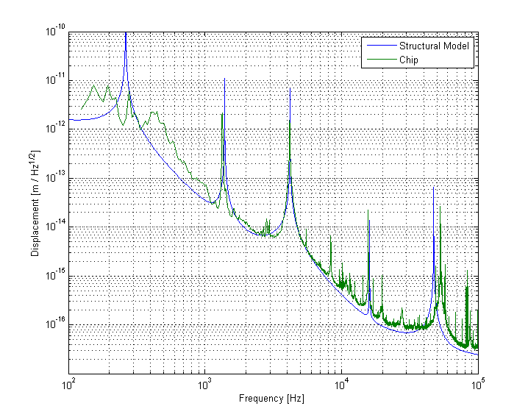
Damping Looks Structural

Slide 19
What do you need for a useful Squeezer on a Chip
Small Oscillators
Small Mode Volume / Short Cavity
Room Temperature Operation (quantum effects dominate thermal noise even for a room temperature thermal bath)

Slide 20
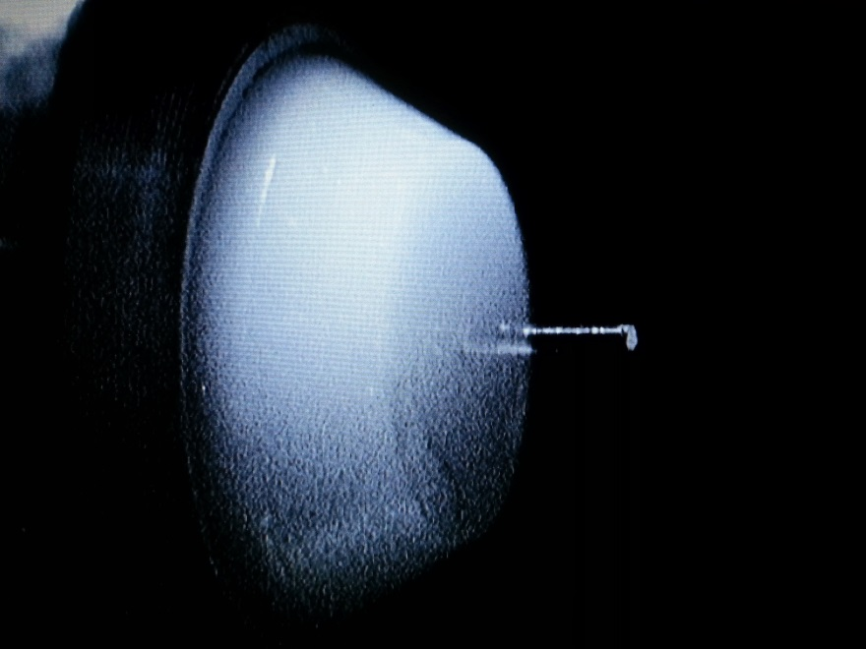
Fiber Coupled Cavity
Fiber mirror on one side of the cavity, flat mirror on the other
Allows a very short cavity with small mode volume
Simplified Coupling and Alignment
Uses standard single mode (or multimode) optical fiber

Slide 21
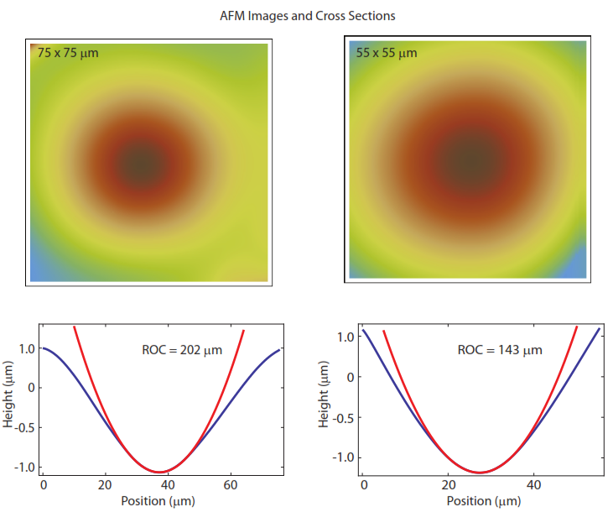
Fiber Mirrors
Mirrors formed by ablating a fiber tip with a CO₂ laser
Radius of curvature around 150-200 µm.
Resulting surface is effectively superpolished

Slide 22
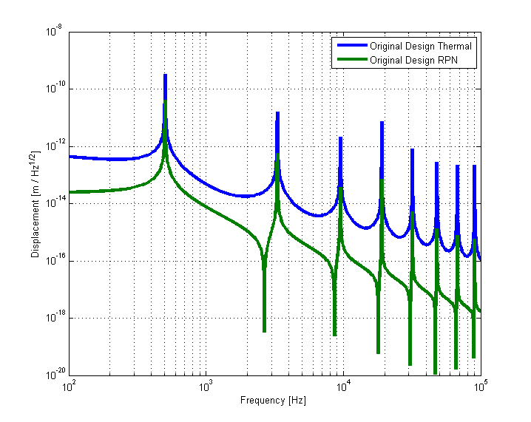
Towards Quantum Limited At Room Temperature

Slide 23
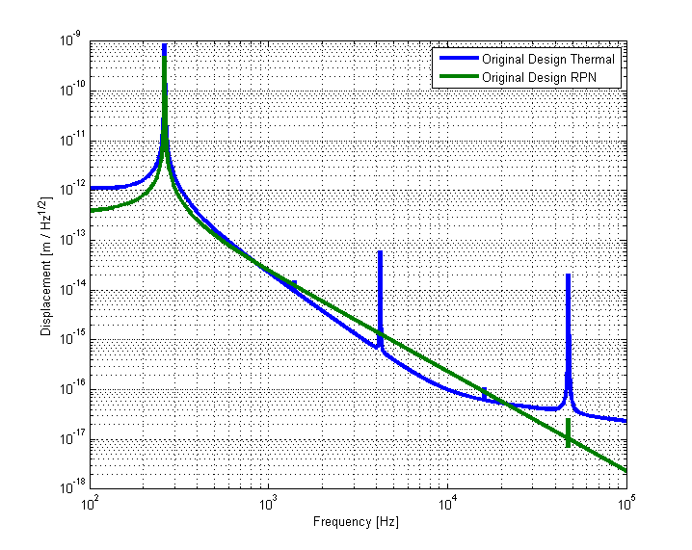
Towards Quantum Limited At Room Temperature

Slide 24
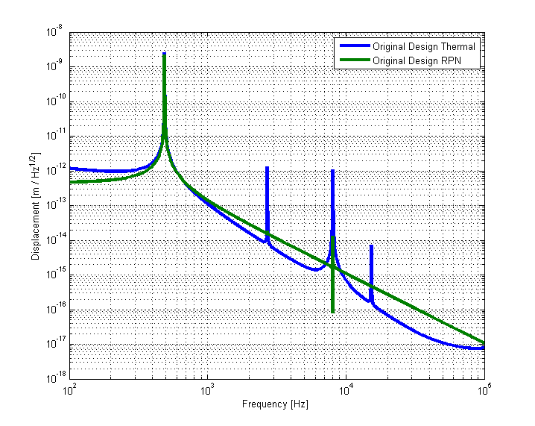
Towards Quantum Limited At Room Temperature

Slide 25
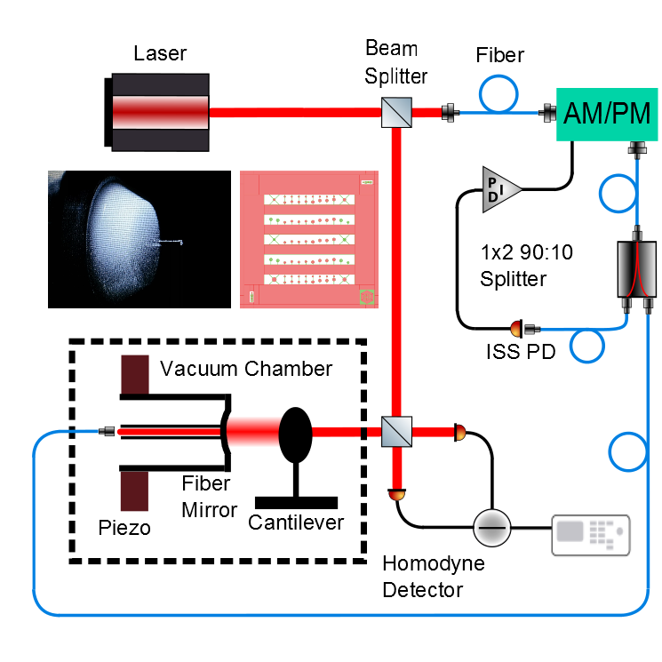
Towards a Squeezer on a Chip

Slide 26
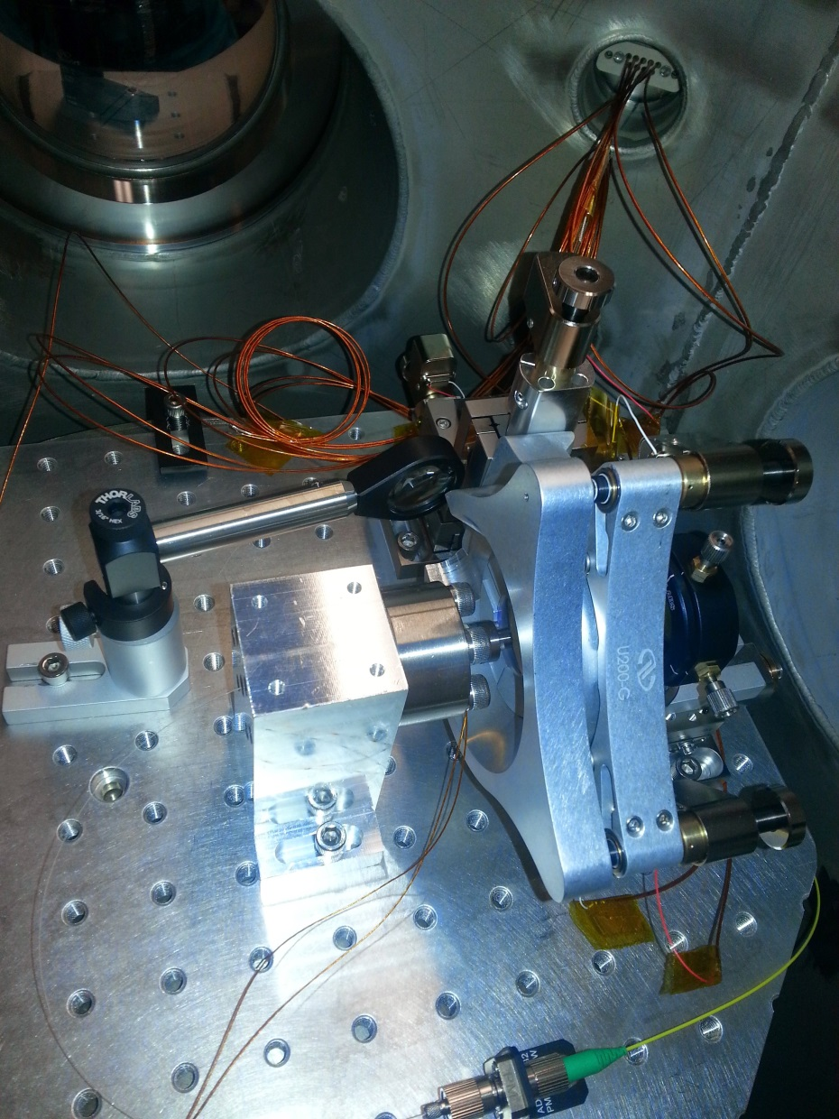
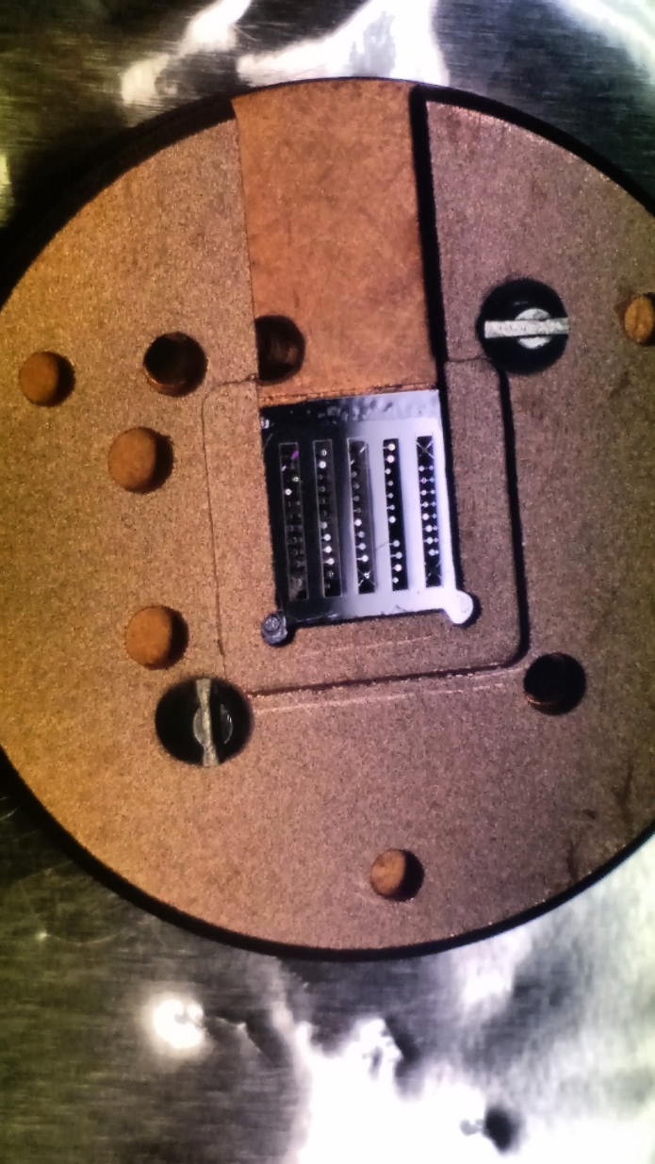
Setup in vacuum

Slide 27
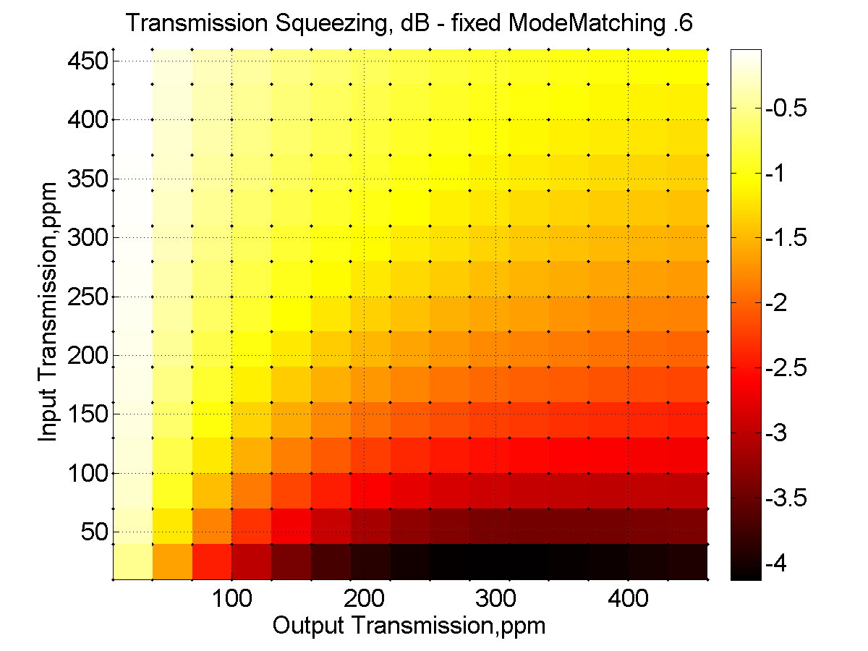
Importance of Escape Efficiency

Slide 28
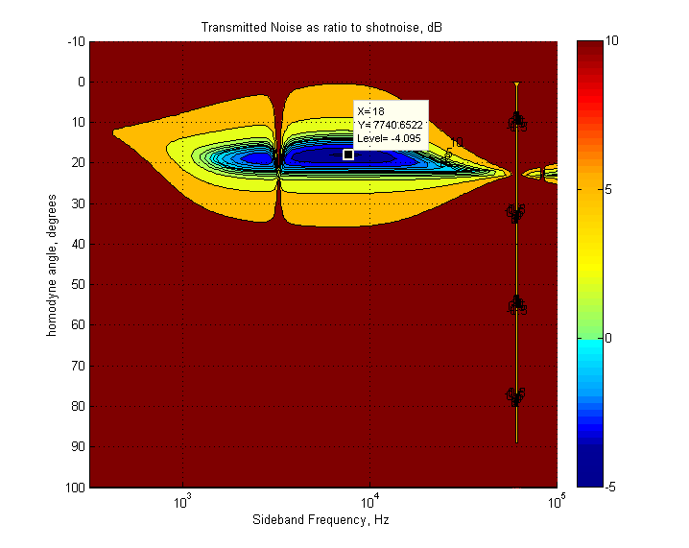
Character of the Squeezing

Slide 29
What’s needed for this to be used in advanced GW detectors
Problem: 4 dB of squeezing isn’t enough
Solution: Lower optical losses and even lower thermal noise. Gains needed are factors of 2, not orders of magnitude. These materials are an active area of research, and it is very reasonable to think these problems will be solved on a 10 year time scale.
Problem(?): System produces a squeezed field with non-zero amplitude instead of a squeezed vacuum state
Solution: Use filter cavites

Slide 30
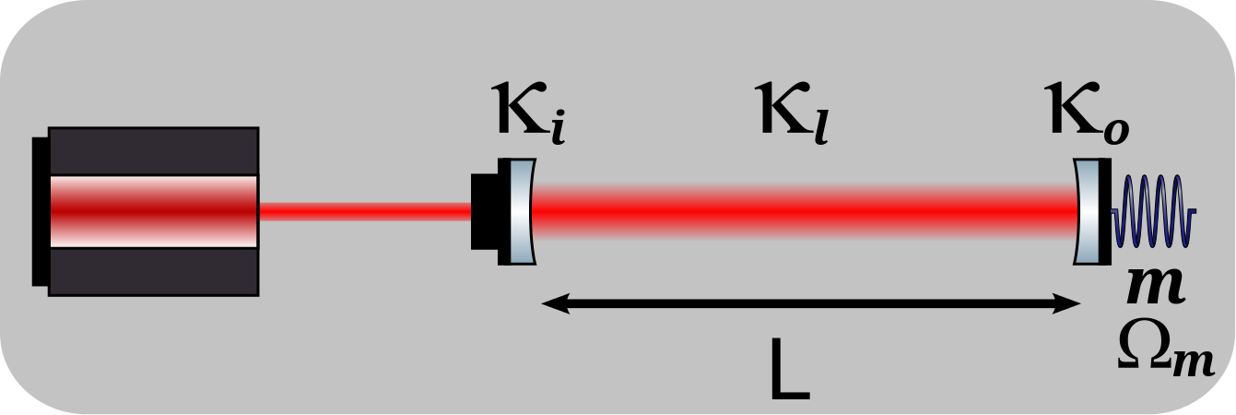
Beyond Squeezing
What else can we do with these optomechanical systems?
Quantum limited table-top system ideal for:
Studying the character of quantum noise
Testing different readout schemes
Tests of sensing beyond the SQL

Slide 31
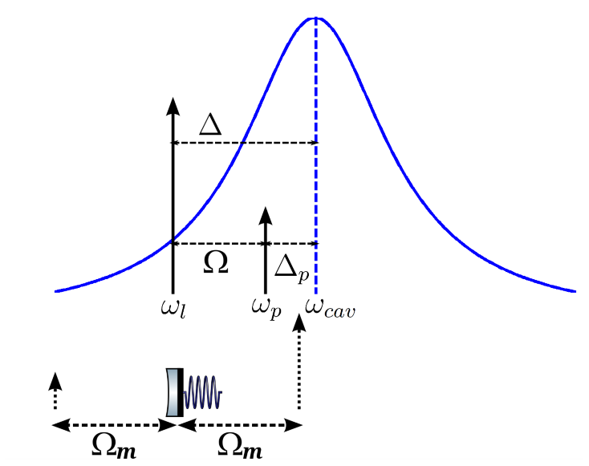
Optomechanically Induced Transparency
Drive laser couples optical mode with mechanical mode
Probe laser interrogates the resulting optomechanical system

Slide 32
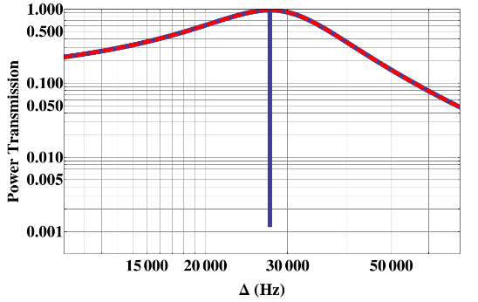
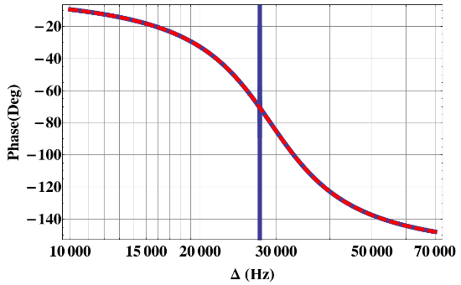
Cavity Transfer Function with OMIT
Bode Plot of the cavity transfer function for the probe laser
Red curve corresponds to the cavity response without the drive laser
Blue curve is with the drive laser coupling the optical and mechanical modes

Slide 33
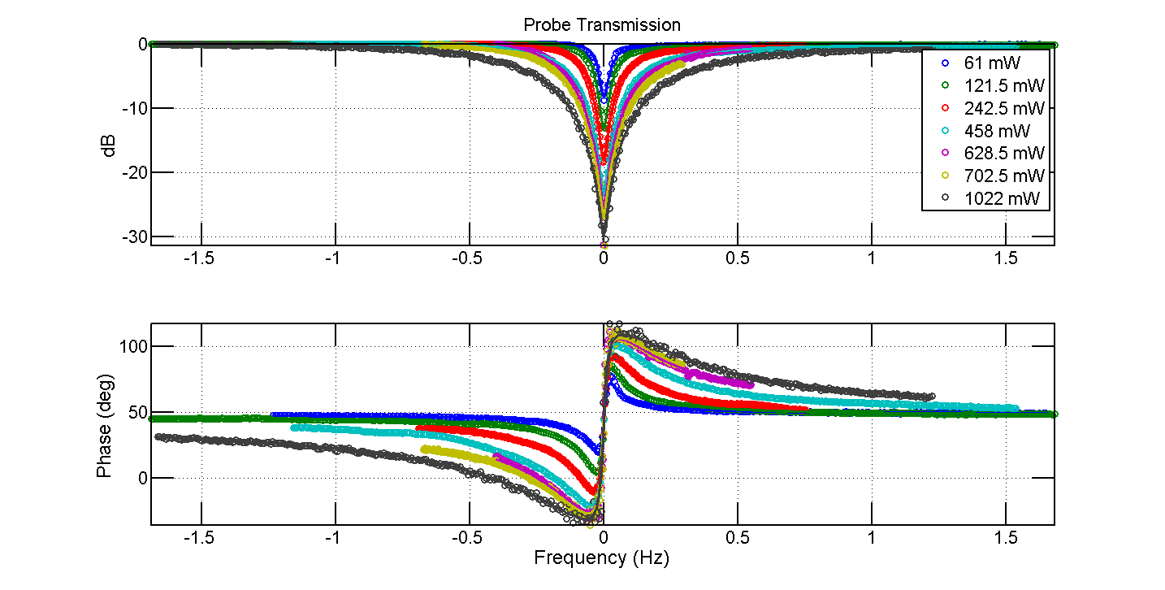
OMIT Dip

Slide 34
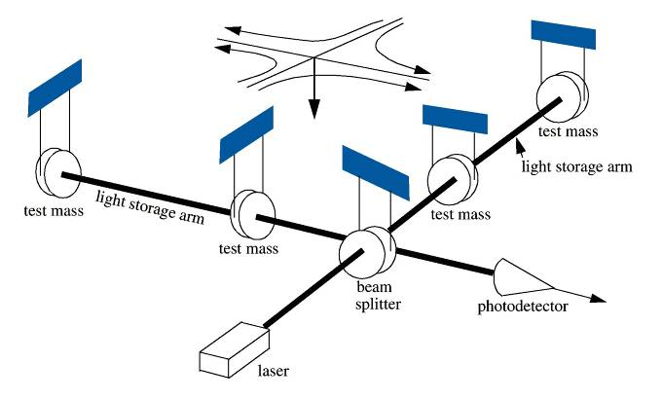
LIGO is a giant optomechanics experiment

Slide 35
Thank You
MIT:
Nergis Mavalvala
Nancy Aggarwal
Shannon Sankar
Eric Oekler
Tim Bodiya
LSU:
Thomas Corbitt
Robi Singh
Jon Cripe
Andreas Muller’s Research Group at University of South Florida

