Slide 1
Vacuum Problems
M. Zucker
LIGO-G1500936
LIGO Management Advance @ Caltech
7/22/2015

Slide 2
Outline
LLO Y tube status
  Tube weld repairs
  LGV7 neutralization
  Water assay
  Status of mitigation & risk reduction
LGV11
  What’s known
  What’s suspected
  Impact on O1 (+)
  Repair concepts
  Repair recovery (bake) concepts
Things we should be doing
  Way too many

Slide 3
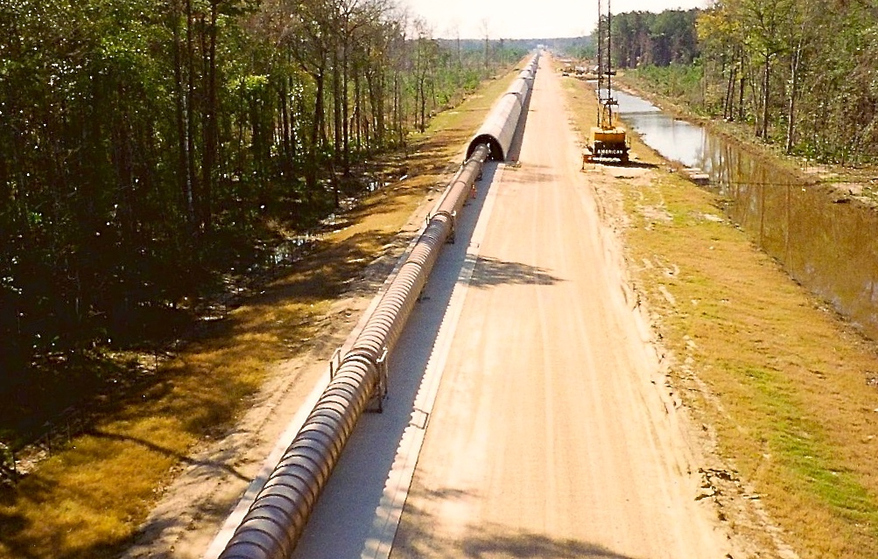

Slide 4
LLO Y Beamtube Leaks Redux
Excess air was discovered in the LLO Y arm early 2012
  Likely onset reconstructs to 10/2008
    No known coincident event
    Undetected/ambiguous due to inadequate instrumentation (colocated with pumping)
  Approximately constant air influx of 2.6x10⁻⁴ Tl/s since onset
Combined leak hunt campaign:
  Visual inspection (requiring complete insulation removal)
  Pressure gradient reconstruction (T1200263)
    Modulate valves at ends of tube to change pumping boundary conditions
    Monitor pressure gradients, reconstruct source location given tube conductance
    Typical test duration ~ 1 week (tube aperture blocked)
    ~ 100m position resolution @ 10⁻⁵ Tl/s rate
  Turbo-assisted He mass-spectrometer leak detection (T1200375)
    Brute force; poly bag sections 1 to 18m long, fill bag with He, monitor tube interior for He
    Subdivide & retest if zone tests positive (cleanup after a positive takes very long)
    Most “signal” disappears down tube; mass spectrometer only sees small sample
    Strong attenuation with distance (sampling ports @ 250m intervals; SNR loss ~ 5:1 at 250 m)
    Time constants far from “normal” leak testing; instrument drift & backgrounds problematic
    With time & care, ~ cm resolution @ sensitivity < 10⁻⁷ Tl/s achieved
Pressure gradient implied location “near” tube center (Y ~ 2km)

Slide 5
LLO Y Beamtube Leaks (cont’d)
Primary leak located by He MSLD and sealed* December 2012
  Evidence of historical rodent nesting under insulation
  Evidence of historical rain leakage from enclosure roof (also natural condensation)
  Two smaller (< 10⁻⁵ Tl/s) leaks subsequently also located and sealed--
    one nearby (presumably correlated)
    another 300m away (presumed independent) under a mud dauber wasp nest
  These leaks were all:
    On welds
    Associated with evidence of moisture
    Located near animal excretion residues (i.e., chloride contamination)
Outside corrosion & welding consultants brought in
  Inconclusive wrt cause, but confirmed no structural risk to tube integrity
  Corrosion strongly suggested, but not proven; no direct visual or chemical evidence
  Stress (or stress-corrosion cracking) is not an apparent factor
    *with VacSeal silicone-based penetrant

Slide 6
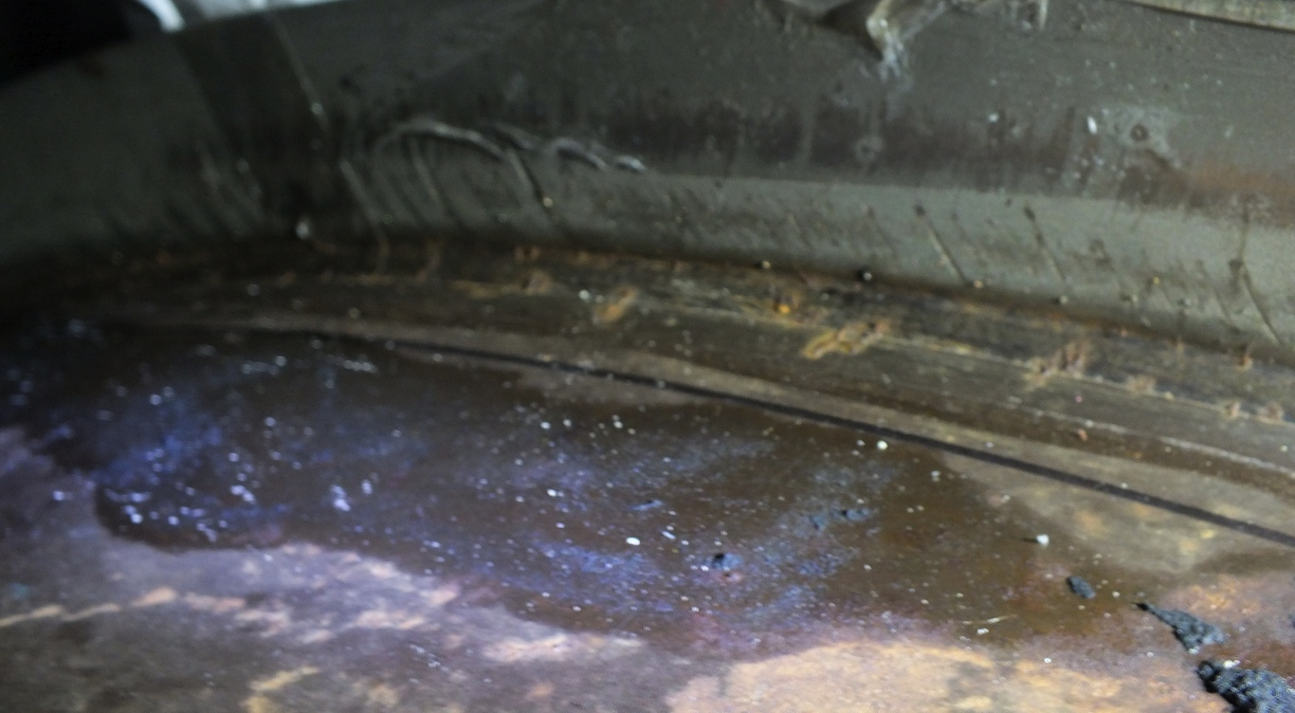
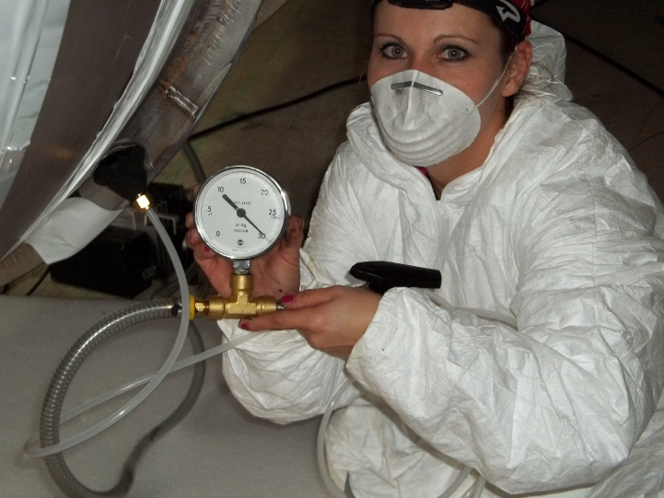
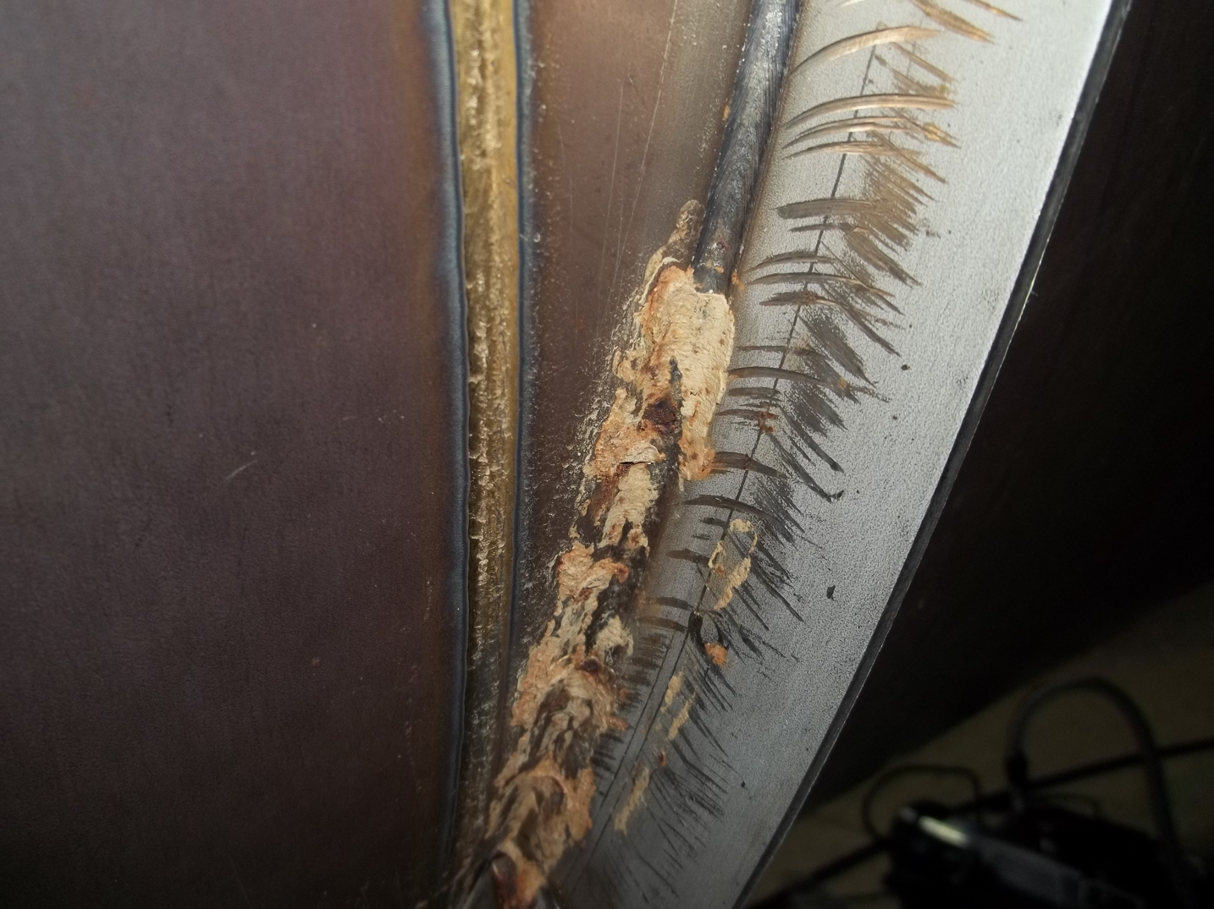
mouse latrine
evacuated “fothering” patch
mud dauber nest
pressure transient vs. distance for He injection

Slide 7
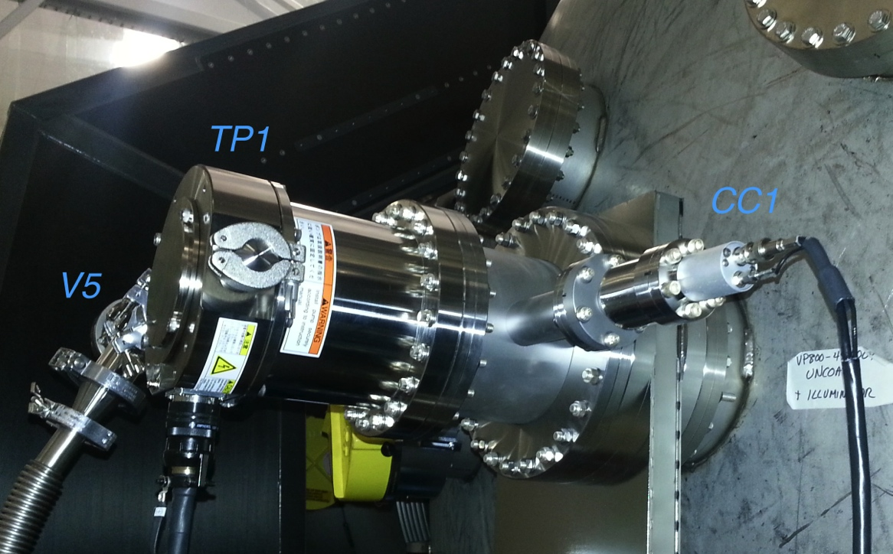
Air gradient localization under 1- and 2-leak hypotheses (R. Weiss)
500 l/s turbo for MSLD compression boost (K. Ryan)
Y =1980 ± 40 m (??)
MSLD response degradation with distance
MSLD response test at 250m (measurement vs. model w/errror bands)

Slide 8
LLO Y Beamtube Leak (Part II)
Air still coming in
4e-5 Tl/s source remained “at large”
  Gradient reconstruction repeatedly implicated tube midsection
  Successive refinements to gradient method (R. Weiss, T1300702)
    Included more sensors
    Regressed effects of temperature, electrometer zero drift
    Allowed multi-leak solutions
    Used more robust statistical algorithm
  Reduced position error to ±50m, solutions always included midpoint
  however…
  …exhaustive He MSLD bag tests on middle km (esp. GV7 gate valve) showed no leaks, with high measurement confidence (< 10⁻⁷ Tl/s)
Started considering “strange” (delayed, virtual) mechanisms (?)
  Long time constant (to evade MSLD) + known total rate → constrained solution
  Seemed to require hidden storage volume or reservoir of permeable substance
  Where could gas hide ? gate valve stem?
  Crazy stuff, but ‘once you have eliminated the impossible…’

Slide 9
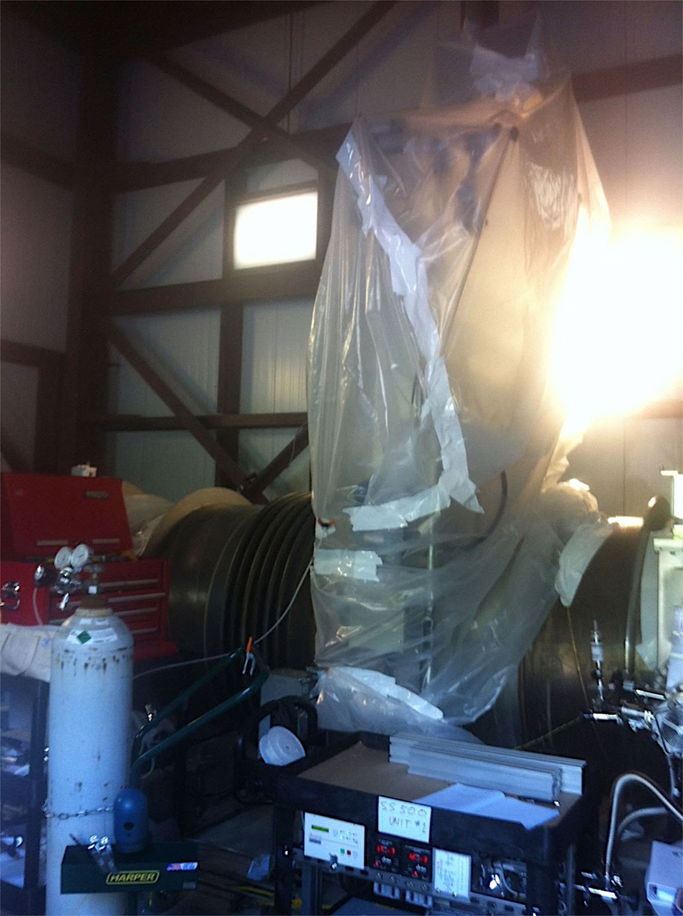
GV7 `Enhanced Interrogation’
Resorted to aggressive tests on GV7
  Test 1 (He): Out-wait the time constant(s)
    Two MSLD sample points, one 550m away to rule out flanking/background sniff
  Test 2 (Argon): Replace air around valve and watch internal composition change
    Look for both presence of test gas and replacement/reduction of air inside tube
Results both convincing and bizarre:
  Gas outside the valve stem gets in
  Composition inside mirrors outside
  but…
  Very long delay for He to enter
  Delay 10-100x longer still for Ar
Weiss: “The Leak from Hell”

Slide 10
He Response: “Direct leak” vs. GV7
He MSLD responses measured adjacent to GV7 (green) and 550m north (blue). For comparison, corresponding responses are also plotted (cyan and red, respectively) for a direct 60-second timed He injection of 1.8e-7 Tl/s near the valve location. In all cases t=0 corresponds to the start of He flow. The delayed GV7 response is unequivocal, but also inconsistent with a simple leak.
✓
?
10 minutes

Slide 11
Air displacement over GV7 stem
RGA ion currents for argon and components of air are plotted vs. time as a fraction of the total ion current, which summed contributions from N₂ (28), O₂ (32), H₂O(18), and Ar(40) (but did not include H₂ or other species).
5 hours

Slide 12
“Delayed Leak” Models
Long thin channel ?
  τ ~ L²/Dv and F ~ vD³/L
  → D ~ 0.3 mm for L ~ 1m (maybe plausible), but…
  gas diffusion → τ ~ m^{1/2} (only 3:1 between Ar and He)
Discrete series leaks w/ dead volume(s) between?
  e.g., V ~ 5 l and τ ~ 1,000 s → F₁ ~ F₂ ~ 5e-3 l/s , P_{mid} ~ .01 Torr
  If limit is viscous (choked flow), rate ~ P, but…
  molecular mass dependence of τ is even weaker
Permeation/percolation?
  Weld or gasket fissure which is plugged with liquid, e.g., condensate or lubricating grease?
  →Expect bulk diffusion τ ~ a² m^{1/2} (Ar : He ~ 20:1)
Is it important? Maybe…
  Risk of future “evolution”
  Potential failure mode for other valves**
_{** wait for it..}

Slide 13
Test of Ar diffusion through a sample of valve mechanism lubricant
From R. Weiss, LIGO-T1400183

Slide 14
Valve Repair Options
Out-pump it ? ✖
  Conductance limited; only two 10” ports available nearby
  IFO is most sensitive near this location (laser beam waist)
  “Grease theory” → leak rate could spontaneously change!
Vent and fix it ? ✖
  Requires re-bakeout of entire tube
  Very costly (large % of LIGO annual budget)
  Too time consuming ( ~ year(s) ?)
Pull an external vacuum? ✔ …but…
  No cutting, welding or disassembly allowed
  “Captured” seals, “as-built” (rough) sealing surfaces
  Weight constraints
  Trapped grease, plastics
→ Unique engineering challenge

Slide 15
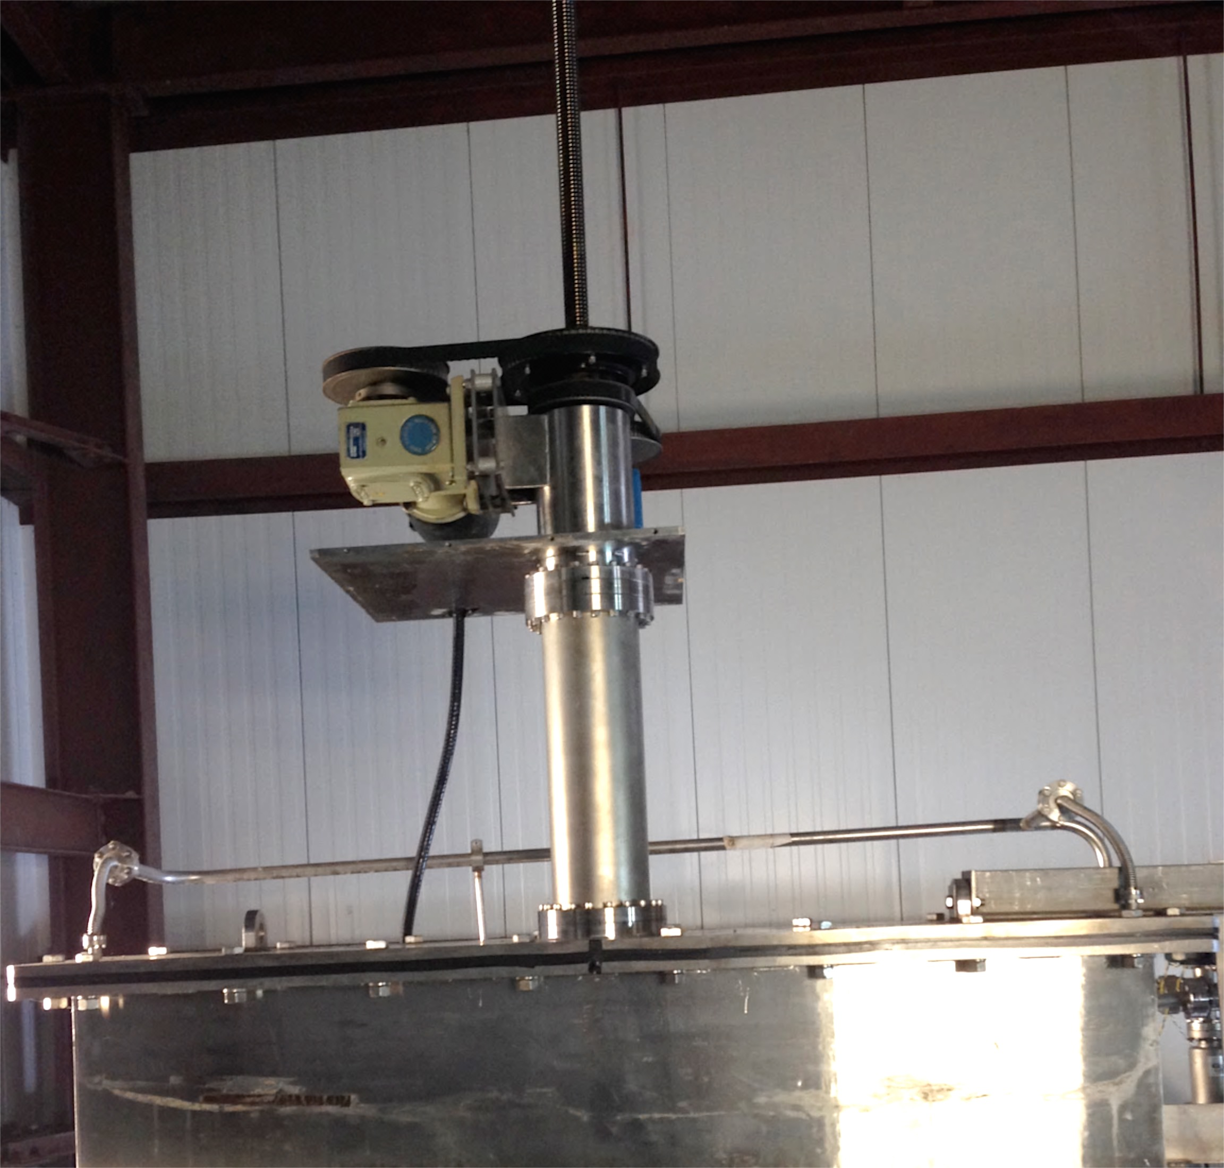
GV7 sarcophagus concept
SEAL

Slide 16
actuator leadscrew housing
gate valve
Vacuum enclosure for GV7 stem/actuator assembly
K. Mason 5/1/2014
ion pump
upper housing
existing valve mechanism
lower housing
captured split housing base
(assembled & bonded together in situ)
captured seal gland
(CNC-profiled to conform to existing nozzle)
GV7 stem nozzle
structural support
GV7 trunk

Slide 17
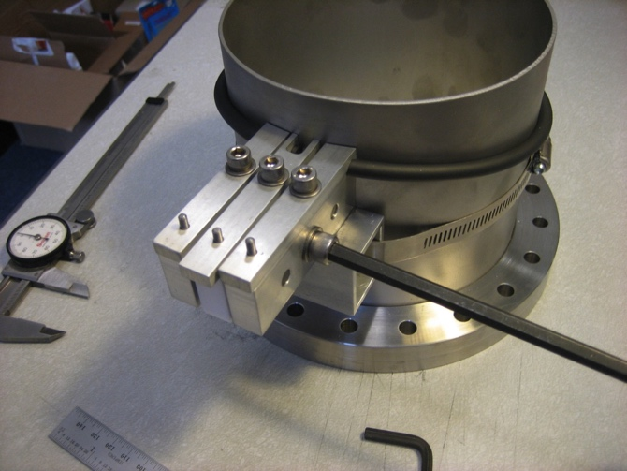
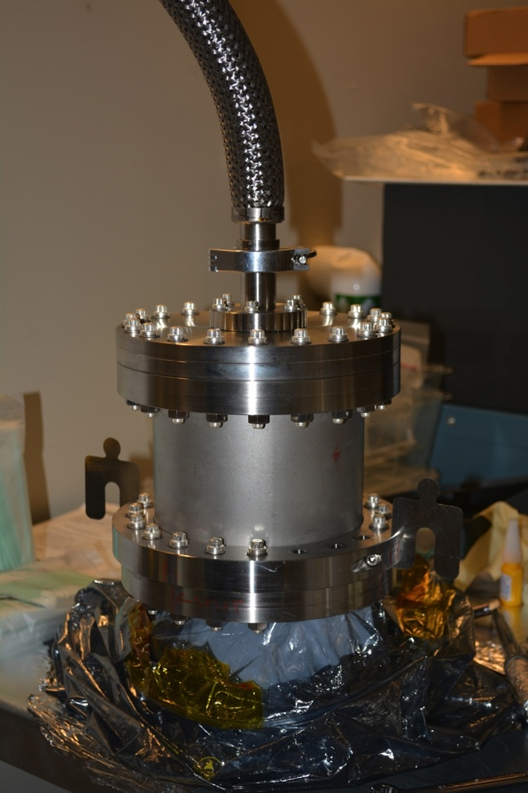
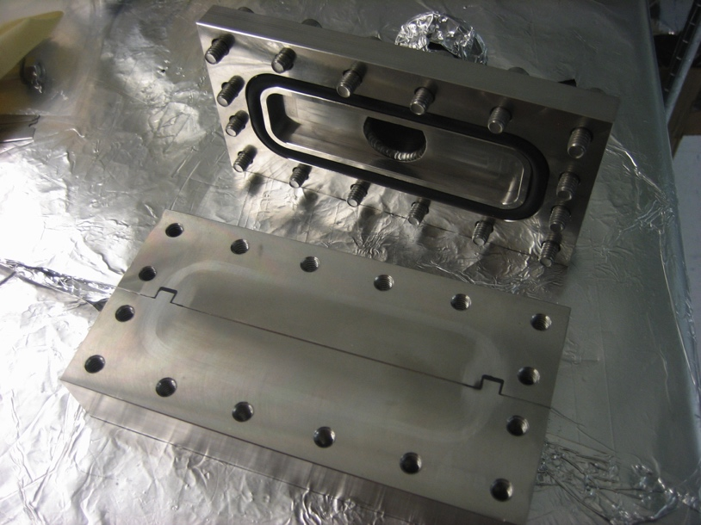
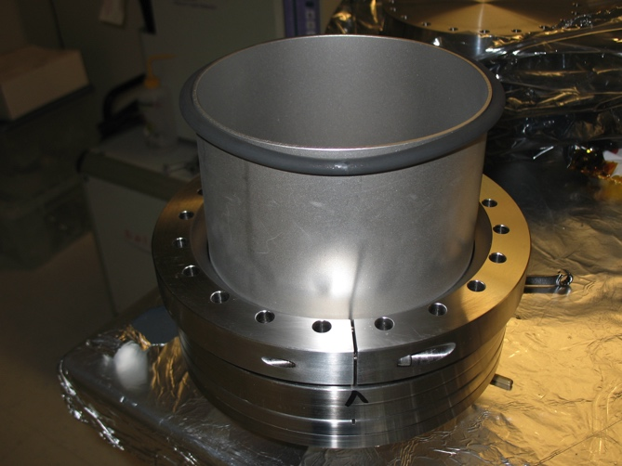
Split plate & captured seal engineering
O-ring field weld & seal gland leak test
Plate joint/crossed seal test

Slide 18
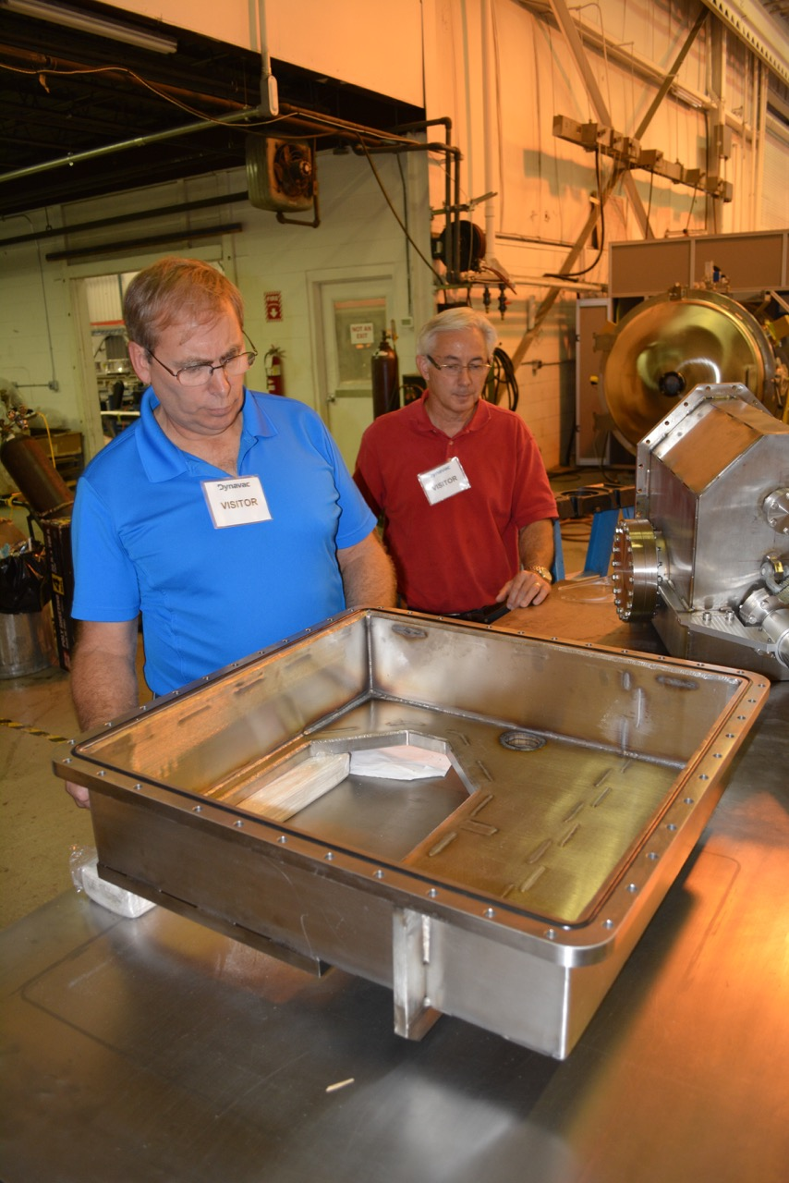
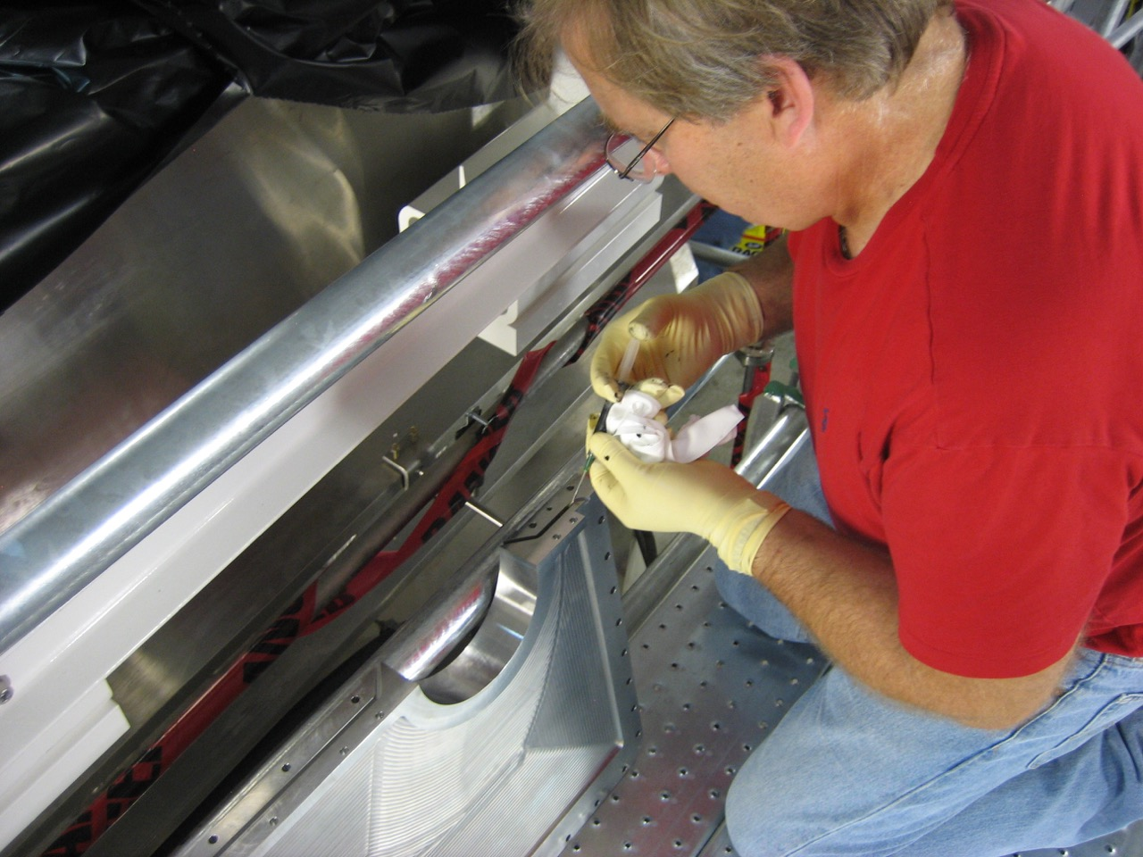
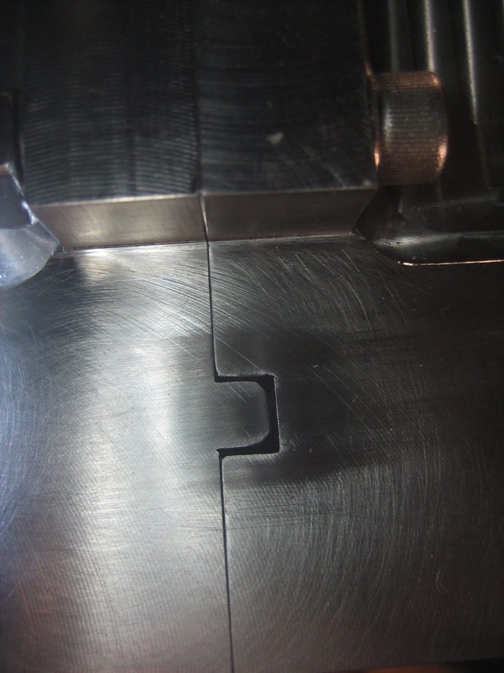
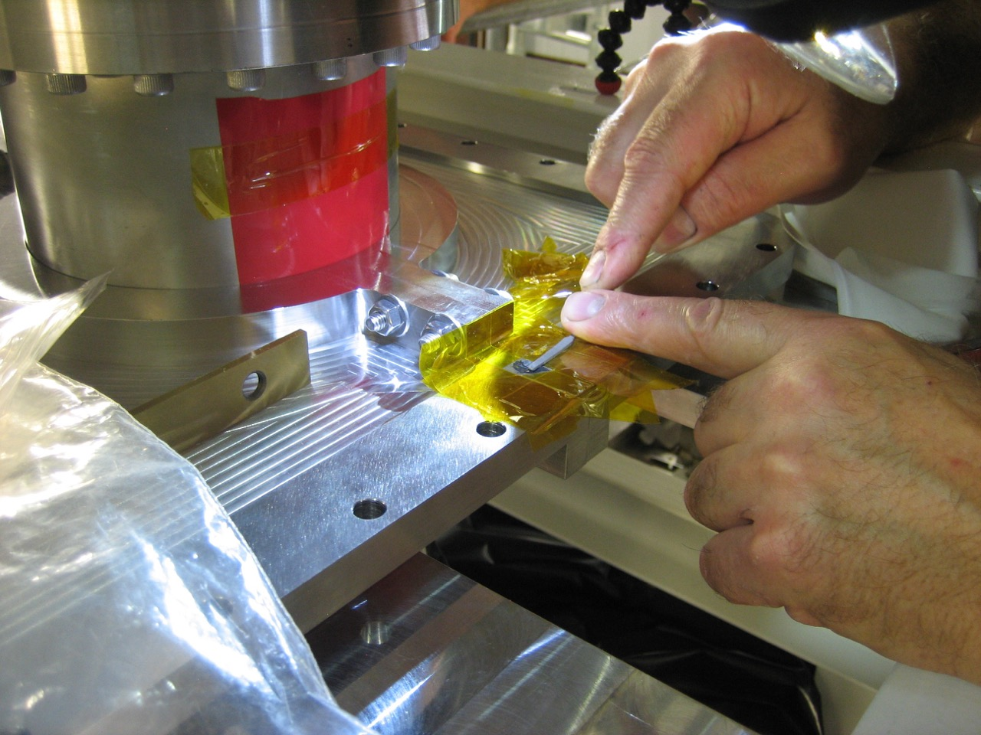
GV7 sarcophagus installation

Slide 19
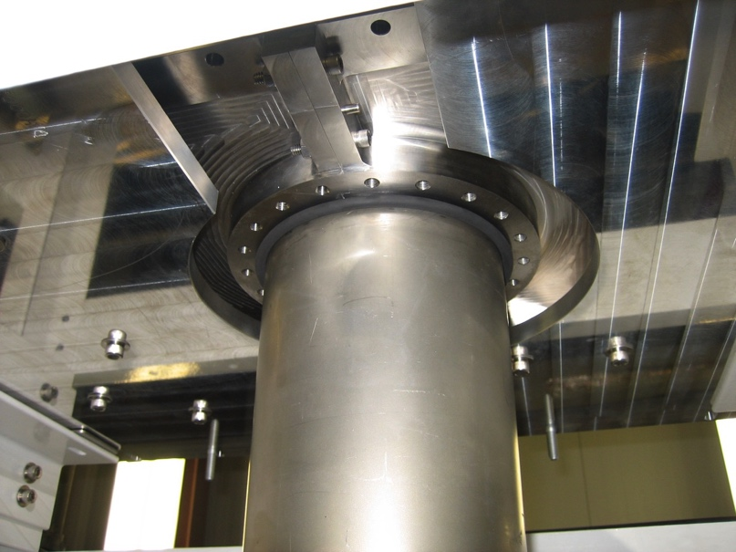
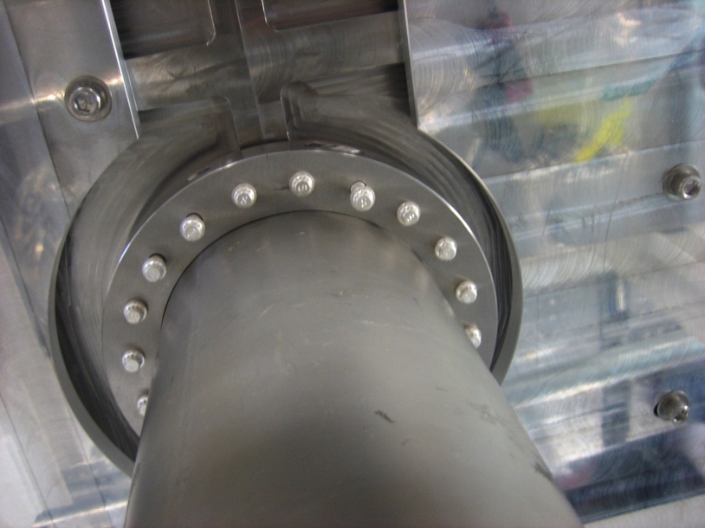
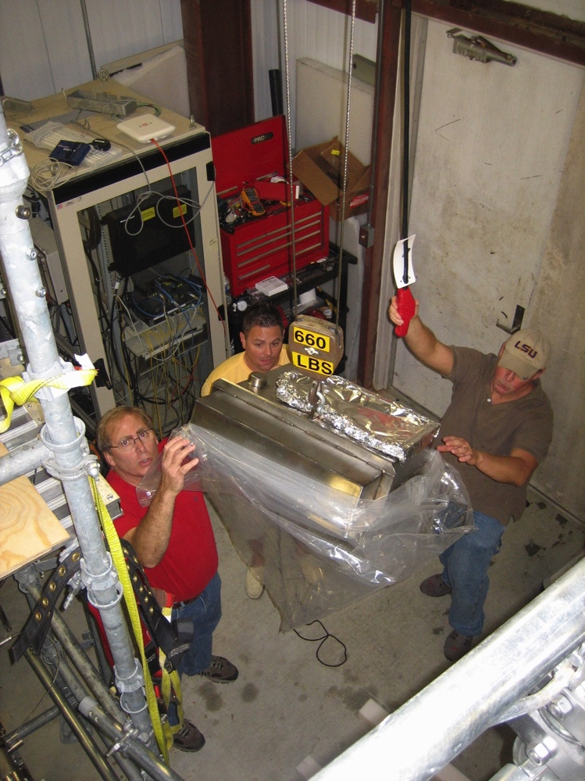
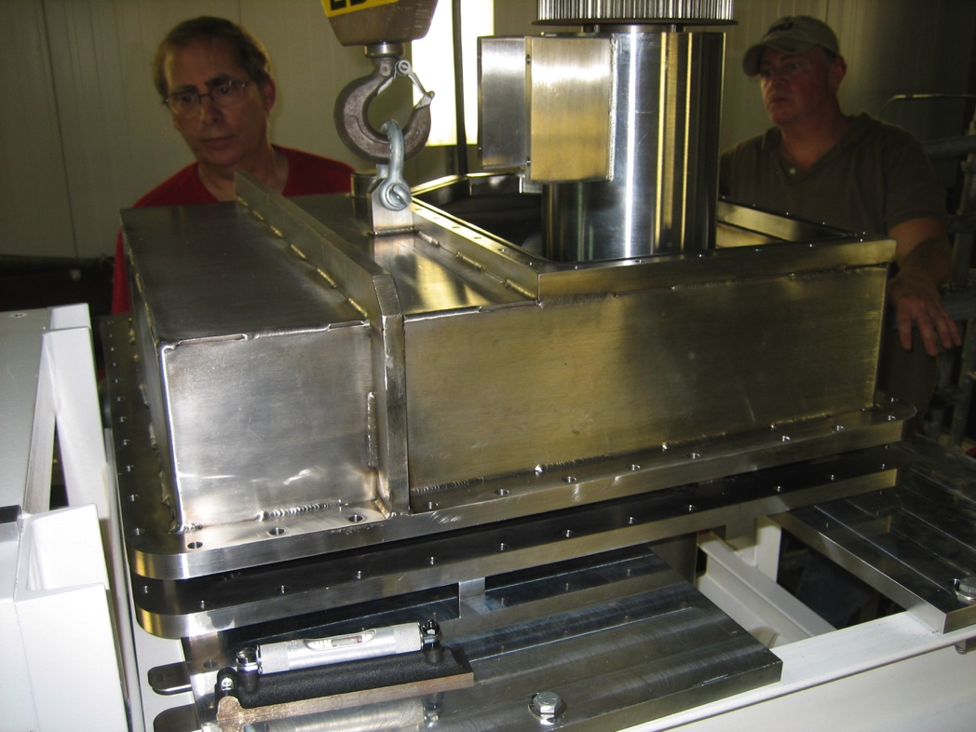
GV7 sarcophagus installation

Slide 20
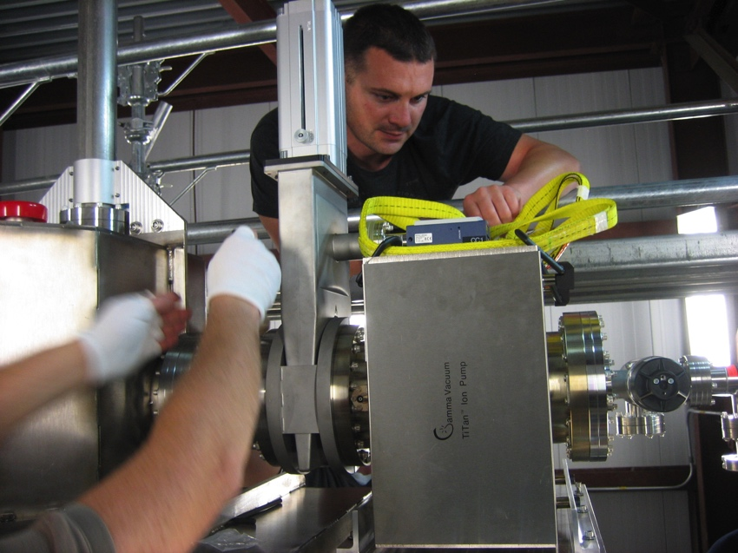
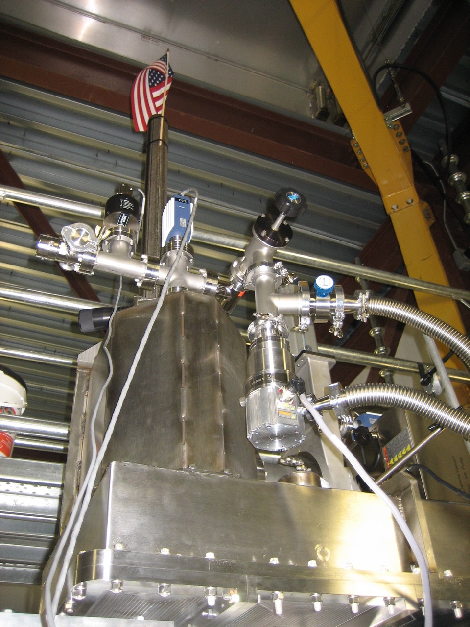
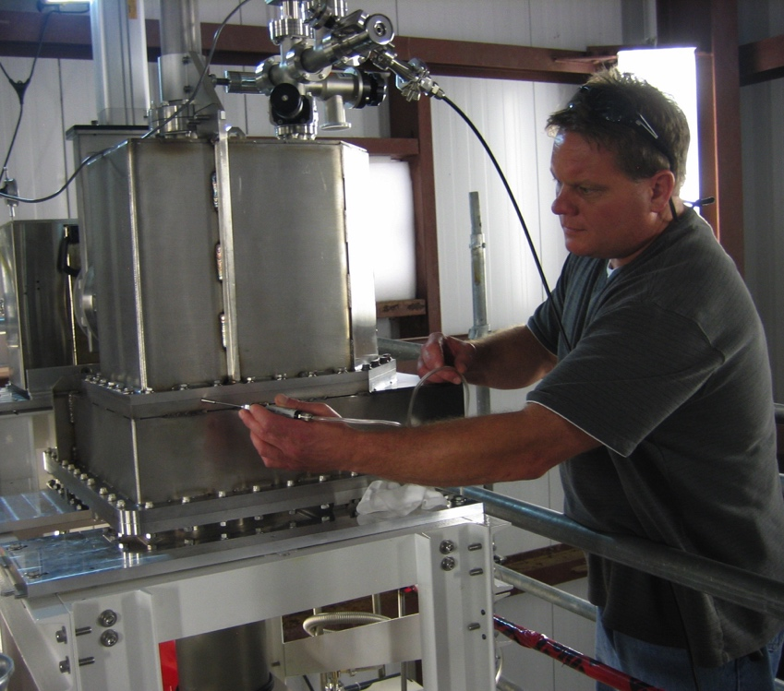
GV7 sarcophagus installation

Slide 21
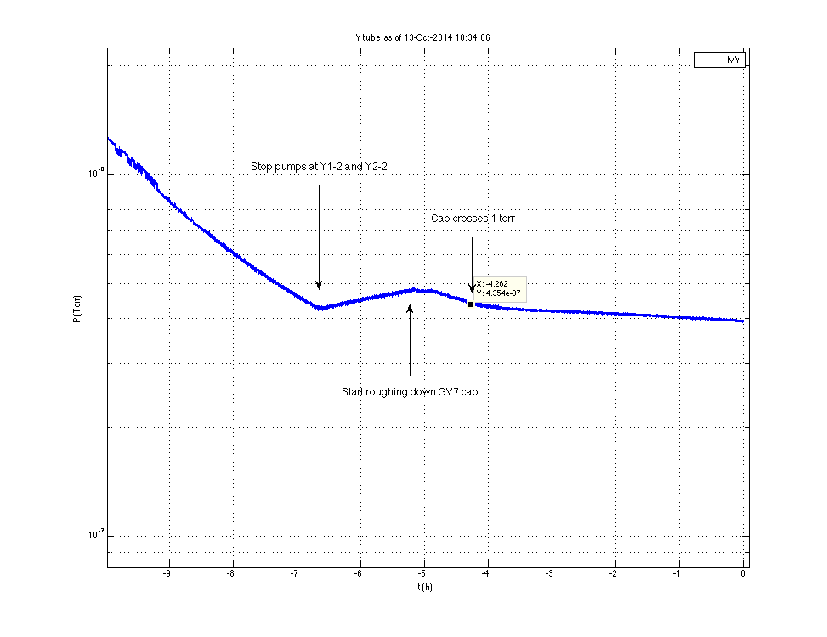
IT WORKED…

Slide 22
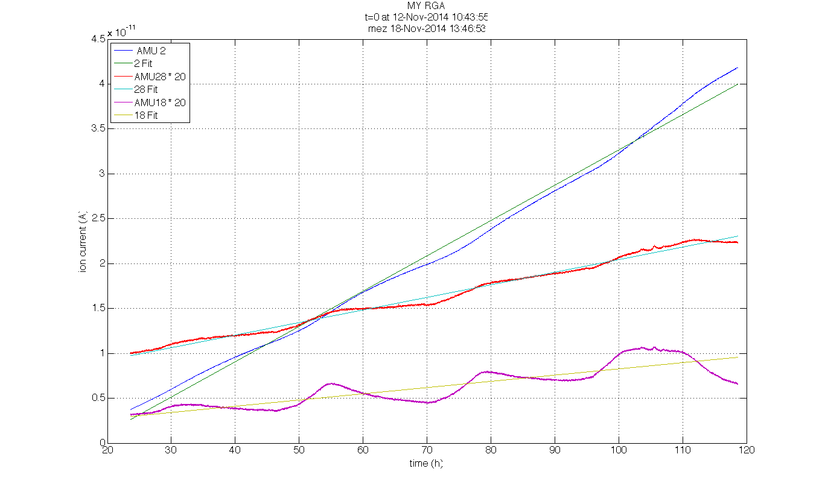
LLO Y ARM ACCUMULATION (AFTER GV7 CONTAINMENT)
H₂
N₂ (x 20)
Q < 10⁻⁸ Tl/s
H₂O (x 20)
(LIGO-T1400723)

Slide 23
Some Good Breaks…
Sarcophagus pumpdown was quick
  Maintained solely on ion pump within 2 days
  Steady-state stem P < 10⁻⁷ Torr, despite contamination
LOWER residual water vapor desorption than calculated based on leak exposure
  We expected x10³ increase in water desorption due to 4 years of air leakage
  In reality only x100; not a threat to aLIGO sensitivity (with added pumps)
  Part of the answer: we underestimated the 48C “mini-bake” occurring naturally each summer– potentially critical for future repair scenarios

Slide 24
Modeled desorption of water adsorbed from atmospheric leakage (assuming constant T)
now
leak fixed
R. Weiss, T1200399

Slide 25
Modeled desorption with step-approximated seasonal temperature profile included (preliminary)
Constant 27C
now
Seasonal, 10C – 48C
leak fixed
R. Weiss, 6/9/2015

Slide 26
Big Picture: Recovery Program So Far
Removed old beamtube bakeout insulation (both sites) ✓
Install temp, RH, pressure sensors & network (LLO) ✓
Install AC power along both LLO arms ✓
He MSLD test LLO Y tube stopped after 3200 m (leak free) ✓
Develop & install BTE Dehumidification plant (LLO) ✓
Upgrade BTE joint caulking (LLO done ✓, LHO pending)
Install ion pumps to mitigate sorbed gas at LLO (in progress)
Inspect and clean steel of chlorides (in progress,~ 75% both sites)
Install new insulation (both sites) deferred, not req’d. (next slide)
Cap & neutralize GV7 ✓
  Σ (EAC) ~ $M2.8 (vs. $M3.8 budgeted)

Slide 27
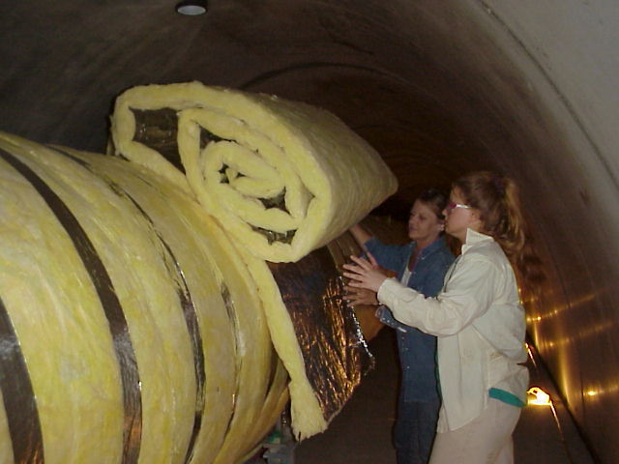
To Insulate, or Not To Insulate?
Original bake insulation t= 150 mm, R = 4.3 m² K/W, τ_{therm} = 15 h
  When new, diurnal ΔT of tube wall attenuated by ~ ¼ (seasonal ΔT unaffected)
  Fiberglass, foil & paper; destroyed at both sites by insects, rodents & rain leaks
  Removed & discarded to allow cleaning and inspection
  Intent (until recently) was to replace with something ‘similar,’ but vermin-proof
  Sought to specify its functional requirements…
Study undertaken of direct and secondary effects
  Metal fatigue: No insulation needed
    > 300 years fatigue life at 80C p-p daily (4x actual)
  Vacuum: Insulation doesn’t help (much)
    Seasonal cycle (28C p-p) dominates gas evolution
    Summer PM H₂ peak slightly affected; but insulation not a cost-effective mitigation
Most important effect studied: optical scattering
  Old insulation had side effect of damping some tube wall modes
  Coating defect on early ETM’s enhanced scattering
    NEW ETM’S FREE OF THIS DEFECT-
    REPLACEMENT CONSIDERED AFTER O1
  Again, insulation would be a weak countermeasure (at best)
    Dominant 14 Hz bulk mode is unaffected (need another approach if it’s an issue)
    30-50 Hz modes have safety margin, particularly if/when improved ETM’s are installed
    Local damping at optical interaction zone(s) more effective, if needed
Replacing original insulation (were it deemed appropriate) potentially very costly
  >$1M per site (est.)
  Sites out of action >4 months
  Interference with future tube diagnostics/leak testing/repairs
LIGO TRB convened in May 2015 to weigh risks & benefits
  Decided to defer action, keep tubes bare after cleaning is completed
  Directed to consider alternatives in light of actual performance issues, if any
About $800k budgeted for insulation now redirected to Lab staffing and other shortfalls

Slide 28
WARNING
Material beyond this point may not be suitable for sensitive viewers.

Slide 29
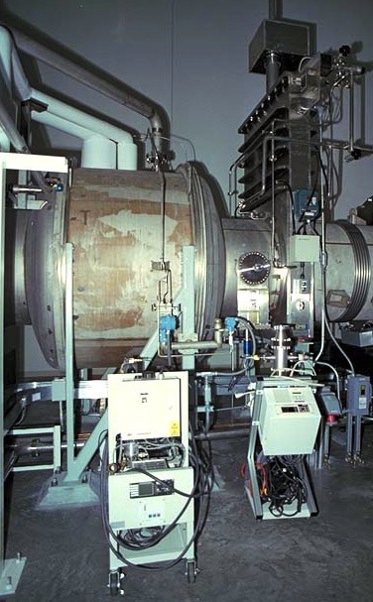
Some Breaks, Not So Good…
(Just when you think it’s safe…)
Another valve found leaking (LGV11)
Retarded He response, i.e., another “diffusion-moderated” stem leak; see G1500110
Slower leak than LGV7, but not stable:
Grew x3 in 1.5 years
Interval included 8 strokes; unclear if correlated, but suspicious
Now Q_{air} ~ 4 x 10⁻⁶ Tl/s
LGV11 bounds a cryo trap–
cannot be abandoned (unlike GV7)

Slide 30
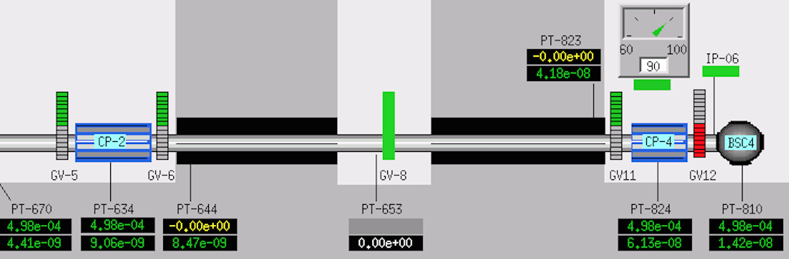
Where it is
EX
LLO X ARM
MX
￼
￼
￼
￼

Slide 31
Apparent change in rate between 8/2013 and 3/2015
GV-11 STROKES
2013-present:
09-19-13 closed
01-13-14 open
02-28-14 closed
03-01-14 open
04-23-14 closed
04-25-15 open
08-02-14 closed
09-02-14 open
➔ 4 CYCLES BETWEEN
MEASUREMENTS
(63 total cycles since installation )
T1300757 (8/29/13)
Included BSC4 (EX) , CP3, CP4
5 GV’s open (GV2 closed)
Q(air) ~ 1.5e-6 Tl/s
T1500126 (3/16/2015)
Included CP3, CP4
3 GV’s open (GV5 & GV12 closed)
Q(air) ~ 4e-6 Tl/s

Slide 32
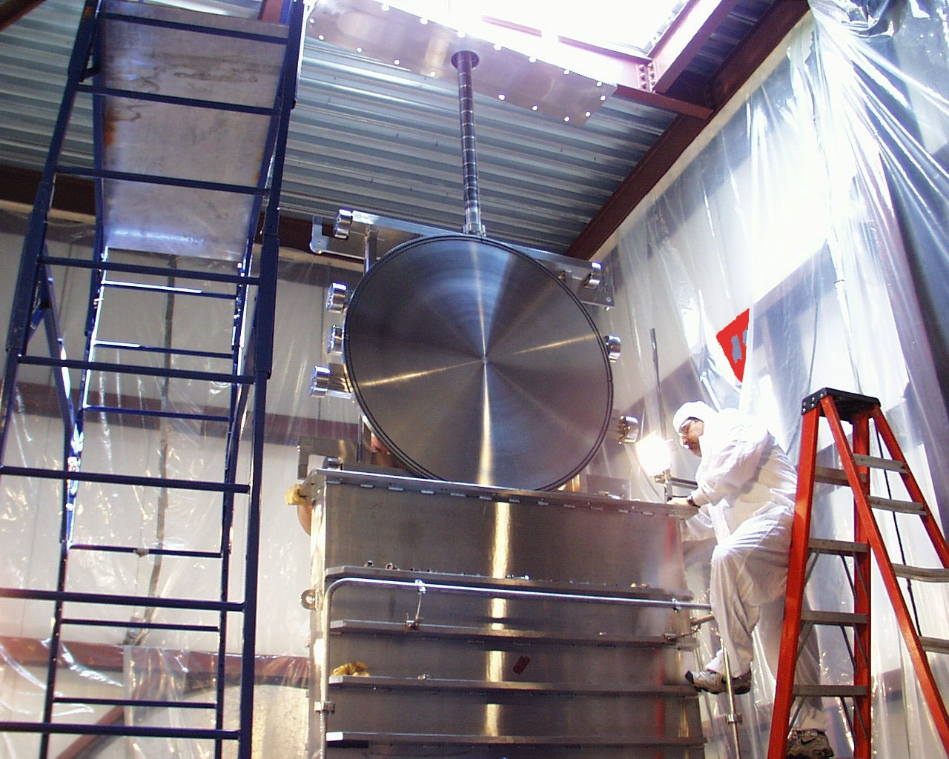
GNB Valve Anatomy bonnet plate bellows ballscrew socket & flange carriage gate (this side to beamtube) trunk

Slide 33
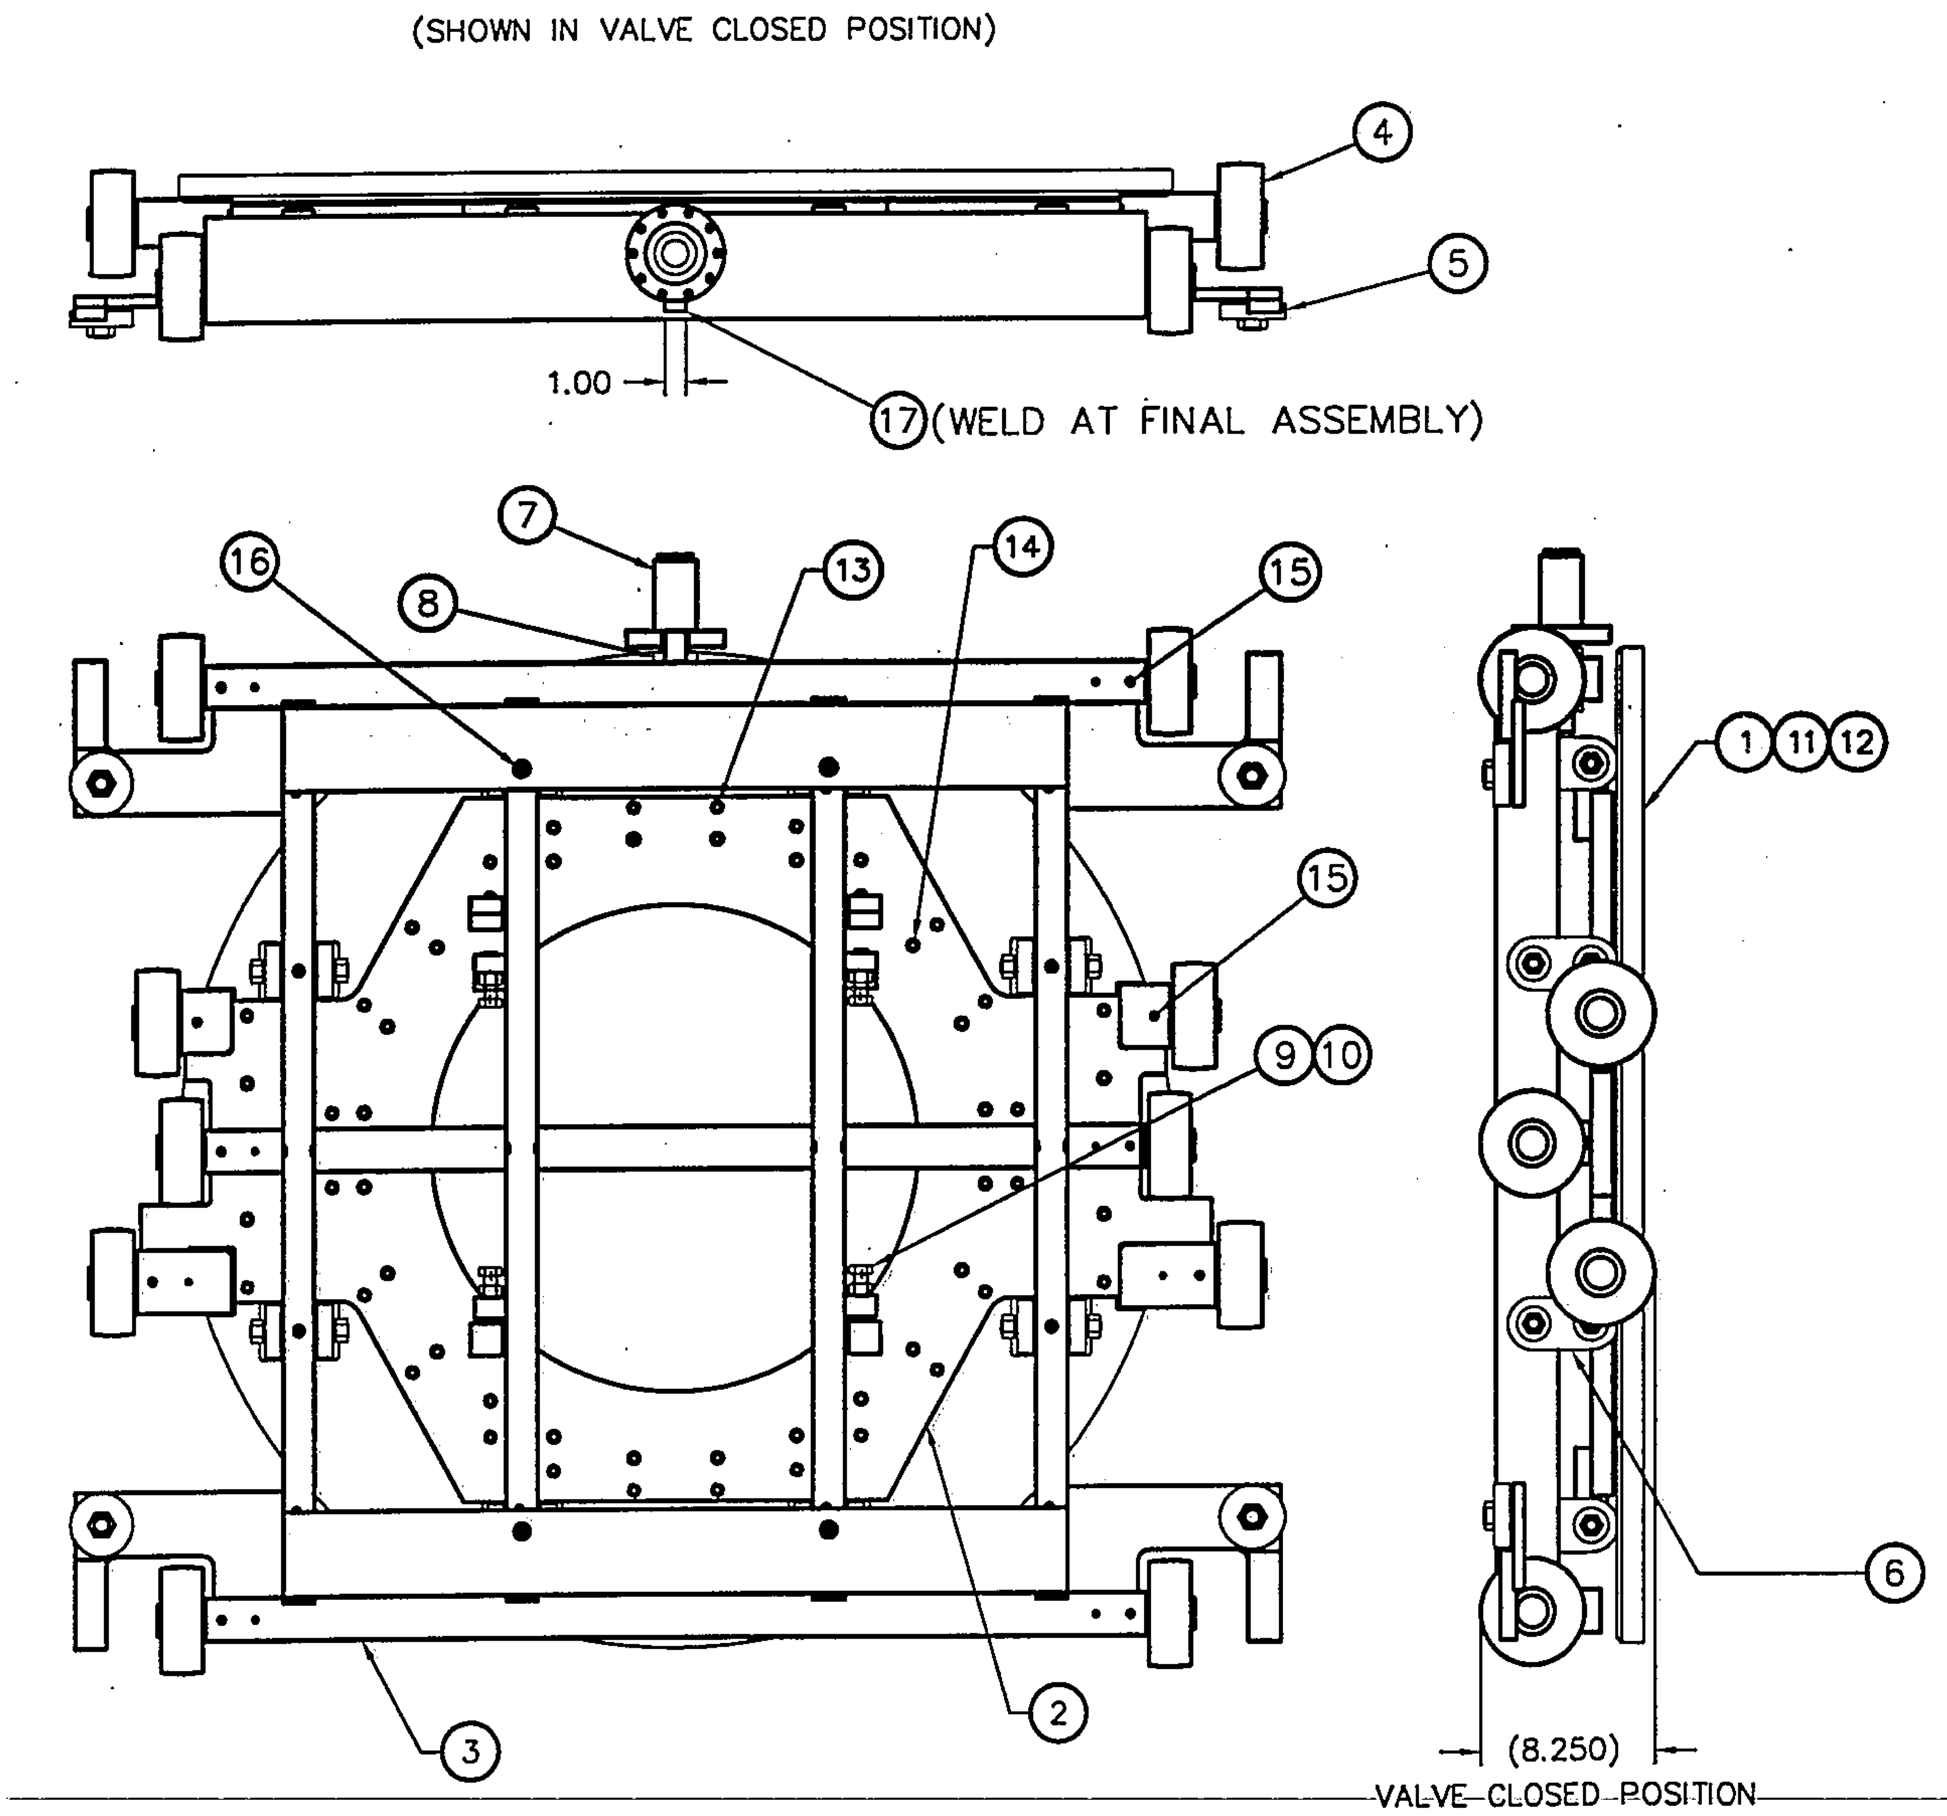
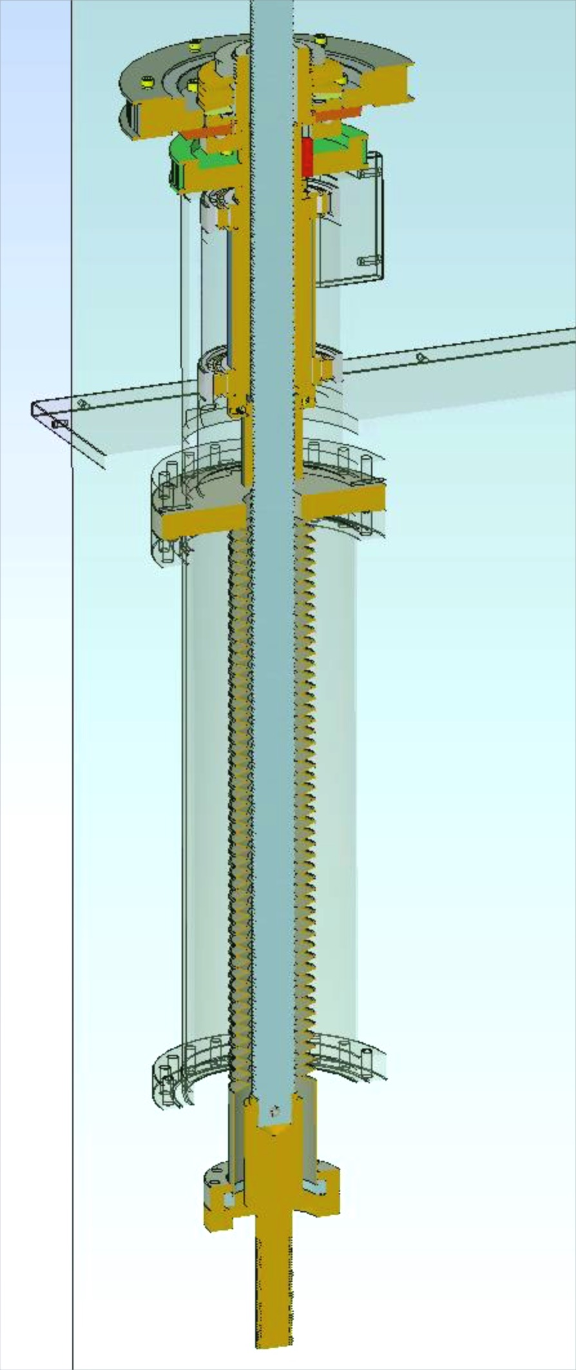
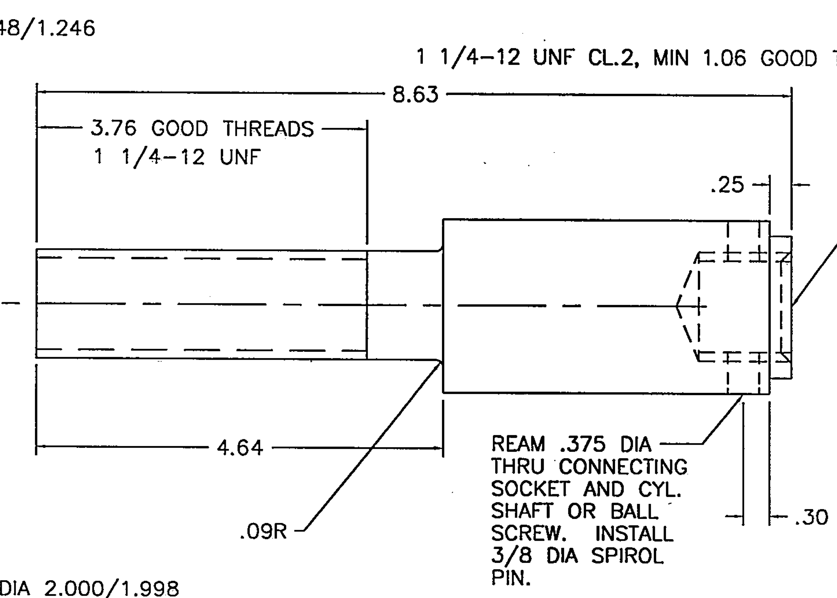
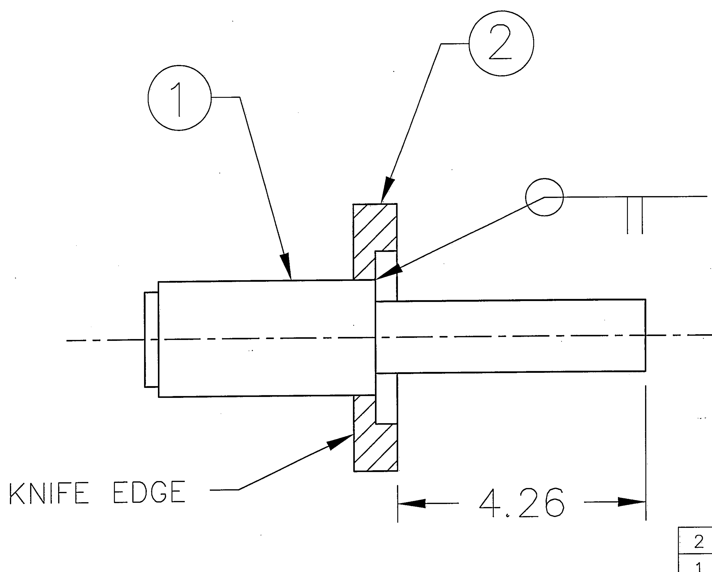
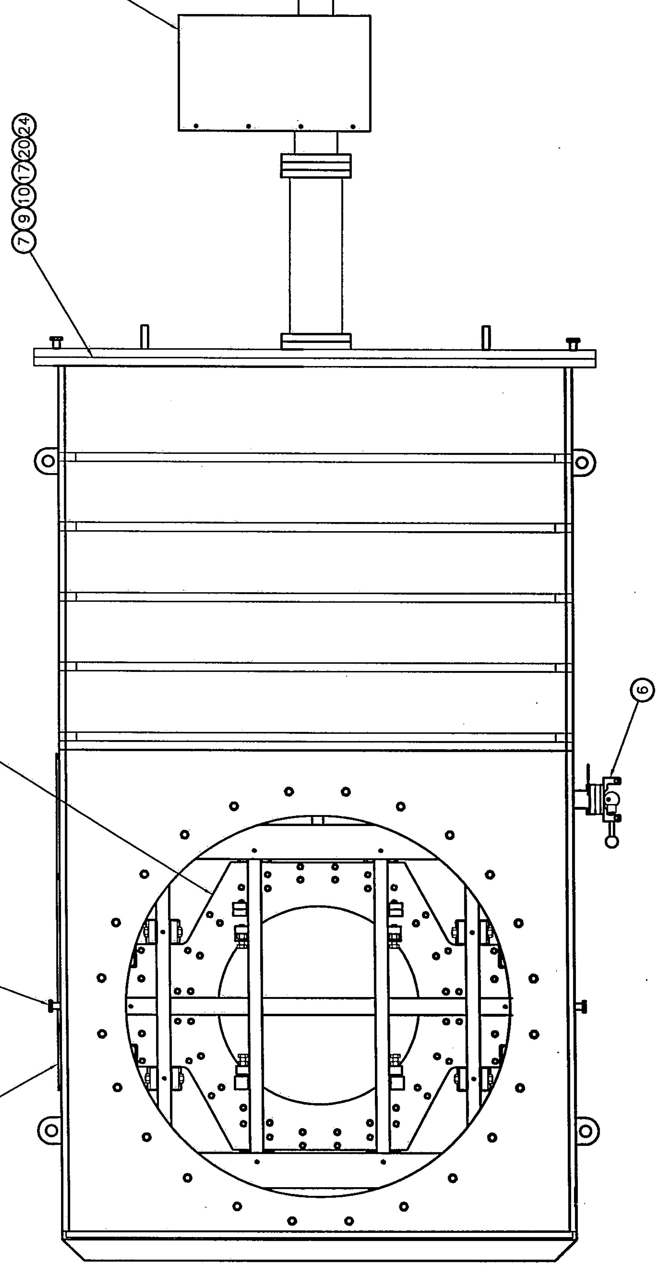
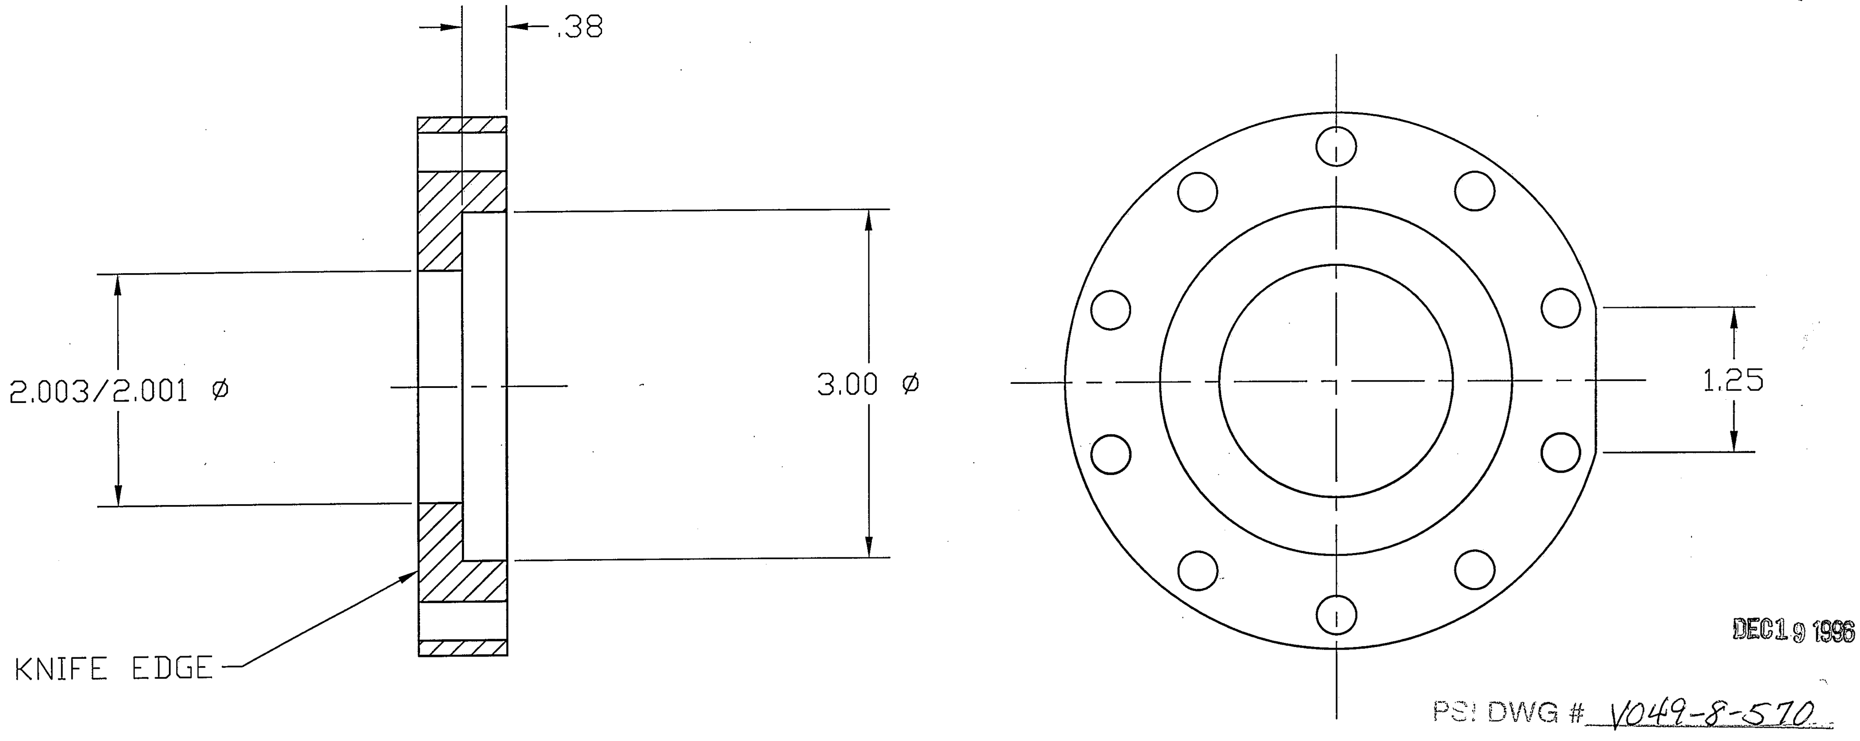
Valve Construction:
Weak Link?

Slide 34
Near term impact of GV11 leak
O1-3 noise impact (next page)
Operations risk
  CP4 cannot be isolated w/out closing GV11
  Until now, this was required in a hurricane emergency (i.e., possible extended loss of power & site access; about 1 per 3 years, historically)
    Trap “passive” hold time ~ days
    LN₂ storage can extend to ~ month w/ manual filling
    Uncontrolled trap warmup, gate open, would saturate tube with decades of integrated water and hydrocarbons (probable disaster)
  For now, we have “adjusted” the risk threshold for CP4
    If we do close it, not sure how risky to reopen, or how to minimize that risk…
“New reality”
  Revised “Bayesian prior”
    2 of 24 valves are leaking!
  Probability/rate appears to increase with age and with each stroke
  We have started to defer or curtail useful and important work that might require cycling a large valve (including valve diagnostics!)
  THIS IS UNACCEPTABLE FOR THE LONG TERM

Slide 35
Leak impact in 3 pumping scenarios
(IP’s at ends disabled due to charging; Y arm slightly wet)
From LIGO-T1500210-v1

Slide 36
Index noise by arm & gas species with LGV11 leak
1/10 of ‘100 Mpc’ bucket minimum
1/10 of ‘225 Mpc’ bucket minimum
➔ difficult to get gas index noise < 1/10 of design bucket minimum without fixing the leak, and/or restoring full pump speed at ends
(1/3 of bucket minimum is achievable, maybe ok)

Slide 37
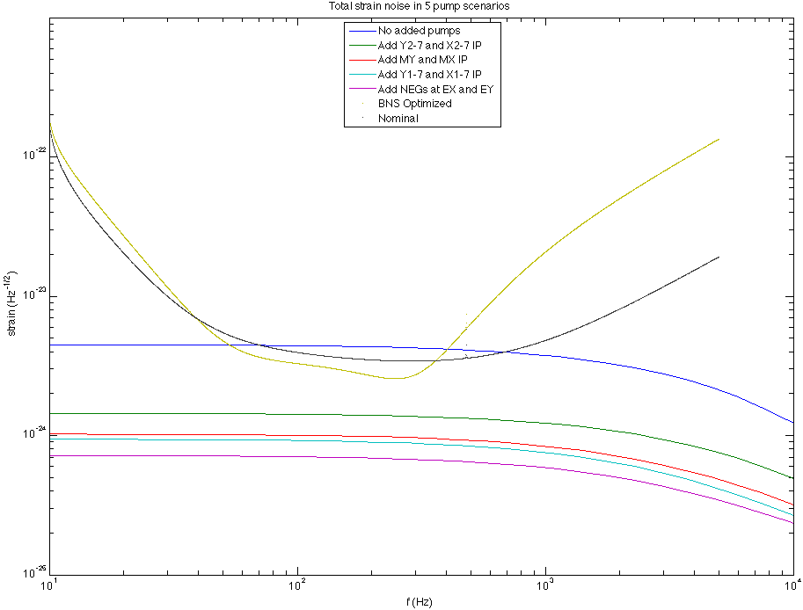
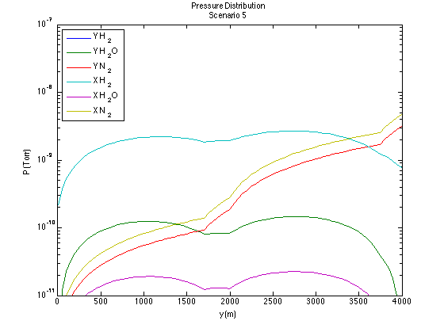
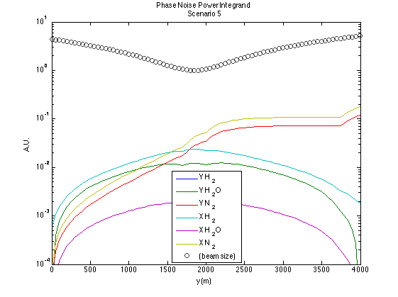
Index phase noise w/GV11 leak
(ion pumps at 1.75, 2, 3.75 km + NEGs at ends)

Slide 38
Gate Valve Repair Options: Rock or Hard Place?
29 years ago, we chose to risk a “one-off bakeout” design. This means
“LIGO BEAMTUBES MUST REMAIN UNDER HARD VACUUM FOR THE LIFE OF THE FACILITY”
  Tough choice, but we had to build to cost, or go home!
  Durable/reusable bake capacity (like, e.g., Virgo*) was not affordable.
  OTOH, we (optimistically) expected to need 10⁻¹⁰ Torr H₂O within 10 years , so bake was required
  (also, a specified 20-year design life seemed generous …)
From an engineering standpoint, best answer is to revisit and break this constraint
  Capability to repair your mistakes is a ‘fundamental right’ for ground-based experiments!
  It (now) seems reasonable to expect more gate valve stem leaks
  Based on what little we know, stem faults could accelerate catastrophically (grease bubble scenario)
  We also see, and should thus expect, other failure modes (besides bad valves and rodents)…
    Catastrophic viewport failures at Virgo and HPLF
    Truck collisions and lightning strikes on our BTE
    Brush fires and Cat 5 hurricanes
    Rifle rounds through buildings & disgruntled employees
    Safety valve failures and human errors (lots)
We also DON’T REALLY KNOW the consequences of air exposure from the current state!
  As a matter of principle:
LIGO SHOULD HAVE MEANS TO PERFORM A CONTROLLED TUBE VENT AND RECOVERY
LIGO SHOULD ALSO HAVE A PLAN TO RECOVER FROM AN ACCIDENTAL TUBE VENT

Slide 39
Gate Valve Repair Options: Rock or Hard Place? (ii)
Even if we resolve to proceed, and secure funding and staff, it will take time and effort to develop this missing capability. We may have to act sooner; are there fallbacks?
Plan B: “Living Dead” sarcophagus
  Encapsulate & evacuate the valve stem while maintaining valve function
  Replace or modify drive components that won’t survive (?)
  Much more complicated engineering problem than GV7 sarcophagus
  High risk of accidental dump or contamination during procedure
  Continued deterioration with future valve operation possible (probable?)
  ➔repair likely to fail, contaminate tube with HC, and obstruct future action
Plan C: “Last Lick, then Kick”
  Close valve one last time; regenerate & vent CP
  Cut in and install a new valve in series with the failed one
  Pump out dead space, reopen faulty valve, & encapsulate/disable in open state (a la GV7)
  Similarly complicated engineering
  Similar risk of accidental dump or HC contamination (but stable after it’s open)
“Sometimes it’s better to fall flat on your face, than to bend over too far backward…”
-James Thurber

Slide 40
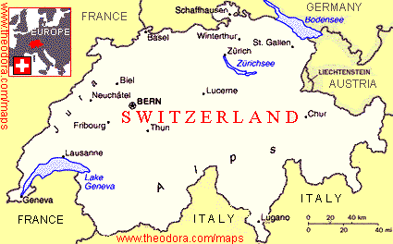
possible series valve position (TBR)
?
36”

Slide 41
Gate Valve Repair Options: Rock or Hard Place? (iii)
Plan A: Develop & test backfill and recovery protocol, THEN :
A1: Vent tube and fix the valve
  Backfill tube, release bonnet , & crane out mechanism
  Repair (somehow), reinstall & test
  Pump down & bake (as required)
    + May figure out what is wrong with this (all?) valves
    - Extended tube vent (more water adsorbed for a given concentration)
    - Risk of guessing wrong about how to repair, parts to replace
    - Still the same old shi++y gate valve when you’re done
or… A2: Vent tube and replace the valve entirely
  Backfill tube & remove bad gate valve
  Install replacement valve & test
  Pump down & bake (as required)
    + Can probably figure out what is wrong, once it’s out on the test bench
    - Extended tube vent (more water adsorbed)
or…A3: Close valve once (Plan C style), then gut & cap it, leave empty shell
  Close bad valve one last time; regenerate & vent CP
  Cut in and install a new valve in series with the failed one (BT still under vacuum)
  Quickly vent beamtube & reopen failed valve
  Crane out failed mechanism, then cap & reinstall bonnet on empty shell
  Pump down & bake (as required)
    + Can probably figure out what is wrong, once guts are out on the bench
    + Very short tube vent required
    - Need space for series valve

Slide 42
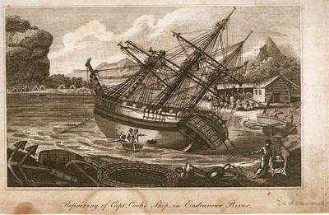
Gate Valve Repair Options: Rock or Hard Place? (iv)
How can we buy time?
Control atmosphere around the valve stem
  Install “non-vacuum” sealed enclosure
  Backfill with dry air or other gas
    Tempting to try gases with less index noise… but they have high permeation rates, maybe little to gain
  May use a flexible membrane sealed over valve ( “Fothering” in maritime parlance)
    Must reinforce to take atm
  Could pump in emergency
    Dangerous, but…
    If leak accelerates, nothing to lose

Slide 43
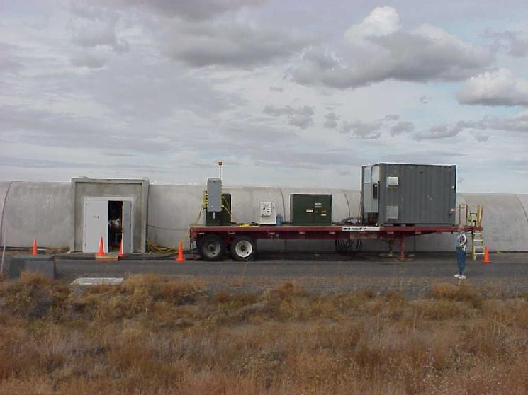
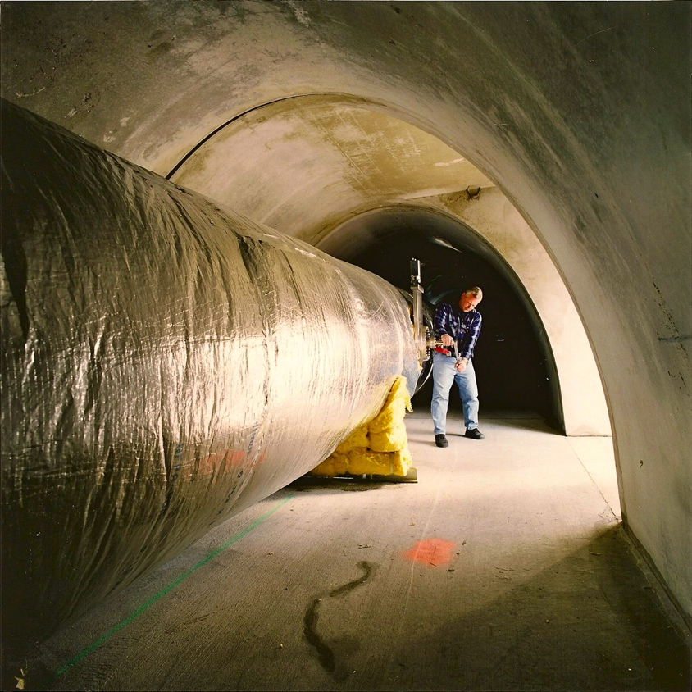
Refresher: Original I²R Bakeout to Desorb Water
Glass wool insulation, R = 4.3 m²K/W, t = 15 cm
I_{DC} = 2,000 A (surplus FNAL magnet supplies)
Soak ~ 4 weeks @ 150ºC
Cryopumps every 250 m; ports later valved off
Final J(H₂0) < 2e-17 Tl/s/cm
FY97$6.5M for both sites
➔OVERKILL

Slide 44
Bakeout Results (Hanford)

Slide 45
Revisiting the J(H₂O) Requirement
Consider 2- and 15- pump cases
+ cryopumps at ends
Assign S_{h}^{1/2}(H₂0) < 0.1 x min aL curve¹
➔S_{h}^{1/2} (H₂0) < 2.6 x 10⁻²⁵ Hz^{-1/2}
Then², for 2 pumps
J(H₂O)_{2p} < 2.0 x 10⁻¹⁵ T l s⁻¹ cm⁻²
and for 15 pumps
J(H₂O)_{15p} < 4.3 x 10⁻¹⁵ T l s⁻¹ cm⁻²
(no leaks, just autogenous water; F_{i} = 534 l/s)
2 pumps
15 pumps
¹ T1400177, Fig. 3, “BNS Optimized 125W”
² T1500202
NB: 1 T l s⁻¹ cm⁻² = 1.33 x 10³ W m⁻²

Slide 46
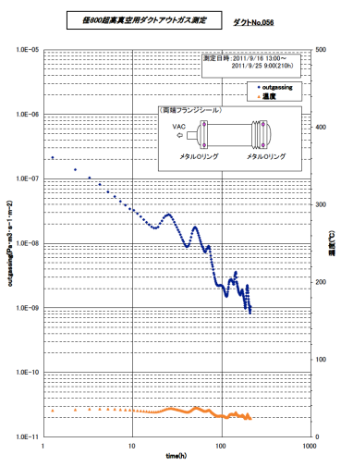
Unbaked Water Outgassing
(norm. to 1000 hours)
Weiss et al, T970111
LHO beamtube
J(H₂O) ~ 8 x 10⁻¹² T l s⁻¹ cm⁻² x (1000 h)/t
Li and Dylla (1993)
Electropolished 304L
10 ppm water content air re-exposure
J(H₂O) ~ 4 x 10⁻¹² T l s⁻¹ cm⁻² x (1000 h)/t
Saito et al (KAGRA, 2011)
ECB 304L, 200C conditioning bake
-40C dewpoint (127 ppm) re-exposure
J(H₂O) ~ 2 x 10⁻¹³ T l s⁻¹ cm⁻² x (1000 h)/t
Passive desorption @ ambient T too weak (t > 5 yr)
Modest bake probably required
For “controlled backfill” scenarios, can assist by:
  Ultra-dry backfill (< 1 ppm, -75C dewpoint)
  Minimize atm. exposure time
Summer heat helps
Weiss et al, T940090
BTD at CB&I
J(H₂O) ~ 3 x 10⁻¹² T l s⁻¹ cm⁻² x (1000 h)/t
(~ 10⁻¹⁶ T l s⁻¹ cm⁻² post-bake)

Slide 47
Modeled desorption with step-approximated seasonal temperature profile included (preliminary)
Constant 27C
now
Seasonal, 10C – 48C
leak fixed
R. Weiss, 6/9/2015

Slide 48
Easy-Bake A: Operation Endless Summer?
Duct hot air through the BTE & heat tube by convection
BTE compatible with > 50C internal temperature (60C? 80C?)
Install pumps in local cooled enclosures at each pump port
Relocate network, instruments, electrical outside temporarily
Rent LNG space heaters & fans
Blanket/electrically heat gates at endpoints
Possible Problems:
BTE a poor insulator (R ~ 1.3 M² K/W); only in summer?
LLO Y no longer has midpoint valve! :^( (maybe have to replace it)
Effect on BTE seam sealants?
Maintenance/repair on guided supports & insulators?
Max. T too limited to degas in tolerable period?
NEEDS STUDY

Slide 49
Easy-Bake B: Operation Viscous Breeze?
Piecewise bake with reusable local heater & blanket sets
Flow dry purge from completed toward future sections
Viscous flow entrains vapor w/out (much) redeposition (?)
Crew “leapfrogs” heated section to reposition blankets
Possible Problems:
Flow gas, while rarified, still needs to be very dry
Only effective (even theoretically) in narrow (P,T,v) regime
Turbulence in wake of baffles ?
Sustainable over module length?
Continuous high-volume pumping (and production) required
Total time to complete module in steps may be much longer
Never been tried
NEEDS STUDY

Slide 50
Things to do (i)
Complete & commission 3.75 km IP sets @ LLO, LHO
Procure, build & install 2km, 1.75km IP sets @ LLO
Complete & commission D3500 NEG’s @ LLO, LHO
Research & test new air-tolerant “HV Series” NEG’s
Develop, procure, fit UV baffles for 1200 and 2500 l/s IP’s
Develop & deploy GV11 environmental enclosure
Develop protocol to check all large gates @ both sites
Survey valve vendors & obtain specs & budgetary quotes
Study economical bake scenarios & establish limits
Study “industrial scale” dry backfill systems

Slide 51
Things to do (ii)
Upgrade and extend water ad/desorption model
Develop failsafe turbopump sets for unattended operation
Fabricate & condition BT-representative sample chambers
Build & characterize H₂O outgassing test system
Bench characterize backfill and bakeout protocols
Intermediate-scale qualification test
Procure & deploy site valve(s), backfill and bake hardware
Vent & fix/replace valve(s)
Perform forensics on failed GNB valve(s)
Recover & bake tube(s)

Slide 52
Troops & Treasure
?

Slide 53
EXTRA SLIDES

Slide 54
Squeeze film damping
Narrow gap between ETM and ESD reaction plate enhances viscous damping by residual gas
Increases thermal noise at low frequencies
Exacerbates penalty for any vacuum problem affecting pressure at end chambers
Possible mitigations
  Increased pumping
  Repair leaks, reduce outgassing
  Redesign ESD for larger gap
from LIGO-T0900582-v6 (10⁻⁸ torr H₂)

Slide 55
Electrostatic Test Mass Charging
Correlated w/ operation of ion pumps nearby
  Theory: PE due to UV / soft X rays from discharge (no direct line of sight)
  Induced σ ~ 10⁻¹² coulomb/cm² over hours-days
  Effect on input TM’s less; probably due to distance from local pumps
Wreaks havoc
  Interferes with electrostatic force drive operation
  Couples V noise from nearby circuits & ‘groundplanes’
  Couples mechanical noise from image charges in nearby conductors
  Intrinsic noise due to spontaneous charge dissipation & redistribution
Interim solution: seal off IP’s at ends
  no pumping of non-condensibles, except via beamtube
  Almost immediately hit both squeeze-film and gas index noise in rapidly improving noise budget
In progress now:
  Remote IP’s (250m from end, on beamtube pumpout ports)
    Reduced speed for noncondensibles
  NEG pumps at ETM chambers
    Reduced speed, limited life for gases other than H₂
    Poor margin against detector outgassing, leakage
Longer term:
  Chevron UV baffle retrofit to IP nozzles
    Degrades pump speed
  Reengineer TMP’s for continuous duty
    ultra-low vibration, fault-tolerance, backstreaming safety

Slide 56
Ion Pump UV emission
A. Kontos, 6/10/2015

Slide 57
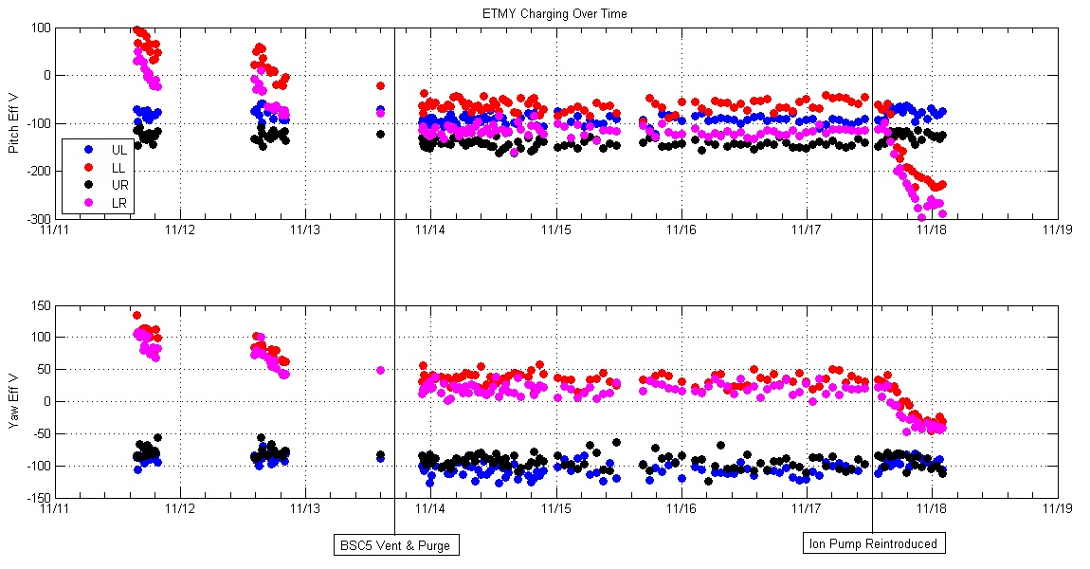
IP charging evidence (LHO)

Slide 58
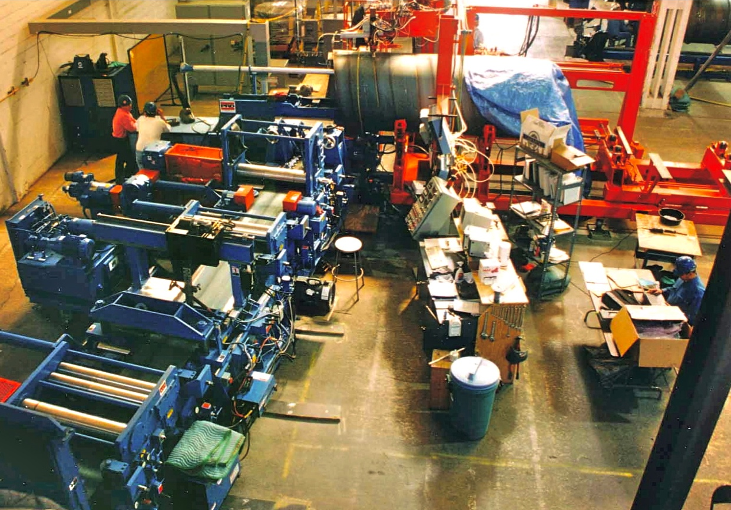
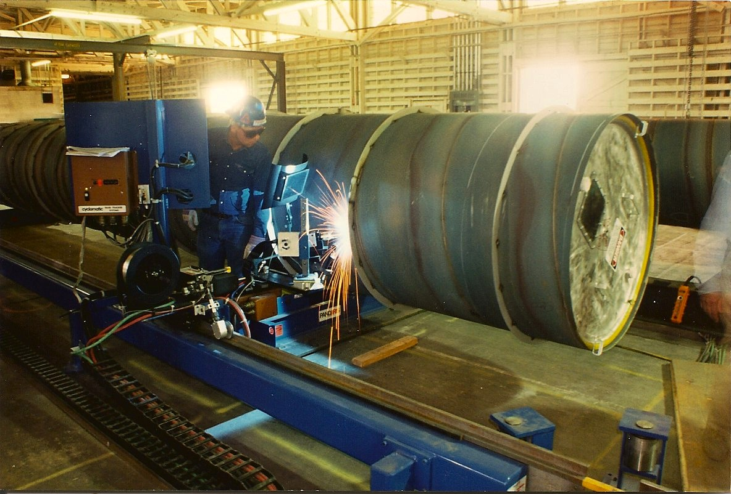
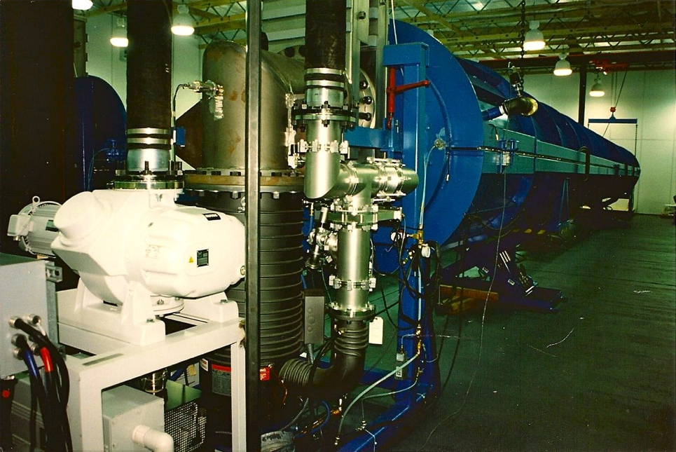
Beam Tube Overview
304L SS, 3.2 mm thick with external stiffeners
raw coiled stock air baked 36h @ 455C to deplete hydrogen
  J_{H2} < 10⁻¹³ Tl/s/cm²
  process developed by LIGO
prepared coil spiral-welded into 1.2m tube on modified culvert mill
16m sections cleaned, leak tested, and capped
FTIR analysis to confirm HC-free
Sections butt-welded together in travelling clean room at sites
Over 50 linear km of weld; no leaks
Tubes designed never to be vented after installation

Slide 59
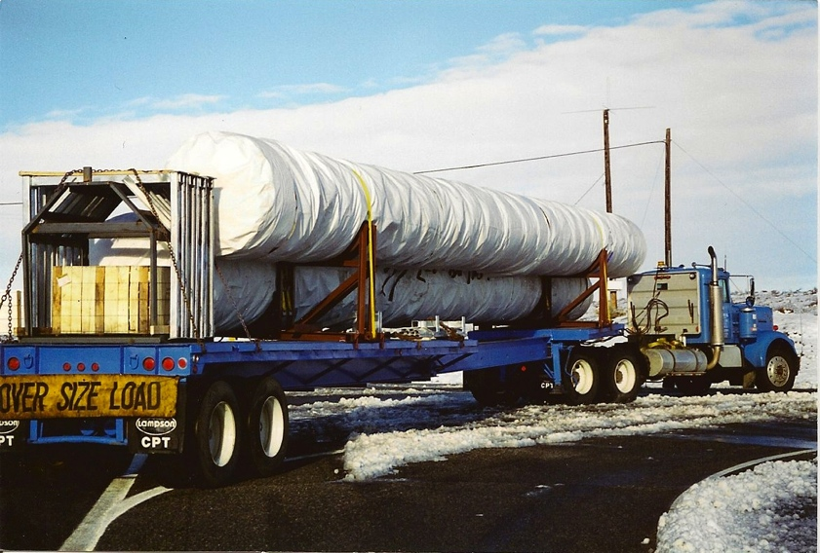
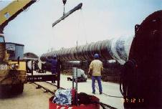
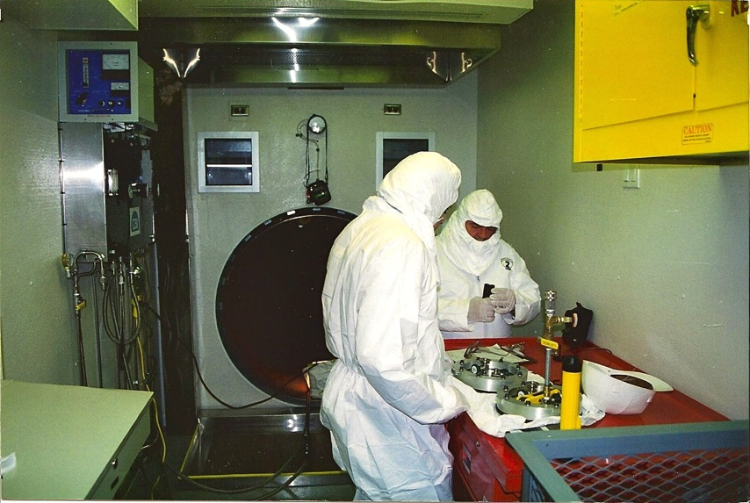
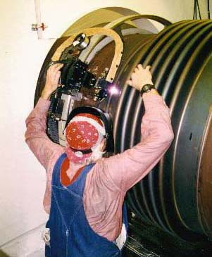


Field Assembly & welding
transport
position
field fitup
butt weld
leak check
next section

Slide 60


I²R Bakeout to Desorb Water (cont’d)

Slide 61

Beamtube Gate Valves
44” clear aperture
@ beamtube ends and midpoints
Custom low-shock dual-seal electric design
40” & 44” ID
Double O-ring gates & bonnet seals
independently pumped annulus*
Two actuator varieties: electric (ballscrew) and pneumatic (cylinder)
Custom design by GNB Corp.
* Main volume is connected when gate is open!

Slide 62



Residual Gas Index Fluctuation Noise
Statistical model verified by 40m interferometer experiment
ρ = gas number density (~ pressure)
α = optical polarizability (~ index)
w = beam radius
v₀ = most probable thermal speed
L₀ = arm length
ΔL = arm optical path difference
S. Whitcomb and MZ, Proc. 7th Marcel Grossmann Meeting on GR, R. Jantzen and G. Keiser, eds. World Scientific, Singapore (1996).

Slide 63


Residual Gas Pressure Limits in Beam Tubes
then
now
Initial Req

