Slide 1
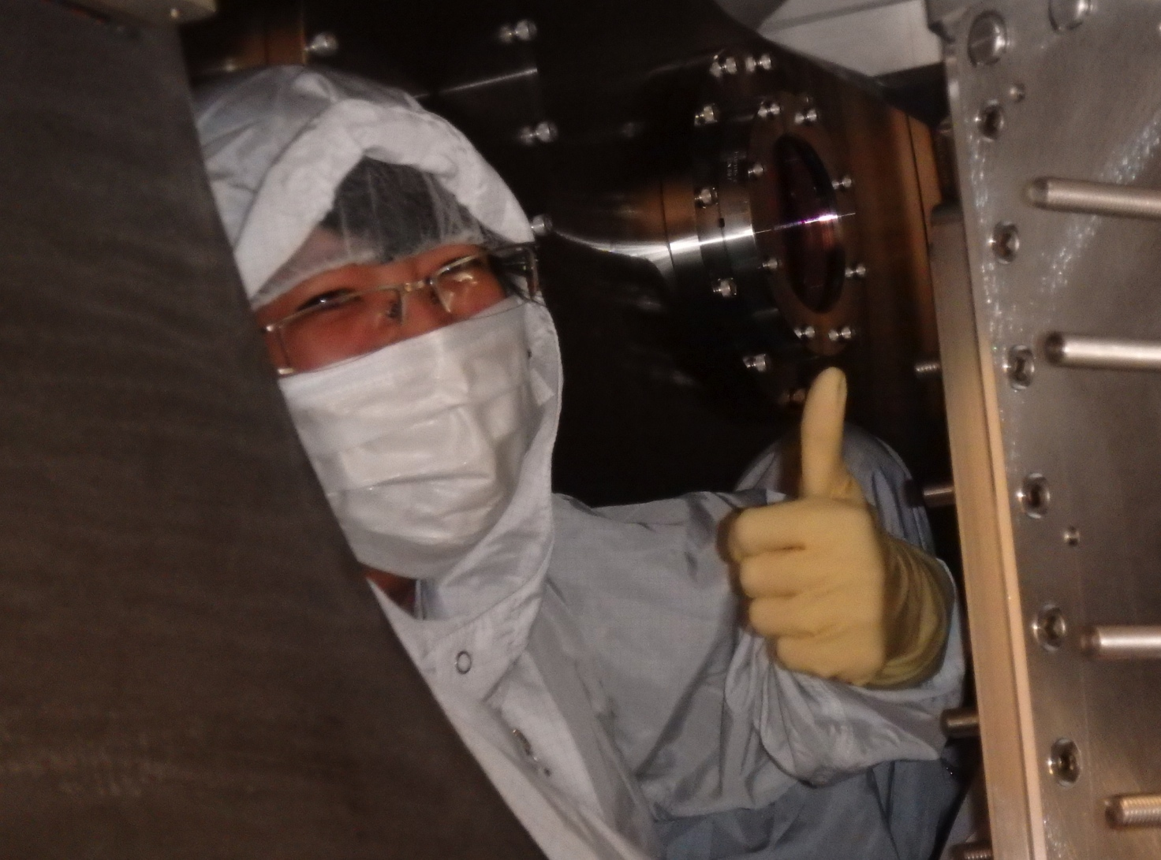
PEM pre-O1
1) Current status of PEM system pre-O1: 80/90% working
2) What we have learned so far about environmental coupling to the new instrument.
a) Magnetic: >10 below, glitches at LLO a couple below
b) Vibration, acoustic and seismic (scattering, jitter): 2 below, trucks don’t matter, at least O1, thanks to SEI!
c) RF: good so far, much more to check
d) Wind tilt: very local
e) Beam tube particulate glitches: like estimate of intersite rate
3) Coupling to electronics: some improvements
Robert Schofield, UO, Katie Banowetz, OSU, Terra Hardwick, LSU, Vinnie Roma, UO, Jordan Palamos, UO, Sudarshan Skarki, UO, Anamaria Effler, LSU, Ray Frey, UO, Dipongkar Talukder, UO, Hugh Radkins, LHO, Nutsinee Kijbunchoo, LHO, Richard McCarthy, LHO, Filiberto Clara, LHO

Slide 2
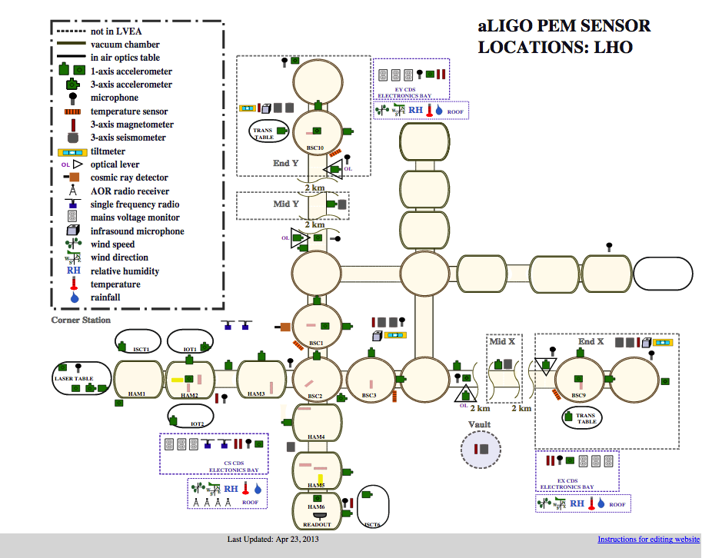
Current status of PEM pre-O1
Continuing installation
2) Recent tests of every accelerometer, microphone and magnetometer. Some cross-talk problems with accelerometers.
3) LIGOCam tuning
4) pem.ligo.org

Slide 3
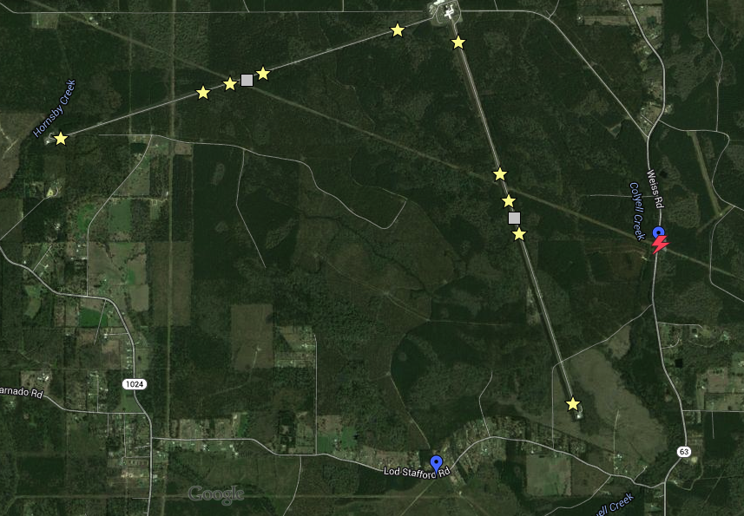
1.8 A
3.7e-7 T
3.3 A
Magnetic coupling
2.2 A
5.1e-7 T
2.3 A
3.5e-7 T
2.9 A
7.3e-7 T
5.6e-7 T
3.0 A
Coupling at end, corner station (link)
Coupling ended up at low end of pre-sensitive estimates (link)
3) Beam tube current glitches make low frequency coupling worse at LLO (link)
4) Studies of Schumann resonance detection and testing of sensitive magnetometers (link); estimates suggest not a problem in O1, but likely problem at higher sensitivity
5.1e-7 T
4.3e-7 T
2.7 A
7.0e-7 T
6.1 A
1.1e-7 T
0.5 A
Substation
1.3e-7 T
0.9 A

Slide 4
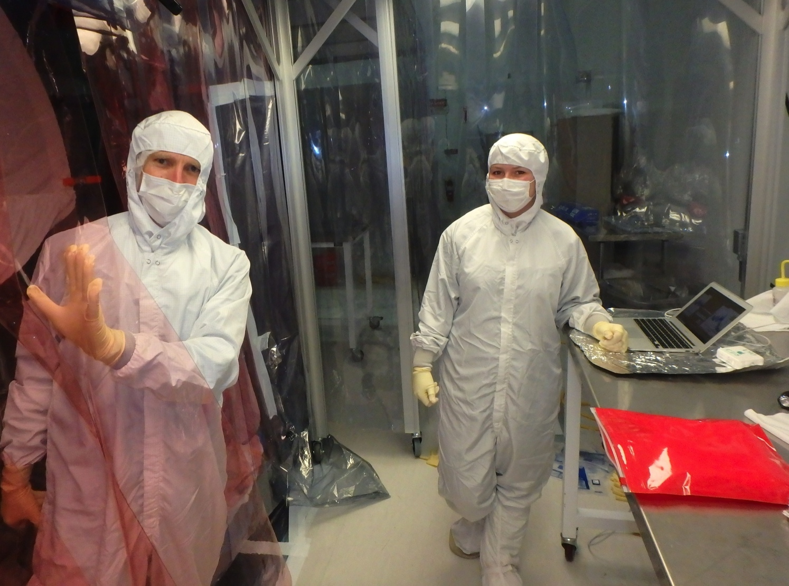
Vibration, acoustic and seismic
LVEA acoustic coupling (link)
Input beam jitter noise (source identification: link)
mount resonance tuning (link), (link)
IMC alignment (link)
Servos, ISS and special (link)
Coupling at LHO HAM6 (link), coupling at LLO similar, not scattering (link)
Blade spring and flexure resonances likely source of coupling at HAM6; possible damping solutions (link)
Scattering from OMC (link)
Scattering from beam tube baffles (link)

Slide 5
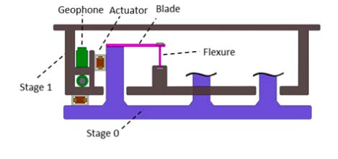
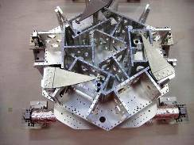
Greater Transmission at Blade and Flexure Resonances
Slide: Katie Banowetz
(2)
3 Flexures inside HAM connect the two stages
When HAM 6 was shaken, peaks appeared
Possibly the result of flexures vibrating at natural frequencies
Testing with Viton lined clamps to damp
(3)

Slide 6
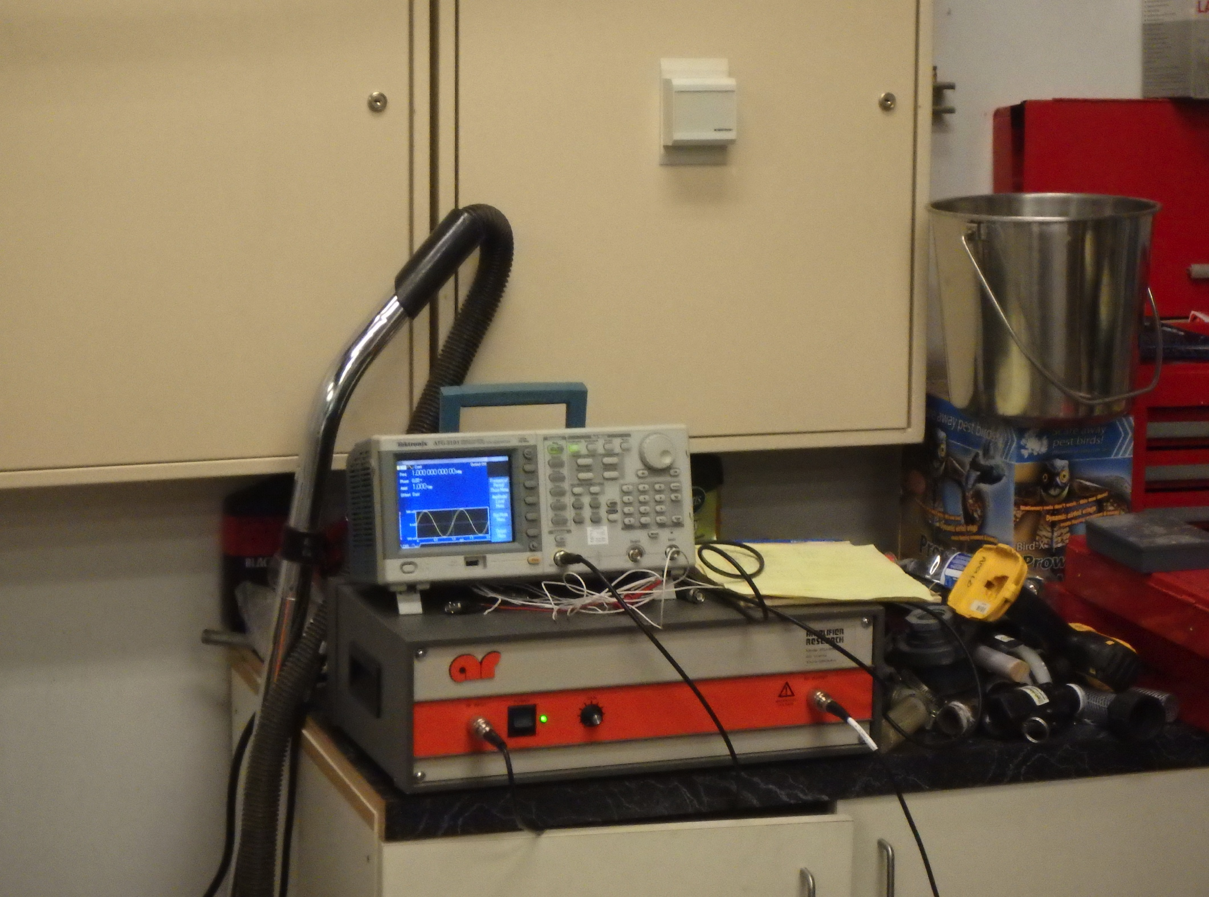
RF
RF recievers being installed. Four lambda/2 antennae inside, 4/2 wide band on roof
Injection at all modulation frequenies etc. to look for sensitivites. So far injections not loud enough to see in DARM
Jordans scanner

Slide 7
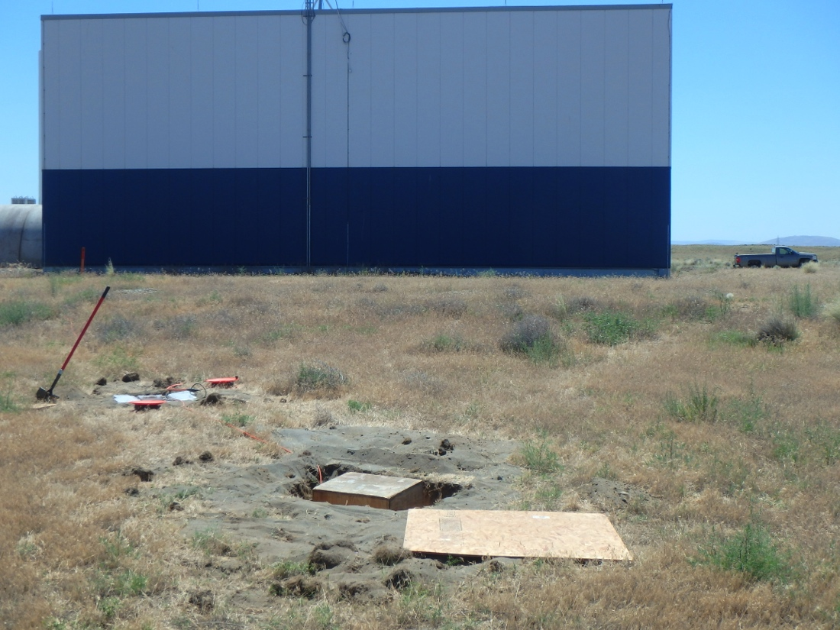
Wind tilt
One year of wind tilt at LHO (link)
Much lower tilt 40m from building (Link)
Lower tilt in beer garden (Link)

Slide 8
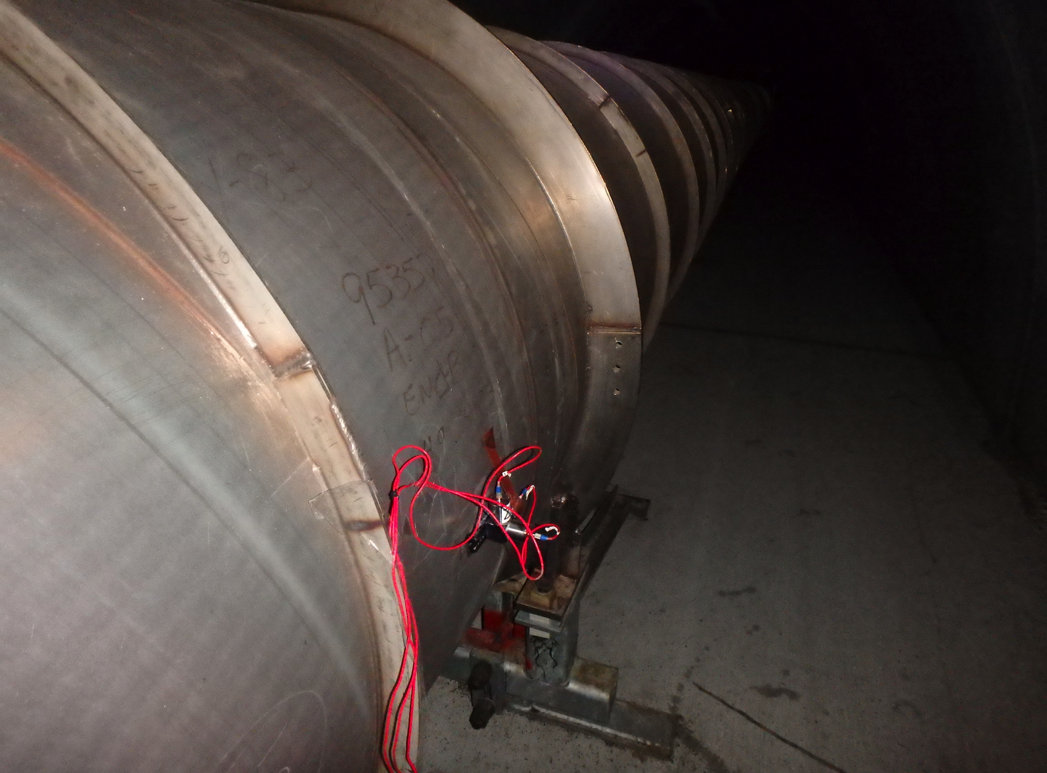
Beam Tube Particulate Glitching
Beam tube cleaning bumps at 0.1 g, 1000 Hz cause particulate glitches (link)
Proposed experiment to test ambient intersite coincidence rate: shake at several amplitudes and try to get rate vs. amplitude curve for projection

Slide 9
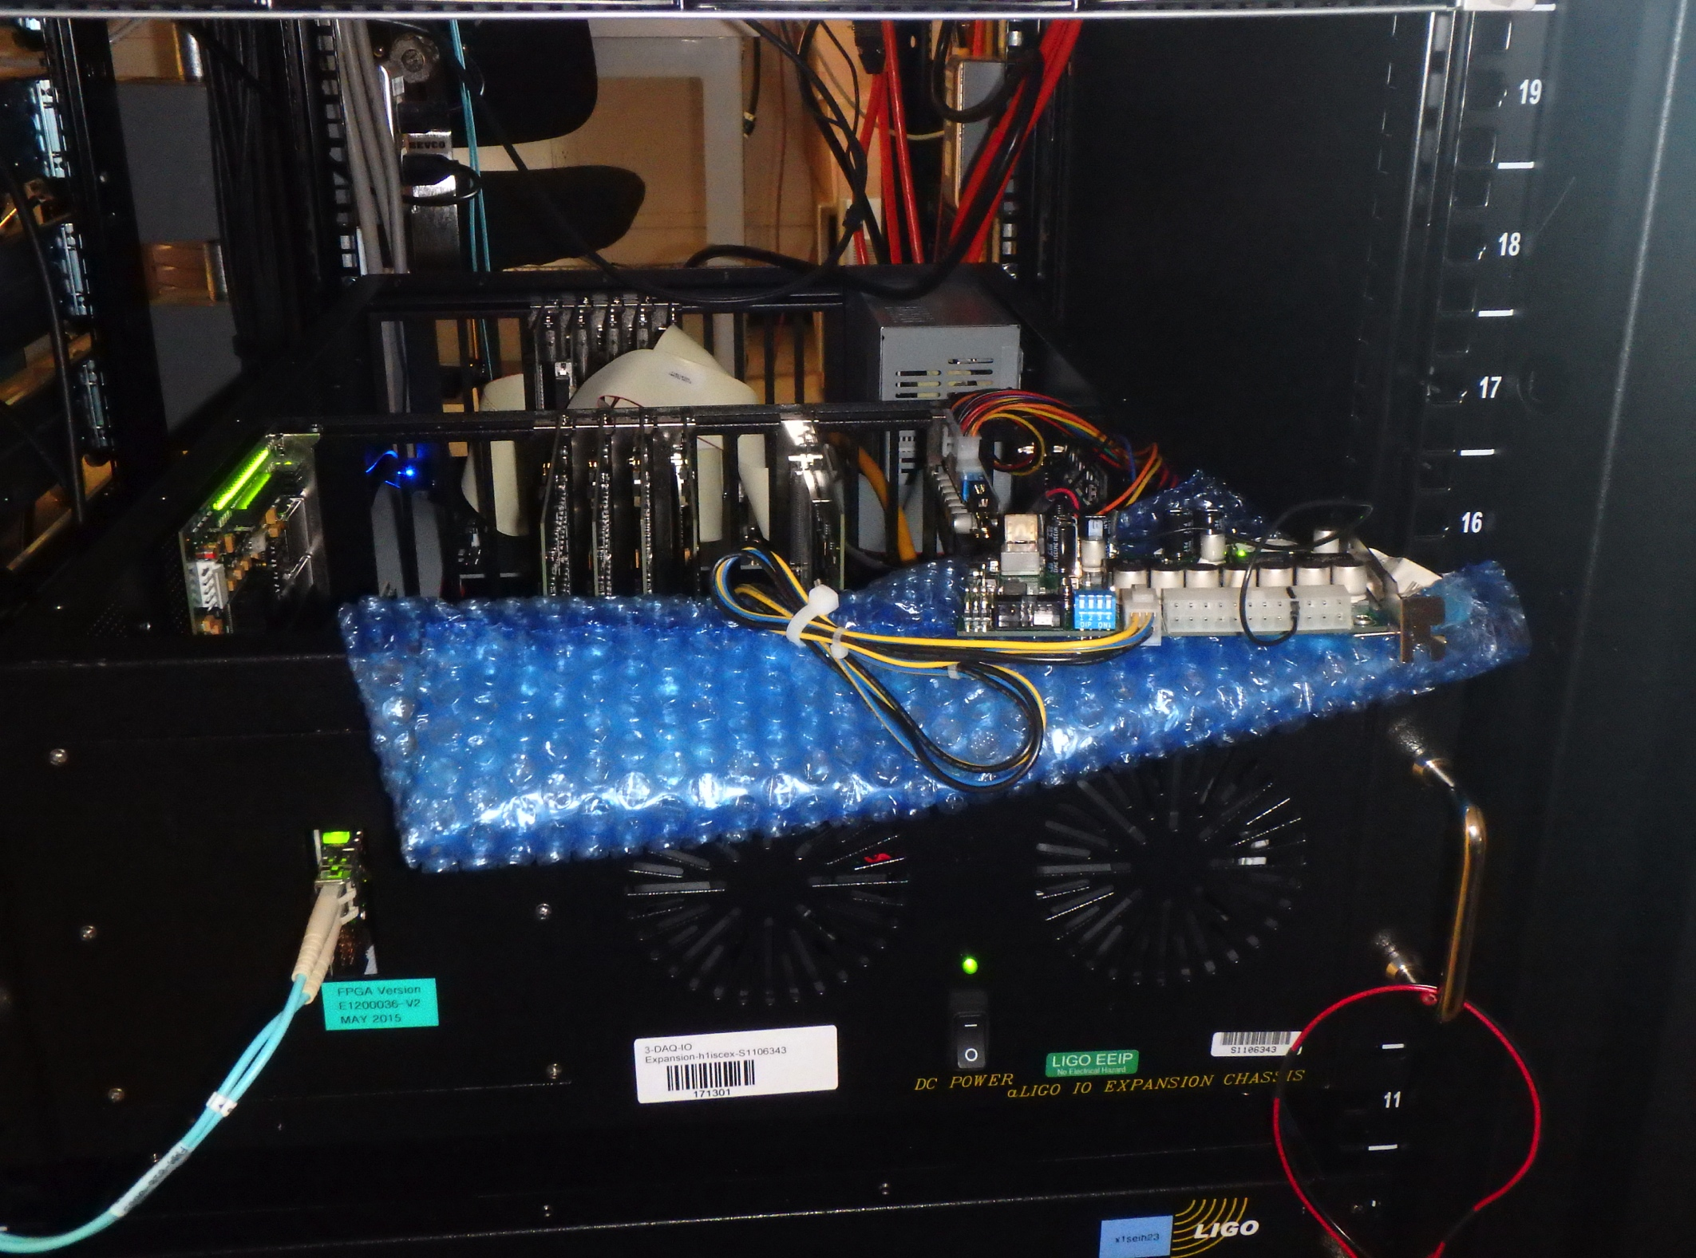
Coupling to electronics
1) I/O chasis coupling (link)
I/O power supply replaced with magnetically quieter supply
Separate power supply for I/O chasis fans still not installed
2) Rack magnetometers were useful in identifying combs from HWS and ring heater at LLO, LHO (link)

