Slide 1
Modeling Internal Friction in Amorphous Oxides Using Two-Level Systems
Chris Billman
9/18/2015

Slide 2
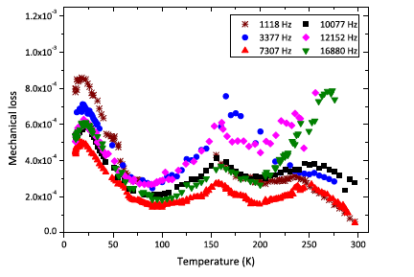
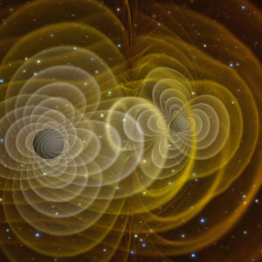
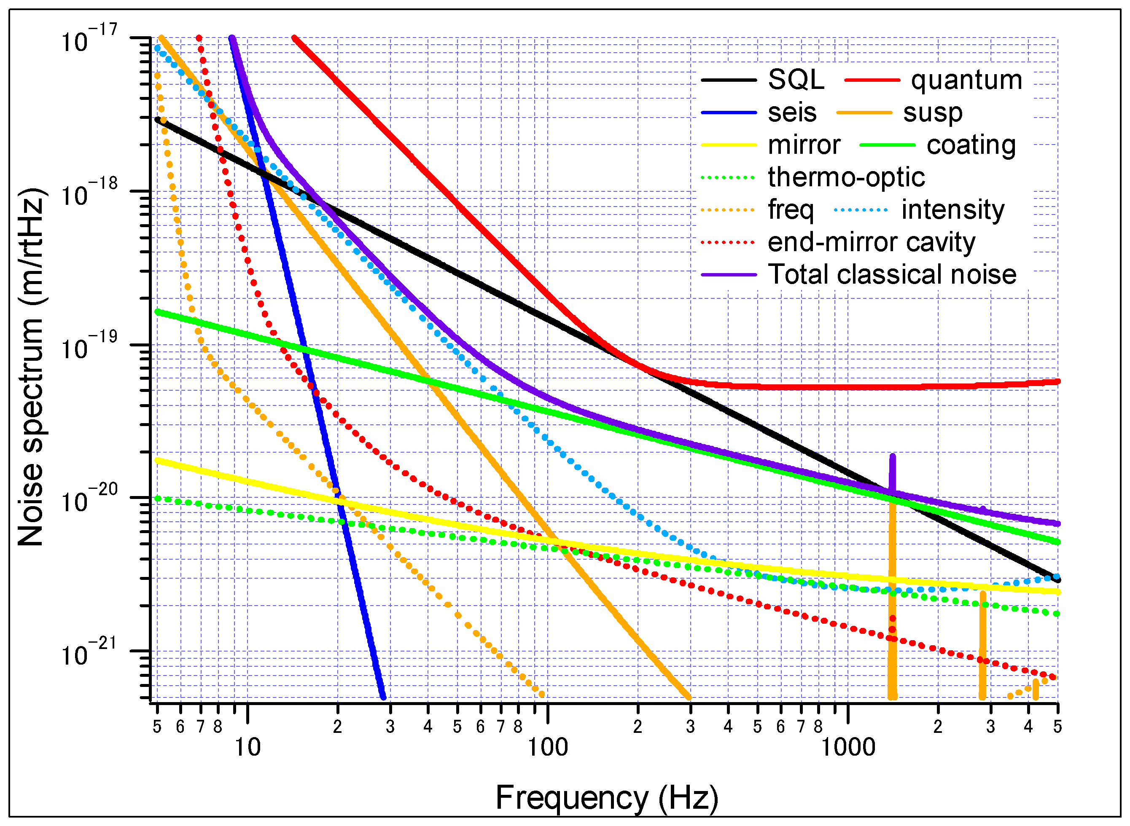
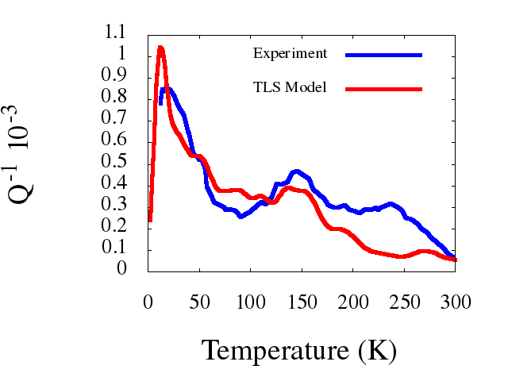
http://www.ligo.org/science/GW-Sources.php
I W Martin, Class. Quantum Grav. 2014.
http://10m-prototype.aei.uni-hannover.de/design-and-sensitivity

Slide 3
Outline
Describe Theory (W. A. Phillips Rep. Prog. Phys. 1987)
Introduce two-level systems (TLS)
Find the susceptibility
Calculate the internal friction
Describe Model: Classical molecular dynamics (MD)
Apply the model to Ta₂O₅ and SiO₂
Conclusion

Slide 4
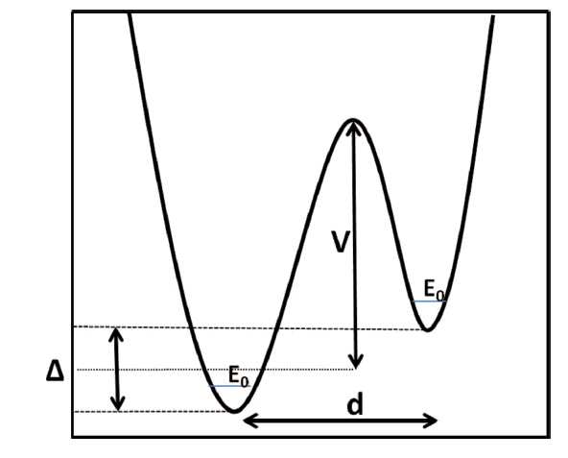
Two-Level System: The Basics
Rashid Hamdan, J. Phys. Chem 2014.

Slide 5
Two-Level System: The Basics

Slide 6
Two-Level System: Electric Susceptibility and Dipolar Relaxation

Slide 7
Two-Level System: Mechanical Loss

Slide 8
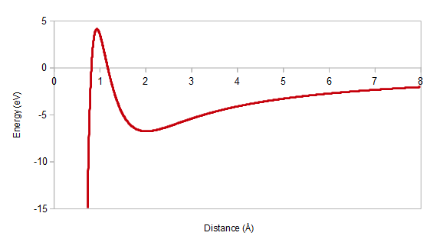
Classical MD Basics
Classical description of forces:
Built on F=ma
Interatomic potentials are modeled to fit experimental data (Density, elastic moduli, radial distribution functions, etc.)
Potentials were developed by Jonathan Trinastic.
https://en.wikipedia.org/wiki/Buckingham_potential

Slide 9
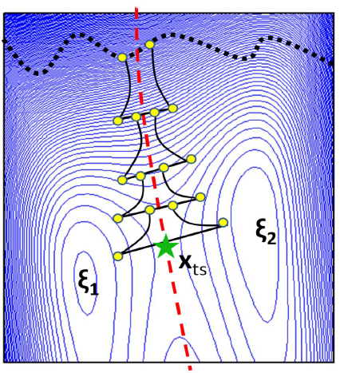
The TLS model in MD
Rashid Hamdan, unpublished.

Slide 10
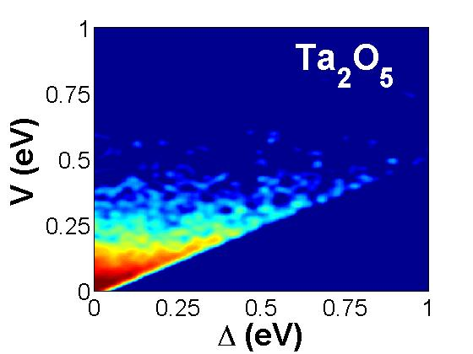
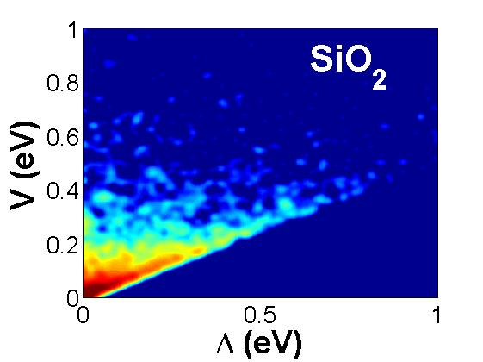
Model Inputs: TLS Distribution

Slide 11
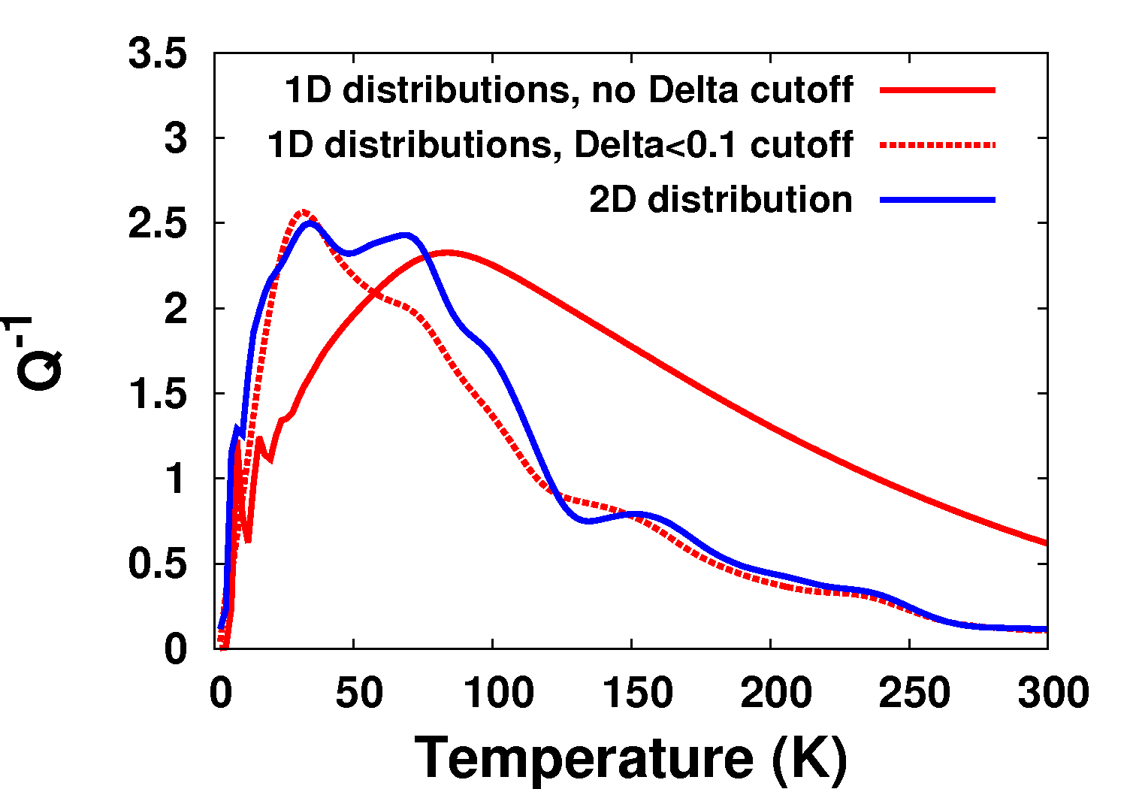
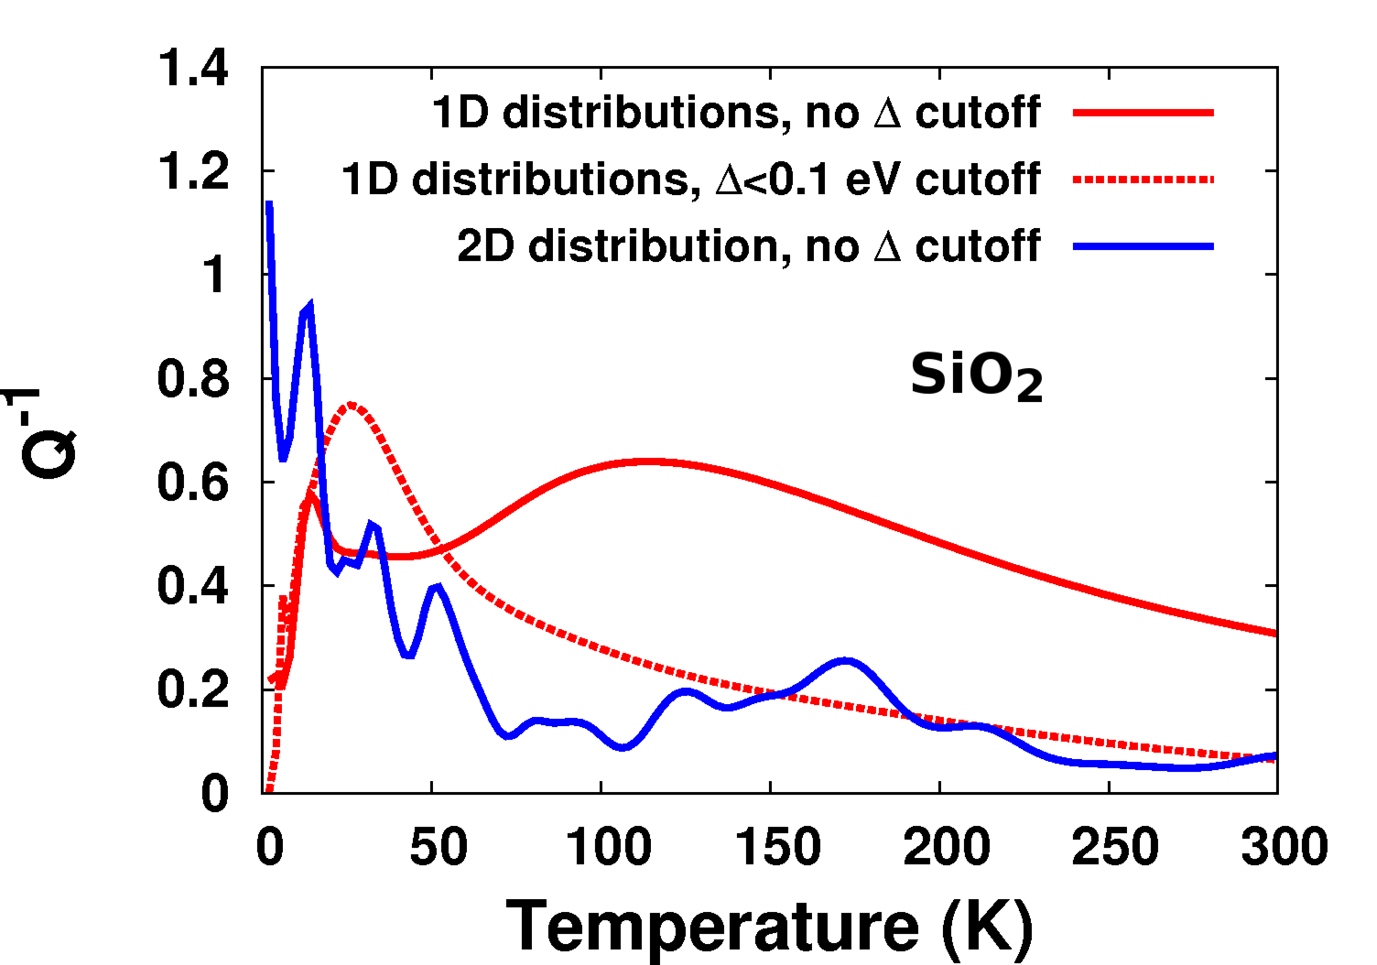
Mechanical Loss: Approximations
Asymmetry Cut-off
Previously, a 0.1 eV asymmetry cut-off was used to better match experiment.
Ta₂O₅

Slide 12
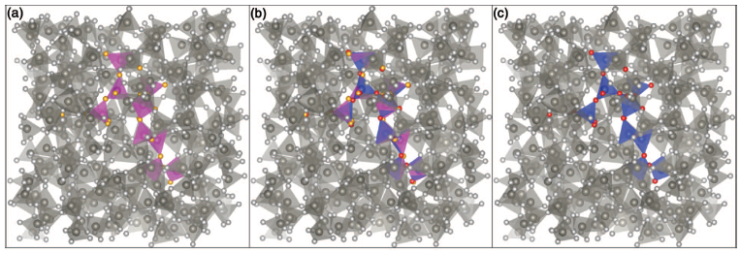
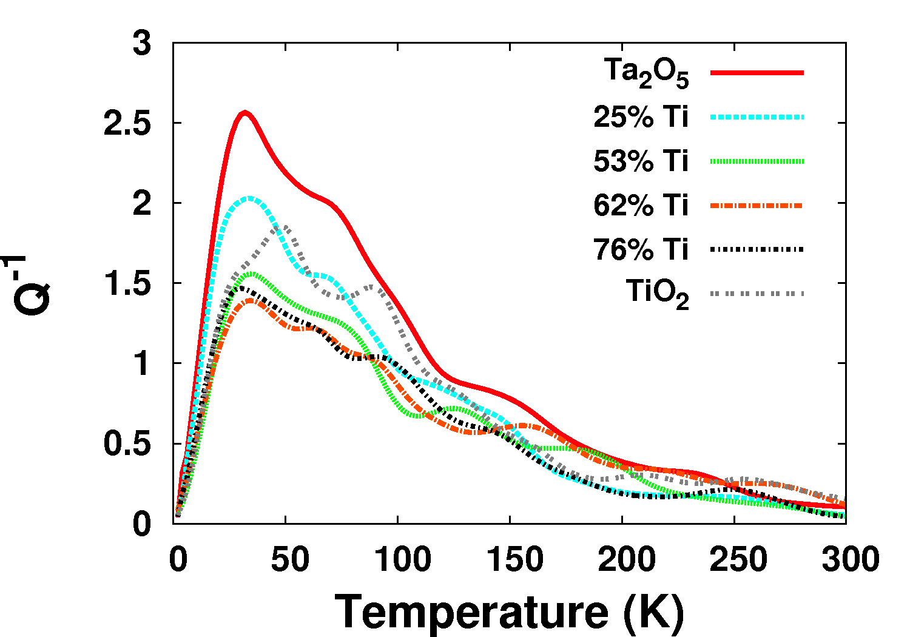
What our model contributes
Rashid Hamdan, J. Phys. Chem 2014.

Slide 13
Conclusion
The acoustic loss in amorphous solids is a consequence of applying a mechanical field to systems of dipoles, and can be derived from a model Hamiltonian where we assume two-level systems where symmetry is broken by an applied field.
Using classical molecular dynamics to provide inputs for the TLS model gives good agreement with the low temperature peak. Using the 2-D distribution, more detailed features can be seen at higher temperature.
For SiO₂ this shows a second peak at 150K which matches experiment.
For Ta₂O₅, it does not lead to a better description but better statistics may be required.
This allows us to
Understand the atomic transitions that cause internal friction
Predict internal friction under different doping
Determine what causes higher temperature peaks

Slide 14
Model Inputs: Elastic Moduli and Coupling

Slide 15
Model Inputs: Relaxation Time

