Slide 1
Gravitational Wave Experiments
Notes:
Thank you very much for giving me an opportunity to represent LIGO and wider interferometer GW detector community here.

Slide 2
TOC
About GW (I will skip most of it)
Interferometers and LIGO
  Time line
  Evolution from prototypes to 1st gen to 2nd gen and how
  Advanced LIGO’s first observation run, O1
  Future
Notes:
It’s kind of embarrassing to talk about GW in front of experts but I’ll do it quickly, then I’ll talk about interferometers and LIGO,
Specifically time line, how we reached so-called second-gen detectors, a bit about the performance of current detectors and especially the observation run LIGO is performing right now,
And finally I’ll talk a bit about the future.

Slide 3
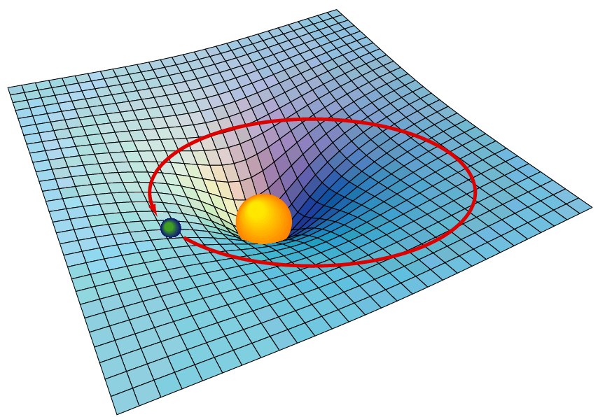
Spacetime is not entirely unlike stretchy fabric
It dynamically interacts with matters, stretching and shrinking as matters move while telling them where to move next.
Notes:
Bla bla bla.
And naturally,

Slide 4
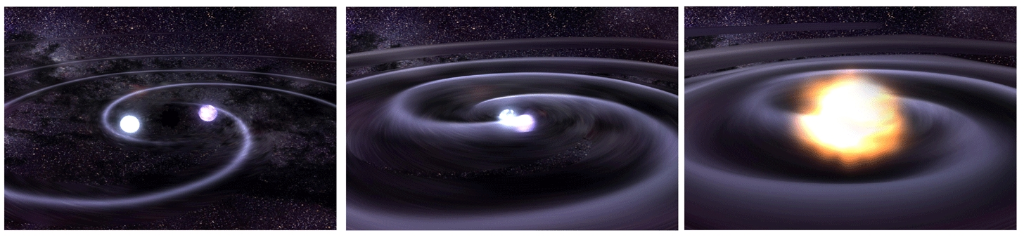
1917: Einstein’s prediction of
Gravitational Waves
GW = Wave solution of the linearized Einstein field equations in vacuum.
Ripple in spacetime when it is stirred up by rapid motions of large concentrations of matter or energy.
Credit: NASA
Notes:
As such, naturally, Einstein found that there’s a wave solution.

Slide 5

But GW is very, very small
There are stars accelerating/decelerating violently, which are the primary sources of GW.
  But the wave amplitude falls as 1/distance.
We’re talking about the “stretching” of spacetime by O(10⁻²¹) at most on the earth, for example.
Therefore it wasn’t until much later (1960’s) when the technology reached the point where people started to think seriously about the detection of GW.
GW generation in lab? No.
  Despite a popular myth, waving your hands around will NOT generate gravitational wave unless you live 10⁶ years or so. See appendix.
Notes:
OK, so I said rapid motion of large concentration of mass and energy.
But the thing is, GW is very very small.
Bla bla.

Slide 6
OK, so why do we want to detect GW?
After all, existence of GW was already experimentally confirmed by PSR B1913+16.
  And these people already got Nobel!

Slide 7
OK, so why do we want to detect GW?
Opening a new window for the Universe!
  Astronomy and Astrophysics
B. Sathyaprakash on GW astronomy and GR test on Wed.
P. Ajith on GW astronomy on Thu.

Slide 8
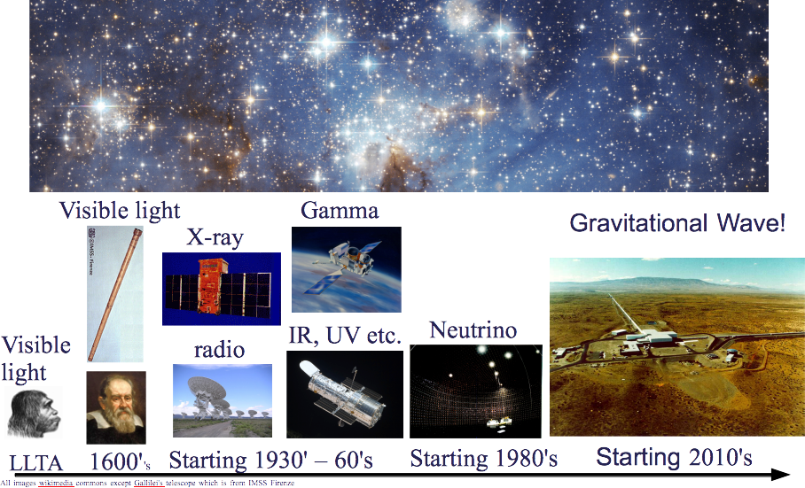
We want to open a new window…
Notes:
Whenever a new observation window is opened for observing universe, each of these greatly expanded our knowledge of universe.
We want to do the same with gravitational waves, and we want to start it now!

Slide 9
But who are trying other than tracking orbital decay of PSR B1913+16?

Slide 10
Turns out that there are many techniques for different frequency windows,
Direct measurement by looking at the “distance” between two or more free falling masses modulated by GW.
  Terrestrial Interferometers: This talk, O(1~1000) Hz source frequency
  Space Interferometers: O(weeks~seconds) source period
    LISA path finder just launched (Dec 2015)! Awesomeness!!
  Pulsar Timing Arrays: Dick Manchester’s talk, O(1~100 years) source period
  Doppler tracking of satellites (not actively pursued for now)
Direct measurement by looking at the the deformation of elastic body caused by GW tidal force.
  Cylinders, spheres, torsion resonators etc.: Narrow band AF
Measure the GW signature imprinted in the B-mode polarization of CMB
  Silvia Galli’s talk about Keplar and CMB polarization on Thu.: Source period O(universe’s age).

Slide 11
Many potentially interesting sources.

Slide 12
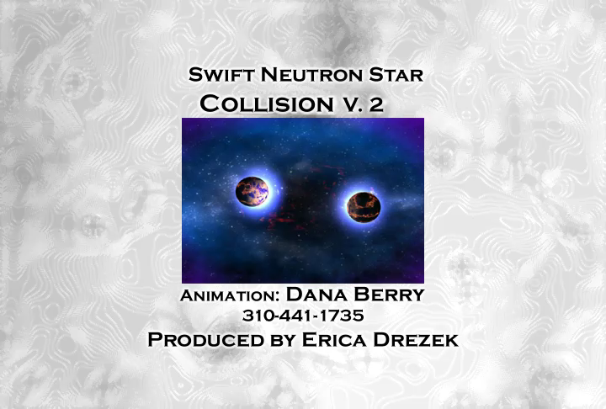
Coalescing binary system
NSNS, BHBH, NSBH
  Terrestrial interferometers for compact system
  Space IFOs for the massive BBH.
  PTAs for super massive BBH.
Artistic animation: NASA/Goddard Space Flight Center

Slide 13
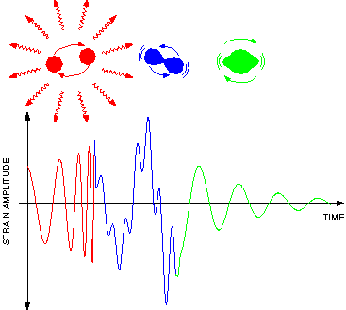
Coalescing binary system:
Numerical relativity is the key
Numerical relativity is the primary tool to know the waveform, and is essential for the detection and source parameter extraction.
  Luc Branchet today.
  Harald Pfeiffer on Wed.

Slide 14
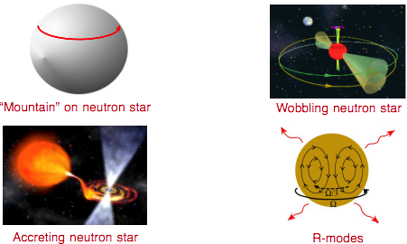
Periodic sources and Bursts
Periodic: Binary pulsars, spinning NS, X-ray binaries
Burst: e.g. supernovea with asymmetric collapse.
  Unknown waveform
  Mostly for terrestrial detectors
Notes:
I’ll skip this one

Slide 15
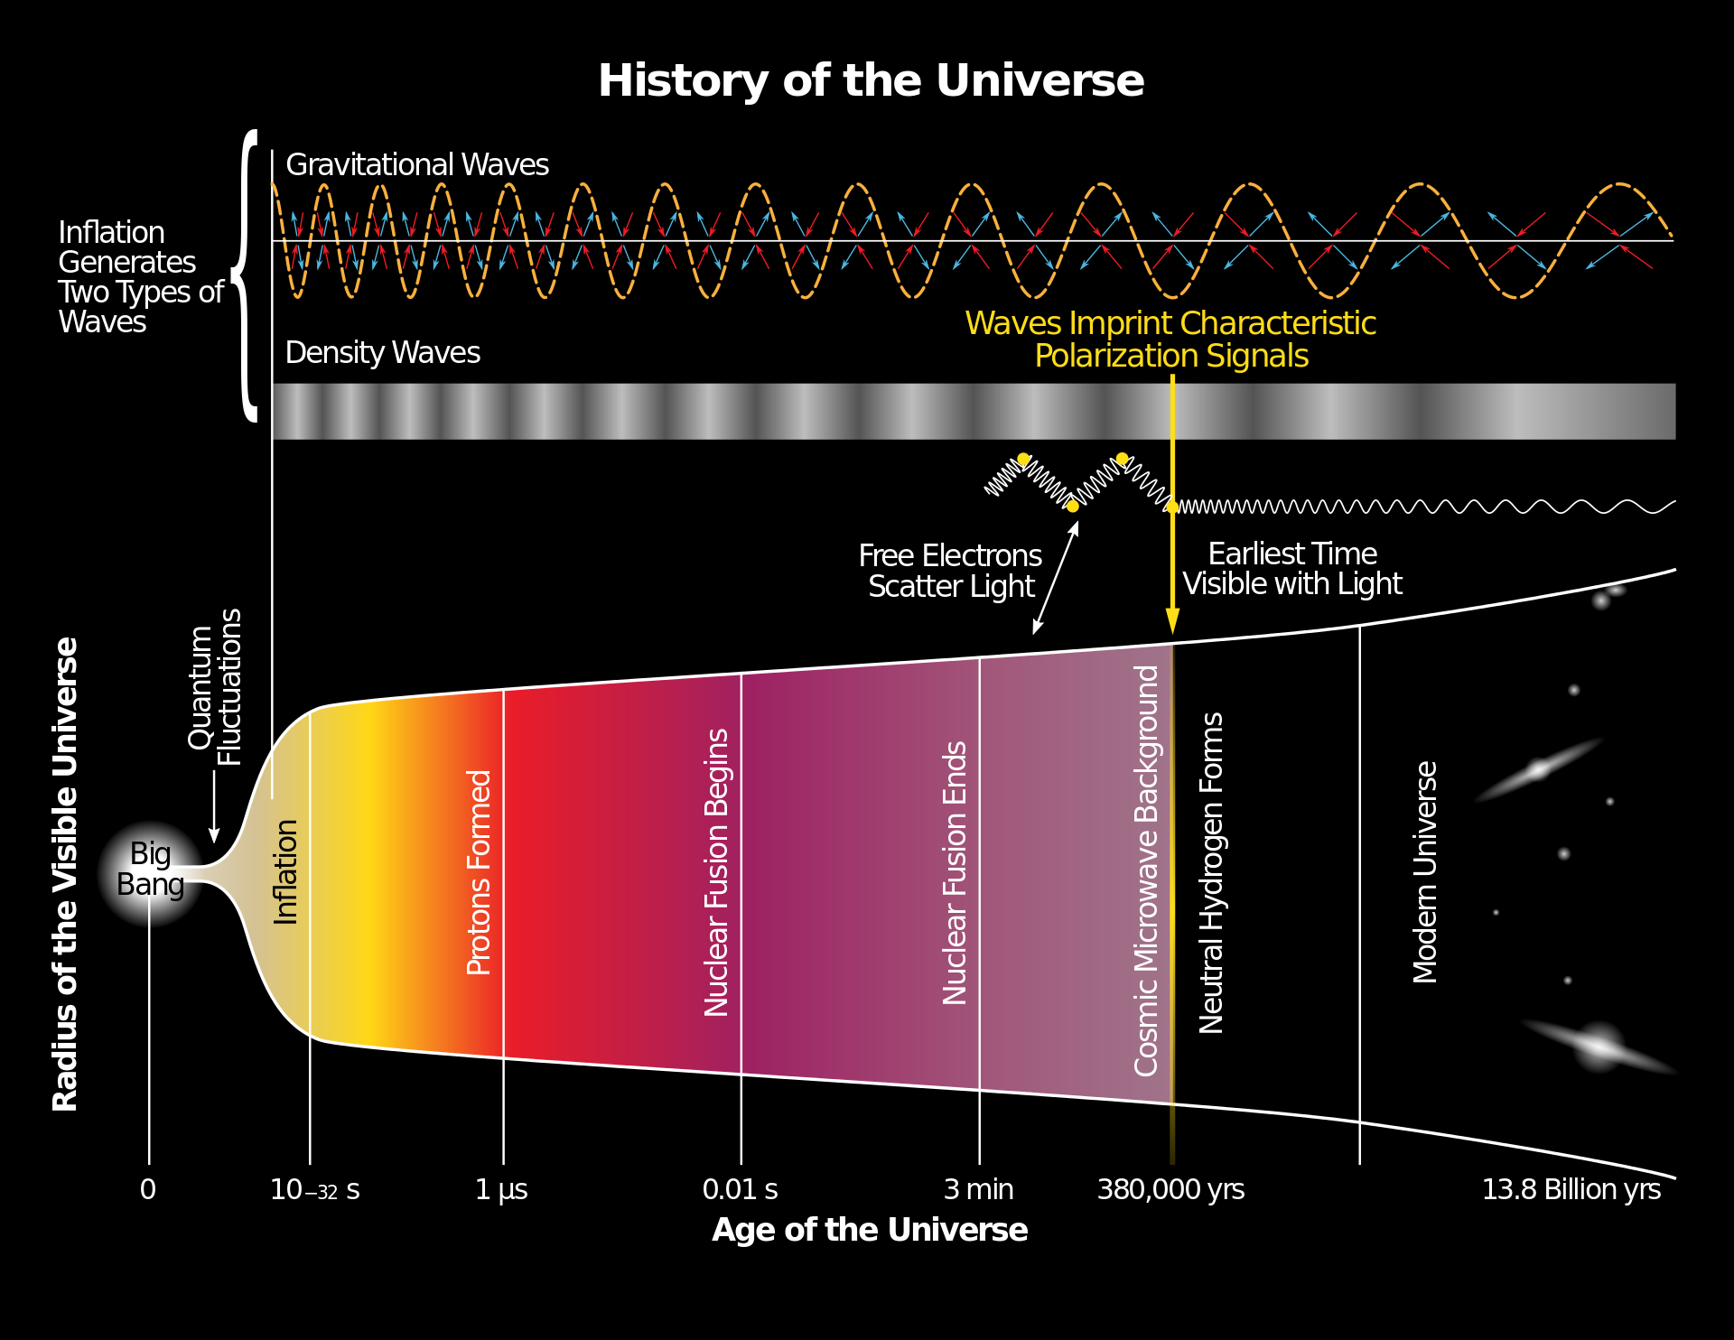
Stochastic GW
Superposition of many binary mergers, rotating NS, magnetars, supernovae
  Terrestrial IFO, Space IFO, PTA, depending on the frequency
Primordial GW
  Terrestrial and space IFO, PTA, and B-mode polarization searches, depending on the frequency

Slide 16
Interferometers and LIGO

Slide 17
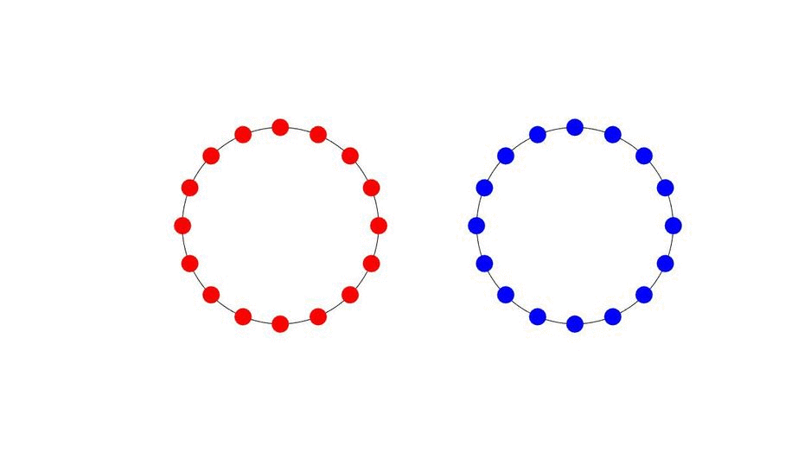
Effect of GW on free-falling masses
Distance between free-falling masses is stretched in one direction, compressed in the other.
Two polarizations.
Plus-polarized wave
X-polarized wave
Propagation axis
(perpendicular to screen)
“Plus”-polarized
“X”-polarized
Notes:
(skip)
And the quadrapole nature of GW means that, like tidal force,
Bla bla bla.
And this is directly exploited by many GW measurement experiments, which I’ll briefly talk about later.

Slide 18
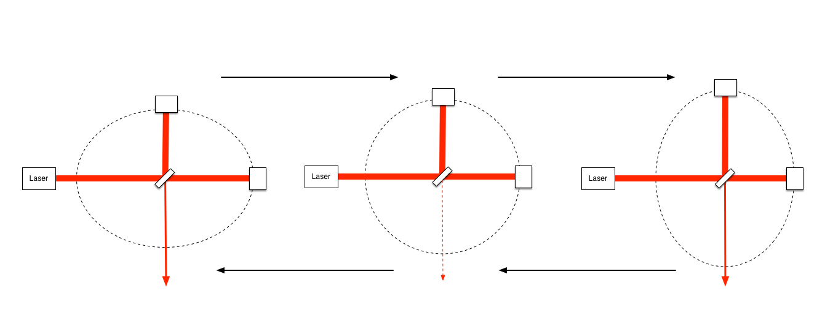
How interferometers detect GW
Example: Simple Michelson interferometer and “plus”-polarized GW travelling vertical to the screen.
GW information is encoded in the power of light coming out of IFO. We decode this light power.
An output of one IFO is one-dimensional time series not unlike a single microphone.
Notes:
Bla bla blah.

Slide 19
IFO is like a microphone that measures noise except when there’s an event
Noise is the single most important characteristic of an instrument.
We often use amplitude spectral density of the noise in terms of “equivalent strain” that would be imprinted in the instrument by GW.
The smaller the noise, the smaller signal we can detect, thus the farther we can listen to the events.

Slide 20
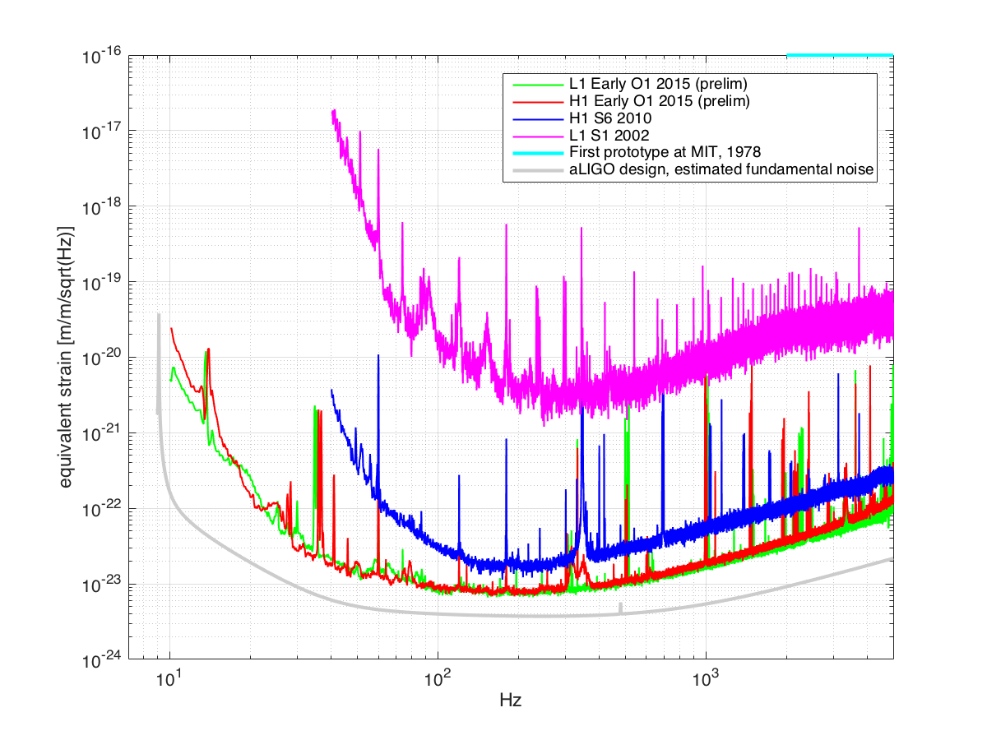
Evolution from Michelson prototype to iLIGO to aLIGO

Slide 21
From the very 1st prototype to iLIGO over-simplified
2m -> 4km
Michelson -> FP in the arms
(longer effective path length)
~50mW -> ~30W
frequency- and intensity- stabilized
Laser
Power recycling increases the available power by a better impedance matching.
Much better seismic isolation, (but not awesome).
Much better monolithic mirrors.
Notes:
All diffs are related to make noise smaller.
We use higher power laser, and added on mirror here for better use of power, both for optimized quantum noise.
Use of larger mirror contributes both to the better thermal and quantum noise.
We use monolithic suspension instead of steel wire suspension for better thermal noise.
We use sophisticated multi stage suspension and much better seismic isolation system for smaller external disturbances.

Slide 22
iLIGO on one page
6 science runs, with other projects
Exceeded the design sensitivity in S6, ~1yr data.
NSNS range ~20Mpc (Virgo cluster!)

Slide 23
1st gen (iLIGO) to 2nd gen (aLIGO) again over-simplified
Larger TMs with optimized beam size (better Brownian and quantum)
Better multi-stage suspension with monolithic last stage (better Brownian/seismic)
Laser
30W -> 120W
(better quantum noise)
Better active seismic isolation for low frequency performance
Smarter optical configuration (better use of power, optimized quantum noise)
Notes:
All diffs are related to make noise smaller.
More power for better quantum.
Bigger mirrors for better quantum (and thermal).
Better suspensions for better Brownian and seismic.
Better seismic isolation for better seismic.
Another mirror here to better use the power for better quantum noise.
I’ll explain each of these.

Slide 24
Quantum noise: Shot noise and radiation pressure noise
  Quantum Noise:
  Shot ∝ 1/sqrt(P) -> larger P,
  Radiation Pressure ∝ sqrt(P)
  -> larger mass
Larger Rad-press
Smaller Shot (larger P, better readout)
Notes:
First of all, quantum noise is the combination of shot noise and photon recoil noise,
both of which comes from the fact that the light is not a classical field but quantized.
Shot is inversely prop to sqrt(P), so you might want to make the power very large, but then the rad pressure will dominate at low frequency, so it’s a balancing act.
We made the laser larger and made the mirror larger to keep the recoil displacement smaller.

Slide 25
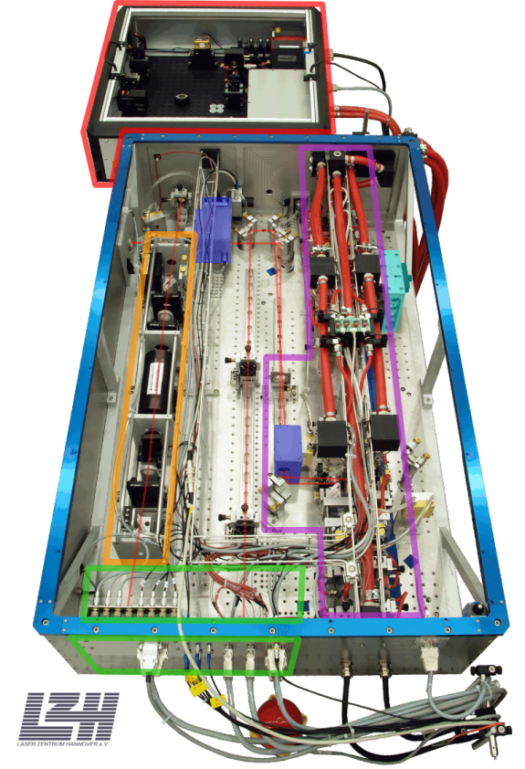
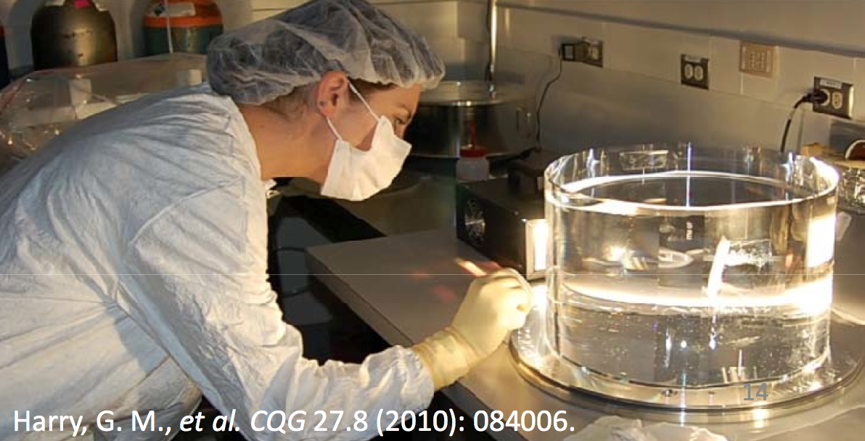
High power laser, bigger mirror
NPRO + 35W medium power amplifier used in iLIGO
180W high power stage for aLIGO

Slide 26
Quantum noise: Shot noise and radiation pressure noise
  Brownian motion:
  Monolithic suspension,
  Larger Mirror with optimized beam shape
Notes:
Brownian motion is the thermally excited motion of the mirror, it could be suspension, or bulk motion of the mirror, or thermal motion due to the mechanical loss in the coating.
Suspension thermal is reduced by using monolithic silica fiber suspension with very high Q.
Bulk brownian is suppressed by a larger mirror with an optimized beam shape.
And now the suspension thermal was reduced, and this high frequency part is dominated by the coating brownian.

Slide 27
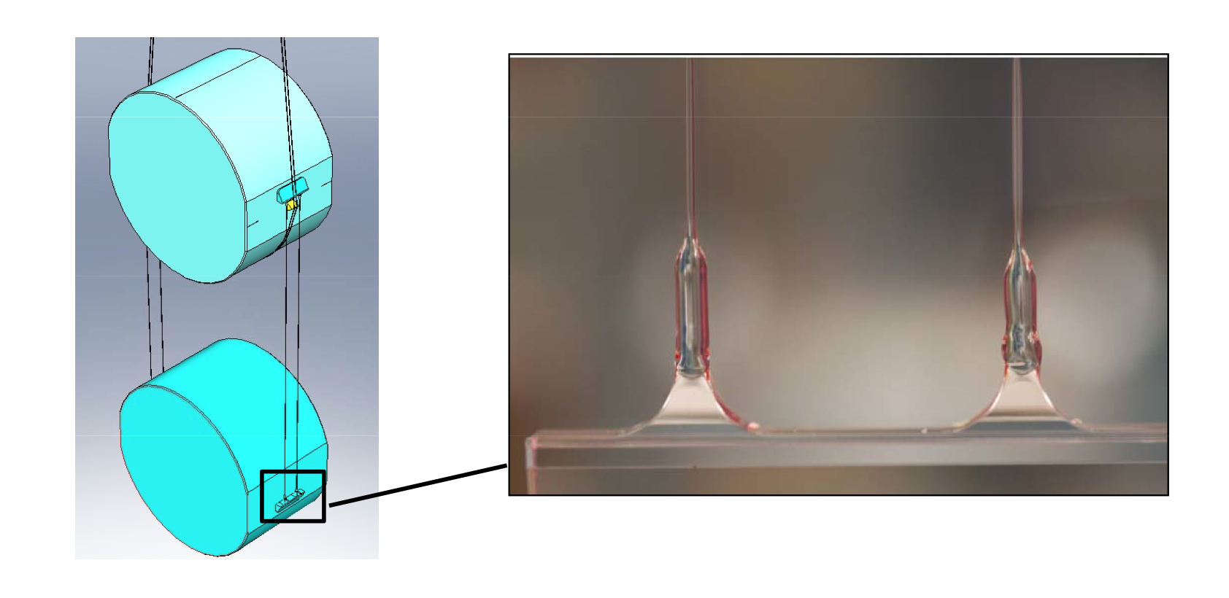
Smaller Brownian motion
Monolithic suspension for lower mechanical dissipation (think dissipation-fluctuation theorem) for pendular thermal motion
Larger mirror with optimized beam size reduce the sensitivity for thermal excitation of mirror deformation

Slide 28
Quantum noise: Shot noise and radiation pressure noise
  Seismic motion:
  Multistage suspension
  Active seismic platform
Notes:
And the seismic motion.
iLIGO seismic isolation was not that good. We learned, and made a next version. Which should bring this terrible thing down to this level

Slide 29
Seismic isolation
Multi-stage (quad) suspension, which is isolated by
  ISI (Internal Seismic Isolation) system, which is isolated by
    HEPI (Hydraulic External Pre-Isolator)

Slide 30
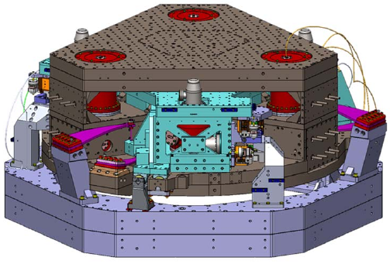
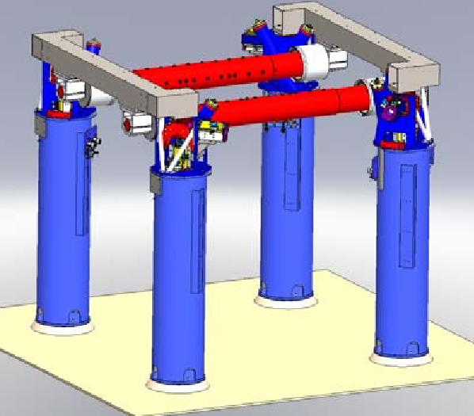
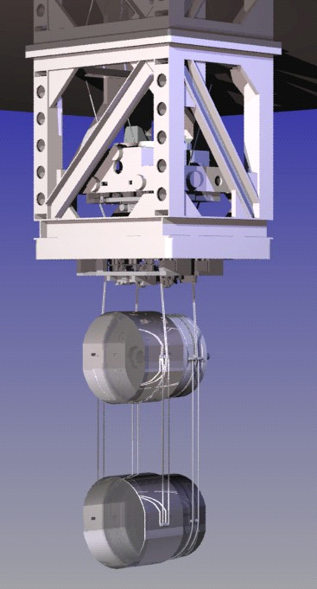
Seismic isolation
ISI
HEPI
Quad

Slide 31
(But fundamental noise sources are not the only ones we fight)
Technical noise: See appendix

Slide 32
Over-Simplified IFO Time Line
1970-80’s: Prototypes with O(1) to O(10) meters arms.
  MIT, Caltech, Garching, Glasgow among others.
1990’s: Mid-scale (TAMA, GEO), and then first gen large IFOs (LIGO, VIRGO) emerge. O(100) to O(1000) meters.
2000’s: Science runs by 1st gen detectors. LIGO finally exceeds its design sensitivity in 2010, reaching ~20Mpc NSNS range (Virgo cluster!).
LIGO (2010) and VIRGO (2011) go on hiatus for fundamental upgrade (“advanced” 2nd gen detectors).
2015: aLIGO’s first observation run, O1, started on Sep/18 with non-final configuration, ~40Mpc NSNS initially (but 60-80 now).
2016: O1 will likely end on Jan/14. Another O run (O2) after an upgrade. VIRGO will come back online.
2019(?): LIGO reaches its design sensitivity, ~180Mpc.
Notes:
I’ll skip this.
And I’d like to show you this in a graphical form, but before doing that I have to tell you how we quantify the performance of the instruments by noise.
Bla bla.
(20Mpc)
This was kind of a big deal because, frankly, it’s not like there’re many galaxies nearby, you know? So we’re like in this bubble void of any realistic source except super lucky coincidence, until we were able to listen to Virgo cluster, and from there on, source number is proportional to the cube of the reach, so we’re motivated more than ever!

Slide 33
aLIGO’s first observational run, O1

Slide 34
aLIGO’s first observational run, O1
First run using LIGO’s two “advanced” instruments separated by 3000km or 10ms.
Started on Sep/18/2015, run period ~ 4 months.
Non-final configuration
  20W instead of 120~150W
  End mirrors not final
  SRM not final
Both instruments running with unprecedented sensitivity, NSNS inspiral 60~80 Mpc (preliminary).
EM followup partnership in place.

Slide 35
Quantum noise: Shot noise and radiation pressure noise
Factor of 3 to 5 improvement over 1st Gen @ 100-300 Hz.
N(events) ∝ volume ∝ reach³
10 days obs > All 1st Gen obs combined!
Notes:
Going back to the noise spectrum, if you compare iligo and aligo now, there’s maybe a factor of 3 to 5 improvement over 100-300Hz band.

Slide 36
O1, cont’d
Non-negligible detection likelihood
  Let’s say NSNS merger happens 1/Mpc³/Myear
    “Realistic” (but uncertain) rate, LIGO-P0900125, arxiv 1003.2480
  Observing with 60Mpc reach will give us roughly 1/year event. If our double IFO duty factor is ~50%, 4 month run will give us O(0.1) event.

Slide 37
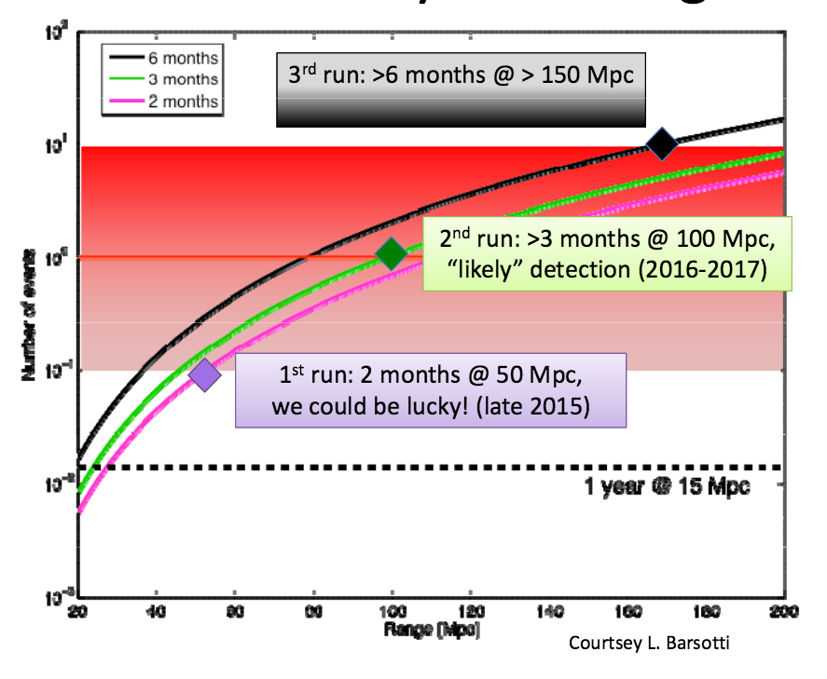
O1, optimistic guess
60- to 80-ish MPc, ~4Mo period, maybe ~2Mo coincidence?
G1400194
Notes:
X-axis is NSNS range, Y is the number of expected events, and three curves are …

Slide 38
What happens in the future?
LIGO repeats several upgrade-run cycles
  Because, in reality, there are many many technical noise that need to be eliminated before we can enjoy the benefits of any upgrade.
  Next upgrade before O2 will be the laser power (both), fixing Faraday (L1), and lots of technical noise hunting!
O2: ~100 Mpc, >3 Months in 2016, O(1) expected event.
O3: >150 Mpc, 6 Months, O(10) expected events.

Slide 39
And others will join soon!
Advanced VIRGO
  Installation/integration going on right now
  First “lock” expected in spring 2016, hopefully join O2 later
KAGRA
  Underground@Kamioka
  Cryogenic
  Installing initial version. Final version 2018
LIGO-India (will talk later)

Slide 40
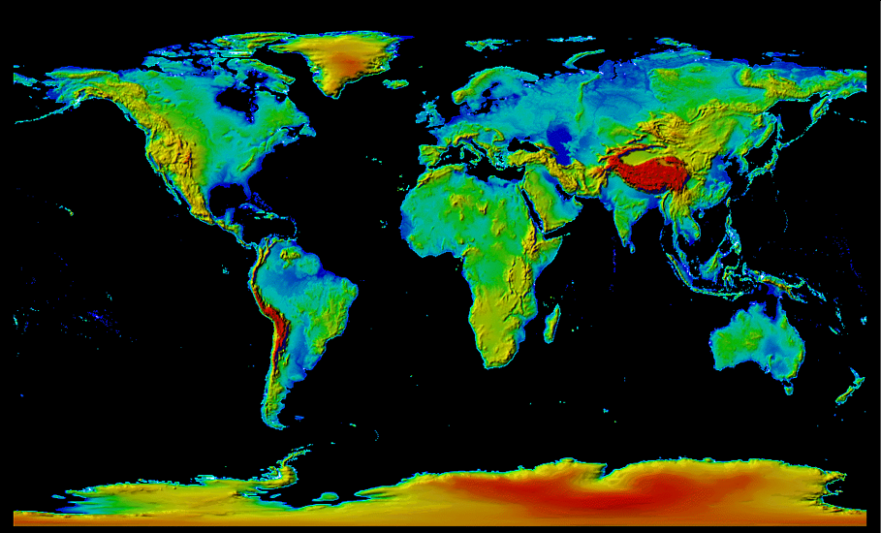

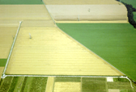
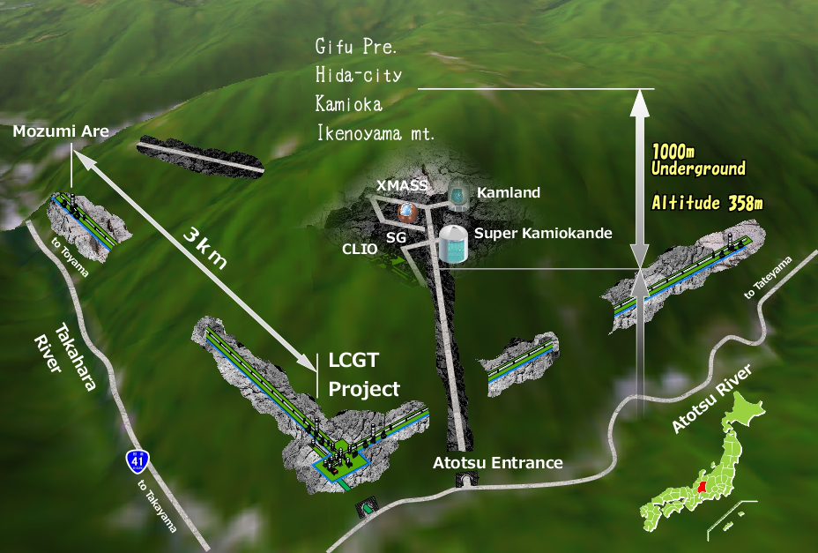


Network of km-scale instruments
GEO600
(600m folded = 1200m, operating)
aLIGO Hanford
(4km, operating)
aLIGO Livingston
(4km, operating)
AdVIRGO
(3km, ~2016)
KAGRA
(3km, 2018)
LIGO India
(4km, ~2020)
Notes:
As you see, we’re right now witnessing the formation of global network of 2nd gen detectors.
This is pretty exciting prospect.

Slide 41
Do we need more than one instrument?
It’s all about sky localization.
Being an immobile “microphone”, each instrument cannot pinpoint the sky location of an event, even though it has an antenna pattern.
Need three instruments for triangulation.
  Each IFO has its antenna pattern as well as polarization sensitivity, so it’s more than triangulation.
The more instruments out of a plane we have, the tighter the sky localization.

Slide 42
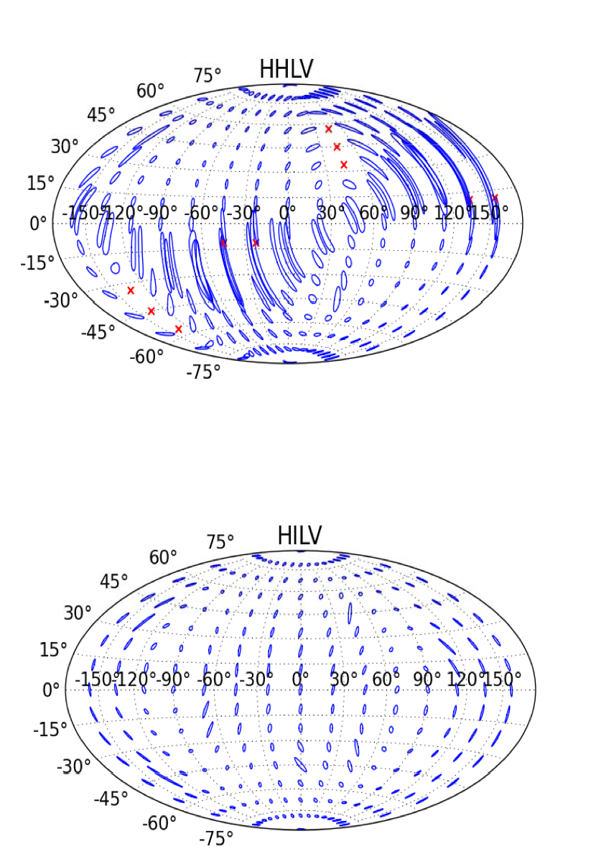
That’s where LIGO India comes in
Localization with Hanford, Livingston and Virgo
Localization with Hanford, Livingston, India and Virgo

Slide 43
LIGO India
LIGO US will provide components for one aLIGO instrument
  Components were put on storage at LHO.
LIGO India will provide facility, staffs and operating funds through 2026
Expected to come online ~2020
Awaiting for final approval by Indian government
http://gw-indigo.org

Slide 44
And then? We’ll go 3rd Gen.
Manipulate quantum noise by using non-classical field: Squeezing
  Simple squeezing demonstrated on GEO and then iLIGO.
Notes:
1Gpc : z~2
10Gpc:

Slide 45
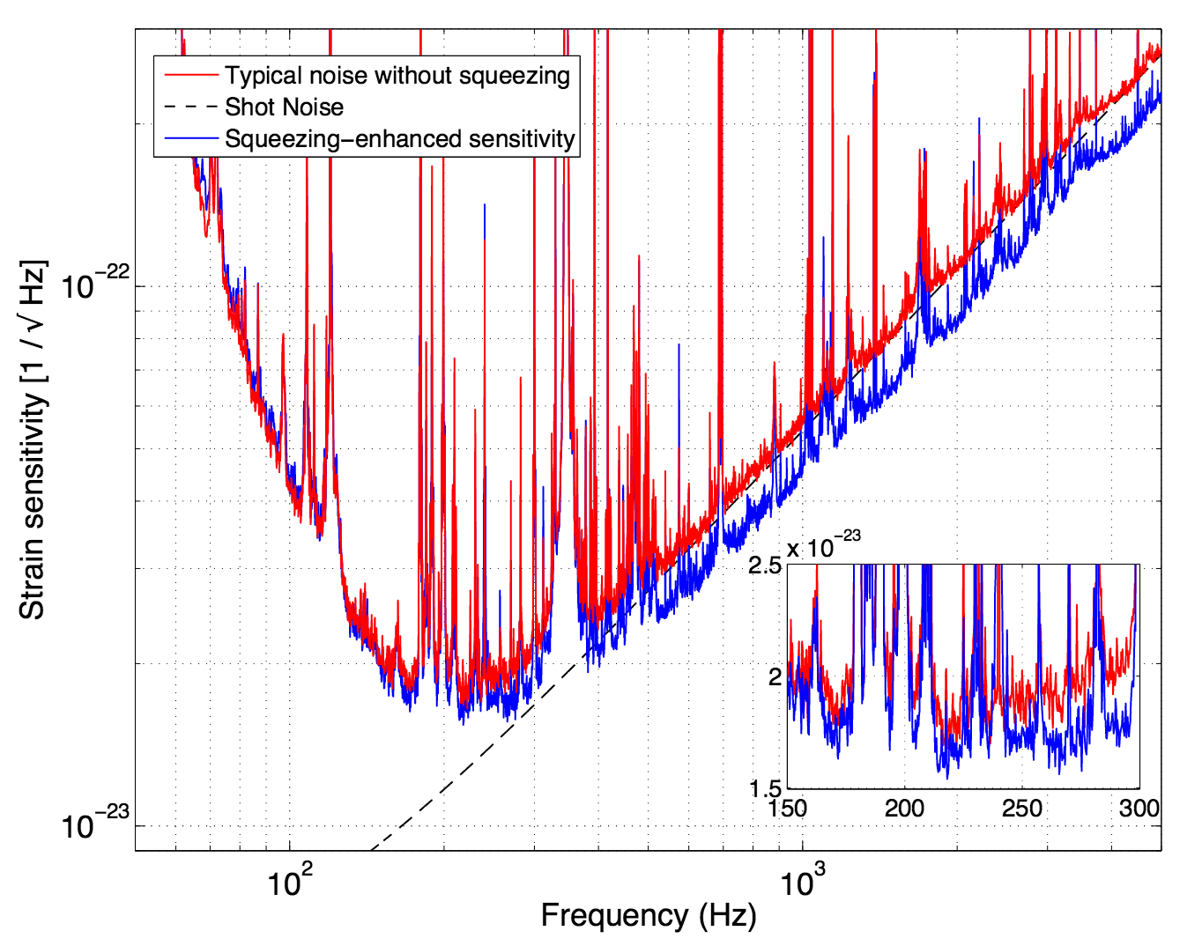
Squeezing demonstration in initial LIGO:
Technology is there.
2+ dB decrease in the shot noise level was demonstrated without any ill effect.
But simple squeezing means smaller phase noise, larger amplitude noise i.e. larger radiation pressure noise.
  Frequency-dependent squeezing will eventually be needed.
Notes:
I’ll skip this

Slide 46
And then? We’ll go 3rd Gen.
Manipulate quantum noise by using non-classical field: Squeezing
  Simple squeezing demonstrated on GEO and then iLIGO.
  Potential near-term upgrade for aLIGO.
  Non-simple squeezing a must-have for 3rd-gen.
  N. Mavalvala talk on Wed.
Design studies going on
  Einstein Telescope in Europe, http://www.et-gw.eu/
  LSC AIC working group on near, mid and long term LIGO path, e.g. LIGO-T1500290.
  The reach of z>O(10) for BNS doesn’t seem to be impossible (!!).
Notes:
1Gpc : z~2
10Gpc:

Slide 47
Summary
Interferometer technology is maturing, allowing us to operate km-scale instruments reliably with unprecedented sensitivity.
  Current aLIGO: NSNS 40 to 60-80Mpc (preliminary), will reach 150-180Mpc by 2019, some O runs in between.
First detection imminent.
A new window for astronomy/astrophysics will be opened by world network of 2nd Gen instruments.
  aLIGO, AdVIRGO (2016), KAGRA (2018), LIGO India (2020)
3rd Gen instruments being envisioned and studied.

Slide 48
Appendix

Slide 49
Live long to emit GW!
Misner, Thorne and Wheeler
“Gravtitation” p979,
for rotating beams
L_{int} = M l ²w³/24
M=10 kg (!!!)
l = 1 m
w = 2*pi*3 Hz (!!)
L₀=c⁵/G=3.53 10⁵⁹ erg/sec
L_{out} ~ (L_{int}/L₀)²L₀~ 2 10⁻³⁹ erg/sec
E_{graviton}=hf=6.62 10⁻²⁷ erg sec x 3 Hz ~ 2 x 10⁻²⁶ erg
emission rate = L_{out} /E_{graviton} ~10 ⁻¹³ /sec
~ 3 x 10⁻⁶ / year

Slide 50
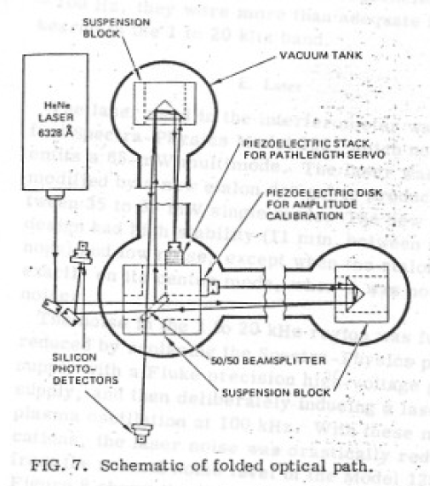
First Prototype GW IFO
1972, proposal by R. Weiss
1978, implementation (R. L. Forward)
Simple Michelson, 2m arm (folded, 4.25m path)
35-55mW laser
Strain~O(10⁻¹⁶) /sqrt(Hz) @ ~kHz

Slide 51
IFO noise in reality: Technical Noise

Slide 52
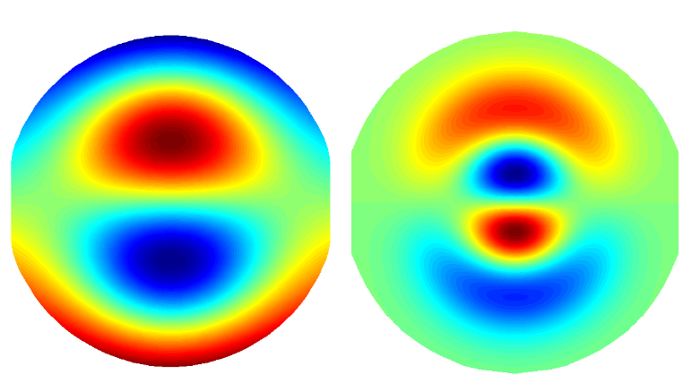
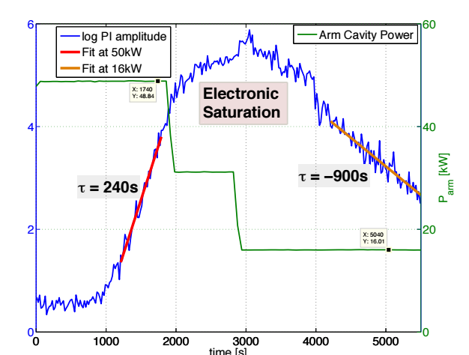
Parametric Instability
Mechanical mode
Optical mode
First observed at L1, then H1 at about 15kHz
  100kW in each arm
https://dcc.ligo.org/P1400254
Mitigation strategies:
  Thermal tuning for now.
  Fast DAQ for single mode damping via ESD.

Slide 53
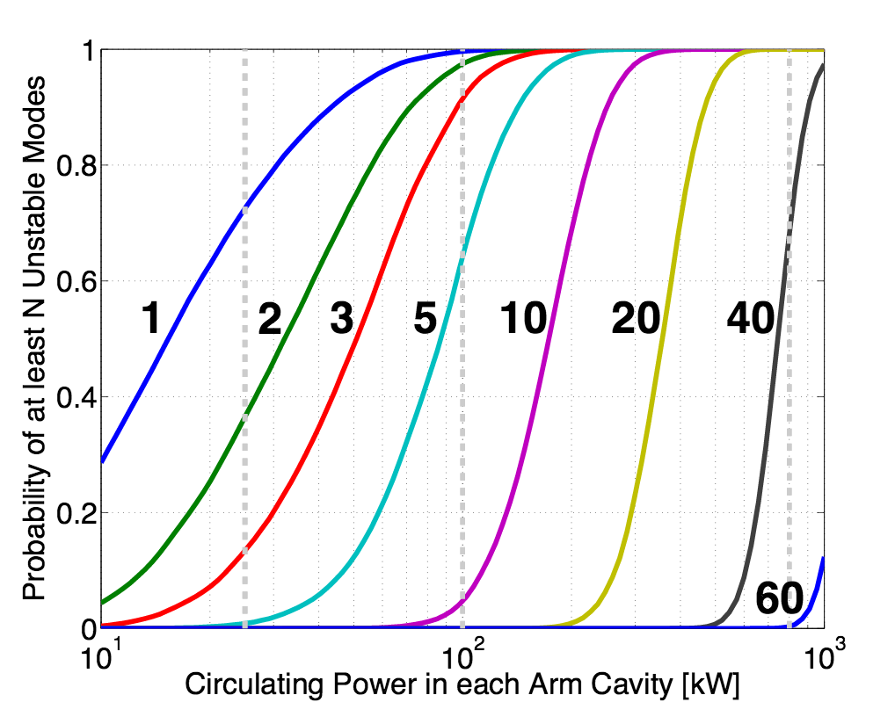
PI, cont’d
We cannot operate IFO with full designed power without doing something.
  In the future, resonant damper on the TM to absorb the mechanical energy of offending modes.

Slide 54
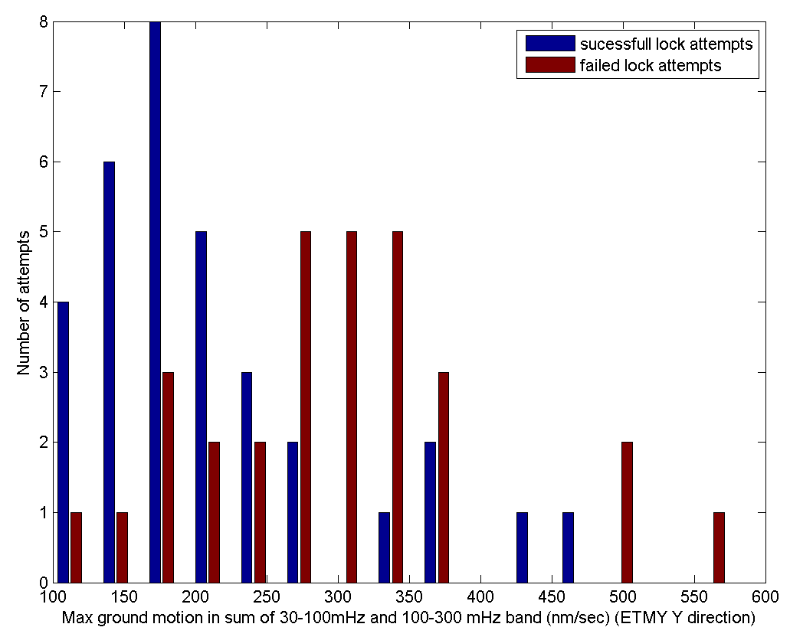
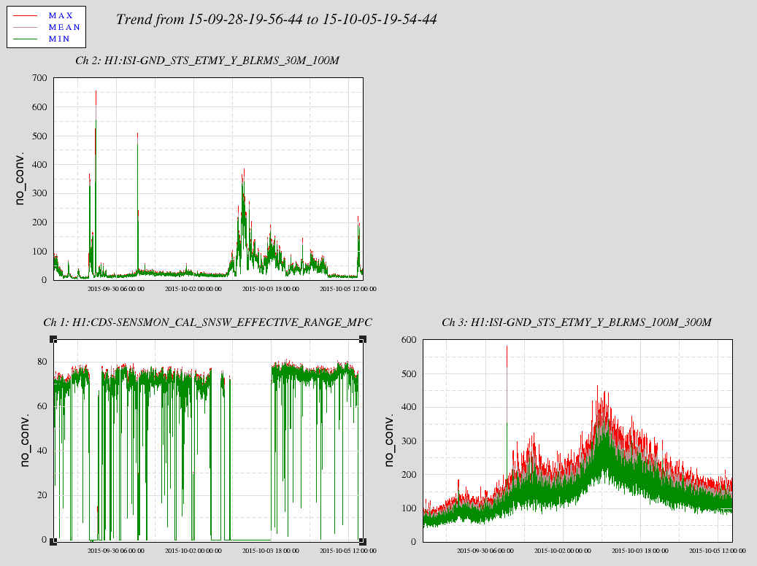
Lock acquisition success rate is a function of seismic level
This is from early O1, but no fundamental change up to now

Slide 55
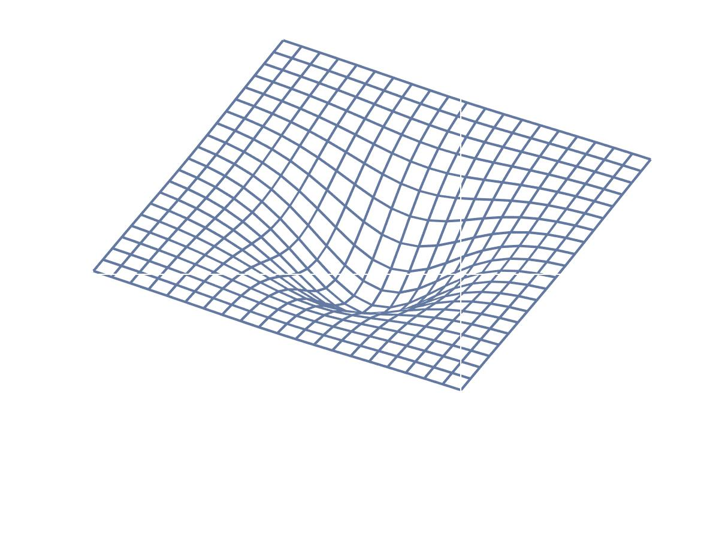
General Relativity, Spacetime and Matter
G_{μν} = 8 π T_{μν}
Matter “tells” spacetime how to curve
Matter
(energy)
Spacetime
Spacetime “tells” matter how to move
Notes:
100 years ago Einstein showed the world the Einstein field equations, which is the relation between matter represented by energy momentum tensor,
And the spacetime which is represented here by this einstein tensor.
To paraphrase Wheeler, spacetime tells matter how to move, and matter tells spacetime how to curve.

