Slide 1
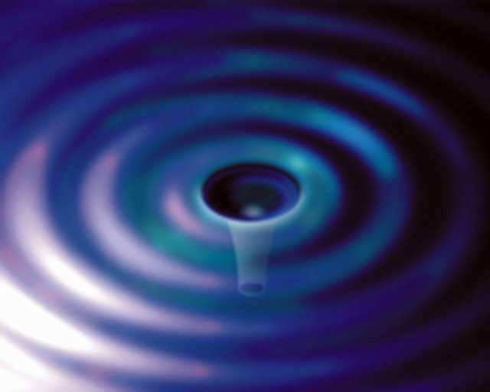
LIGO’s Detection of Gravitational Waves from Two Black Holes
Gregory Harry
Department of Physics, American University
February 17,2016
LIGO-G1600274

Slide 2
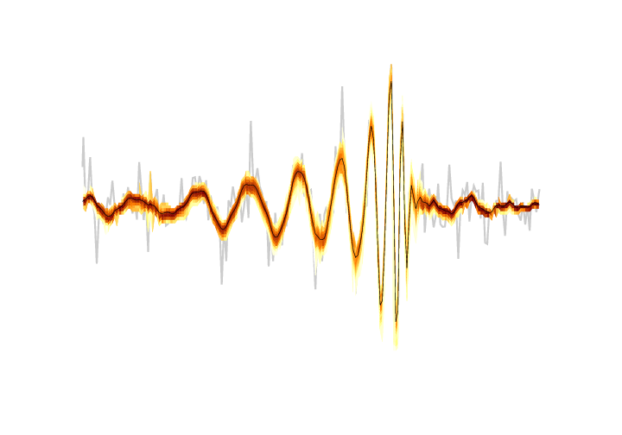
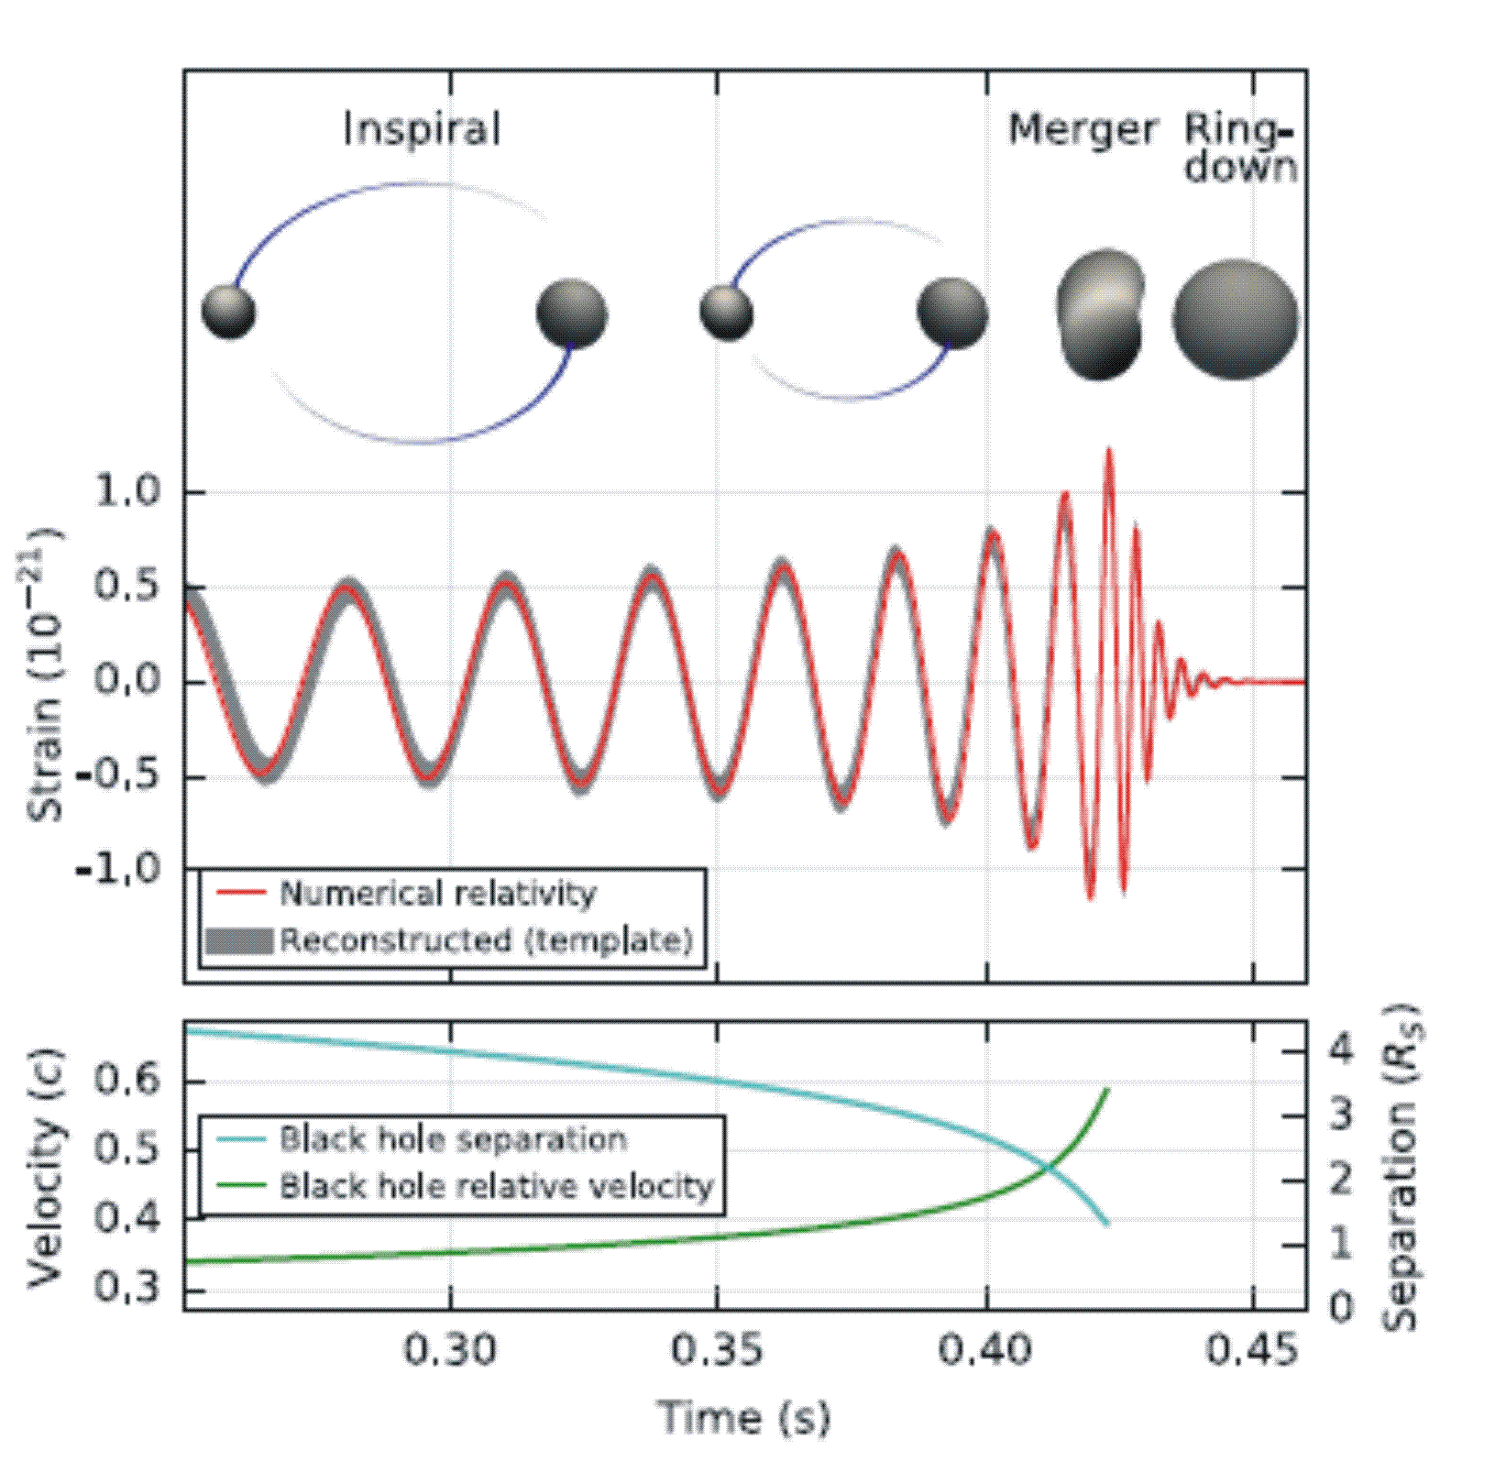
GW150914

Slide 3
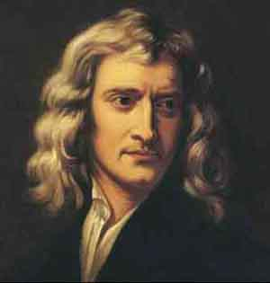
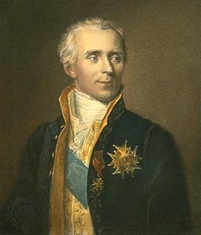
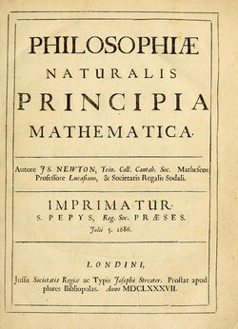
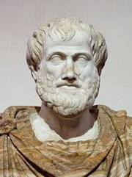
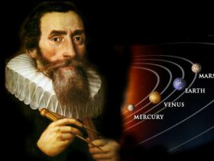
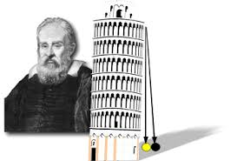

Early History of Gravity
Aristotle
Kepler
Laplace
Galileo
$$F=\frac{GM_{1}M_{2}}{r^{2}}$$
Isaac Newton

Slide 4
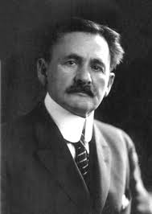
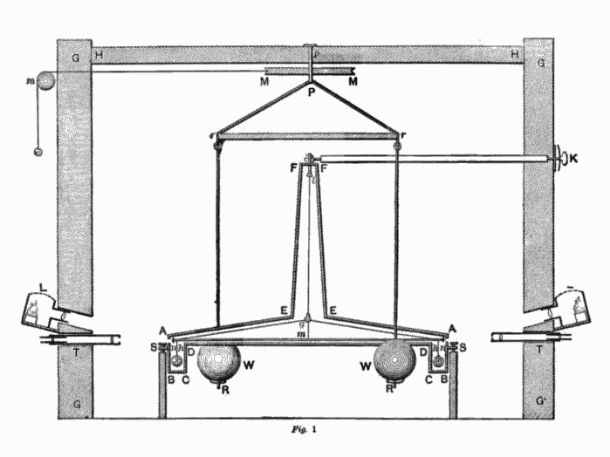
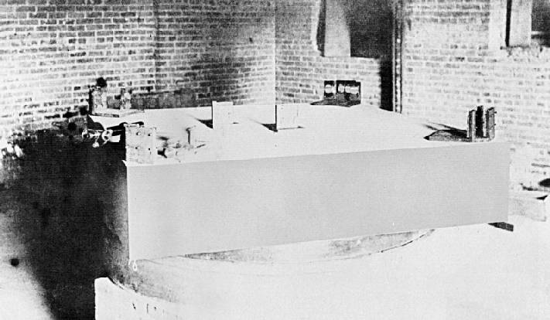
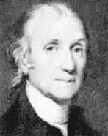
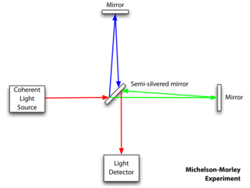
19th Century History of Gravity
Albert Michelson
Cavendish

Slide 5
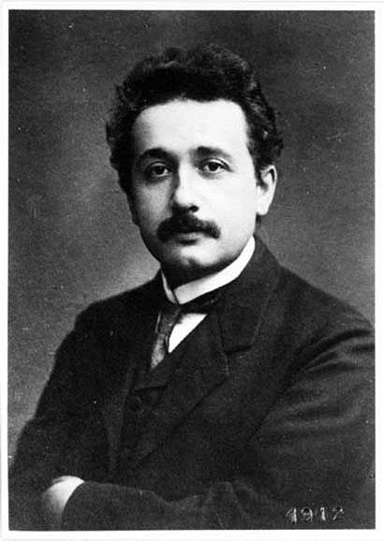
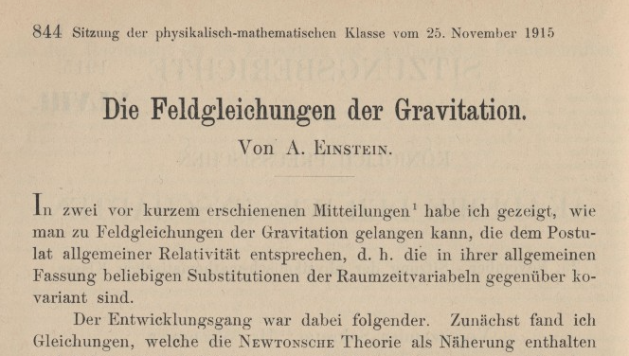
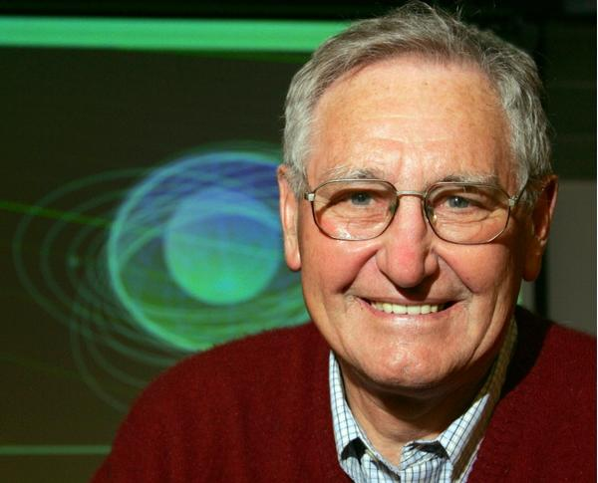
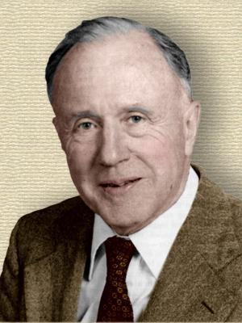
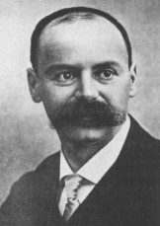
20th Century History of Gravity (General)
Albert Einstein
1915
Wheeler
Kerr
Schwarzschild

Slide 6
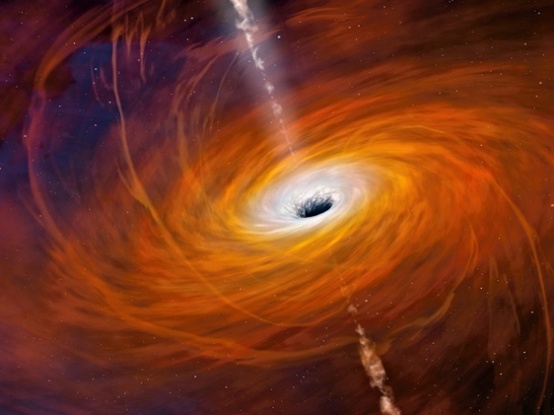
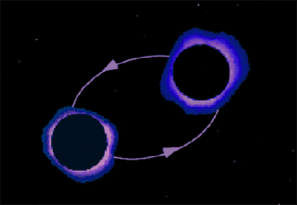
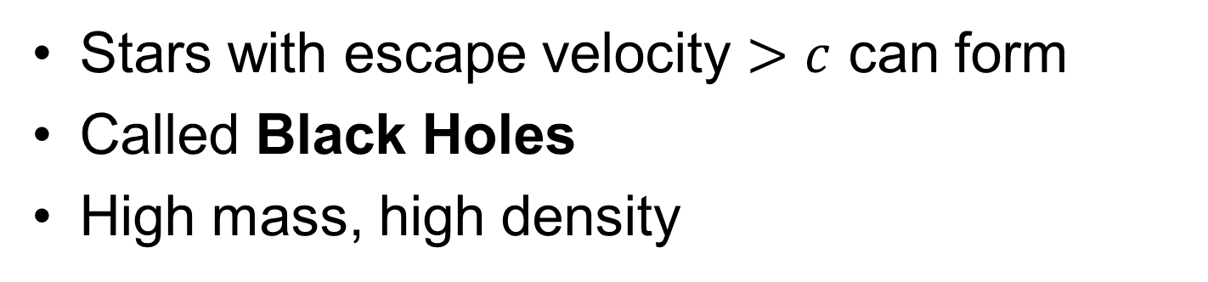
Black Holes
Stars with escape velocity $>c$ can form
Called Black Holes
High mass, high density
Two black holes are a good source of gravitational waves
Know black holes exist
Unknown whether black holes form in pairs ???
Unknown what mass range black holes can have ???

Slide 7
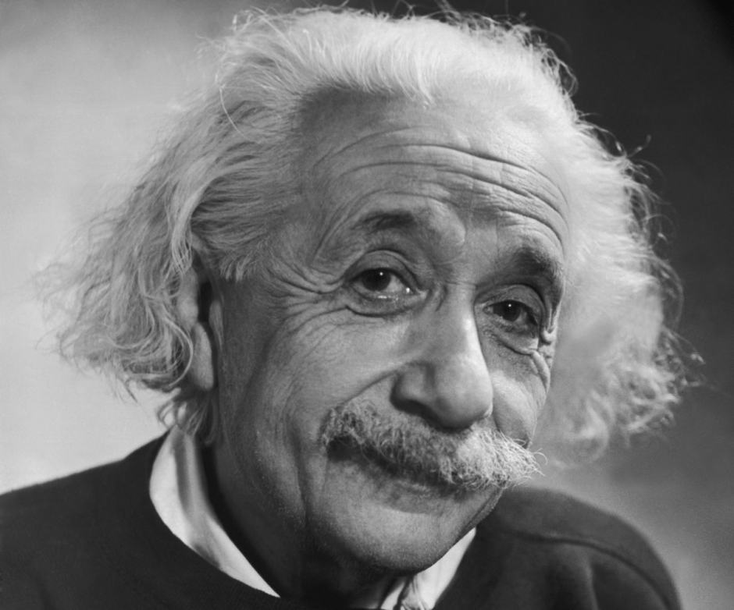
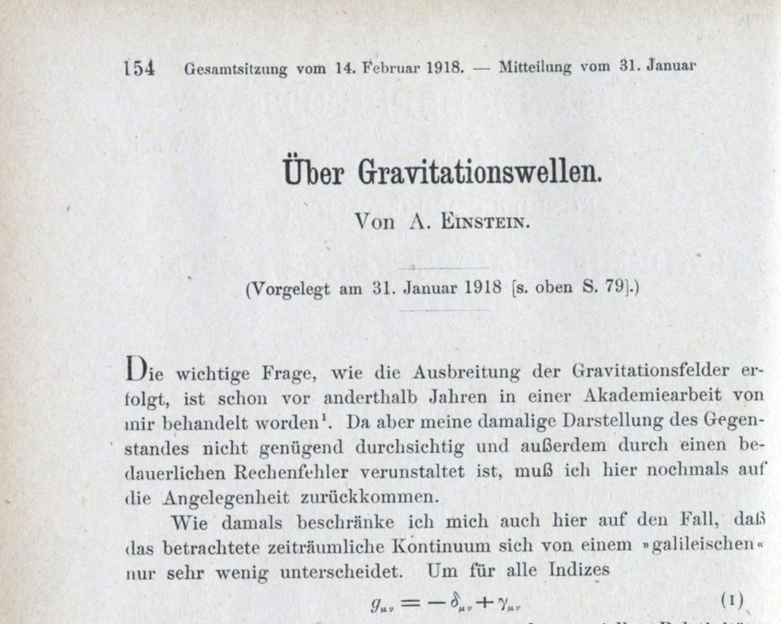
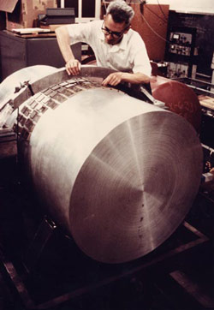
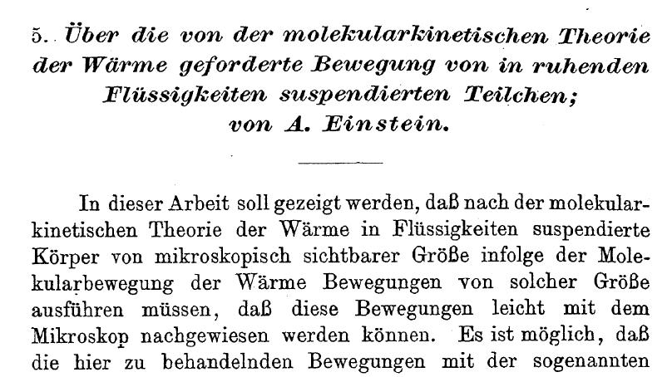
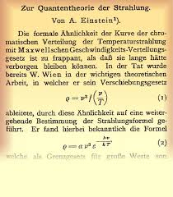
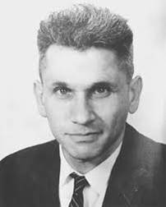
20th Century History of Gravitational Waves
Thermal Noise
Joe Weber
Lasers

Slide 8

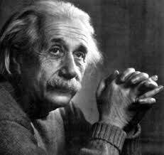
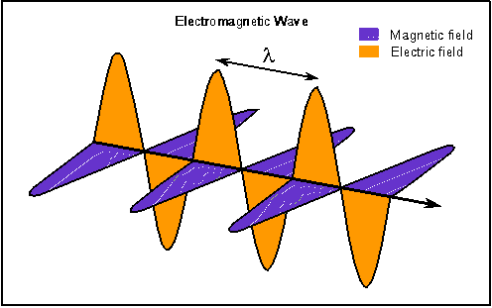
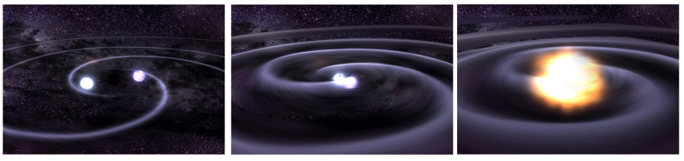
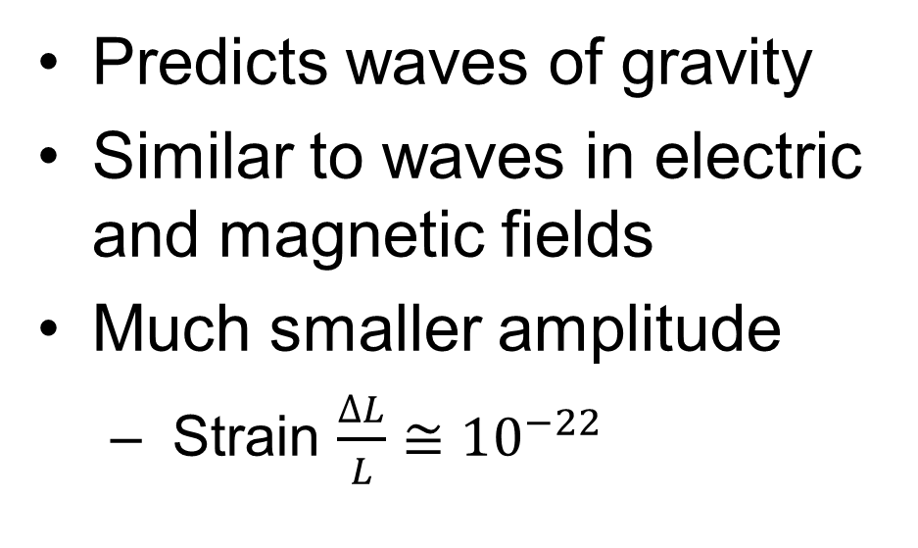
Gravitational Waves
Einstein’s theory of gravity is called the General Theory of Relativity
Gravity can not travel faster than the speed of light
Predicts waves of gravity
Similar to waves in electric and magnetic fields
Much smaller amplitude
  Strain $\frac{∆L}{L}≅10^{−22}$

Slide 9
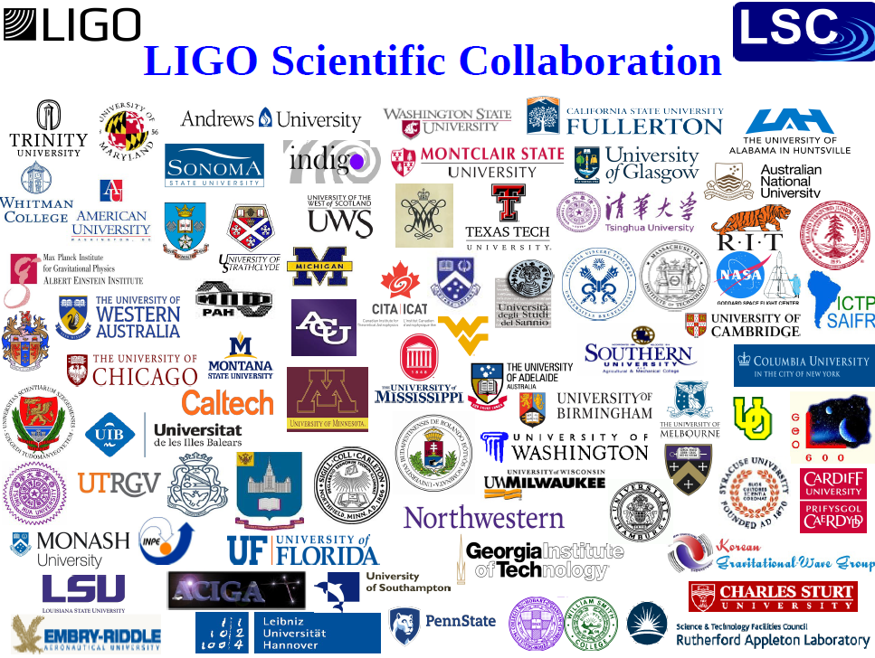
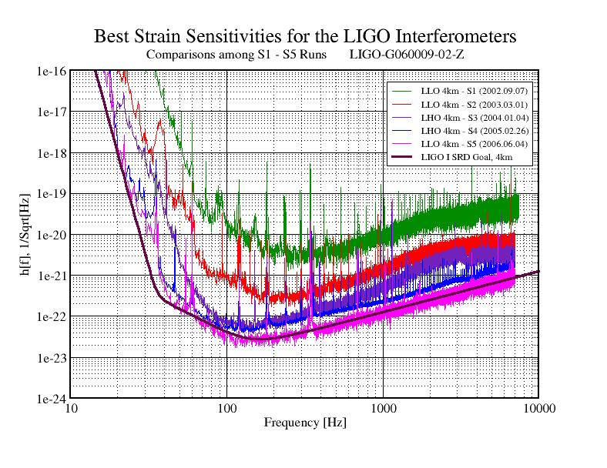
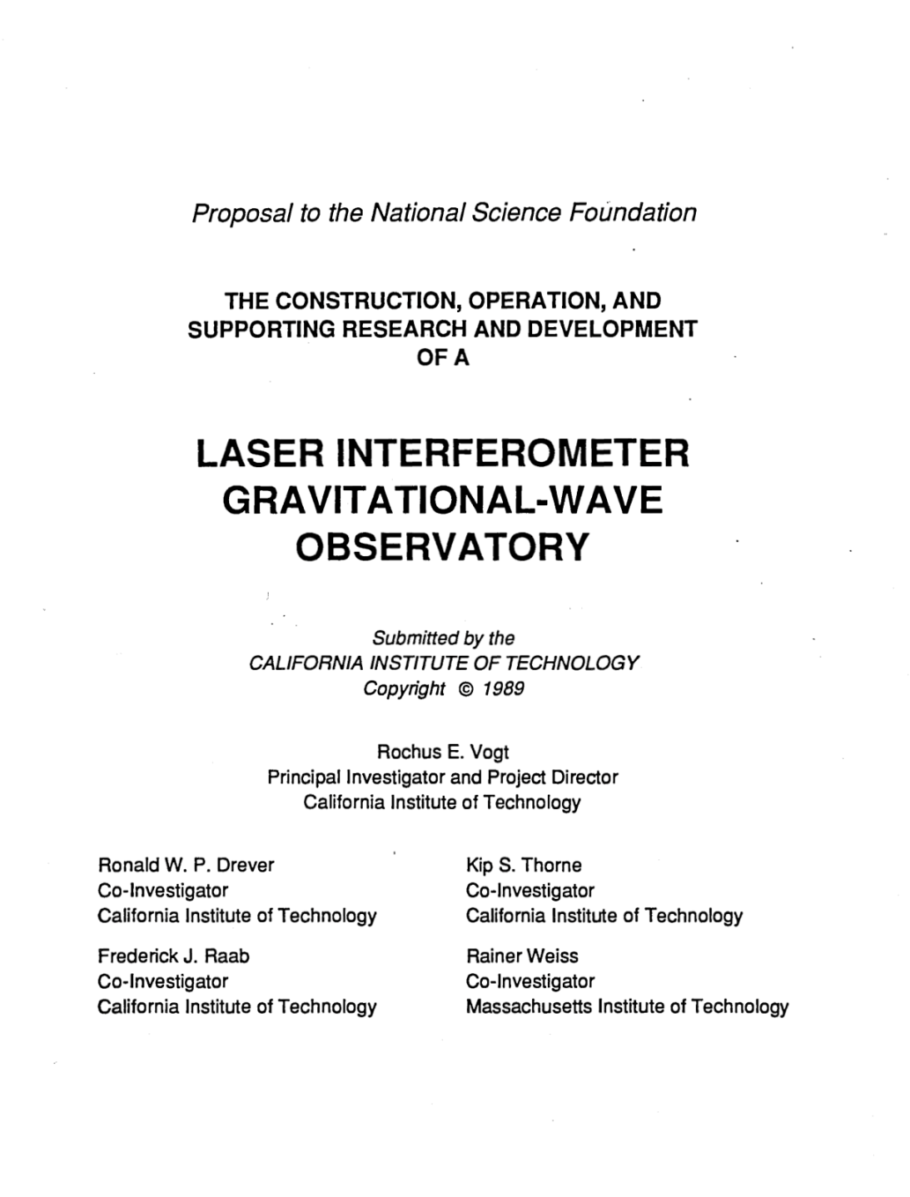
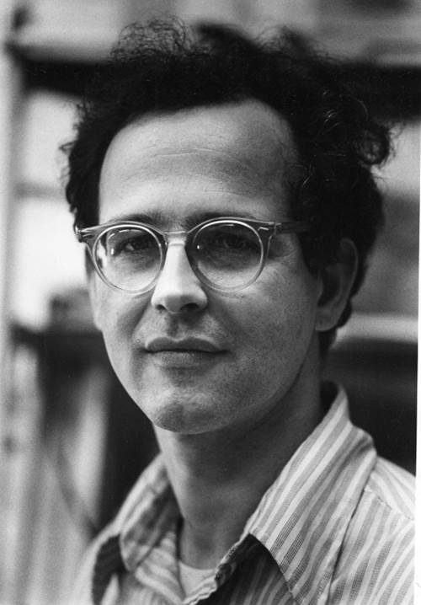
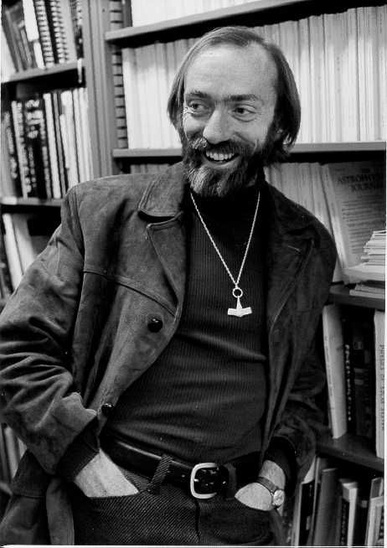
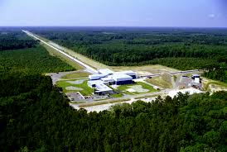
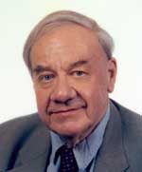
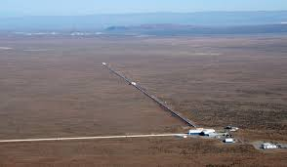
History of LIGO
Rai Weiss
Kip Thorne
Ron Drever

Slide 10
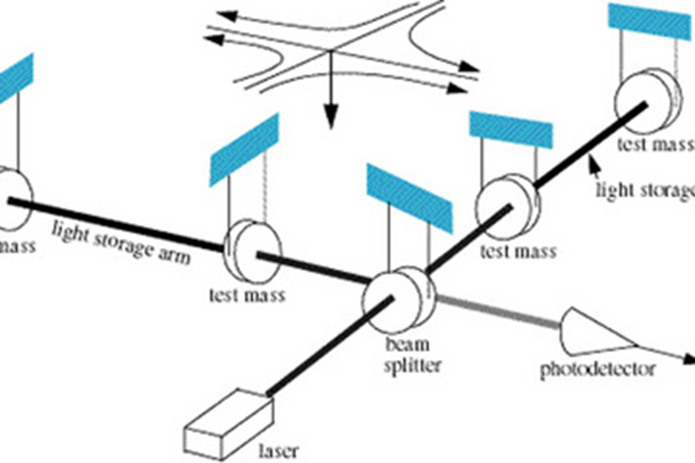
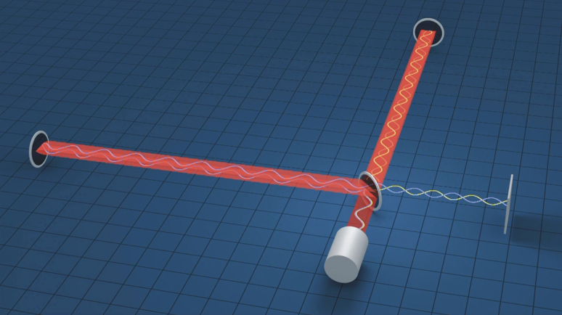
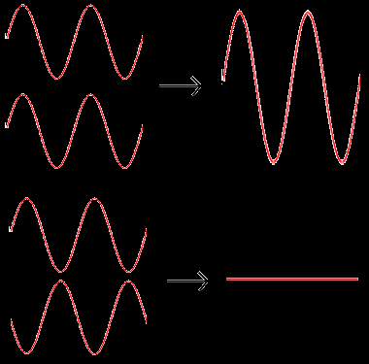
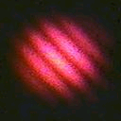

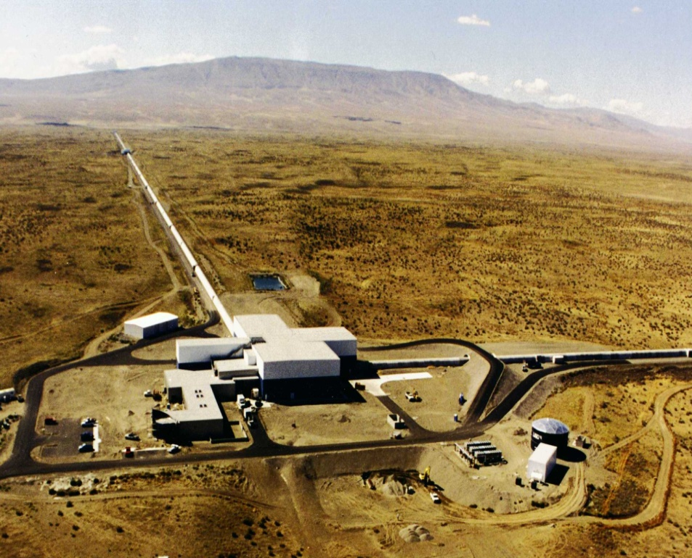
LIGO Interferometers
Detectors use interferometry
Sense tiny motion of mirrors
Reduction of noise crucial
US has two sites
  Livingston, Louisiana (LLO) and Hanford, Washington (LHO)
4 kilometer-long beam tubes
  Entire 8 km length in vacuum
  Low seismic noise environment

Slide 11
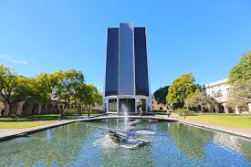
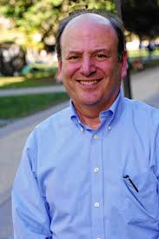
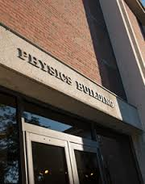
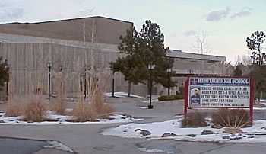




My History with Gravitational Waves
Heritage High School AP Physics project on gravitational waves 1985
Syracuse Univ
American University LIGO Group
University of Maryland PhD
Peter Saulson
MIT LIGO Group
Caltech Undergrad
1985-1990
Class with Kip Thorne
Advisor Ron Drever
Ho Jung Paik

Slide 12




Advanced LIGO
Improved Detectors
  Active seismic isolation
  Wider frequency range (10 Hz)
  Higher power laser (180 W)
  Larger mirrors (40 kg)
  Additional mirror to enhance signal
Data taking at intermediate sensitivity from Aug 2015 – Jan 2016
First detection September 2015
Currently improving sensitivity for further observations late 2015

Slide 13


Advanced LIGO Sensitivity
Limited by Earth motion, thermal motion, and quantum mechanics
Higher
power
laser
Better
seismic
isolation
Better
test masses

Slide 14


Advanced LIGO Mirrors and Coatings
Fused silica optics
  40 kilograms
  Very low absorption
  Continuous connection to suspension
Optical coatings
  Reflect light
  Form resonance cavity
  Very low absorption
  Low thermal noise

Slide 15




Gravitational Waveform from Binary Black Hole Inspiral

Slide 16



Detection of GW150914

Slide 17




Three Discoveries
Parameter | Value
Mass of first black hole | $39×$ Mass of the sun
Mass of second black hole | $32×$ Mass of the sun
Total mass of final black hole | $67×$ Mass of the sun
Mass converted to gravitational waves | $3×$ Mass of the sun
Distance to event | 390 Mpc
Gravitational wave exist as predicted by Einstein
Black holes exist with masses about $30×$ solar mass
Black holes can form into binaries that eventually collide and merge into single larger black hole

Slide 18

International Network

Slide 19






Future Hopes and Plans
Form International Network
  Virgo in Europe
  KAGRA in Japan
LIGO India
  Tweet from Indian PM
LISA - Space
Upgrades to Advanced LIGO
  Squeezing, optics, seismic noise cancellation
Einstein Telescope

Slide 20




LIGO at AU
AU is a member of the LIGO collaboration
  80+ institutions, 16 countries
International collaboration
  1000+ total members, 500+ US
AU LIGO Lab Winter 2016
Campus lab working on reducing thermal noise
  Improve mirror properties
Next generation detectors
Train students to enter field
AU LIGO Lab Summer 2013

Slide 21





AU LIGO Contributions
Advanced LIGO
Titania/tantala coatings
Epoxies to minimize noise for optics retrofit
Addressed optics storage concern for LIGO/India
Continual optics monitor
Organizational
Optics chair, Coating cognizant scientist
Academic affairs, political outreach
Future detectors
Crystalline AlGaAs coatings
Thermal noise in different directions

