Slide 1
Mirror scattering loss analysis by integrating sphere measurement
Scattering and loss by test mass
  Discrepancy between the measured arm loss, 50ppm/mirror, and the loss based on optics measurement, 25ppm/mirror
  Loss by mirror is estimated as
    Loss by surface figure = 10ppm,
    Larger angle scattering = 10ppm = 5ppm by micro roughness + 5ppm by point scattering,
    Misc and uncertainty = sevetal ppm
Large angle scattering measurement covers down to 1°.
What if TIS(θ<1°) is comparable to TIS(θ≥1°)
Integrating sphere measurement with extension to measure TIS in large and small angle (L. Zhang)
  Preliminary and proof of concept
  Small angle (θ≤1°) and large angle (θ≥1°) scattering
    Missing energy in the small angle scattering
    Information defect size/distribution
  Micro roughness on coated surface is correlated to uncoated surface

Slide 2
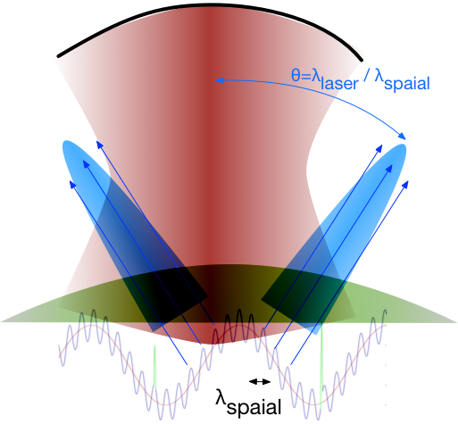
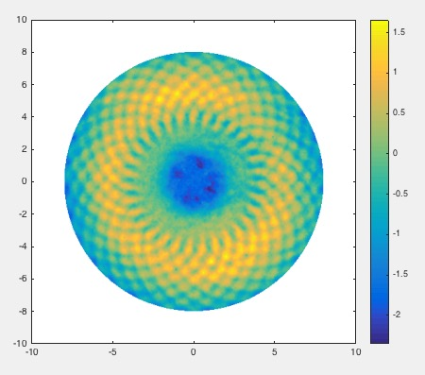
Three scattering sources
Figure error, micro roughness and point scattering
 | Figure error | Micro roughness | Point scattering
λ_{spatial} | > 5mm | < 5mm | < 0.1mm
data | phasemap | PSD | data
cause | Reflect back into cavity | Reflect out of cavity to a fixed direction | Reflect uniformly, mostly out of cavity
effect | Change of resonating mode | Hit specific part of IFO, e.g., beam tube baffle. | Additional loss
ETM07
coated
polished
16 cm
0.2 mm

Slide 3
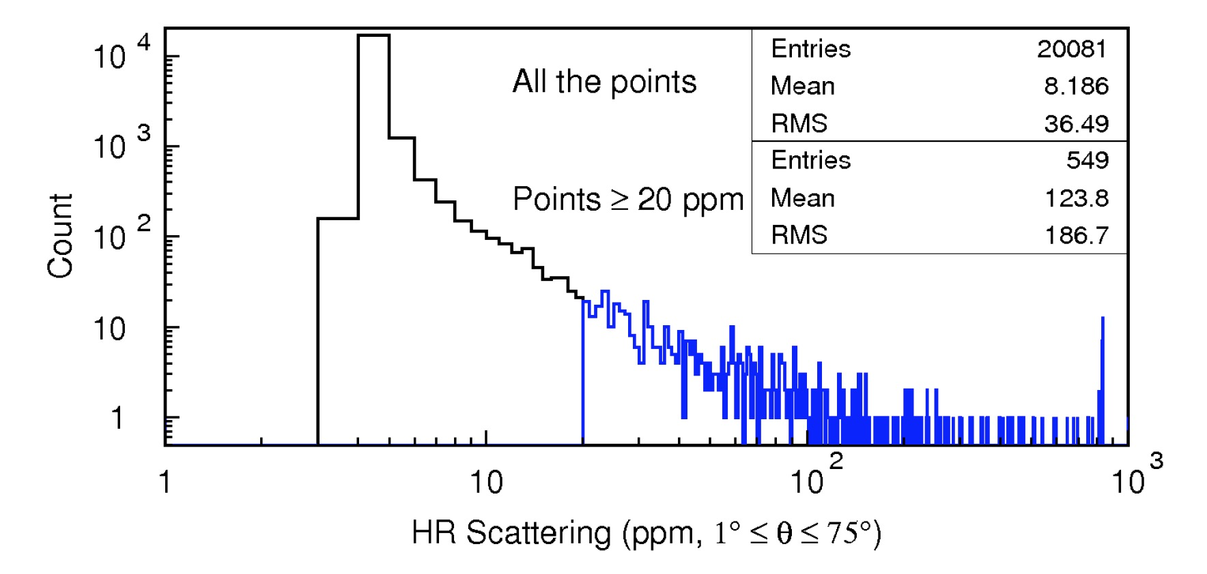
aLIGO ETM TIS(θ≥1°) using integrating sphere
θ≥1°
W=150μm
Micro roughness
Point scattering
95%

Slide 4
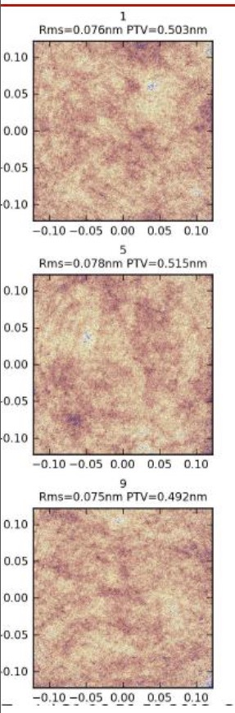
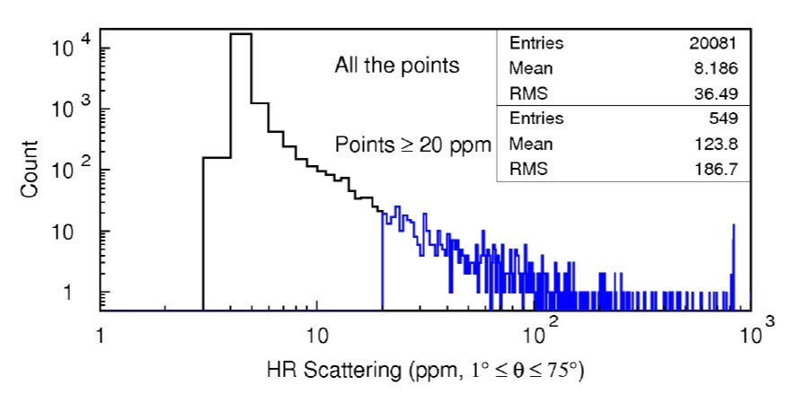
Micro roughness : coated ~ polished low end of TIS(θ≥1°) ~ 3-4 x polished surface
TIS(λ_{s}<75μm) / (4π σ(λ_{s}<80μm)/λ_{laser})²
Around the peak
~2
1/10
1mm
PSD
ETM16 case
Zygo 50x PMM
80μm > λ_{s} > 0.9μm
1/1000
peak
1mm

Slide 5
Angular distribution of reflected field depends on the defect size
3% of solid angle
θ
r
Mie
Larger defects induce sharper reflection
r
Geometry
√π r

Slide 6
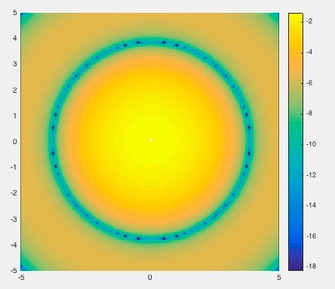
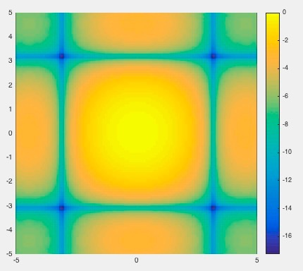
Far field and small size defects small defects cannot be characterized by PSD
reflected power = power density at defect ∙ defect size ∙ |A|²
circle with radius a
small
rectangle size of du x dv
k a θ =1 when
a = 1μm, θ=10°
or
a=10μm, θ=1°
Defect size looks different seen at different angle
log( power )
axis : k a θ = 0.1 a(μm) θ(degree)

Slide 7
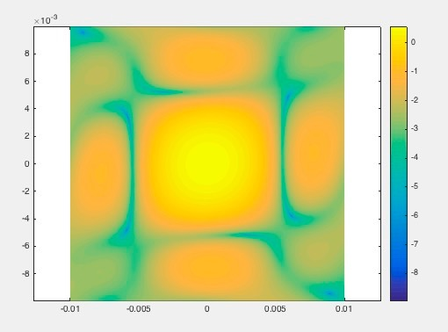
Clustered defects behave like a single defect
Same distribution generated by
Power distribution generated by small defects in a square

Slide 8
Setup for measuring
TIS(θ≤1°) and TIS(θ≥1°)
150μm

Slide 9
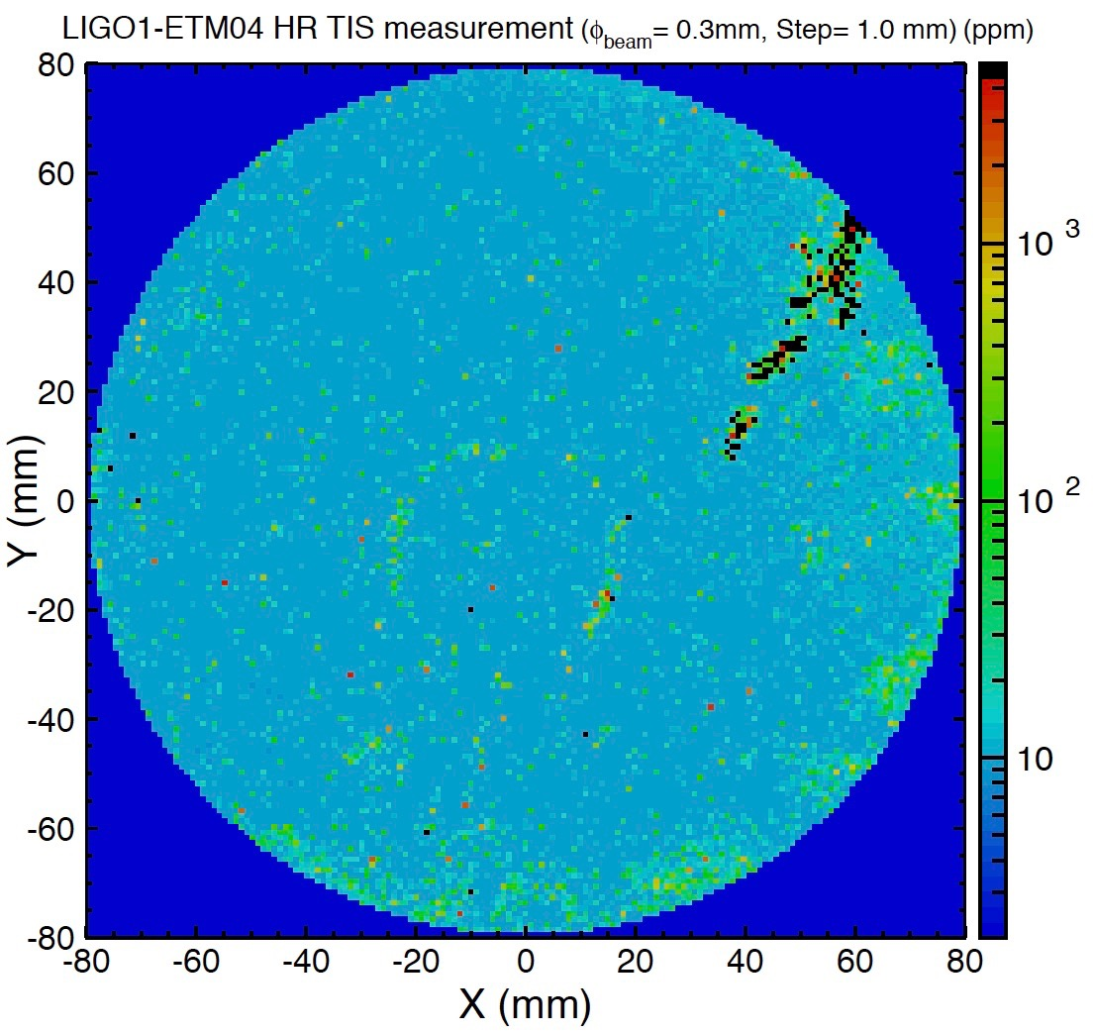
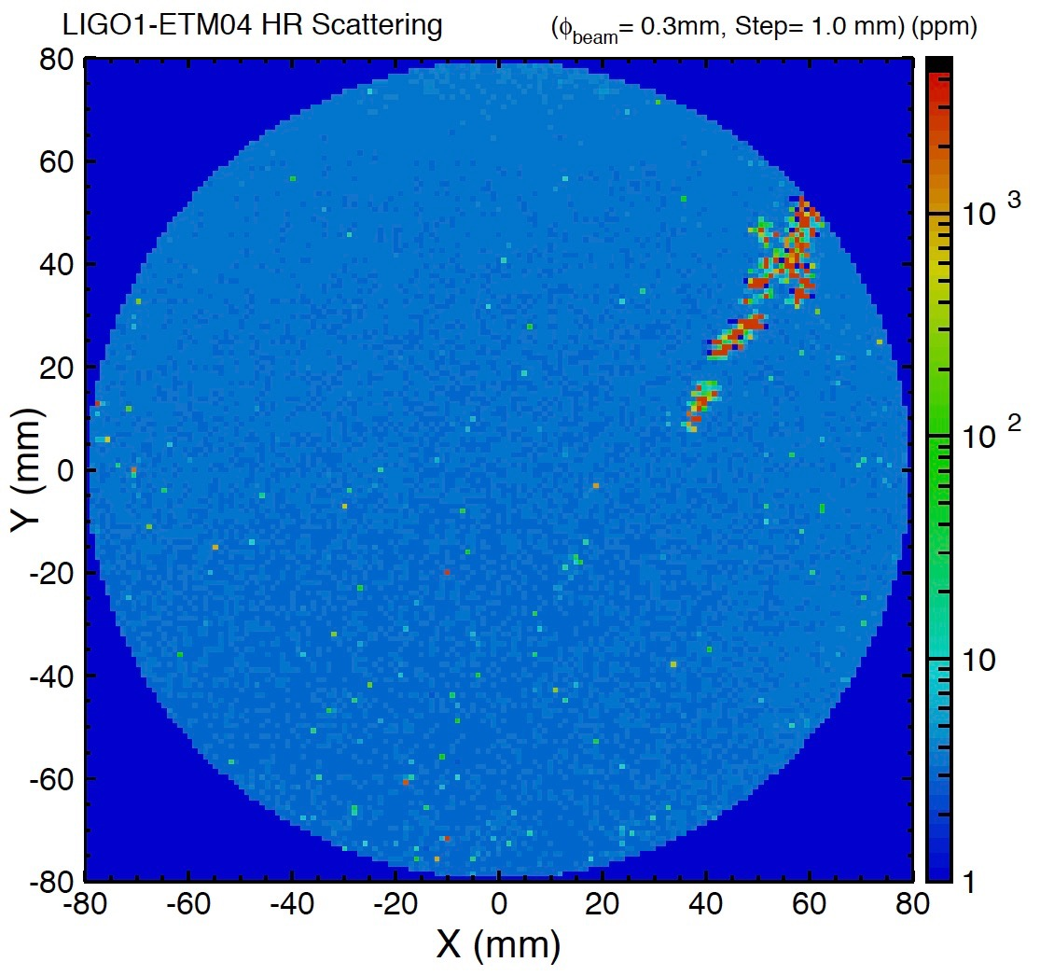
Very preliminary results mirror : initial LIGO ETM04
TIS (θ≥1°)
TIS (0.7°≤ θ≤1°)
dΩ=1.5e⁻⁴
scratch

Slide 10
TIS(θ≤1°) vs TIS(θ≥1°) very preliminary
Quadrants no scratch
Quadrant with scratch
brighter
(2) Scratch
Large defect on surface
(4) Large defect
(1) Isolated small defect or micro roughness
(3) Clustered small defects
Large TIS(θ≥1°), small TIS(θ≤1°)
total size>1.5 μm

Slide 11
Revised setup
Lens moved out of the path to reduce noise
Beam diverging toward the second mirror,
which induces larger tail noise of the undisturbed beam.
Hole in the mirror
θ > 0.3°
θ > 0.7°

Slide 12
Comparison of results :
PD2(0.7°≤ θ≤ 1°) vs PD2(0.3°≤ θ≤ 1°)
iLIGO
ETM04
Why different?
lens in path
1) Cleaning issue?
PD2(0.7°≤ θ≤ 1°)
2) Efficiency difference?
lens out path
3) Tail of gaussian
Beam (1mm beam
going thr 2.5mmx2
hole)
Mirror with larger
hole being prepared
PD2(0.3°≤ θ≤ 1°)
PD1(1°≤ θ≤ 75°)

Slide 13
Summary
Extended Integrating Sphere measurement
  Preliminary result – proof of concept
  In the small solid angle (10⁻⁴ , θ<1°), comparable energy observed as in the large solid angle(θ≥1°)
  Improvement of measurement setup and understanding of systematic uncertainties are necessary to quantify the conclusion
Large angle (θ≥1°) TIS may underestimate the loss
Measurement of aLIGO test masses coated by LMA
  Necessary to quantify the loss contribution from defects
Quantitative comparison of larger and small angle TIS may provide further information of defects
  Size, clustering, …

Slide 14
End of slides

Slide 15
Defect size and total loss assuming defect shape is circle
Defect size vs TIS(θ≥1°)
Total / TIS(θ≥1°) vs TIS(θ≥1°)

Slide 16
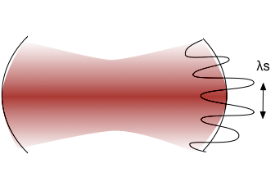
Loss function

