Slide 1
Photos from the Building 20 epoch
Photos from Dan Dewey, Jeff Livas, Steve Meyer, Peter Kramer, Mary Jane Doherty, David Shoemaker
17 March 2016
G1600667-v1

Slide 2
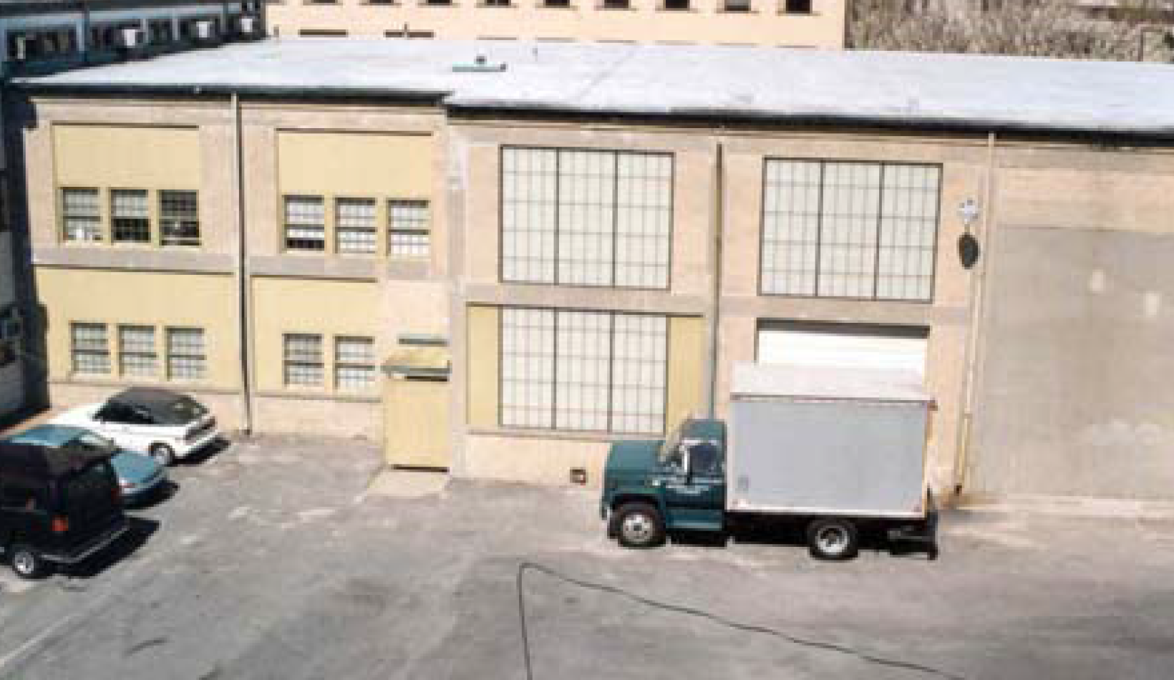
Building 20, Wing F

Slide 3
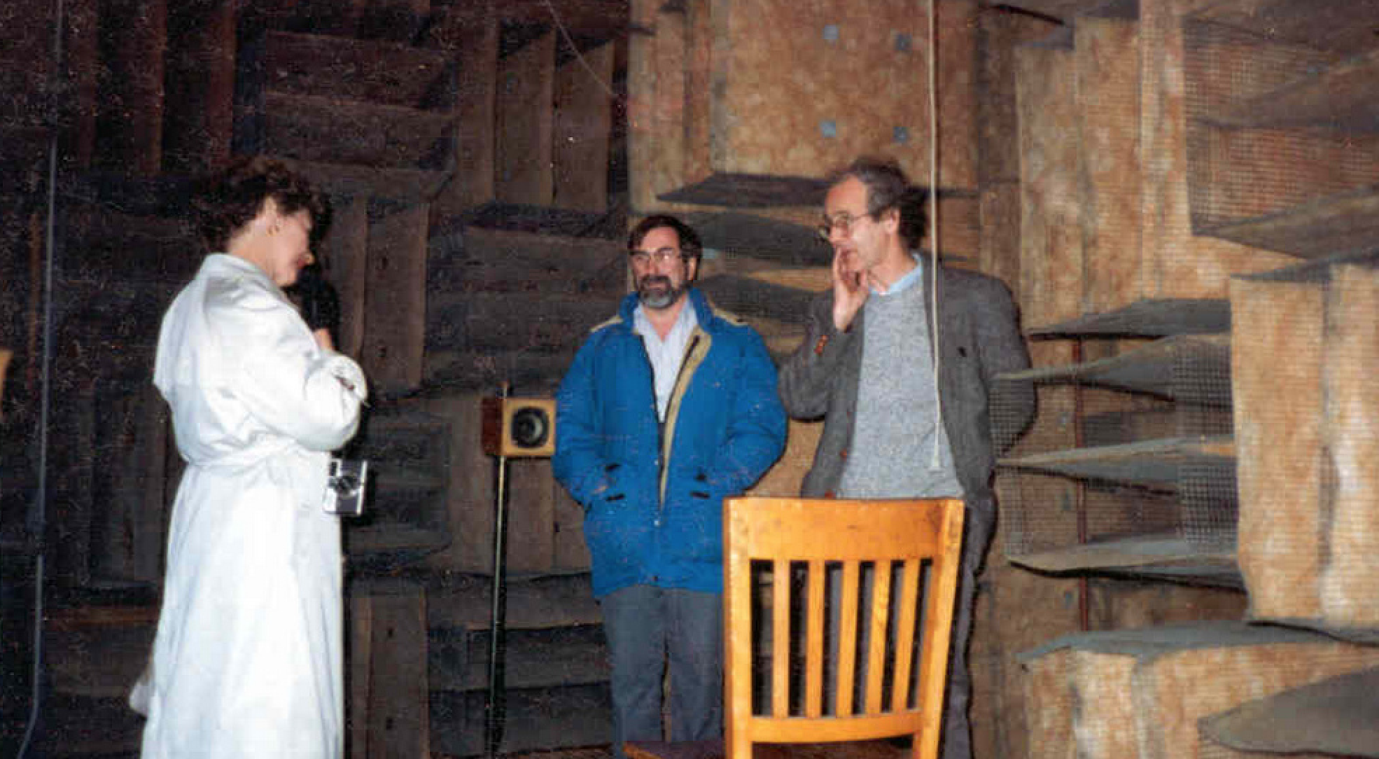
Anechoic chamber in Wing F
(a good place for naps etc.)

Slide 4
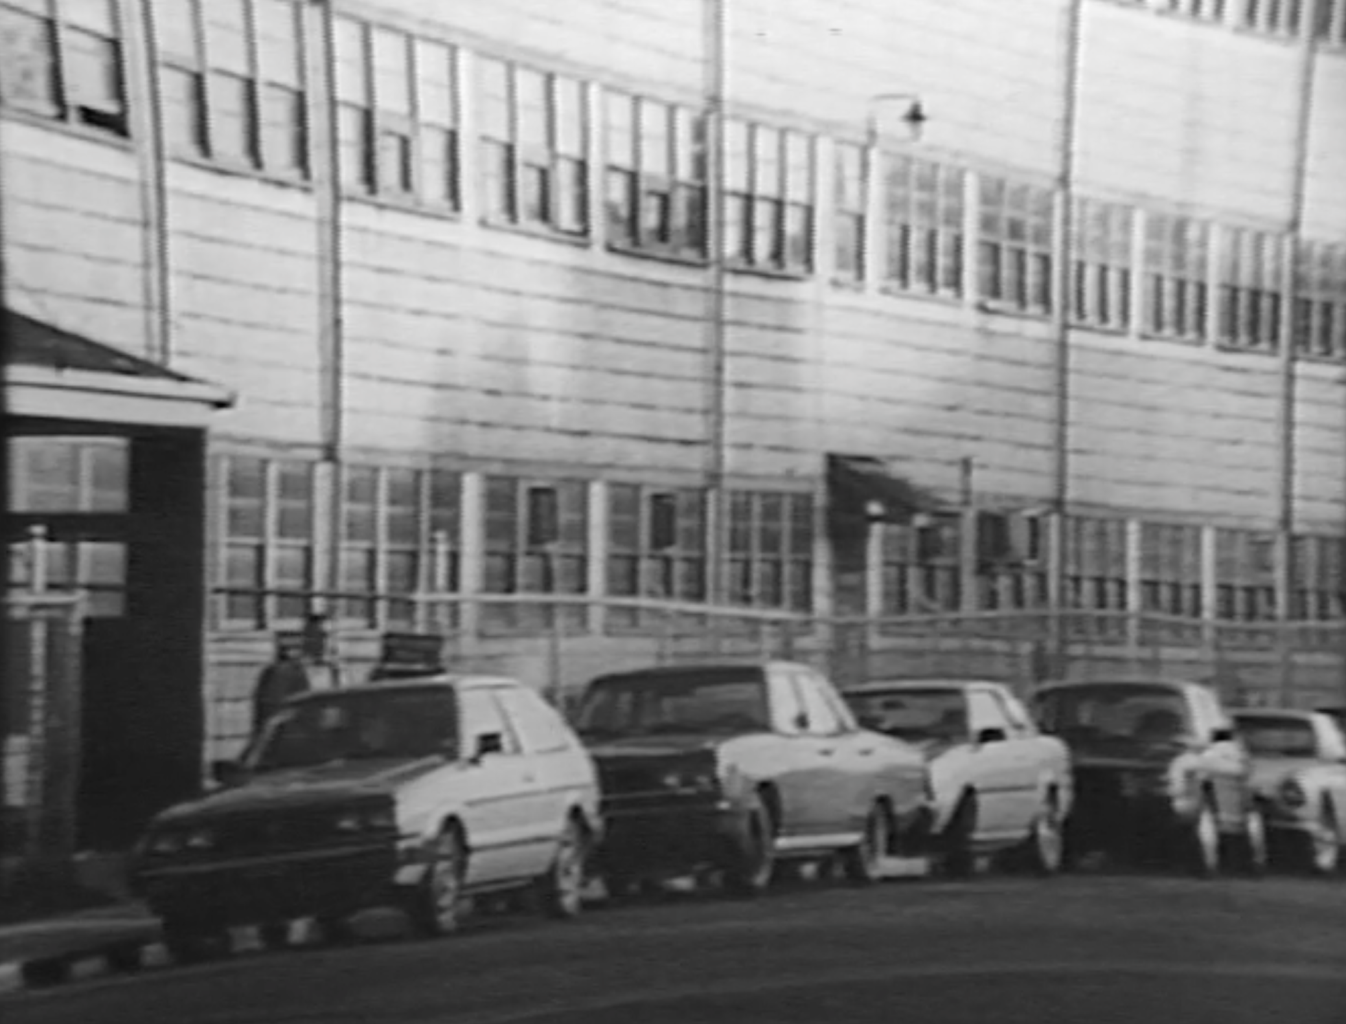

Slide 5
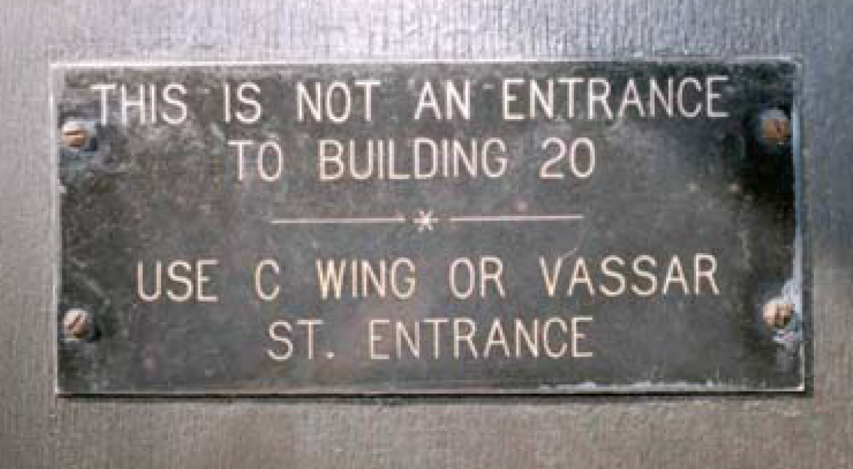
Label on the best entrance door

Slide 6
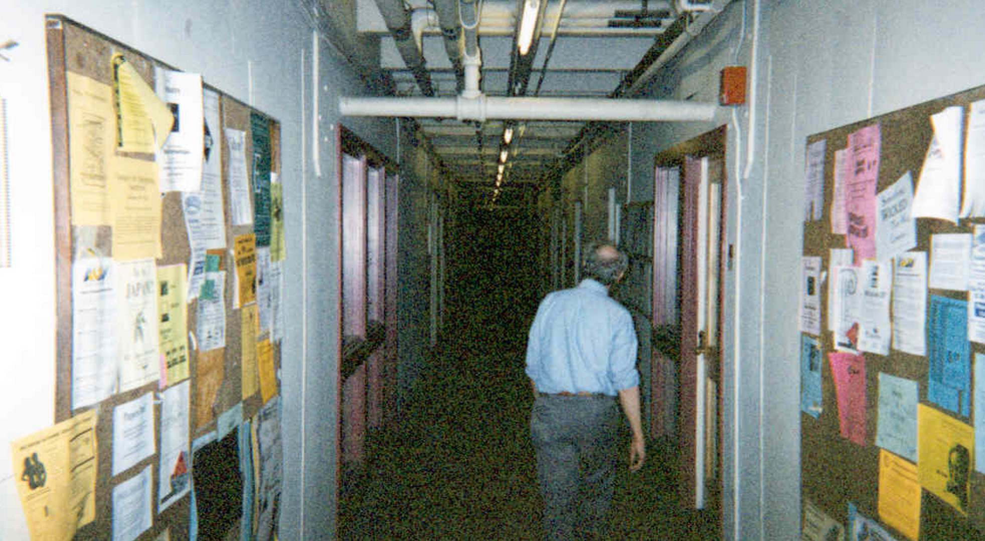
A corridor in Building 20

Slide 7
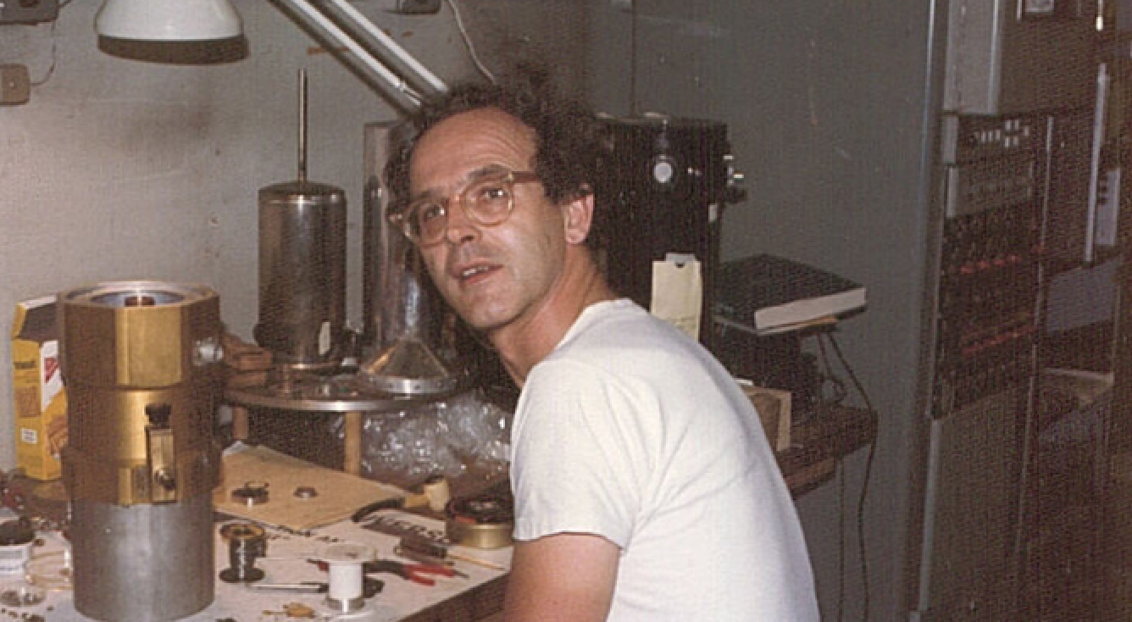
When CMB was the focus

Slide 8
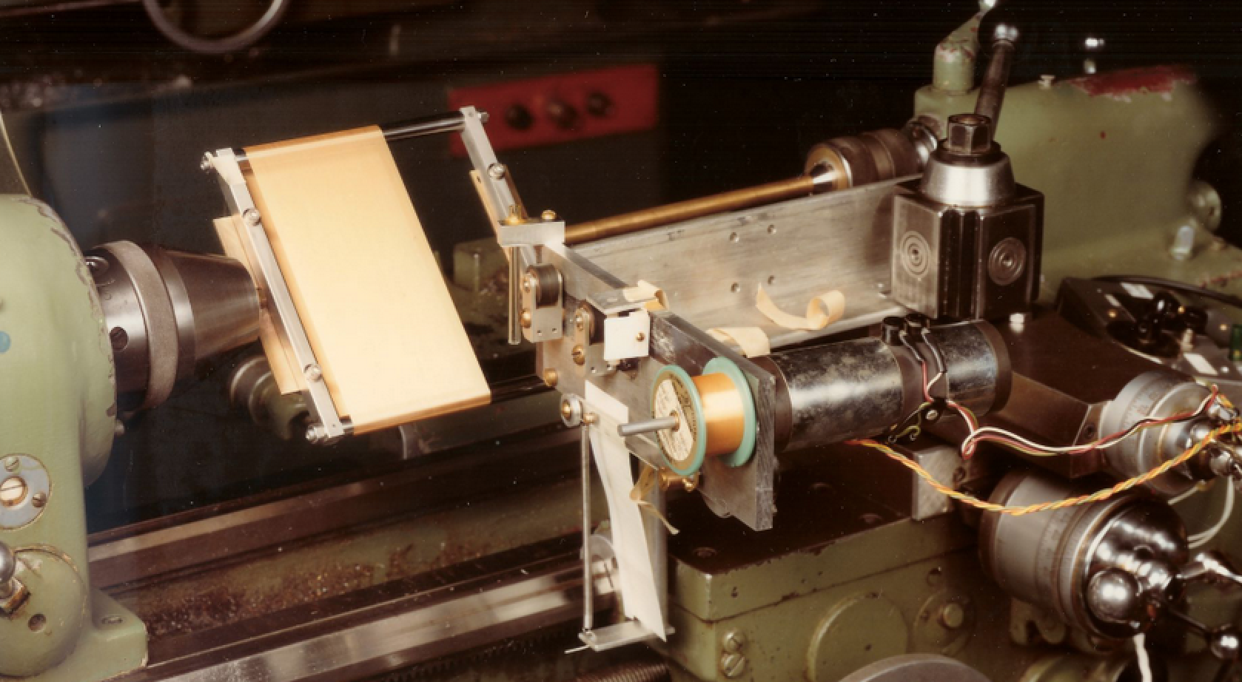
David’s first servo system

Slide 9
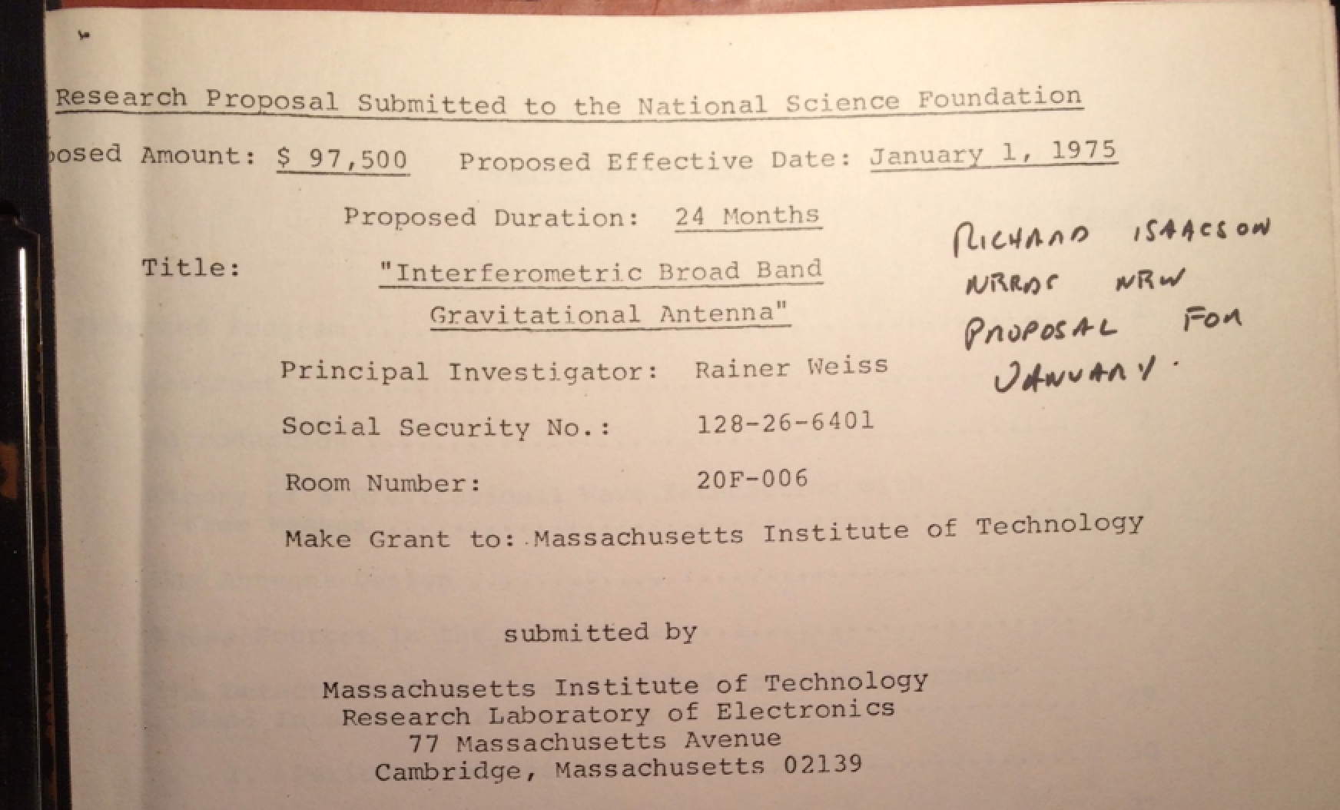

And: on to Gravitational Wave Detectors

Slide 10
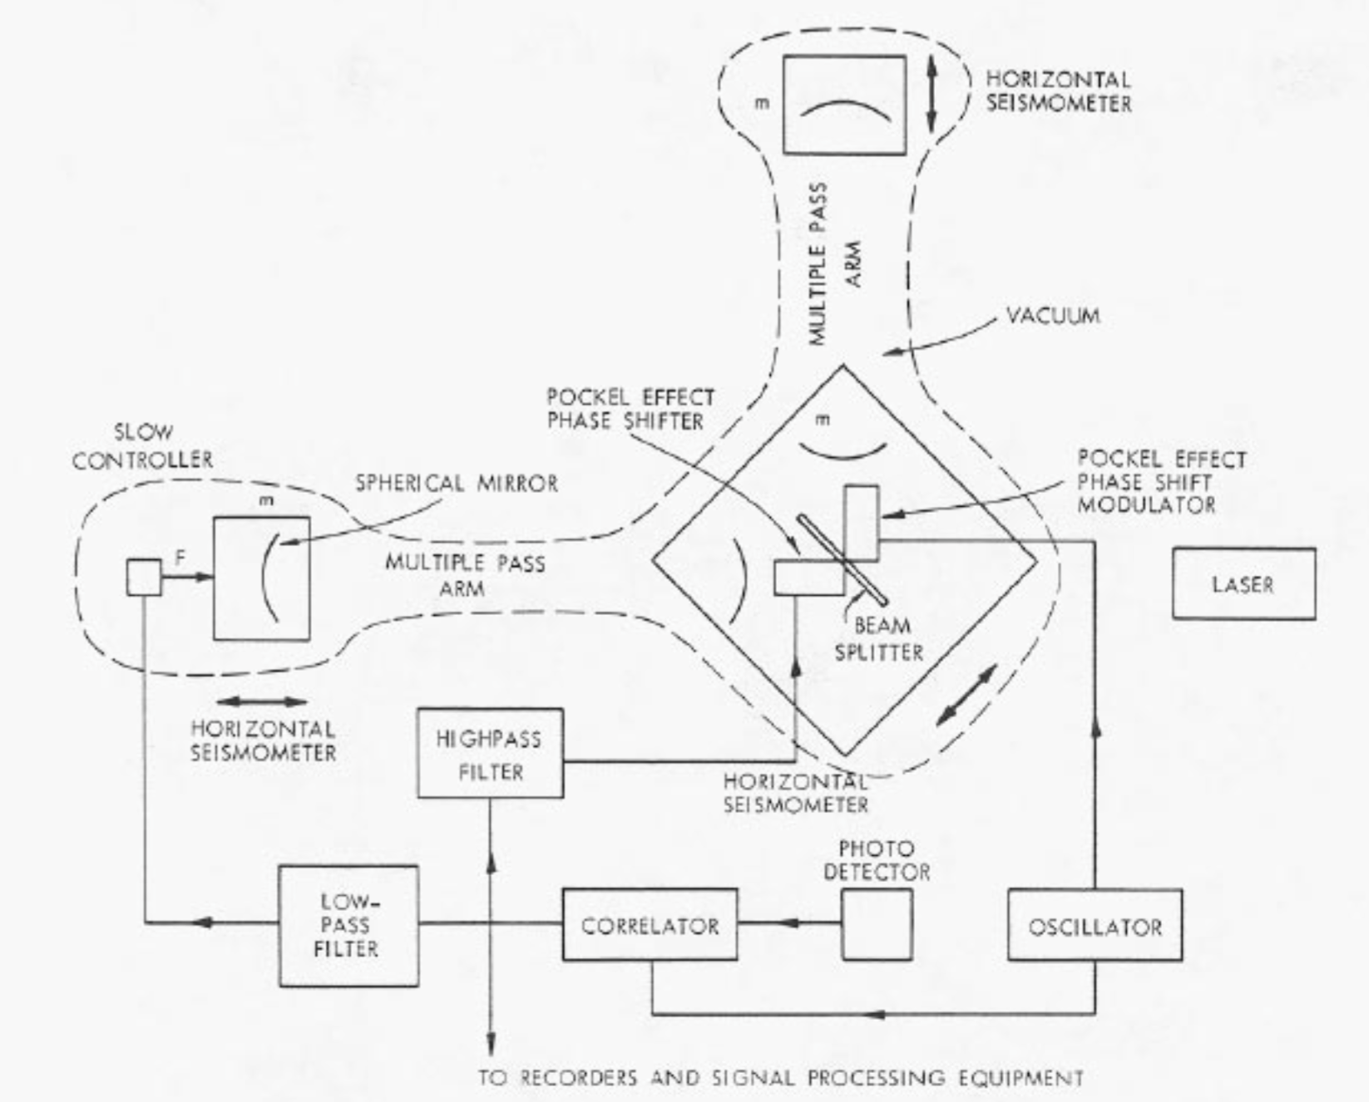
The Detailed Engineering Drawings

Slide 11
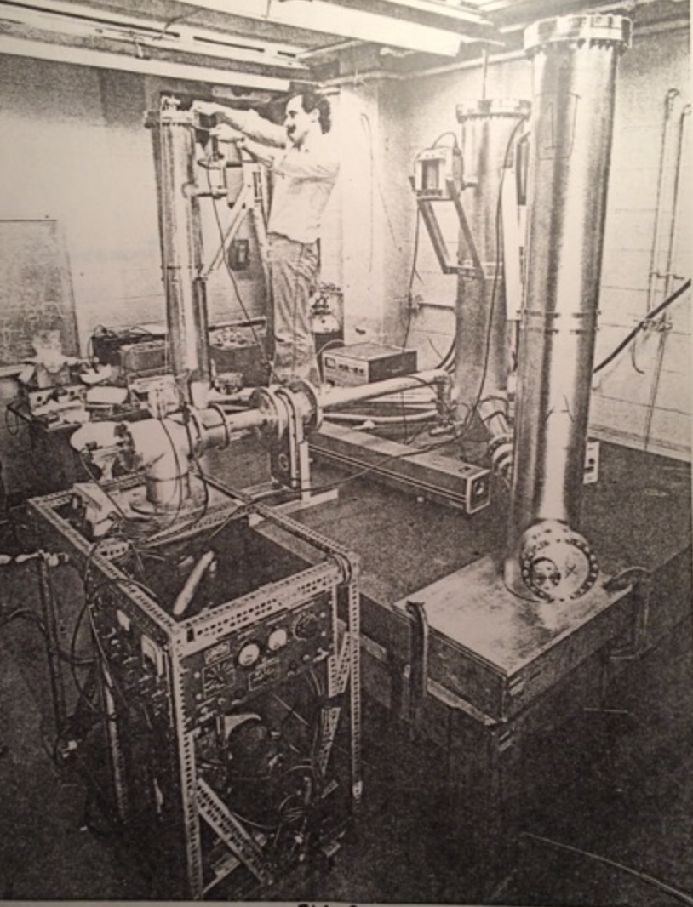
Peter Kramer assembling the vacuum system for the 1.5 meter prototype

Slide 12
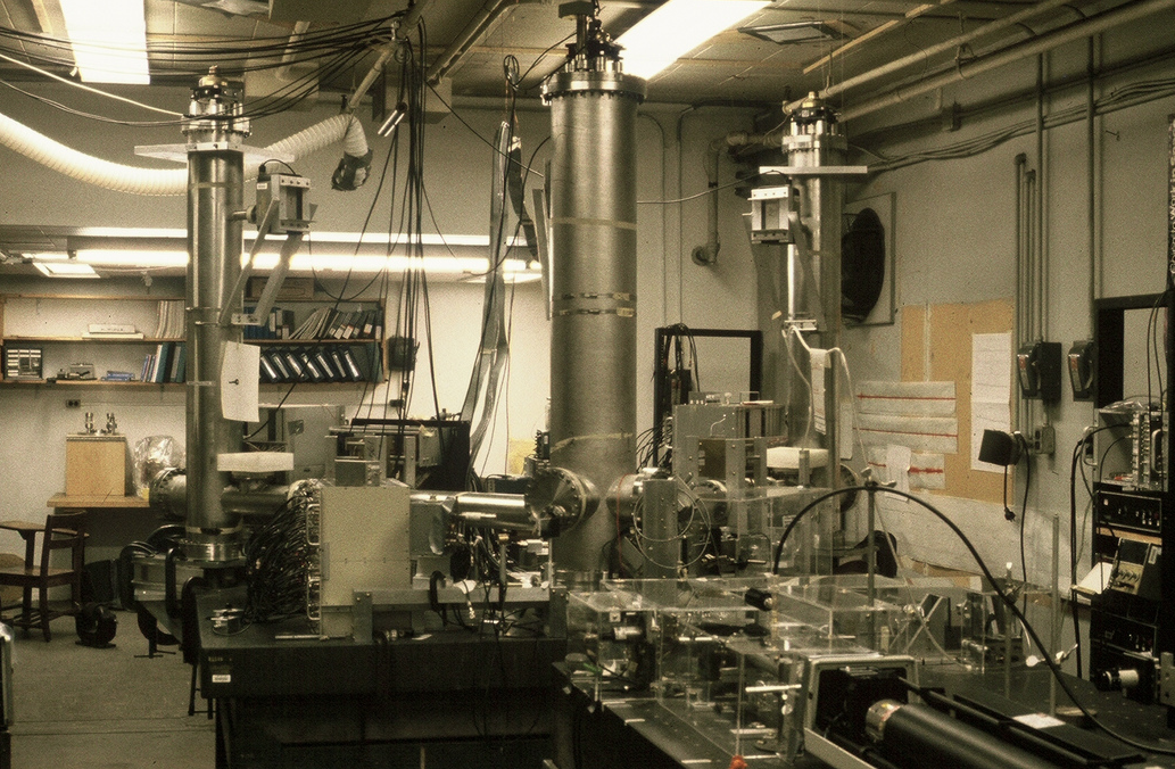
General view of the 1.5 meter prototype

Slide 13
General view of the 1.5 meter prototype

Slide 14
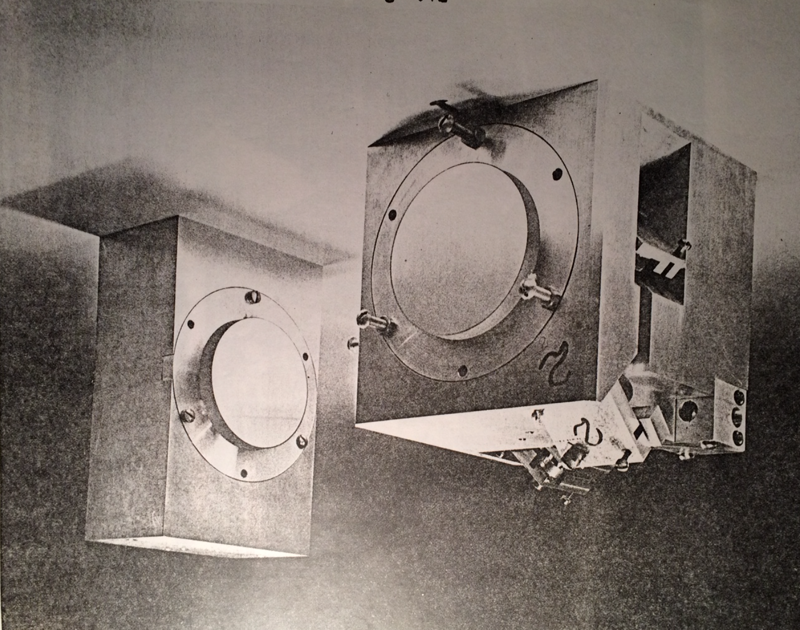
Beamsplitter and input mirror block; end test mass/mirror

Slide 15
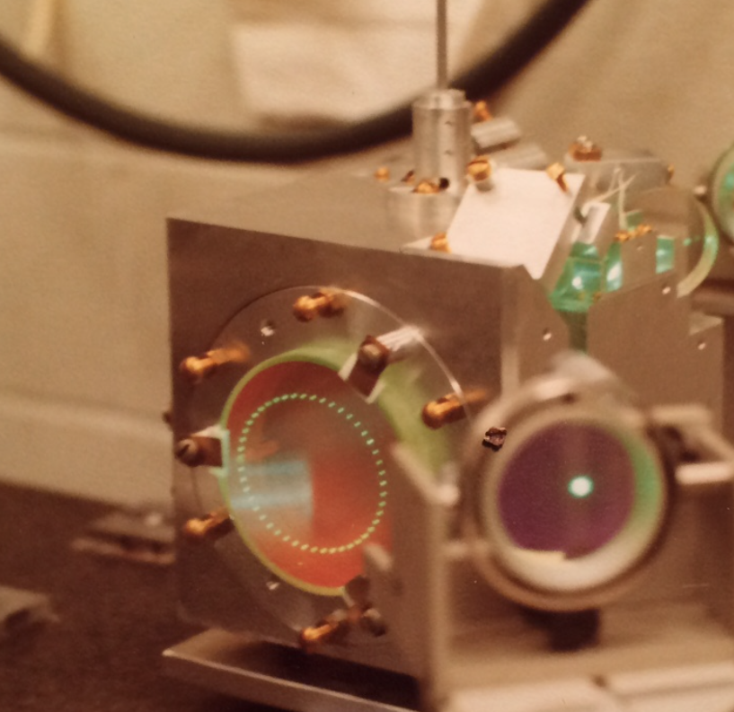
Herriot delay line on the ‘vertex block’, illuminated with Argon laser; rod suspension

Slide 16
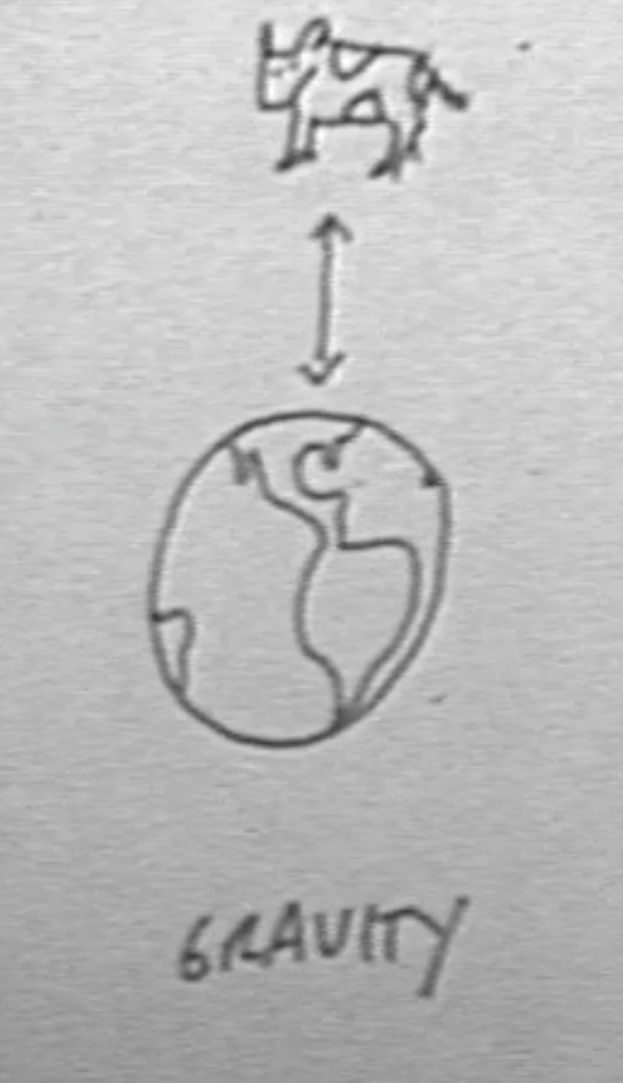
‘Fuzzy’ photos are from Mary Jane Doherty

Slide 17
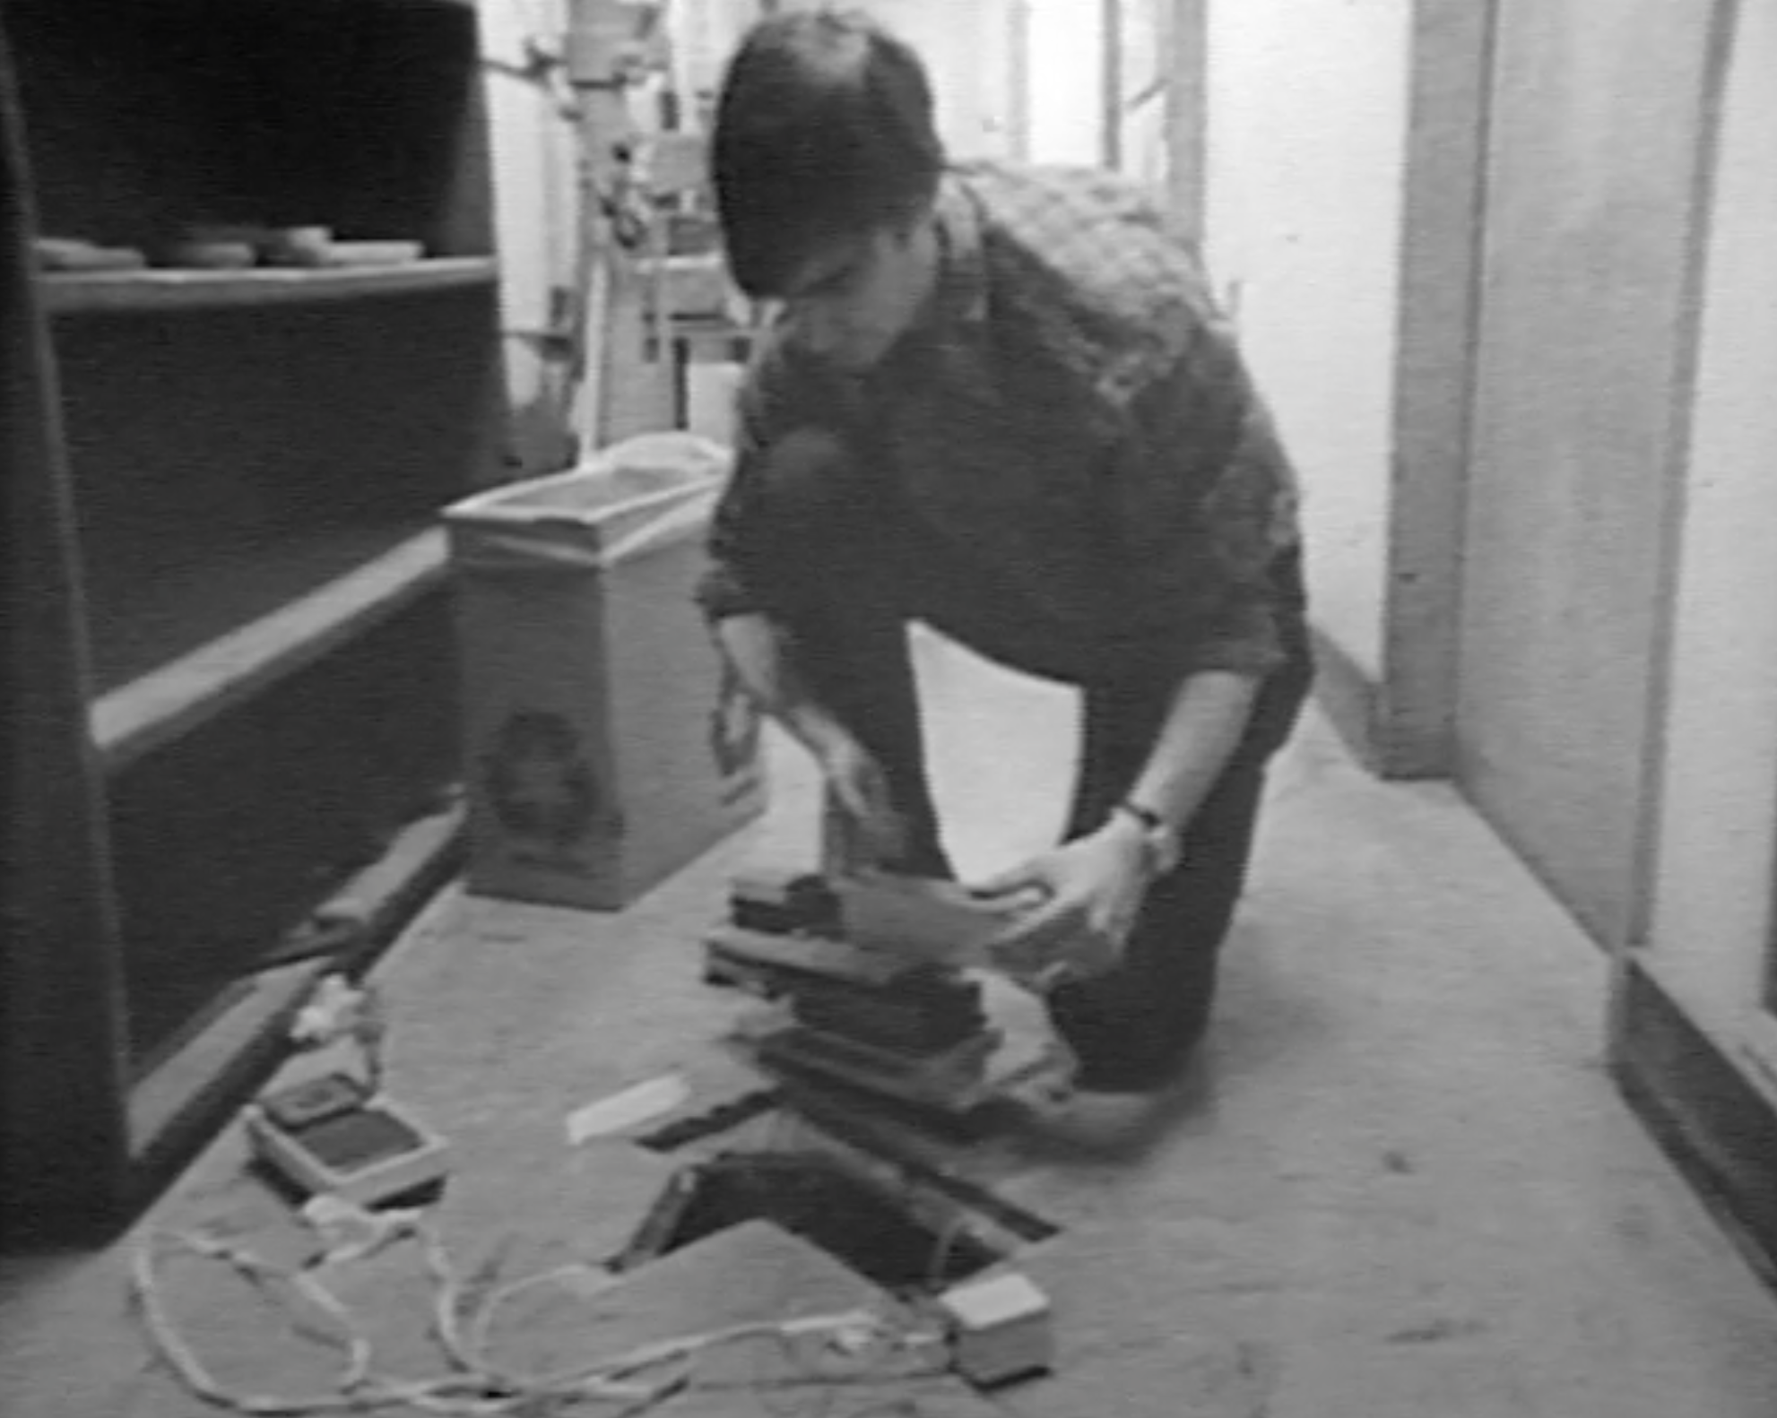
Jeff Livas; hole in upstairs floor to install pendulum suspension below

Slide 18
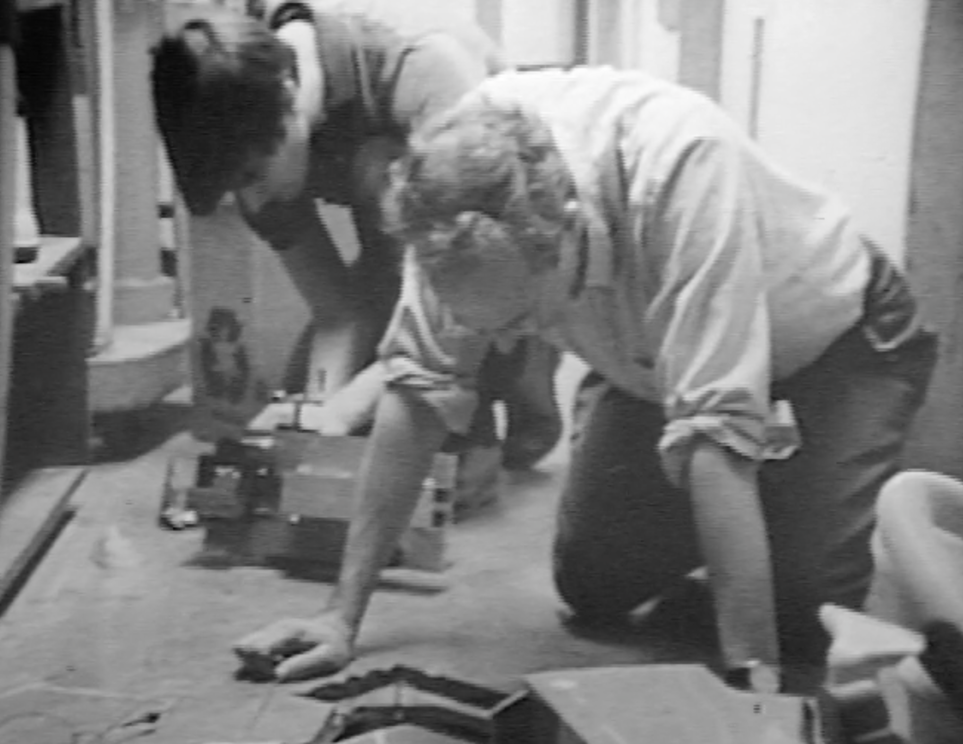
Rai and Jeff

Slide 19
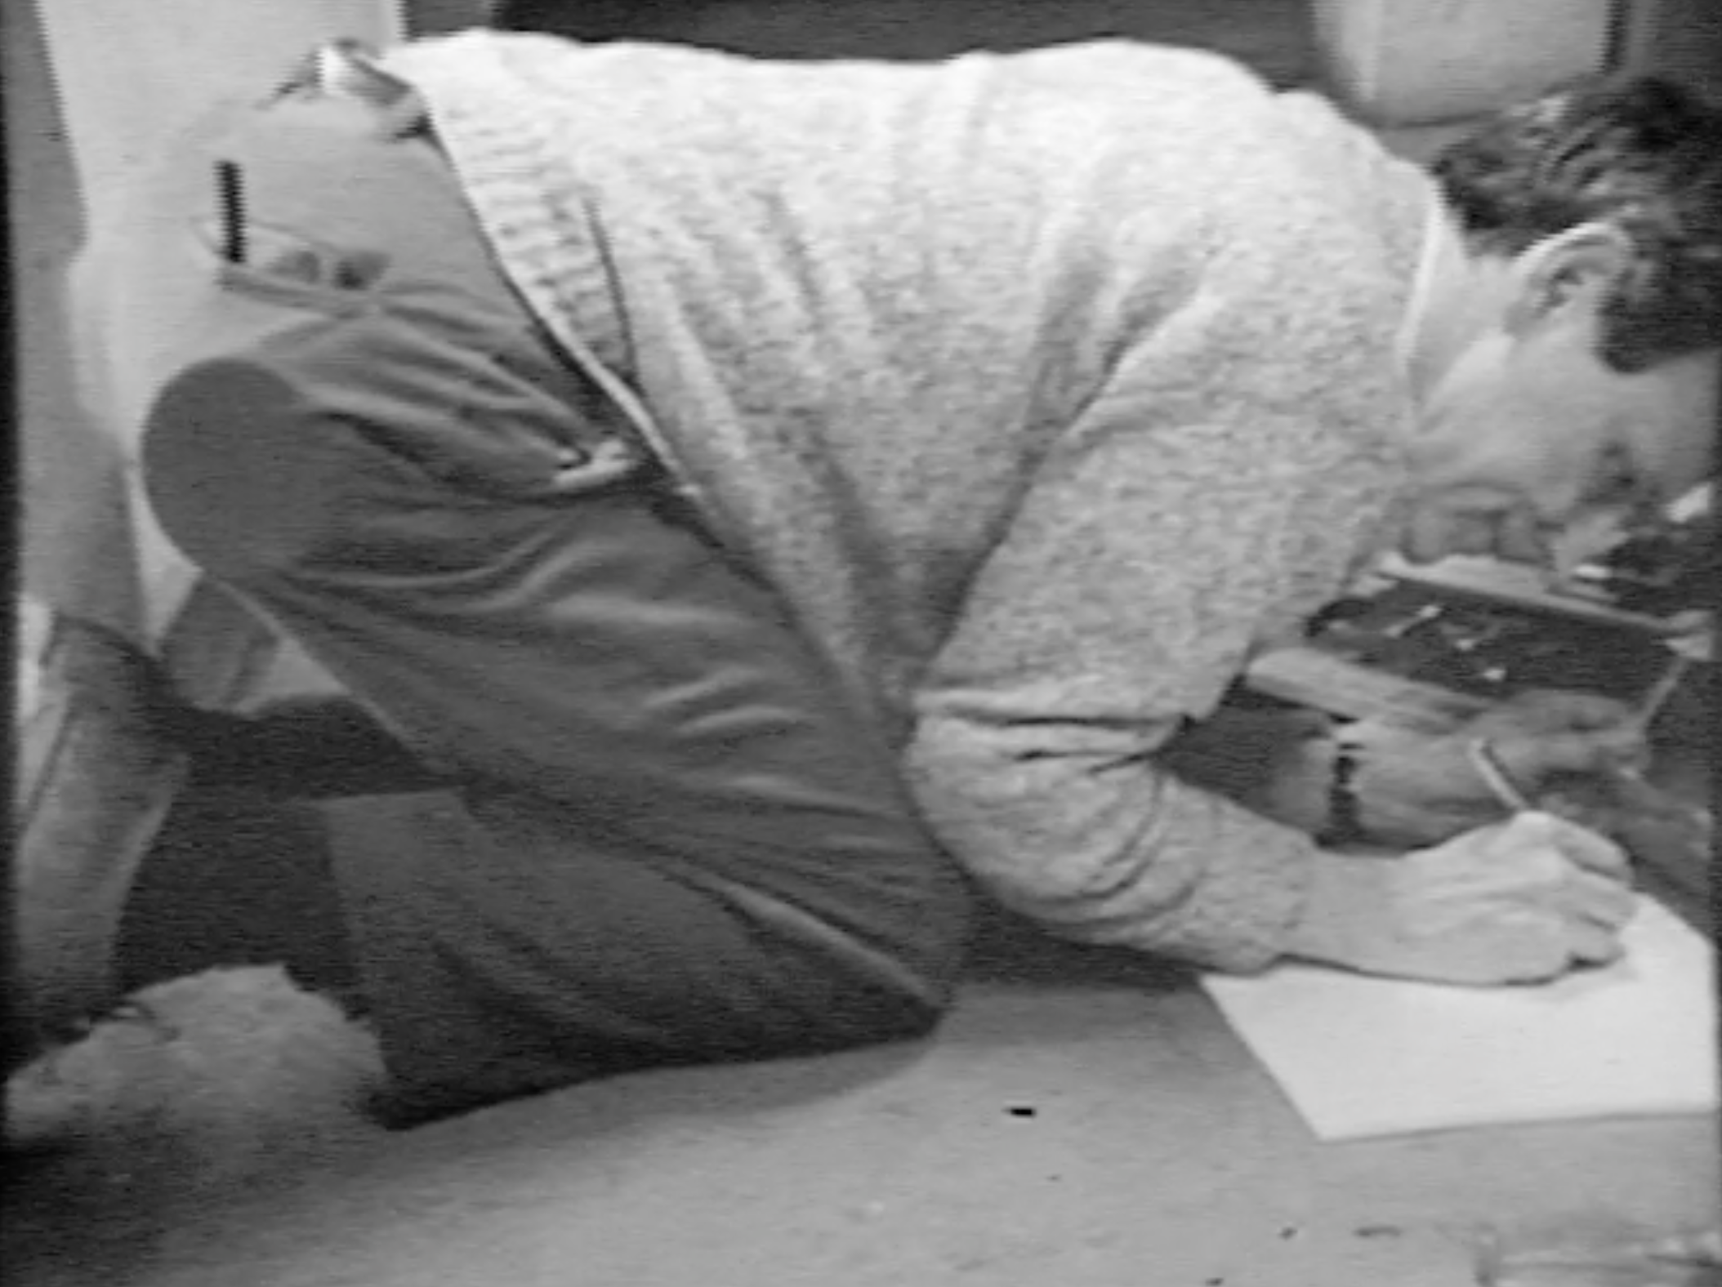
Rai. Note pipe and tobacco at the ready.

Slide 20
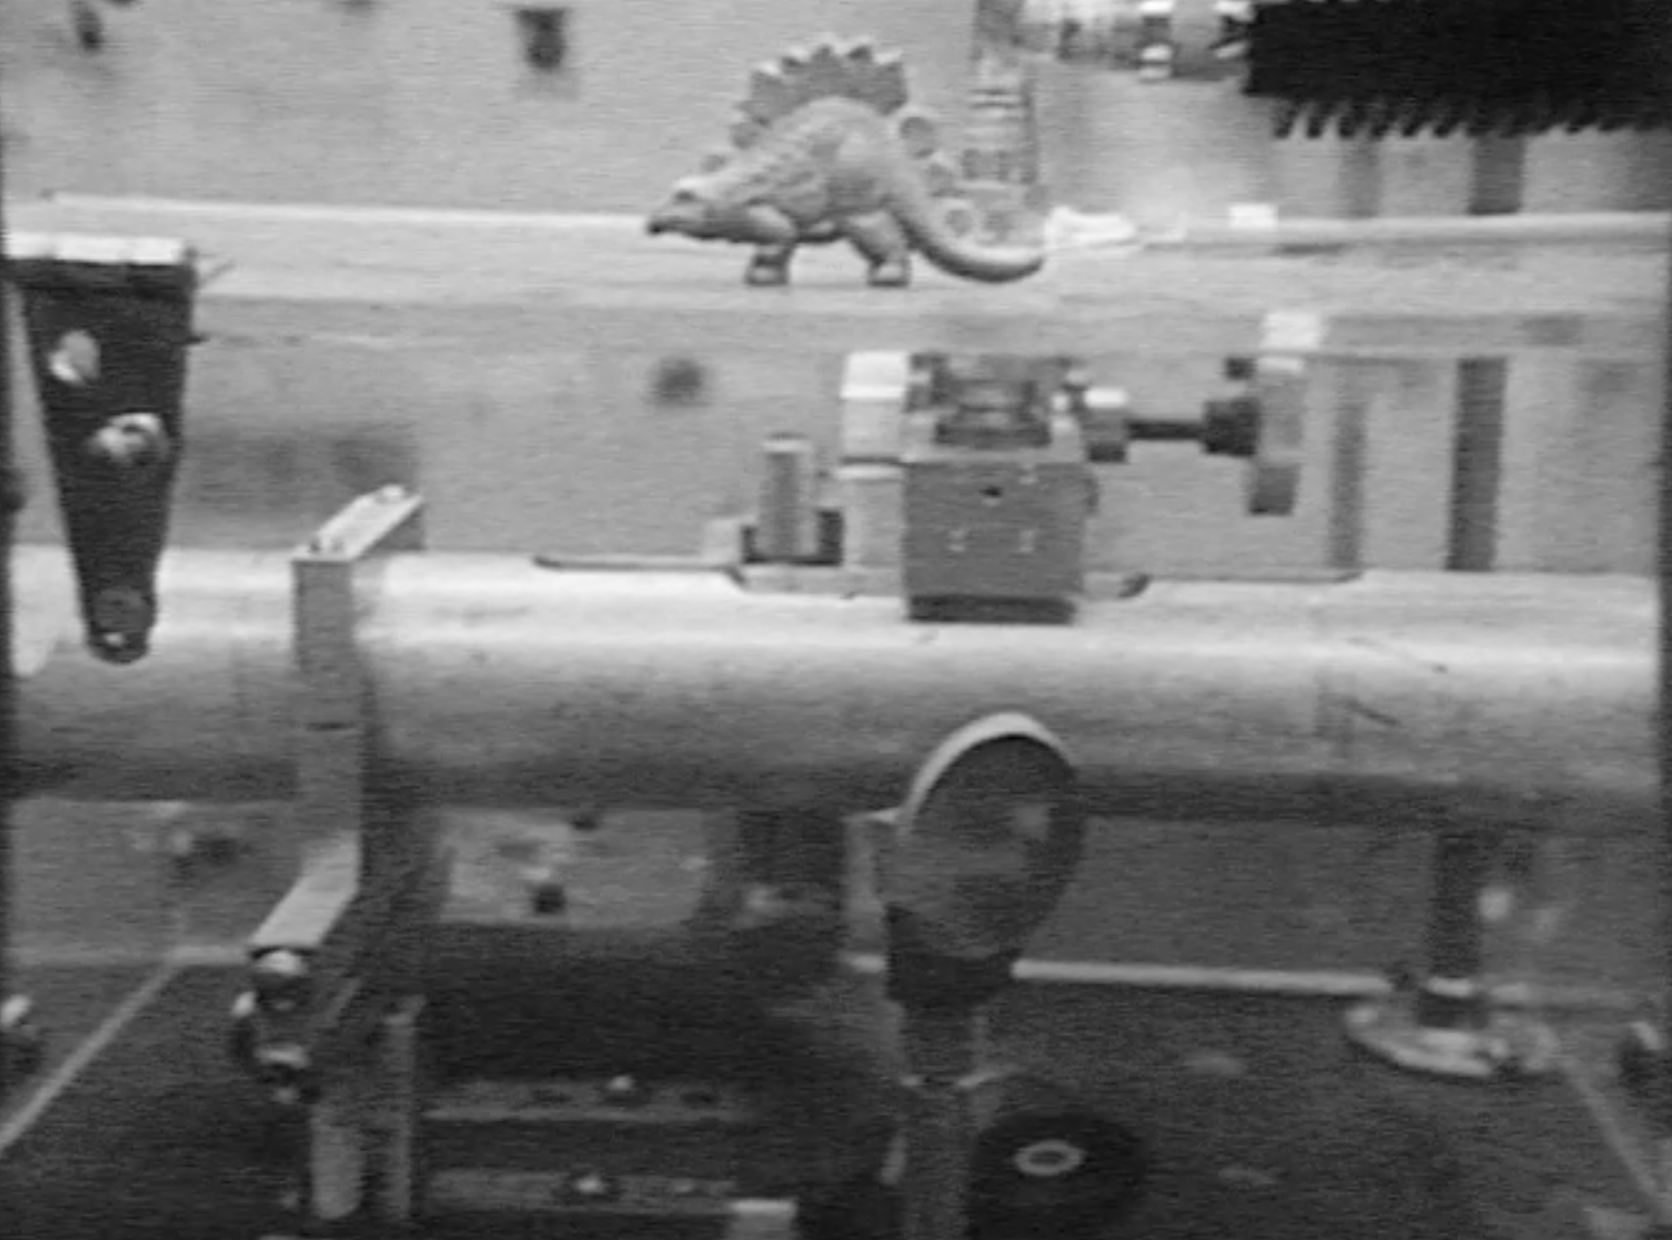
RF phase modulator (in tube under dinosaur)

Slide 21
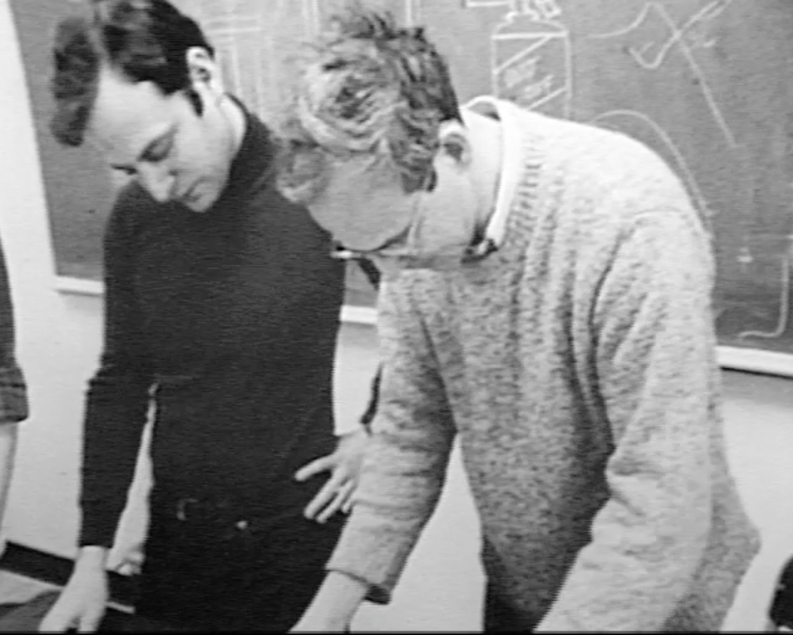
Peter Saulson and Rai

Slide 22
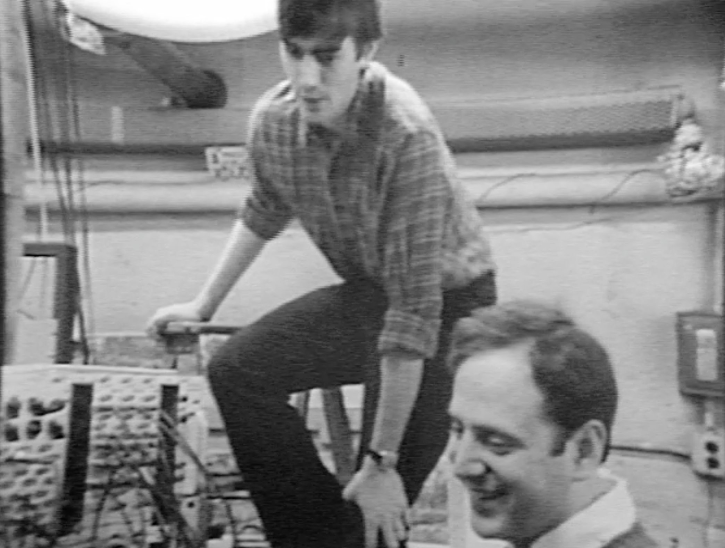
Jeff and Peter

Slide 23
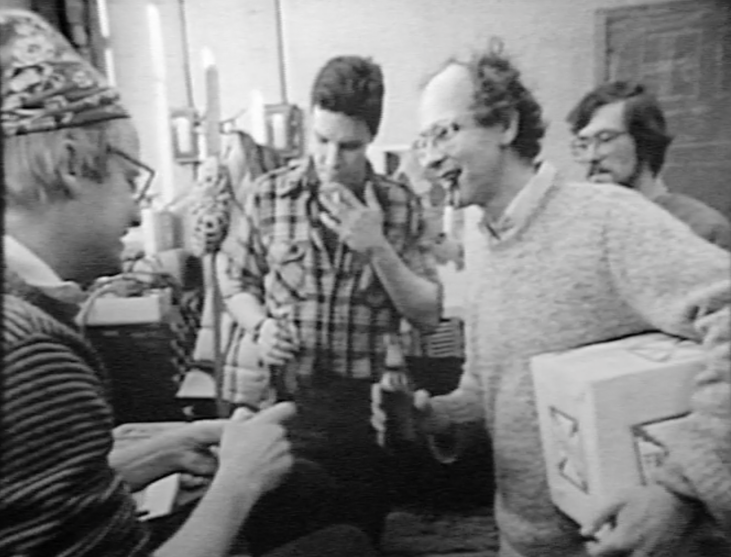
Rai (pipe and beer) celebrating
Lyman Page failing his exams

Slide 24
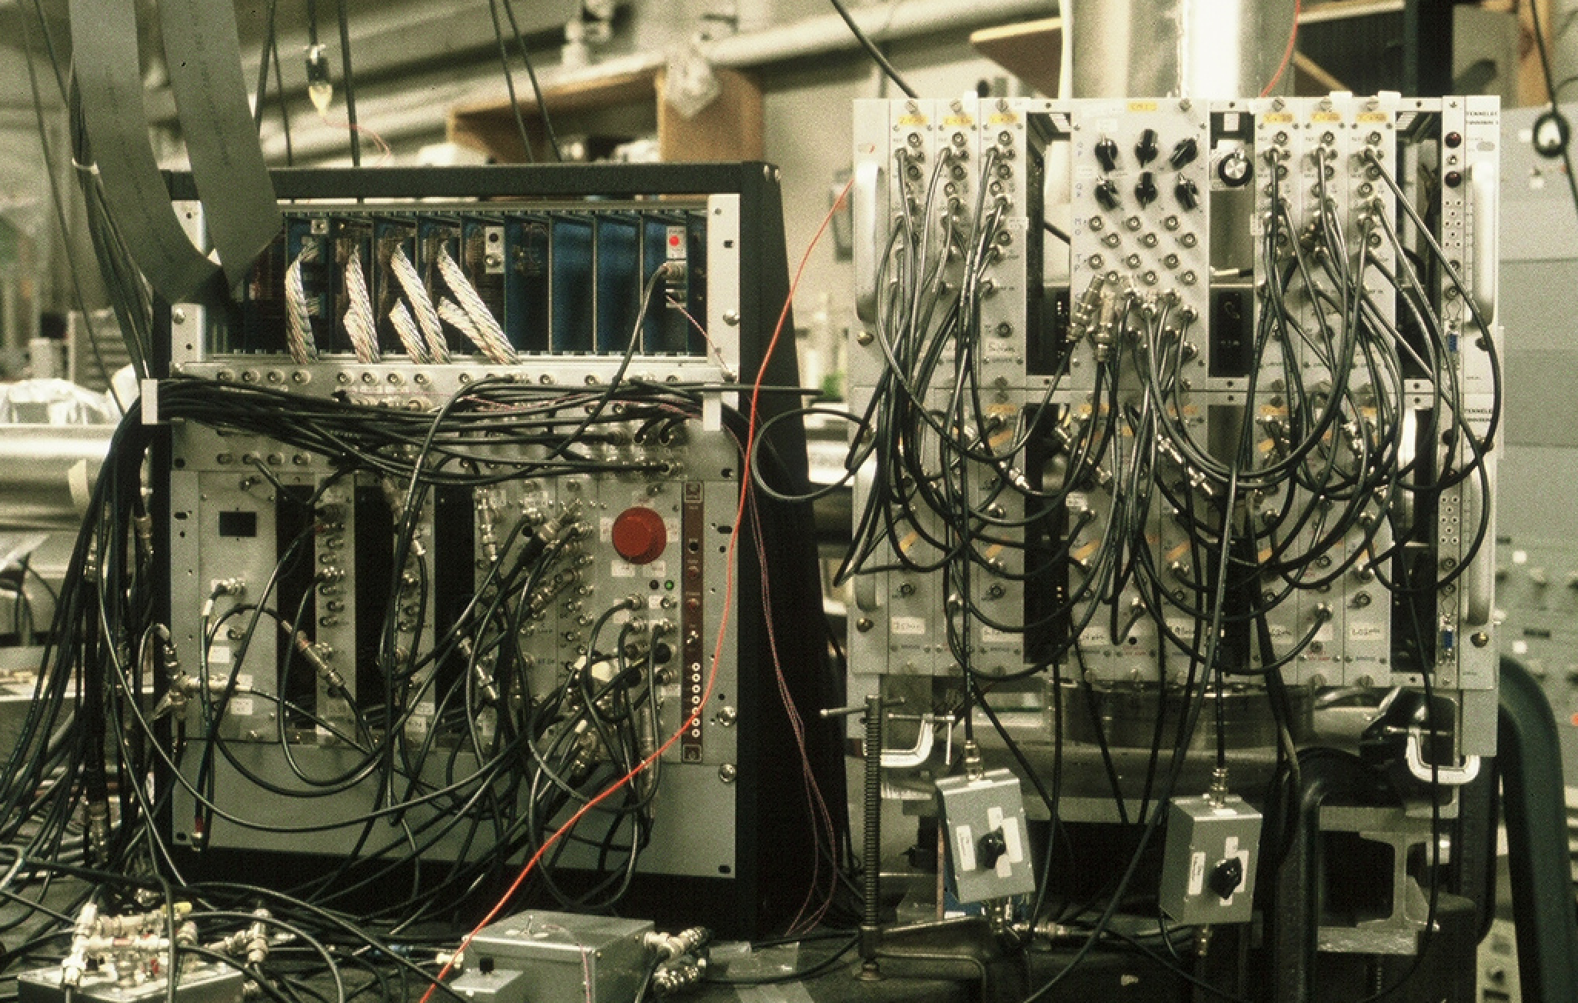
Test mass controller, servo control, and
DAQ for 1.5 meter prototype

Slide 25
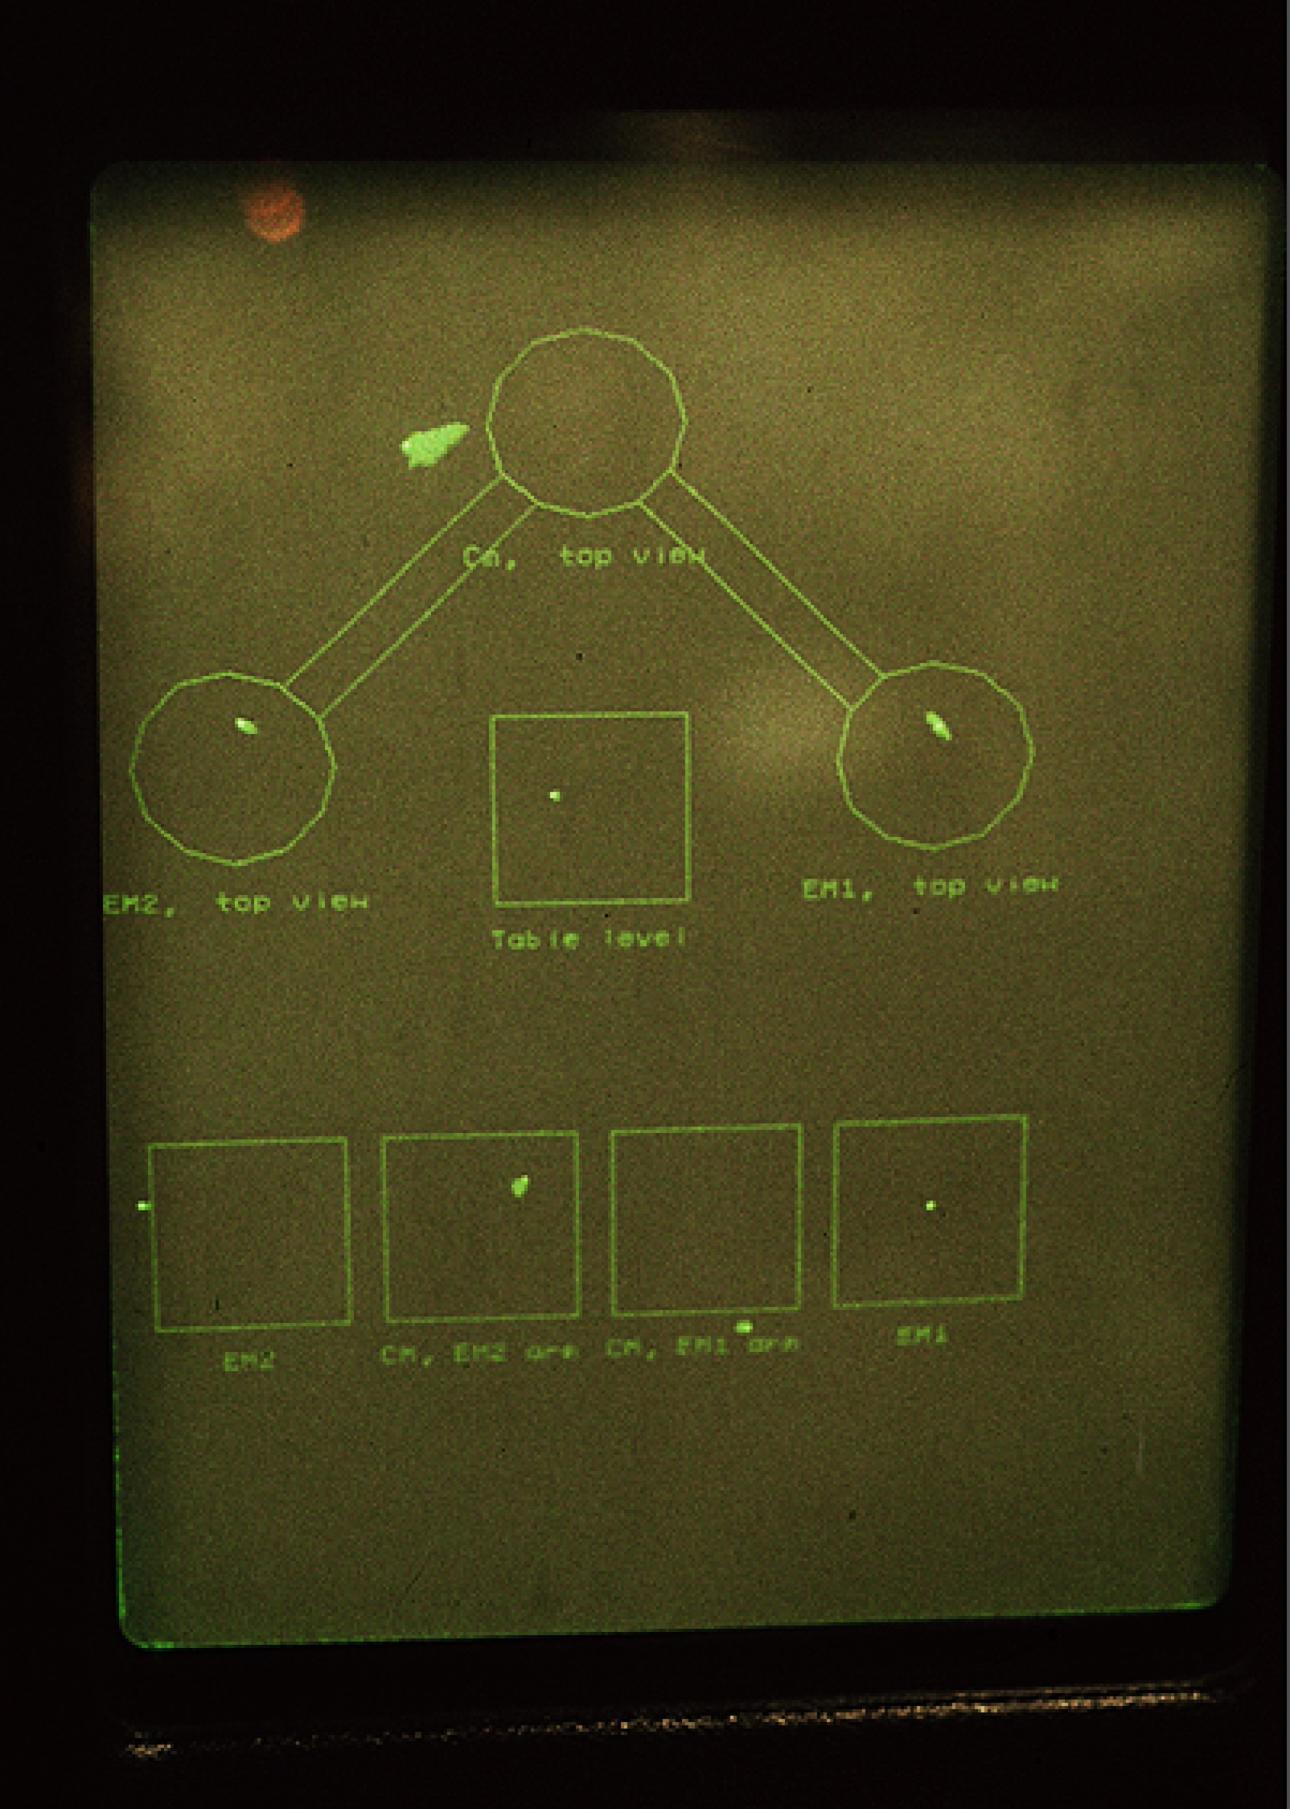
The Control Room Display

Slide 26
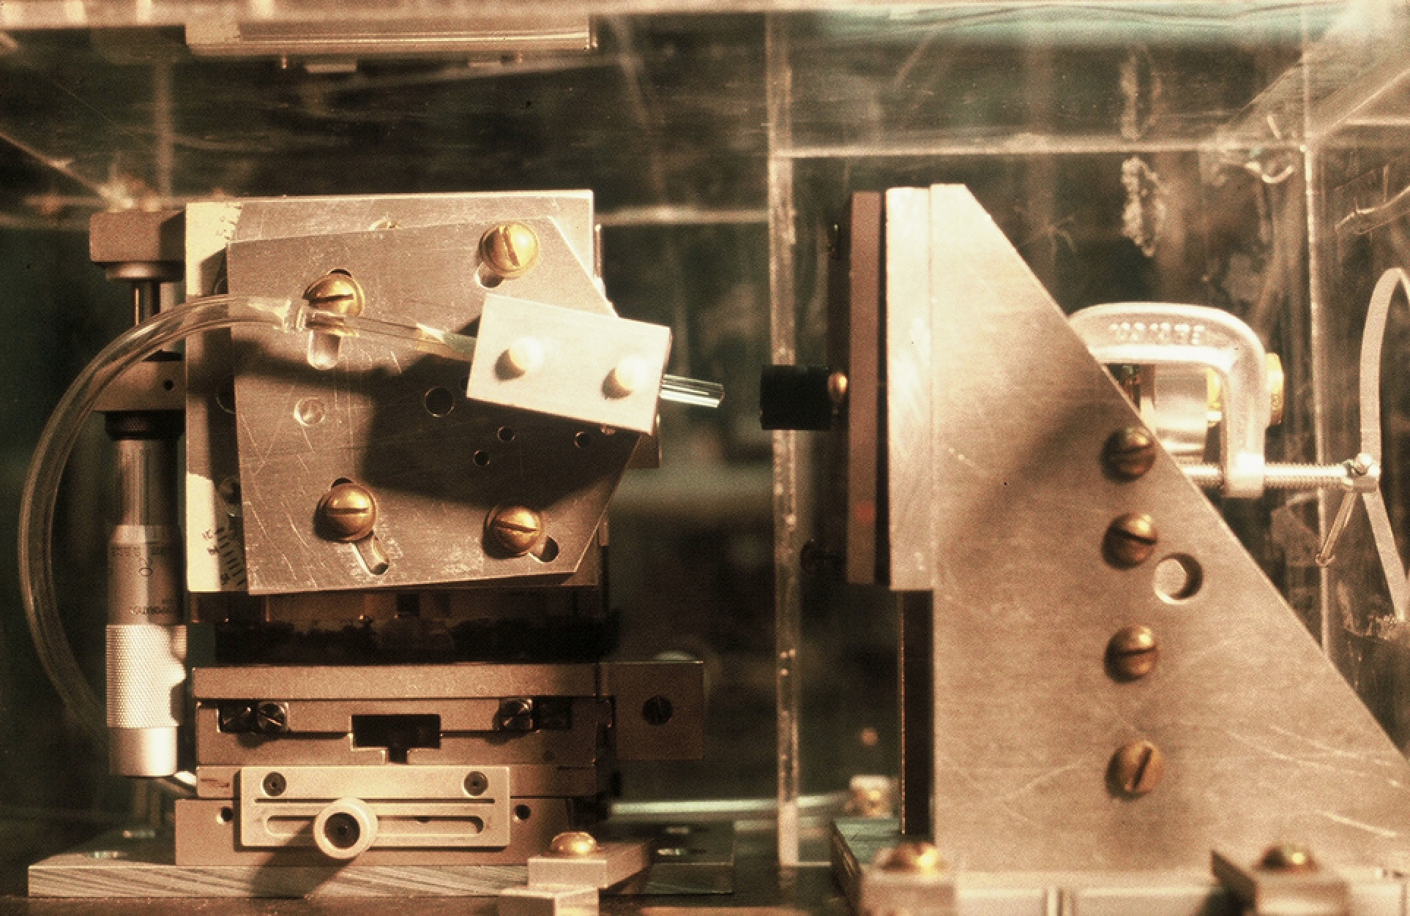
Single mode fiber, microscope objective

Slide 27
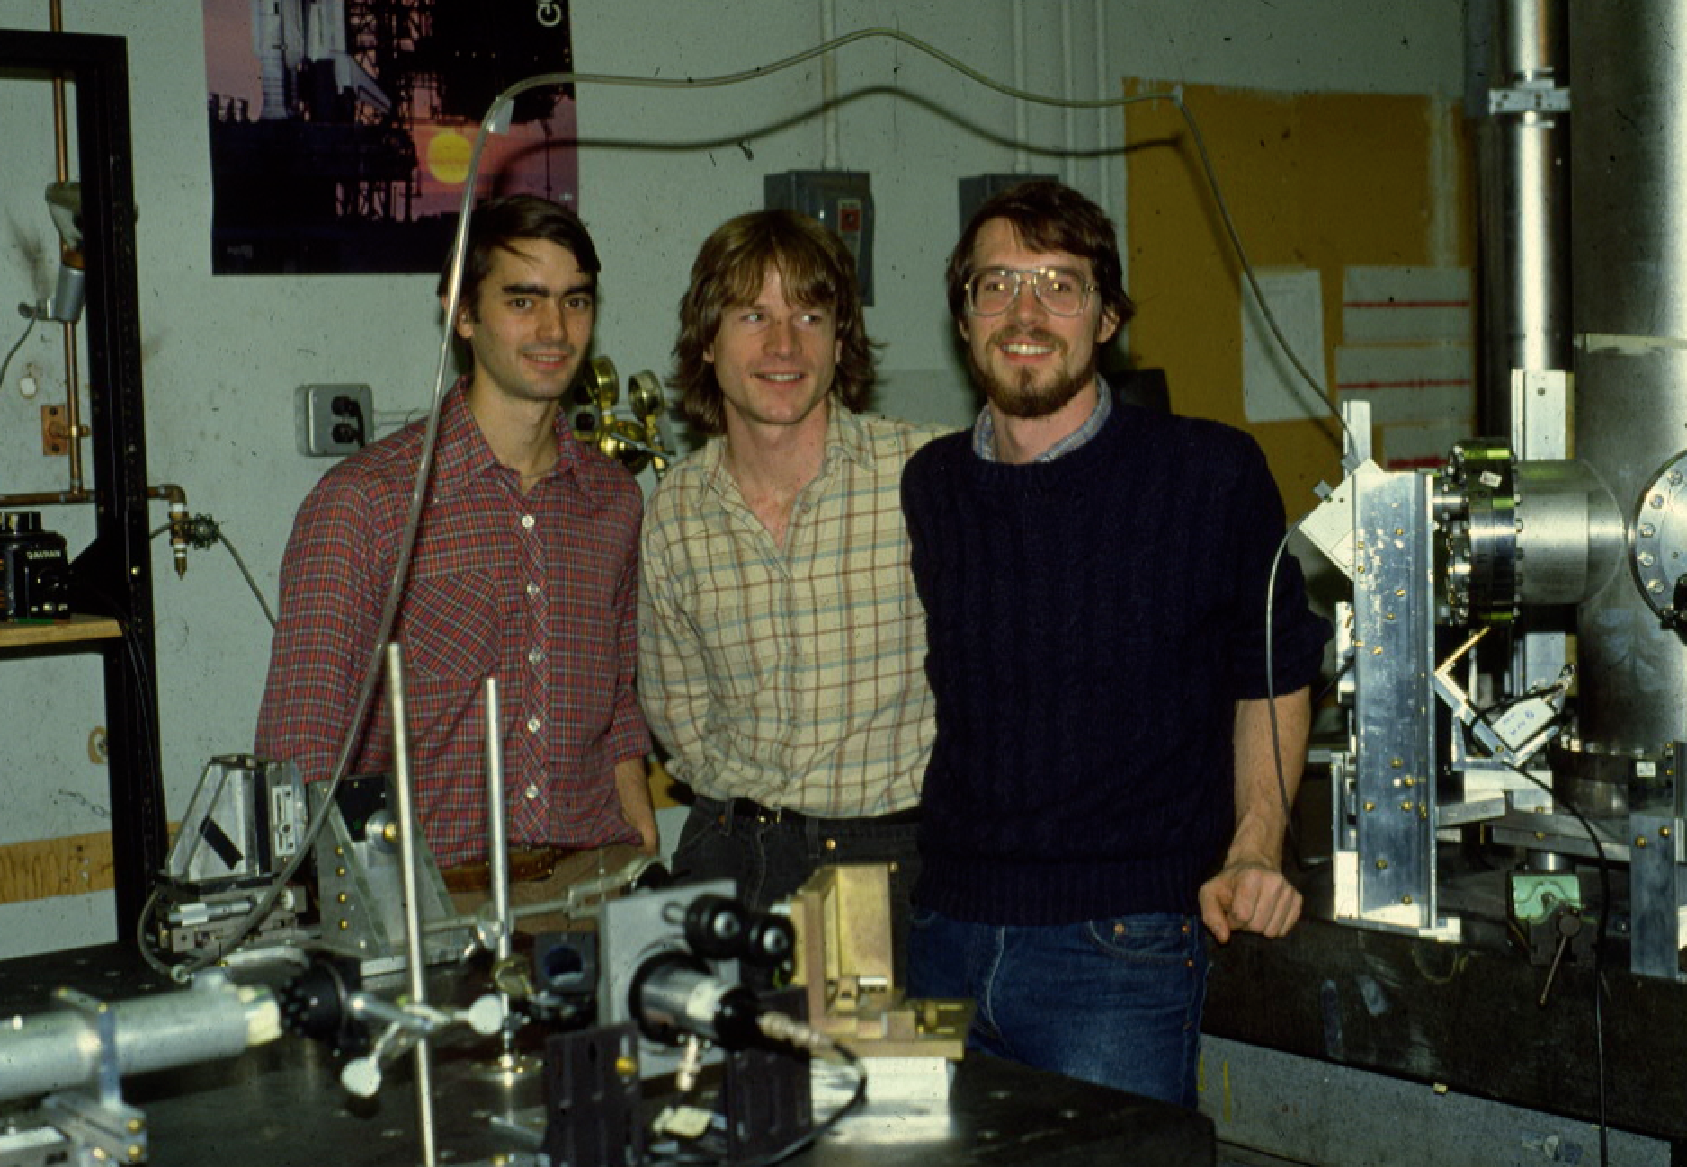
Single-mode fiber light delivery from laser to interferometer table
(Jeff Livas, David Shoemaker, Dan Dewey)

Slide 28
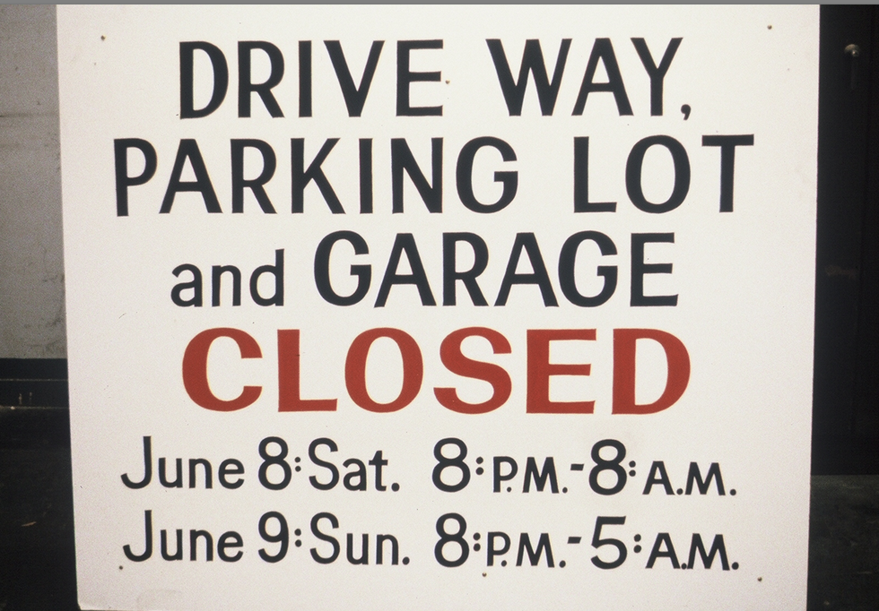
The last gasp for the 1.5 meter: a data-taking weekend leading to a couple of PhD theses

Slide 29
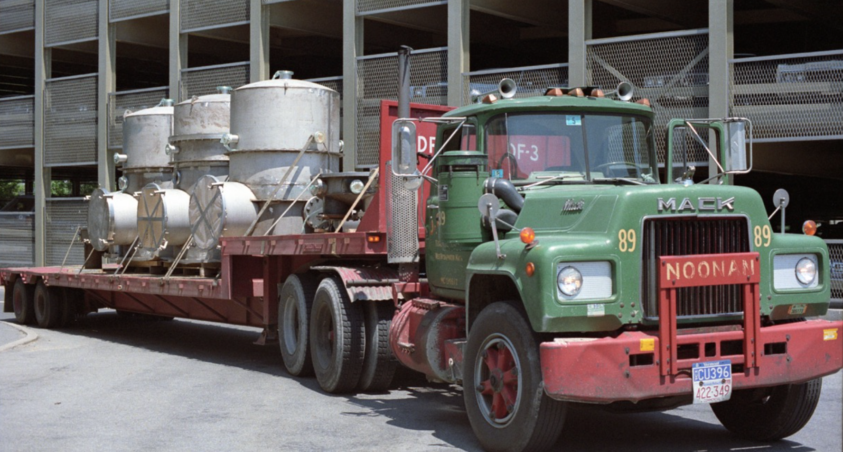
Delivery of the ‘new’ vacuum system

Slide 30
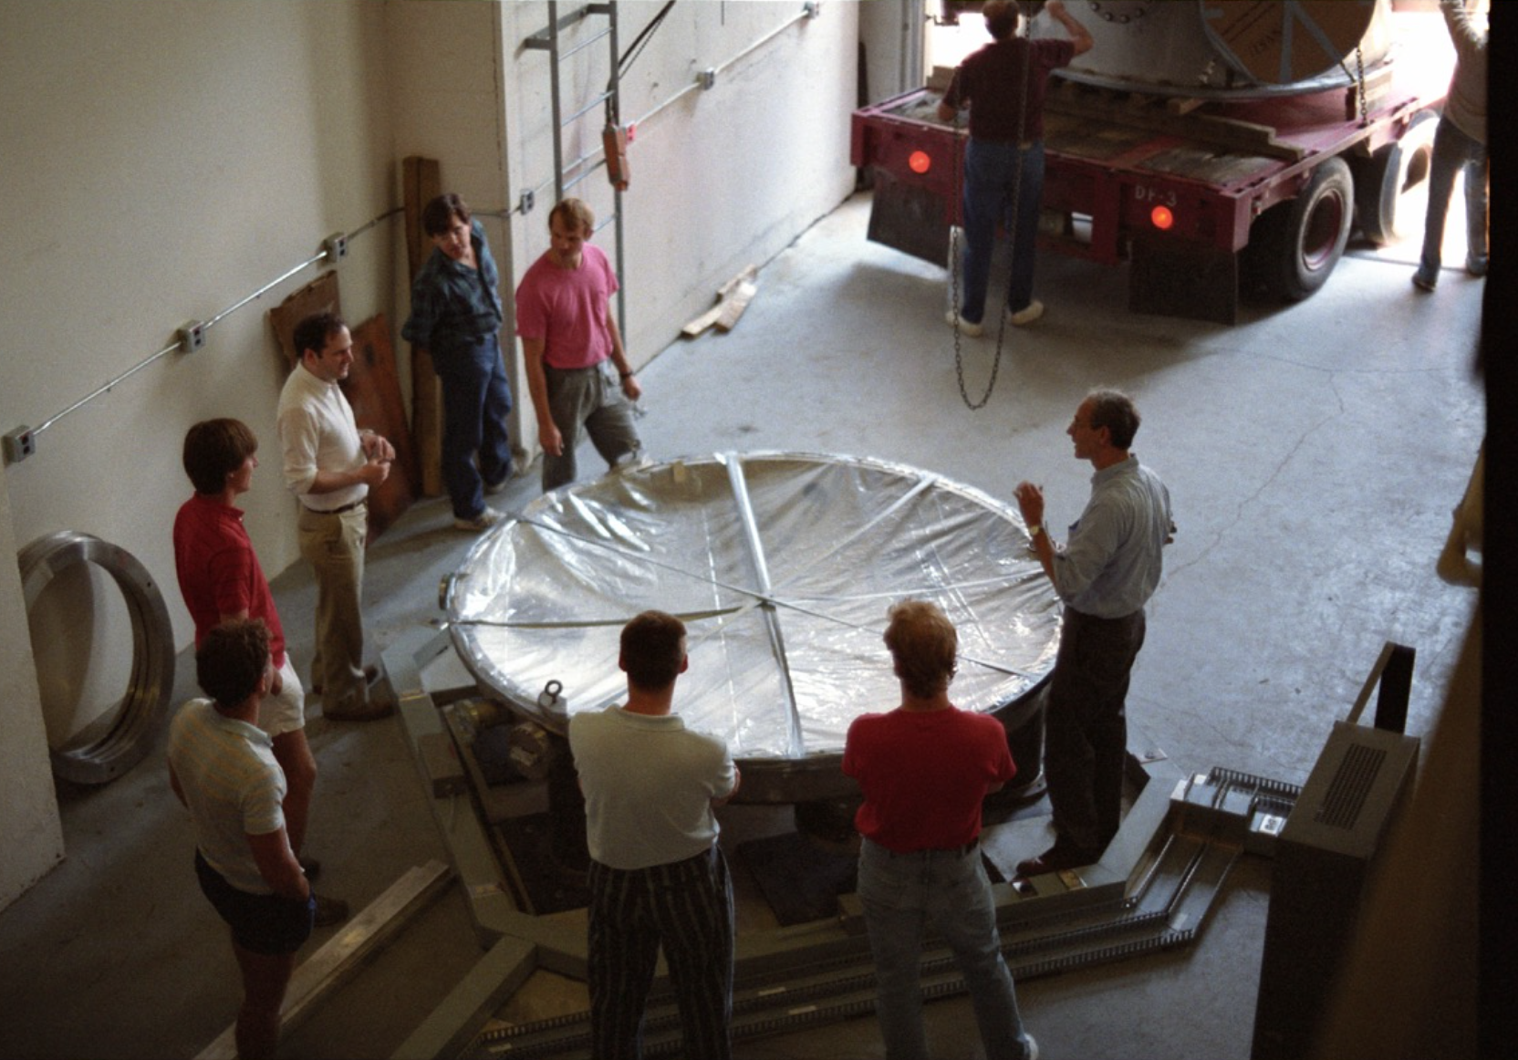
Rai giving instructions to the riggers, a.k.a. grad students

Slide 31
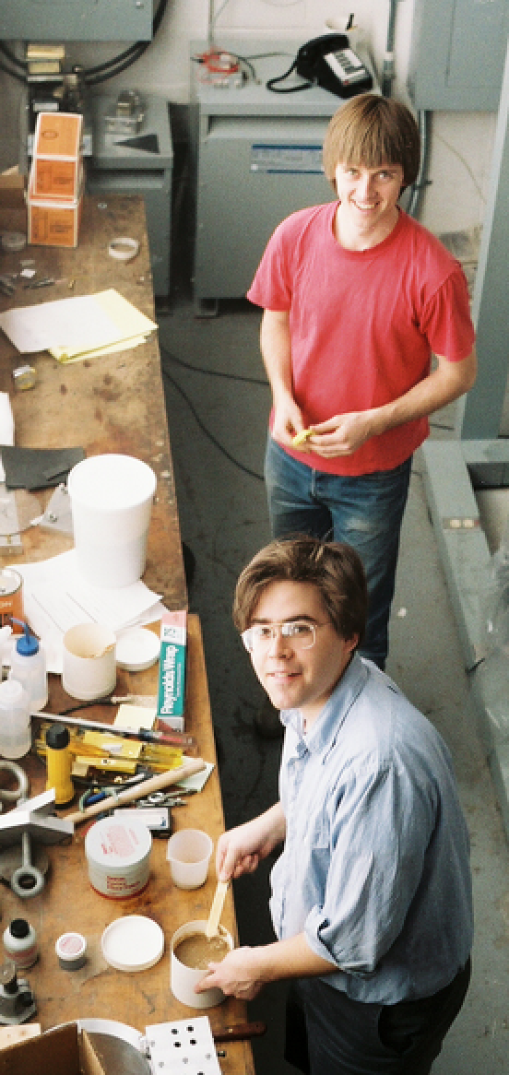
Nelson Christensen and Peter Fritschel mixing glue

Slide 32
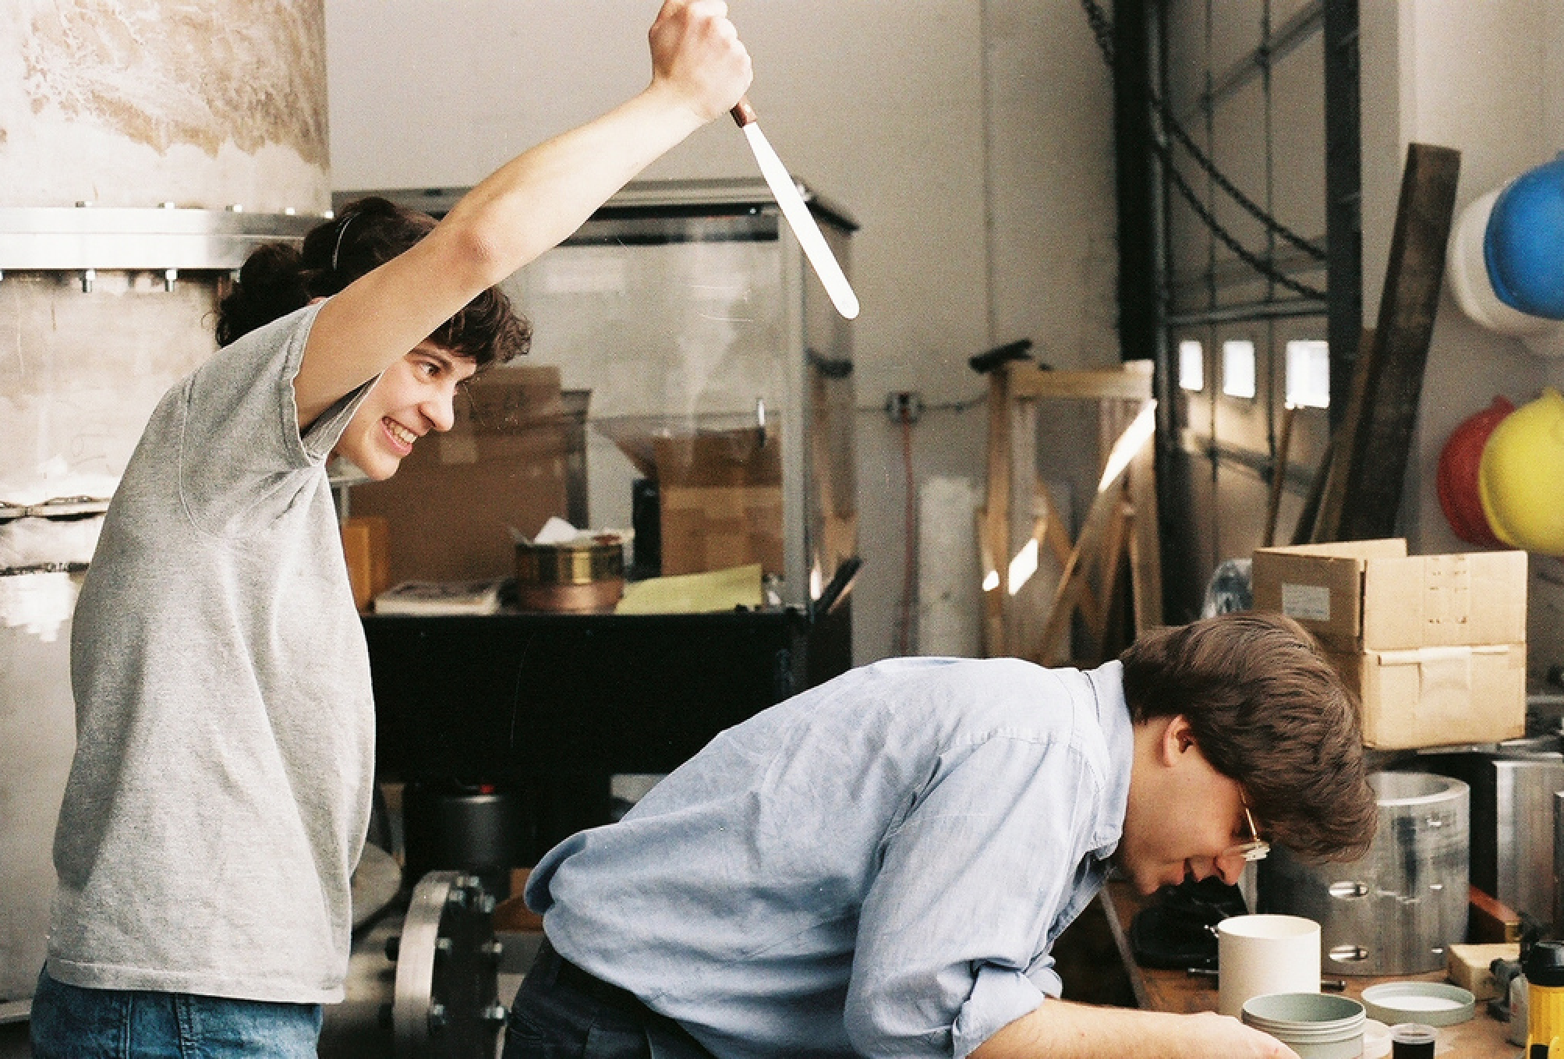
Michele Stephens and Peter Fritschel

Slide 33
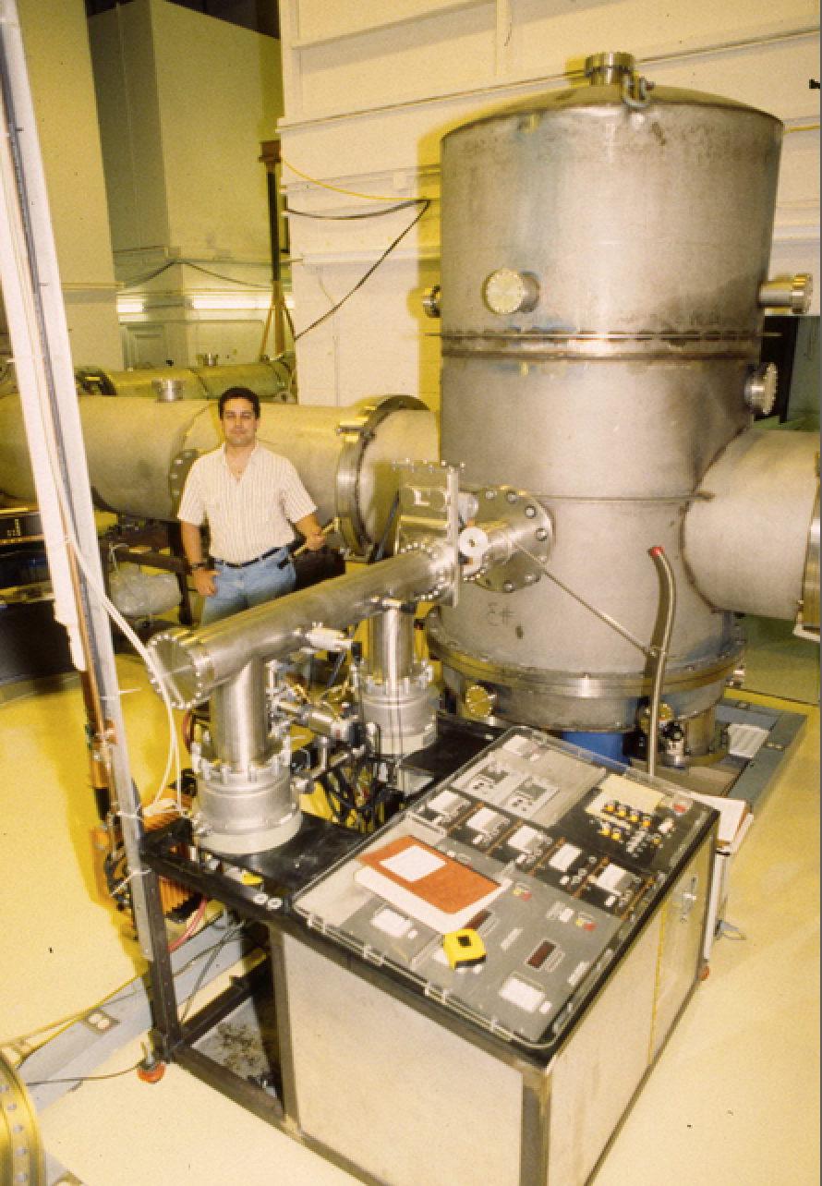
Not Mike Zucker’s first, or last, vacuum system

Slide 34
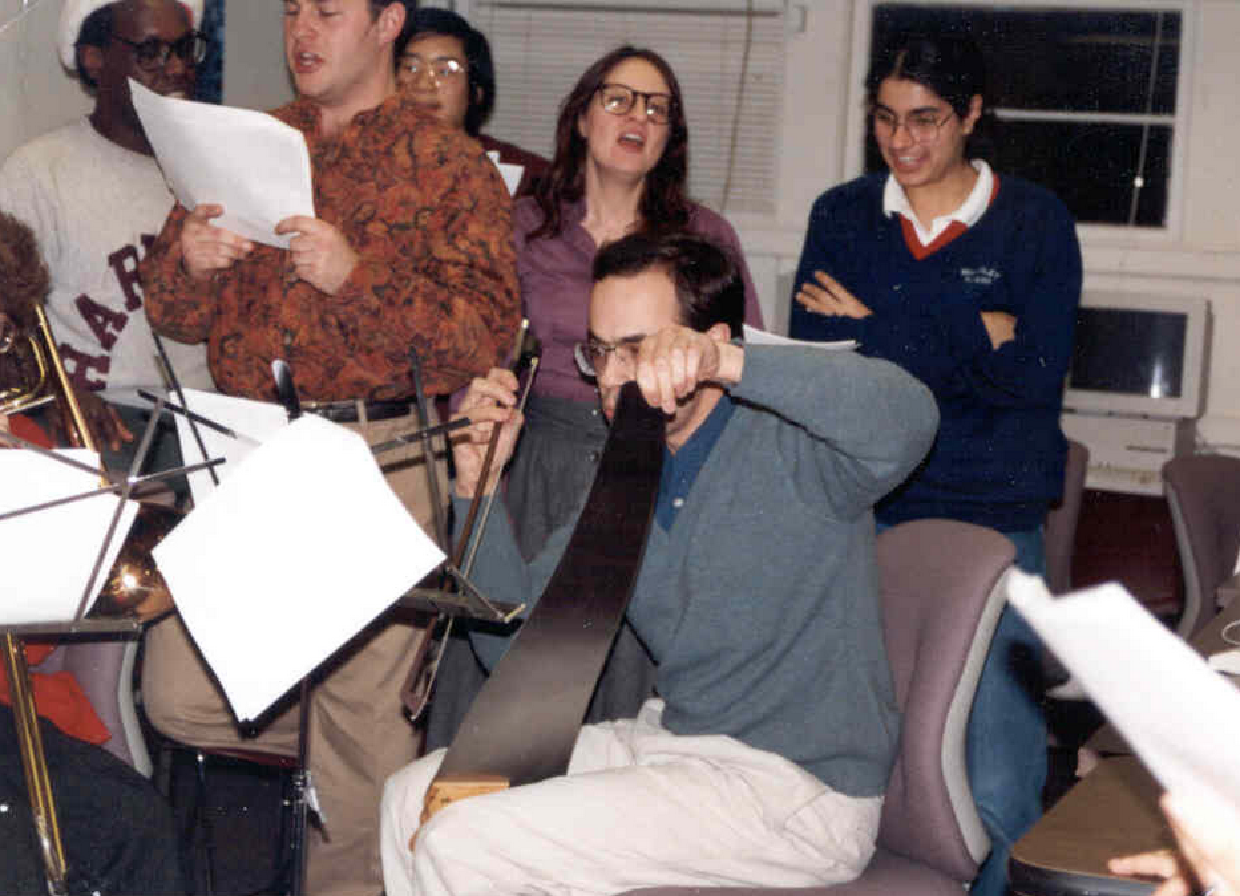
Joe Giaime on saw, with
Joe Kovalik and Nergis in the choir

Slide 35
