Slide 1

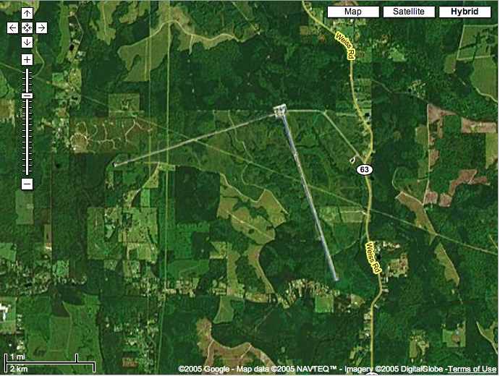
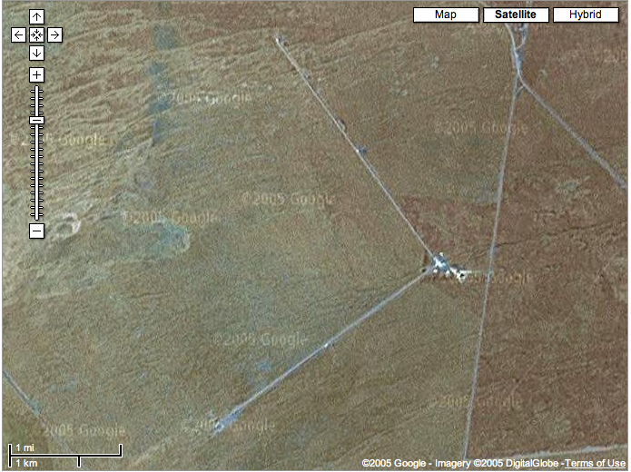
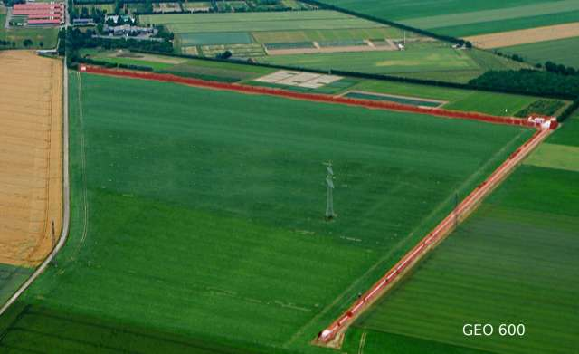
The LIGO Scientific Collaboration
Gabriela González,
Louisiana State University
For the LIGO Scientific Collaboration
LIGO Livingston Observatory
LIGO Hanford Observatory

Slide 2
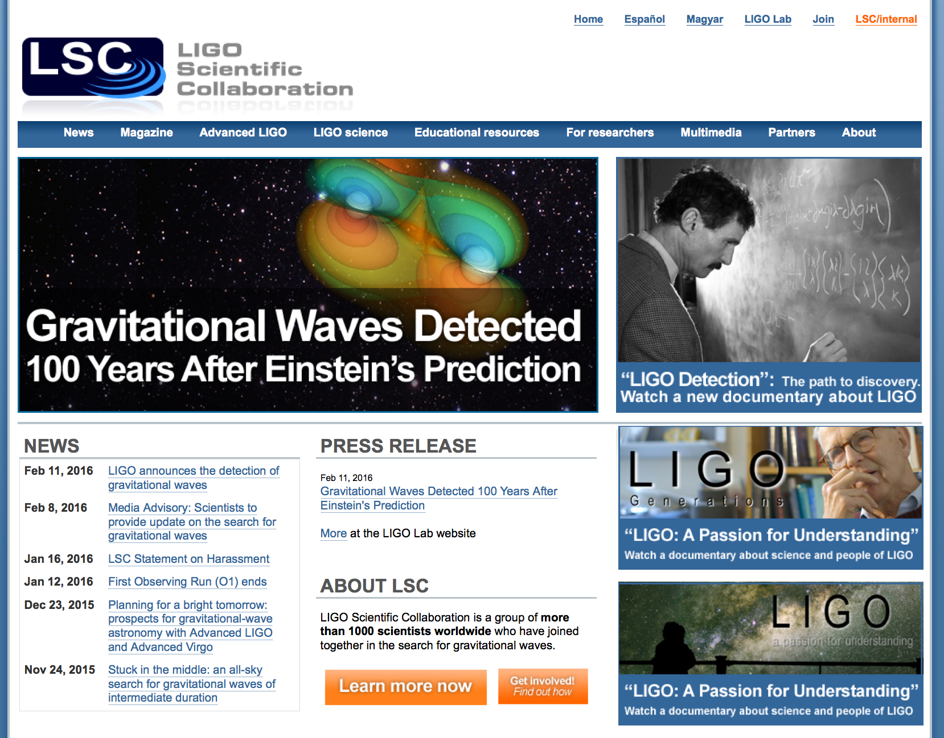
www.ligo.org

Slide 3

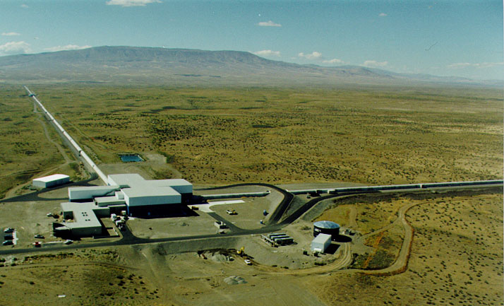




LIGO detectors
Hanford, WA
Livingston, LA
Advanced LIGO detectors:

Slide 4

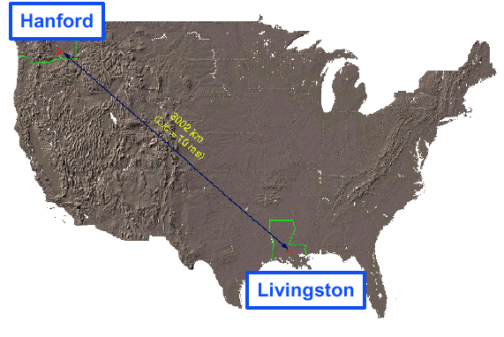
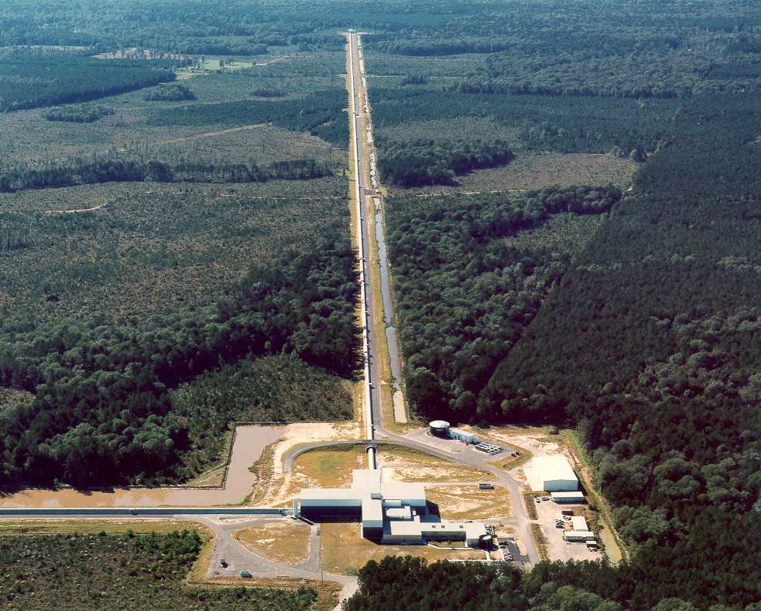
LIGO Laboratory
Mission: Observe gravitational wave sources; operate the LIGO facilities; develop the instrument science and technology; scientific education and public outreach.
NSF Major Research Facilities Construction LIGO grant in 1992 and in 2008; cooperative agreements since 1992, jointly managed by Caltech and MIT.
~200 scientists, engineer and staff; includes physicists working on instrument science and data analysis.
MIT
Caltech
LIGO Livingston
Notes:
LIGO is actually two observatories.
Describe parameters
Emphasize that the arms are in ultra high vacuum. 8 km of steel 1.2 m dia beam tubes at each site
Separate observatories allow for coincidence detection – since the detectors see uncorrelated noise, only a true gravitational wave would appear on all the interferometers with the correct amplitude.
Emphasize that the LIGO Observatories were designed and are operated by Caltech and MIT

Slide 5























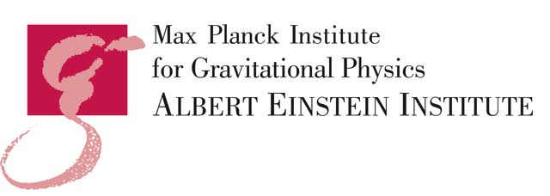





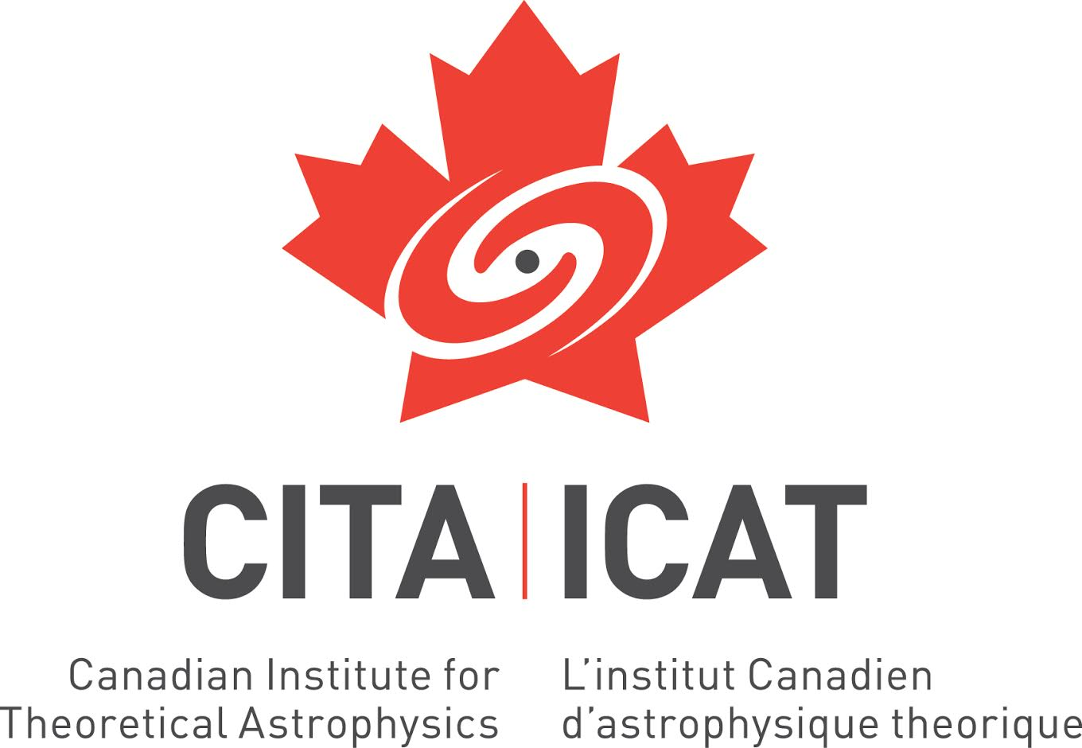




















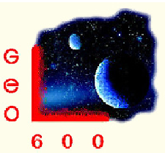














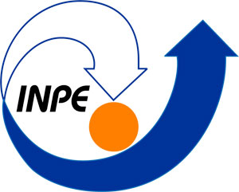





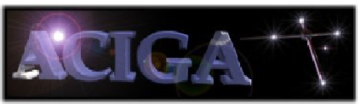







LIGO Scientific Collaboration

Slide 6
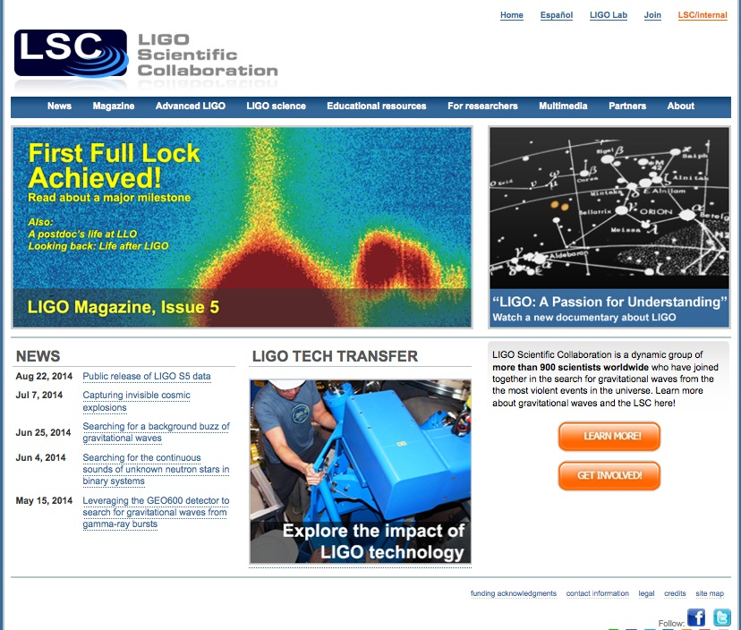
LIGO and LSC
The LSC and the LIGO Laboratory together make up “LIGO”.
LSC Mission: The LIGO Scientific Collaboration (LSC) is a self-governing collaboration seeking to detect gravitational waves, use them to explore the fundamental physics of gravity, and develop gravitational wave observations as a tool of astronomical discovery.
LSC Responsibilities:
  data analysis strategy, goals, and timeline, and carry out the data analysis program;
  identify priorities for research and development, and carry out the R&D program;
  carry out a public outreach, and provide educational opportunities for young people;
  disseminate the results of the data analysis program and the R&D program;
  participate in the scientific operations of the LIGO detectors;
  perform internal evaluation of progress in data analysis and R&D.
www.ligo.org

Slide 7
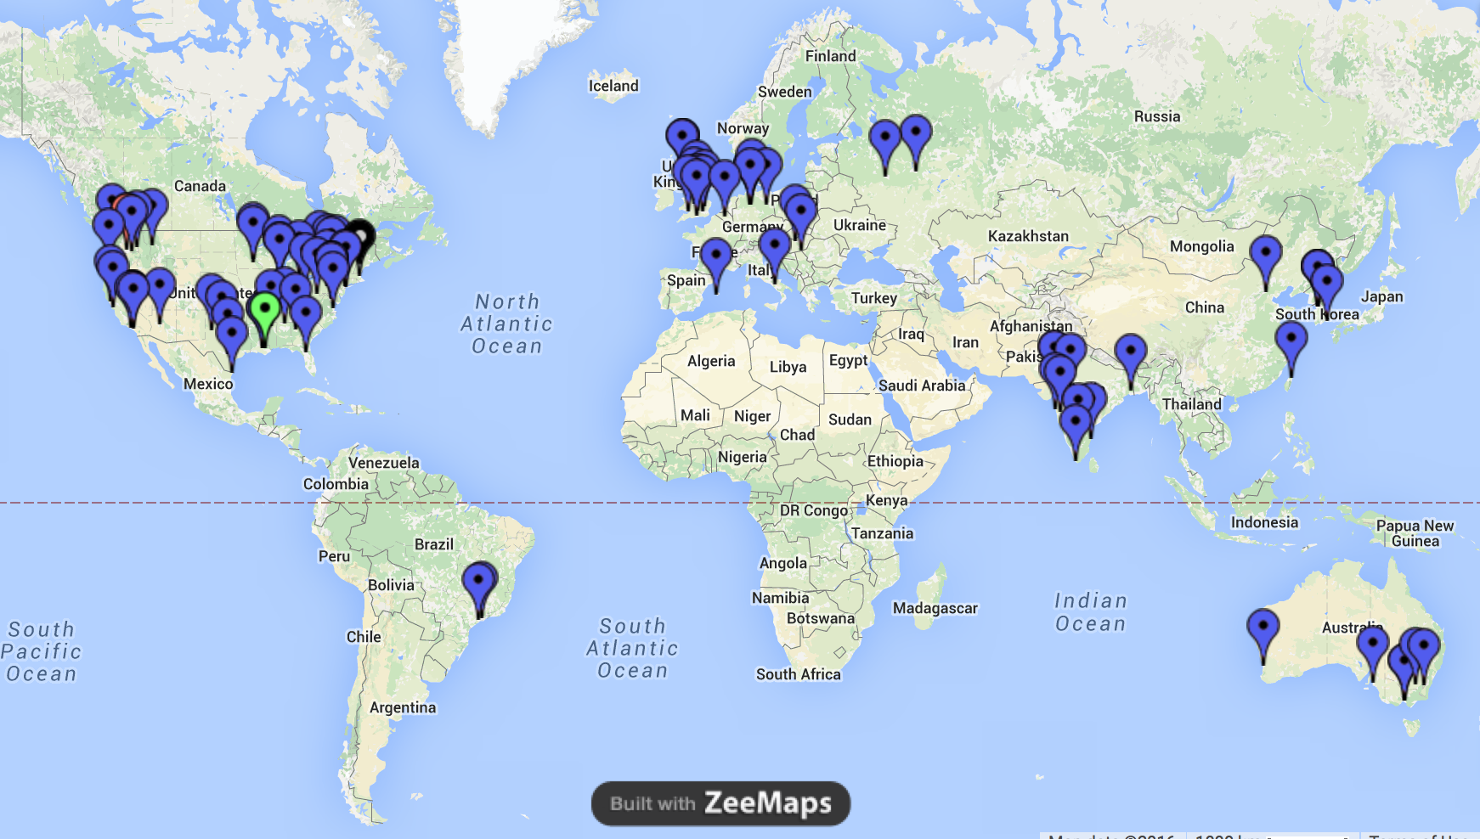
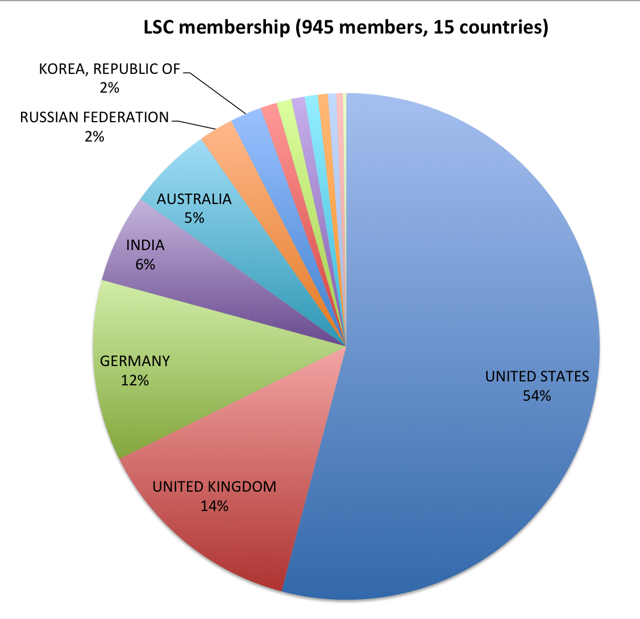
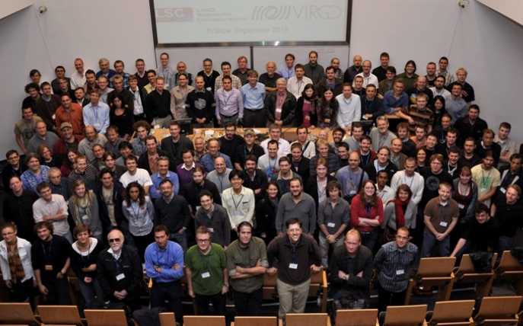
LIGO Scientific Collaboration
ITALY
HUNGARY
BRAZIL
SPAIN
CHINA
TAIWAN
CANADA
BELGIUM
www.ligo.org

Slide 8
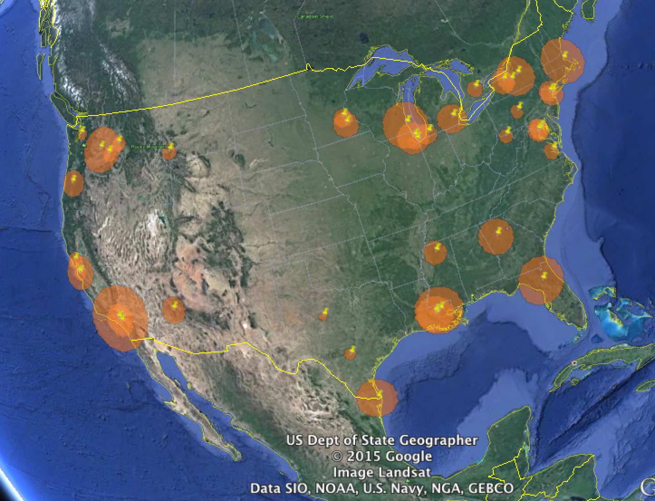



LSC-USA
Large institutional diversity: large and small departments, graduate and undergraduate institutions, several serving large under-represented groups.
Most US groups are supported by NSF with competitive, single investigator NSF grants. LIGO Laboratory (~30% of LSC) is supported by CA NSF grant to Caltech and MIT.
Many LSC “graduates” now working in STEM industries (Intel, Synaptics, Google, SpaceX, Apple, Facebook,…), national facilities (Lincoln Labs, NASA, …) and academia.

Slide 9
LIGO Scientific Collaboration
Some LSC Principles:
  Open: “No individual or group will be denied membership on any basis except scientific merit and the willingness to participate and contribute as described in this Charter.”
  Member agreements (MOUs) describe scientific, not financial, commitments.
  Democratic: Spokesperson and working group leaders elected (w/2 yr terms).
  Formal LSC/LIGO Lab interaction: “LIGO directorate” consists of the LSC spokesperson, and the Executive and Deputy Directors of the LIGO Laboratory. The LIGO Directorate will be ex officio members of all planning and evaluative bodies of the LSC. (On the ground, there are no differences between LIGO Lab LSC members and other group members, other than funding.)
Some history:
  Created in 1997, already international (Germany, UK, Australia, Russia).
  Initially ~25 groups, 200 people, Rai Weiss spokesperson 1997-2003
  Peter Saulson elected spokesperson 2003-2007, David Reitze 2007-2011, GG 2011-2017.

Slide 10
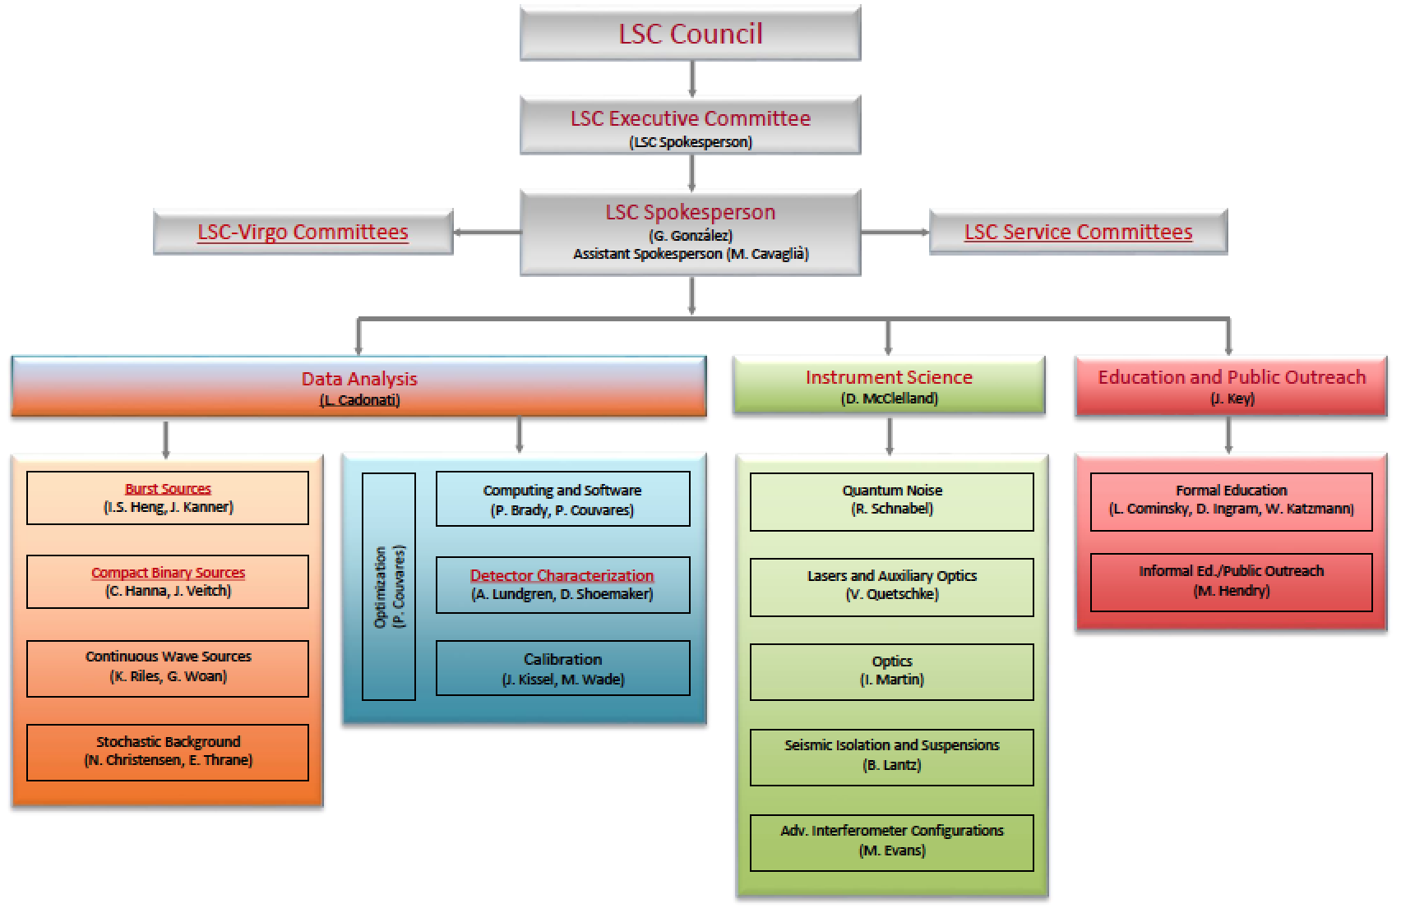
The LIGO Scientific Collaboration

Slide 11
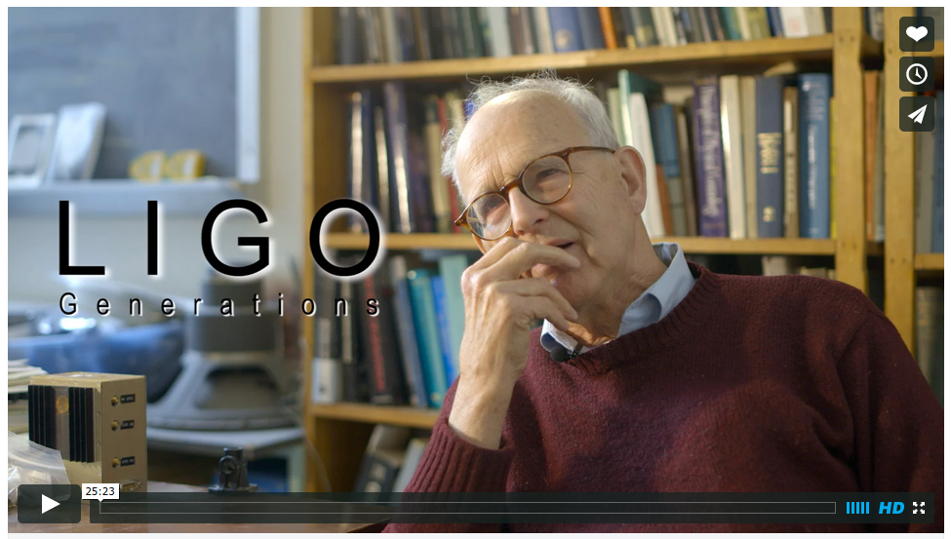
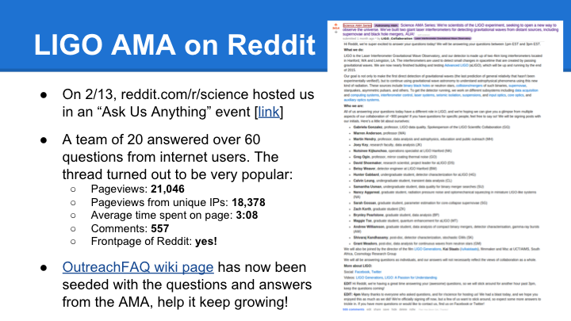
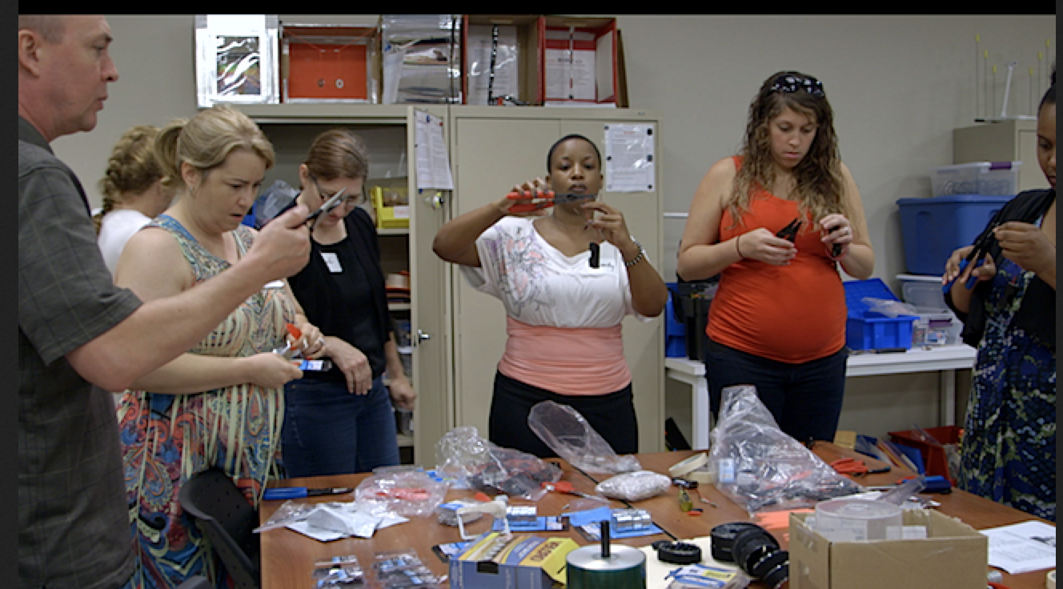
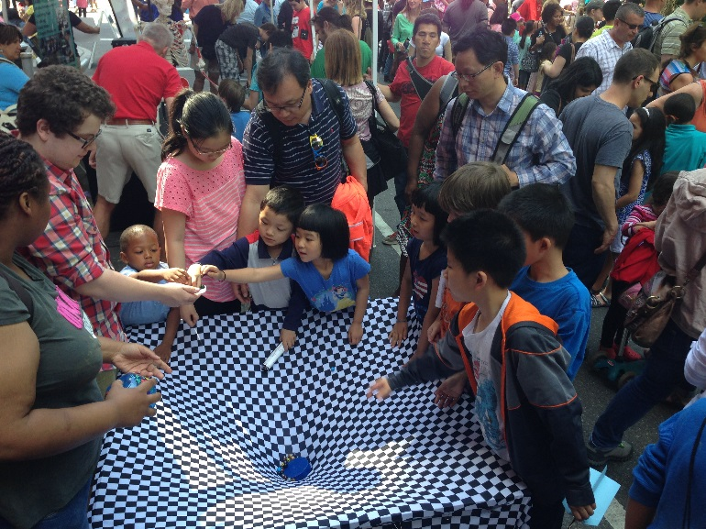
Education and Public Outreach
http://facebook.com/ligofilm
Multimedia
Social media
Science teachers’ education
Science fairs, exhibits, Science Education Center

Slide 12

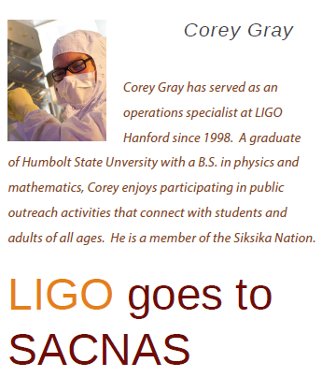
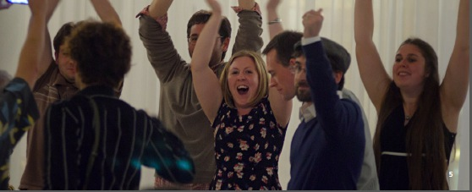
Other important LSC activities
Diversity
  LSC has a “Diversity Committee. Some initiatives:
    LSC Diversity statement; anti-harassment policy, LSC “best practices”
    LSC “Ombudsperson” (former NSF program officer!)
    LIGO summer undergraduate fellowships sponsored by NSBP and NSHP
    “Family grants” to attend LSC meetings
    Set up a booth and organize sessions in scientific meetings of women and minorities
Academic mentoring
  The LSC has an “Academic Advisory Committee” to care about mentoring of young members. Some recent activities:
    Student and postdoc events and useful tutorials.
    “Industry panels” with colleagues working now in industry.
    Mentoring program: a platform for members of the LSC to form and maintain mentoring relationships.

Slide 13


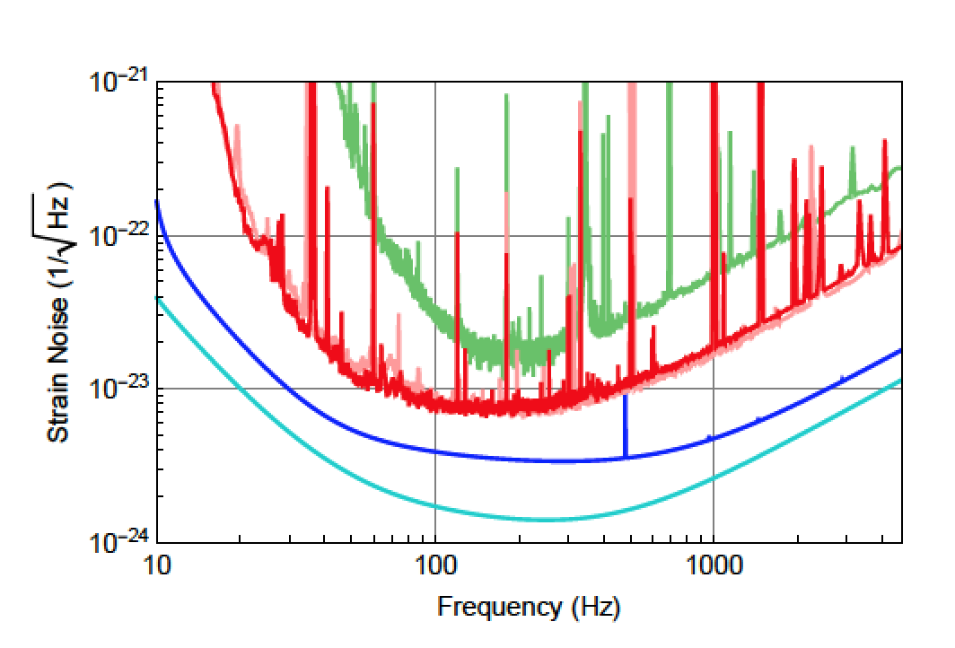
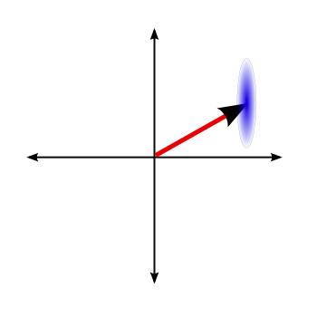

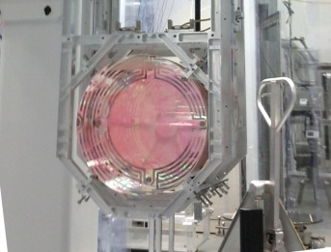
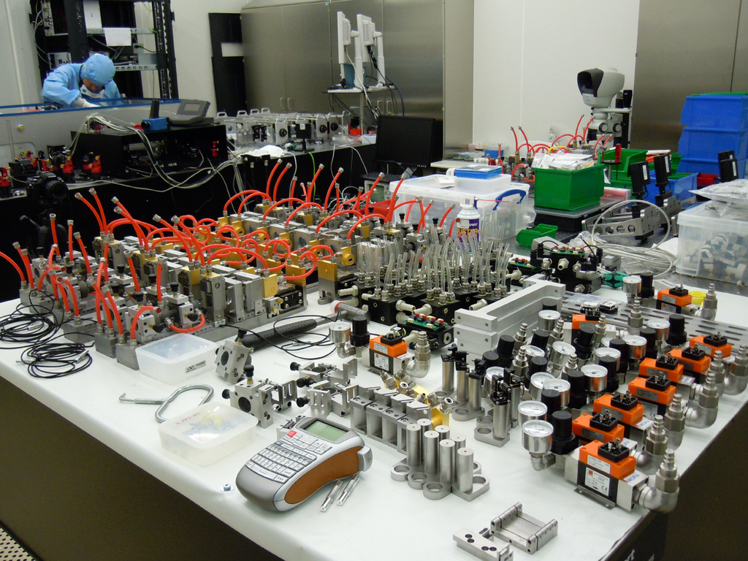
LIGO Detector Technology
2010 LIGO
2015 aLIGO
aLIGO design sensitivy
aLIGO+
Five instrumental working groups – white paper LIGO-T1500290 (dcc.ligo.org)
about R&D for future detectors with improved sensitivities

Slide 14
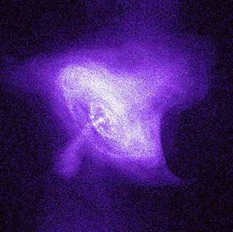
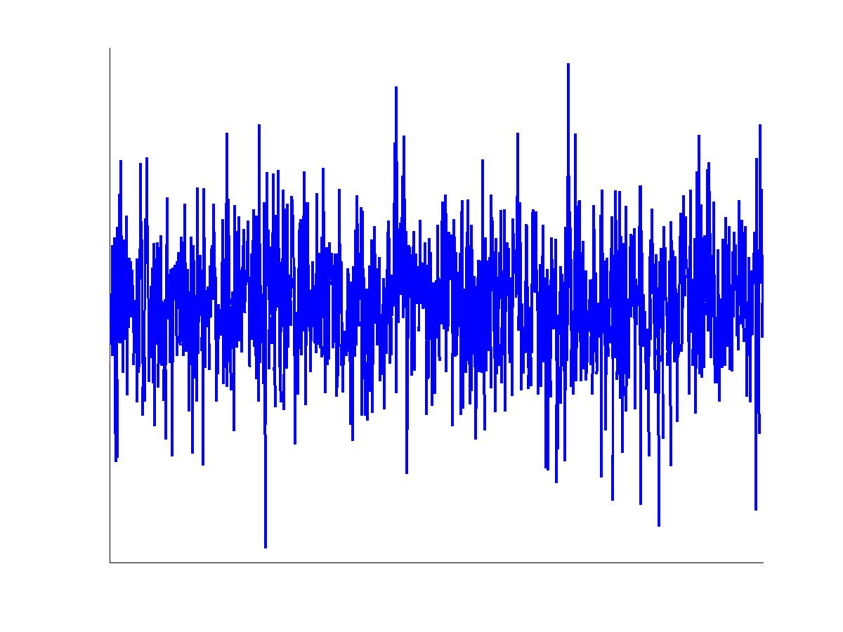
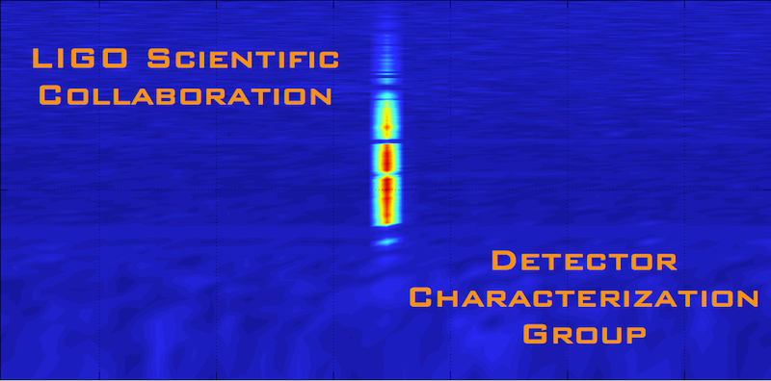
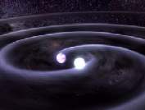
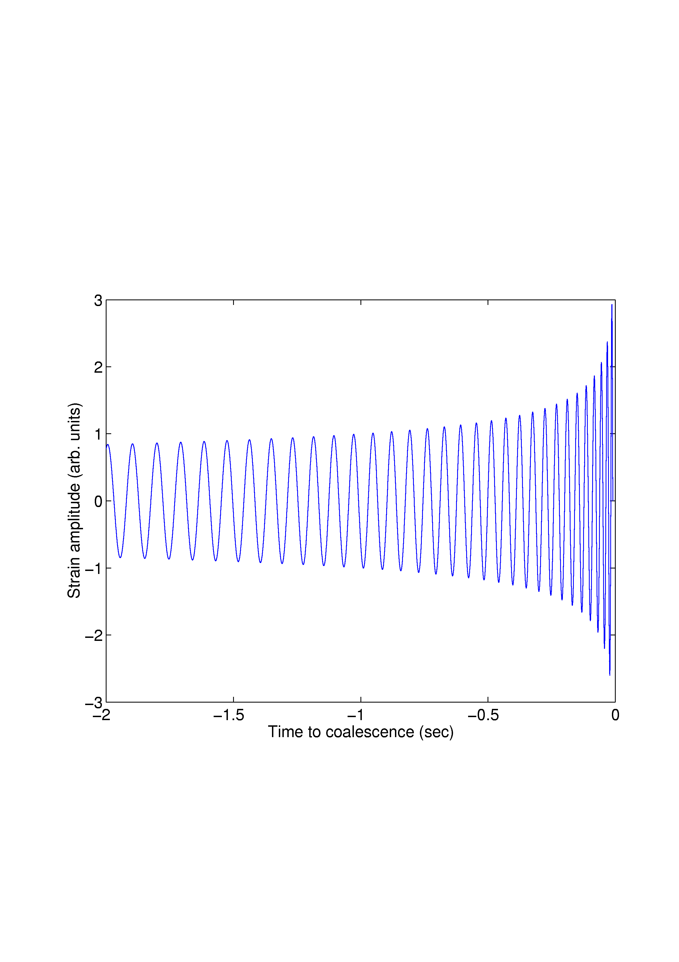
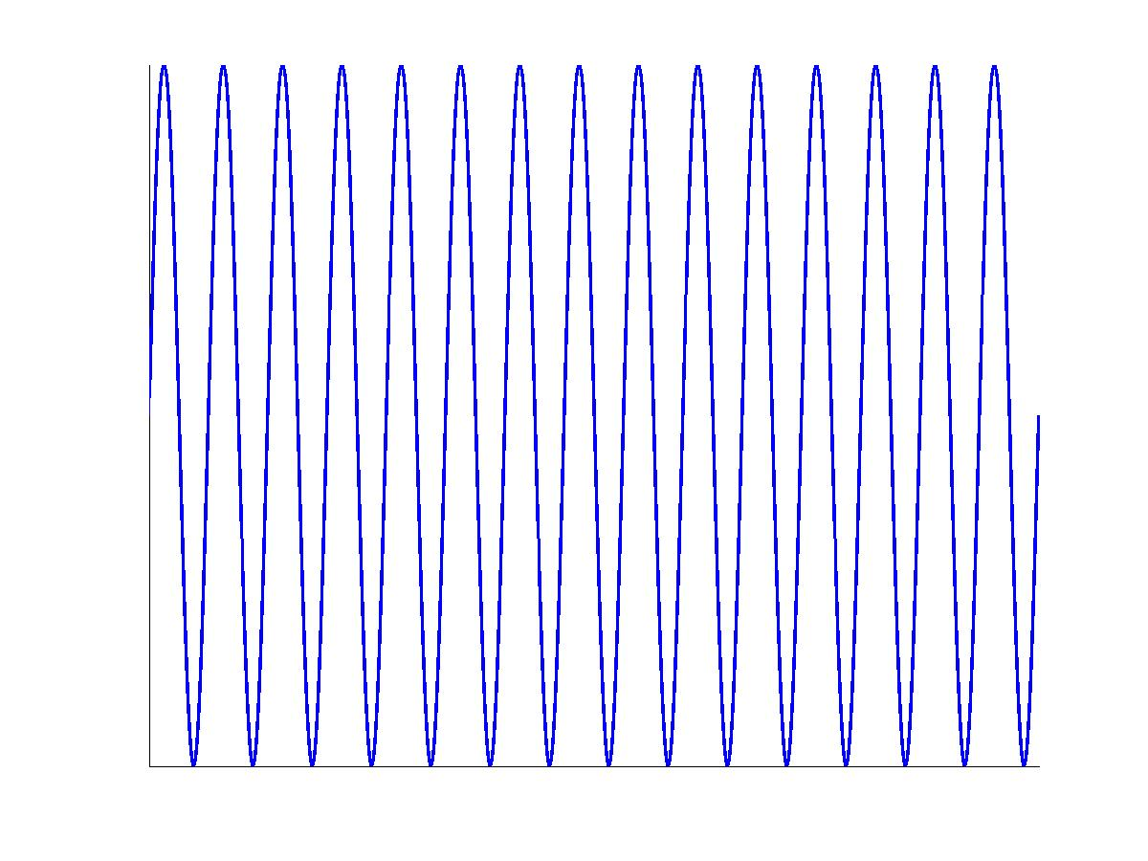
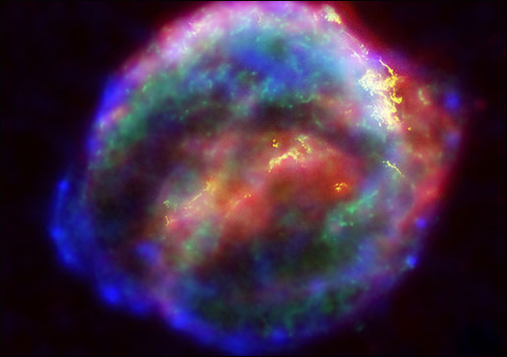
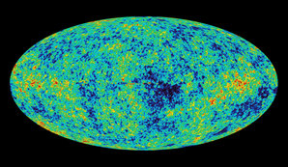
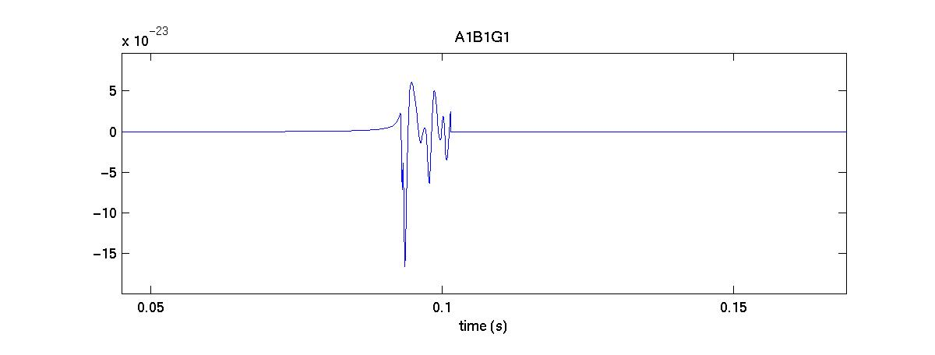
LIGO Data Analysis
Crab pulsar (NASA, Chandra Observatory)
2010 LIGO
2015 aLIGO
aLIGO design sensitivy
aLIGO+
?
NASA, WMAP
Four analysis working groups (plus detector characterization, software and computing)
white paper LIGO-LIGO-T1500055 (dcc.ligo.org)
about search plans for Adv LIGO and Virgo detections

Slide 15
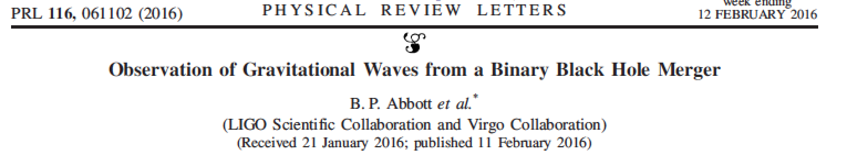

Slide 16
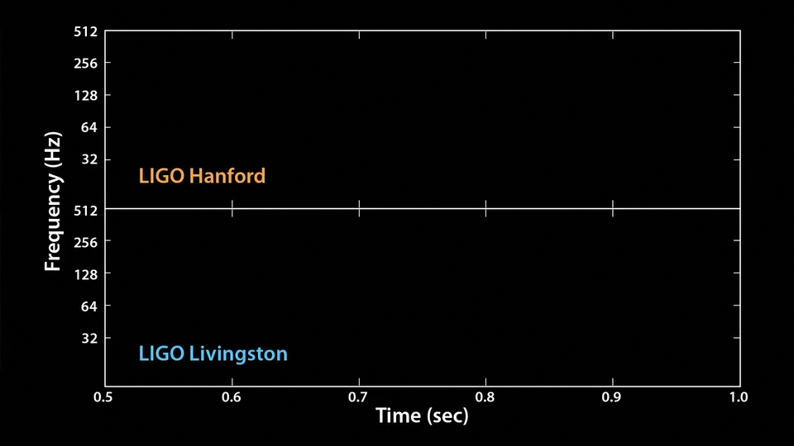
Notes:
We can also translate the signal into sound: listen carefully for the very short “thump” – that’s the tiny chirp of two black holes merging.

Slide 17
Notes:
The animation plays again, this time slower and with the frequencies shifted, so you can hear the signal better. This is the song and dance of two black holes colliding. It’s remarkable how much we can learn from this!

Slide 18
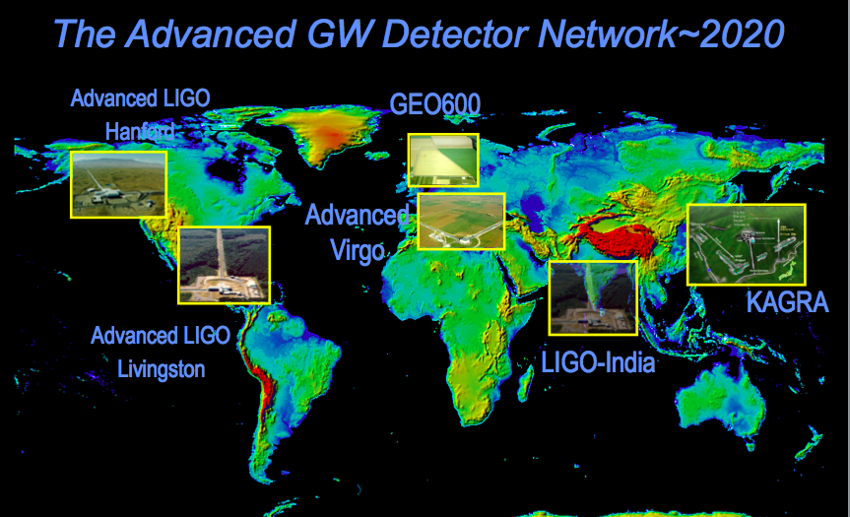
LIGO leads but it’s not alone: gravitational wave network

Slide 19
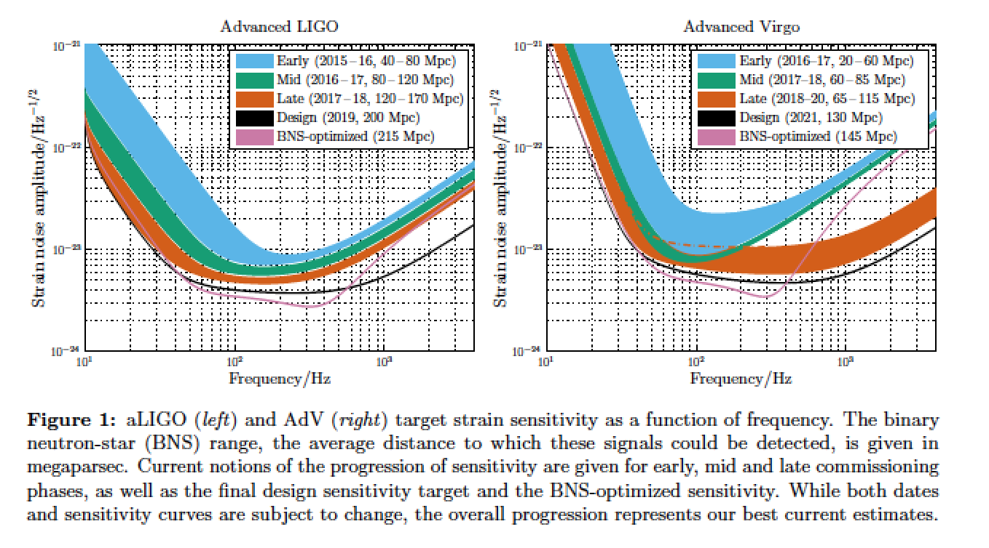
Prospects:
LIGO – Virgo network
Living Rev. Relativity, 19 (2016), 1, doi:10.1007/lrr-2016-1,
URL : http://www.livingreviews.org/lrr-2016-1.

Slide 20
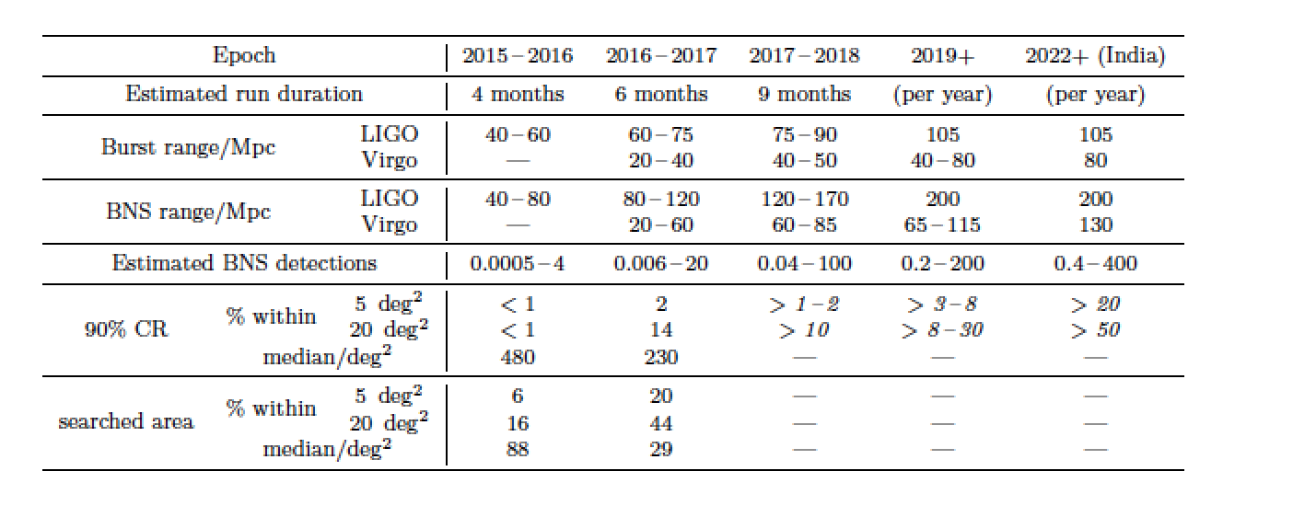
The near future
Living Rev. Relativity, 19 (2016), 1, doi:10.1007/lrr-2016-1,
URL : http://www.livingreviews.org/lrr-2016-1.

Slide 21
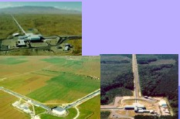

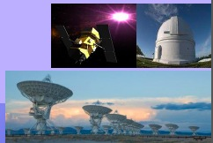
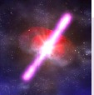
Multi-messenger astronomy:
GW/EM observations
We will obtain rich astrophysics combining gravitational-wave and electromagnetic information.
LSC and Virgo opened a call to sign agreements for the identification of EM counterparts to GW triggers in Advanced detectors starting in 2015: http://www.ligo.org/scientists/GWEMalerts.php
We received and approved more than 60 applications from 19 countries, with about 150 instruments covering the full spectrum, from radio to high-energy gamma-rays.
Shortly after a few detections, LSC/Virgo will publicly release GW triggers for follow up: dcc.ligo.org, LIGO-M1200055.

Slide 22
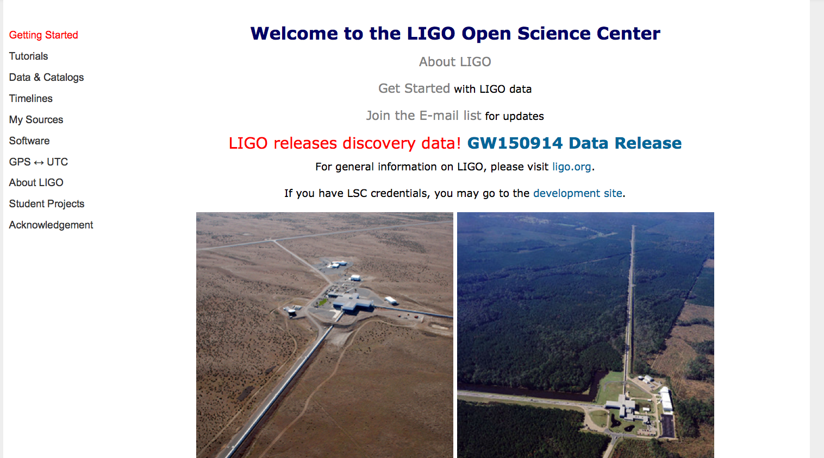
LIGO open data
LIGO is committed to open data and prompt release of GW observations
https://losc.ligo.org/

Slide 23
Conclusions
Although atypical, the LSC model with an open and international collaboration created around a “LIGO Laboratory” has worked well.
Large size has already many challenges. More challenges lie ahead: collaboration model will evolve in the presence of detections and open data, funding for future detectors, …
The field will always need a large collaborative team working on operations, timely science analysis, and R&D ready for installation in new detectors, plus innovative methods for analysis and research on new technologies.

