Slide 1
Conception de l’isolement mécanique du VOPO
LIGO MIT Lab: Matichard, Fabrice
ISAE-Supaero: Michon, Guilhem
Fernandez Galiana, Alvaro
PFE M2R Génie Méchanique
28.09.15

Slide 2
INDEX
aLIGO INTRODUCTION
VOPO SUSPENSION DESIGN
CONCLUSIONS

Slide 3
INDEX
aLIGO INTRODUCTION
  LIGO PROJECT
  SEISMIC AT LIGO
  VOPO SQUEEZER IN LIGO

Slide 4
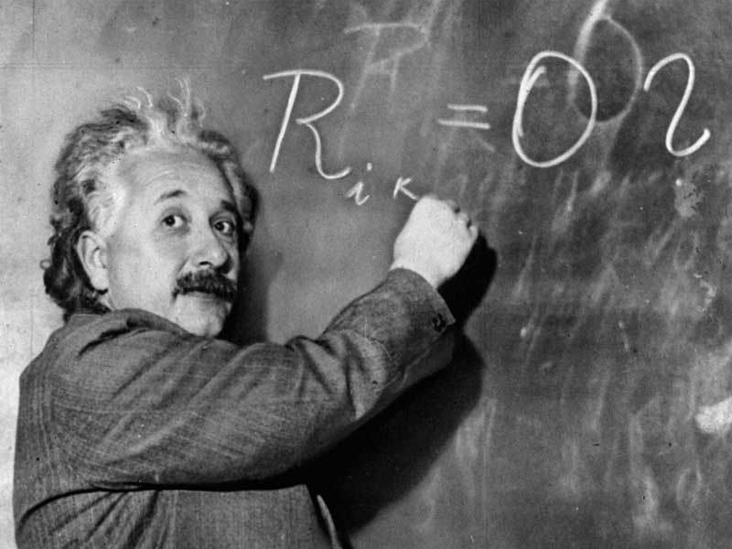
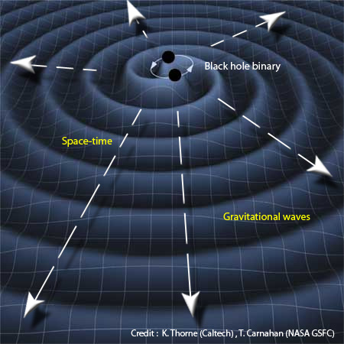
aLIGO INTRODUCTION
  LIGO PROJECT
    Laser Interferometer Gravitational-Wave Observatory
  Gravitational Waves predicter by General Relativity
GR published November 25th 1915

Slide 5
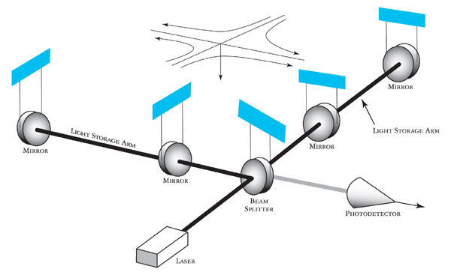
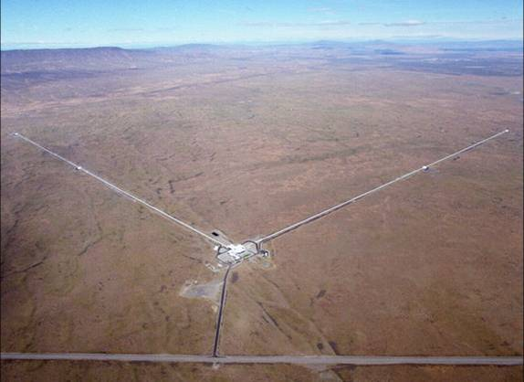
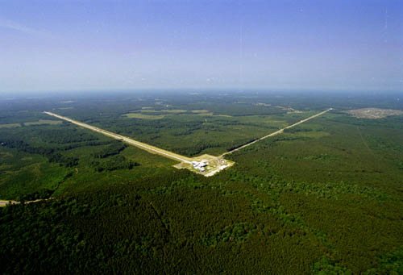
aLIGO INTRODUCTION
  LIGO PROJECT
    2X 4km-arm Michelson interferometer with Fabry-Perot cavity
Hanford, WA
Livingston, LA

Slide 6
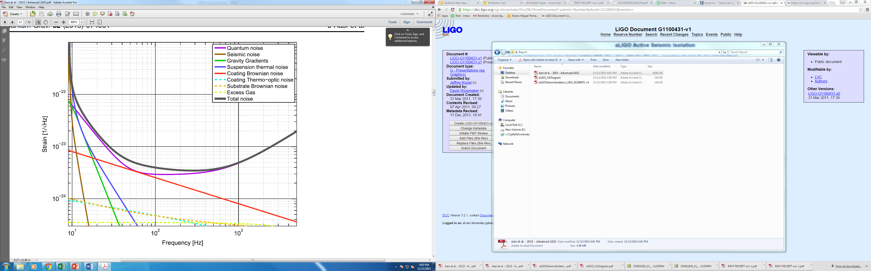
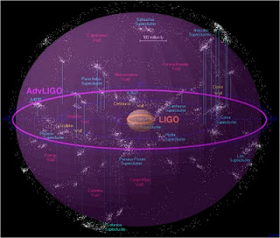
aLIGO INTRODUCTION
  LIGO PROJECT
    aLIGO
Sensitivity improvement in aLIGO
aLIGO expected sensitivity

Slide 7
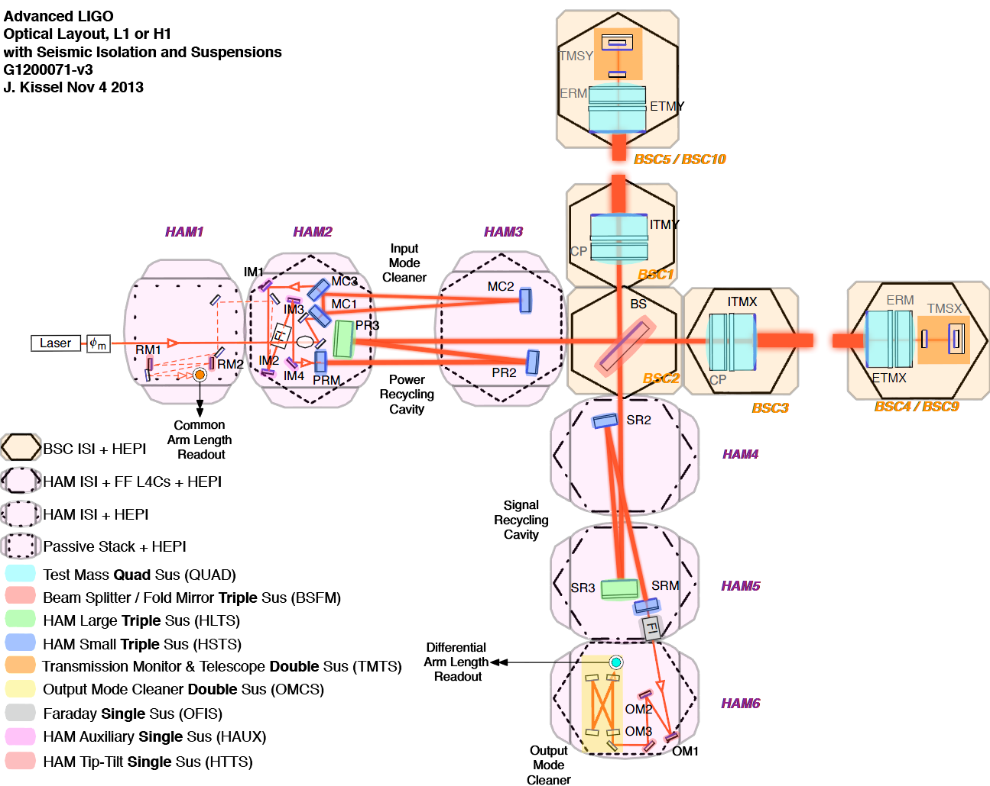
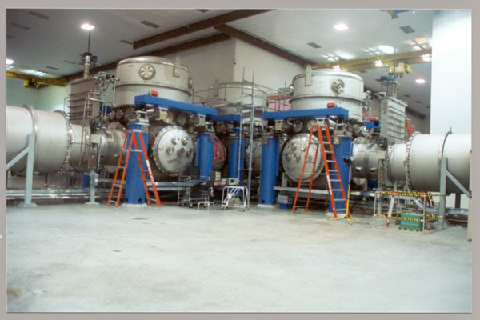
aLIGO INTRODUCTION
  SEISMIC AT LIGO
    CHAMBERS LAYOUT
Chambers Layout

Slide 8
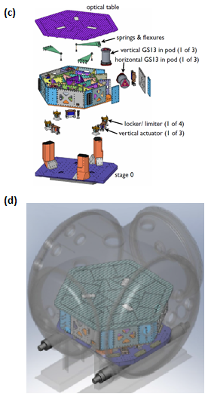
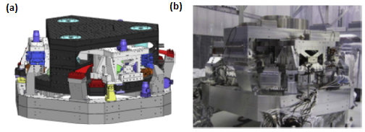
aLIGO INTRODUCTION
  SEISMIC AT LIGO
    HAM-ISI / BSC-ISI
BSC-ISI CAD model (a) and prototype (b);
HAM-ISI exploded view (c) and in chamber (d)

Slide 9
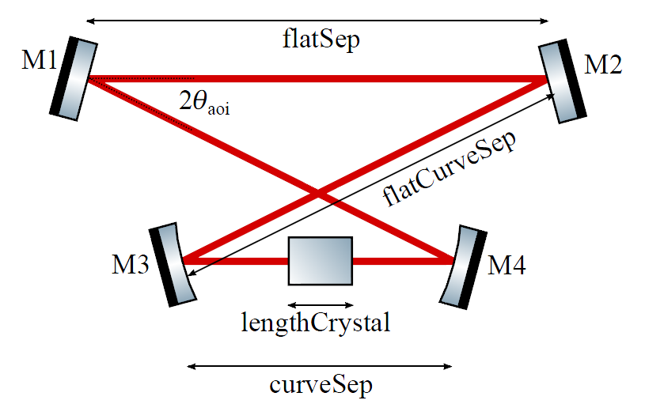
aLIGO INTRODUCTION
  VOPO SQUEEZER IN LIGO
    In Vacuum Optical parametric oscillator
VOPO CAVITY LAYOUT

Slide 10
INDEX
VOPO SUSPENSION DESIGN
  REQUIREMENTENTS
  EARLY SUSPENSION DESIGNS
  VOPO SUSPENSION OVERVIEW
  MONOSTAGE SUSPENSION DESIGN
  INJECTION BENCH DESIGN
  CONTACT ANALYSIS
  GLOBAL FREQUENCIES

Slide 11
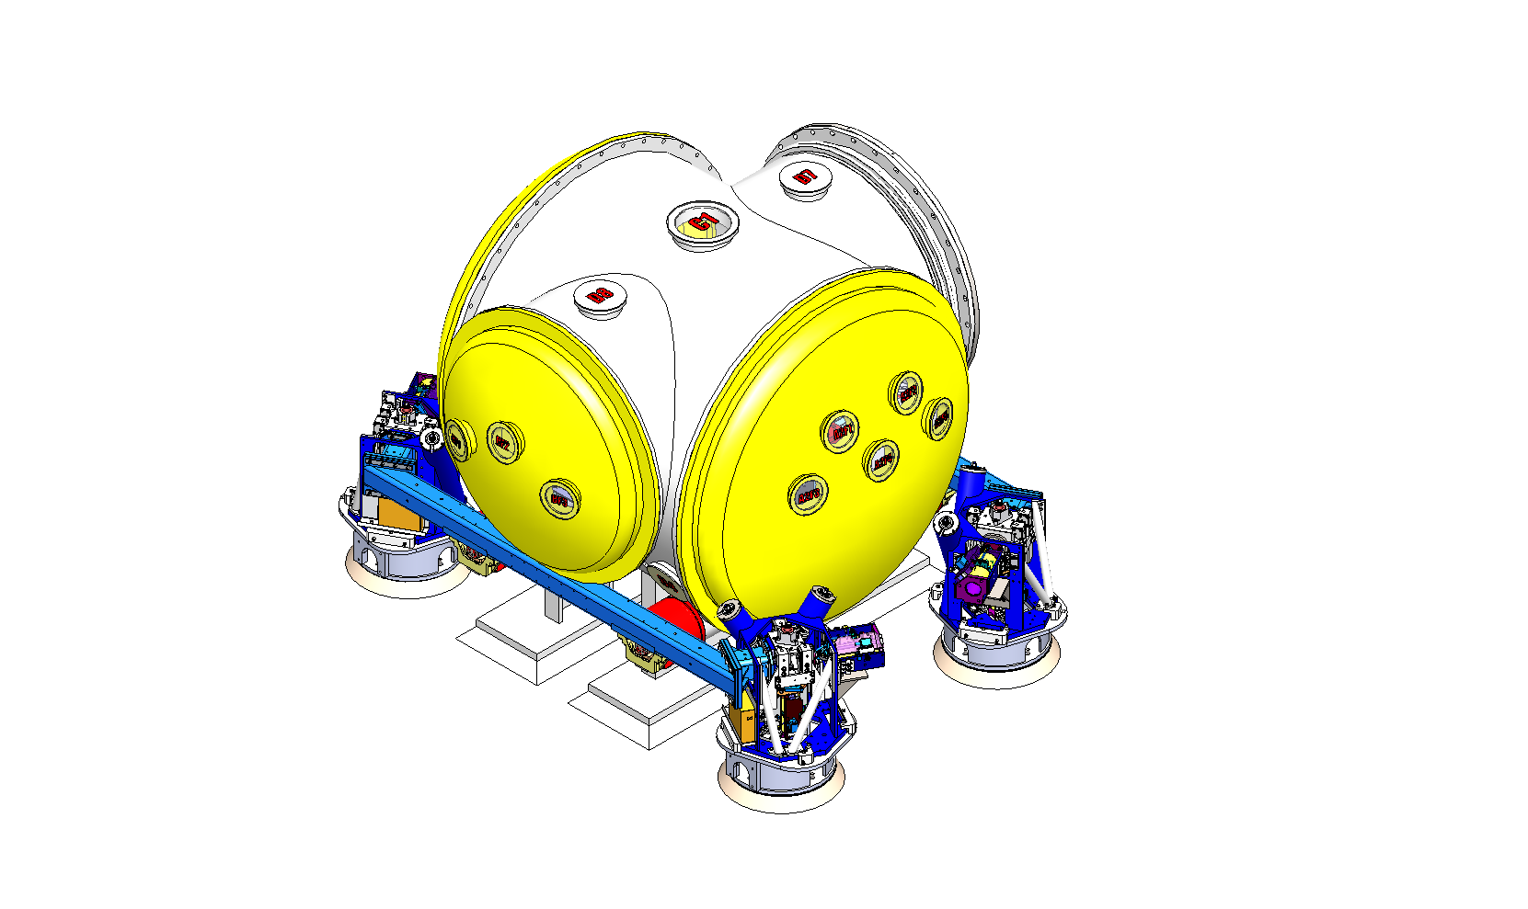
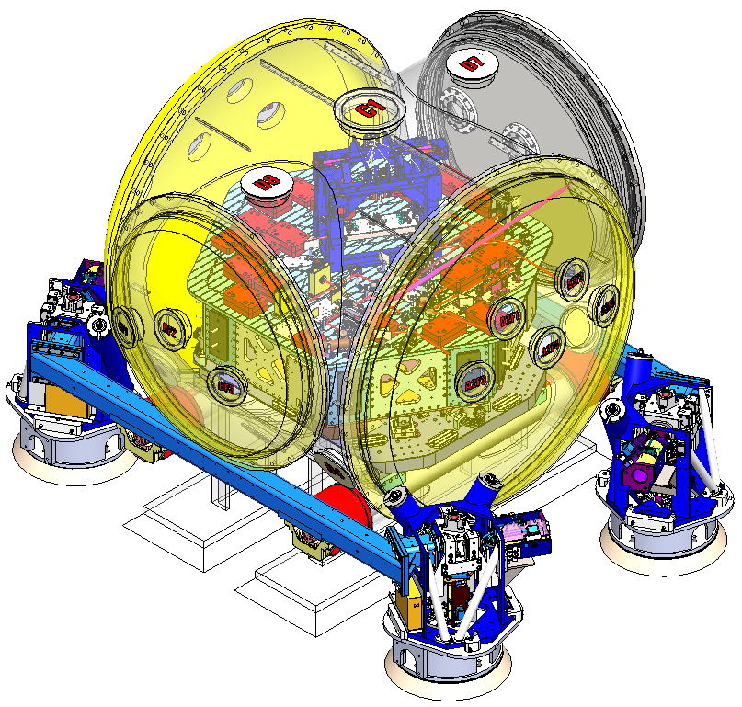
VOPO SUSPENSION DESIGN
  VOPO SQUEEZER IN LIGO
    REQUIREMENTS
      f < 1.5Hz (passive isolation)
      HAM 6 chamber
      Connected to HAM 5 (Faraday)
      Active damping control

Slide 12
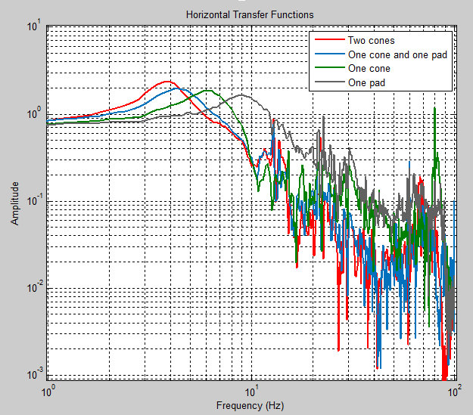
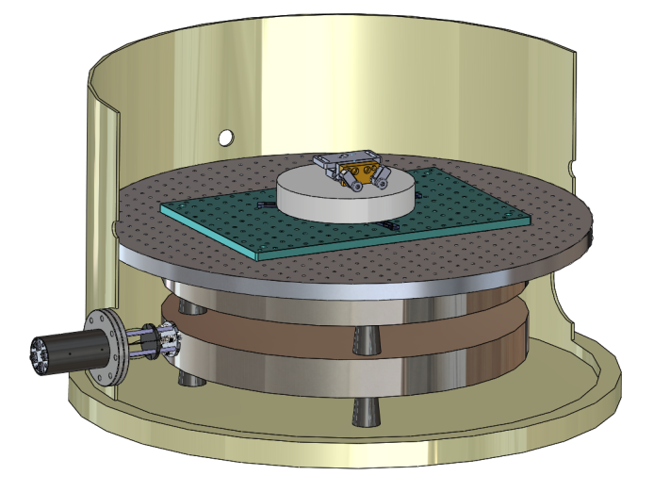
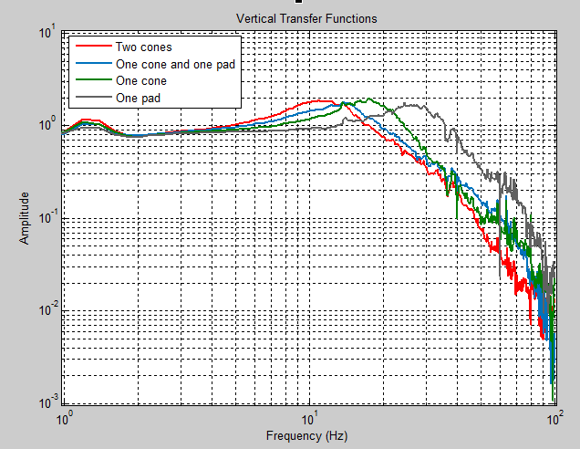
VOPO SUSPENSION DESIGN
  VOPO SQUEEZER IN LIGO
  EARLY SUSPENSION DESIGNS
CAD Model of the stack assembly used
in the VOPO experiment at MIT
Horizontal (top), and vertical (bottom)
measurements of transmissibility stack layers

Slide 13
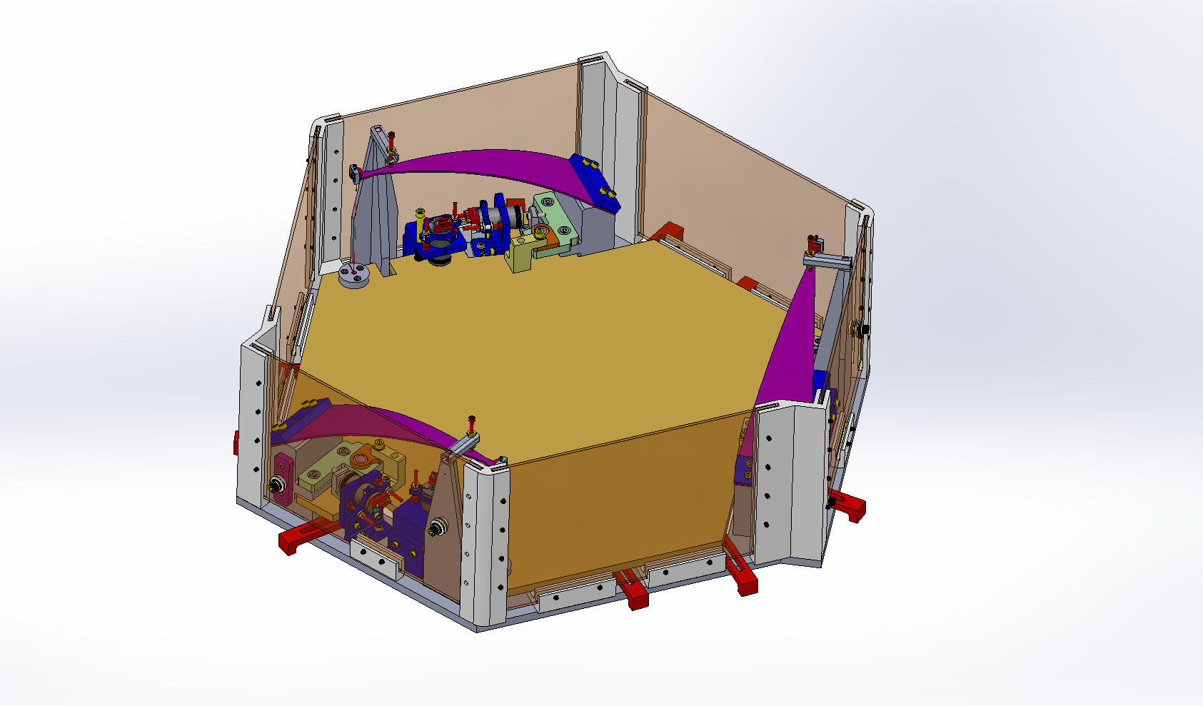
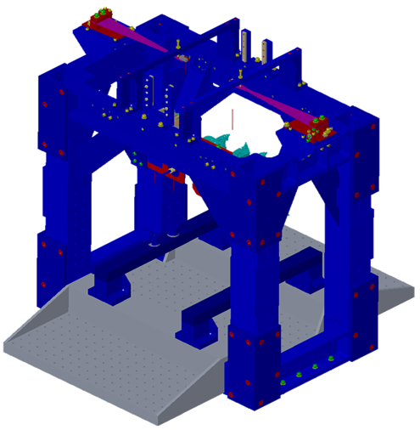
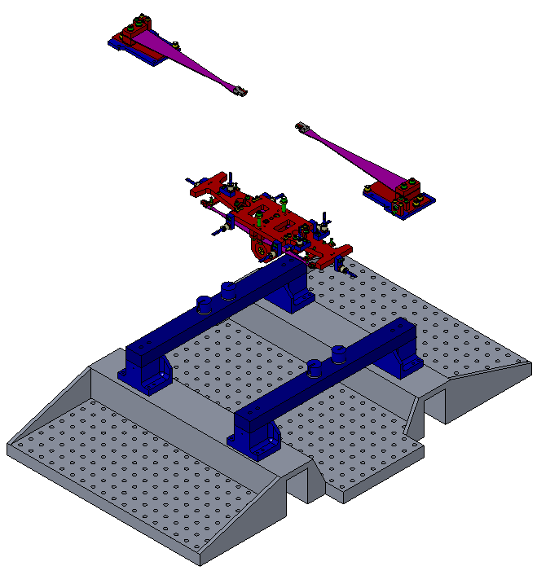
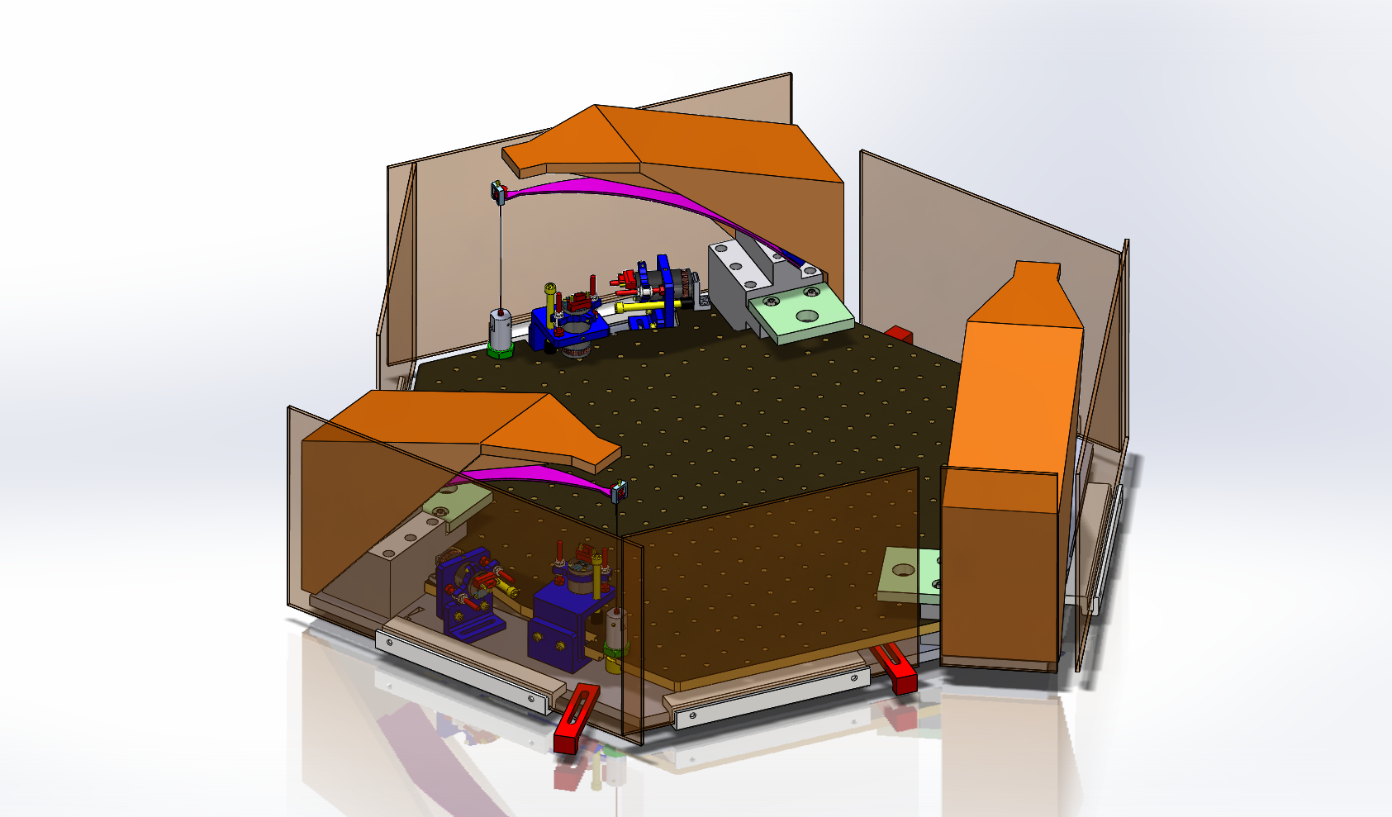
VOPO SUSPENSION DESIGN
  VOPO SQUEEZER IN LIGO
  EARLY SUSPENSION DESIGNS
Stage 1
Stage 0
Stage 2
VOPO Suspension Re-Using OMC 2 stage suspension
Early designs hexagonal VOPO suspension

Slide 14
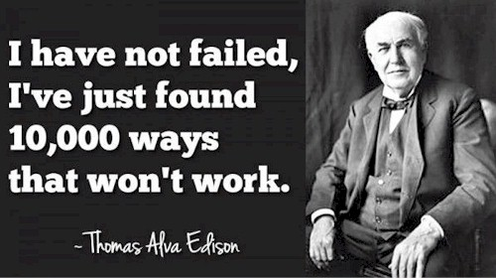
VOPO SUSPENSION DESIGN
  VOPO SQUEEZER IN LIGO
  EARLY SUSPENSION DESIGNS
VOPO SUSPENSION DESIGN
MONOSTAGE SUSPENSION DESIGN METHODOLOGY
BLADE CONTACT STUDY
SW SIMULATION VALIDATION
INJECTION BENCH OPTIMIZATION

Slide 15
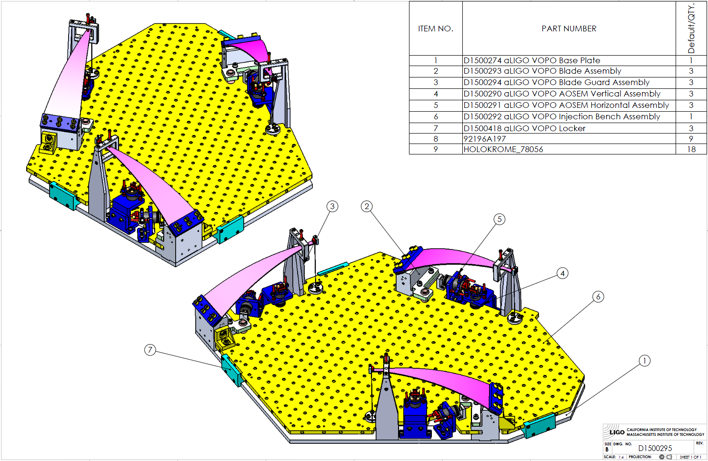
VOPO SUSPENSION DESIGN
  VOPO SQUEEZER IN LIGO
  VOPO SUSPENSION OVERVIEW

Slide 16
VOPO SUSPENSION DESIGN
  VOPO SQUEEZER IN LIGO
  MONOSTAGE SUSPENSION DESIGN
SITUATION IN THE CHAMBER
MASS BUDGET ESTIMATION
PRELIMINARY LAYOUT
BLADES PRELIMINARY DESIGN
THEORY
FEA
CHAMBERS’ LAYOUT
FLEXURE DESIGN
LOCATION OF THE BLADES
CAD MODEL OF THE OPTICAL LAYOUT
REAL MASS BUDGET
ACTUATORS
INJECTION BENCH DESIGN & BALANCING
BASE PLATE
BLADE PLATFORM
MOTION LIMITERS< LOCKERS< ASSEMBLY BRACKETS
ASSEMBLY PROCEDURE
OPTIMIZATION
CONTACT ANALYSIS
ISOLATION LEVEL
F < 1.5Hz
PHYSICAL
HAM 6 chamber
4” from the table
OPTICS REQUIRED
Preliminary layout
Mass
Area
Connection HAM5
Rigid modes damping

Slide 17
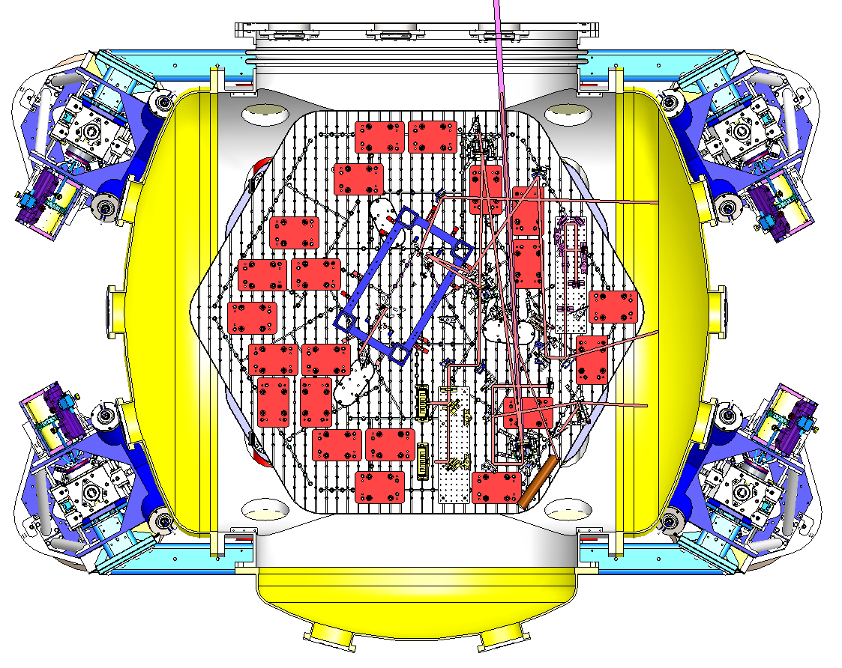
VOPO SUSPENSION D.
SITUATION IN THE CHAMBER
MASS BUDGET ESTIMATION
PRELIMINARY LAYOUT
BLADES PRELIMINARY DESIGN
THEORY
FEA
CHAMBERS’ LAYOUT
FLEXURE DESIGN
LOCATION OF THE BLADES
CAD MODEL OF THE OPTICAL LAYOUT
REAL MASS BUDGET
ACTUATORS
INJECTION BENCH DESIGN & BALANCING
BASE PLATE
BLADE PLATFORM
MOTION LIMITERS< LOCKERS< ASSEMBLY BRACKETS
ASSEMBLY PROCEDURE
OPTIMIZATION
CONTACT ANALYSIS
  VOPO SQUEEZER IN LIGO
  MONOSTAGE SUSPENSION DESIGN
HAM6 Chamber

Slide 18
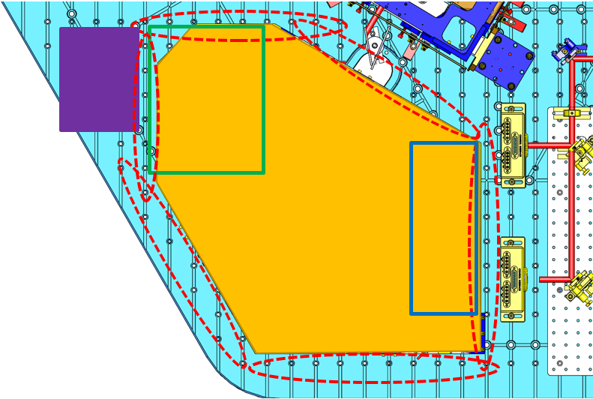
VOPO SUSPENSION D.
SITUATION IN THE CHAMBER
MASS BUDGET ESTIMATION
PRELIMINARY LAYOUT
BLADES PRELIMINARY DESIGN
THEORY
FEA
CHAMBERS’ LAYOUT
FLEXURE DESIGN
LOCATION OF THE BLADES
CAD MODEL OF THE OPTICAL LAYOUT
REAL MASS BUDGET
ACTUATORS
INJECTION BENCH DESIGN & BALANCING
BASE PLATE
BLADE PLATFORM
MOTION LIMITERS< LOCKERS< ASSEMBLY BRACKETS
ASSEMBLY PROCEDURE
OPTIMIZATION
CONTACT ANALYSIS
  VOPO SQUEEZER IN LIGO
  MONOSTAGE SUSPENSION DESIGN
Holes availability (Dog Clamps)
“Shooting” Area (for the outcome beam)
In Vacuum RFPD Area
Space for Tip Tilt

Slide 19
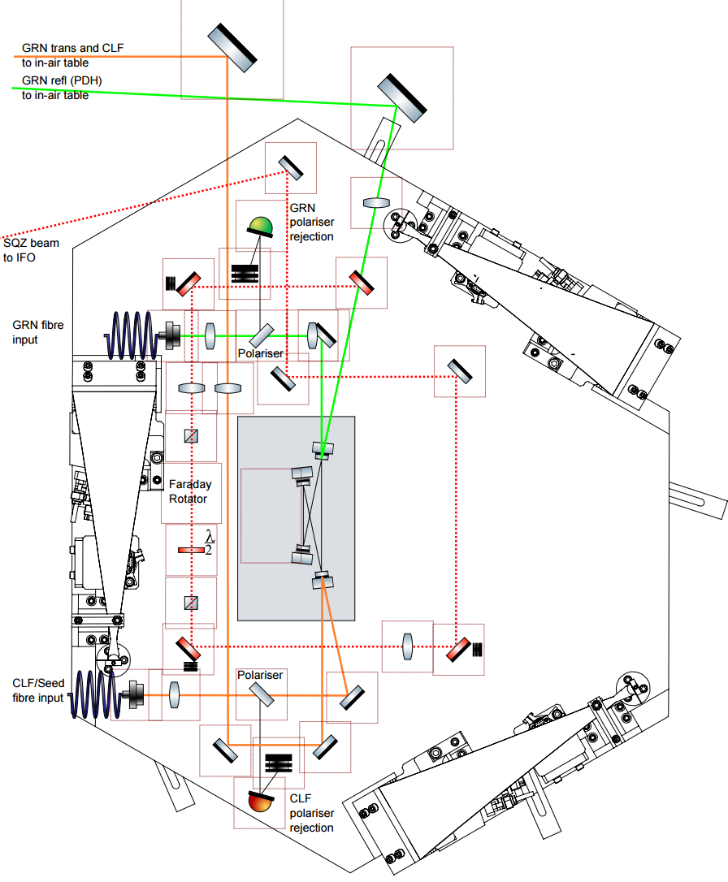
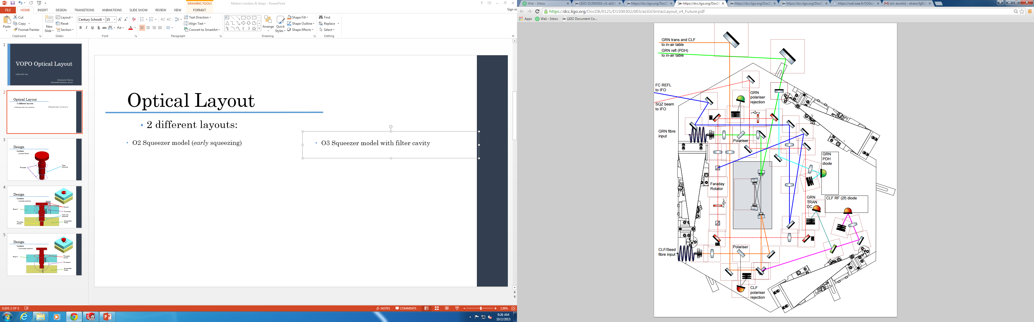
VOPO SUSPENSION D.
SITUATION IN THE CHAMBER
MASS BUDGET ESTIMATION
PRELIMINARY LAYOUT
BLADES PRELIMINARY DESIGN
THEORY
FEA
CHAMBERS’ LAYOUT
FLEXURE DESIGN
LOCATION OF THE BLADES
CAD MODEL OF THE OPTICAL LAYOUT
REAL MASS BUDGET
ACTUATORS
INJECTION BENCH DESIGN & BALANCING
BASE PLATE
BLADE PLATFORM
MOTION LIMITERS< LOCKERS< ASSEMBLY BRACKETS
ASSEMBLY PROCEDURE
OPTIMIZATION
CONTACT ANALYSIS
  VOPO SQUEEZER IN LIGO
  MONOSTAGE SUSPENSION DESIGN
Optics: 12 kg
Bench: 18 kg
Balancing Mass: 6kg
SUSPENDED MASS: 36 kg
VOPO optical layout for O2 (left) and O3 (right)

Slide 20
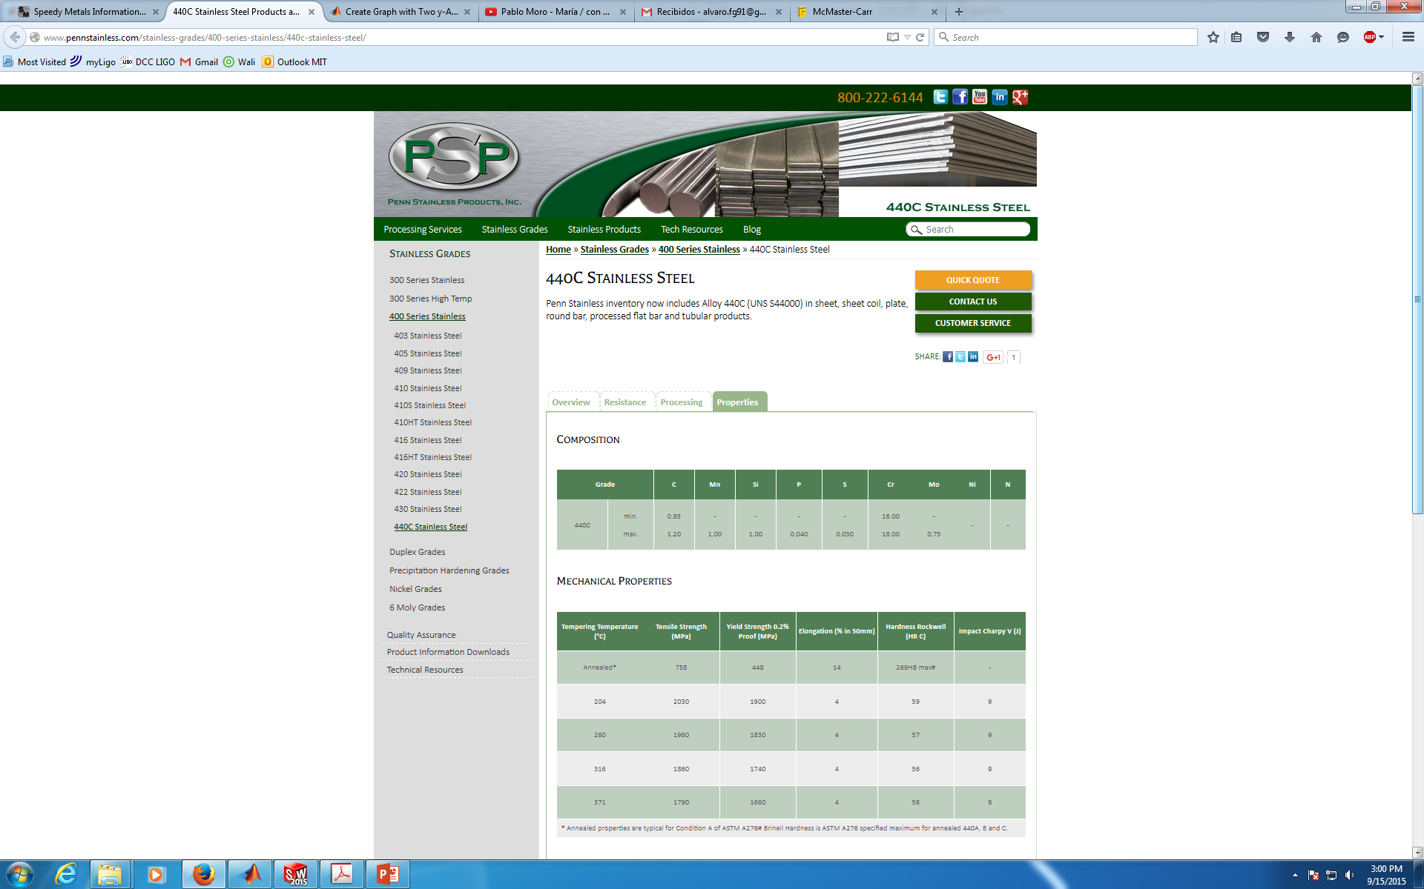
VOPO SUSPENSION D.
SITUATION IN THE CHAMBER
MASS BUDGET ESTIMATION
PRELIMINARY LAYOUT
BLADES PRELIMINARY DESIGN
THEORY
FEA
CHAMBERS’ LAYOUT
FLEXURE DESIGN
LOCATION OF THE BLADES
CAD MODEL OF THE OPTICAL LAYOUT
REAL MASS BUDGET
ACTUATORS
INJECTION BENCH DESIGN & BALANCING
BASE PLATE
BLADE PLATFORM
MOTION LIMITERS< LOCKERS< ASSEMBLY BRACKETS
ASSEMBLY PROCEDURE
OPTIMIZATION
CONTACT ANALYSIS
  VOPO SQUEEZER IN LIGO
  MONOSTAGE SUSPENSION DESIGN
Material: 440C SSTL (E = 210 GPa, Y = 1800 MPa, UTS = 1970 MPa, ρ = 7800 kg/m³, ν = 0.285)
Total Suspended Mass: m = 36 kg
Charge per blade: P = 117.72N (12 kg)
Constraints:
Factor of Safety: ≥ 33.3% (FoS ≥ 3)
Desired frequency: f ≈ 1.5 Hz

Slide 21
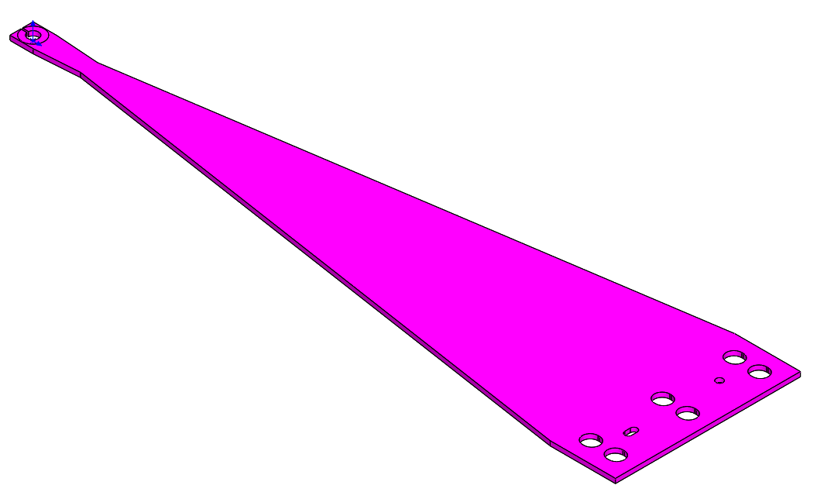
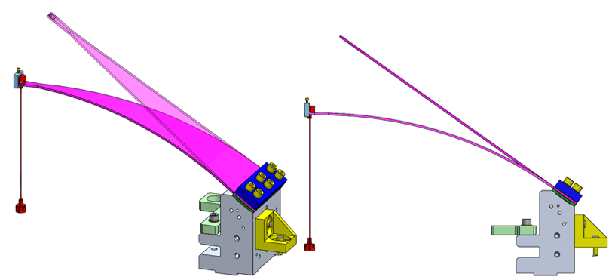
VOPO SUSPENSION D.
SITUATION IN THE CHAMBER
MASS BUDGET ESTIMATION
PRELIMINARY LAYOUT
BLADES PRELIMINARY DESIGN
THEORY
FEA
CHAMBERS’ LAYOUT
FLEXURE DESIGN
LOCATION OF THE BLADES
CAD MODEL OF THE OPTICAL LAYOUT
REAL MASS BUDGET
ACTUATORS
INJECTION BENCH DESIGN & BALANCING
BASE PLATE
BLADE PLATFORM
MOTION LIMITERS< LOCKERS< ASSEMBLY BRACKETS
ASSEMBLY PROCEDURE
OPTIMIZATION
CONTACT ANALYSIS
  VOPO SQUEEZER IN LIGO
  MONOSTAGE SUSPENSION DESIGN

Slide 22

VOPO SUSPENSION D.
SITUATION IN THE CHAMBER
MASS BUDGET ESTIMATION
PRELIMINARY LAYOUT
BLADES PRELIMINARY DESIGN
THEORY
FEA
CHAMBERS’ LAYOUT
FLEXURE DESIGN
LOCATION OF THE BLADES
CAD MODEL OF THE OPTICAL LAYOUT
REAL MASS BUDGET
ACTUATORS
INJECTION BENCH DESIGN & BALANCING
BASE PLATE
BLADE PLATFORM
MOTION LIMITERS< LOCKERS< ASSEMBLY BRACKETS
ASSEMBLY PROCEDURE
OPTIMIZATION
CONTACT ANALYSIS
  VOPO SQUEEZER IN LIGO
  MONOSTAGE SUSPENSION DESIGN
Design Parameters:
  Blade Width: a
  Blade Length: l
  Blade thickness: h
Equations (for triangular blades):
  $K﷮zz =\frac{Eah^{3}}{4l^{3}}$
  $f=\frac{1}{2π}\sqrt{\frac{K_{zz}}{m}}=1.5 Hz$
  $σ_{max}=\frac{6Pl}{ah^{2}}$
3 Parameters
1 DOF
2 Equations
l = 280 mm
NOTE: The choice of this length has been made after checking the optical layout

Slide 23
VOPO SUSPENSION D.
SITUATION IN THE CHAMBER
MASS BUDGET ESTIMATION
PRELIMINARY LAYOUT
BLADES PRELIMINARY DESIGN
THEORY
FEA
CHAMBERS’ LAYOUT
FLEXURE DESIGN
LOCATION OF THE BLADES
CAD MODEL OF THE OPTICAL LAYOUT
REAL MASS BUDGET
ACTUATORS
INJECTION BENCH DESIGN & BALANCING
BASE PLATE
BLADE PLATFORM
MOTION LIMITERS< LOCKERS< ASSEMBLY BRACKETS
ASSEMBLY PROCEDURE
OPTIMIZATION
CONTACT ANALYSIS
  VOPO SQUEEZER IN LIGO
  MONOSTAGE SUSPENSION DESIGN

Slide 24
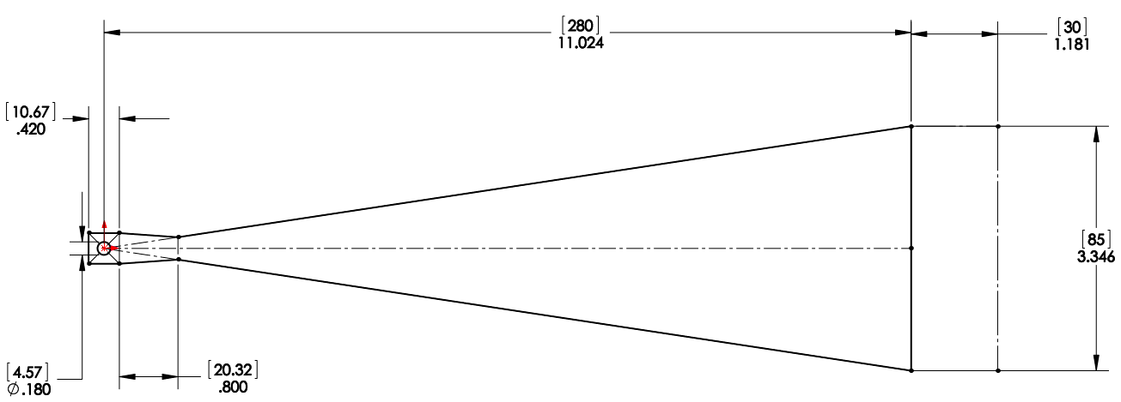
VOPO SUSPENSION D.
SITUATION IN THE CHAMBER
MASS BUDGET ESTIMATION
PRELIMINARY LAYOUT
BLADES PRELIMINARY DESIGN
THEORY
FEA
CHAMBERS’ LAYOUT
FLEXURE DESIGN
LOCATION OF THE BLADES
CAD MODEL OF THE OPTICAL LAYOUT
REAL MASS BUDGET
ACTUATORS
INJECTION BENCH DESIGN & BALANCING
BASE PLATE
BLADE PLATFORM
MOTION LIMITERS< LOCKERS< ASSEMBLY BRACKETS
ASSEMBLY PROCEDURE
OPTIMIZATION
CONTACT ANALYSIS
  VOPO SQUEEZER IN LIGO
  MONOSTAGE SUSPENSION DESIGN
FINAL DIMENSIONS:
f = 1.5252 Hz
Kzz = 1255.1 N/m
FoS = 3
l = 280 mm
b = 85 mm
h = 2.1 mm
m = 41kg
f = 1.6277 Hz
Kzz = 1255.1 N/m
FoS = 3.5473
m = 36kg
NOTE: The expected performances are those shown for 36 kg (that already include some contingency). However, the suspended mass could be raised up to 41 kg keeping FoS ≥ 3

Slide 25
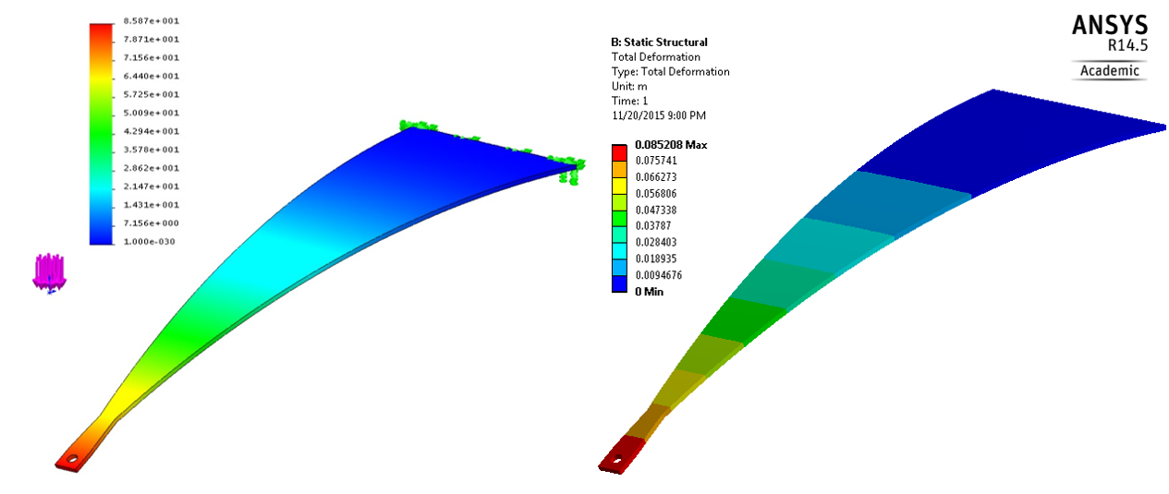
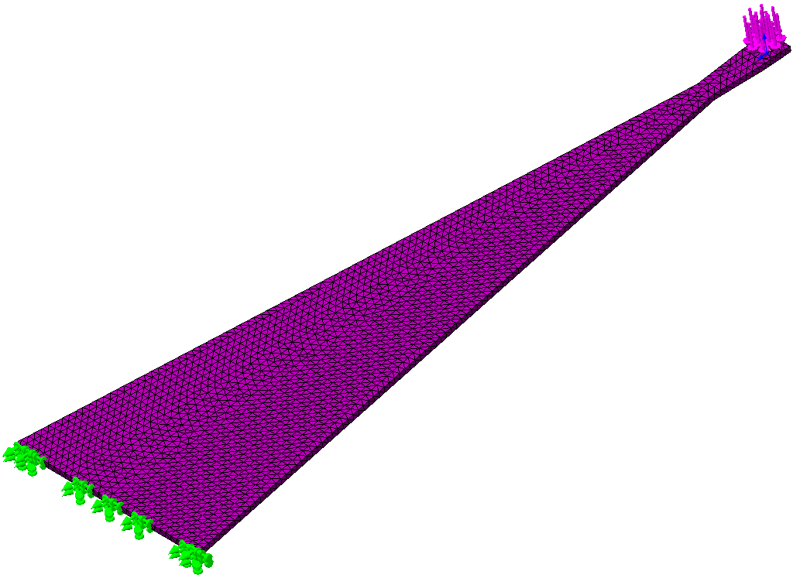
VOPO SUSPENSION D.
SITUATION IN THE CHAMBER
MASS BUDGET ESTIMATION
PRELIMINARY LAYOUT
BLADES PRELIMINARY DESIGN
THEORY
FEA
CHAMBERS’ LAYOUT
FLEXURE DESIGN
LOCATION OF THE BLADES
CAD MODEL OF THE OPTICAL LAYOUT
REAL MASS BUDGET
ACTUATORS
INJECTION BENCH DESIGN & BALANCING
BASE PLATE
BLADE PLATFORM
MOTION LIMITERS< LOCKERS< ASSEMBLY BRACKETS
ASSEMBLY PROCEDURE
OPTIMIZATION
CONTACT ANALYSIS
  VOPO SQUEEZER IN LIGO
  MONOSTAGE SUSPENSION DESIGN
    FEA
      Horizontal blade, m = 36kg, Vertical force
FEA results run in SW (left) and ANSYS (right): Blade deformation

Slide 26
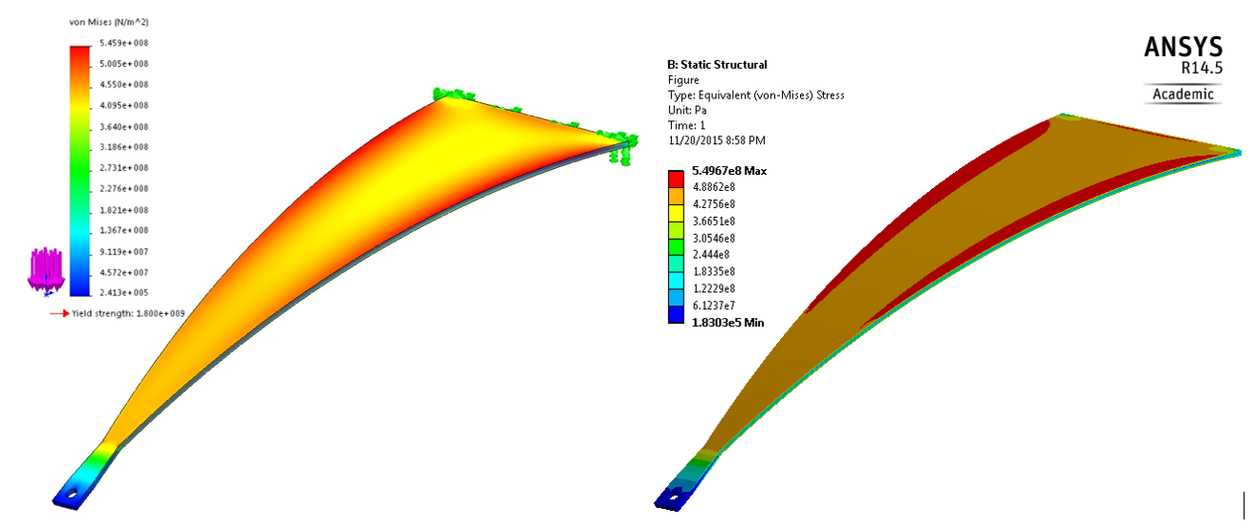
VOPO SUSPENSION D.
SITUATION IN THE CHAMBER
MASS BUDGET ESTIMATION
PRELIMINARY LAYOUT
BLADES PRELIMINARY DESIGN
THEORY
FEA
CHAMBERS’ LAYOUT
FLEXURE DESIGN
LOCATION OF THE BLADES
CAD MODEL OF THE OPTICAL LAYOUT
REAL MASS BUDGET
ACTUATORS
INJECTION BENCH DESIGN & BALANCING
BASE PLATE
BLADE PLATFORM
MOTION LIMITERS< LOCKERS< ASSEMBLY BRACKETS
ASSEMBLY PROCEDURE
OPTIMIZATION
CONTACT ANALYSIS
  VOPO SQUEEZER IN LIGO
  MONOSTAGE SUSPENSION DESIGN
    FEA
      Horizontal blade, m = 36kg, Vertical force
FEA results run in SW (left) and ANSYS (right): Blade stress

Slide 27
VOPO SUSPENSION D.
SITUATION IN THE CHAMBER
MASS BUDGET ESTIMATION
PRELIMINARY LAYOUT
BLADES PRELIMINARY DESIGN
THEORY
FEA
CHAMBERS’ LAYOUT
FLEXURE DESIGN
LOCATION OF THE BLADES
CAD MODEL OF THE OPTICAL LAYOUT
REAL MASS BUDGET
ACTUATORS
INJECTION BENCH DESIGN & BALANCING
BASE PLATE
BLADE PLATFORM
MOTION LIMITERS< LOCKERS< ASSEMBLY BRACKETS
ASSEMBLY PROCEDURE
OPTIMIZATION
CONTACT ANALYSIS
  VOPO SQUEEZER IN LIGO
  MONOSTAGE SUSPENSION DESIGN
    FEA
      Horizontal blade, m = 36kg, Vertical force
FEA results run in SW (left) and ANSYS (right): Blade stress

Slide 28
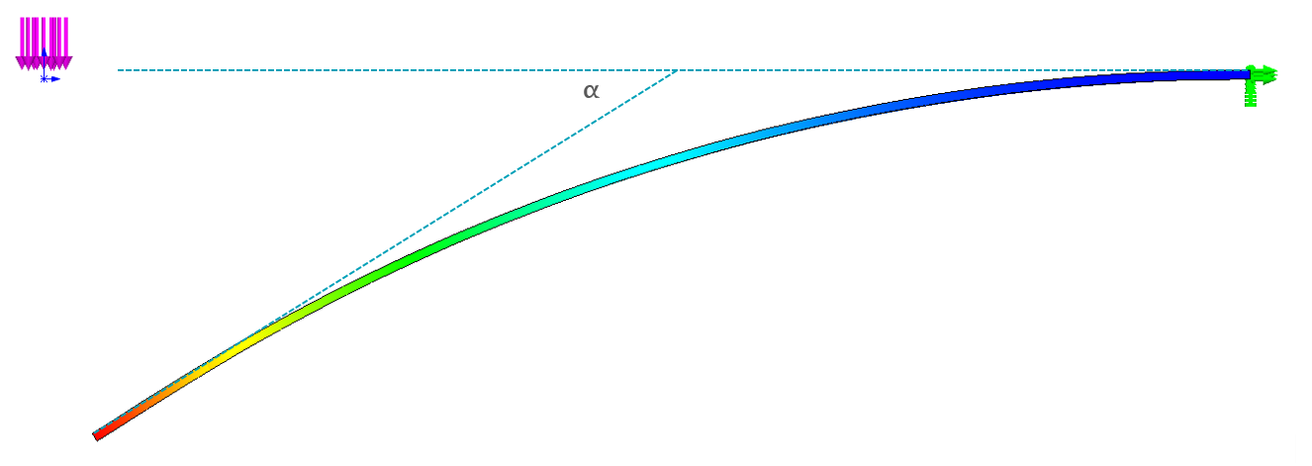
VOPO SUSPENSION D.
SITUATION IN THE CHAMBER
MASS BUDGET ESTIMATION
PRELIMINARY LAYOUT
BLADES PRELIMINARY DESIGN
THEORY
FEA
CHAMBERS’ LAYOUT
FLEXURE DESIGN
LOCATION OF THE BLADES
CAD MODEL OF THE OPTICAL LAYOUT
REAL MASS BUDGET
ACTUATORS
INJECTION BENCH DESIGN & BALANCING
BASE PLATE
BLADE PLATFORM
MOTION LIMITERS< LOCKERS< ASSEMBLY BRACKETS
ASSEMBLY PROCEDURE
OPTIMIZATION
CONTACT ANALYSIS
  VOPO SQUEEZER IN LIGO
  MONOSTAGE SUSPENSION DESIGN
NOTE: This is the preliminary FEA of the blade, a detailed contact analysis has to be run in order to predict the real behavior
Calculated Tip Deflection Angle: 33.16°

Slide 29
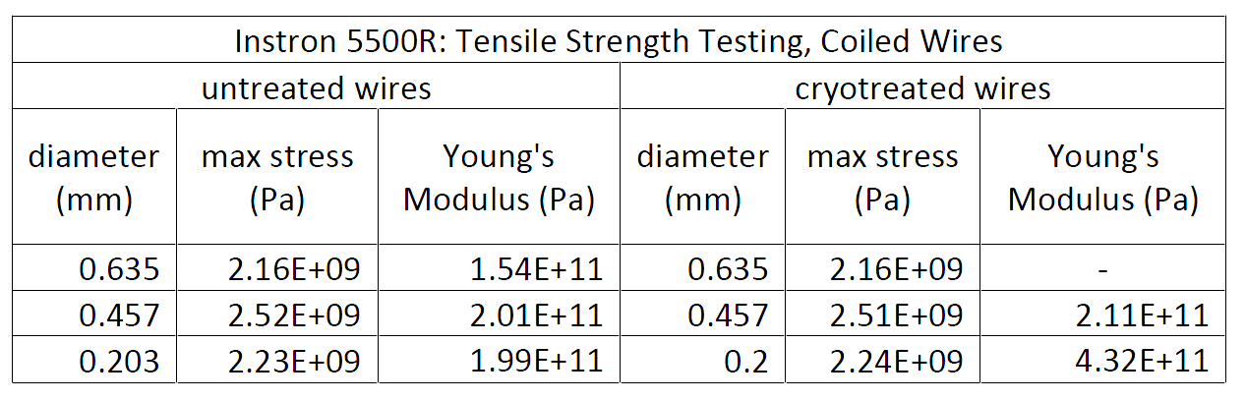
VOPO SUSPENSION D.
SITUATION IN THE CHAMBER
MASS BUDGET ESTIMATION
PRELIMINARY LAYOUT
BLADES PRELIMINARY DESIGN
THEORY
FEA
CHAMBERS’ LAYOUT
FLEXURE DESIGN
LOCATION OF THE BLADES
CAD MODEL OF THE OPTICAL LAYOUT
REAL MASS BUDGET
ACTUATORS
INJECTION BENCH DESIGN & BALANCING
BASE PLATE
BLADE PLATFORM
MOTION LIMITERS< LOCKERS< ASSEMBLY BRACKETS
ASSEMBLY PROCEDURE
OPTIMIZATION
CONTACT ANALYSIS
  VOPO SQUEEZER IN LIGO
  MONOSTAGE SUSPENSION DESIGN
Material: Music Wire Steel (E = 154-201 GPa, Y = 1600-2000 Mpa)
Charge per wire: P = 117.12 N
T1500539
Minimum Tensile Strengths (E1100187)
NOTE: T1500539 shows a 84.6% average relation between Y and UTS. Therefore, in further calculations Y is calculated as 80% of the Minimum Tensile Strength

Slide 30
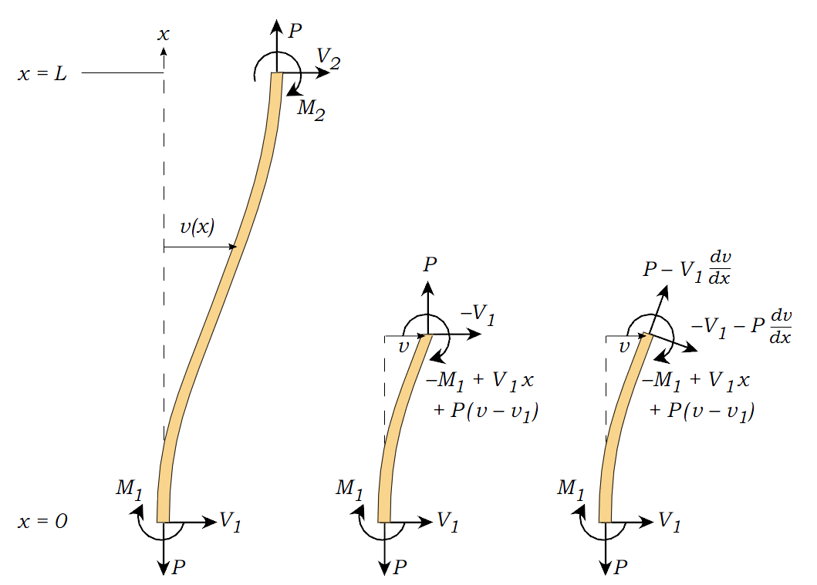




VOPO SUSPENSION D.
SITUATION IN THE CHAMBER
MASS BUDGET ESTIMATION
PRELIMINARY LAYOUT
BLADES PRELIMINARY DESIGN
THEORY
FEA
CHAMBERS’ LAYOUT
FLEXURE DESIGN
LOCATION OF THE BLADES
CAD MODEL OF THE OPTICAL LAYOUT
REAL MASS BUDGET
ACTUATORS
INJECTION BENCH DESIGN & BALANCING
BASE PLATE
BLADE PLATFORM
MOTION LIMITERS< LOCKERS< ASSEMBLY BRACKETS
ASSEMBLY PROCEDURE
OPTIMIZATION
CONTACT ANALYSIS
  VOPO SQUEEZER IN LIGO
  MONOSTAGE SUSPENSION DESIGN
Desired frequency: f < 1.5 Hz
FoS ≥ 33.3% (FoS ≥ 3)
$$I= π\frac{d^{4}}{64}$$
$$K=\sqrt{\frac{P}{E I}}$$
$$ZMP=\frac{1}{K}\tanh\left(K\frac{l}{2}\right)$$
$$Section=\frac{π D^{2}}{4}$$
$$σ_{norm}=\frac{P}{Section}$$
$$σ_{bend max}=\frac{P ZMP\frac{D}{2}δ}{I l_{Z}}$$
$$τ_{max}=\frac{Pδ}{Section l_{Z}}$$
$$σ_{eq}= \sqrt{σ_{norm}^{2}+σ_{bend}^{2}+3 τ_{max}^{2}}$$
$$FoS=\frac{σ_{Y}}{σ_{eq}}=2.9148$$
$$l_{Z}=l−2 ZMP$$
$$K_{XX}=K_{YY}=\frac{m g}{3 l_{Z}}$$
$$f_{XX}=\frac{1}{2π}\sqrt{\frac{{3 K}_{XX}}{m}}$$

Slide 31
VOPO SUSPENSION D.
SITUATION IN THE CHAMBER
MASS BUDGET ESTIMATION
PRELIMINARY LAYOUT
BLADES PRELIMINARY DESIGN
THEORY
FEA
CHAMBERS’ LAYOUT
FLEXURE DESIGN
LOCATION OF THE BLADES
CAD MODEL OF THE OPTICAL LAYOUT
REAL MASS BUDGET
ACTUATORS
INJECTION BENCH DESIGN & BALANCING
BASE PLATE
BLADE PLATFORM
MOTION LIMITERS< LOCKERS< ASSEMBLY BRACKETS
ASSEMBLY PROCEDURE
OPTIMIZATION
CONTACT ANALYSIS
  VOPO SQUEEZER IN LIGO
  MONOSTAGE SUSPENSION DESIGN
Lf = 130mm
d = 0.61 mm
Calculated using
d = 0.61 mm as reference
FlexureDesign.m
f = 1.4203 Hz
Kxx = 955.62 N/m
FoS = 2.9148
NOTE: Diameter of 0.61mm raise FoS up to almost 3, which is considered enough as the minimal guaranteed tensile strength has been considered

Slide 32
aLIGO INTRODUCTION
SITUATION IN THE CHAMBER
MASS BUDGET ESTIMATION
PRELIMINARY LAYOUT
BLADES PRELIMINARY DESIGN
THEORY
FEA
CHAMBERS’ LAYOUT
FLEXURE DESIGN
LOCATION OF THE BLADES
CAD MODEL OF THE OPTICAL LAYOUT
REAL MASS BUDGET
ACTUATORS
INJECTION BENCH DESIGN & BALANCING
BASE PLATE
BLADE PLATFORM
MOTION LIMITERS< LOCKERS< ASSEMBLY BRACKETS
ASSEMBLY PROCEDURE
OPTIMIZATION
CONTACT ANALYSIS
  VOPO SQUEEZER IN LIGO
  MONOSTAGE SUSPENSION DESIGN
Lf = 130mm
d = 0.61 mm
Calculated using
d = 0.61 mm as reference
FlexureDesign.m
f = 1.4203 Hz
Kxx = 955.62 N/m
FoS = 2.9148
Desired frequency: f < 1.5 Hz
FoS ≥ 33.3% (FoS ≥ 3)
NOTE: Diameter of 0.61mm raise FoS up to almost 3, which is considered enough as the minimal guaranteed tensile strength has been considered

Slide 33
aLIGO INTRODUCTION
SITUATION IN THE CHAMBER
MASS BUDGET ESTIMATION
PRELIMINARY LAYOUT
BLADES PRELIMINARY DESIGN
THEORY
FEA
CHAMBERS’ LAYOUT
FLEXURE DESIGN
LOCATION OF THE BLADES
CAD MODEL OF THE OPTICAL LAYOUT
REAL MASS BUDGET
ACTUATORS
INJECTION BENCH DESIGN & BALANCING
BASE PLATE
BLADE PLATFORM
MOTION LIMITERS< LOCKERS< ASSEMBLY BRACKETS
ASSEMBLY PROCEDURE
OPTIMIZATION
CONTACT ANALYSIS
  VOPO SQUEEZER IN LIGO
  MONOSTAGE SUSPENSION DESIGN

Slide 34
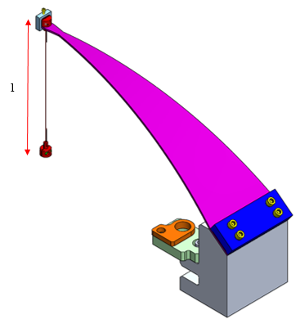
CONCEPTION
SITUATION IN THE CHAMBER
MASS BUDGET ESTIMATION
PRELIMINARY LAYOUT
BLADES PRELIMINARY DESIGN
THEORY
FEA
CHAMBERS’ LAYOUT
FLEXURE DESIGN
LOCATION OF THE BLADES
CAD MODEL OF THE OPTICAL LAYOUT
REAL MASS BUDGET
ACTUATORS
INJECTION BENCH DESIGN & BALANCING
BASE PLATE
BLADE PLATFORM
MOTION LIMITERS< LOCKERS< ASSEMBLY BRACKETS
ASSEMBLY PROCEDURE
OPTIMIZATION
CONTACT ANALYSIS
CONCEPTION DES CABLES
f < 1.5 Hz
FoS ≥ 33.3% (FoS ≥ 3)
Paramètres:
  l = 130mm
  d = 0.61 mm
CONTRAINTE
$$Section=\frac{π D^{2}}{4}$$
$$σ_{norm}=\frac{P}{Section}$$
$$σ_{bend max}=\frac{P ZMP\frac{D}{2}δ}{I l_{Z}}$$
$$τ_{max}=\frac{Pδ}{Section l_{Z}}$$
$$σ_{eq}= \sqrt{σ_{norm}^{2}+σ_{bend}^{2}+3 τ_{max}^{2}}$$
$$FoS=\frac{σ_{Y}}{σ_{eq}}$$
Notes:
LA QUATRIEME ETAPE, EN SLIDE 17
LES CABLES SONT RESPONSABLES DE L’ISOLATION HORIZONTALE ET LES CONTRAINTES SONT
LES PARAMÈTRES DE CETTE CONCEPTION
ON PRESENTE AUSSI LES EQUATIONS…. LES RESULTATS MONTRENT QUE LA CONTRAINTE DUE A L’EFFORT NORMAL EST LA PLUS IMPORTANTE ET QUE L.ESFFORT TRANCHANT EST NEGLIGEABLE

Slide 35
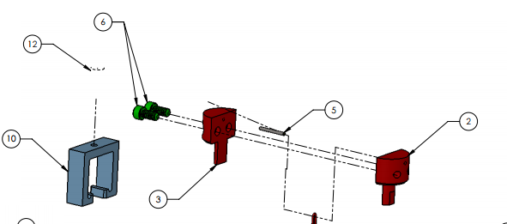
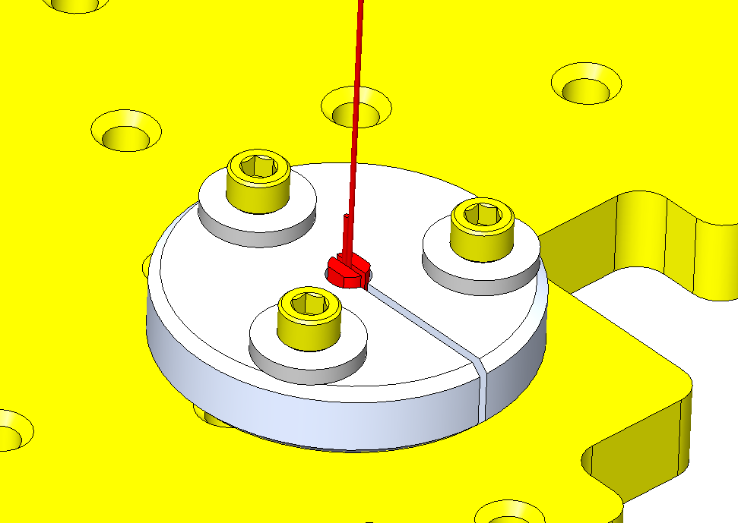
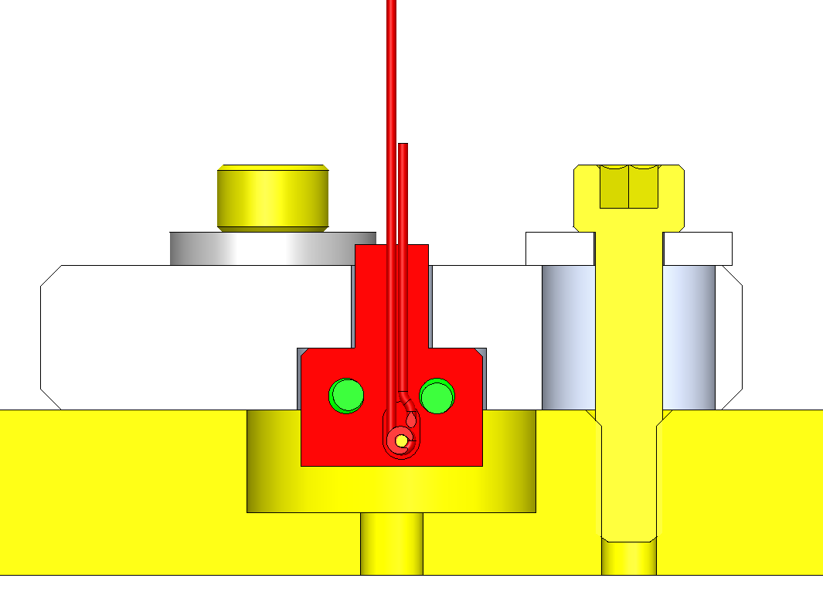
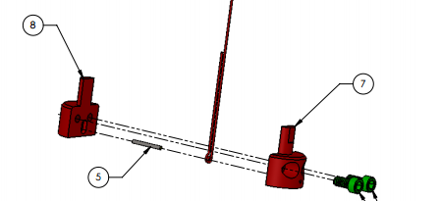
CONCEPTION
SITUATION IN THE CHAMBER
MASS BUDGET ESTIMATION
PRELIMINARY LAYOUT
BLADES PRELIMINARY DESIGN
THEORY
FEA
CHAMBERS’ LAYOUT
FLEXURE DESIGN
LOCATION OF THE BLADES
CAD MODEL OF THE OPTICAL LAYOUT
REAL MASS BUDGET
ACTUATORS
INJECTION BENCH DESIGN & BALANCING
BASE PLATE
BLADE PLATFORM
MOTION LIMITERS< LOCKERS< ASSEMBLY BRACKETS
ASSEMBLY PROCEDURE
OPTIMIZATION
CONTACT ANALYSIS
CONCEPTION DES CABLES
Attaches du câble aux extrémités
Attaches du câble ‘a la table
Notes:
UNE FOIS QUE LE DIAMTRE DU CABLE EST DEFINIE, NOUS POUVONS CONCEVOIR LES ATTACHES
A GAUCHE …
A DROITE…

Slide 36
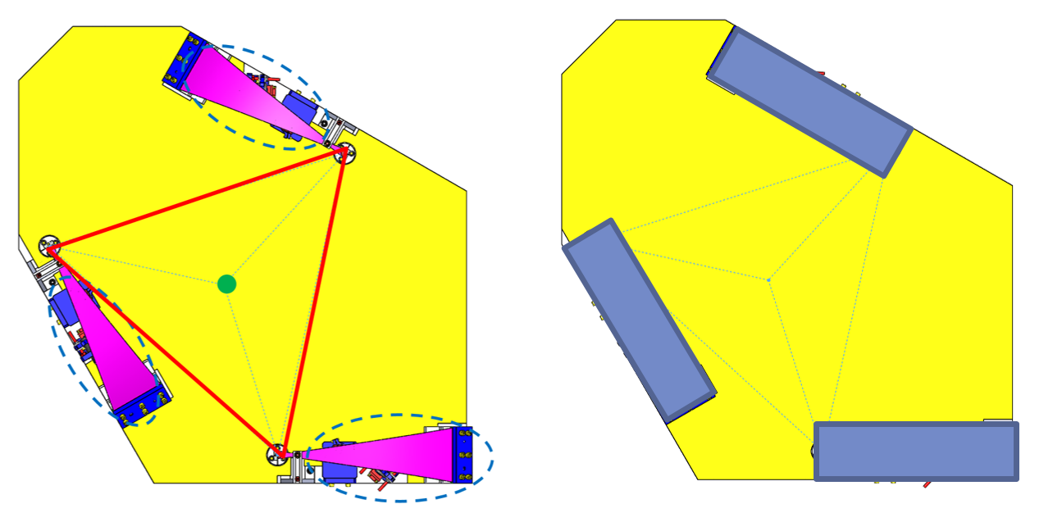
CONCEPTION
SITUATION IN THE CHAMBER
MASS BUDGET ESTIMATION
PRELIMINARY LAYOUT
BLADES PRELIMINARY DESIGN
THEORY
FEA
CHAMBERS’ LAYOUT
FLEXURE DESIGN
LOCATION OF THE BLADES
CAD MODEL OF THE OPTICAL LAYOUT
REAL MASS BUDGET
ACTUATORS
INJECTION BENCH DESIGN & BALANCING
BASE PLATE
BLADE PLATFORM
MOTION LIMITERS< LOCKERS< ASSEMBLY BRACKETS
ASSEMBLY PROCEDURE
OPTIMIZATION
CONTACT ANALYSIS
POSITIONNEMENT DES LAMES
Notes:
ETAPE SUIVANTE… DANS LA SUSPENSION
FORMENT UN TRIANGLE EQUILATERAL -> REPARTITION DES CHARGES
UNE FOIS LA POSITION DES LAMES EST DEFINIE, LE POINT QUI DOIT CORRESPONDRE AU CENTRE DE MASSE EST FIXEE

Slide 37
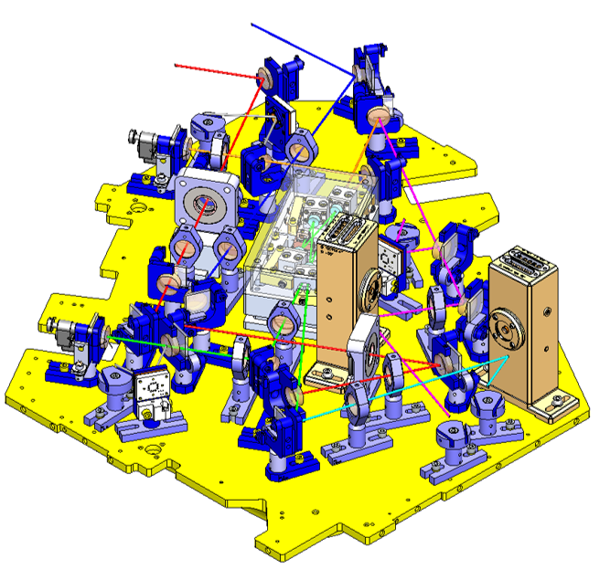
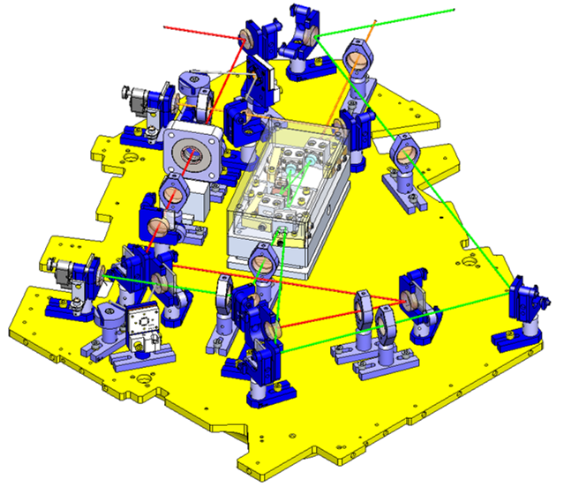
CONCEPTION
SITUATION IN THE CHAMBER
MASS BUDGET ESTIMATION
PRELIMINARY LAYOUT
BLADES PRELIMINARY DESIGN
THEORY
FEA
CHAMBERS’ LAYOUT
FLEXURE DESIGN
LOCATION OF THE BLADES
CAD MODEL OF THE OPTICAL LAYOUT
REAL MASS BUDGET
ACTUATORS
INJECTION BENCH DESIGN & BALANCING
BASE PLATE
BLADE PLATFORM
MOTION LIMITERS< LOCKERS< ASSEMBLY BRACKETS
ASSEMBLY PROCEDURE
OPTIMIZATION
CONTACT ANALYSIS
    MODEL 3D DE LA DISPOSITION DES OPTIQUES
Notes:
L’ETAPE SUIVANTE, EN SLIDE 20, REPRESENTE EST..
MODELES 3D DES OPTIQUES AVEC LE POIDS ET VOLUME REEL
MODELE 2D -> PAS EXACT
CECI N’AVAIT PAS ÉTÉ FAIT AVANT -> AVANTAGES

Slide 38
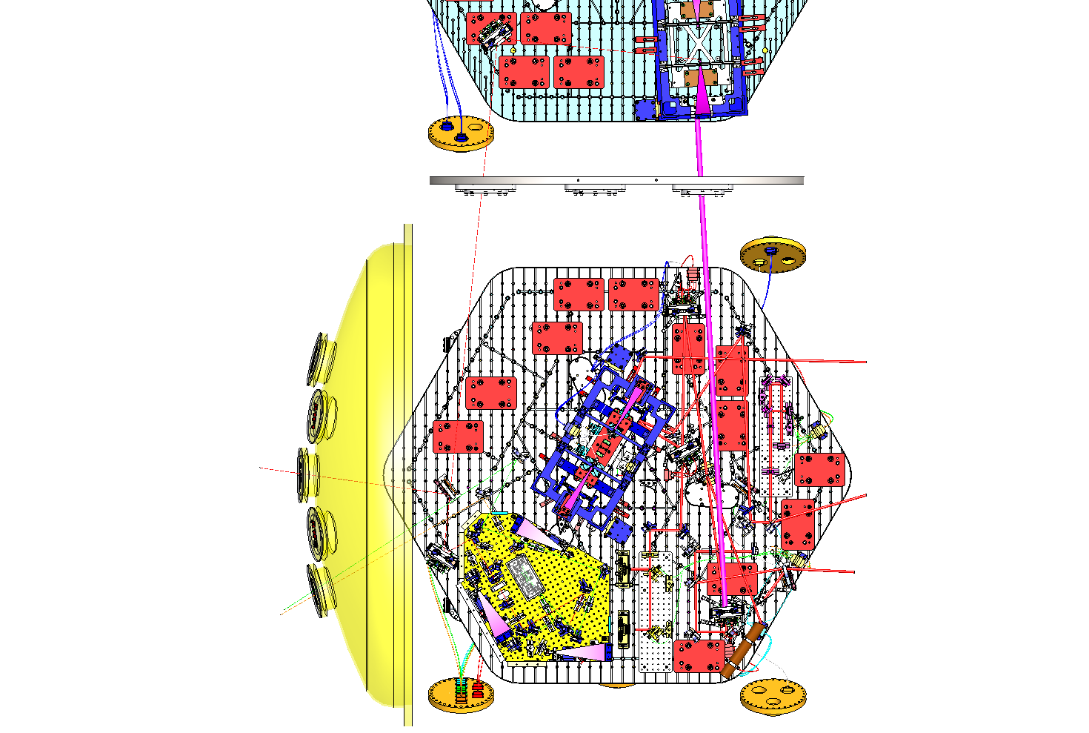

CONCEPTION
SITUATION IN THE CHAMBER
MASS BUDGET ESTIMATION
PRELIMINARY LAYOUT
BLADES PRELIMINARY DESIGN
THEORY
FEA
CHAMBERS’ LAYOUT
FLEXURE DESIGN
LOCATION OF THE BLADES
CAD MODEL OF THE OPTICAL LAYOUT
REAL MASS BUDGET
ACTUATORS
INJECTION BENCH DESIGN & BALANCING
BASE PLATE
BLADE PLATFORM
MOTION LIMITERS< LOCKERS< ASSEMBLY BRACKETS
ASSEMBLY PROCEDURE
OPTIMIZATION
CONTACT ANALYSIS
DISPOSITION DES CHAMBRES
Faraday
VOPO
Notes:
A CONTINUATION…

Slide 39
CONCEPTION
SITUATION IN THE CHAMBER
MASS BUDGET ESTIMATION
PRELIMINARY LAYOUT
BLADES PRELIMINARY DESIGN
THEORY
FEA
CHAMBERS’ LAYOUT
FLEXURE DESIGN
LOCATION OF THE BLADES
CAD MODEL OF THE OPTICAL LAYOUT
REAL MASS BUDGET
ACTUATORS
INJECTION BENCH DESIGN & BALANCING
BASE PLATE
BLADE PLATFORM
MOTION LIMITERS< LOCKERS< ASSEMBLY BRACKETS
ASSEMBLY PROCEDURE
OPTIMIZATION
CONTACT ANALYSIS
BILAN MASSIQUE REEL
Notes:
A CE POINT, NOUS POUVONS FAIRE UN BILAN MASSIQUE REALISTIQUE
IL Y A ENCORE DE L’INCERTITUDE -> IL FAUT PRENDRE DE LA MARGE

Slide 40

CONCEPTION
SITUATION IN THE CHAMBER
MASS BUDGET ESTIMATION
PRELIMINARY LAYOUT
BLADES PRELIMINARY DESIGN
THEORY
FEA
CHAMBERS’ LAYOUT
FLEXURE DESIGN
LOCATION OF THE BLADES
CAD MODEL OF THE OPTICAL LAYOUT
REAL MASS BUDGET
ACTUATORS
INJECTION BENCH DESIGN & BALANCING
BASE PLATE
BLADE PLATFORM
MOTION LIMITERS< LOCKERS< ASSEMBLY BRACKETS
ASSEMBLY PROCEDURE
OPTIMIZATION
CONTACT ANALYSIS
ACTUATEURS
Actuateur magnétique avec système de détection optique
Notes:
EN SLIDE 23 NOUS PRESENTONS LES ACTUATEURS…
POUR LE VOPO 3 HORIZONTAUX ET 3 VERTICAUX

Slide 41


CONCEPTION
SITUATION IN THE CHAMBER
MASS BUDGET ESTIMATION
PRELIMINARY LAYOUT
BLADES PRELIMINARY DESIGN
THEORY
FEA
CHAMBERS’ LAYOUT
FLEXURE DESIGN
LOCATION OF THE BLADES
CAD MODEL OF THE OPTICAL LAYOUT
REAL MASS BUDGET
ACTUATORS
INJECTION BENCH DESIGN & BALANCING
BASE PLATE
BLADE PLATFORM
MOTION LIMITERS< LOCKERS< ASSEMBLY BRACKETS
ASSEMBLY PROCEDURE
OPTIMIZATION
CONTACT ANALYSIS
CONCEPTION DE LA TABLE OPTIQUE ET EQUILIBRAGE
Fréquence résonance élevée
Centre de gravite
Notes:
L’ETAPE SUIVANTE EST…
DANS CETTE CONCEPTION LES OBJETIFS SONT
FREQUENCE NON PAS DE LA TABLE MAIS TABLE + OPTIQUES + CONTREPOIDS
LA SOLUTION EST D’UTILISER UN RAIDISSEUR

Slide 42


VOPO SUSPENSION D.
SITUATION IN THE CHAMBER
MASS BUDGET ESTIMATION
PRELIMINARY LAYOUT
BLADES PRELIMINARY DESIGN
THEORY
FEA
CHAMBERS’ LAYOUT
FLEXURE DESIGN
LOCATION OF THE BLADES
CAD MODEL OF THE OPTICAL LAYOUT
REAL MASS BUDGET
ACTUATORS
INJECTION BENCH DESIGN & BALANCING
BASE PLATE
BLADE PLATFORM
MOTION LIMITERS< LOCKERS< ASSEMBLY BRACKETS
ASSEMBLY PROCEDURE
OPTIMIZATION
CONTACT ANALYSIS
CONCEPTION DU PLATEAU
Notes:
OBJECTIFS:
CONTACT AVEC LA CHAMBRE
GARANTIR LE TRANSPORT
FEA

Slide 43


CONCEPTION
SITUATION IN THE CHAMBER
MASS BUDGET ESTIMATION
PRELIMINARY LAYOUT
BLADES PRELIMINARY DESIGN
THEORY
FEA
CHAMBERS’ LAYOUT
FLEXURE DESIGN
LOCATION OF THE BLADES
CAD MODEL OF THE OPTICAL LAYOUT
REAL MASS BUDGET
ACTUATORS
INJECTION BENCH DESIGN & BALANCING
BASE PLATE
BLADE PLATFORM
MOTION LIMITERS< LOCKERS< ASSEMBLY BRACKETS
ASSEMBLY PROCEDURE
OPTIMIZATION
CONTACT ANALYSIS
POSTE DES LAMES
δ
Analyse de contact
H
Notes:
FINALEMENT,
LE POSTE A DEUX PARAMENTRES IMPORTANTS ….. , QUI VONT DEFINIR LA POSITION DE L’EXTREMITE DE LA LAME PAR RAPPORT A LA SUSPENSION -> PROBLEMES DE MAUVAIS ALIGNEMENT
DELTA EST 90-ALPHA
C’EST POURQUOI, ANALYSE DE CONTACT LAMES PINCES

Slide 44

CONCEPTION
SITUATION IN THE CHAMBER
MASS BUDGET ESTIMATION
PRELIMINARY LAYOUT
BLADES PRELIMINARY DESIGN
THEORY
FEA
CHAMBERS’ LAYOUT
FLEXURE DESIGN
LOCATION OF THE BLADES
CAD MODEL OF THE OPTICAL LAYOUT
REAL MASS BUDGET
ACTUATORS
INJECTION BENCH DESIGN & BALANCING
BASE PLATE
BLADE PLATFORM
MOTION LIMITERS< LOCKERS< ASSEMBLY BRACKETS
ASSEMBLY PROCEDURE
OPTIMIZATION
CONTACT ANALYSIS
ELEMENTS ADDITIONNELS
  SYSTÈME DE VERROUILLAGE
  SYSTÈME DE BUTEE
  ELEMENTS DE TRANSPORT
PROCEDURE D’ASSEMBLAGE

Slide 45
PLAN
INTRODUCTION aLIGO
CONCEPTION DE LA SUSPENSION
ANALYSE DU CONTACT
OPTIMISATION DE LA TABLE OPTIQUE
CONCLUSIONS

Slide 46



ANALYSE DU CONTACT
ANALYSE DU CONTACT
Notes:
IMPORTANT DANS DES LAMES QUI SONT FABRIQUES PLATES…
CONTACT ENTRE LAME ET LES PINCES
DEFINIR LE NOMBRE DE VISES ET LES PRECONTRAINTES
PROCESSUSS: ASSEMBLAGE SIMPLIFIE ET 3 ETUDES: SOLIDAIRE, CONTACT SW, CONTACT ANSYS
A DROITE… LE TEORIQUE N’EST PAS REALISTIQUE

Slide 47


ANALYSE DU CONTACT
  ANALYSE DU CONTACT
Notes:
LA SLIDE SUIVANTE ES UN PEU CHARGE D’INFORMATION ET MONTRE LES RESULTATS QUI SONT TRES INTUITIFS
LES ELEMENTS QUE ON DOIT PREDIRE POUR EVITER DES MAUVAIS ALIGNEMENTS SONT: ROUGE, VERT, ALPHA NIVEAU DE COTNRIANTE
LES RESULTATS DES GRAPHIQUES LES DONNES NE SONT PAS IMPORTANTE MAIS L’EVOLUTION EN FONCTION DE LA PRECHARGE DE VISES. ESSENTIELLEMENT, CE QUE MONTRE …
CES RESULTATS SONT POUR 6 VISES ET UN PRECHARGE ELEVEE

Slide 48


ANALYSE DU CONTACT
  ANALYSE DU CONTACT
Notes:
LA PROCHAINE SLIDE MONTRE LE DETAIL DE CES DIFFERENCES
EN ROUGE ON PEUT VOIR QUE LE CONTACT PINCE – LAME N’EST PAS PARTFAITE -> PAS SURFACE MAIS LIGNE

Slide 49
PLAN
INTRODUCTION aLIGO
CONCEPTION DE LA SUSPENSION
ANALYSE DU CONTACT
OPTIMISATION DE LA TABLE OPTIQUE
CONCLUSIONS

Slide 50


OPTIMISATION DE LA TABLE OPTIQUE
OPTIMISATION DE LA TABLE OPTIQUE
Notes:
CET UNE OPTIMISATION DE TABLE + POSTITIONEMENT DES CONTREPOIDS -> MODELE EF DE L’ENSEMBLE
TABLE -> PREMIER NIVEAU + RAIDISSEUR AU DESOUS -> PARAMETRES POUR OPTIMISATION

Slide 51


OPTIMISATION DE LA TABLE OPTIQUE
OPTIMISATION DE LA TABLE OPTIQUE
Notes:
SLIDE SUIVANTE
PARAMETERS TYPIQUES DE OPTIMISATION -> LOGICIEL SW SIMULATION (VALIDE)
CONTRAINTES ET OBJECTIS -> MAXIMISER LA FREQUENCE AVEC UN POIDS MAXIMAL
FREQUENCE 250Hz

Slide 52
PLAN
INTRODUCTION aLIGO
CONCEPTION DE LA SUSPENSION
ANALYSE DU CONTACT
OPTIMISATION DE LA TABLE OPTIQUE
CONCLUSIONS

Slide 53
CONCLUSIONS
CONTRIBUTIONS DE CE PROJET
  Système d’isolation pour l’instrument VOPO
  Méthodologie pour des suspensions mono étage
  Étude du contact des lames
  Méthodologie d’optimisation des tables optiques
Notes:
SOMMAIRE
MONO ETAGE
- AMELIORATION DES BASSES FREQUENCES
- SIMPLICITE (SOUPRESSION DES SOUDURES)
- ADAPTABILITE A L’ESPACE
- COUT ET TMEPS DE LIVRAISON
CONTACT
- LAMES FABRICATION PLATE
- PREDICTION
OPTIMISATION
- OBTENIR LES MEILLEURES PERFORMANCES POUR CE TYPE DE SUSPENSION

Slide 54

CONCLUSIONS
TÂCHES A RÉALISER:
    Contrôle des modes rigides
    Test des performances
    Assemblage complet
Notes:
TEST QUI VALIDERA TOUS LES RESULTATS

Slide 55

MERCI DE VOTRE ATTENTION

