Slide 1

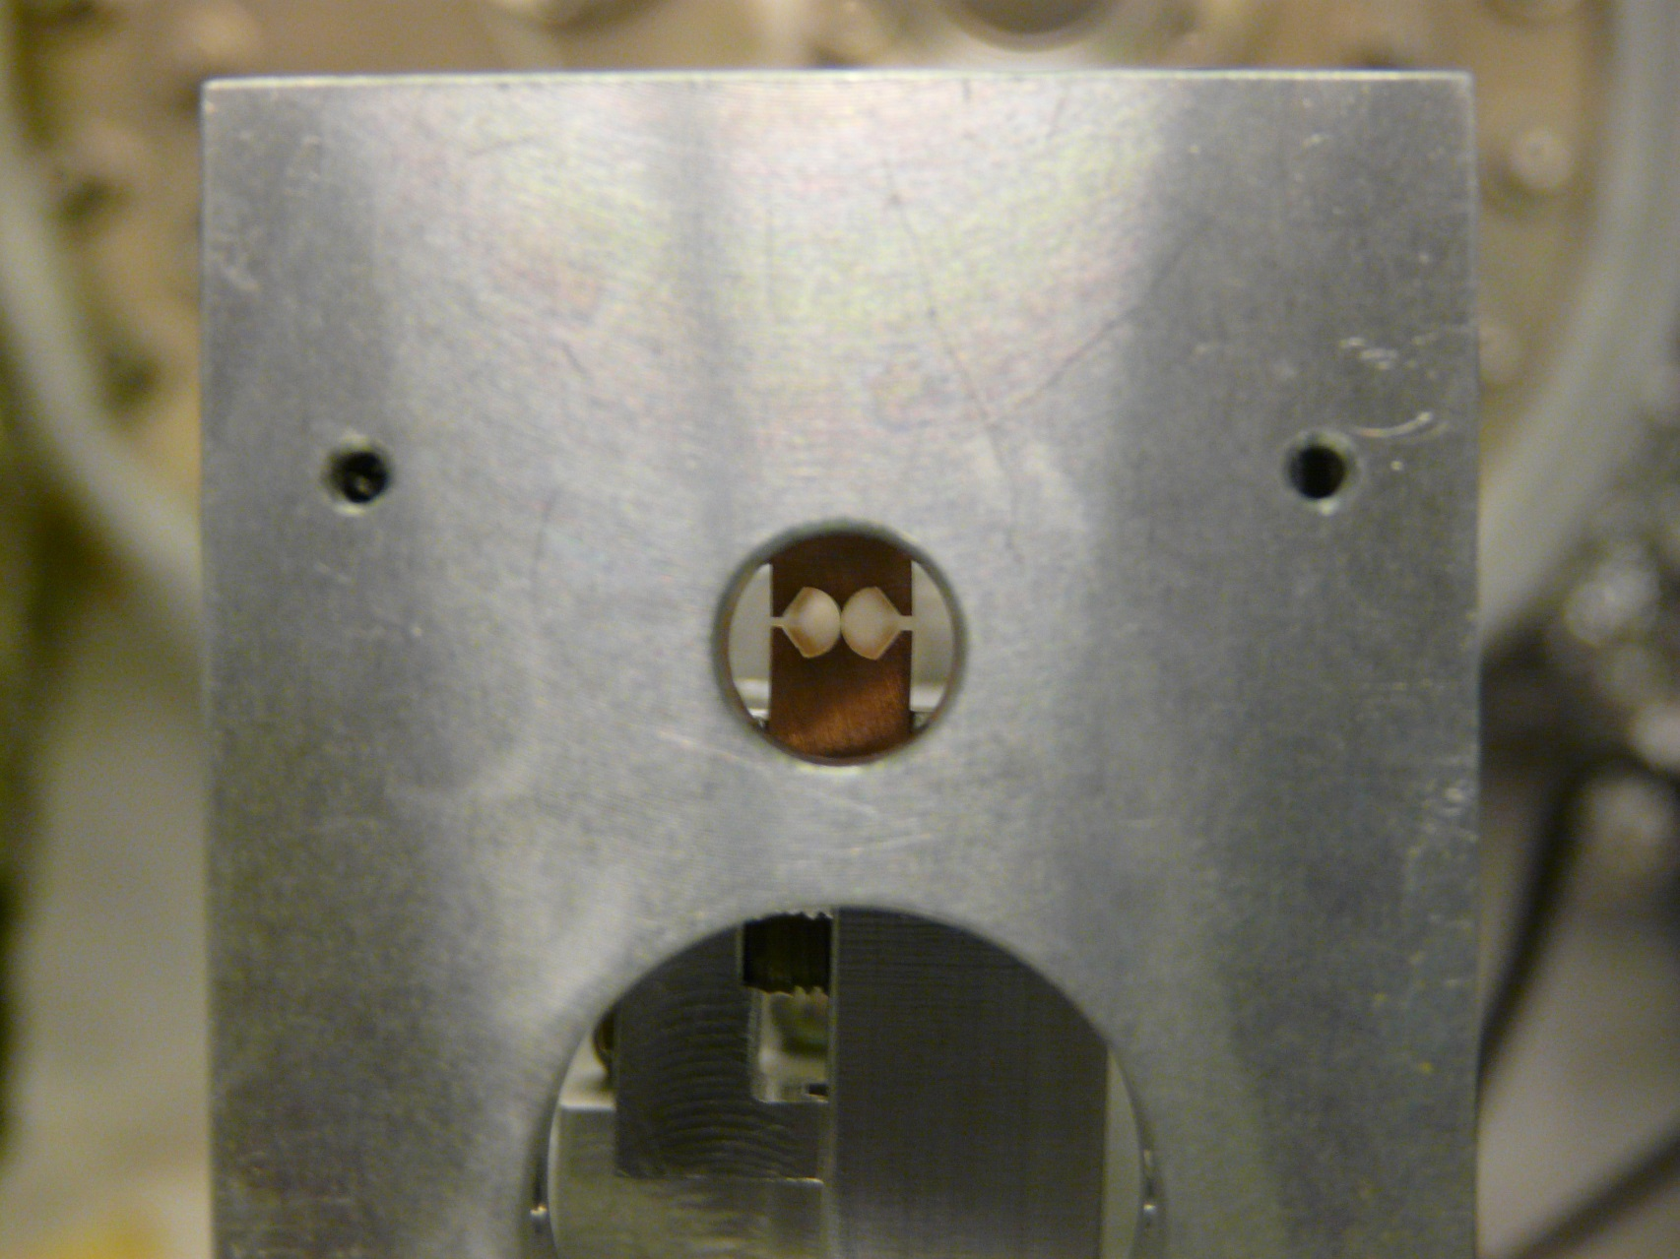
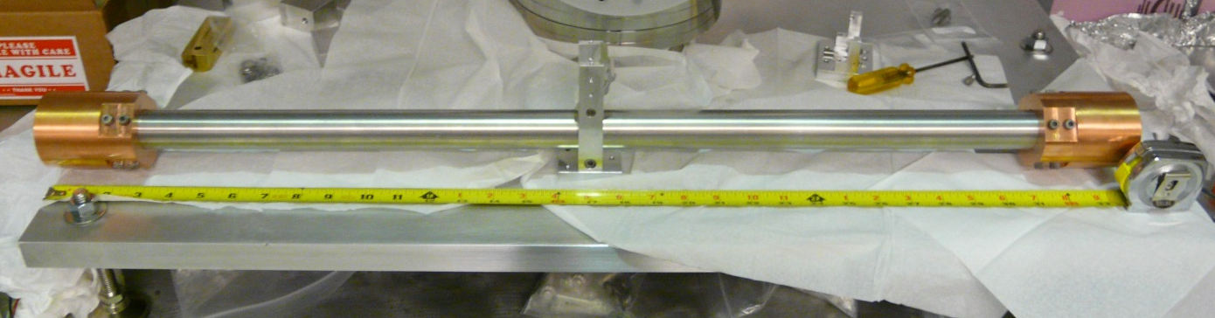
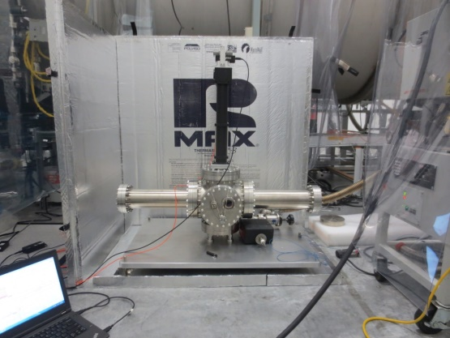
Tilt-correction and
Sensor-correction at LHO
Using offline data for designing and quantifying filters
Conor Mow-Lowry
Thanks to: Krishna, Jeff, Brian, Jim, Hugh, Robert

Slide 2
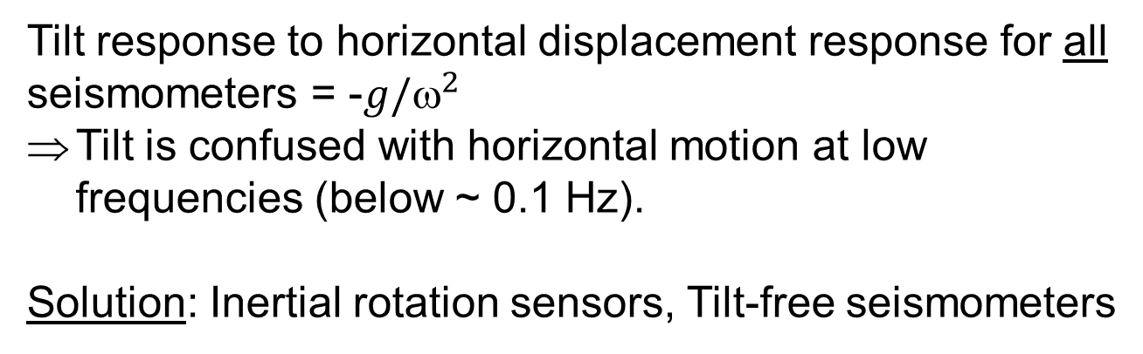
Tilt versus Horizontal displacement
Conventional seismometers and tiltmeters cannot differentiate between horizontal displacement and ground tilt.
δx ∝ ax
δx ∝ gθ
Tilt response to horizontal displacement response for all seismometers = -$g/^{2}$
Tilt is confused with horizontal motion at low frequencies (below ~ 0.1 Hz).
Solution: Inertial rotation sensors, Tilt-free seismometers
Source: Krishna Venkateswara

Slide 3
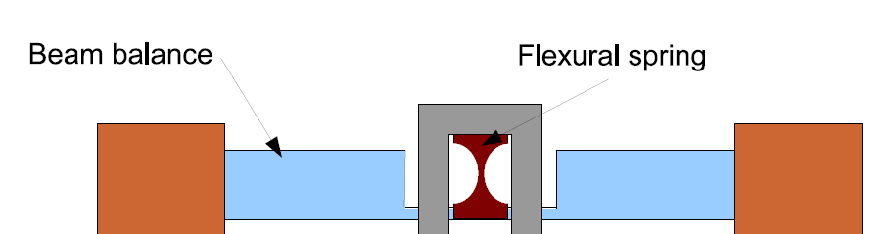
Schematic
Autocollimator
10-25 μm-thick Cu-Be Flexures
Source: Krishna Venkateswara

Slide 4
The ISI tilt problem, Stage 2
GS-13 tilt-noise and its effect on horizontal translation
Calibration step | Effect on displacement | Relevant frequency
GS-13 measures velocity | 1/f | ω = 1
Amplifier noise | 1/√f | f_{c} = 1 Hz
Plant inversion | 1/f² | f₀ = 1 Hz
Tilt-baseline | 1 | --
Tilt-to-horizontal coupling | 1/f² | g/ω² = 1 @0.5 Hz
Result | 1/f^{5.5} | Below 0.5 Hz

Slide 5
Some points
RMS velocity is a good figure of merit, and probably what we care about below ~0.3 Hz.
Sensor correction allows us to use a lower-tilt seismometer for low-frequency isolation.
Below 100mHz, ground motion is pretty common mode. The primary microseism ~70mHz sees at least a factor 4 direct subtraction.
We should design further ISI improvements in the IFO basis, and potentially using IFO readout.

Slide 6
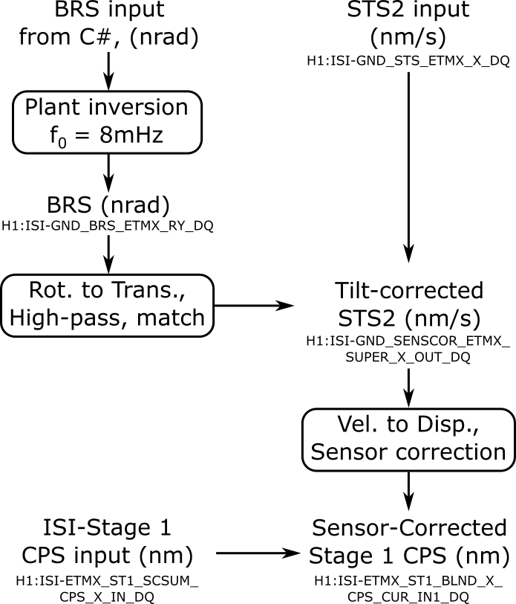
BRS Signal Path
Offline data was used to tune all the BRS filters for improved tilt-subtraction and reduced low-frequency noise injection.
Most benefit came from matching the high-pass filter to the STS2 AC-coupling.

Slide 7
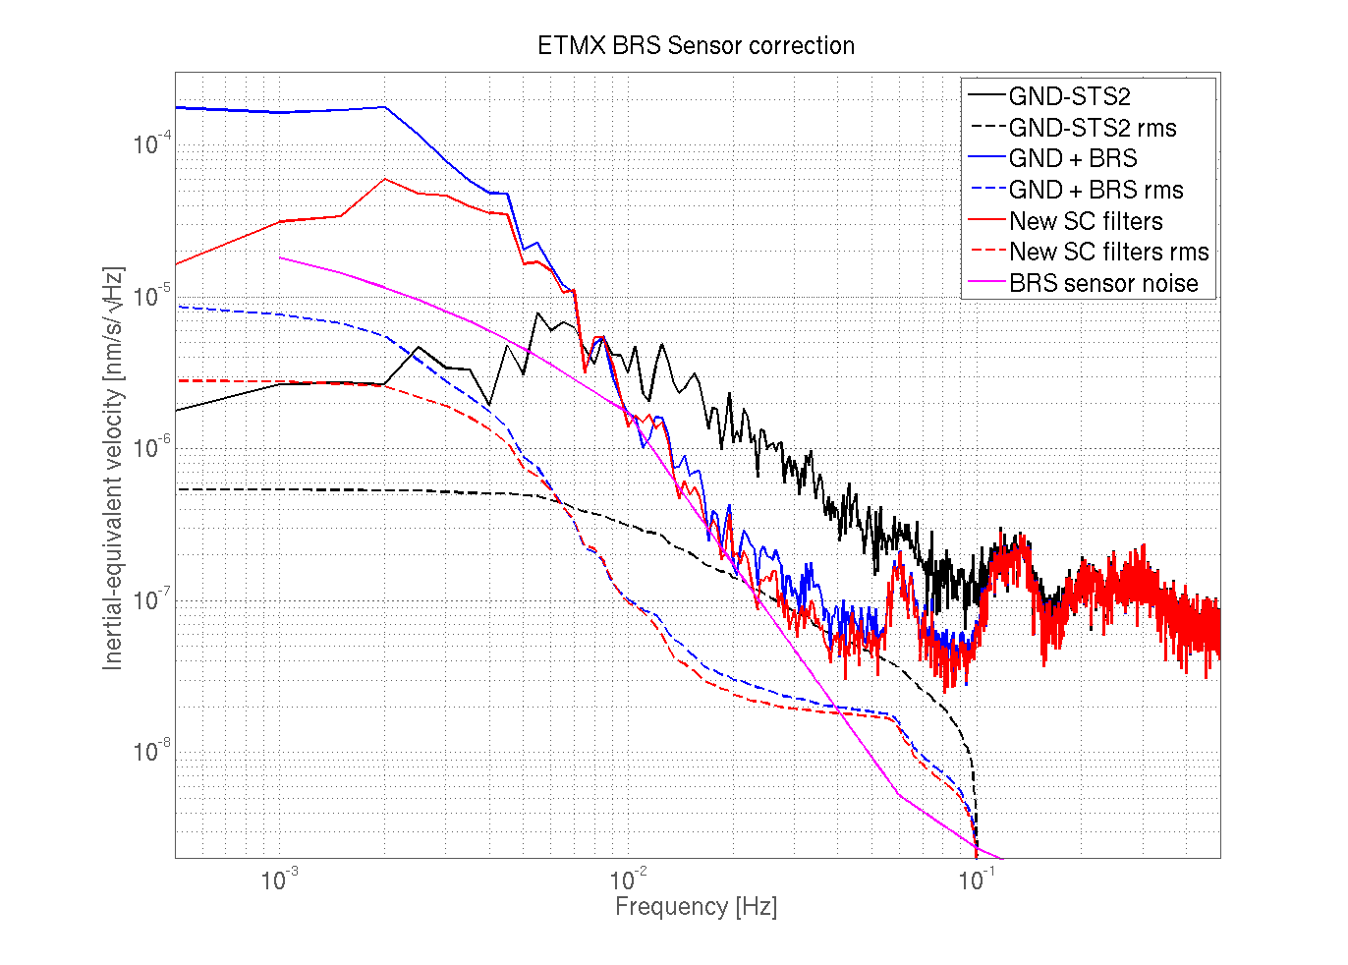
BRS Tilt-correction filter tuning (ETMX)
m/s
nm/s

Slide 8
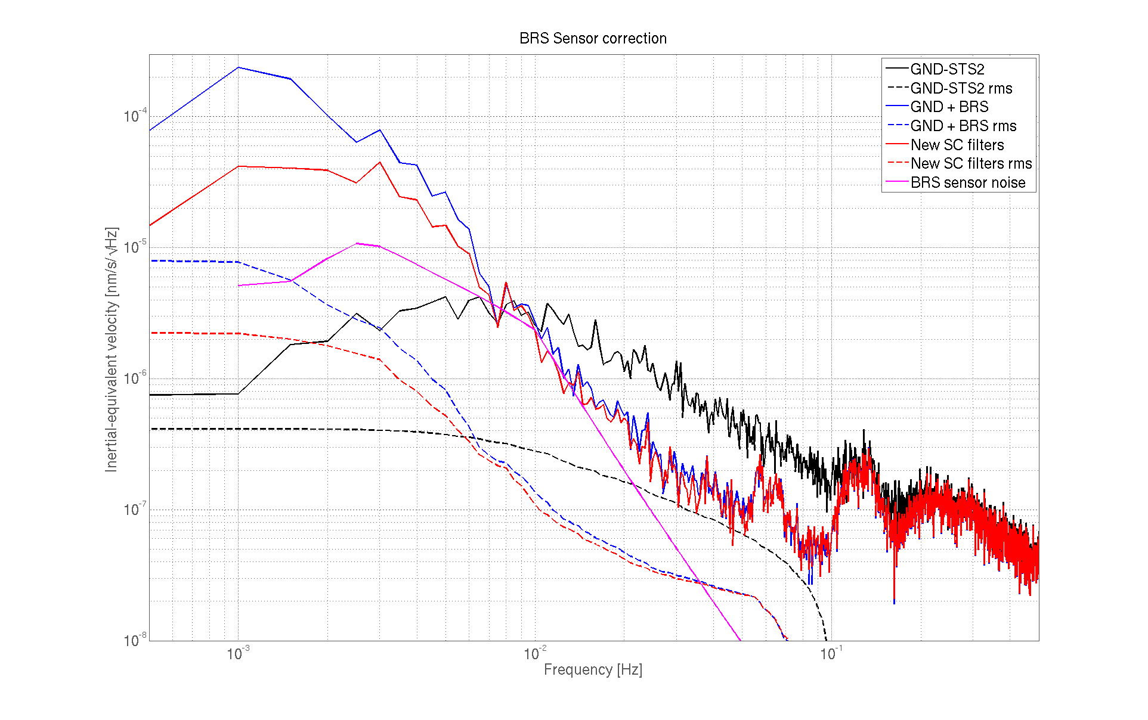
BRS Tilt-correction filter tuning (ETMY)
m/s
nm/s

Slide 9
Figure of merit
We want to minimise the low-frequency RMS velocity transmitted through the Sensor-Correction filter.
This motion is typically dominated by (uncorrelated) tilt.
We want to see whether the BRS causes harm when there is no wind.
And measure the reduction of injected arm-length motion during high winds.

Slide 10
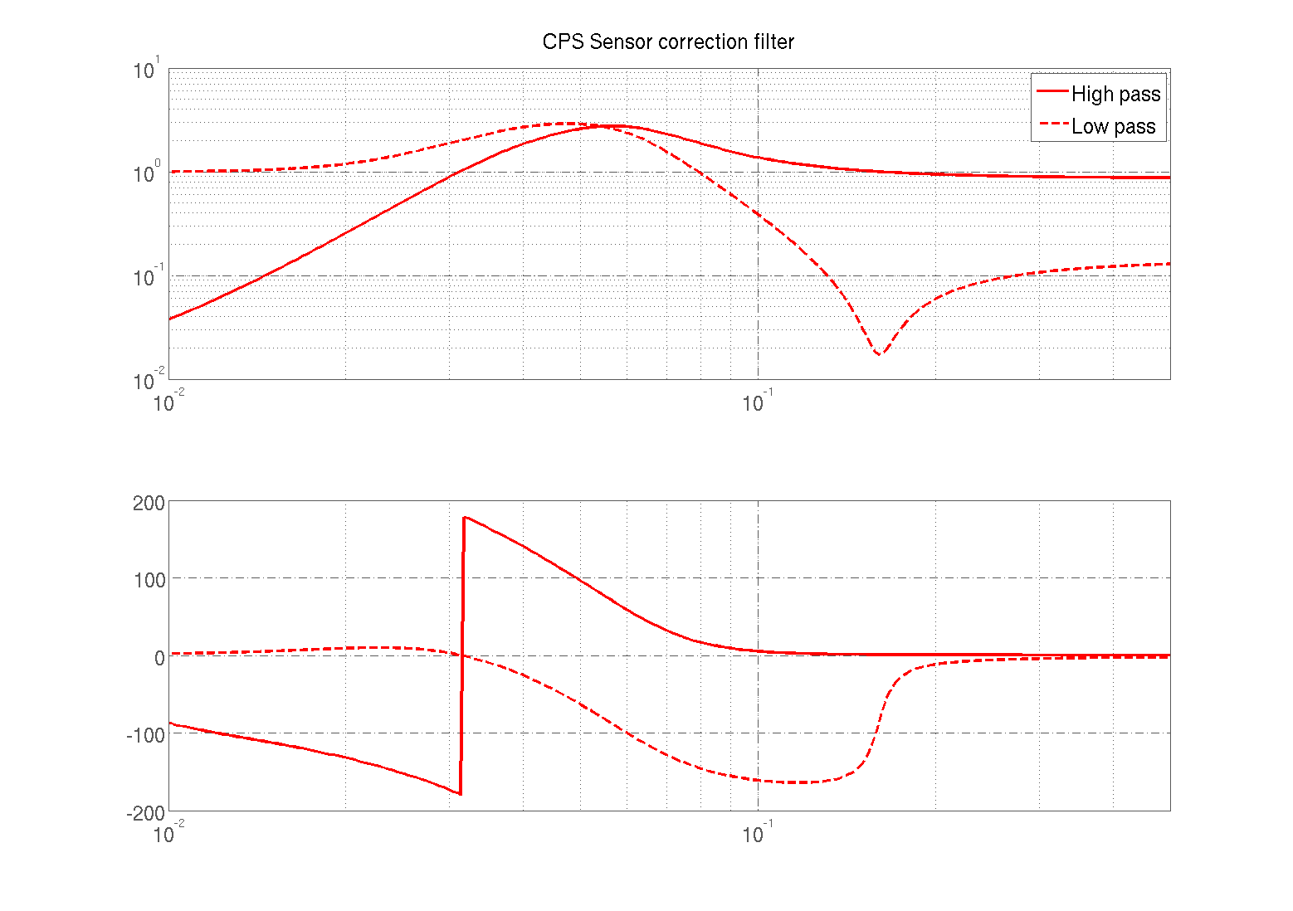
Sensor Correction filter

Slide 11
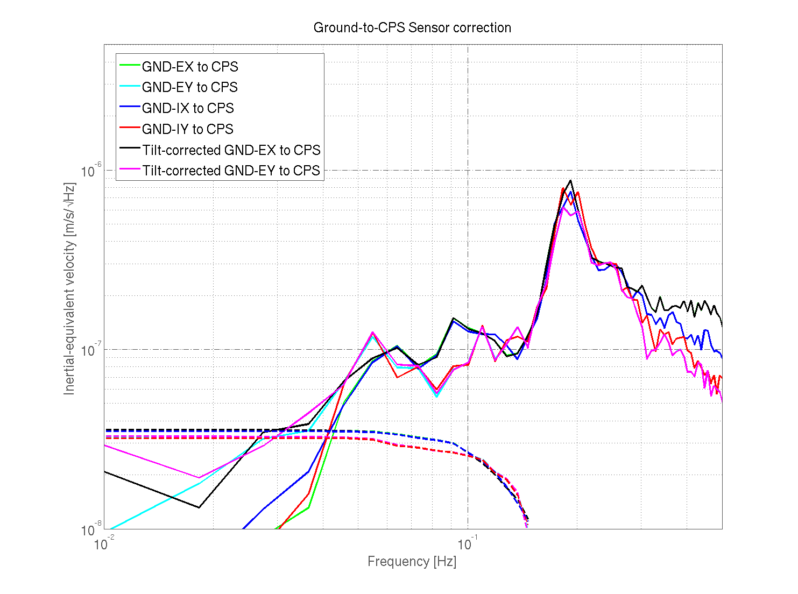
BRS impact, no wind (<4mph)

Slide 12
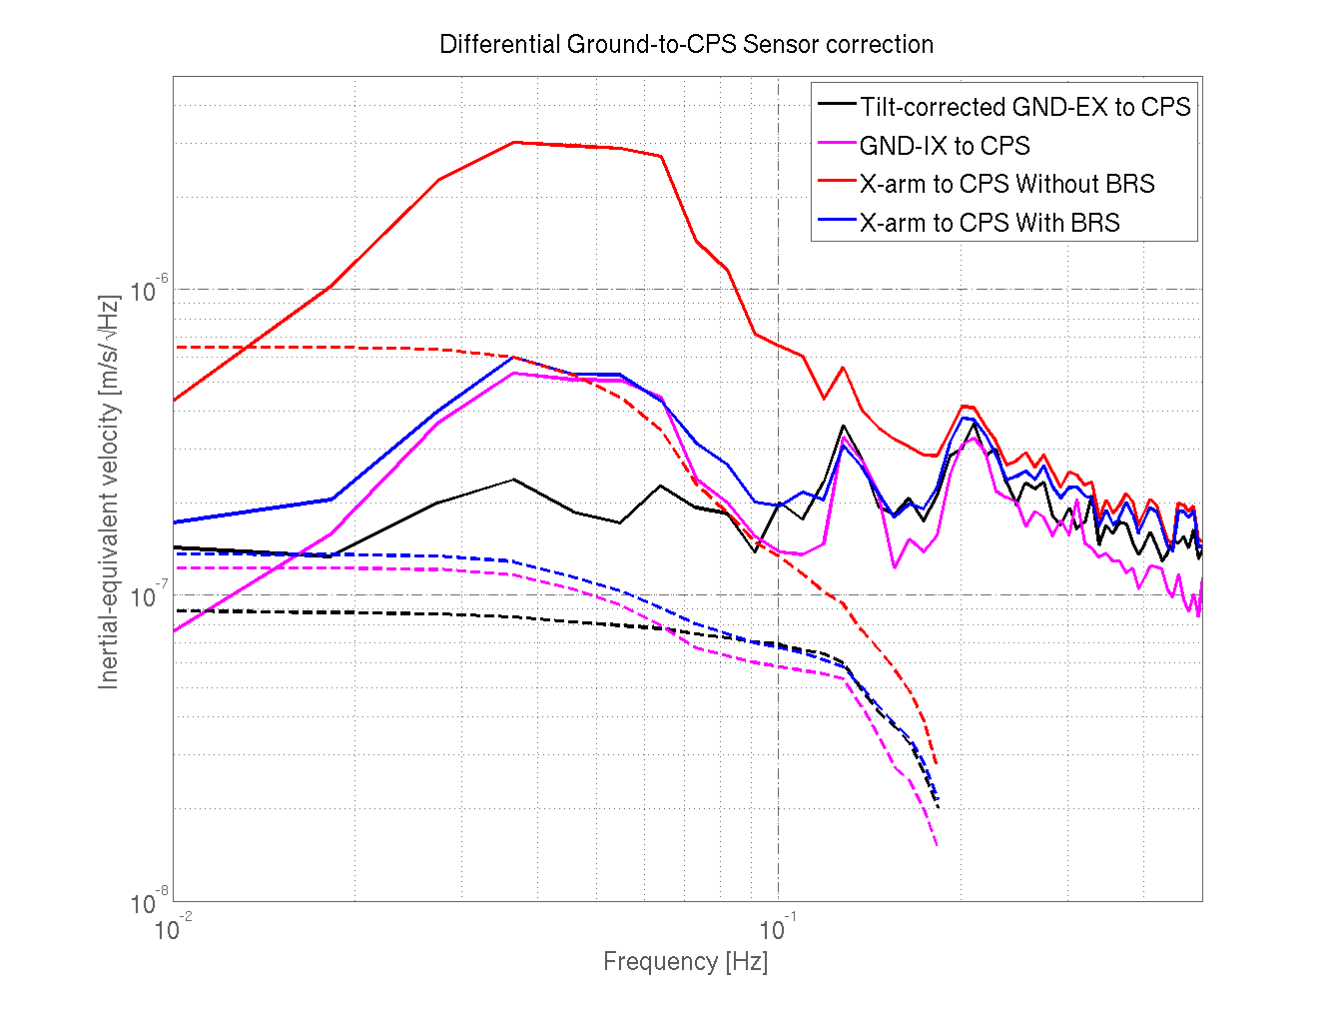
BRS impact, X-arm, high wind (~25 mph)

Slide 13
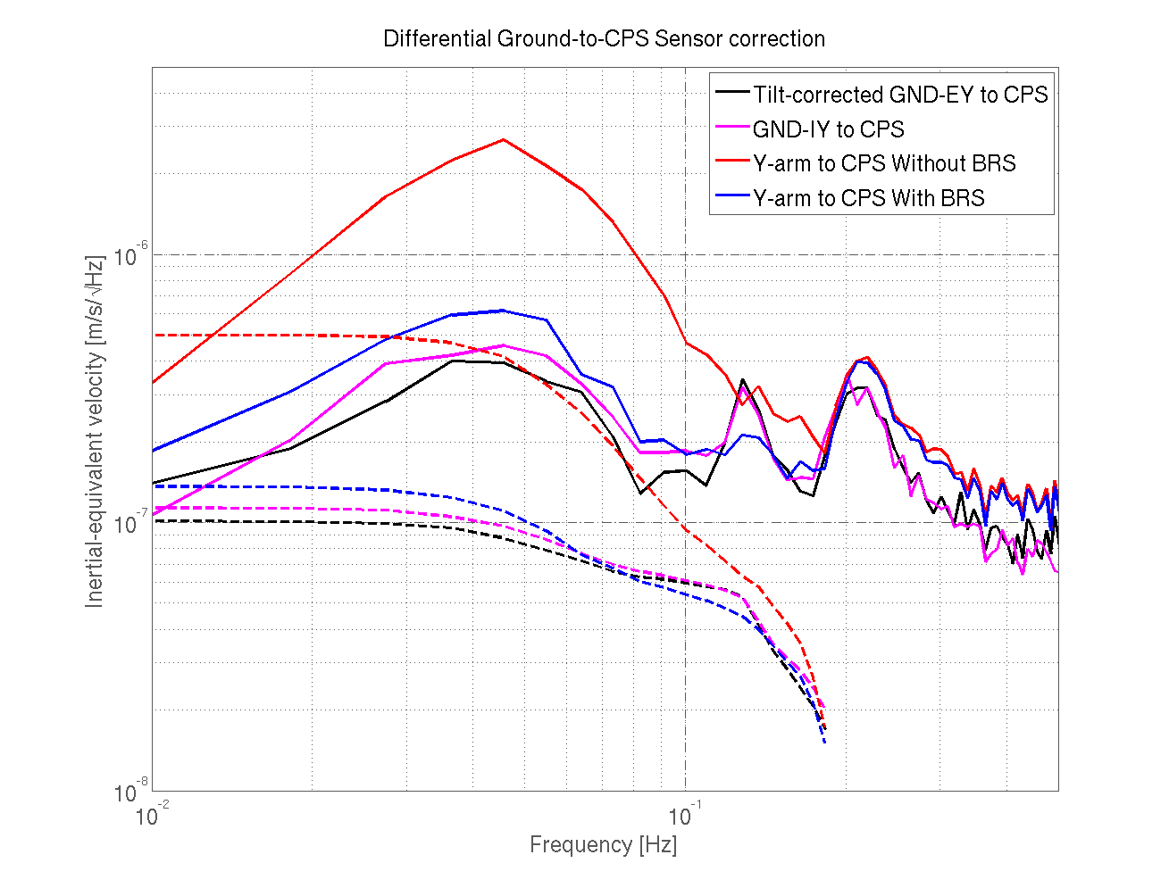
BRS impact, Y-arm, high wind (~25 mph)

Slide 14
Conclusions
The BRS does no harm, even with no wind.
At high winds, it provides ~a factor of 5 reduction in arm-length RMS velocity.
The low-tilt corner station STS2 is nearly as good as tilt-corrected ETMY in pretty high winds.
Identical Sensor correction filters in all corner-station horizontal-translation Stage-1 DoFs should result in substantially less differential motion.
Sensor correction and blending should be tuned using real data with high microseismic motion.

Slide 15
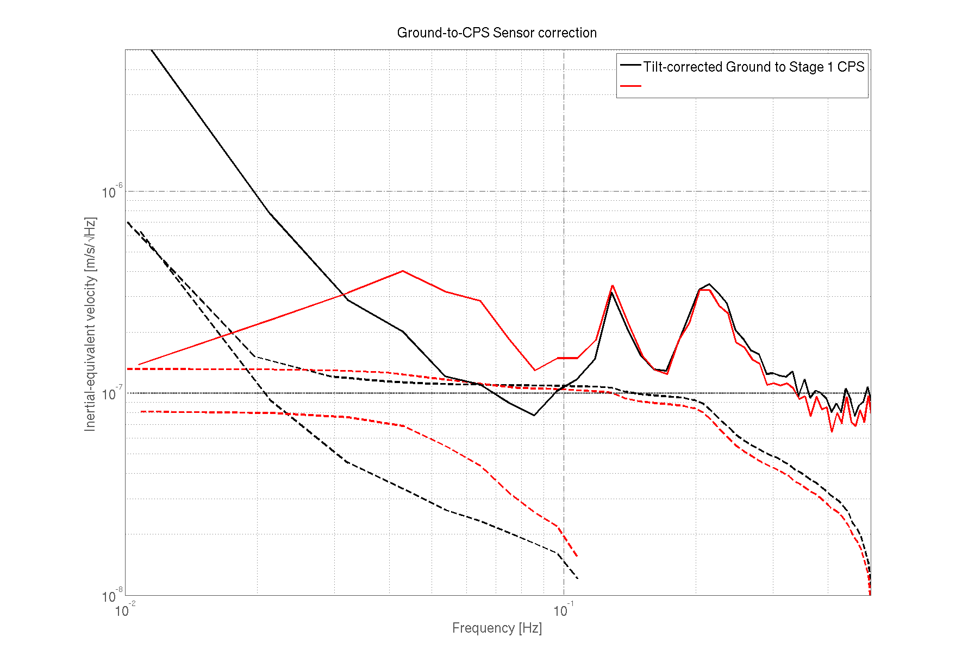
Does Sensor Correction help? (yes)
Tilt-corrected ground
After sensor correction filter

Slide 16
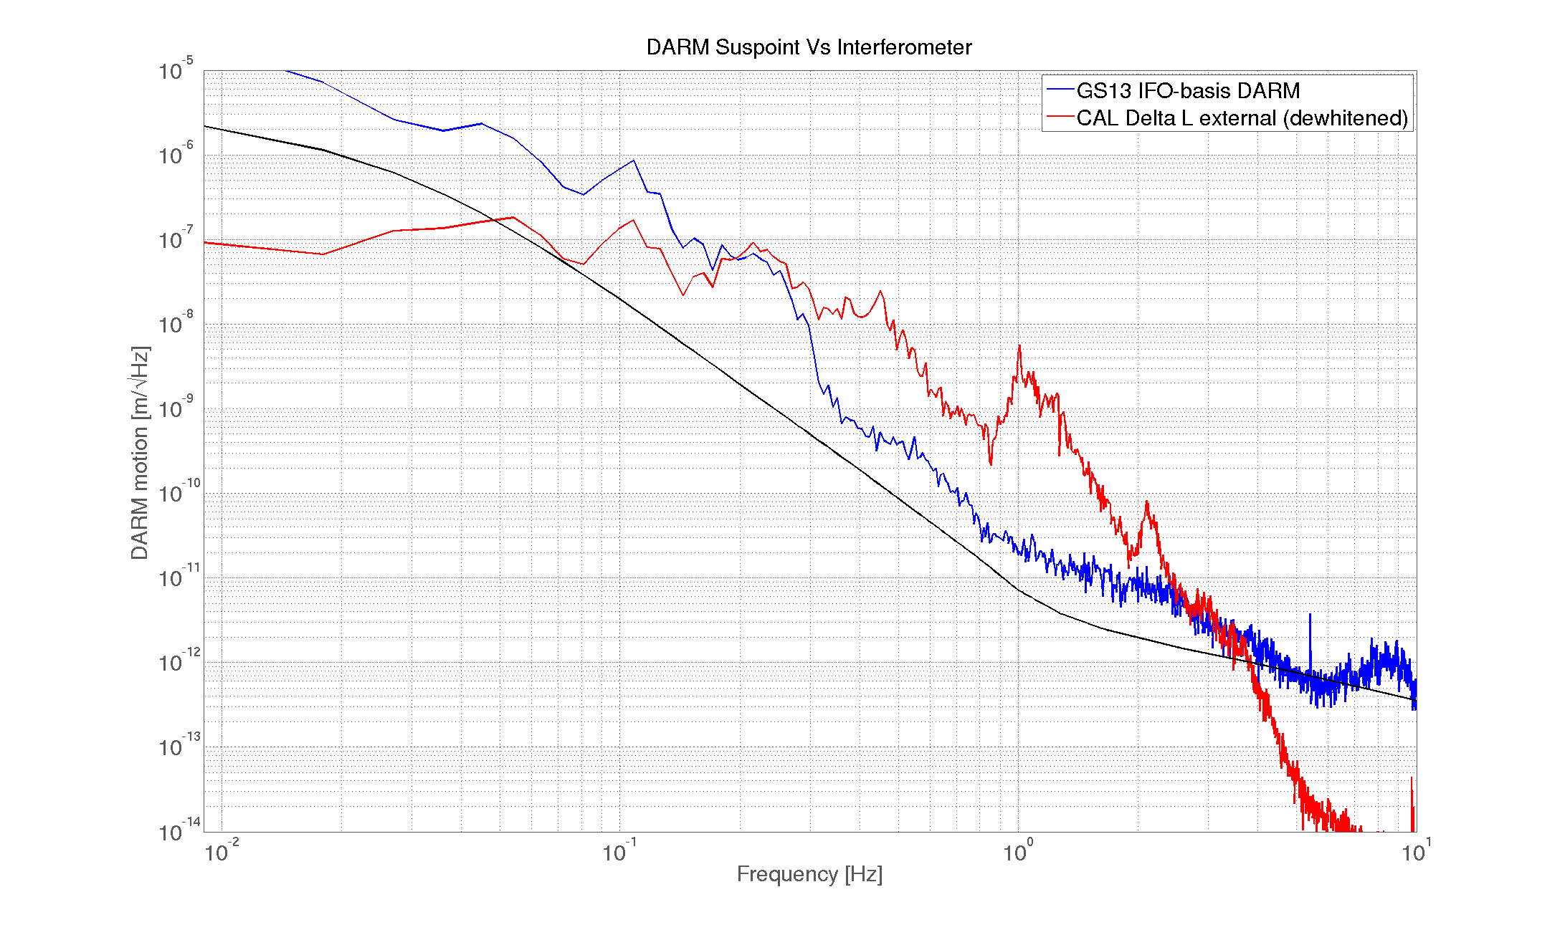
IFO-basis seismic motion is useful!

Slide 17
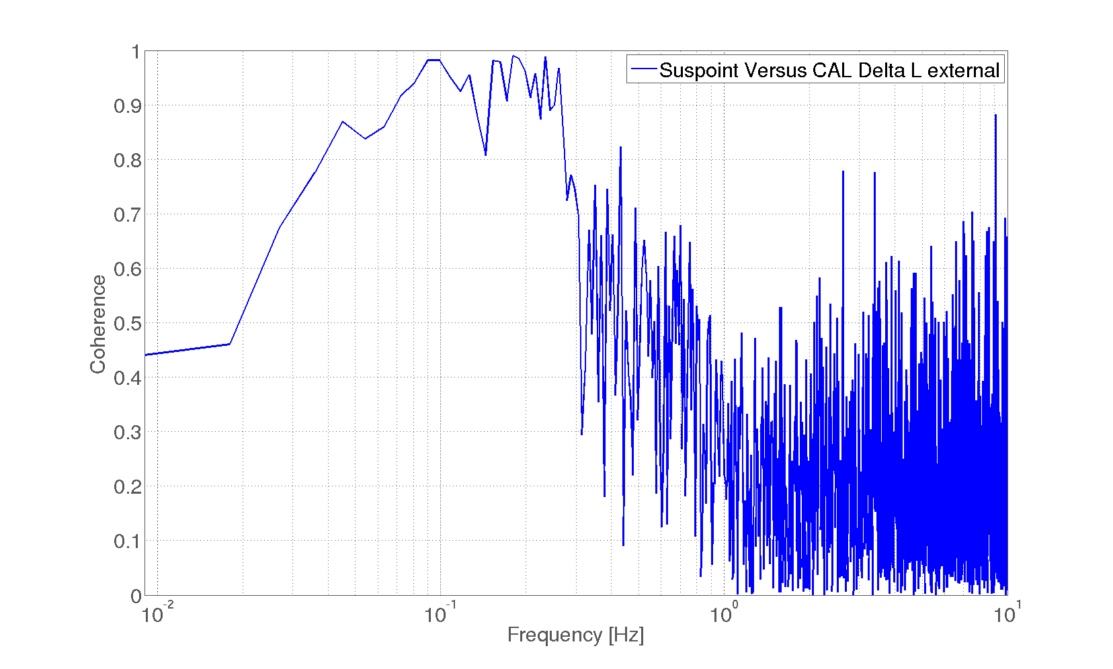
IFO-basis seismic motion is useful!

Slide 18
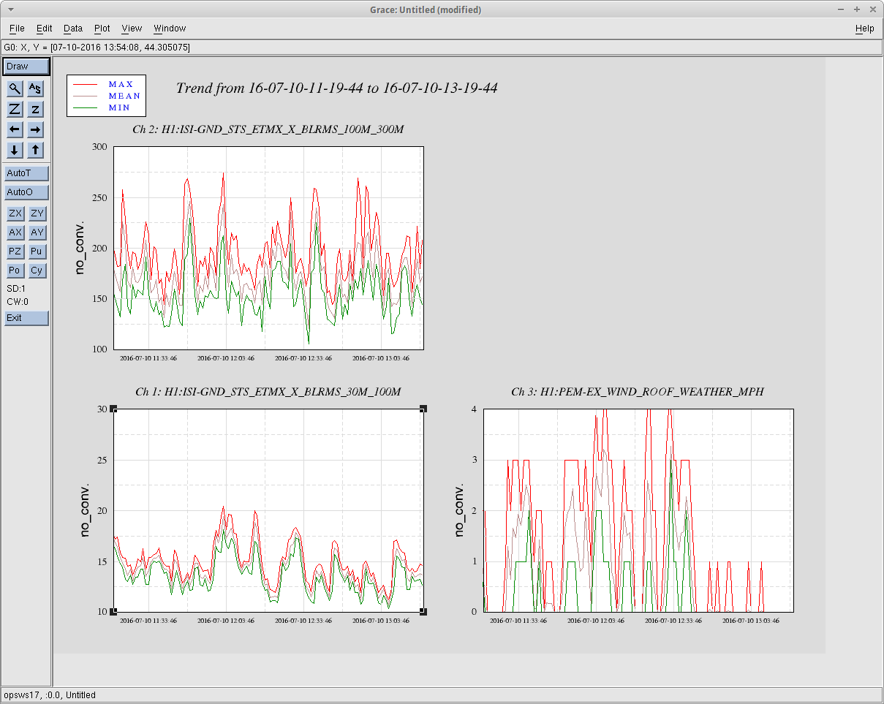
No-wind data
Tilt-corrected ground
After sensor correction filter

Slide 19
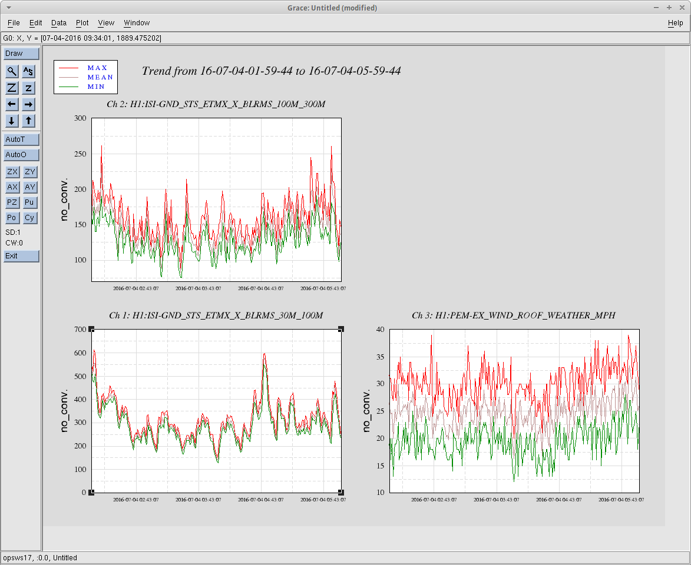
High-wind data
Tilt-corrected ground
After sensor correction filter

