Slide 1
Detector characterization
Lessons learned from O1 and preparing for O2
Jess McIver
TJ Massinger
for the DetChar group
LIGO DCC G1601646

Slide 2
Outline
Most problematic noise for the searches during O1
Overview of DQ vetoes applied during O1
Development towards O2

Slide 3
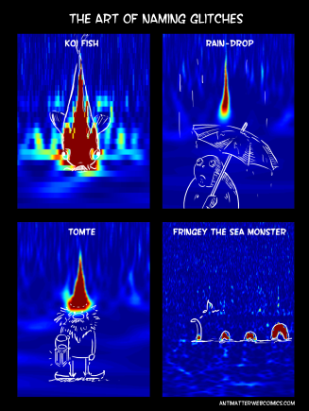
Most problematic noise for the searches during O1
Glitches
Combs
Breathing noise
Low-frequency noise
DetChar keeps track of this here: https://wiki.ligo.org/DetChar/WhiteBoard
N. Kijbunchoo

Slide 4
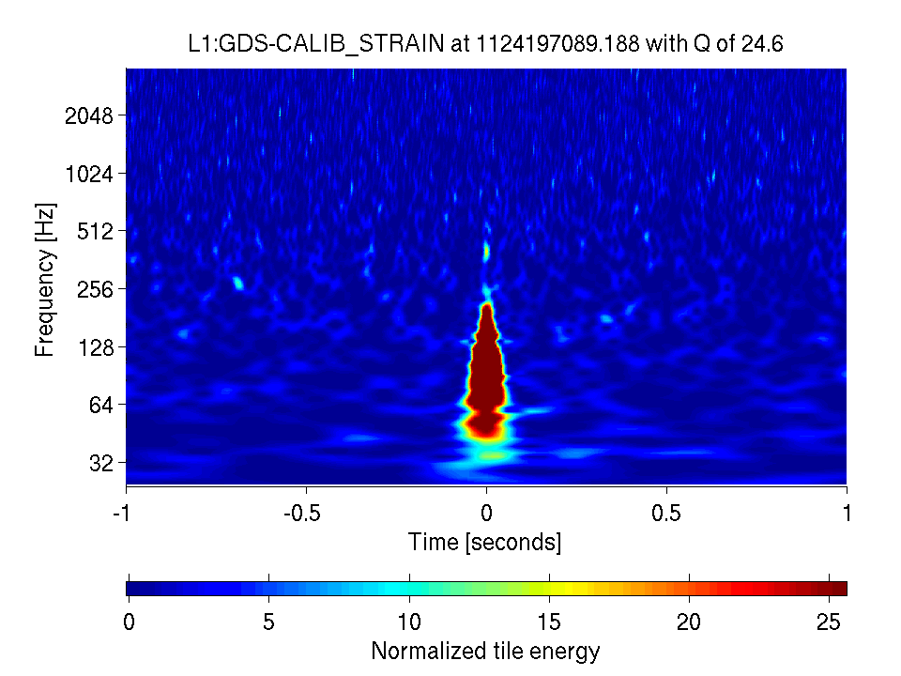
Blip glitches
#1 Most wanted
Summary
10ms or less in duration
16-1024 Hz
Appear in H1 and L1 ~1x/hour
Similar glitches seen in S6
Impact
Biggest contributor to CBC and burst backgrounds
What do we know?
No strong correlation with auxiliary channels
Multiple different morphologies (different time-frequency content)
These different classes potentially originate from different mechanisms
Studies by Miriam Cabero: G1600359, G1600583
They are consistent with the step response of a high-pass filter
Seen in both DCPDs simultaneously
Correlation with humidity reported at LHO: alog (Paul S, Robert, Jordan)

Slide 5
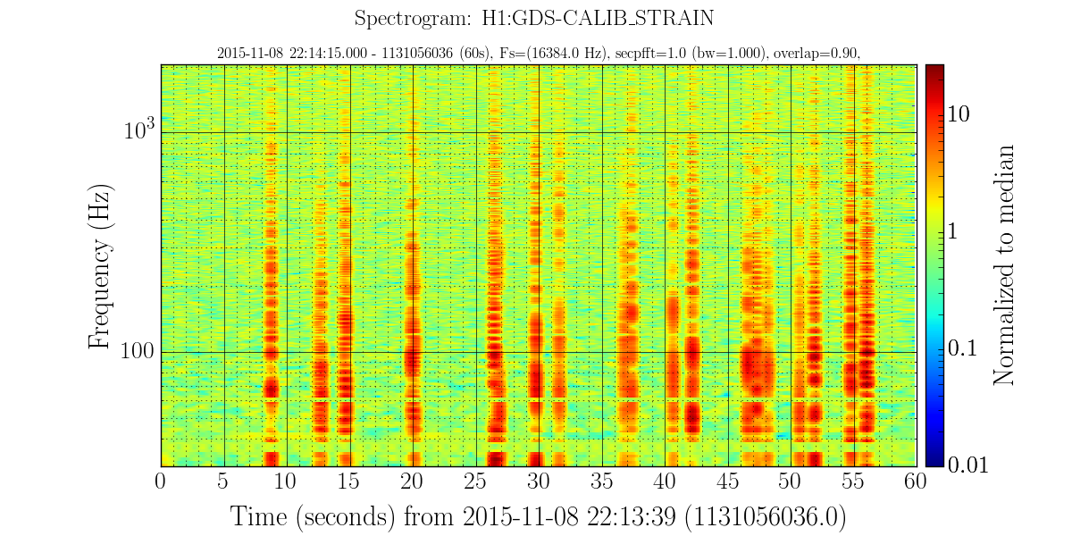
RF modulation
#2 Most wanted
Summary
Seen at LHO only
Shows up in demodulated photodiodes (9, 36, 45 MHz)
Seen in vertex DOFs (MICH, SRCL, PRCL)
Broadband h(t) pollution; makes data unusable for the astrophysical searches
Impact
Easy to veto, but costs a significant amount of coincident lifetime.
Seen hours before GW151226.
What do we know?
RF noise showed up in several demodulated photodiode signals throughout the run, but there was no consistent best witness channel: alog (TJ, Laura)
Next step tests: now that a stabilization box is also installed for 9 MHz, compare photodiode witnesses for 9 MHz and 45 MHz during a period of RF modulation noise

Slide 6
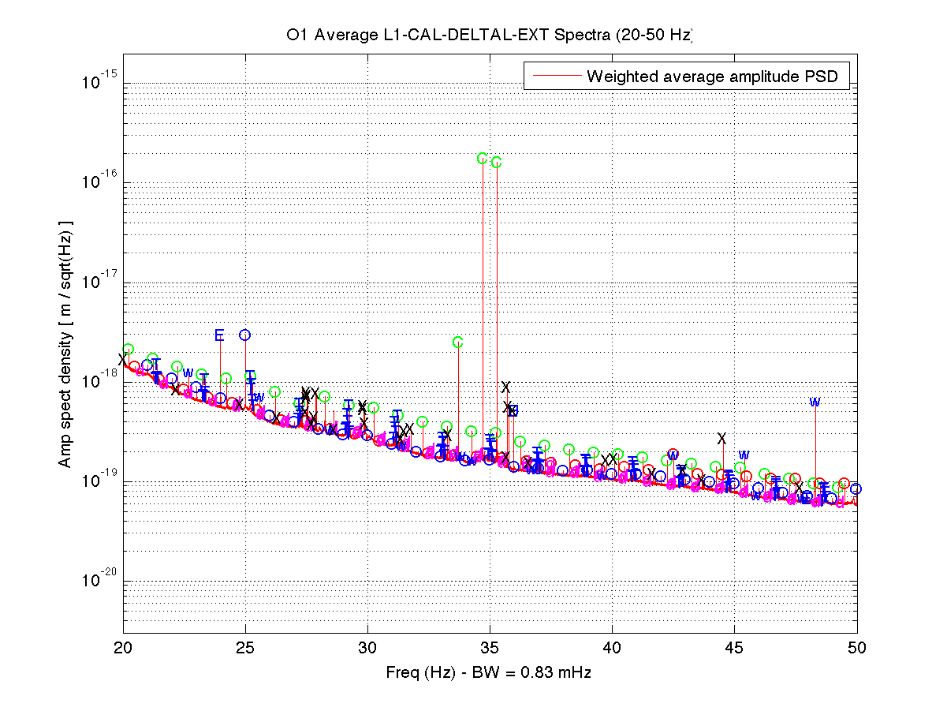
1 Hz combs
#3 Most wanted
Impact
Biggest contributor to CW and stochastic backgrounds; many frequencies need to be excised from the data.
Summary
Appear in intervals of ~1Hz at both L1 and H1 before, during, and after O1.
Line character has changed between iLIGO and aLIGO.
What do we know?
Summary of blinking LED interventions: alog (Keith R)
During O1 ~1 Hz combs were observed in L1 h(t) up to 113 Hz, with various offsets in rough multiples of 0.25 Hz: alog (Keith R)
~1 Hz combs also seen in H1 during O1, and new 1 and 2 Hz combs seen up to ~200Hz during ER9: alog (Keith R)
c= calibration line
O = 1 Hz comb (4 offsets)
w= 22.7 Hz & 25.6 Hz lines
E= ~12 Hz comb
X = single line
See talks by Keith, Ansel, Pat and Duo at the CW-Stochastic-Detchar session Monday afternoon

Slide 7
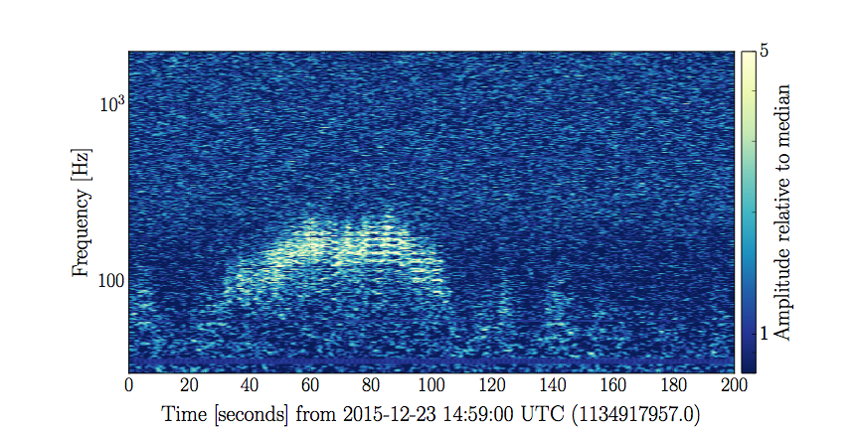
60-200 Hz non-stationary noise
#4 Most wanted
Summary
Observed in LLO data
Affects 60-200 Hz on the scale of minutes
What do we know?
It is actually composed of discrete glitches with a repeating structure of n*14Hz lines: G1601301
Shows up in bursts ~2 minutes long on the order of 1 per tens of minutes
Impact
Pollutes LLO data in a critical frequency range.
Contributor to CBC and burst backgrounds.
L1:GDS-CALIB_STRAIN

Slide 8
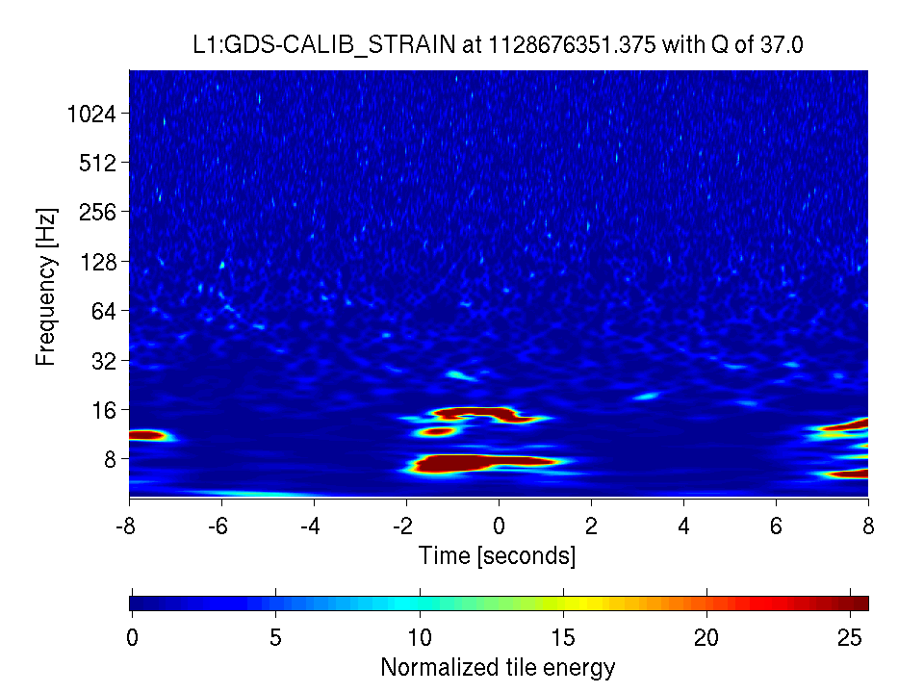
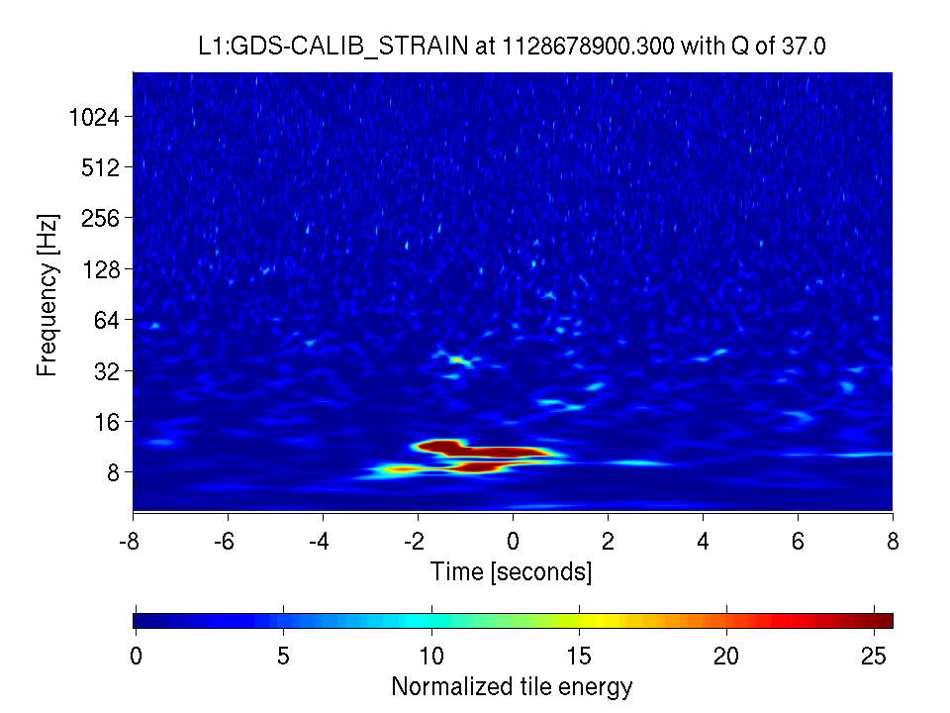
Low frequency glitching
#5 Most wanted
Summary
Observed below ~30 Hz at LLO starting in mid-October 2015
Two major morphologies: scattering and short duration ‘scratchy’ glitches
Impact
Pollutes the data at important frequency range for BBH parameter estimation.
CBC and burst searches will extend below 30 Hz.
What do we know?
Some correlation between rate of low frequency glitching and elevated ground motion, particularly the microseism band
The scattering below 30 Hz is sometimes well predicted by monitoring the motion of the major suspended optics. (Summary pages scattering monitor developed by Fullerton)
Will look for improvement now that new Faraday isolator is installed
40 min prior to LVT151012
Arches
Centered at the time of LVT151012
No arches
No correlation with optic motion

Slide 9
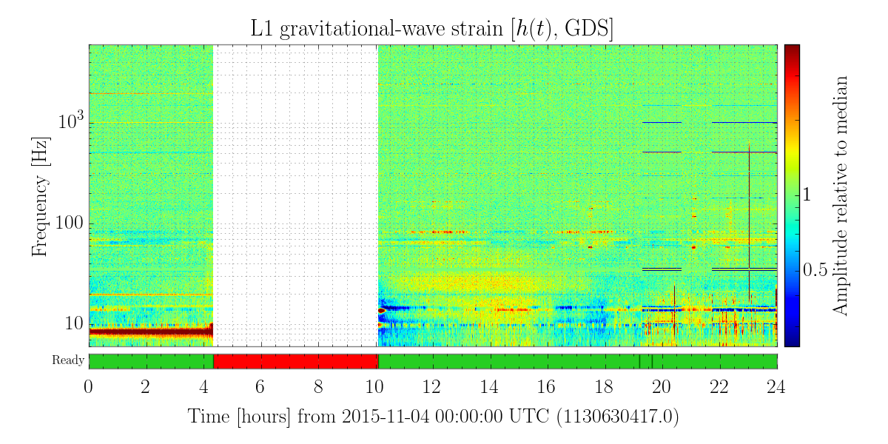
Breathing 55-90 Hz noise
#6 Most wanted
Summary
Seen in L1 data during O1.
Impact
Pollutes LLO data in a critical frequency range.
What do we know?
This appears as a long-duration effect (breathing in and out on the scale of minutes)
Given the timescale, some correlation with environmental effects is suspected
Slow-correlation tracker in development at Fullerton should help target this. (See slide 12)

Slide 10
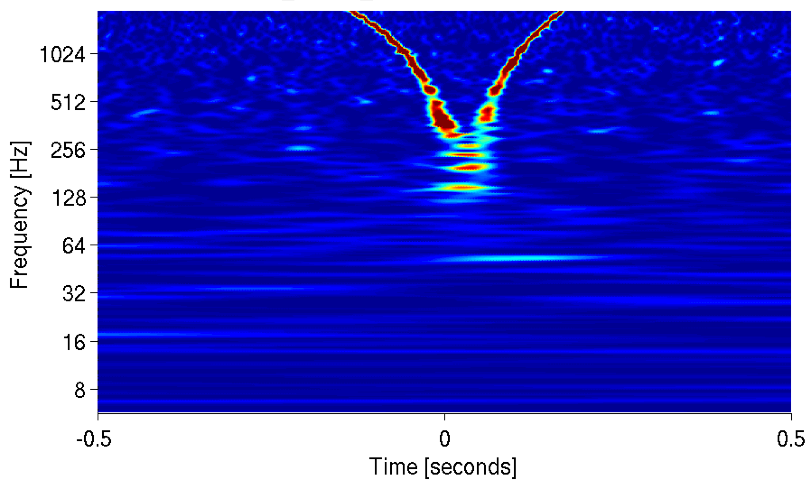
RF beatnotes
#7 Most wanted
Summary
Occur at both L1 and H1
Associated with RF beatnote between PSL VCO and stationary RF fields inside the PSL enclosure
Appear as a sweep down and up in frequency as the two beating frequencies cross
Impact
Occasionally pollute h(t) in the bucket
Pollute h(t) above 2 kHz at LLO
Constantly pollute auxiliary channels at both sites, hindering searches for other correlations
What do we know?
Recipe for mitigation of radiated RF fields at LLO: alog (Rich Abbott et al)
    Replace connections on phase frequency discriminator chassis
    Remove BALUN transformers for PSL, ALS DIFF, and ALS COM VCOs and ISS AOM
    Clip-on common mode choke on PSL VCO output

Slide 11
Overview of the DQ vetoes applied to the astrophysical searches during O1

Slide 12
“Category 1” vetoes
        Indicate some egregious issue with the data; this data is not analyzed.
        Applied to all searches (CBC, burst, CW, stochastic)
        Consequences: search pipelines require some minimum amount of continuous data for analysis.
              For PyCBC, this is more than 2000 seconds.
              One second of cat 1 veto could cost the better part of an hour.
        Examples from O1:
              LHO Y-end Beckhoff failure (1.5% deadtime)
              LHO RF modulations (~3% deadtime)
              Both sites: data just before lock-losses
              LLO PCal DC power fluctuations

Slide 13
“Category 2” vetoes
        Indicate some known instrumental problem that impacts the search backgrounds.
        Different searches use different category 2 vetoes
        Consequences: This data is still analyzed; any candidate signals found during these times would be rejected.
        Examples from O1:
              Both sites: ETMY SUS ESD saturations
              Both sites: OMC PD ADC overflows
              Hanford 10-30 Hz seismic noise (~0.4% deadtime)

Slide 14
Development towards O2

Slide 15
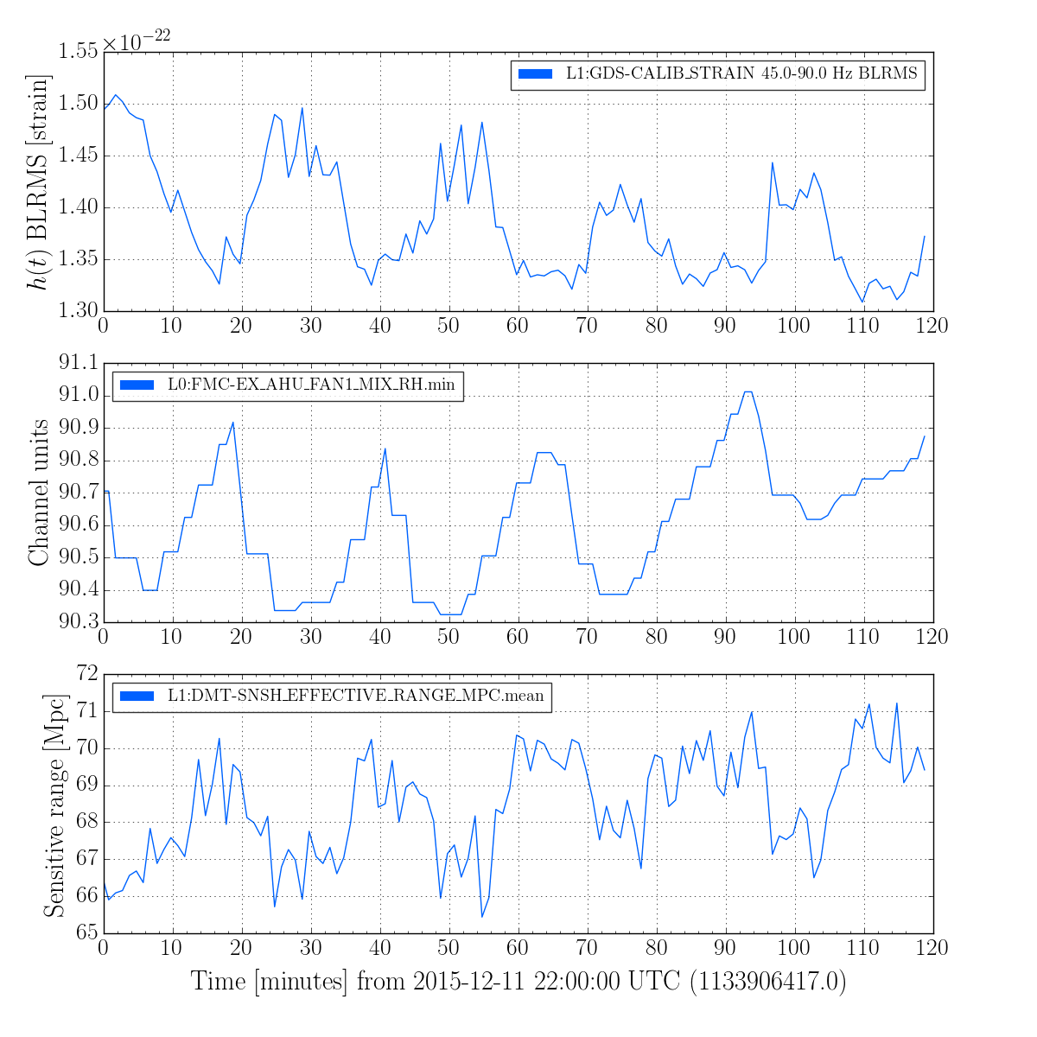
Slow correlation tracker
Isa Patane, Michelle Aleman, Josh Smith, CSU Fullerton
Uses a Pearson’s correlation coefficient to quantity correlation between band-limited RMS h(t) and many slow trend auxiliary channels
O1 examples produced for correlations between L1 h(t) and PEM channels and L1 h(t) and FEC channels: https://wiki.ligo.org/DetChar/O1NoiseBreathing

Slide 16
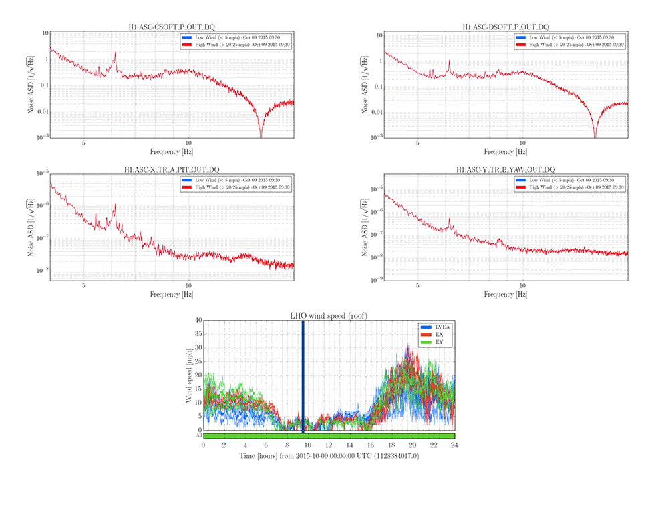
Studying seismic-ASC loop coupling
Michael Anita, TJ Massinger, Jess McIver, Paul Altin
Link

Slide 17
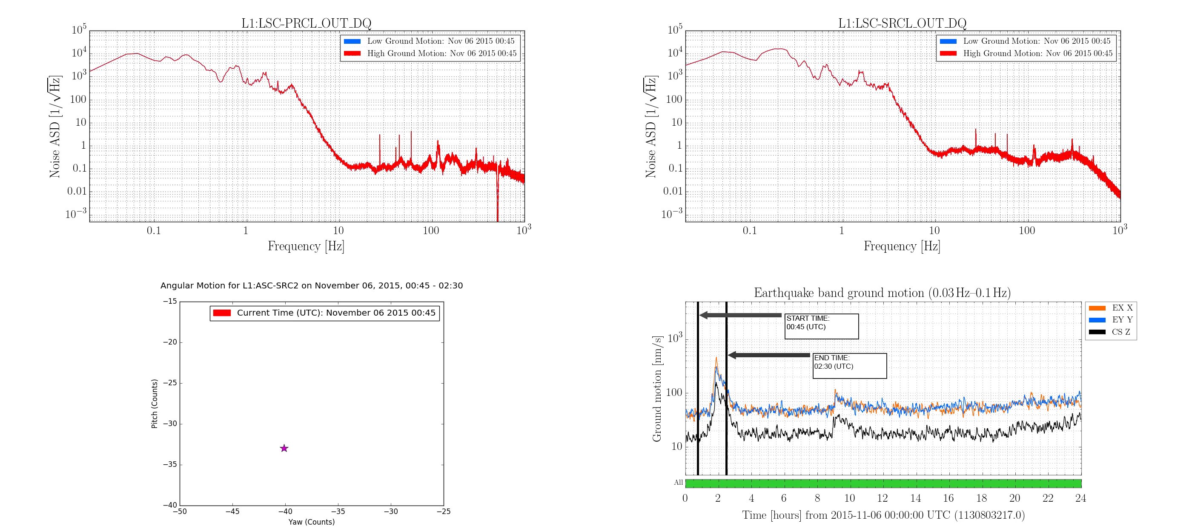
Studying seismic-ASC loop coupling
Michael Anita, TJ Massinger, Jess McIver, Paul Altin
Big pushes in angular control generate glitches in vertex DOFs
Link

Slide 18
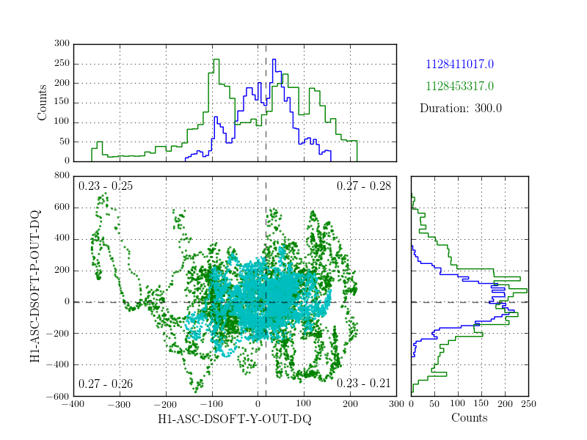
Studying seismic-ASC loop coupling
Michael Anita, TJ Massinger, Jess McIver, Paul Altin
Plotting ASC phase space for times of varying seismic noise
Low wind
High wind

Slide 19
Interacting with DetChar
Have a request for the summary pages?
        Sure! Please send it to detchar@ligo.org or file an issue here: https://git.ligo.org/detchar/ligo-summary-pages/issues
DetChar intends to communicate with the commissioning teams primarily:
            via the alogs
            on the Friday commissioning call
            through the subsystem leads
Who are the DetChar subsystem leads?
          https://wiki.ligo.org/DetChar/AligoSubsystemMatrix
Another link to the DetChar whiteboard:
https://wiki.ligo.org/DetChar/WhiteBoard

