Slide 1
Finite Element Analysis of the Third Generation Mirror Suspension System for Voyager
Joy Westland
Mentors: Alastair Heptonstall and Eric Gustafson
Central Washington University
California Institute of Technology

Slide 2
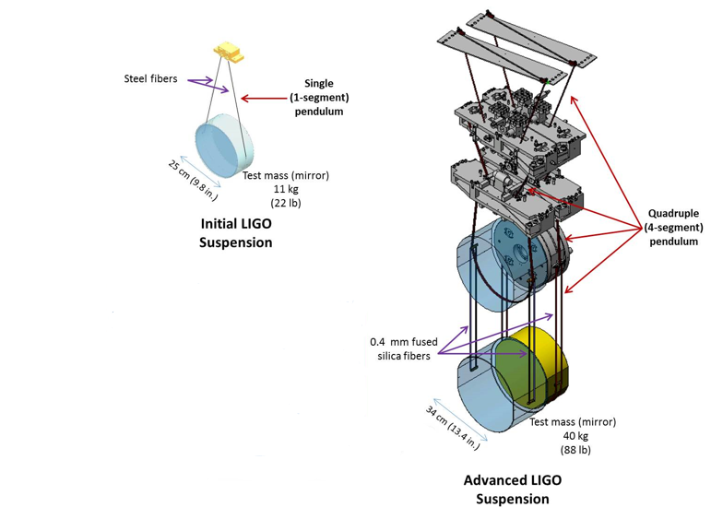
The Michelson Interferometer
LIGO is a Michelson interferometer measuring strain in space-time for GWs
Mirrors suspended to isolate from ground noise
Interferometer is so quiet that thermal noise from mirrors and their suspension is a significant noise source
aLIGO has quad suspension systems to decrease Thermal Noise (TN)
4 stages 1/f² per stage seismic isolation
Fused silica fibers replace metal fibers
Mirror mass is increased from 11 kg to 40 kg
Passive and Active isolation
Figure 1: iLIGO vs. aLIGO suspension systems provided by LIGO Caltech Laboratory. https://www.ligo.caltech.edu/page/about-aligo

Slide 3
Thermal Noise
Thermal Energy is stored in translation, vibration, and rotation of atoms
Brownian motion: Random motion of particles
Thermal fluctuations
Thermally induced motion of test mass
Fluctuation Dissipation Theorem: Relationship between power spectral density of a thermal driving force to the dissipative part of the mechanical impedance (Callen and Welton)
Friction in the test mass
Internal damping inside test masses
Vibrations that drown out signals of GW
Future GW require lower Thermal Noise
Finite Element Analysis (FEA) will be used to investigate thermal noise in the suspensions
$$Sx\left(ω\right)=\frac{4k_{B}T}{ω2}R\left[Y\left(ω\right)\right]$$
Where: $Y=\frac{1}{Z}$

Slide 4
Finite Element Analysis
Finite Element Analysis: Numerical technique to approximate real world situations given a set of boundary conditions for a specific model
Accurate representation of complex geometry
Understanding physical reality computationally
Program: ANSYS Computer-aided engineering software
SolidWorks

Slide 5
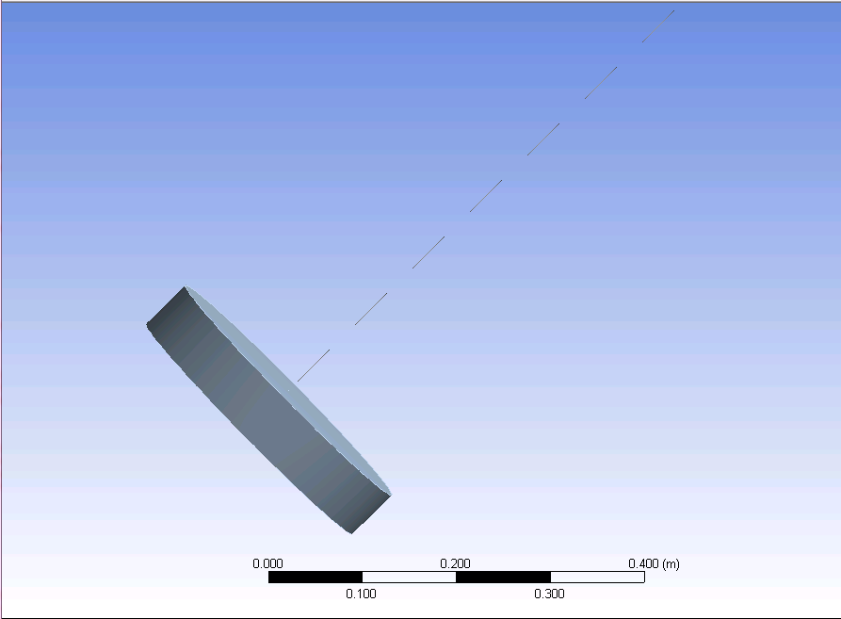
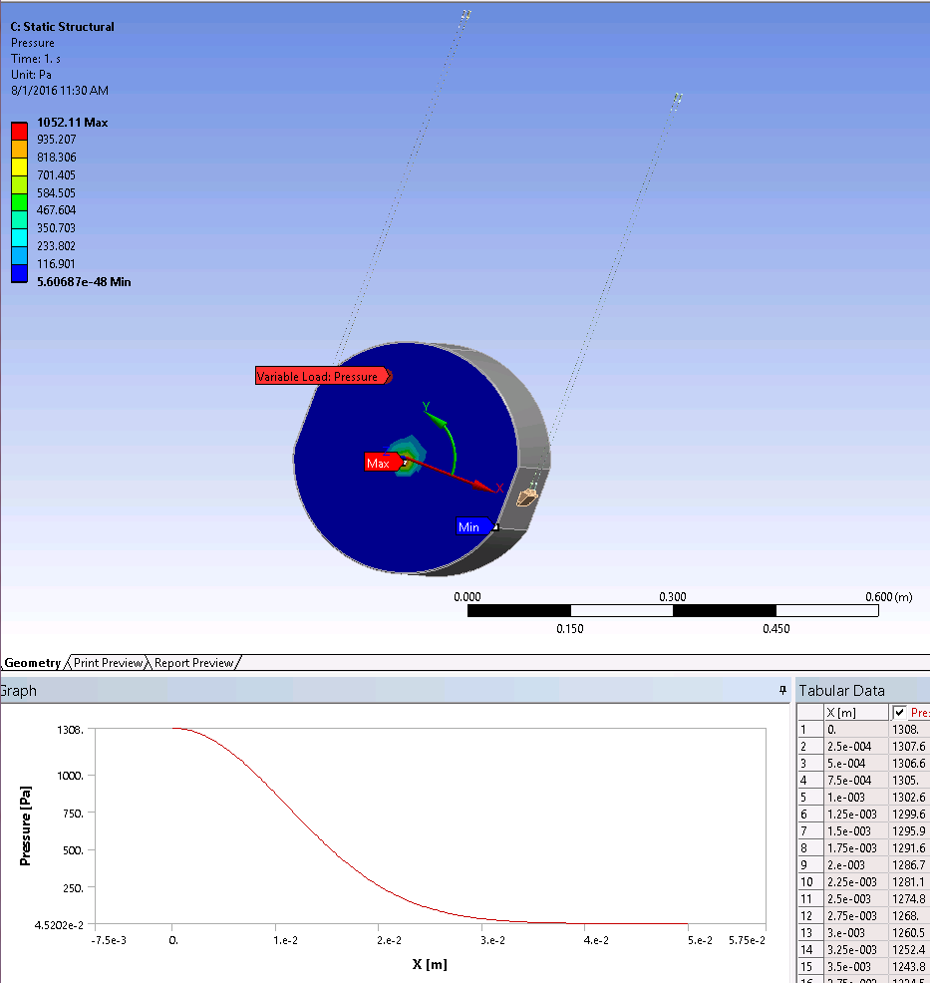
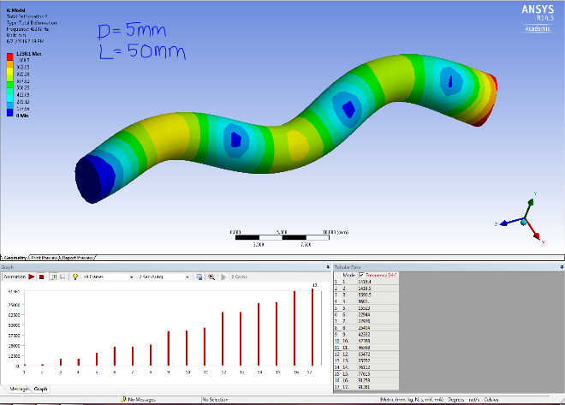
Increasing Complexity of Models in ANSYS
Cantilever Bar measuring the mode frequencies
Simple Pendulum Calculating the violin modes
Lower mass suspension system with wires and ears

Slide 6
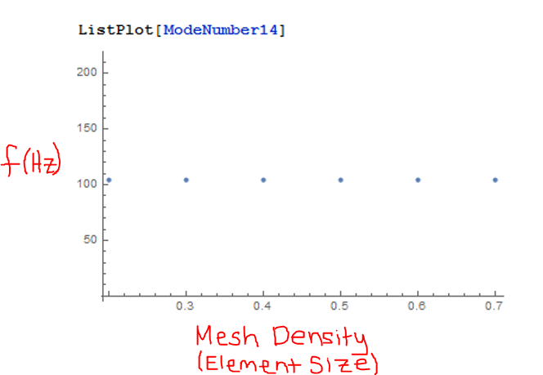
Calculating and Comparing Violin Modes of a Clamped Pendulum
Convergence of Meshing:
Meshing element size and the frequencies associated with each mode.
Look at the consistencies and what element size have all the frequencies converging at.
Equation for Violin Modes
$fn=\frac{n}{2l}\sqrt{\frac{T}{ρl}}[1+ \frac{2}{l}\sqrt{\frac{EI}{T}}+\frac{EI}{2T}\left(\frac{nπ}{l}\right)2]$
Where: $fn \text{is} \text{the} \text{frequency} \text{of} \text{the} \text{nth} \text{mode}$, $T$ is the tension in the wire, $l$ is the length of the wire, $I$ is the moment of cross section ($I= \frac{π}{64}d4$) for cylindrical, $E$ is Young’s Modulus of Elasticity, and $ρl$ Linear Density (mass per unit length)
Figure 2: Convergence element meshing
Figure 3 Comparison of violin modes (Analytical and Computational)

Slide 7
Levin Formulation
The Levin formulation of the fluctuation-dissipation theorem allows direct calculation of the thermal noise
Apply a pressure that mimics the light beam intensity
Gaussian profile
Thermal Noise: $Sx\left(f\right)=\frac{2k_{B}T}{π^{2}f^{2}}\frac{W_{diss}}{{F_{0}}^{2}}$
Strain energies calculated using ANSYS can be used to find the total energy dissipated in the wires
$φ_{total}=\frac{E_{wire}}{E_{total}}φ_{wire}$ where: $φ_{wire}={10}^{−7}$
$W_{diss}=E_{wire}φ_{wire}$

Slide 8
Applying a Gaussian Force
A Gaussian Pressure was applied to the face of a test mass. The strain energies were recorded.
Static Structural Model
$f\left(r\right)= \frac{1}{π{ro}^{2}}e^{\frac{−r^{2}}{{ro}^{2}}}$
Where:
$ro$ is 1.56 cm or 0.015 m.

Slide 9
Acquiring Strain Data
Model uses lower mass with wires and ears. Gravity is applied, and a force with a pressure integrated to 1/100 N was applied on the face of the test mass. The wires were fixed at the top.
Situation | Strain Energy (J)
Whole Part | 1.2117243
Test Mass Only | 1.1207E-05
Both Ears Only | 1.106E-04
Wires Only | 1.21160259

Slide 10
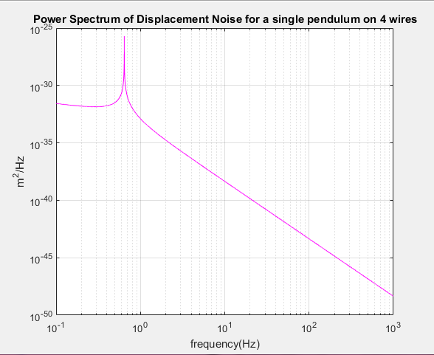
Calculation of Thermal Noise
Using Modal Summation
$S_{x}\left(ω\right)= \frac{4k_{B}T}{ω}\frac{φ(ω){ω_{0}}^{2}}{m[{ω_{0}}^{4}φ\left(ω\right)2+\left({ω_{0}}^{2}−ω^{2}\right)2]}$
The Power spectrum of the displacement noise was calculated analytically
Q factor decreases at low temperature Fused Silica
Mechanical loss increases

Slide 11
Research Goals for the Future
Calculate the thermal noise using the Levin approach in order to compare and contrast different materials for realistic 3rd generation suspensions
This is through calculating W_diss
Build a physical full fledge mirror suspension system
FEA can be used for thermal analysis of cryogenically cooled mirrors
Investigate different material choices such as silica and silicon

Slide 12
Conclusion
We have been able to model the final stage in ANSYS and compare frequencies to an analytical model
Using ANSYS static structural model we can extract the strain energy in the wires
We have used a basic modal summation method to give approximate measure of noise in room temperature fused silica suspension

Slide 13
Acknowledgements
Mentors: Alastair Heptonstall and Eric Gustafson
Alan Weinstein
National Science Foundation
Caltech LIGO SURF
References
https://www.ligo.caltech.edu/page/about-aligo
Callen, H. B., & Welton, T. A. (1951). Irreversibility and Generalized Noise. Phys. Rev. Physical Review, 83(1), 34-40. doi:10.1103/physrev.83.34
Heptonstall, A. W. (2004). Characterisation of Mechanical Loss in Fused Silica Ribbons for use in Gravitational Wave Detector Suspensions (Unpublished master's thesis). University of Glasgow.
Levin, Y. (1998). Internal thermal noise in the LIGO test masses: A direct approach. Physical Review D Phys. Rev. D, 57(2), 659-663. doi:10.1103/physrevd.57.659
Robertson, N. A., Cagnoli, G., Crooks, D. R., Elliffe, E., Faller, J. E., Fritschel, P., . . . Willems, P. (2002). Quadruple suspension design for Advanced LIGO. Class. Quantum Grav. Classical and Quantum Gravity, 19(15), 4043-4058. doi:10.1088/0264-9381/19/15/311

