Slide 1
Introduction to the Control System Working Group (CSWG)
Brett Shapiro
For the CSWG
29 August 2016 – Glasgow, Scotland

Slide 2
Control System Working Group (CSWG)
Chair: Dennis Coyne.
Deputy co-chairs: Brett Shapiro, Robert Ward.
Group charter at M1600033

Slide 3
CSWG Role
The CSWG is unique among working groups
Feedback control “is pervasive within, and enabling to, the work of many of the other instrument science working groups.”
It’s relevance is demonstrated through application to the other working groups.

Slide 4
CSWG Role
Support of other groups
training references: G1600726, G1601640, G1601417, G1600525, G1400557, G1400102
support of particular problem areas
reviews on the applicability of new controls techniques
Research into advanced techniques
Machine learning
Feedback optimization (automated design)
etc

Slide 5
5 current focus areas identified
5 problem/focus areas identified to support CSWG’s role
Get involved in these focus areas!
IFO lock maintenance with machine learning
Test mass length-to-angle decoupling
Feedback optimization
Transfer function fitting algorithms
IFO earthquake robustness

Slide 6
5 current focus areas identified
Machine Learning for lock maintenance
Leader - Rob Ward
Use an algorithm to ‘learn’ the best way to maintain lock
See example of acquiring a Bose-Einstein condensate
P. B. Wigley, et al. Fast machine-learning online optimization of ultra-cold-atom experiments. Scientific Reports, 2016; 6: 25890
Test mass control
Test mass

Slide 7
5 current focus areas identified
Length to angle decoupling
Leader – TBD
Separate the problems of controlling cavity length and alignment. Alignment control is currently suboptimal and contributing noise to the IFO.
Length control drive
Test mass

Slide 8
5 current focus areas identified
3) FB optimization (esp. applied to angular controls)
Leader – TBD
Collaboration with UC Berkeley and Google
Cost function
Control Filter
Optimization Algorithm:
Monte carlo, particle swarm, gradient descent, etc
Cost
Magnitude
Parameters
e.g. filter poles and zeros
Frequency

Slide 9
5 current focus areas identified
4) Transfer function fitting algorithms
Leader – TBD
Motivation: G1601173 - Hopes and Dreams: One TF Fitting Program to Rule Them All
Various tools exist: vectfit, n4sid, etc. How to best apply them? Do we need something new?
Part of a more general topic of experiment design and system identification
Quad Pitch TF Fit
Model
rad/Nm (dB)
Measurement
Frequency (Hz)

Slide 10
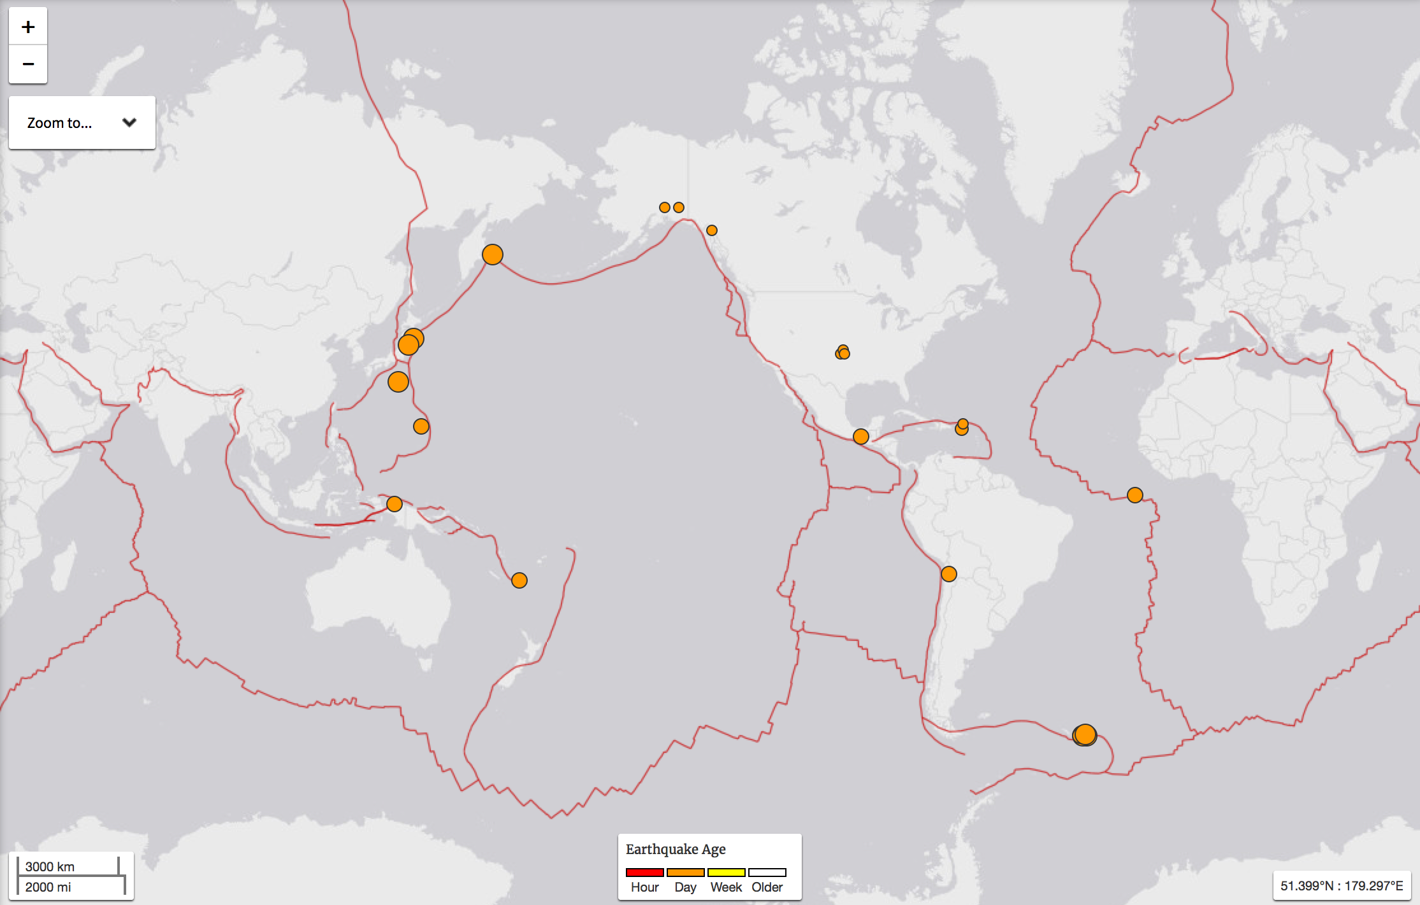
5 current focus areas identified
5) IFO robust configuration for earthquakes
Leader – Sebastien Biscans
We already receive early warnings. How best to configure the IFO to not loose lock?
Earthquake map – 22 August 2016
USGS

Slide 11
Additional Focus Areas?
The CSWG is not restricted to these 5 areas
Please suggest any other areas the CSWG should prioritize

Slide 12
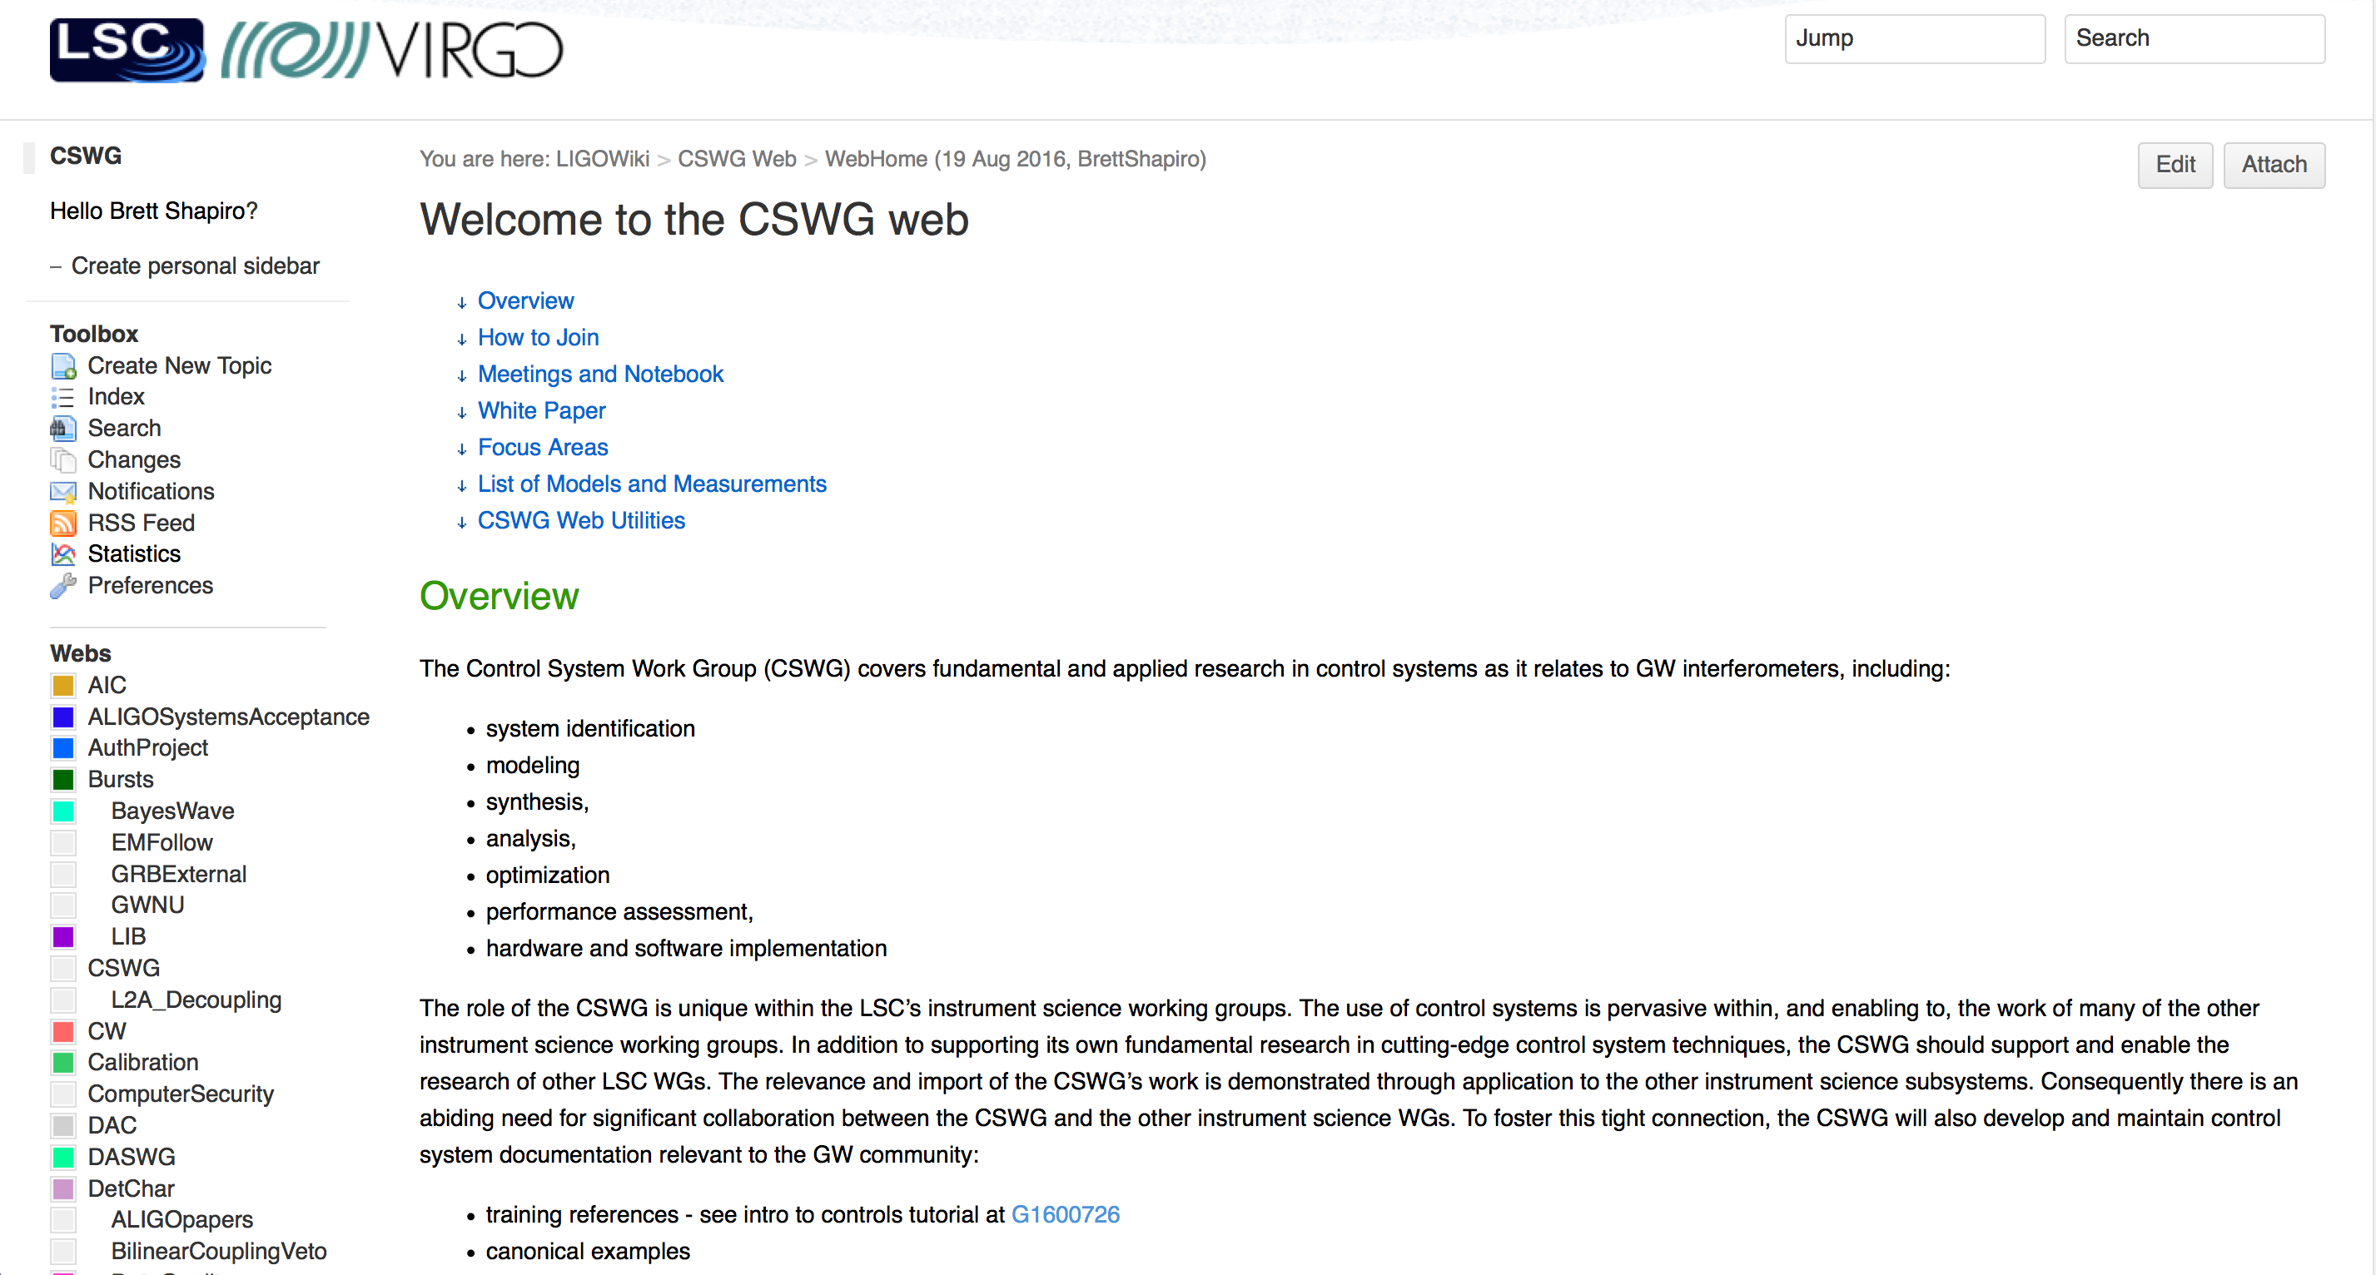
CSWG Wiki
https://wiki.ligo.org/viewauth/CSWG/WebHome

Slide 13
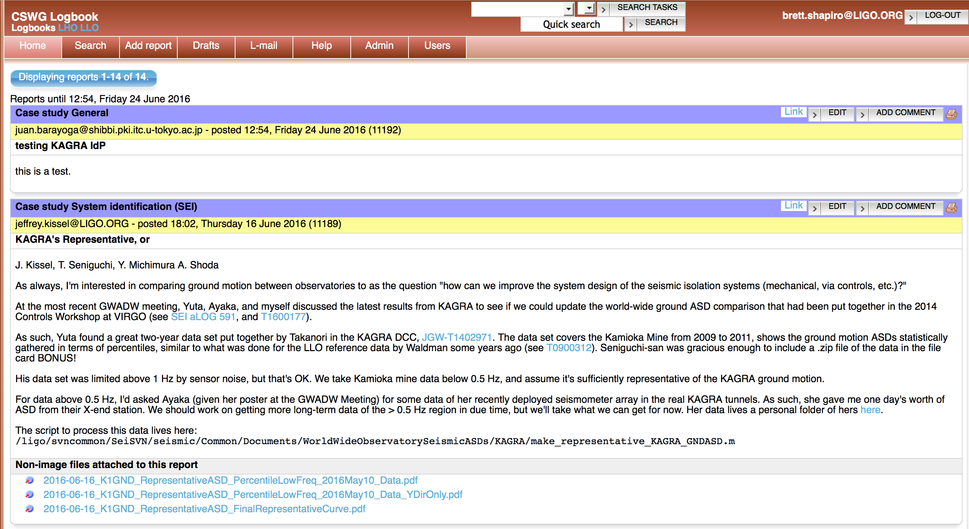
CSWG tools
alog
https://alog.ligo-la.caltech.edu/CSWG/
Mailing list: cswg@sympa.ligo.org
Sign up at https://grouper.ligo.org/mailinglists/cswg
Teamspeak channel: CSWG

Slide 14
Meetings
Bi-monthly Teamspeak meetings
US-western hemisphere: 1st Fri of the month, 9am US-PT (6pm CET, 9:30pm IST)
US-eastern hemisphere: 3rd US Thu of the month, 4pm US-PT (Fri 9am AET, 8am JST, 4:30am IST)

