Slide 1
Visual Timeline for
SR3 ROC Actuator
Outgassing Testing
Re: ICS BAKE-8278
Supplement to T1600401-v2
Stephen Appert
14 Apr 2017

Slide 2
SR3 ROC Actuator
Development Background Info
SR3 ROC Actuator: D1500258-v7 (production)
Qty 6 of D1500258-v7 have been fabricated and built, and as of 14 April 2017:
  Qty 4 currently at sites
  Qty 2 currently at CIT
    Qty 1 used in various testing in Thomas Lab
      Thermal resistance / impact of thermal gasket
      Effect of flexure loading
      Input Power vs Temperature
    Qty 1 used in outgassing evaluation in C+B Lab

Slide 3
SR3 ROC Actuator
Outgassing Testing Overview
Initial Testing
Table and Charts of ICS Bake-8278 Parameters
Problems with VBO F
2016
September
Start Again, now in VBO D
Outgassing Results while:
Operating Assembly in VBO D (ICS Bake-8278)
(TIMELINE)
Open VBO D for install of fixture
Outgassing Results while:
Operating Heater Plate only,
in VBO D (ICS Bake-8278)
2017
April (present)
Open VBO D for isolation of heater plate

Slide 4
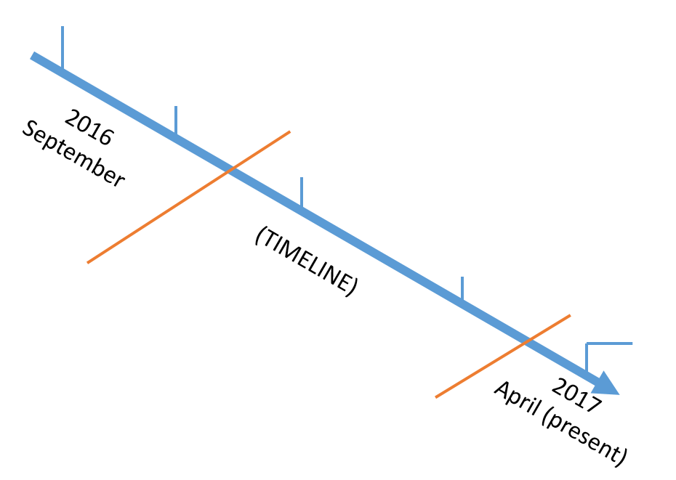
Initial Testing
Back to Overview
Heater off
12 hrs at 50° C, then rest to room temp and scan
VBO F
Start
Metallic Parts
Bake-8172
Assembled D1500278-v7
Polymer/Low Temp Parts
Bake-8222
Bake-8223
Standard E960022 Processing
Problems with VBO F
Bake 8237
Empty VBO F with shelf
48 hrs at 200° C
End
SERIES OF TESTS TO DETERMINE SOURCE OF LEAK SYMPTOMS
INCLUDED BAKEOUT OF OVEN, SHELF, FEEDTHRU (BACKGROUND)
WIRE SEAL ON OVEN F DETERMINED TO BE LIKELY SUSPECT
Decision made to transfer experiment to VBO D

Slide 5
Initial Testing
Back to Overview
Before ICS-8278, there were a number of efforts to evaluate outgassing of the SR3 ROC
Dates and Bake Loads include the following:
  For initial Class A clean and Bake loads of piece parts, refer to Bake-8172 and Bake-8222 in ICS.
  For Initial Bakeout, then RGA scans (heater off) refer to Bake-8223.
  After Run 00, Dennis and Calum requested a Hot Bake (200°C over 48 hours) of the oven and shelf with no D1600090 feed thru. This bake is found at Bake-8237.

Slide 6
Problems with VBO F
Back to Overview
SERIES OF TESTS TO DETERMINE SOURCE OF LEAK SYMPTOMS
  Bakeout of oven + shelf to try to establish a clean background were not successful
Wire seal on VBO F determined most likely suspect
Documentation of this effort is pretty poor; if effort is desired to document fully, can be done
UPSHOT: Decision made to transfer experiment to VBO D

Slide 7
Start Again, now in VBO D
Back to Overview
In short, VBO D was a clean, functioning oven which could be used in place of the leaky VBO F
A fixture was designed to house the heater in a horizontal configuration
  The Al 6061-T6 fixture (with SSTL 304 hardware) was prepared Class B (120°C in Air Bake oven)
The assembly was stored on a C+B Lab laminar flow bench under foil during the transition
VBO D was scanned under vacuum with feedthrough and cable (without fixture) at room temperature (based on memory - citation needed)
The assembly was mounted to the fixture at the C+B Lab laminar flow bench, then the fixture assembly was mounted in VBO D with proper clean protocol

Slide 8
Outgassing Results while:
Operating Assembly in VBO D (ICS-8278)
Back to Overview
VBO D was scanned under vacuum and deemed fit for proceeding
  ICS-8278 scans 11-16
The heater was powered via the SR3 ROC Actuator Heater Driver, with scans on ICS-8278
  1.5 W
    Duration: Many days
  6 W
    Duration: Almost 3 days
  3 W
    Duration: More than 3 days

Slide 9
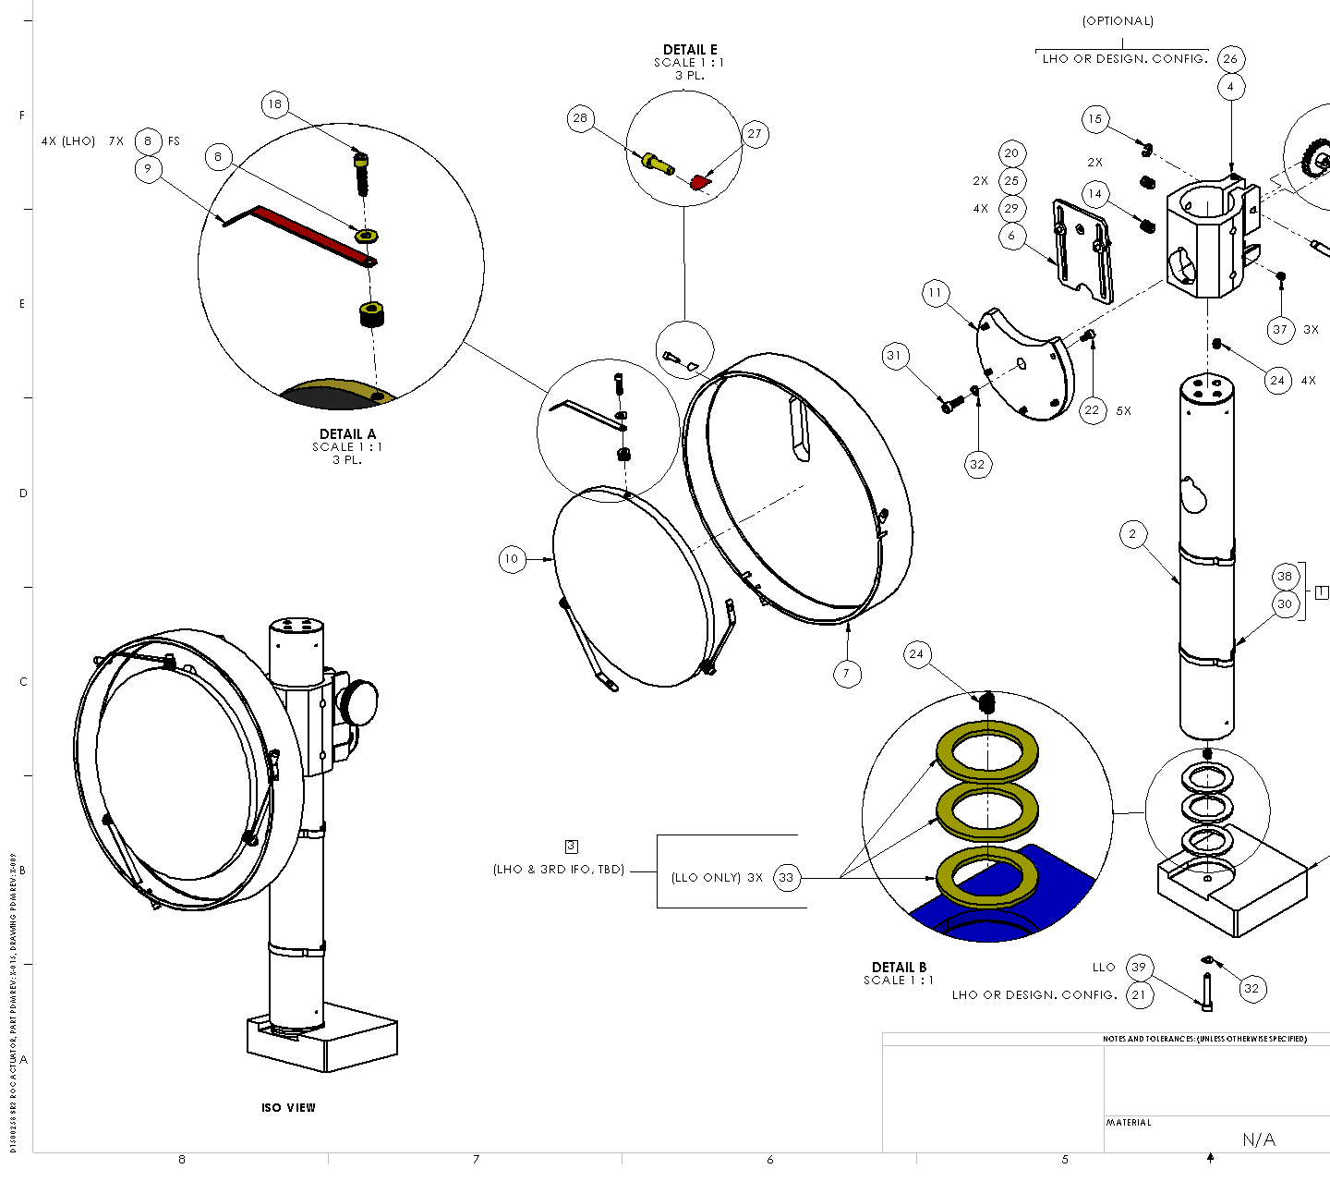
Isolation of Heater Plate
Back to Overview
Results were not great with full assembly
Desired simplification of test
The D1500387 Heater Plate Assembly was separated from the post, horizontal arm, and radiation shield
  Item 10 + friends
    Orange outline
Excerpt from D1500258

Slide 10
Isolation of Heater Plate
Back to Overview
Oven contents now are:
  Feedthru D1600090
  Cable D1600072
  Fixture D1600471
  Heater Plate Assy D1500387
    Heater D1600104
    Radiative Plate D1500385
    Retaining Clip D1500386
    Indium Gasket
  Radial Springs Qty 3 D1500384
This means that the following PEEK Parts were removed:
  Cable ties Qty 2 D1500258.30
  Flat washers, #6 Qty 4 D1500258.29
  Rack D1500388
  Pinion D1500258.13

Slide 11
Outgassing Results while:
Operating Heater Plate Only (ICS-8278)
Back to Overview
The ISOLATED heater was powered via the SR3 ROC Actuator Heater Driver, with scans on ICS-8278 (Scans 15-23)
  3 W
    Duration: Almost 6 days
  4 W
    Duration: 7 days

Slide 12
Outgassing Results while:
Operating Heater Plate Only (ICS-8278)
Back to Overview
The ISOLATED heater was powered via the SR3 ROC Actuator Heater Driver, with scans on ICS-8278 (Scans 15-23)
  3 W
    Duration: Almost 6 days
  4 W
    Duration: 7 days

Slide 13
Outgassing Results while:
Operating Heater Plate Only (ICS-8278)
Back to Overview
The ISOLATED heater was powered via the SR3 ROC Actuator Heater Driver, with scans on ICS-8278 (Scans 15-23)
  3 W
    Duration: Almost 6 days
  4 W
    Duration: 7 days

Slide 14
SR3 ROC Actuator
ICS Bake-8278 Parameters
Back to Overview
This table is summarized / visualized on next two pages:
Sequential Timeline
Temperature + Power vs Time
ICS Bake-8278 Parameter Table
Scan Date (T1700164 ID) | Temp (°C) | Power (W) | Duration (hrs)
03 January 2017 (1) | 22 | 0 | 3
25 January 2017 (2) | 22 | 0 | 516
13 February 2017 (3) | 42 | 1.5 | 96
14 February 2017 (4) | 82 | 6 | 21
16 February 2017 (5) | 82 | 6 | 41
17 February 2017 (6) | 82 | 6 | 29
21 February 2017 (7) | 61 | 3 | 98
21 February 2017 | 61 | 3 | 98
30 March 2017 (8) | 55 | 3 | 886
(waiting) | 55 | 3 | 201
14 April 2017 (9) | 64 | 4 | 167
(vented due to turbo failure) | 54 | 4 | 259
(current status as of 26 April) | 54 | 4 | 26

Slide 15
SR3 ROC Actuator
ICS Bake-8278 Parameters
Back to Overview
Current
Status
Vented due to Turbo failure
Vent for configuration change –
Now in “Isolated” Configuration
Assembly was typically at room temperature and off after closing Oven D, before installing SR3 ROC Actuator Heater Driver

Slide 16
SR3 ROC Actuator
ICS Bake-8278 Parameters
Back to Overview
Vented due to Turbo failure
Assembly was typically at room temperature and off after closing Oven D, before installing SR3 ROC Actuator Heater Driver
Current
Status
Vent for configuration change –
Now in “Isolated” Configuration

Slide 17
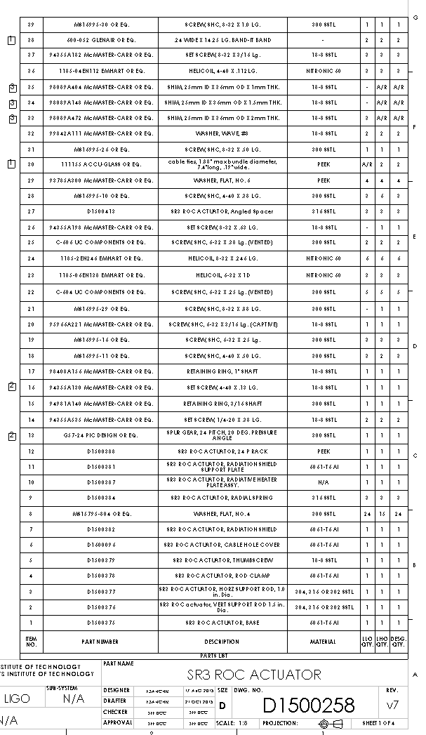
Appendix – D1500258-v7 Image
Back to Overview

