Slide 1


Vacuum Technology of the LIGO Interferometers presentation to the
Southern California Chapter AVS
28 March 2017
Learn more about LIGO at https://www.ligo.caltech.edu/page/about

Slide 2
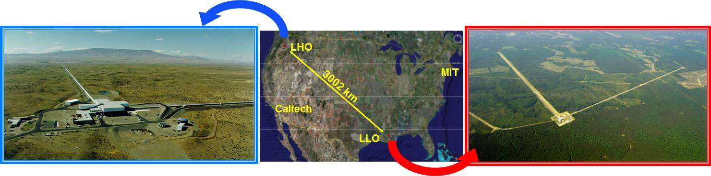
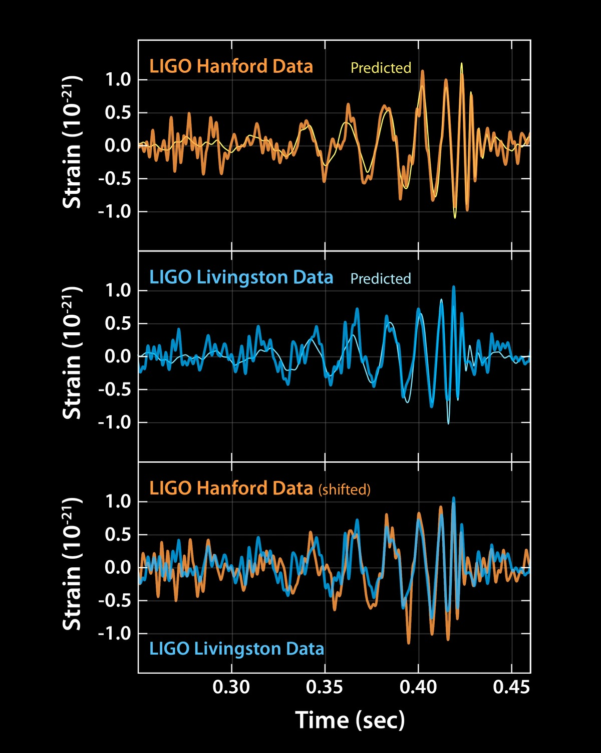

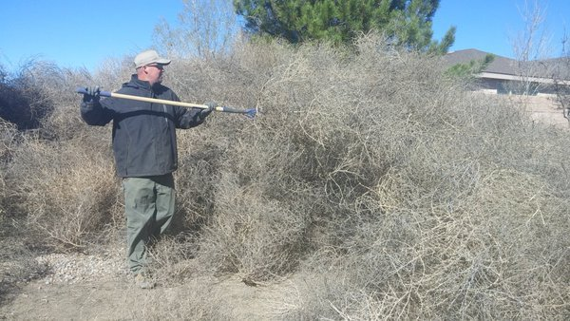
Ligo HANFORD and Ligo LIVINGSTON
Observatories are about 10 ms apart by gravity wave, a long way apart
by geography

Slide 3
LIGO Project Timeline
1980s
LIGO 40m (1% scale) interferometer constructed at CIT (we will tour this facility later)
1990s
Funding from NSF, LIGO Hanford (94) and Ligo Livingston (95) construction begins
2000s
LIGO operational
2010-2015
LIGO offline for Advanced LIGO sensitivity upgrade
2016-present
A-LIGO operational, historic 1st observation of a GW event occurs
The LIGO vacuum systems have now been in service for 20 years

Slide 4
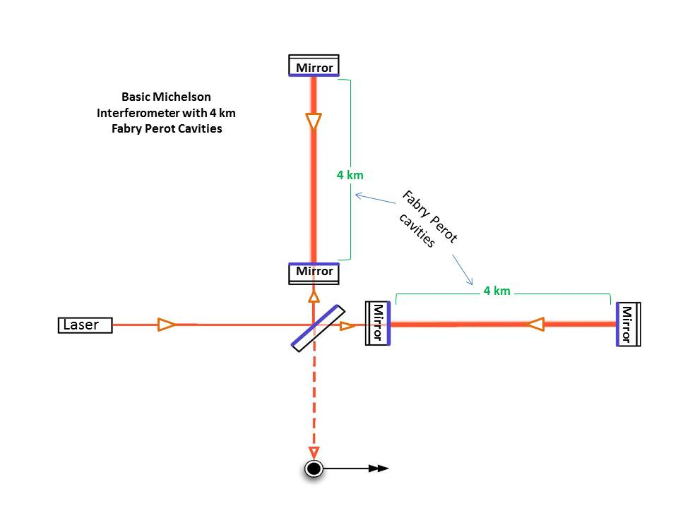
Why is a 4 km vacuum system required?
UHV
Michelson interferometer sensitivity ~ L
Want storage time in cavity ~ ½ GW period
150 km would be about optimum, but……..
  Too expensive $$$
  Earth curvature 1 meter/4 km, 1.7 km/150km
  Mirrors hang, consider g-vector
  Space-based system ideal, has its own problems
Add Fabry-Perot cavity to increase path length
Still represents 10⁴ cubic meters of plumbing
Pressure ~1e-9 Torr
No vibration…. limits pump type (ion, getter, LN2 cold traps)
Measure amplitude (null) not phase (time)
Feedback control loop keeps signal at null
Measure feedback signal
Both sites signals should overlay but be 10 mS apart

Slide 5
Why is vacuum operation necessary ?
Required to reduce phase noise
Noise Sources
  Beam refraction due to gas density fluctuations
  Acoustic noise transmitted to mirrors
  Mirror absorption due to films ~ monolayers
  Requires operation at UHV

Slide 6
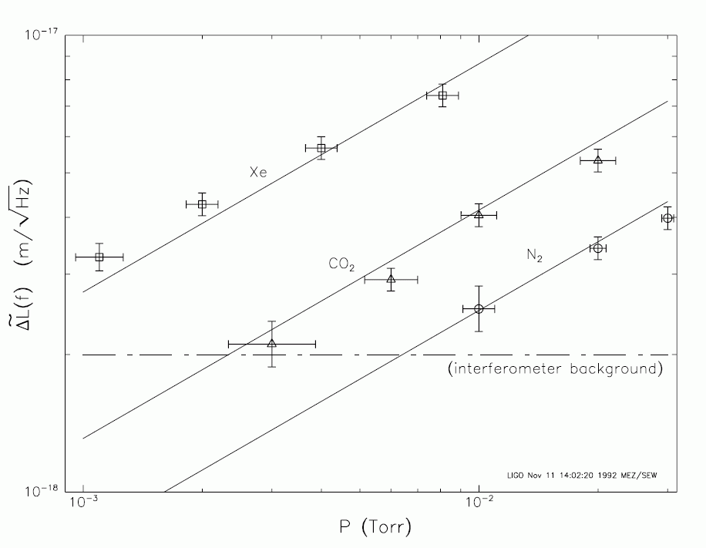
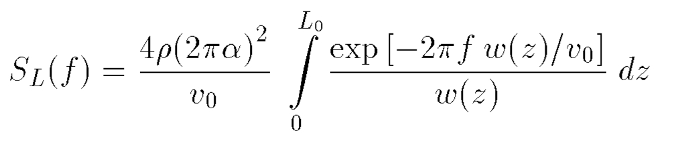

Residual Gas Index Fluctuation Noise
ρ = gas number density (~ pressure)
α = optical polarizability (~ index)
w = beam radius
v₀ = most probable thermal speed
L₀ = arm length
ΔL = arm optical path difference
From a vacuum engineering perspective, about all we can do to help is get the pressure as low as practically possible
S. Whitcomb and MZ, Proc. 7th Marcel Grossmann Meeting on GR, R. Jantzen and G. Keiser, eds. World Scientific, Singapore (1996).

Slide 7
Vacuum system requirements
Light scattering from residual gas
    Function of molecular polarizability, transit speed and partial pressure
    Primary goals for beam tubes:
      ➔P(H₂) < 10⁻⁹ Torr
      ➔P(H₂O) < 10⁻¹⁰ Torr
No contamination of optics
    Mirror absorption < 0.1 ppm
    Hydrocarbons deposition < 1 monolayer/10 years
      ➔Aggressive cleaning and vacuum bake of every component
    Particulates < one 10 µm particle on any mirror
      ➔ISO Class 5 or better clean room protocol for worker access, internal components, surface exposure, backfill/roughing speed
Vibration-free environment
      ➔No mechanical, turbo or displacer-piston cryopumps during site observation
To our advantage, we do not have to contend with radiation, thermal, or ion/electron induced desorption,
LIGO outgassing is passive at ambient temperature

Slide 8
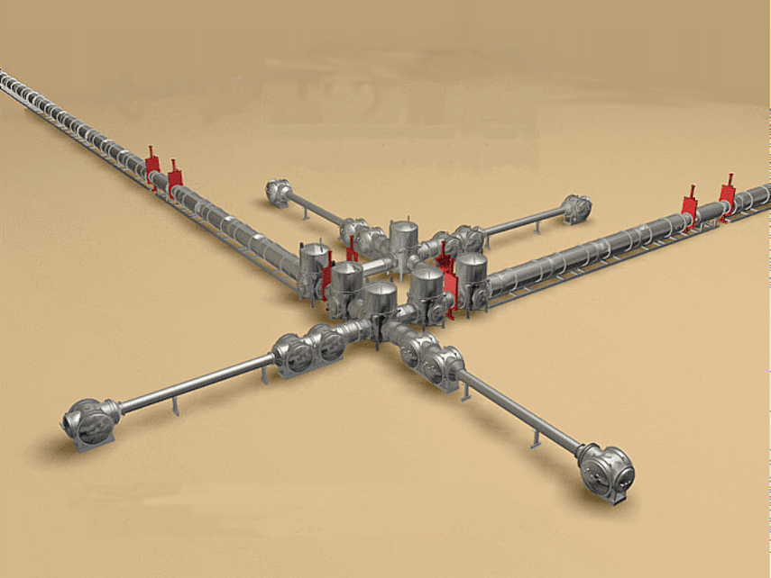
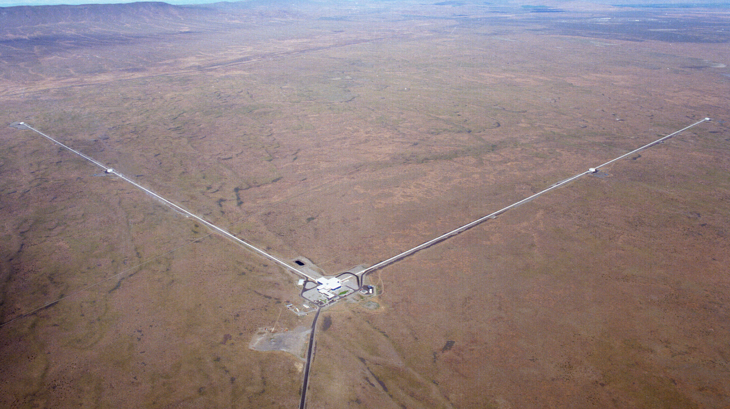
LIGO Vacuum Chambers and Equipment
Stations contain modular components called HAM and BSC chambers
End Stations
4km
Vertex or Corner Station
Vertex diagram
Corner and End Stations are connected by beam tubes which are 1.2m diameter x 4 km long, and are aligned (straight) to 5 mm rms. The arms are orthogonal to 5μ radians.

Slide 9
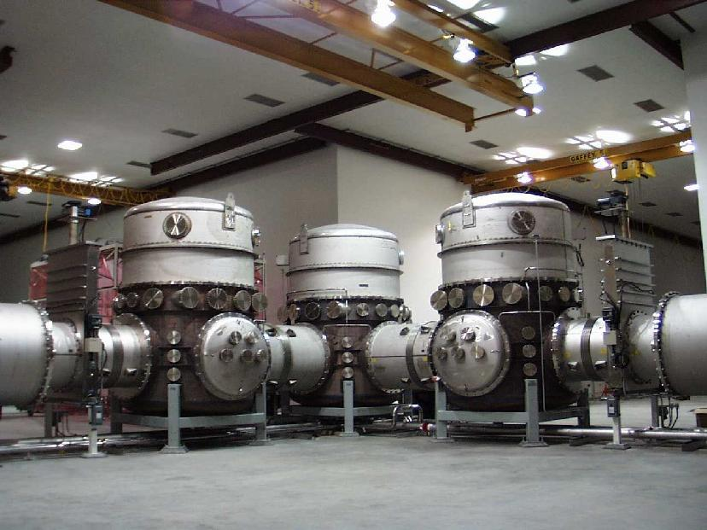

Essentially two vacuum systems that share one volume……?
1. Chambers (at the vertex and end stations)
  Frequently opened
  Numerous penetrations; flanges, fittings, viewports, feedthrus
  Large doors
  House the electrical, mechanical and optical equipment
  Pumps, valves, backfill vents
  O-ring sealed
  Create a large water (and some crud) load
2. Beam tubes (which connect the stations)
  Designed never to be opened (i.e.vented)
  1.2 m diameter x 4 km long
  20 million liters volume (per site)
    600 million cm² surface area (per site)
    200 l/s char. conductance (thin tube ??)
    All metal
    Baked 150 C for 3 weeks, UHV with low H2 diffusion
    Isolated by 44 Inch diameter gate valves
These two systems have very different purposes but are open to each other for months at a time during observation runs. How can they coexist?
Hint: 77 K

Slide 10
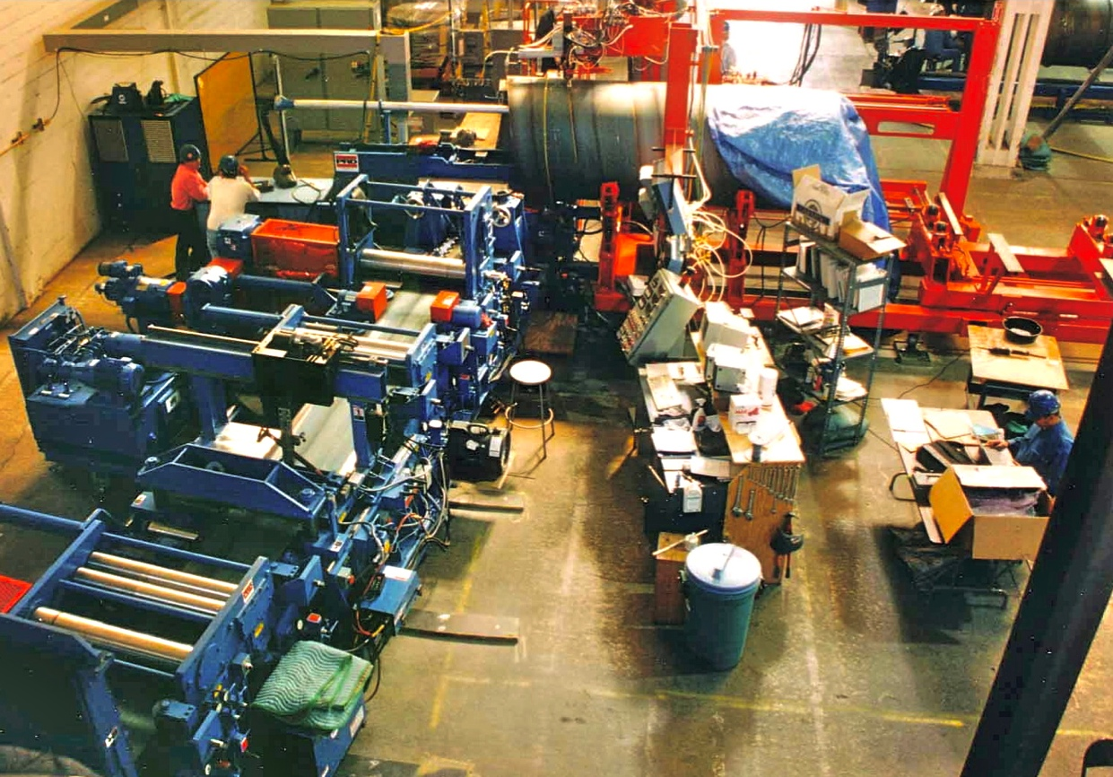
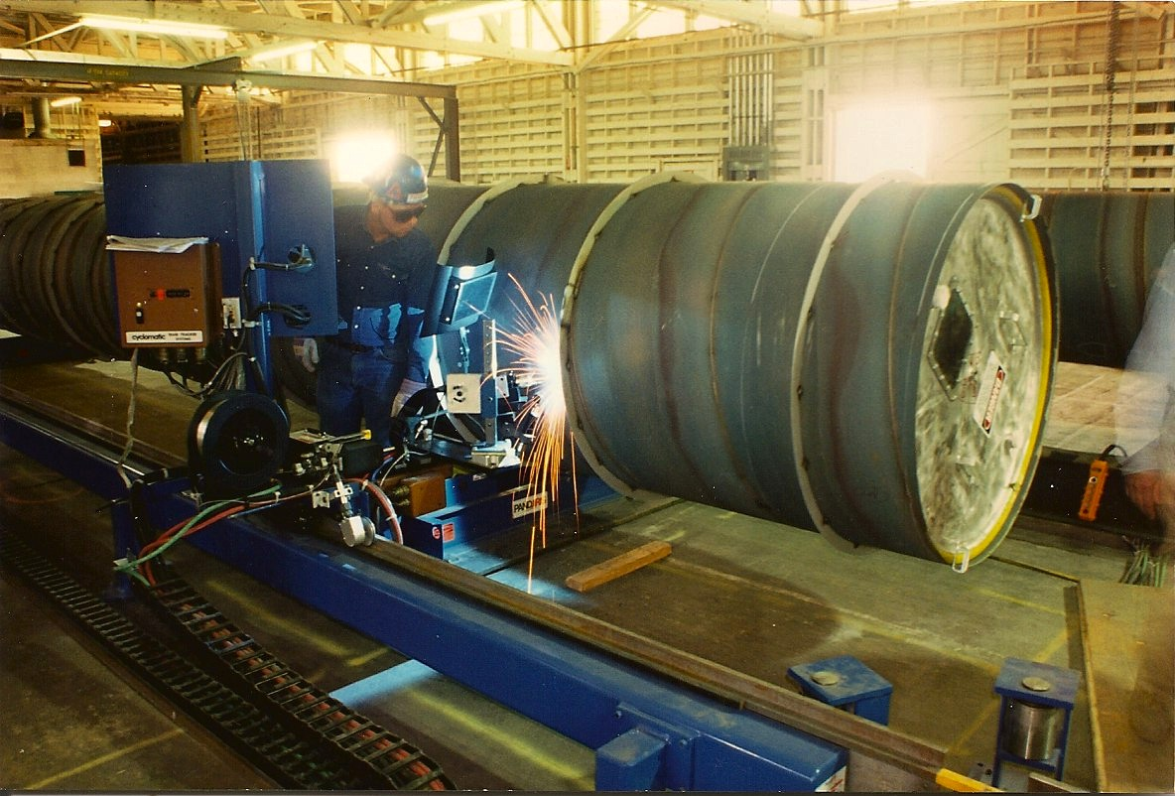
Beam tubes were fabricated by winding coiled sheet
304L SS, 3.2 mm thick with external stiffeners
Raw coiled stock air baked 36h @ 455C to deplete hydrogen
  J_{H2} < 10⁻¹³ Tl/s/cm²
  process developed by LIGO
Prepared coil spiral-welded into 1.2m tube on modified culvert mill
16m sections cleaned, leak tested, and capped
FTIR analysis to confirm HC-free
Sections butt-welded together in travelling clean room at sites
Over 50 linear km of weld; no leaks
Tubes designed never to be vented after installation
CBI (Chicago Bridge and Iron) was fabricator
Spiral rolling and seam welding
Adding the stiffener rings

Slide 11
Cleaning and leak testing a tube section
Steam/water/detergent cleaning followed by FTIR sampling
Helium leak testing a section of beam tube. Note large diffusion pump, Roots-backed forepump

Slide 12
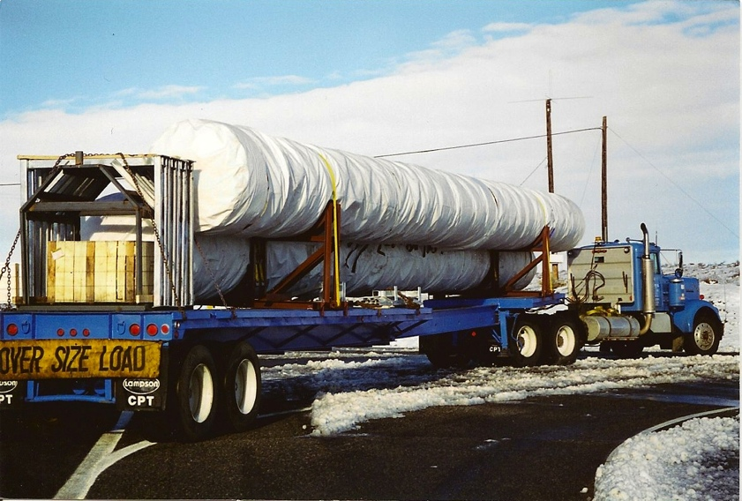
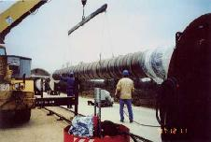
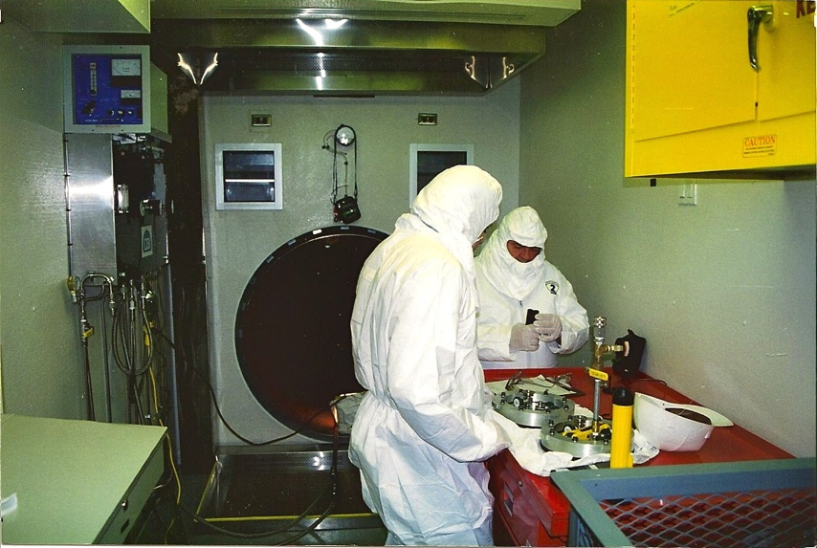
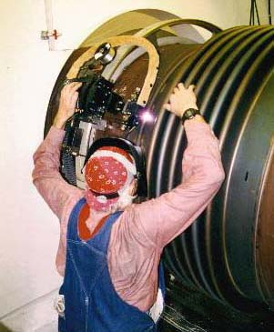
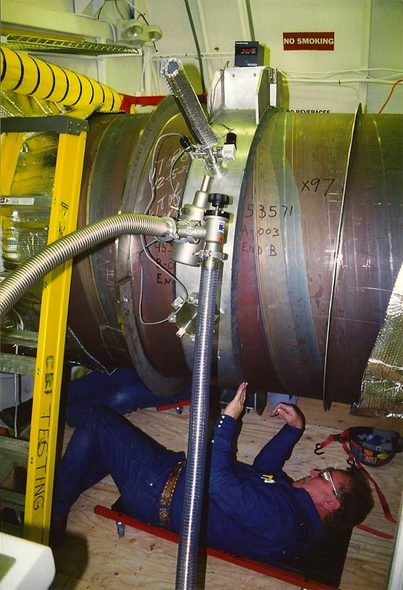
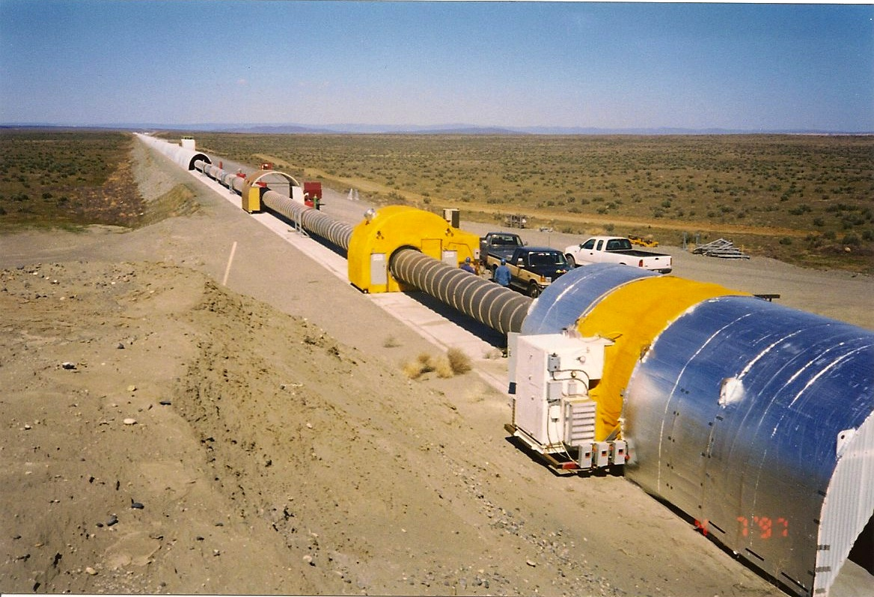
Field assembly of the beam tubes
Transport
Position
Field fitup
Butt weld
Leak check
Add next section

Slide 13
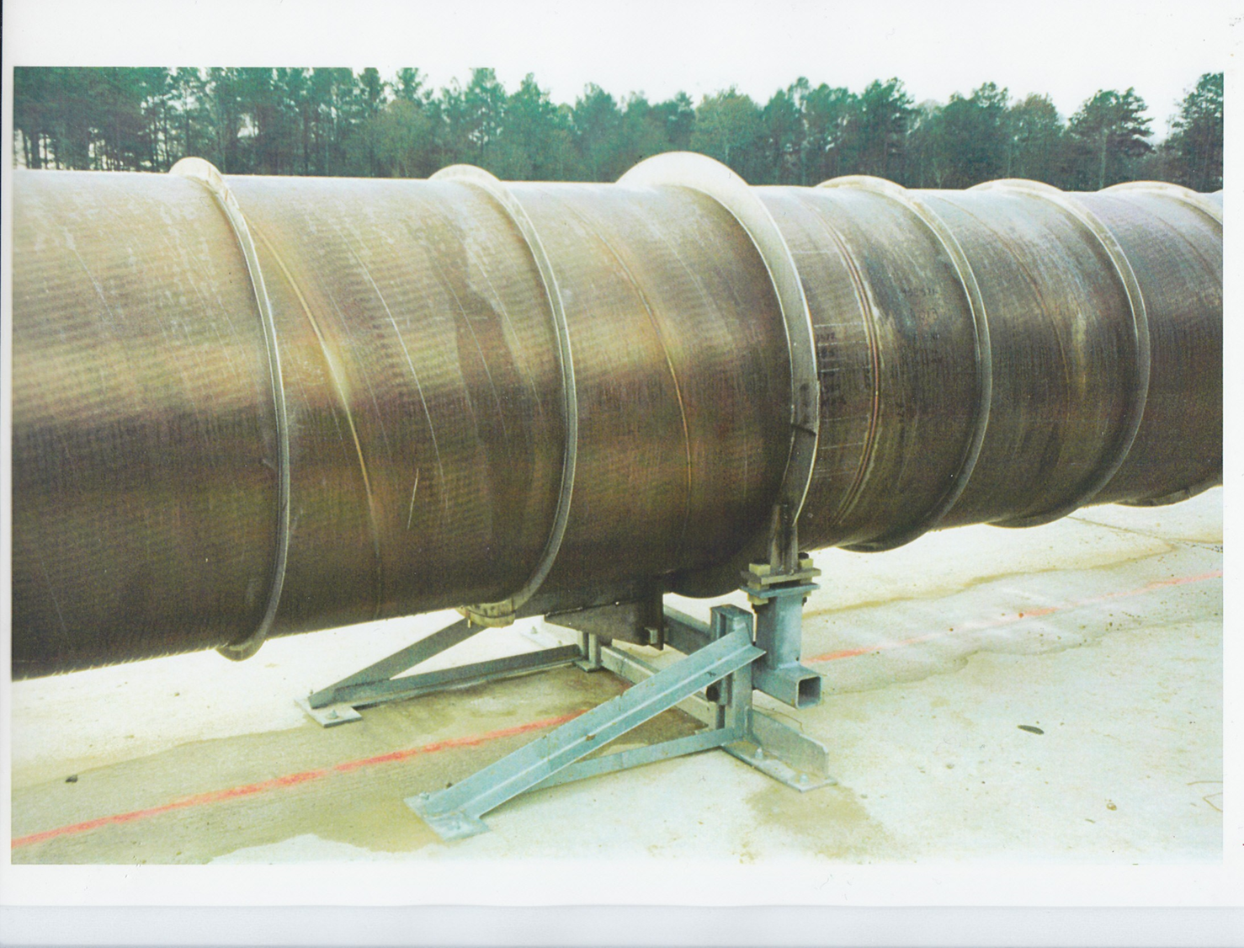
Completed beam tube joint
There are 50 km of weld bead per beam tube. The inner bead is autogenous, the outer bead low-hydrogen filler wire
The unique color of the steel is due to the air-firing process used to reduce hydrogen diffusion
Stiffening rings prevent buckling of the tube by air pressure. The tube is 3.2 mm thick
Beam tubes were aligned using dual-frequency differential GPS, 5 mm/4 km straightness*
See Rev. Sci. Instr. V 72, No. 7 p 3086, July 2001.

Slide 14
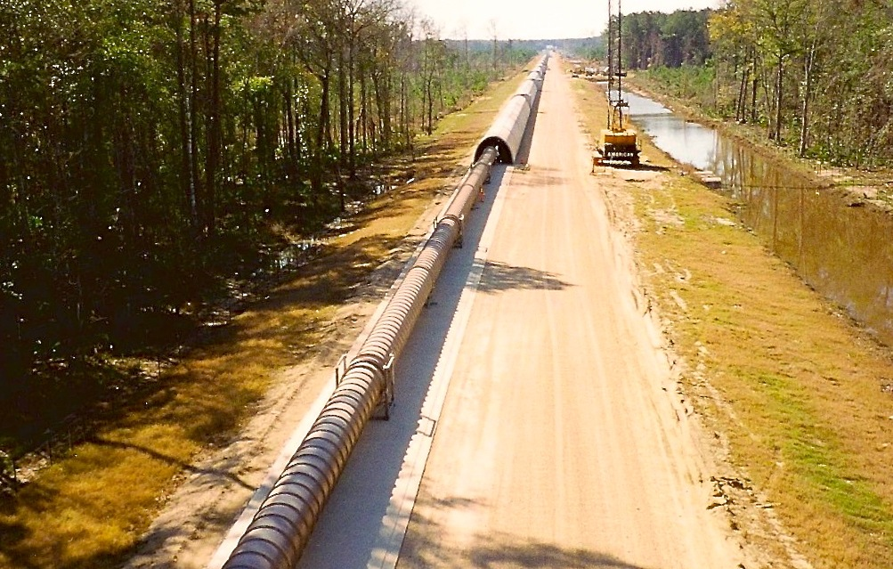
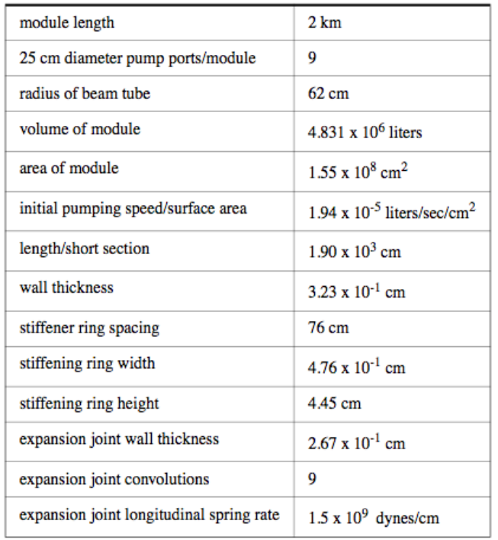
LIGO beam tubes
  9000 m³ volume
  30000 m² surface area
  50000 m of spiral welds
  ~10⁻⁹ Torr operating pressure

Slide 15
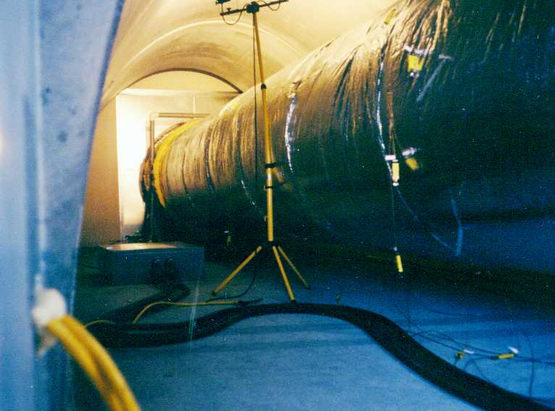
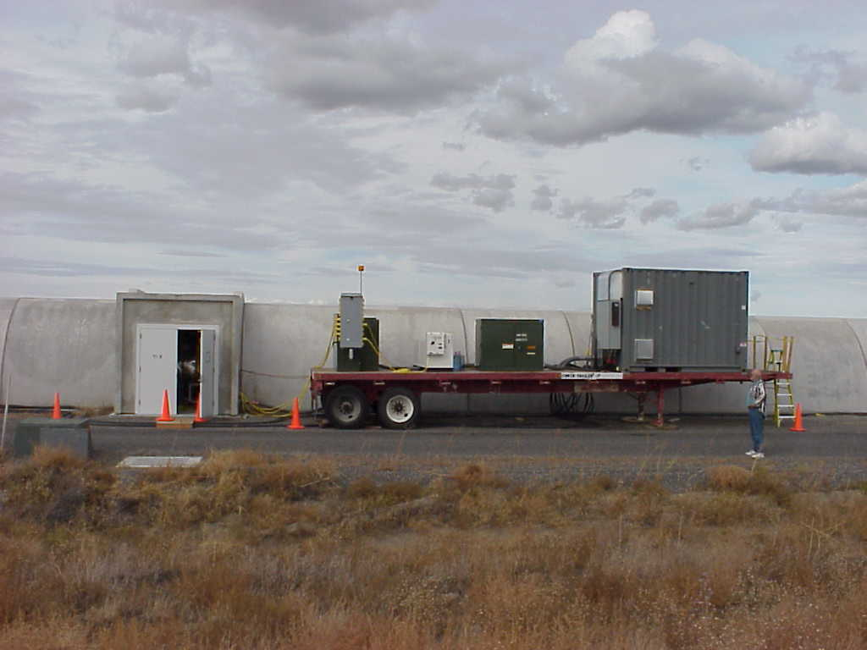
Beam Tube Bakeout….. I²R using beam tube as the “R”
Insulate tube and conduct 2000 amps x 65 volts from end to end
Tube with power cable junction box
“Portable” magnet supply from Fermilab. 13 kV primary power
Bake for 3 weeks 160 C, $1M of electricity

Slide 16
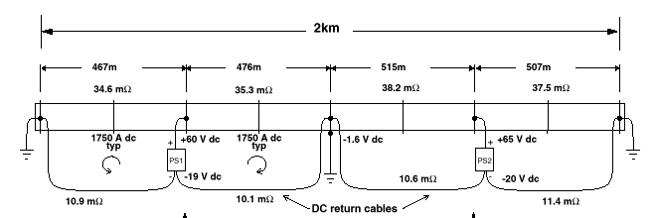

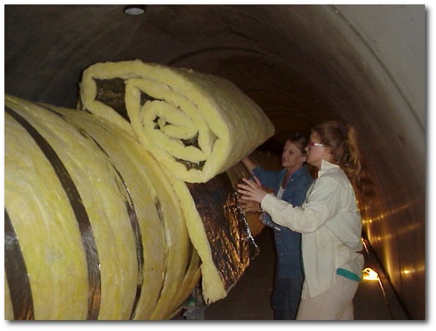
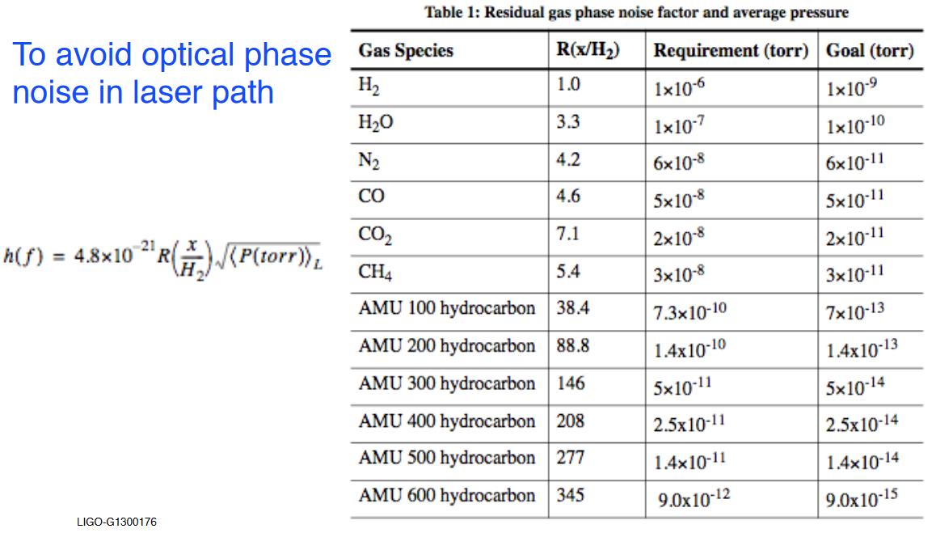
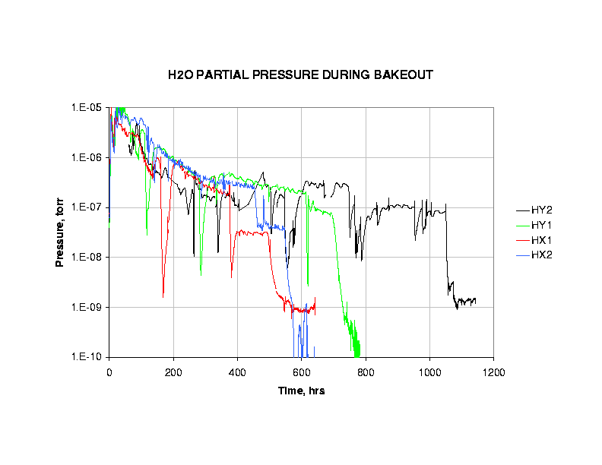
I²R Bakeout Schematic. Desorb Water
Temporary cryopumps were used during bakeout 17, places, removed after bake

Slide 17
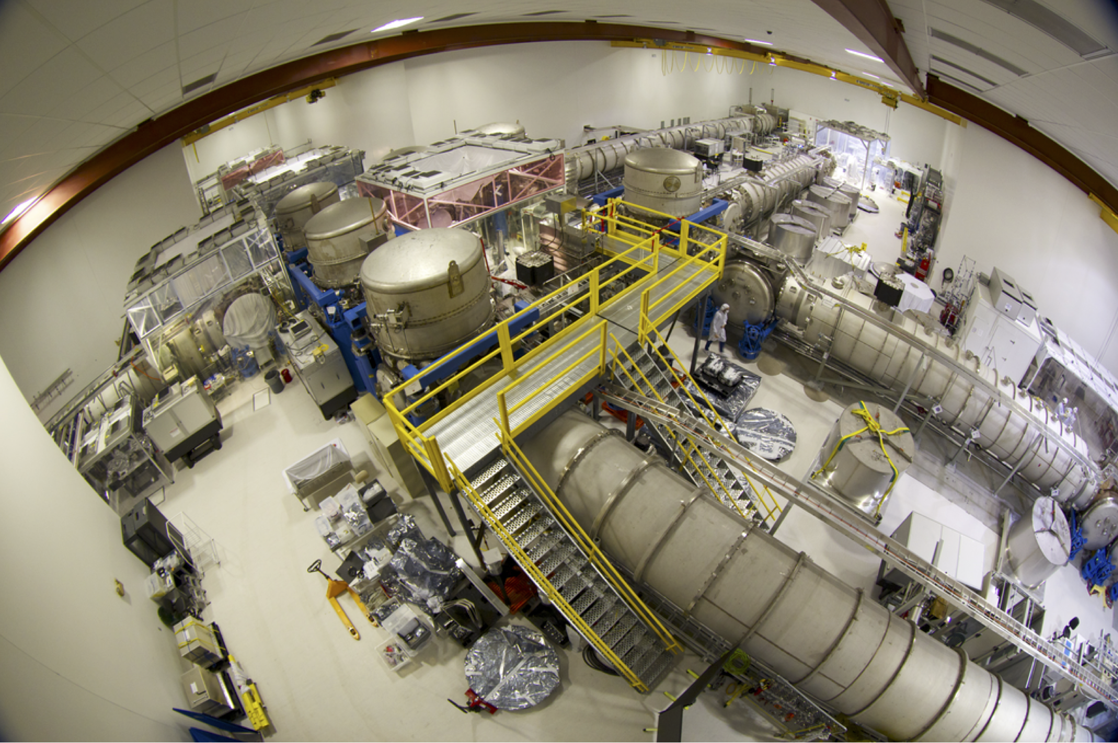
Vacuum equipment at the “Corner” or “Vertex”
The corner stations are busy places…. they house the lasers, beam splitters, most of the diagnostic and control equipment, also monitor the laser signal for GW detection
The end stations have (fewer but similar) chambers that house the suspended mirrors, some diagnostic and vacuum control equipment, etc.

Slide 18
Two chamber types, modular construction
Optics Table
Horizontal access module “HAM”
Basic Chamber “BSC”

Slide 19
BSC Chambers at the Vertex
Also referred to as the “LVEA” or Laser Vacuum Equipment Area
Chamber connected by expansion joints, isolated by 44 and 48 inch gate valves

Slide 20
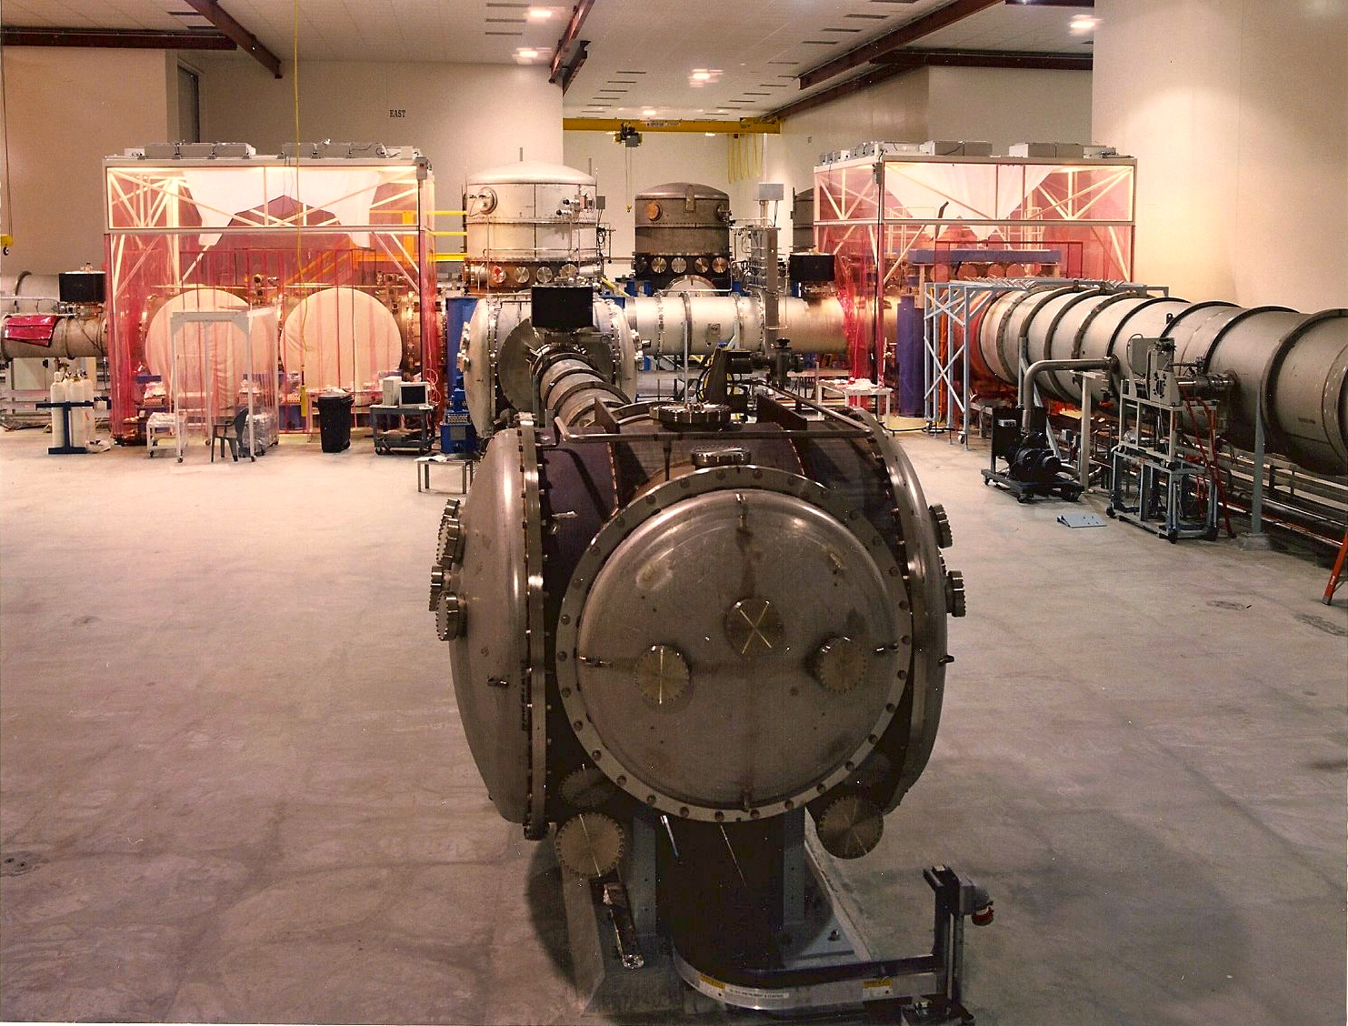
HAM Chambers
House complex input/output optics
2.1m Ø x 2m W
More than 70% of area are removable access doors
O-ring seals

Slide 21
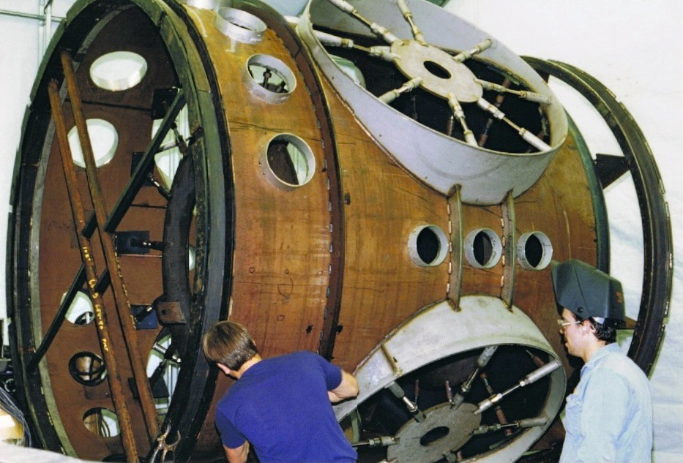
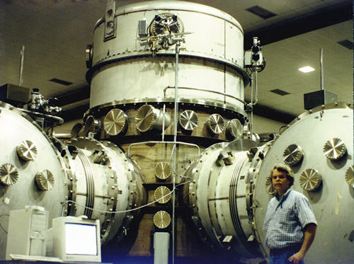
BSC chamber manufacture
2.8m Ø x 5.5m h for large cavity optics
Upper third is a removable dome
Thin (10-15mm) 304L SS shell with welded stiffeners, F&D heads
Combination of GTAW and plasma welding
Major weldments were stress-relieved
Ports < 35cm Ø: ConFlatTM
Ports > 35cm Ø: Dual O-ring
  Treated Viton elastomer
  DRY (no grease)
  Isolated pumped annulus between inner and outer seal
  Permeation and damage tolerant

Slide 22
Differentially pumped flanges
Large metal sealed flanges would be impractical for
the chambers seals, so o-ring seals were used. To reduce permeation, differential seals were specified. You can also see these in use on the 40m system at Caltech, just look for the pumpout tubes when you are on the tour.
Dual o-ring
Pumped annulus
Vacuum maintained by ion pump (which is unusual….no vibration)
Independent of main volume
Gate valve disk also dual o-ring
Seal faces single-point machined
“Fluorel” o-rings, pre-processed

Slide 23
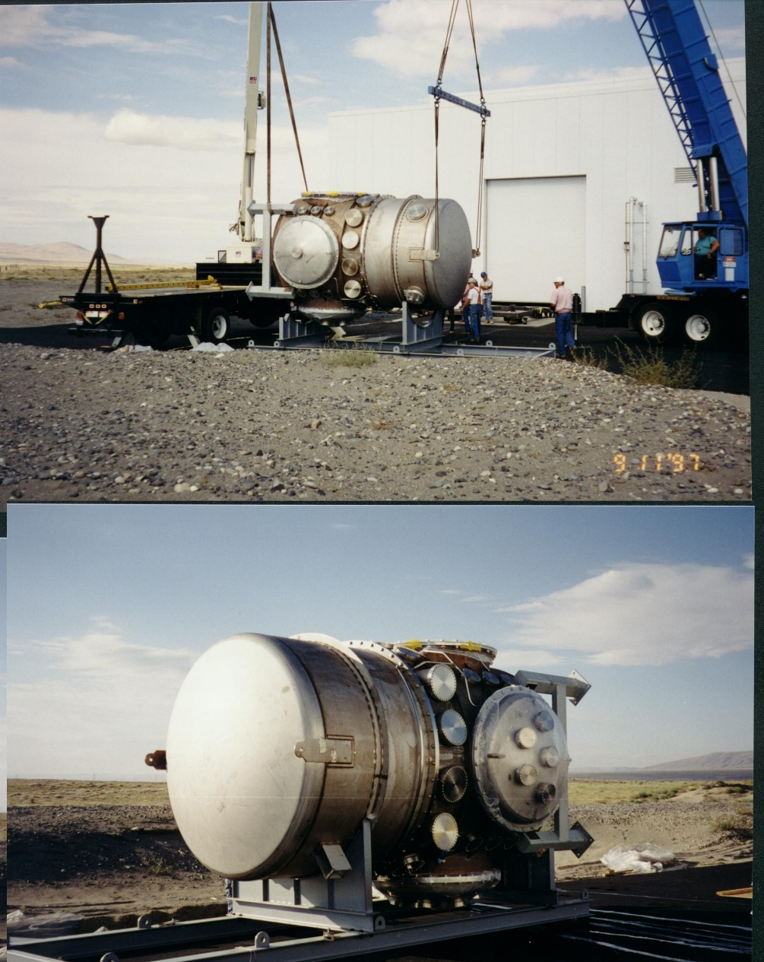
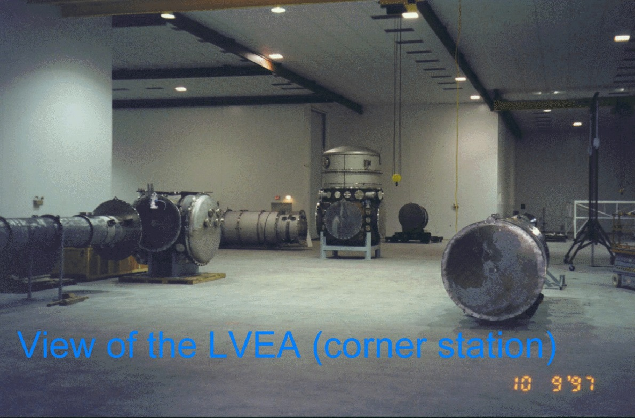
Chamber installation circa 1997
Fabricated and cleaned off-site
Delivered in sealed condition for installation

Slide 24
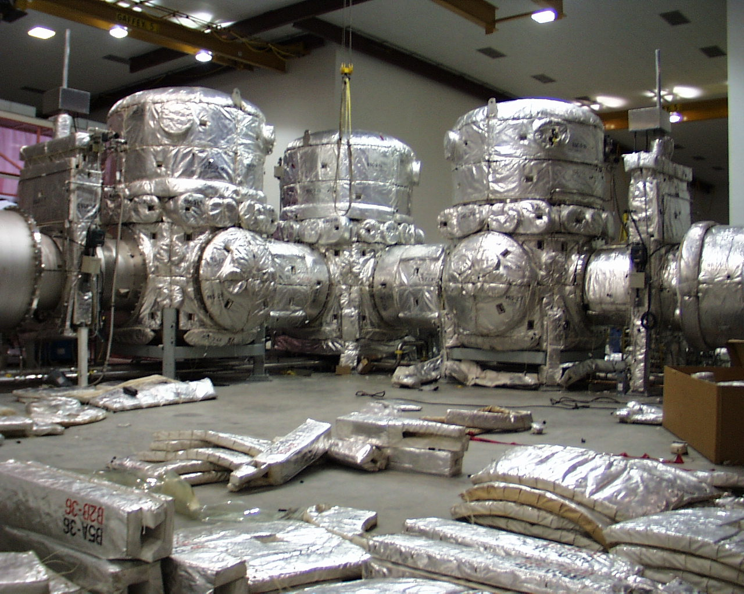
Chamber Bakeout
Conventional bakeout using heater blankets and heat tracing. 150 C

Slide 25
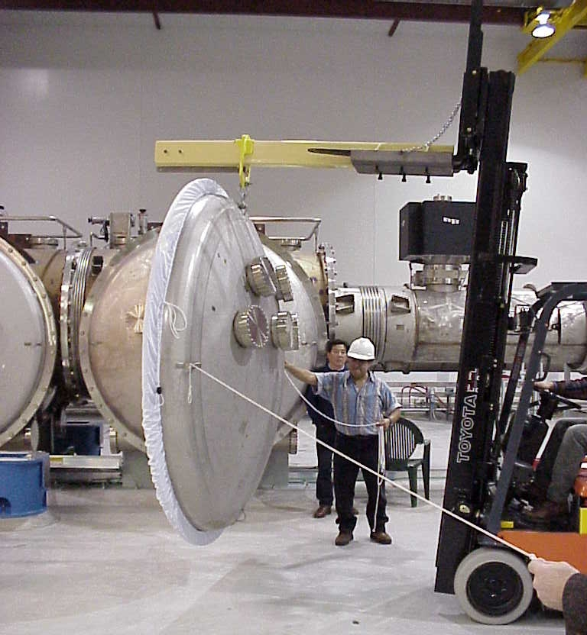
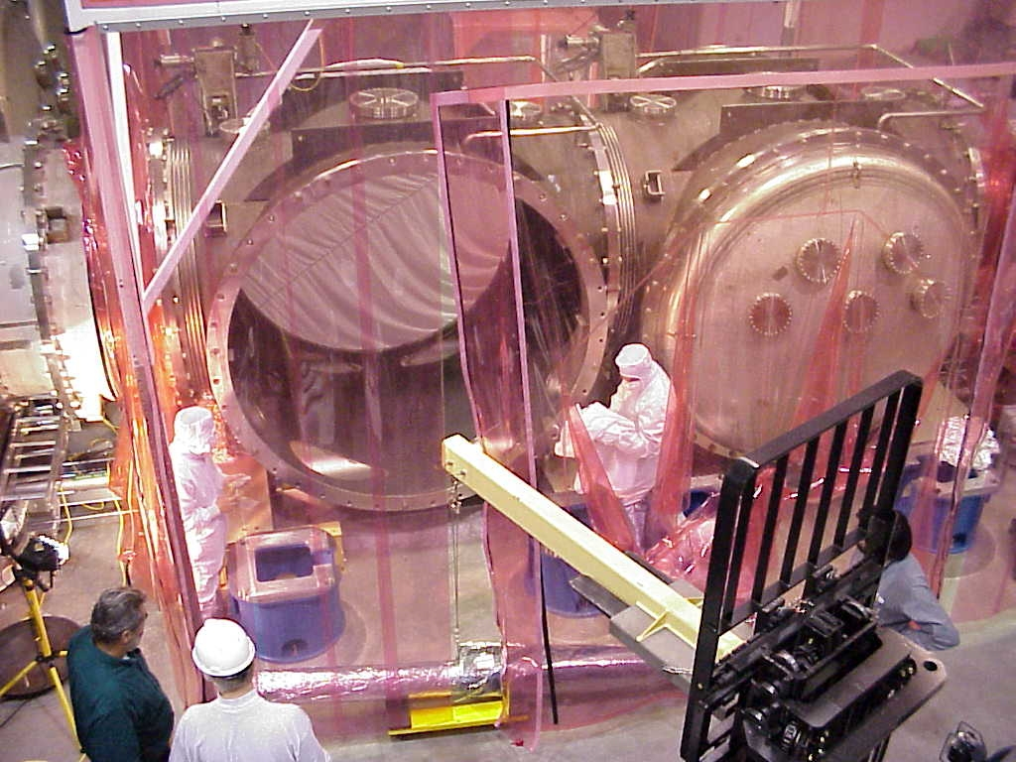
Mobile clean-rooms are used for contamination (particulate) control

Slide 26
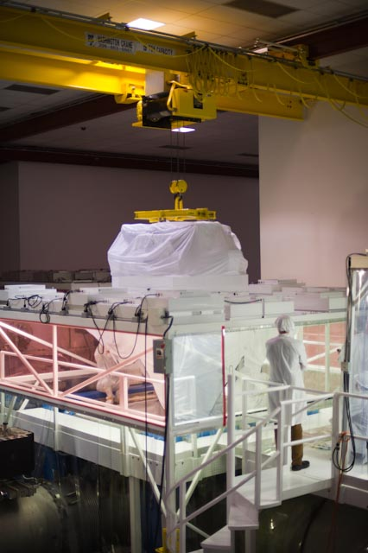
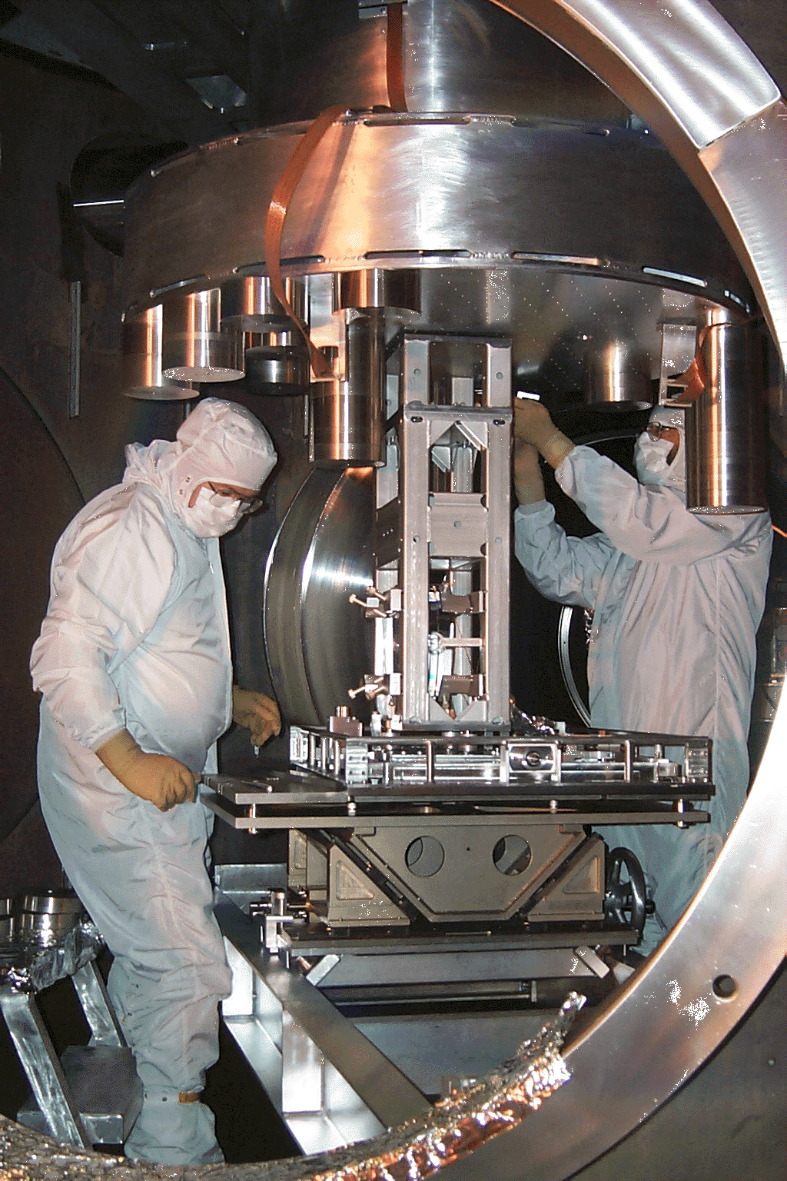
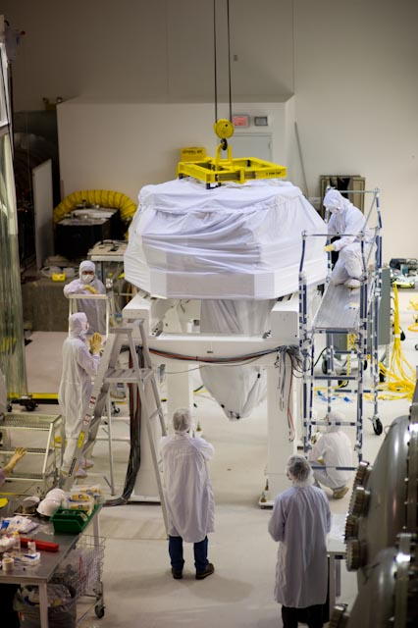
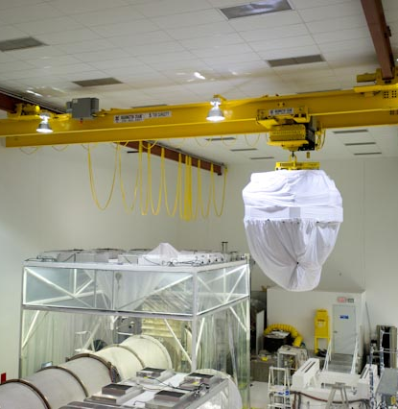
Internal Equipment Installation
Strict part cleanliness and cleanroom techniques are required

Slide 27
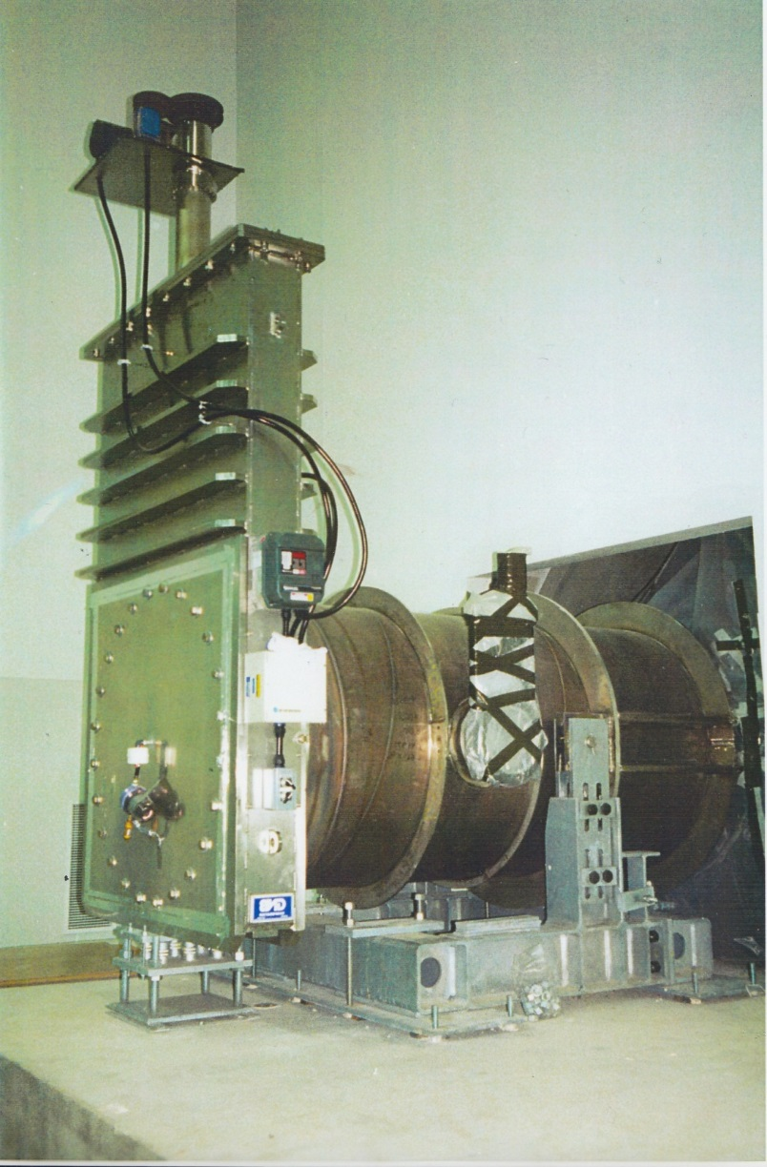
Large Gate Valves
There are approximately 17 large gate valves at each LIGO installation. These valves have a clear opening diameter of 44 or 48 inches depending on their location in the system. They were made in California by GNB
Valves are actuated by either a mechanical (screw drive) or pneumatic servo. A valve cycle takes about 4 minutes.
The bonnet plate and valve disk
have dual o-ring, differentially pumped seals. A 60 l/s ion pump maintains the differential volume.

Slide 28
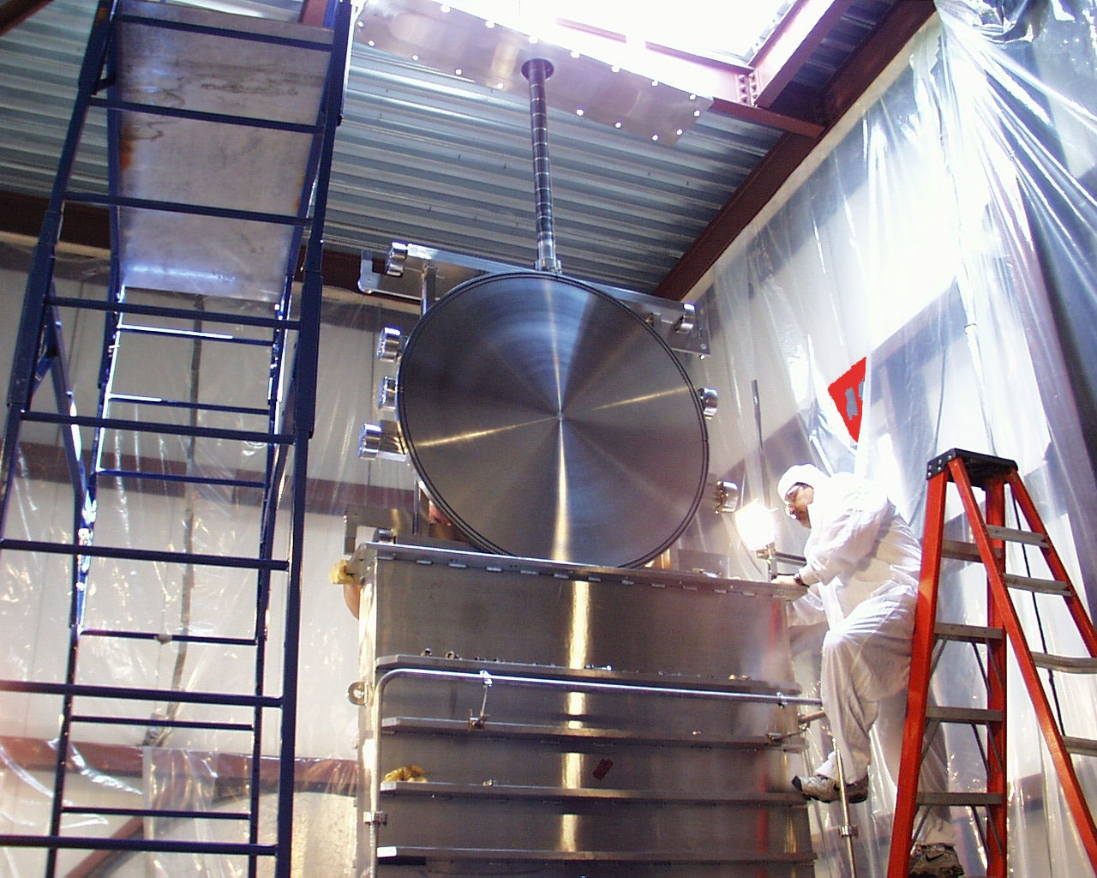
Large Gate Valve with bonnet open
44” & 48” ID gate
valves used to isolate
beamtubes, LN2 traps
Double o-ring gates & bonnet seals with pumped annulus
Two actuator varieties electric (ballscrew) and pneumatic (cylinder)

Slide 29
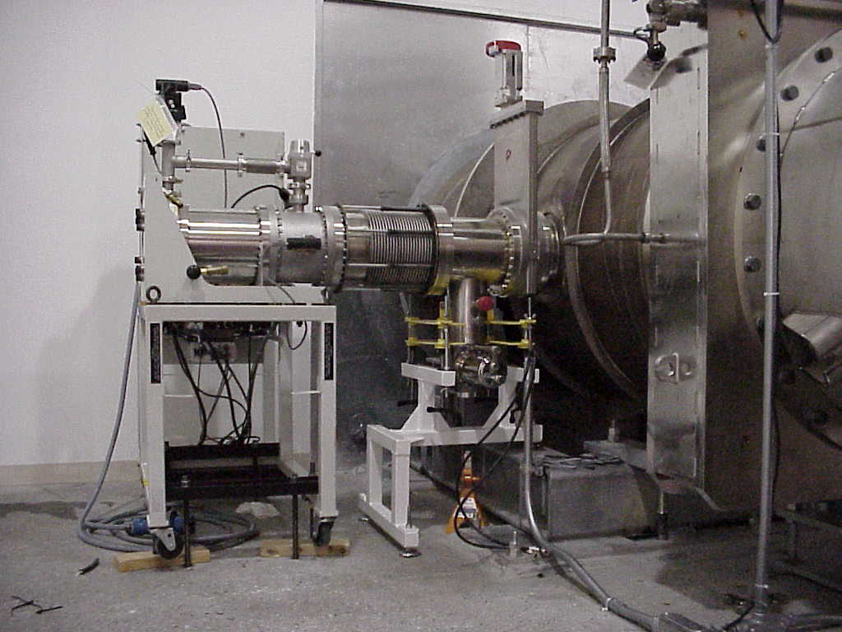
Pumping Systems
Roughing pumps and Roots blowers (background), also visible is backfill equipment -50 C dew point air dryer, + oil-free compressor
Maglev Turbopumps
2500 l/s ion pumps
(16.5” Conflat flange) with Ta “Noble Diode” Cathode
Roughing and turbopumps are used for evacuation and achieving initial high vacuum in chambers. Ion pumps control H2 partial pressure. Getter pumps are being evaluated as well

Slide 30
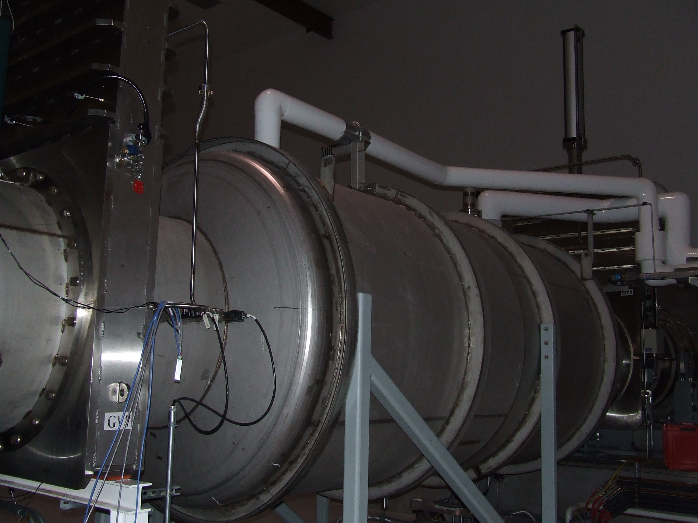
Elephant in the room
The LIGO beamtubes are bounded by gate valves and coaxial 10⁵ liter/second cryotraps. These traps protect the beamtube from the water loads introduced by the HAM and BSC chambers. The cryopumps have a unique design that reduces boiling noise.
Special “low vibration” design
  LN2 reservoir suspended by compliant springs with Fluorel dampers
  Dual-phase liquid delivery (horizontal vacuum-jacketed lines) maintain continuous liquid and vapor flow without slugging
  Sloped “chute” introduces new liquid to reservoir
  Reservoir shape & free surface area designed to preclude boiling
  Continuous level control (PID with differential pressure level sensor)
Low-emissivity aluminum cold surface
Low-emissivity tube liners reduce thermal flux
Outdoor storage dewars refilled periodically by truck delivery
Liquid nitrogen is fed from large external dewars, and transferred to pump by vacuum insulated lines.

Slide 31
End Station Cryopump Arrangement
LN₂ storage
(outdoors)
Coaxial
LN₂ trap
1.4e5 l/s (H₂O)
ion pump
2500 l/s (N₂)
beamtube
BSC chamber
1.2m Ø gate valves

Slide 32
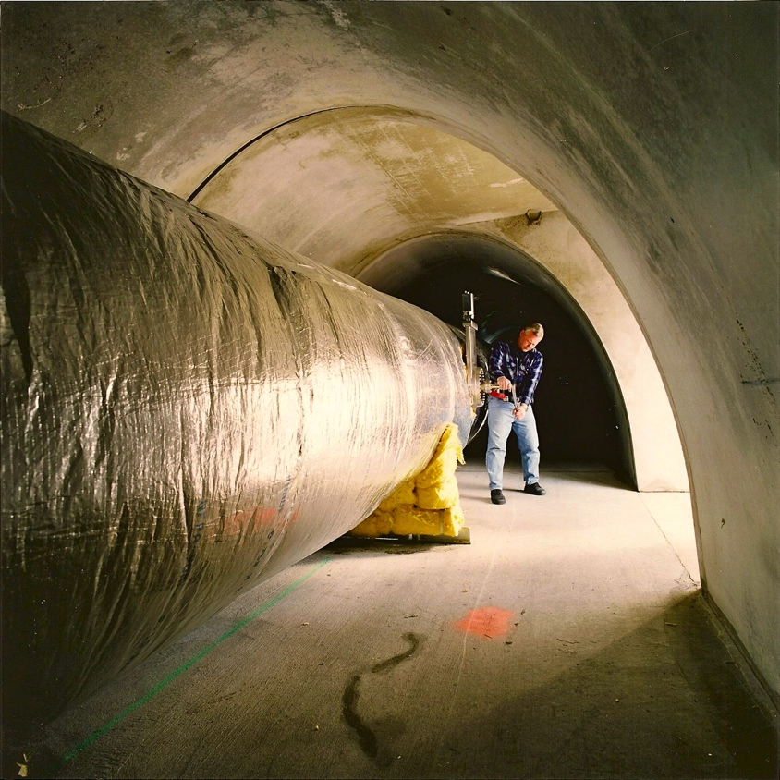
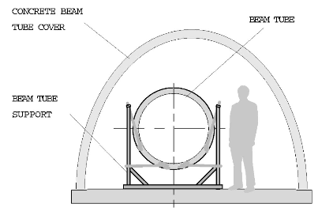
Concrete Enclosure
Enclosure is pretty spartan, minimal utilities, access doors, lighting, environmental control, etc.
Not a fun place to work in.

Slide 33
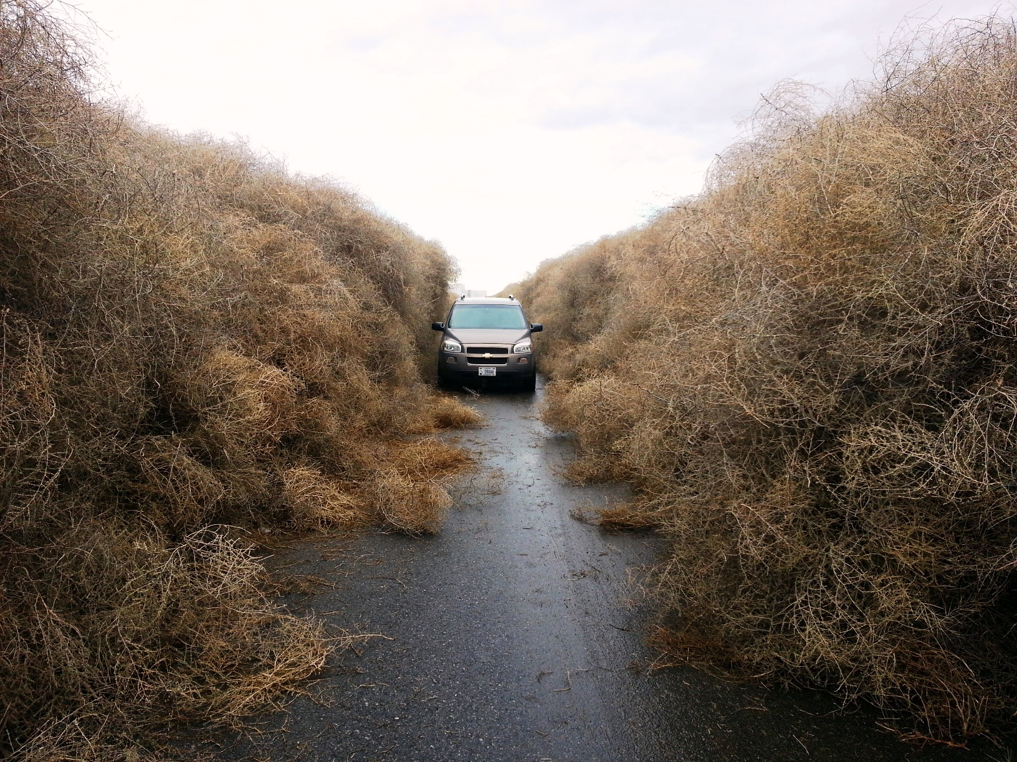
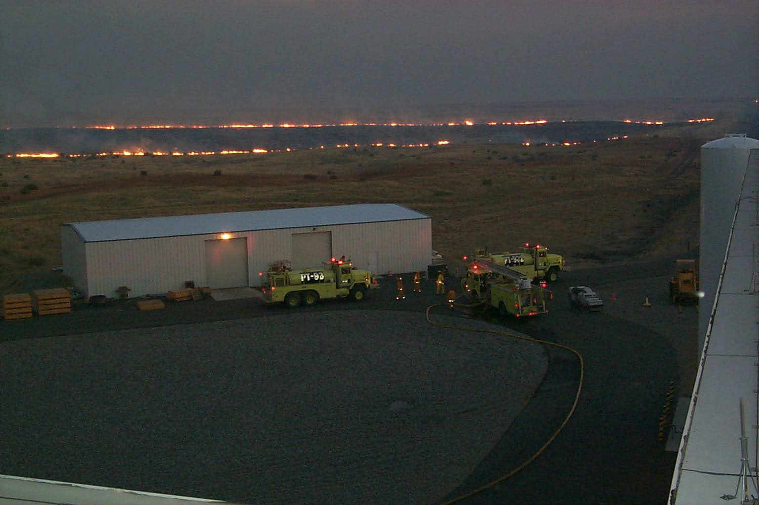
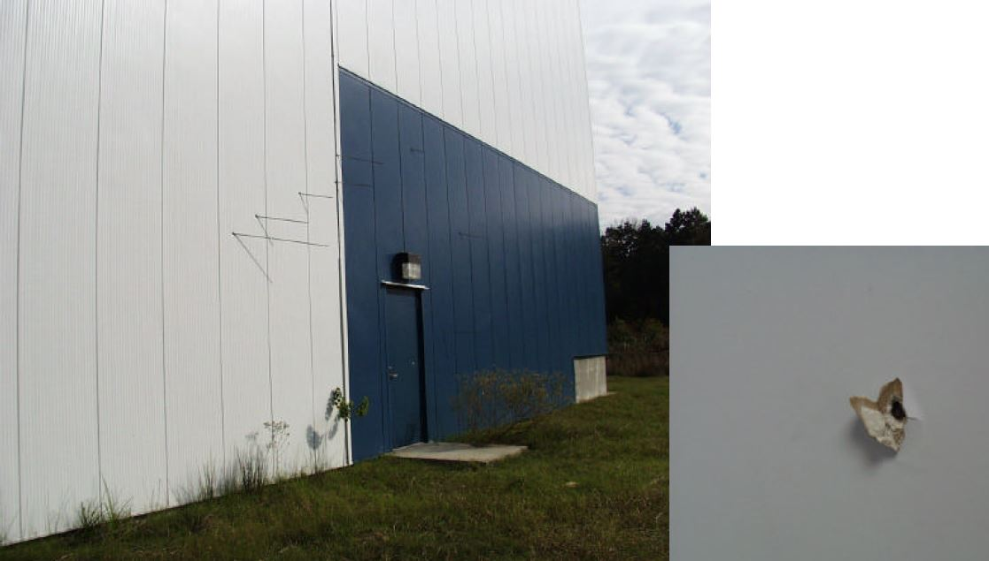
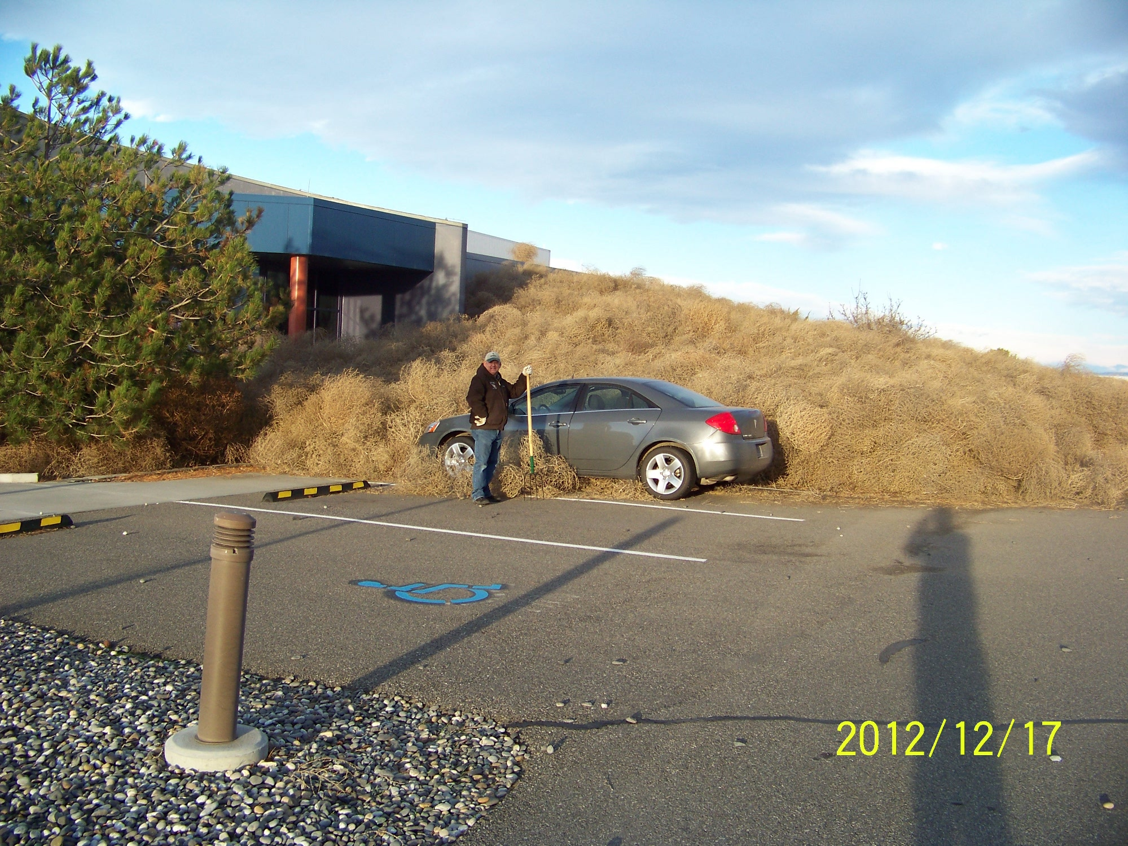
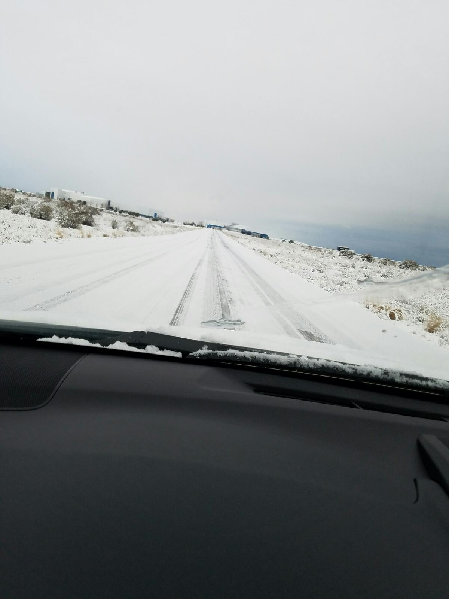


Enclosures doing their job
Bullets
Tumbleweeds and range fires
Icy Roads

Slide 34

Vacuum System Schematic and Gauging
4 km
50 m
Gauging monitors pressure, cryopump levels, LN2 supply, etc. sends a text message if unusual condition occurs. Pressure monitored by cold-cathode (magnetron) gauges

Slide 35



Challenges: Leaks and corrosion
evacuated “fothering” patch
mouse latrine
pressure transient vs. distance for He injection
mud dauber nest
Cracks and corrosion create
~1e-6 TL/s leaks…sounds easy to find but……

Slide 36

Challenges: Leaks and Detection
500 l/s turbo for MSLD compression boost (K. Ryan)
MSLD response test at 250m (measurement vs. model w/error bands)
MSLD response degradation with distance
Time constant of system makes Helium MSLD difficult, locating a leak extremely challenging, plus “where to start”?

Slide 37



GV7 sarcophagus concept
Challenges: Valve bonnet leak
~ 4e-5 TL/s leak
SEAL
Odd time constant…. leaking through grease?
There is no mechanism to vent a beam tube, repair a valve and rebake, so what to do? Answer….design and install an enclosure to evacuate the volume outside the valve screw drive mechanism. Leak reduced, but valve now permanently inoperable (located at 2 km “mid-station”) in open position. Luckily…. this valve could be abandoned w/o compromising operations

Slide 38








Current Vacuum Research
Molecular dynamics of beam tube
Steel surface modeling
Dry gas backfill
Vortex system
Ion pump UV induced charging
Squeeze film damping
Water injection

Slide 39

Thank you for visiting LIGO !
Enjoy the 40m (1% scale) lab tour

