Slide 1
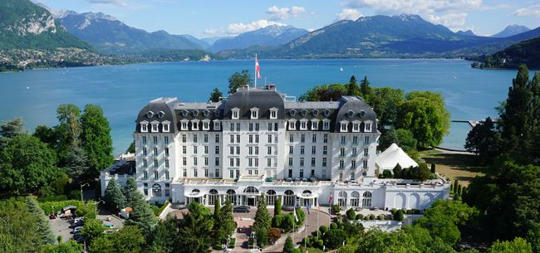
Some highlights from GWPAW 2017 Annecy, France
Alan Weinstein
Caltech, LIGO Laboratory
2 June 2017
Alan Weinstein, Caltech & LIGO Laboratory

Slide 2
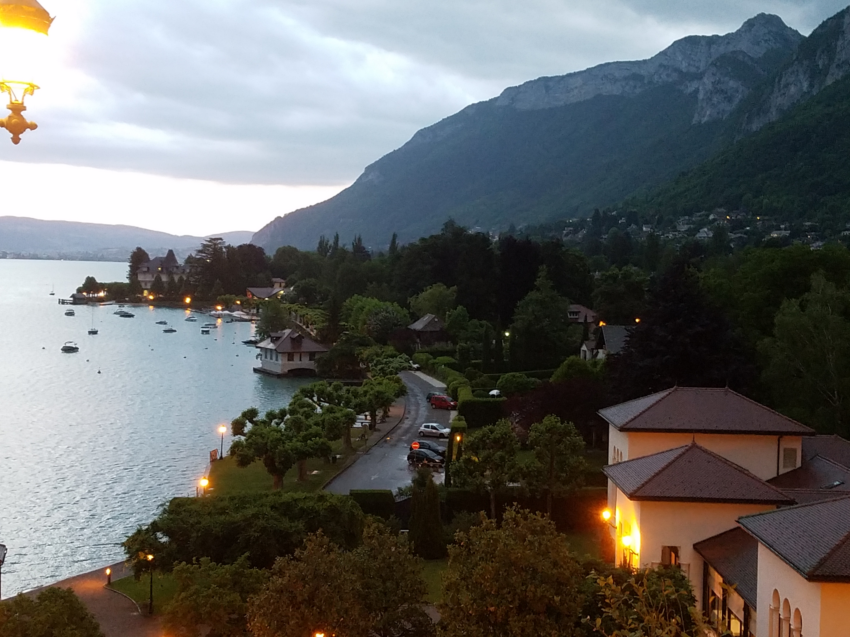
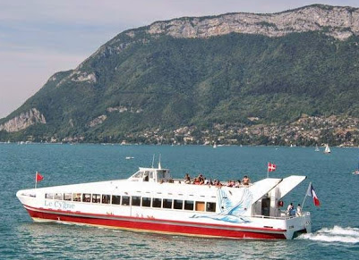
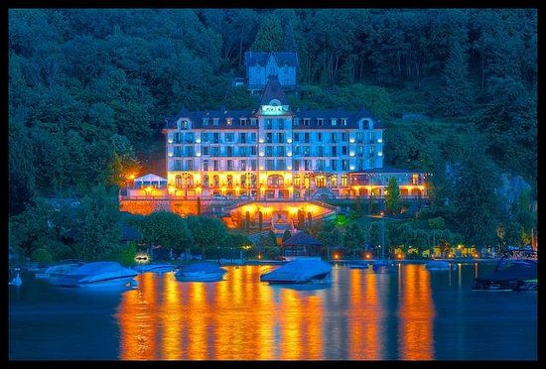
Le Cygne
Le Cygne
Le Palace De Menthon

Slide 3
Filling in the spectrum of BH masses
Notes:
Chad Hanna

Slide 4
Excellent agreement with waveforms based on General Relativity
No evidence for exotic dispersion relation in propagation
No deviation from GR in inspiral, merger, ringdown
Notes:
Chad Hanna

Slide 5
GW170104 Primary BH spin suggestive of anti-alignment with respect to orbital angular momentum
GW150914
LVT151012
GW151226
GW170104

Slide 6
Notes:
Ian Harry

Slide 7
Status of Advanced LIGO, GEO 600, Advanced Virgo
Mike Landry
Notes:
Landry

Slide 8
Sheila ROWAN
Notes:
Sheila Rowan

Slide 9
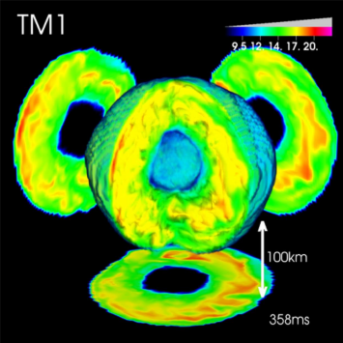
GW Spectrograms from 3D-GR models with strong SASI vs. weak SASI activity
Kei KOTAKE
(from Kuroda, KK, & Takiwaki ApJL (2016), see also Andresen et al. (2016))
✓ Two EOSs → SFHx (Steiner et al. (2013), fits well with experiment/NS radius,Steiner+(2011)),
HS(TM1) (Shen et al. (1998)).
✓15 M_{sun} star (Woosley & Weaver (1995))
SFHx :softer
TM1 :stiffer
✓SASI activity higher for softer EOS (due to shorter growth rate, e.g., Foglizzo et al. (‘06)).
Notes:
One possible way is

Slide 10
Summary
Kei KOTAKE
 | Neutrino mechanism | MHD mechanism
Progenitor | Non- or slowing- rotating star （$Ω_{0}<\sim 0.1 rad/s)$ | Rapidly rotating star with strong B fields ($Ω_{0}>\sim π rad/s,B_{0}>{\sim 10}^{11} G)$
Main GW signatures | Three generic phases: Prompt convection, neutrino-driven convection & SASI, and explosion | Rotating bounce (< 20 ms p.b.) and non-axisymmetric instabilities ( < ? ms)
Detection Prospect | ✓Requires 3rd generation detector to see every Galactic event (with high SNR). ✓Closeby events (2~3kpc) detectable by LIGO-class detectors. ✓ Circular polarization with SASI-dominated models ✓ If detected, critical information about SN engine (convection-dominant vs. SASI dominant) can be obtained. | ✓ Bounce GW signal: horizon of LIGO, depending on Ω_{0,} can cover our Milky way and beyond. ✓ GWs from non-axisymmetric instabilities: “quasi-periodicity” enhances chance of detection. ✓ Circular polarization: probe of rotation (Talk by Hayama!) ✓ Clear directionality of GW and neutrino signals

Slide 11
Advanced LIGO (O1) Search for IMBHB’s
Francesco SALEMI

Slide 12
Letizia SAMMUT
Notes:
Letizia Sammut

Slide 14
Generic dispersion relation for GW propagation
Anuradha SAMAJDAR
Chris VAN DEN BROCK
Notes:
Chris van den Brock for

Slide 15
Lionel LONDON
Notes:
Lionel London

Slide 16
Carlos Filipe DA SILVA COSTA

Slide 17
Ringdown and echoes as probes of strong-field dynamics of GR
Archisman GHOSH

Slide 18
Archisman GHOSH
Notes:
Archisman Ghosh

Slide 19
Miriam CABERO MUELLER
It is thrilling to see predictions I made over 40 years ago such as the black hole area and uniqueness theorems being observed within my lifetime. -SH
Notes:
Miriam Cabero

Slide 21
Echoes from the ABYSS
Jahed ABEDI

Slide 22
Echoes from AEI
Alex NIELSEN

Slide 23
Duncan BROWN
Notes:
Duncan Brown

Slide 24
Yuki INOUE
Notes:
Yuki InoueYuki INOUE, KAGRA

Slide 25
Paola LEACI

Slide 27
Notes:
Paola Leaci

Slide 28
Einstein@Home all-sky search
Sinead WALSH
Notes:
Sinead Walsh

Slide 29
Directed searches for CWs from Sco X-1
John WHELAN
Notes:
John Whelan

Slide 30
The oxymoronic transient CWs
David KEITEL

Slide 31
Nelson CHRISTENSEN
Notes:
Nelson Christensen

Slide 33
As the last speaker, it is my privilege to say merci beaucoup to the organizers: Frederique Marion Benoit Mours Damir Buskulic and the rest of the L.A.P.P. team for an extremely well-organized and fascinating meeting in a lovely venue here in this beautiful city of Annecy!

