Slide 1
Gravitational Wave detectors: Accomplishments and Plans for the Future
Nordita
21 June 2017
David Shoemaker, ed.
For the LSC and Virgo, and
The LISA Consortium

Slide 2
What are the ground-based Gravitational-wave detectors?
What limits their sensitivity?
What have we accomplished with them to date?
What improvements can we expect in the next year, several years, decades?
…and space?

Slide 3
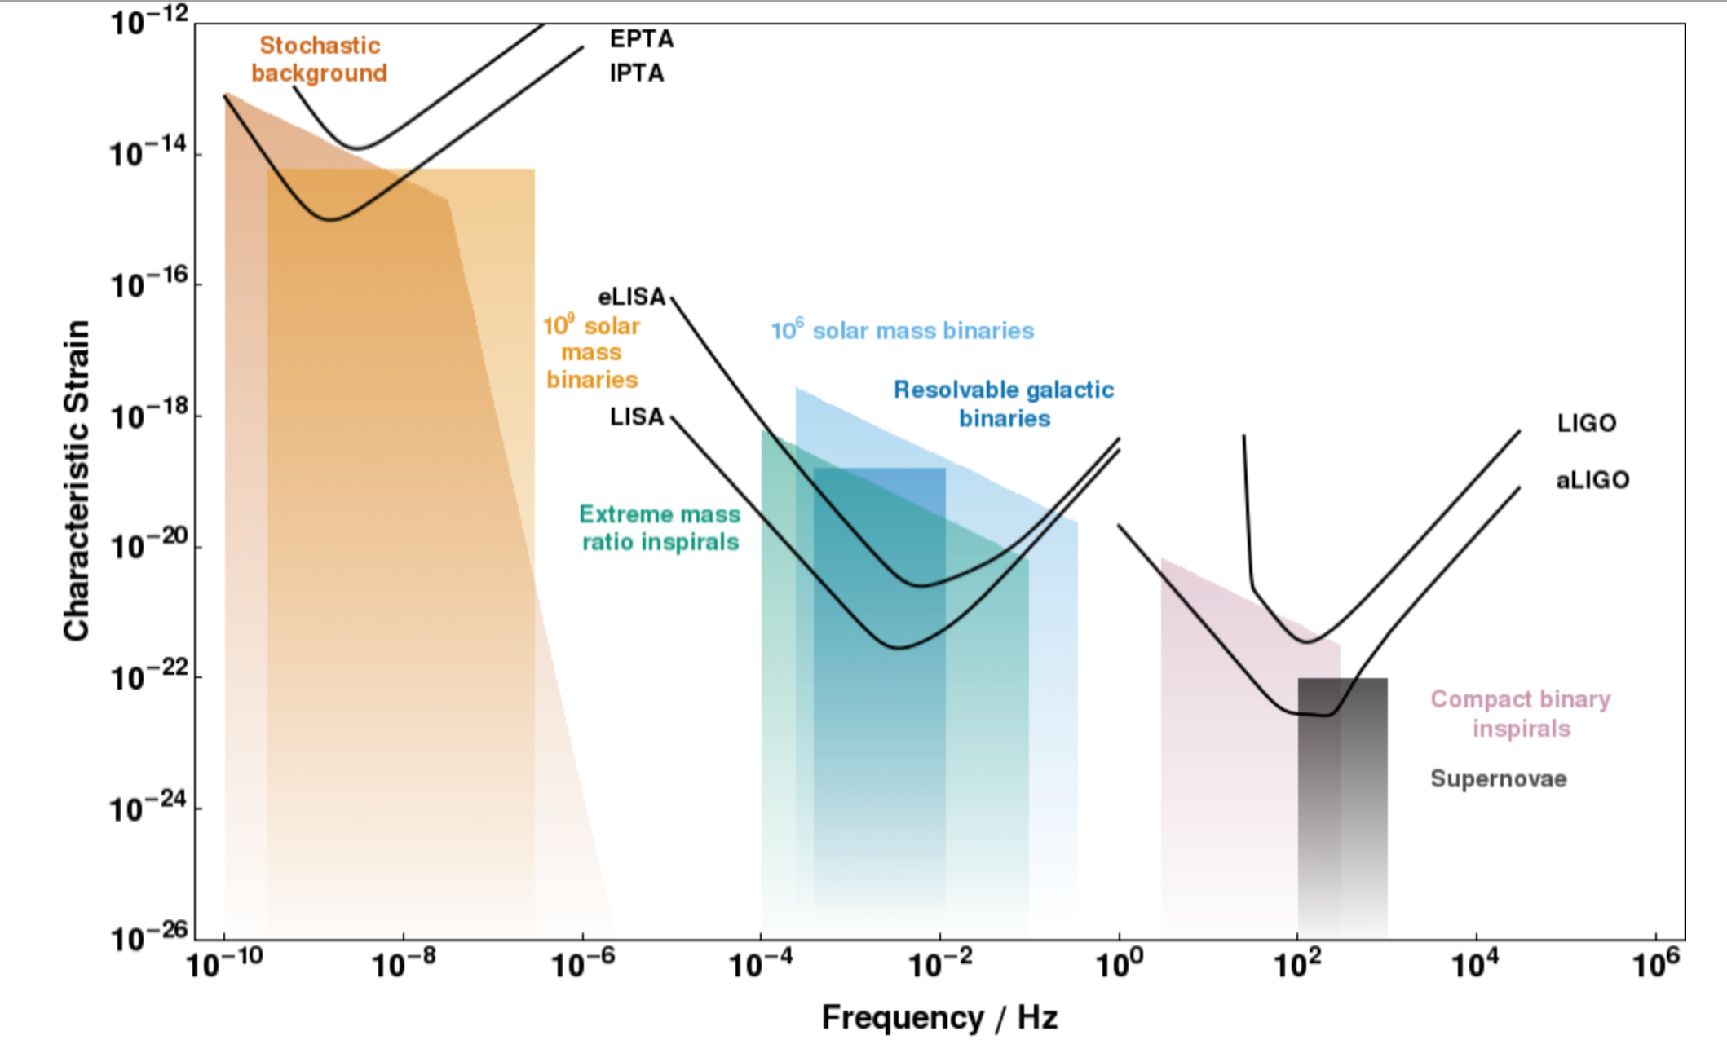
A spectrum of GW Sources and Sensors
CQG, 32 (2015) 015014

Slide 4
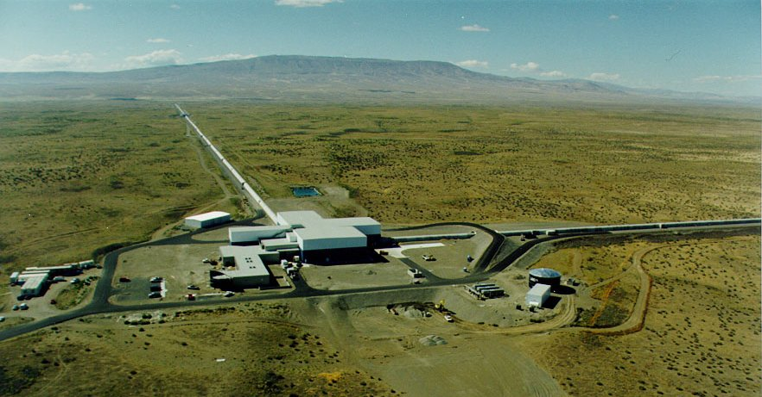

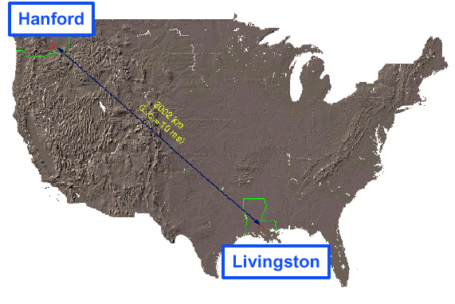
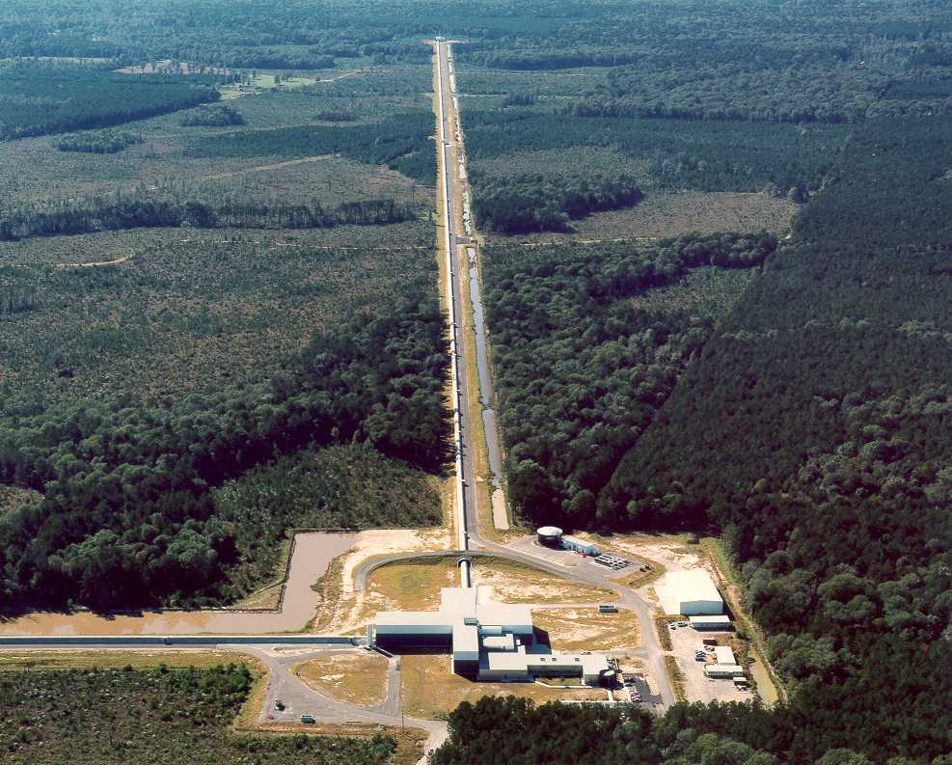
LIGO Laboratory – Caltech, MIT – built observatories in ‘90s
Built, then observed with initial detectors 2005-2011;
Advanced LIGO Project 2008-2015
3000 km
10 msec
LIGO Livingston
Notes:
And, you need two observatories to be really sure you have seen something, and to get an idea from where the signal comes. With the NSF – and the US Taxpayer’s – help, the LIGO Laboratory run by Caltech and MIT built the two LIGO sites, and put in initial detectors. We observed with them until 2011 – and the 1000-plus-person LIGO and Virgo Collaborations analyzing the data saw nothing. Interesting nothing – with new upper limits on some sources –, but
.

Slide 5
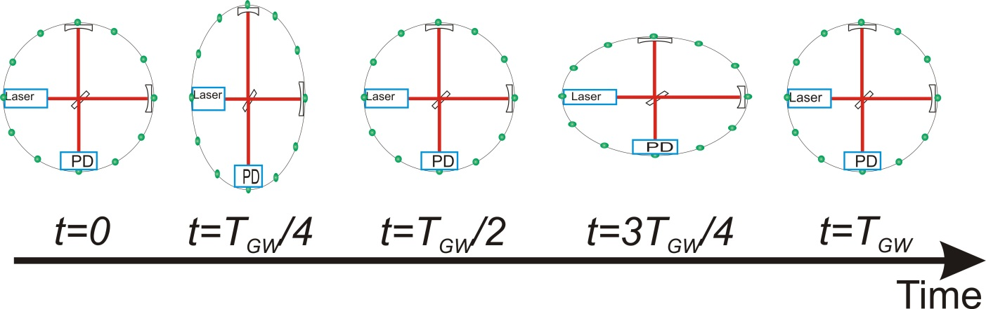
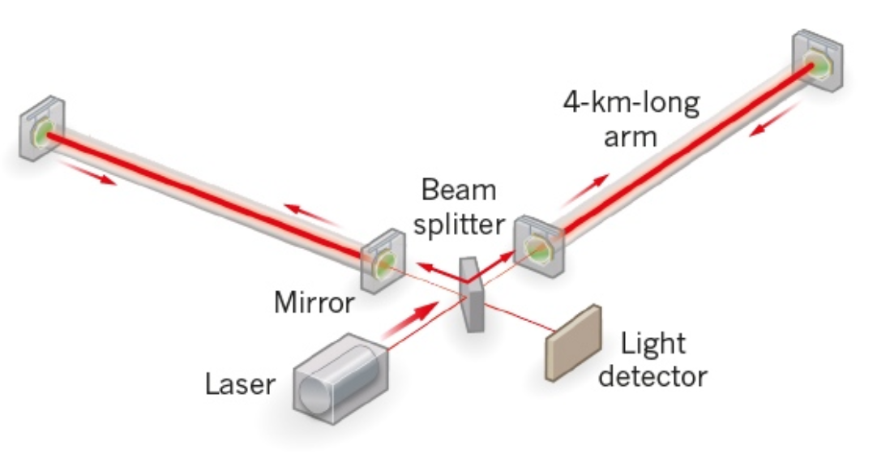
What is LIGO’s measurement technique?
Enhanced Michelson interferometers
  LIGO, Virgo, and GEO600 use variations
Passing GWs modulate the distance between the end test mass and the beam splitter
The interferometer acts as a transducer, turning GWs into photocurrent proportional to the strain amplitude
Arms are short compared to our GW wavelengths, so longer arms make bigger signals
→ multi-km installations
Arm length limited by
taxpayer noise….
Magnitude of h at Earth:
  Largest signals h ~ 10⁻²¹
  (1 hair / Alpha Centauri)
  For L = 1 m, ΔL= 10⁻²¹ m
  For L = 4km, ΔL= 4x10⁻¹⁸ m

Slide 6
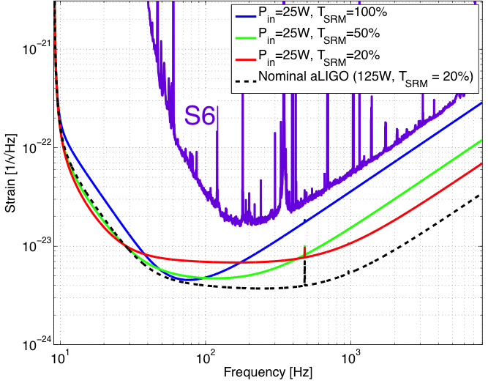
  Measuring ΔL= 4x10⁻¹⁸ m
  Readout
Shot noise – ability to resolve a fringe shift due to a GW (counting statistics)
Zum gegenwärtigen Stand des Strahlungsproblems,
A. Einstein, 1909
Fringe Resolution at high frequencies improves as as
(laser power)^{1/2}
Point of diminishing returns when buffeting of test mass
by photons increases
low-frequency noise –
use heavy test masses!
‘Standard Quantum Limit’
Advanced LIGO will reach this limit with its 200W laser,
40 kg test masses

Slide 7
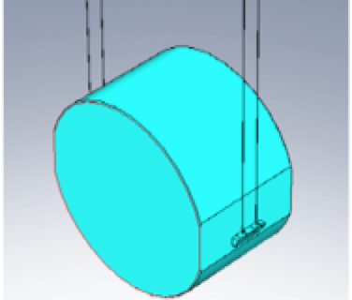
Measuring ΔL= 4x10⁻¹⁸ m
Internal motion
Thermal noise – kT of energy
per mechanical mode
Über die von der molekularkinetischen Theorie
der Wärmegeforderte Bewegung
von in ruhenden Flüssigkeiten suspendierten Teilchen,
A. Einstein, 1905
Motion of components due to thermal energy masks GW
Low mechanical loss materials gather this motion into a narrow
peak at resonant frequencies
Realized in aLIGO with an all
fused-silica test mass
suspension – Q of order 10⁹
Test mass internal modes,
Mirror coatings engineered for
low mechanical loss

Slide 8
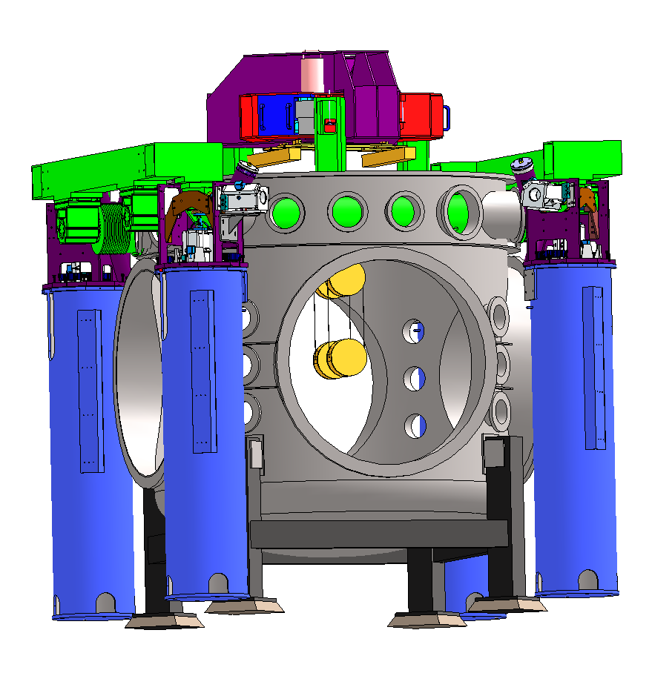
Measuring ΔL= 4x10⁻¹⁸ m
Forces on test mass
Seismic noise – must prevent masking of GWs, enable practical control systems
(did Einstein work on seismic motion…?)
Motion from waves on coasts…and people and their machines
GW band: 10 Hz and above – direct effect of masking
Control Band: below 10 Hz – forces needed to hold optics
on resonance and aligned
aLIGO uses active servo-controlled platforms, multiple pendulums
Ultimate limit on the ground: Newtownian background – wandering net gravity vector; a limit in the 10-20 Hz band

Slide 9
The complexity of a real instrument…

Slide 10
And technical noise sources….

Slide 11
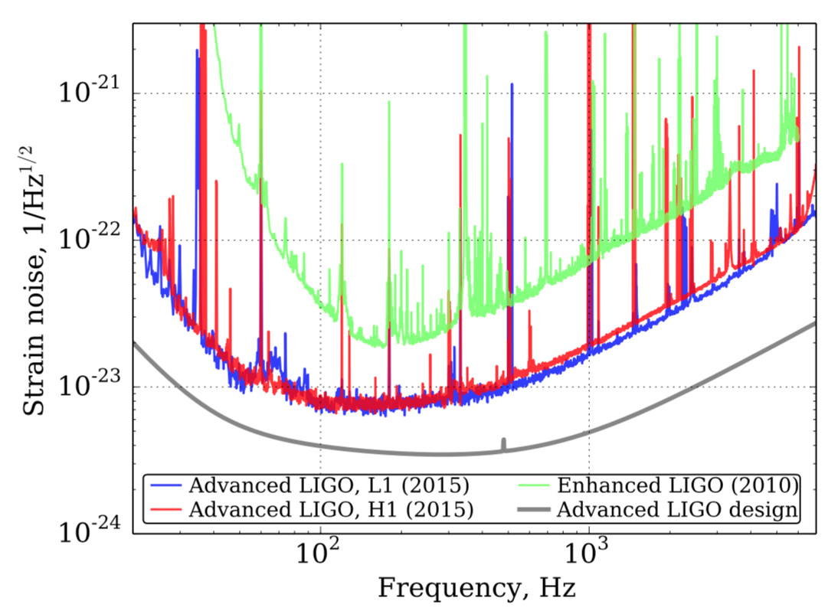
Current Sensitivity, Observing Schedule
  O1 started 12 September 2015, ended 19 January 2016
  O2 started 30 November 2016, will end ~ 31 August 2017
Initial LIGO
O1 aLIGO
Design aLIGO

Slide 12
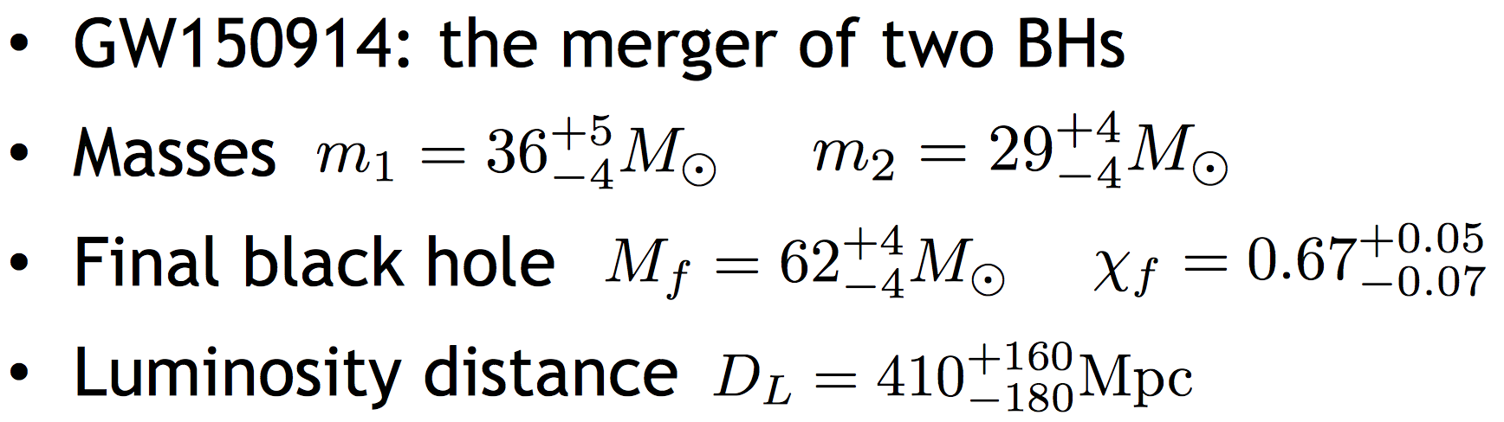
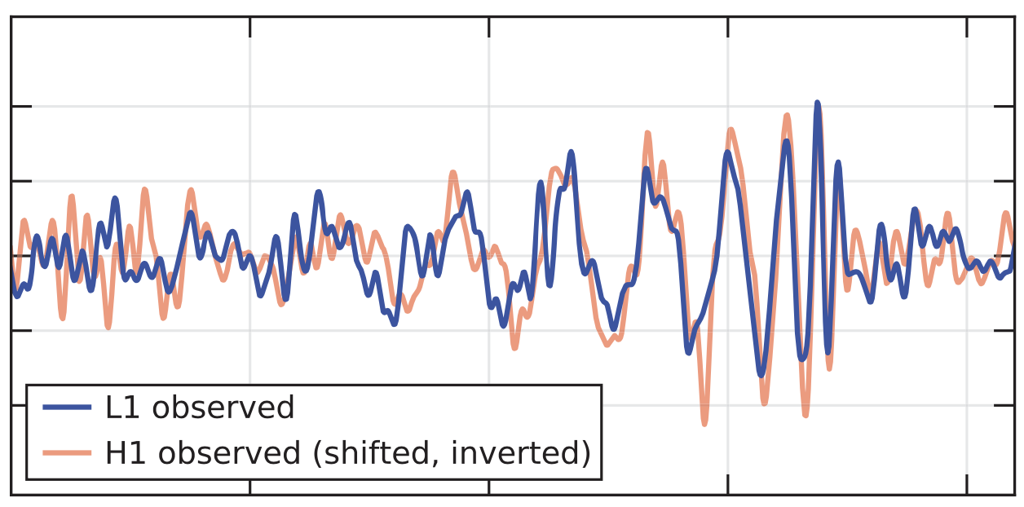

Two days after the start of observing in O1:
Our first detection

Slide 13
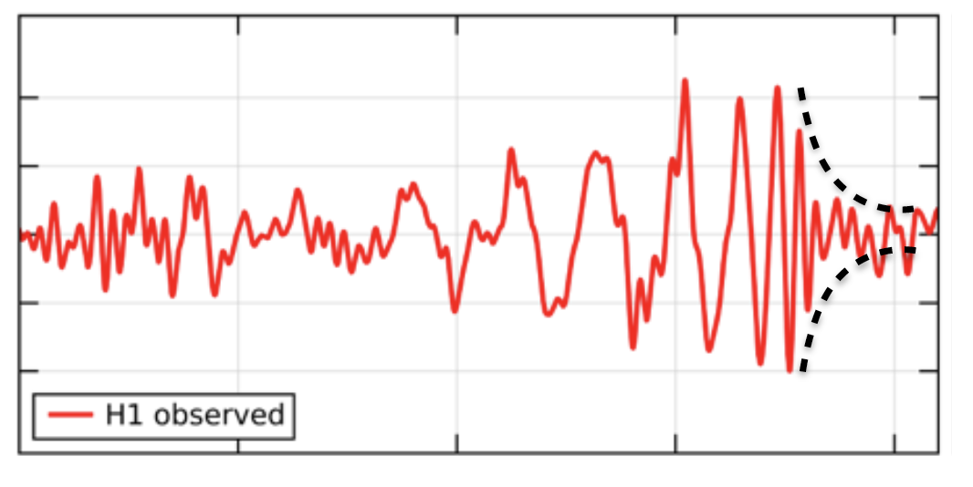
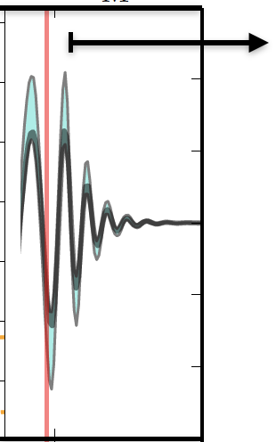

Ringdown of final black hole
We almost see a ringdown of the remnant – SNR ~ 8
Waveform post-merger is consistent with pre-merger
But cannot isolate it and measure the frequency and Q with precision
(we’ll come back to this)

Slide 14
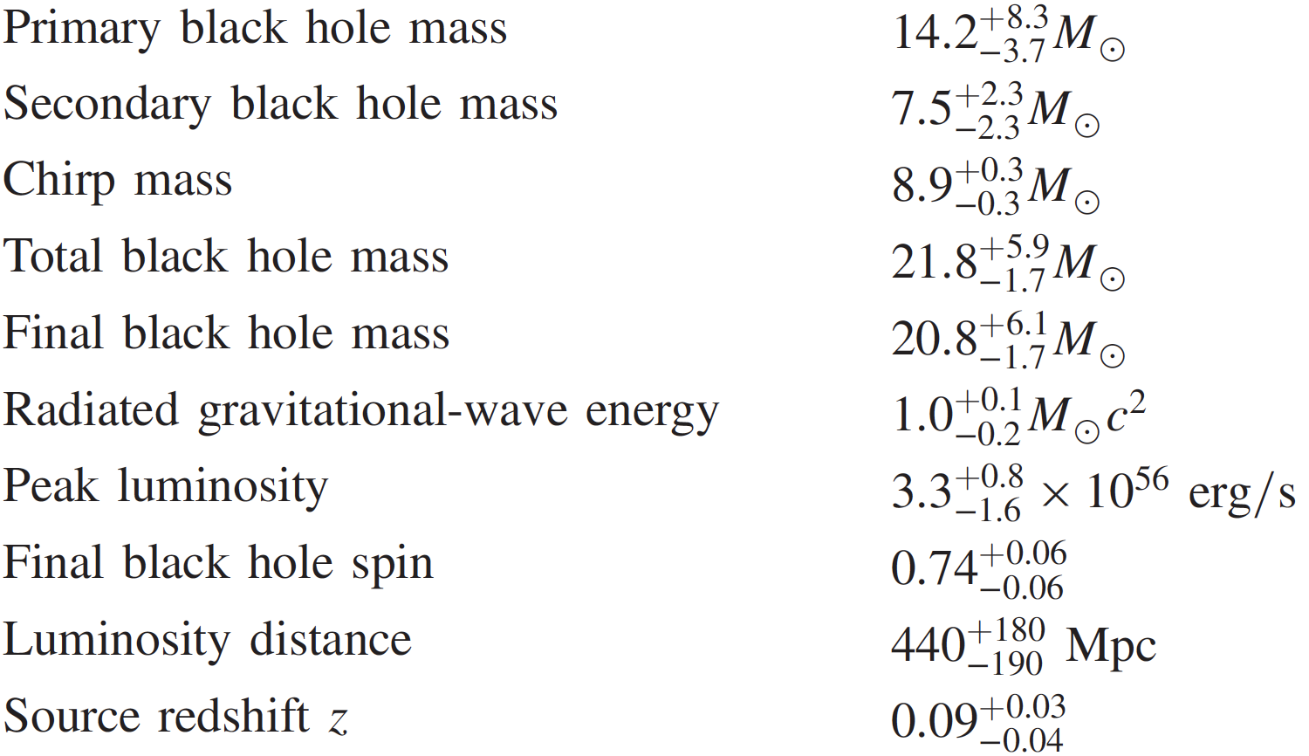
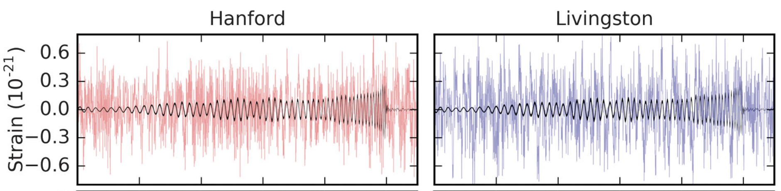

The second detection:
“Boxing Day” GW151226

Slide 15
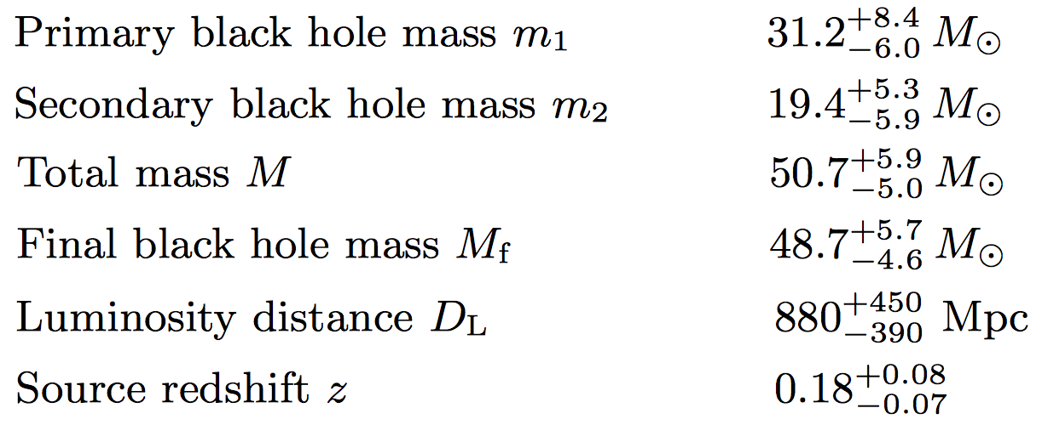
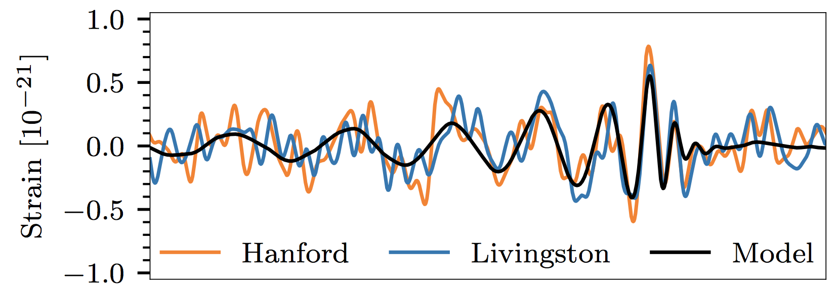

Our third discovery:
GW170104

Slide 16
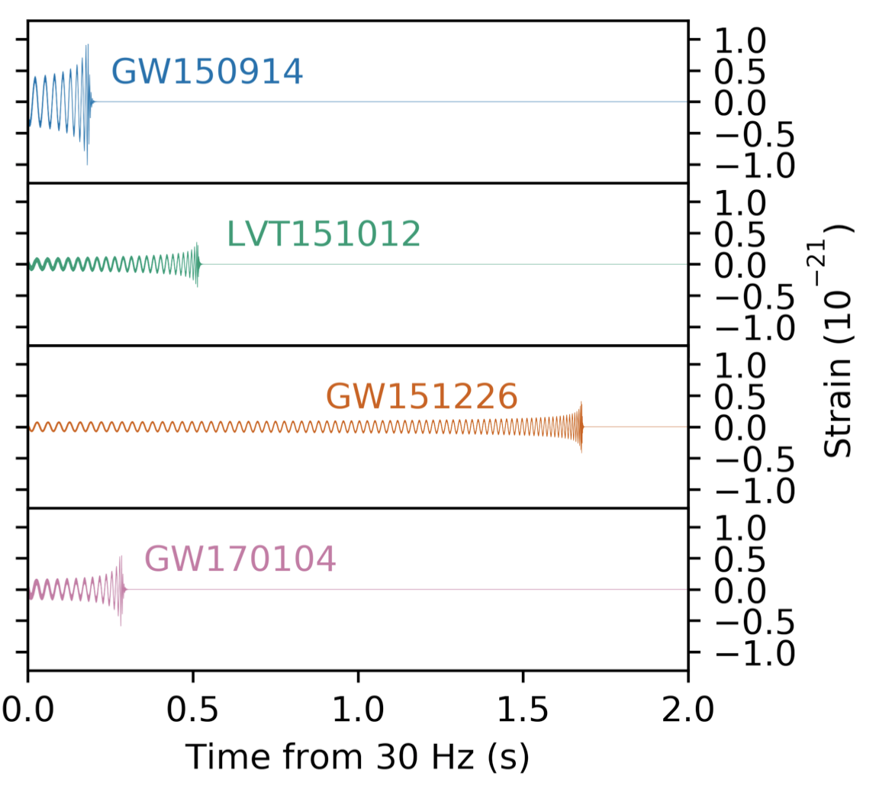
The 3.5 signals all together

Slide 17
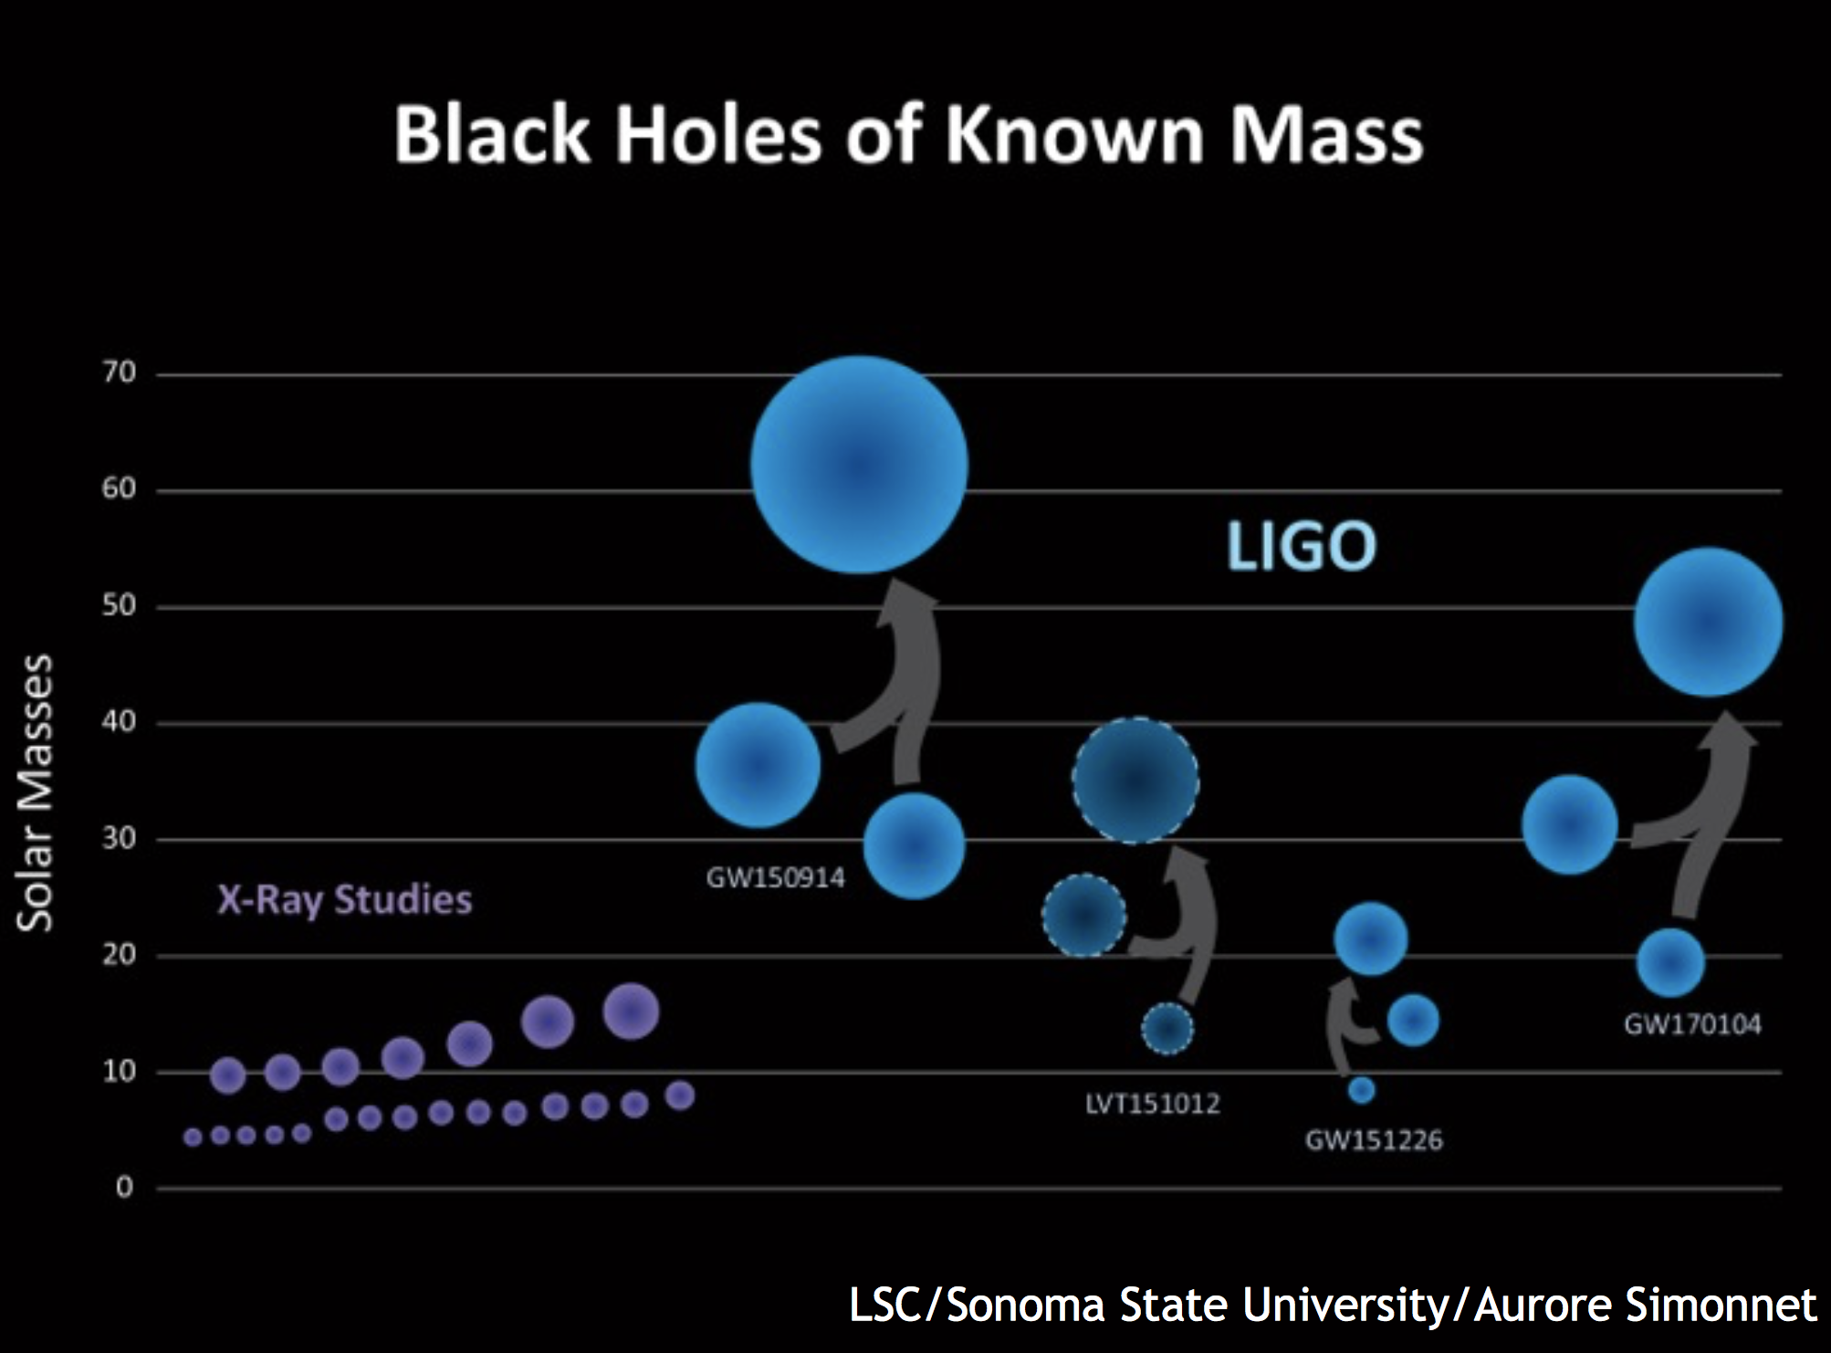

Slide 18
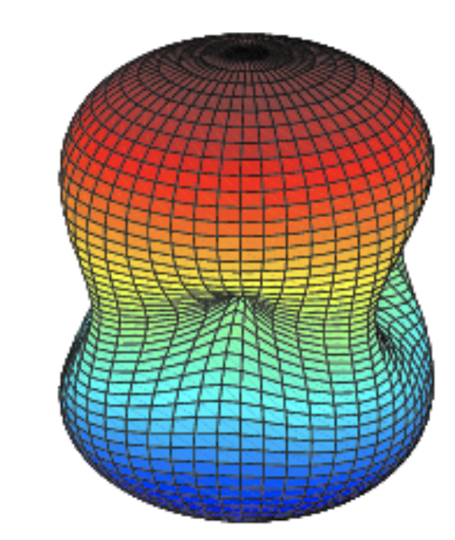
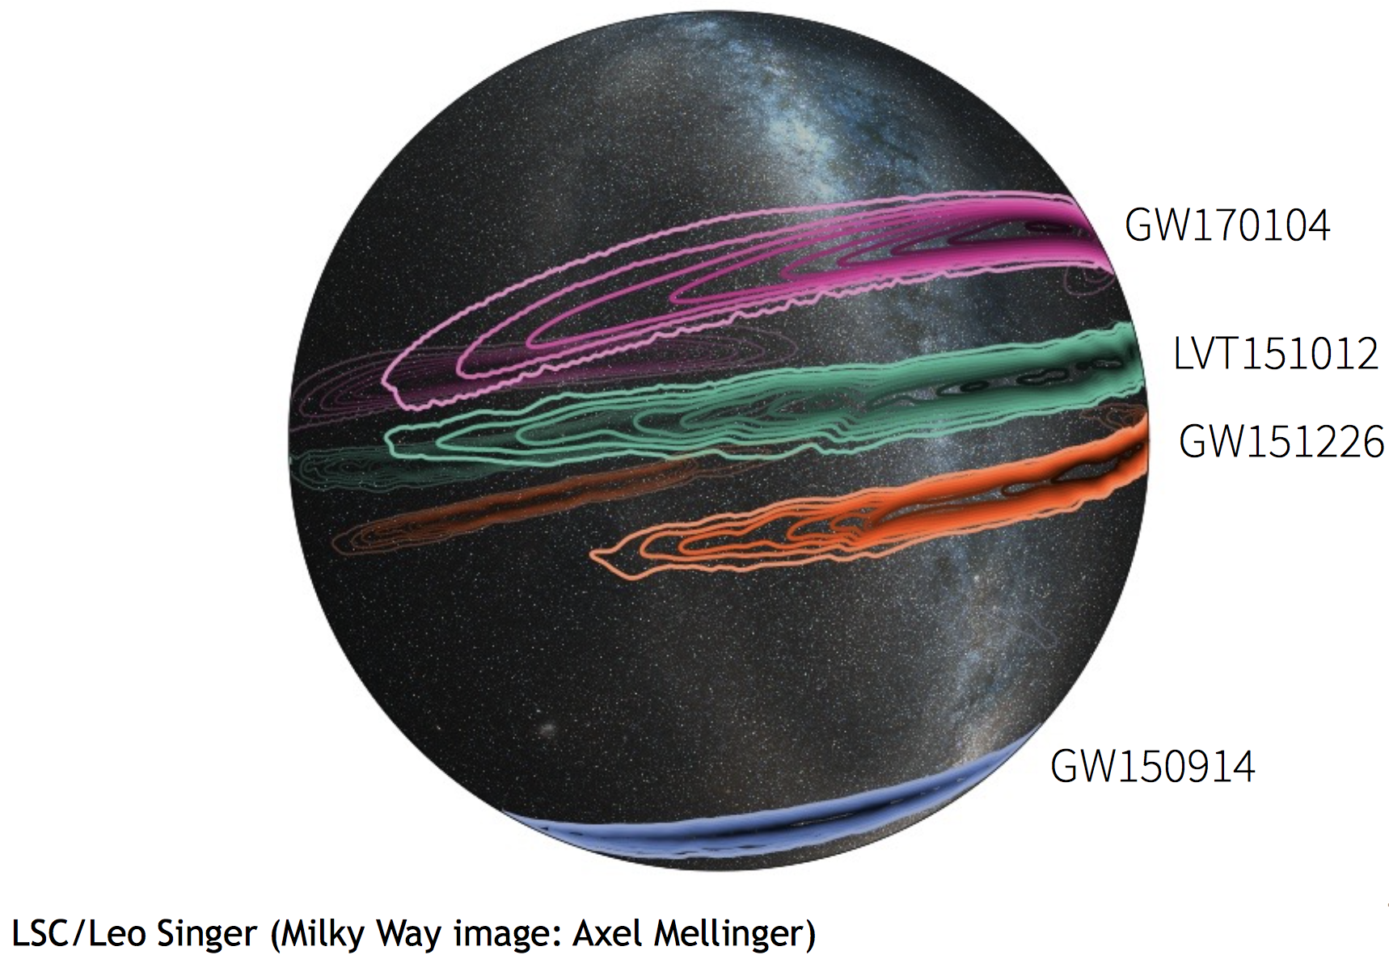
Localization with two detectors
An Annulus, with some further refinement from the antenna pattern:

Slide 19
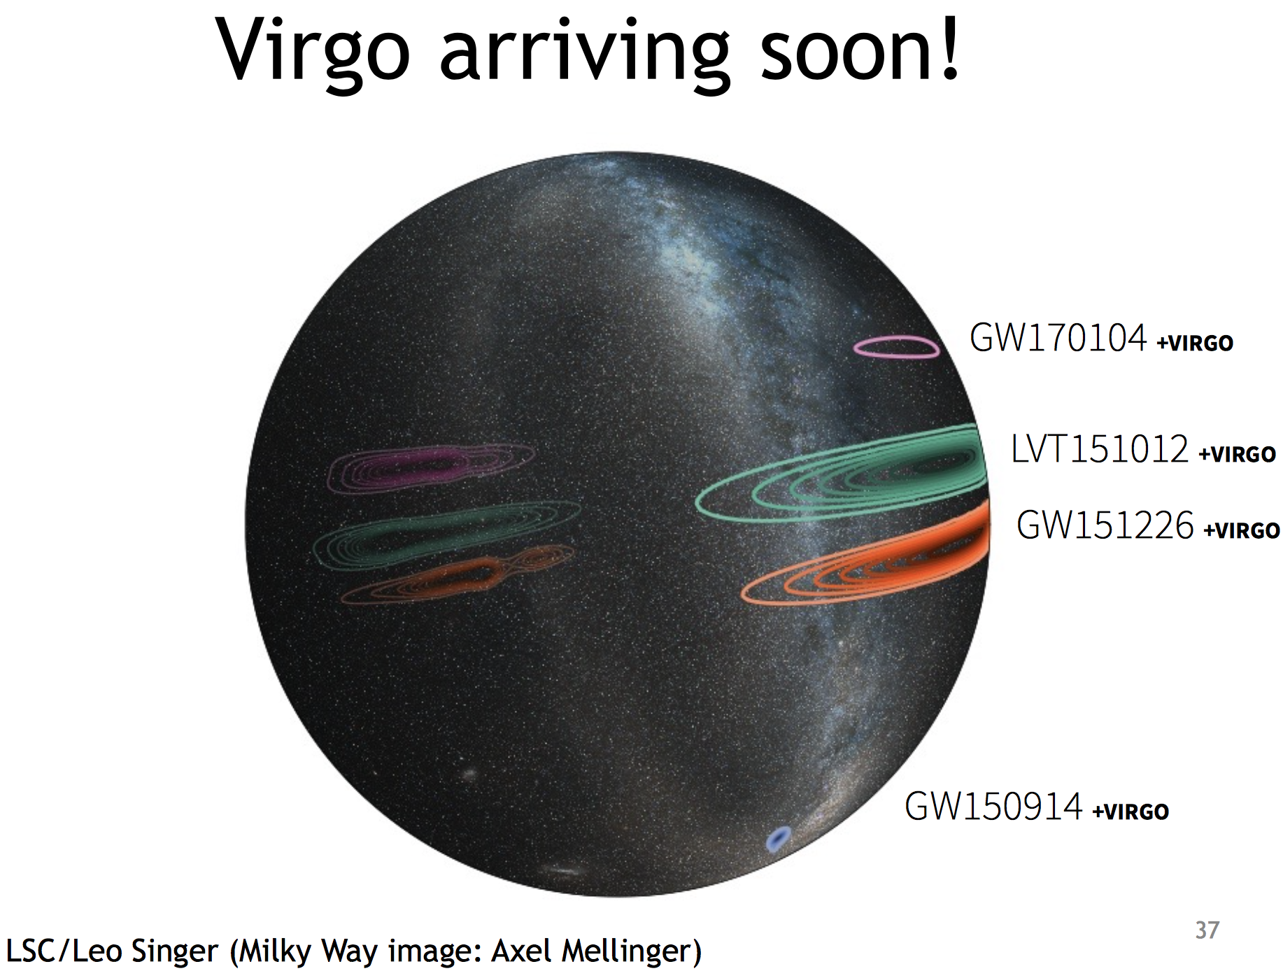
Adding a 3rd detector helps

Slide 20
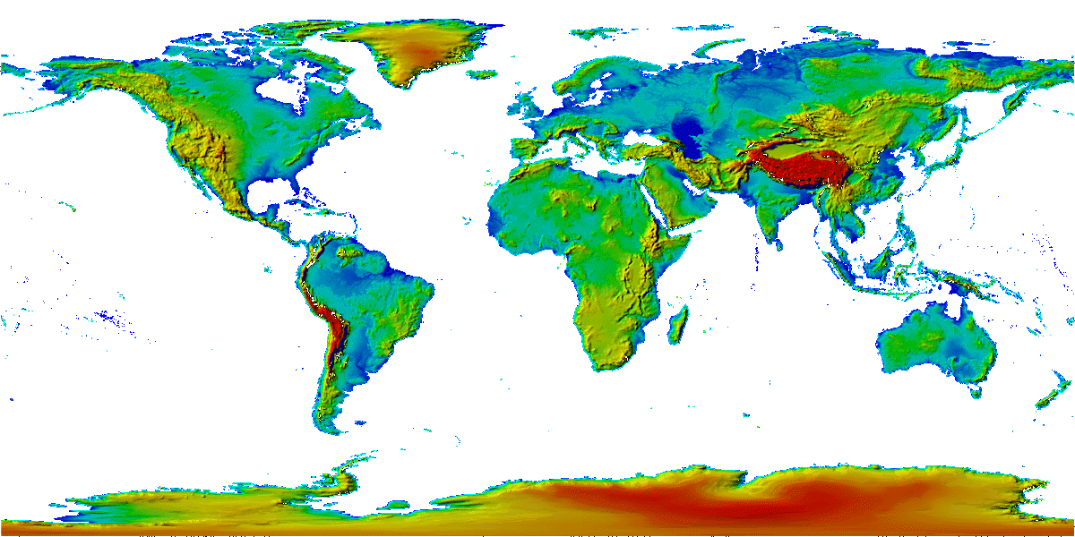
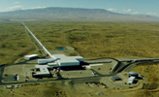
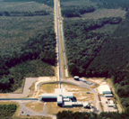

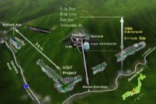


The advanced GW detector network
Advanced
Virgo
2017
Advanced
LIGO
Hanford,
Livingston
2015
KAGRA
2018
LIGO-India
2024
20
20

Slide 21
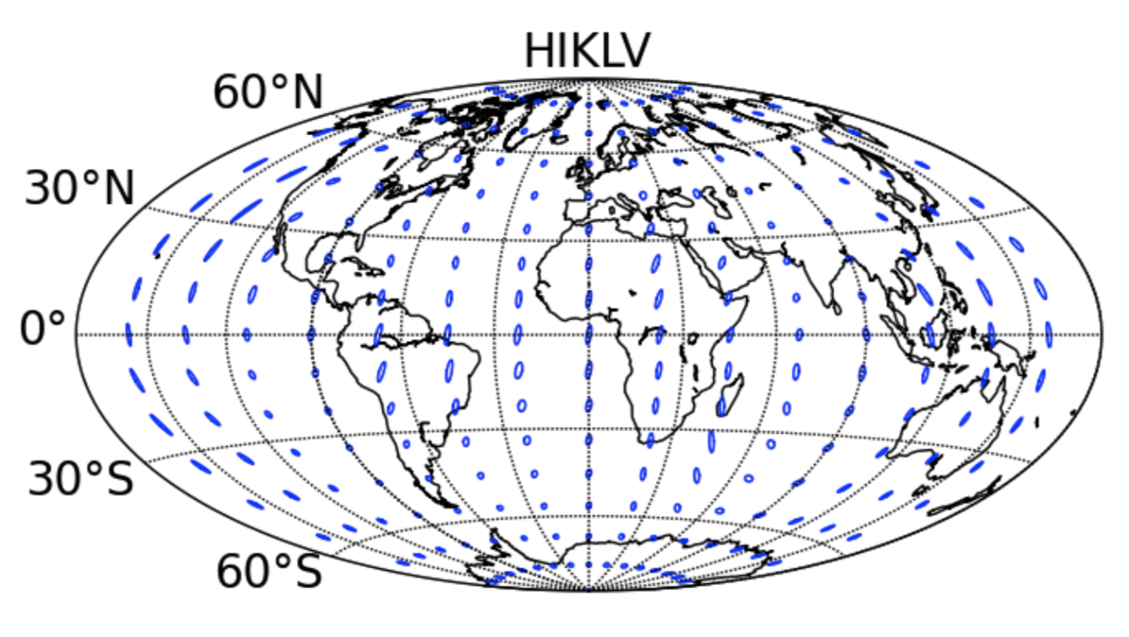
2024 Sensitivity/configuration:
5 detectors
far improved source localization
~60% in 10 sq deg
2022
Notes:
P0900125-v8

Slide 22
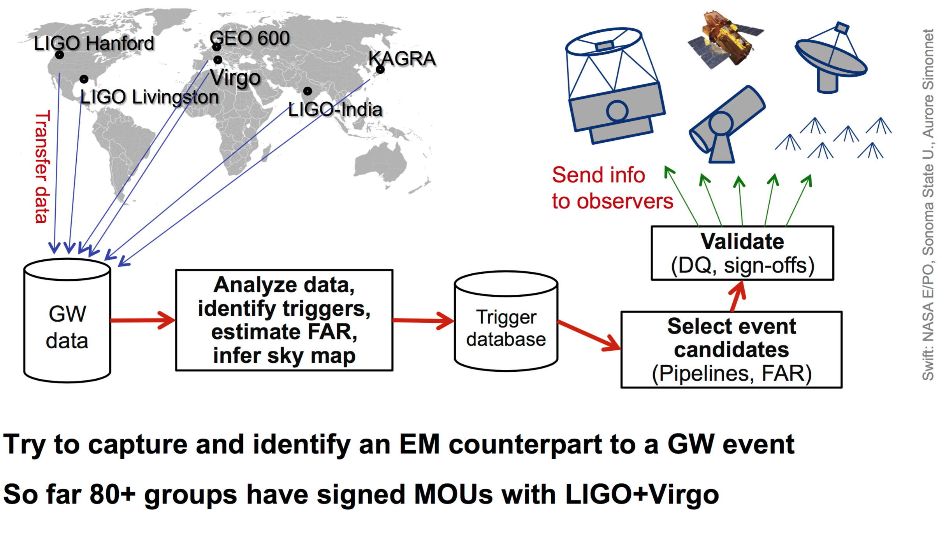
EM followup
No EM counterparts have been identified yet...black holes are quiet.
  Hope to have a detection soon with a Neutron Star

Slide 23
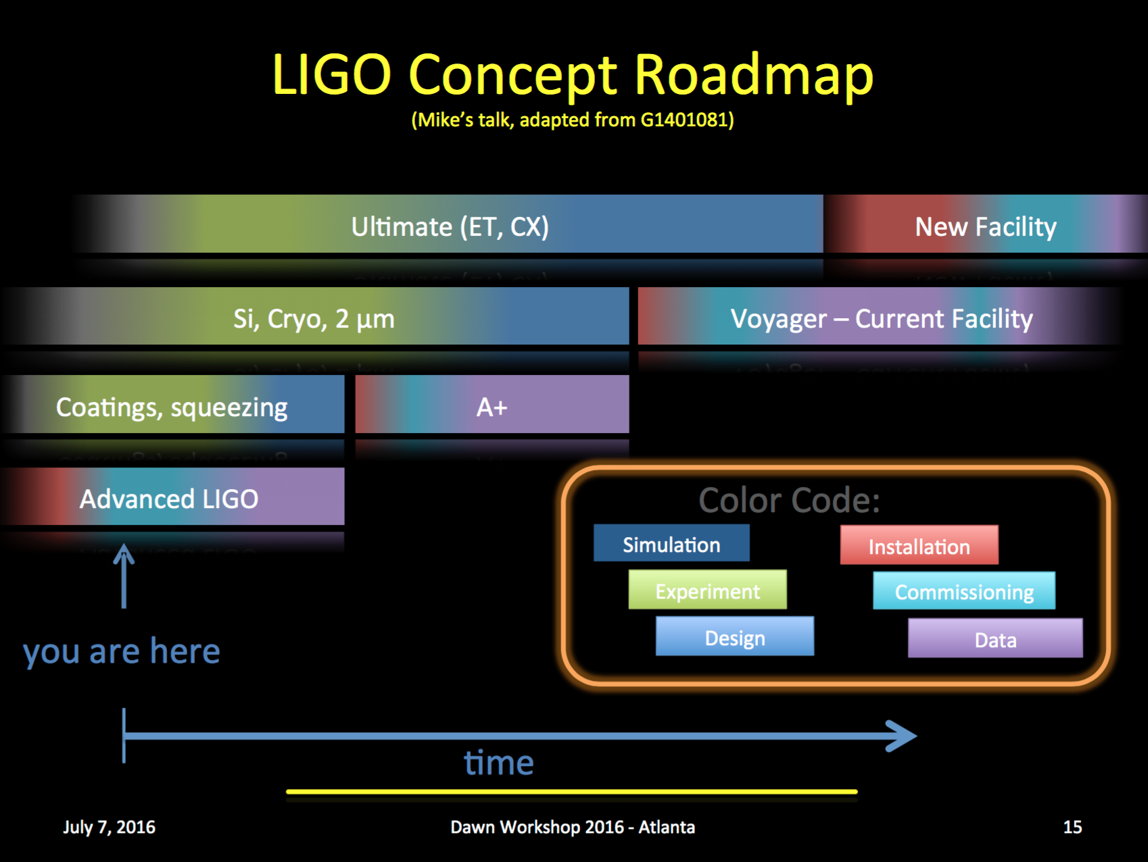
Barsotti/Zucker

Slide 24
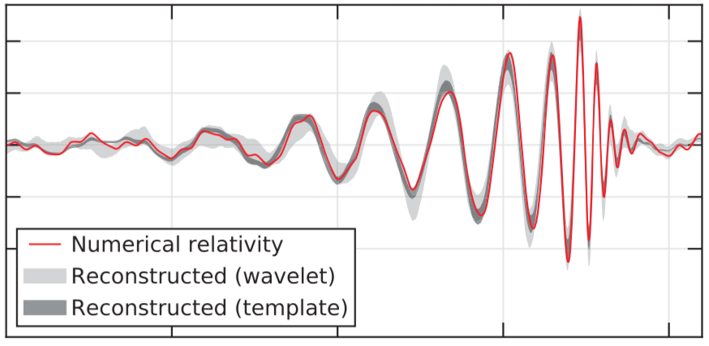
aLIGO operating at full power and fully commissioned (~3x better than now)
aLIGO
BNS reach: 180 Mpc
BBH reach: 2200 Mpc
(z = 0.2)
QNM SNR ~25
(for an event like GW150914)
ZUCKER

Slide 25
aLIGO with the addition of frequency-dependent squeezing and lowered optical coating thermal noise
A+
BNS reach: 510 Mpc
BBH reach: 3700 Mpc
(z = 1.1)
QNM SNR ~40
(for an event like GW150914)
ZUCKER

Slide 26
A+
An incremental upgrade to aLIGO
leverages existing technology and infrastructure, with
  minimal new investment,
  moderate risk, and
  modest interruption in observing
Target: factor of 1.7* increase in range over aLIGO
About a factor of 5 greater event rate
Stepping stone to future 3G detector technologies
Link to future GW astrophysics and cosmology
Could be observing within < 6.5 years (mid-2022)
  (with FY’19 or earlier funding)
“Scientific breakeven” within 1/2 year of operation
Incremental cost: a small fraction of aLIGO
  Formulating proposal now
*BBH 20/20 M: 1.64x
*BNS 1.4/1.4 M: 1.85x
ZUCKER

Slide 27
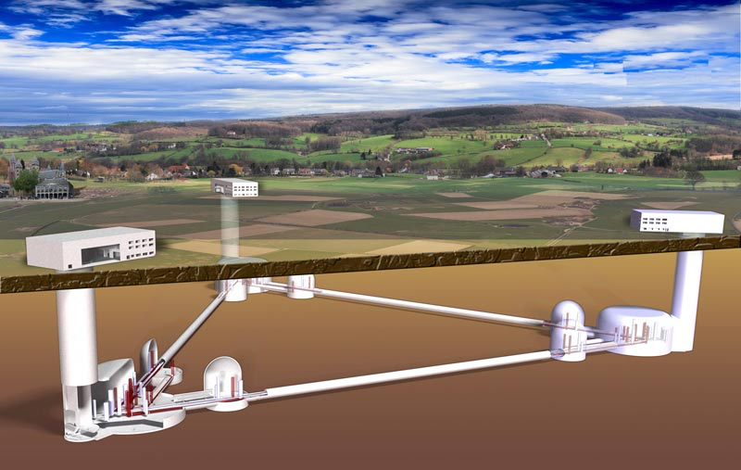
Further Future Improvements: The 3rd generation
European Concept: Einstein Telescope
Significant design study undertaken for both Facility and Instruments
Underground construction proposed to reduce Newtonian Background
  (and be compatible with densely-populated Europe)
Triangle – LISA-like –
with 10km arms
Multiple instruments in a
‘Xylophone’ configuration
  Allows technical challenges
  for low- and high-frequency
  to be separated
Designed to accommodate a
range of detector topologies and
mechanical realizations
  Including squeezing and
  cryogenics

Slide 28
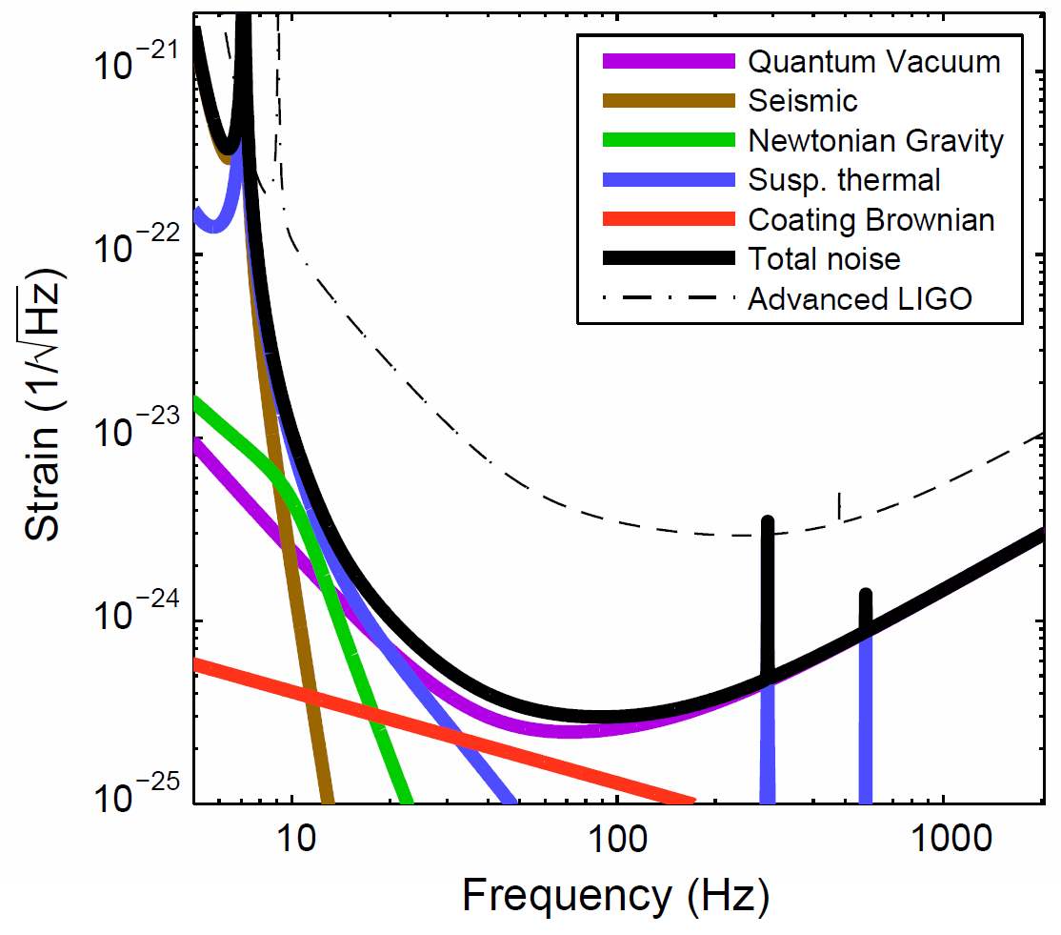
US Concept:
Make Advanced LIGO 10x longer,
10x more sensitive
Signal grows with length – not most noise sources
Thermal noise, radiation pressure, seismic, Newtonian unchanged
Coating thermal noise improves faster than linearly with length
40km surface Observatory ‘toy’ baseline
  can still find sites, earthmoving feasible; costs another limit…
Concept offers sensitivity without new measurement challenges; could start at room temperature, modest laser power, etc.
 | Adv. LIGO | 40 km LIGO
Arm length | 4 km | 40 km
Beam radius | 6.2 cm | 11.6 cm
Measured squeezing | none | 5 dB
Filter cavity length | none | 1 km
Suspension length | 0.6 m | 1 m
Signal recycling mirror trans. | 20% | 10%
Arm cavity circulating power | 775 kW
Arm cavity finesse | 446
Total light storage time | 200 ms | 2 s
Sigg et. al

Slide 29
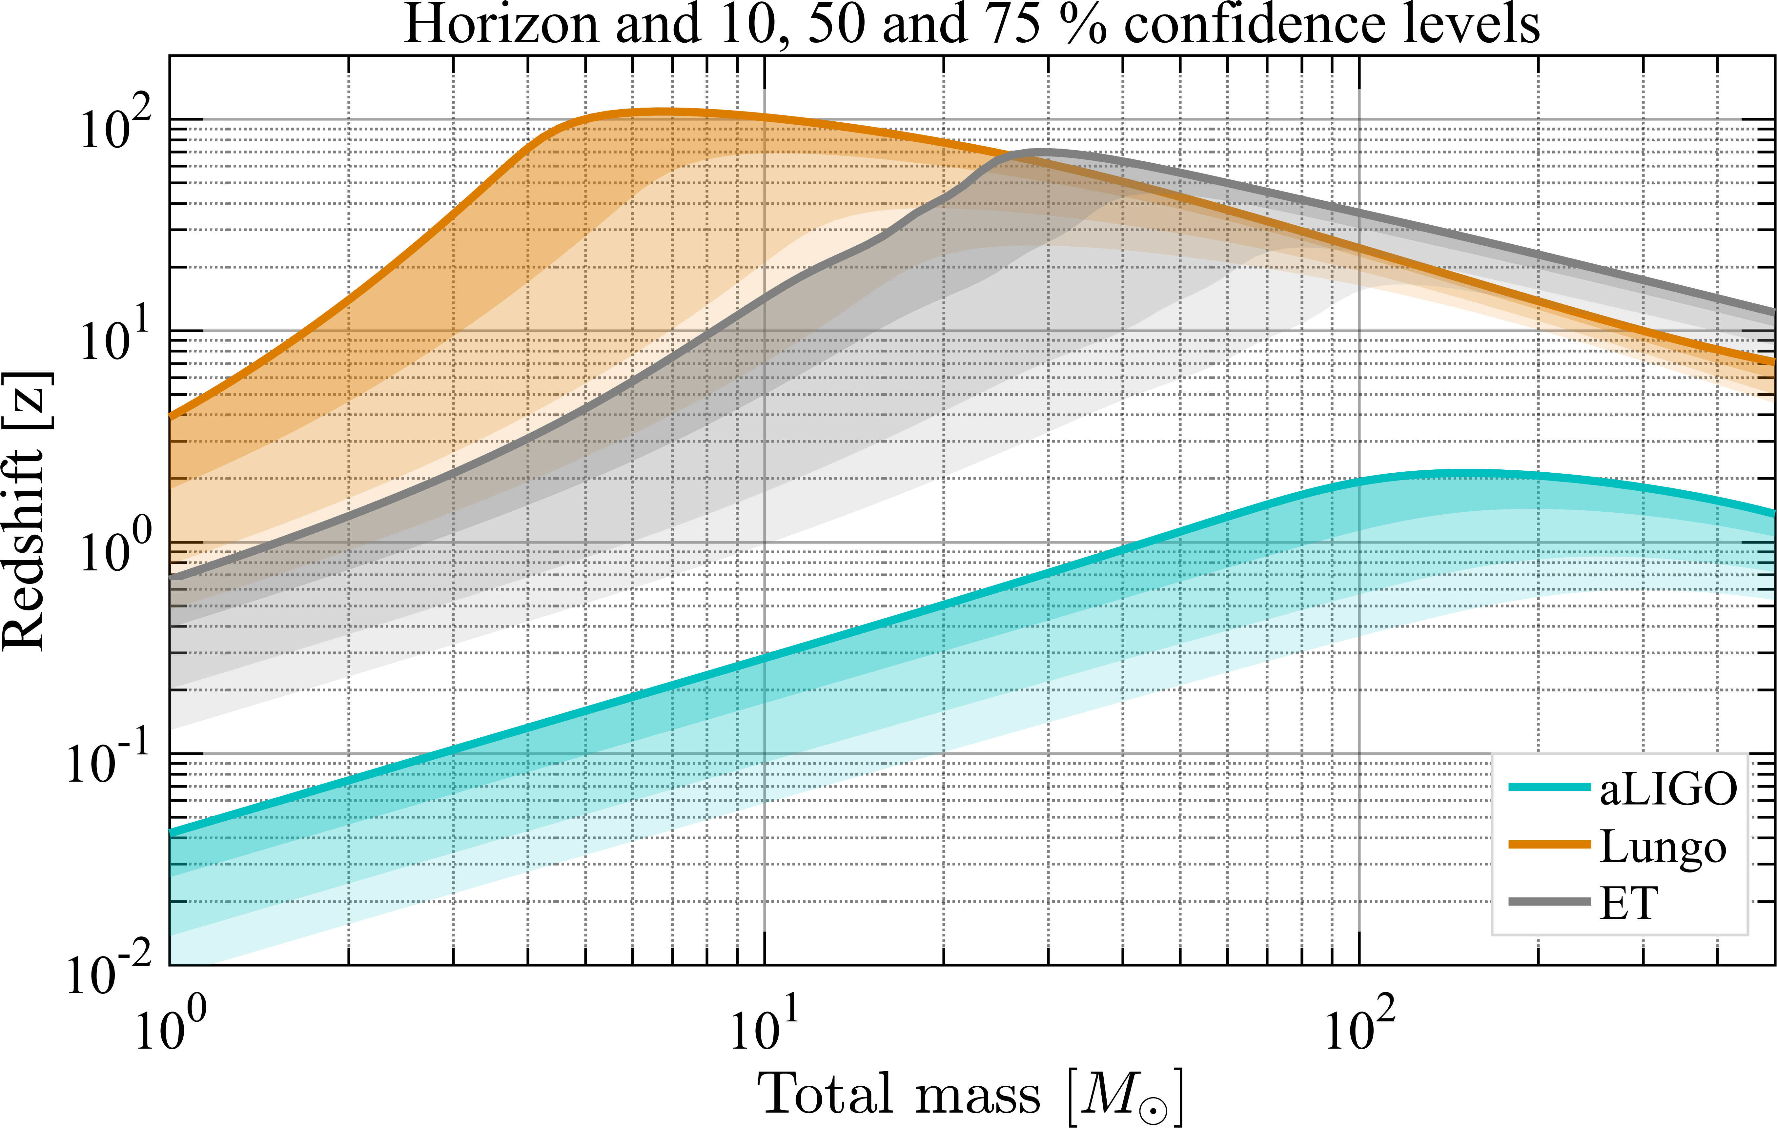
Einstein Telescope, Cosmic Explorer
‘Green field’ multi-generation Observatories ~G$/G€
SNR in QNM ~600
CE
BNS
NSBH
BBH
POP3?
John Miller, T1500491;
P1400147; ET-0106C-10
Sigg et. al

Slide 30
3rd Generation
When could this new wave of ground instruments come into play?
Appears 15 years from t=0 is a feasible baseline
  Initial LIGO: 1989 proposal, and at design sensitivity 2005
  Advanced LIGO: 1999 White Paper, GW150914 in 2015
Modulo funding, could envision…
  Einstein Telescope in the early 2030’s
  Cosmic Explorer in the mid-2030s
Should hope – and strive and plan – to have great instruments ready to ‘catch’ the end phase of binaries seen in LISA (ref. Sesana)
Crucial for all these endeavors: to grow the scientific community planning on exploiting these instruments far beyond the GR/GW enclave
  Costs are like TMT – needs a comparable audience

Slide 31
A spectrum of GW Sources and Sensors
CQG, 32 (2015) 015014

Slide 32
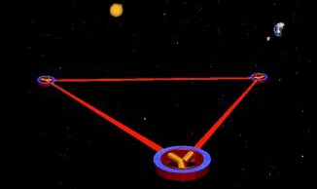
LISA
Notion of a space-based interferometric
detector dates from 1974
  Rai Weiss and Peter Bender
Basically a timing measurement
between test masses in space
Take advantage of vacuum in space: make very long arms
  h = ΔL/L ; L can be ~10⁹ m, making ΔL ~10⁻¹² m (not LIGO’s 10⁻¹⁹)
  Also moves best sensitivity to milliHz
  region – explores much more massive
  objects
Triangular configuration
Sums and differences around the triangle
  Allows both polarizations of the
  gravitational waves to be measured
  Provides signals to remove laser
  frequency noise
Earth-trailing orbit provides scan of the sky,
provides sky localization

Slide 33
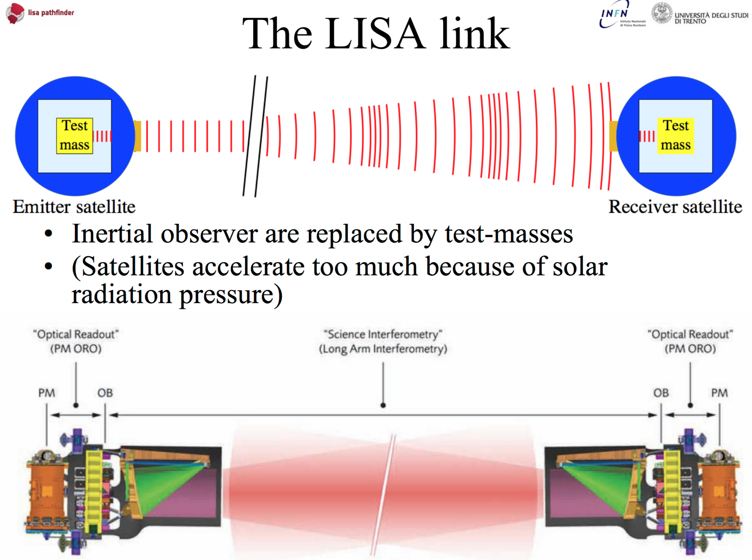
← 2…5 Million km →
Protect test masses with slaved shield satellites
Send out watts, receive picowatts
Weigh the zip-tie tails…

Slide 34
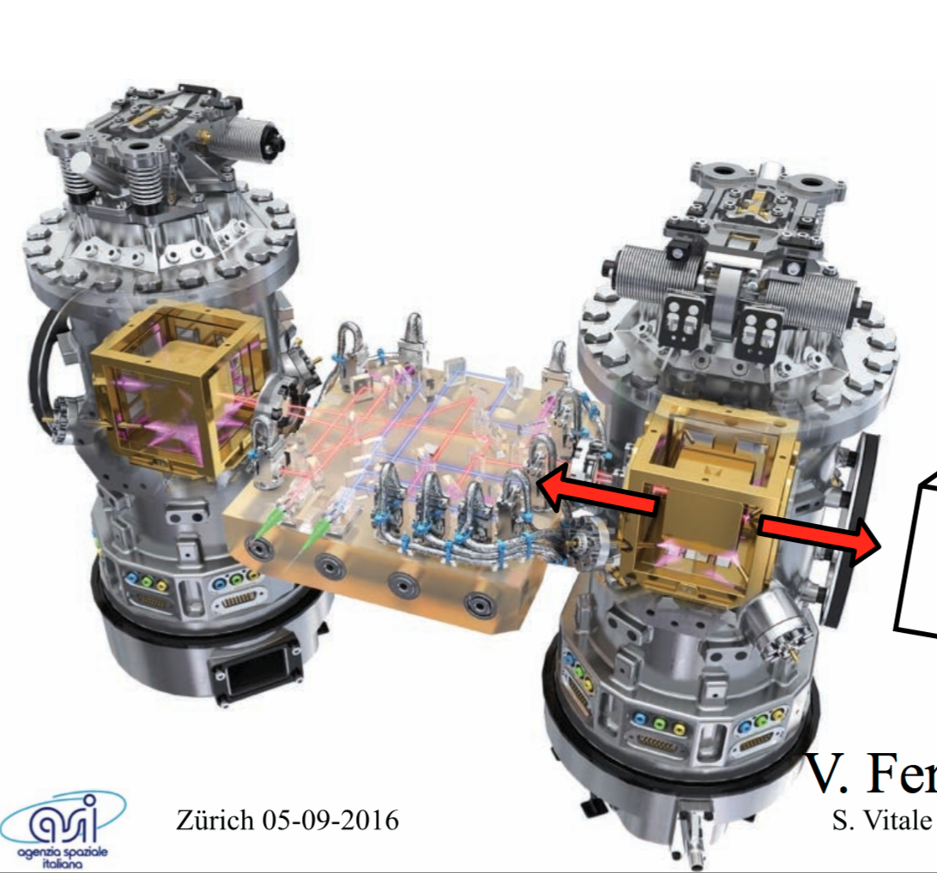
LISA Pathfinder test mission, now underway: interferometry between two LISA test masses

Slide 35
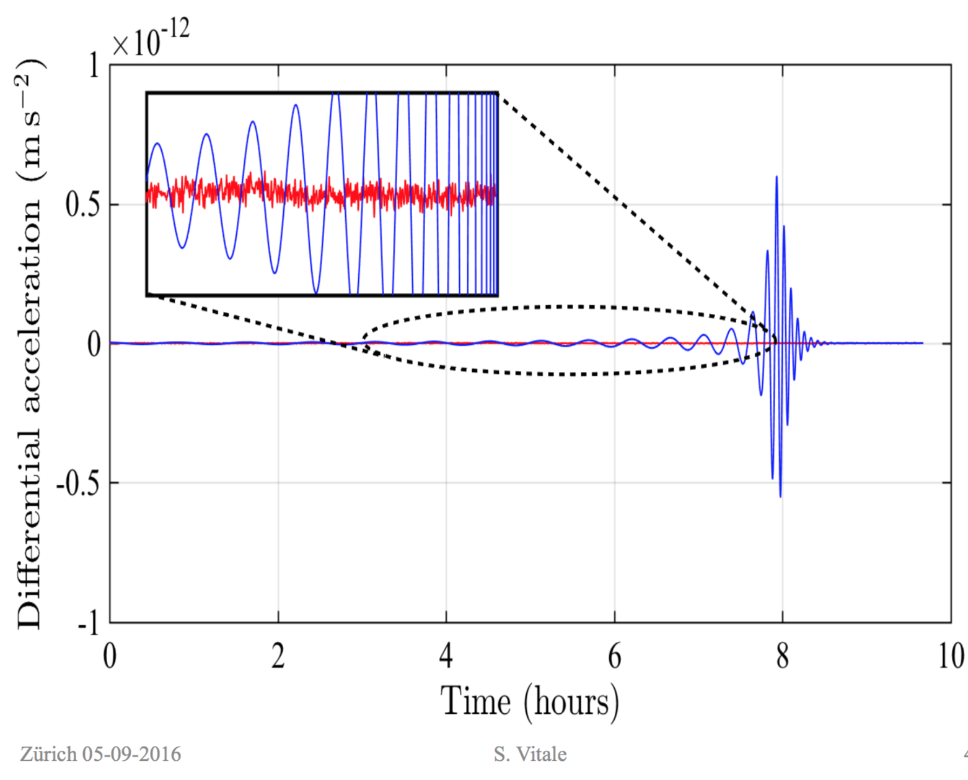
LISA Pathfinder
LISA Pathfinder worked very well – far better than its requirements, basically meeting the ful LISA requirements
Demonstrated all technologies needed for LISA that can only be tested in space
Development for Telescope, etc. remain but are low risk
Blue: Simulated signal for inspiral of
two 5x10⁵ Black Holes inspiraling
at z=5
Red: LISA Pathfinder interferometer
performance

Slide 36
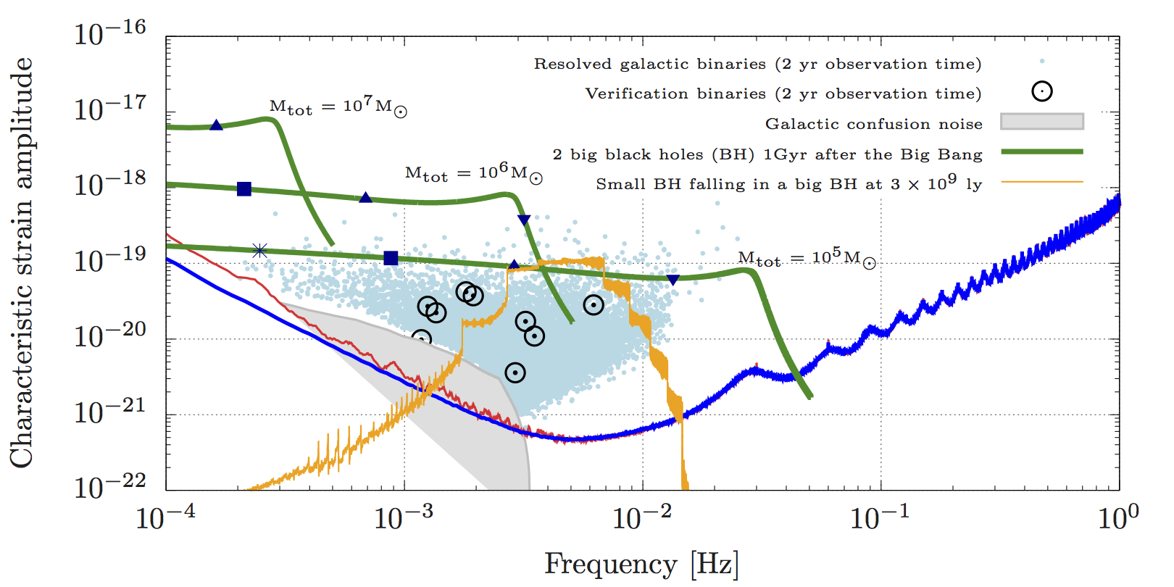
LISA Sensitivity, with current Pathfinder Performance
A. Petiteau 2016

Slide 37
LISA Status
ESA-led mission; NASA minority partner
  Both Agencies enthusiastic
ESA-NASA discussions underway on specific contributions
EU-US community joint collaboration
  Both Communities enthusiastic, too!
  In US, the ‘L3 Study Team’ the Community ‘motor’
EU-US team proposed to ESA 16 January
Approved as an ESA mission yesterday!
Phase A imminent; mission adoption planned for 2024 (maybe 2022?)
Launch date nominally 2034; may bring in to ~2030
Next major challenge for the US NASA participation in LISA: 2020 Decadal

Slide 38
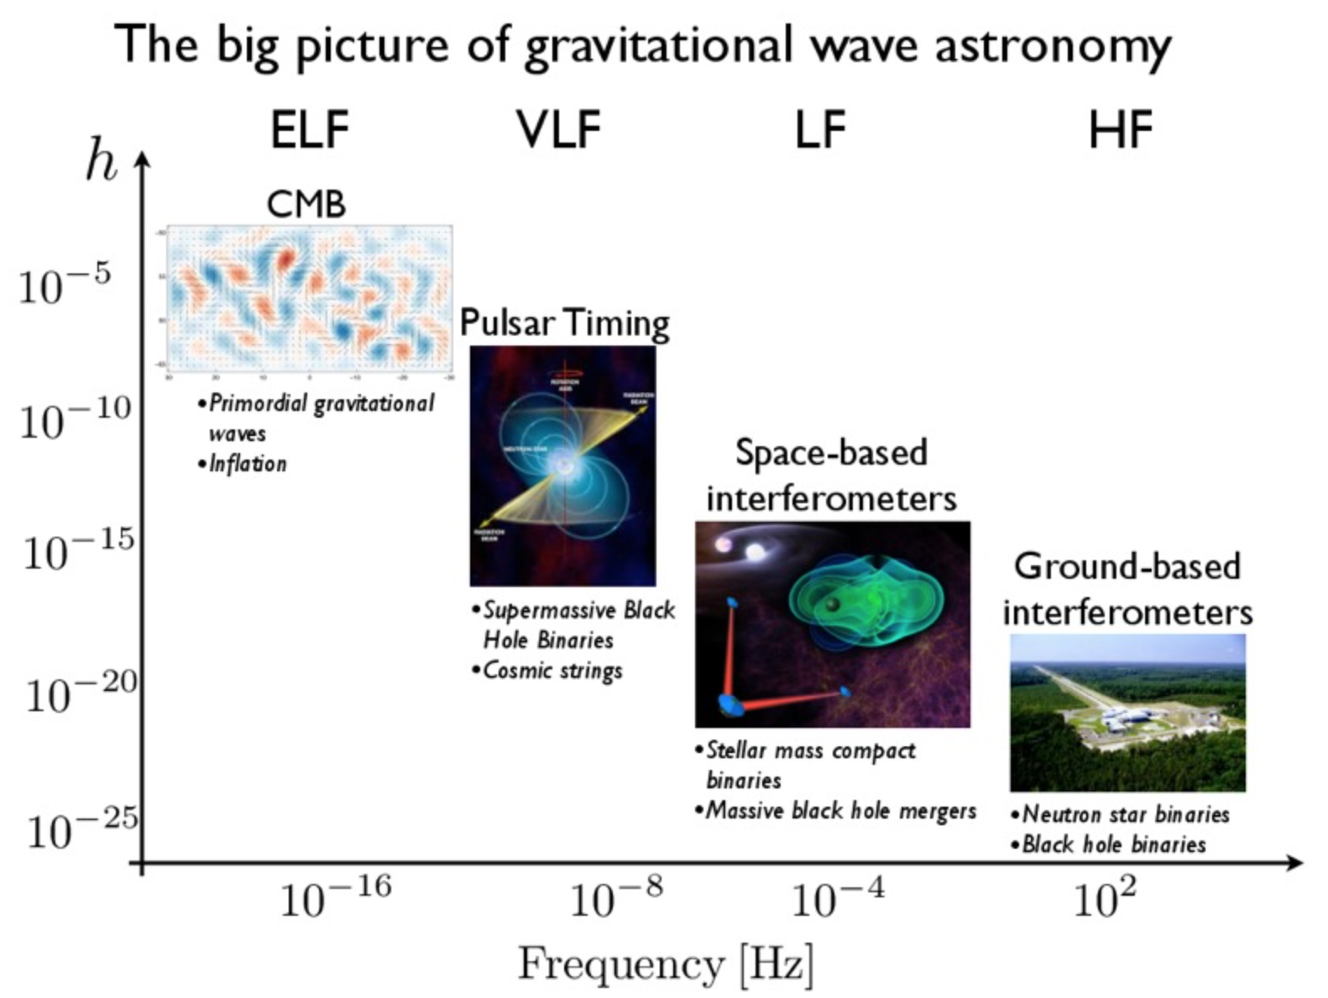
The End – and
The Beginning
Wonderful GW science opportunities within the reach of technology
Nanograv

