Slide 1
Characterization of Test Mass Scattering
SURF 2017
Jigyasa Nigam
Mentors- Gautam Venugopalan, Johannes Eichholz

Slide 2
Why worry about light scattering?
Scattering is the deflection of light from this path defined by specular reflection and is mainly caused by irregularities of the reflecting surface.
Dual demerits of scattering
Firstly this scattered light can reflect off other objects in the setup and couple back into the instrument, adding noise
Secondly, the light power that is lost to scattering leads to a lower signal- to-noise ratio in the interferometer.

Slide 3
Why worry about light scattering?
Coupling of scattered light to the IFO, adding noise.

Slide 4
Major Objectives
Selection of a lens for the camera/ implementation of a two lens telescope solution
Installation of the GigE cameras
Set up communication with the camera
Acquire and analyze images of the test mass
Calibrate the CCD
Quantify scattered power
Examine point scatterers

Slide 5
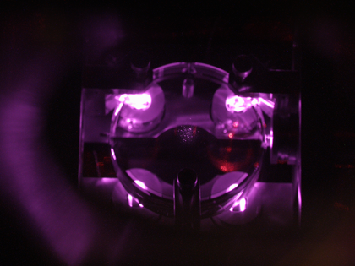
Using a CCD to estimate scatter
Use of a Gigabit Ethernet (GigE) camera to establish communication, retrieve images for data processing
CCD’s previously employed for imaging test masses have their outputs directed to a CRT monitor via BNC cables
Utilize the pixels efficiently, prevent saturation from the OSEM’s . If pixels saturate, then additional light will hit the sensor without being registered in the image.

Slide 6
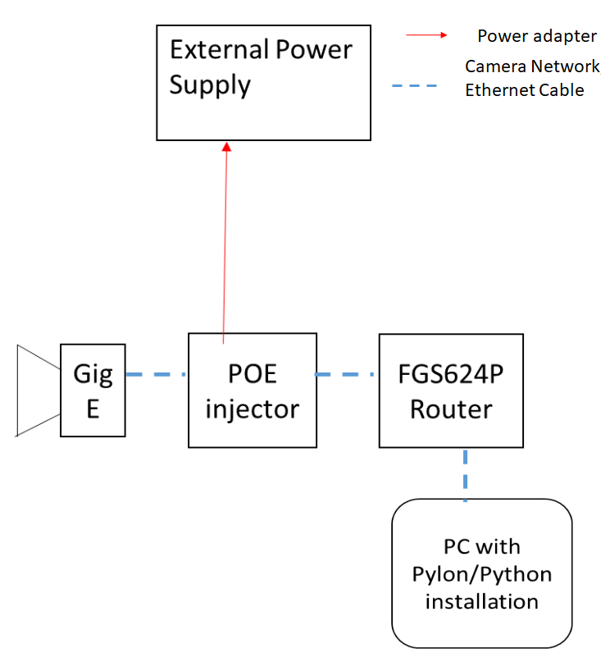
CCD network configurations
The camera is powered through a PoE adapter and Basler’s commercial software Pylon can be used to communicate with the camera, although we interface with the camera through Python wrappers to enable faster processing

Slide 7
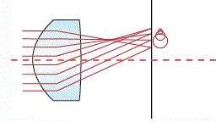
Lenses on the CCD
Initial plan to implement a telescope solution with 2” biconvex lenses, with AR coating at 1064 nm. 2’’ optics preferred to optimize light gathering power. (Collected power varies as the square of the radius)
Focal lengths -optimized for accessing a number of focal plane distances while ensuring desired magnification was achieved (Focus on the beam spot or on the entire test mass)
The distance between the lenses would range from 5 mm to 10 cm, object distance between 500 and 1100 mm. Expected issues- coma, spherical aberrations, difficulties due to the finite thickness of the lenses.
Currently a 50 mm focal length, 2/3’’ diameter AR coated lens with adjustable manual iris and focus controls is being used.

Slide 8
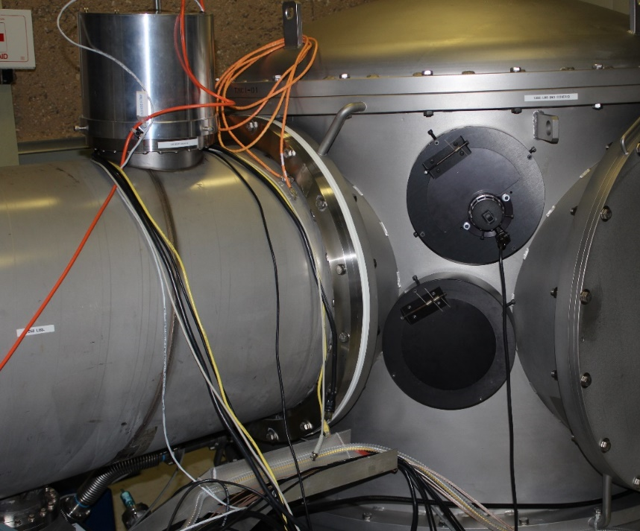
Camera installed at the viewport
Image of the vacuum enclosure and location of GigE Installation.

Slide 9
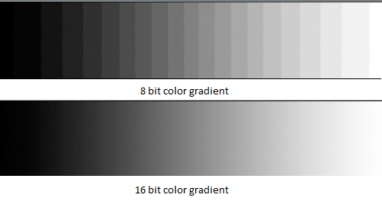
High Dynamic Range (HDR) imaging
With the objective of improving the quality of images and enhancing intelligibility.
Dynamic Range is defined as the ratio of brightness between the darkest and brightest parts of the image. However, if the image is viewed on a monitor with limited DR, it doesn’t appear to be much different than an LDR image as the brightness range is compressed to fit a smaller range. The linear response of the sensors imposes an abrupt limit to the dynamic range captured
once the sensor capacity is reached.
Evidently, a higher bit depth implies a higher dynamic range capacity.

Slide 10
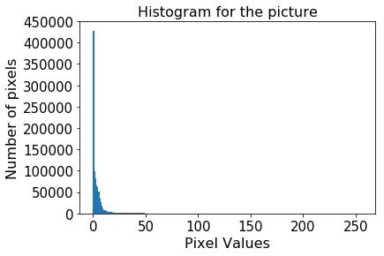
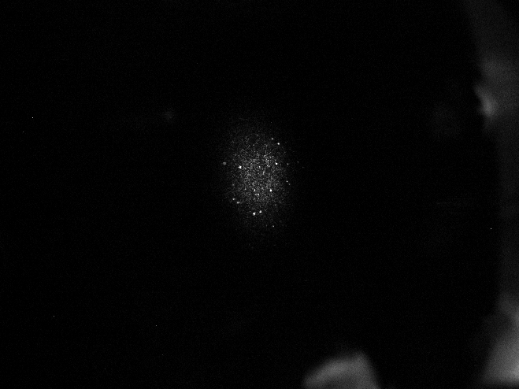
Image Histogram

Slide 11
Images at different exposure

Slide 12
Images at ETMX
14 ms exposure

Slide 13
Point Scatter
Point scatterers might extend through the depth of the coatings on the test masses.
For the purposes of this project, we were more concerned with the point scatterers on the surface of the test masses which include dust speckles
Once the point scatterers are identified, their motion on the surface of the mirrors could be monitored. Subsequently relations between the scatter loss and the number/ location of scatterers could be drawn.

Slide 14
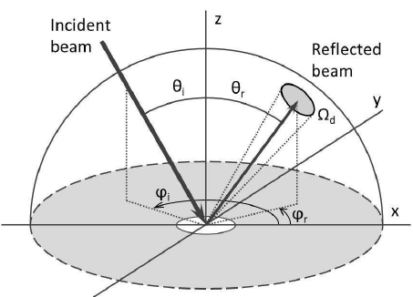
Bidirectional Reflectance Distribution Function
Relates irradiance onto a surface to the radiance towards the detector.
Radiance, L, accounts for the intensity of optical radiation emitted or reflected from a certain location on a surface in a particular direction.
BRDF is defined as the ratio of the scattered radiance to the incident intensity.
$$BRDF= \frac{P_{s}}{P_{i }\cos{θ_{d} Ω}}$$
$BRDF\left({\text{θ}}_{i}{\text{, }\text{ϕ}}_{i}{, \text{θ}}_{s}, {\text{ϕ}}_{s}, λ, x, y\right)$ ; $λ=$wavelength of light, ${\text{θ}}_{i}{\text{, }\text{ϕ}}_{i}$ parametrizing incident light direction , ${, \text{θ}}_{s}, {\text{ϕ}}_{s}$ outgoing light direction, x, y account for positional variance
Fig: Geometry for BRDF measurements, courtesy Design of a gonio-spectro-photometer for optical characterization of gonio-apparent materials

Slide 15
CCD Radiometric Calibrations
Radiometric Calibration is the conversion from the sensor measurement to a physical quantity, essentially, determining the factor to convert from the recorded digital number or ADU(Analog to Digital Unit) to radiance
${BRDF}_{\text{LS}}=\frac{1}{π}$ sr⁻¹ irrespective of the direction of incidence if light and the direction of observation.
Illuminate a Lambertian Scatterer with a linearly polarized 1064 nm light at any arbitrary angle, capture pictures with the CCD at different viewing angles, at different exposures.
Relate power scattered to the observed pixel counts.
$P_{s}={BRDF. P}_{i}.cos{θ. Ω}$ = $CF. \frac{\sum_{ROI}{\left(PixelValue\right)}}{T_{exp}}$
where
Pi =incident power, Ω = solid angle of the camera and θ_{s} = scattering angle at which measurement is taken; CF is the required calibration factor.

Slide 16
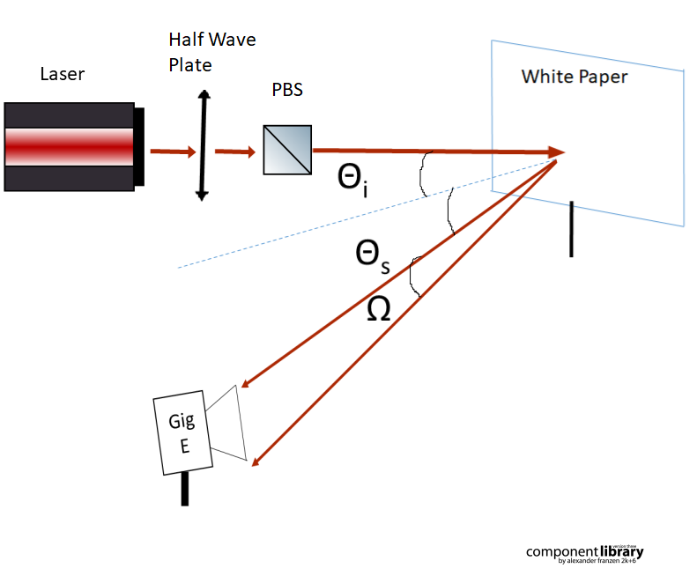
Calibration Setup

Slide 17
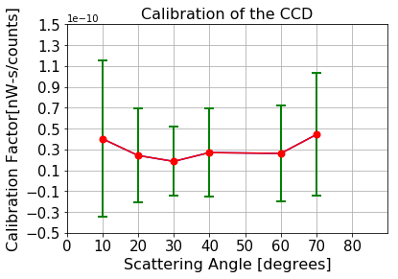
Results
Mean CF= 3.004 e-11 nW-s/counts

Slide 18
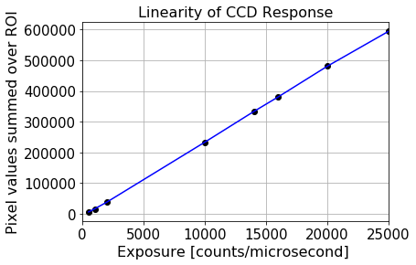
Linearity of CCD Response

Slide 19
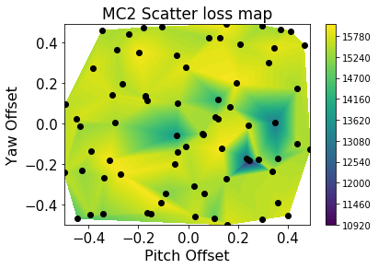
MC2 Loss Map
The pitch and yaw offsets of the Wavefront Sensor (WFS) in the mode cleaner(MC2) were varied randomly to values conned between -0.5 and 0.5 and the corresponding transmitted intensity was observed.

Slide 20
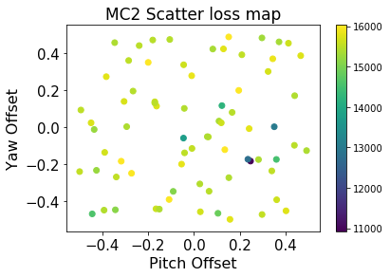
MC2 Loss Map
To identify the offsets corresponding to maximum transmission. It is hypothesized that the areas of minimum transmission are prone to maximum scatter loss.

Slide 21
Future Work
Establish a dedicated camera server and client network which could connect to the Martian.
Implement the deigned telescope system with 2” optics.
To explore the point scattering in much more detail, potential causes and mitigation strategies and establish a more quantitative relation between the number of point scatterers and contributed noise.
To calibrate the change in offsets of MC2 to an actual movement( in mm) of the beam spot across the test mass.

Slide 22
Acknowledgements
I would like to thank LIGO SURF Program, all members of the LSC for this opportunity, everyone at the 40m, in particular my mentors Gautam Venugopalan, Johannes Eichholz, Rana Adhikari for helping me open my eyes to new steps of opportunity and strength.
Special thanks to Joseph Betzweiser (LLO) and Jamie Rollins for being patient with my questions and going out of their way to help me!
I will forever be grateful for your guidance and kindness.

Slide 23
Thank You!

