Slide 1
Ground-based Gravitational-wave Detectors: Beyond 2030
Dave Reitze
LIGO Laboratory, Caltech

Slide 2
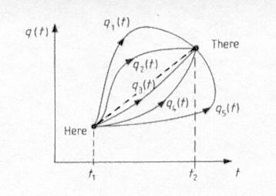
What do we want to be doing 15 – 20 years from now??
How do we get there??
Credit: https://universe-review.ca/I12-03-pathintegral.jpg

Slide 3
Outline
Third Generation Detector Planning: 2007-2017
The Gravitational-wave International Committee
Coordinating the Global Effort

Slide 4
Historical Gestation Periods for GW Detectors in the US
Initial LIGO → 23 years
  1983 MIT and Caltech jointly present results of the km-scale interferometer study to NSF. Receive endorsement by NSF committee on new large programs in physics.
  1990 The US National Science Board (NSB) approves the LIGO construction proposal, which envisions Initial LIGO followed by Advanced LIGO.
  1994-1995 Site construction begins at the Hanford and Livingston locations.
  2002 The first coincident operation of Initial LIGO interferometers with the GEO600 interferometer.
  2006 Initial LIGO design sensitivity achieved.
Advanced LIGO → 16 years
  1999 The LSC Concept Paper for Advanced LIGO completed.
  2003 LIGO Laboratory submits proposal to NSF for Advanced LIGO proposal.
  2006 NSF conducts review of Advanced LIGO Construction.
  2008 Advanced LIGO Construction is funded by NSF.
  2014 Advanced LIGO Construction completed.
  2015 Advanced LIGO begins science operations

Slide 5
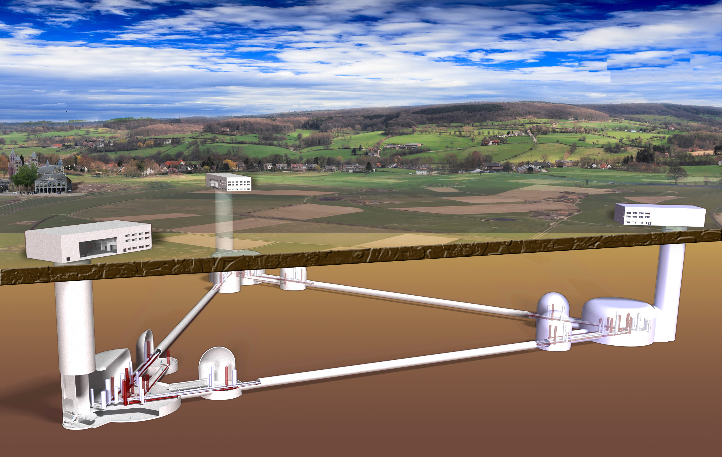
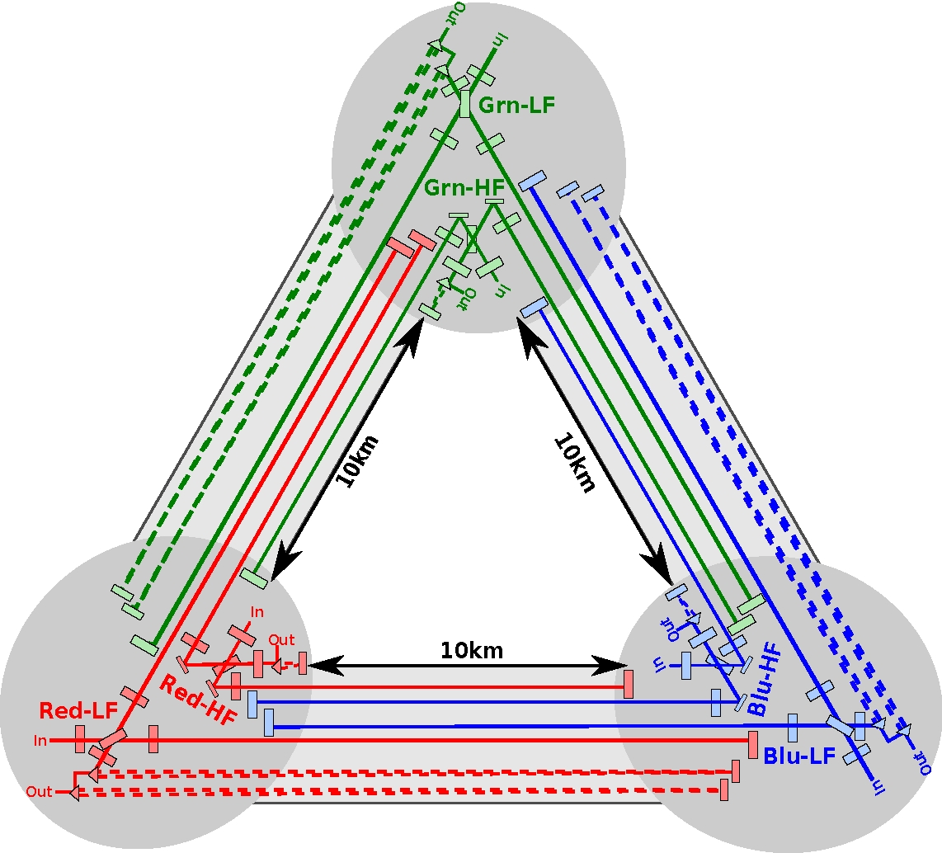
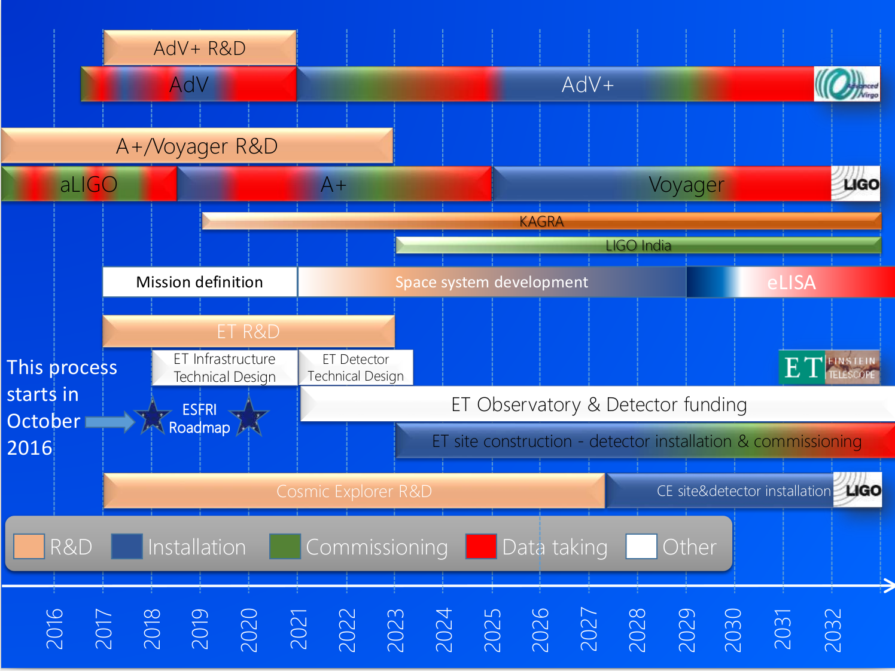
Einstein Telescope (EU)
Third-generation GW observatory
Target sensitivity for ET a factor of ten improvement in comparison to current advanced detectors
10 km long, Underground
Xylophone configuration, 6 interferometers
Formal Design Study completed in 2011:
http://www.et-gw.eu/etdsdocument
Slide Credit:
Vaishali Adya, AEI

Slide 6
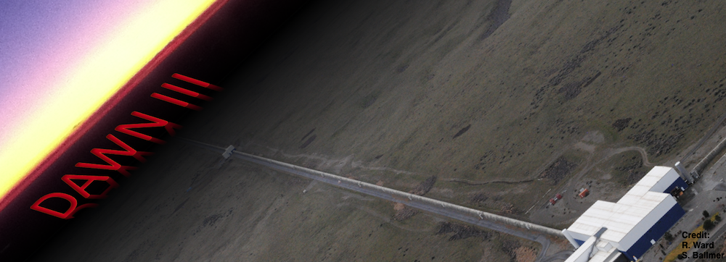
Cosmic Explorer (US)
Third-generation GW observatory
Target sensitivity a factor of > 10 improvement in comparison to current advanced detectors
Above ground, 40 km arm length, L configuration
Formal Design Study: not yet, but proposal under development (M. Evans, MIT, PI
First Stars Formed

Slide 7
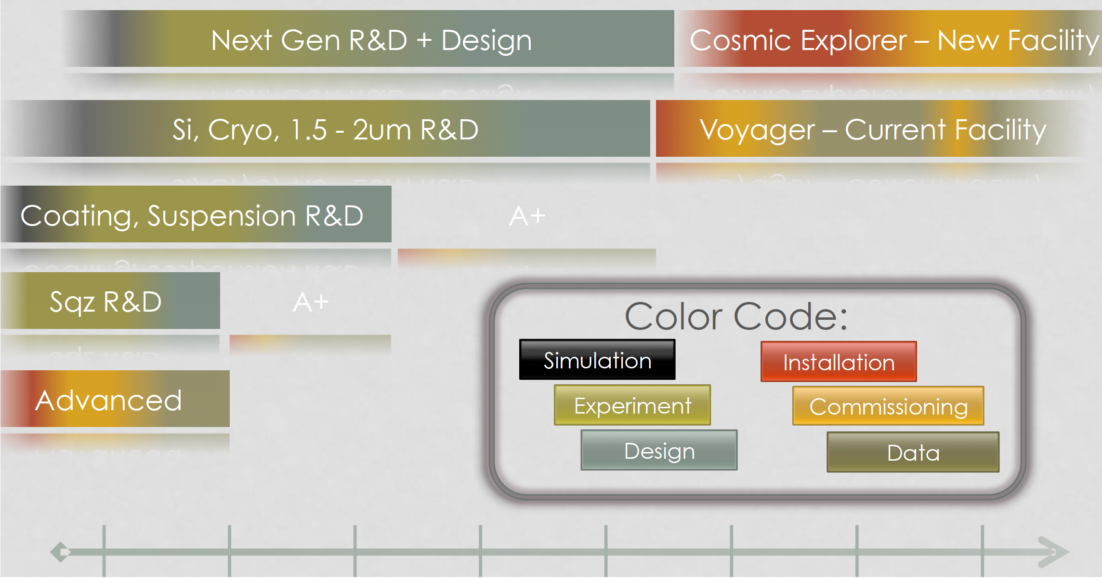
(Very) Conceptual Timeline for CE
LSC Instrument Science White Paper 2017-2018, LIGO-T1700231–v2
  q
(b)
(a)
Today
2030

Slide 8
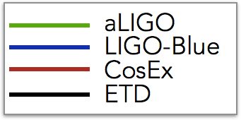
The 3G Sensitivity Horizon
(circa 2015)

Slide 9
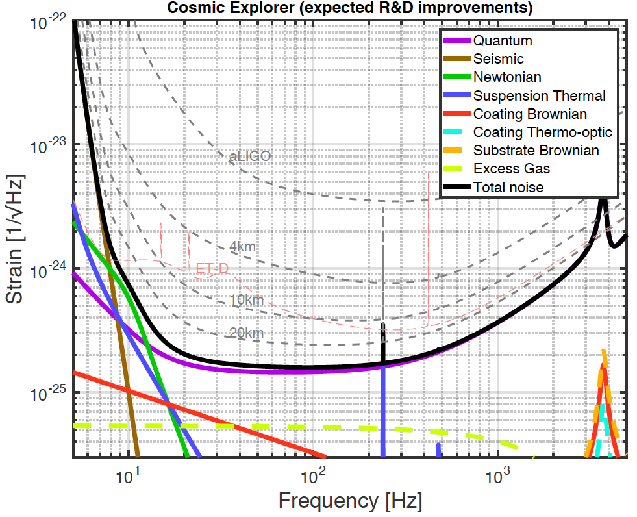
The 3G Sensitivity Horizon
(circa 2017)
LSC Instrument Science White Paper 2017-2018, LIGO-T1700231–v2

Slide 10
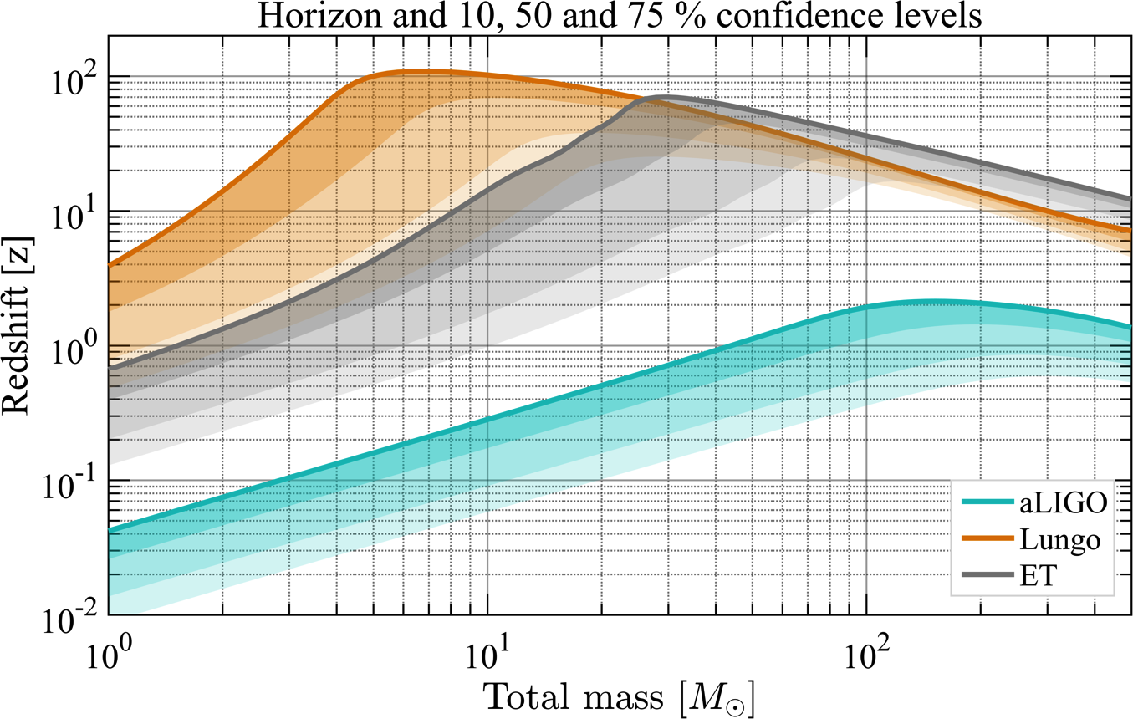
ET and CE Have Cosmological Reach!
Cost ~ 10⁹$/10⁹€
First Stars Formed
High SNR Signals!
CE
BNS
NSBH
BBH
POP3?
LIGO Documents T1600140;T1500491;
P1400147;
ET Document ET-0106C-10

Slide 11
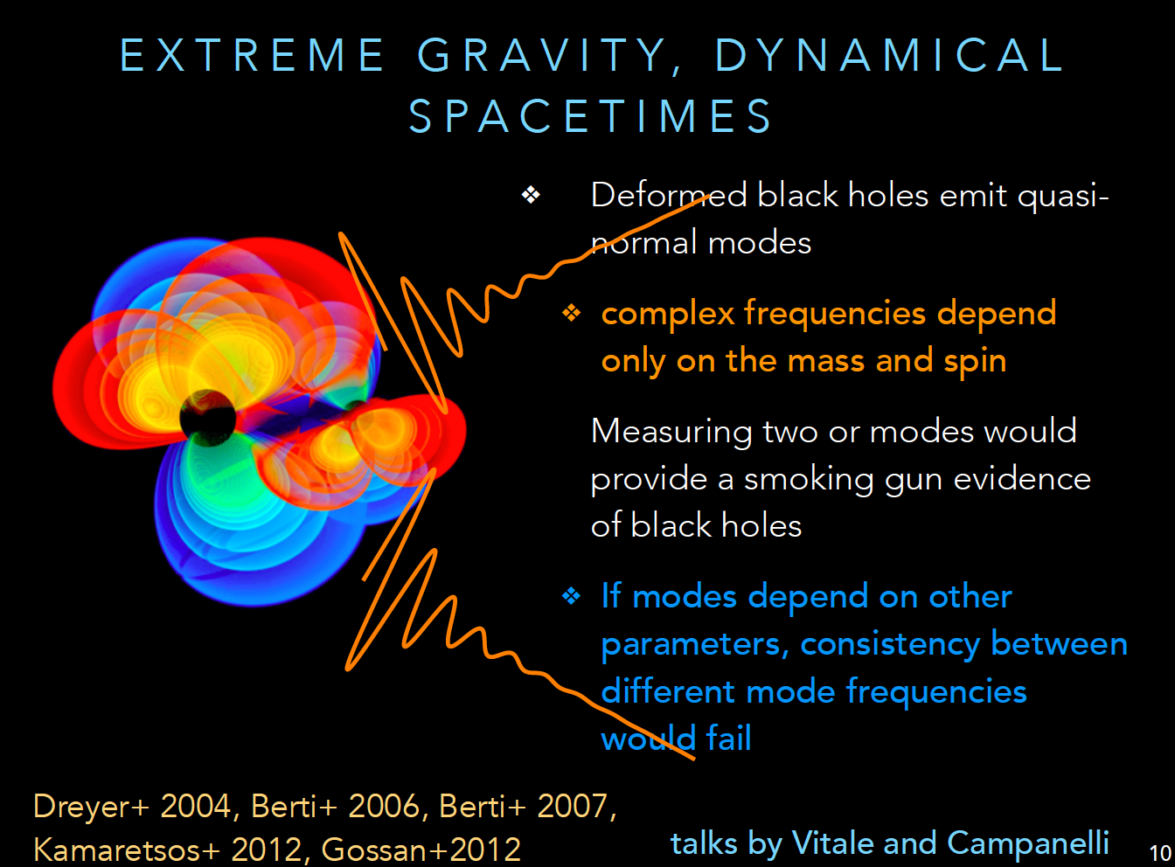
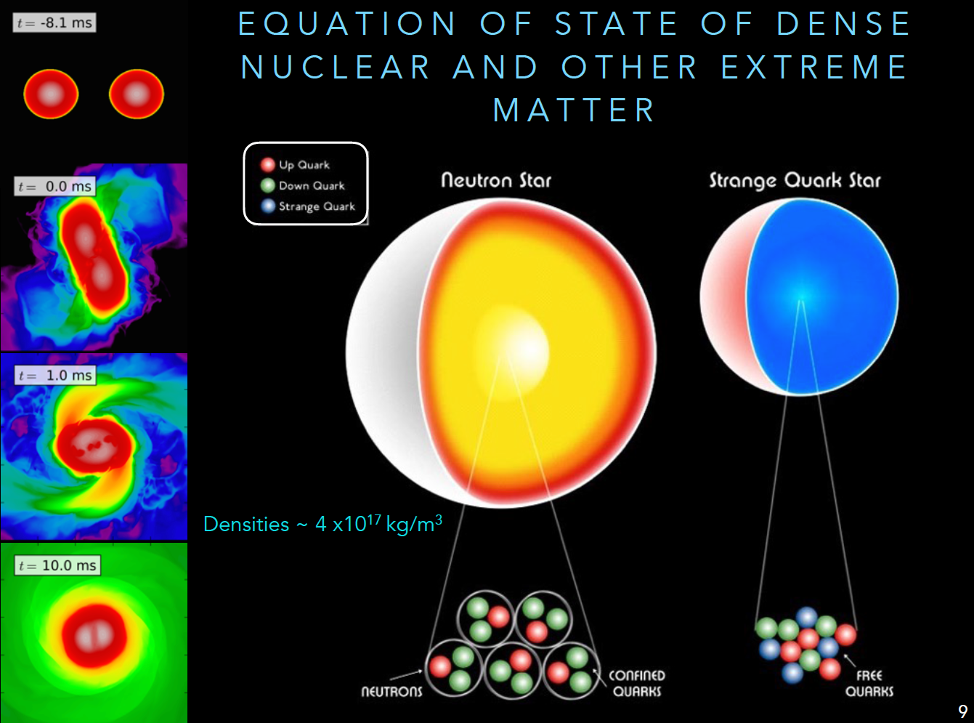
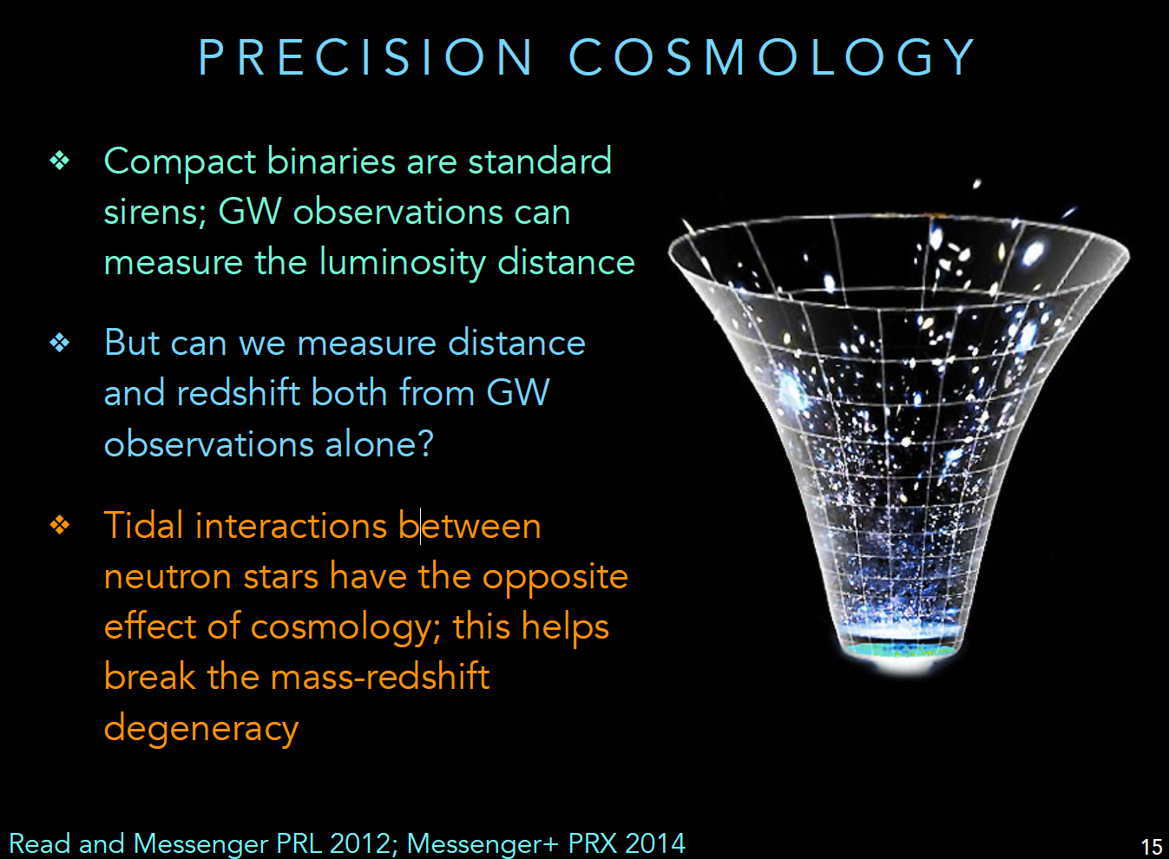
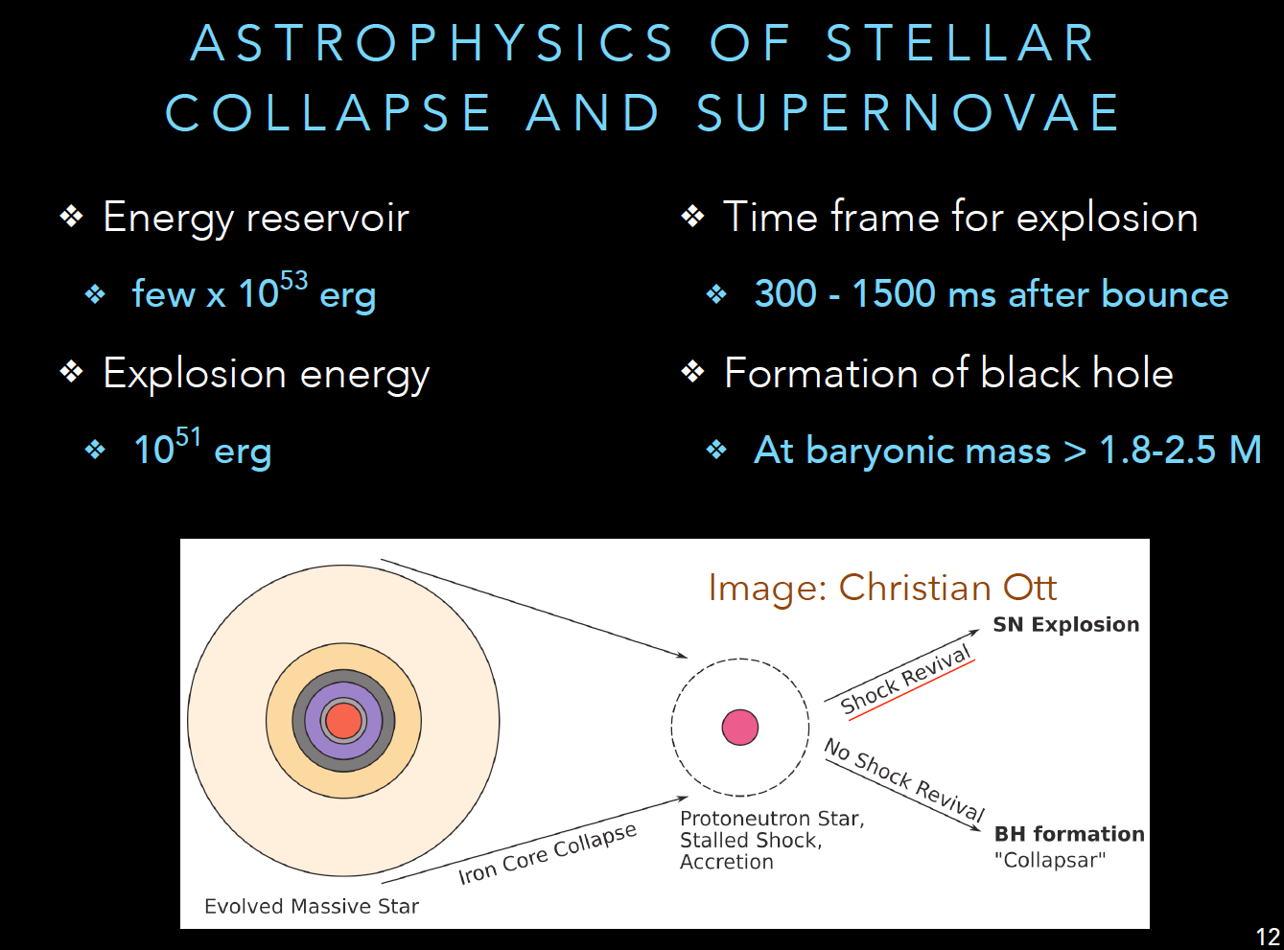
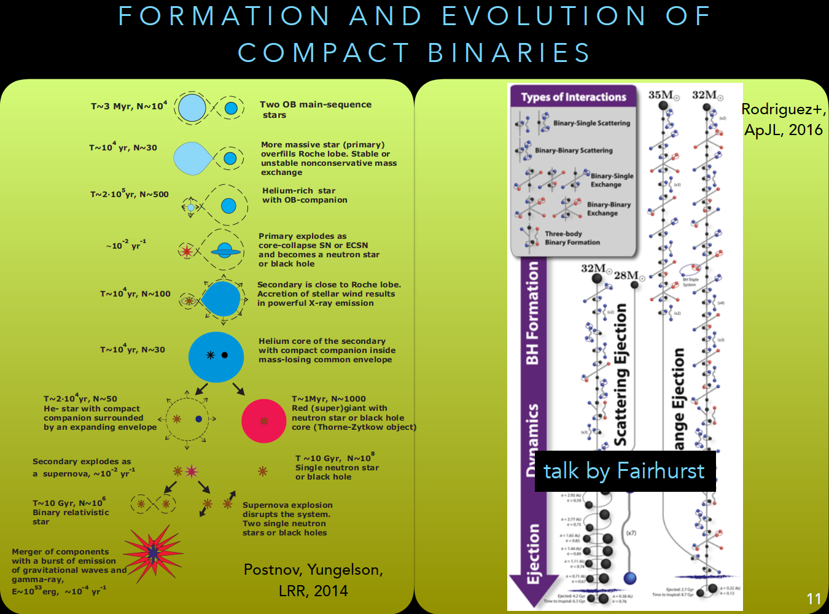
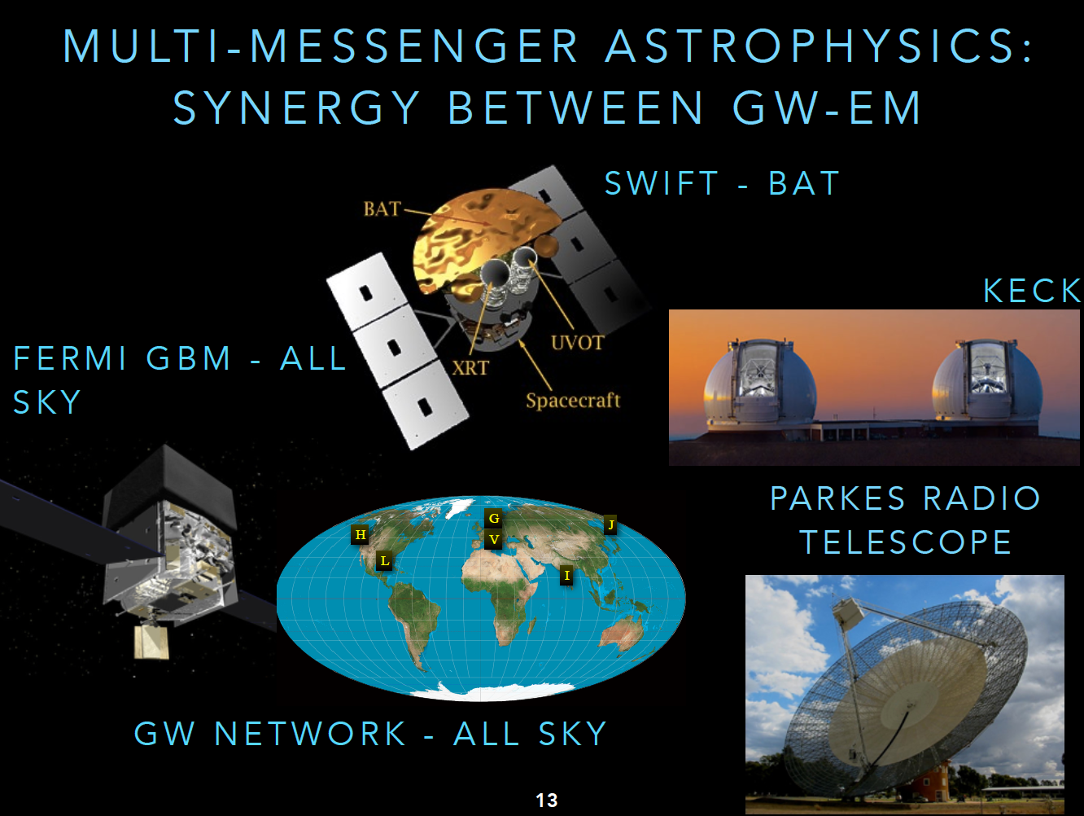
Making the 3G Science Case
The 3G Gravitational Wave
Ground-based Network
Credit: B. Sathyaprakash, Dawn III Workshop,
https://wiki.ligo.org/LSC/LIGOworkshop2017/WebHome

Slide 12
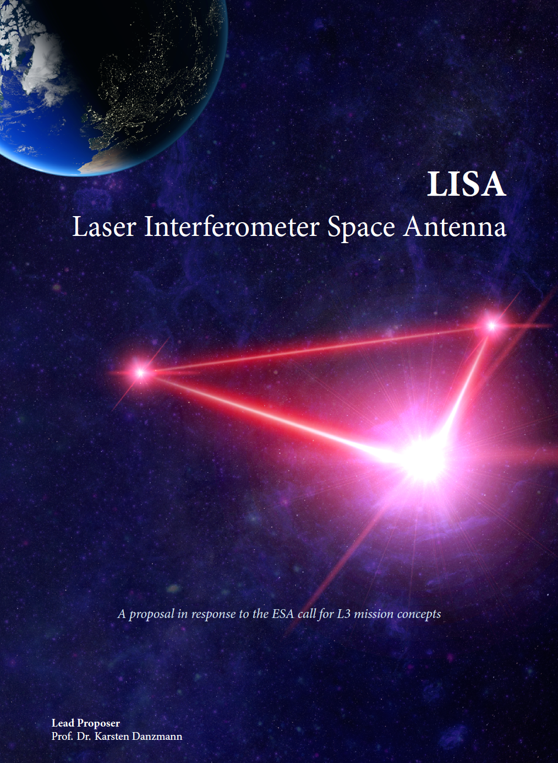
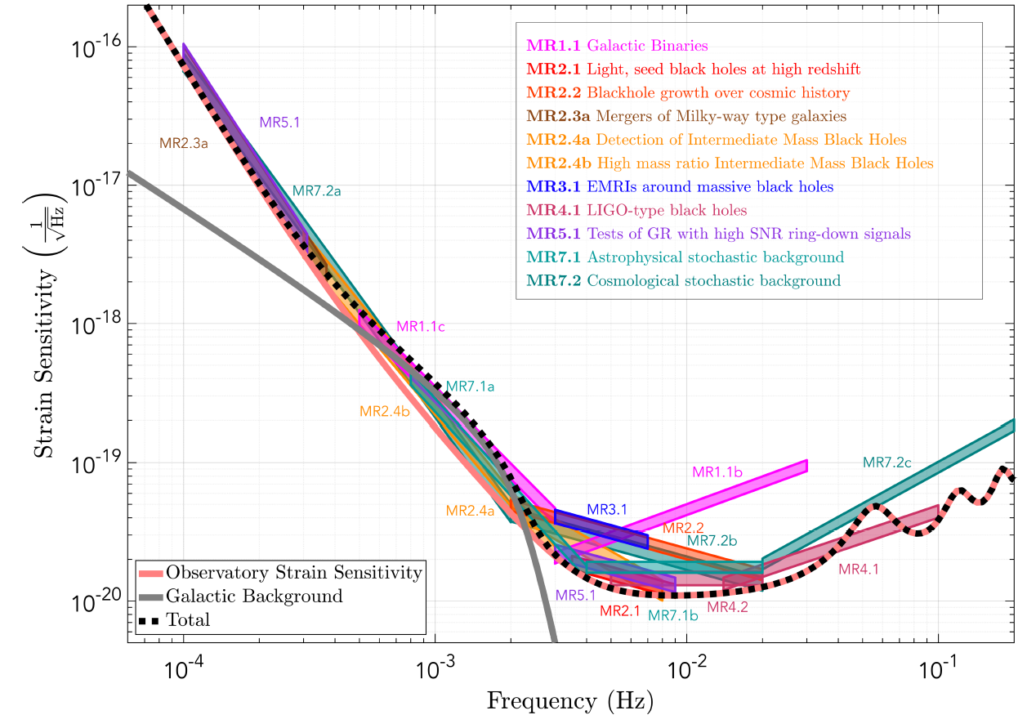
An Excellent Case Study:
The LISA Science Case
https://www.elisascience.org/files/publications/LISA_L3_20170120.pdf

Slide 13
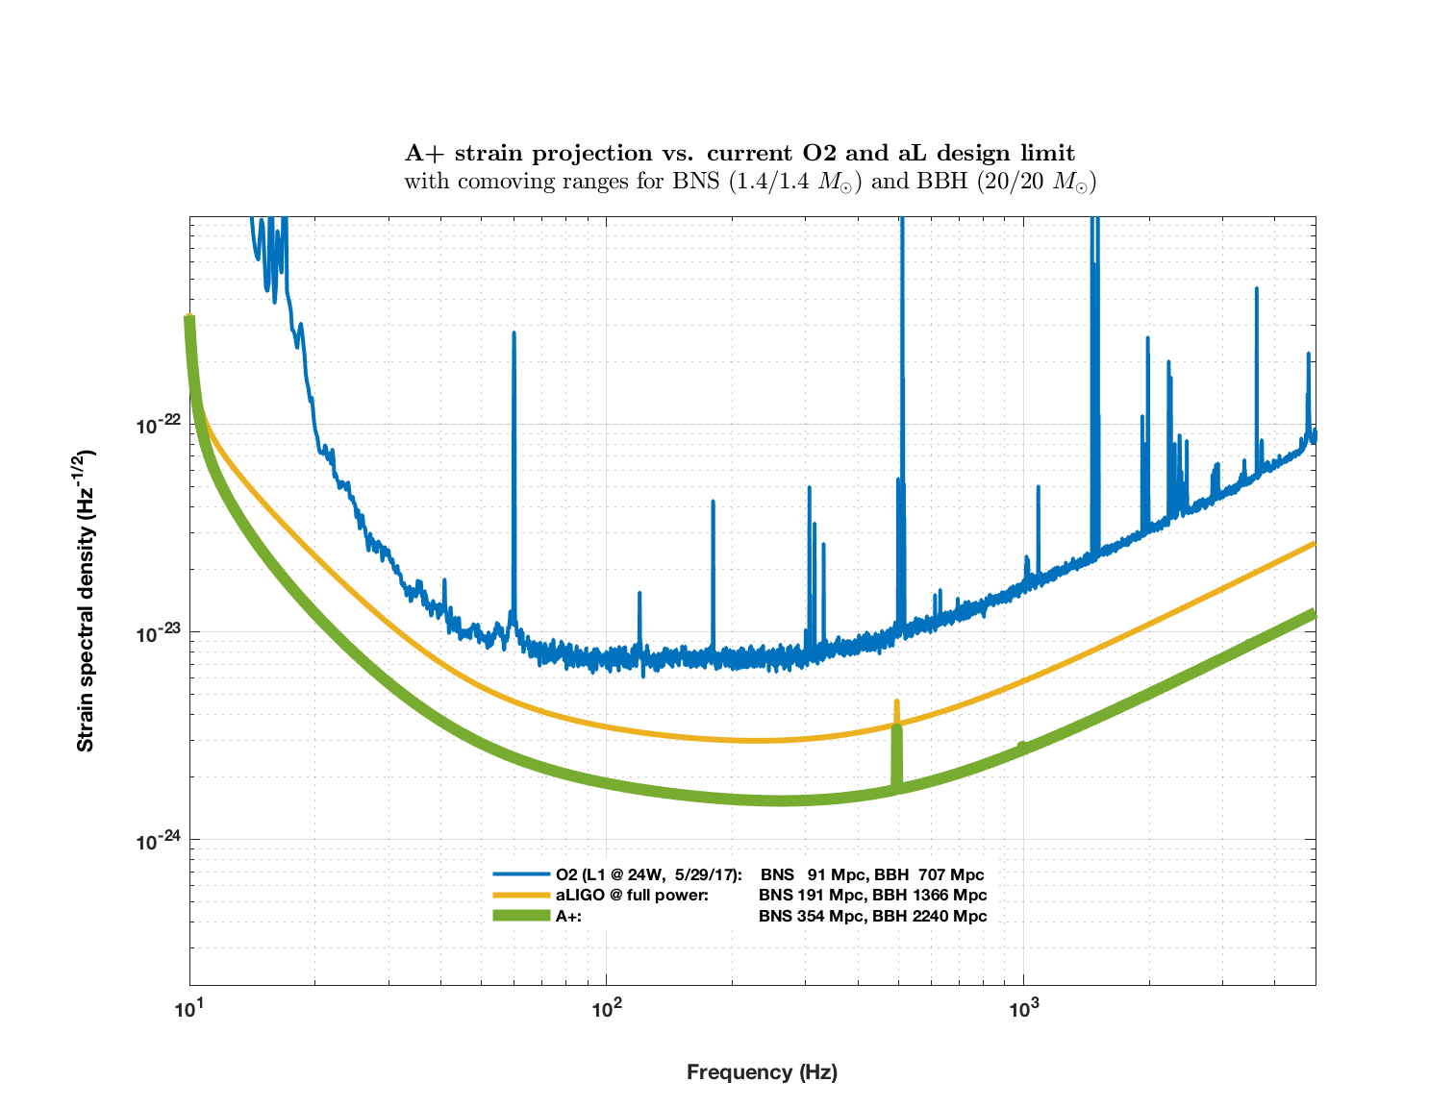
A+: a Mid-Life Enhancement for
Advanced LIGO
Near term: ‘A+’, a mid-scale upgrade of Advanced LIGO
  Improvements across all bands
Projected time scale for A+ operation: 2023 - 2025

Slide 14
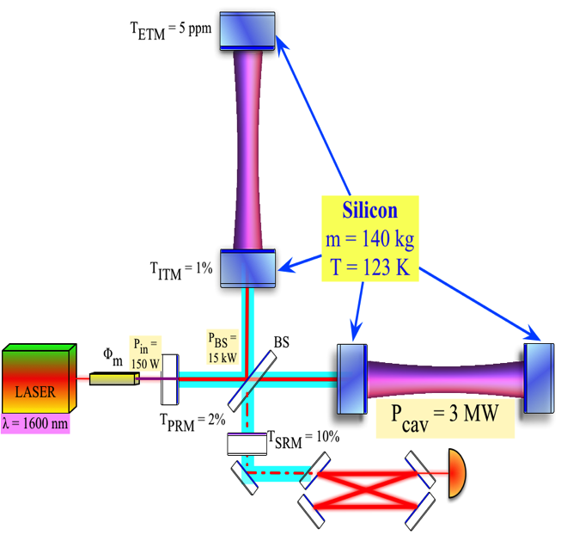
LIGO Voyager:
Fully Exploiting the Current LIGO Facilities
Si optics, > 100 kg
Si or AlGaAs coatings
(Mildly) Cryogenic
λ~2 µm, 300 W
BNS Range = 740 Mpc
aLIGO
Voyager
BNS R < 800 Mpc
BBH z < 5 (@10 M)
Cost ~10⁸ M$
https://dcc.ligo.org/LIGO-T1400226,
https://dcc.ligo.org/LIGO-T1200031,
https://dcc.ligo.org/LIGO-T1200099
https://dcc.ligo.org/LIGO-T1600140

Slide 15
How to Get From Here to There?
GWIC (Gravitational Wave International Committee)
Body formed in 1997 to facilitate international collaboration and cooperation in the construction, operation and use of the major gravitational wave detection facilities world-wide
Affiliated with the International Union of Pure and Applied Physics
  From 1999 until 2011, GWIC was recognized as a subpanel of PaNAGIC (IUPAP WG.4).
  In 2011, GWIC was accepted by IUPAP as a separate Working Group (WG.11).
Links to the:
International Astronomical Union (IAU)
International Society for General Relativity and Gravitation (ISGRG)

Slide 16
Who is GWIC?
The membership of GWIC represents all of the world’s active gravitational wave projects*, as well as other relevant communities, covering gravitational wave frequencies from nanohertz to kilohertz. Each project has either one, two, or four members on GWIC depending on size.
ACIGA Bram Slagmolen
AURIGA (retiring in 2017) Massimo Cerdonio
Einstein Telescope Michele Punturo
European Pulsar Timing Array Michael Kramer
GEO 600 Karsten Danzmann, Sheila Rowan (Chair)
IndIGO Bala Iyer
KAGRA Yoshio Saito, Takaaki Kajita
LIGO Dave Reitze, David Shoemaker
LISA Neil Cornish, Bernard Schutz,
Ira Thorpe, Stefano Vitale
*no CMB community membership
NANOGrav Xavier Siemens
NAUTILUS (retiring in 2017) Eugenio Coccia
Parkes Pulsar Timing Array George Hobbs
Spherical Acoustic detectors Odylio Aguiar
Theory Community Clifford Will
Virgo Jo Van den Brand, Fulvio Ricci
IUPAP AC2 (ISGRG) Beverly Berger
IAU D1 Marica Branchesi
Executive secretary : David Shoemaker
Co- secretary: Stan Whitcomb

Slide 17


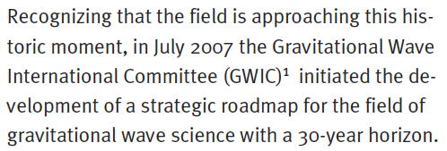
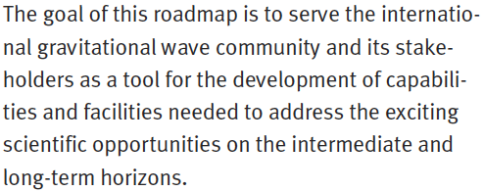
https://gwic.ligo.org/roadmap/Roadmap_110726_WEB.pdf

Slide 18
GWIC’s role in coordinating 3G detector development
GWIC Subcommittee on Third Generation Ground-based Detectors
GWIC subcommittee purpose and charge:
With the recent first detections of gravitational waves by LIGO and Virgo, it is both timely and appropriate to begin seriously planning for a network of future gravitational-wave observatories, capable of extending the reach of detections well beyond that currently achievable with second generation instruments.
The GWIC Subcommittee on Third Generation Ground-based Detectors is tasked with examining the path to a future network of observatories/facilities

Slide 19
Membership of GWIC 3G Committee
Co-Chairs:
Michele Punturo – Einstein Telescope
David Reitze - LIGO
Federico Ferrini – European Gravitational Observatory
Takaaki Kajita - KAGRA
Vicky Kalogera – Northwestern (co-opted)
Harald Lueck, AEI (co-opted)
Jay Marx, LIGO (co-opted)
David McClelland, ACIGA (co-opted)
Sheila Rowan - GWIC Chair
Bangalore Sathyaprakash – Penn State (co-opted)
David Shoemaker – Executive Secretary

Slide 20
Goals
Science Drivers for 3G detectors
(Kalogera, Sathyaprakash + subcommittee)
“Commission a study of ground-based gravitational wave science from the global scientific community, investigating potential science vs architecture vs. network configuration vs. cost trade-offs, recognizing and taking into account existing studies for 3G projects (such as ET) as well as science overlap with the larger gravitational-wave spectrum.”

Slide 21
Goals
2) Coordination of the Ground-based GW Community:
(Lueck, McClelland + subcommittee)
“Develop and facilitate coordination mechanisms among the current and future planned and anticipated ground-based GW projects, including identification of common technologies and R&D activities as well as comparison of the specific technical approaches to 3G detectors. Possible support for coordination of 2G observing and 3G construction schedules.”

Slide 22
Goals
3) Networking among Ground-based GW Community:
(Punturo, Reitze)
“Organize and facilitate links between planned global 3G projects and other relevant scientific communities, including organizing:
town hall meetings to survey the community
dedicated sessions in scientific conferences dedicated to GW physics and astronomy
focused topical workshops within the relevant communities”

Slide 23
Goals
4) Agency interfacing and advocacy:
(Rowan)
“Identify and establish a communication channel with funding agencies who currently or may in the future support ground-based GW detectors; communicate as needed to those agencies officially through GWIC on the scientific needs, desires, and constraints from the communities and 3G projects (collected via 1) – 3) above) structured in a coherent framework; serve as an advocacy group for the communities and 3G projects with the funding agencies.”

Slide 24
Goals
5) Investigate 3G detector governance schemes
(Ferrini, Marx + subcommittee)
“By applying knowledge of the diverse structures of the global GW community, propose a sustainable governance model for the management of detector construction and joint working, to support planning of 3rd generation observatories.”

Slide 25
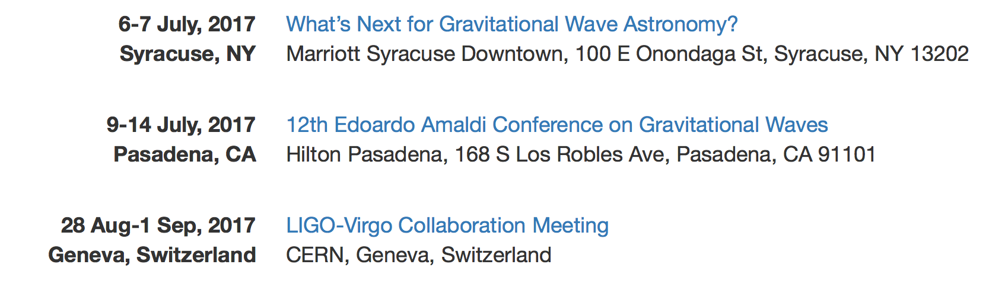
Upcoming Near Term Meetings of Interest
The committee will need your input and help to develop
the proper path forward!
gwic-3g@sympa.ligo.org

Slide 26
What Next?
A Town Hall Meeting
This afternoon 2:00 – 3:30 pm, Hilton Ballroom
The committee will need your input and help to develop
the proper path forward!
gwic-3g@sympa.ligo.org

