Slide 1
The first four pages of this document describe how John and Fabrice have constructed the first three ovens.
Oven history:
The prototype oven is installed on the prototype OPO cavity, operating in LASTI
The first oven production unit was installed on the LLO cavity and came apart during connectorization. This unit was then disassembled and used to develop a more robust technique using hydrochloric acid as a flux. Failing to put it together with this technique, the parts were dissembled, rinsed and sent to Rich at Caltech. Note that these parts carry black stained caused by the hydrochloric acid.
The second production oven is installed on the LLO cavity. The LLO cavity was tested at MIT with this oven, was shipped to LLO and is now mounted on the VIP.

Slide 2
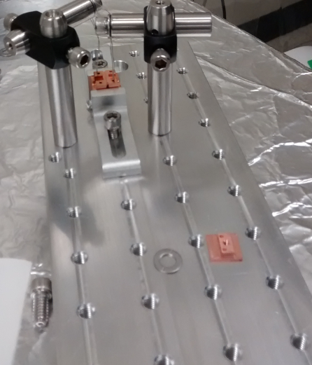
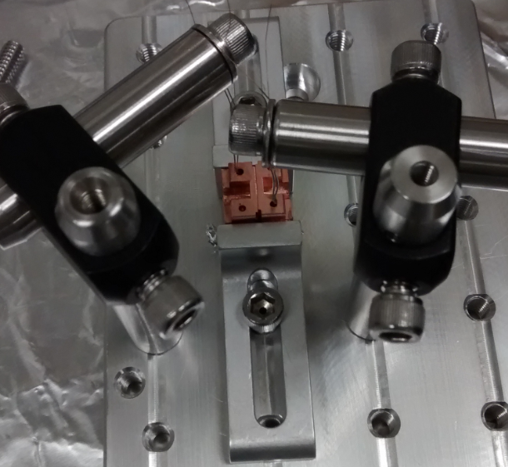
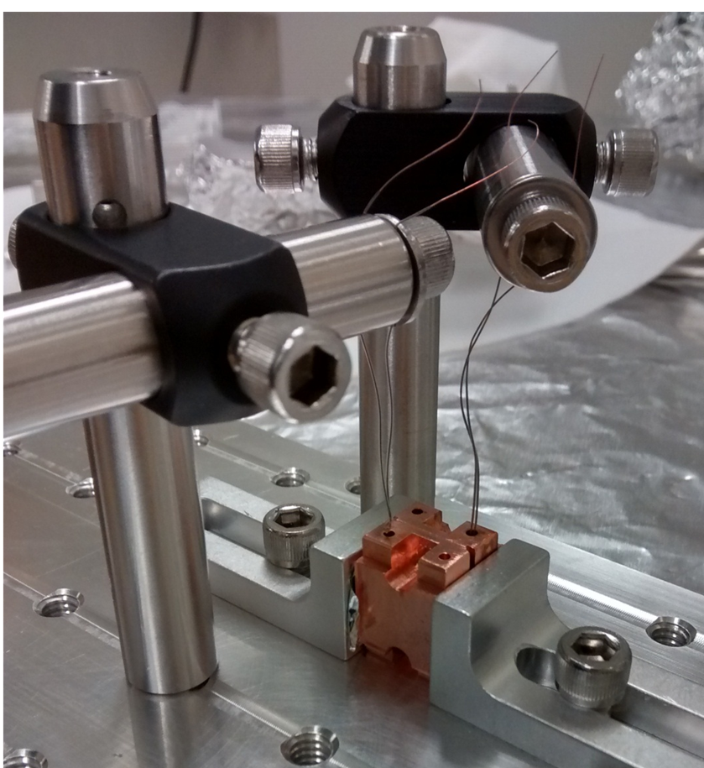
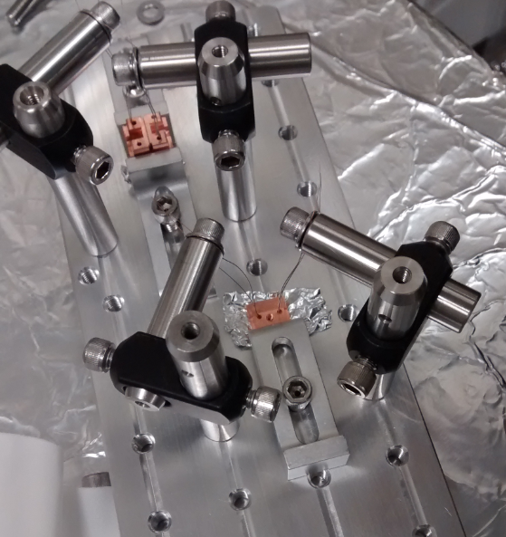

Slide 3
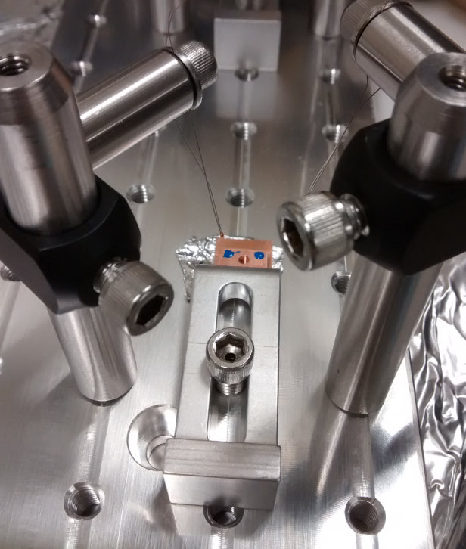
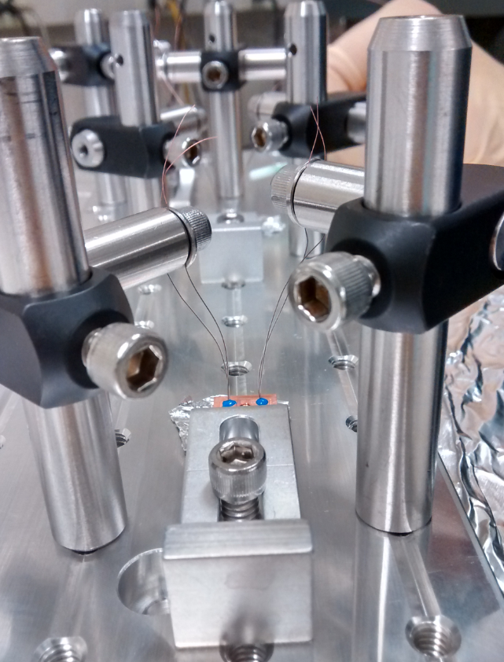
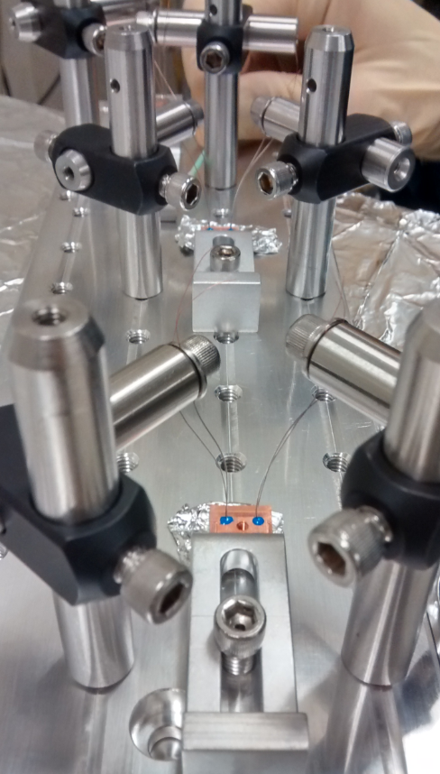

Slide 4
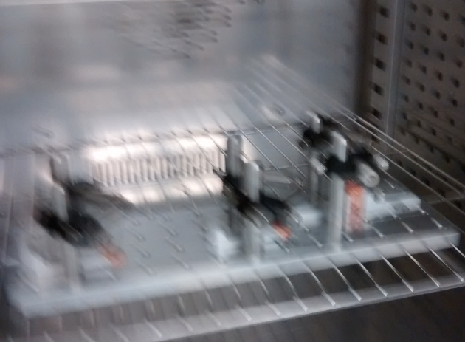

Slide 5
