Slide 1
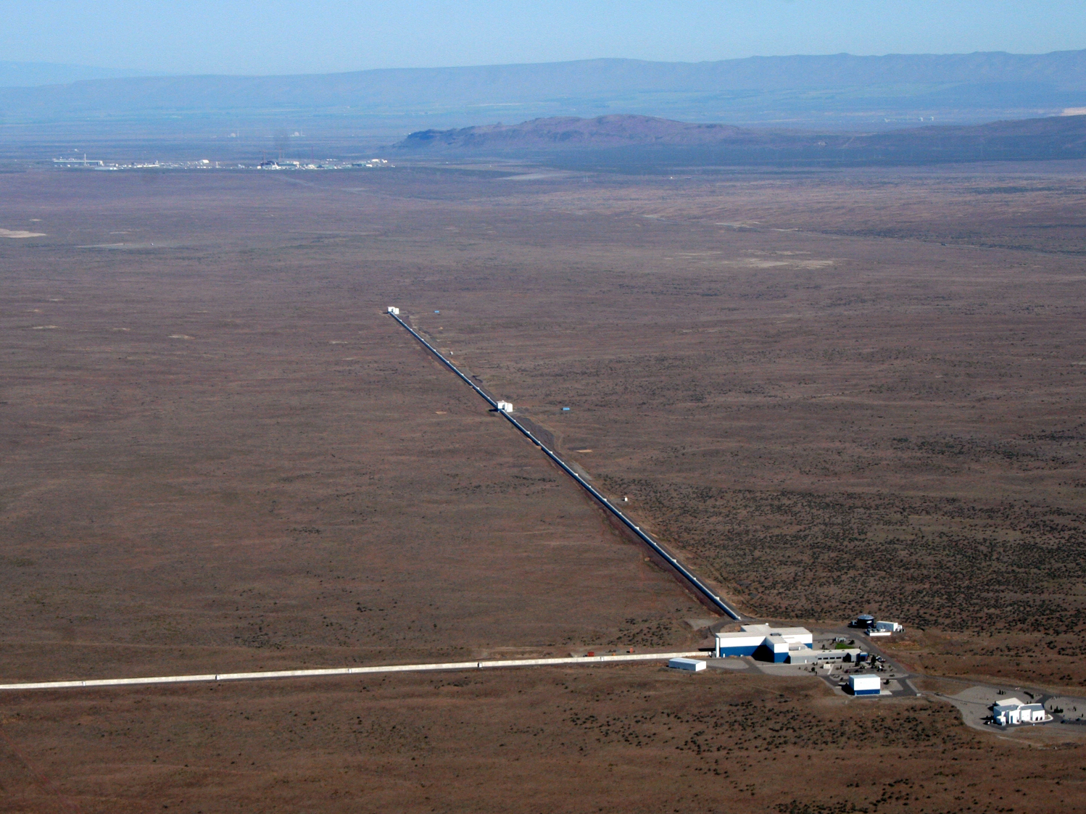



LSC, Open Data Workshop #1, March 25-27, 2018, Pasadena
Gravitational-wave Detectors:
A Primer
David Reitze
LIGO Laboratory
California Institute of Technology
LIGO-G1800277-v2
LIGO Hanford Observatory

Slide 2
Welcome! Welcome! Welcome!
This is the first LIGO Open Data Workshop where you will get a hands-on introduction to working with LIGO data and software tools necessary for accessing and manipulating the data.
You represent a broad and diverse set of participants, ranging from undergraduates to faculty to others interested in learning about LIGO data
Your lecturers are all experts in one or in many cases multiple aspects of LIGO data, so you are in good hands!

Slide 3
Outline of this talk
Gravitational Waves & Gravitational Wave Astrophysics: a Brief Introduction
What is LIGO? Interferometry 101
Advanced LIGO: Advanced Interferometry 201
The Global Network of Ground-based Gravitational-wave Detectors

Slide 4
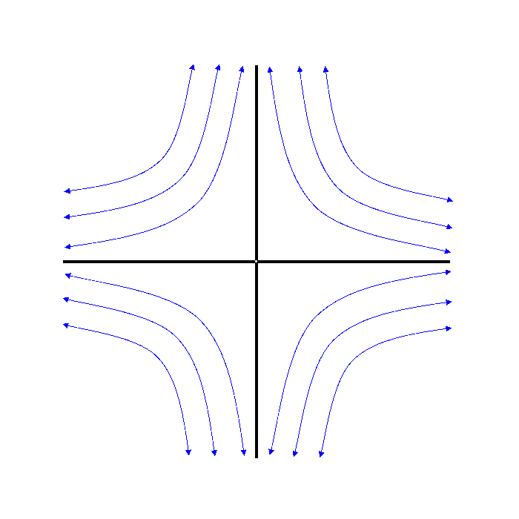
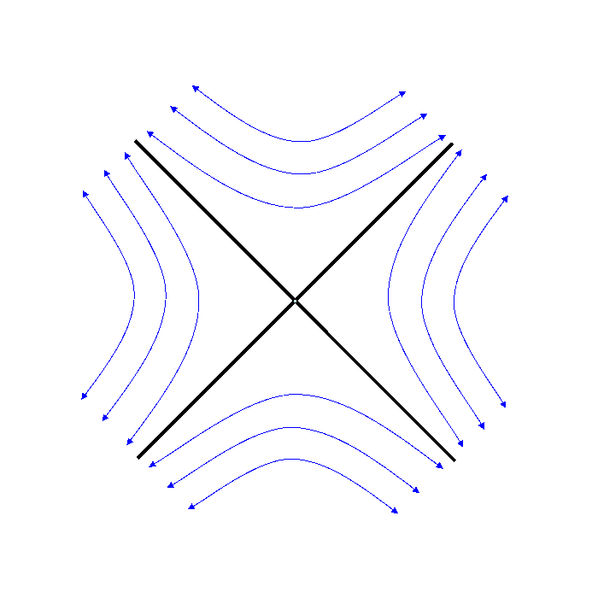
Gravitational Waves
Gravitational waves are propagating solutions to the Einstein Field Equations of General Relativity → solutions h(r,t) → dynamic space-time!
transverse to the propagation direction of the gravitational wave
10M Binary Black Hole System
ω_{orb}
h₊
h_{x}
M
R
Physically, h is a strain: ΔL/L

Slide 5
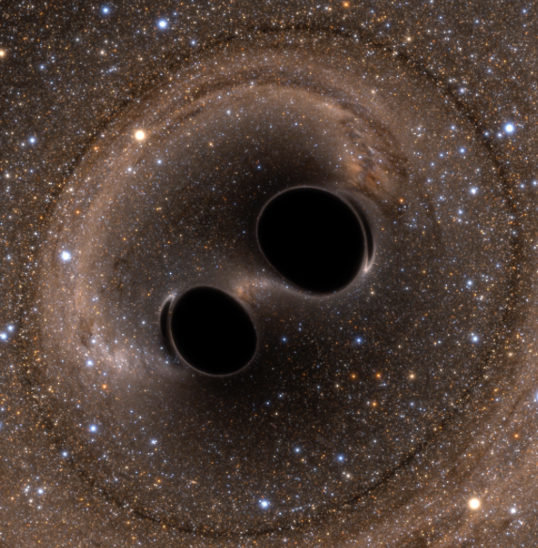
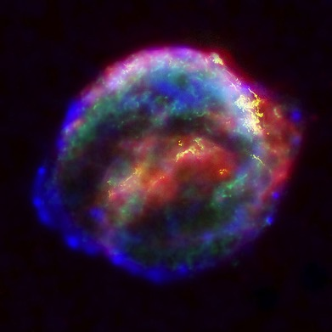

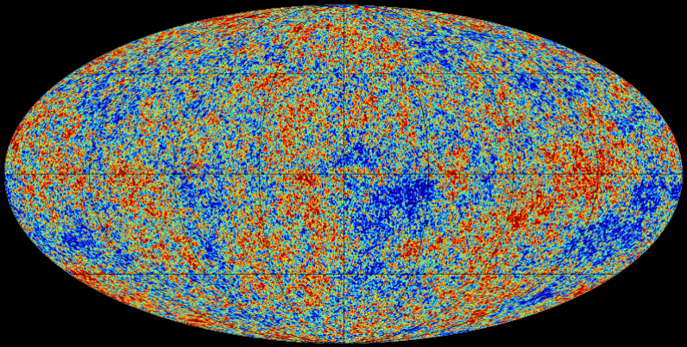
The Astrophysical
Gravitational-Wave Source Catalog
Coalescing Binary Systems
Black hole – black hole
Black hole – neutron star
Neutron star – neutron star
(modeled waveform)
Transient‘Burst’Sources
asymmetric core collapse supernovae
cosmic strings
???
(Unmodeled waveform)
Credit: Bohn, Hébert, Throwe, SXS
Credit: Chandra X-ray Observatory
Stochastic Background
residue of the Big Bang
incoherent sum of unresolved ‘point’ sources
(stochastic, incoherent noise background)
Continuous Sources
Spinning neutron stars
(monotone waveform)
Credit: Planck Collaboration
Credit: Casey Reed, Penn State
Notes:
LIGO is designed to be an observatory, not a one-off proof that GWs exist. What do we look for?
There are number of predicted astrophysical sources of gravitational radiation, and most of them involve cataclysmic events.
Binary systems – NSs and BHs, most likely source, theoretically well understood with known waveforms
Bursts – GW emissions that are not well modeled or understood. These include asymmetrically core collapse supernova, cosmic strings, and perhaps unknown sources
The residual GW background
Continuously emitting sources such as spinning neutron stars, which have a pure monotone emission.

Slide 6
What is LIGO:
Interferometry 101

Slide 7
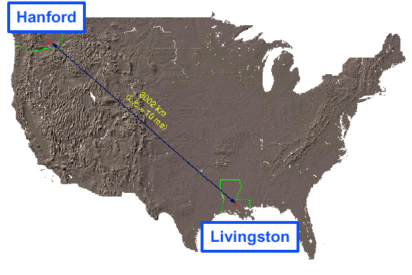
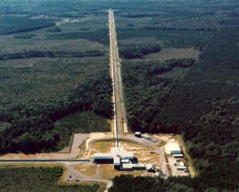
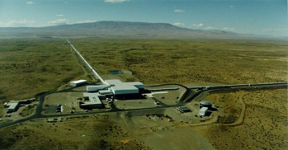

LIGO = Laser Interferometer Gravitational-wave Observatory
LIGO Laboratory is operated by Caltech and MIT.
LIGO Science is conducted by the LIGO Scientific Collaboration (and hopefully you!)
LIGO Laboratory:
180 staff located at Caltech, MIT, Hanford, Livingston
LIGO Scientific Collaboration:
~ 1200 scientists, ~100 institutions, 19 countries
Hanford, WA
LIGO Livingston
Observatory
LIGO Hanford Observatory
Livingston, LA
Notes:
LIGO is actually two observatories and three interferometers.
Describe parameters
Emphasize that the arms are in ultra high vacuum. 8 km of steel 1.2 m dia beam tubes at each site
Separate observatories allow for coincidence detection – since the detectors see uncorrelated noise, only a true gravitational wave would appear on all the interferometers with the correct amplitude.
Emphasize that the LIGO Observatories were designed and are operated by Caltech and MIT

Slide 8
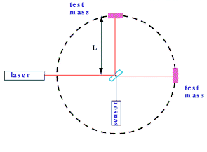
Interferometer: A Gravitational
Wave Transducer

Slide 9
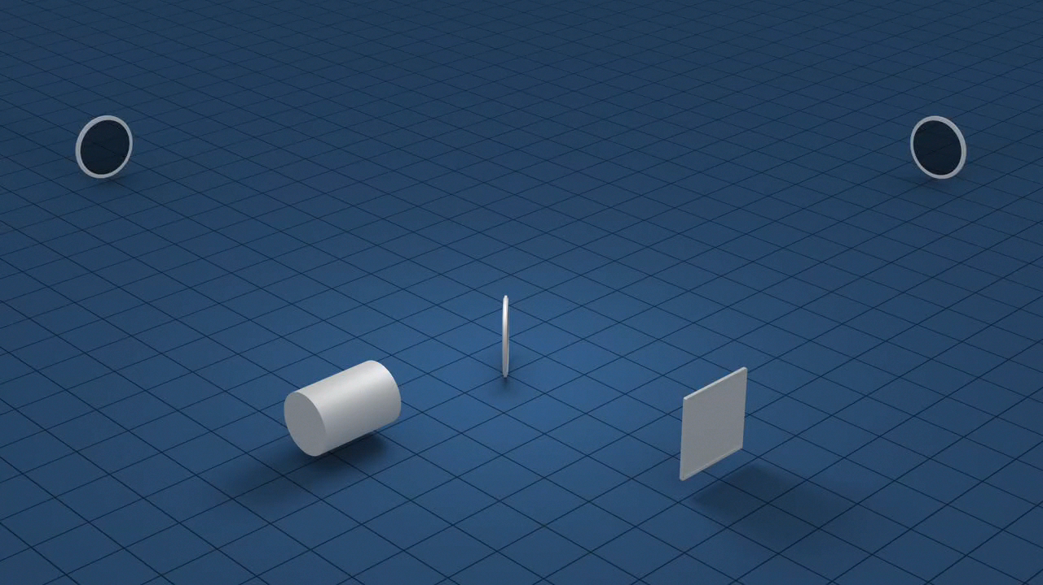
Interferometer: A Gravitational
Wave Transducer

Slide 10

How to measure a gravitational-wave strain less then 10⁻²¹?
Light is quantized in discrete units (‘photons’)
Photons obey the Heisenberg Uncertainty Relationship
  For our purposes, this means that the arrival times of photons at the output photodetector have statistical variability
  → σ_{N}/N = 1/√N
  Physically, the interferometer can’t distinguish between a change in power resulting from a differential change in the arm length or from quantum fluctuations of the photon field
  Some numbers: λ = 1.06 μm, P = 100 W, L = 10 km
  → h_{shot} ≅ 7.3 x 10⁻²³ /√Hz

Slide 11
The Challenges: Noises!
Seismic Noise
test mass (mirror)
Quantum Noise
Residual gas scattering
Radiation pressure
"Shot" noise
LASER
beamsplitter
Wavelength & amplitude fluctuations
Thermal Noise
photodiode

Slide 12
Advanced LIGO:
Advanced Interferometry 201

Slide 13
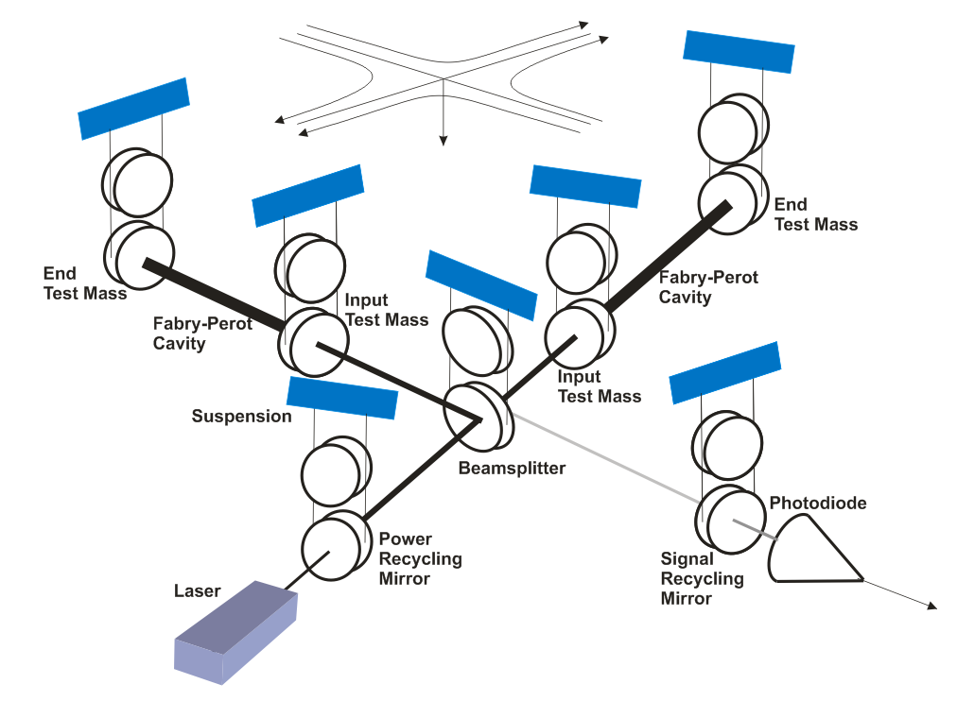
Advanced LIGO Interferometer Architecture
~700 kW
~700 kW
4 km
3 kW
+ Analog to digital
converters
125 W
h(t): 16384 Hz rate
LOSC h(t): 4096 Hz rate

Slide 14
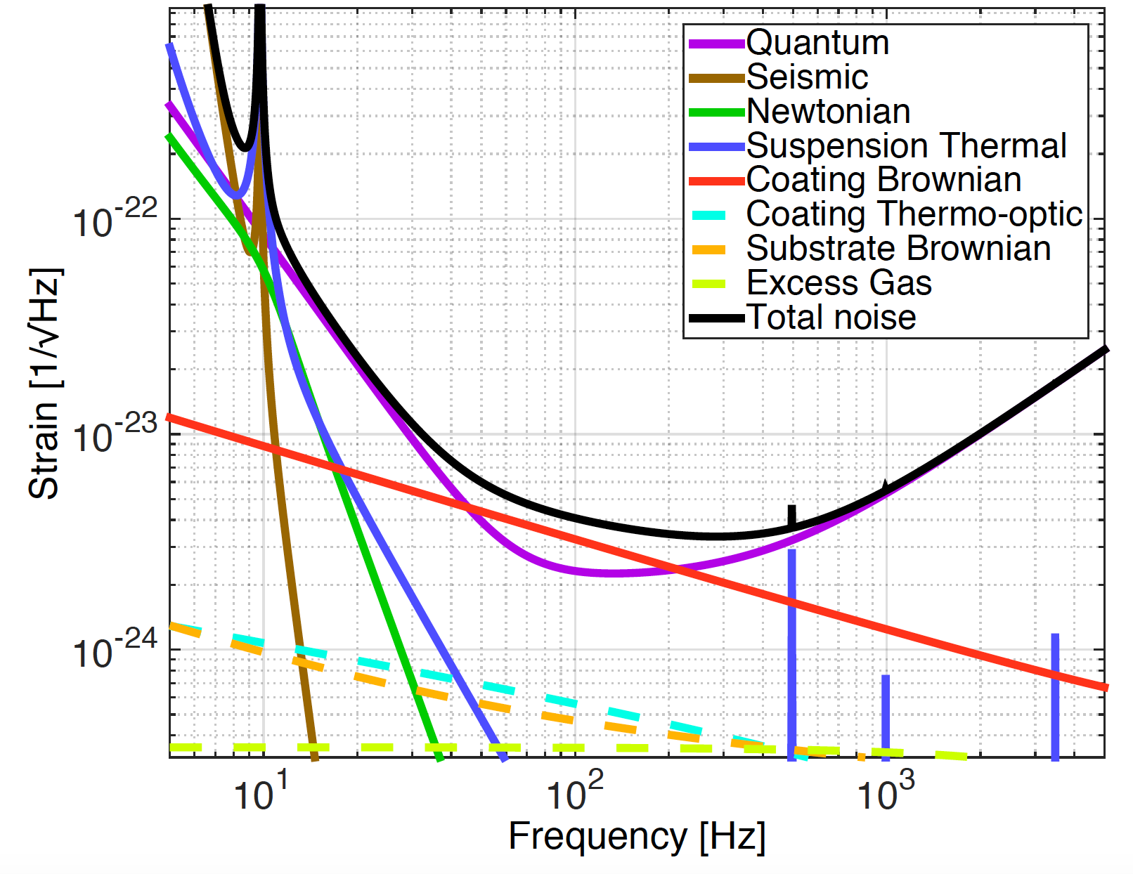
Precision Interferometry = Understanding Measurement Noises
Fundamental Noises:
Displacement Noises
→ ΔL(f)
  Seismic noise
  Radiation Pressure
  Thermal noise
    Suspensions
    Optics
II. Sensing Noises
→ Δt_{photon}(f)
    Shot Noise
    Residual Gas
Technical Noises:
Advanced LIGO Design Noise Budget
→ Hundreds of them…
Notes:
Explain top level three noise sources
Do animation explaining limitations and as a way of previewing next slides

Slide 15

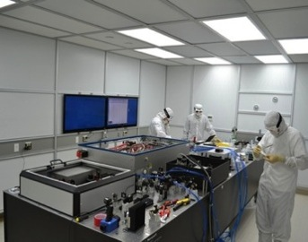
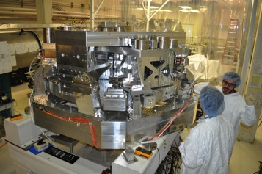
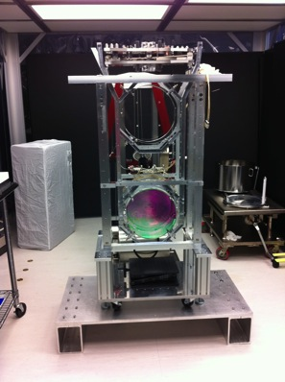
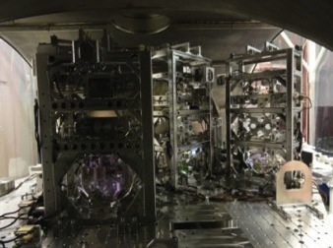
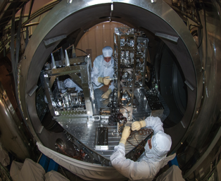
Advanced LIGO Interferometer: A More Detailed Look
Pre-stabilized Laser
200W , 1064 nm
Active Seismic Isolation
40 kg ‘Test Mass’ Mirror
Input Optics
Output Mode Cleaner
Auxiliary Laser
Notes:
Go through the slide from laser forward

Slide 16
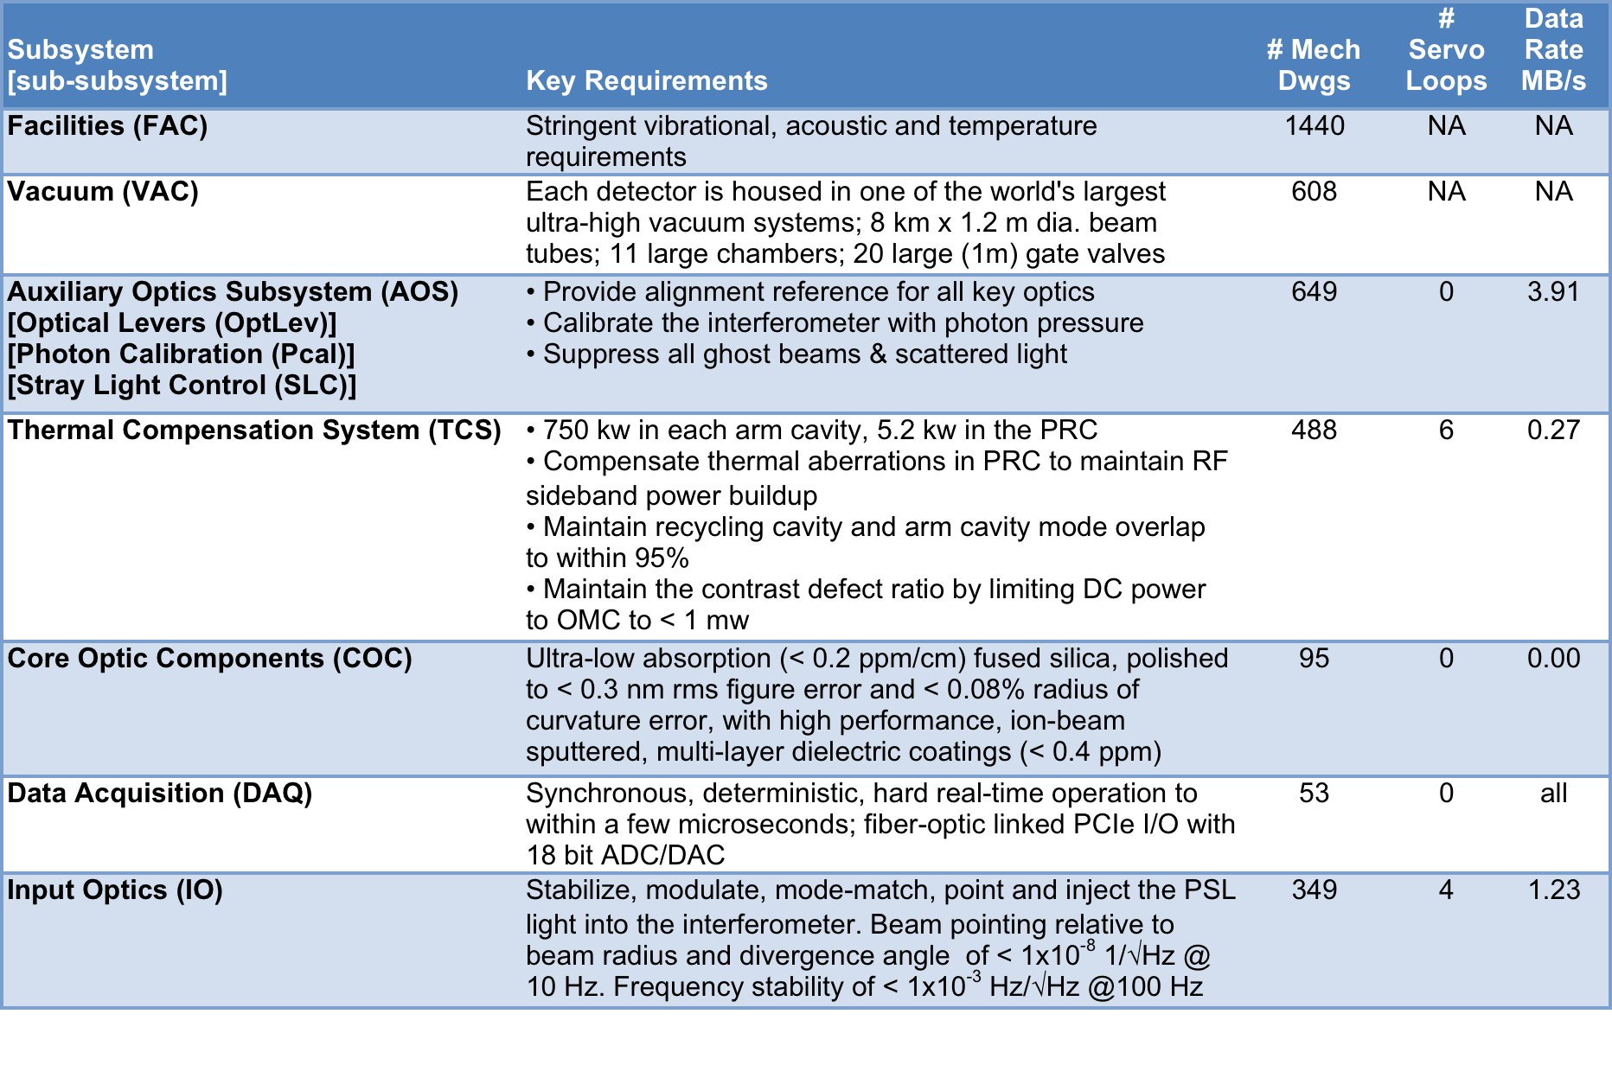
Advanced LIGO by Subsystem

Slide 17


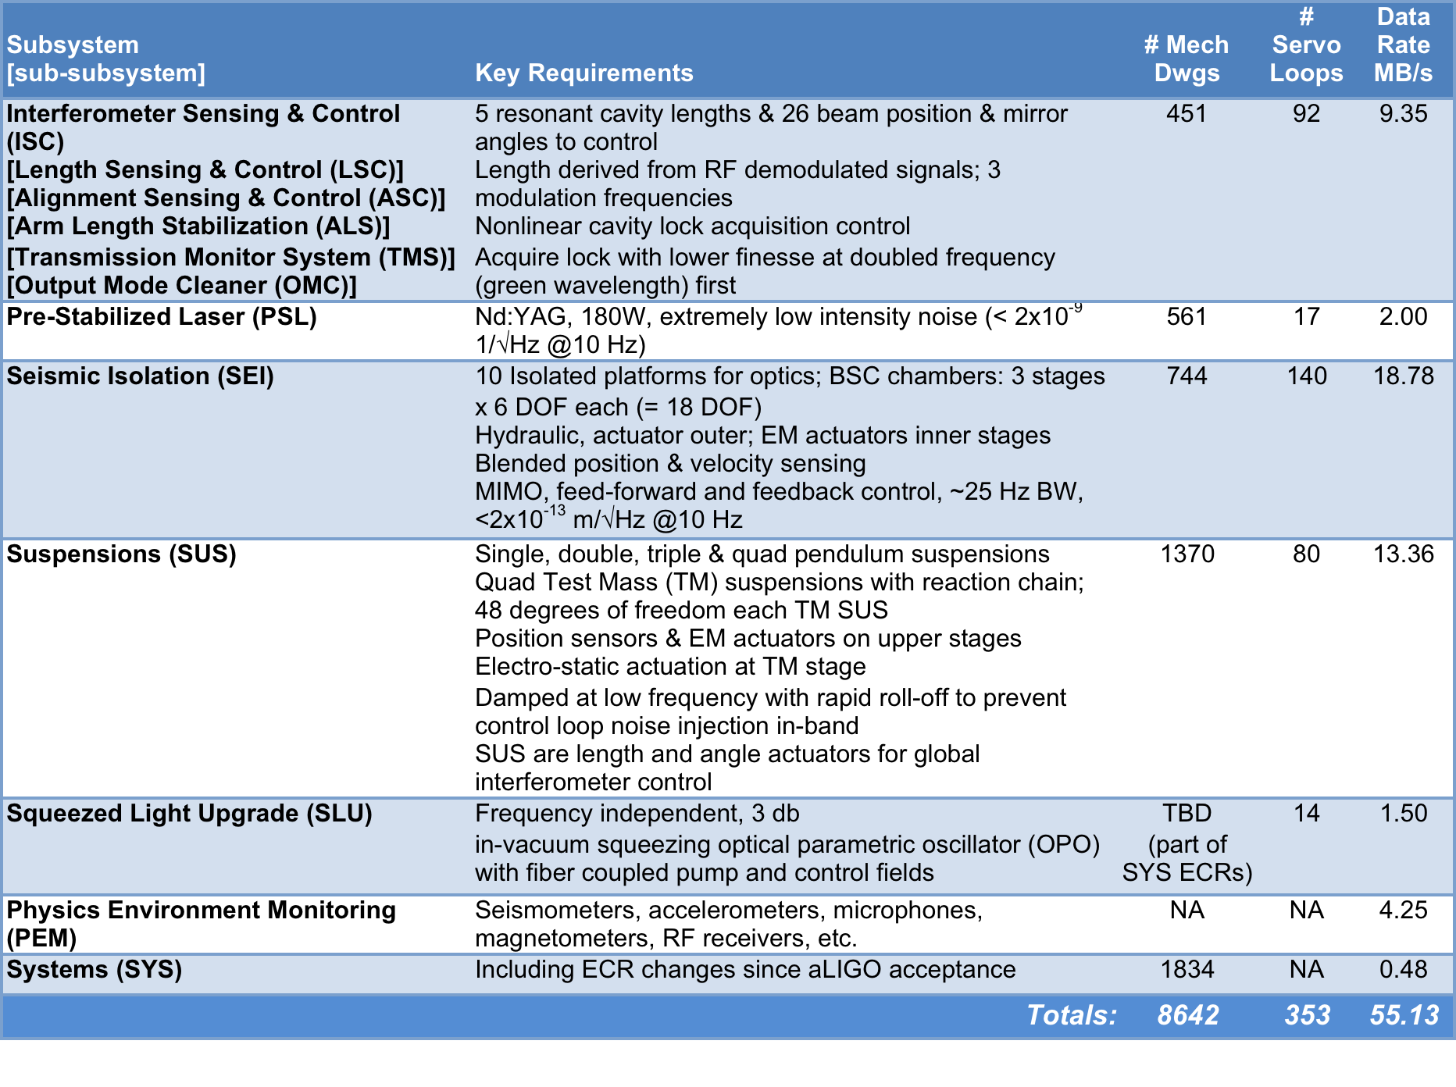
Advanced LIGO by Subsystem (II)

Slide 18
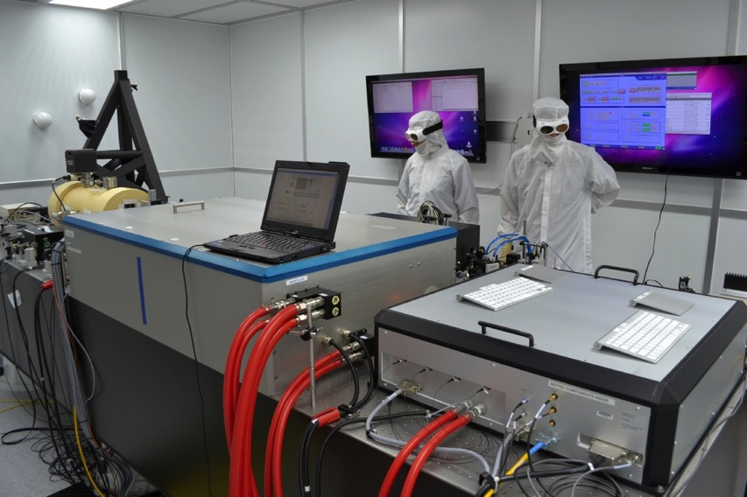
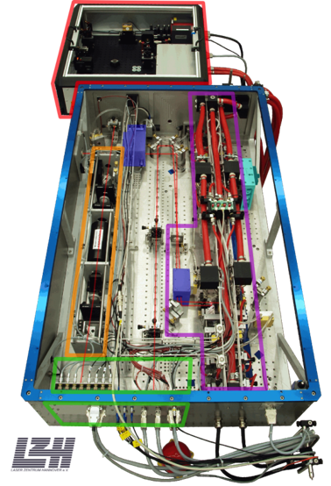
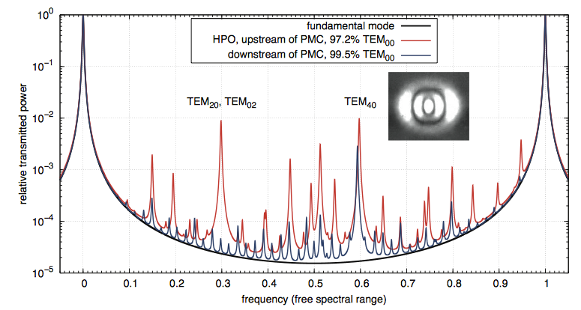
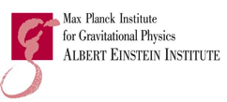
Advanced LIGO Front-end Stabilized
200W Laser
Stabilized in power and frequency – using techniques developed for time references
Uses a Nd:YAG monolithic master oscillator followed by two-stage amplification
  35W Nd:YVO₄ MOPA
  200 W injection-locked Nd:YAG rod ring amplifier
Collaboration w/
MPG Albert Einstein Institute;
Laser Zentrum Hannover
Notes:
Quckly go over

Slide 19

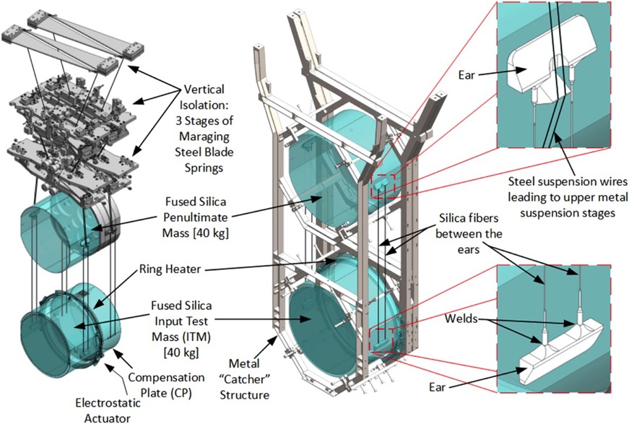
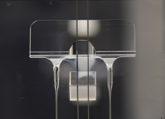
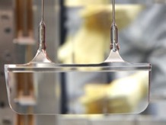
Advanced LIGO Suspensions
4 Stage Transfer Function:
Concept:
Implementation:
Collaboration w/ U. Glasgow
Upper ‘ear’
Lower ‘ear’

Slide 20
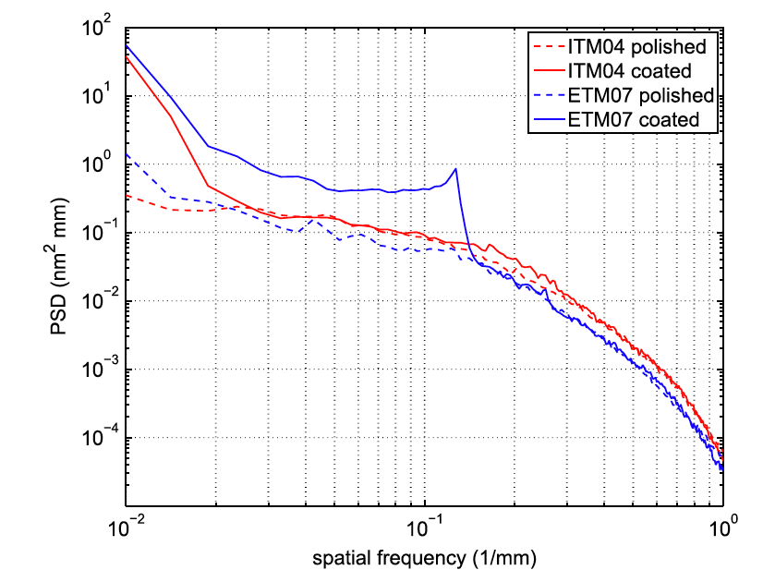
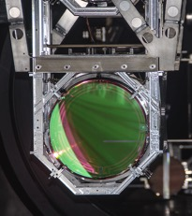
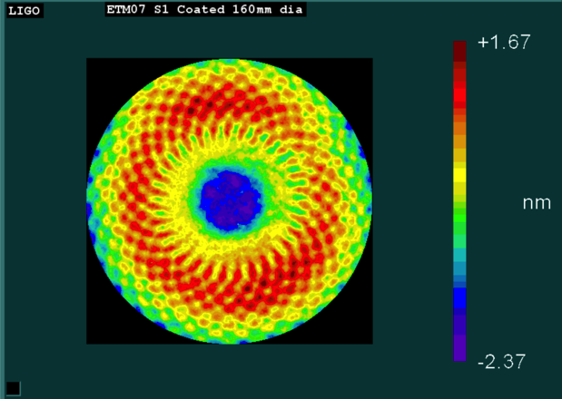
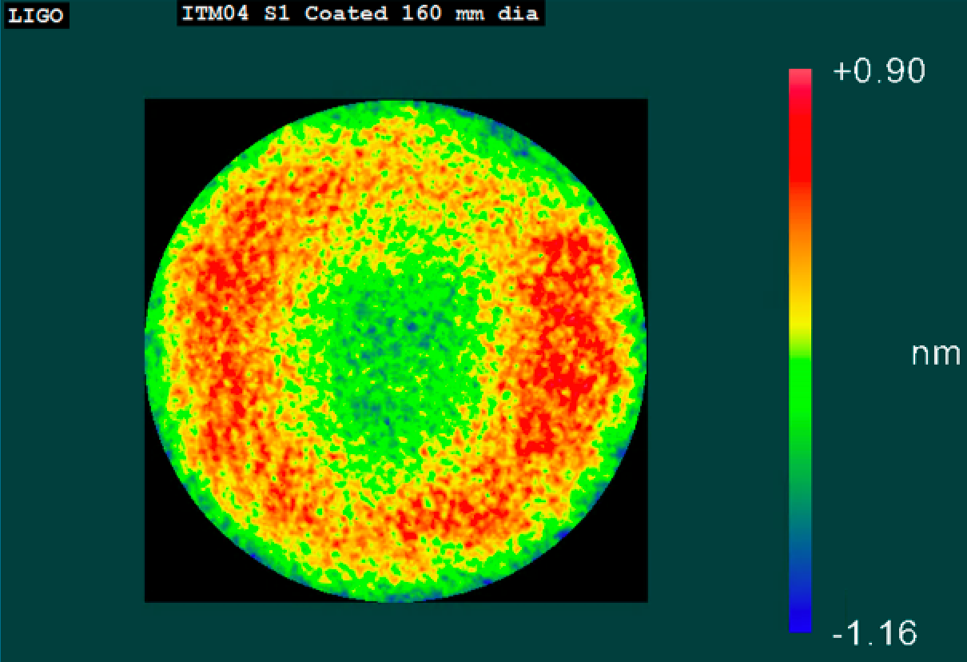
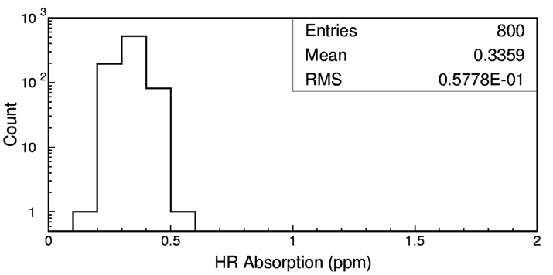
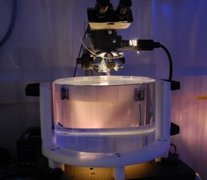
Advanced LIGO ‘Test Mass’ Mirrors
Physical specifications:
  Ultra-pure, ultra-homogeneous Hereaus Suprasil fused silica
  340 mm diameter, 200 mm thick, 40 kg mass
Surface figure: super-polish followed by ion beam sputtering
  < 0.15 nm RMS deviation from sphere
Coatings: TiO₂-doped Ta₂O₅/SiO₂
  Reflectivity depends upon type of mirror
  Ultralow absorption (< 0.5 ppm)

Slide 21
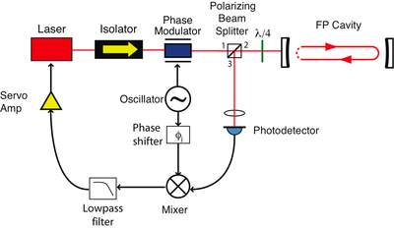
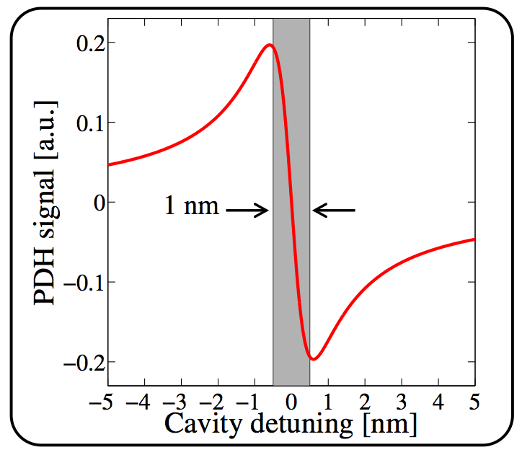
Advanced LIGO = Servo Control
Suspended cavity mirrors must be held to sub-picometer absolute position in length → must know the (relative) positions of the mirrors and be able to control them
Concept: Pound-Drever-Hall locking
Polarizing
Beam
Spiitter
Laser
Isolator
Phase
Modulator
Fabry-Perot Cavity
Servo
Amplifier
Reference
Oscillator
Servo
Amplifier
Phase
Shifter
Photodetector
Lowpass
filter
Mixer
Lowpass
filter

Slide 22
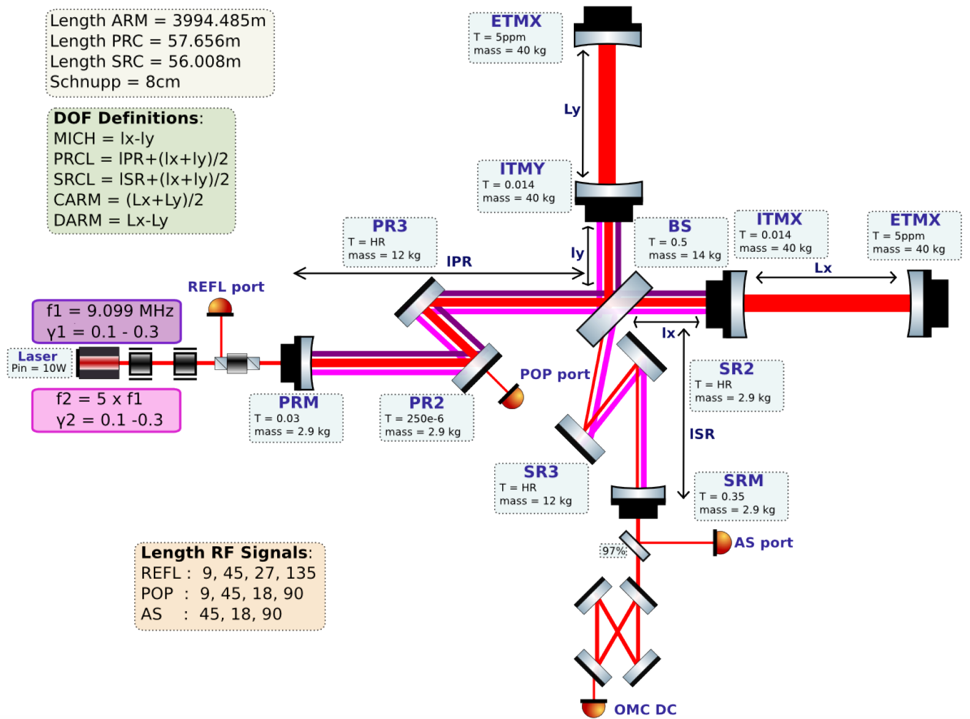
Advanced LIGO = Servo Control (II)
Length Sensing System
h(t)
Slide: Anamaria Effler, LIGO Livingston

Slide 23
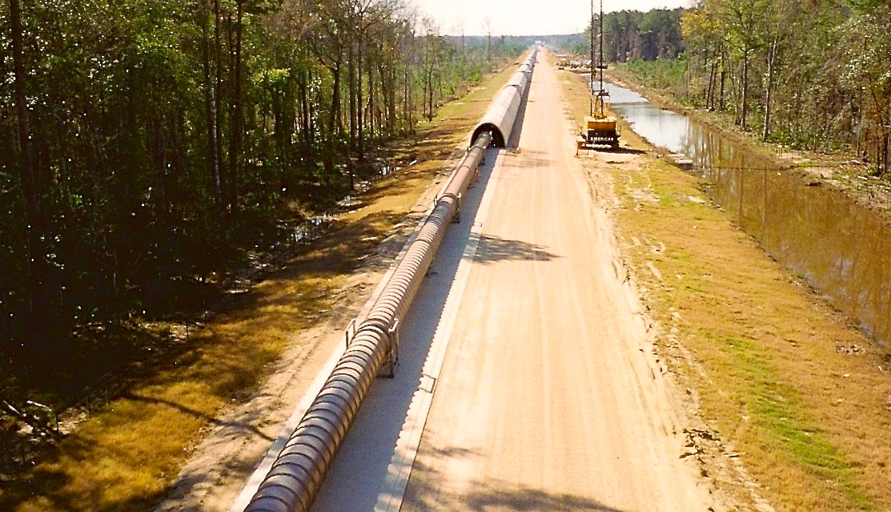
The LIGO Vacuum System
Consists of:
  9000 m³ volume
  30000 m² surface area
  50000 m of spiral welds
  10⁻⁸ - 10⁻⁹ torr
At each observatory

Slide 24
LIGO Livingston Performance
70.6 Mpc BNS Range)
ΔL ~ 3 x 10⁻¹⁹ m
Notes:
Point out
What BNS range means
Curves look similar, but BNS range benefits from low frequency senstivity

Slide 25
The Global Network of Gravitational-wave Detectors

Slide 26

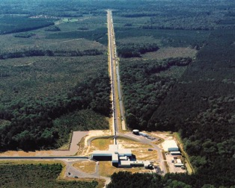
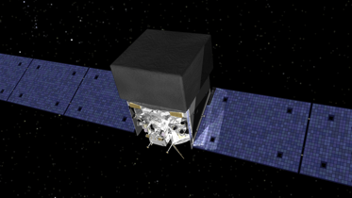
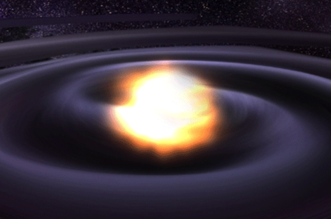
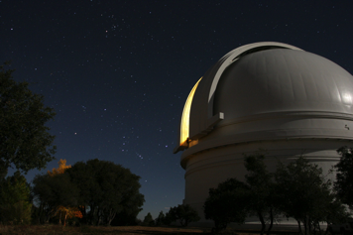
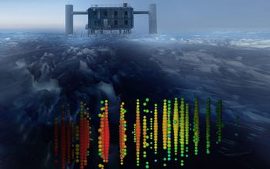
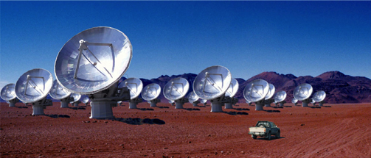
Multi-messenger Astronomy with Gravitational Waves
Binary Neutron Star Merger
X-rays/Gamma-rays
Gravitational Waves
Visible/Infrared Light
Neutrinos
Radio Waves

Slide 27
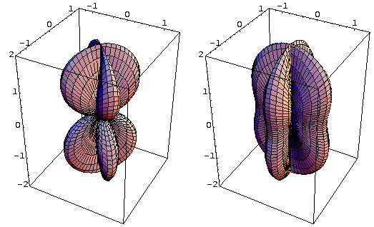
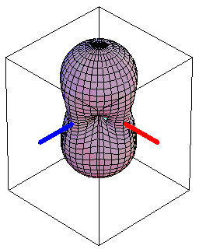
Interferometer Antenna Pattern: Omnidirectional Microphone
Sensitivity depends upon propagation direction, polarization, frequency
“×” polarization
“+” polarization
RMS sensitivity

Slide 28
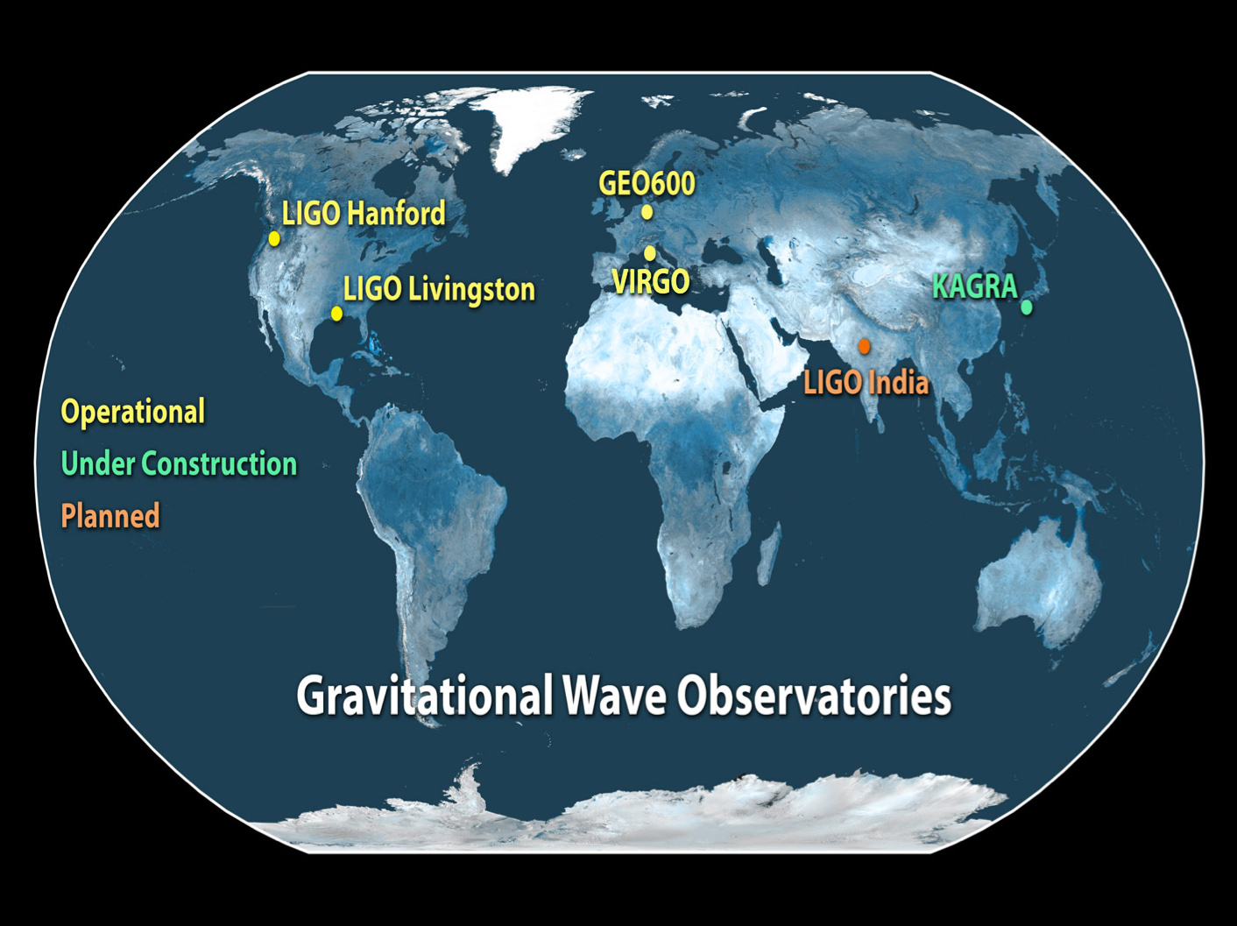

Slide 29
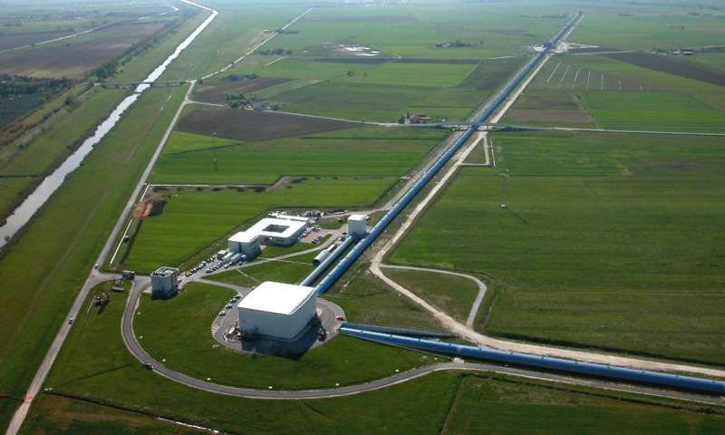
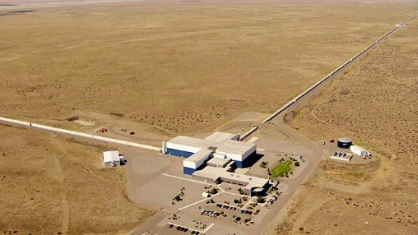

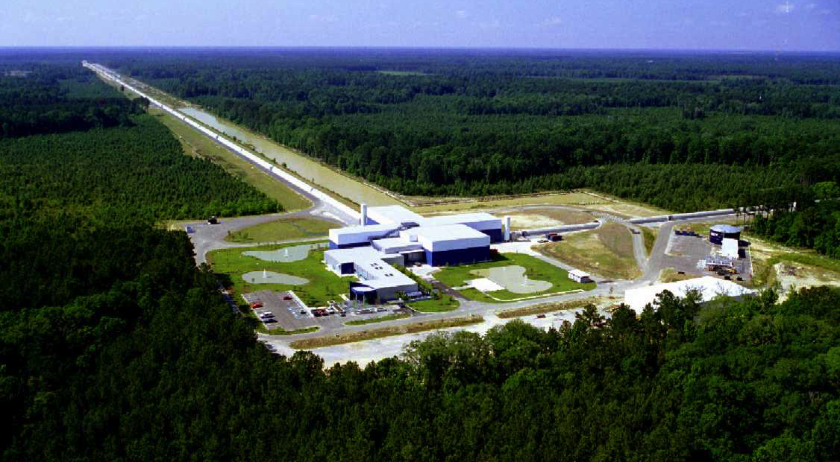
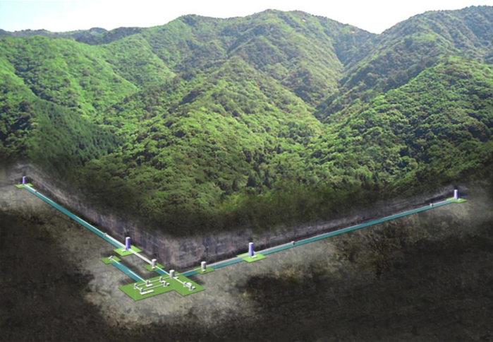

LIGO Hanford
Observatory
Washington, USA
Virgo
Observatory
Italy
KAGRA
Observatory (2019)
Japan
LIGO Livingston
Observatory
Louisiana, USA
LIGO-India (2025)

Slide 30


Binary Neutron Star Merger Localization: Hanford-Livingston-Virgo
3 site network
x denotes blind spots
S. Fairhurst, “Improved source localization with
LIGO India”, J. Phys.: Conf. Ser. 484 012007
Notes:
Note that this map assumes design sensitivity for LIGO and Virgo

Slide 31

Binary Neutron Star Merger Localization: Hanford-Livingston-Virgo-India
4 site network
S. Fairhurst, “Improved source localization with
LIGO India”, J. Phys.: Conf. Ser. 484 012007

Slide 32
Further reading on GW interferometers
Peter Saulson, Fundamentals of Interferometric Gravitational-wave Detectors 2nd Edition (2017); Singapore: World Scientific Publishing
B. Abbott, et al., (The LIGO Scientific Collaboration) “Advanced LIGO”, Class. Quantum Grav. 32 (7): 074001 (2014).
R. X. Adhikari, “Gravitational radiation detection with laser interferometry” Rev. Mod. Phys. 86 (1):121--151 (2014).

