Slide 1
O2 C02 Calibration Uncertainty Review / Summary / Update
C. Cahillane, M. Hulko, J. Kissel, for the LSC Calibration Team

Slide 2
What’s New In O2’s C02 Release
PCAL (our absolute displacement reference) was identified to have beam clipping on its reflection photodiode (RXPD) for both observatories
  Time-dependent systematic error
  C02 switched to using the transmitted photodiode (TXPD) for the entire run, therefore correcting the error
  C02 uncertainty budget no longer needs to include this systematic error
The GDS/DCS developers in the group figured out how to apply frequency dependent time-dependent corrections to the data
  Can now correct for time-dependent changes in the sensing function’s coupled cavity pole frequency
  C02 has corrected for the time-dependence of the cavity pole.
  C02 uncertainty budget no longer needs to include this systematic error
  Note: because only LHO significantly suffers from SRC detuning, and any time-dependence in the pole frequency / Q has negligible impact on the overall uncertainty, we did not correct for it in C02 h(t), thus it remains as a systematic error
This essentially reduces the uncertainty budget to only statistical uncertainty from measurements
  These still contain time-dependence (i.e. from coherence of calibration lines), but it’s MUCH smaller, which now means very little variation from event to event

Slide 3
Data & Scripts Used In the Review
Many thanks to Craig and Mykyta for resurrecting the O2 calibration uncertainty pipeline.
I’ve only used C01 data from Analysis Chucks 2&3 – and used GW170104 as my comparison between C01 & C02.
  Need to commit C01 .tar file for Oct-06-2017_O2UncertaintyTxts that (presumably) was used in uncertainty paper (?)
  Should be good enough to demonstrate the differences, but I won’t have exact C01 vs C02 comparisons for all events, or for “All O2” comparisons.
C02 Event Data is posted to EVNT aLOG 12055, but really, using
${CalSVN}/trunk/Runs/O2/${IFO}/Results/Uncertainty/ResponseFeb-26-2018_O2_LHO_GPSTime*.txt
1-hour stride data is posted to EVNT aLOG 12056, but really, unzipped from
${CalSVN}/trunk/Runs/O2/${IFO}/Results/Uncertainty/UncertaintySpectrograms/Feb-21-2018_O2UncertaintyTxts/
O2_${OBSERVATORY}_GPSTime_1186007541_C02_RelativeResponseUncertainty.tar
Script(s) used to analyze data and produce the review:
${CalSVN}/trunk/Runs/O2/Common/Scripts/Uncertainty/
plotuncertaintyspectrograms_O2_C02_forG1800319.m
plotuncertaintyspectrograms_O2a_forG1700081.m

Slide 4
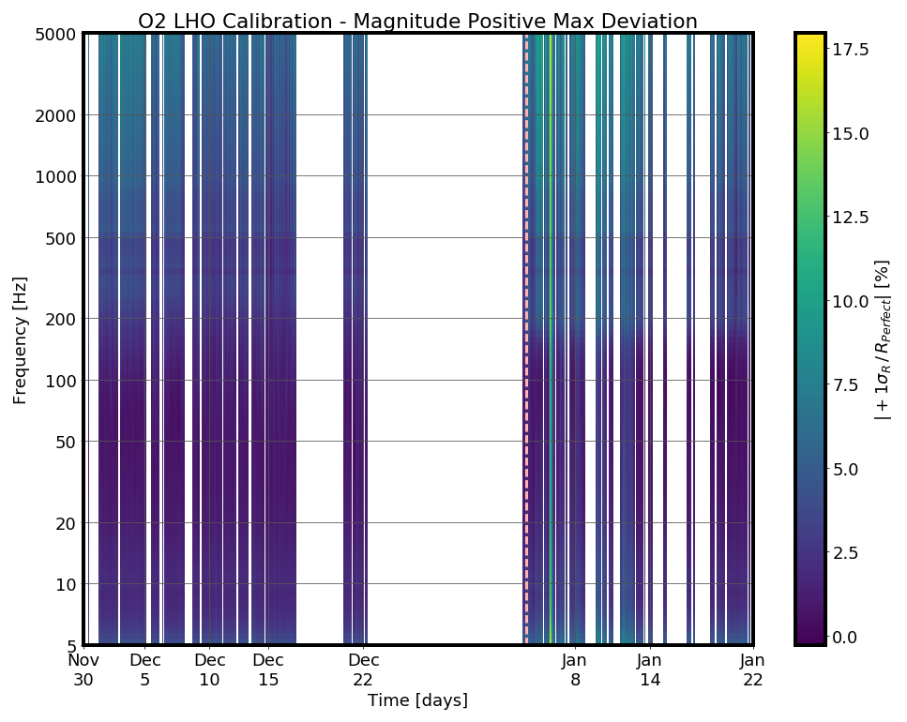
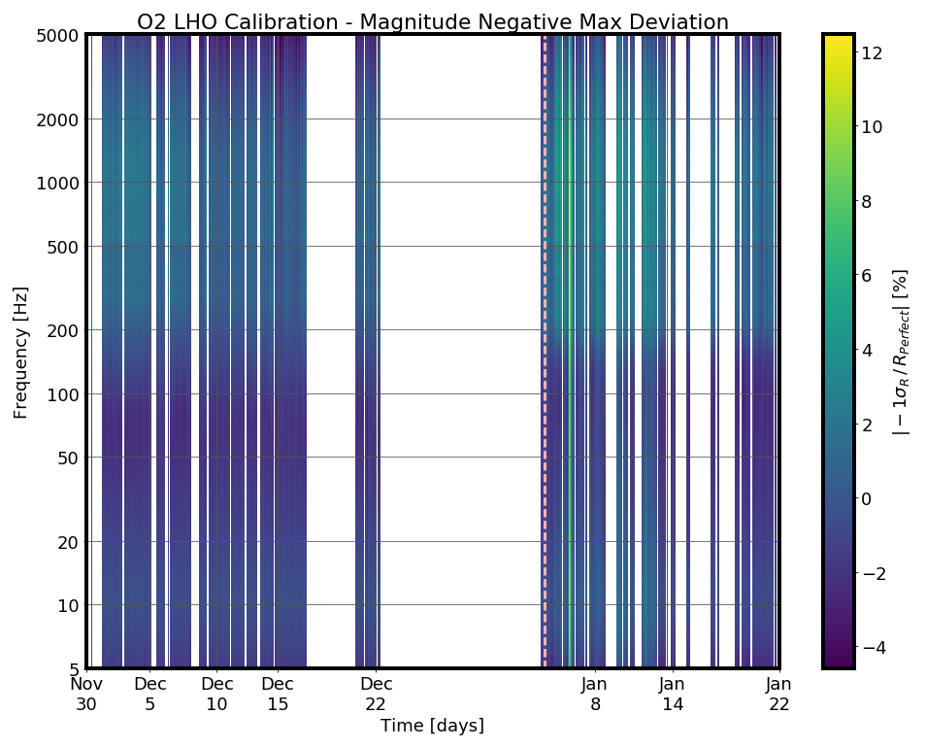
Primer: Reminder of the Process
(2) Do this for many times during the run during analysis ready times, with 1 hour cadence, to form spectrograms of error and uncertainty (upper and lower bounds, mag and phase)
Compute the uncertainty at a given time, based on
  time-independent statistical uncertainty
  Posteriors of MCMC fit to reference measurements
  time-independent systematic error
  Gaussian Process fit over residuals of all sweeps from Run
  time-dependent systematic error and uncertainty
  Computed from
  calibration lines
(3) Use percentile statistics on spectrogram data to find what is “normal” and how a specific time compares to it
(4) Use percentiles to find maximum deviation from perfect, over a chosen frequency band

Slide 5
Case Study: GW170104, C01 vs C02
H1’s systematic error is scaled closer to zero b/c PCAL clipping no longer a systematic error
Low frequency at L1 still dominated by statistical uncertainty from less UIM and PUM measurements than H1
H1 larger in phase uncertainty because we didn’t measure sensing function sweeps to as high a frequency
Both IFO’s no longer have error from time-dependent coupled cavity pole
Phase tightens up nicely also b/c removal coupled cavity pole error

Slide 6
H1 Percentile Outliers Improve without PCAL Clipping Error
All O2, C01
No More Cavity Pole Error!
No More Clipping Error!
No More Cavity Pole Error!
All O2, C02
Direct comparison of 99.7th percentiles
between C01 (A.C. 2 & 3) vs. C02

Slide 7
L1 Percentiles Improve at with out Cavity Pole Error
All O2, C01
No More Cavity Pole Error!
All O2, C02
Direct comparison of 99.7th percentiles
between C01 (A.C. 2 & 3) vs. C02

Slide 8
GW170104 and O2 Maximum Uncertainty and Error Improve!
GW170104, 68th Percentile
C01 Result: 5.4/4.1 %, 2.1/2.2 deg
(Different from Uncertainty paper…
4.6/3.7 %, 1.8/1.9 deg
... I used Feb-27-2017, A.C. 2&3 results, and time *near* event, not actuatly event time)
C02 Result: 2.6/3.8 %, 2.3/2.1 deg
All O2, 68th Percentile
C01 Result: 6.1/4.8 %, 2.2/2.2 deg
(Different from Uncertainty paper…
Isn’t Quoted in paper, on figure
... I used Feb-27-2017, A.C. 2&3 results)
C02 Result: 2.6/3.9 %, 2.4/2.2 deg

Slide 9
Another C02 Result – GW170817

Slide 10
New Answers!
(Divided by IFO)
Frequency Range: 20- 2048 Hz
68% Confidence Interval (i.e. 1-sigma)
Systematic Error + Statistical Uncertainty
O2 C02 | H1 | L1
GW170104 | 2.58% / 2.29 deg | 3.8% / 2.13 deg
GW170608 | 2.56% / 2.38 deg | 3.89% / 2.18 deg
GW170729 | 2.72% / 2.31 deg | 3.78% / 2.13 deg
GW170809 | 2.52% / 2.39 deg | 3.79% / 2.13 deg
GW170814 | 2.58% / 2.34 deg | 3.85% / 2.16 deg
GW170817 | 2.57% / 2.3 deg | 3.85% / 2.15 deg
GW170823 | 2.55% / 2.35 deg | 3.8% / 2.15 deg
GW170825 | 2.64% / 2.36 deg | 3.86% / 2.12 deg
All of O2 | 2.6% / 2.36 deg | 3.85% / 2.15 deg

Slide 11
New Answers!
(Divided by Mag / Phase)
Frequency Range: 20- 2048 Hz
68% Confidence Interval (i.e. 1-sigma)
Systematic Error + Statistical Uncertainty
O2 C02 | H1 / L1 Mag [%] | H1 / L1 Pha [deg]
GW170104 | 2.58 / 3.8 | 2.29 / 2.13
GW170608 | 2.56 / 3.89 | 2.38 / 2.18
GW170729 | 2.72 / 3.78 | 2.31 / 2.13
GW170809 | 2.52 / 3.79 | 2.39 / 2.13
GW170814 | 2.58 / 3.85 | 2.34 / 2.16
GW170817 | 2.57 / 3.85 | 2.3 / 2.15
GW170823 | 2.55 / 3.8 | 2.35 / 2.15
GW170825 | 2.64 / 3.86 | 2.36 / 2.12
All of O2 | 2.6 / 3.85 | 2.36 / 2.15

Slide 12
Some Results for the CW Group
For O1, C01 data, the uncertainty was re-analyzed for the CW group in T1500576 using these same methods, but for frequency bands
  20-100 Hz, Einstein @ Home
  20-475 Hz, Most Other Papers (PowerFlux, Freq. Hough, Sky Hough, and Time-domain F-Statistic, “Low Frequency” CW Paper
  475-2000 Hz, High-Frequency CW paper
Here we’ve done the same (I’ll skip the plots this time, but you can see from whence the numbers came on pg 10):
Freq. Band [Hz] | Magnitude (H1 / L1) [%] | Phase (H1 / L1) [deg]
20-100 | 1.6 / 3.9 | 0.9 / 2.2
20-475 | 2.3 / 3.9 | 1.1 / 2.2
475-2000 | 2.4 / 2.1 | 2.3 / 1.7

Slide 13
Conclusions
Removal of primary systematic errors drastically improve the error + uncertainty budget
We’re able to reduce maximum error + uncertainty limits
Now limited by measurement uncertainty (i.e. patience, IFO time, and person power)
We have some lessons learned to (potentially) get even better
Craig and Mykyta are patient and awesome
We are ready for O3 at ~3 % and 2 deg!

