Slide 1
ITM03; LHO ITMx
Post O2 inspection
The Hanford ITMx exhibited high absorption. The optic was examined and cleaned in-chamber, May 2017.
The absorption persisted, the optic was removed after O2
A feature was found at the location predicted by TCS. This feature is highly absorbing. A feature at this location was present in the scatter scans of the optic as received from the coater. Several other post-coating absorbers over 20 ppm were found in the center 60 mm of the optic.
G. Billingsley, L. Zhang
LIGO-G1800345-v1

Slide 2
Experimental process
Scatter measurement - The map before installation: measured after First Contact cleaning with ion gun. The map after O2: measured as-returned from LHO, no cleaning
Cleaning with ion gun because there was some dust visible when checking with a flash light.
Gentle absorption: the measurement was carried out with a beam of 0.3mm in diameter and 0.9W, i.e. 12.7W/mm^2. The lower limit of sensitivity for this scan was about 20ppm.
High resolution probe of the high absorption spot. The measurement was done with a beam of 60 um in diameter at 25 mW, i.e. 8.8 W/mm^2.
All scatter and absorption data are referenced from LIGO-E1000766

Slide 3
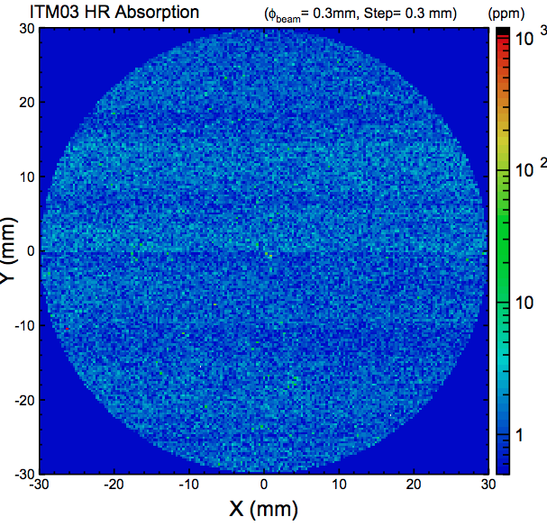
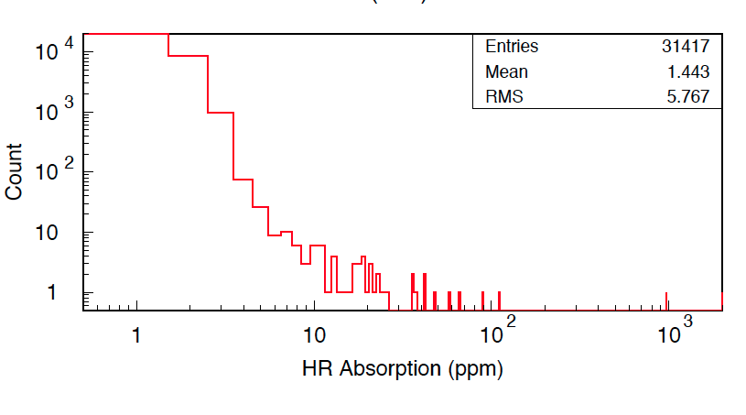
“Gentle” Absorption Scan
Absorber found!
Lower power and larger beam than the usual absorption scan: Noise floor ~20 ppm

Slide 4
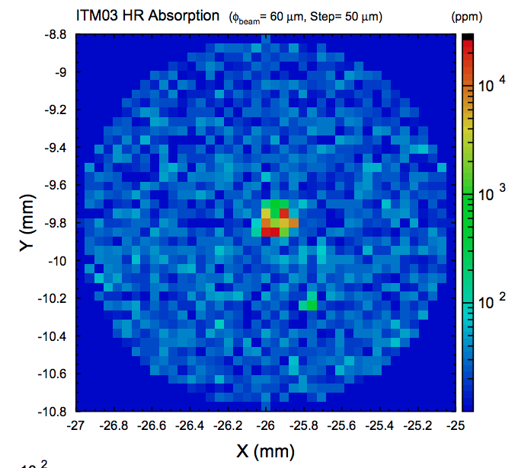
Probe absorption with smaller beam

Slide 5
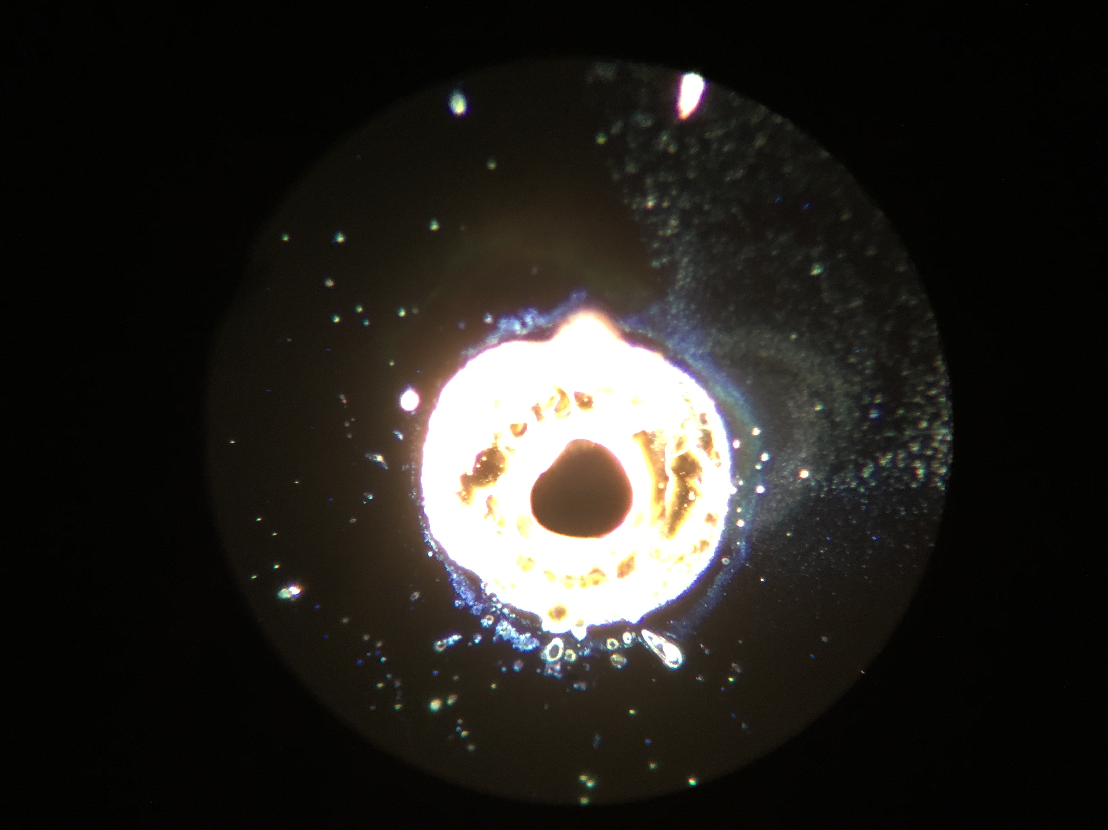
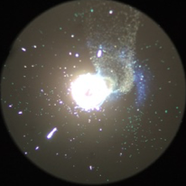
absorber: 155 µm across bright center

Slide 6
absorber: 155 µm across bright center

Slide 7
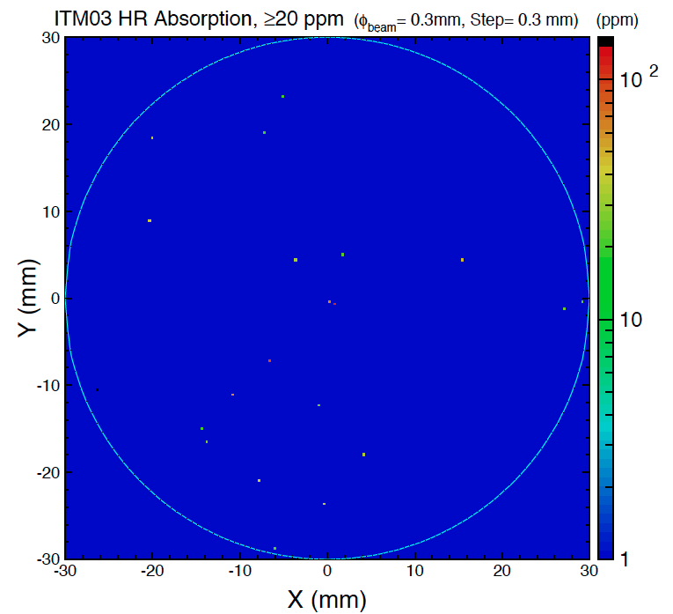
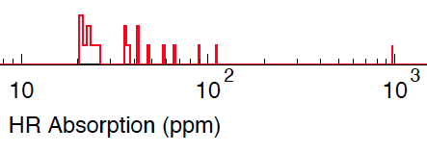
“Gentle” Absorption Scan with bottom noise chopped off
Note there was no first contact cleaning before this scan.
Possible dust added during chamber removal or installation on absorption test stand

Slide 8
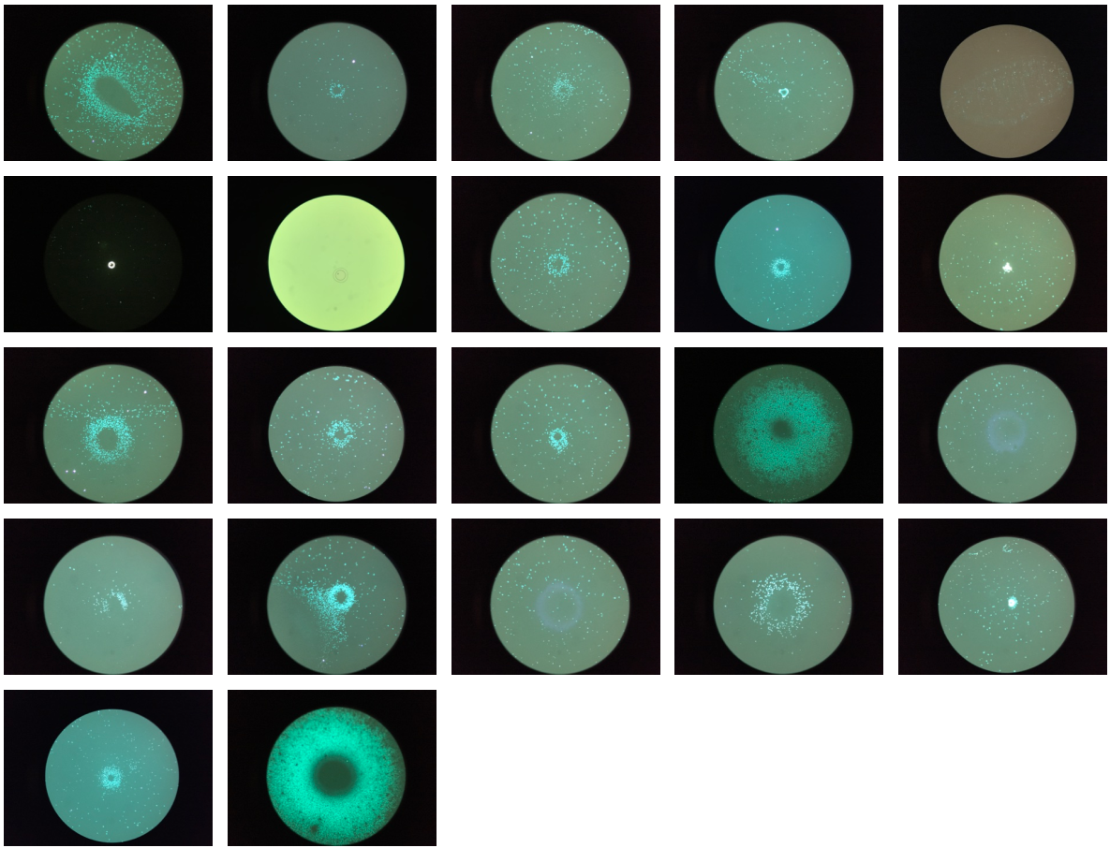
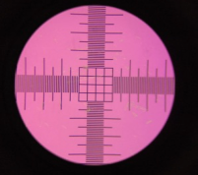
Dark Field Microscopy
Features found within a radius of ~60 mm of center.
1 mm ∅ field
Center scale squares are 50 µm

Slide 9
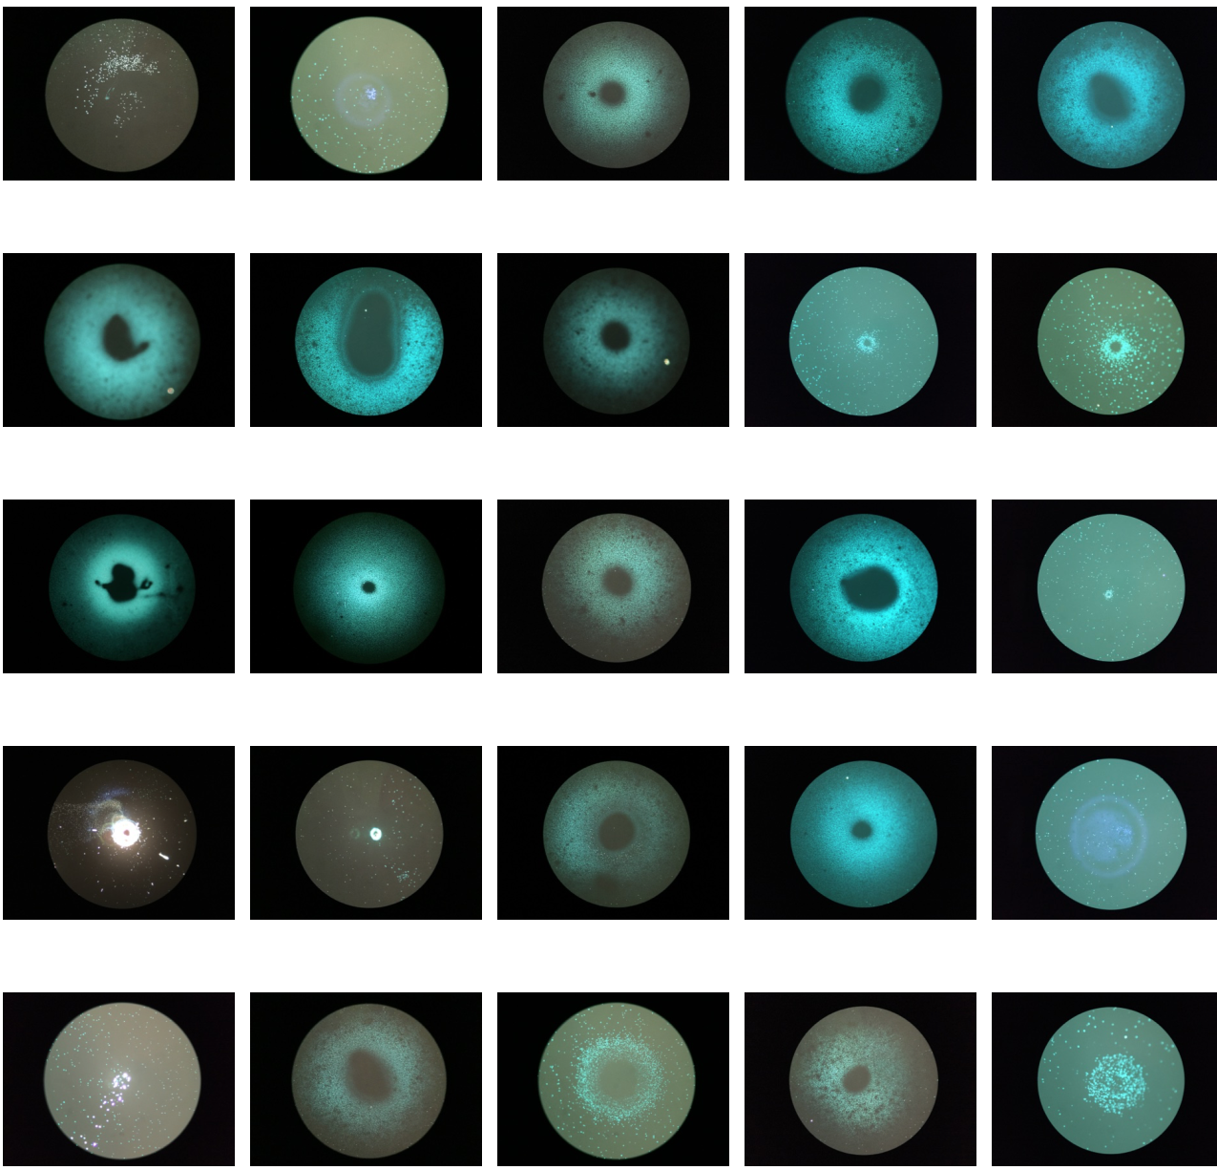
Interesting 1
Features found within a radius of ~60 mm of center.
1 mm ∅ field
Center scale squares are 50 µm
(-23, -27)
(5, -27)
(27, -47)
(-1.4, -62)
(8, -30)
(-2, 23)
(-60, -43)
(15, -41)
(11, -61)
(-3, -33)
(11, 21)
(11, -26)
(-2, -50)
(32, -59)
(1, -44)
Absorbing
Interesting 2
Interesting 3
(-21, -13)
(-8, -34)
(-4, -43)
(40, -56)
(-41, -52)
(0.4, -4)
(8, -30)
(6, -27)
(-2, -46)
(47, -43)

Slide 10
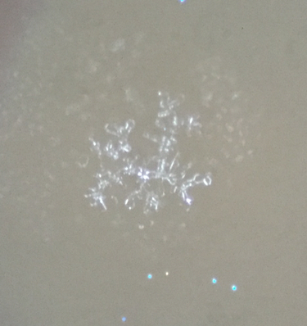
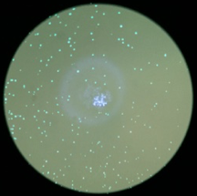
Interesting 1 (5, -27)
Branch-like center structure

Slide 11
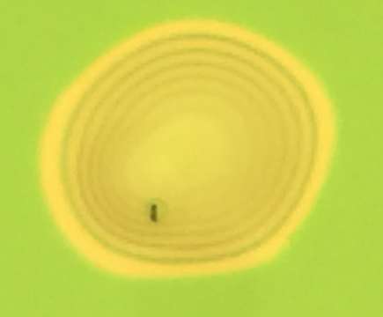
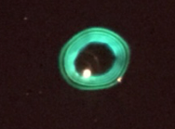
Interesting 2 (-8, -39)
Shown in bright field
~80 µm in diameter

Slide 12
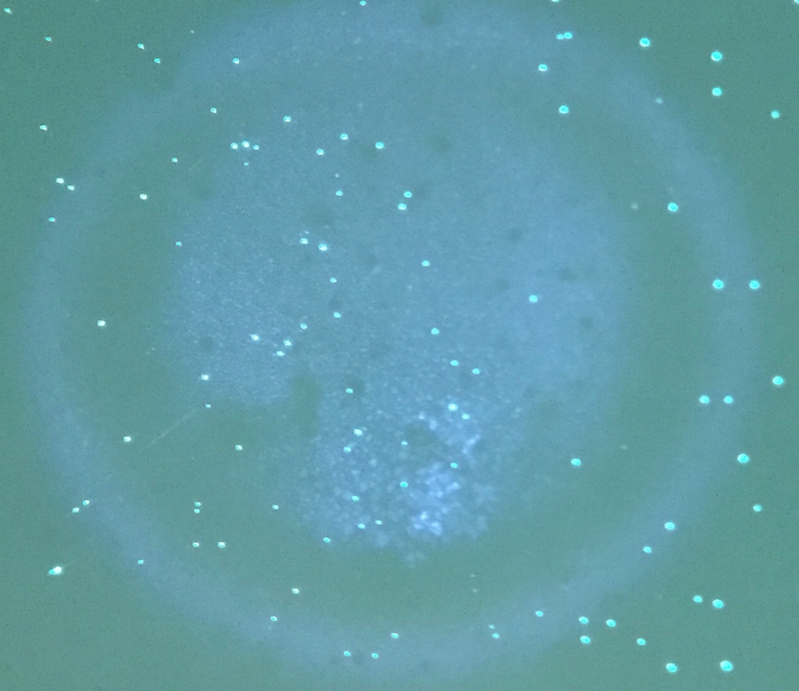
Interesting 3 (-60, -43)
Center is filled

Slide 13
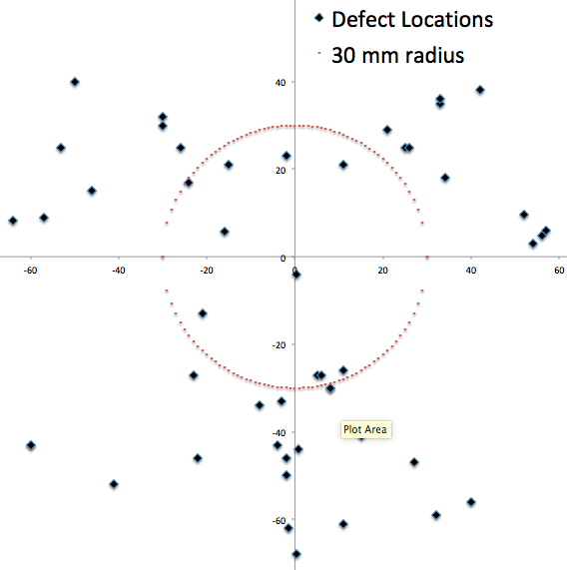
Distribution

Slide 14
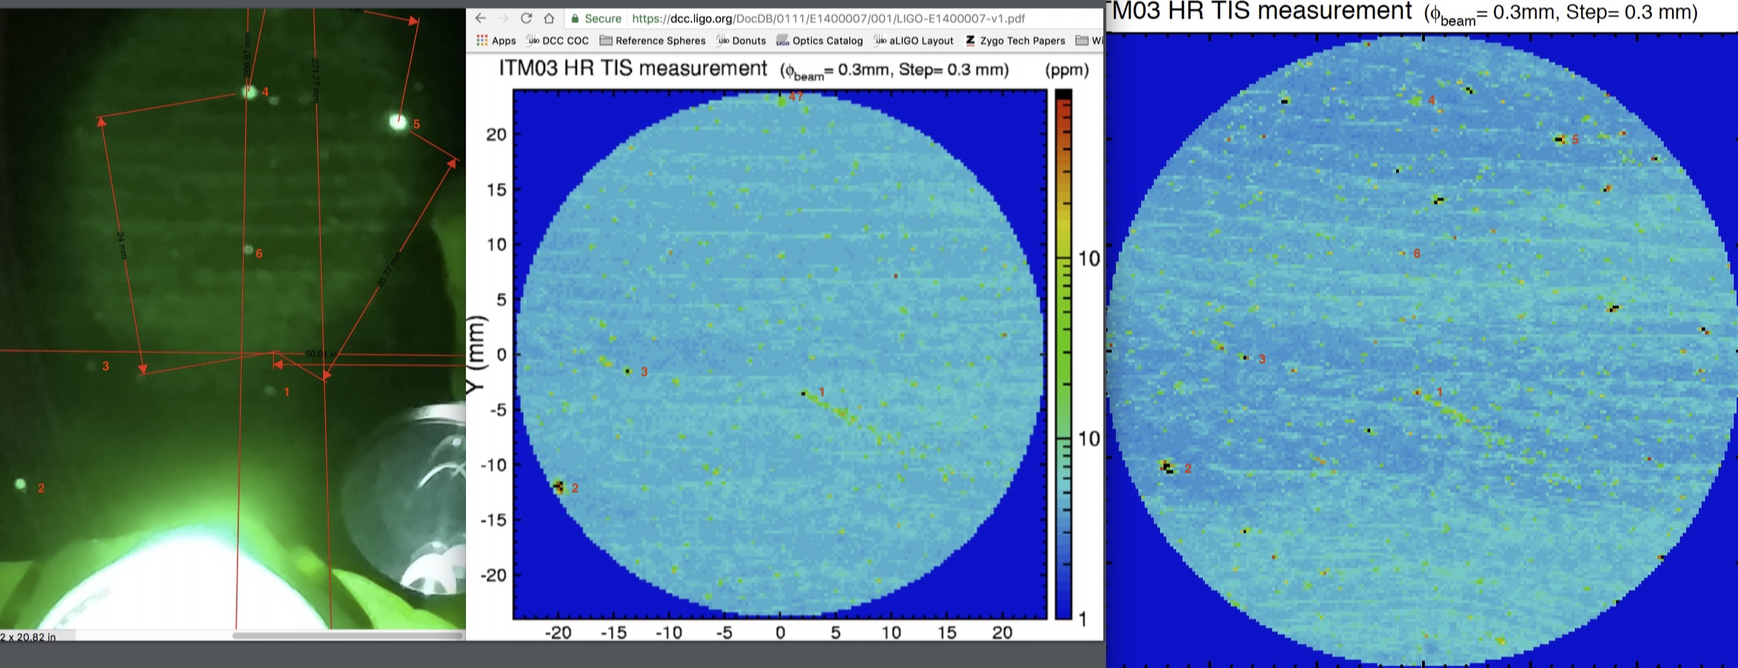
ITM03 scatter
In chamber view, before install, after removal
Scatter before installation: 5.6 ppm. Scatter after installation 6.3 ppm
Spot # 2 found to be the high absorber,
Present in “before” and “after” scatter scans

Slide 15
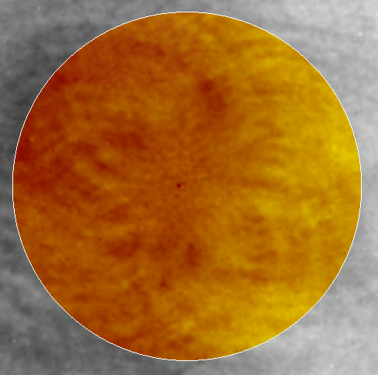
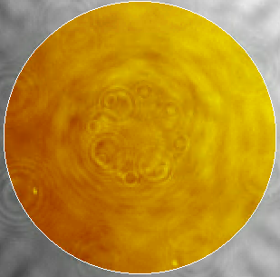
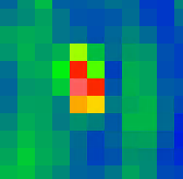
Absorption spot seen in figure data? Or dust?
Polished and coated data, 60 mm mask (orange circle) 0.06 nm rms polished, PV 0.49 nm 0.08 nm rms coated, PV 1.06 nm - 1 pixel = 400 µm
"Interesting point" #1 (page 10) is in a similar, though not exact location to the point seen low right.

Slide 16
Next
Scanning available ITM spares to screen for possible high absorption spots using the “gentle” absorption method.
See E1000766 for ITM03 Characterization data
See T1700193 for the in-chamber inspection at LHO

