Slide 1
Ground-based Gravitational-wave detectors: Results and Plans
Aspen 2018 - The Particle Frontier
Aspen 26 March 2018
David Shoemaker
For the LIGO and Virgo Scientific Collaborations

Slide 2

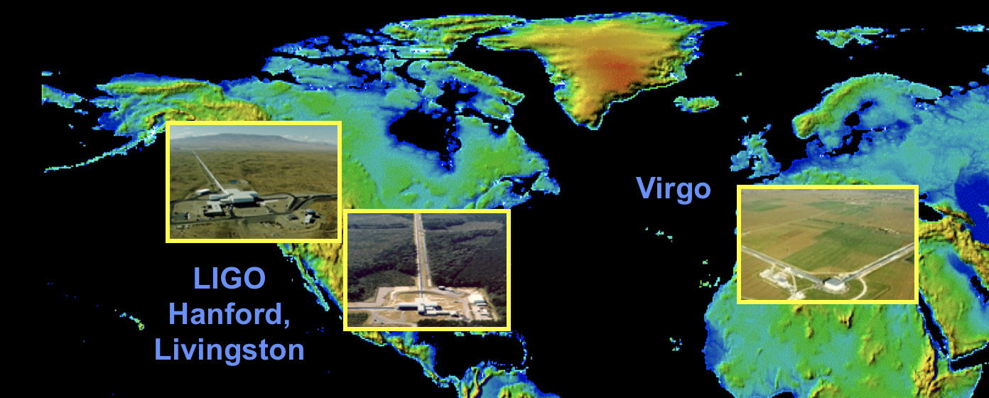
Ground based detectors
Initial observatories, and instruments, constructed starting in mid-90’s
  NSF Physics for LIGO; Virgo’s support from CNRS and INFN
Observed, setting upper limits until 2011
Both Virgo and LIGO undertook a complete rework of the instruments
Advanced LIGO came on line in 2015 – First discovery 15 Sept 2015
Advanced Virgo came on line in 2017 – First signal 14 August 2017

Slide 3
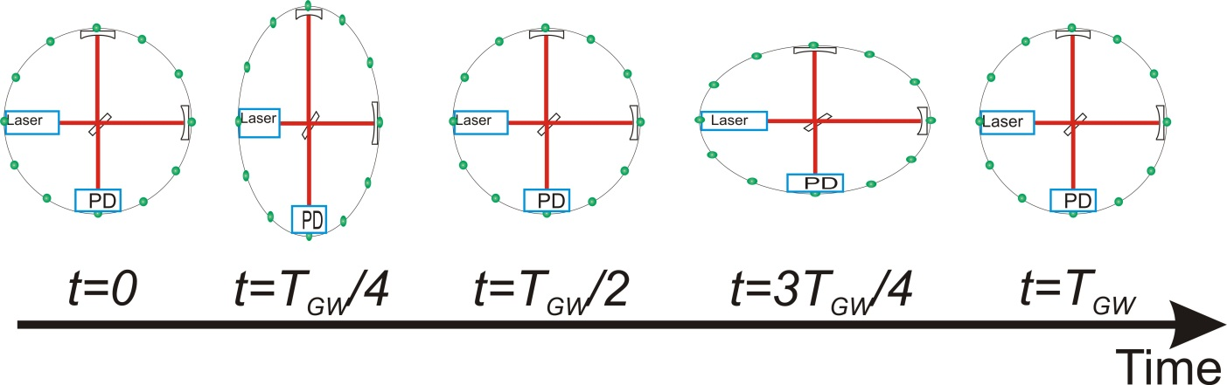
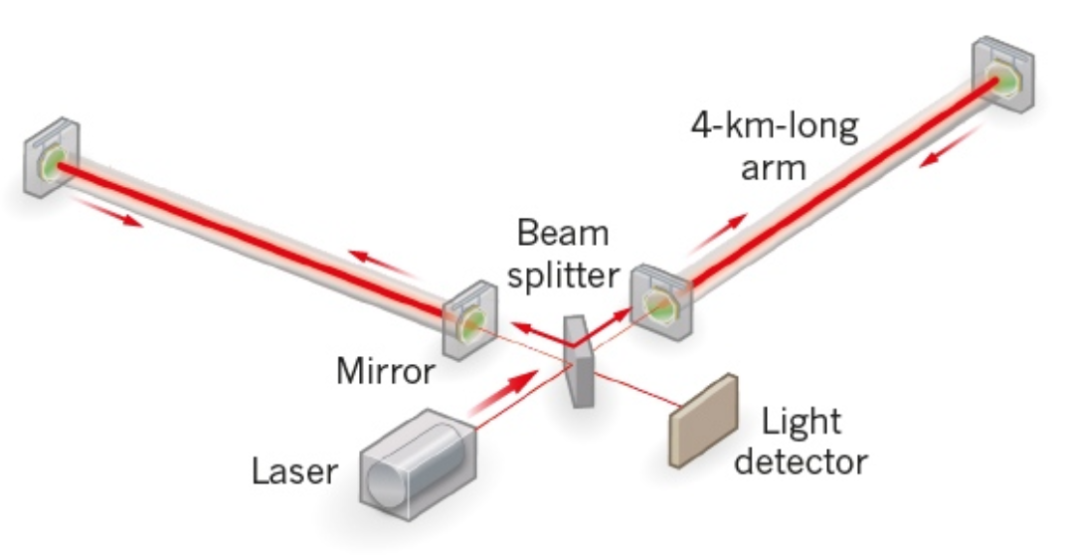
Measurement technique
Enhanced Michelson interferometers
GWs modulate the distance between the end test mass and the beam splitter
The interferometer acts as a transducer, turning GWs into photocurrent proportional to the strain amplitude
Arms are short compared to our GW wavelengths, so longer arms make bigger signals
→ multi-km installations
Arm length limited by
taxpayer noise….
Magnitude of h at Earth:
  Detectable signals h ~ 10⁻²¹
  (1 hair / Alpha Centauri)
  For L = 1 m, ΔL= 10⁻²¹ m
  For L = 4km, ΔL= 4x10⁻¹⁸ m

Slide 4
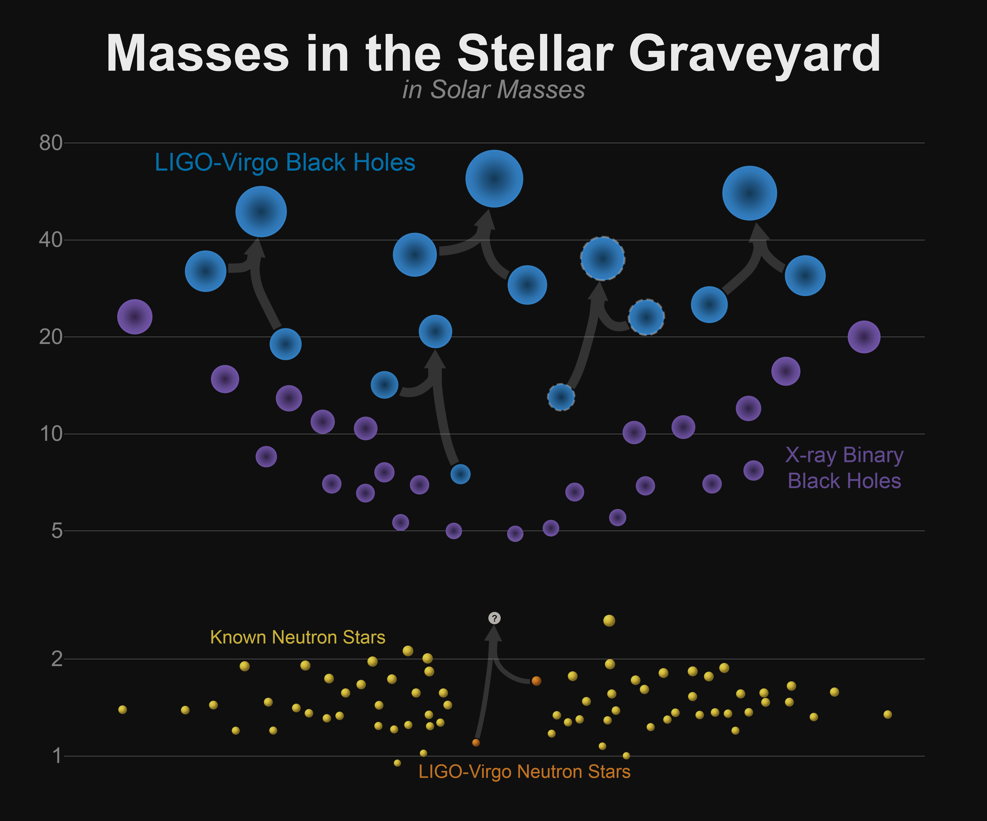
Stellar-mass Binary Black Holes
5 events published to date; 1 with both LIGO and Virgo detectors
Consistency with GR in extremes of compactness and v/c ~0.6
Revealed an unexpected class of heavier Stellar-mass BH

Slide 5
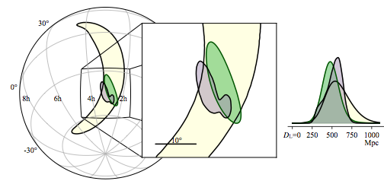

GW170814: Virgo and LIGO detectors, enabling triangulation, polarization sensing
Sky localization improves ~20x; Uncertainty in volume reduced ~34x
LIGO-Hanford and Livingston have similar orientations -> little information about GW polarizations
Virgo is not aligned with LIGO – giving polarization information
Hanford
Virgo
Livingston
13

Slide 6
Three days later…

Slide 7
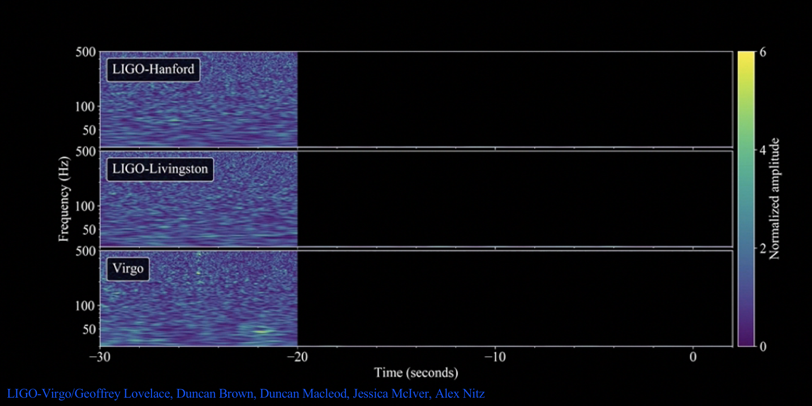
GW170817:
Binary Neutron Star Coalescence
LIGO-Virgo/Geoffrey Lovelace, Duncan Brown, Duncan Macleod, Jessica McIver, Alex Nitz
https://doi.org/10.1103/PhysRevLett.119.161101
1

Slide 8
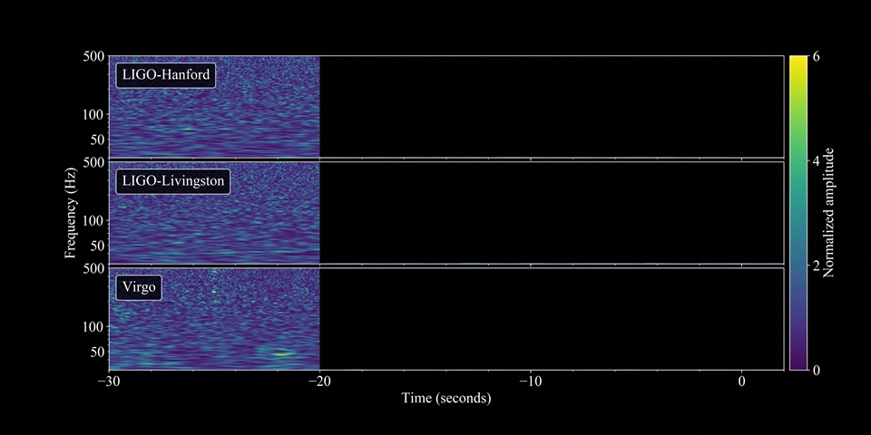
GW170817:
Binary Neutron Star Coalescence
LIGO-Virgo/Geoffrey Lovelace, Duncan Brown, Duncan Macleod, Jessica McIver, Alex Nitz
https://doi.org/10.1103/PhysRevLett.119.161101
1

Slide 9
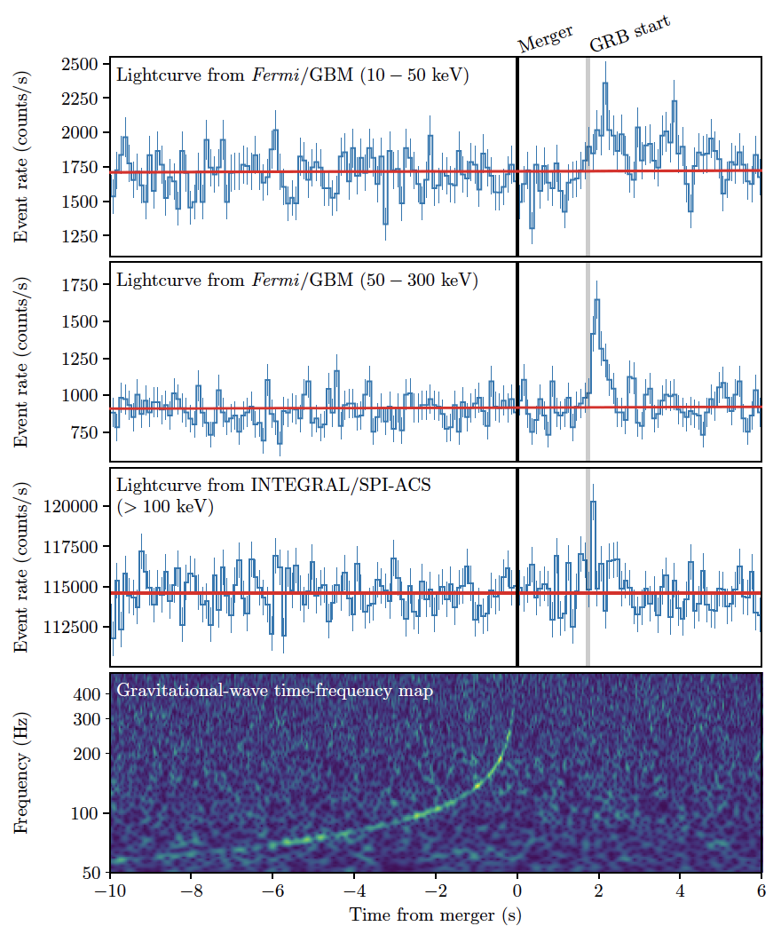
GRB 170817A
GRB 170817A occurs (1.74 ± 0.05) seconds after GW170817
It was autonomously detected in-orbit by Fermi-GBM (GCN was issued 14s after GRB) and in the routine untargeted search for short transients by INTEGRAL SPI-ACS
Probability that GW170817 and GRB 170817A occurred this close in time and with location agreement by chance is 5.0x10⁻⁸ (Gaussian equivalent significance of 5.3σ)
-> BNS mergers are progenitors of
(at least some) SGRBs
B. P. Abbott et al., Gravitational Waves and Gamma Rays from a Binary Neutron Star Merger: GW170817 and GRB 170817A, 2017, ApJL
3

Slide 10
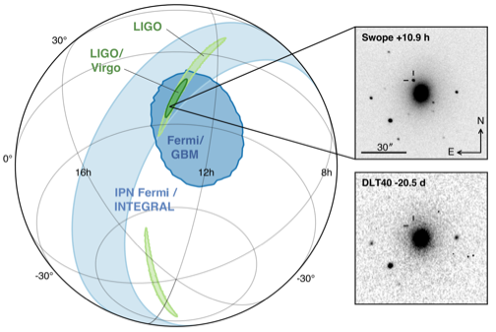
Multimessenger Observations
Approximate timeline:
GW170817 - August 17, 2017 12:41:04 UTC = t₀
GRB 170817A
t₀ + 2 sec
LIGO signal found
t₀ +6 minutes
LIGO-Virgo GCN reporting BNS signal associated with the time of the GRB
t₀ +41 minutes
SkyMap from LIGO-Virgo t₀ + 4 hours
Optical counterpart found
t₀ + 11 hours
The localisation region became observable to telescopes in Chile 10 hours after the event time (wait for nightfall!)
Approximately 70 ground- and space- based observatories followed-up on this event
And…: transmutation of common elements (pure neutron matter) into gold!
B. P. Abbott, Multi-messenger Observations of a Binary Neutron Star Merger, 2017, ApJL in press. doi:10.3847/2041-8213/aa91c9
6

Slide 11
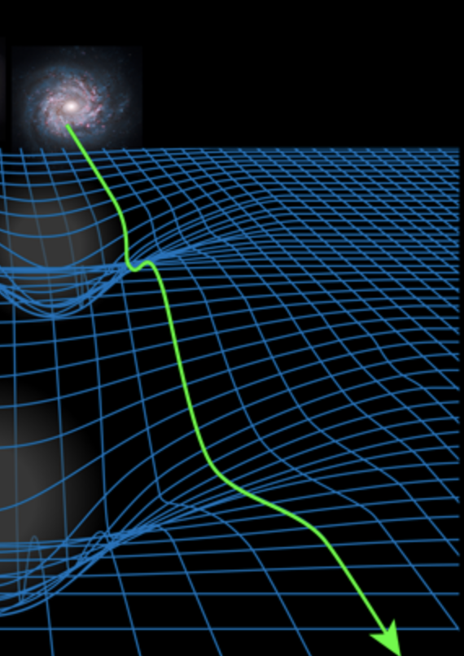
GW Physics with BNS
Tight constraints on total mass (2.74 M😎), individual masses likely 1.2 and 1.5
Equation of State/tidal deformability informed by deviations from point-mass waveform at end of coalescence
Hubble constant calculated using new independent GW distance measurement to source
Speed of GWs the same as Photons to one part in 10¹⁵ ; and Shapiro delay also the same
…and a wealth of knowledge on the post-merger evolution, from EM observations
APS/Alan Stonebraker

Slide 12
Visual summary of signals to date

Slide 13
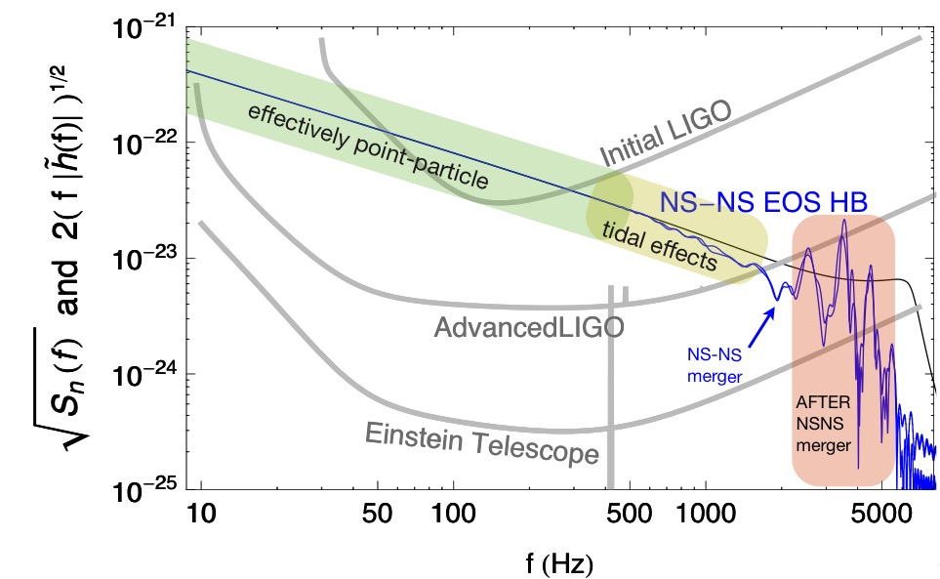
Near Future: 2019-20
O2 – The Second Advanced detector Observing Run – was undertaken at 1/3-1/2 of the design sensitivity of the LIGO and Virgo instruments
Currently both LIGO and Virgo improving sensitivity of instruments
Next: ~1 year long O3 run
  Start in Winter (late 2018/early 2019)
  LIGO with a NS-NS ‘reach’ of ~120 Mpc, Virgo ~65 Mpc
Best guesses for O3:
BBH: Several per month to
several per week
BNS: 1 to 10 in the year-long run
NSBH: N=0 not ruled out in any
scenario, most give ~50% N>0
…and: better sensitivity offers
more physics

Slide 14
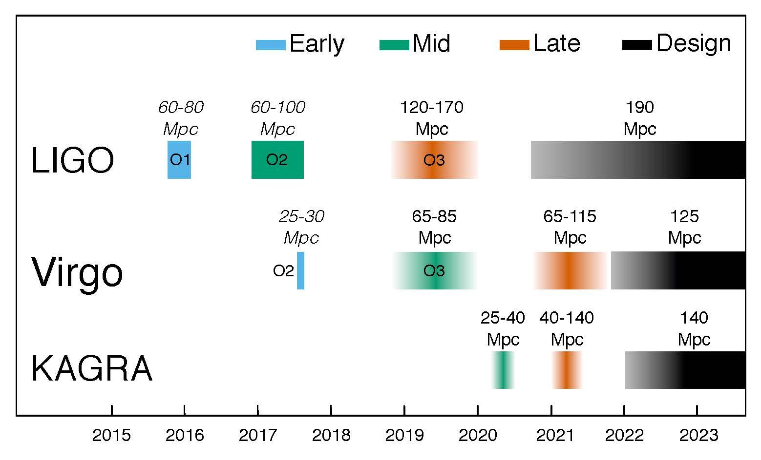
5-year plan

Slide 15
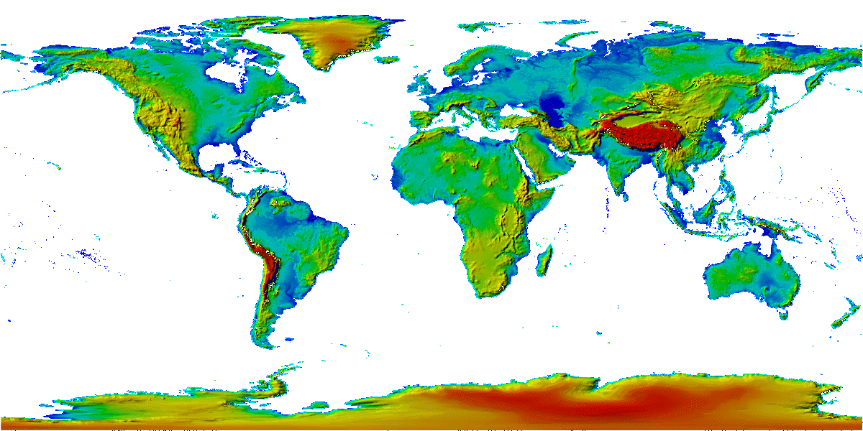
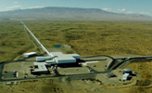
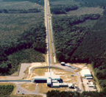

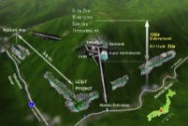
The advanced GW detector network
Advanced
Virgo
2017
Advanced
LIGO
Hanford,
Livingston
2015
KAGRA
2019
LIGO-India
2025
15
15

Slide 16
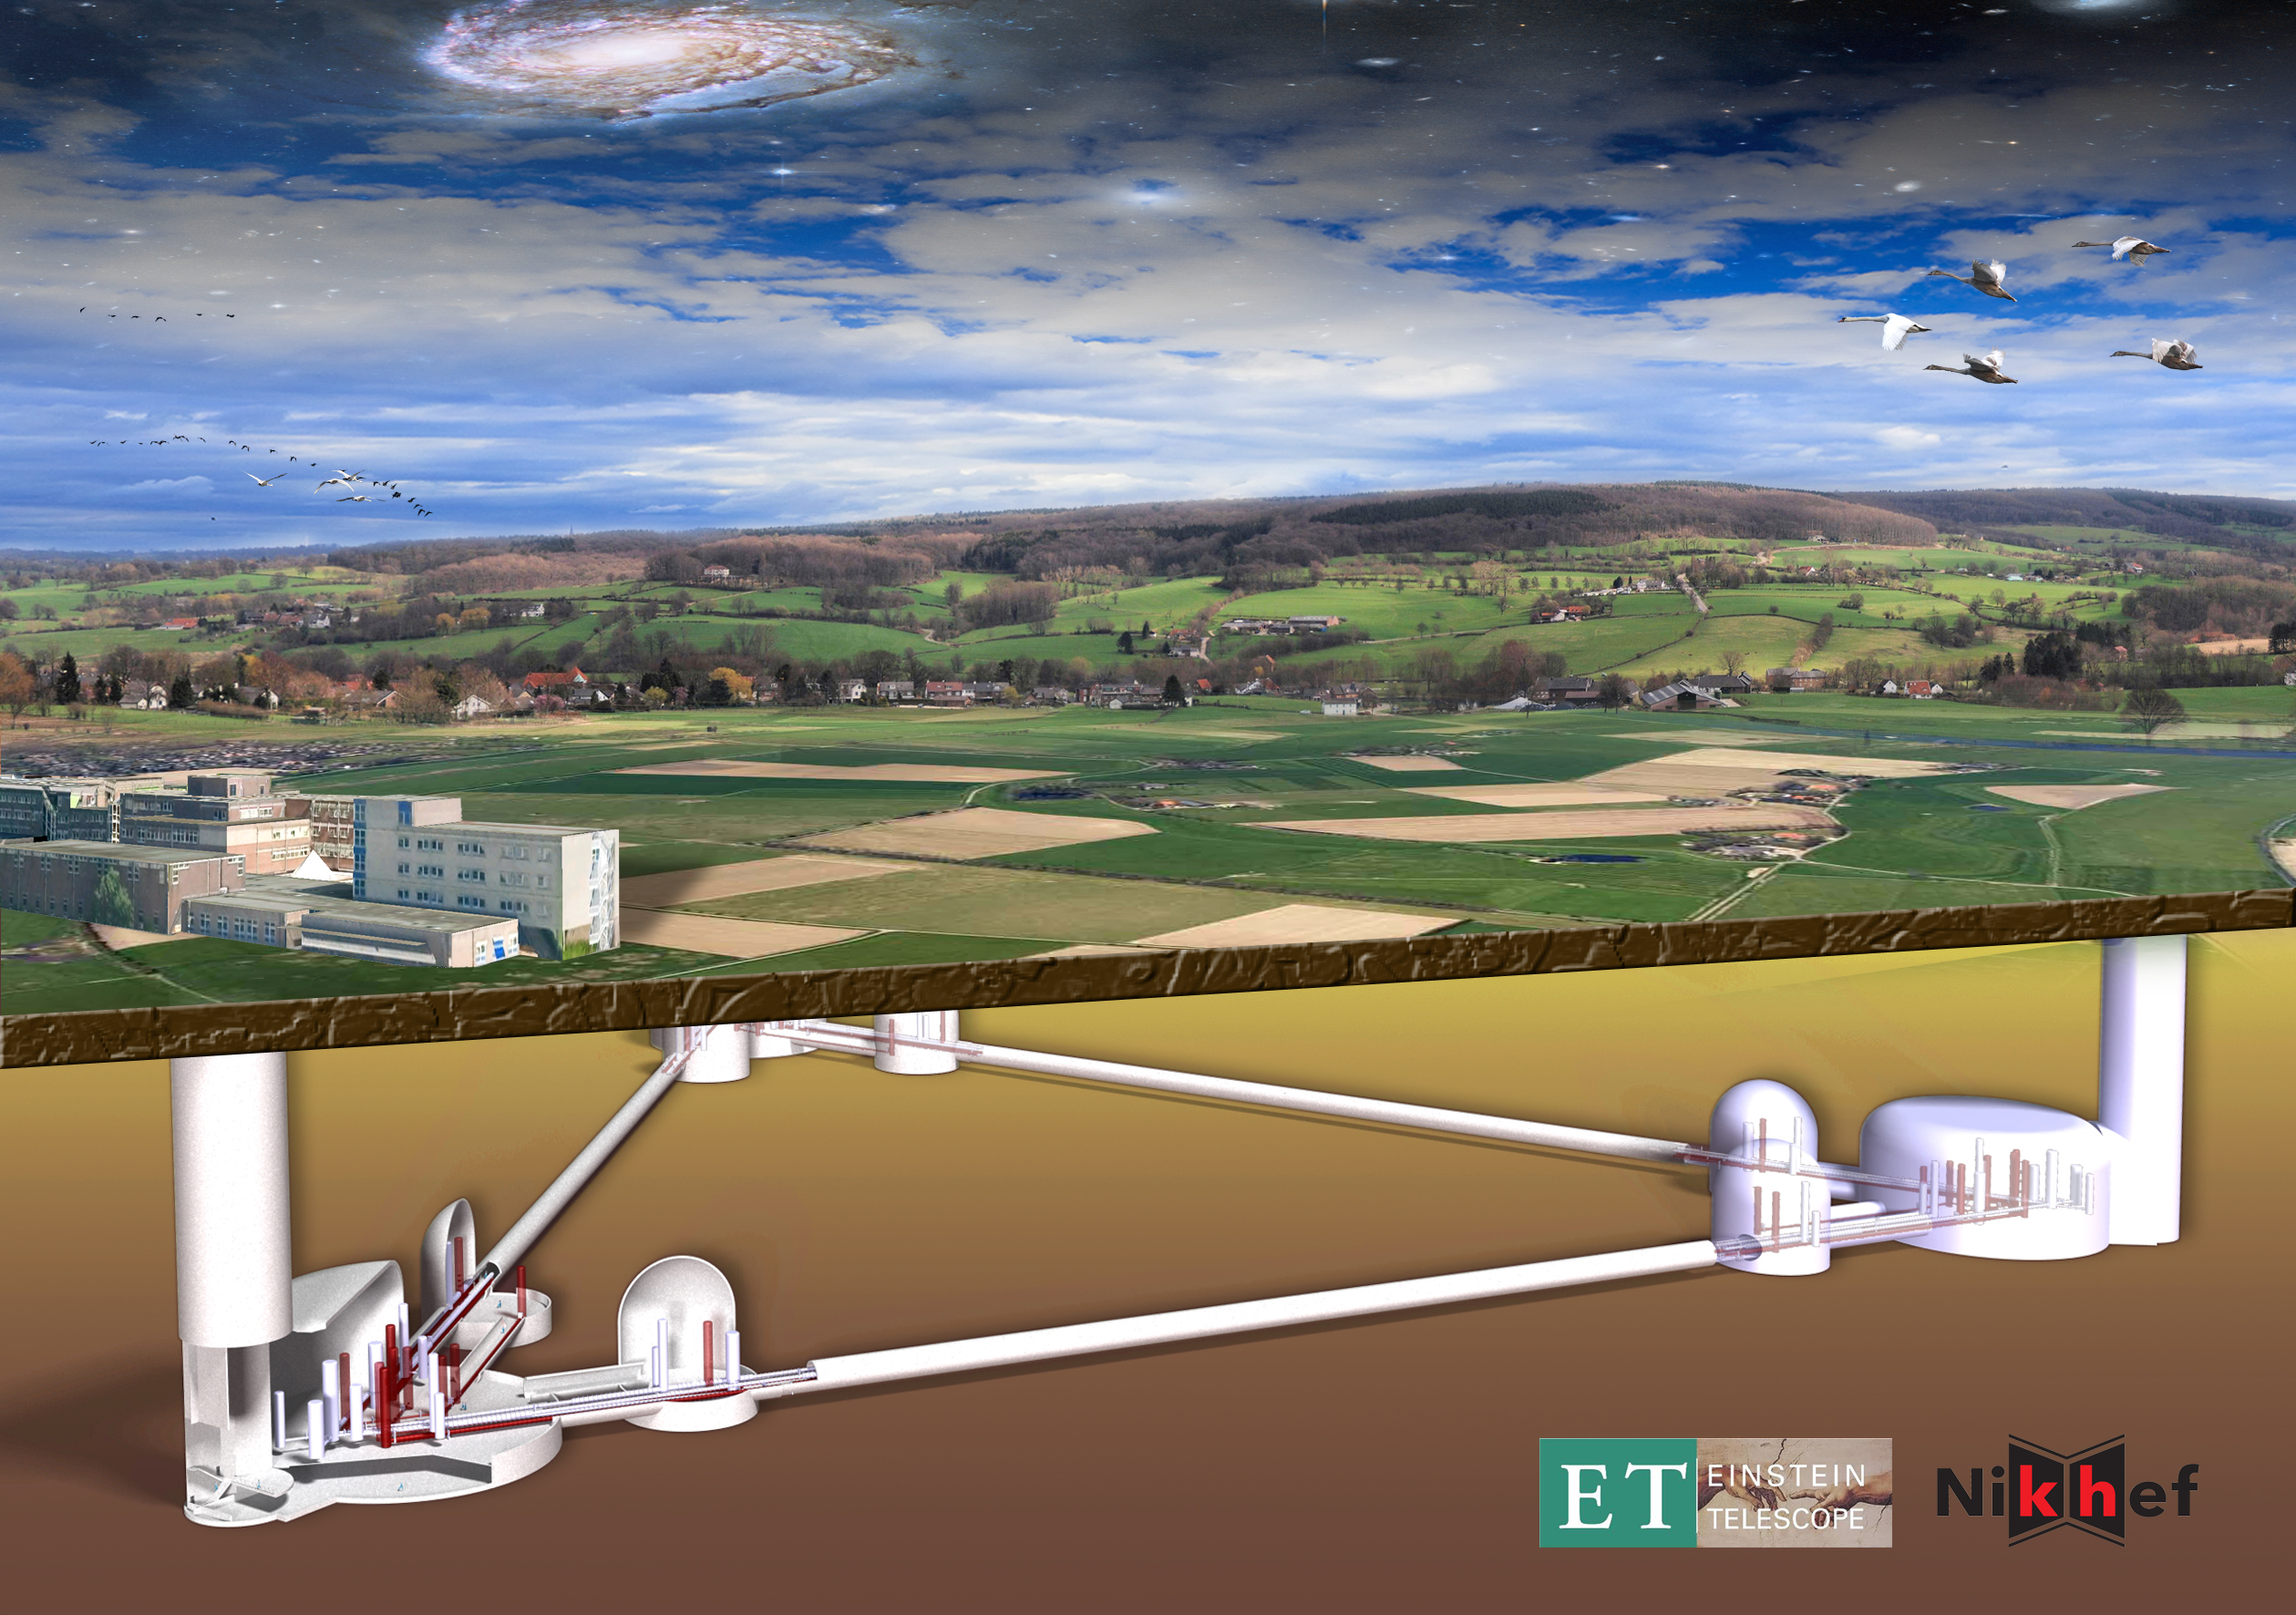
Longer Future
Signal grows with length – not most noise sources
Thermal noise, radiation pressure, seismic, Newtonian unchanged
Coating thermal noise improves faster than linearly with length
40km surface Observatory ‘toy’ baseline
  can still find sites, earthmoving feasible; costs another limit…
Concept offers sensitivity without new measurement challenges; could start at room temperature, modest laser power, etc.
US and (figure) European visions
Surface or underground
‘L’ or Δ geometry
Cryogenics, multiple instruments

Slide 17
3rd Generation
When could this new wave of ground instruments come into play?
Appears 15 years from t=0 is a feasible baseline
  Initial LIGO: 1989 proposal, and at design sensitivity 2005
  Advanced LIGO: 1999 White Paper, GW150914 in 2015
Modulo funding, could envision 2030’s
Should hope – and strive and plan – to have great instruments ready to ‘catch’ the end phase of binaries seen in LISA (ref. Sesana)
Worldwide community working together on concepts and the best observatory configuration for the science targets
Crucial for all these endeavors: to expand the scientific community planning on exploiting these instruments far beyond the GR/GW enclave
  Costs are like TMT/GMT/ELT – needs a comparable audience
  Events like GW170817 help!

Slide 18
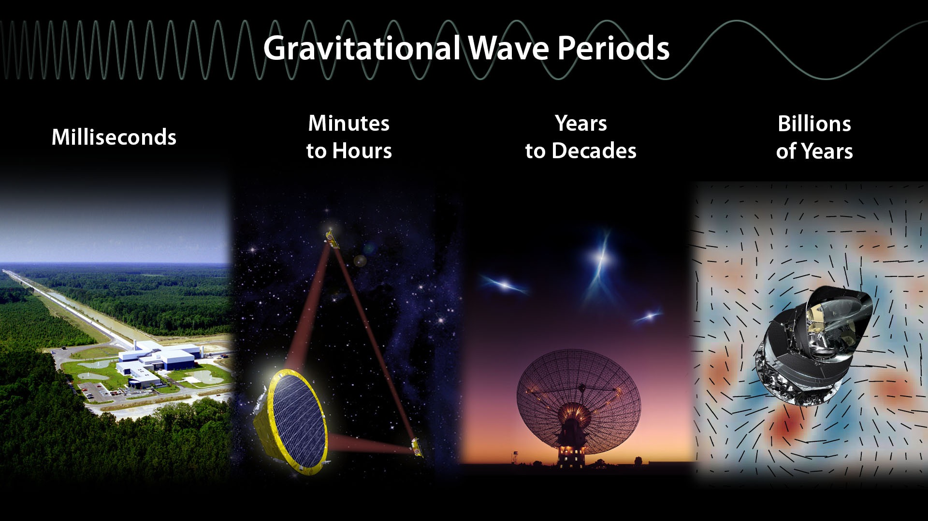
Just the beginning of a new field –
new instruments, new discoveries, new synergies
LIGO/Virgo
LISA
Pulsar Timing Array
Cosmology Probes

