Slide 1
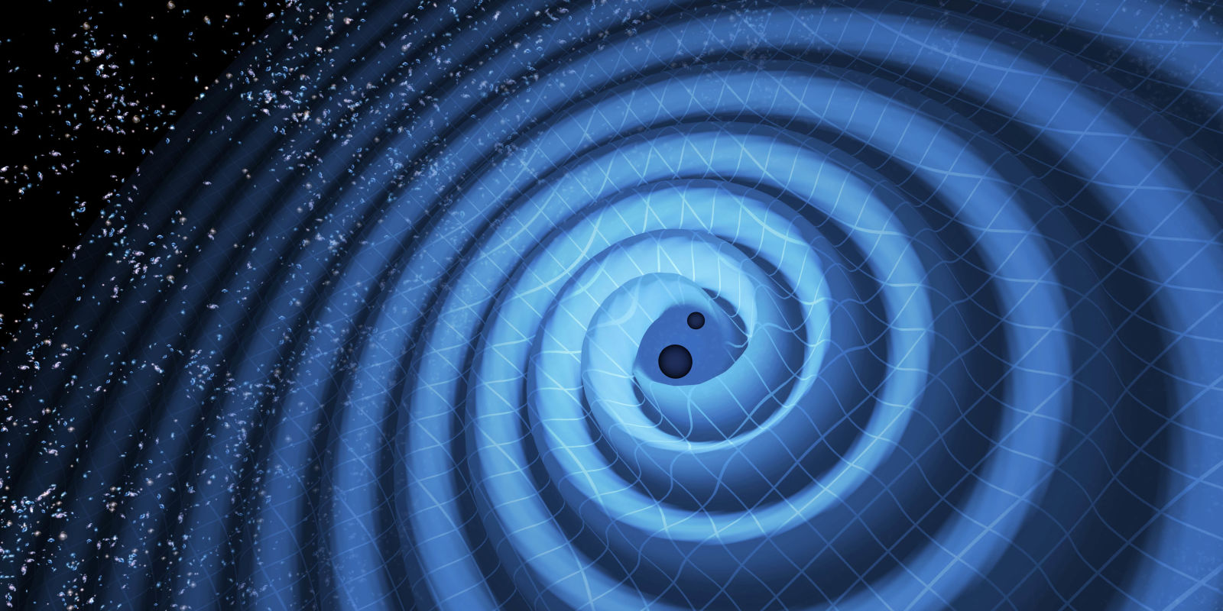



Multi-messenger astronomy with Advanced LIGO and Virgo
Min-A Cho
University of Maryland Department of Physics
LSC Open Data Workshop · March 26, 2018
LIGO DCC: G1800652
Image credit: LIGO/Caltech

Slide 2
1
Outline
Progenitors of gravitational wave transients
Low-latency searches
Information for multi-messenger astronomy
Image credit: LIGO/Caltech

Slide 3
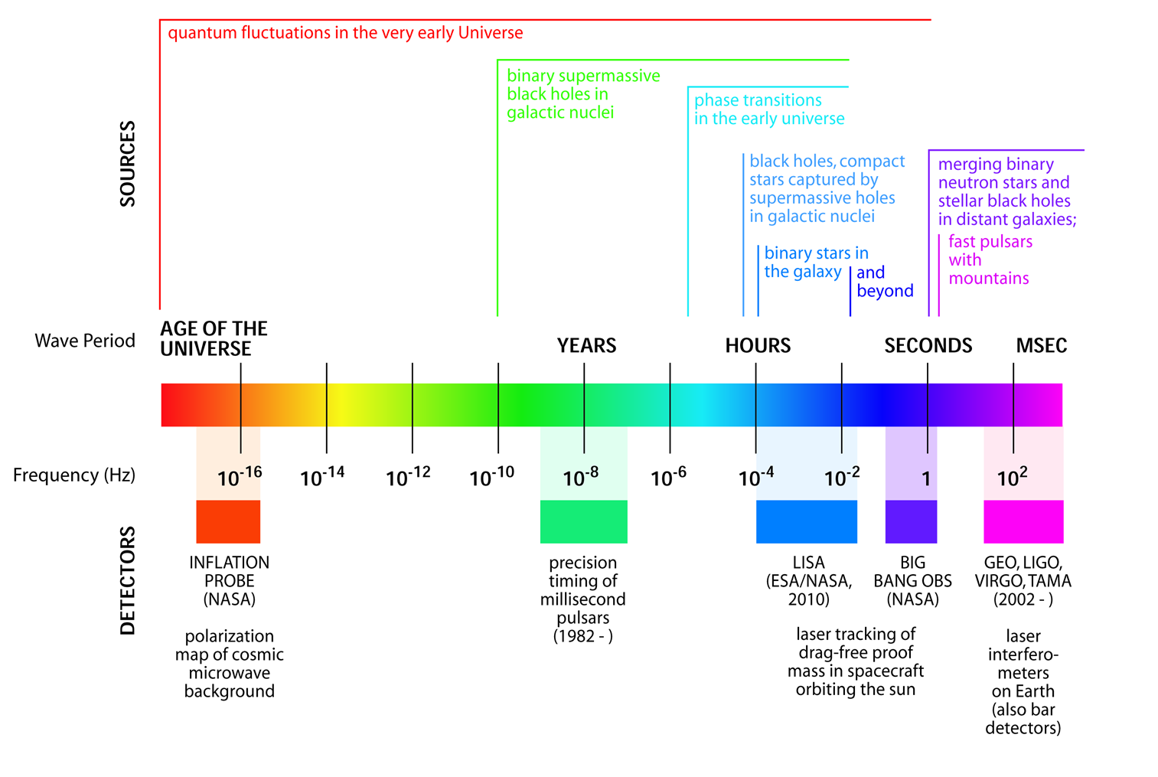
The gravitational wave spectrum
2
The gravitational wave spectrum spans over 18 orders of magnitude, which is largely unexplored – we had our first direct detection on September 14, 2015!
Gravitational waves…
Are excellent probes because they are not absorbed or scattered by matter and energy
Come from the central engine of astrophysical objects
Are only weakly beamed meaning detectors act as “microphones”
Image credit: LIGO

Slide 4
The gravitational wave spectrum
2
Advanced ground-based detectors
The gravitational wave spectrum spans over 18 orders of magnitude, which is largely unexplored – we had our first direct detection on September 14, 2015!
Gravitational waves…
Are excellent probes because they are not absorbed or scattered by matter and energy
Come from the central engine of astrophysical objects
Are only weakly beamed meaning detectors act as “microphones”
Image credit: LIGO

Slide 5
Compact binary mergers
3
Image credit: NSF/LIGO/Sonoma State University/A. Simonnet

Slide 6
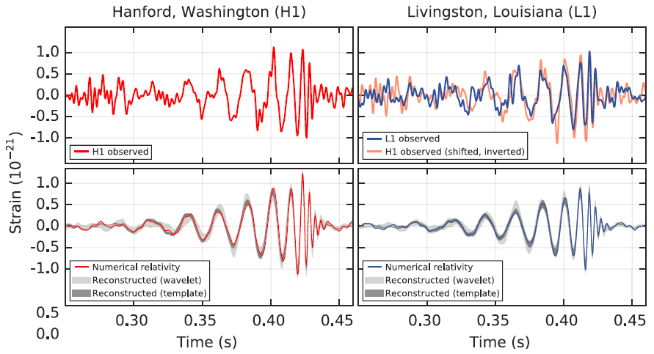
Compact binary mergers
3
GW signal from GW150914, a BBH merger
Image credit: NSF/LIGO/Sonoma State University/A. Simonnet, B. P. Abbott et al., Phys. Rev. Lett. 116, 061102 (2016)

Slide 7
Compact binary mergers
3
The waveform of the merger: the collected history of the stretching and squeezing of space by gravitational waves
GW signal from GW150914, a BBH merger
Image credit: NSF/LIGO/Sonoma State University/A. Simonnet, B. P. Abbott et al., Phys. Rev. Lett. 116, 061102 (2016)

Slide 8
Compact binary mergers
3
The chirp:
rising frequency of the gravitational waves
The waveform of the merger: the collected history of the stretching and squeezing of space by gravitational waves
GW signal from GW150914, a BBH merger
Image credit: NSF/LIGO/Sonoma State University/A. Simonnet, B. P. Abbott et al., Phys. Rev. Lett. 116, 061102 (2016)

Slide 9
Compact binary mergers
3
The chirp:
rising frequency of the gravitational waves
The waveform of the merger: the collected history of the stretching and squeezing of space by gravitational waves
Unique information about the source is encoded in the amplitude/phase evolution:
masses, spins, and more…
GW signal from GW150914, a BBH merger
Please see Katerina Chatziioannou’s talk!
Image credit: NSF/LIGO/Sonoma State University/A. Simonnet, B. P. Abbott et al., Phys. Rev. Lett. 116, 061102 (2016)

Slide 10
Compact binary mergers
4
If the merger includes a neutron star, possible EM counterparts include
Short gamma-ray burst
Kilonova emissions: multi-wavelength afterglow emissions in X-ray, UV ray, optical, near infrared, and radio
Radio blast wave emissions
Image credit: NSF/LIGO/Sonoma State University/A. Simonnet

Slide 11
Compact binary mergers
5
Scientific motivation for joint observations
Confirm short gamma-ray burst/BNS/NSBH connection
Learn about energetics of short gamma-ray bursts from the beaming angle of the burst
Independently measure the Hubble constant
Image credit: NSF/LIGO/Sonoma State University/A. Simonnet

Slide 12
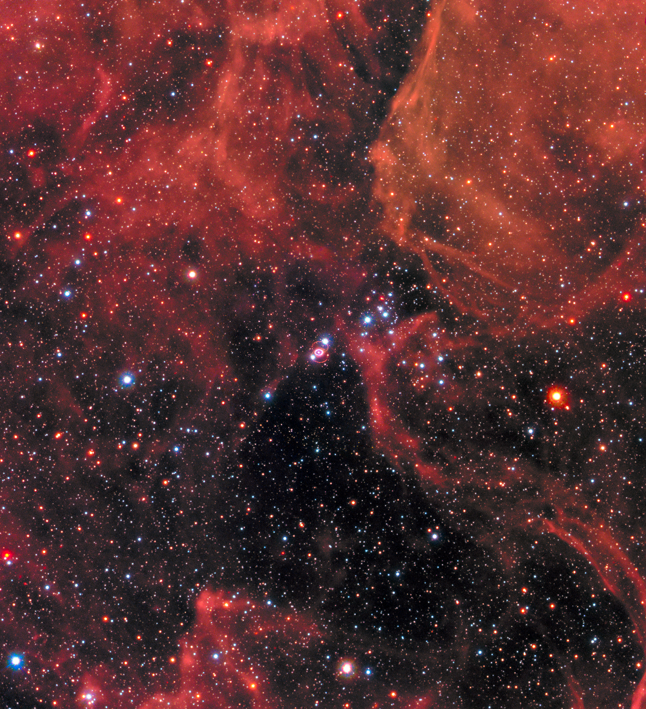
Core-Collapse Supernovae
6
Image credit: NASA, ESA, R. Kirshner (Harvard-Smithsonian Center for Astrophysics and Gordon and Betty Moore Foundation), and M. Mutchler and R. Avila (STScI)

Slide 13
Core-Collapse Supernovae
6
The explosion occurred about 160,000 years ago
Light is just reaching the earth now (in 1987)
Image credit: NASA, ESA, R. Kirshner (Harvard-Smithsonian Center for Astrophysics and Gordon and Betty Moore Foundation), and M. Mutchler and R. Avila (STScI)

Slide 14
6
Core-Collapse Supernovae
Scientific motivation for joint observations
Unknown explosion mechanism
Confirm observed mass gap in supernova remnants
Image credit: NASA, ESA, R. Kirshner (Harvard-Smithsonian Center for Astrophysics and Gordon and Betty Moore Foundation), and M. Mutchler and R. Avila (STScI)

Slide 15
GW’s from core-collapse supernovae
7
The key to the resultant gravitational waves is the initial rotation rate ($Ω_{0}$) of the iron core!

Slide 16
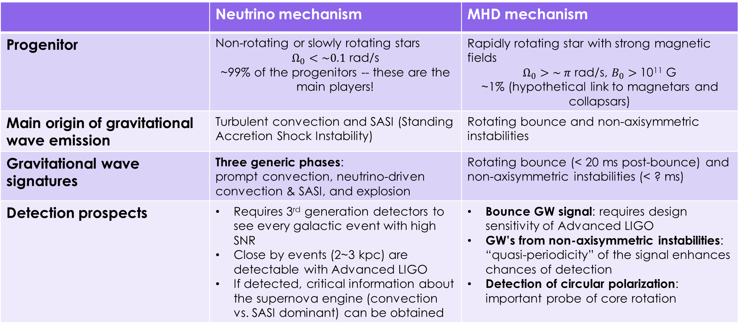
GW’s from core-collapse supernovae
8
 | Neutrino mechanism | MHD mechanism
Progenitor | Non-rotating or slowly rotating stars $Ω_{0}<\sim 0.1$ rad/s ~99% of the progenitors -- these are the main players! | Rapidly rotating star with strong magnetic fields $Ω_{0}>\sim π$ rad/s, $B_{0}>$ 10¹¹ G ~1% (hypothetical link to magnetars and collapsars)
Main origin of gravitational wave emission | Turbulent convection and SASI (Standing Accretion Shock Instability) | Rotating bounce and non-axisymmetric instabilities
Gravitational wave signatures | Three generic phases: prompt convection, neutrino-driven convection & SASI, and explosion | Rotating bounce (< 20 ms post-bounce) and non-axisymmetric instabilities (< ? ms)
Detection prospects | Requires 3rd generation detectors to see every galactic event with high SNR Close by events (2~3 kpc) are detectable with Advanced LIGO If detected, critical information about the supernova engine (convection vs. SASI dominant) can be obtained | Bounce GW signal: requires design sensitivity of Advanced LIGO GW’s from non-axisymmetric instabilities: “quasi-periodicity” of the signal enhances chances of detection Detection of circular polarization: important probe of core rotation
See reviews in: Janka (2017), Mezzacappa et al. (2015), Burrows (2013), Kotake et al. (2012)

Slide 17
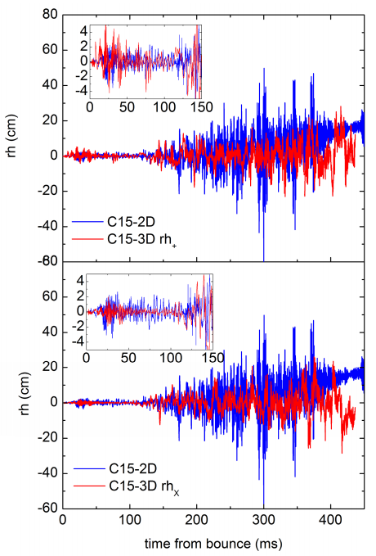
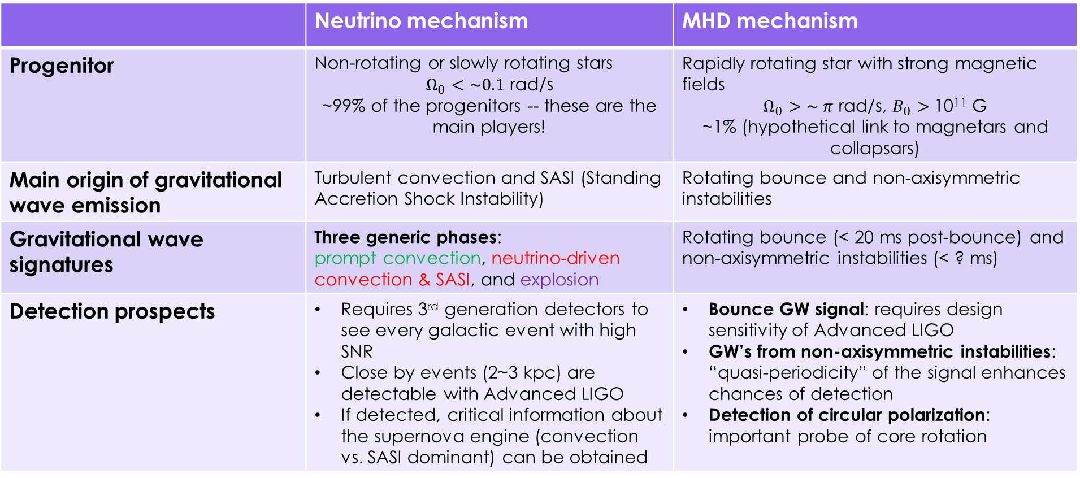
GW’s from core-collapse supernovae
8
 | Neutrino mechanism | MHD mechanism
Progenitor | Non-rotating or slowly rotating stars $Ω_{0}<\sim 0.1$ rad/s ~99% of the progenitors -- these are the main players! | Rapidly rotating star with strong magnetic fields $Ω_{0}>\sim π$ rad/s, $B_{0}>$ 10¹¹ G ~1% (hypothetical link to magnetars and collapsars)
Main origin of gravitational wave emission | Turbulent convection and SASI (Standing Accretion Shock Instability) | Rotating bounce and non-axisymmetric instabilities
Gravitational wave signatures | Three generic phases: prompt convection, neutrino-driven convection & SASI, and explosion | Rotating bounce (< 20 ms post-bounce) and non-axisymmetric instabilities (< ? ms)
Detection prospects | Requires 3rd generation detectors to see every galactic event with high SNR Close by events (2~3 kpc) are detectable with Advanced LIGO If detected, critical information about the supernova engine (convection vs. SASI dominant) can be obtained | Bounce GW signal: requires design sensitivity of Advanced LIGO GW’s from non-axisymmetric instabilities: “quasi-periodicity” of the signal enhances chances of detection Detection of circular polarization: important probe of core rotation
See reviews in: Janka (2017), Mezzacappa et al. (2015), Burrows (2013), Kotake et al. (2012),
Yakunin et al. (2017), arXiv: 1701.07325v1
Notes:
Figure is from Yakunin et al. 2017, arXiv:1701.07325v1
Based on the 3D and 2D models from Lentz et al. (2015), ApJ L
The three generic phases are also seen in 3D
But the 2D model overestimates the gravitational wave amplitude relative to 3D
r is 10 kpc
15 solar mass star
Standing accretion shock instability can driving neutrino heating

Slide 18
GW’s from core-collapse supernovae
8
 | Neutrino mechanism | MHD mechanism
Progenitor | Non-rotating or slowly rotating stars $Ω_{0}<\sim 0.1$ rad/s ~99% of the progenitors -- these are the main players! | Rapidly rotating star with strong magnetic fields $Ω_{0}>\sim π$ rad/s, $B_{0}>$ 10¹¹ G ~1% (hypothetical link to magnetars and collapsars)
Main origin of gravitational wave emission | Turbulent convection and SASI (Standing Accretion Shock Instability) | Rotating bounce and non-axisymmetric instabilities
Gravitational wave signatures | Three generic phases: prompt convection, neutrino-driven convection & SASI, and explosion | Rotating bounce (< 20 ms post-bounce) and non-axisymmetric instabilities (< ? ms)
Detection prospects | Requires 3rd generation detectors to see every galactic event with high SNR Close by events (2~3 kpc) are detectable with Advanced LIGO If detected, critical information about the supernova engine (convection vs. SASI dominant) can be obtained | Bounce GW signal: requires design sensitivity of Advanced LIGO GW’s from non-axisymmetric instabilities: “quasi-periodicity” of the signal enhances chances of detection Detection of circular polarization: important probe of core rotation
There are 11 long GRB—core-collapse supernovae associations
The neutrino mechanism is inefficient; it can’t deliver hyper-energetic supernovae
See reviews in: Janka (2017), Mezzacappa et al. (2015), Burrows (2013), Kotake et al. (2012)

Slide 19
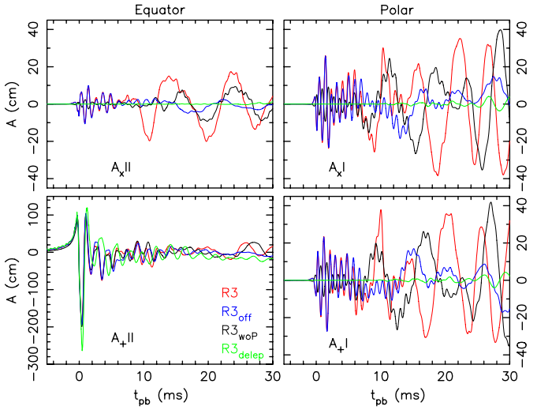
GW’s from core-collapse supernovae
8
 | Neutrino mechanism | MHD mechanism
Progenitor | Non-rotating or slowly rotating stars $Ω_{0}<\sim 0.1$ rad/s ~99% of the progenitors -- these are the main players! | Rapidly rotating star with strong magnetic fields $Ω_{0}>\sim π$ rad/s, $B_{0}>$ 10¹¹ G ~1% (hypothetical link to magnetars and collapsars)
Main origin of gravitational wave emission | Turbulent convection and SASI (Standing Accretion Shock Instability) | Rotating bounce and non-axisymmetric instabilities
Gravitational wave signatures | Three generic phases: prompt convection, neutrino-driven convection & SASI, and explosion | Rotating bounce (< 20 ms post-bounce) and non-axisymmetric instabilities (< ? ms)
Detection prospects | Requires 3rd generation detectors to see every galactic event with high SNR Close by events (2~3 kpc) are detectable with Advanced LIGO If detected, critical information about the supernova engine (convection vs. SASI dominant) can be obtained | Bounce GW signal: requires design sensitivity of Advanced LIGO GW’s from non-axisymmetric instabilities: “quasi-periodicity” of the signal enhances chances of detection Detection of circular polarization: important probe of core rotation
Collapse
Bounce
Oscillations
See reviews in: Janka (2017), Mezzacappa et al. (2015), Burrows (2013), Kotake et al. (2012), Kuroda, Takiwaki, and Kotake PRD 89 044011 (2014)
Notes:
15 solar mass star

Slide 20
Supernova 1987a
9
We would see the gravitational wave signal first
Then a massive burst of neutrinos within a few seconds
Then a shock wave breaking out of the star, releasing a bright UV flash (a few hours later)
The supernova becomes visible at optical wavelengths as it expands
Image credit: NASA, ESA, R. Kirshner (Harvard-Smithsonian Center for Astrophysics and Gordon and Betty Moore Foundation), and M. Mutchler and R. Avila (STScI)

Slide 21
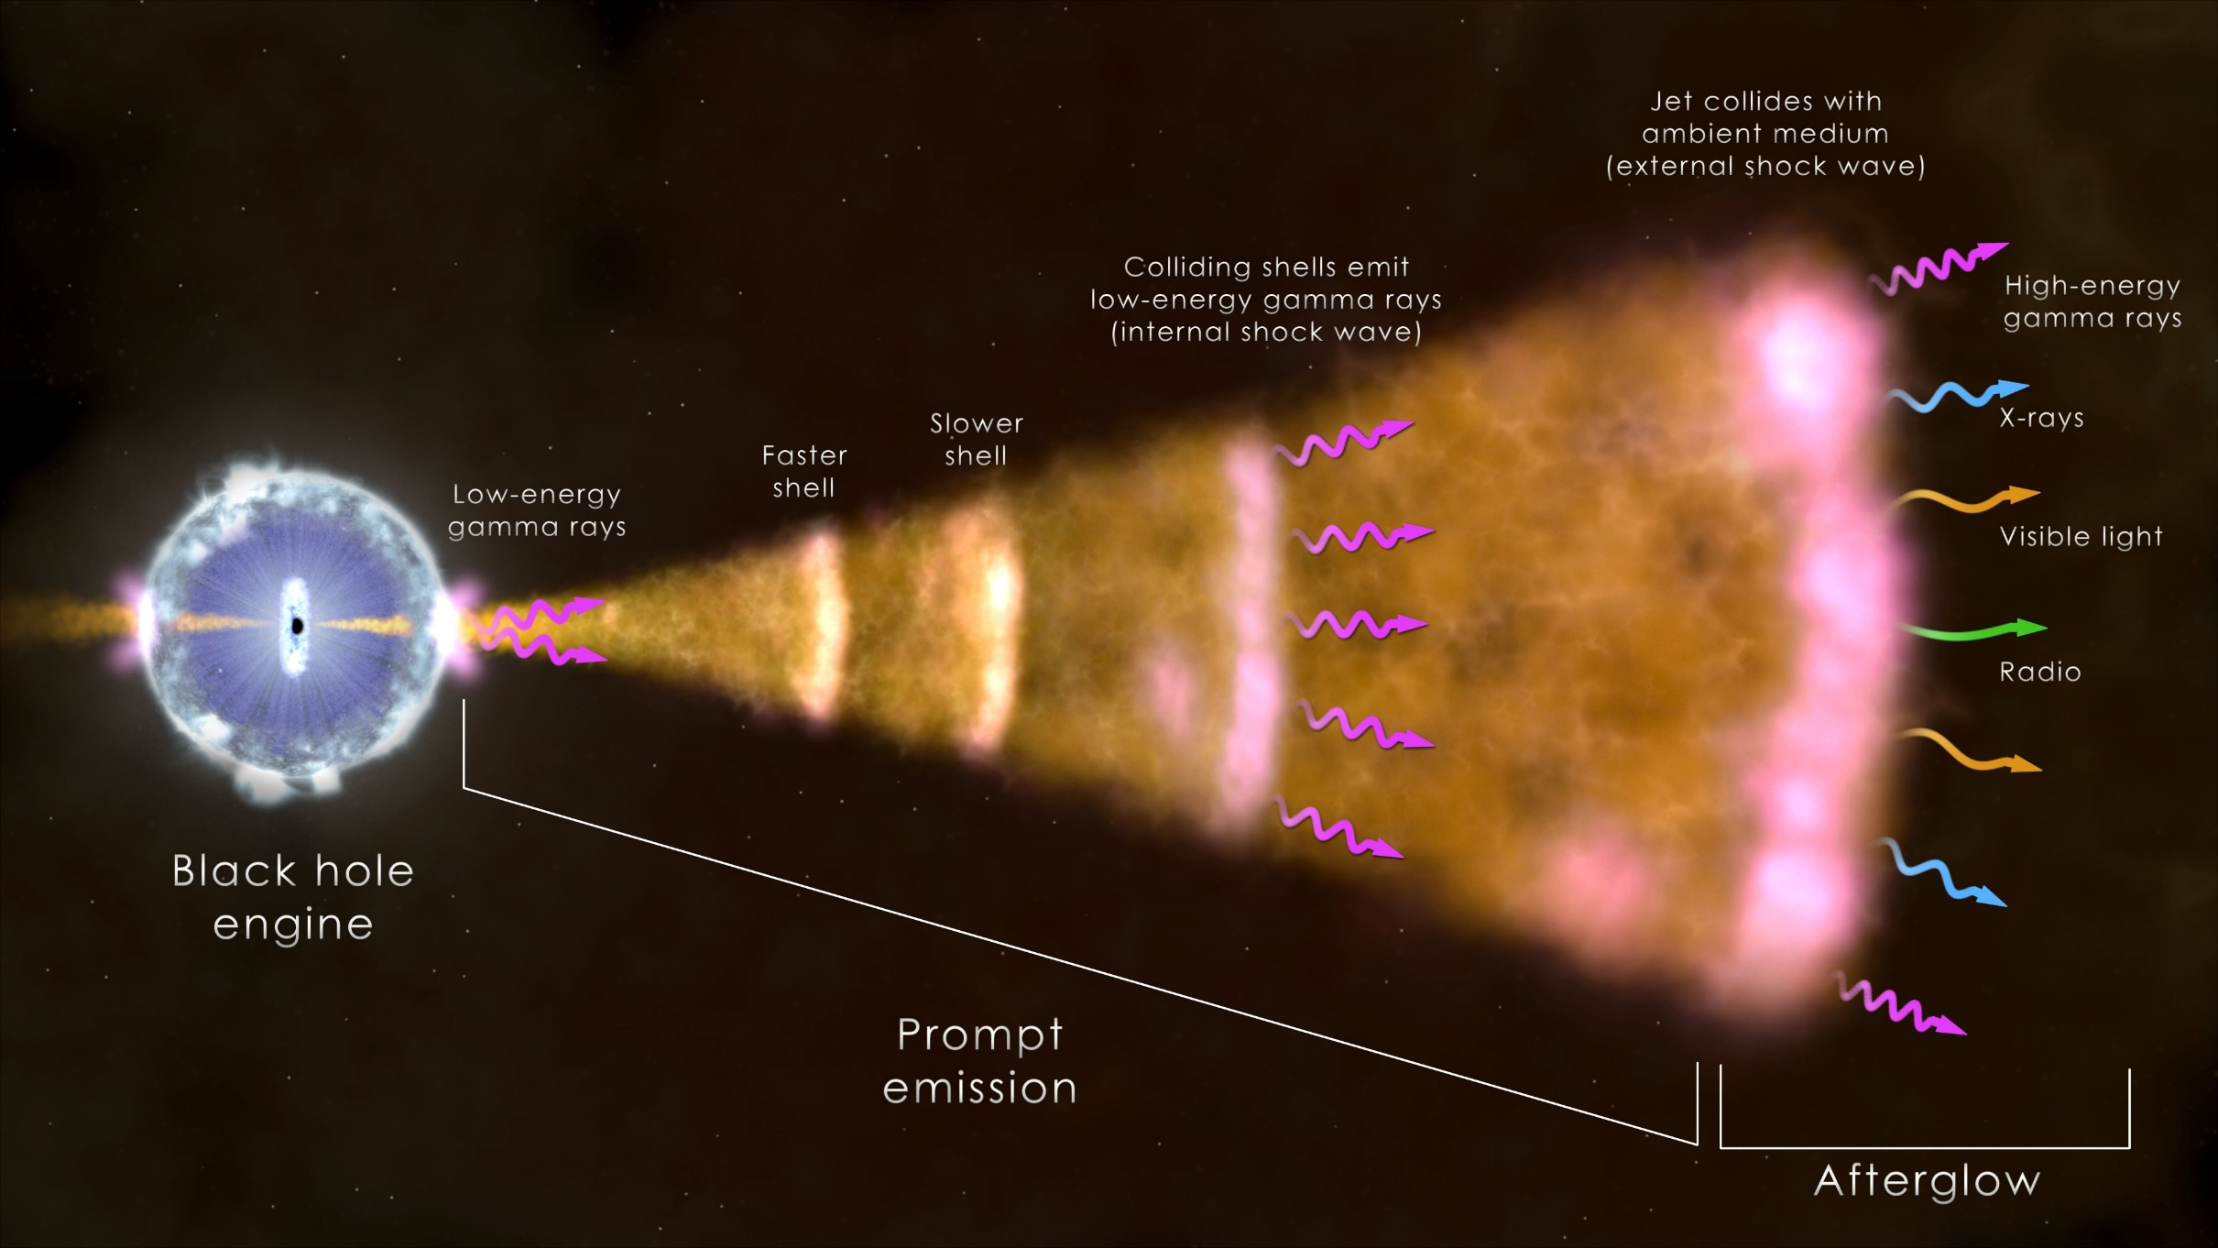
Long Gamma-ray bursts For rotating progenitors
10
We will see the burst up to 5 minutes after the gravitational wave signal if we are lucky because they are beamed!
Image credit: NASA‘s Goddard Space Flight Center

Slide 22
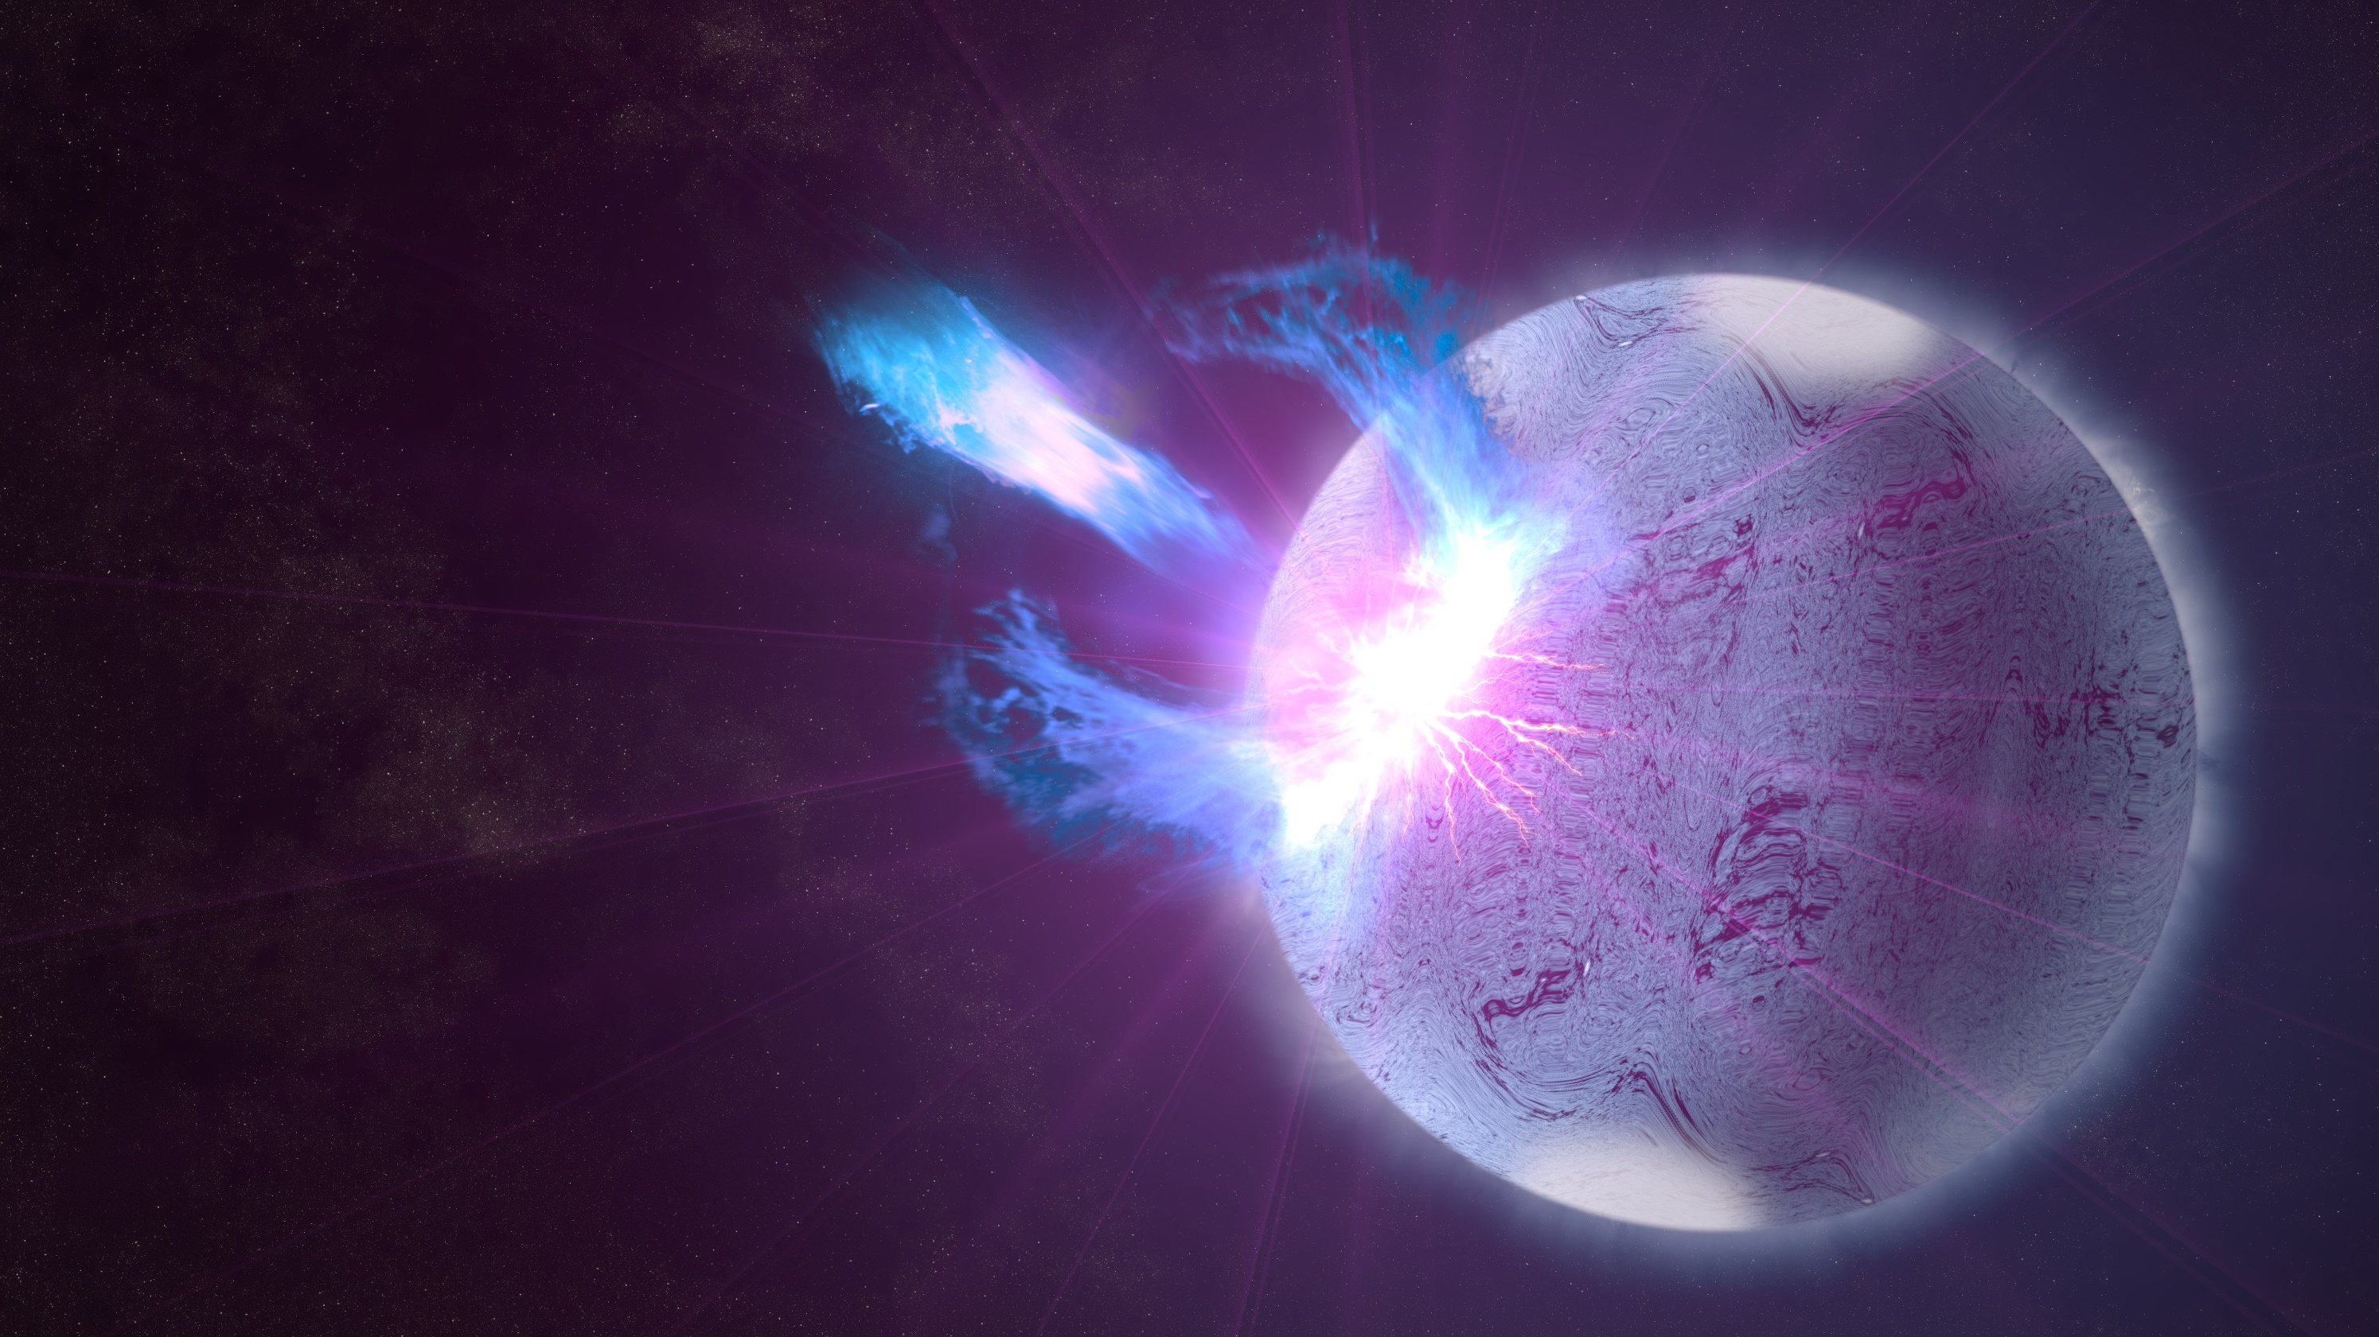
Magnetar starquakes
11
Image credit: NASA

Slide 23
Magnetar starquakes
11
Possible electromagnetic counterparts:
Soft gamma repeaters
Anomalous X-ray pulsars
Radio/X-ray pulsar glitches
Image credit: NASA

Slide 24
Magnetar starquakes
12
Scientific motivation for joint observations:
Unknown GW signal → Neutron star asteroseismology → Possible constraints on the equation of state
Image credit: NASA

Slide 25
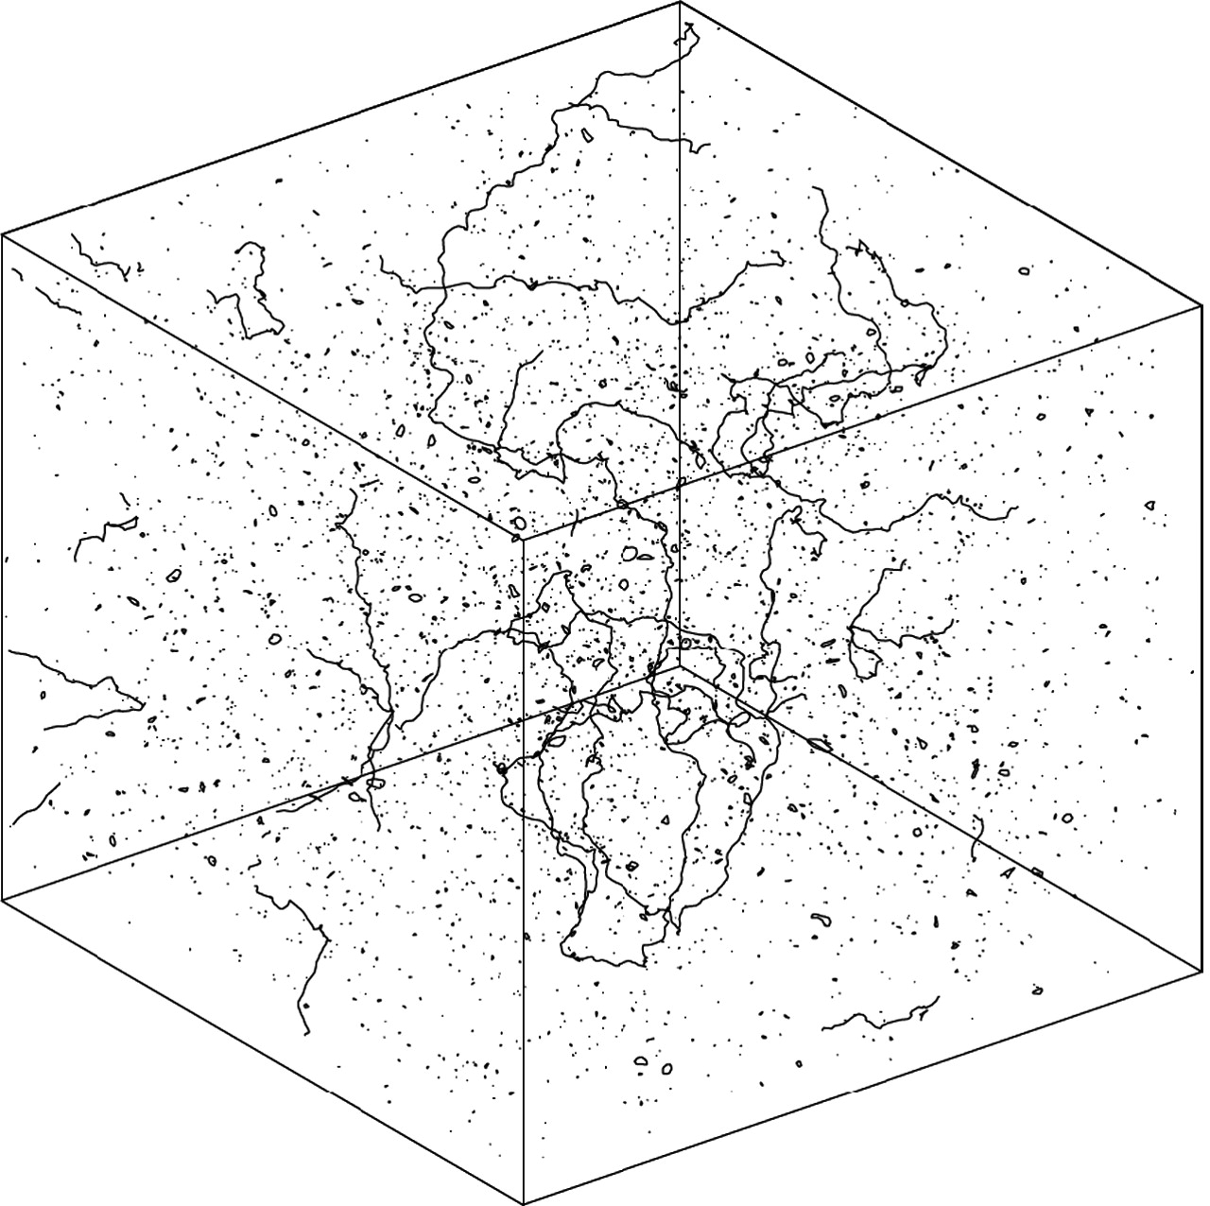
13
Other sources of GW transients
More speculative sources
Intersecting cosmic strings
Simulation of a cosmic string network
Image credit: Allen & Shellard (1990)

Slide 26
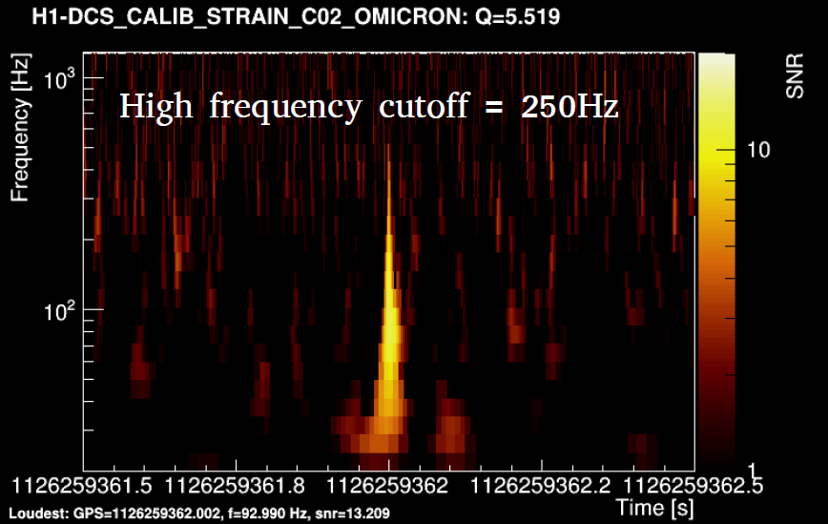
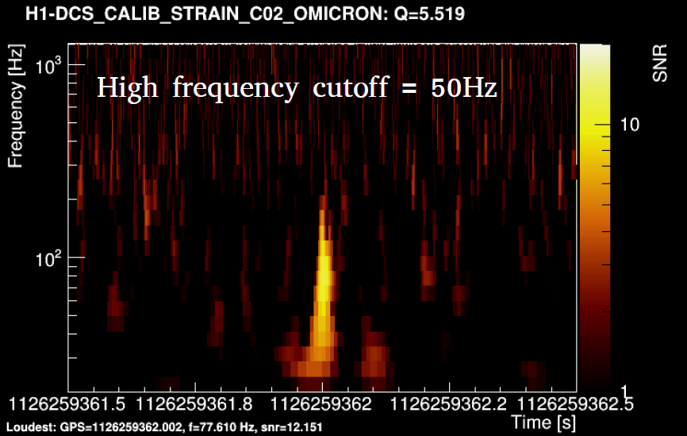
13
Simulation of a cosmic string network
Cosmic string cusp injections
Image credit: Allen & Shellard (1990), LIGO DCC G1602392

Slide 27
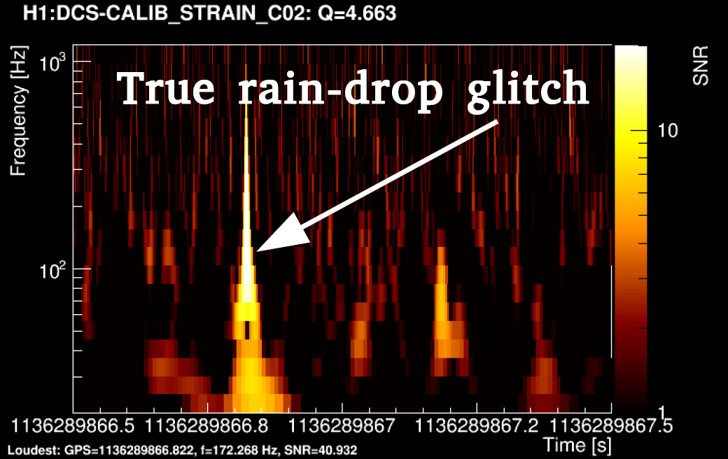
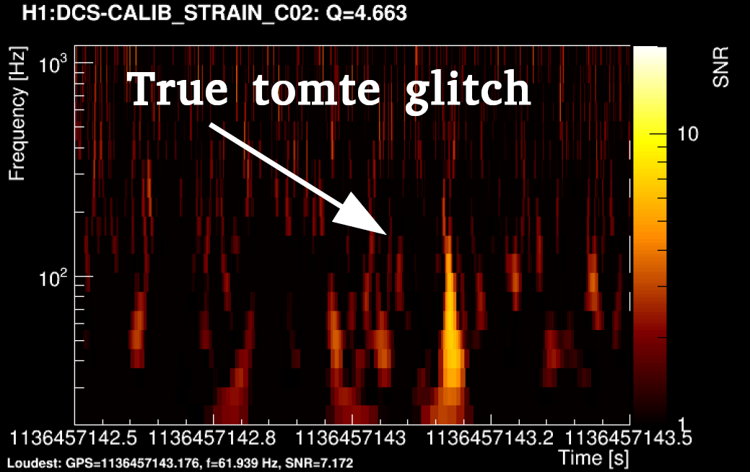
13
Cosmic string cusp injections
Image credit: Allen & Shellard (1990), LIGO DCC G1602392

Slide 28

13
Cosmic string cusp injections
Image credit: Allen & Shellard (1990), LIGO DCC G1602392

Slide 29
13
Other sources of GW transients
More speculative sources
Intersecting cosmic strings
Yet known GW sources
Simulation of a cosmic string network
Image credit: Allen & Shellard (1990)

Slide 30
14
Outline
Progenitors of gravitational wave transients
Low-latency searches
Information for multi-messenger astronomy
Image credit: LIGO/Caltech

Slide 31
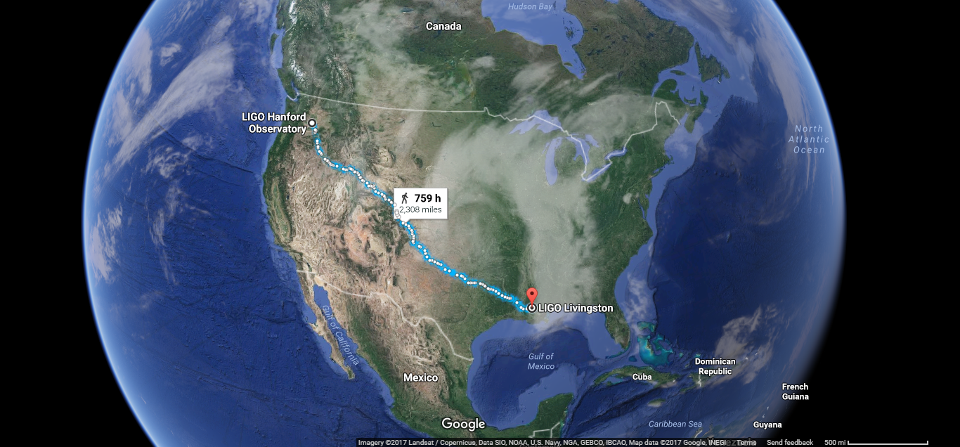
LIGO: Laser Interferometer Gravitational-Wave Observatory
15

Slide 32
LIGO: Laser Interferometer Gravitational-Wave Observatory
15
3,002 km:
10 ms light travel time
Please see Dave Reitze’s and Alex Urban’s talk!

Slide 33
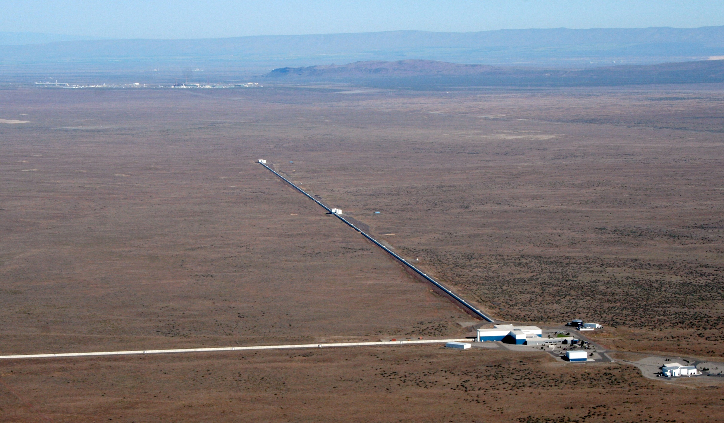
16
LIGO Hanford
4 km
4 km
Image credit: LIGO Laboratory

Slide 34
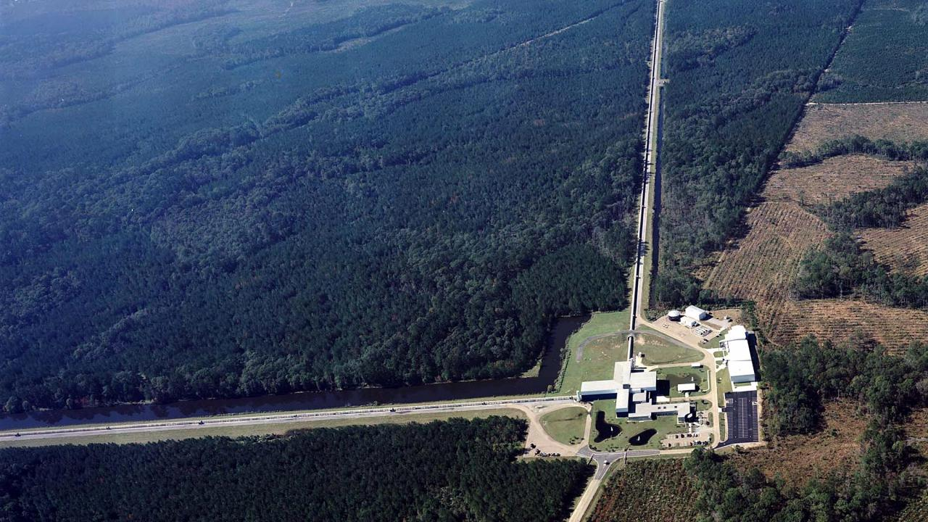
17
LIGO Livingston
4 km
4 km
Image credit: Science Magazine

Slide 35
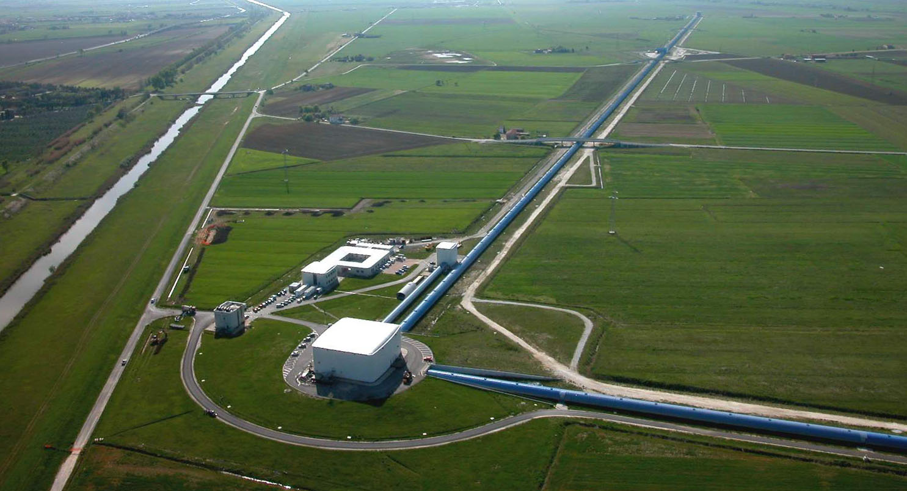
18
Virgo
3 km
3 km
Image credit: Virgo Collaboration

Slide 36
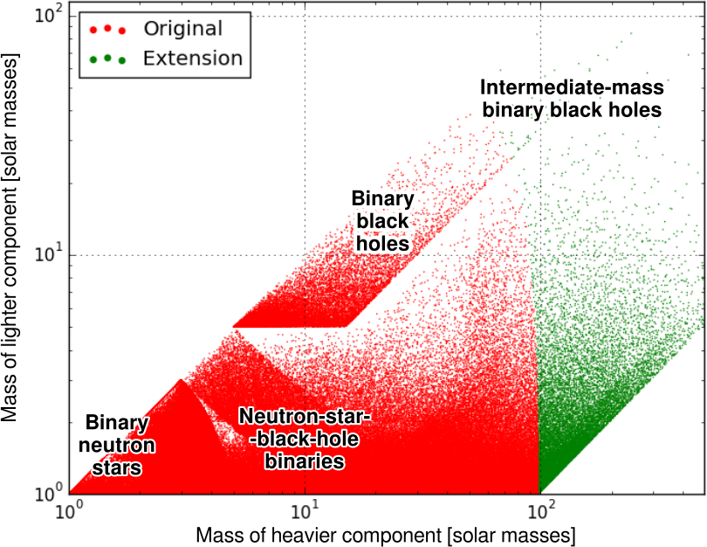
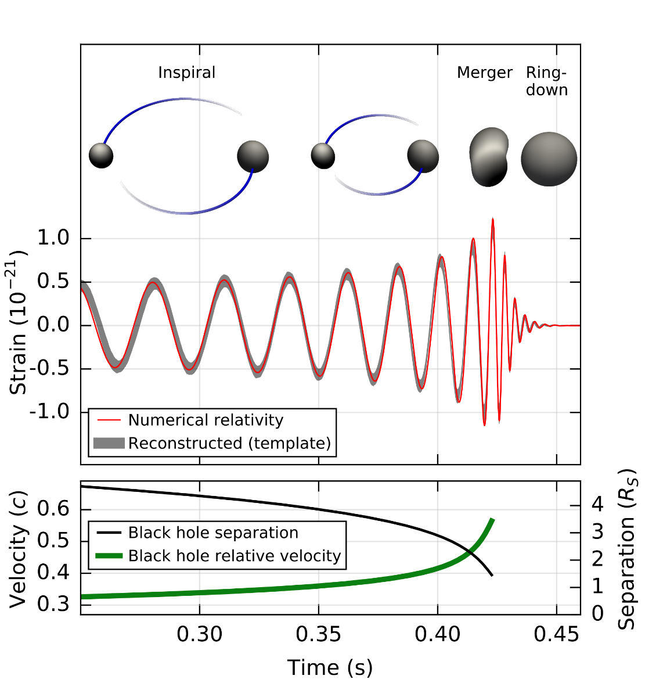
Modeled (CBC) searches:
Matched filtering
Please see Alex Nitz’s and Alan Weinstein’s talk!
19
GW150914
Image credit: LIGO/Caltech, Tito Dal Canton, Sennett, Phys. Rev. Lett. 116, 061102 (2016), Phys. Rev. Lett. 116, 241103 (2016)

Slide 37
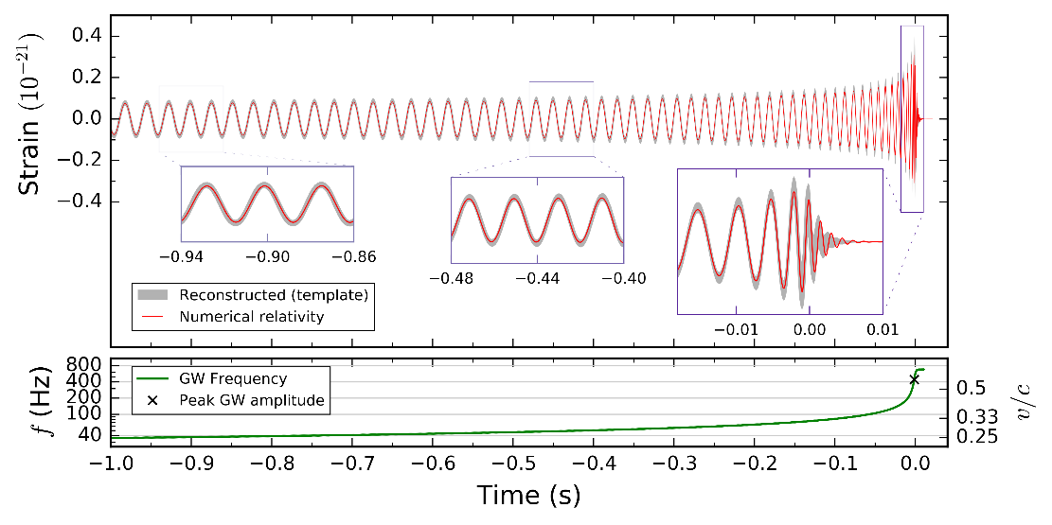
Modeled (CBC) searches:
Matched filtering
Please see Alex Nitz’s and Alan Weinstein’s talk!
19
GW150914
GW151226
Image credit: LIGO/Caltech, Tito Dal Canton, Sennett, Phys. Rev. Lett. 116, 061102 (2016), Phys. Rev. Lett. 116, 241103 (2016)

Slide 38
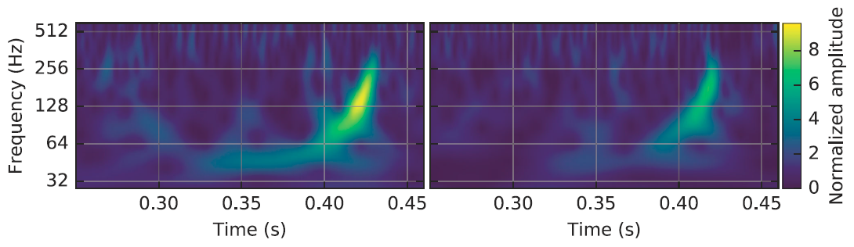
20
Unmodeled (Burst) searches:
Excess Power
GW150914
Image credits: Science Magazine, B. P. Abbott et al., Phys. Rev. Lett. 116, 061102 (2016)

Slide 39
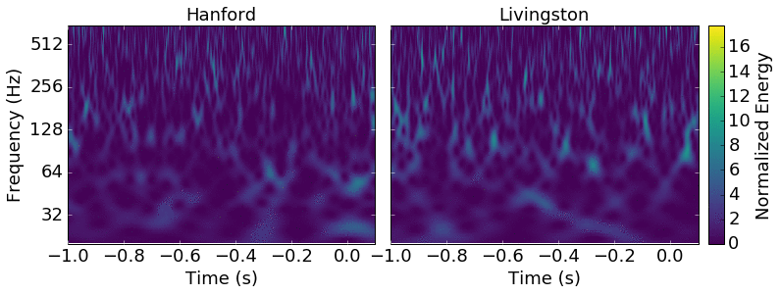
20
Unmodeled (Burst) searches:
Excess Power
GW150914
GW151226
Image credits: Science Magazine, B. P. Abbott et al., Phys. Rev. Lett. 116, 061102 (2016)

Slide 40
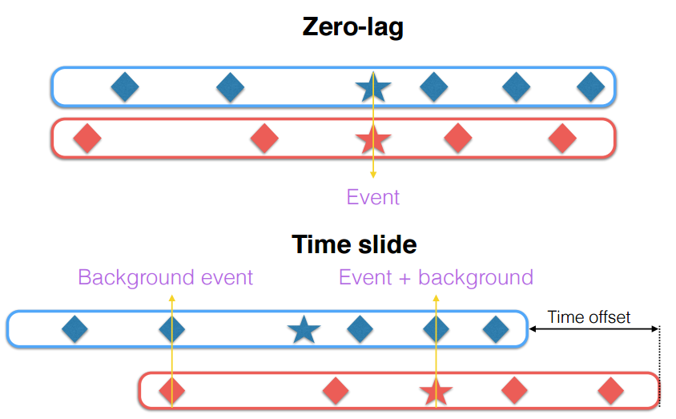
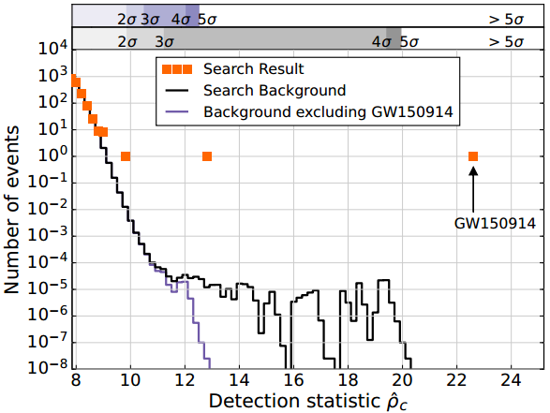
measuring backgrounds To determine significance
21
Image credits: Laura Nuttall, B. P. Abbott et al., Phys. Rev. Lett. 116, 061102 (2016)

Slide 41
measuring backgrounds To determine significance
21
Significance of a trigger is determined by its false alarm rate (FAR)
Image credits: Laura Nuttall, B. P. Abbott et al., Phys. Rev. Lett. 116, 061102 (2016)

Slide 42
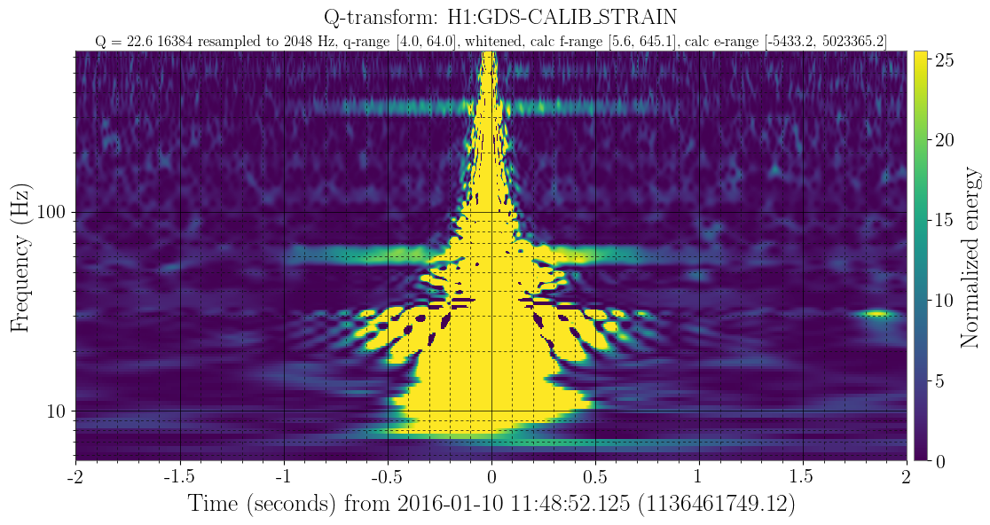
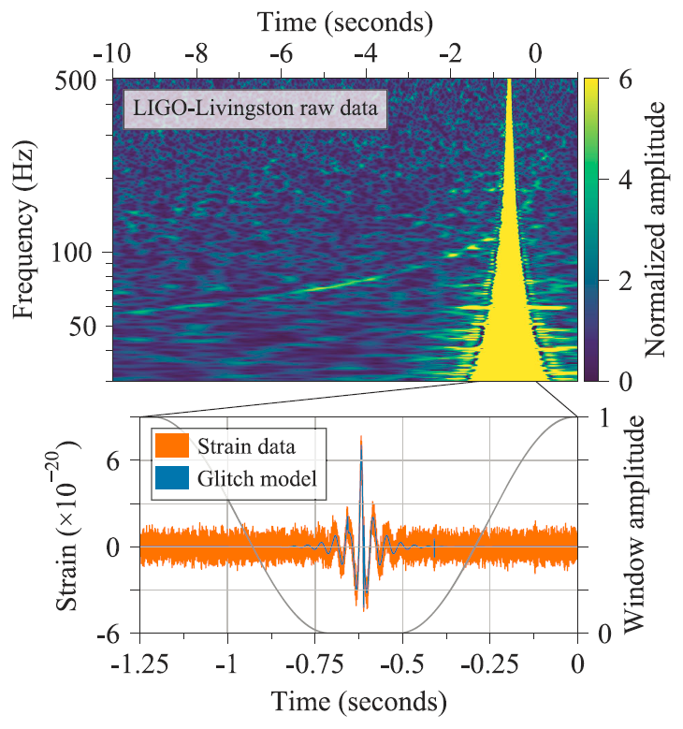
Checking for glitches and noise
22
Please see Jess McIver’s and Katerina Chatziioannou’s talk!
1. Could transient noise account for a trigger that we see? → If yes, veto
2. Could transient noise bias the estimate of the source parameter/properties? → If yes, mitigate
Q-transform of data containing GW170817
Q-transform of a glitch at Hanford caused by an overflow in the Y-end test mass control loop
Image credits: B. P. Abbott et al., Phys. Rev. Lett. 119, 161101 (2017)

Slide 43
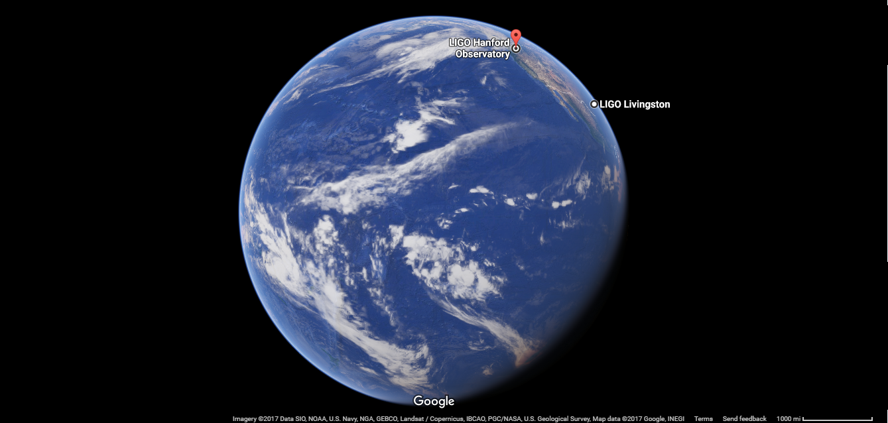
23

Slide 44

Idea behind detection and Localization w/ 2 detectors
24
Hanford
Livingston
Image credit: 3dportfolio.de

Slide 45
Idea behind detection and Localization w/ 2 detectors
24
10ms
Hanford
Livingston
Source
Image credit: 3dportfolio.de

Slide 46
Idea behind detection and Localization w/ 2 detectors
24
10ms
Source
Hanford
Livingston
Source
Image credit: 3dportfolio.de

Slide 47
Idea behind detection and Localization w/ 2 detectors
24
Source
7ms
10ms
Source
Hanford
Livingston
Source
Image credit: 3dportfolio.de

Slide 48
Idea behind detection and Localization w/ 2 detectors
24
Source
7ms
10ms
Source
Hanford
Livingston
Source
Image credit: 3dportfolio.de

Slide 49
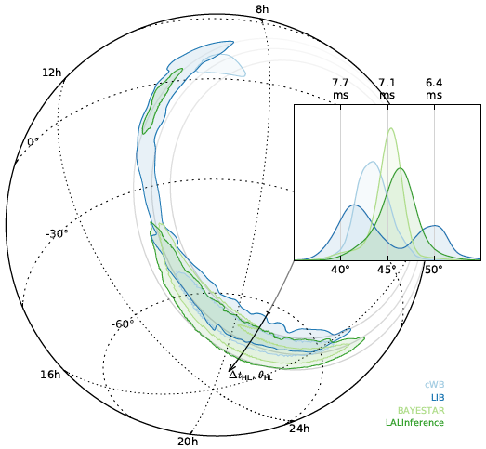
Idea behind detection and Localization w/ 2 detectors
24
Source
7ms
10ms
Source
Hanford
Livingston
Source
Image credits: 3dportfolio.de, B. P. Abbott et al., ApJ Letters, Volume 826, Number 1 (2016), L. P. Singer et al., ApJ Letters, 829:L15, (2016)

Slide 50
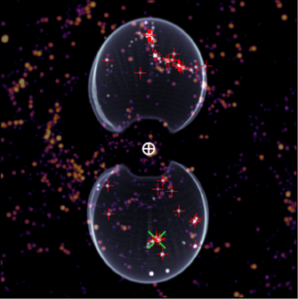
Idea behind detection and Localization w/ 2 detectors
24
Source
7ms
*Only when distance information is available!
10ms
Source
Hanford
Livingston
Source
Image credits: 3dportfolio.de, B. P. Abbott et al., ApJ Letters, Volume 826, Number 1 (2016), L. P. Singer et al., ApJ Letters, 829:L15, (2016)

Slide 51
Idea behind detection and Localization w/ 2 detectors
24
Source
7ms
*Only when distance information is available!
10ms
Source
Hanford
Livingston
Source
Pop quiz: Why not the full circle?
Image credits: 3dportfolio.de, B. P. Abbott et al., ApJ Letters, Volume 826, Number 1 (2016), L. P. Singer et al., ApJ Letters, 829:L15, (2016)

Slide 52
Idea behind detection and Localization w/ 2 detectors
24
Source
7ms
*Only when distance information is available!
10ms
Source
Hanford
Livingston
Source
Pop quiz: Why not the full circle?
Answer: Localization comes from a combination of time-delay information (triangulation) and amplitude coupling through the antenna patterns
Image credits: 3dportfolio.de, B. P. Abbott et al., ApJ Letters, Volume 826, Number 1 (2016), L. P. Singer et al., ApJ Letters, 829:L15, (2016)

Slide 53
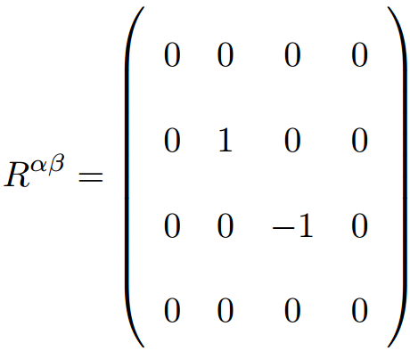
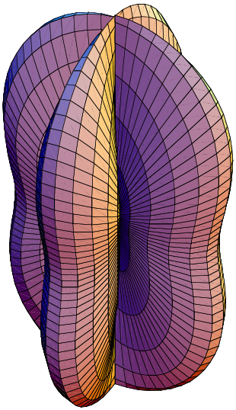
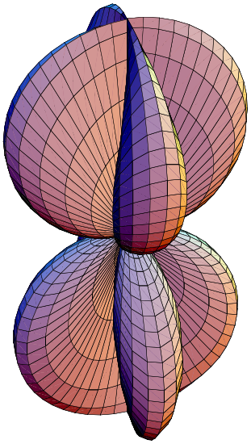
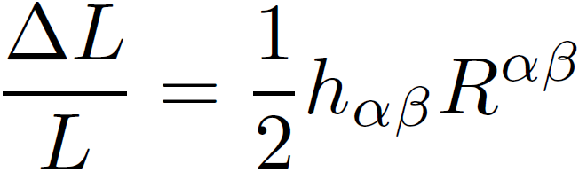

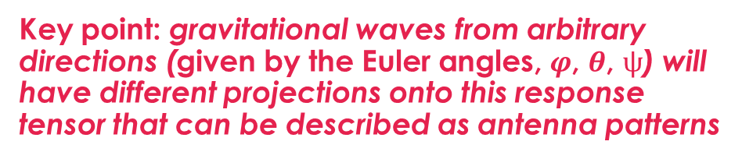
Interferometer antenna response
25
Key point: gravitational waves from arbitrary directions (given by the Euler angles, $φ$, $θ$, $ψ$) will have different projections onto this response tensor that can be described as antenna patterns
A detector in a plane that is perpendicular to the incident gravitational waves has a response tensor in the reference frame of the beam splitter:
For polarization angle $ψ$= 0:
where the resulting response of the detector is given by:
“+” polarization
“×” polarization
Image credit: Keppel, Drew Garvin (2009) Ph.D. Dissertation

Slide 54
Interferometer antenna response
25
Key point: gravitational waves from arbitrary directions (given by the Euler angles, $φ$, $θ$, $ψ$) will have different projections onto this response tensor that can be described as antenna patterns
A detector in a plane that is perpendicular to the incident gravitational waves has a response tensor in the reference frame of the beam splitter:
For polarization angle $ψ$= 0:
A LIGO interferometer is a microphone, not a telescope, where sensitivity depends on propagation direction and polarizations
where the resulting response of the detector is given by:
“+” polarization
“×” polarization
Image credit: Keppel, Drew Garvin (2009) Ph.D. Dissertation

Slide 55
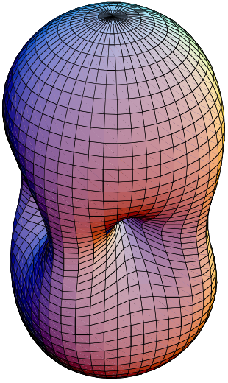
Interferometer antenna response
26
For polarization angle = 0:
“+” polarization
“×” polarization
RMS
sensitivity
Image credit: Keppel, Drew Garvin (2009) Ph.D. Dissertation

Slide 56
Interferometer antenna response
26
For polarization angle = 0:
“+” polarization
“×” polarization
RMS
sensitivity
Image credit: Keppel, Drew Garvin (2009) Ph.D. Dissertation

Slide 57
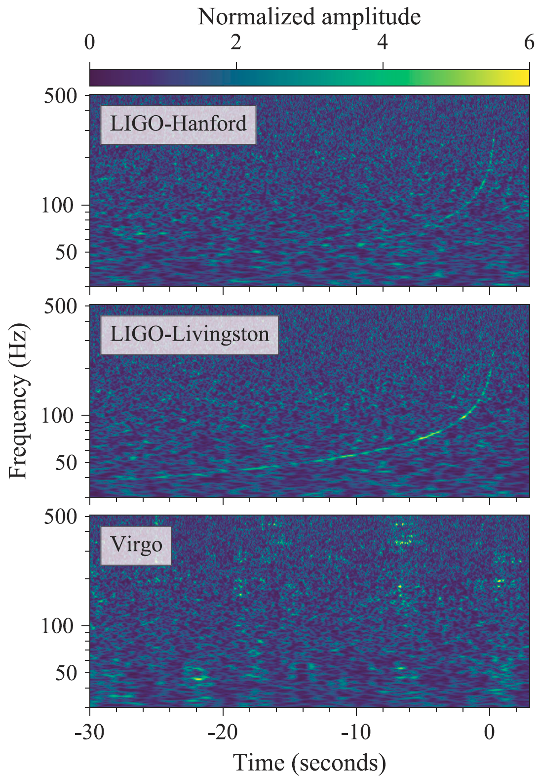
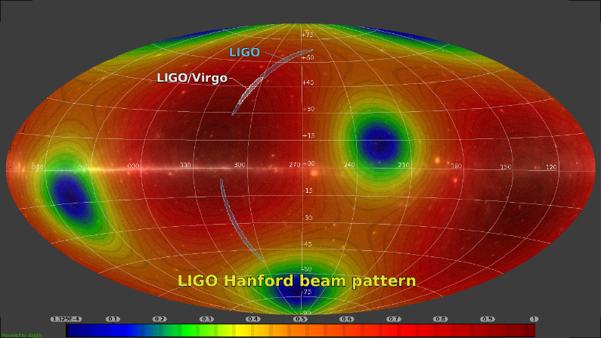
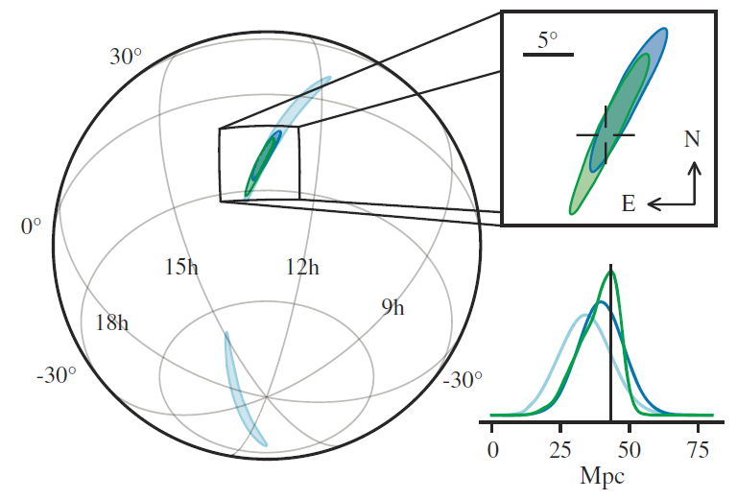
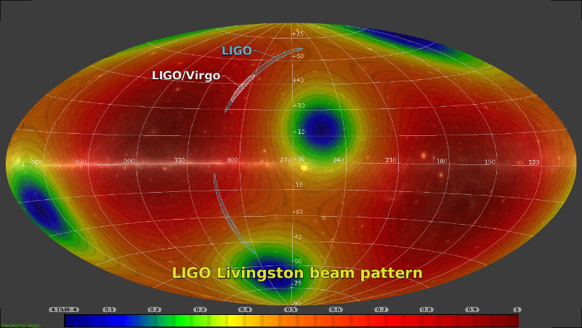
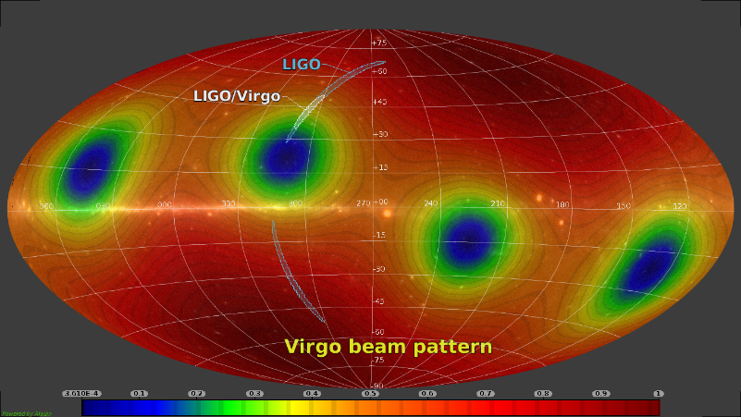
GW170817
Galactic coordinates
28
Image credit: Giuseppe Greco using GWSky;
B. P. Abbott et al., Phys. Rev. Lett. 119, 161101 (2017)
Aitoff projection

Slide 58
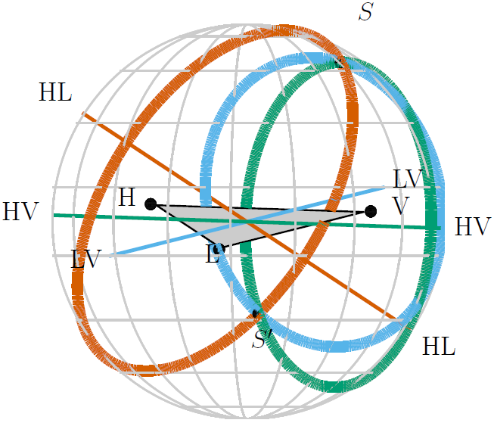
Localization w/ 3 detectors
Advanced LIGO + Virgo
27
Image credits: 3dportfolio.de, , B. P. Abbott et al., Living Rev. Relativity 19 (2016) 1; B. P. Abbott et al., Phys. Rev. Lett. 119, 161101 (2017)

Slide 59

Localization w/ 3 detectors
Advanced LIGO + Virgo
27
*Only when distance information is available!
Image credits: 3dportfolio.de, , B. P. Abbott et al., Living Rev. Relativity 19 (2016) 1; B. P. Abbott et al., Phys. Rev. Lett. 119, 161101 (2017); mielkesfiberarts.com

Slide 60
28
Outline
Progenitors of gravitational wave transients
Low-latency searches
Information for multi-messenger astronomy
Image credit: LIGO/Caltech

Slide 61
Open Public Alerts
29
From the LSC Town Hall meeting at MIT on 3/16/18:
We (LIGO/Virgo) will release public alerts for all event candidates in which we have a reasonable confidence and feel we can stand behind.
What is an open, public alert?
For more, see:
https://gw-astronomy.org/wiki/pub/OpenLVEM/TownHallMeetings2018/what-is-an-opa.pdf

Slide 62
Open Public Alerts
30
Two types of GCN alerts:
“Notices”: automated, machine-readable packets. Available as VOEvent XML, binary, and plain text. Listen anonymously or pre-register for connection and delivery tracking.
“Circulars”: human-readable, citable, non-refereed astronomical bulletins. Pre-register in order to receive and submit by email.
Sign-up for alerts here:
https://gw-astronomy.org/registry/pages/public/lv-em-user

Slide 63
Alert Information
31
For modeled (CBC) triggers:
Significance, time, GW signal classification, 3D sky position + distance
FAR >= 1/100 years: number will be stated in Circulars
FAR <= 1/100 years: will be described simply as “highly significant”
P_astro (higher latency): probability that the signal is astrophysical in origin accounting for both observed merger rate distribution and background distribution
Image credit: NSF/LIGO/Sonoma State University/A. Simonnet

Slide 64
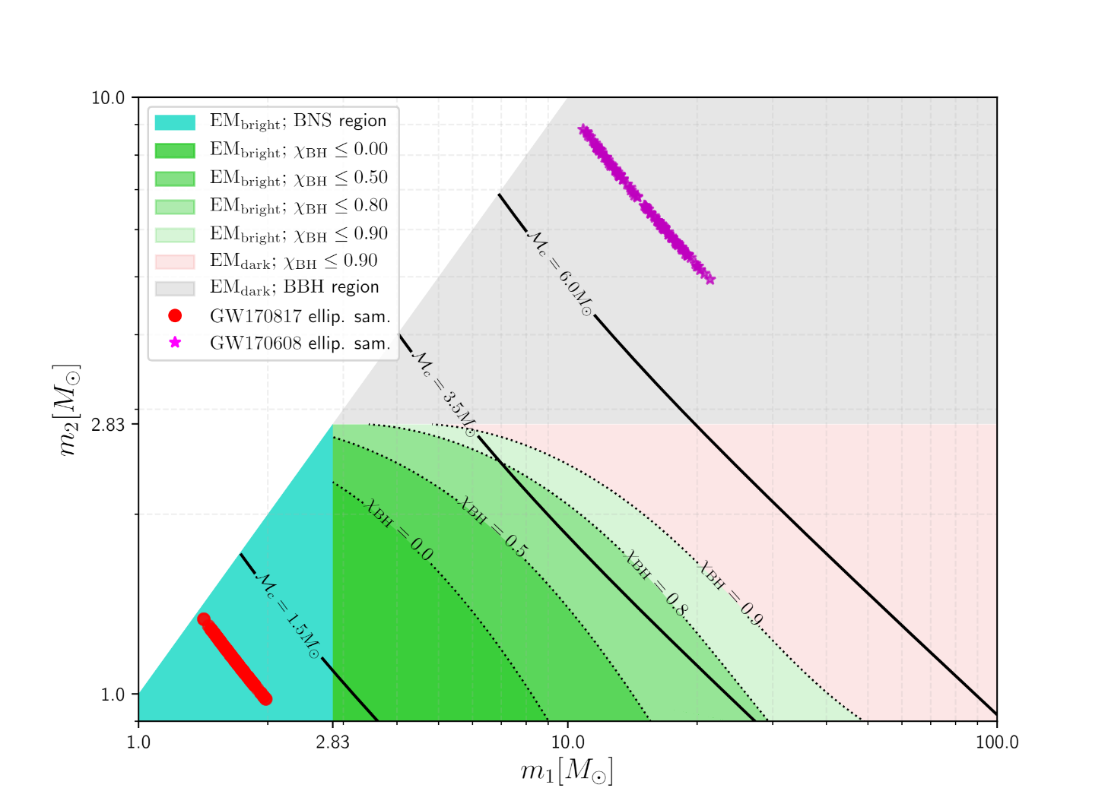
Alert Information
32
For modeled (CBC) triggers:
Significance, time, GW signal classification, 3D sky position + distance
Simple statement of signal consistency with a BNS, BBH, or NSBH signal
ProbHasNS: probability that the less massive companion has a mass consistent with a neutron star
ProbHasRemnant (higher latency): probability that there is matter left outside of the remnant
Image credit: NSF/LIGO/Sonoma State University/A. Simonnet, Deep Chatterjee/Shaon Ghosh

Slide 65
Alert Information
32
For modeled (CBC) triggers:
Significance, time, GW signal classification, 3D sky position + distance
Simple statement of signal consistency with a BNS, BBH, or NSBH signal
ProbHasNS: probability that the less massive companion has a mass consistent with a neutron star
ProbHasRemnant (higher latency): probability that there is matter left outside of the remnant
2H EOS
Image credit: NSF/LIGO/Sonoma State University/A. Simonnet, Deep Chatterjee/Shaon Ghosh
Notes:
We use a very stiff equation of state, the 2H EOS to err on the side of having more counterparts than not.

Slide 66
Alert Information
32
For modeled (CBC) triggers:
Significance, time, GW signal classification, 3D sky position + distance
Simple statement of signal consistency with a BNS, BBH, or NSBH signal
ProbHasNS: probability that the less massive companion has a mass consistent with a neutron star
ProbHasRemnant (higher latency): probability that there is matter left outside of the remnant
2H EOS
Foucart’s fitting formula
Image credit: NSF/LIGO/Sonoma State University/A. Simonnet, Deep Chatterjee/Shaon Ghosh
Notes:
In the NSBH region use Foucart’s fitting formula using the two masses of the compact objects and the primary object’s aligned spin component compute the probability there is any matter left outside the remnant

Slide 67
Alert Information
33
For modeled (CBC) triggers:
We will not release quantitative estimates of masses and spins
We will not release the GW strain or the waveform regressed from the data
Image credit: NSF/LIGO/Sonoma State University/A. Simonnet

Slide 68
Alert Information
34
For unmodeled (Burst) triggers:
Significance, time, 2D sky position
FAR threshold for sending Burst trigger alerts will be more restrictive, on the order of 1/10 years – 1/100 years (in comparison with 1/month – 1/year for CBC triggers)
Image credit: NASA

Slide 69
35
GCN Notices:
Basic Info
 | CBC | Burst
IVORN | ivo://nasa.gsfc.gcn/LVC#{G, M}nnnnnn-{1, 2, 3}-{Preliminary, Initial, Update}
Who | LIGO Scientific Collaboration and Virgo Collaboration
What | GraceDB: {G, M}nnnnnn
Search group | CBC | Burst
Pipeline | {Gstlal, MBTA, PyCBC} | {CWB, LIB}
FAR | Estimated false alarm rate in Hz
Network | Flag for each detector that participated
Sky map | URL of HEALPix FITS localization file
WhereWhen | Arrival time (UTC, ISO-8601)

Slide 70
36
GCN Notices:
Inference (CBC Only)
 | CBC
What | GraceDB ID: {G, M}nnnnnn
… | …
Distance | a posteriori mean luminosity distance in Mpc
DistanceError | a posteriori standard deviation of luminosity distance in Mpc
ProbHasNS | Probability (0-1) that the 2nd mass companion has a source frame mass < 2.83 M⊙
ProbHasRemnant | Probability (0-1) that there is any remnant matter left outside the remnant
P_astro | Probability (0-1) that the signal is astrophysical in origin accounting for both observed merger rate distribution and background distribution

Slide 71
37
GCN Circulars:
GCN 21509
“A binary neutron star candidate was identified in data from the LIGO Hanford detector at gps time 1187008882.4457 (Thu Aug 17 12:41:04 GMT 2017). The signal is clearly visible in time-frequency representations of the gravitational-wave strain in data from H1. The current significance estimate of ~1/10,000 years is based on data from H1 alone. Information about this candidate is available in GraceDb here...”

Slide 72
39
GCN Circulars:
GCN 21513
“…Investigation of L1 data identified a noise transient from a known class of instrumental glitches during the inspiral signal. The duration of this glitch is a small fraction of a second and does not appear to affect the signal at times away from the glitch. To make an improved preliminary estimate of the sky position, we re-analyzed the data, removing the L1 noise transient at GPS time 1187008881.389 by multiplying the strain data with a Tukey window, such that the total duration of the zeroed data is 0.2 s and the total duration of the Tukey window is 1.2 s…”

Slide 73
38
GCN Circulars:
GCN 21513
“…An updated BAYESTAR sky map (Singer et al. 2016, ApJL 829, 15) that uses data from all three gravitational-wave observatories (H1, L1, and V1) is available for retrieval from the GraceDB page (https://gracedb.ligo.org/events/view/G298048): bayestar-HLV.fits.gz. The centroid (maximum a posteriori) sky location is R.A.=12h57m, Dec.=-17d51m. The 50% credible region spans about 9 deg2 and the 90% region about 31deg2. The luminosity distance is 40 +/- 8 Mpc (all-sky a posteriori mean +/- standard deviation). This is the preferred sky map at this time...”

Slide 74
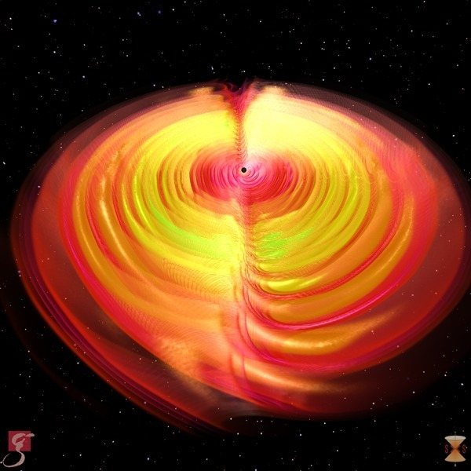


39
Conclusion
……….Thank you for listening!
Questions?
Gravitational waves as emitted during a black hole merger
Image credits: S. Ossokine, A. Buonanno, R. Haas (Max Planck Institute for Gravitational Physics), Simulating eXtreme Spacetime project

