Slide 1
OFI shroud design review
Alena A., Calum T., Corey A., Eddie S., Stephen A.

Slide 2
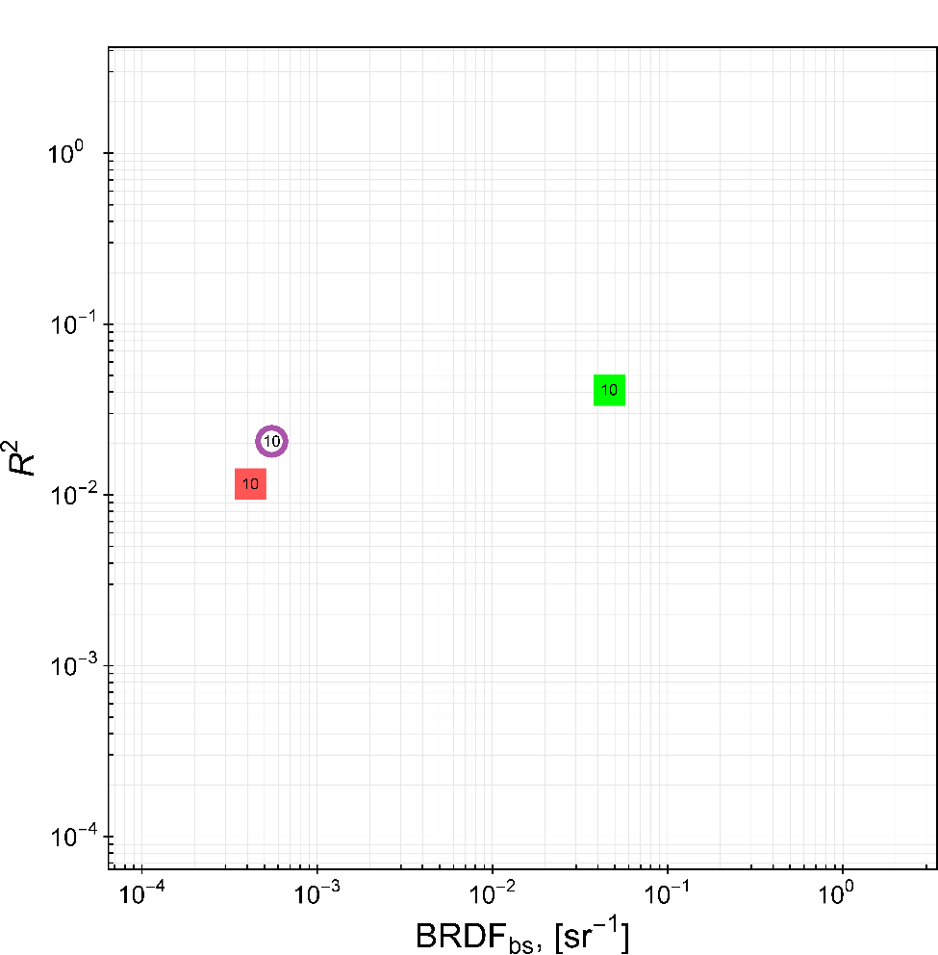
Scatter from OFI during operation
Scatter from a moving vacuum enclosure wall (HAM5 ) aLog41449
Robert Schofield LIGO-G1800717
Vacuum enclosure wall – speculated numbers
Black Nickel on stainless steel super #8 (Anoplate)
DLC on stainless steel Super#8 (Duralar)
DLC on stainless steel Super#8 (Richter)

Slide 3
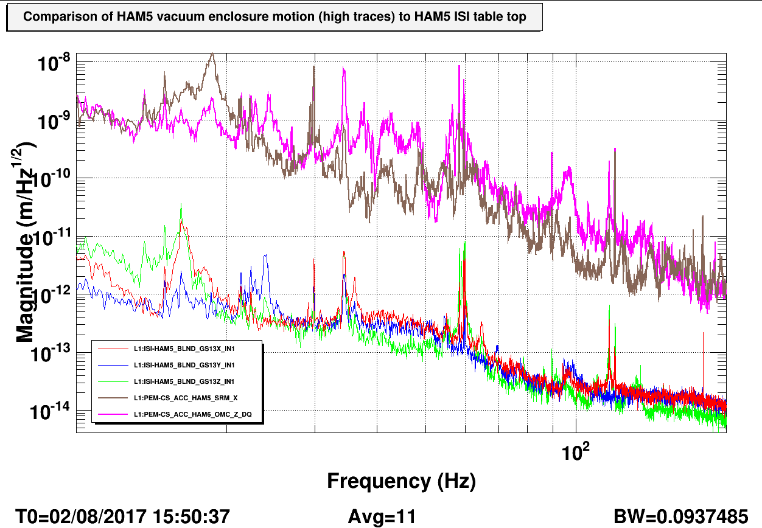
https://alog.ligo-wa.caltech.edu/aLOG/index.php?callRep=41449
As a quick check, the attached figure shows that the vacuum enclosure walls of LLO HAM5 move between about 10^2 and 10^3 times more than the table top in the 10-100 Hz band. Thus, even if baffles that were mounted on the table top were as good at back-scattering light as the HAM5 doors (unlikely), and they were only 10 cm away from an OFI scattering site, a linear estimate suggests they would cause less noise than reflections off of the more distant door. Of course, for the same geometric attenuation reason, the further the baffles are from the OFI, the better.

Slide 4
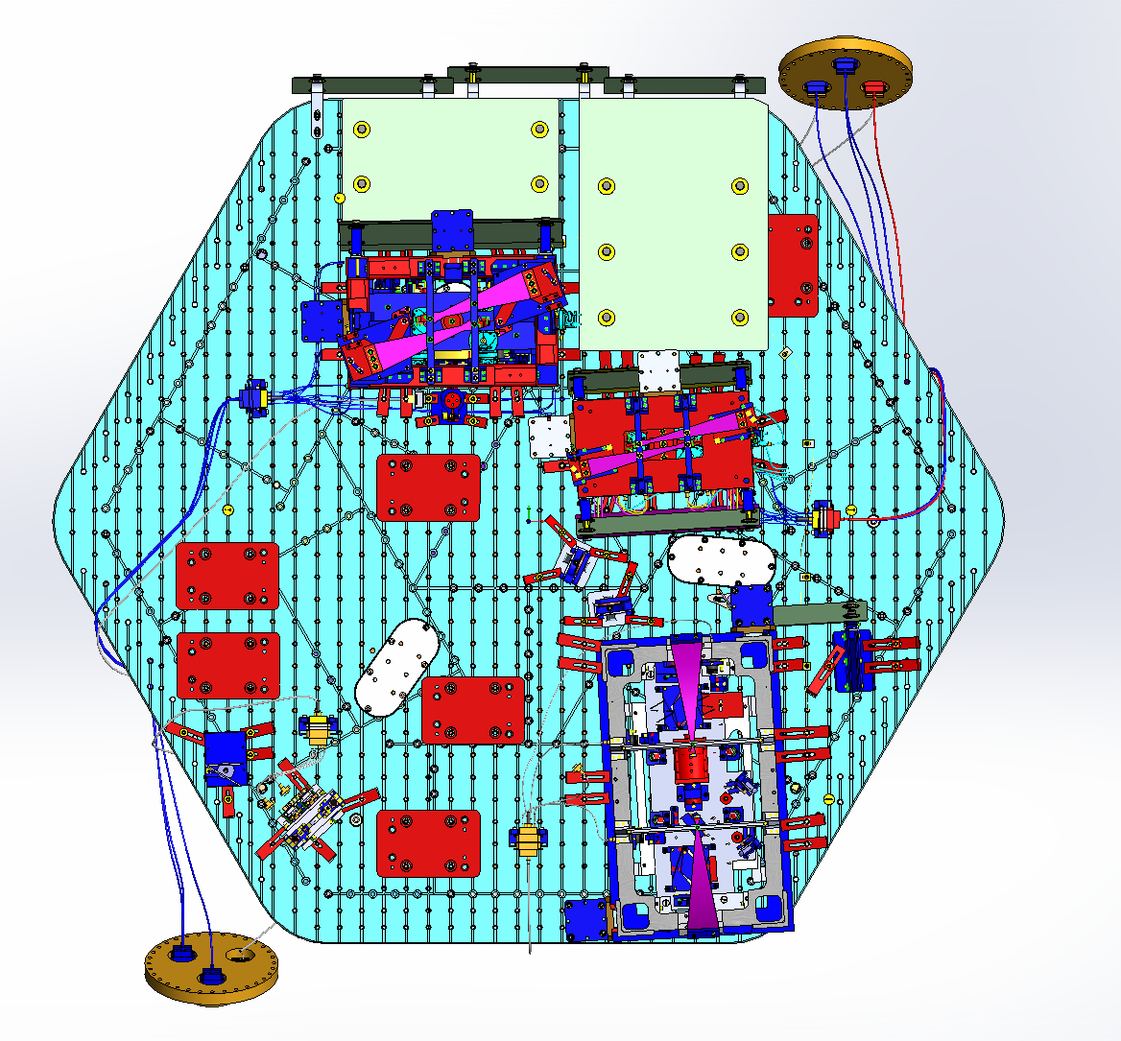
HAM 5 post SLiC part A install (LLO) – Existing as of 4/18/2018
Table baffle
Table baffle
SRM AWC
SR3
SRM
Existing
Septum baffle
Squeezer (transmission) beam dump
OFI
ZM2
https://dcc.ligo.org/LIGO-D0900456

Slide 5
Faraday Isolator Refl Baffle removal
A ghost beam from septum window was found hitting the reflection baffle (uncoated) and going back to the window
FRS 9647
ECR E1700425
D0901134
Already removed at LLO
Pending at LHO (function handled by shroud)
Refl baffle in NOT part of the new shroud!

Slide 6
Purpose of the shroud:
Block scatter paths from OFI to vacuum enclosure and absorb the scatter with minimum bounces (Super #8 * side of panels should face the inside of the shroud)
Minimize new stray light scatter from added panels with apertures (Super #8 * side of panels should face the laser input)
Septum window ghost beam dumping
* Super #8 is only finished on one side, the other side is ~ mill finish

Slide 7
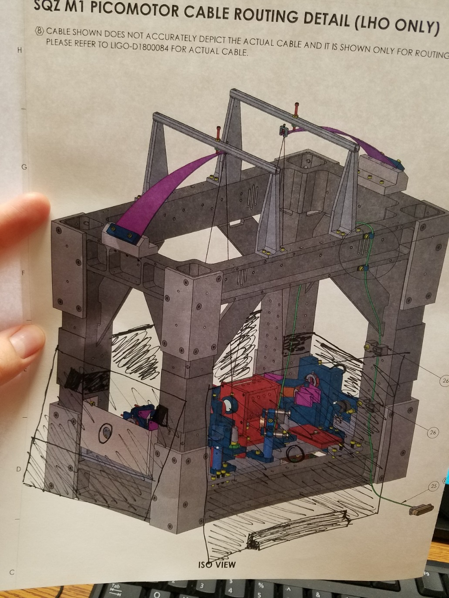
Inspiration:
excising structure, angled walls, apertures
Every house needs a roof!
Bar / restaurant in Seattle, WA

Slide 8
#1 High roof concept
#2 Low roof concept
Existing
Septum baffle
Existing
Septum baffle
Squeezer input
Squeezer input
OFI input baffle
- 13 panels!
- 8 panels
Minimizes uncoated surfaces inside the shroud

Slide 9
OFI input side (panels are not yet detailed)
Aperture:
- same as output side baffle and old reflection baffle D0902845
- additional vertical and horizontal adjustment
Same bracketry as SLiC part A
Existing
Septum baffle
Squeezer input
OFI input baffle
Non-polished side
Trapezoidal panel pitched 10°
Polish – on the inside of the shroud
Stray light on the outside – dumping on SRM baffle

Slide 10
OFI output side (panels are not yet detailed)
Two panels:
OFI output baffle
Septum window ghost beam baffle
Aperture:
- same as input side baffle and old reflection baffle D0902845
- additional vertical and horizontal adjustment
Same bracketry as SLiC part A
Super #8 side
Non-polished side
Existing Septum baffle
OFI output trapezoidal baffle is pinched 10°
OFI output baffle
Ghost beam baffle
ghost beam
Ghost beam baffle pitched 10° and optionally yawed with a 5° wedge

Slide 11
Squeezer input side (panels are not yet detailed)
Two panels on squeezer input side:
Table baffle (stop stray light purpose)
10° pitched rectangle
polished side facing the input
small aperture
optional yaw
2) Inside baffle (stop scatter purpose)
10° pitched parallelogram
polished side inside
large aperture
same bracketry as SLiC part A
Aperture of the inside baffle
Existing
Septum baffle
Super #8 side
Non-polished side
OFI input baffle
Squeezer input

Slide 12
Panel opposite to squeezer input
10° pitched parallelogram
polished side inside
same bracketry as SLiC part A
Non-polished side
clearance for the cable

Slide 13
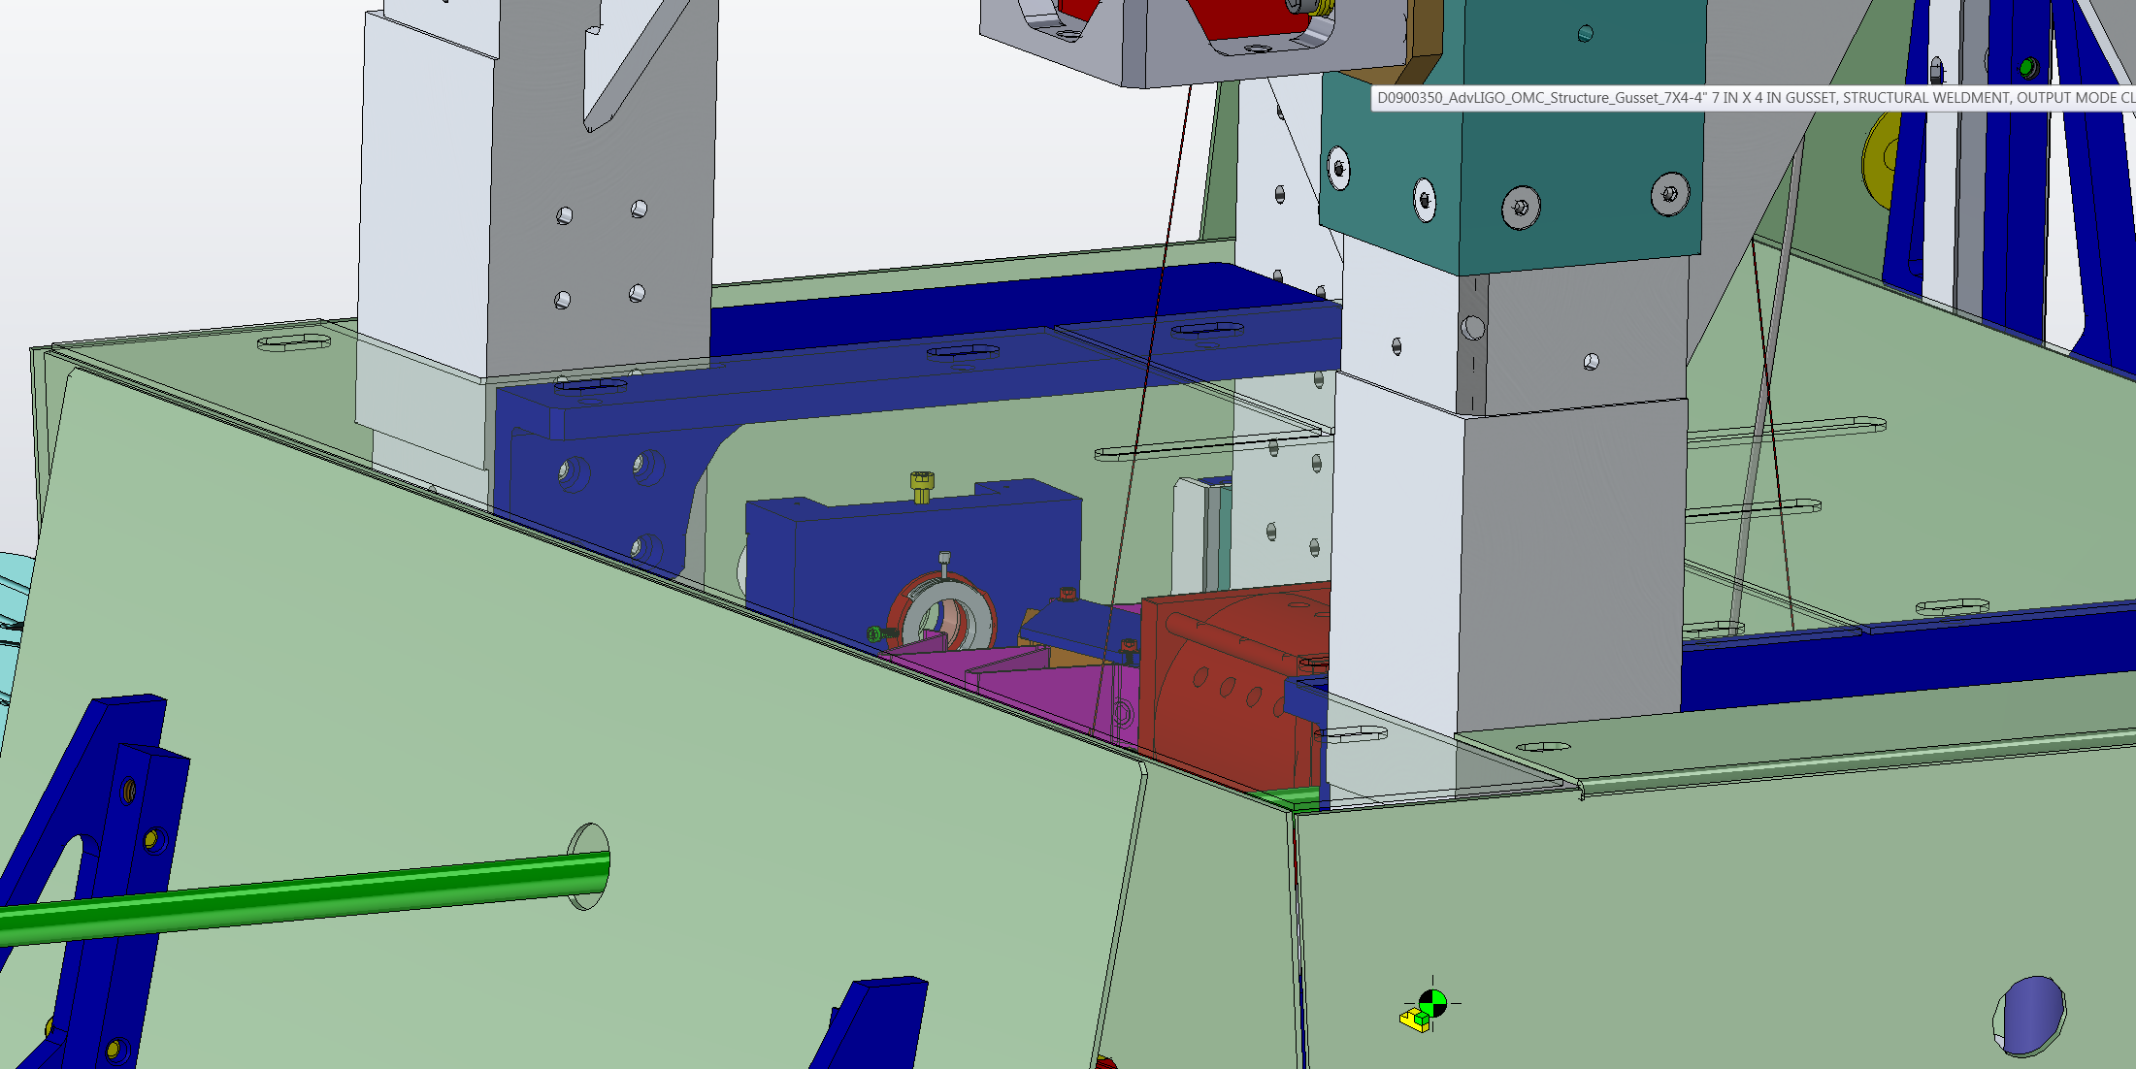
The roof
Roof extends outside the OFI for better coverage
Wide slots
Polished side on inside
No pitch required
Extended coated bracket for better coverage

Slide 14
OFI TFP Beam Dump
Alena A., Calum T., Corey A., Eddie S., Stephen A.

Slide 15
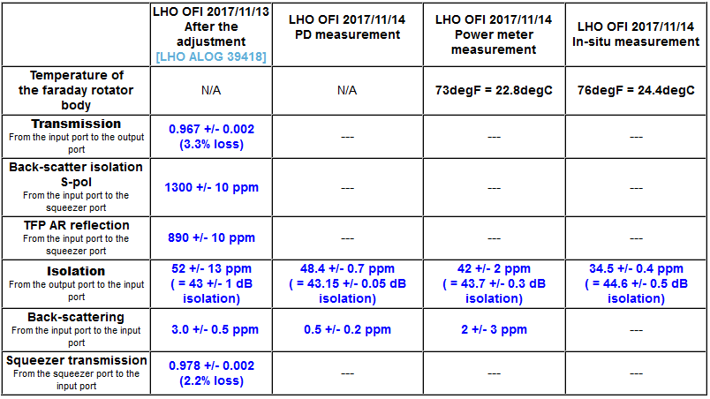
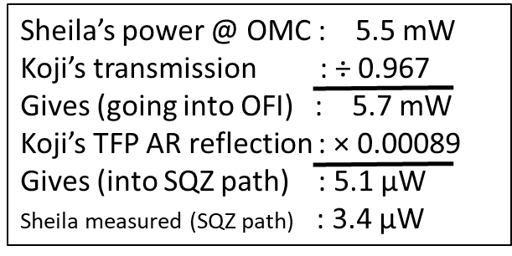
How much scattered power in SQZ path?
Koji’s Optics Lab Measurements (LHO #39436)
Where does this beam go?
Sheila’s Single Bounce Measurements (LHO #41229)

Slide 16
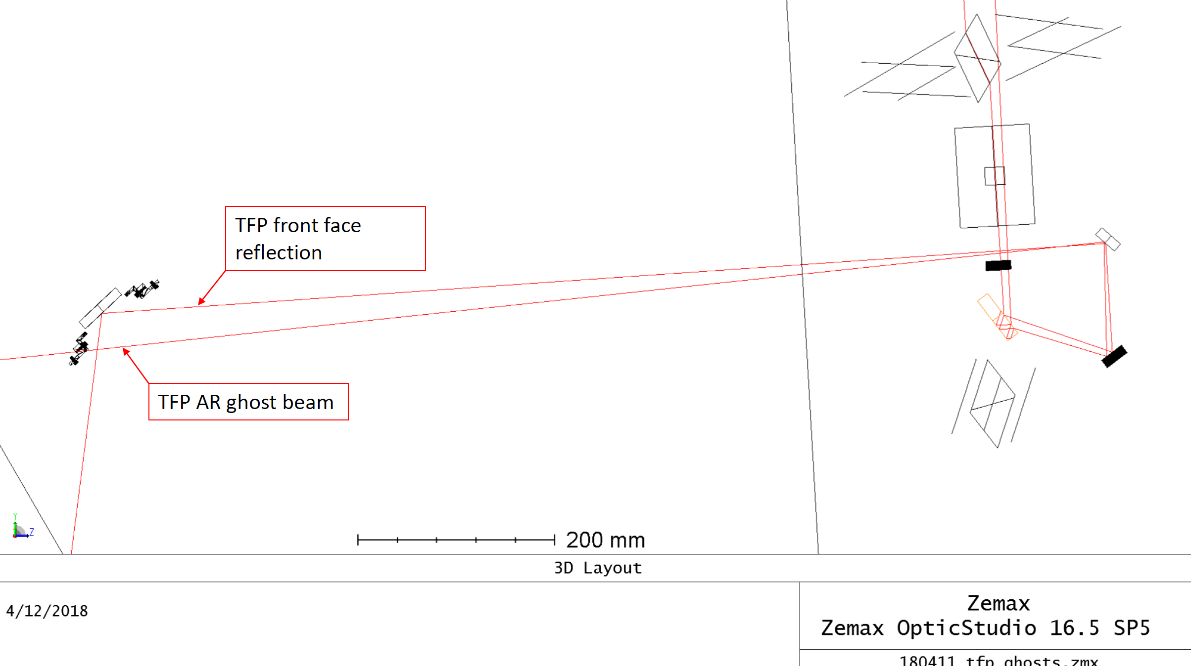
OFI TFP AR Ghost Beam – adding V-shaped beam dump
This beam is an artifact of Zemax model – not real
https://dcc.ligo.org/LIGO-G1800771

Slide 18
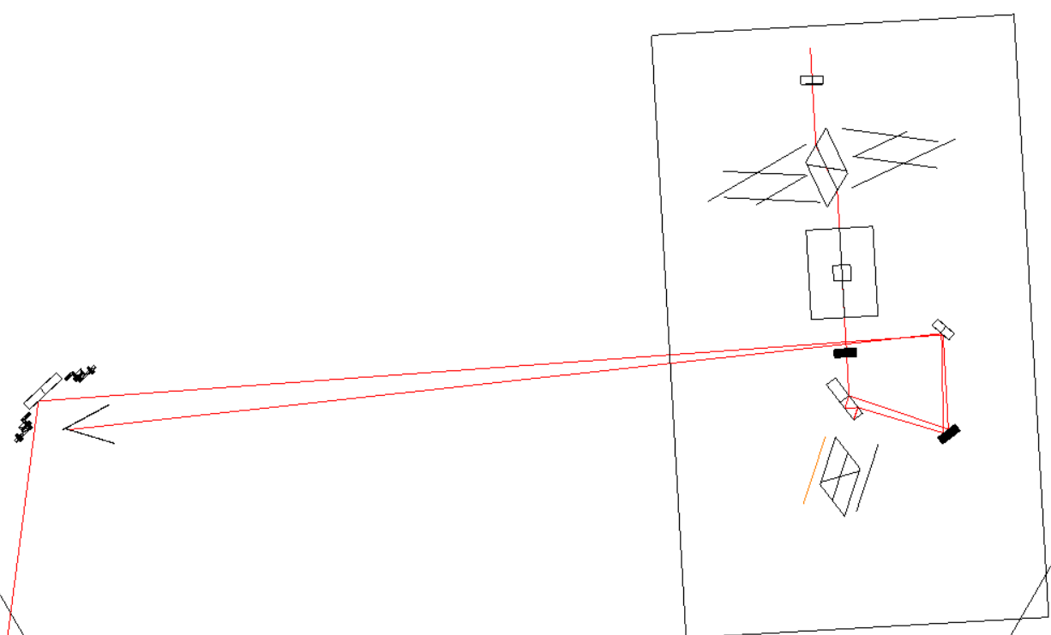
OFI TFP AR Ghost Beam – adding V-shaped beam dump
TFP Front Side Reflection
TFP AR Ghost Beam
Cartoon Beam Dump. Location TBD.

Slide 19
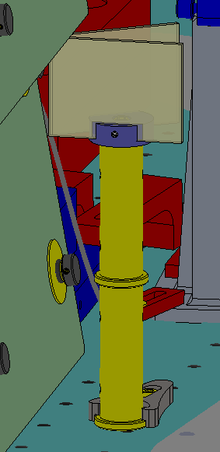
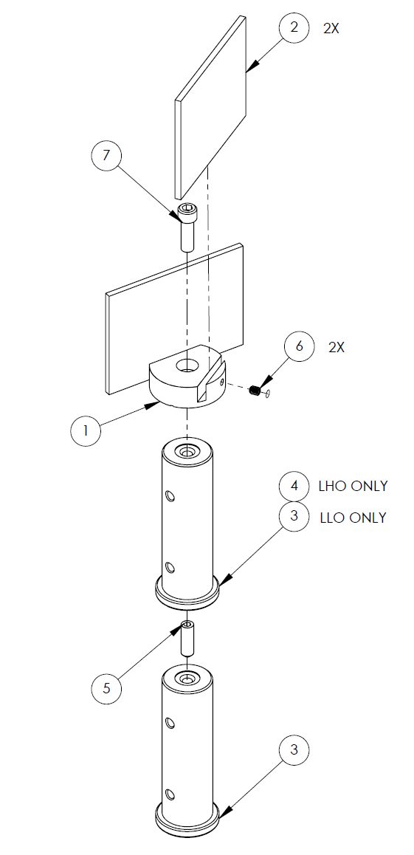
OFI TFP AR Ghost Beam – adding V-shaped beam dump
SYS black glass beam dump
Based on D1400222
For HAM5 beam heights
L1 (9.11”)
H1 (8.35”)
Flexible positioning in front of ZM2
All dirty parts will be in CIT’s hands by end of this week
Related to Ticket 10407
Representation of design, not in final location.
Pending: FEA on beam dump and possibility of adding damping (viton)

