Slide 1
Real-Time Universal Transfer Function Synthesizer
Izabella Pastrana
Washington University in St. Louis
Advisors: Johannes Eichholz, Rana Adhikari, Christopher Wipf
Izabella Pastrana, Washington University in St. Louis | Real-Time Universal Transfer Function Synthesizer | T18-00184 – LIGO SURF Program 2018

Slide 2
Project Outline
Measure transfer functions with high accuracy
Complex modeling and fitting
Implementation in embedded system (FPGA)
Izabella Pastrana, Washington University in St. Louis | Real-Time Universal Transfer Function Synthesizer | T18-00184 – LIGO SURF Program 2018
Notes:
Hi accuracy – auto resolution

Slide 3
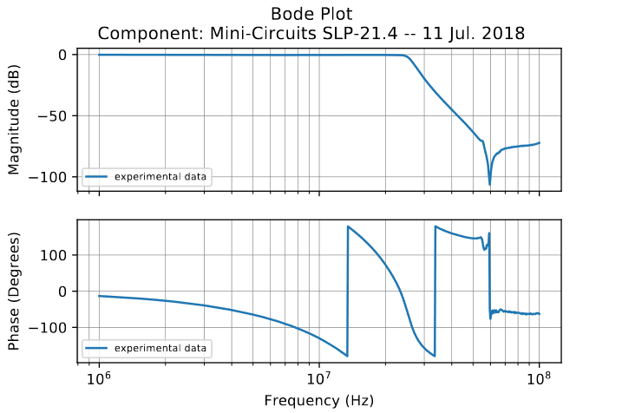
Transfer Functions
Laplace transform of the impulse response of a linear-time invariant (LTI) system when initial conditions are set to zero
Relates output to input in Laplace/Fourier domain
H(s) = Y(s) / X(s)
Bode plots – show gain and phase response of system
Plot magnitude (dB) and phase (degrees) against logarithmic frequency
Izabella Pastrana, Washington University in St. Louis | Real-Time Universal Transfer Function Synthesizer | T18-00184 – LIGO SURF Program 2018
Notes:
Transfer functions fully describe a control system (order, type, frequency response, etc.). Defined as… Unless you’ve worked with TFs before, that might seem a bit abstract
Laplace transform – maps function from time domain to s domain integral f(t) e^-st dt
Fourier transform – maps function from time domain to frequency domain integral f(t) e^-jwt dt
h(t) differential equations! y(t) would be a convolution
H(s) transfer functions! Y(s) would just be multiplication

Slide 4
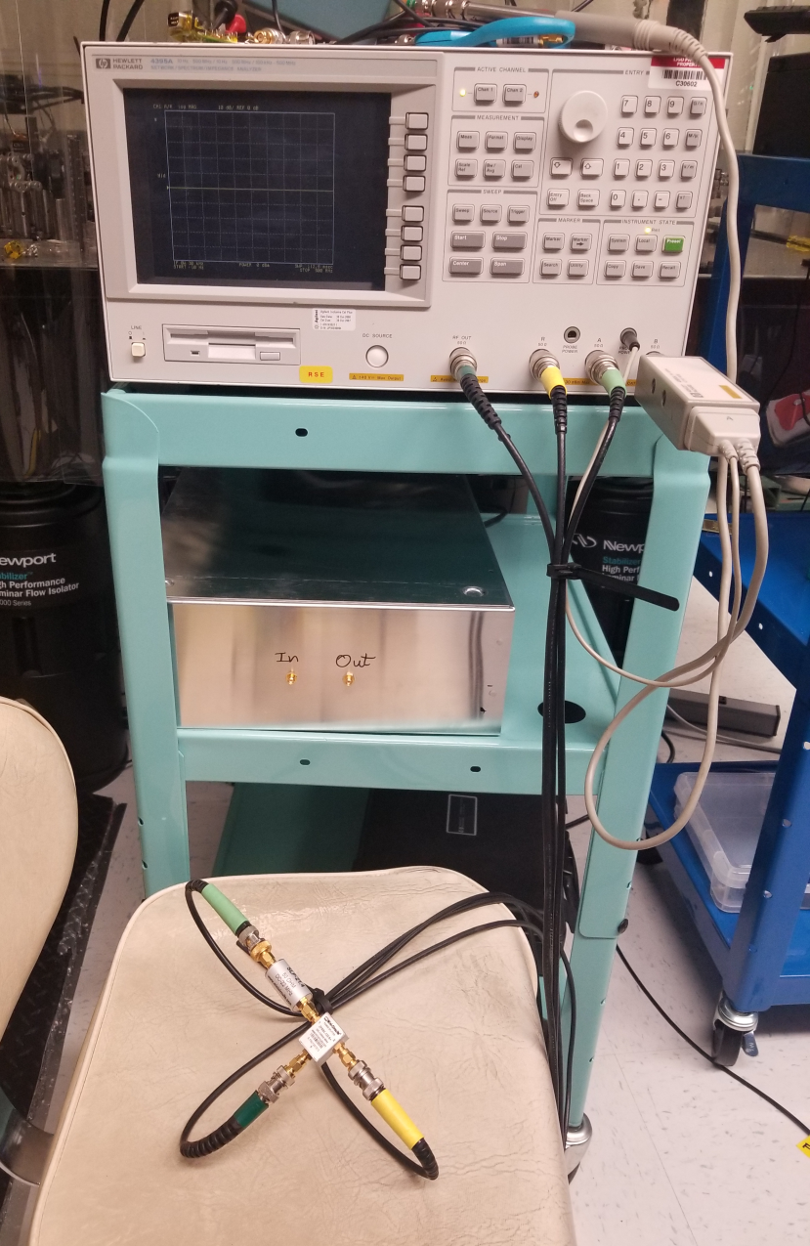
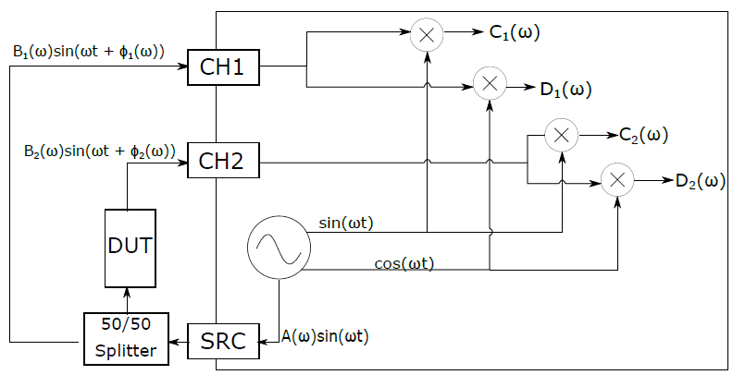
Measuring TFs
Agilent 4395A Vector Network Analyzer
Izabella Pastrana, Washington University in St. Louis | Real-Time Universal Transfer Function Synthesizer | T18-00184 – LIGO SURF Program 2018
Notes:
TF data can be noisy due to limited drive magnitudes, depending on system under measurement,
Send excitation signal out the SRC
Sample signal before and after passing through the DUT
Can use errors at each frequency as weights in fitting process, adding credibility to TF estimates (multiply the individual data point errors by the inverse uncertainty before the summation)

Slide 5
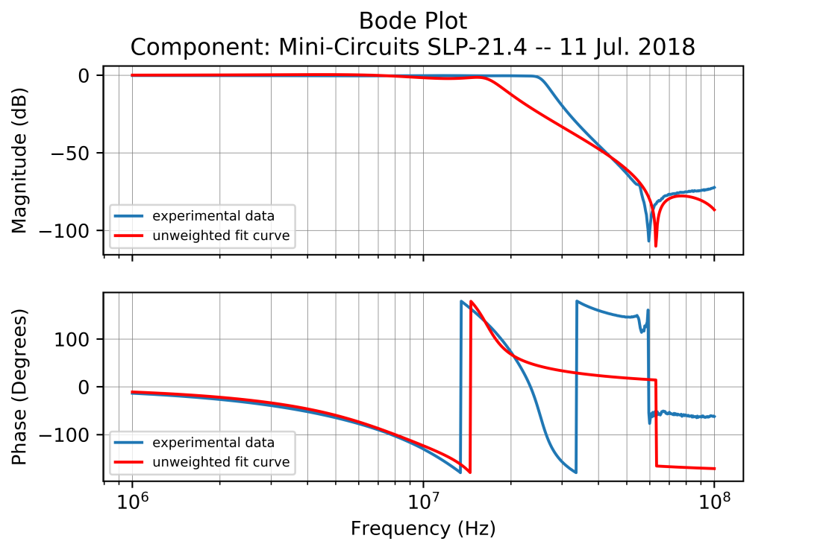
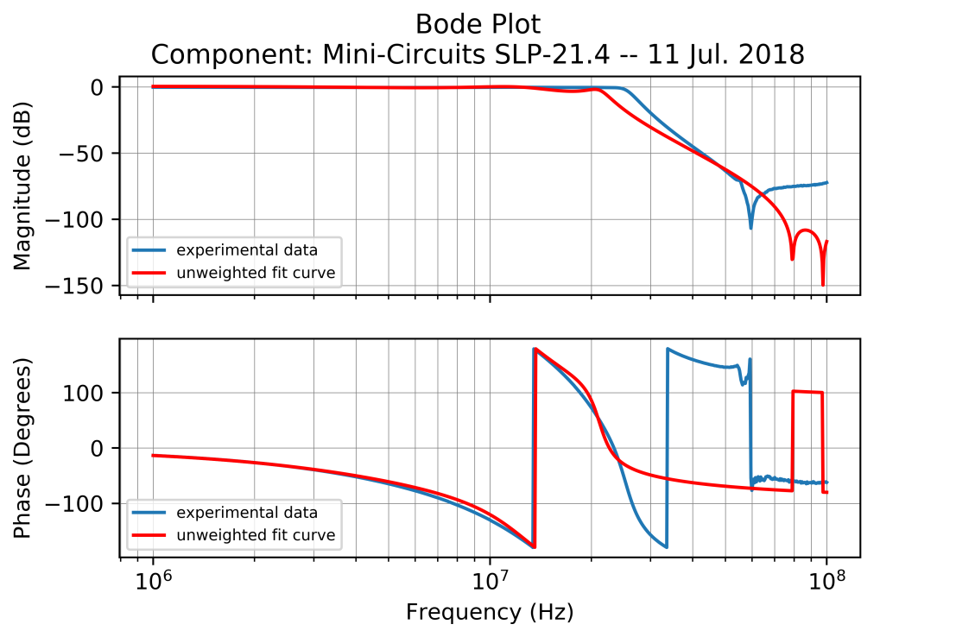
Modeling TFs
TF fitting to pole-zero model of a 4th order elliptic low-pass filter
Fit model parameters by minimizing root mean square error between model and data
More interested in fitting to passband and transition region than stopband
Izabella Pastrana, Washington University in St. Louis | Real-Time Universal Transfer Function Synthesizer | T18-00184 – LIGO SURF Program 2018
Notes:
Modified to write out median complex TF and uncertainty measurements for series of single sweeps
Can use errors at each frequency as weights in fitting process, adding credibility to TF estimates
In a weighted fit, we give less weight to the less precise measurements and more weight to more precise measurements when estimating the unknown parameters in the model. The model I first tried using was the 4th order elliptic filter … then tried with a 5th order elliptic filter
I don’t actually know what

Slide 6
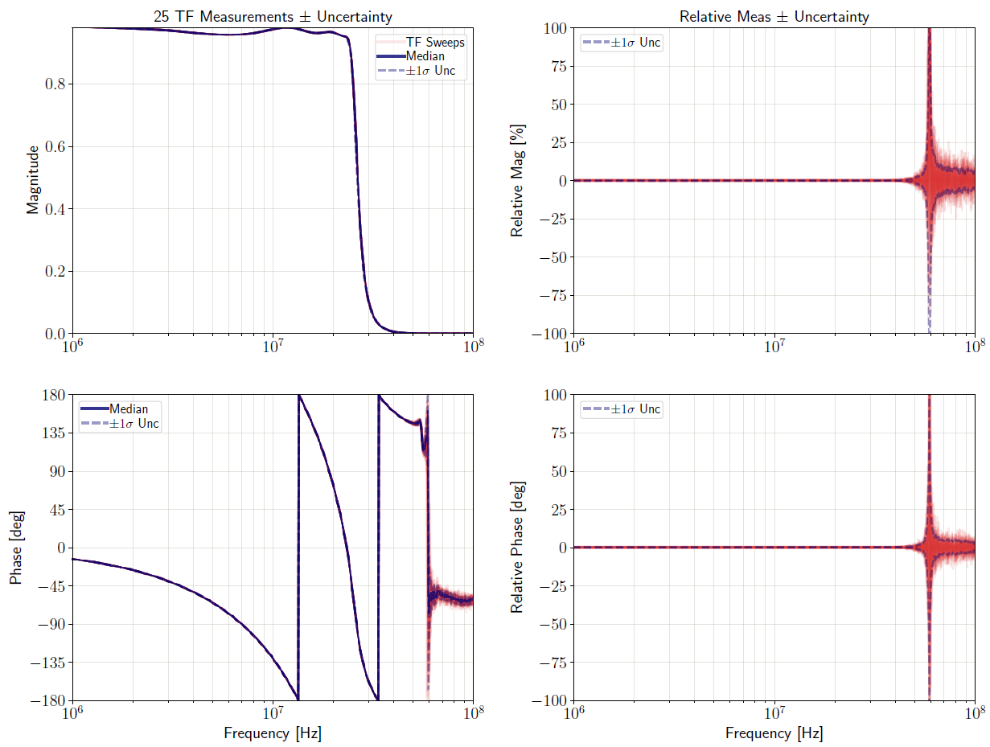
Modeling TFs
Tradeoff: accuracy v. time
Feature-rich data
- Problem: under-sampling
Noisy data
- Problem: trust
Uncertainties!
IRIS software – Craig Cahillane (https://git.ligo.org/40m/labutils/tree/master/iris)
Visualization tool
Plots individual sweeps and spread in values
Izabella Pastrana, Washington University in St. Louis | Real-Time Universal Transfer Function Synthesizer | T18-00184 – LIGO SURF Program 2018
Notes:
Feature-rich data – lots of SNR, very smooth; increase number of points to resolve features
Noisy data (can’t drive signal as hard as you’d like to avoid noise floor) – average longer to get data that you trust more
Depending on features of TF, save time doing only a rough scan where there are not many features, increase #points where function appears to be rapidly changing, longer averaging where noisy
Next slide: working out good adaptive algorithm, Red Pitaya (cheap, basic functionality required for TF measurements w/o data transfer bottleneck , transparent (FPGA code))

Slide 7
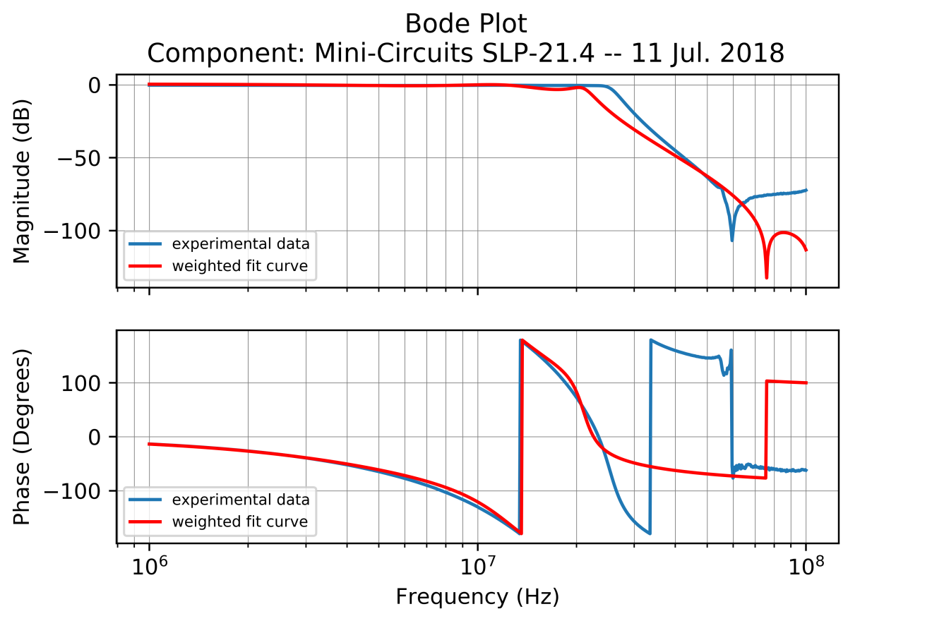
Modeling TFs
TF fitting to pole-zero model – now with weights!
Modified IRIS to write out median complex TF and uncertainty measurements for use in fitting process
Izabella Pastrana, Washington University in St. Louis | Real-Time Universal Transfer Function Synthesizer | T18-00184 – LIGO SURF Program 2018
Notes:
In a weighted fit, we give less weight to the less precise measurements and more weight to more precise measurements when estimating the unknown parameters in the model. The model I first tried using was the 4th order elliptic filter … then tried with a 5th order elliptic filter

Slide 8
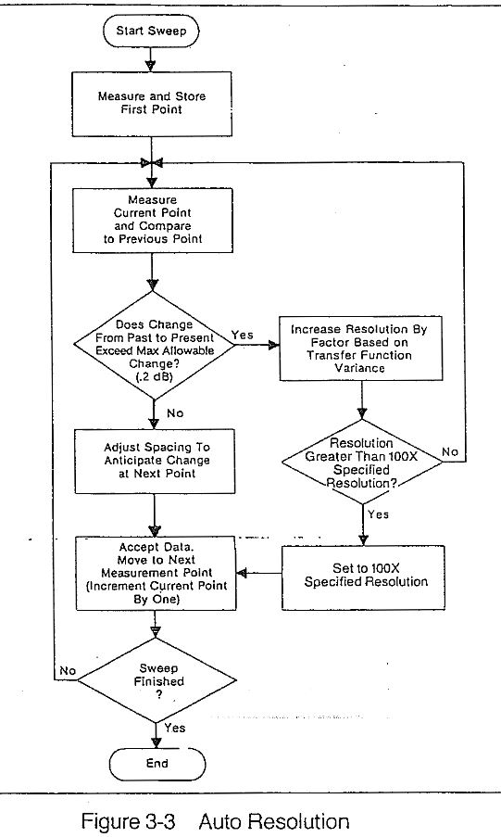
Adaptive Sweeping
Some network analyzers have auto-resolution features
Hard programmed into device
Could emulate in software, but data transfer rate too slow
Developing own auto-resolution algorithm
Euclidean distance – measuring in higher resolution
Izabella Pastrana, Washington University in St. Louis | Real-Time Universal Transfer Function Synthesizer | T18-00184 – LIGO SURF Program 2018
Notes:
Conventional VNAs have a fixed program, can’t really configure – can’t emulate in software bc data transfer rate too slow
Auto-resolve algorithm in complex plane

Slide 9
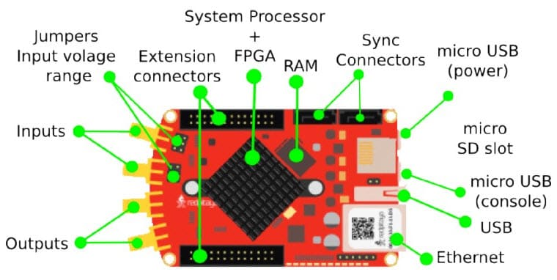
The Red Pitaya
A customizable data acquisition and signal generation platform
½ FPGA + ½ CPU
Advantages
Cheaper
Faster data transfer (TCP/IP rather than GPIB)
Highly flexible use
Red Potato
Disadvantages
Cheaper for a reason
Izabella Pastrana, Washington University in St. Louis | Real-Time Universal Transfer Function Synthesizer | T18-00184 – LIGO SURF Program 2018
Notes:
Flexible – cpu could allow for partial implementation of algorithm
Other things:
Global emulated real-time system that employs analog-to-digital and digital-to-analog converters clocked slowly up to 64kHz
These frequencies are suitable for processes which do not require high control bandwidths, such as feedback to temperature or suspensions.
Faster components—like the servos for laser amplitude and frequency stabilization—would benefit from being monitored at higher frequencies, necessitating higher clocking frequencies and high frequency transfer function measurements.

Slide 10
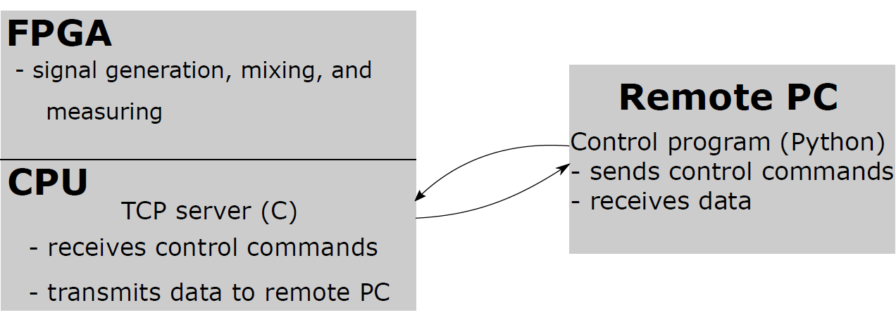
The Red Pitaya as TF Measuring Device
Modified to run and take sweep parameters by command line (for easier automation)
Automatically take multiple sweeps
Pass data to IRIS
Re-sweep at new frequencies
Izabella Pastrana, Washington University in St. Louis | Real-Time Universal Transfer Function Synthesizer | T18-00184 – LIGO SURF Program 2018
Notes:
TCP server (C)
receives control commands,
transmits data to control program on PC
runs on Red Pitaya OS (Alpine Linux)
Client (Python)
source code of control program
sends instructions & receives measurement data over TCP/IP

Slide 11
The Red Pitaya as TF Measuring Device
Mixers
Communication
Low-pass filtering
ADCs
Signal generation
Pavel Demin (https://github.com/pavel-demin/red-pitaya-notes)
Izabella Pastrana, Washington University in St. Louis | Real-Time Universal Transfer Function Synthesizer | T18-00184 – LIGO SURF Program 2018
Notes:
RP ships with a Bode plotter but Demin’s was better, easier to configure

Slide 12
Unfortunately…
Much too late in game – realized something was amiss with the Red Pitaya TF measurements
Wrapping in phase in weird way
Got only to point where data can be grabbed from Red Pitaya and incorporated into algorithm
Insufficient calibration of data
Must run calculations ourselves separately from the Red Pitaya
Izabella Pastrana, Washington University in St. Louis | Real-Time Universal Transfer Function Synthesizer | T18-00184 – LIGO SURF Program 2018
Notes:
calibration w rp not straightforward, …

Slide 13
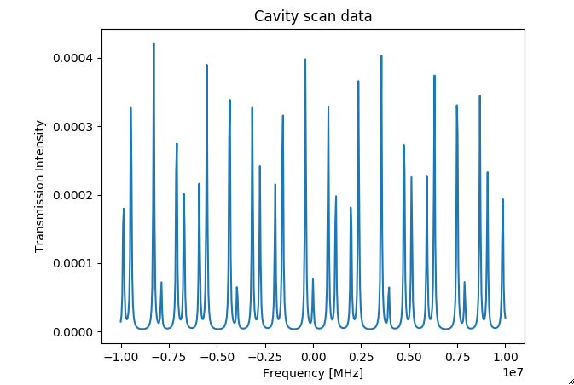
Conclusions, Next Steps, and What Could have Been…
Engineering useful, functional technology is hard!! Love and appreciate your instrumentation people!!!
Comment your code!
Red Pitaya as it currently exists cannot quite yet do adaptive sweeping as desired
Adapt FPGA code to better fit needs of auto-res
Improve TF fitting model for use with Red Pitaya
If things had worked, it could have:
Increased repetition rate of TF measurements
Made cavity arm scans at the 40m Prototype Lab a little easier
© Keerthana S. Nair
Izabella Pastrana, Washington University in St. Louis | Real-Time Universal Transfer Function Synthesizer | T18-00184 – LIGO SURF Program 2018
Notes:
Merge w 14
Must adapt/overhaul existing FPGA code to better fit needs of auto-resolution algorithm
Create a better transfer function fitting model so Red Pitaya can take measurement and immediately estimate a transfer function for the system, giving back TF zeros, poles, gain
As it can be directly programmed to operate as desired, using the Red Pitaya as the VNA in the AUX laser scans, in lieu of using the Agilent, whose sweep configurations are limited by the manufacturer's design, would allow researchers further control over their measurements, in addition to the benet of the Red Pitaya's faster data transfer rate. To make the Red Pitaya-based VNA better-suited for use in such measurements at the 40m Lab, it would be useful to have the option to fully configure the sweeps governing the frequency offset between the AUX carrier and the PSL carrier. The Red Pitaya VNA should be able to generate a drive signal at the specied start frequency of the sweep and hold there until a trigger that signals it to actually begin sweeping through frequencies. This hold at the start frequency will allow time for initial locking of the AUX and PSL lasers.

Slide 14
Thank you
The sincerest, most heart-felt, most enthusiastic thanks to
Johannes Eichholz, Rana Adhikari, Christopher Wipf
Caltech LIGO SURF
Viewers like you ☺
Izabella Pastrana, Washington University in St. Louis | Real-Time Universal Transfer Function Synthesizer | T18-00184 – LIGO SURF Program 2018

Slide 15
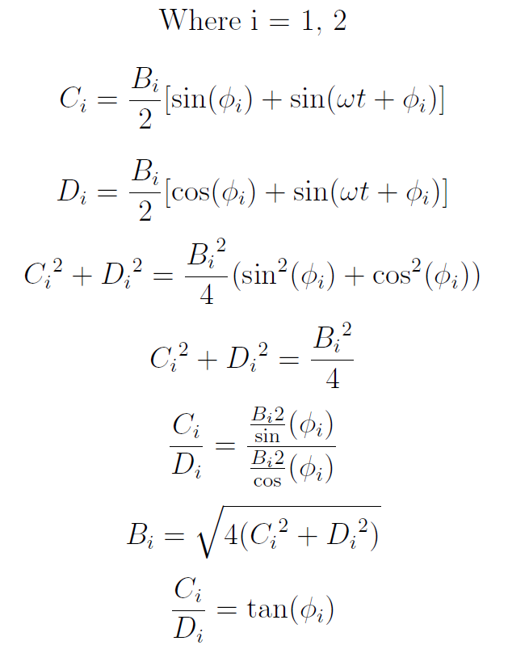
TF Measurement Math, Hooray!
Izabella Pastrana, Washington University in St. Louis | Real-Time Universal Transfer Function Synthesizer | T18-00184 – LIGO SURF Program 2018

Slide 16
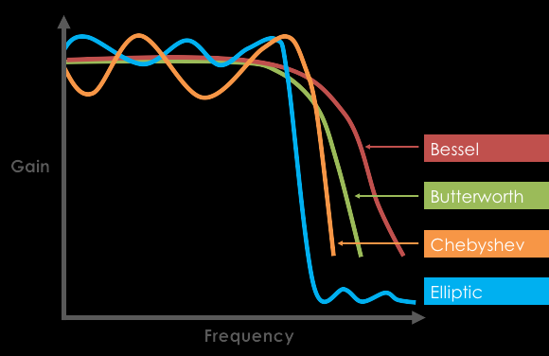
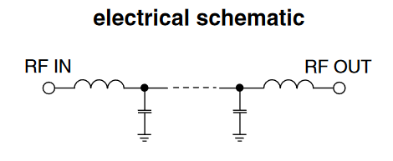
Elliptic Low-Pass Filter
Elliptic filters
Ripple behavior in both passband and stopband
Fastest transition in gain between pass- and stopband among filters of same order
Why 4th order
Rana
© Biley Technologies
© Mini-Circuits
Izabella Pastrana, Washington University in St. Louis | Real-Time Universal Transfer Function Synthesizer | T18-00184 – LIGO SURF Program 2018

