Slide 1
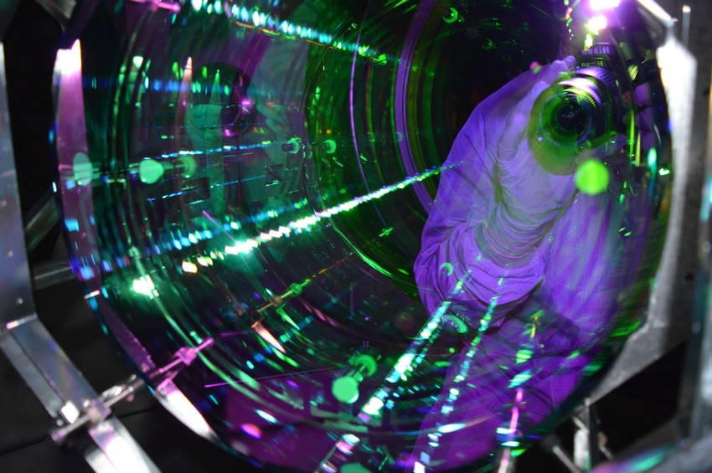
Overview of coating thermal noise
Gabriele Vajente
LIGO Laboratory Caltech
GWADW 18
15th May 2018, Girdwood, Alaska
LIGO-G1800920-v4
Image credits: LIGO/Joe Hanson

Slide 2
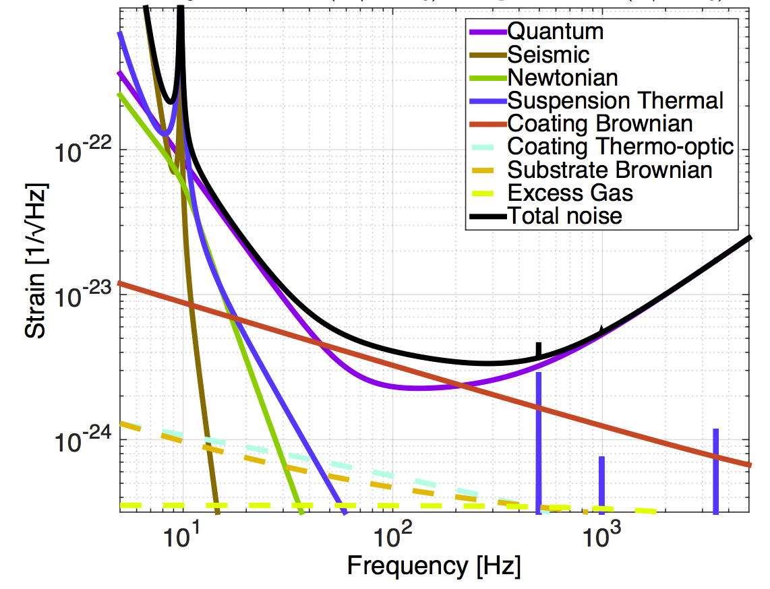
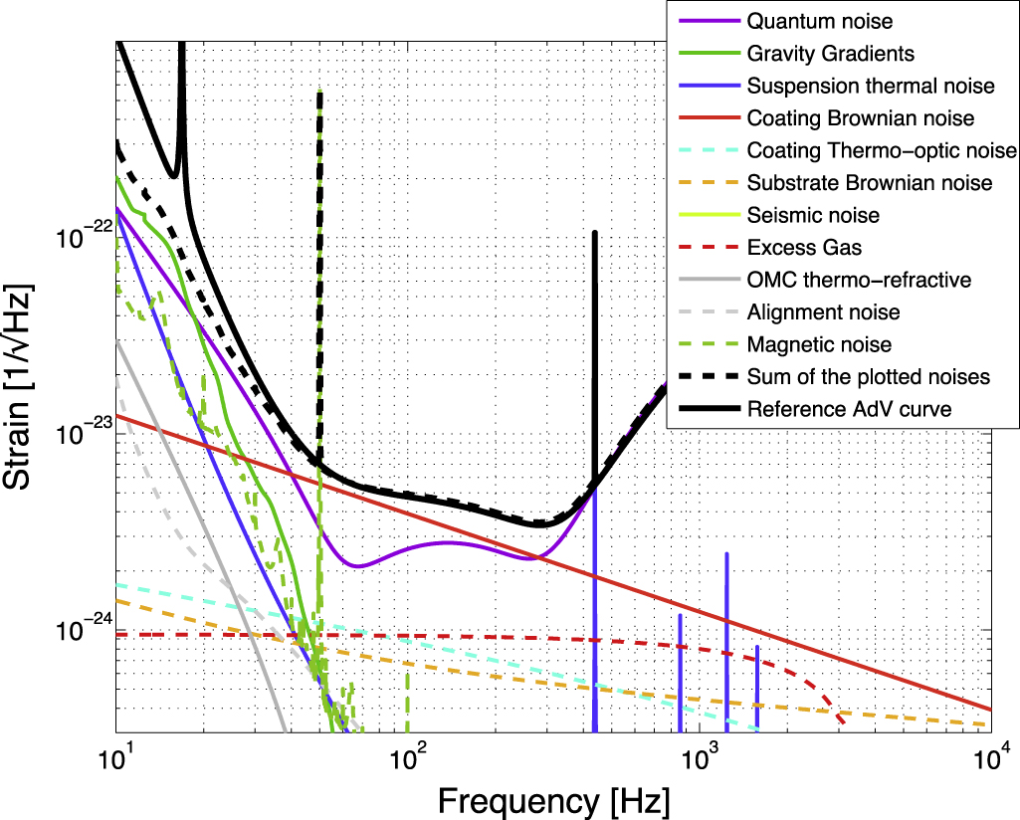
Advanced Detector Sensitivities
New aLIGO design curve from LIGO-T1800044-v5
Thermal noise measurement
Gras et al. arxiv:1802.05372
AdVirgo design curve
From Acernese et al. CQG 32, 024001 (2015)

Slide 3
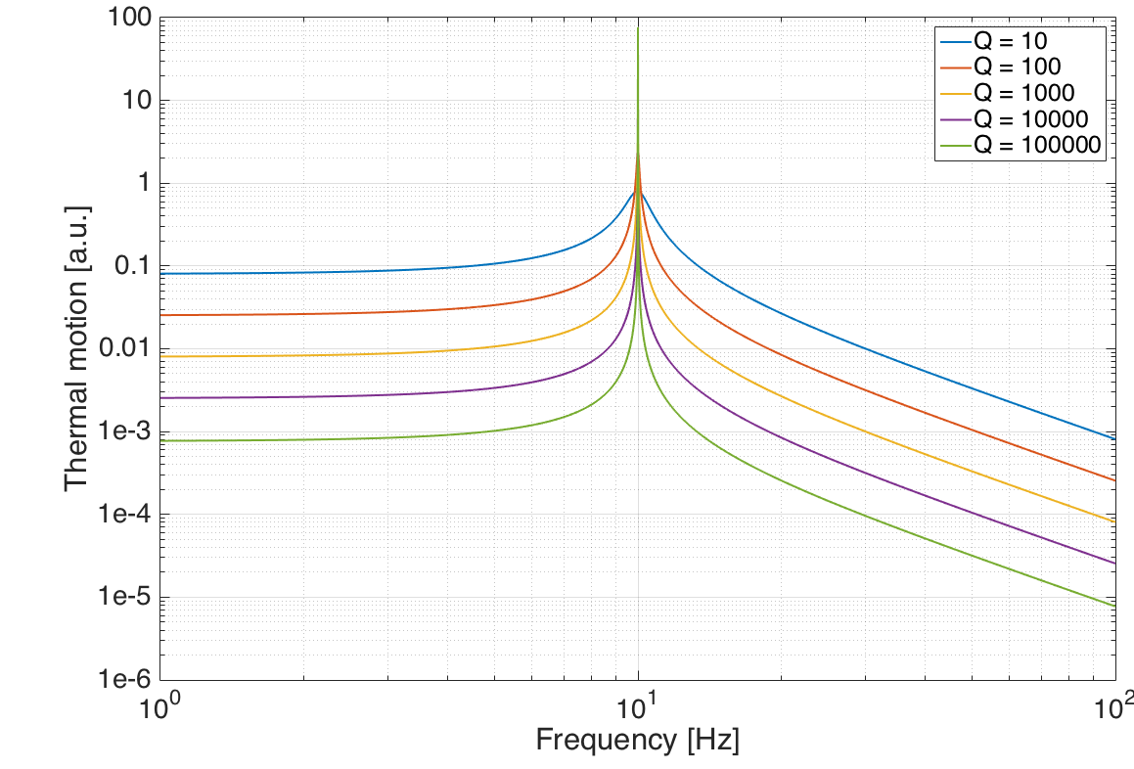




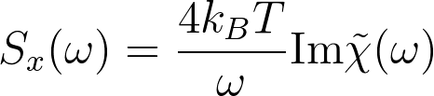
Coating Thermal Noise: a primer
Thermal (Brownian) noise:
  system in thermal equilibrium, couples energy to thermal bath through mechanical dissipations
  The reverse is true: energy coupled to the system (k_{B}T per each mode), random over all frequencies
  The higher the dissipations, the more energy is spread out of resonance
Other sources of thermal noise: thermo-elastic, thermo-refractive
Imaginary part of the system transfer function (linked to dissipations)
Power spectral density of fluctuations in the (mechanical) variable x
Fluctuation dissipation theorem
H. B. Callen, T. A. Welton (1951). "Irreversibility and Generalized Noise". Physical Review. 83: 34

Slide 4
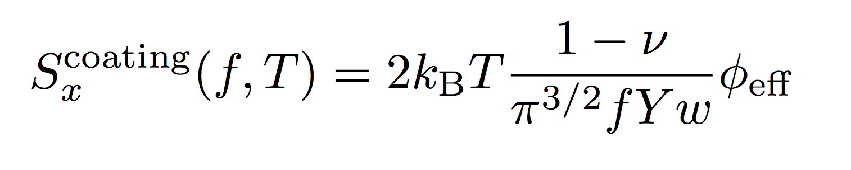
How we make high reflection coatings
Interference of
Fresnel reflections
Alternate layers of high and low refractive index materials
Silica
Tantala*
Material | Refractive index | Loss angle (100 Hz)
Silica SiO₂ | 1.45 | 0.5 x 10⁻⁴
Tantala Ta₂O₅ | 2.03 | 3.4 x 10⁻⁴
Titania-doped tantala Ta₂O₅-TiO₂ | 2.07 | (original design*) 2.4 x 10⁻⁴ (MIT direct CTN*) 3.6 x 10⁻⁴
Silica
Tantala*
Silica
* Titania doped
Tantala*
Substrate
The effective loss angle is a combination of those of the two materials: dominated by the high index material
*Class. Quantum Grav. 24 (2007) 405–415
**Phys. Rev. D 95, 022001

Slide 5
The future
M. Evans G1800462
Exploring the sensitivity of next generation gravitational wave detectors
CQG 34, 044001 (2017)

Slide 6
Future coatings: different requirements
 | aLIGO | aLIGO+ | AdVirgo+ | Voyager | C.E. | E.T.
Temperature | 300 K | 300 K | 300 K | 123 K | 123 K | 10 K
Wavelength | 1064 nm | 1064 nm | 1064 nm | 1.5 - 2 μm | 1.5 - 2 μm | HF 1064 nm LF 1.5-2 μm
Substrate | Silica | Silica | Silica | Silicon | Silicon | HF Silica LF Sapphire
Beam radius (approx.) [cm] | 6 | 6 | 9 | 6.5 | 14 | HF 9 LF 7 (LG)
Coating thermal noise at 100 Hz [m/√Hz] | 1.3x10⁻²⁰ | 6.5x10⁻²¹ (5.0x10⁻²¹) | 9x10⁻²¹ (5x10⁻²¹) | 2.3x10⁻²¹ | Optimistic 1.3x10⁻²¹ Pessimistic 5x10⁻²¹ | HF 3x10⁻²¹ LF 1.1x10⁻²¹
Coating loss [rad] | 3.6x10⁻⁴ (2.4x10⁻⁴) | 0.9x10⁻⁴ (0.6x10⁻⁴) | 2.4x10⁻⁴ (0.8x10⁻⁴) | 6.5x10⁻⁵ | Optimistic 5x10⁻⁵ Pessimistic 1.2x10⁻⁴ | HF 1.2x10⁻⁴ LF 1.3x10⁻⁴
Coating materials | SiO₂ TiO₂-Ta₂O₅ | SiO₂ ?-Ta₂O₅ | SiO₂ ?-Ta₂O₅ | SiO₂/Al₂O₃ a-Si | SiO₂/Al₂O₃ a-Si | SiO2/Al₂O₃/SiN ?-Ta₂O₅ a-Si ?
CE: Class. Quantum Grav. 34 (2017) 044001
ET: Class. Quantum Grav. 28 (2011) 094013 / Conceptual Design Doc.
aLIGO+: Phys. Rev. D 91 (2015) 062005 / LIGO-G1800514
Voyager: LIGO-T1400226-v9 / LIGO-G1801004
AdVirgo+ LIGO-G1800999

Slide 7
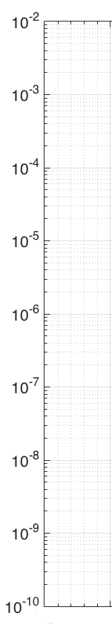
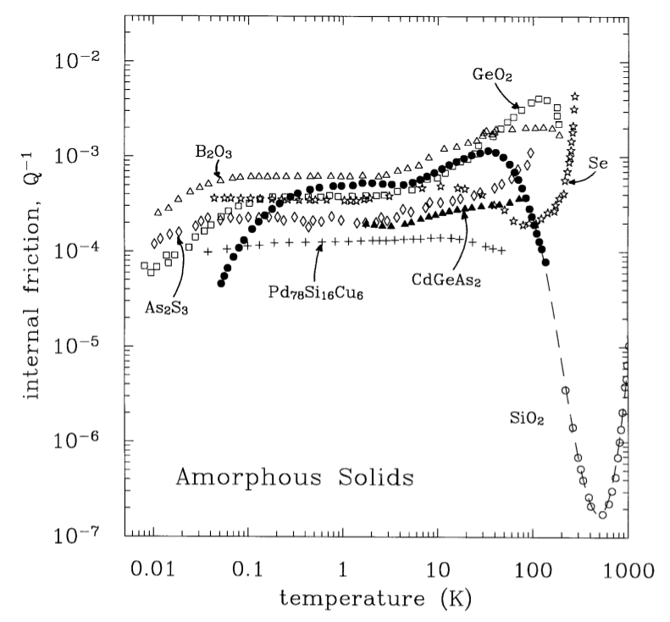
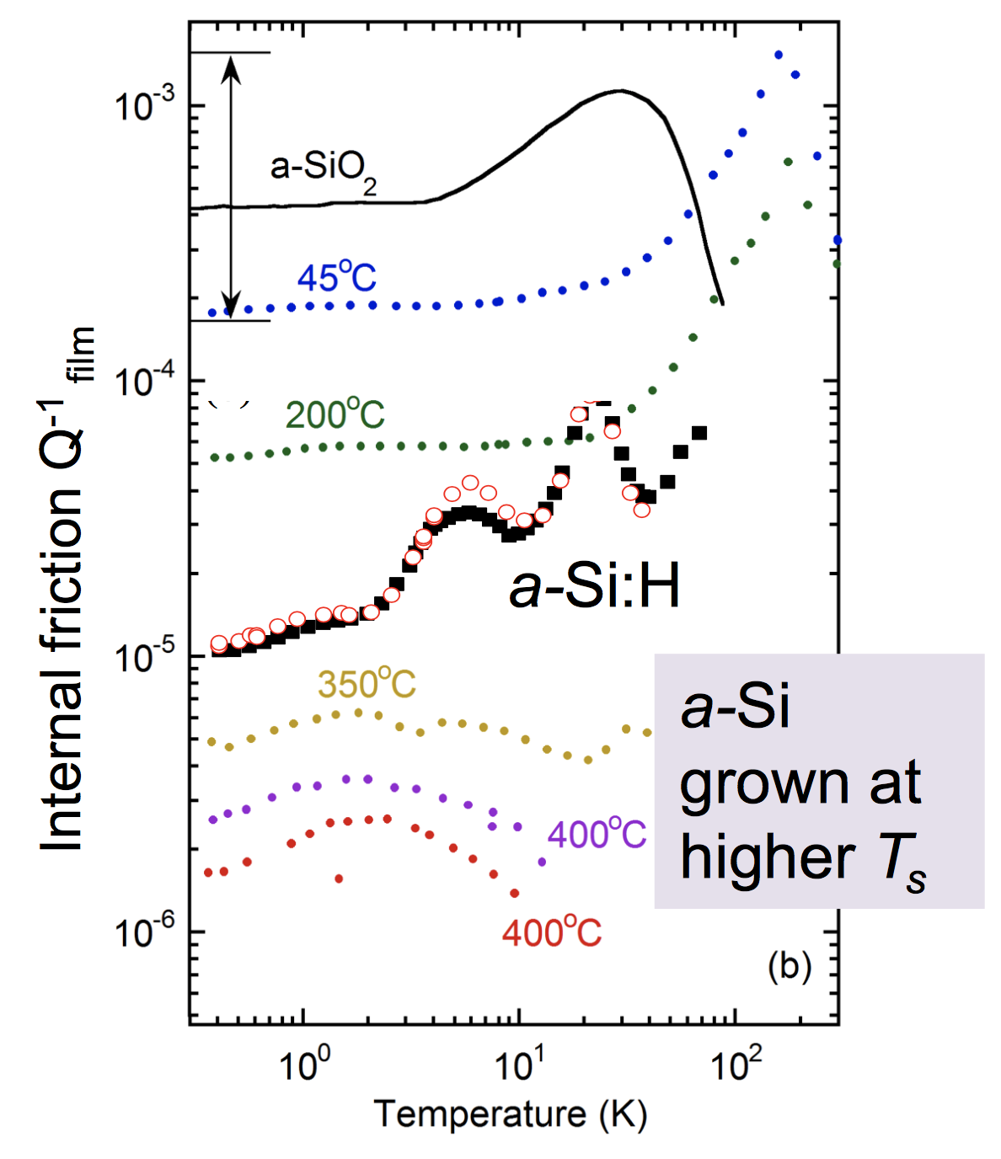
Why do we think we can improve?
More in Frances Hellman’s talk
Zeitschrift für Physik B Condensed Matter. 101. 235-245
Phys. Rev. Lett. 113, 025503 (2014)
Ta2O5/TiO2
SiO₂ IBS
What happens here?
Material loss angle
SiO₂ disks
Most amorphous solids have loss angles in a limited range
(At least) two exception (in glasses):
  bulk silica at room temperature (low mechanical loss measured at room temperature)
  amorphous silicon grown at high temperature (low mechanical loss measured at low temperature)
SiO₂ bulk

Slide 8
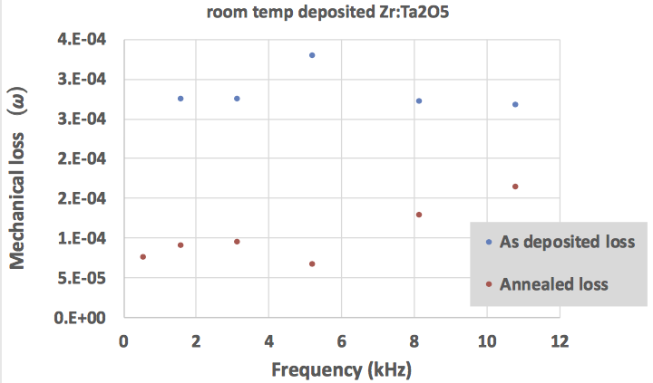
Room temperature coatings (A+)
High temperature deposition of tantala did not
show enough improvement
Two promising candidates: doping of tantala
Loss target
0.9x10⁻⁴
(0.6x10⁻⁴)
Class. Quantum Grav. 35 (2018) 075001
15% Zirconia-doped-Tantala
Univ. of Strathclyde
LIGO-G1800585
Refr. Index
n = 2.12
Annealed 750C
Very slow deposition
high energy ions

Slide 9
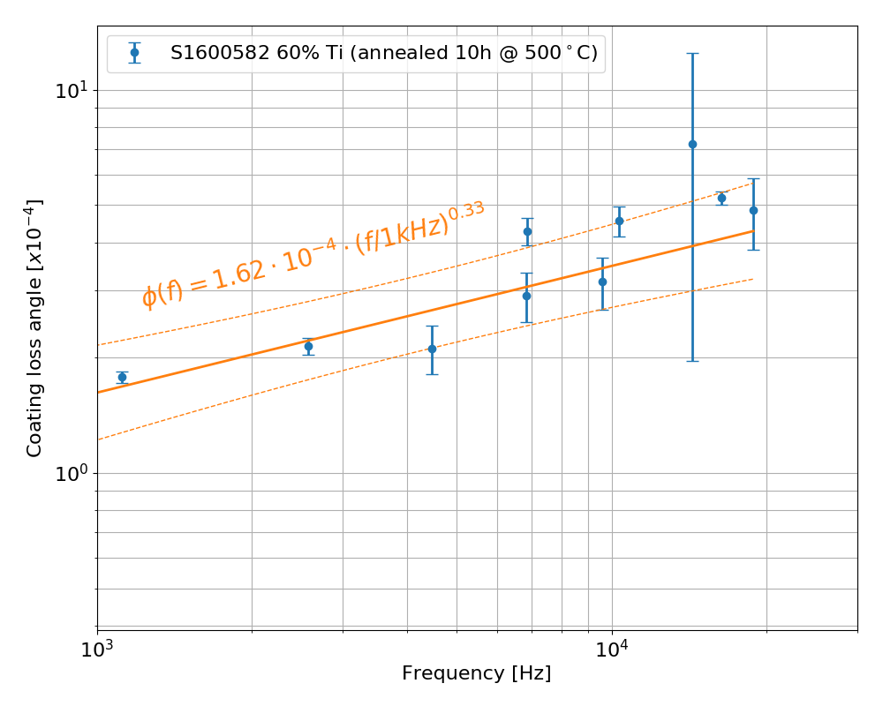
Room temperature coatings (A+)
Loss target
0.9x10⁻⁴
(0.6x10⁻⁴)
Two promising candidates: doping of tantala
60% Titania-doped-Tantala
Univ. Colorado
Fort Collins
and Caltech
LIGO-G1800360
Refr. Index
n = 2.36
Steep frequency dependence
High optical absorption (contamination)

Slide 10
What’s next?
Zr-doped-Ta:
  check dependency on concentration / deposition rate / method
  structural and modeling studies
  produce a multi-stack and do a direct measurement of thermal noise
Ti-doped-Ta:
  fix contamination and high optical absorption
  repeat measurements probing low frequencies, to confirm the slope
More in Kiran Prasai’s talk

Slide 11
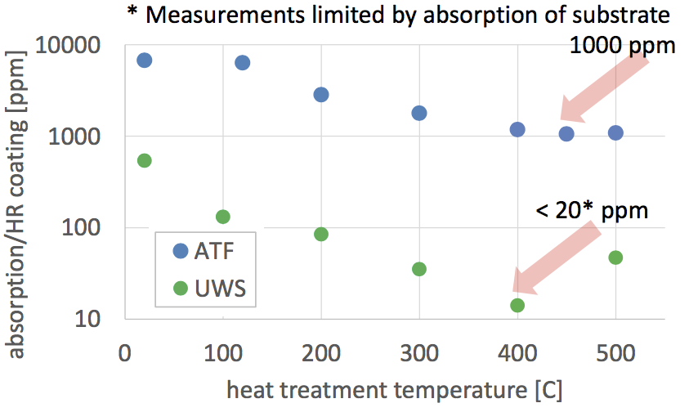
123 K coatings (Voyager – C.E.)
Amorphous silicon deposited at high temperature is the best candidate
  High refractive index ~3.4
Low mechanical loss at low temperature. But at 123K?
  Measurements of loss at room temperature shows 𝜙 < 1x10⁻⁴ depending on deposition method
Optical absorptions still high, but improving
Loss target
5.5x10⁻⁵
High-T deposited a-Si, loss
at low temperature (Berkeley)
annealed 350C
deposition temperatures, T_{s}

Slide 12
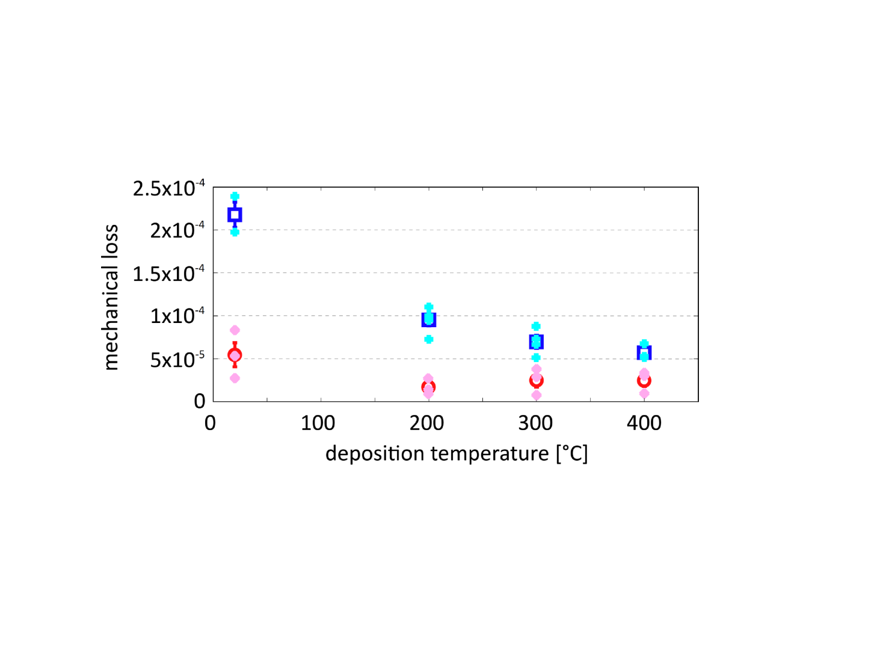
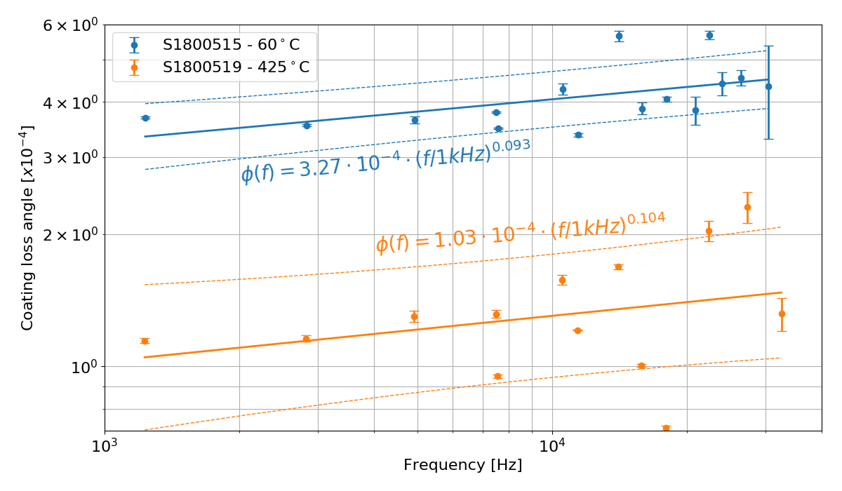
123 K coatings (Voyager – C.E.)
Amorphous silicon deposited at high temperature is the best candidate
  High refractive index
Low mechanical loss at low temperature. But at 123K?
  Measurements of loss at room temperature shows 𝜙 < 1x10⁻⁴ depending on deposition method
Optical absorptions still high, but improving
High-T IBS deposited a-Si,
Loss at room temperature (Strathclyde)
High-T e-beam deposited a-Si (Berkeley)
Loss at room temperature (Caltech)
Blue: no post-deposition heat treatment
Red/pink: heat treated for 1hr at 400°C
Minimum loss: < 2 x 10⁻⁵
for deposition at 200°C + heat treatment at 400°C

Slide 13
What’s next?
Measure mechanical loss angle of a-Si at 123 K
Improve optical absorptions
Structural measurements and modeling
Why the different behavior of mechanical loss with growth temperature?
Understand differences due to deposition method
More in Kiran Prasai’s talk
More in Frances Hellman’s talk

Slide 14
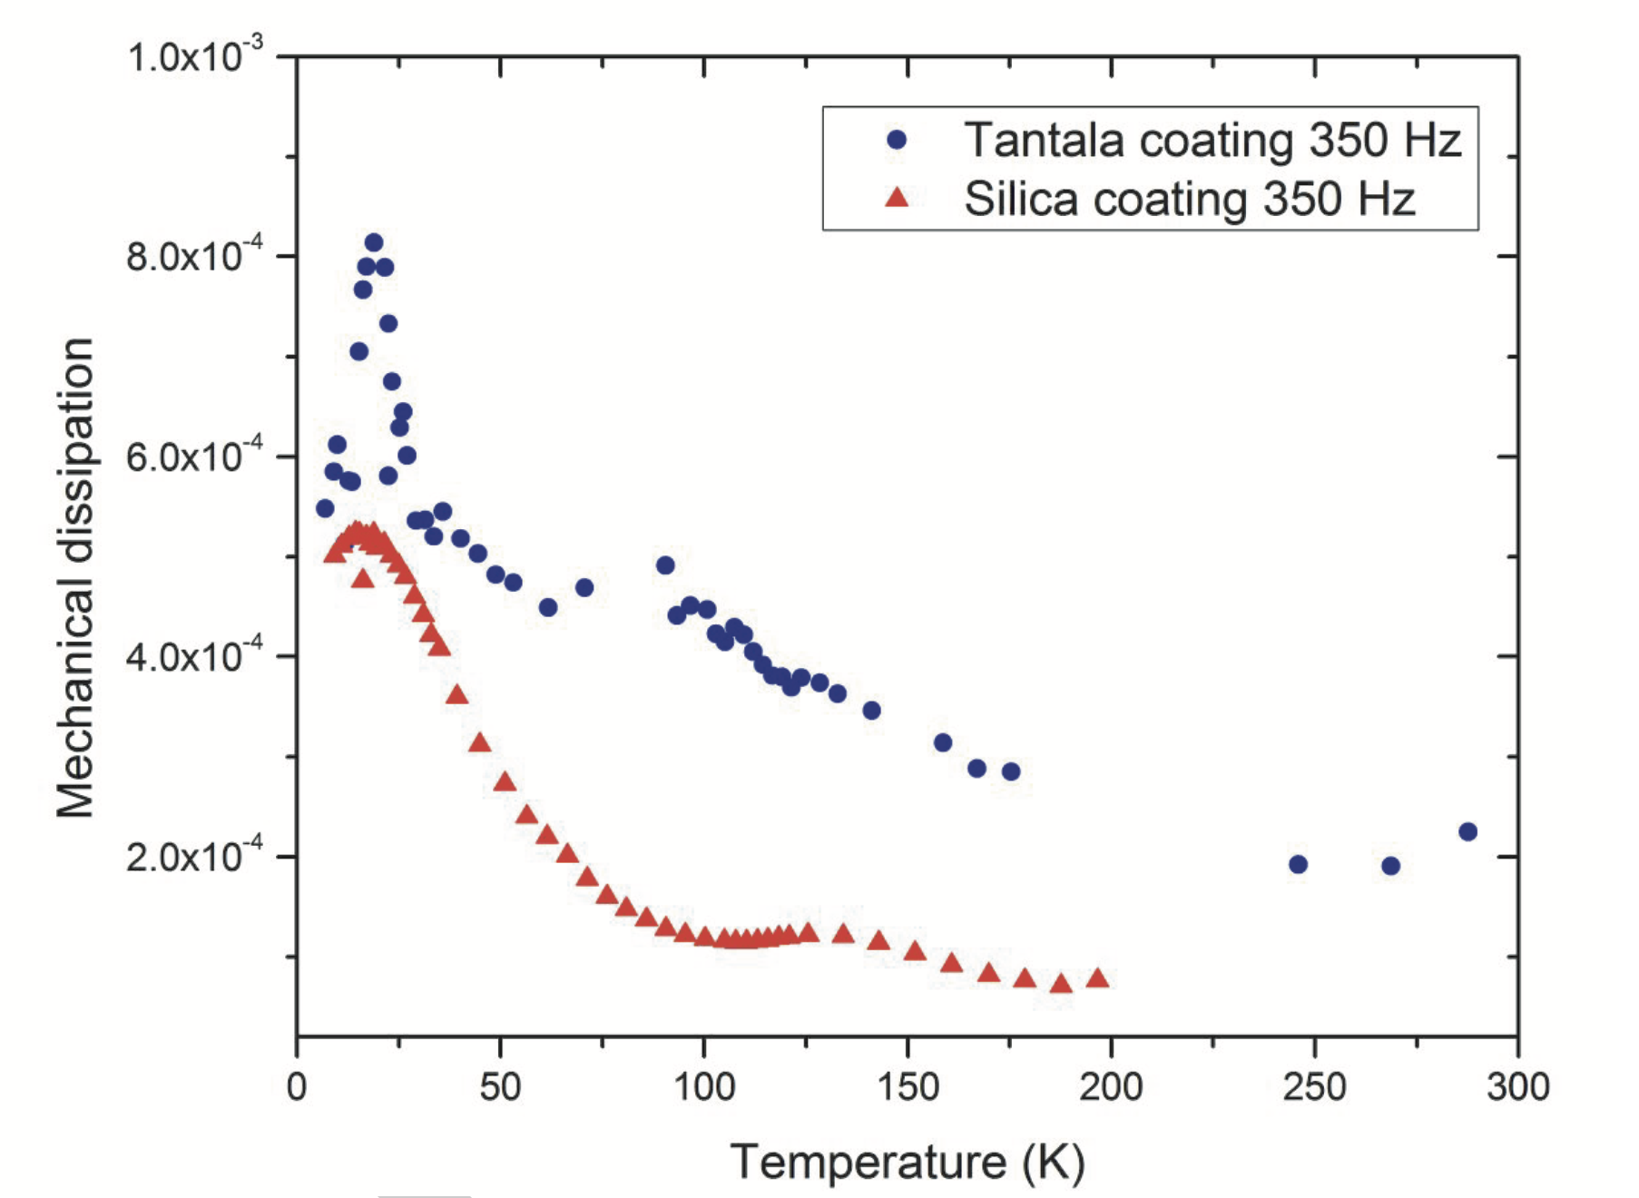
Low temperature coatings (E.T.)
Amorphous silicon is a promising high index material
What about the low index material?
Silica ≈ 5x10⁻⁴ at 10 K
Dependent on heat
treatment
  In many cases annealing
  improves high
  temperature loss,
  but worsen low
  temperature loss
Al₂O₃ and SiN good
low index candidates
Loss target
HF 1.2x10⁻⁴
LF 1.3x10⁻⁴
From ET
conceptual
design
Class. Quantum Grav. 31 (2014) 035019

Slide 15
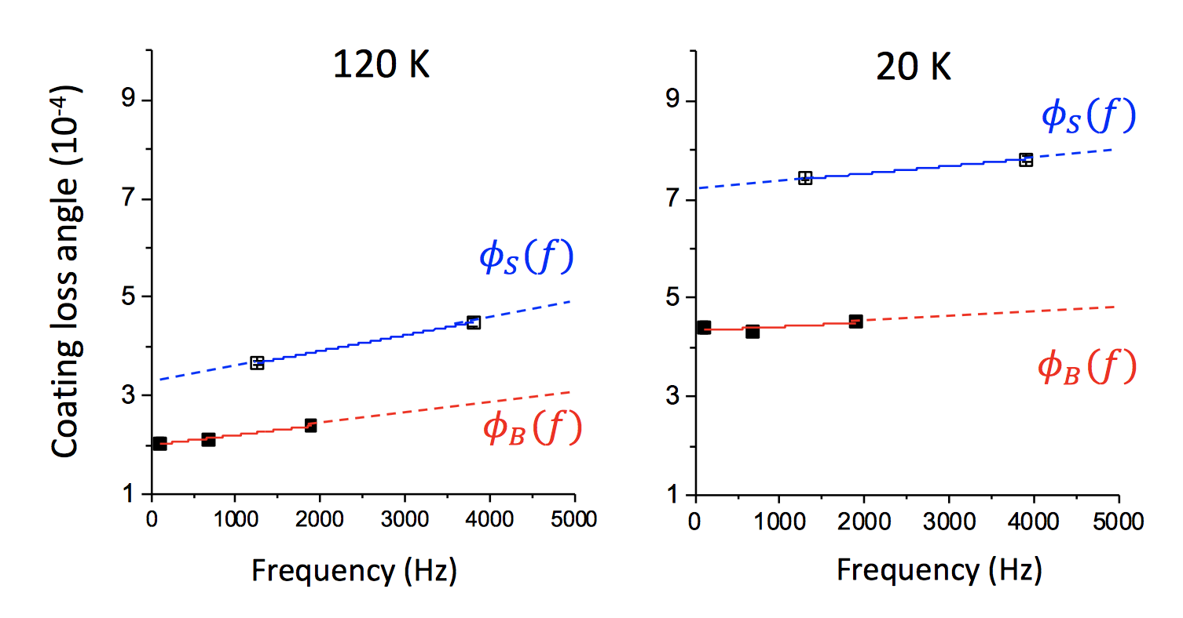
Low temperature coatings (E.T.)
Amorphous silicon is a promising high index material
What about the low index material? Silica ≈ 5x10⁻⁴ at 10 K
Dependent on heat treatment
  In many cases annealing improves high temperature loss, but worsen low
  temperature loss
Al₂O₃ and SiN good low index candidates
Magnetron sputtered
Al₂O₃ (NRL) LIGO-G1800418
SiN CVD deposition
LIGO-G1800350
10⁻⁴

Slide 16
What’s next?
Further characterize Al₂O₃ and SiN mechanical loss
Improve optical absorption
Alumina shows improvement with growth temperature, similar to a-Si, dissimilar to Ta₂O₅

Slide 17
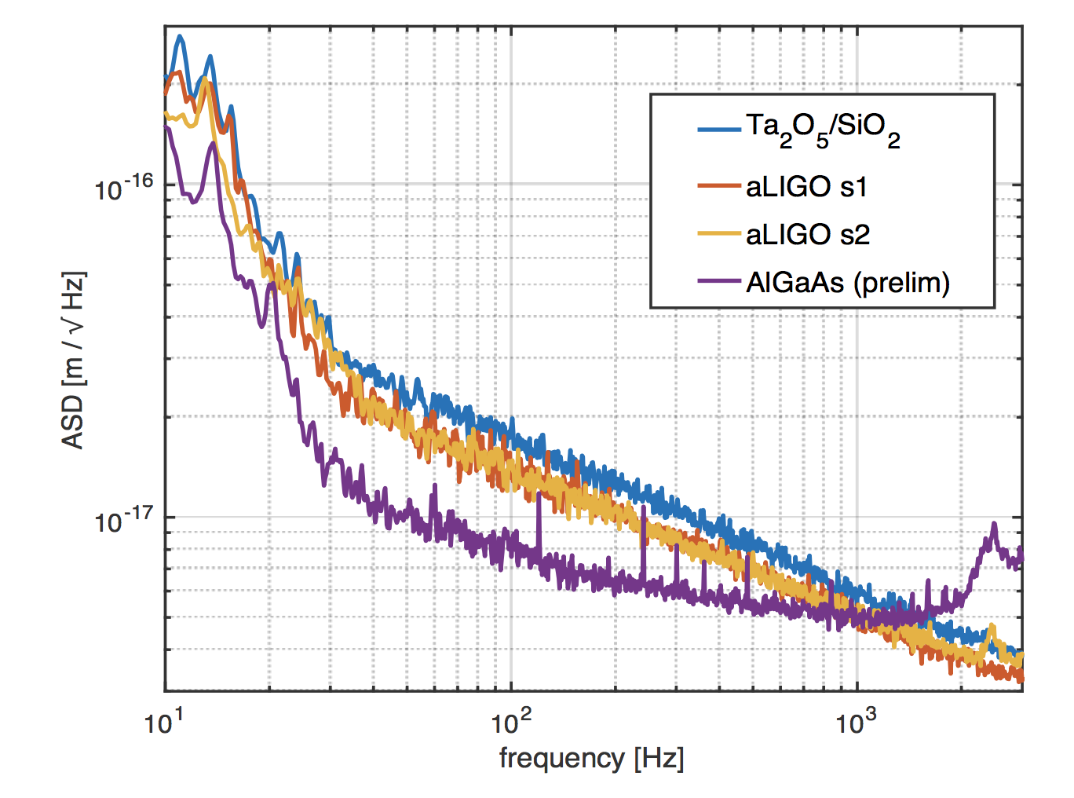
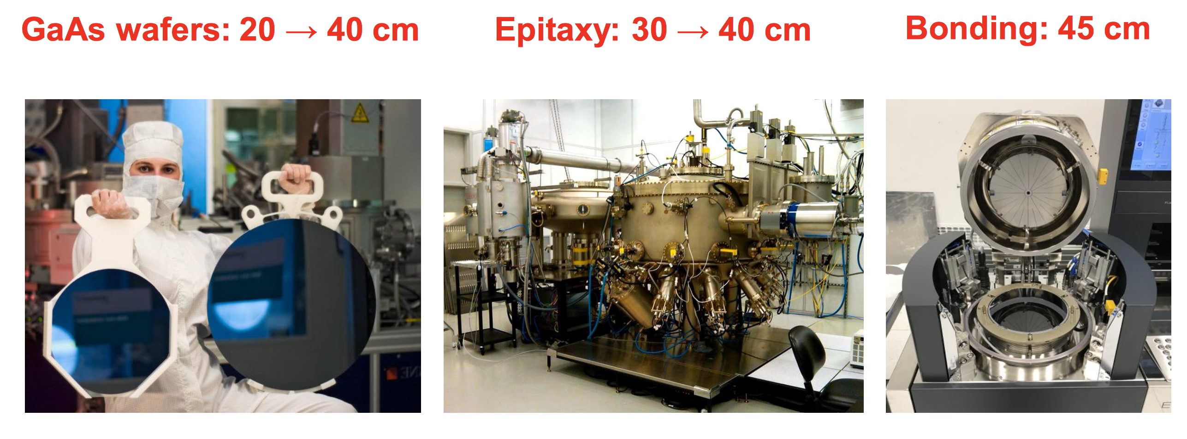
Crystalline coatings
Promising candidate for
3rd generation
Low mechanical loss at
room temperature (2x10⁻⁵)
Good optical absorption
and good figure
Need to develop technology to scale up to large mirror size
AlGaAs room temperature:
φRT < 4×10⁻⁵
AlGaAs cryogenic :
    φcryo < 5×10⁻⁶
More in Garret Cole’s
and Manuel Marchio’s talks
Class. Quantum Grav. 32 035002 (2015)
G. Cole LIGO-G1800645
G. D. Cole, et al., Nature Photonics (2013)

Slide 18
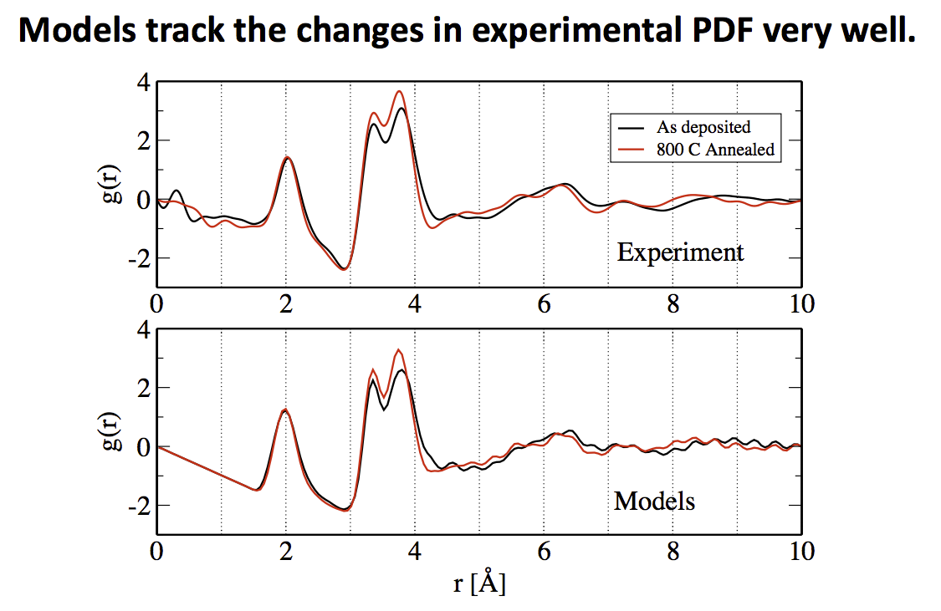
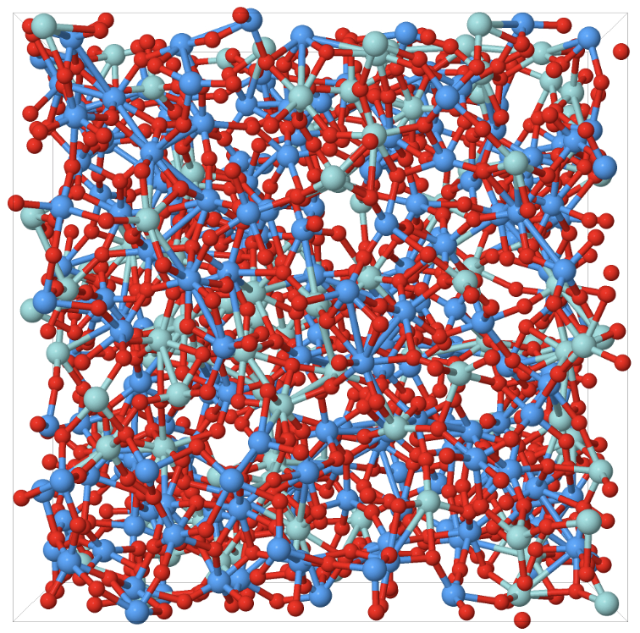
Structure and Modeling
Scientific Reports 6, 32170 (2016)
Important to bridge mechanical loss, structural studies and modeling efforts
Use measured distributions to tune simulations and extract structural information
Reverse Monte Carlo + Energy
minimization
Crucial: simulate
the deposition
process
Measurements of pair distribution functions
K.Prasai LIGO-G1800872

Slide 19
Outlook
Rate of progress significantly
increased in the last few years
Promising candidates for
A+ detector coatings (but we
need a recipe very soon)
Amorphous silicon a promising
candidate at mid and low T,
but some more characterization are needed (and on-going)
Low temperature low index material? Some candidates (Al₂O₃, SiN)
Not one material good for all configurations
Other complementary directions:
Crystalline coatings Class. Quantum Grav. 32 035002 (2015)
Nano-layers LIGO-G1800300

