Slide 1
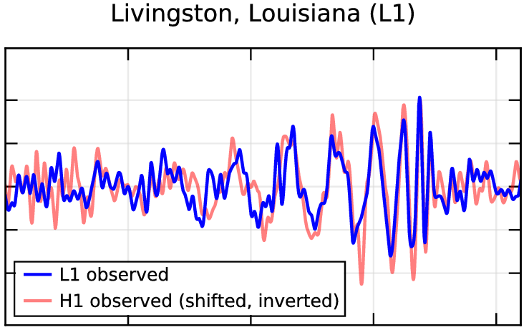

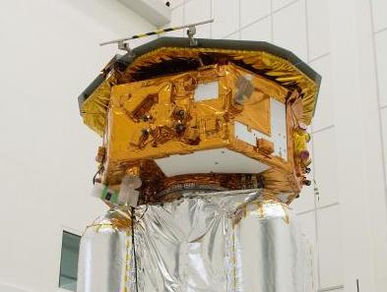




Gravitational Wave Astronomy and Cosmology
RAS Discussion Meeting May 11, 2018
Bernard Schutz
Cardiff University, Wales; Albert Einstein Institute, Germany

Slide 2

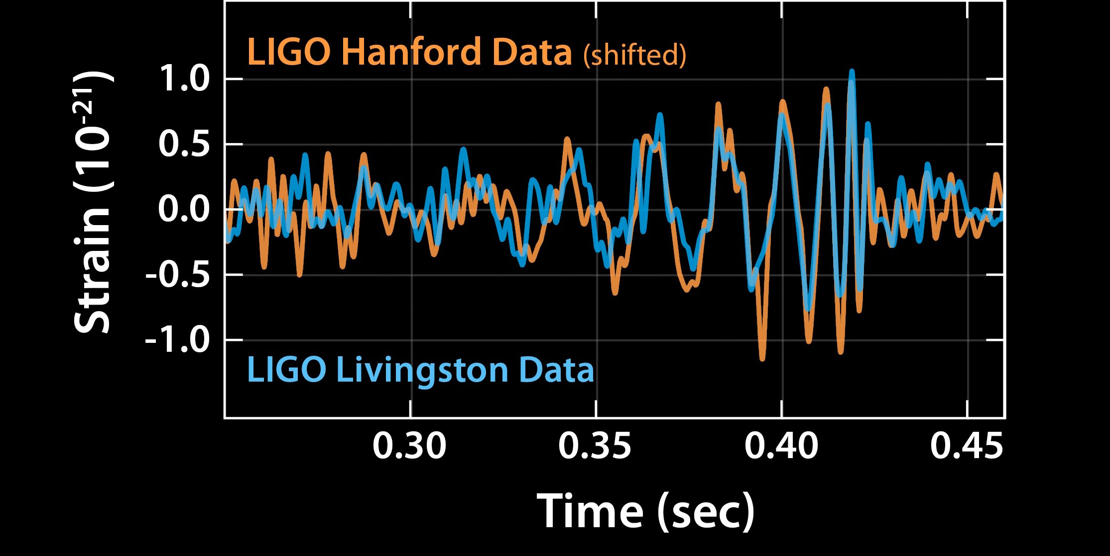
On 14 September 2015, we listened, for the first time, to a sound from the Universe, made by two BHs!
Notes:
This lasted only 200 ms

Slide 3



Just a year after the 2016 announcement, we celebrated the Nobel Prize.
Rainer Weiss
(MIT)
Barry Barish
(Caltech)
Kip Thorne
(Caltech)
Notes:
Coming so quickly after the first detection, the award demonstrated how big the impact was, and how secure the science was.

Slide 4
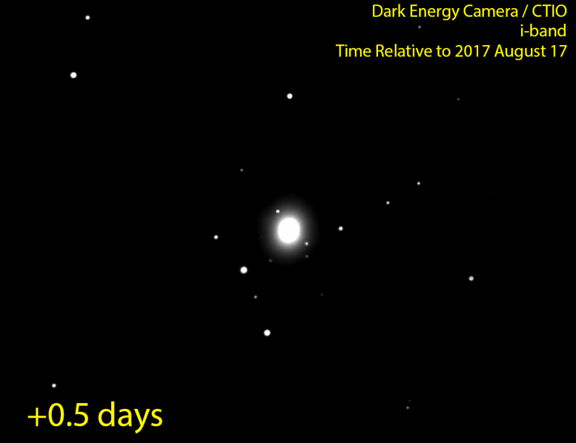
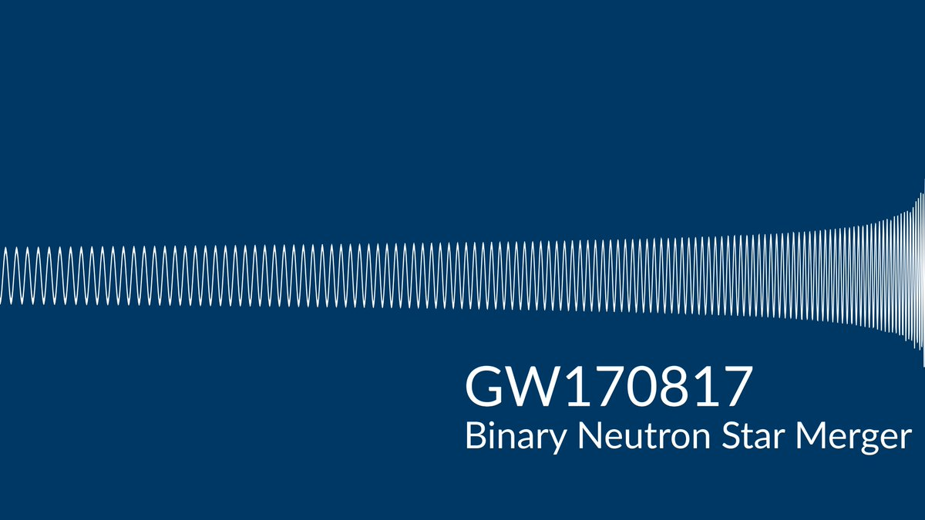
And even before Stockholm, on 17 August 2017, we saw the explosion associated with another sound, made by two NSs!
Notes:
This sound lasted over a minute!

Slide 5
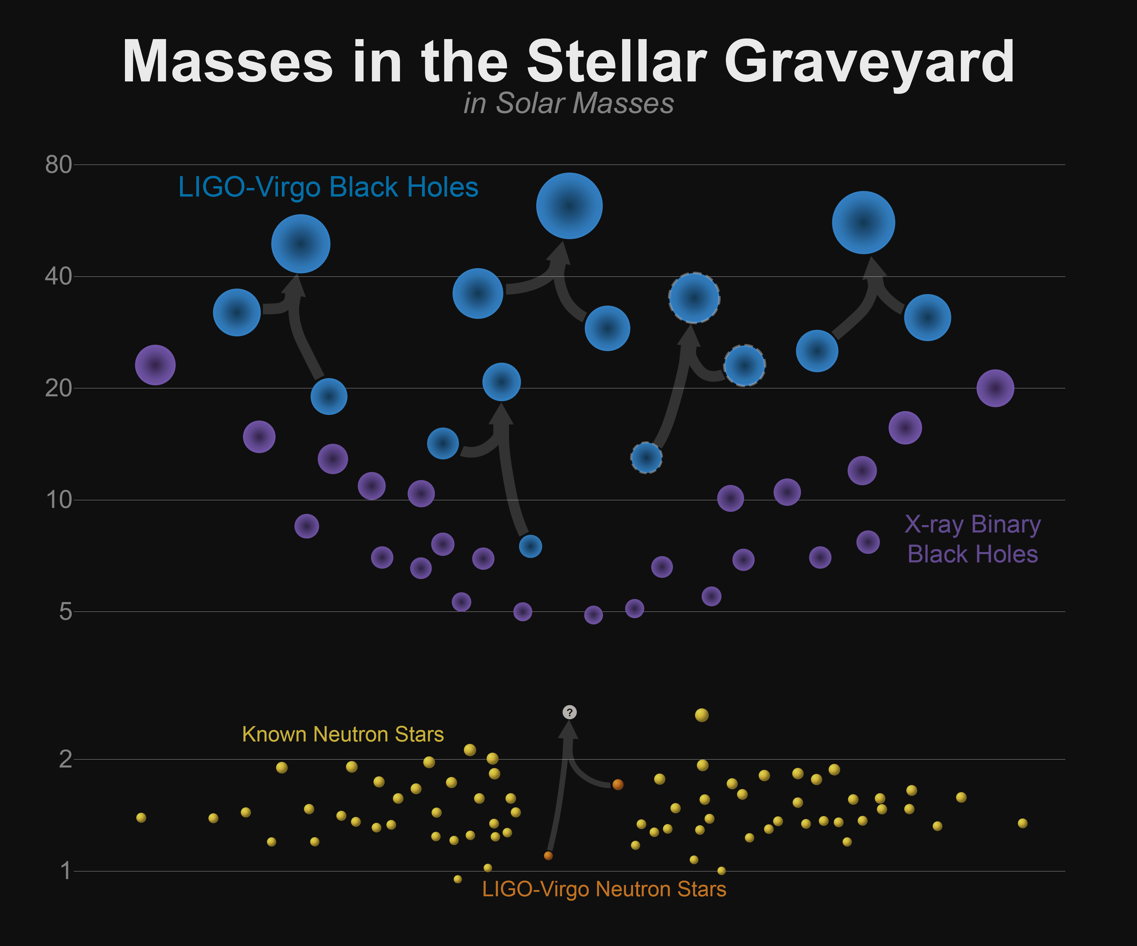
Notes:
With these observations we have added significantly to the statistics. X-ray observations had not prepared us. It turns out they sample mainly our galaxy. LIGO reaches 10^5 times further, so it picks up the rare ones, the monsters.

Slide 6


Slide 7
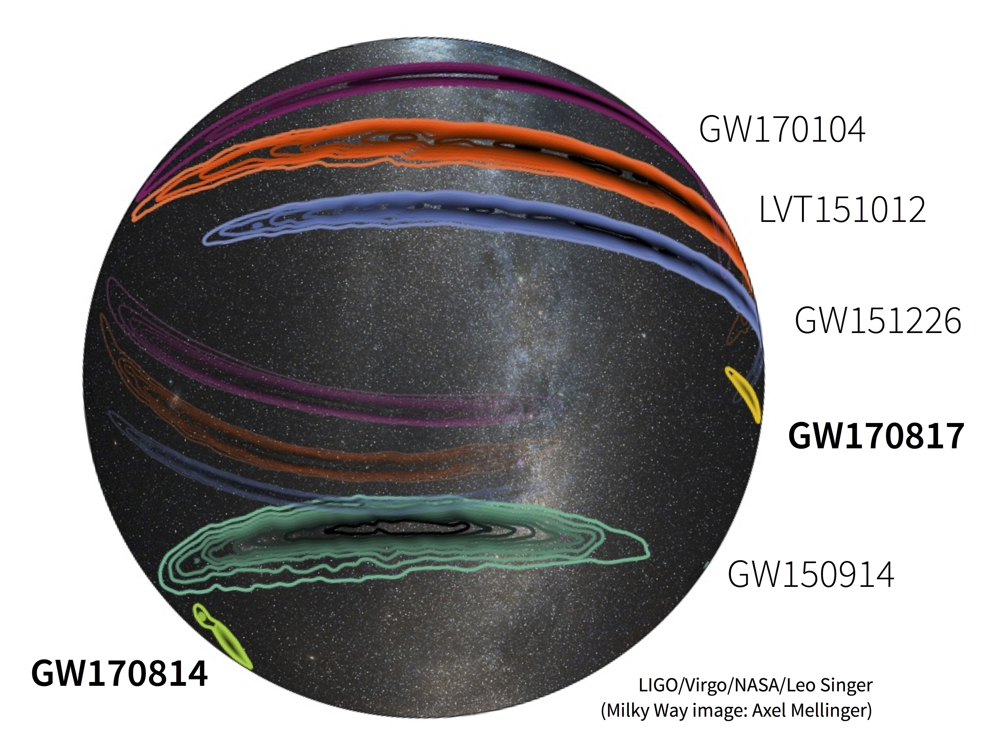

Slide 8
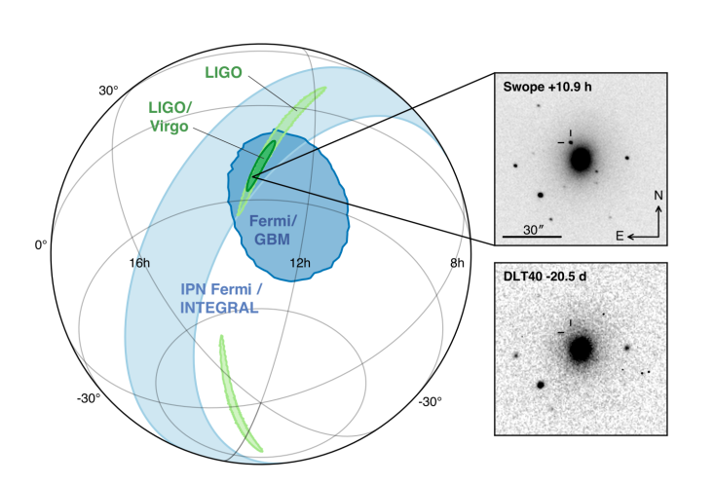

Slide 9
Standard Sirens
Binary system signals carry the information about their distance: they are called standard sirens (Schutz; Holz & Hughes; Nissanke; …).
The formula for the radiation amplitude h depends on 3 intrinsic variables that determine the Newtonian orbit, (m₁, m₂, Ω ), and of course h falls off as 1/r. But at the lowest pN order, it happens that h depends only one mass, the chirp mass
ℳ := (m₁*m₂)^{3/5}/(m₁+m₂)^{1/5}
There is enough information in the phase of the signal to solve for these lowest order variables: f and df /dt determine ℳ. Then h ~ℳ / r. But to determine h accurately, one needs all orientations: location on sky, inclination of binary orbit. For GW170817, we did not get the inclination accurately.

Slide 10
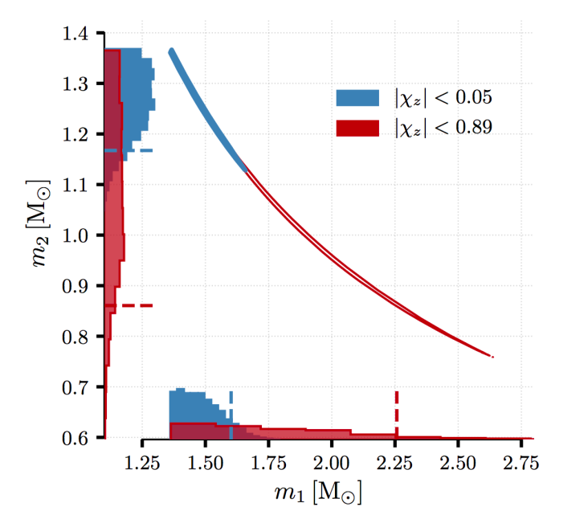
Masses of the stars
Chirp mass
1.188 (+0.004,-0.002)
-- tight correlation.

Slide 11
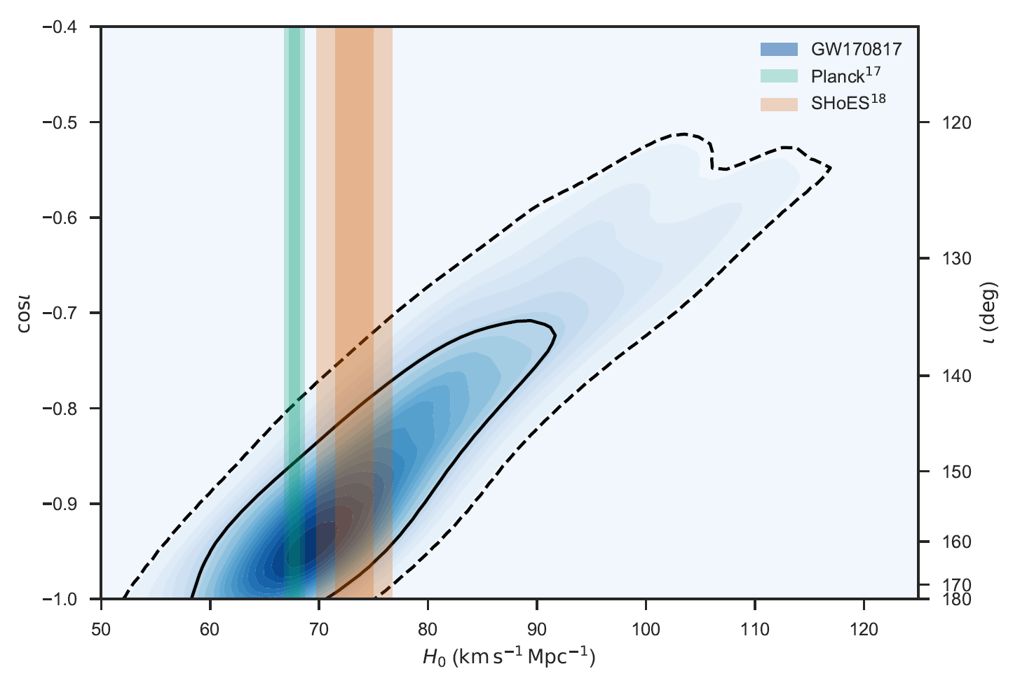
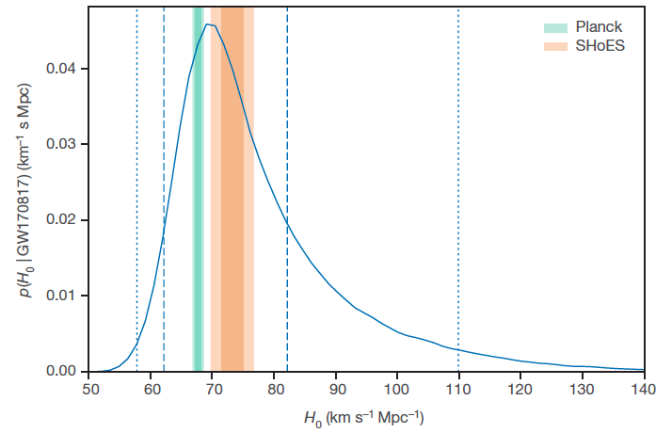

… if you can measure inclination
With a standard siren, you measure H₀
Big uncertainty due to inclination (polarisation) uncertainty
(Nissanke has emphasised this)
Notes:
Is it a standard gamma-ray burst seen off-axis? Or a new class of sources? Cocoon?

Slide 12
LIGO-Virgo future
When LIGO and Virgo come back online after current upgrade work (end 2018?), we hope for sensitivity improvement × 2, detection volume × 8. NS-NS binary rate could be ~ 1/month. BH-BH rate ~ 1 or 2 per week.
Important to understand that GW detections are declared after passing both of 2 different significance tests:
local SNR (Gaussian noise significance at time of detection);
chance coincidence probability (non-Gaussian glitch noise).
Having 3 detectors improves SNR but improves glitch rejection even more! Laura Nuttall will discuss the detectors in detail, and look at what we can expect from the future network.

Slide 13


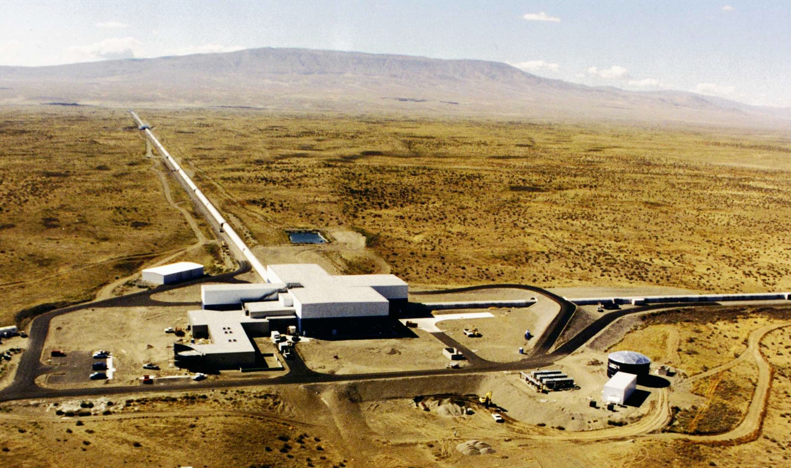
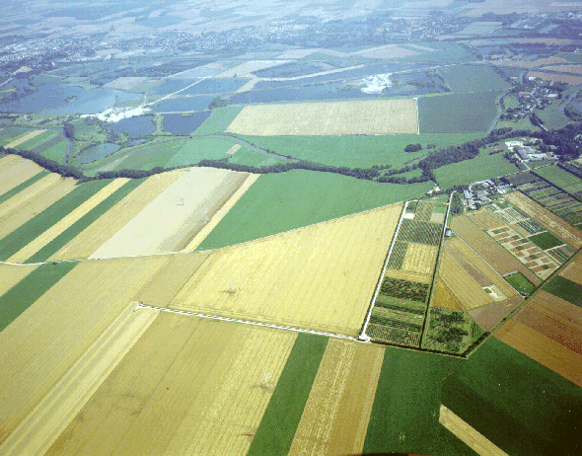



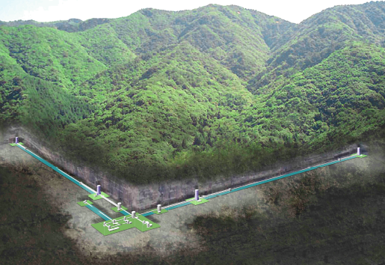


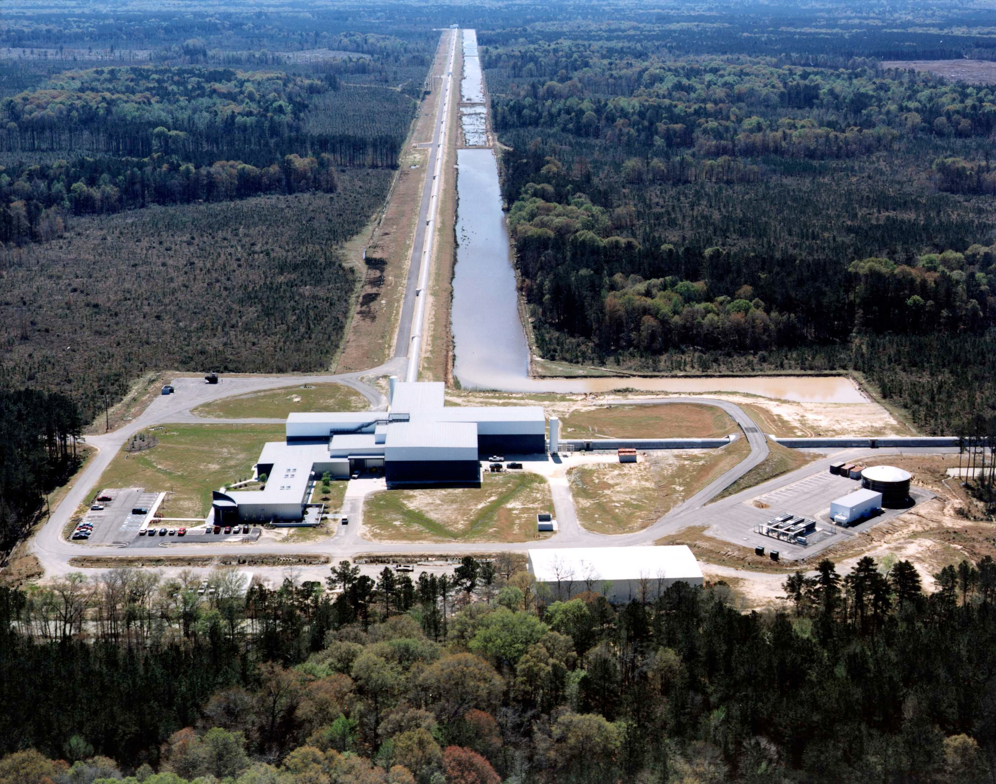
Expanded IFO network 2020+
LIGO
4 km
GEO-HF
600m
Virgo
3 km
KAGRA
3 km
LIGO
4 km
See Laura Nuttall’s talk!
LIGO-
INDIA
4 km
13

Slide 14
Science Goals of Ground-based Detectors
NS-NS and BH-BH events will be plentiful, GW pulsars will be detected in the long term, so will a stochastic GW background.
  Astrophysics: origin of binaries, markers of cosmic evolution, feedback.
  Nuclear physics: NS’s are laboratories for physics we cannot duplicate on the ground.
  GR: Cosmic censorship, non-GR propagation (v<c, birefringence), look for extra polarisations.
  Cosmology: Local H₀ to 1% or better; anisotropy tests; lensing; stochastic GW background.
  Discovery space: Networks veto glitches well, making searches for unmodelled bursts much more sensitive. Cosmic strings? Completely unexpected sources?
14

Slide 15
LIGO is just the beginning! Over next 20 years:
Big improvements in LIGO and partners, including 2.5G and new-build 3G instruments, bringing the reach for BNS to z > 2. (Nuttall talk).
ESA’s space-based detector LISA opening up the richest frequency band (0.1 -100 mHz) for GW observations; LISA Pathfinder (2016-18) was enormously successful, exceeding sensitivity goal by ×10, proving the technology and energizing ESA to put LISA on the fast track.
Detections at very low frequencies by pulsar timing arrays, with SKA becoming a nHz observatory of SMBH binaries.
Detection of GWs from the Big Bang by their signature in the polarization of the CMB.

Slide 16
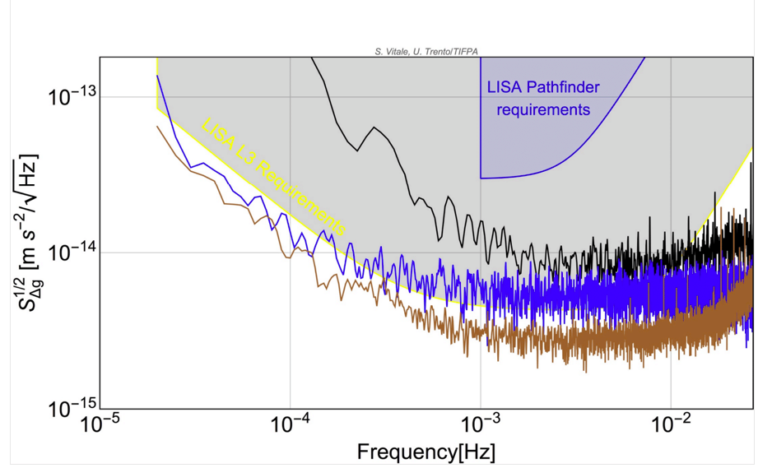
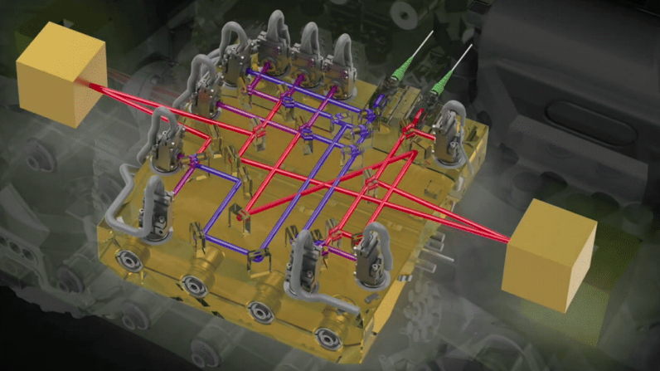
The amazing LISA Pathfinder

Slide 17
LISA: Hunting Black Holes
Remember the LIGO chirp?
Here is what we expect LISA to hear!
By detecting MBHB mergers out to z = 20, LISA will trace hierarchical galaxy formation and measure H0 to 1%, w to 15% [Tamanini et al, 1601.07112].
LISA will listen as supermassive BHs capture smaller black holes (EMRIs), which gradually spiral closer and closer for months or years before merging. These will provide exquisite high-precision tests of general relativity.
17

Slide 18
GW Astronomy is here!
The experimental teams have delivered –
  LIGO & Virgo have made the first direct observation of GWs.
  LISA Pathfinder worked “out of the box”; fewer faults than any previous ESA sciencecraft; exceeded spec by x10.
Nature has delivered too –
  We were conservative predicting BBH numbers, maybe also BNS.
  Data analysis algorithms, supported by numerical relativity, work!
While we extract the science from the current observations, this is also the right time to work toward the future:
  Upgrade LIGO, Virgo; bring KAGRA online; build LIGO-India.
  Join the LISA Consortium.
  Form the international collaboration to build 3G detectors.
  Press on with pulsar timing and CMB detection programmes.

Slide 19
THANK YOU!

Slide 20
Further on GWs
Review: Sathyraprakash & Schutz, Liv Rev Relativity.
Help us with our data analysis – discover the first pulsar signals! Download Einstein@Home: http://www.aei.mpg.de/154894/03_Einstein_Home
Science outreach online
  Einstein Online: http://www.Einstein-Online.info
  Scienceface (interviews): http://www.scienceface.org
Science outreach books
  B Schutz, Gravity from the ground up
  other authors: H Collins, M Bartusiak, T Bührke, L Smolin, J Ehlers, J Levin

Slide 21
The facts about GW150914
Time: 14 Sept 2015 09:50:45 UTC (GMT)
System: inspiral and merger of two BHs.
  Duration: ~100 ms
  BH1 mass: 36 M⊙
  BH2 mass: 29 M⊙
  Remnant mass: 62 M⊙, spinning at 70% maximum
Energy radiated in GWs by merger: 3 M⊙
Luminosity: 3.6 x 10⁴⁹ W = 10²³ L⊙ > 10 x Universe!
Distance: 410 Mpc, z = 0.09
Detection: LIGO instruments in WA and LA
  Combined SNR = 24 (amplitude), or 570 (energy)
False alarm rate << 1 per 200,000 years

Slide 22
The facts about GW151226
Time: 26 Dec 2015 03:38:53 UTC (GMT) – Boxing Day
System: inspiral and merger of two BHs.
  Duration: ~2 s
  BH1 mass: 14.2 M⊙
  BH2 mass: 7.5 M⊙
  Remnant mass: 20.8 M⊙, spinning at 74% maximum
Energy radiated in GWs by merger: 1 M⊙
Luminosity: 3.3 x 10⁴⁹ W = 10²³ L⊙~ 10³ x Universe!
Distance: 440 Mpc, z = 0.09
Detection: LIGO instruments in WA and LA
  Combined SNR = 13 (amplitude), or 169 (energy)
False alarm rate < 1 per 200,000 years

Slide 23
The facts about LVT151012
Time: 26 Dec 2015 03:38:53 UTC (GMT) – Boxing Day
System: inspiral and merger of two BHs.
  Duration: ~0.5 s
  BH1 mass: 23 M⊙
  BH2 mass: 13 M⊙
  Remnant mass: 35 M⊙, spinning at 66% maximum
Energy radiated in GWs by merger: 1.5 M⊙
Luminosity: 3.1 x 10⁴⁹ W = 10²³ L⊙~ 10³ x Universe!
Distance: 1000 Mpc, z = 0.2
Detection: LIGO instruments in WA and LA
  Combined SNR = 9.7 (amplitude), or 95 (energy)
False alarm rate 1 per 3 years

Slide 24
The facts about GW170104
Time: 04 January 2017 10:11:58.6 UTC (GMT)
System: inspiral and merger of two BHs.
  Duration: ~0.5 s ***
  BH1 mass: 31.2 M⊙
  BH2 mass: 19.4 M⊙
  Remnant mass: 48.7 M⊙, spinning at 66% maximum
Energy radiated in GWs by merger: 2 M⊙
Luminosity: 3.1 x 10⁴⁹ W = 10²³ L⊙~ 10³ x Universe!
Distance: 880 Mpc, z = 0.18
Detection: LIGO instruments in WA and LA
  Combined SNR = 13 (amplitude), or 169 (energy)
False alarm rate 1 per 70,000 years

Slide 25
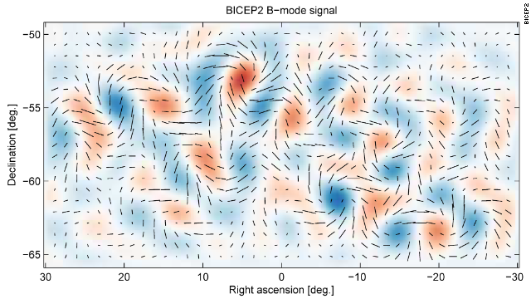
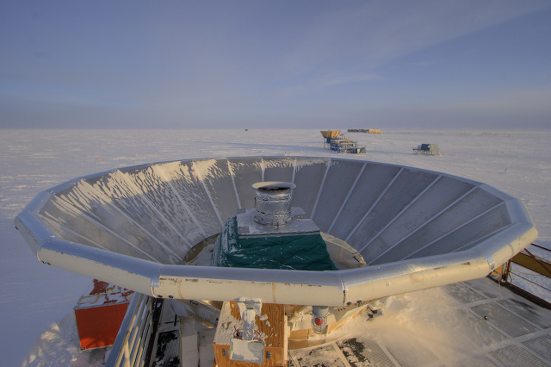
BICEP2: GWs & Big Bang?
The latest measurements show that BICEP2 only saw a ‘foreground signal’, caused by interstellar dust. But there are more measurements by more instruments underway, and it is only a matter of time before we get our first detections!
Or not! We don’t know how strong these waves should be! Real discovery space!

Slide 26
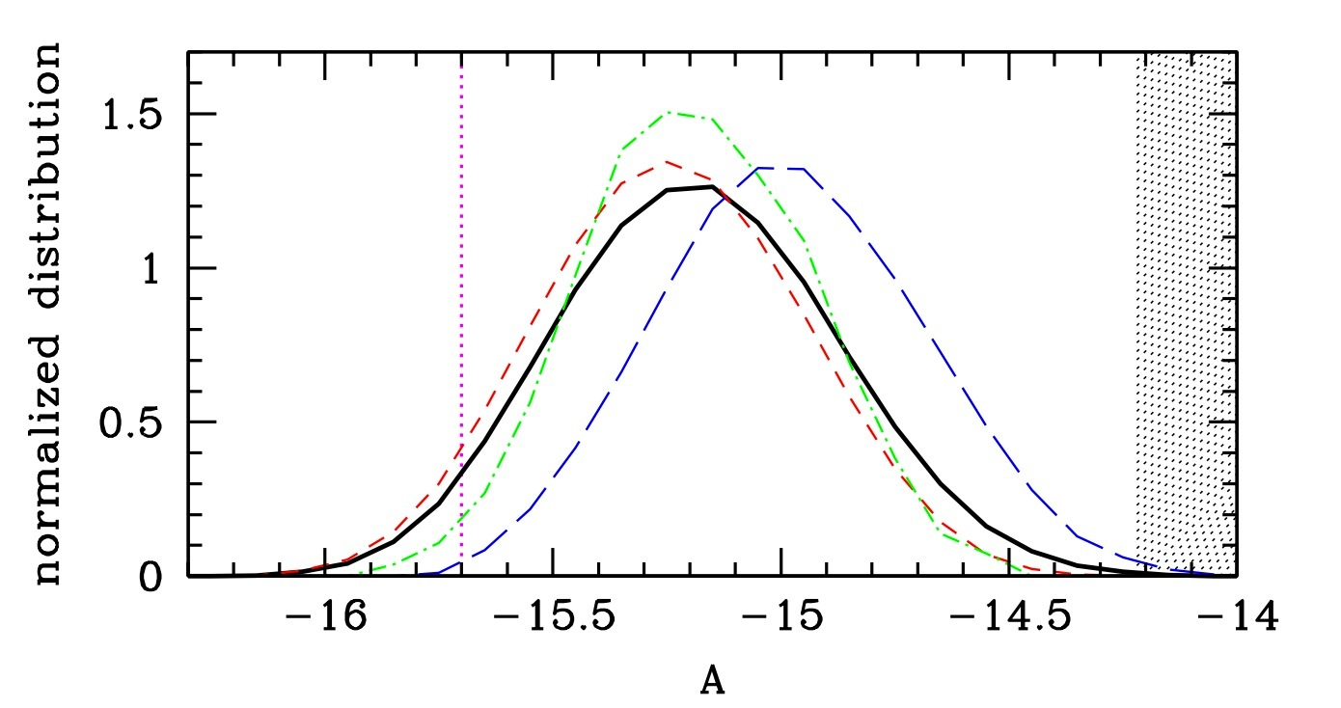
Pulsar Timing Arrays
Radio astronomers around the world are precisely recording the arrival times of pulses of ultra-stable millisecond pulsars to find the tiny variations produced by GWs passing the Earth. They should this decade detect GWs from the most massive BHs: 10⁹ times the mass of the Sun!
GW amplitude pdf based on large ensemble of evolutionary models.
Shaded: current PTA limits.
Black: PTA with 20 MSPs for 10 years.
Sesana, arXiv:1211.5375
26

Slide 27
Binaries are standard sirens
Binaries are clean systems: we have accurate models even in full general relativity.
Loss of energy to GWs causes orbit to decay, orbital frequency to go up. So the GWs will chirp up in frequency. Chirp time t_{chirp} ~ f / [df / dt ].
Signal contains both apparent brightness (from h and f ) and intrinsic luminosity (from t_{chirp}), from which we can compute the distance to the source:

Slide 28
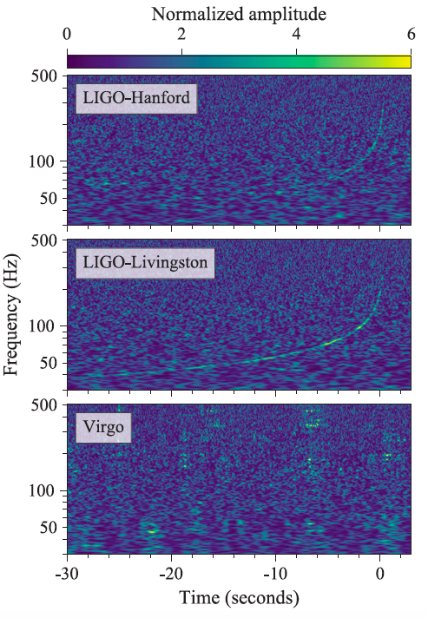
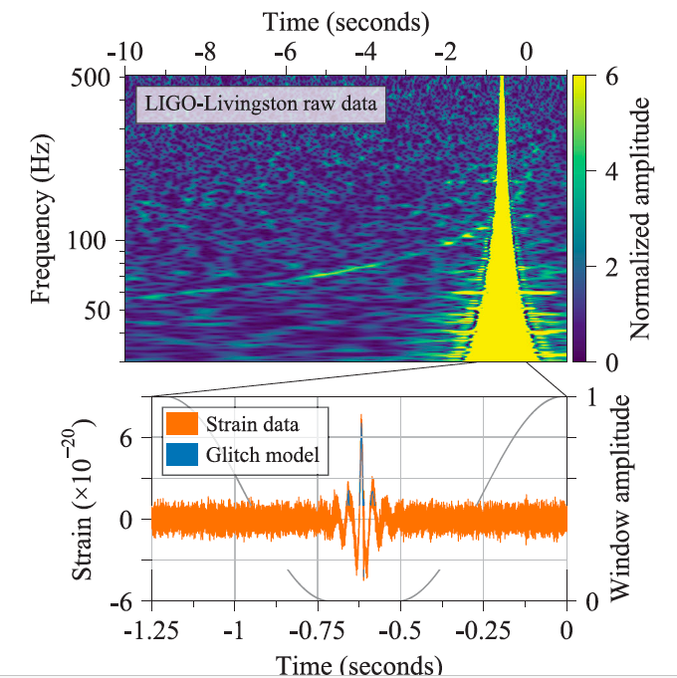

Slide 29
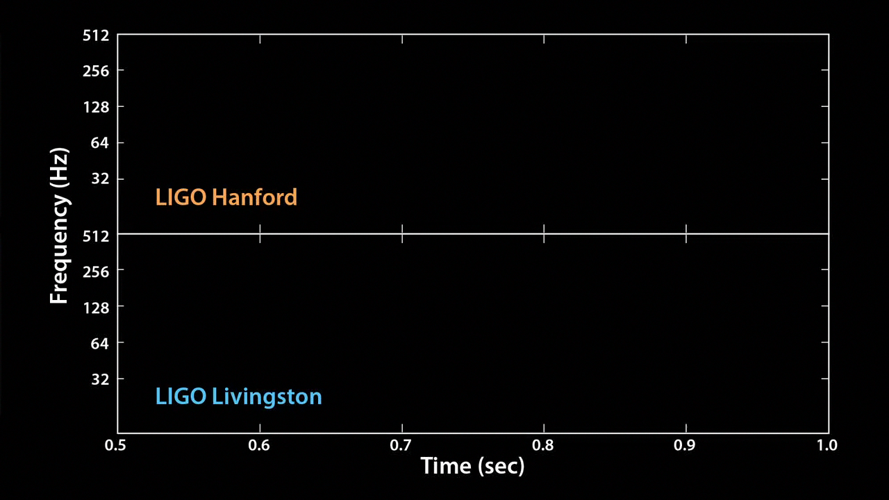
Audio and visual chirp

