Slide 1
Absolute Calibration of A Gravitational Wave Detector Network
Jeffrey Kissel
LIGO Hanford Controls Engineer
LIGO Calibration Group Co-Chair

Slide 2
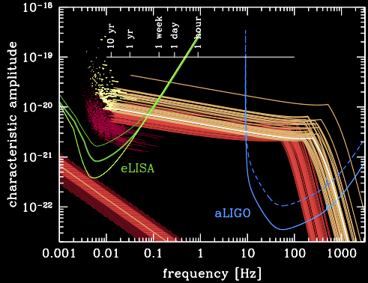
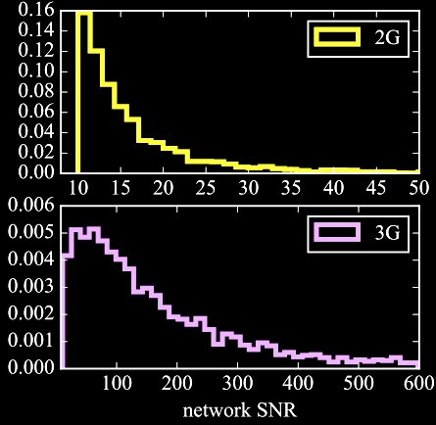
Inspiration
2G , 3G, Space, and PTAs
will have events with SNRs of O(~100)…
…Detector calibration must get better than ~1%
And if multi-band, we must understand each other’s systematic errors.
PRD 94.12 (2016): 121501
PRL 116.23 (2016): 231102

Slide 3
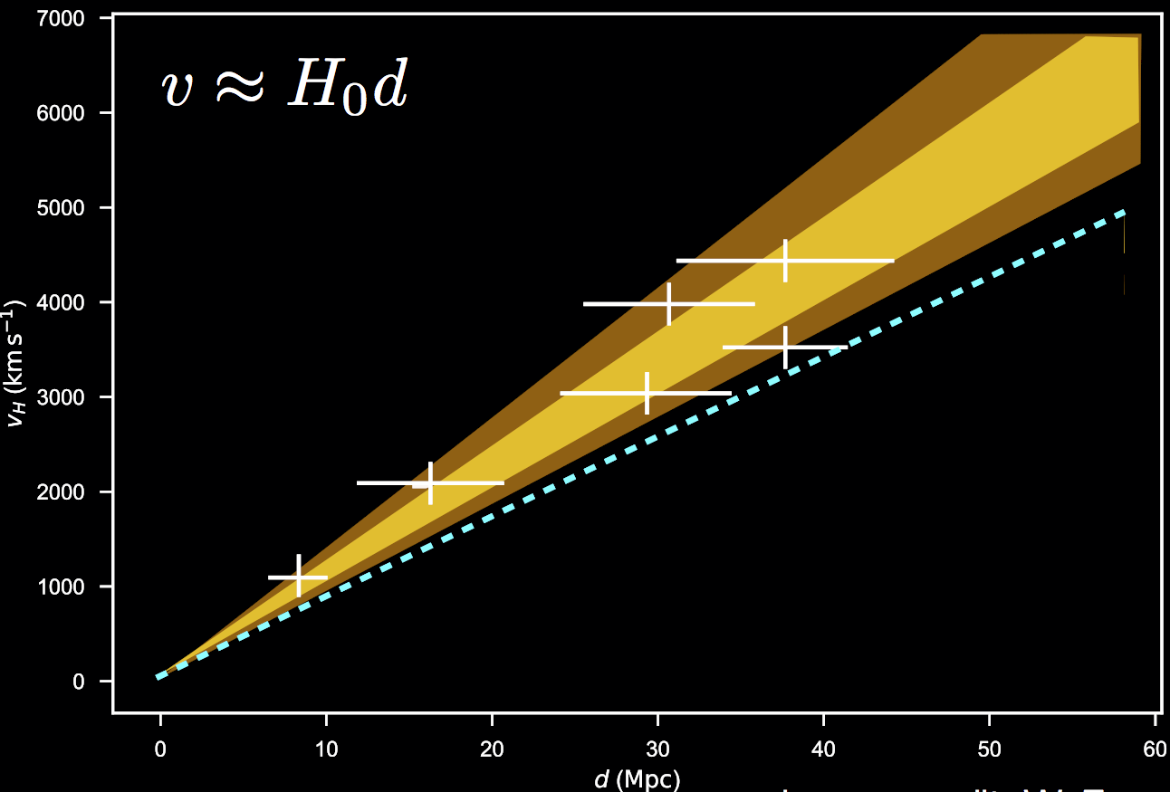
Cosmology and Correlated Systematic Errors
Toy Future BNS Detections…
Correlated Systematic
Error...
Reported H₀
True H₀
Could get H₀ wrong...
From G1800504

Slide 4
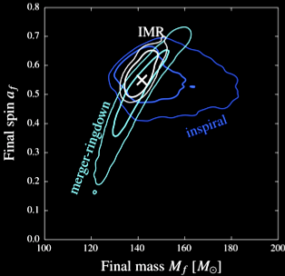
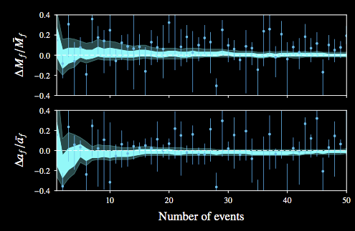
Tests of GR and Correlated Systematic Errors
Similar systematic error across events may lead you astray in GR consistency checks
Will not get SQRT(N) improvement, because calibration’s systematic errors (biases) are correlated b/w events.
Will need to consider calibration uncertainty and systematic error over several events, several observation runs as the detector hardware changes
CQG 35.1 (2017): 014002.
(and from yesterday; G1800976)

Slide 5
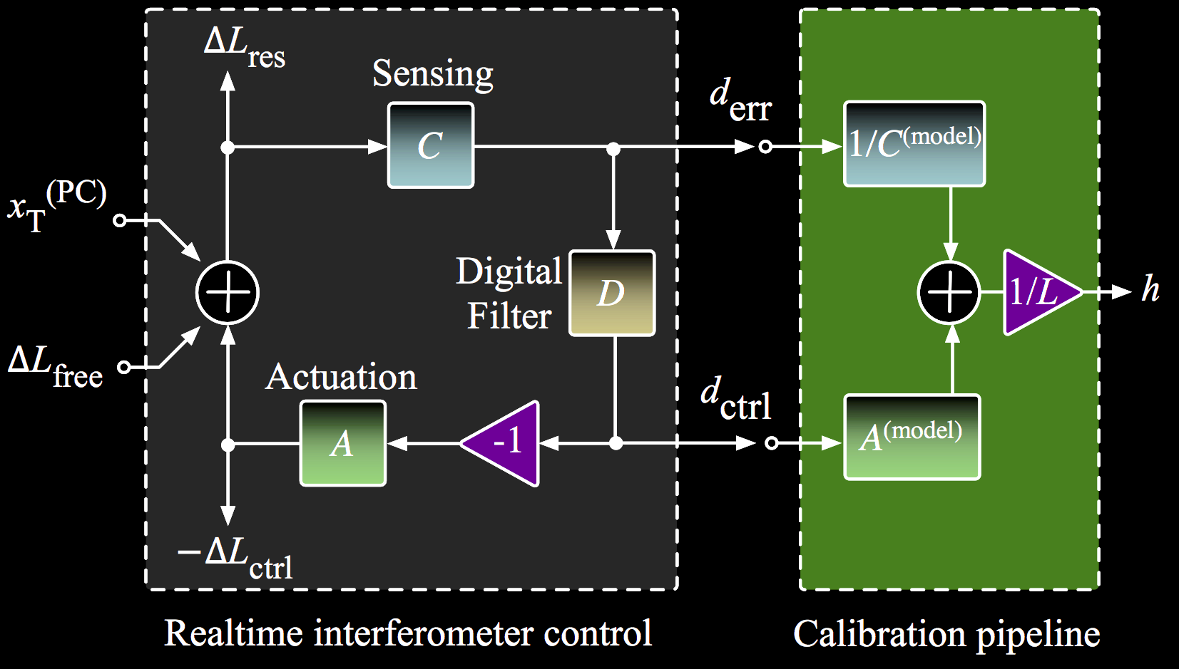
State of the Art Example: LIGO 2G
h =
R
d_{err}
1
1 + G
1
R =
__
_________
G = A D C
h L =
____
d_{err}
+ A
d_{ctrl}
L
C
C
(
1
)
(
dC
)
(
G
)
(
dA
)
dR ² =
²
²
+
²
²
_________
____
_________
____
1 + G
C
1 + G
A
PRD 95.6 (2017): 062003.
+ Systematic Error

Slide 6
Absolute Reference: Radiation Pressure
RSI 87.11 (2016): 114503

Slide 7
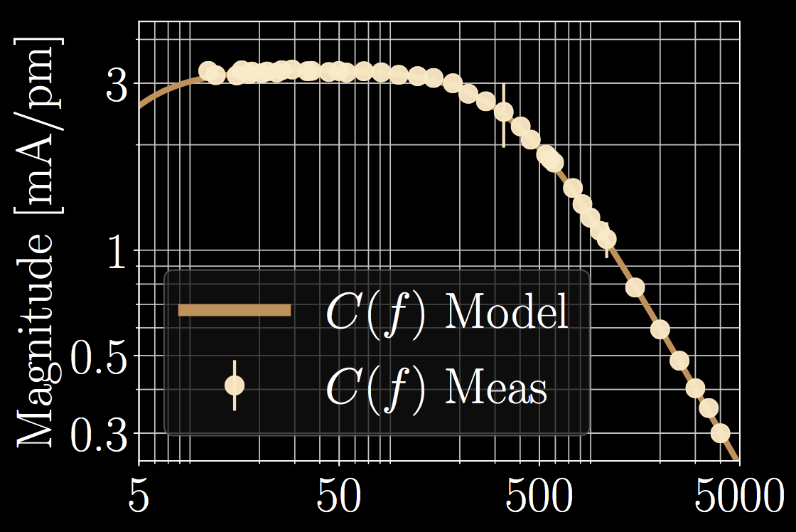
How does LIGO Determine dC and dA
d_{exc}
d_{err}
x_{pcal}
C =
____
x
____
x
____
d_{IN2}
x_{pcal}
pd_{pcal}
Complex TFs
w/ Full IFO
Absolute Scale Factor
d_{err}
x_{pcal}
pd_{pcal}
A =
____
x
____
x
____
Phase uncertainty is entirely from Full IFO transfer functions, not set by absolute scale.
d_{exc}
d_{err}
x_{pcal}
PRD 96.10 (2017): 102001

Slide 8
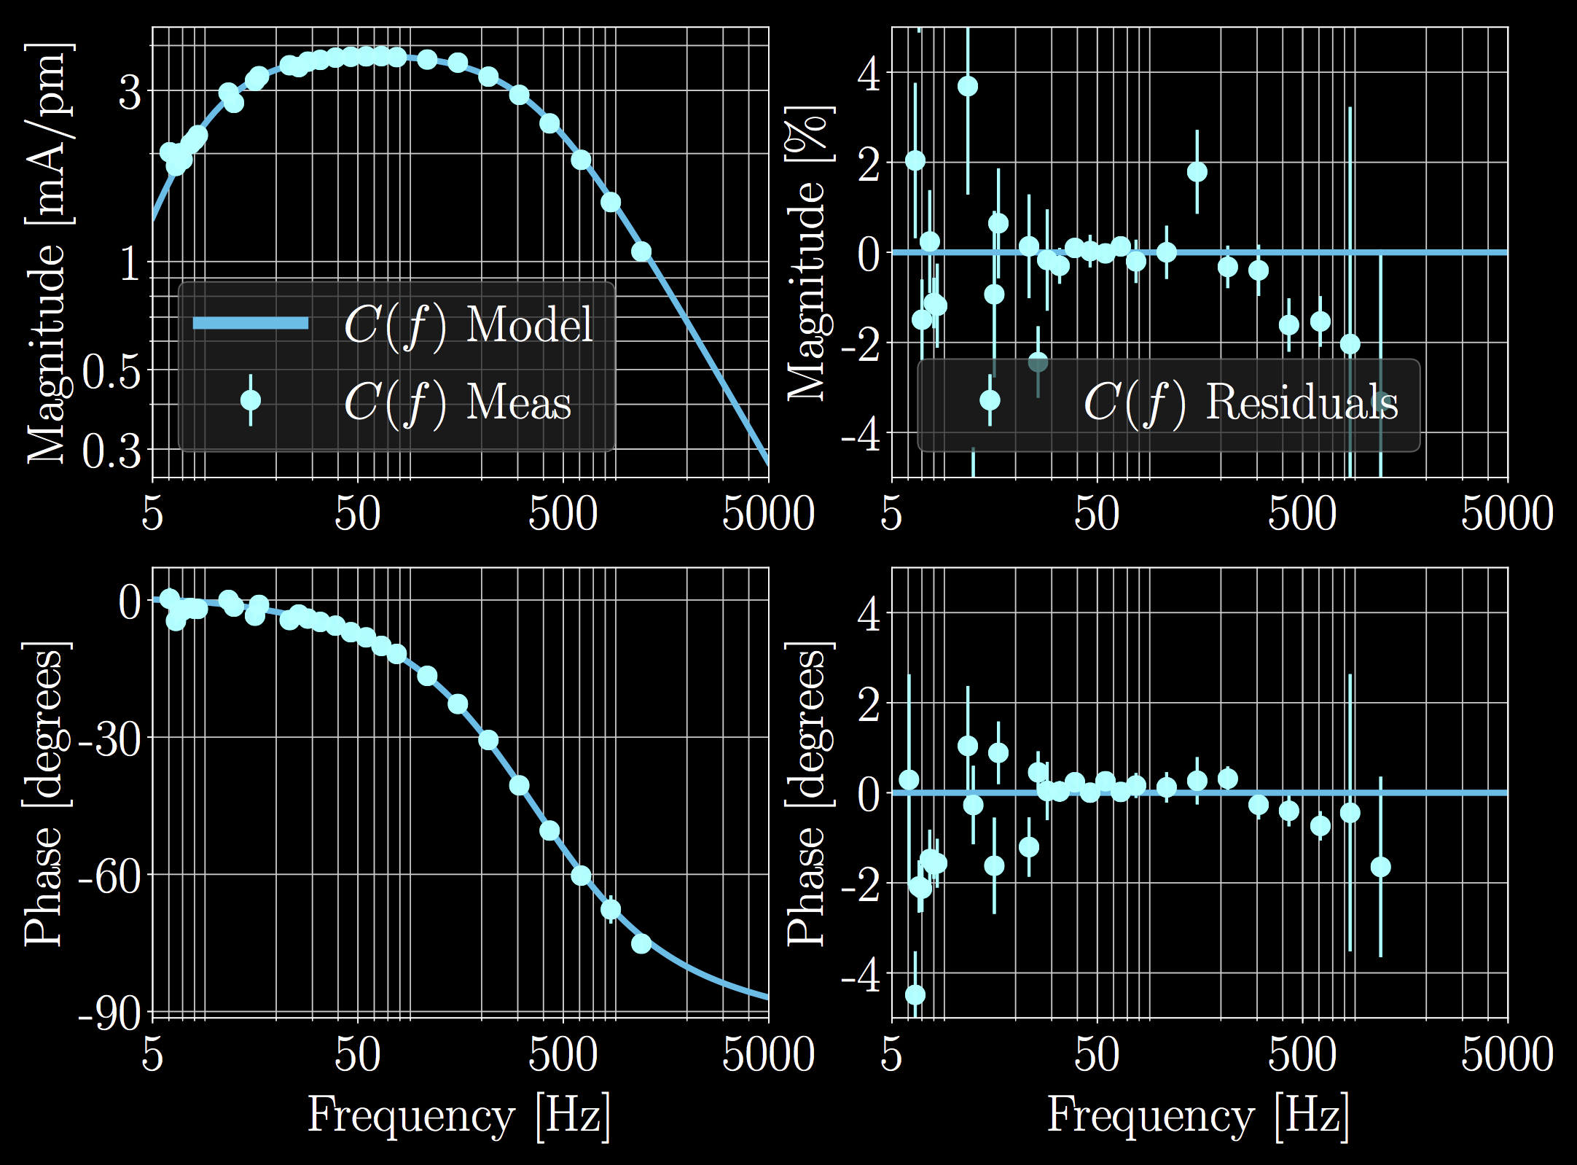
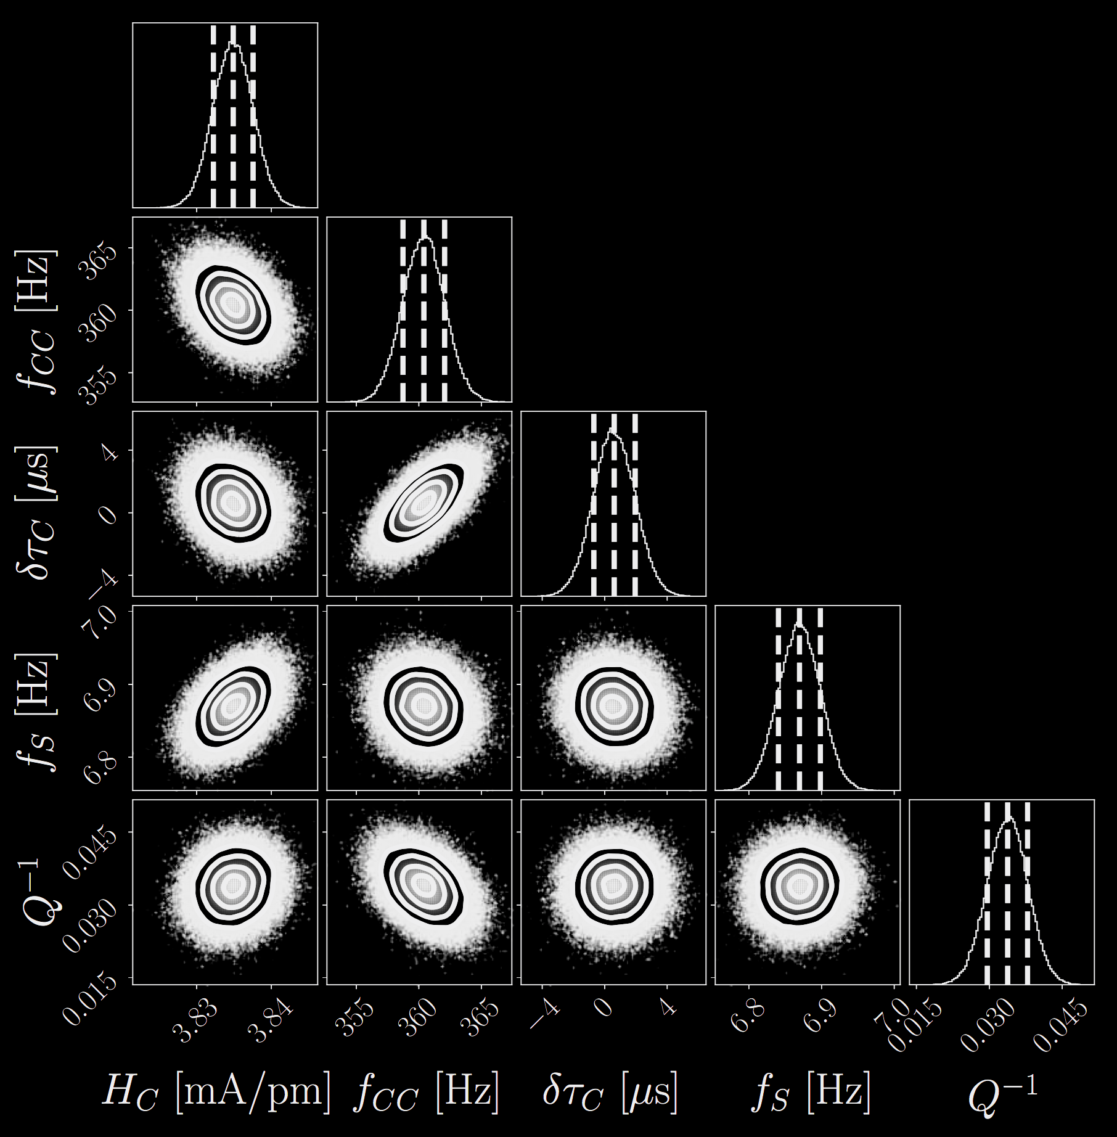
Systematic Error vs. Statistical Uncertainty
Statistical uncertainty: MCMC posteriors to the model parameters sampled to form a sample response function.
Systematic Error:
Any residual, statistically significant, frequency dependence
Fundamental reference error
For the Latest IFO Model: T1800115

Slide 9
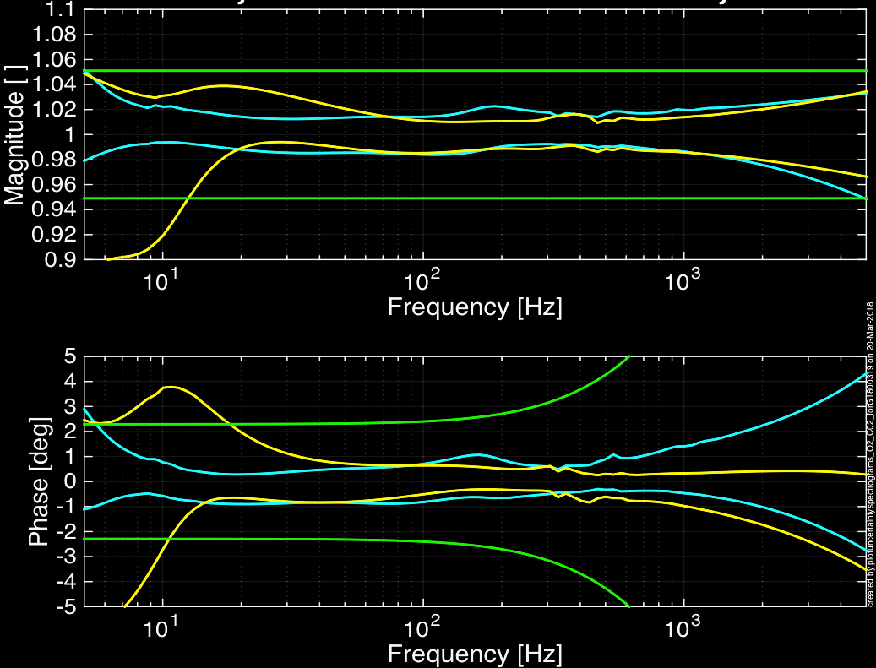
2G Detector (Known) Error and Uncertainty
H1
V1
L1
H1
L1
V1
(
1
)
(
dC
)
(
G
)
(
dA
)
dR ² ≈
²
²
+
²
²
_________
____
_________
____
1 + G
C
1 + G
A
+ Systematic Error

Slide 10
What are the 2G limits?
d_{exc}
d_{err}
x_{pcal}
Yes… Propagation of NIST factor
Years of practice has this nailed down
BUT ALSO:
PCAL Actuator Alignment
Will be improved for O3!
But can’t track anymore…
IFO Actuator Strength
To measure open loop gain and DARM actuator drive
Detector Performance
If noise improves, SNR improves for fixed actuator
For detector upgrades, actuation strength will decrease
C =
____
x
____
x
____
d_{IN2}
x_{pcal}
pd_{pcal}
Absolute Scale
Factor
Complex TFs
w/ Full IFO
d_{err}
x_{pcal}
pd_{pcal}
A =
____
x
____
x
____
d_{exc}
d_{err}
x_{pcal}
AND OF COURSE,
… patience
... person power
... interferometer time
(see last year’s talk, G1700810)

Slide 11
The International Reference Exchange
“Working”
Standards
“GOLD”
Standard
ETMY
RX
TX
H
ETMX
RX
TX
“Propagation of reference” program, with over ~10 years of experience, led by Rick Savage at LHO.
KAGRA has already joined the reference comparison program. VIRGO has begun discussions of doing so.
Mitigates differential scale error between detectors (single event: Sky Position)
Still leaves vulnerability to common scale error (single event: Distance)
L
K
V
iLIGO: CQG 26.24 (2009): 245011.
aLIGO: RSI 87.11 (2016): 114503, T1800046, T1800207, G1800505

Slide 12
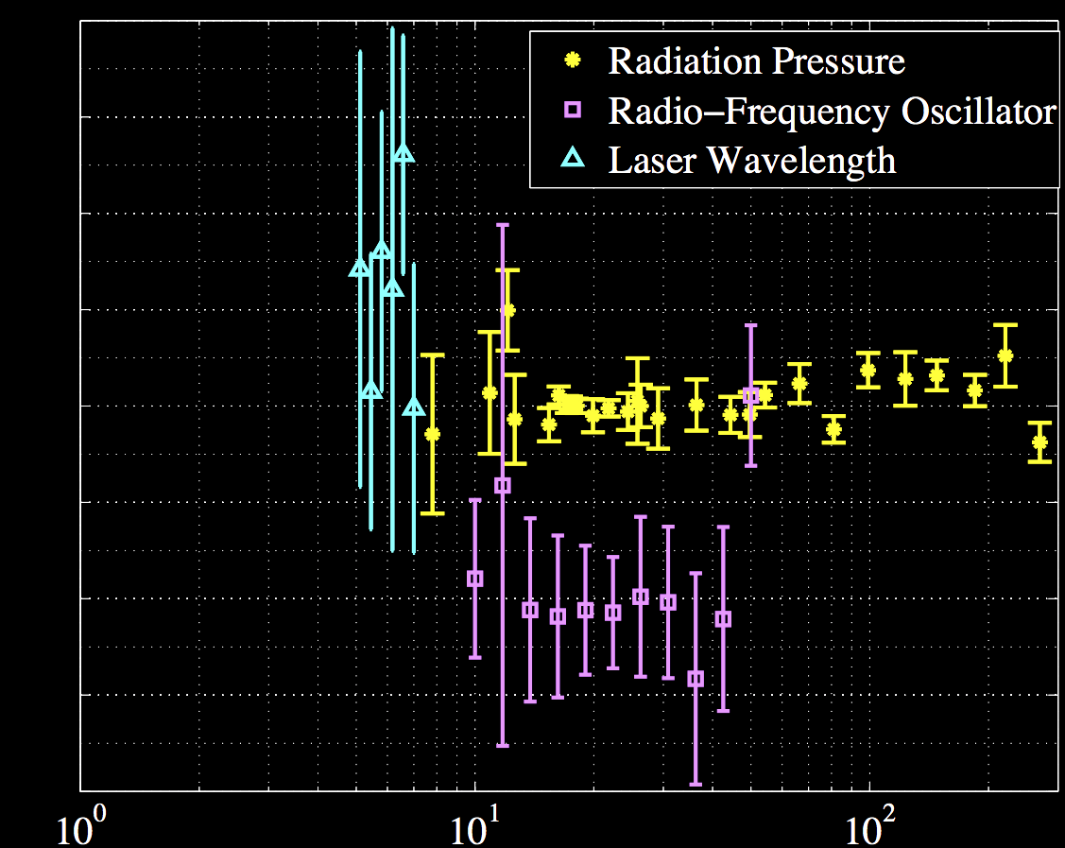
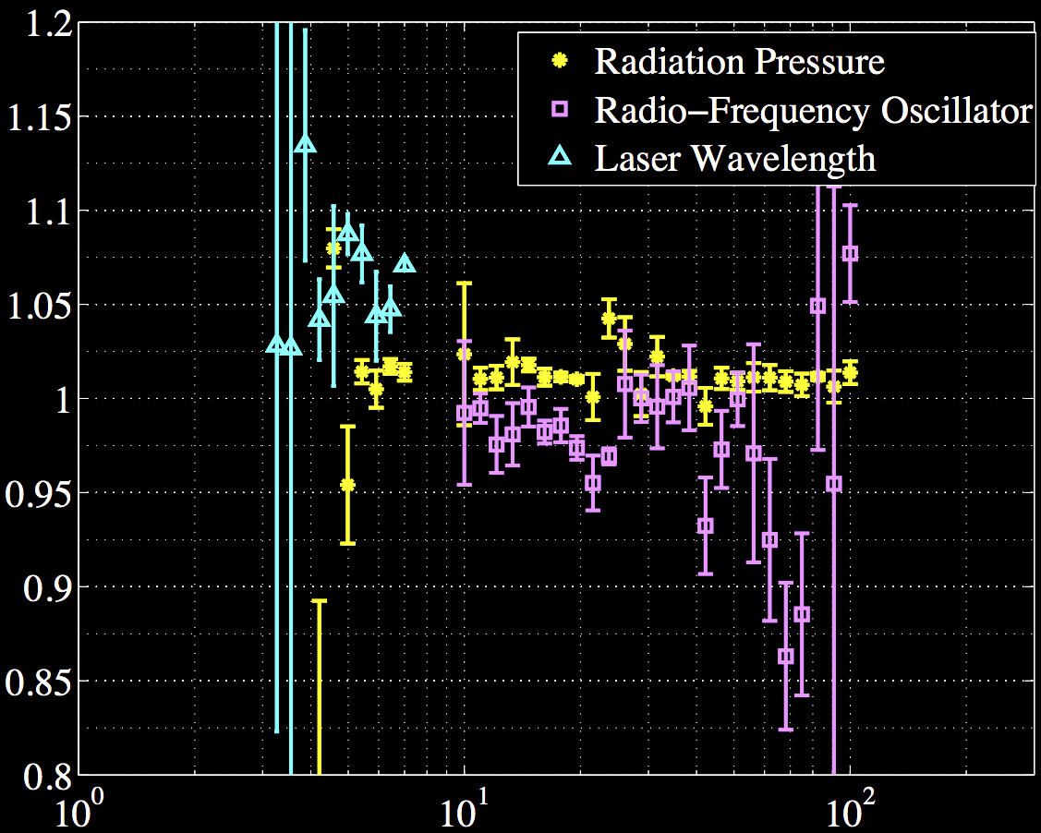
In-House PCAL Reference Check
FSM
FSM
PCAL
PCAL
ALS
L1
ALS
H1
Frequency
Frequency
Free-swinging Michelson doesn’t work well for LIGO. ITM must drive at PUM, too weak a drive.
Arm Length Stabilization is too noisy, and electronics weren’t well understood at the time.
Checks are not (yet?) precise.
Plans are to revisit this for O3.
Abbott, B. P., et al. PRD 95.6 (2017): 062003.

Slide 13
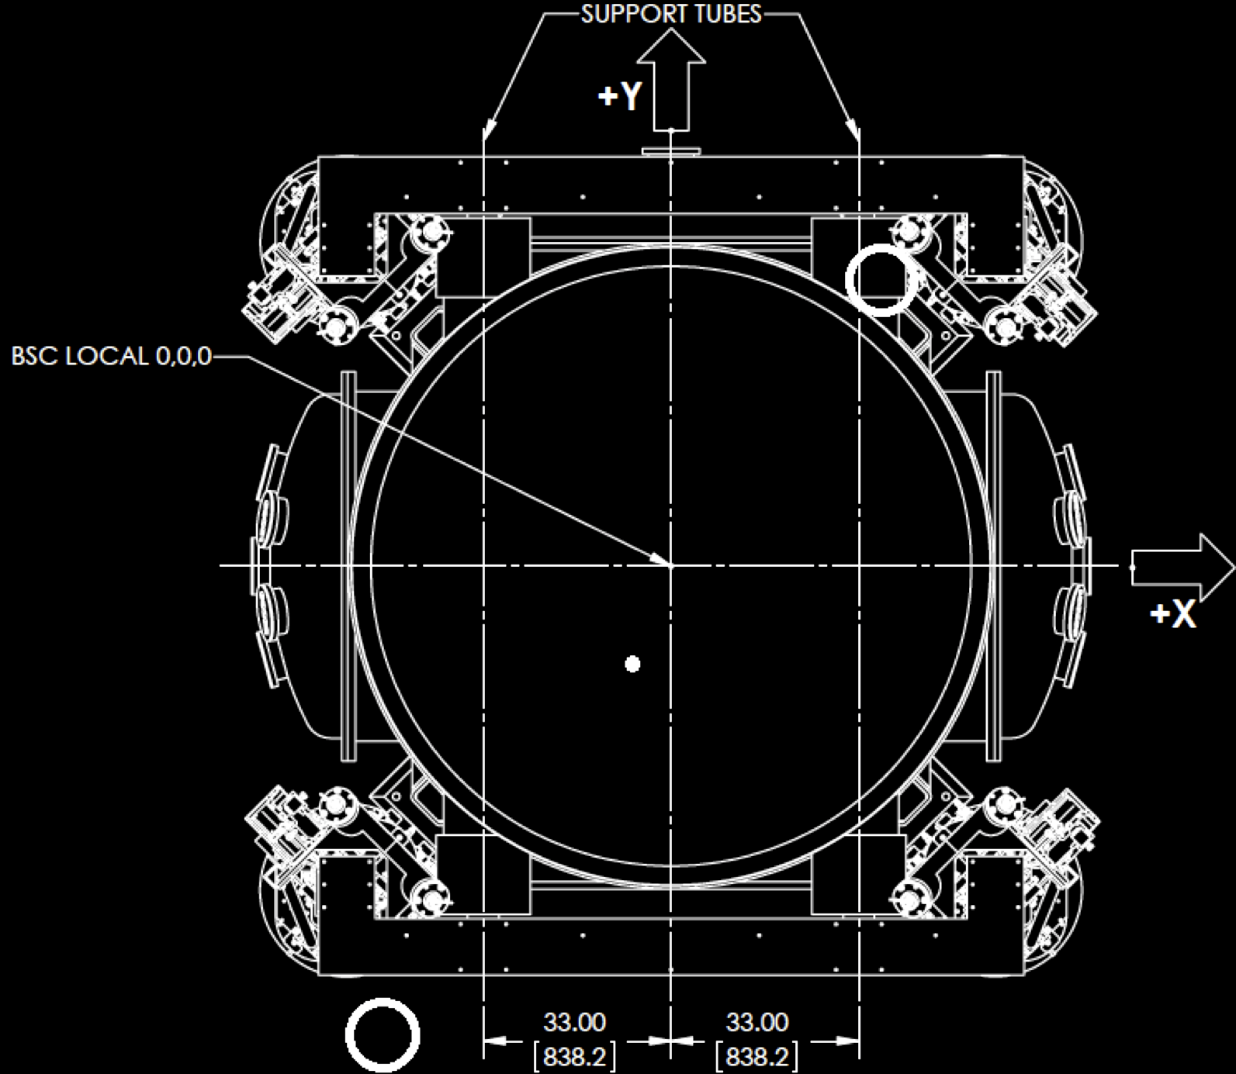
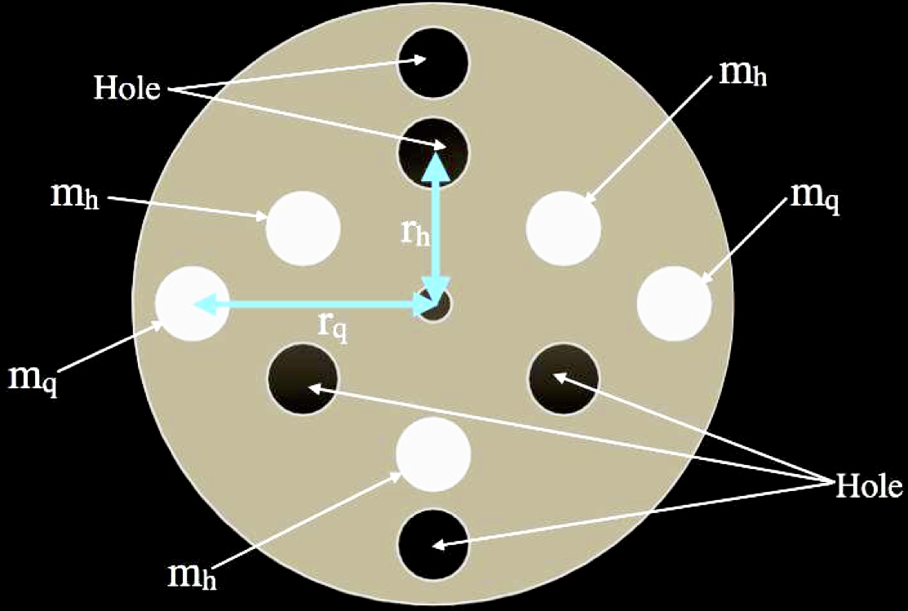
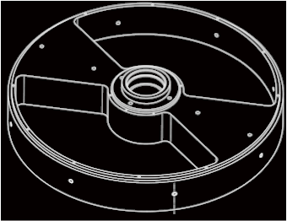
Terrestrial Detectors: The Next “New” Idea
Newtonian Gravitational Calibrators (NCAL, GCAL) have recently (re)-picked up steam
In-theory a ~0.1% level reference
PCAL starts at ~0.5%
May be ready to corroborate PCAL by O3
m
Mirror
2r
d
Basic Principle
x(t) = C cos(4πf_{rotor}t)/(d⁴ f_{rotor}²)
m
where C = (9G/32π²)(z ρ sin(α)(r_{max}⁴- r_{min}⁴)/4)
α
r_{max}
r_{min}
KAGRA -
arXiv:1804.08249 (2018).
VIRGO - G1800442
LIGO – “in prep.”

Slide 14
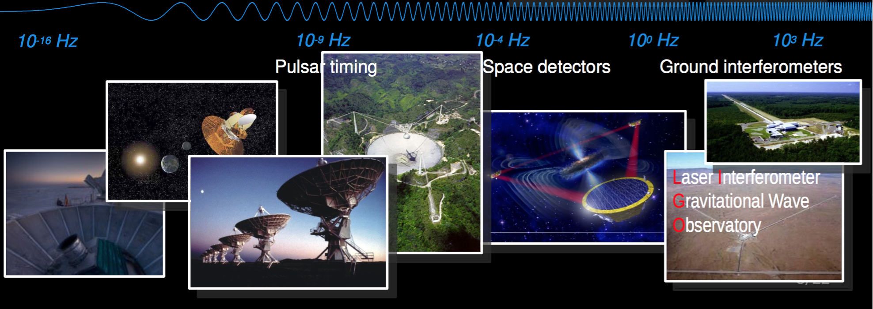
What about Space and Galactic Detectors?
Pulsar Timing Arrays (timing systems)
Limited by diverse Timing Systems in Array, over Decades?
Everyone uses TEMPO2… (Hobbs et. al 2006)
LISA (phase meters and microthrusters)
Time Delay Interferometry – More clocks and Frequency Refs.
needs to measure individual, ~1e6 m arm lengths to ~10m precision
needs clocks synchronized at the ~50 nsec level

Slide 15
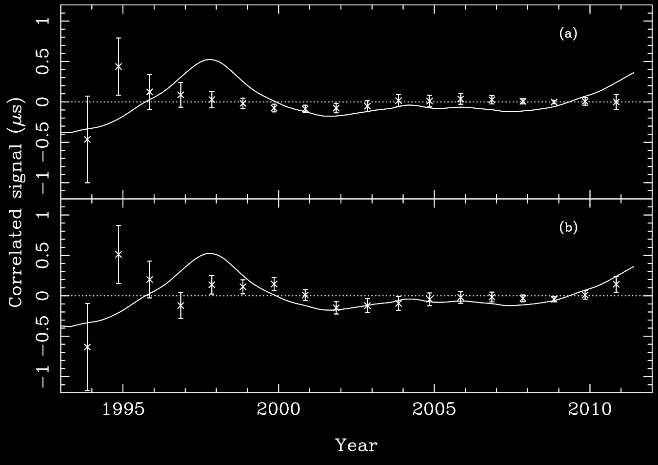
Example Timing System Systematics
Pulsar Timing Data, Systemic Errors in Solar System Ephemeris
TT(BIPMyy) - TT(TAI) ,
quadratic polynomial removed
Pulsar Timing Data, w/ modeled realization of GWB ~ 10⁻¹⁵ level
TT = Terrestrial Time
BIPM = Bureau International des Poids et Mesures
TT(TAI) = International Atomic Time -> Basis for UTC
TT(BIPMyy) -- updates / corrections, released over time
MNRAS 427, 2780–2787 (2012)

Slide 16
Discussion & Questions
Calibration is service work precision engineering
Precision/accuracy will not linearly increase with time and costs real money, not “just” time and person power.
We’re actively working with NIST to understand the EUROMET study – Rick @ NIST this week!
(+ soon new post-doc John Cripe!)
Already working to make ground-based detectors internally consistent via Photon Calibrator, starting to think how to get past its limits
Need to begin dialogue with fundamentally different GW detectors

Slide 17
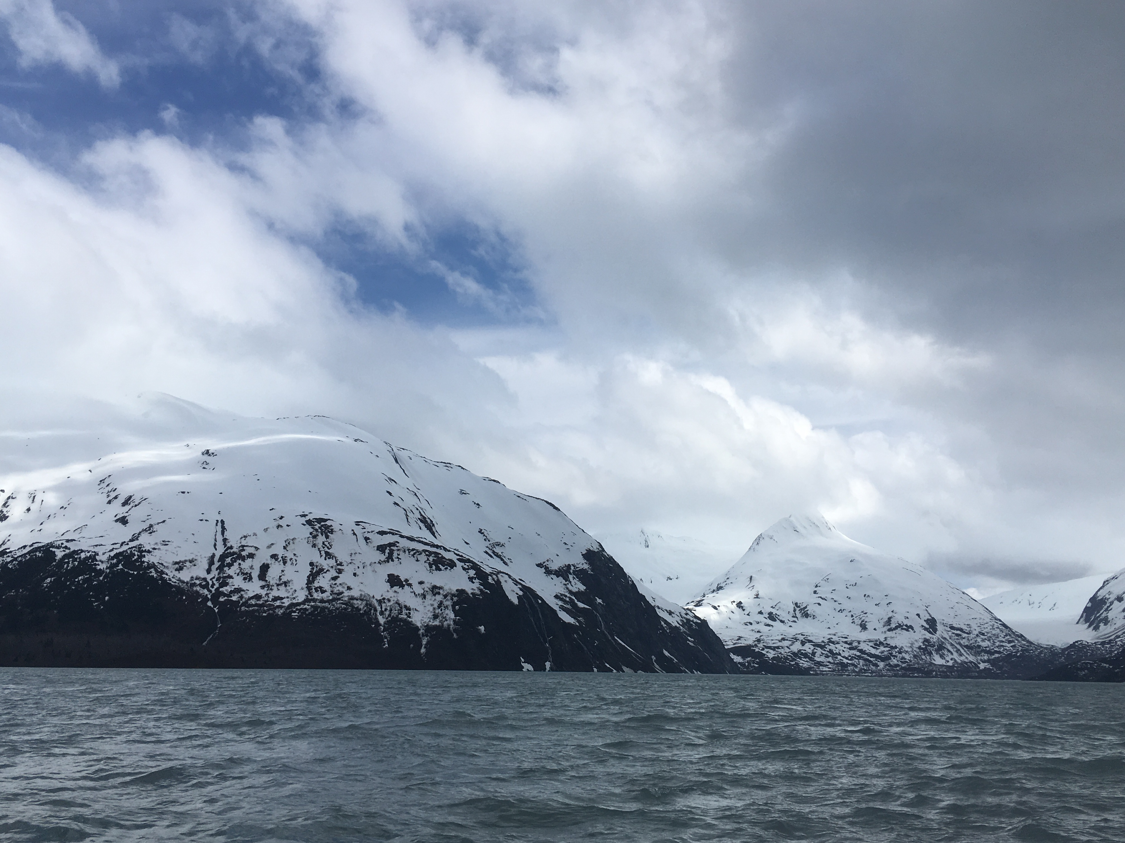
Thank You!

Slide 18
Bonus Slides

Slide 19
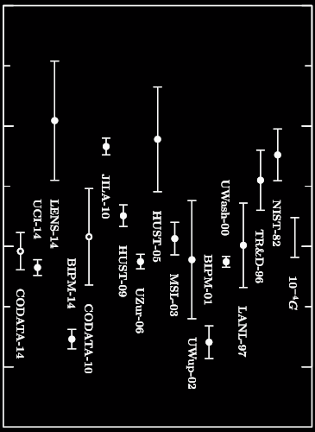
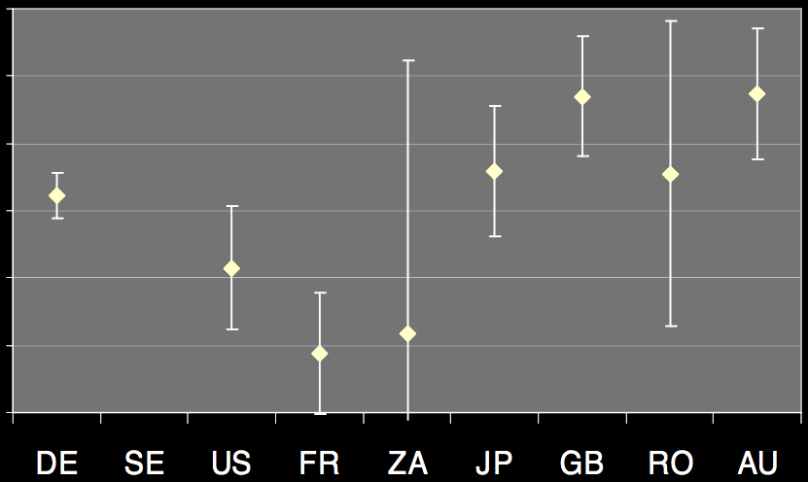
Primer
Big G / (1e-11 m³ kg⁻¹ s⁻²)
Response of a Photodetector
6.670
Percent Difference from Weighted Mean Response of a Reference Photodetector
3%
6.672
2%
1%
0%
6.674
-1%
-2%
6.676
-3%
Figure 6
CODATA 2014: Mohr, Newell, and Taylor. Phys. Chem. Ref. Data 45 (2016): 043102.
Figure 9
Kück Metrologia 47.1A (2010): 02003.

Slide 20
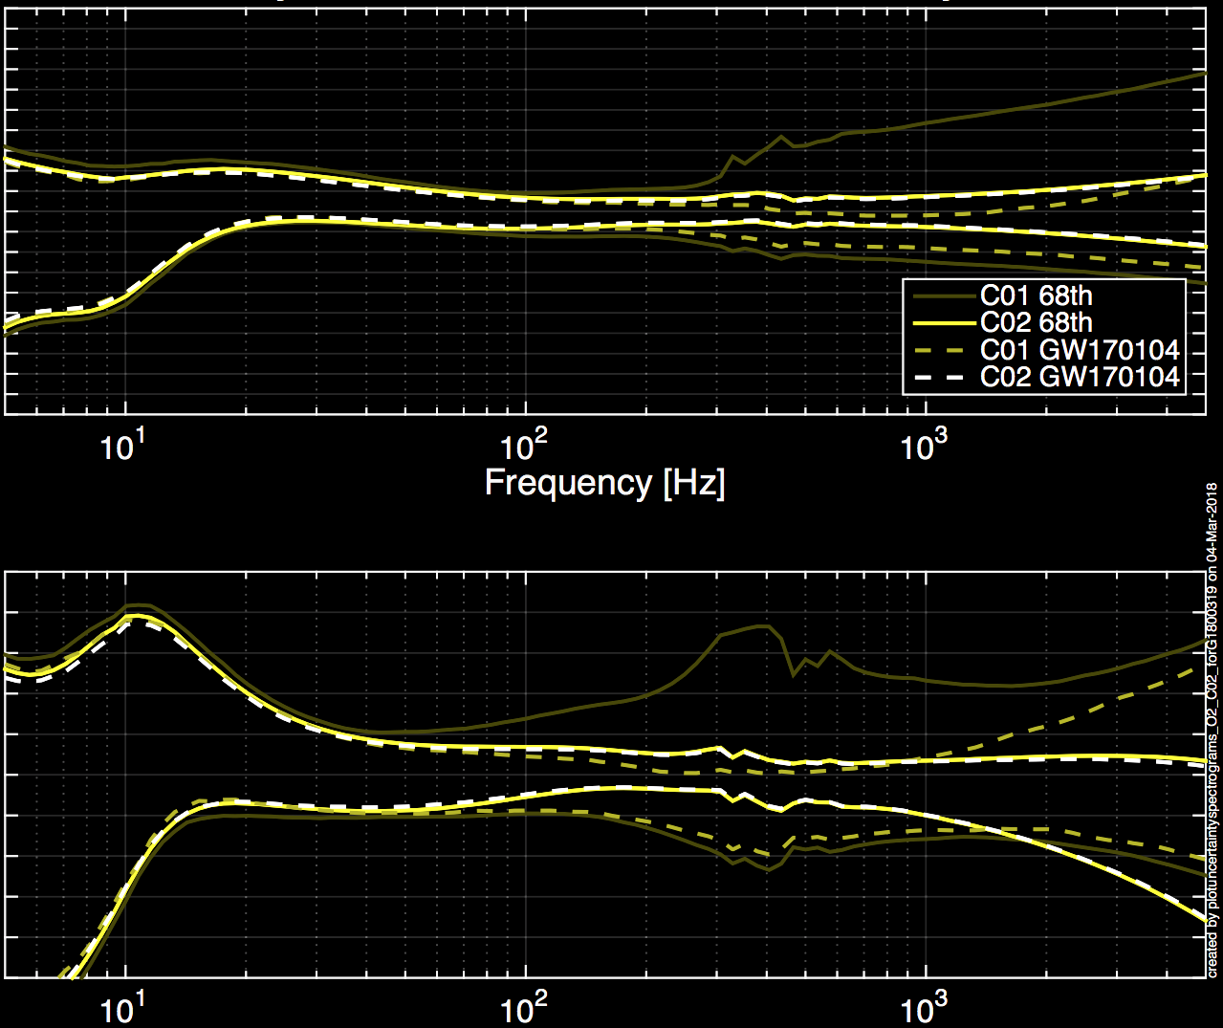
Bonus Slides: Removal of Systematic Error
1.20
L1
1.10
1.00
Magnitude
0.90
0.80
No More Cavity Pole Error!
5
4
3
2
1
Phase (deg)
0
-1
-2
-3
-4
-5

Slide 21
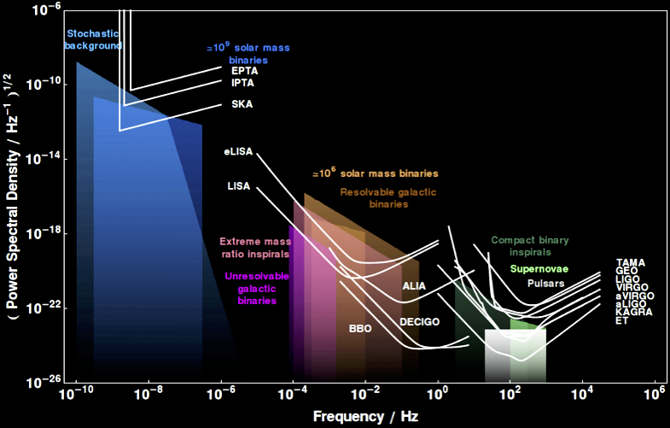
Common Sensitivity Plot
We’ve figured out how to speak the same language in terms of *noise*…
CQG 32.1 (2014): 015014.
http://rhcole.com/apps/GWplotter/

Slide 22
PTA Resolved Signal Parameter Estimation
Current IPTA is at 49 Pulsars
MNRAS 458.2 (2016): 1267-1288
7 parameters – 3 for Sky Location, Amplitude, Source Inclination, Polarization Angle, Rotation Frequency
( Distance and Mass are degenerate ☹ )
For SNR = 10, sky location uncertainty typically simulate (Fisher Matrix) to ~40 deg² and 30% in amplitude
PRD 81.10 (2010): 104008.
Amplitude uncertainty scales with SNR, sky location scales with SNR²

Slide 23
Pulsar Timing Array Papers
Verbiest, J. P. W., et al. "Status update of the Parkes pulsar timing array." Classical and Quantum Gravity 27.8 (2010): 084015.
Sesana, Alberto, and Alberto Vecchio. "Measuring the parameters of massive black hole binary systems with pulsar timing array observations of gravitational waves." Physical Review D 81.10 (2010): 104008.
Arzoumanian, Z., et al. "Gravitational waves from individual supermassive black hole binaries in circular orbits: Limits from the North American Nanohertz Observatory for Gravitational Waves." The Astrophysical Journal 794.2 (2014): 141.
Verbiest, J. P. W., et al. "The international pulsar timing array: first data release." Monthly Notices of the Royal Astronomical Society 458.2 (2016): 1267-1288.
Hobbs, G., et al. "Development of a pulsar-based time-scale." Monthly Notices of the Royal Astronomical Society 427.4 (2012): 2780-2787.
Becker, Werner, Michael Kramer, and Alberto Sesana. "Pulsar Timing and Its Application for Navigation and Gravitational Wave Detection." Space Science Reviews 214.1 (2018): 30.

Slide 24
Time Delay Interferometry Papers
Tinto, Massimo, and Sanjeev V. Dhurandhar. "Time-delay interferometry." Living reviews in relativity 17.1 (2014): 6.
Hellings, Ronald W. "Elimination of clock jitter noise in spaceborne laser interferometers." Physical Review D 64.2 (2001): 022002.
Armstrong, J. W., F. B. Estabrook, and Massimo Tinto. "Time delay interferometry." Classical and Quantum Gravity 20.10 (2003): S283.
Tinto, Massimo, Frank B. Estabrook, and J. W. Armstrong. "Time-delay interferometry for LISA." Physical Review D 65.8 (2002): 082003.

Slide 25
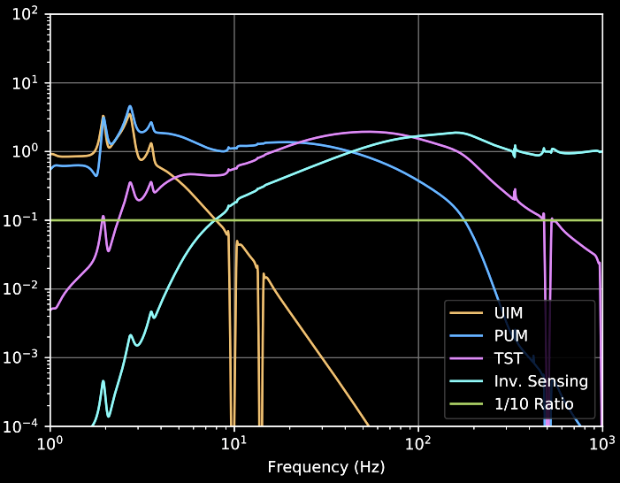
What Contributes Where?
From G1800273
Fractional Contribution to
Uncertainty in Response
(
1
)
(
dC
)
(
G
)
(
dA
)
dR ² =
²
²
+
²
²
_________
____
_________
____
1 + G
C
1 + G
A

Slide 26
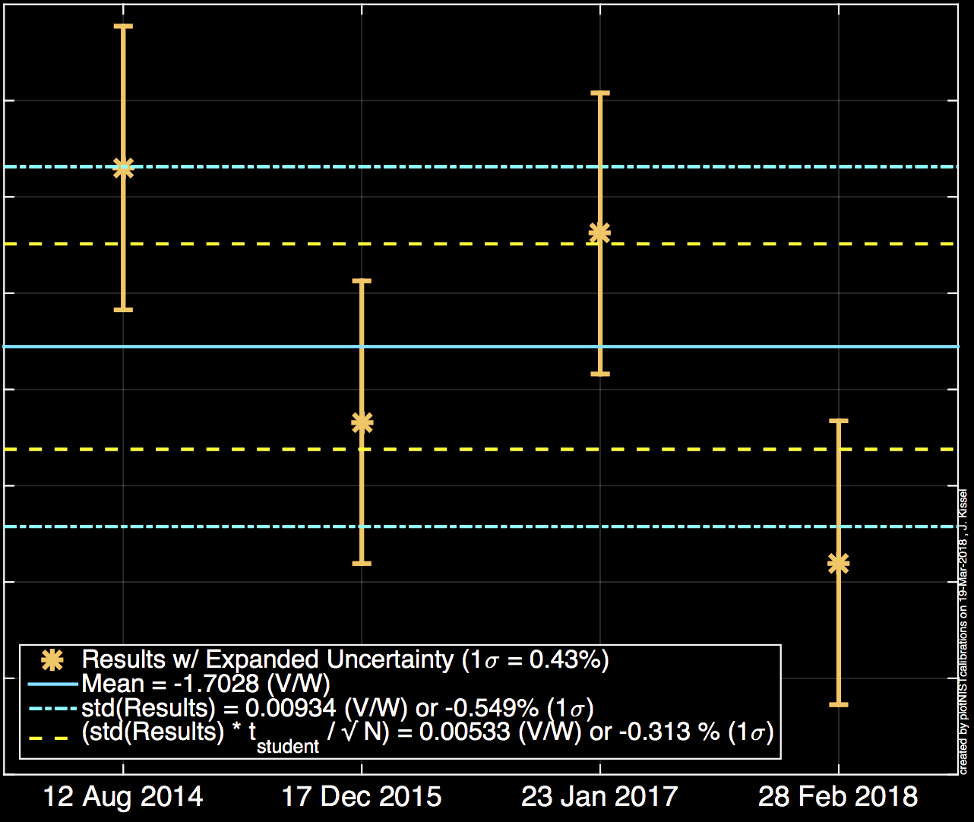
4 Years of aLIGO NIST Data
“GOLD”
Standard
~$8k per calibration T1100068

Slide 27
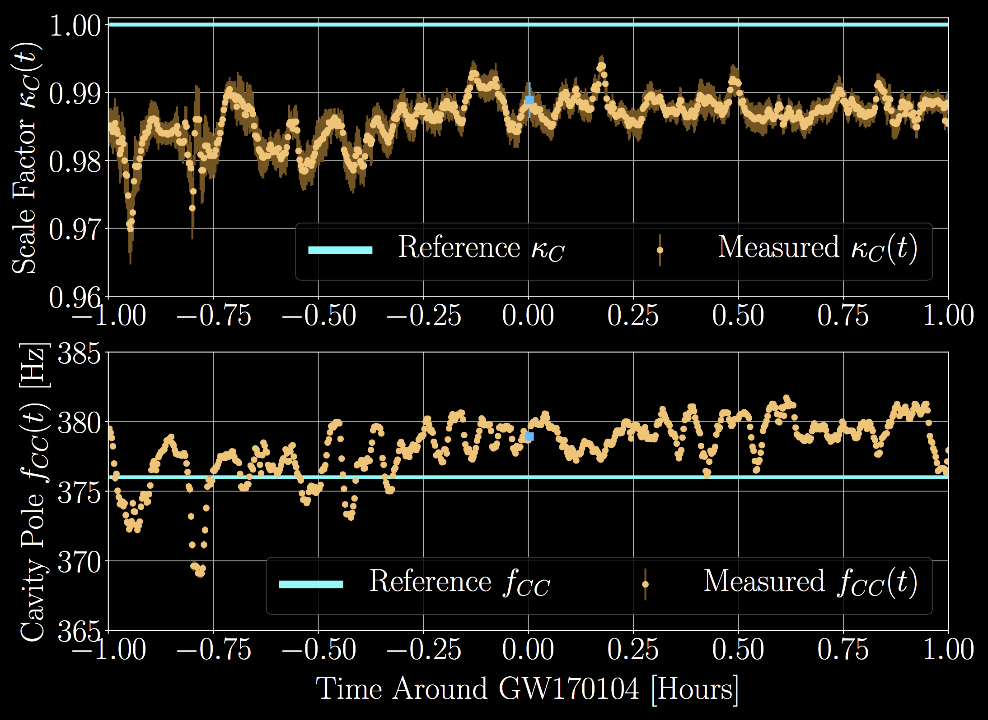
Systematic Error vs. Statistical Uncertainty
Interferometer parameters vary as a function of time.
Calibration Lines > Constantly Measuring C and A at single frequencies
Alignment Drifts
Thermal Equilibrium
Charge on the Test Mass
Distance between Reaction Chain and Test Mass Chain

Slide 28
Systematic Error vs. Statistical Uncertainty
During O2 – the response of the receiver reference dropped compared the the transmitter reference
Temperature dependence of
Beam Relay Periscope.
Systematic error of reference!
These are real laser systems!!

Slide 29
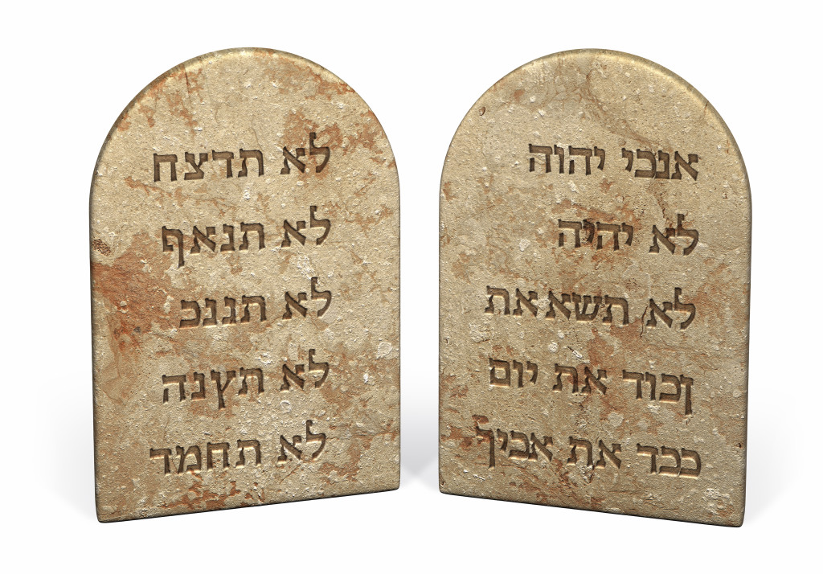
In summary (From G1700810 )
Any one can build a calibration to within a factor of 2 once.
But can you build a 1% / 1 deg calibration over ~1 year?
Seven Commandments of Calibration
Your GW response will be more complicated than you want it to be
You’ll need to invert it
It will be time dependent
You’ll be fighting your awesome isolators
Your reference will not be perfect
Your calibration will change between runs, even with the same detector
1%/1 deg will be a bookkeeping nightmare

