Slide 1
The Laser Interferometer Space Antenna: Millihertz gravitational wave science
John Baker, NASA/GSFC
GWADW 2018
Gridwood, AK - 13 May 2018

Slide 2
LISA: Opening the millihertz band
Stronger gravity
Numerous sources
Notes:
Adapt for experts

Slide 3
LISA science in milli-Hz band
Science Objectives:
Trace the formation, growth, and merger history of massive black holes
Explore stellar populations and dynamics in galactic nuclei
Test General Relativity with observations
Probe new physics and cosmology
Survey compact stellar-mass binaries and study the structure of the Galaxy
Credit: M. Hewitson / LISA Consortium
LISA is sensitive to signals above dashed V-shaped curve
Notes:
Structure talk more on these top level sci obj.
Need more on Trace formation growth….
Need more on Stellar populations

Slide 4
Trace the formation, growth, and merger history of massive black holes

Slide 5
SO2: Trace the origin, growth and merger history of massive black holes across cosmic ages | SI 2.1 | Search for seed black holes at cosmic dawn | OR 2.1 | Have the capability to detect the inspiral of MBHBs in the interval between a few 10³ M⊙ and a few 10⁵ M⊙ in the source frame, and formation 10 < z < 15. Enable the measurement of the source frame masses and the luminosity distance with a fractional error of 20% to distinguish formation models.
 | SI 2.2 | Study the growth mechanism of MBHs from the epoch of the earliest quasars | OR 2.2.a | Have the capability to detect the signal for co- alescing MBHs with mass 10⁴ < M < 10⁶ M⊙ in the source frame at z ≲ 9. Enable the measurement of the source frame masses at the level limited by weak lensing (5 %).
 |  |  | OR 2.2.b | For sources at z<3 and 10⁵ <M<10⁶M⊙, enable the measurement of the dimensionless spin of the largest MBH with an absolute error better than 0.1 and the detection of the misalignment of spins with the orbital angular momentum better than 10 deg, corresponding to an accumulated SNR (up to the merger) of at least ∼ 200.
 | SI 2.3 | Observation of EM counterparts to unveil the astrophysical environment around merging binaries | OR 2.3.a | Observe the mergers of Milky-Way type MBHBs with total masses between 10⁶ and 10⁷ M⊙ around the peak of star formation (z ∼ 2), with sufficient SNR to allow the issuing of alerts to EM observatories with a sky-localisation of 100 deg² at least one day prior to merger.
 |  |  | OR 2.3.b | Observe the OR 2.3a sources with excellent post-merger sky localisation (about 1 deg²) to distinguish from other variable EM sources in the field months to years after the merger.
 | SI 2.4 | Test the existence of Intermediate Mass Black Hole Binaries (IMBHBs) | OR 2.4.a | Have the ability to detect the inspiral from nearly equal mass IMBHBs of total intrinsic mass between 600 and 10⁴ M⊙ at z < 1, measuring the com- ponent masses to a precision of 30%, which requires a total accumulated SNR of at least 20.
 |  |  | OR 2.4.b | Have the ability to detect unequal mass MBHBs of total intrinsic mass 10⁴−10⁶M⊙ at z<3 with the lightest black hole (the IMBH) in the intermediate mass range (between 10² and 10⁴ M⊙), measuring the component masses to a precision of 10%, which requires a total accumulated SNR of at least 20.
Source: LISA Mission Proposal. Note actual mission science requirements may evolve.

Slide 6
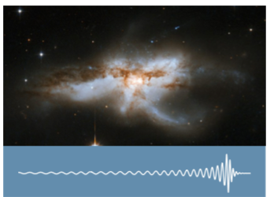
Massive Black Hole Binaries
Sources
Mergers of BHs with mass of 10⁴ ~ 10⁷ M☉
Measurements
~10² detections w/ 10≲ SNR ≲ 10⁴
parameter accuracy scales w/ SNR
0.01% ≲ δM/M ≲ 1% , 3% ≲ δD/D ≲ 10%
0.01% ≲ δΧ/Χ ≲ 1%, 10 arcmin² ≲ δA ≲ 10 deg²
Science
BH merger history over cosmic time
Origin of BH seeds
Precision tests of general relativity

Slide 7
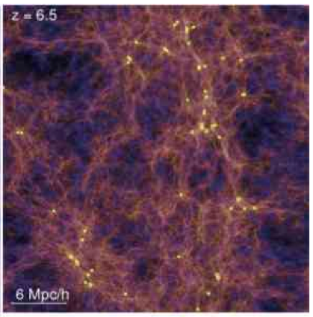
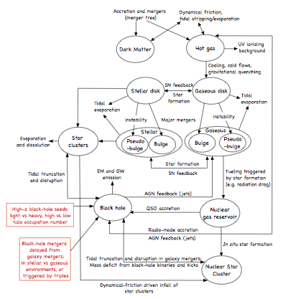
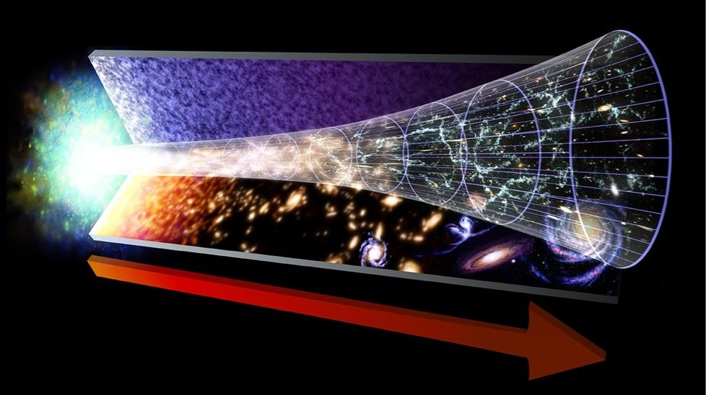
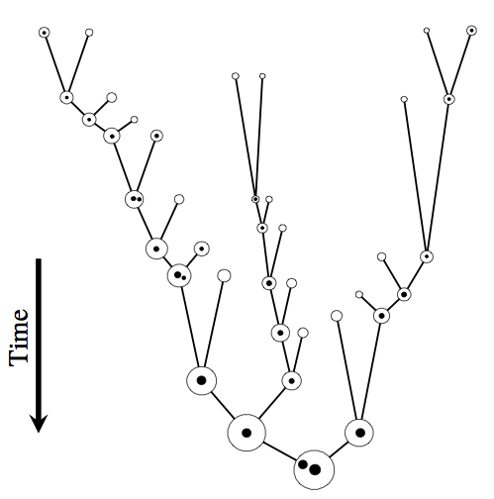
Modeling MBH binary astrophysics

Slide 8
Trace the formation, growth, and merger history of MBHs
Contours: LISA Sensitivity
Tracks: formation of MBH systems
purple: from large seed to z~6 quasar yellow: from Pop III seed z~6 quasar red: to 10⁹ M☉ in giant elliptical green: to Milky-way like MBH circles: merger events
Example LISA measures:
masses -err < 5% for at z~9 for 10⁴ < M < 10⁶ M⊙ spins -err < 0.1 for at z~3 for 10⁵ < M < 10⁶ M⊙ distances -err < 20% at z ~15 for 10⁵ < M < 10⁶ M⊙
A proposed
future
ground-based
instrument
Credit: N. Cornish, M. Hewitson, and the LISA and ET Teams. Created for the Gravitational Wave International Committee (GWIC). Tracks as in Gravitational Universe science theme document (2013)

Slide 9
Explore stellar populations and dynamics in galactic nuclei

Slide 10
SO3: Probe the dynamics of dense nuclear clusters using EMRIs | SI 3.1 | Study the immediate environment of Milky Way like MBHs at low redshift | OR 3.1 | Have the ability to detect EMRIs around MBHs with masses of a few times 10⁵ M⊙ out to red- shift z = 4 (for maximally spinning MBHs, and EMRIs on prograde orbits) with the SNR ≥ 20. This enables an estimate of the redshifted, observer frame masses with the accuracy δM/M < 10⁻⁴ for the MBH and δm/m < 10⁻³ for the SOBH. Estimate the spin of the MBH with an accuracy of 1 part in 10³, the eccentricity and inclination of the orbit to one part in 10³.
Source: LISA Mission Proposal. Note actual mission science requirements may evolve.

Slide 11
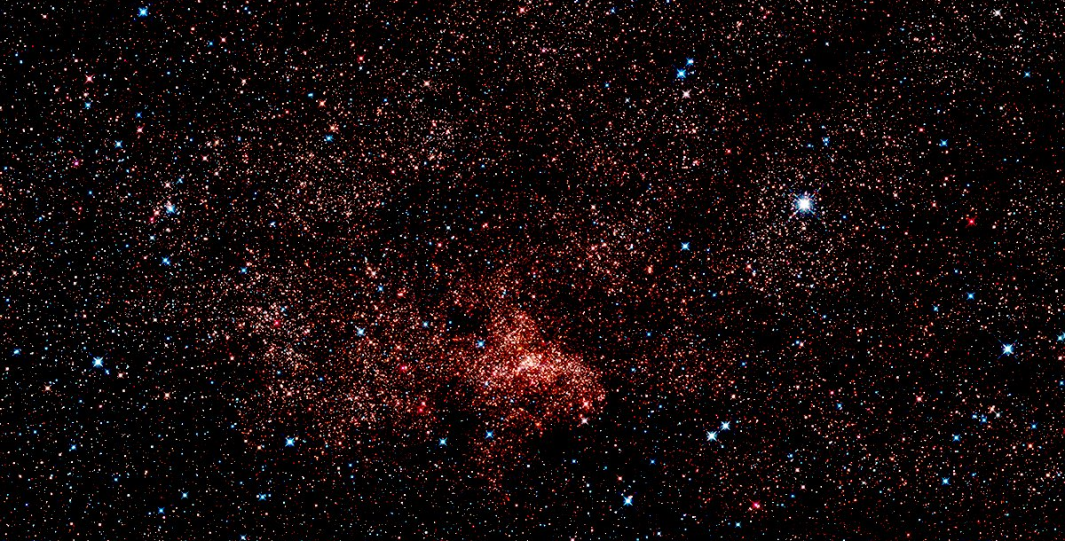

Slide 12
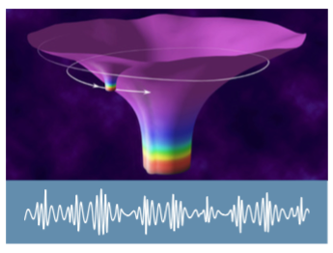
Extreme Mass Ratio Inspirals
Sources
Stellar remnant BHs captured by MBHs in nuclear clusters
Mass ratio of 1000:1 or greater (difficult modeling & analysis)
Measurements
Uncertain rates: 1yr⁻¹ ≲ R_{EMRI} ≲ 1000 yr⁻¹
Rough extrinsic parameters (δD/D~10%, δΑ~10deg²)
Exquisite intrinsic parameters (δM/M ~ 0.01%, δΧ/Χ~0.01%, etc)
Science
Demographics of stellar remnant BHs in nuclear clusters
Precision MBH measurements.
Precision tests of general relativity

Slide 13
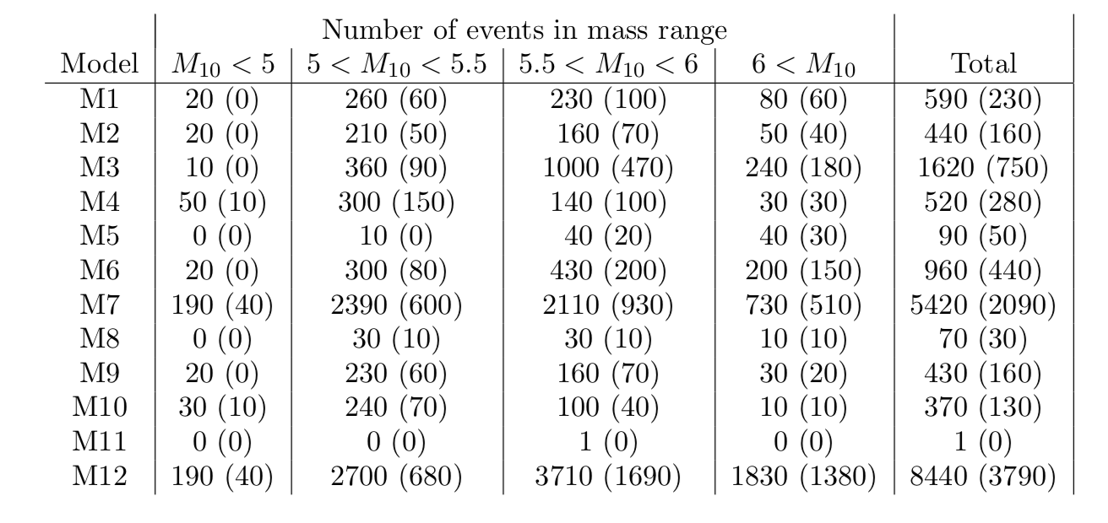
Source: Slide from Alberto Sesana
Gair EA 2017

Slide 14
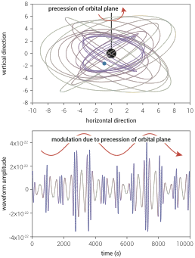
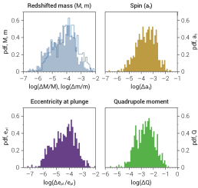
Left: The complicated precession motion of BH falling into an MBH yields structured GWs carrying precise information about the system.
Right: parameter estimation precision for eLISA observations drawn from a simulated EMRI

Slide 15
Source: Slide from Alberto Sesana

Slide 16
Survey compact stellar-mass binaries and study the structure of the Galaxy

Slide 17
SO1: Study the formation and evolution of compact binary stars in the Milky Way Galaxy. | SI 1.1 | Elucidate the formation and evolution of GBs by measuring their period, spatial and mass distributions. | OR 1.1.a | To survey the period distribution of GBs, and have the capability to distinguish between ∼ 5000 systems with inferred period precision δP/P < 10⁻⁶
 |  |  | OR 1.1.b | To measure the mass, distance and sky lo- cation for the majority of these GBs with frequency f > 3 mHz, chirp mass > 0.2 M⊙ and distance < 15 kpc
 |  |  | OR 1.1.c: | To detect the low frequency galactic confu- sion noise in the frequency band from 0.5 to 3 mHz.
 | SI 1.2 | Enable joint gravitational and electromagnetic observations of GBs to study the interplay between gravitational radiation and tidal dissipation in interacting stellar systems. | OR 1.2.a | To detect ∼ 10 of the currently known verification binaries, inferring periods with accuracy δP/P < 10⁻⁶
 |  |  | OR 1.2.b | To enable identification of possible electro- magnetic counterparts, determine the sky location of ∼ 500 systems within one square degree.
 |  |  | OR 1.2.c | To study the interplay between gravitational damping, tidal heating, and to perform tests of GR, localise ∼ 100 systems within one square degree and determine their first period derivative to a fractional accuracy of 10% or better.
Source: LISA Mission Proposal. Note actual mission science requirements may evolve.

Slide 18
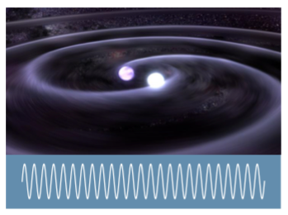
Galactic Binaries
Sources
Millions of compact binaries (WD, NS, BH) in Milky Way
mono- or quasi-mono-chromatic
Measurements
millions unresolved foreground
~2 x 10⁴ individually resolved
δM/M~1%, δD/D~3%, δA~10deg²
Science
Binary demographics (WD-WD vs. AM CVn vs. NS-WD, etc.)
Galactic structure in WD binaries

Slide 19
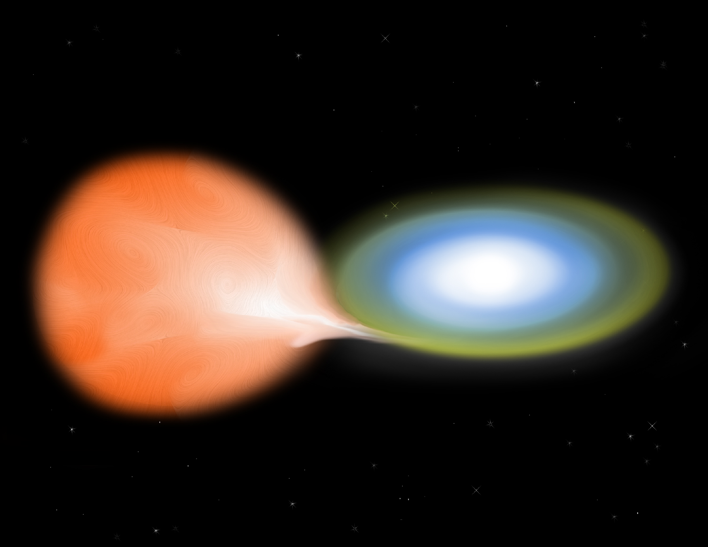
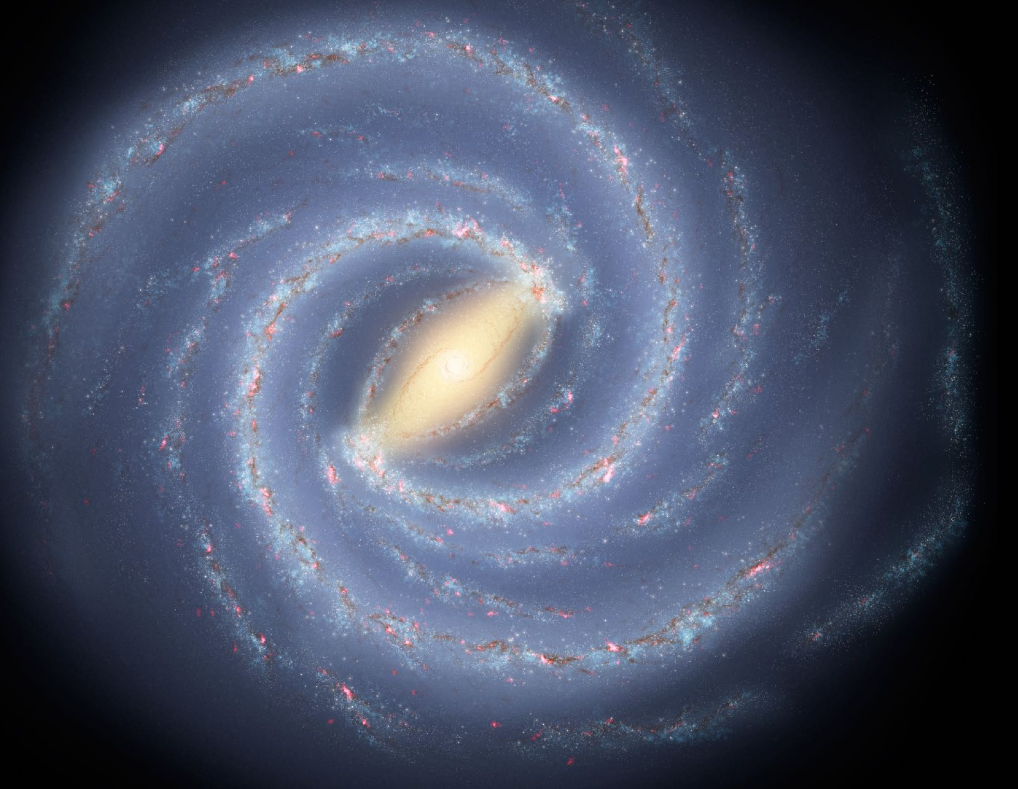

Slide 20
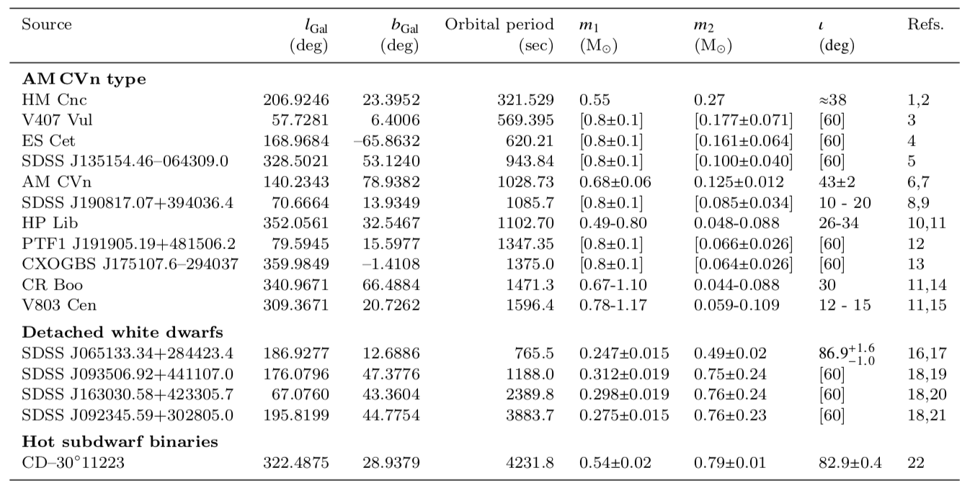
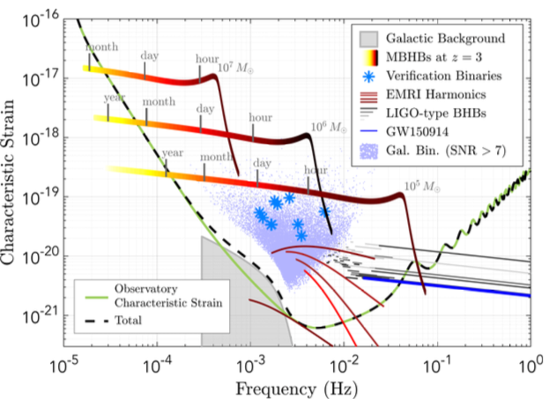
Known LISA verification binaries
Kupfer et al 2018

Slide 21
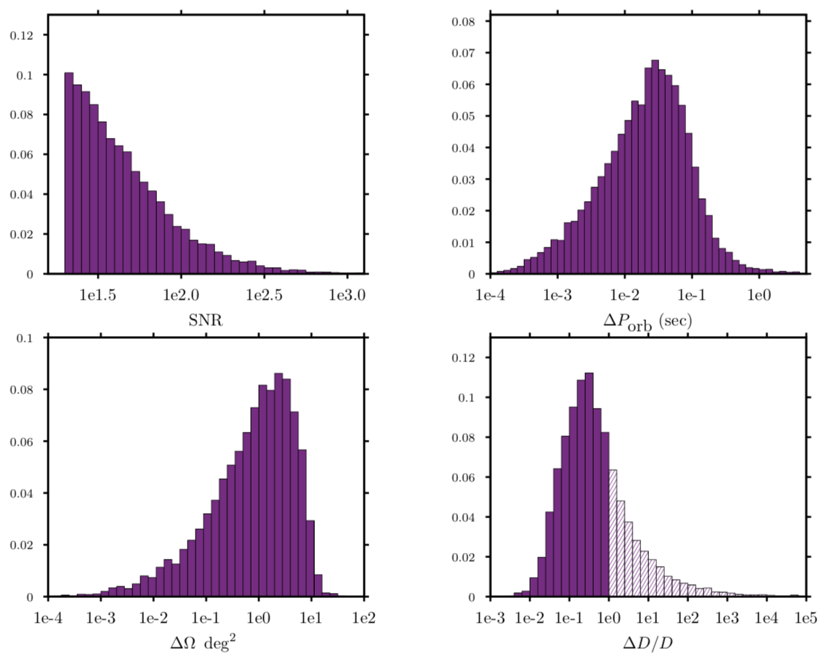
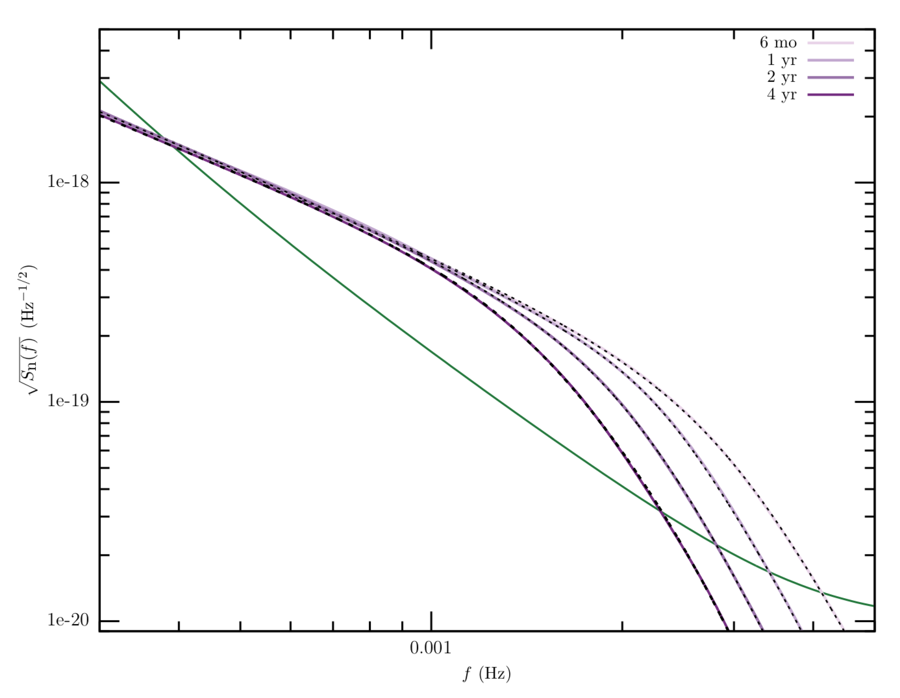
LISA Observations of Galactic Binaries
Above:LISA measurements of resolved Galactic binaries for sources with SNR>20, observed for 4 years.
Below: Estimated rates Cornish-Robson 2017.
Unresolved GW foreground from Galactic binaries. Cornish-Robson 2017.

Slide 22
SO4: Understand the astrophysics of stellar origin black holes | SI 4.1 | Study the close environment of SOBHs by enabling multi-band and multi-messenger observations at the time of coalescence | OR 4.1 | Have the ability to detect the inspiral signal from GW150914-like events with SNR > 7 after 4 years of observation and estimate the sky localisation with < 1 deg2 and the time of coalescence in ground-based detectors to within one minute. This will allow the triggering of alerts to ground-based detectors and to pre-point EM probes at the SOBH coalescence.
 | SI 4.2 | Disentangle SOBH binary formation channels | OR 4.2 | Have the ability to observe SOBH binaries with total mass in excess of 50 M⊙ out to z ~ 0.1, with an SNR higher than 7 and a typical fractional error on the mass of 1 part in 100 and eccentricity with an absolute error of 1 part in 10³.
Source: LISA Mission Proposal. Note actual mission science requirements may evolve.

Slide 23
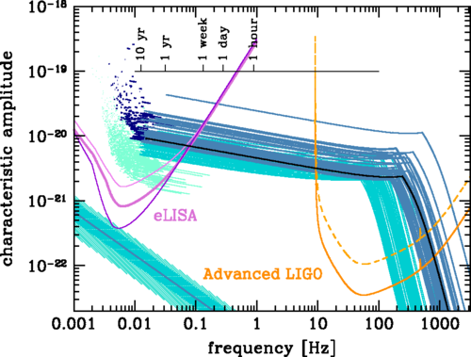
BH binaries & multi-band GW astronomy
Sources
Heavy stellar remnant BH binaries (e.g. GW150914)
LISA will observe for months to years prior to merger.
gap of ~weeks between LISA and LIGO
Science
Advance notice of when and where BH merger will occur. Counterpart?
Compare LISA and ground-based GW waveforms. GW dispersion?
A. Sesana, Phys. Rev. Lett. 116, 231102
The SXS Project

Slide 24
Source: Slide from Alberto Sesana

Slide 25
Test General Relativity with observations
Notes:
Get material from LRR?

Slide 26
SO5: Explore the fundamental nature of gravity and black holes | SI 5.1 | Use ring-down characteristics observed in MBHB coalescences to test whether the post-merger objects are the black holes predicted by GR. | OR 5.1 | Have the ability to detect the post-merger part of the GW signal from MBHBs with M > 10⁵ M⊙ out to high redshift, and observe more than one ring-down mode to test the “no-hair” theorem of GR.
 | SI 5.2 | Use EMRIs to explore the multipolar structure of MBHs | OR 5.2 | Have the ability to detect ‘Golden’ EMRIs (those are systems from OR3.1 with SNR > 50, spin > 0.9, and in a prograde orbit) and estimate the mass of the SOBH with an accuracy higher than 1 part in 10⁴, the mass of the central MBH with an accuracy of 1 part in 10⁵, the spin with an absolute error of 10⁻⁴, and the deviation from the Kerr quadrupole moment with an absolute error of better than 10⁻³ .
 | SI 5.3 | Testing for the presence of beyond-GR emission channels | OR 5.3 | Same as OR 4.1
 | SI 5.4 | Test the propagation properties of GWs | OR 5.4 | Same as combination of ORs 2.2 and 3.1.
 | SI 5.5 | Test the presence of massive fields around massive black holes with masses > 10³ M⊙ | OR 5.5 | Same as combination of ORs 2.2, 4.1 and 4.2
Source: LISA Mission Proposal. Note actual mission science requirements may evolve.

Slide 27
GW Dispersion test
Samajdar+Arun 2017
𝜶=0 : massive graviton
𝜶=2.5 or 3 : Lorentz violations

Slide 28
Probe new physics and cosmology

Slide 29
SO6: Probe the rate of expansion of the Universe | SI 6.1 | Measure the dimensionless Hubble parameter by means of GW observations only | OR 6.1.a | Have the ability to observe SOBH binaries with total mass M>50M⊙ at z<0.1 with SNR higher than 7 and typical sky location of < 1 deg².
 |  |  | OR 6.1.b | Have the ability to localize EMRIs with an MBH mass of 5×10⁵M⊙ and an SOBH of 10M⊙ at z = 1.5 to better than 1 deg².
 | SI 6.2 | Constrain cosmological parameters through joint GW and EM observations | OR 6.2 | Have the capability to observe mergers of MBHBs in the mass range from 10⁵ to10⁶M⊙ at z < 5, with accurate parameter estimation and sky error of < 10 deg² to trigger EM follow ups.
SO7: Understand stochastic GW backgrounds and their implications for the early Universe and TeV-scale particle physics | SI 7.1 | Characterise the astrophysical stochastic GW background | OR 7.1 | Characterise the stochastic GW background from SOBH binaries with energy density normalised to the critical energy density in the Universe today, Ω, based on the inferred rates from the LIGO detections, i.e., at the lowest Ω = 2 × 10⁻¹⁰ ( f /25 Hz)^{2/3}. This requires the ability to verify the spectral shape of this stochastic background over the frequency range 0.8 mHz < f < 4 mHz and to measure its amplitude over 4mHz < f < 20mHz.
 | SI 7.2 | Measure, or set upper limits on, the spectral shape of the cosmological stochastic GW background | OR 7.2 | Probe a broken power-law stochastic background from the early Universe. Therefore, we need the ability to measure Ω = 1.3 × 10⁻¹¹ ( f /10−4 Hz)⁻¹ in the frequency ranges 0.1mHz < f < 2mHz, and Ω = 4.5 × 10⁻¹² (f/10−2 Hz)³ in the frequency ranges 2mHz < f < 20mHz.
SO8: Search for GW bursts and unforeseen sources | SI 8.1 | Search for cusps and kinks of cosmic strings | OR 8.1 | Have the ability to use the Sagnac (or null-stream) TDI channels.
 |  |  | OR 8.2 | Have the ability to use the Sagnac (or null-stream) TDI channels.
Source: LISA Mission Proposal. Note actual mission science requirements may evolve.

Slide 30
Black Hole Cosmology
BH mergers as “standard sirens”
chirp rate gives mass
mass gives intrinsic amplitude
measured amplitude gives distance
Redshift
Need EM follow-up to identify (or constrain) hosts
Luminosity distances for simulated catalog of LISA BH binaries (N. Tamanini)

Slide 31
LISA Science Now

Slide 32
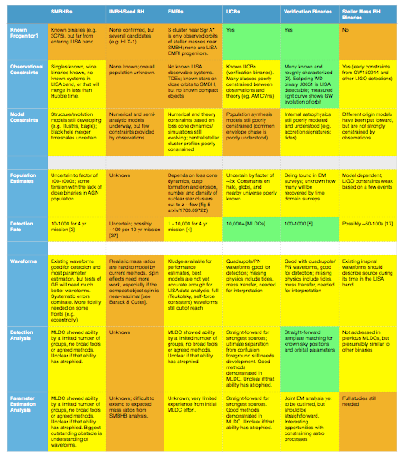
Science Status Overview
Source: LISA Science Roadmap NASA L3 Study Team 2017 Preliminary

Slide 33
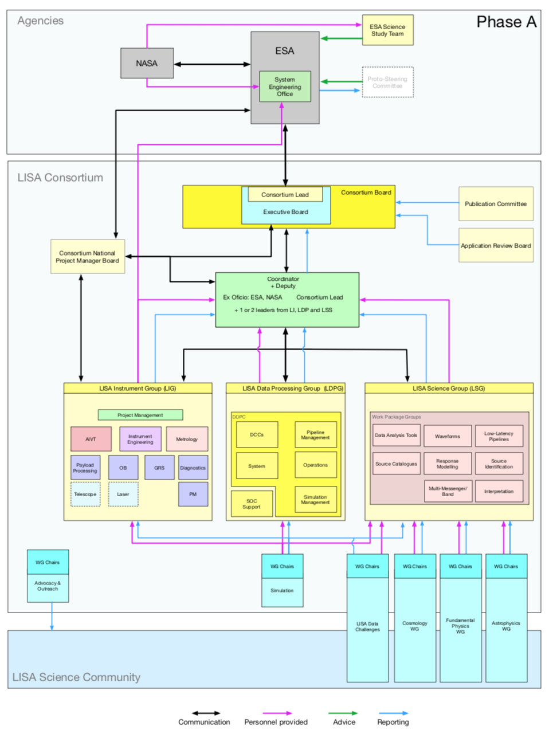
The new LISA Consortium:
Roles -LISA Instrument payload -Science data processing -Science community
Reorganized for Phase-A
Processing Membership Applications ~125 group applications ~800 individual members

Slide 34
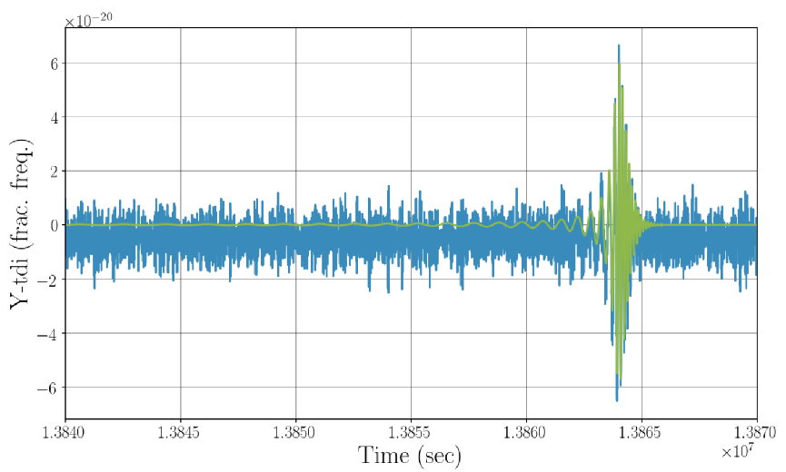
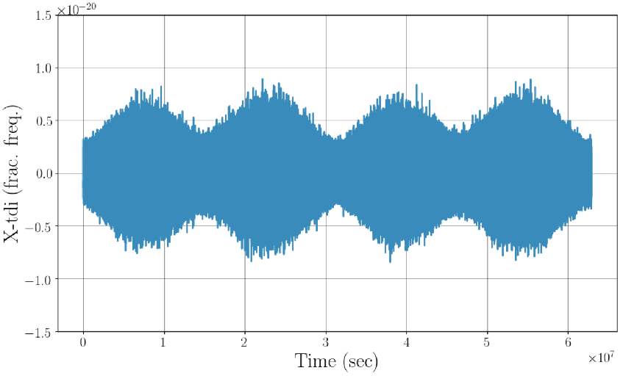
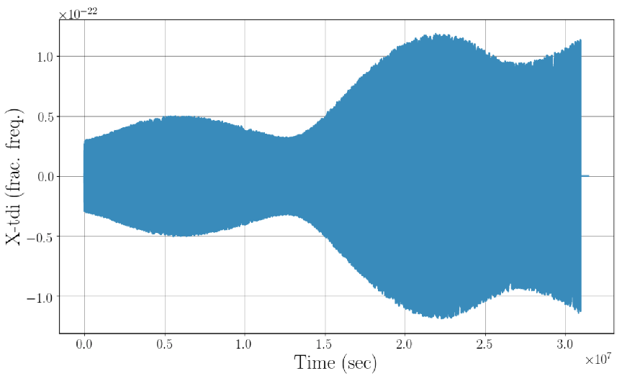
The LISA Data Challenges
2006-2011 Mock LISA Data Challenges
Demonstrated proof-of-concept LISA data analysis
LDC LISA Phase A Project Goals:
Project oriented challenges: Moving away from idealized data
Demonstrate capability to deliver science requirements
Understand the nature of data analysis needs for project planning
Develop software standards and pipelines
Broader LISA data analysis research goals:
Foster LISA data analysis development: improve performance of existing algorithms, try new algorithms
Community oriented challenges / tutorials

Slide 35
Contact US reps. on ESA’s Science Study Team
—Kelly Holley-Bockelmann / Vanderbilt —Robin Stebbins / Colorado —David Shoemaker / MIT
Participate in the LDC:
—Participate in the public challenges: —Join the LDC team: (first join the Consortium)
Join the LISA Consortium:
—Now reorganizing to deliver results for LISA Phase A … technology development, instrument simulations, data challenges —Can sign-on to join the effort —Or just as a curious observer
Engage with the NASA LISA Study Team: —Bringing LISA through the US astro decadal survey —Write great science white papers!
Eng LISA Preparatory Science (LPS) in NASA ROSES —NOIs were due last month —Be a reviewer!
LISA wants you!
Sign up here: https://lisa-ldc.lal.in2p3.fr/ldc
Sign up here: www.LISAmission.org
A proposed
future
ground-based
instrument

