Slide 1
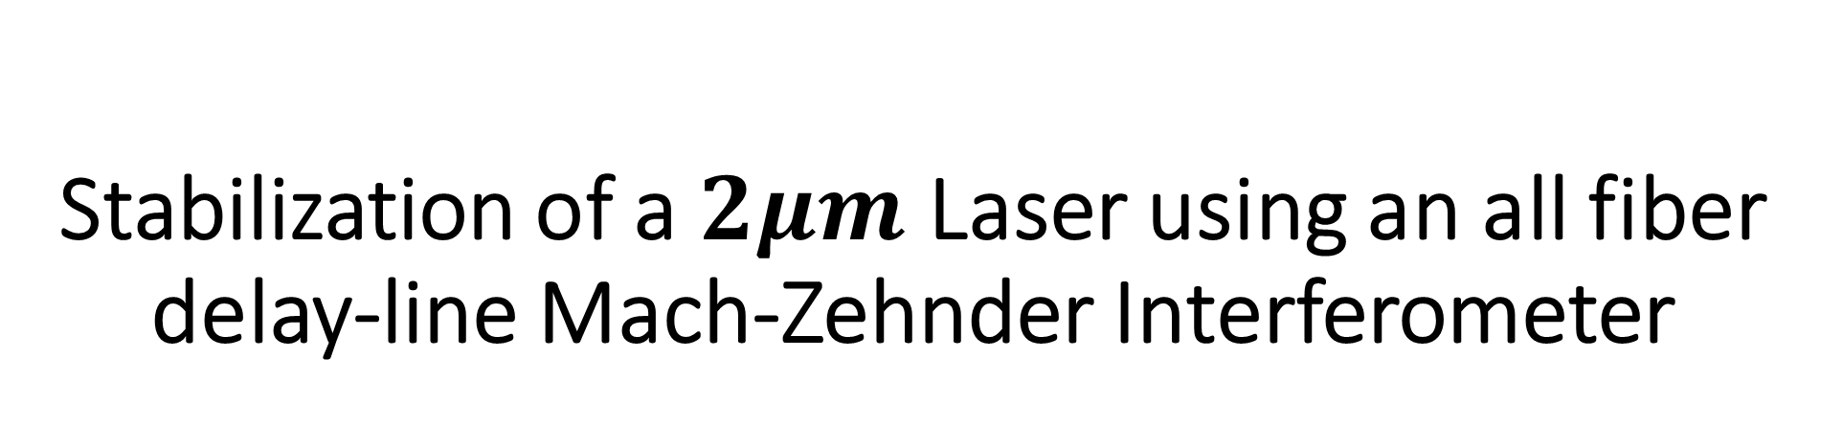
Stabilization of a $2μm$ Laser using an all fiber delay-line Mach-Zehnder Interferometer
Vinicius Wagner
Mentors: Andrew Wade, Aidan Brooks
LIGO SURF - Summer 2018

Slide 2
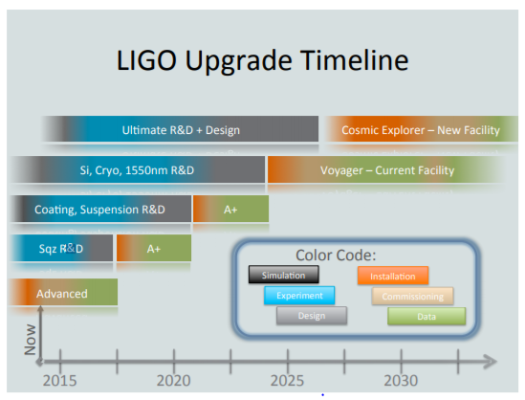
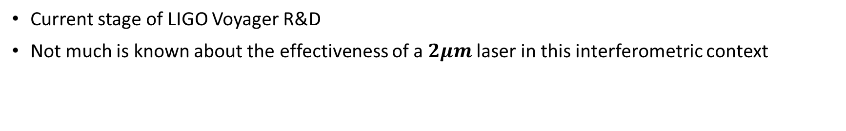
Motivations
Current stage of LIGO Voyager R&D
Not much is known about the effectiveness of a $2μm$ laser in this interferometric context

Slide 3
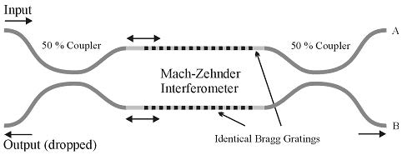
The Experiment
Fibered Mach-Zehnder Interferometer (MZI)
  Fibered set-up provides greater flexibility in
  experiment adjustments
The delay-line, arm length mismatch
  Frequency Discriminator
The nearby “Witness” Interferometer
  Provide a reference for the purpose of prolonged stability

Slide 4
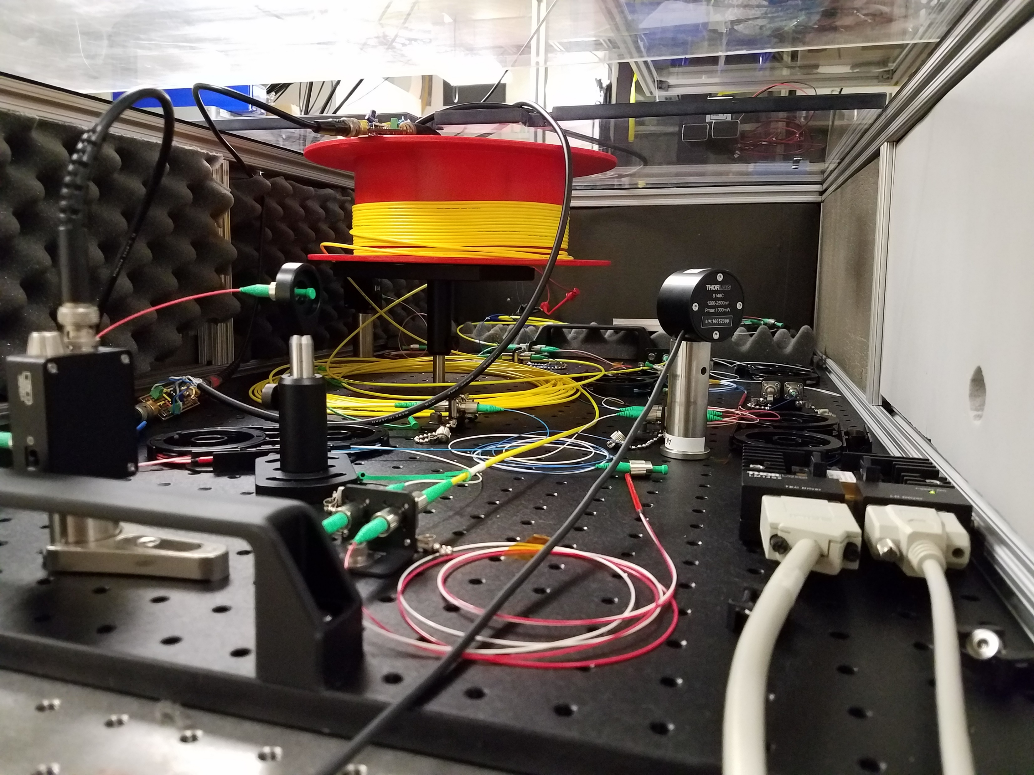
The Experiment

Slide 5








The Experiment
Servo
$$ΔL$$
Photodetector #1
In-loop interferometer
$$\frac{50}{50}$$
$$\frac{50}{50}$$
$$2μm$$
Faraday Isolator
$$\frac{50}{50}$$
Witness Interferometer
$$\frac{50}{50}$$
TEC
$$\frac{50}{50}$$
Photodetector #2
$$ΔL$$
Servo

Slide 6
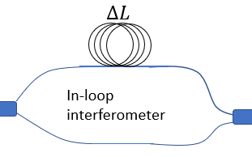
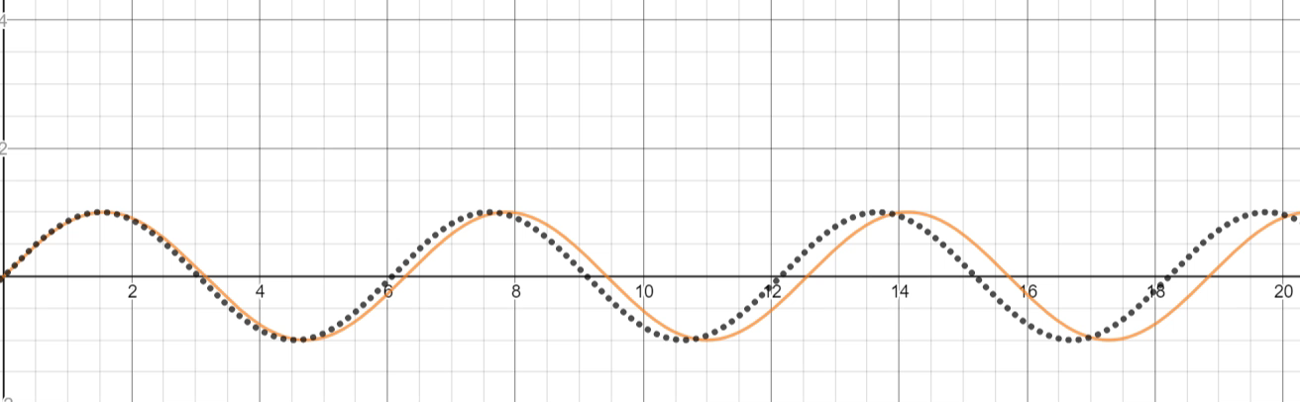
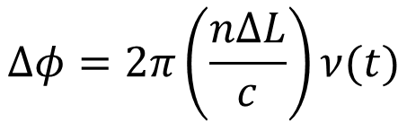
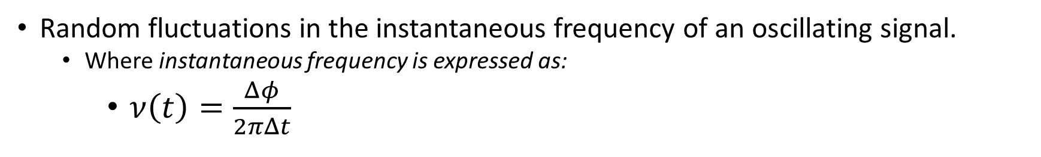
Frequency Noise
Random fluctuations in the instantaneous frequency of an oscillating signal.
  Where instantaneous frequency is expressed as:
    $ν\left(t\right)=\frac{Δφ}{2πΔt}$
$$Δφ=2π\left(\frac{nΔL}{c}\right)ν(t)$$

Slide 7
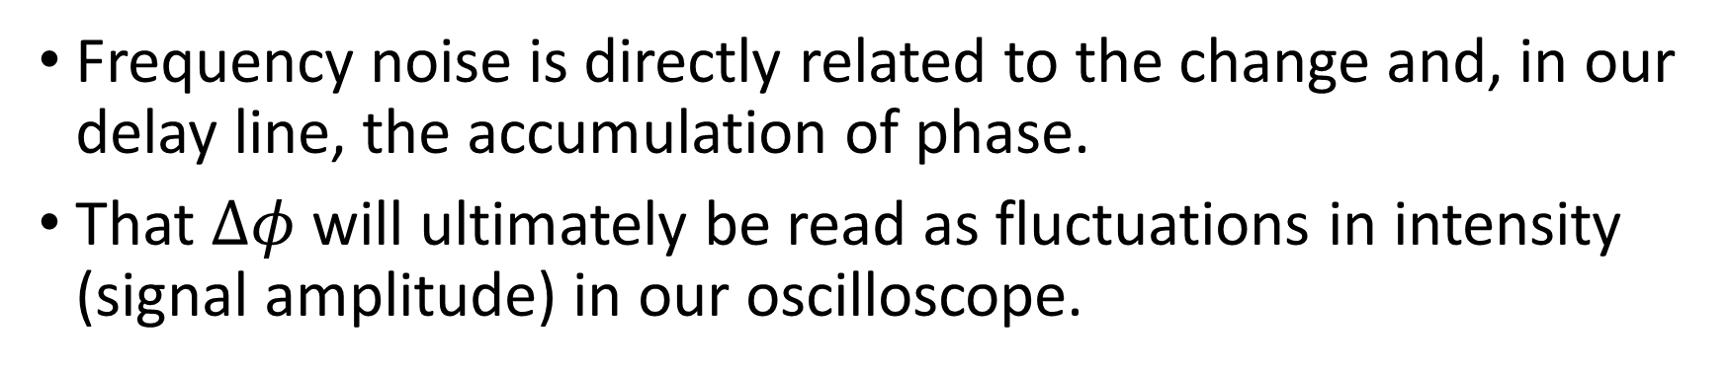
Frequency Noise
Frequency noise is directly related to the change and, in our delay line, the accumulation of phase.
That $Δφ$ will ultimately be read as fluctuations in intensity (signal amplitude) in our oscilloscope.

Slide 8
Delay Line
Manifested through the MZI arm-mismatch.
Phase accumulation in longer arm is converted to power fluctuations.
The longer arm acts as a frequency discriminator.

Slide 9
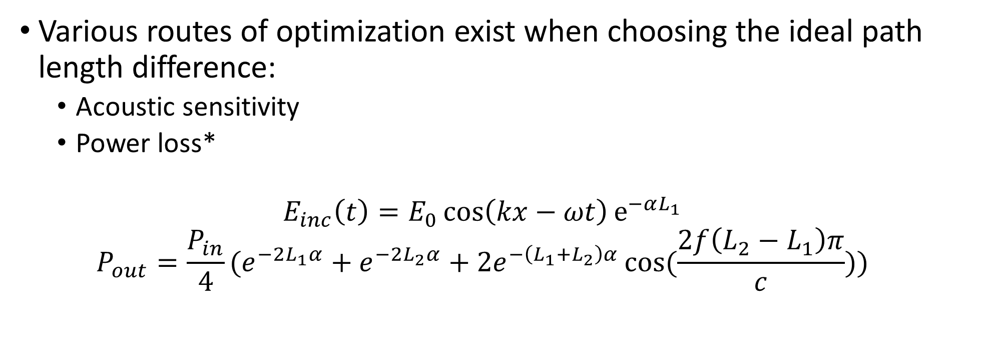

Delay Line, the $ΔL$
Various routes of optimization exist when choosing the ideal path length difference:
  Acoustic sensitivity
  Power loss*
  $$E_{inc}\left(t\right)=E_{0}\cos\left(kx−ωt\right)e^{−αL_{1}}$$
  $$P_{out}=\frac{P_{in}}{4}(e^{−2L_{1}α}+e^{−2L_{2}α}+2e^{−\left(L_{1}+L_{2}\right)α}\cos{(\frac{2f\left(L_{2}−L_{1}\right)π}{c}))}$$

Slide 10
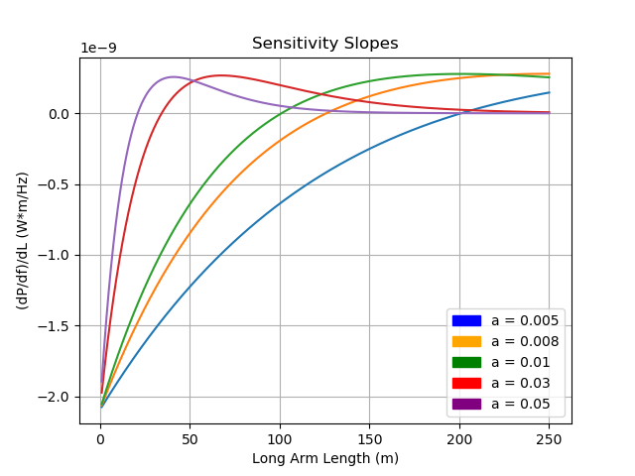
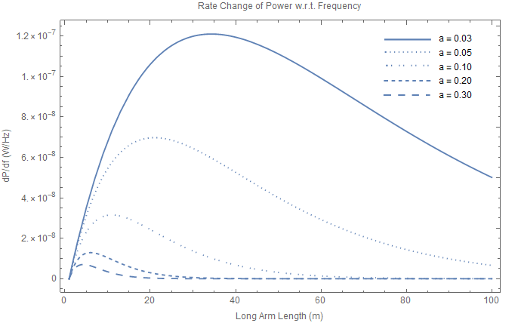
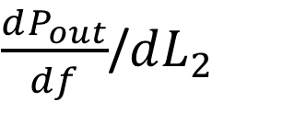
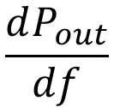
$$\frac{dP_{out}}{df}$$
$\frac{dP_{out}}{df}$/$dL_{2}$
Given this optimization, ideal path length would be roughly 136m.

Slide 11
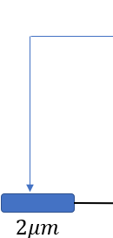
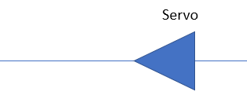
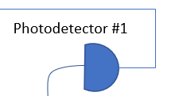
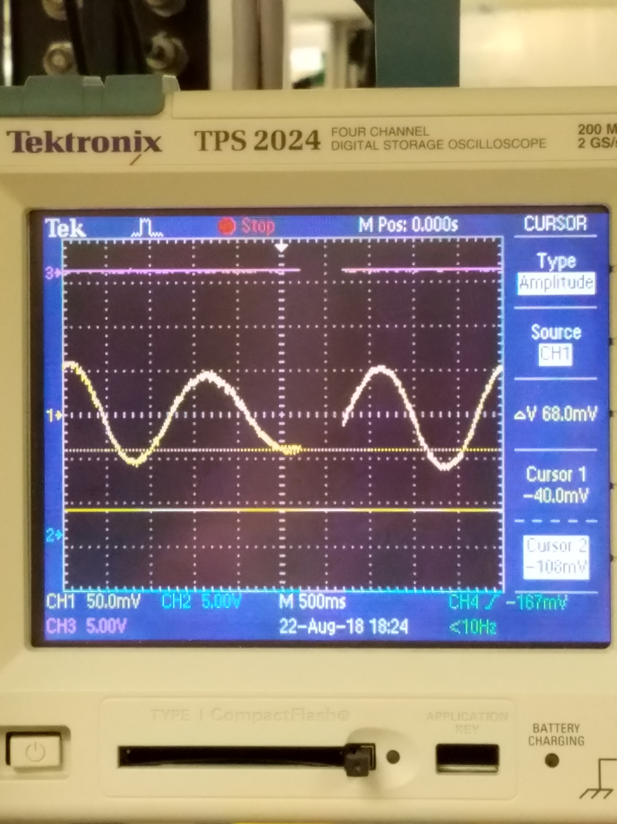
Stabilization, How?
Achieved by locking the photodetector’s output to mid-fringe, and subsequently creating a closed feedback loop with its current controller.
The feedback loop is a PI (Proportional – Integration) control system because of its servo’s integer gain and bandpass filter capabilities, respectively.

Slide 12
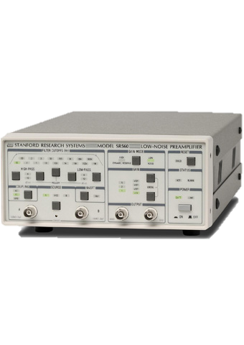
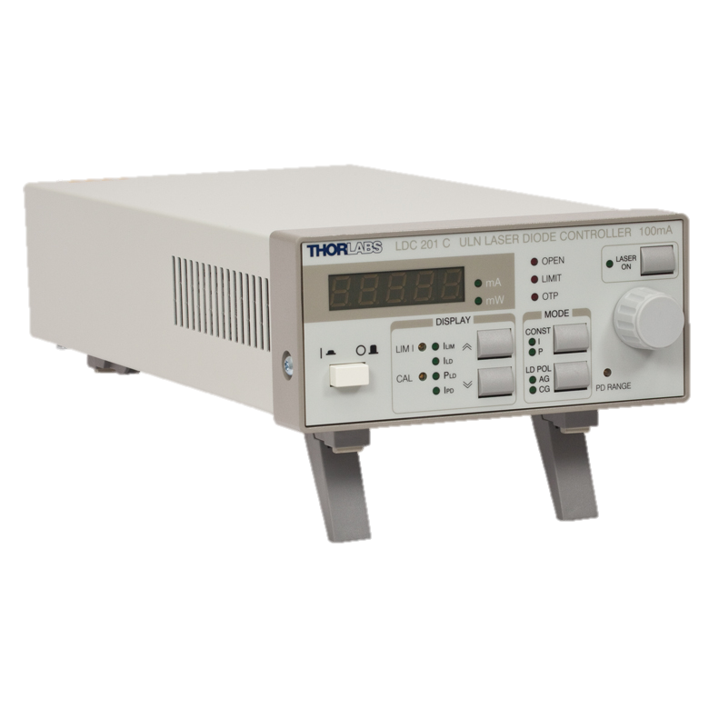








Stabilization, How?
P.I. Servo (SR560)
Plant (Laser current controller)
Plant Variable (PV)
Set point (SP)
$$+$$
$$−$$
Error signal = SP-PV
$$\frac{V}{V}$$
$$\frac{Hz}{V}$$
$$n_{environment}$$
$$Hz$$
Sensor (MZI)
$$n_{sensor}$$
$$\frac{V}{Hz}$$

Slide 13
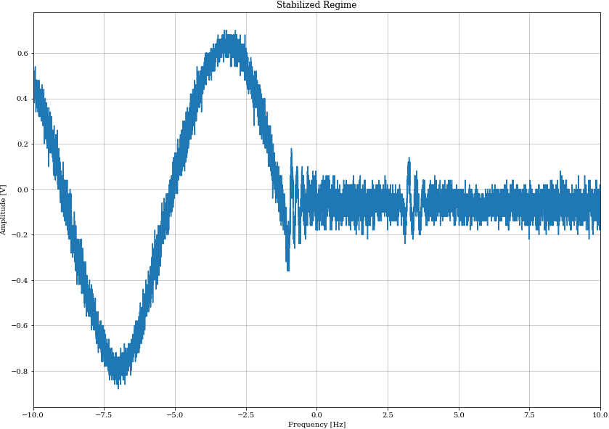
Closed loop stability regime
Open loop signal output, mid-fringe locked

Slide 14
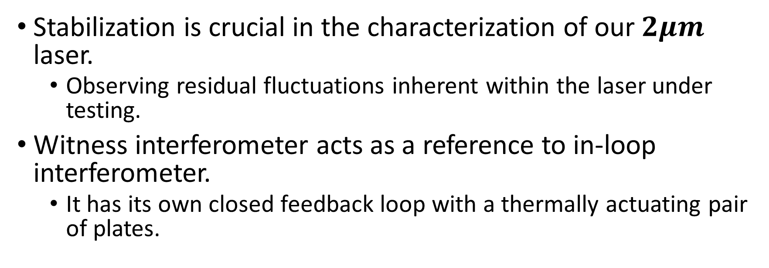
Stabilization, Why?
Stabilization is crucial in the characterization of our $2μm$ laser.
  Observing residual fluctuations inherent within the laser under testing.
Witness interferometer acts as a reference to in-loop interferometer.
  It has its own closed feedback loop with a thermally actuating pair of plates.

Slide 15
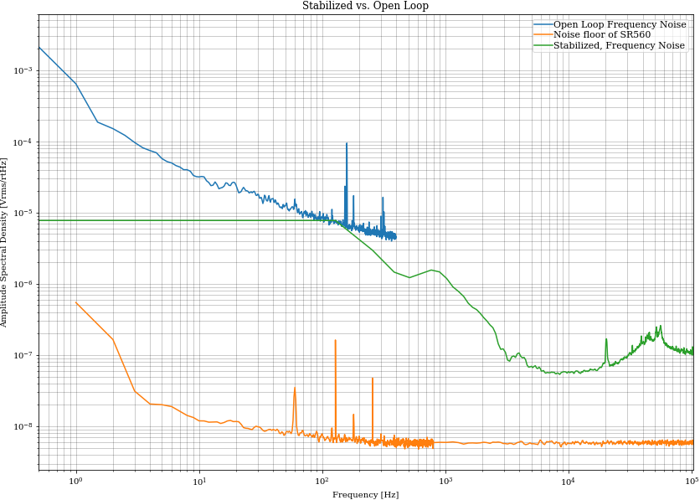
Stabilization

Slide 16
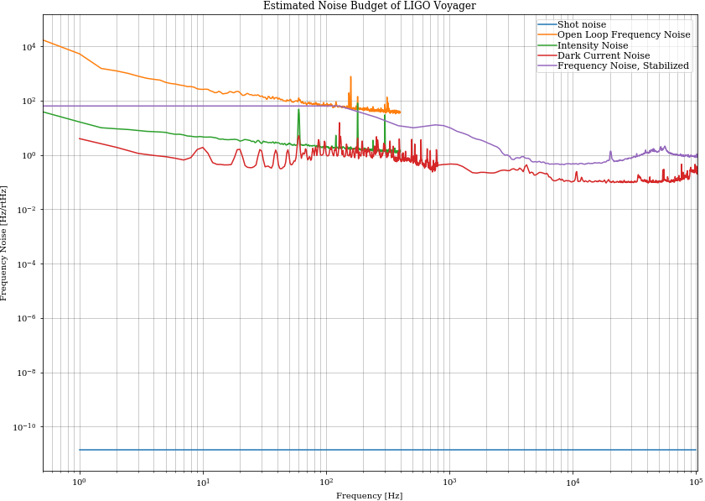
Noise Budget
Shot noise
  Fundamental limit to optical intensity noise.
Open loop frequency noise
  No feedback
Intensity noise
  One arm signal, including electronics noise
Dark current Noise
  From powered photodetector
Frequency Noise of stabilized laser
Speculated LIGO Voyager requirement (based of Advanced LIGO’s)

Slide 17
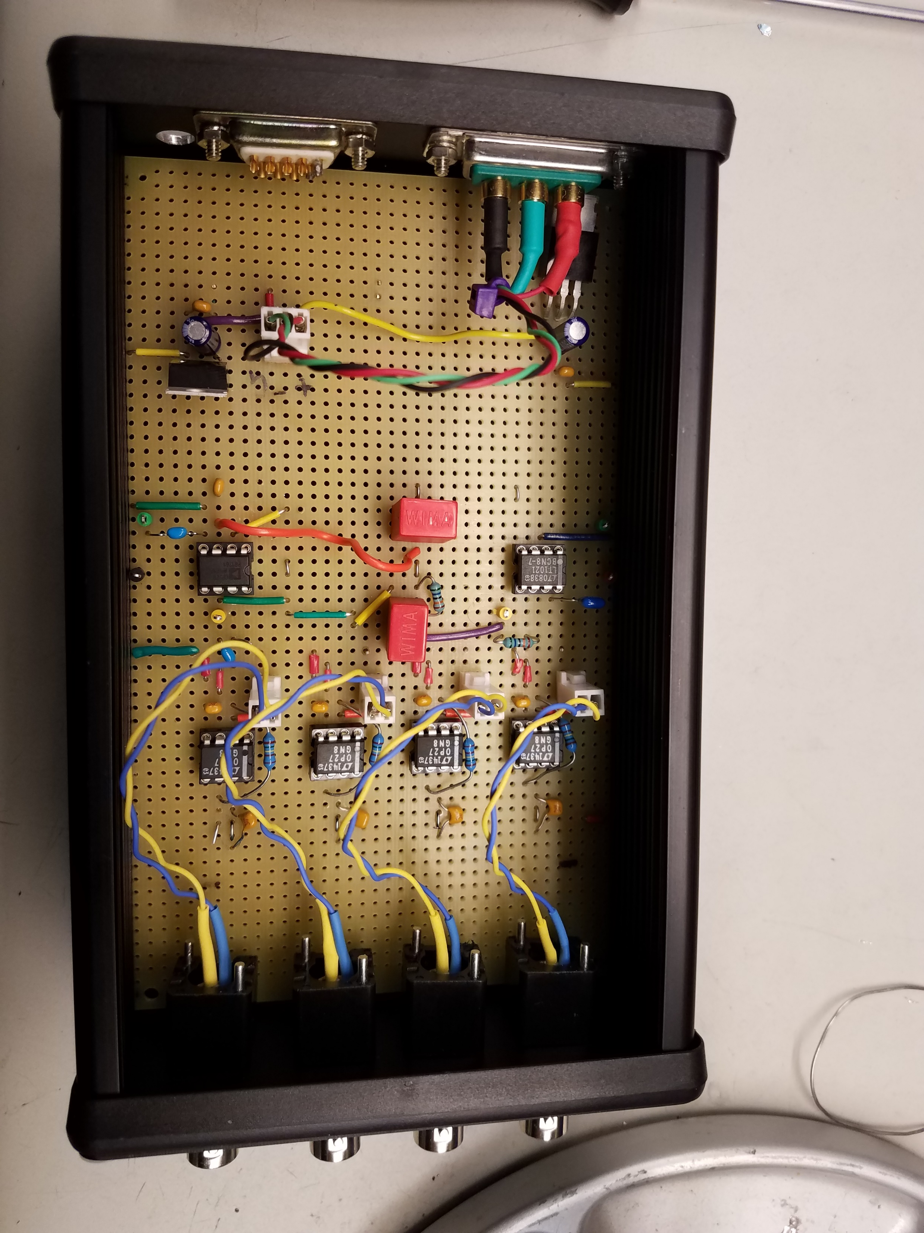
Further work
Acoustic sensitivity measurements within optic fibers
Incorporate thermal sensors within and around TMTF
Characterize potential sources of noise in stabilized laser

Slide 18
Acknowledgements
Andrew Wade, Aidan Brooks
LIGO, Caltech SFP
Laser Safety Guidelines
SURFers

