Slide 1
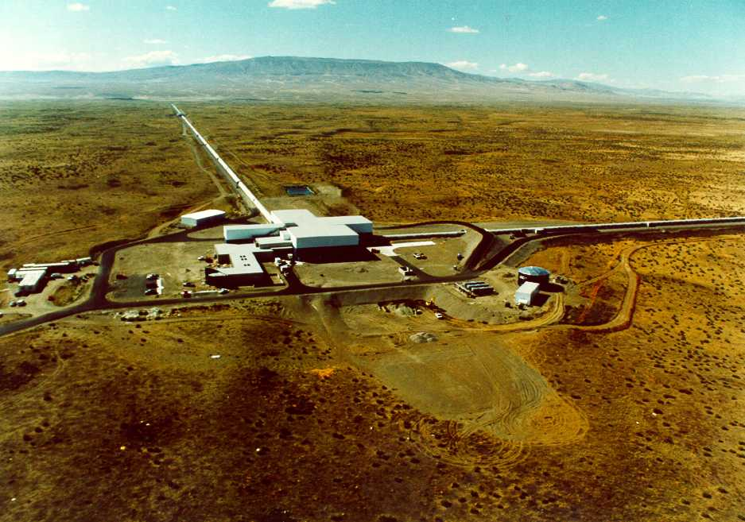
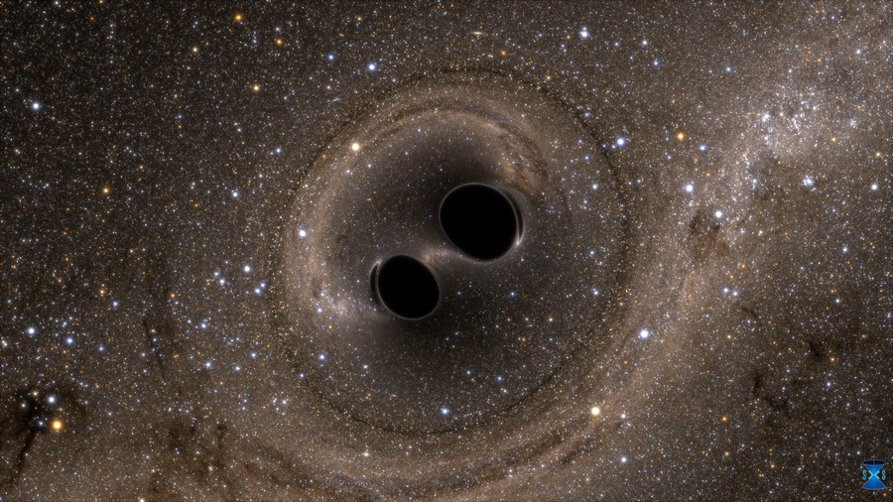
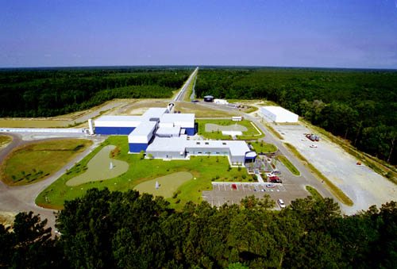
General Relativity
The Basics
Credit: SXS Lensing; http://www.black-holes.org/
The Laser Interferometer Gravitational-wave Observatory: a Caltech/MIT collaboration supported by the National Science Foundation
Gregory Mendell, LIGO Hanford Observatory
LIGO-G1801389
Notes:
1
1

Slide 2
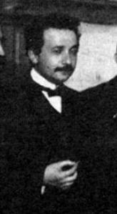
Einstein Wondered:
Can we catch light?
Photo: Albert Einstein at the first Solvay Conference, 1911; Public Domain
Notes:
2
2

Slide 3
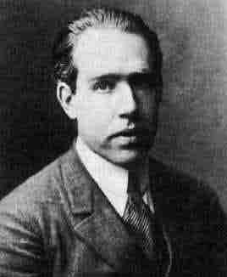
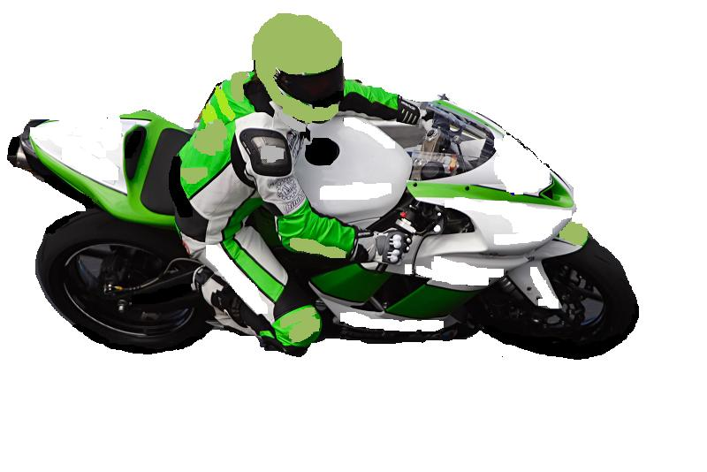
Niels Bohr
Time Dilation
Albert Einstein
Δx=vΔt
cΔT
cΔt
ΔT= Δt 1-v²/c²
Δ = change in
T = time measured by motorcycle riders
t = time measured by observer at “rest”
v = speed of motercycles
c = speed of light
LIGO-G0900422-v1
Start
Warning: thought experiment only; do not try this at home.
Motorcycle: http://en.wikipedia.org/wiki/Motorcycle_racing
Notes:
3
3

Slide 4
The Pythagorean Theorem Of Spacetime
c²ΔT² + v²Δt² = c²Δt²
c²ΔT² = c²Δt² - v²Δt²
c²ΔT² = c²Δt² - Δx²
c = 1 light-year/year
ΔT² = Δt² - Δx²
(Usually known as the spacetime interval)
Notes:
4
4

Slide 5
Example
t
Spacetime
c = 1 light-year/year
ΔT² = Δt² - Δx²
Δt = 30 years; Δx = 29 lt-yrs.
v = 96.7% the speed of light
ΔT² = 30² – 29² = 59 yrs²
ΔT = 7.7 years
ΔT
Δt = 30 years
x
Δx = 29 light-years
Notes:
5
5

Slide 6
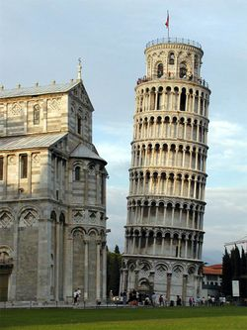
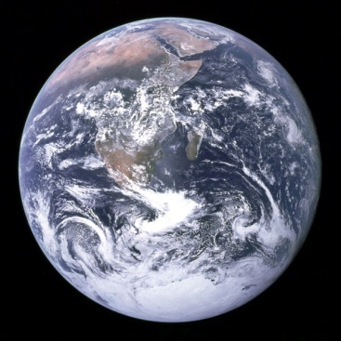
Einstein’s Happiest Thought
Gravity disappears when you free fall!
☺ ☺
Photo: NASA
http://en.wikipedia.org/wiki/Leaning_Tower_of_Pisa
LIGO-G0900422-v1
Warning: thought experiment only; do not try this at home.
Notes:
6

Slide 7
Einstein’s General Theory of Relativity
Δ →d = infinitesimal change
dT² = g_{tt}dt² + g_{xx}dx²
dT² = g_{μν}dx^{μ}dx^{ν}
In GR the components of a 4x4 symmetric matrix called the metric tensor define the curvature of spacetime.
Einstein’s Field Equations
U = 4-Vel.; T = Proper Time
Geodesic Equation
Notes:
7
7

Slide 8
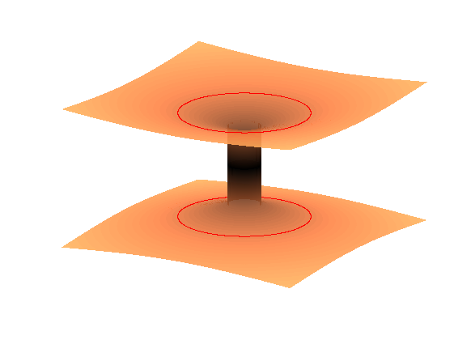
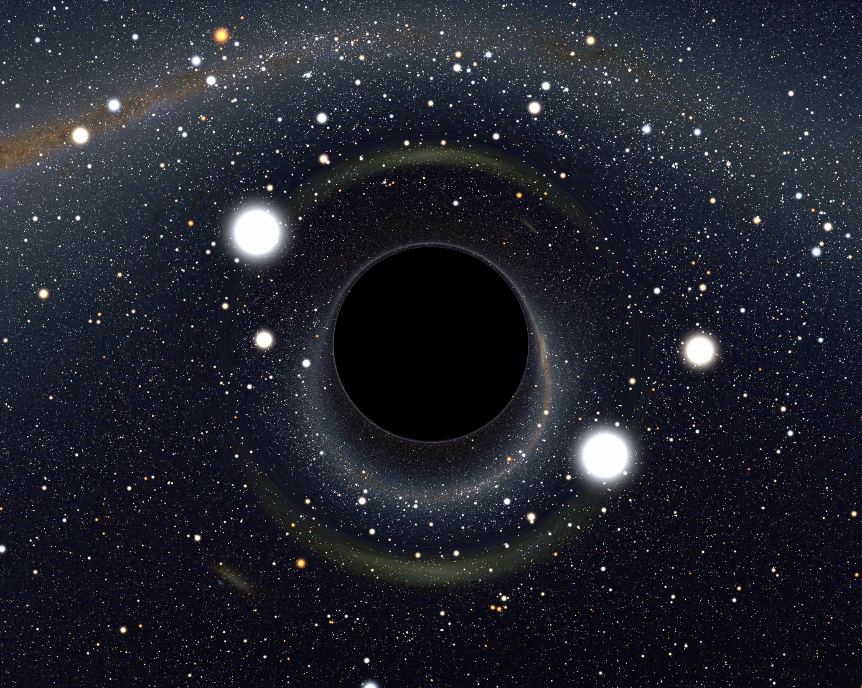
Black Holes are:
Event Horizon
Our Universe
2. Holes in Space
0
Time
Credit: Alain Riazuelo, IAP/UPMC/CNRS
Space
1. Black
3. Space & Time Warps
Escape Velocity = Speed of Light
Schwarzschild 1916; Einstein & Rosen 1935; many others in the 1960s

Slide 9
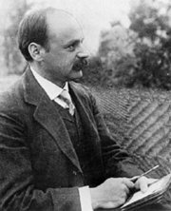
Schwarzschild Black Hole
Karl Schwarzschild
Object Schwarzschild Radius
You 1 thousand, million, million, millionth the thickness of a human hair
Earth 1 cm (size of marble)
Sun 3 km (2 miles)‏
Escape Velocity
Schwarzschild Radius
LIGO-G0900422-v1
Notes:
9
9

Slide 10
Gravitational Time Dilation
Gravity slows time down!
Photo:http://en.wikipedia.org/wiki/Leaning_Tower_of_Pisa
Clock_Photos:http://en.wikipedia.org/wiki/Cuckoo_clock
LIGO-G0900422-v1
Notes:
10
10

Slide 11
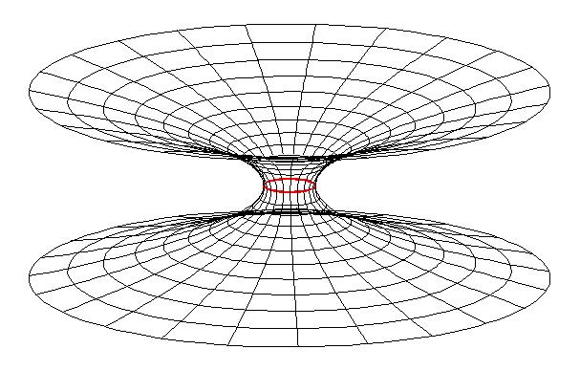
Black Hole Embedding Diagram
Schwarzschild solution to General Relativity for t = constant, θ = π /2:
z
The Schwarzschild Wormhole or Einstein-Rosen Bridge (Flamm 1916, Physikalische Zeitschrift. XVII: 448; Einstein & Rosen 1935, Phys. Rev. 48 73; Misner & Wheeler 1957, Ann. Phys. 2: 525)
y
x
LIGO-G0900422-v1
Notes:
11
11

Slide 12
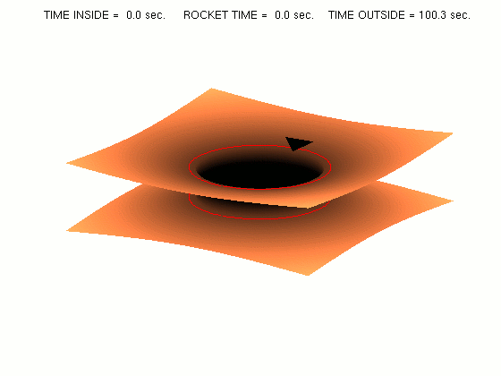
Non-traversable Wormhole
Our Universe
Another Universe
LIGO-G0900422-v1
Notes:
12
12

Slide 13
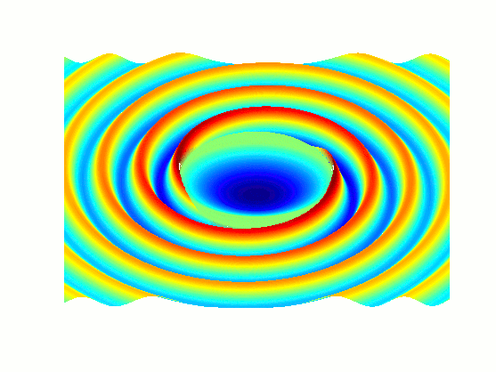
Gravitational Waves
Gravitational waves are ripples in the fabric of spacetime, stirred up by the changing motions of matter and energy.
Notes:
13

Slide 14
Binary Black Hole Merger Simulation
Credit: SXS Collaboration/Canadian Institute for Theoretical Astrophysics/SciNet; http://www.black-holes.org/

Slide 15
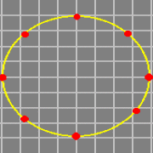
Gravitational Waves
Notes:
15

Slide 16
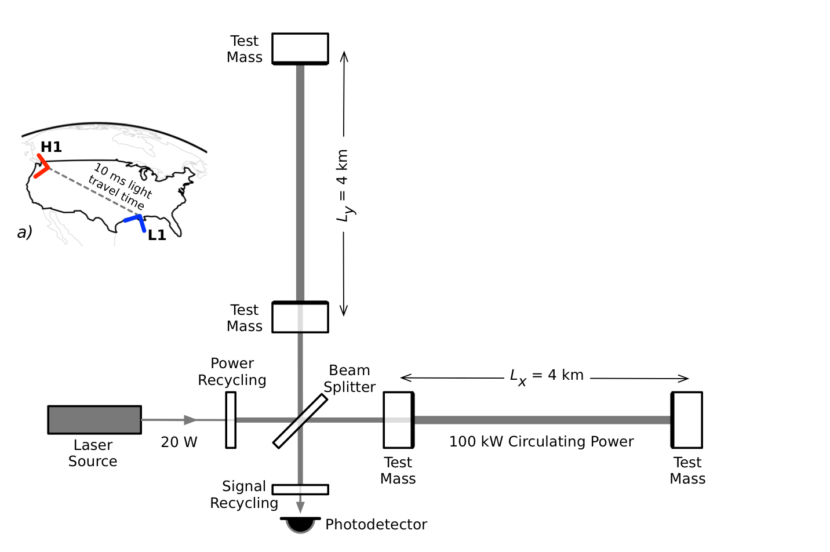
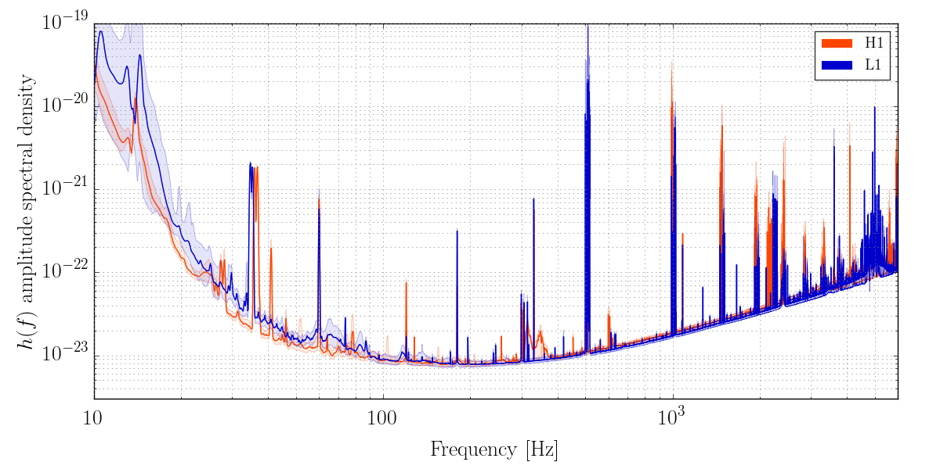
The LIGO Detectors
The waves are extremely weak by the time they reach Earth:
ΔL/L ~ 10⁻²¹

Slide 17
The End
Notes:
17
17

Slide 18
LASER
PHOTODIODE
Notes:
18
18

Slide 19
Detector Response
(Light Travels On Null Geodesics)‏
Notes:
19
19

Slide 20
Summary
Special Relativity, 1905: nothing can faster than light and the faster you go the slower time goes. Space and time become spacetime!
Einstein’s happiest thought, 1907: gravity disappears when you free fall.
General Relativity, 1915: gravity is a warping of space and time.
The Schwarzschild Solution, 1916: Black Holes!
Gravitational Waves, 1916: the changing motion of matter and energy can produce ripples in the fabric of spacetime.
Photo: Albert Einstein at the first Solvay Conference, 1911; Public Domain
Notes:
20
20

Slide 21
Would you believe you could fall into hole in completely empty space, a hole from which nothing can escape, not even light?
Notes:
21
21

Slide 22
Gravitational Waves
Gravitational waves carry information about the spacetime around black holes & other sources.
LIGO-G0900422-v1
Notes:
22
22

Slide 23
Gravitational Waves
Gravitational waves are ripples in the fabric of spacetime, stirred up by the changing motions of matter and energy.
The waves are extremely weak by the times they reach Earth.
Notes:
23

