Slide 1
Searching for Signs of a Galactic Excess of Gravitational-Wave Bursts
Serena Moseley
Mentor: Tom Callister
LIGO SURF 2018

Slide 2
Outline
Galactic Gravitational-Wave Bursts
Project Details
Sky Localization and Skymaps
Simulating and Processing Data
Results

Slide 3
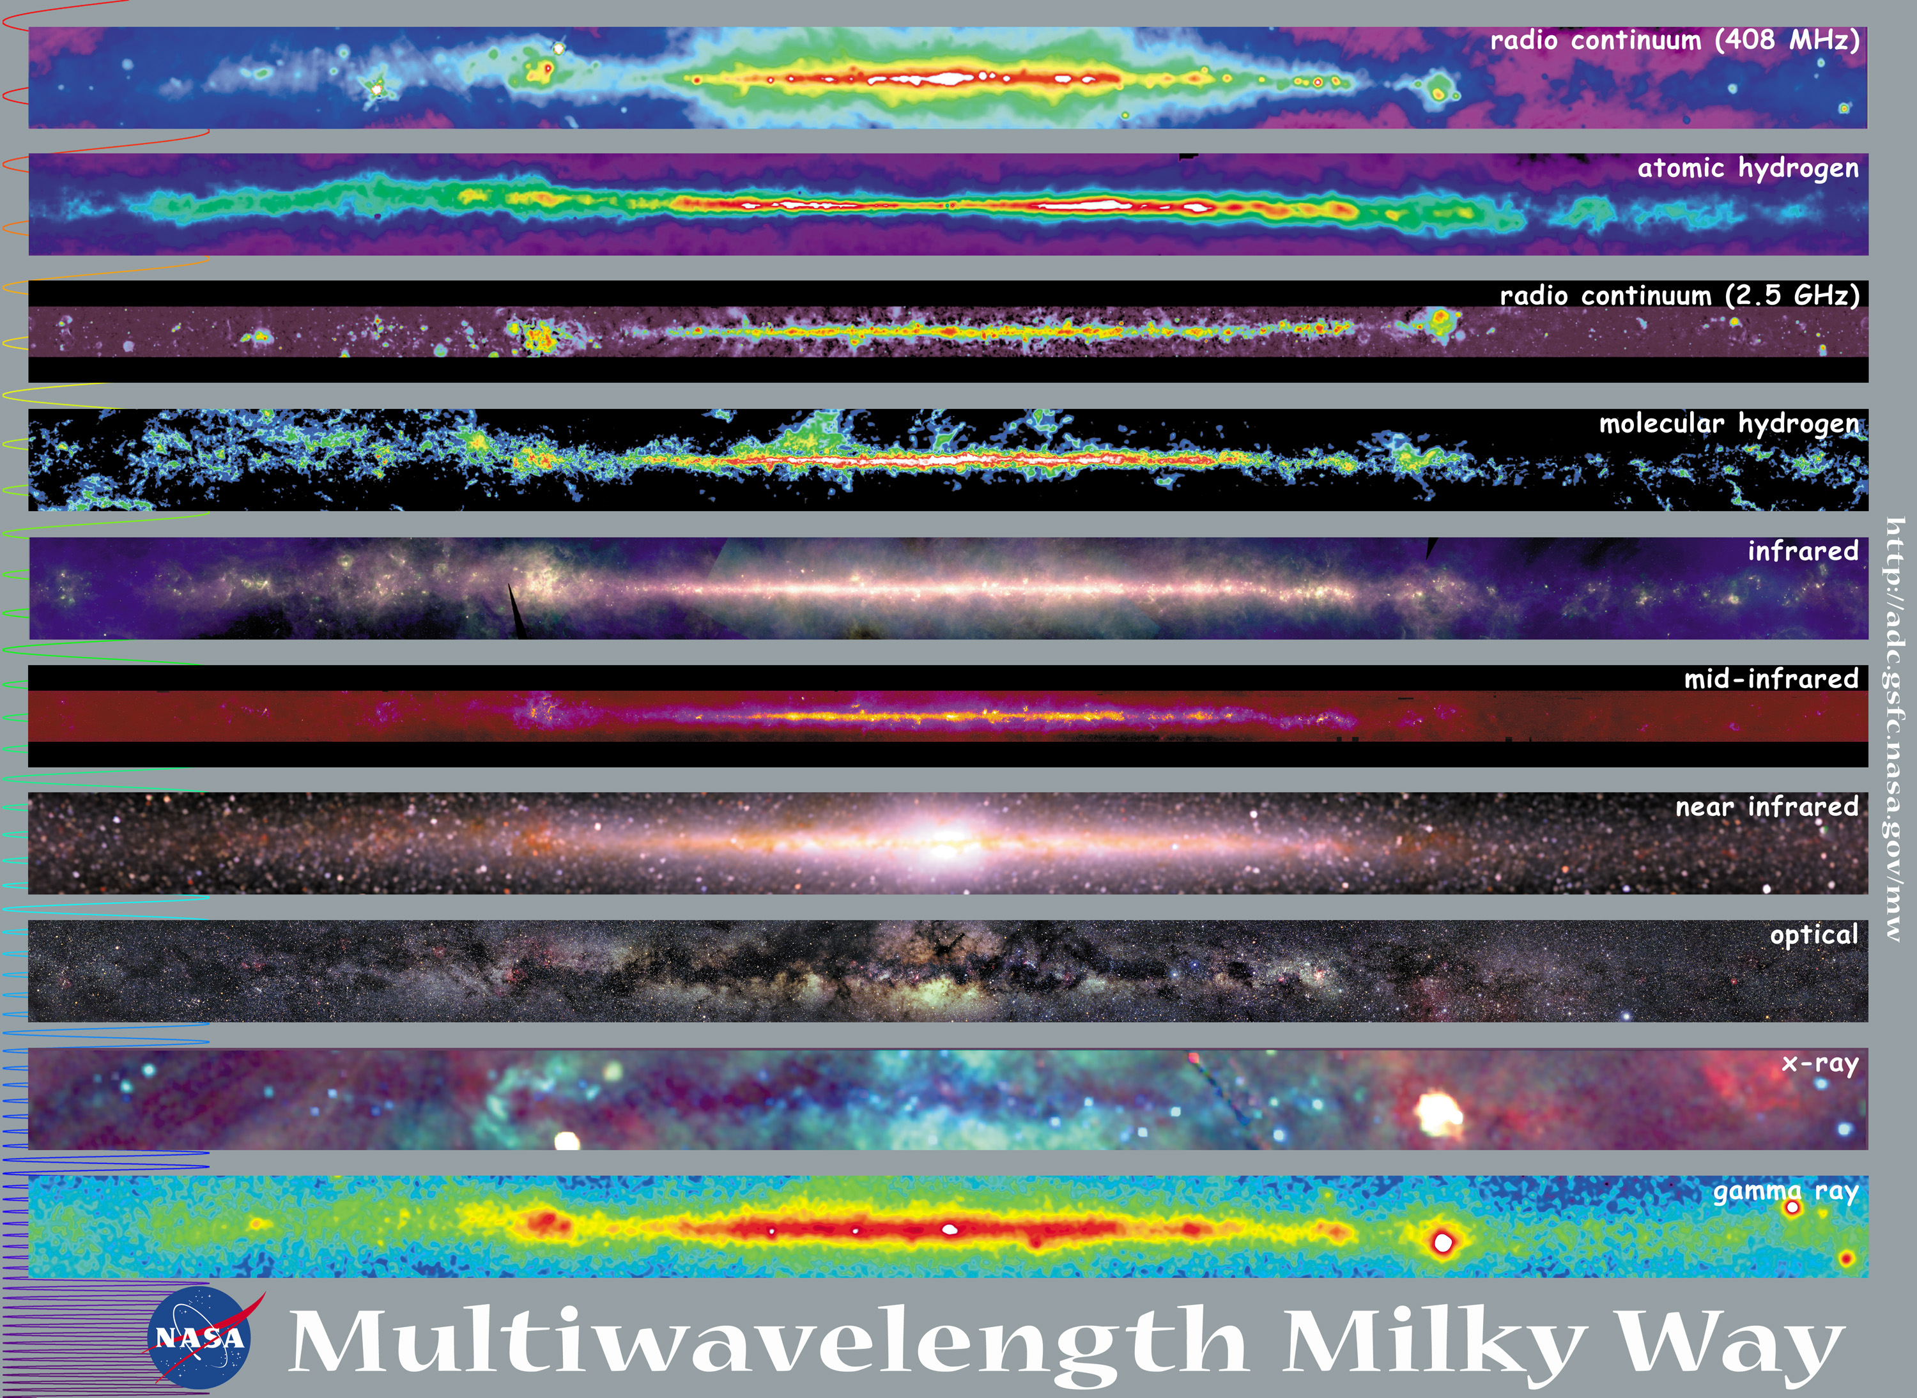
Our Galaxy in the EM Spectrum

Slide 4
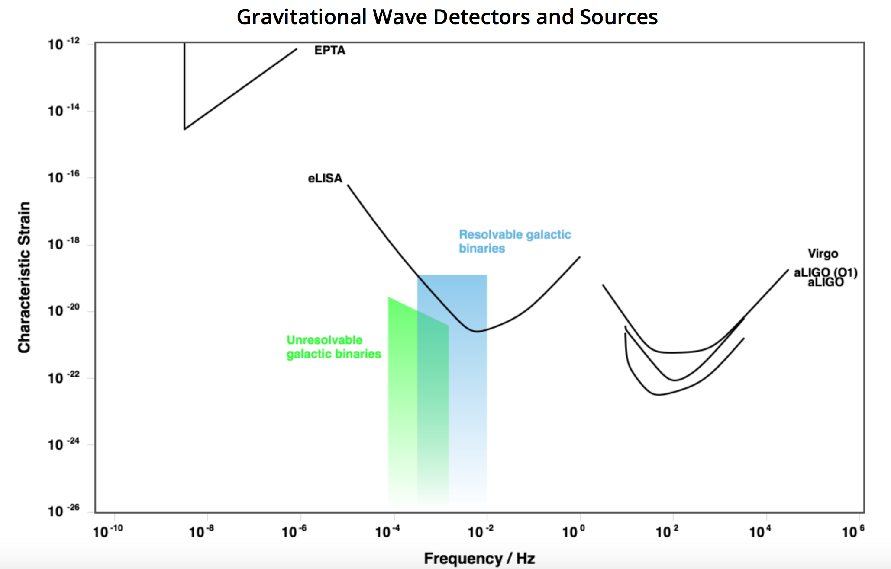
A Galactic Excess
White dwarf binary systems
Radiate at frequencies too low for current detectors

Slide 5
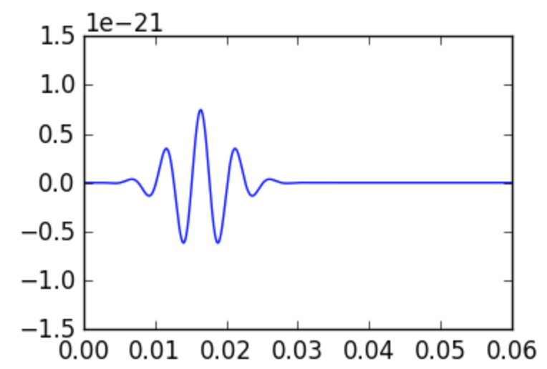
Gravitational-Wave Bursts
Transient event
Unknown source
Supernovae, glitching neutron stars
Unmodeled search
Strain
Duration (s)

Slide 6
Project Motivation
Is there a galactic source of gravitational waves radiating in the LIGO frequency band?
How can we detect it?
How can we identify the source of an unknown burst signal?
Knowing whether origins are galactic or not will help

Slide 7
Project Description
Create two sets of simulated events
Isotropic and galactic
Inject our two sets into Bayeswave and recover individual injections’ sky distributions
For each set, look at the overall population’s distribution and determine if we can tell the difference between our two recovered populations

Slide 8
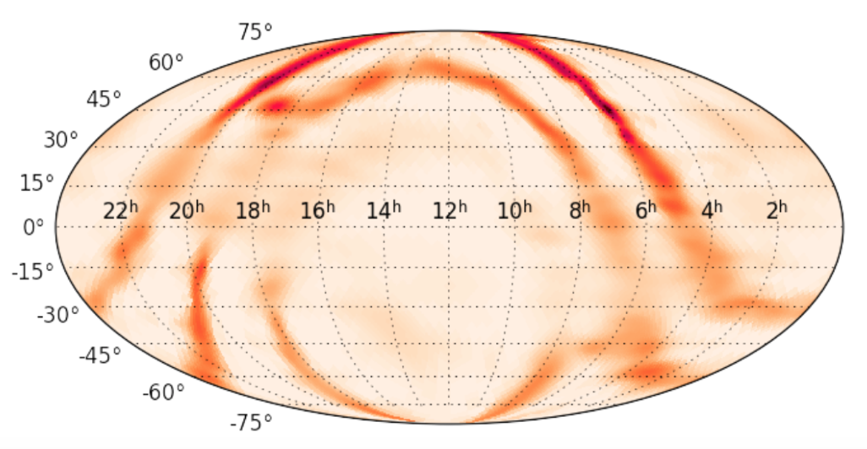
Skymap: Individual Injection
Dec
RA

Slide 9
Sky Localizations
Time delay between the signal’s arrival
Relative amplitude in detectors
Different orientations

Slide 10
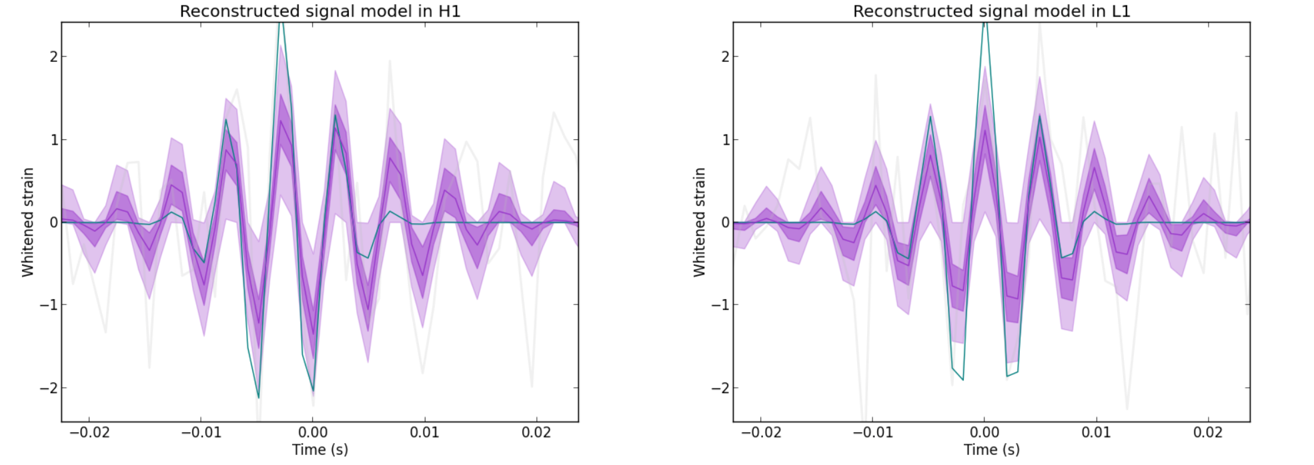
Injected Signal

Slide 11
Injection Sets
2 sets: isotropic and galactic sky distribution
Generated 2000 random sky locations according to given distribution model
Created simulated GW burst events associated with each generated location
Sine-Gaussian signals, low quality factor
2000 injections, total duration spanning the length of a sidereal day

Slide 12
Galactic Distribution Model
Empirical stellar number density function:
Galactic bulge
Galactic thick disk
Galactic thin disk

Slide 13
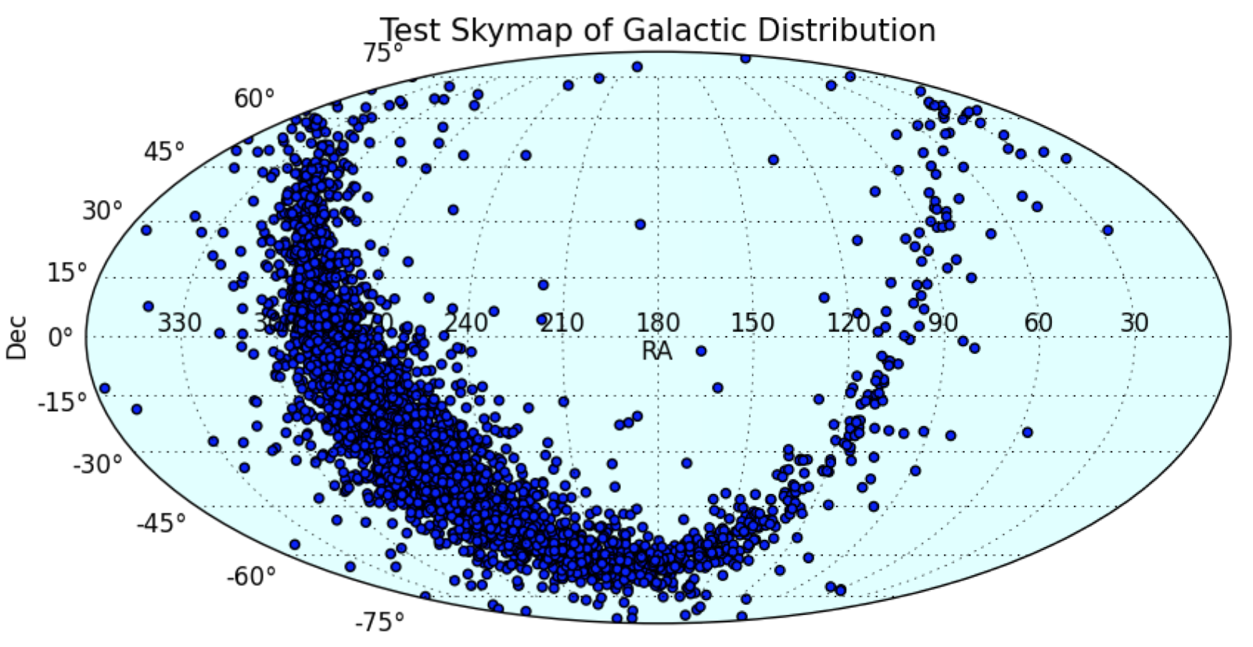
Galactic Distribution

Slide 14
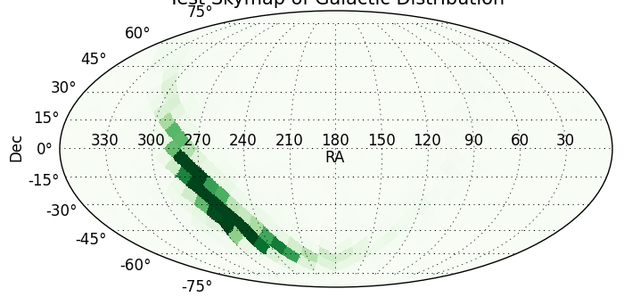
Galactic Distribution - HEALPix
Equal area bins - pixels

Slide 15
Data Processing
Generated 2000 random sky locations based on model
Created bursts for each location
Recover probability distributions for each injection’s sky location
Inject into Bayeswave
Must combine the individual distributions of both the isotropic and galactic injections into a composite map of each population’s overall sky distribution

Slide 16
Maximum Pixel Probability
In each injection’s HEALPix map, determine the pixel with the most probability
Assume the signal did come from that pixel and add value to the corresponding pixel in the overall map

Slide 17
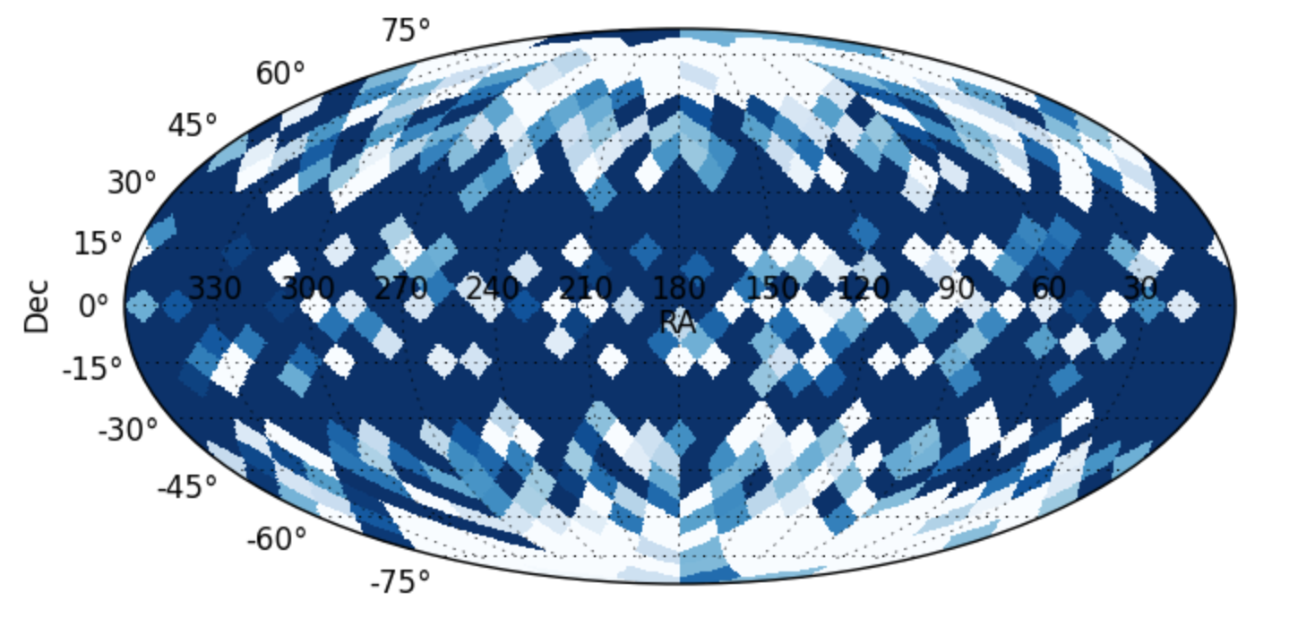
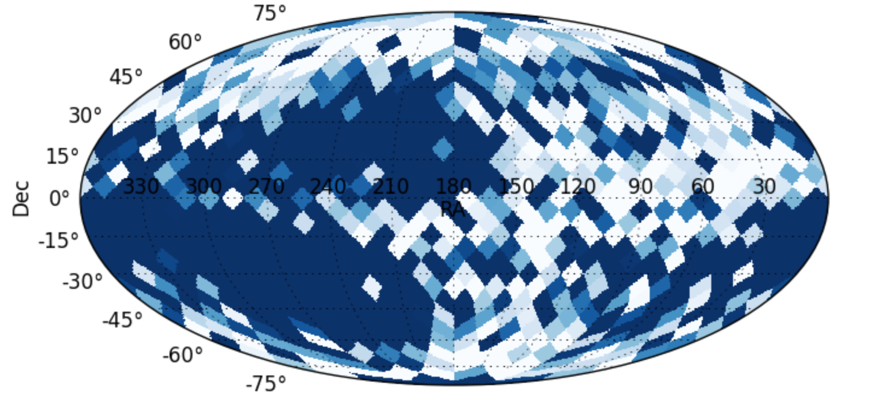
Maximum Pixel Probability
Isotropic
Galactic

Slide 18
Averaging the Maps
Normalize each individual injection’s HEALPix map
Sum all the 2000 individual injection’s values at every pixel and scale up by some factor

Slide 19
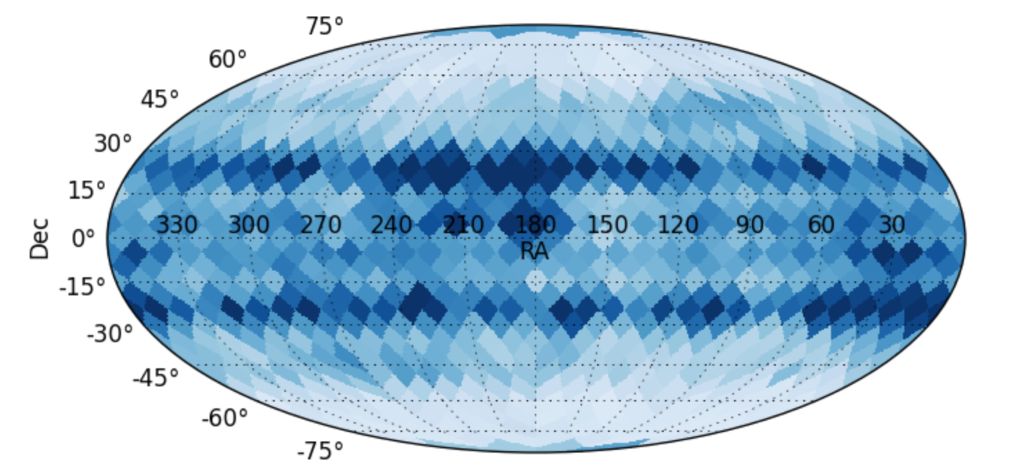
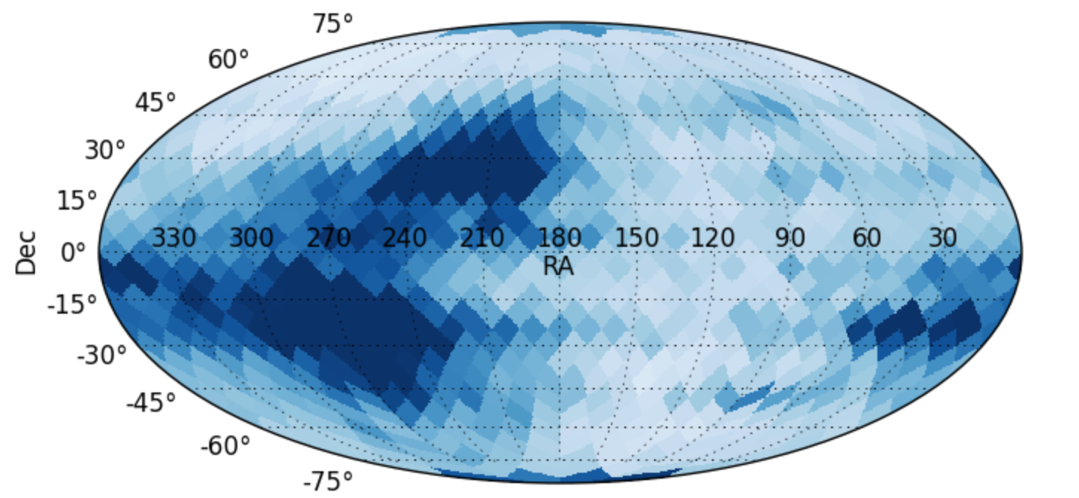
Averaging the Maps
Isotropic
Galactic

Slide 20
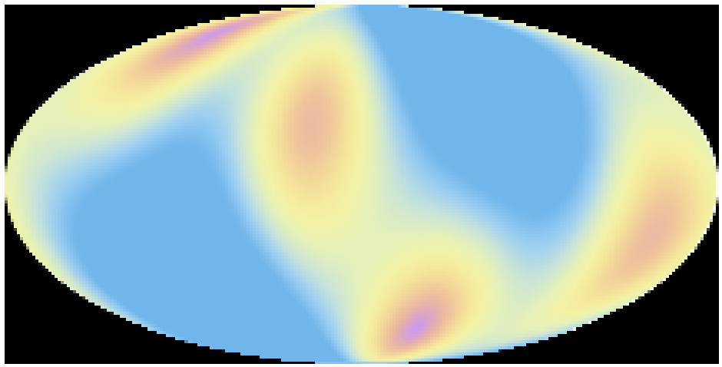
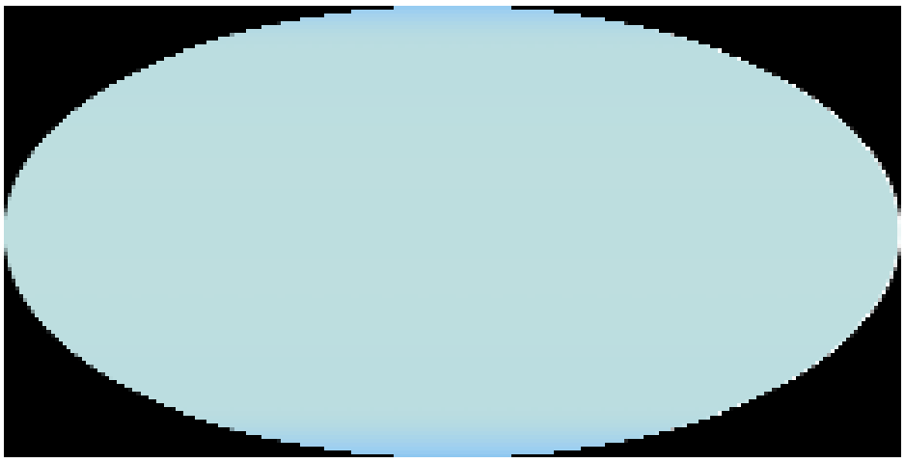
Antenna Pattern

Slide 21
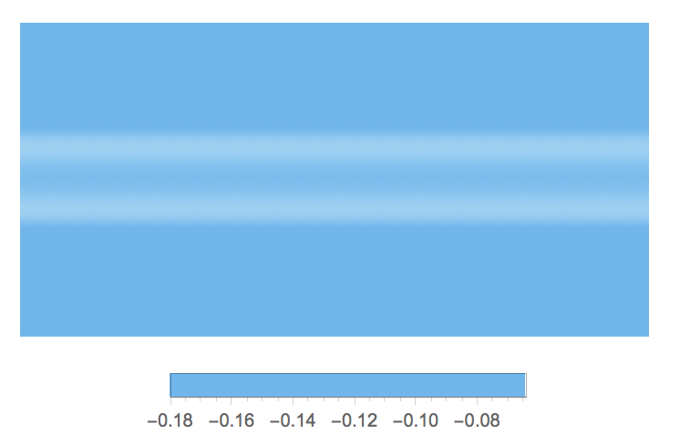
Antenna Pattern

Slide 22
Conclusion
Goal: to develop a method of mapping the sky distribution of a population of unmodeled gravitational-wave bursts and be able to distinguish galactic set
In our resultant skymaps, we can clearly see a difference between the recovered isotropic and galactic sets

Slide 23
Future Work
Removing potential antenna pattern effects
Factoring in Virgo
Processing using a sampling algorithm with a high resolution
Taking glitches and noise into consideration
Using O1, O2 data

Slide 24
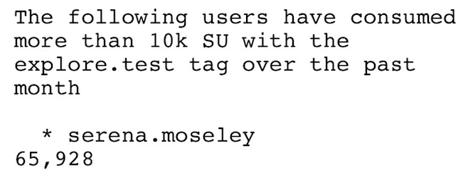
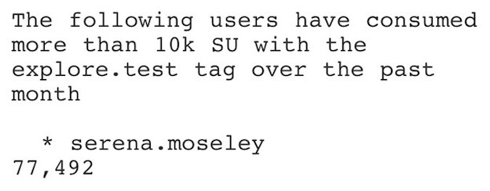
Acknowledgements
Tom
LIGO SURF Program
The NSF
LIGO Data Grid!

Slide 25
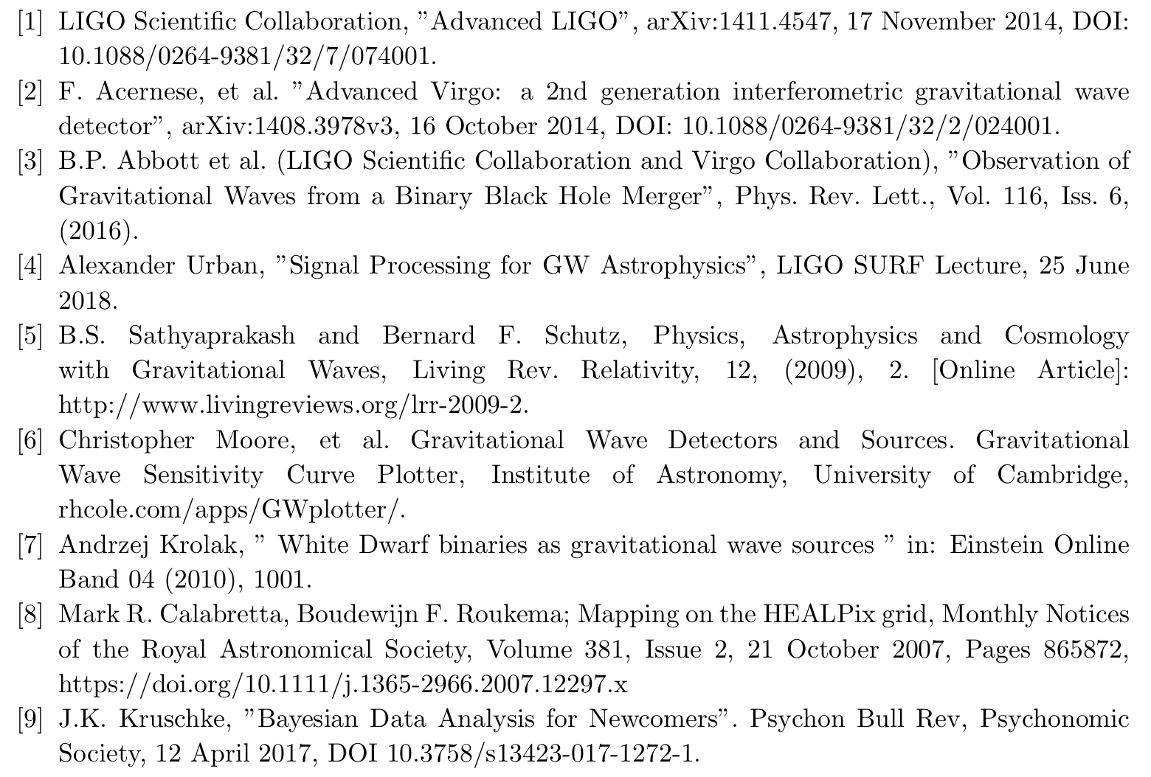
References

Slide 26
Back-up slides

Slide 27
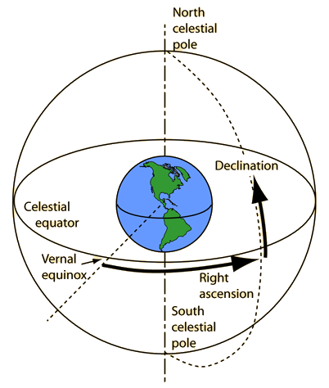
Equatorial Coordinates

Slide 28
Multinest
More correct, but computationally intensive
c: fraction of events coming from a specific direction
d: skymap
P: set of pixel heights for each map
Gives the probability of a certain c, given the skymaps we have for our two injection sets

Slide 29
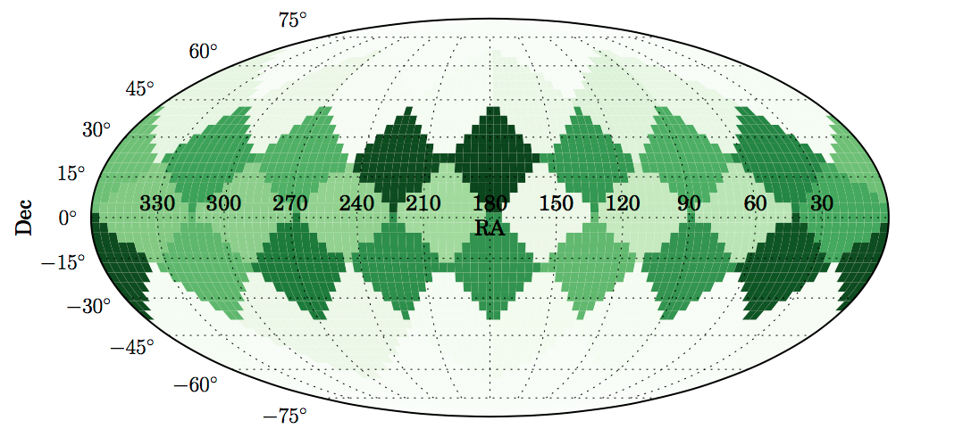
Multinest - Isotropic

Slide 30
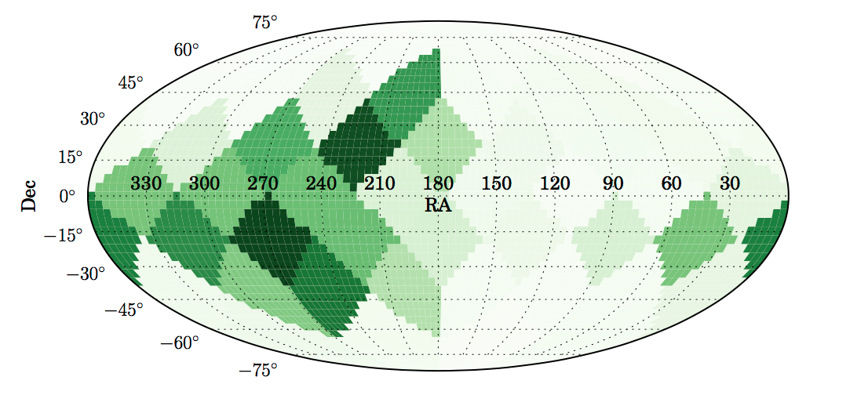
Multinest - Galactic

