Slide 1
Real-time temperature monitoring for Mechanical Oscillators
Mandy Cheung
Mentors: Aaron Markowitz, Brittany Kamai
Advisor: Rana X. Adhikari
24 August 2018

Slide 2
1.3 Billion years ago

Slide 3
Black Hole Merger video from: Simulating eXtreme Systems Project, https://www.black-holes.org. 11 February 2016.

Slide 5
103 years ago

Slide 6
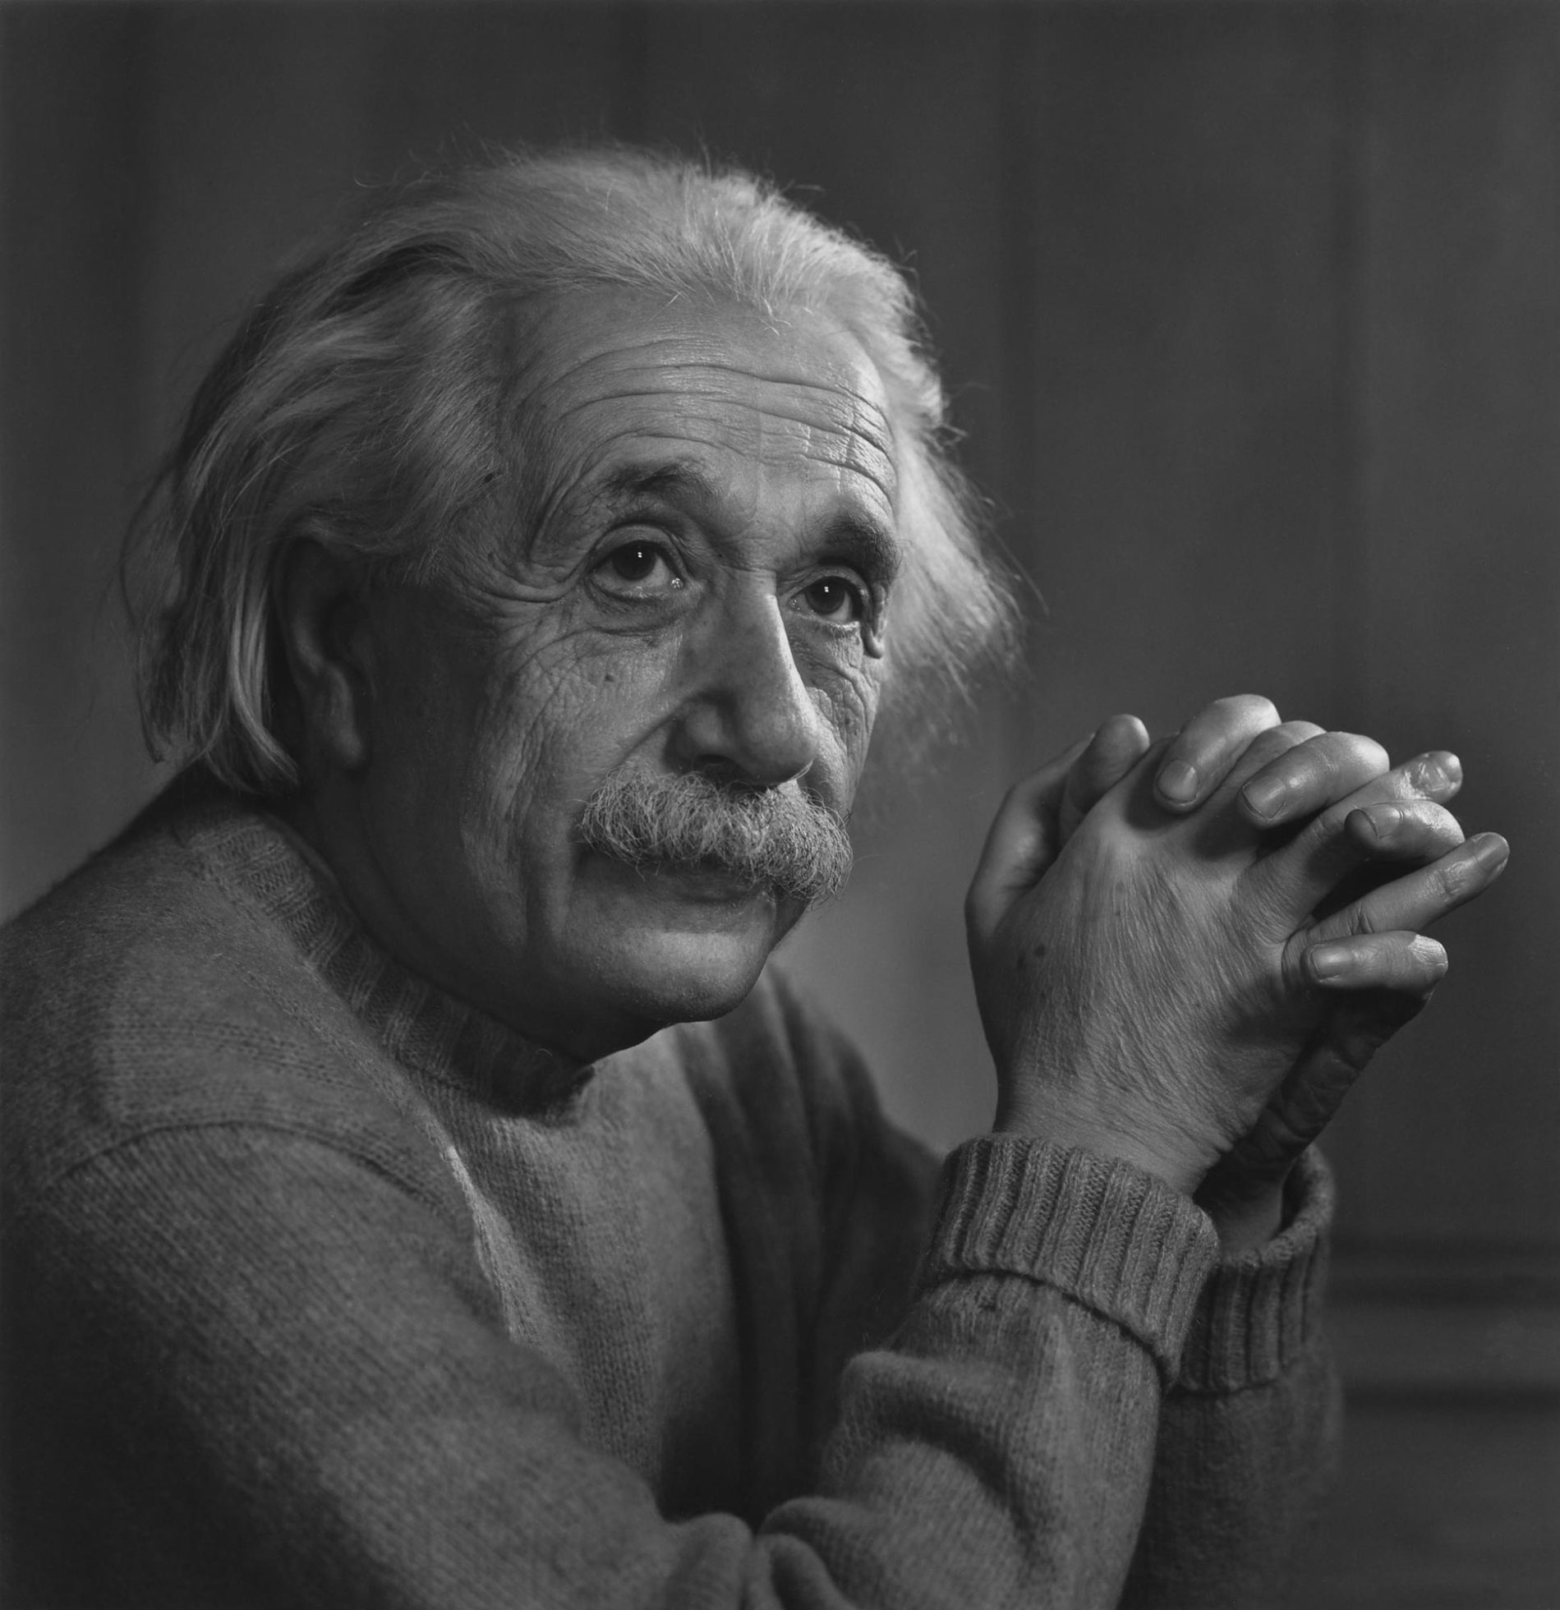

Slide 8
3 years ago

Slide 9
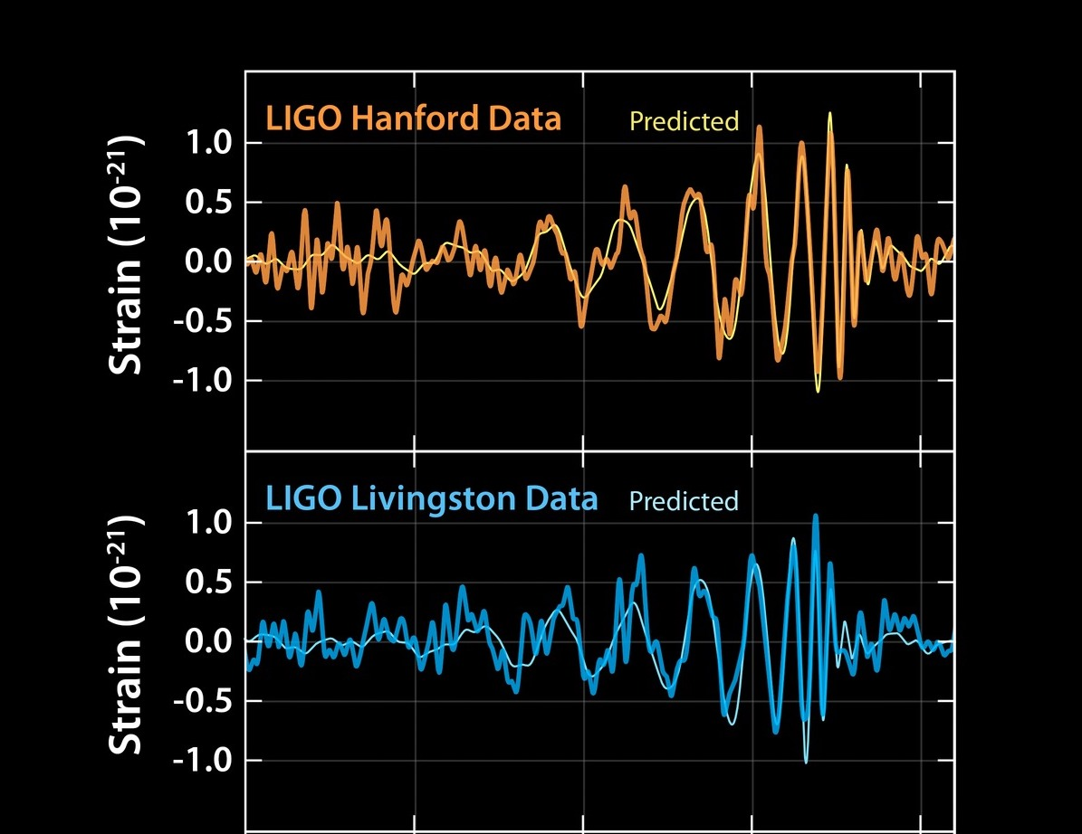
LLO and LHO GW Signals from: LIGO.Caltech.edu, https://www.ligo.caltech.edu/image/ligo20160211a. 11 February 2016.

Slide 10
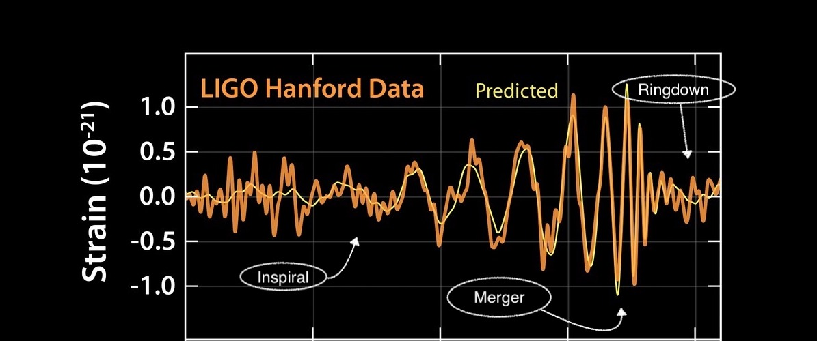
LLO and LHO GW Signals from: LIGO.Caltech.edu,
https://www.ligo.caltech.edu/image/ligo20160211a. 11 February 2016.

Slide 11
The Detectors

Slide 12
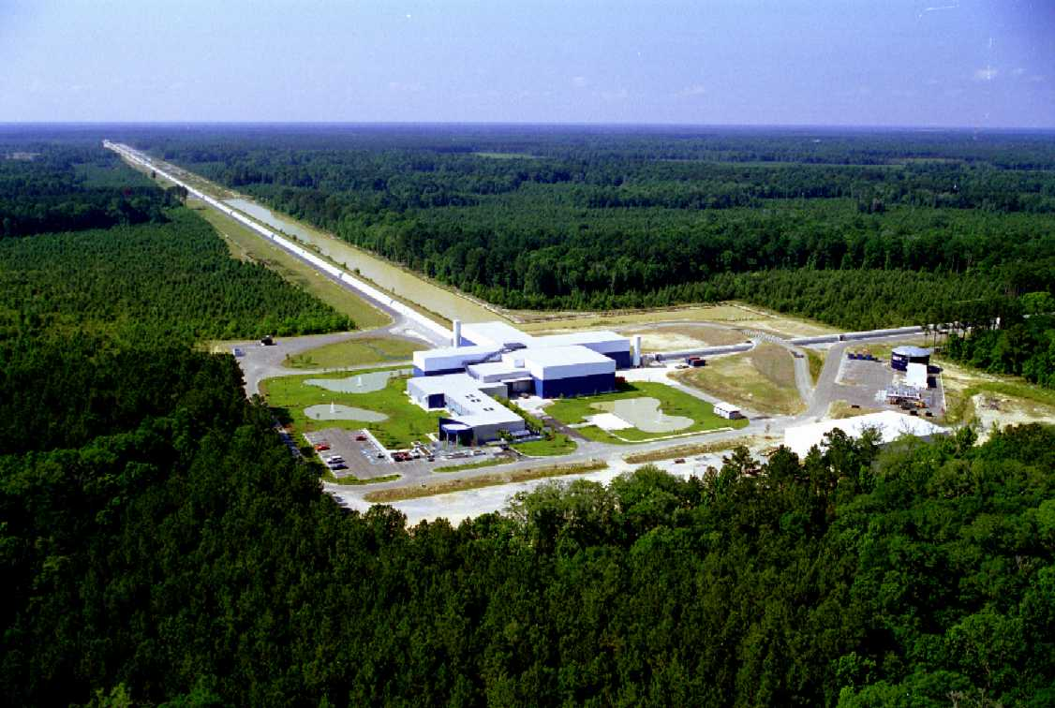
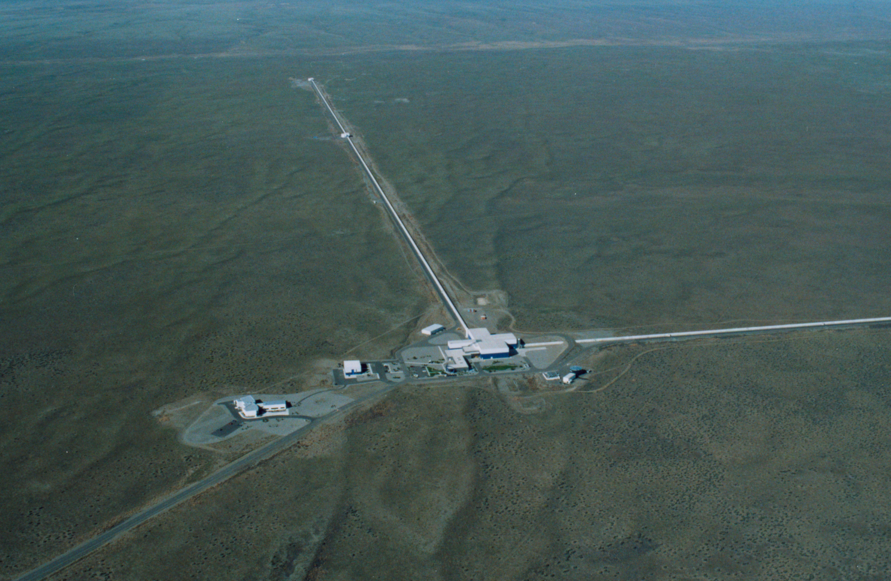
LIGO detector located in Livingston, Louisiana
LIGO detector located in Hanford, Washingston

Slide 13
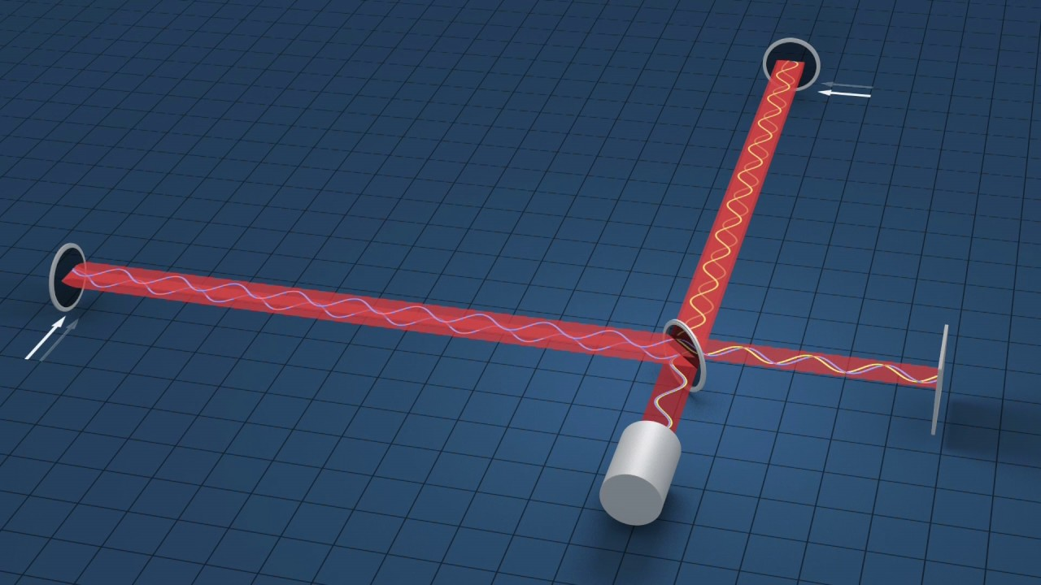
Simplified diagram of Michelson interferometer

Slide 14
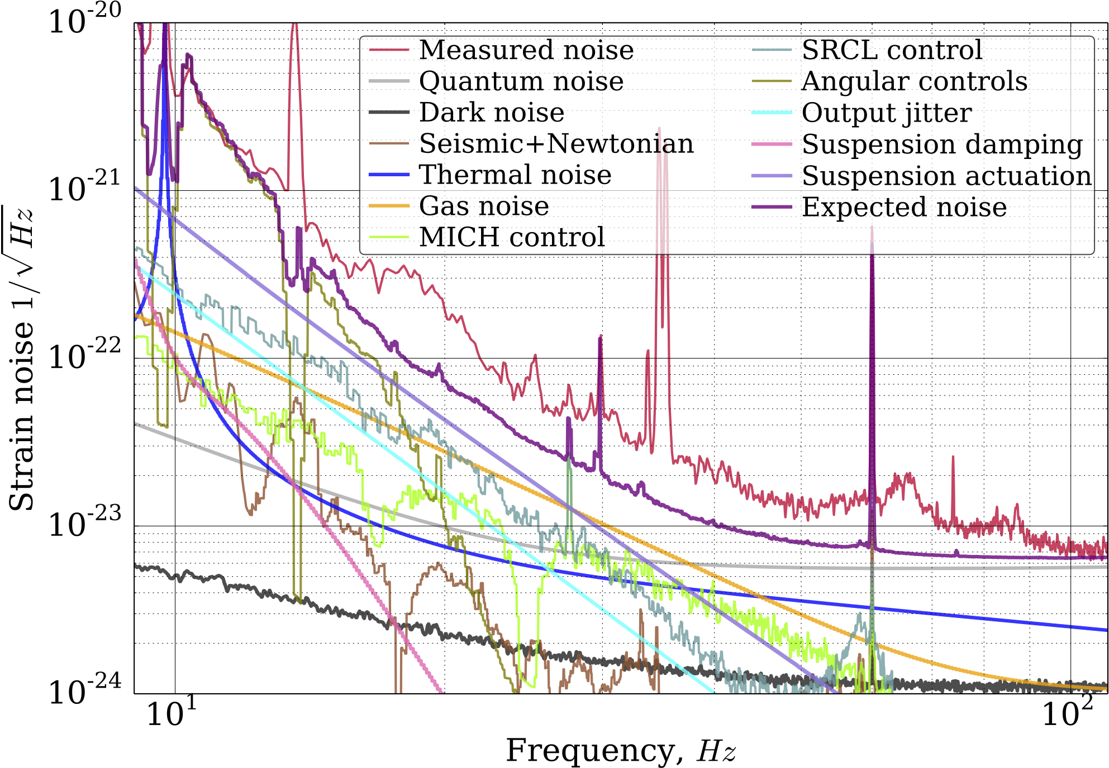
Noise budget of LLO at lower frequencies from: D. V. Martynov et al. “The Sensitivity of the Advanced LIGO Detectors at the Beginning of Gravitational Wave Astronomy.” 13 February 2018, p. 7

Slide 15
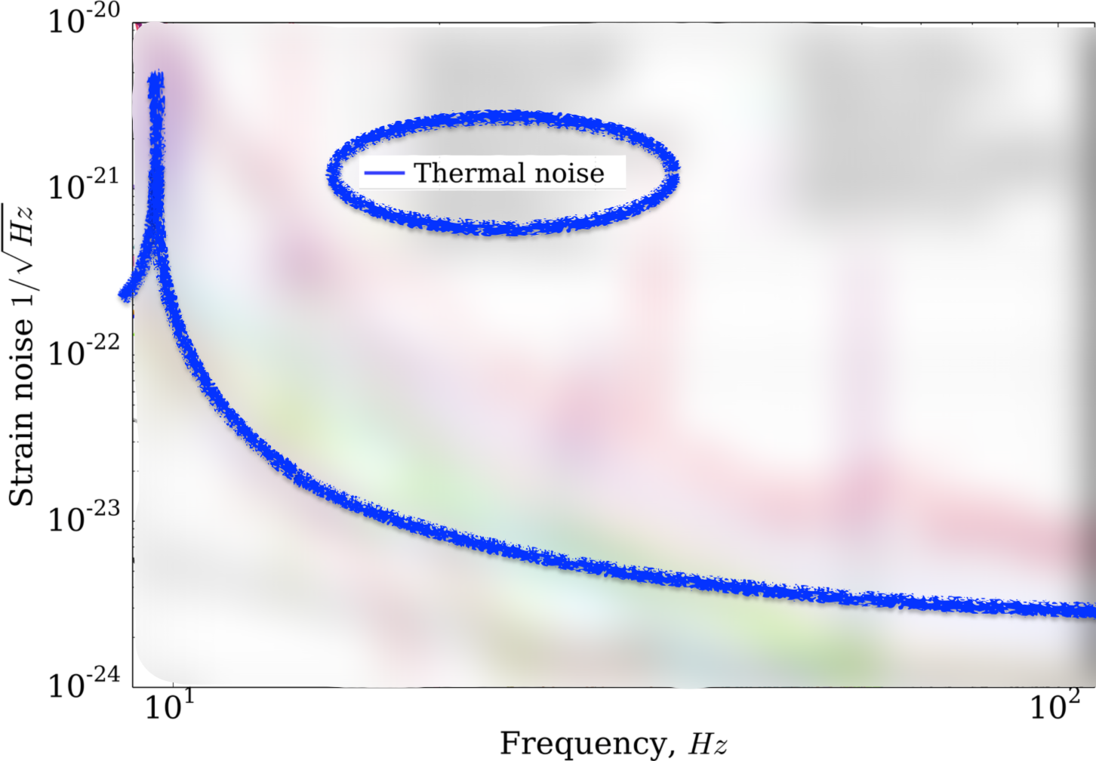
Noise budget of LLO at lower frequencies from: D. V. Martynov et al. “The Sensitivity of the Advanced LIGO Detectors at the Beginning of Gravitational Wave Astronomy.” 13 February 2018, p. 7

Slide 16
LIGO Voyager

Slide 17
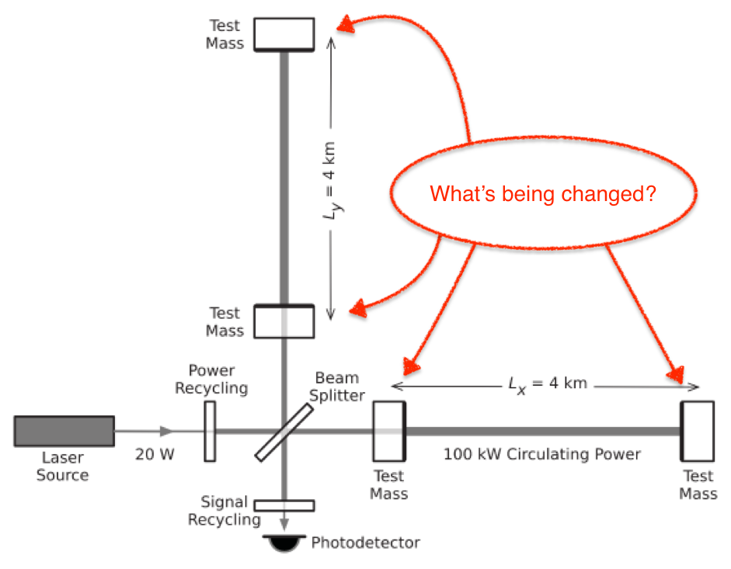
Key Concept: ligo voyager changes
Cryogenic silicon mirrors Changing from fused silica mirrors to ~150 kg silicon test masses cooled to 123K
Cryogenic suspension systems Perhaps silicon ribbons
2um laser Changing from 1680 nm to 2um wavelength
Simplified diagram of detector from: B. Abbott et al. “Observation of gravitational waves from a binary black hole merger.” 12 February 2016, p. 4

Slide 18
The CRYOQ Experiment

Slide 19
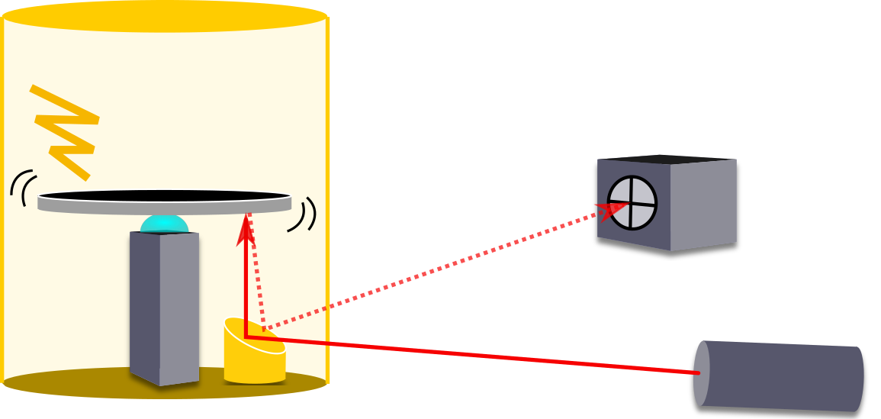
Cryostat
ESD Excitation
Silicon Disk
QPD
Laser
Gentle Nodal Suspension System

Slide 20
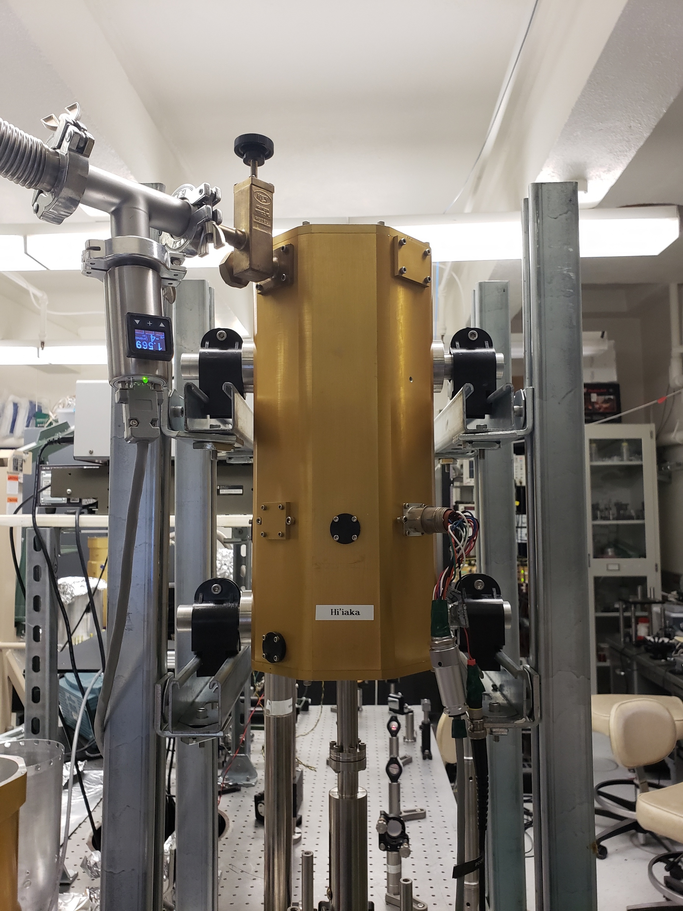
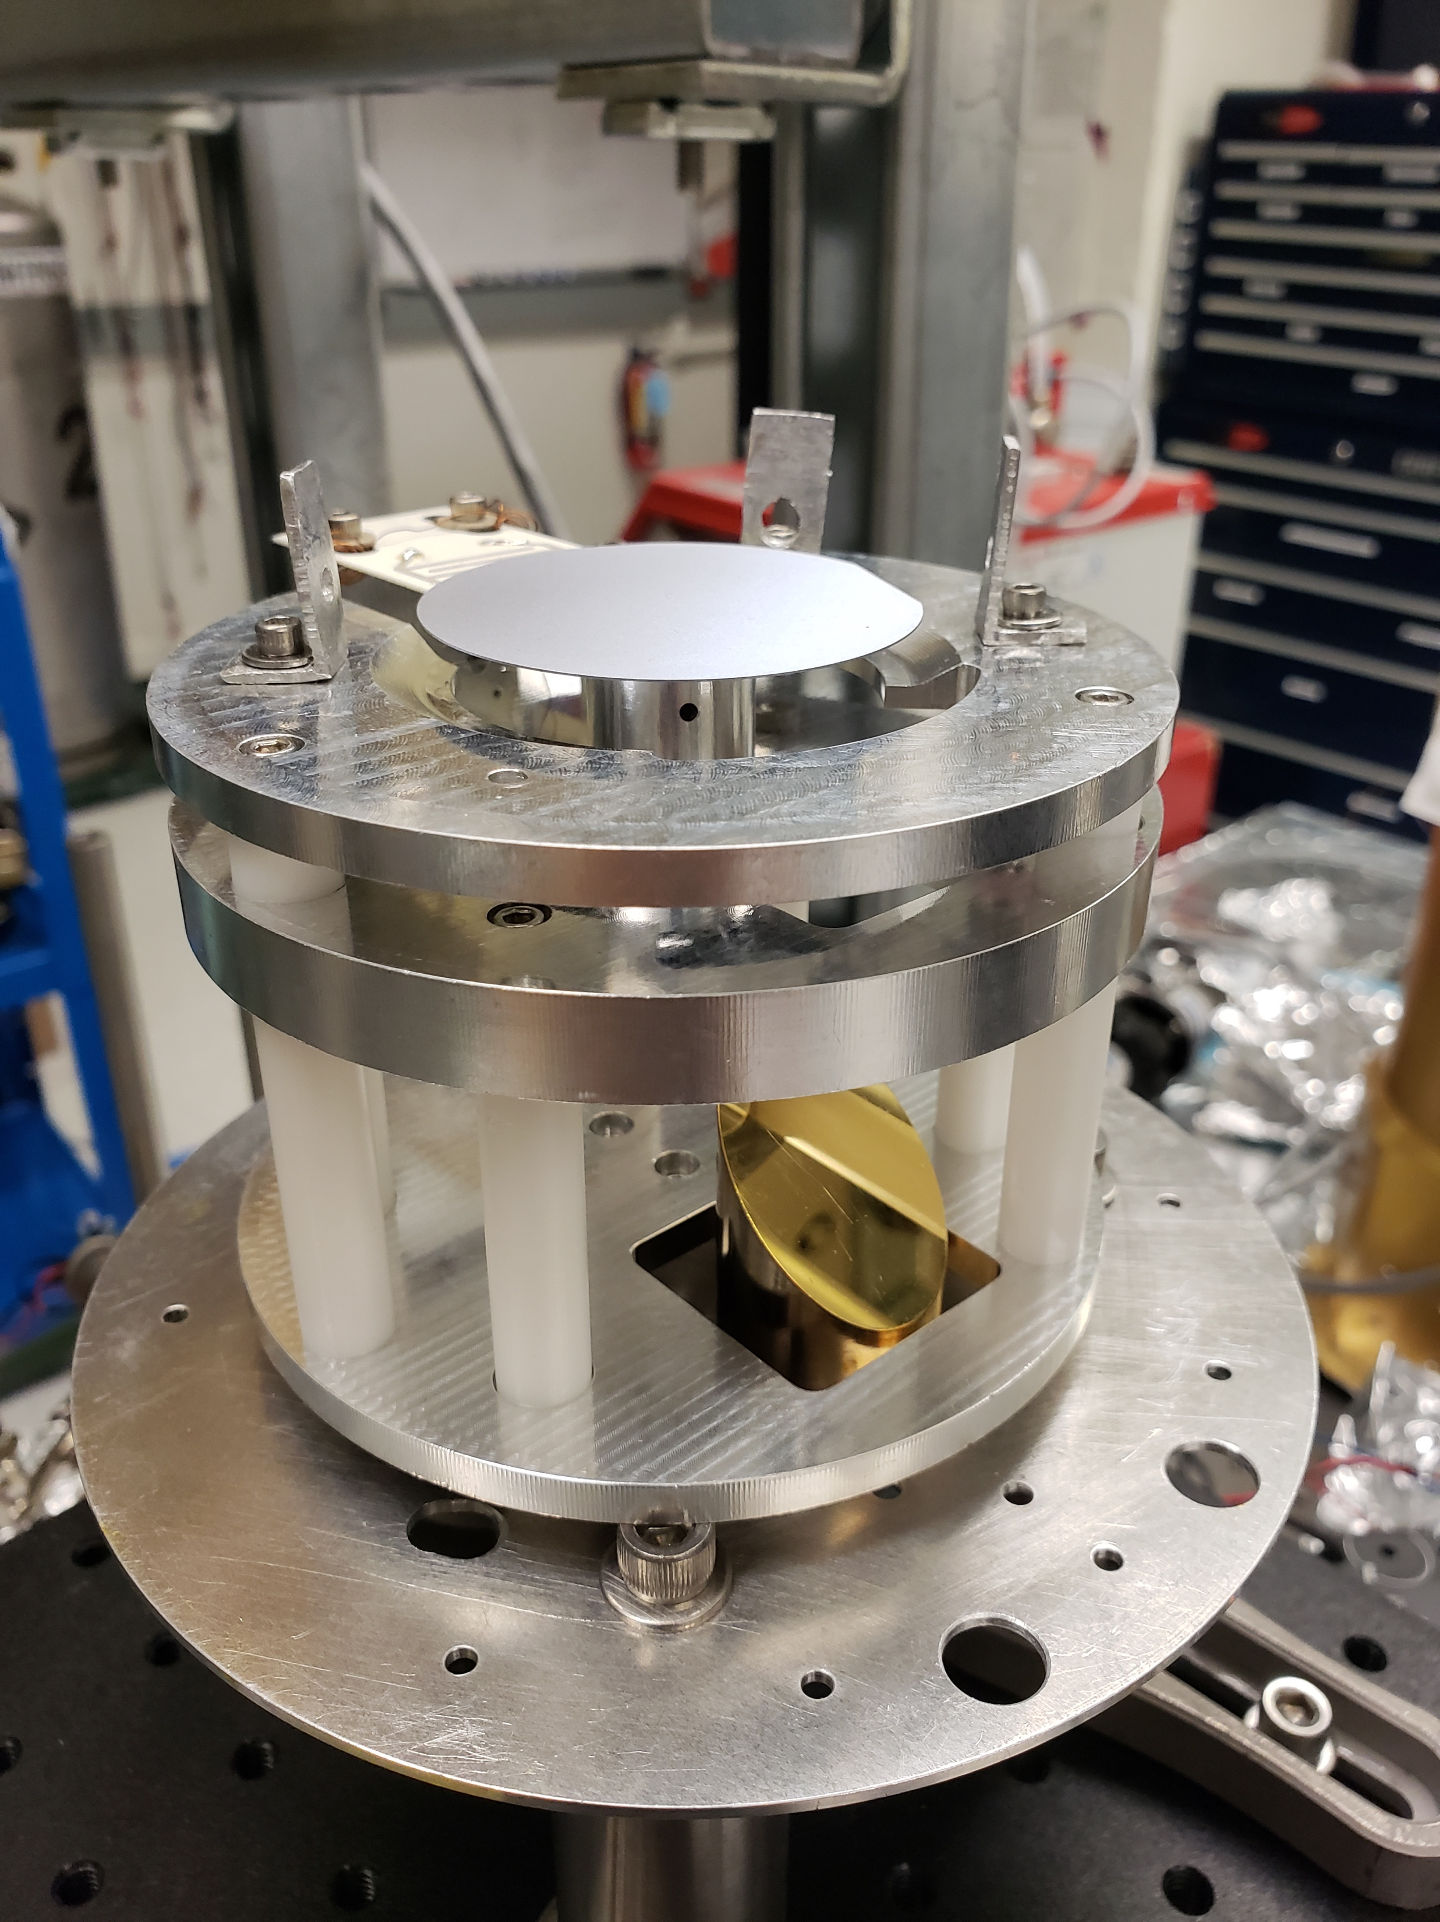
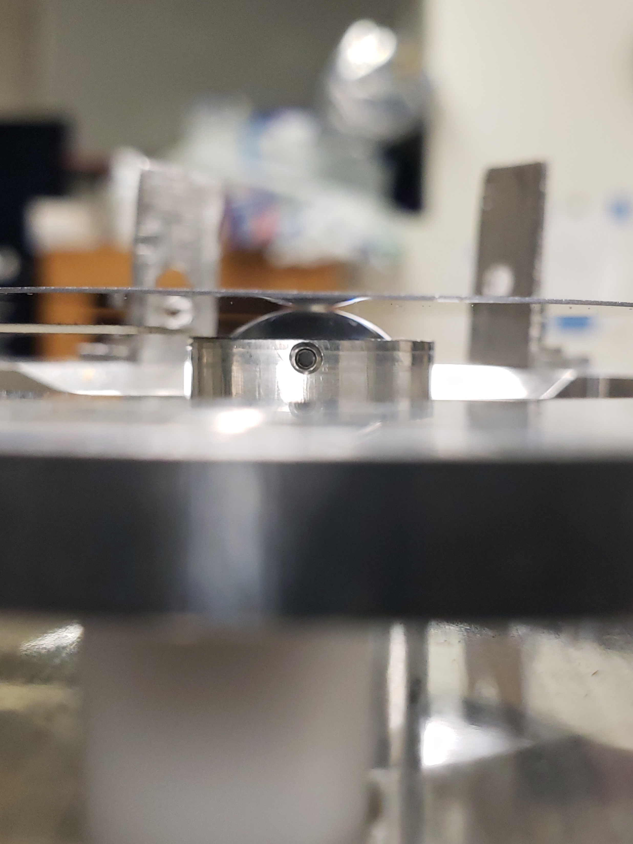
Hi’iaka cryostat
GeNS
Close-up of disk resting on the GeNS lens

Slide 21
Cryostat
ESD Excitation
Silicon Disk
QPD
Laser
Gentle Nodal Suspension System

Slide 22
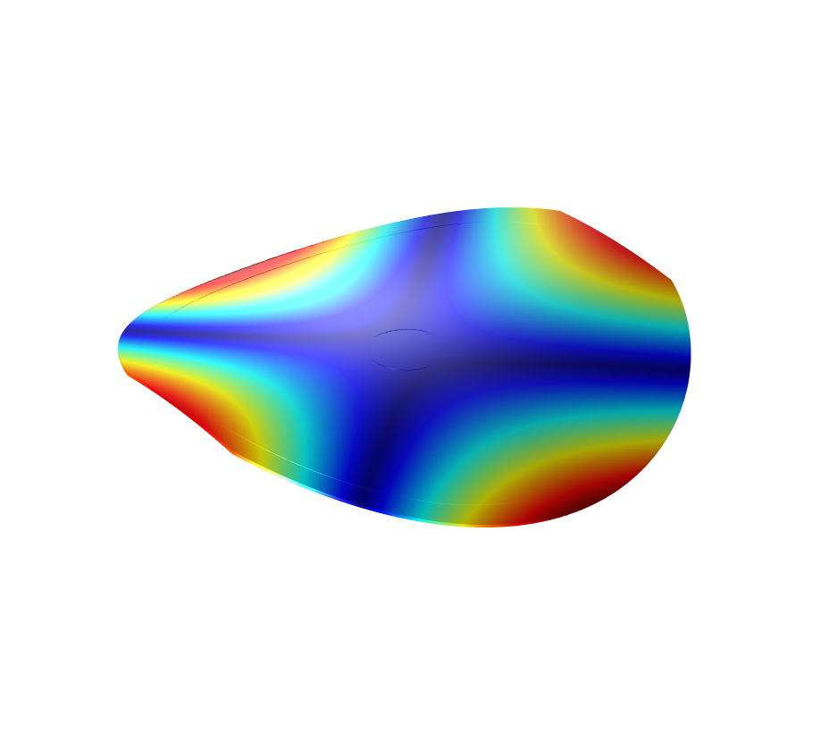
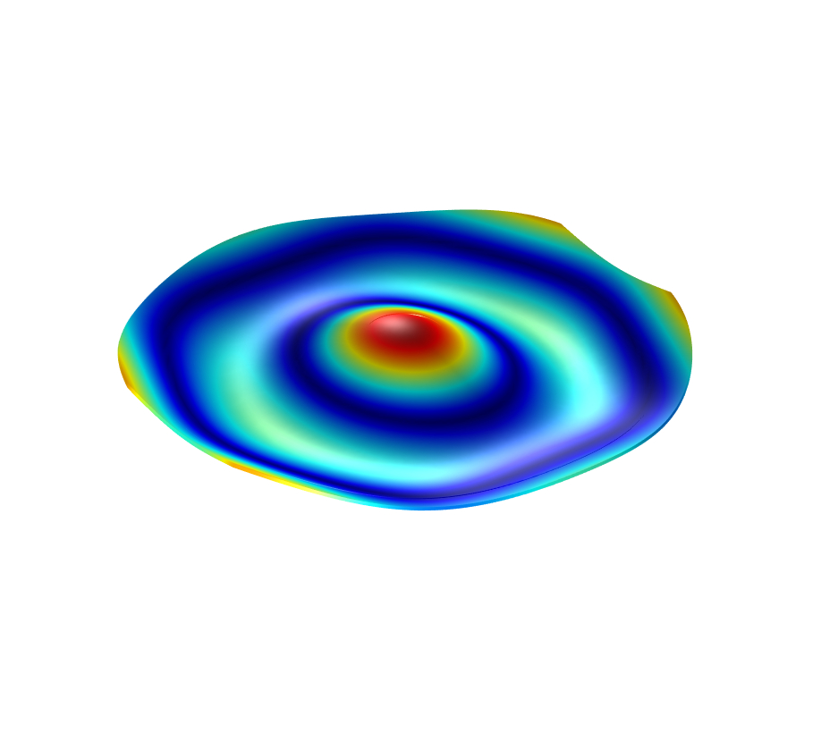
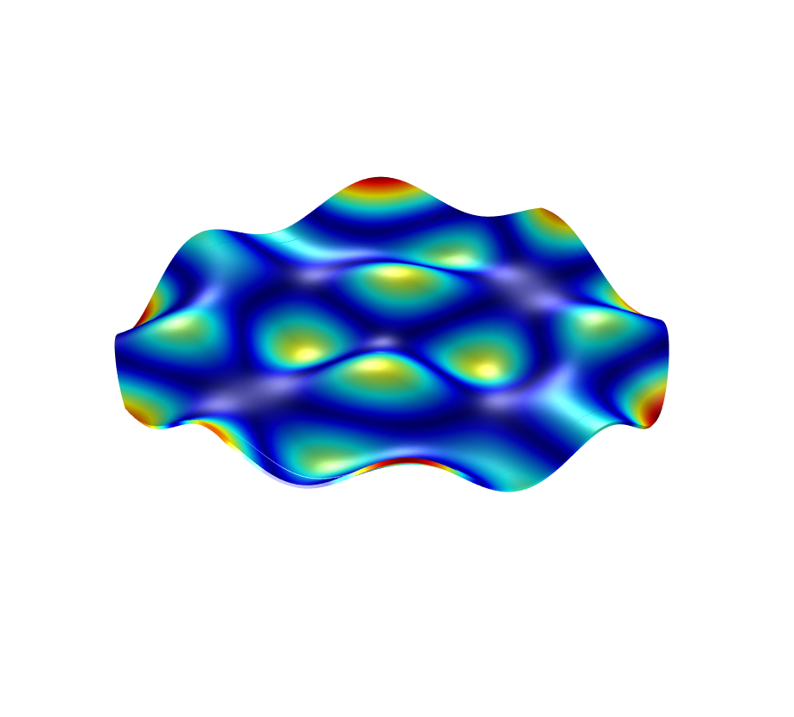
843Hz
6073Hz
27,13249Hz

Slide 23
Key terms: Cryoq measurements
Quality factor : a dimensionless parameter that characterizes a mechanical system’s tendency to retain energy under free oscillations
Ringdown method : a way of measuring Q-factors
Measures the ringdown time after excitation
For multiple modes, white noise excitation is used
Additionally, excitation around known resonant frequencies works too

Slide 24
Surf 2018

Slide 25
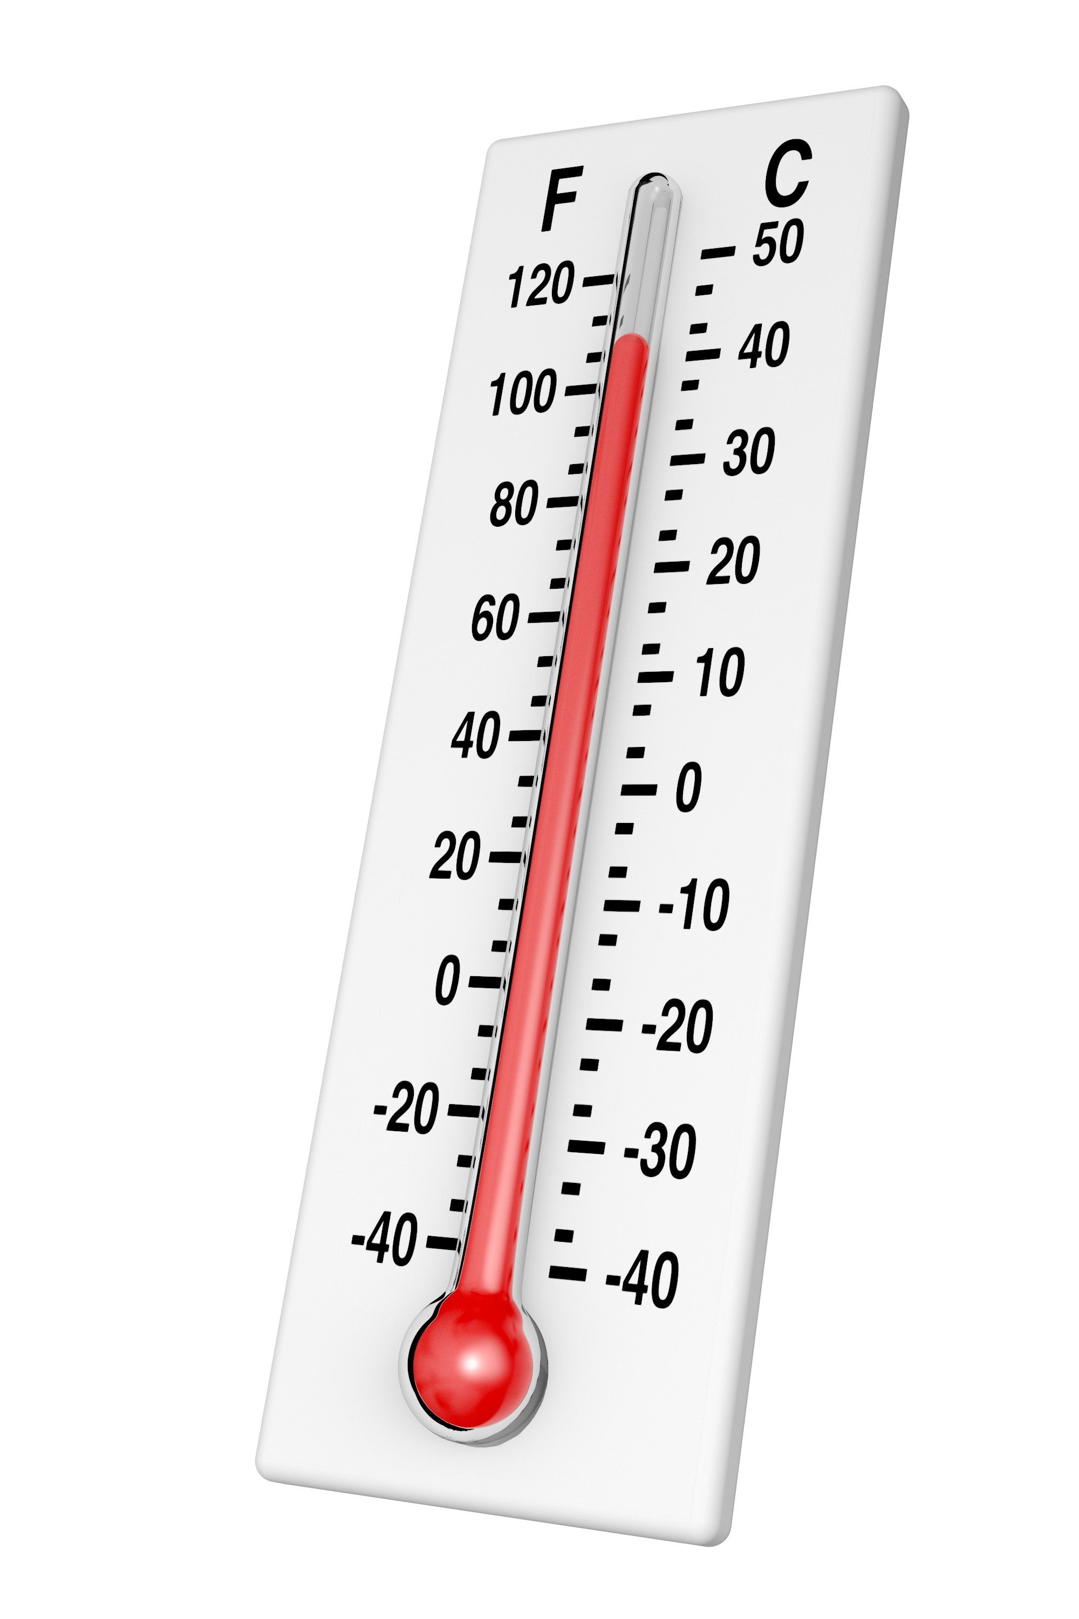
THERMOMETER

Slide 26
Key Concept: resistance temperature detectors
A resistance temperature detector (RTD) is a reliable tool used for precision thermometry
RTDs function by relying on the positive, nearly linear relationship between electrical resistance and temperature that is characteristic of metals
1
2
3
RTDs setup with GeNS

Slide 27
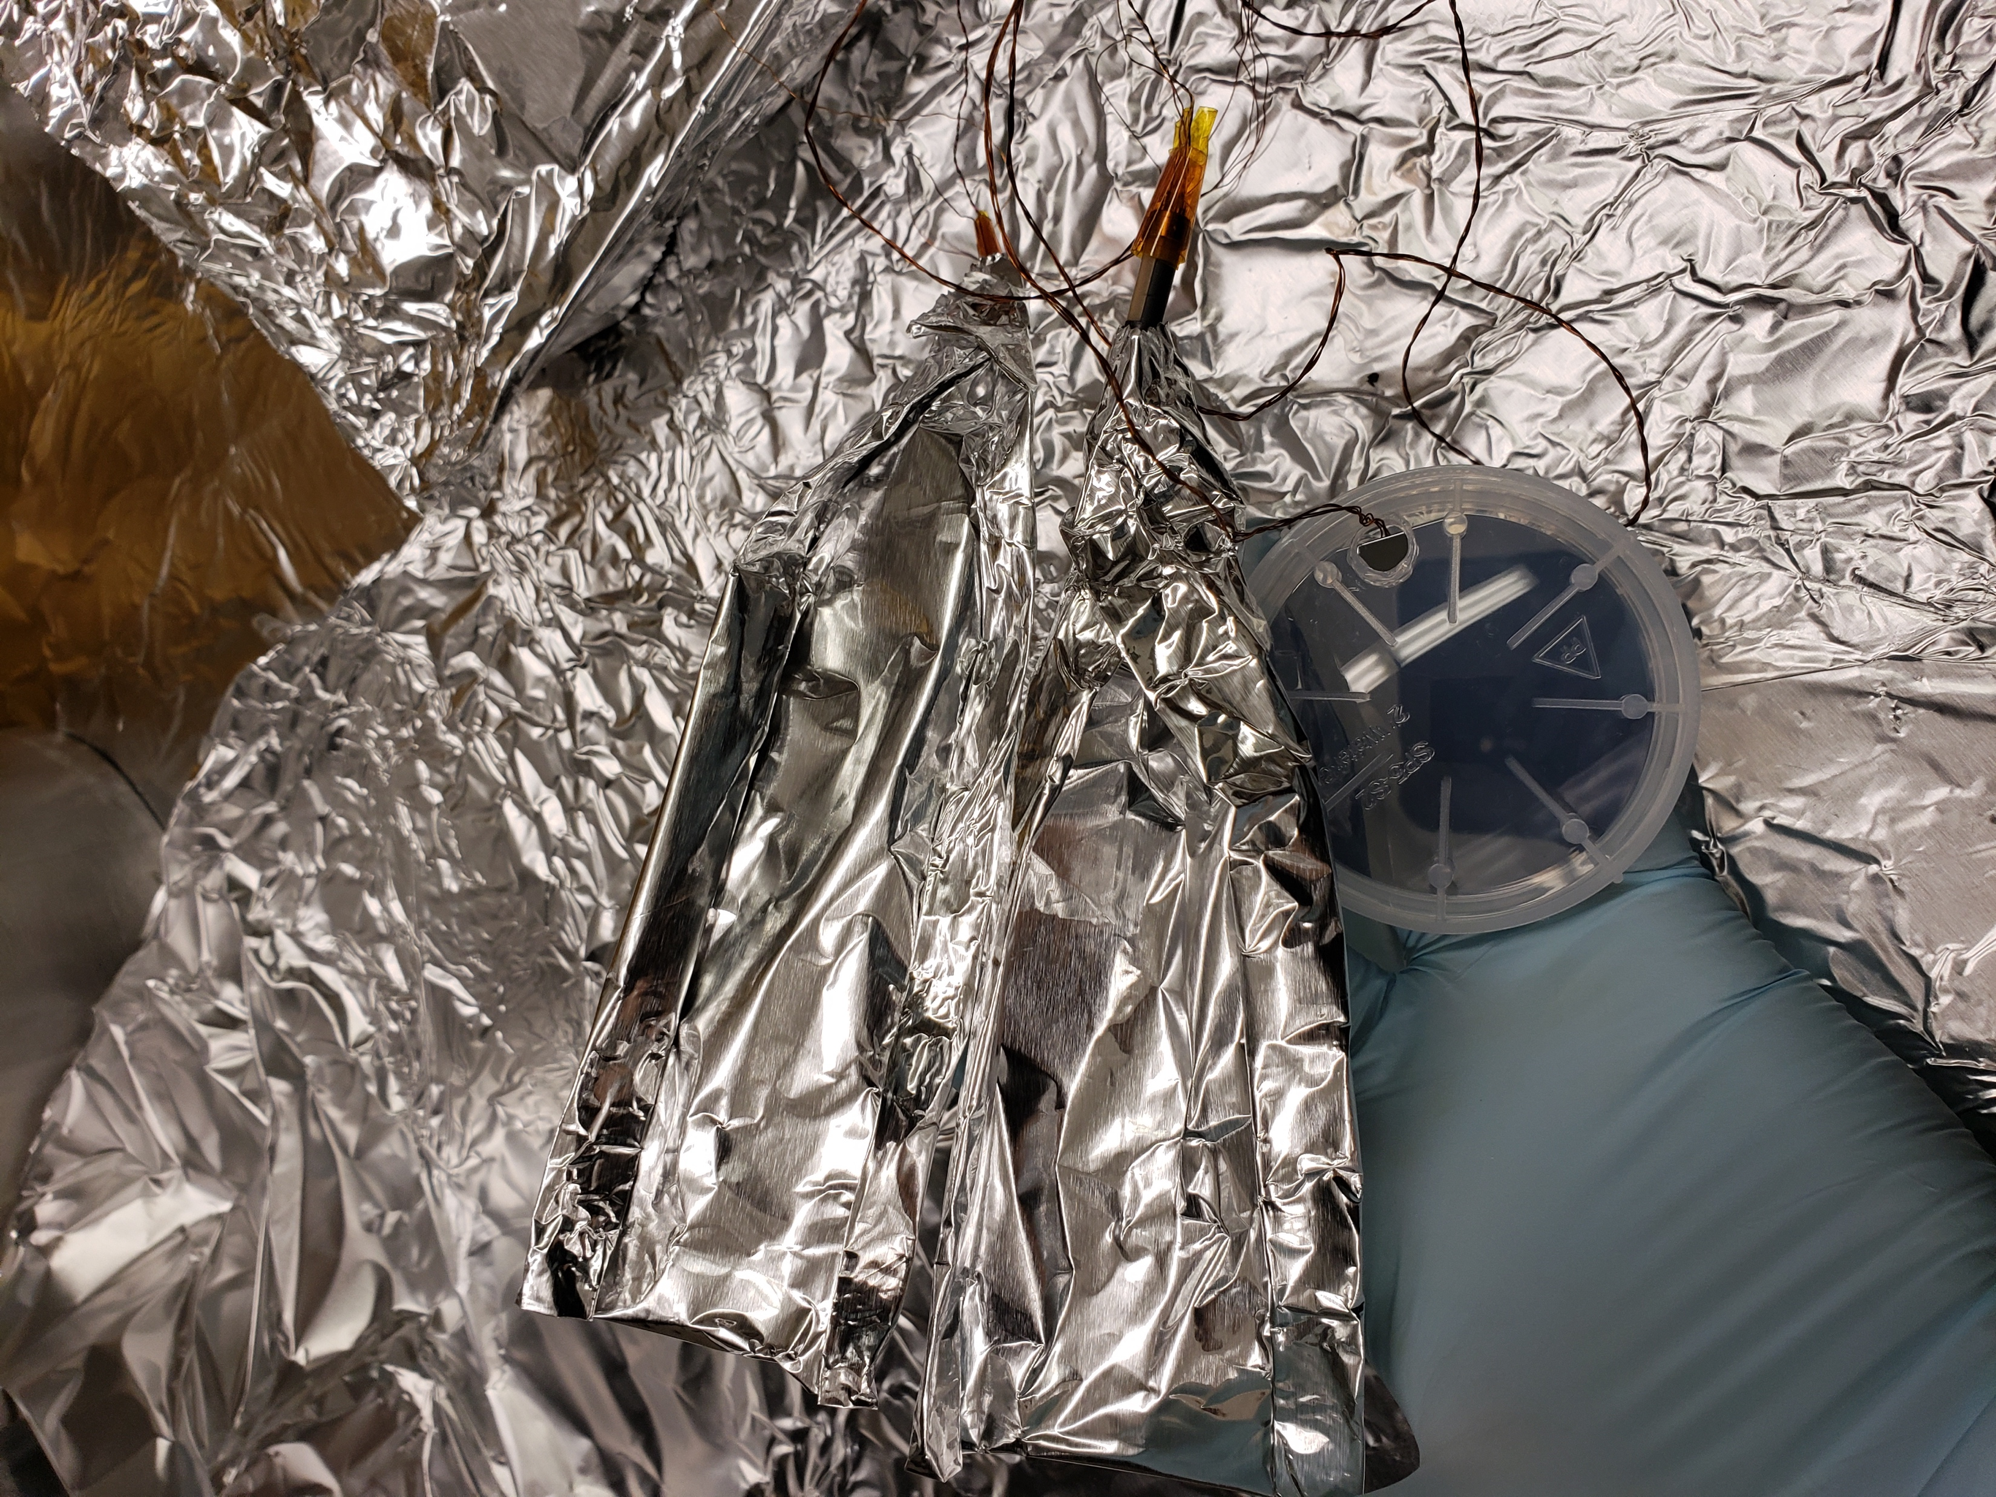
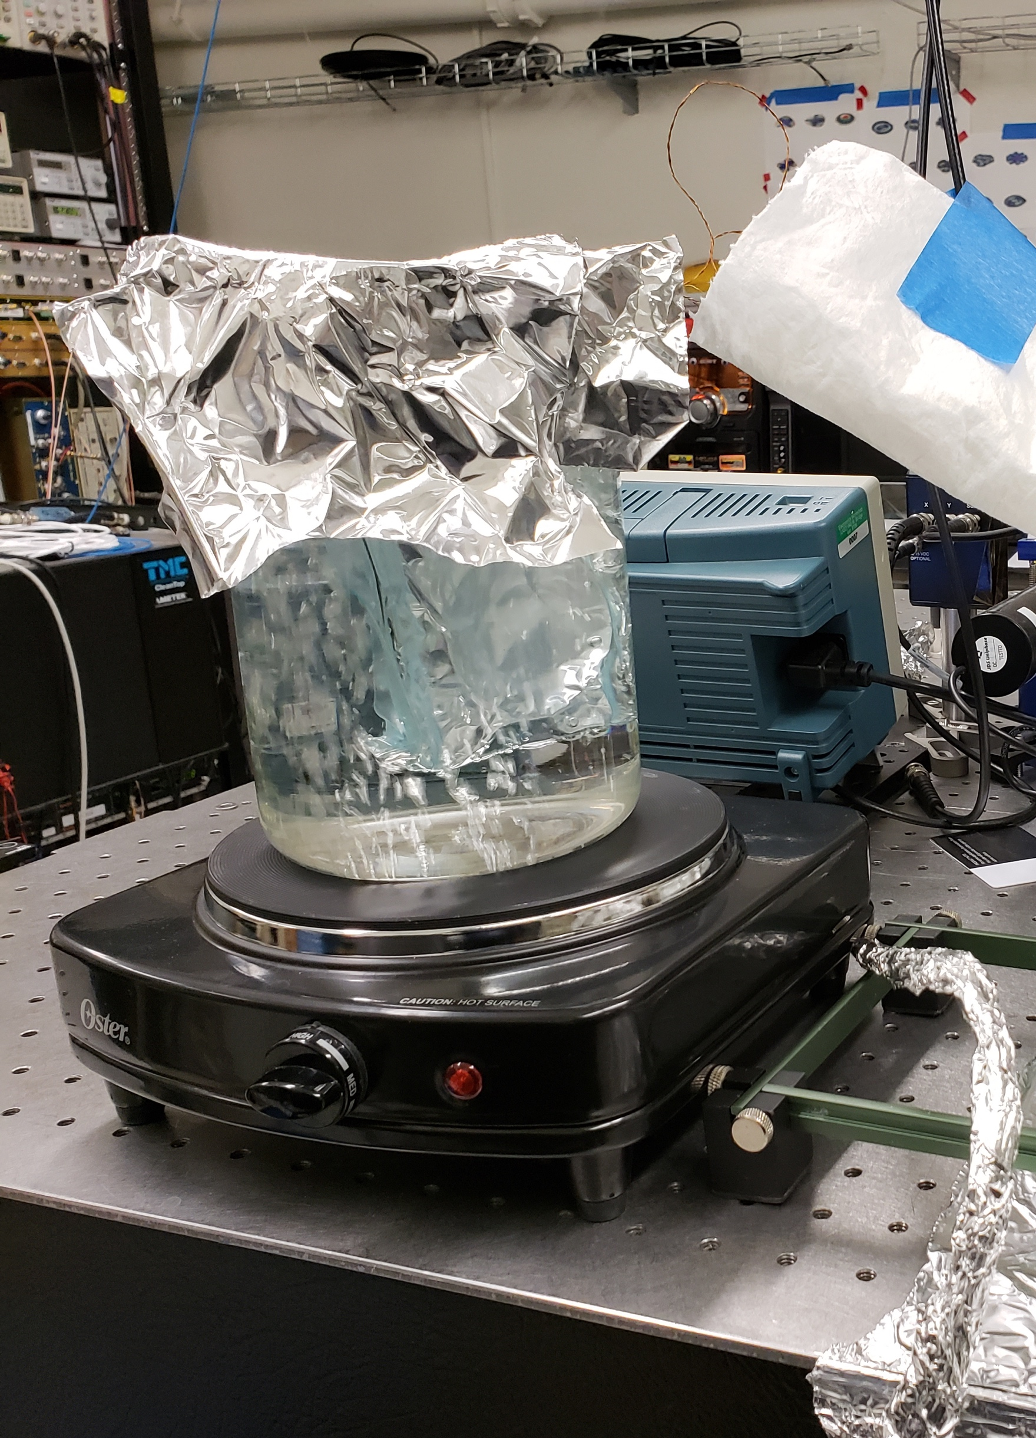
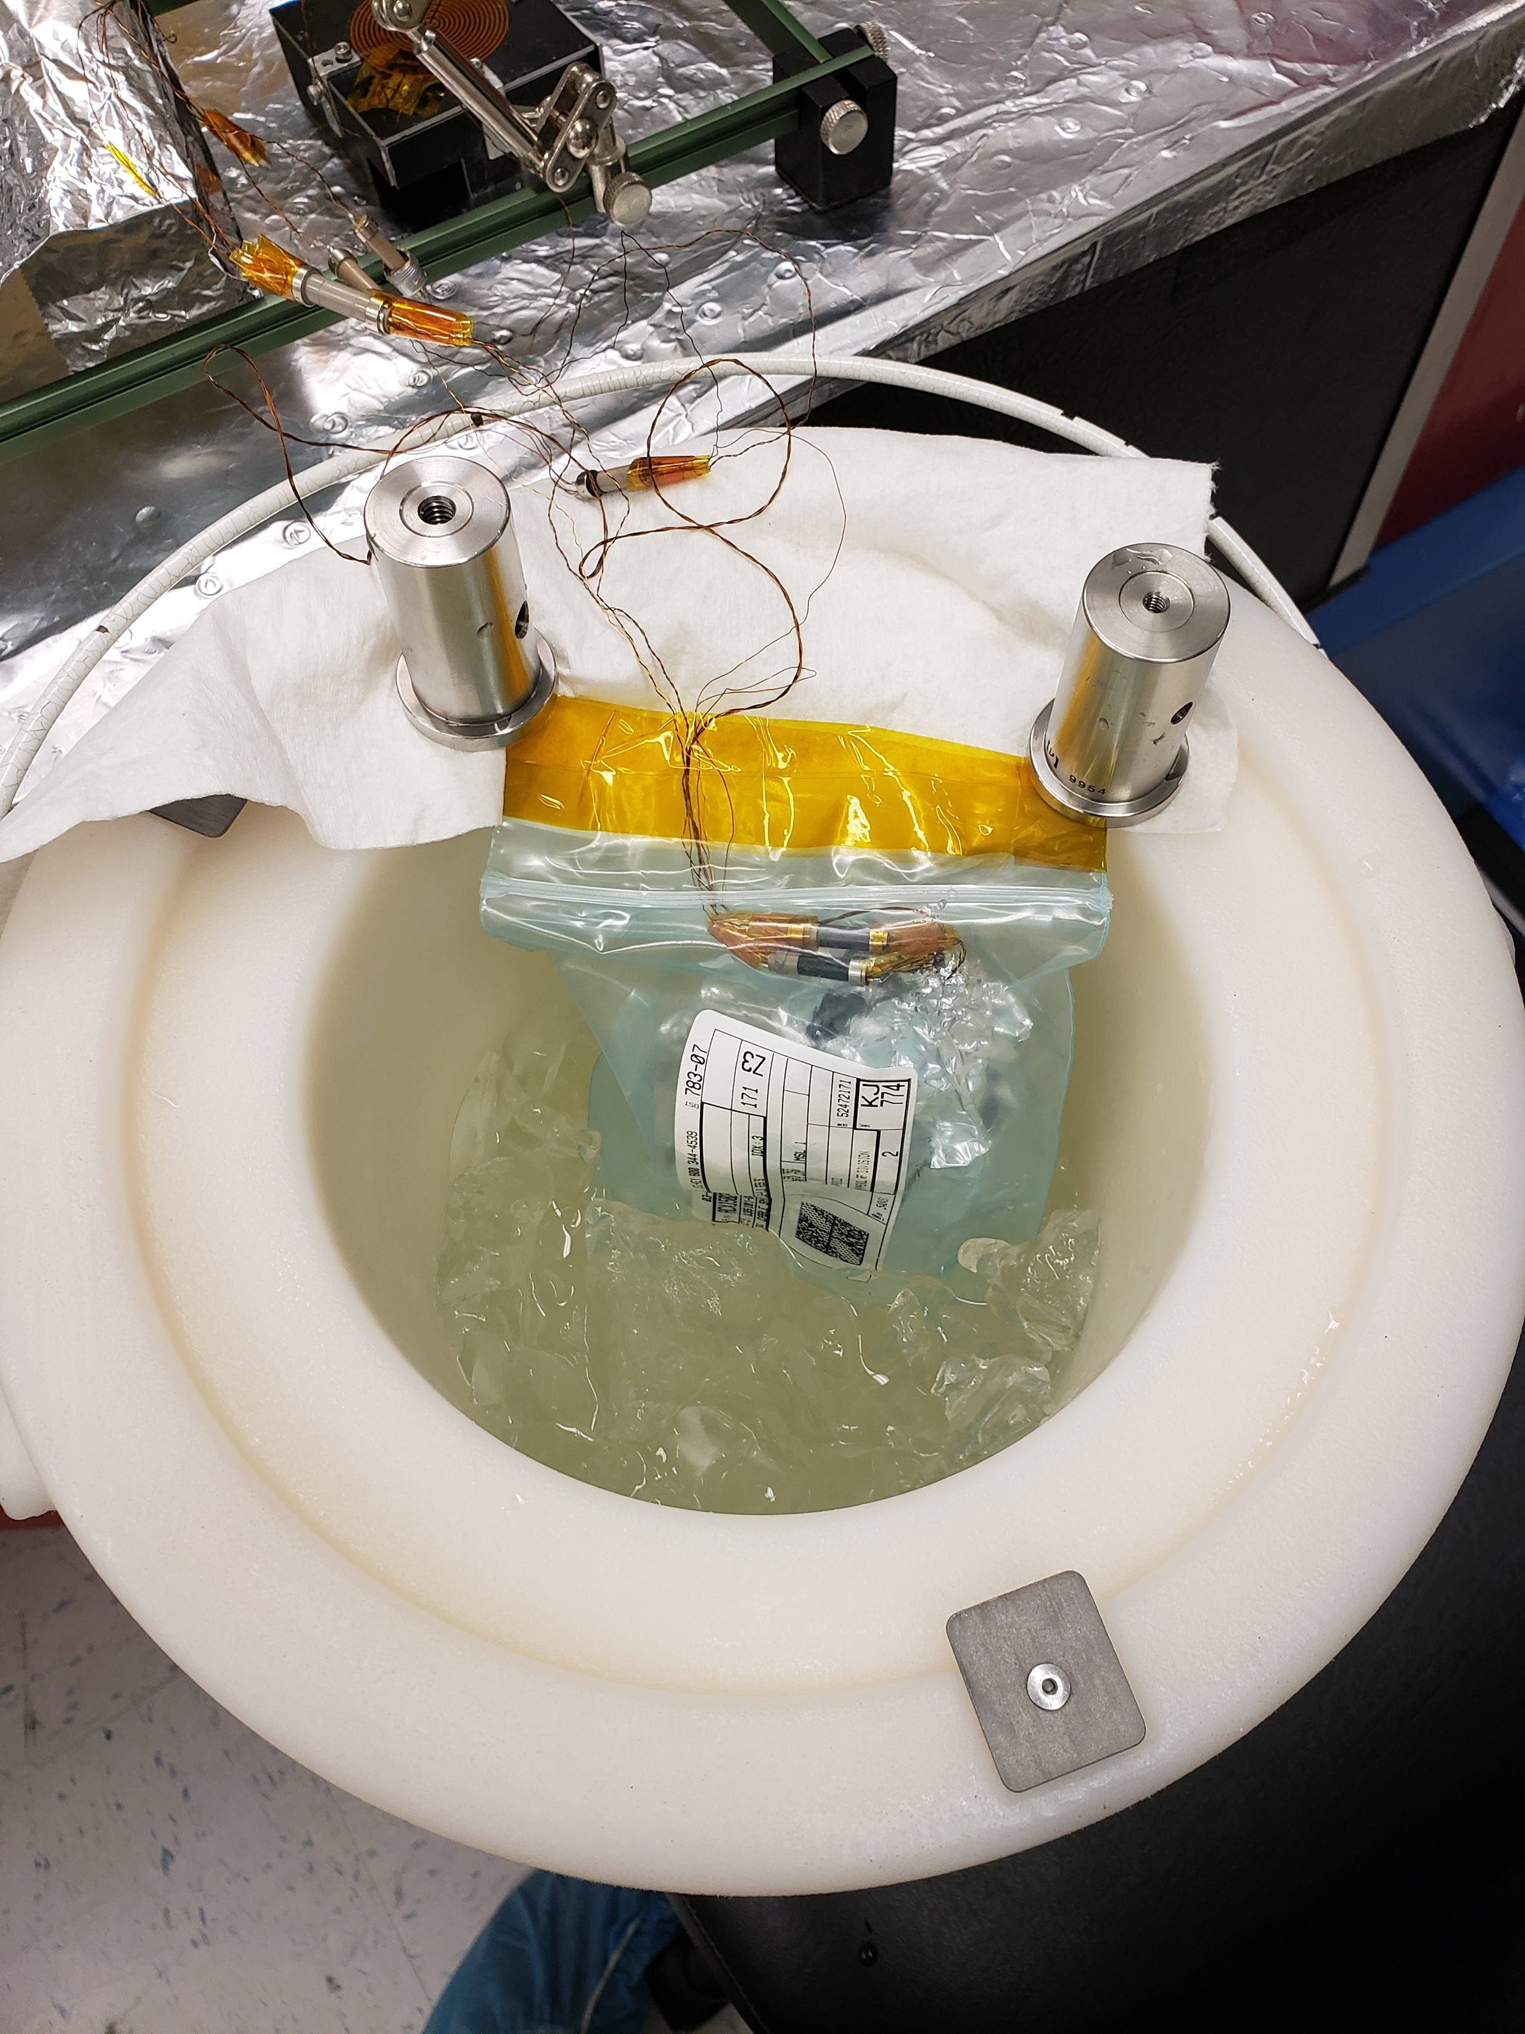
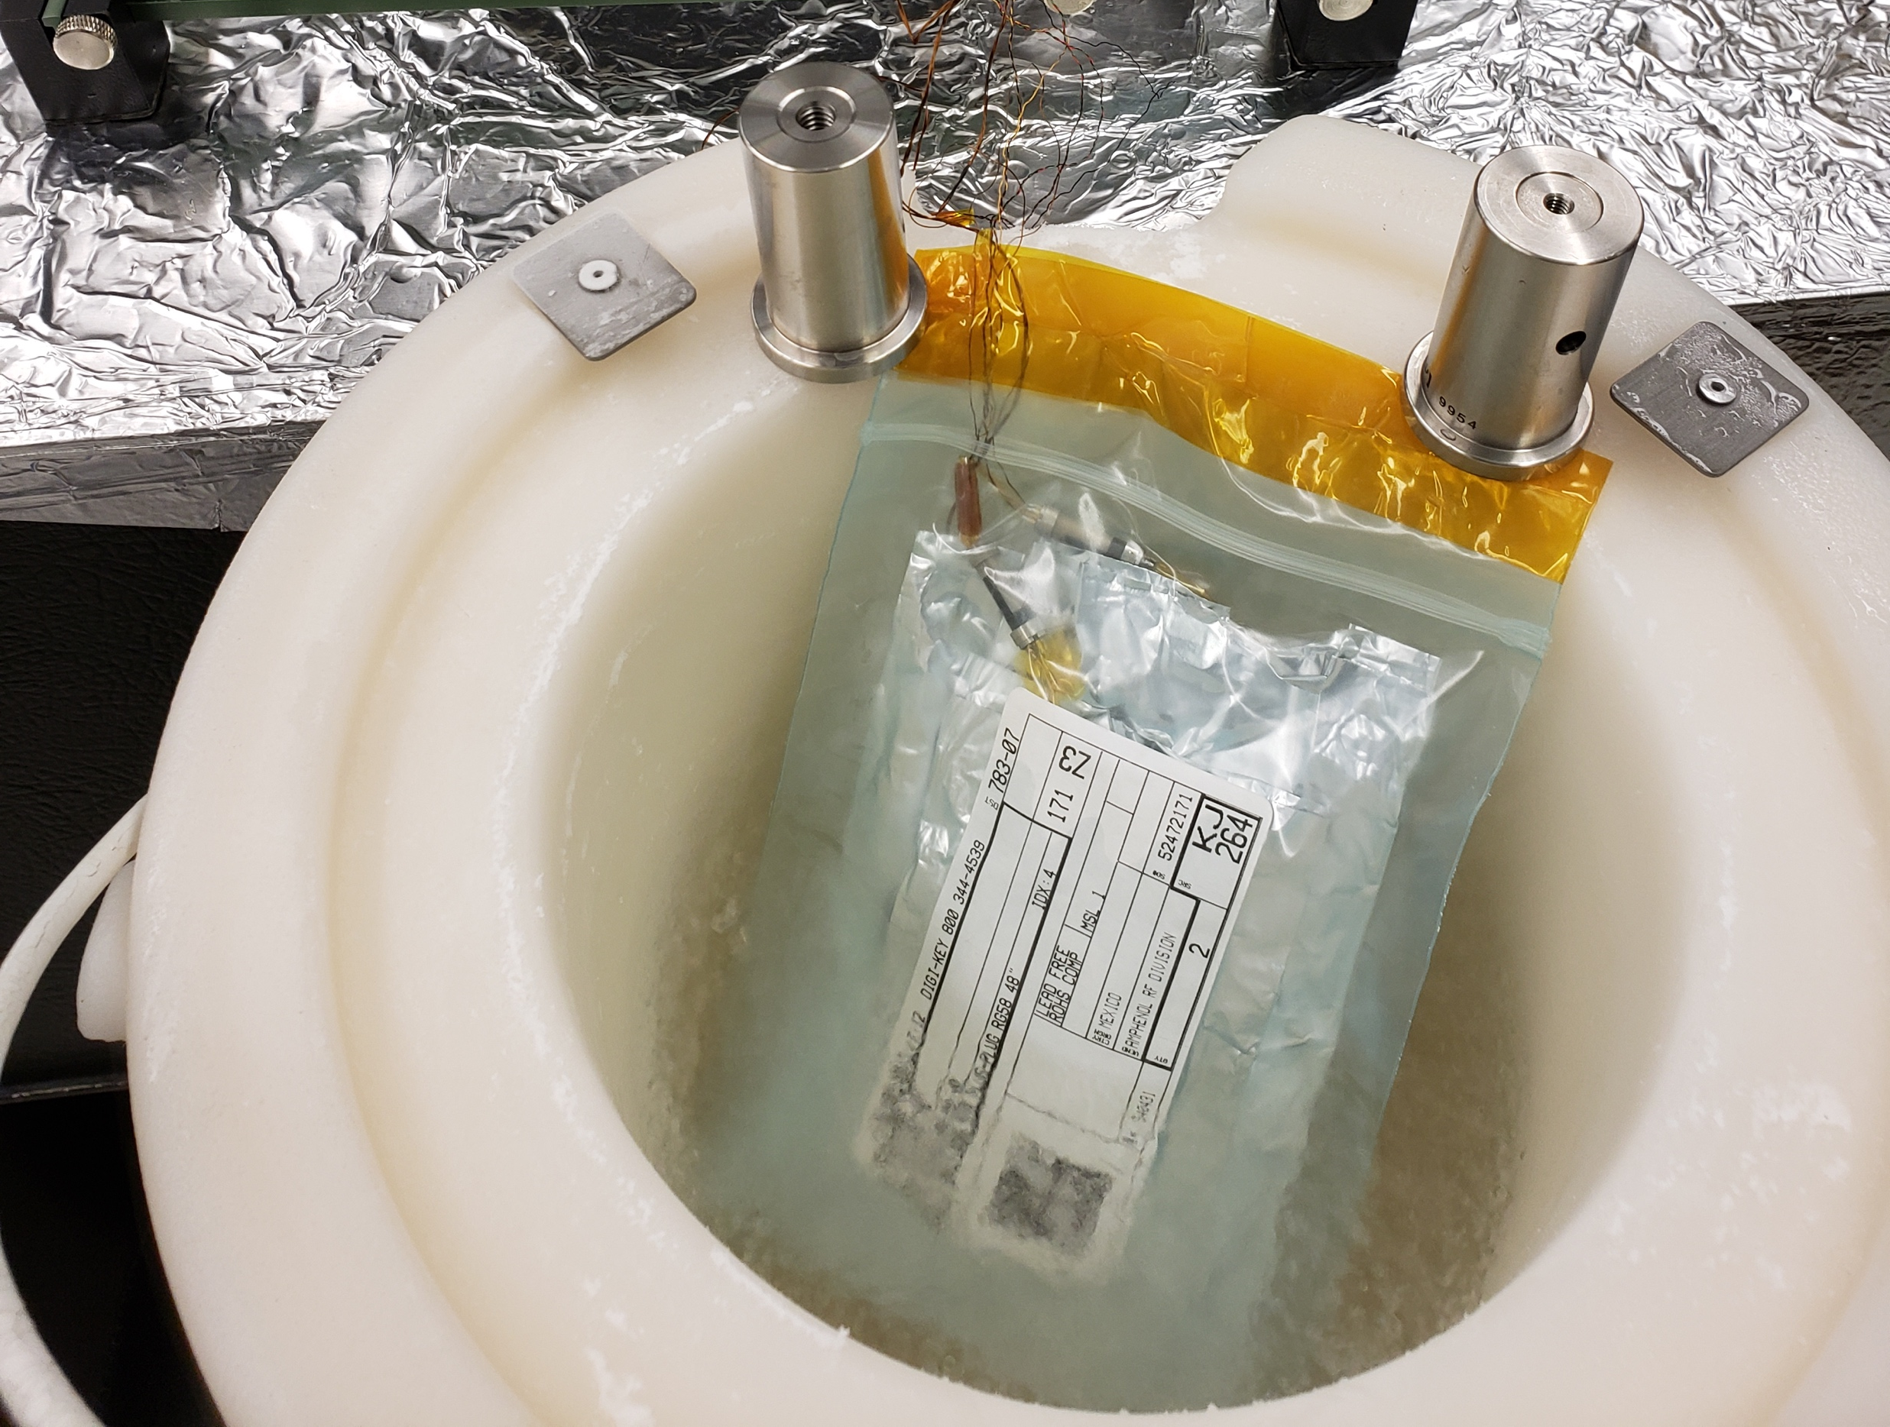
Preparation of RTDs for Submersion
273K Ice Water Calibration Bath
373K Boiling Water Calibration Bath
77K Liquid Nitrogen Calibration Bath

Slide 28
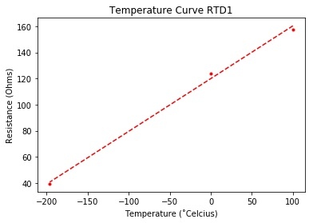
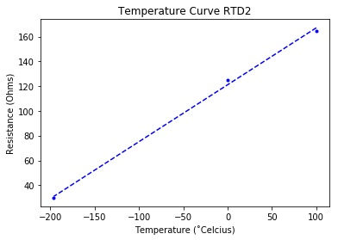
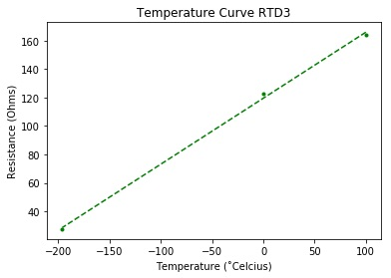
Calibration Equations
RTD 1 : y = 0.0083x + 0.1271
RTD 2 : y = 0.0092x - 0.0878
RTD 3 : y = 0.0093x - 0.1469

Slide 29
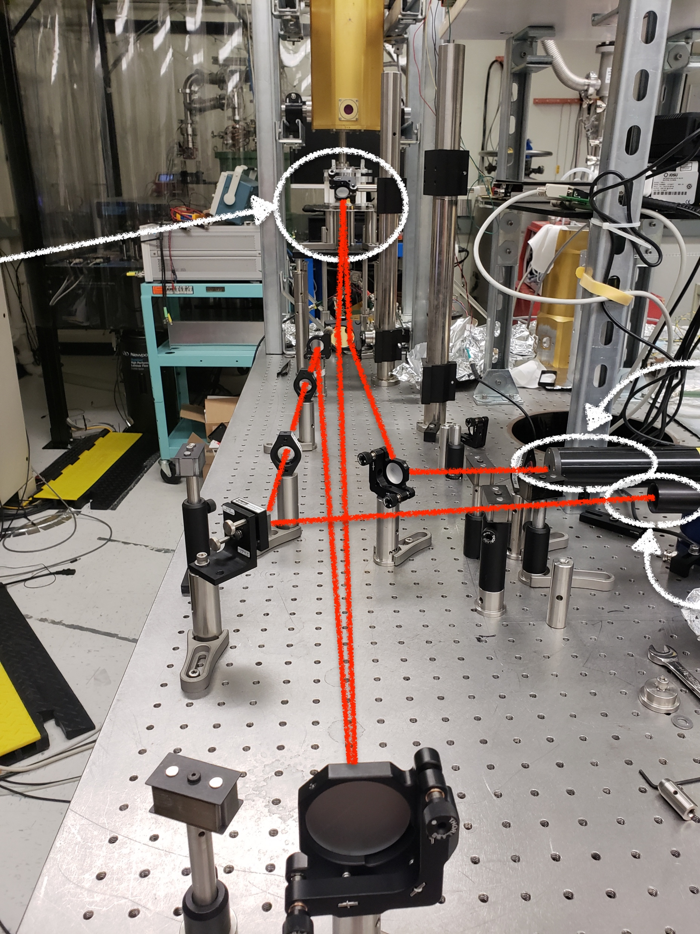
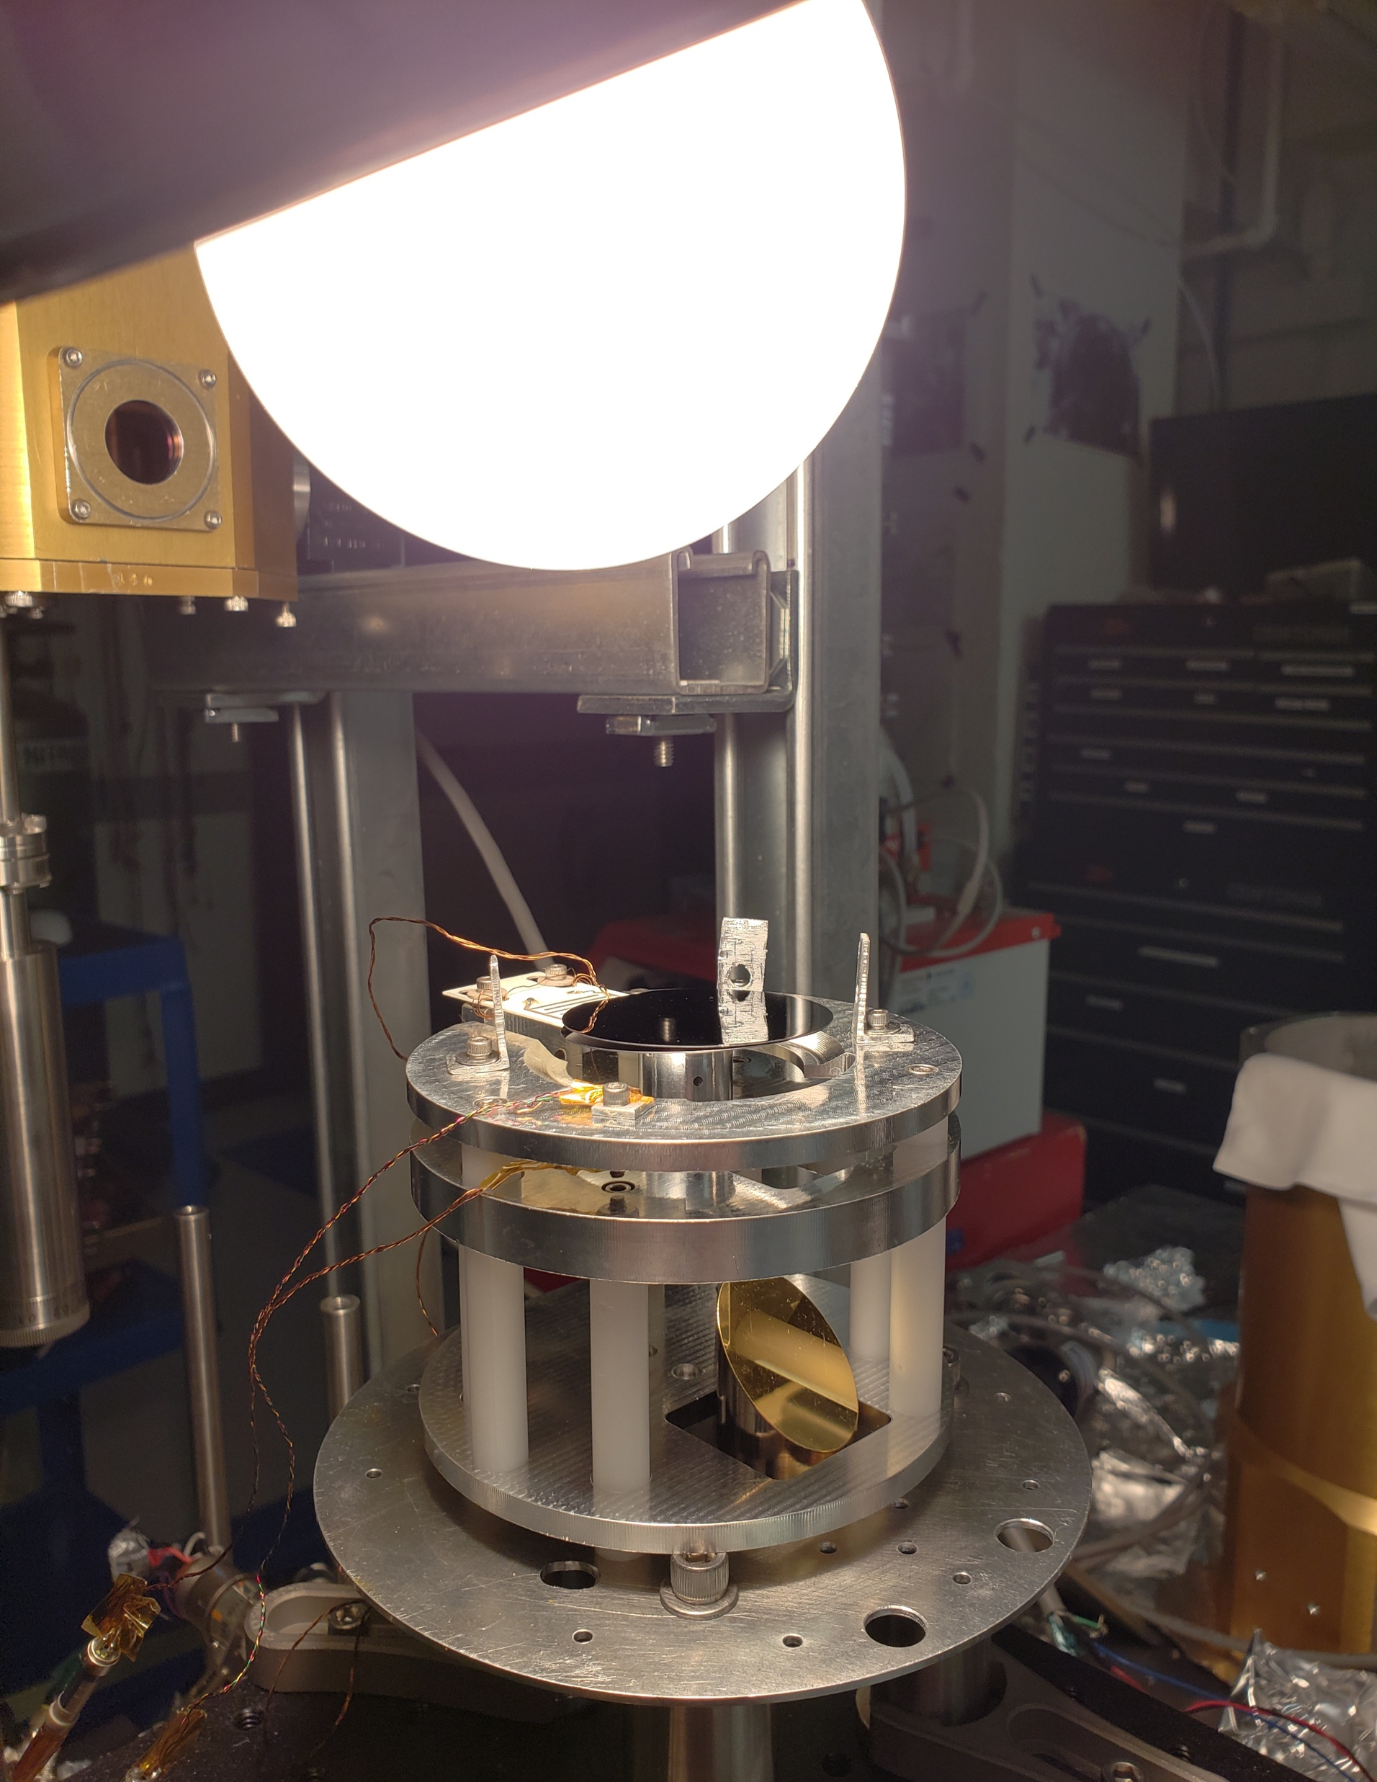
Close-up with Heat Lamp
Laser
QPD
CryoQ Setup (In-Air)

Slide 30
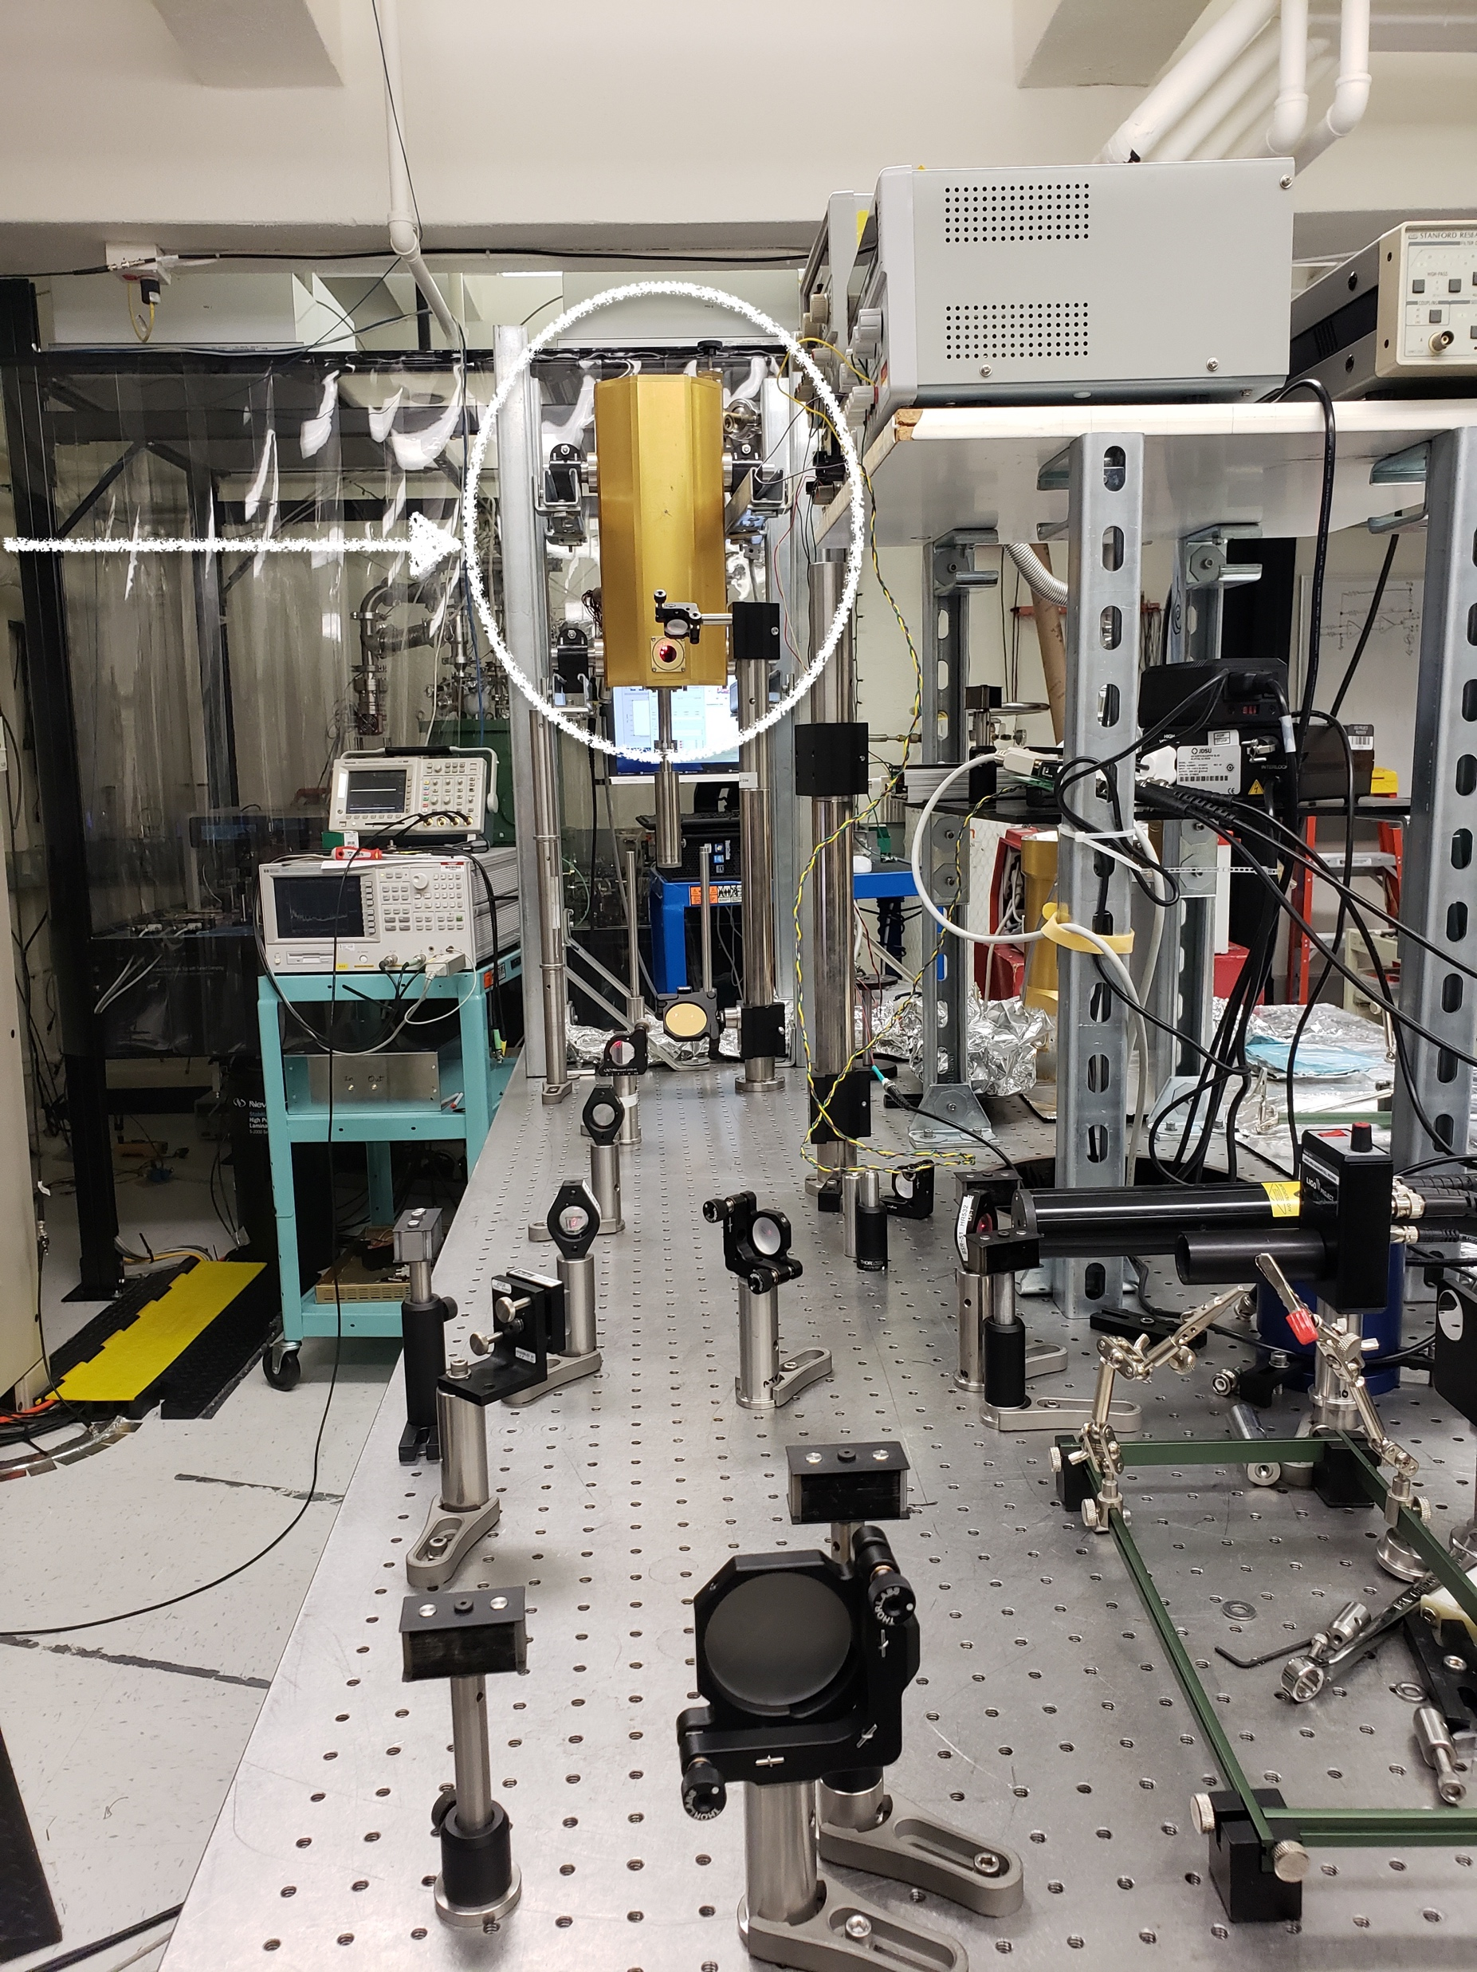
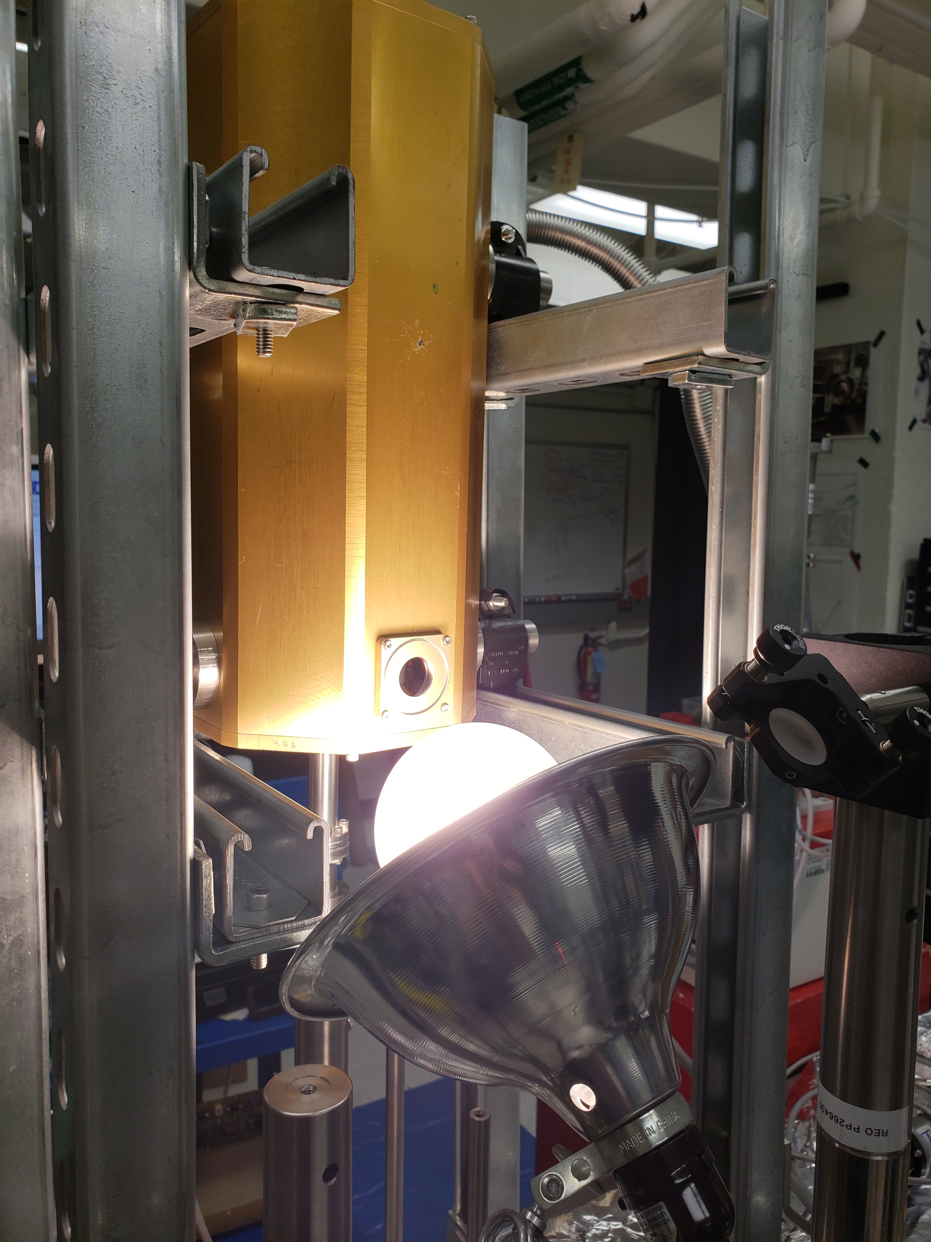
Close-up with Heat Lamp
CryoQ Setup (In-Vacuum)

Slide 31
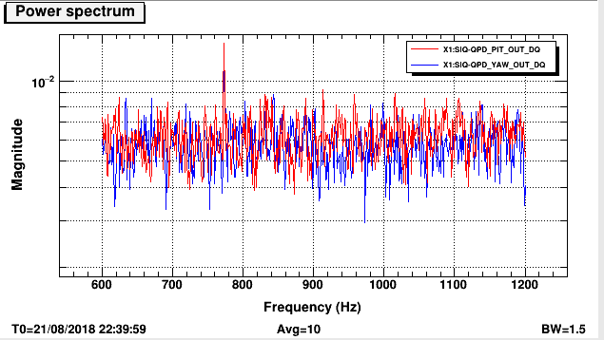
Disk unexcited, room temperature, in-vaccum

Slide 32
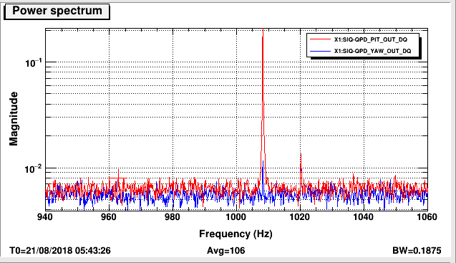
Disk excited, room temperature, in-vaccum

Slide 33
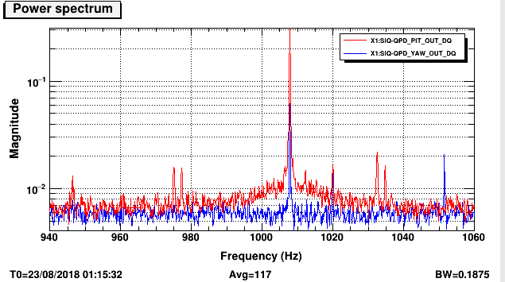
Disk excited, 309K, in-vaccum

Slide 34
Comparing a Predicted Value
Let t be the thickness of a homogenous silicon beam with a uniform cross section, L its length, E its Young’s modulus, its density. The equation for its first eigenmode is given by,
For the silicon disk, given that E is the only parameter heavily dependent on temperature,
It follows then, that the eigenfrequency at some temperature T is,
We found the predicted value for our measurement to be 1007.85Hz!

Slide 35
What now?
Rebuild Resistance Temperature Detector circuit
Obtain better temperature sensor calibration through the use of comparative calibration
More measurements, in a cryostat!
Perhaps utilizing ModeRinger - Smith, Nicolás D. “A technique for continuous measurement of the quality factor of mechanical oscillators,” Review of Scientific Instruments 2015 86:5, https://aip.scitation.org/doi/citedby/10.1063/1.4920922.
PID temperature control loop

Slide 36
Aaron Markowitz
Brittany Kamai
Rana X. Adhikari
Alan Weinstein
Alex Urban
Alicia Lima
Andrew Wade
Aria Chaderjian
Bethany Suter
Carl Blair
Carolyn Peterson
Christopher Wipf
Dick Gustafson
Disha Kapasi
Elizabeth Natividad
Eric Gustafson
Gautam Venugopalan
Izabella Pastrana
Jillian Doane
Johannes Eichholz
John Martyn
Jon Richardson
Jonah Kanner
Julie Hiroto
Ka Yue Alvin Li
Kaila Nathaniel
Keerthana Nair
Kevin Kuns
Koji Arai
Larry Wallace
Melissa Kohl
Melody Araya
Michael Coughlin
Mike Pedraza
Nichole Washington
Pooja Sekhar
Randy Trudeau
Sandrine Ferrans
Sarah McCarthy
Serena Moseley
Shruti Maliakal
Simona Miller
Sky Soltero
Steve Vass
Surabhi Sachdev
Thomas Massinger
Tom Callister
Tri Nguyen
Vinicius Wagner
Wenxuan Jia
Special thanks to...

