Slide 1
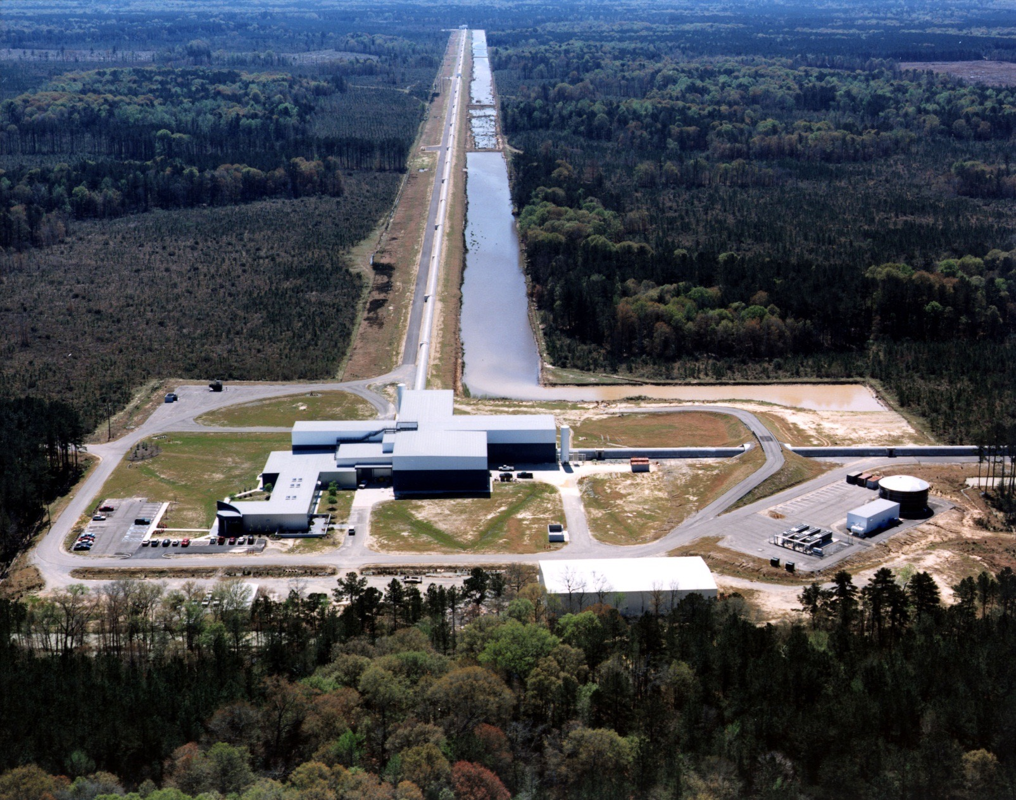
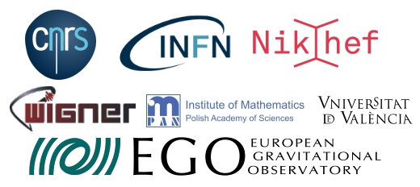
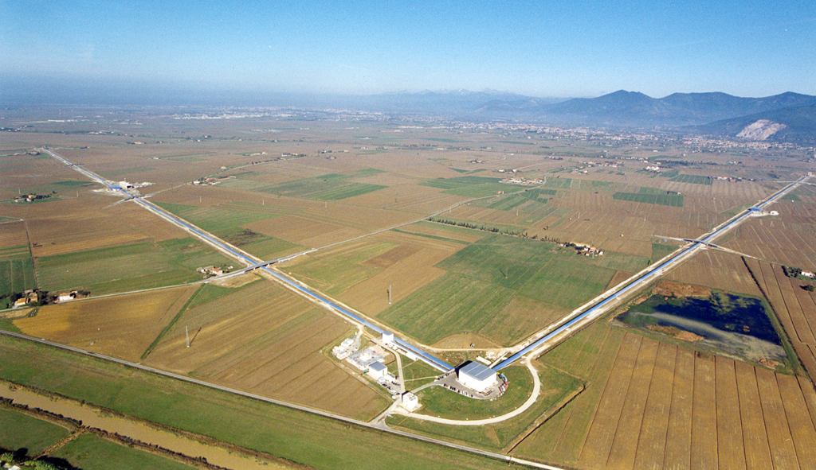
Gravitational-Wave Astronomy - a Long Time Coming
Livia Conti, for the Virgo Collaboration
Fred Raab, for the LIGO Scientific Collaboration
LIGO Hanford, WA
LIGO Livingston, LA
Virgo (Cascina, Italy)

Slide 2
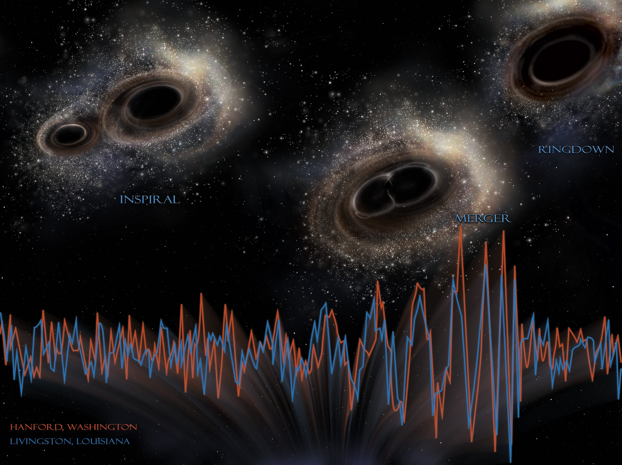
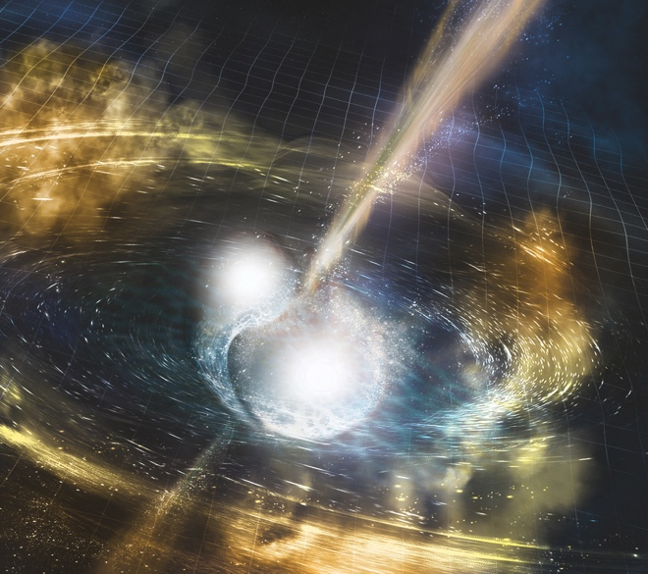
What are we talking about?
Gravitational waves from merging black holes
Gravitational waves and elecromagnetic waves from merging neutron stars
Credits: NSF/LIGO/Sonoma State University/A. Simonnet

Slide 3
Basics of General Relativity and Gravitational Waves
Big idea: space and time are things, whose properties are manifested by the phenomena that we collectively refer to as “gravity”.

Slide 4
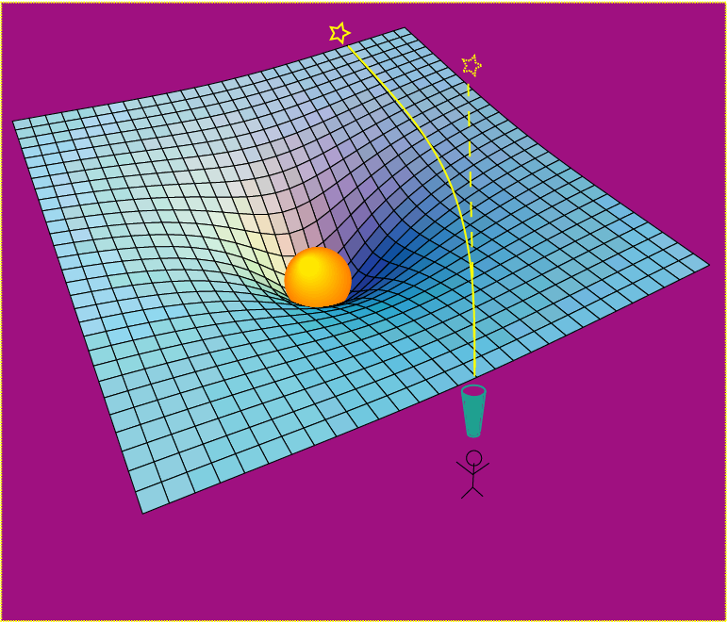
Einstein’s General Relativity:
gravity is a manifestation of space-time curvature
curved spacetime can bend light, too!
dynamic deformation of spacetime
Credit: R. Hurt - Caltech / JPL:
A massive object shifts apparent position of a star
Space has a shape, a stiffness and a maximum speed for information transfer.

Slide 5
Raab - Intro to GW Astronomy
5
Credit: NASA

Slide 6
Detectors of Gravitational Waves
No Law of Physics Forbids Them

Slide 7
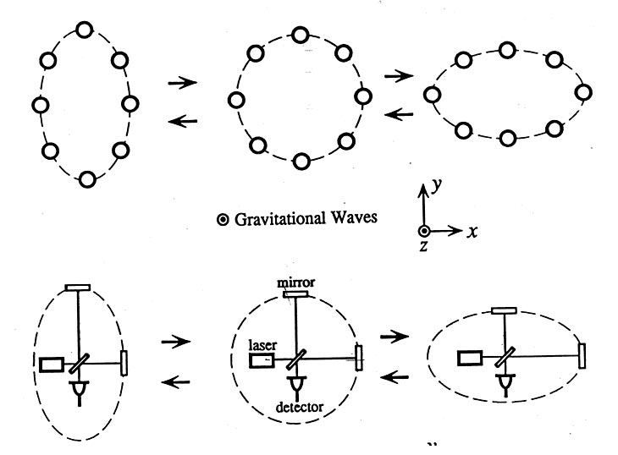
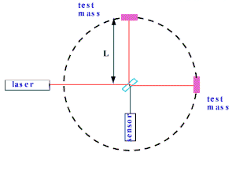
Basic idea is simple:
a GW causes a circle of space to go out of round
GW amplitude h = deformation/size
Isolated mirrors are survey stakes in space
Light takes more (less) time to travel the longer (shorter) path

Slide 8
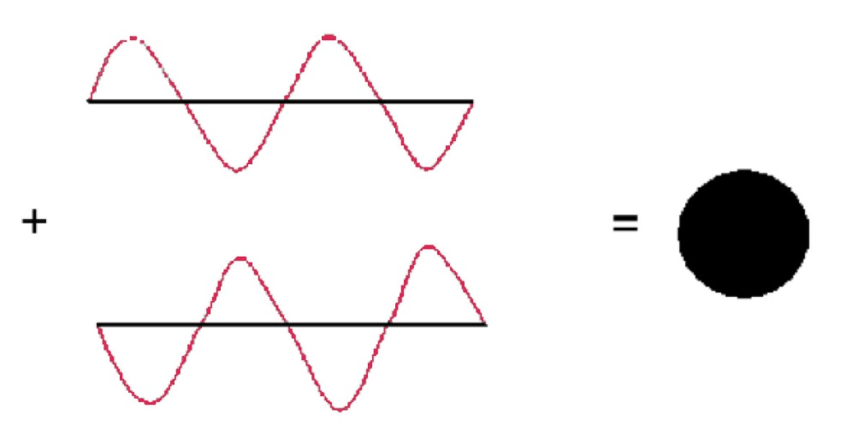
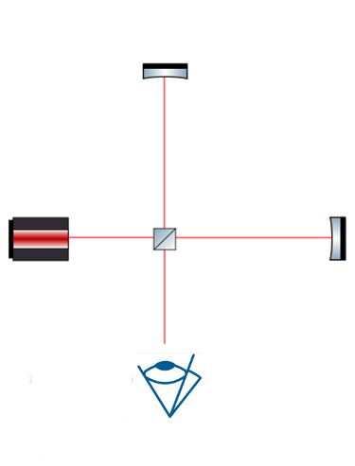
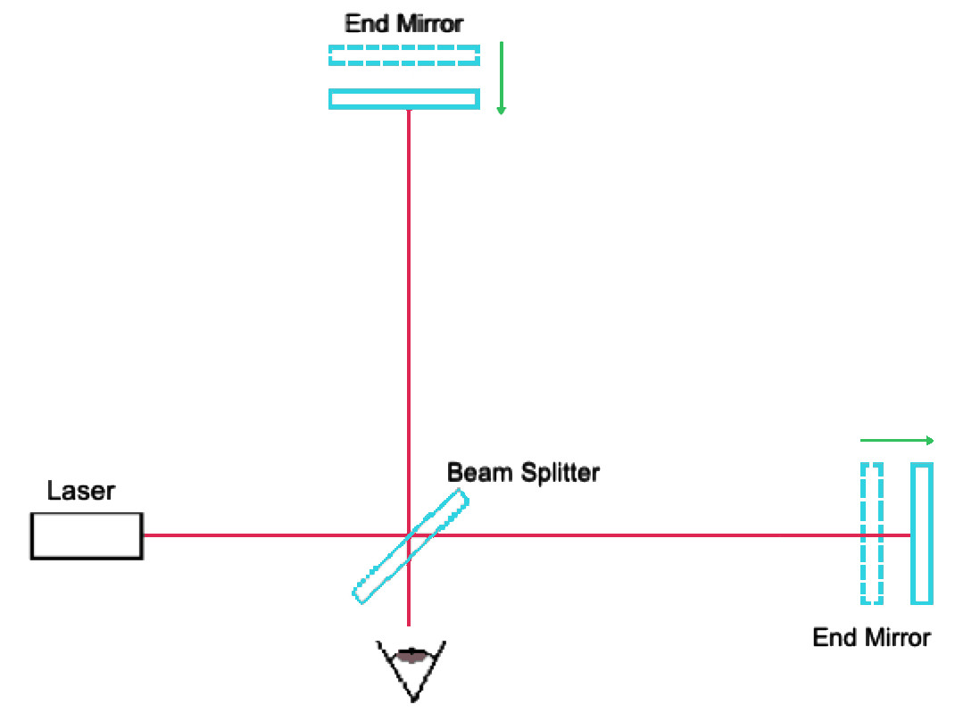
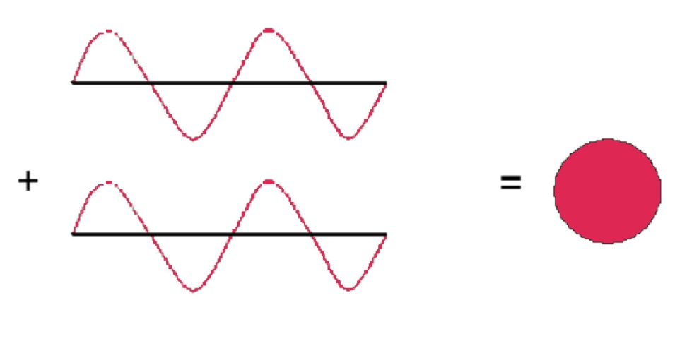
Interferometer as GW detector
Equal arm length → destructive interference
Unequal arm length → constructive interference

Slide 9
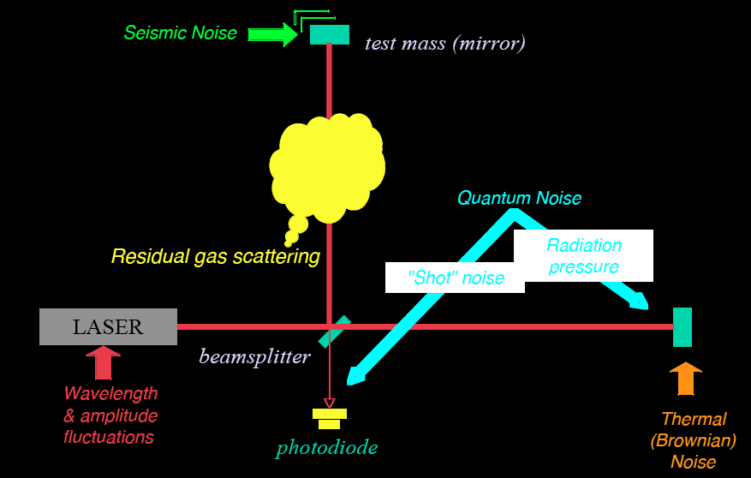
Noise cartoon
R. Adhikari

Slide 10
History: the story of how problems became opportunities

Slide 11
Strategy: Build Facilities That Could House Evolving Generations of More Powerful Detectors as Part of an International Network
LIGO proposed in 1989.
LIGO Observatories constructed from 1994-2000.
LIGO establishes international LIGO Scientific Collaboration (LSC) in 1997.
Initial LIGO operated from 2002-2010.
Advanced LIGO construction 2008-2015.
Virgo proposed in 1989.
Virgo construction from 1996 to 2003.
Virgo and LIGO establish a common data format for GW observatories.
Initial Virgo operated from 2007 to 2011.
Advanced Virgo construction from 2011 to 2016.
LSC and Virgo Collaboration established an MOU for joint operations in 2007.

Slide 12
The Laser Interferometer Gravitational-wave Observatory
LHO
LLO
Livingston, LA

Slide 13
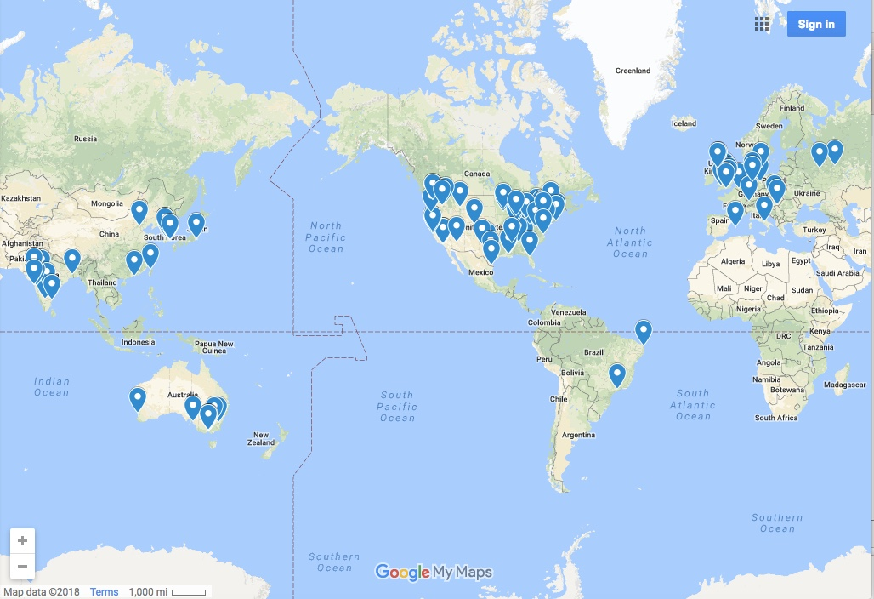
The Laser Interferometer Gravitational-wave Observatory
LHO
LSC Institutions
LLO
Livingston, LA

Slide 14
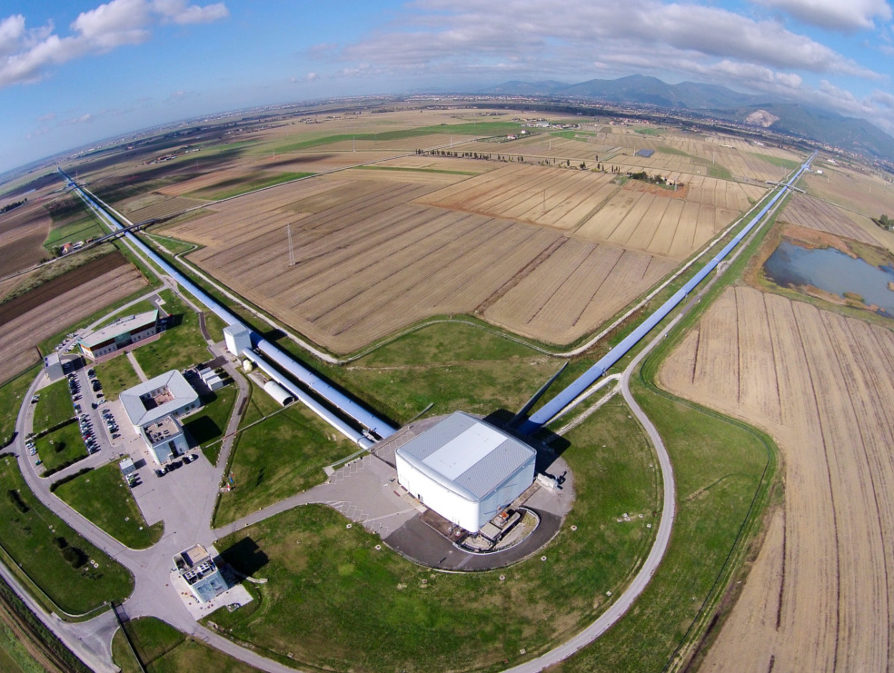
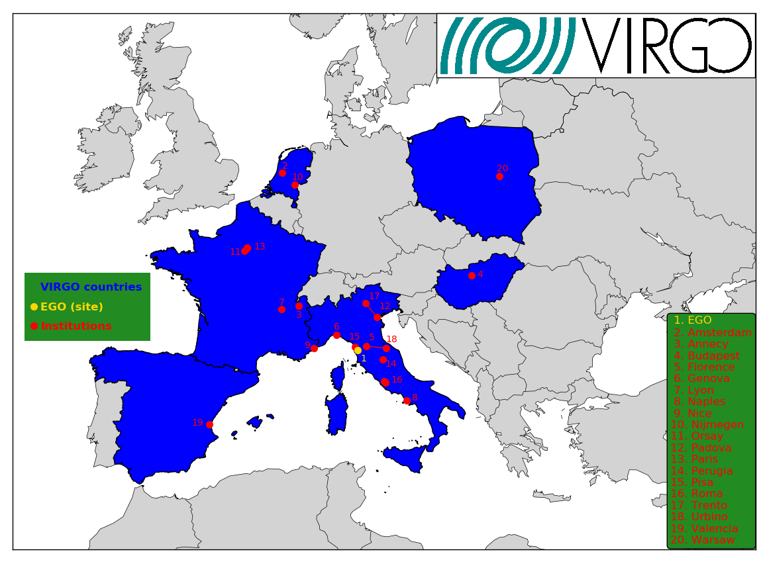
VIRGO
A collaboration made up of 20 laboratories in 6 european countries,
involving more than 280 physicists and engineers
Cascina (Pisa), Italy

Slide 15
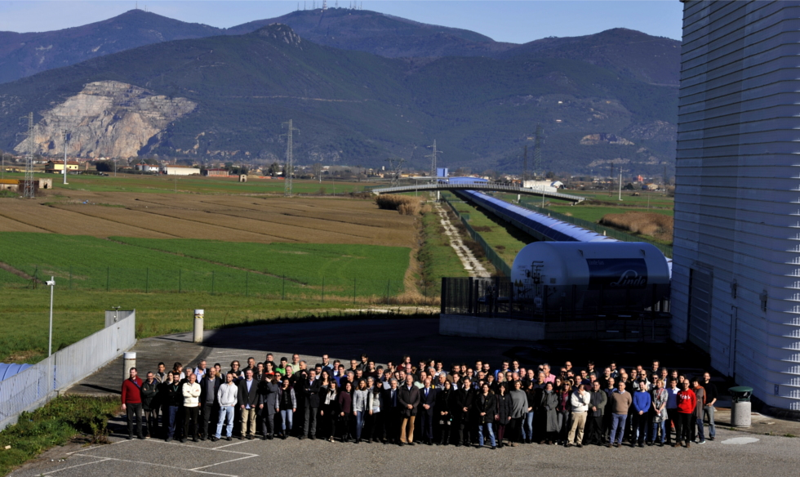
VIRGO
A collaboration made up of 20 laboratories in 6 countries involving the following institutions:
Cascina (Pisa), Italy

Slide 16
The advanced GW detector network:
2015-2025
Livingston, LA

Slide 17
First Direct Detection of Gravitational Waves
Opening a New Window on the Universe

Slide 18
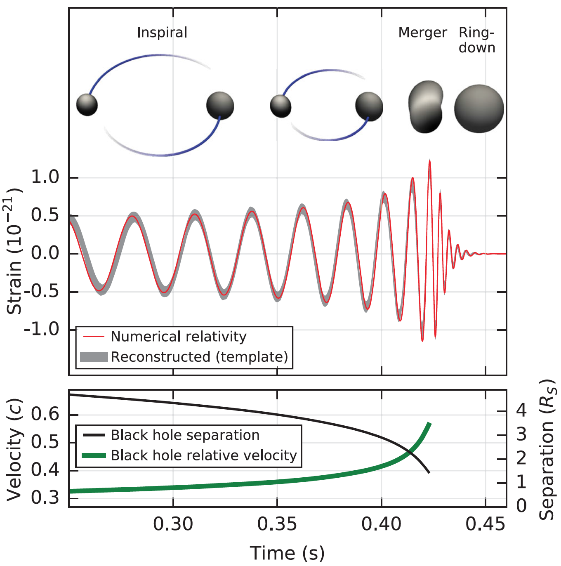
What can we learn from h(t)?
Phase evolution gives chirp mass and aligned components of spin
B. P. Abbott et al. (LIGO Scientific Collaboration and Virgo Collaboration), Phys. Rev. Lett. 116, 061102 (2016)
Ringdown frequency and Q give mass and spin of final black hole
Modulation of amplitude gives nonaligned spin components
Highest frequency gives sizes of objects just before merger.

Slide 19
Multi-Messenger Astronomy
These first observations of dynamic extreme spacetimes with BBHs show us that GR is reasonably accurate in this regime and can be used as a tool for examining and interpreting extreme states of matter.
Raab - Intro to GW Astronomy
19

Slide 20
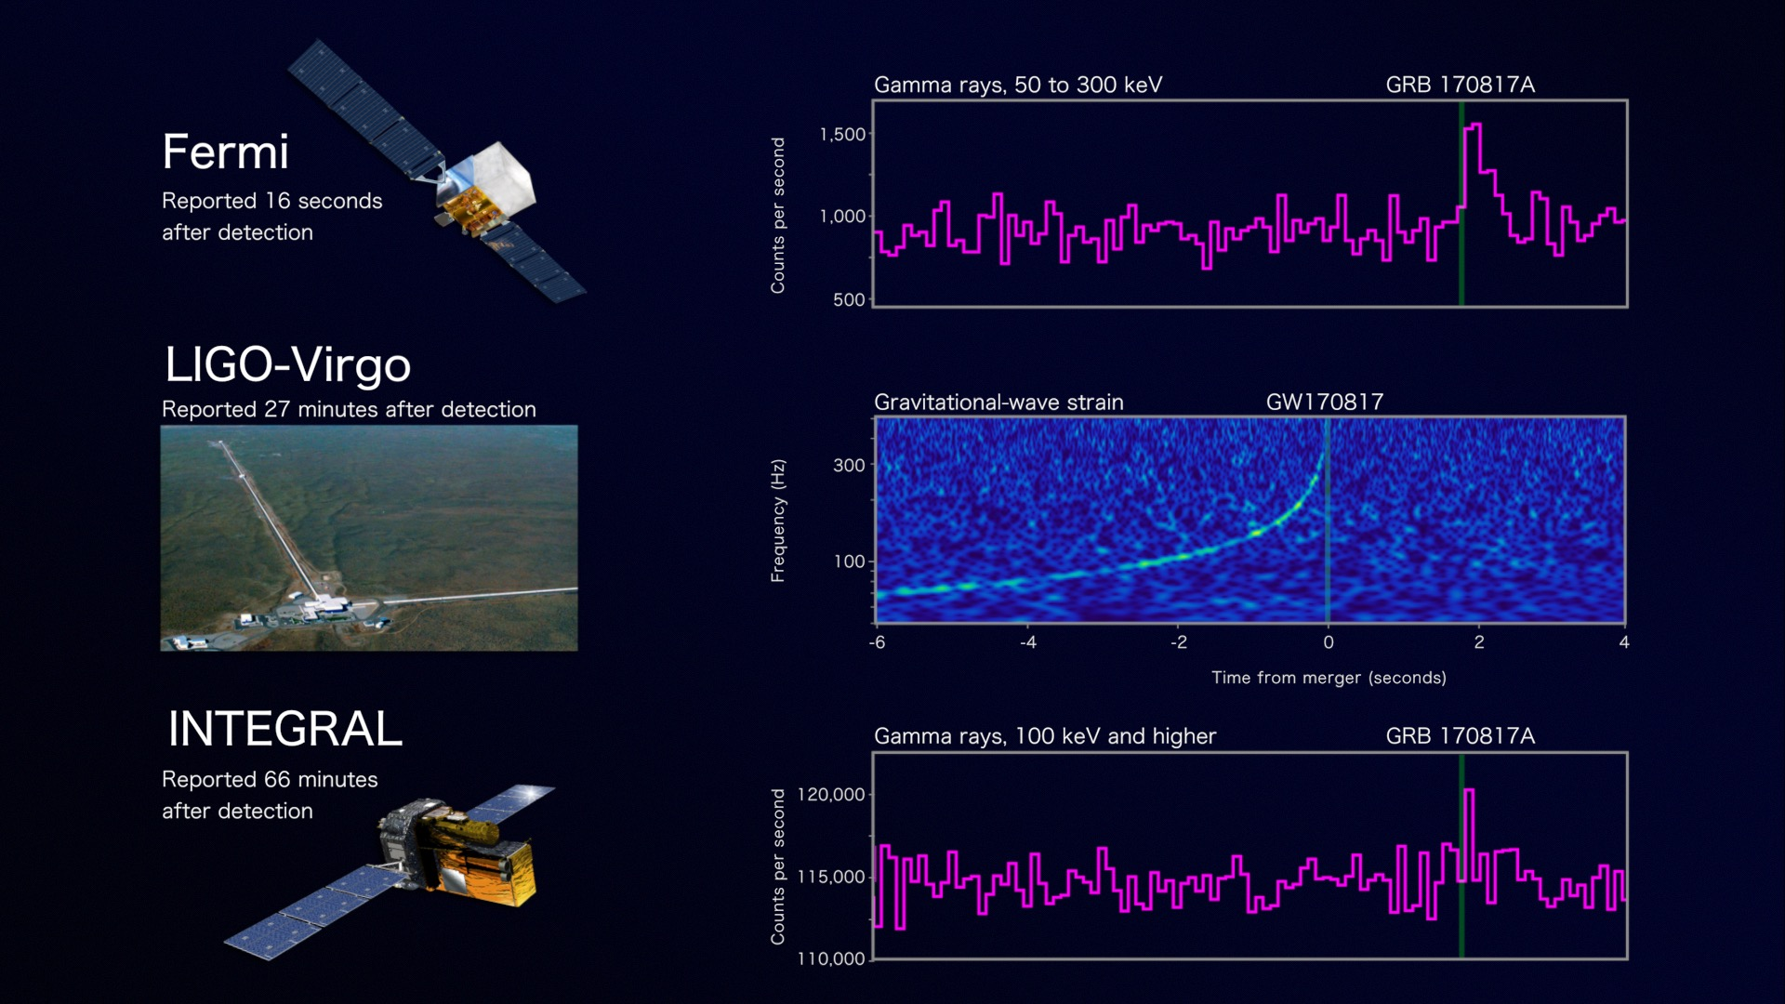
Onto the study of the most extreme states of matter – GW170817
Credit: NASA's Goddard Space Flight Center, Caltech/MIT/LIGO Lab and ESA
Raab - Intro to GW Astronomy
20

Slide 21
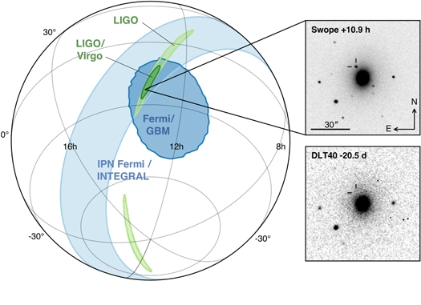
LIGO-Virgo network localization enables discovery of optical counterpart
Figure 1 from Multi-messenger Observations of a Binary Neutron Star Merger
B. P. Abbott et al. 2017 ApJL 848 L12 doi:10.3847/2041-8213/aa91c9

Slide 22
The Future
We now know that black hole binaries merge several times an hour somewhere in the universe; with new detectors and facilities, we should be able to see them out to the first generations of stars.

Slide 23
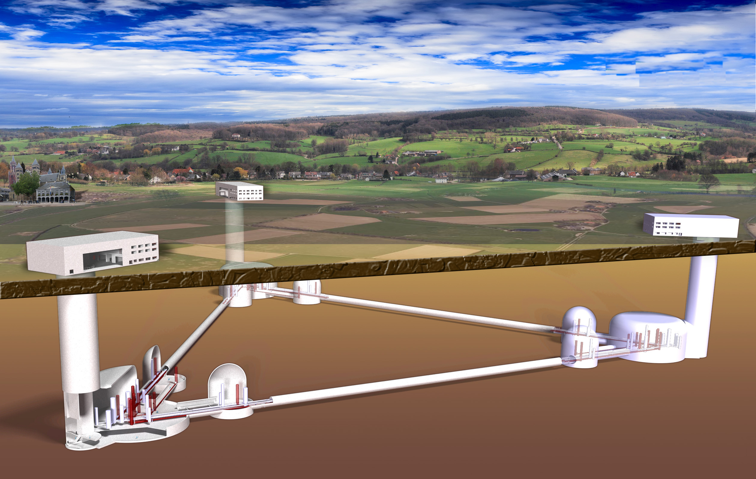
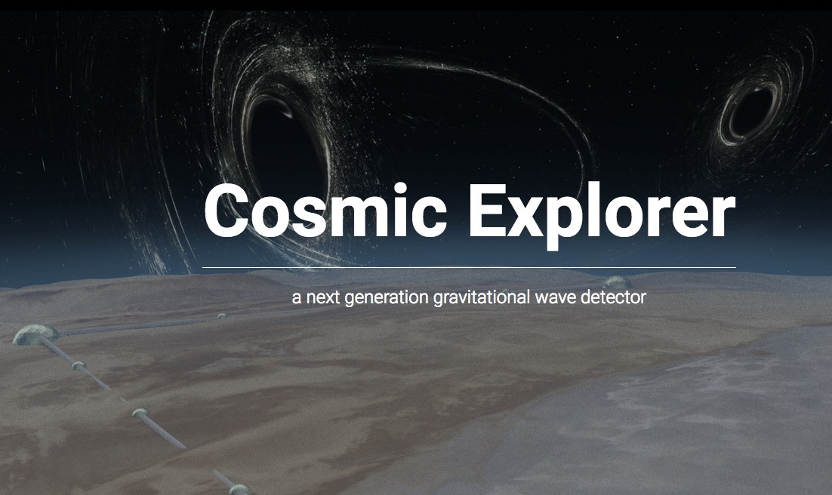
Concepts Under Study for Future Gravitational-Wave Observatories
Artistics rendering of Einstein Telescope,
the 3rd generation european detector
capable of observing compact binary sources with high signal-to-noise ratio throughout the Universe.
Credit: Evan Hall

Slide 24
Personal reflections in summary
There were dozens of reasons not to pursue this, but a single compelling reason to do it: it was good for science.
It was obvious from the start that building the facilities and generations of detectors to make the first detections was a decades-long project.
It took villages across the world to accomplish this and it will take even more villages, with even more diverse participation to pursue the promise of the future.
Scientists do not own these facilities; the people taxed to build them and their children own them. We must do our utmost to share our discoveries with them in meaningful ways.
No good deed goes unpunished! The collaborations, which were optimized for making the first direct detections with high confidence, now must evolve rapidly toward optimizing the throughput of new results to the larger scientific communities in astrophysics, cosmology, nuclear physics, astro-particle physics.
24

Slide 25
Personal reflections, continued
Before detection
one needs to be deeply convinced that the effort is worth and that the final science goal can be reached, even if seems still far
impossible to have publication rates comparable to those of collegues in high energy physics who we are often compared to
little space for R&D on new ideas
After detection
increased interest in the public: almost anyone now involved in outreach activities
increased interest among colleagues: opening of new positions and collaborations
more freedom to work on the next step: to ‘listen’ better and farther the Universe we need to overcome the limits of the existing infrastructures
25

